Slide 1
An essential platform for the compliance with the NIS2 directive
Andrei Perețianu
Business Development Manager SecOps SEE

Slide 2
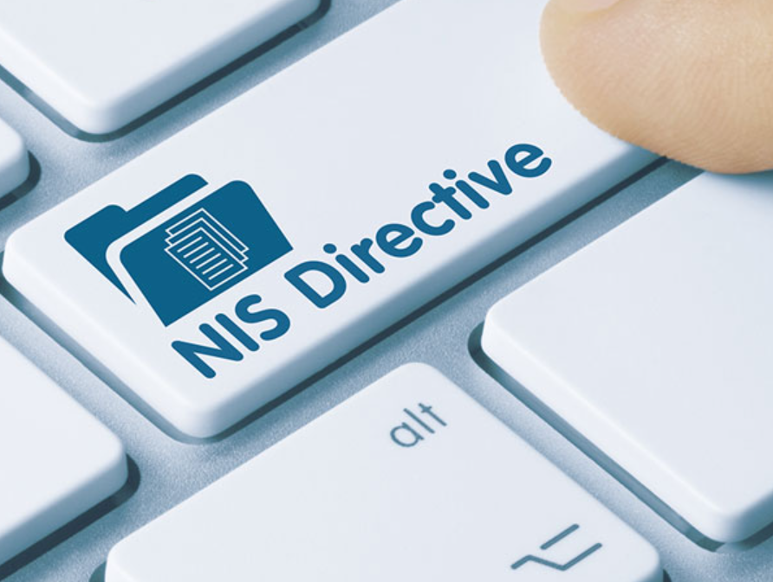
Background
The first EU-wide law on cybersecurity, the NIS(1) Directive (Directive 2016/1148/EC) came to force in 2016 – Romanian Law 362/2018
NIS Directive is about
  Information Security
  Notification of breaches
  Cybersecurity measures
NIS Directive helped to improve the level of security of networks and information systems across the EU
NIS2 EU Directive 2022/2555 to be transposed in Romanian Law on Oct 18th 2024

Slide 3
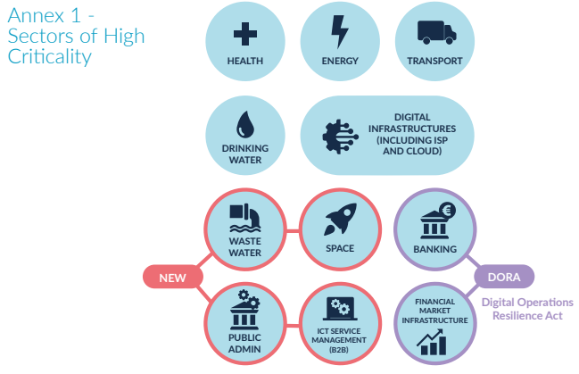

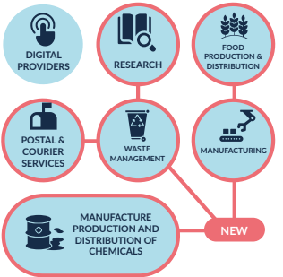
SECTORS & ENTITIES IN SCOPE
NIS2 includes new sectors whilst broadening the criteria for inclusion of entities, categorized as “Essential” or “Important”, within existing sectors.
Source: https://www.ncsc.gov.ie/

Slide 4
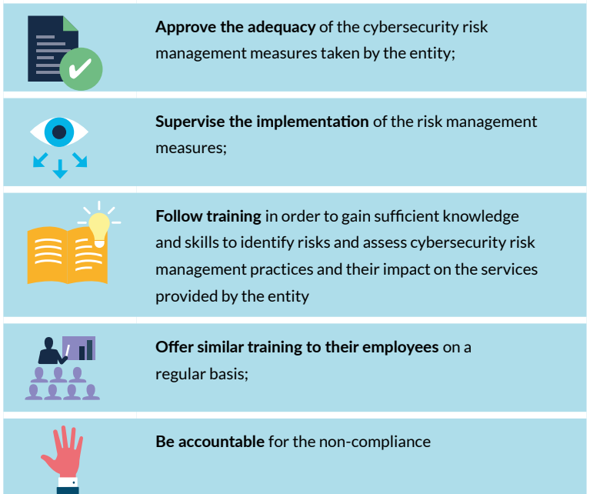
MANAGEMENT RESPONSIBILITIES
Senior management have ultimate responsibility for cybersecurity risk management in essential and important entities.
Failure by management to comply with NIS2 requirements could result in serious consequences, including liability, temporary bans and administrative fines
Source: https://www.ncsc.gov.ie/

Slide 5
Incident Reporting
Significant Incident
Caused or can cause severe operational disruption of the services or financial loss
Has affected or can affect other natural or legal persons by causing considerable material or non-material damage
24 hours / Early Warning
of becoming aware of significant incident, an early warning to the authorities to be made
Confirm whether the incident has a cross-border impact
72 hours / Official Notification
of becoming aware of significant incident, an incident notification to be made to the authorities about the severity and impact and the indicators of compromise
1-month full report / Final Report
Provide report on incident description, severity, impact, threat, root cause, mitigation, cross border impact
Immediate Action
Inform recipients of service about measures or remedies that recipients might take
Intermediate Status Report before the Final Report might be requested

Slide 6
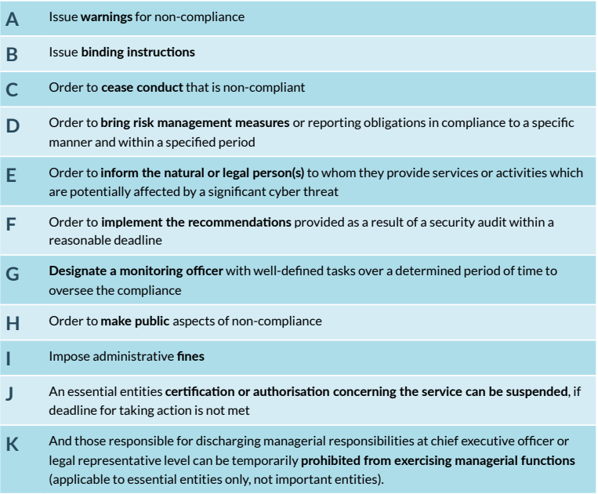
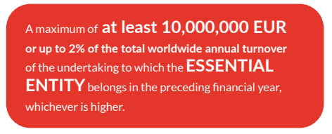
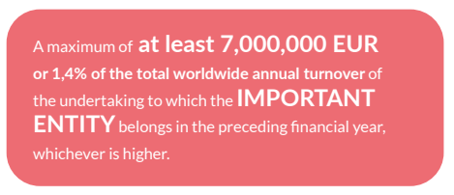
ENFORCEMENT & PENALTIES
Source: https://www.ncsc.gov.ie/

Slide 7

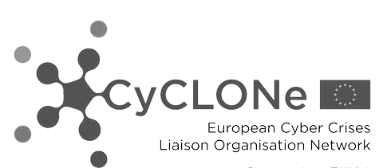
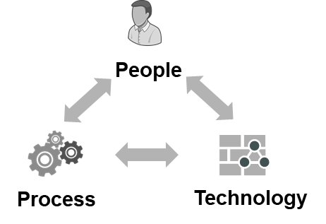
NIS2 Compliance pillars for EEs & IEs
Policies on risk analysis and information system security
NIS 2 Directive
Cyber Risk Management Measures
Cyber Risk Management Measures
Incident handling
Business continuity, Disaster Recovery, and crisis management
Cooperation & Information Sharing
Supply chain security
Network Security, Systems Security & Vulnerability Management
Policies & Procedures to assess the effectiveness of risk management measures
The use of cryptography and encryption
Basic cyber hygiene practices and cybersecurity training
Human resources security, access control policies and asset management
Multi-factor authentication or continuous authentication solutions, secured voice, video and text communications and secured emergency communication systems

Slide 8






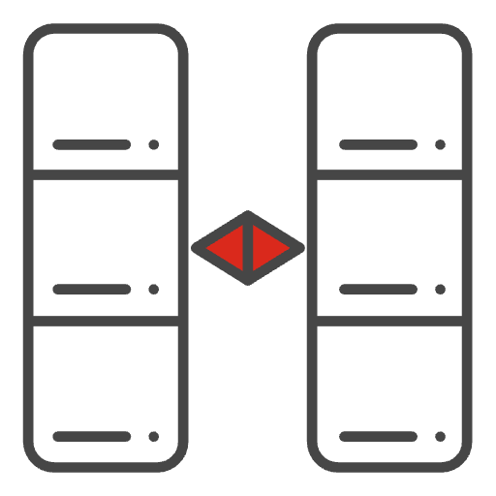










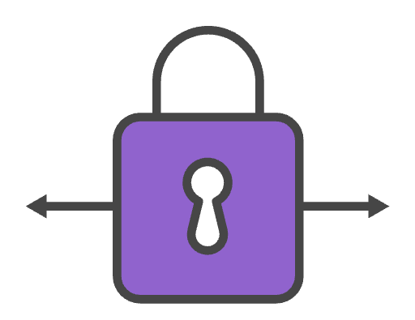
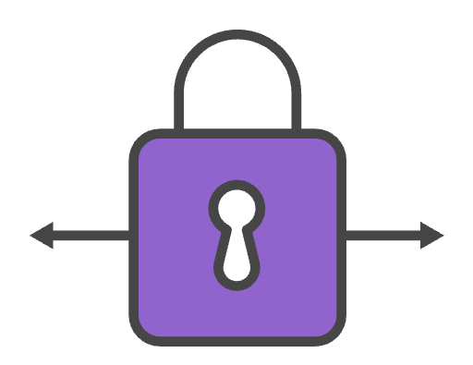

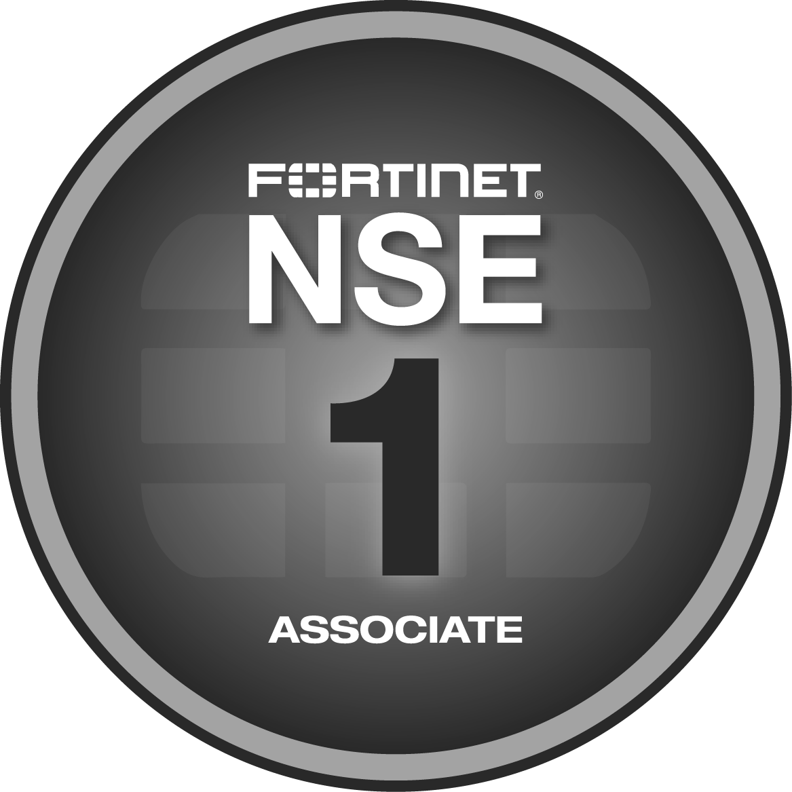
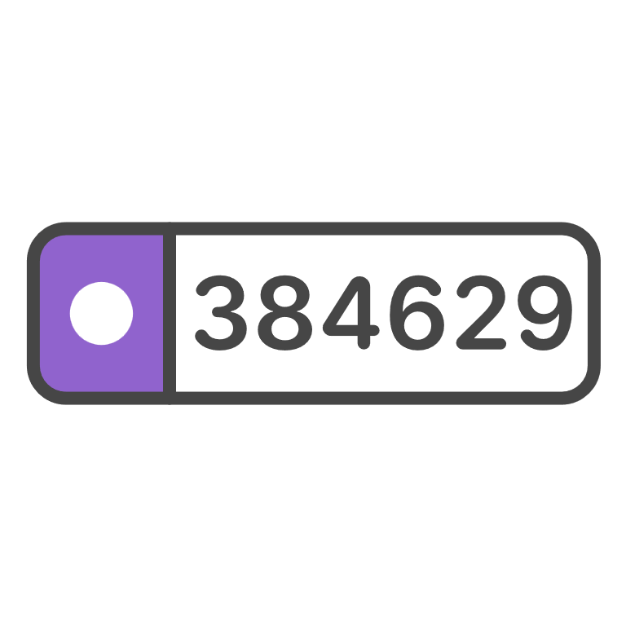


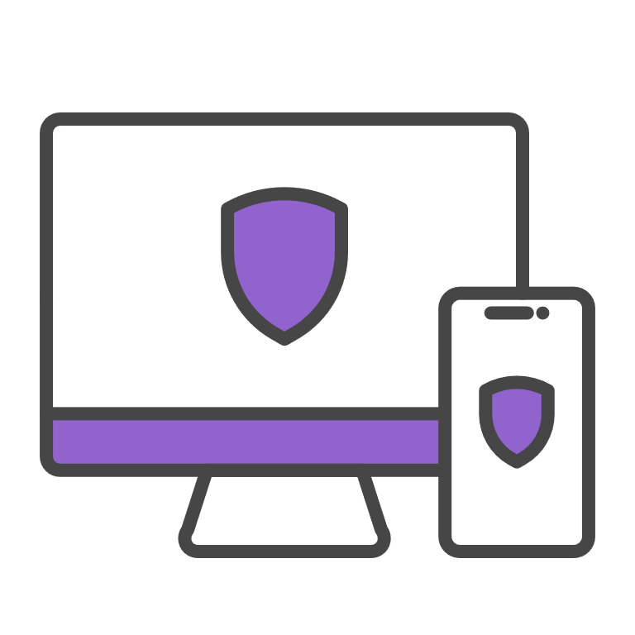
NIS2 Management Measures and Fortinet Products
Technology Framework
Fortinet Solutions
Policies on risk analysis and information system security
Digital Risk Management tools
Security orchestration and event management & correlation
Cyber Risk Management Measures
FortiSIEM
FortiSOAR
FortiRecon
FortiAI
Incident handling
Threat Detection & response,
Easy integration across security functions, monitoring and reporting systems. (Fabric Connectors)
FortiSOAR
FortiSIEM
FortiEDR
FortiNDR
Business continuity, Disaster Recovery, and crisis management
Resilient architectures
High-Availability
Disaster Recovery
HA
FortiADC
FortiSOAR
Supply chain security
DevSecOps
Code vulnerability Assessment & Management
Digital risk protection
FortiCNAPP
FortiDevSec
FortiRecon
FortiDAST
Network Security, Systems Security & Vulnerability Management
Access Control
Network segmentation
API Security
Deep traffic inspection
Vulnerability sharing
Data protection
FortiGate
NGFW
FortiWeb
ZTA
FortiScanner
FortiRecon
Policies & Procedures to assess the effectiveness of risk management measures
Asset management
Risk profiling
Security monitoring, auditing, and testing
FortiTester
FortiSIEM
FortiSOAR
FortiAnalyser
The use of cryptography and encryption
Asset management
Risk profiling
Security monitoring, auditing, and testing
FortiGate SecGW
SSL
IPsec
Basic cyber hygiene practices and cybersecurity training
Security Awareness Training
Fortinet Awareness Training
Fortinet Training Institute
Human resources security, access control policies and asset management
Access Control
Identity Management
Asset management
FortiToken
FortiAuthenticator
FortiPAM
FortiClient
Multi-factor authentication or continuous authentication solutions
Access Control
Identity Management
FortiToken
FortiAuthenticator
FortiPAM
Notes:
FortiDAST, FortiRecon - to supply chain
Disaster recovery – FortiSOAR
Incident Handling – delete Recon / add SIEM and SOAR, EDR, NDR
Network Security – remove DevSecOps and add FortiRecon and FortiScanner
Policies & Procedures – add SOAR

Slide 9

FortiSIEM Seven Strengths
Compliance & Audits
Compliance Management Dashboard
Compliance Reports-SOX, HIPAA, PCI, etc.
Built-in compliance rules and widgets
Performance & Availability
Discovery Driven
Configuration Change Detection
Custom Monitoring
Synthetic Transaction Monitoring
Business Service SLA
Behavioural Anomaly Detection
Baseline & Trend Analysis
Outlier/Anomaly Detection
Flow Analysis
Statistical Anomaly Based
UEBA
Next-Generation SIEM
Cross-Domain Event Correlation
Discovery Driven Event Context
File Integrity Monitoring
Dynamic Identity and Location
Security & Operational
Intelligence
Visual Analytics
Dynamic Dashboards
Inline Reporting
Mobile Ready
Infrastructure Discovery
Relationships Discovery
Comprehensive - Physical, Virtual, Cloud
Automatic CMDB
Ping, L2, Range, Smart, AWS Scan
Superior Architecture
Unified, HW and VM, single data lake
Multi-Tenant (Service Provider Ready)
Scale Out Architecture
Role-Based Access Control

Slide 10
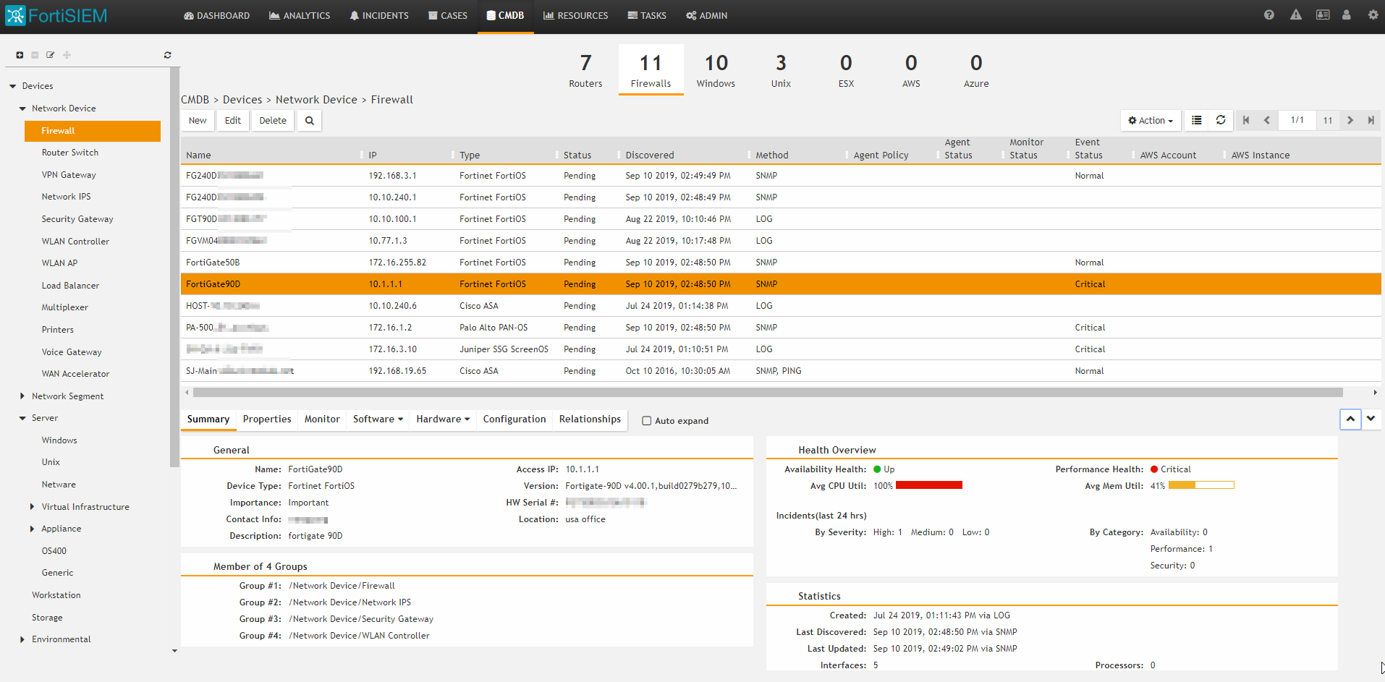
CMDB Overview
Device Summary
Auto Asset Discovery
&
Auto Asset Categorization
Configuration Auditing
Device Detail
Notes:
The integrated CMDB provides additional functionality for servers and network devices
Device details, assisting with asset management
Performance, hardware and software data
Configuration change auditing
Auto device categorization based on discovery parameters
The CMDB can also be referenced in the analytics interface, allowing queries to be more easily built by referencing assets via the GUI. No need to remember server IP addresses!

Slide 11
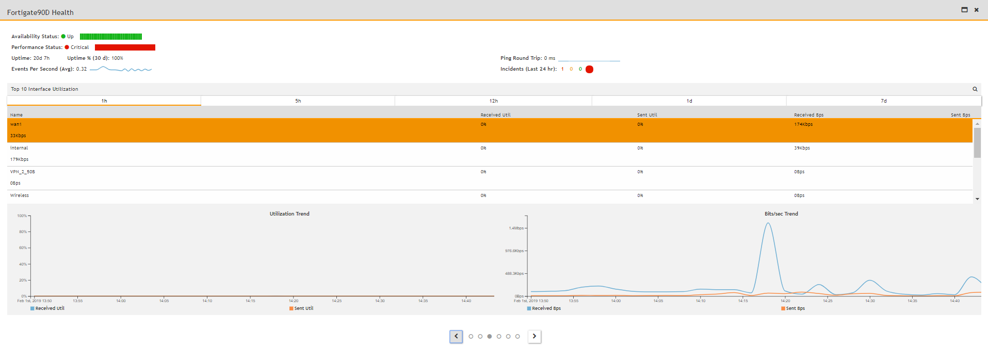
CMDB Performance and Availability Monitoring
Health Summary
Performance Data
Additional Data
Notes:
Performance information is available in the CMDB, as well as via dashboards and analytics
The slide shows the CMDB device health view, which provides a summary of useful performance data for supported devices, including:
Availability and performance summary
Uptime and round trip response
Associated incidents
CPU and memory performance
Network interface utilization

Slide 12
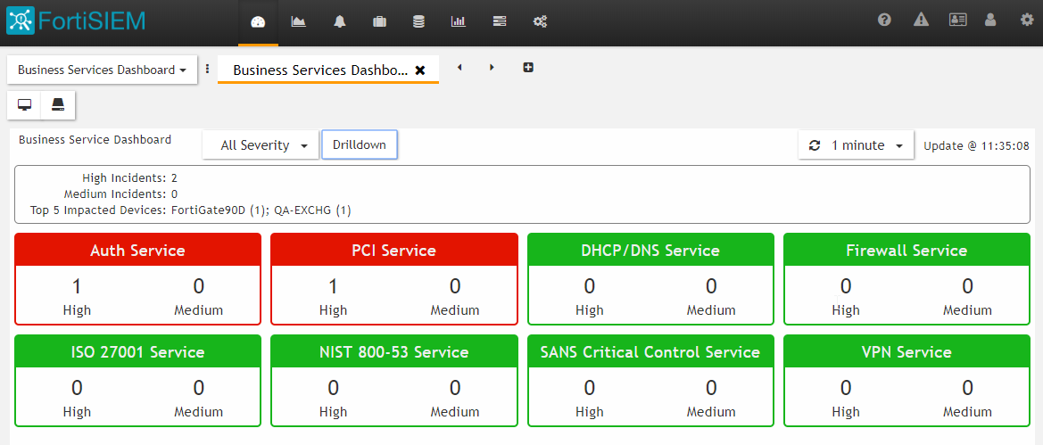
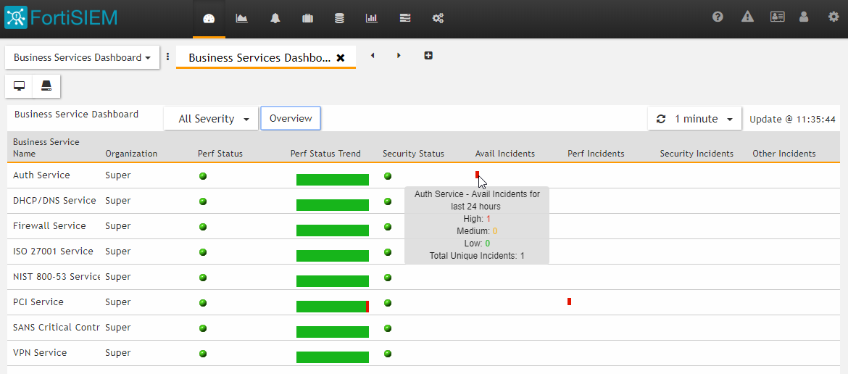
CMDB Business Services
Group disparate devices
Monitor via dedicated dashboards
Report, alert and monitor critical services
Notes:
FortiSIEM business services allow an organization to group together the different devices and applications involved in delivering a critical service in a single logical group.
This group can then be monitored as a logical entity. Business services can also be referenced in queries and reports, providing a business-oriented approach to a traditionally technical function.

Slide 13
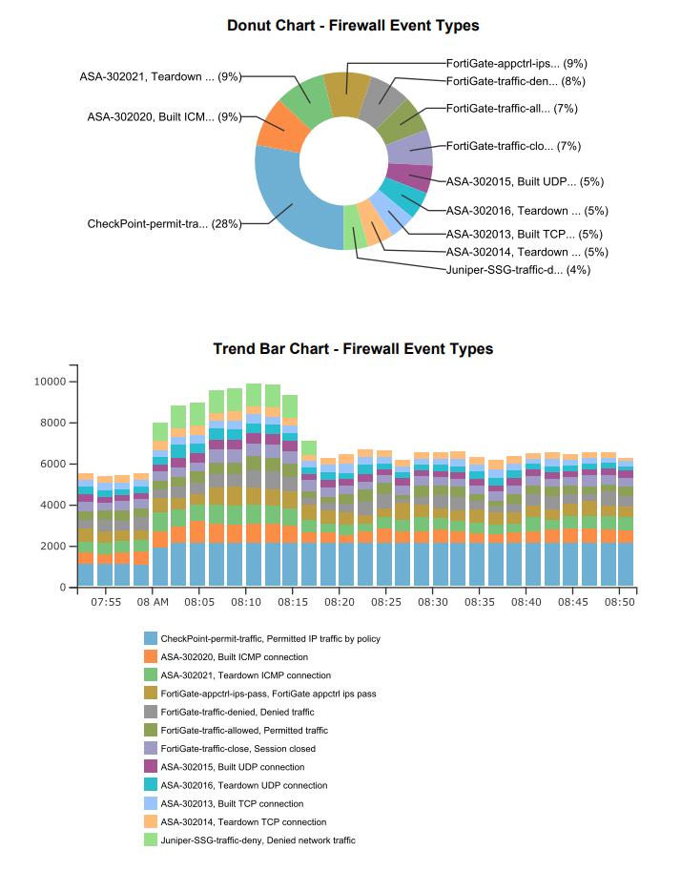
Reporting
2000+ inbuilt reports
  Compliance (PCI, ISO, NIST, ITIL, SOX etc)
  Function (Security, Availability, Performance)
  Device Reports
  And more...
Custom Report Builder
  Cover page customization
  Multi section report format
  Visualizations, tables, free text and attachments
Notes:
FortiSIEM ships with over 2,000 inbuilt reports covering a range of functional areas, such as
Availability
Performance
Change
Security
Compliance
Reports can be customized, or custom reports can be written from scratch.
Reports can be scheduled to run at a pre-specified time and emailed to a recipient, or run on demand.
FortiSIEM also includes a custom report builder feature to provide greater customization of the report format.

Slide 14
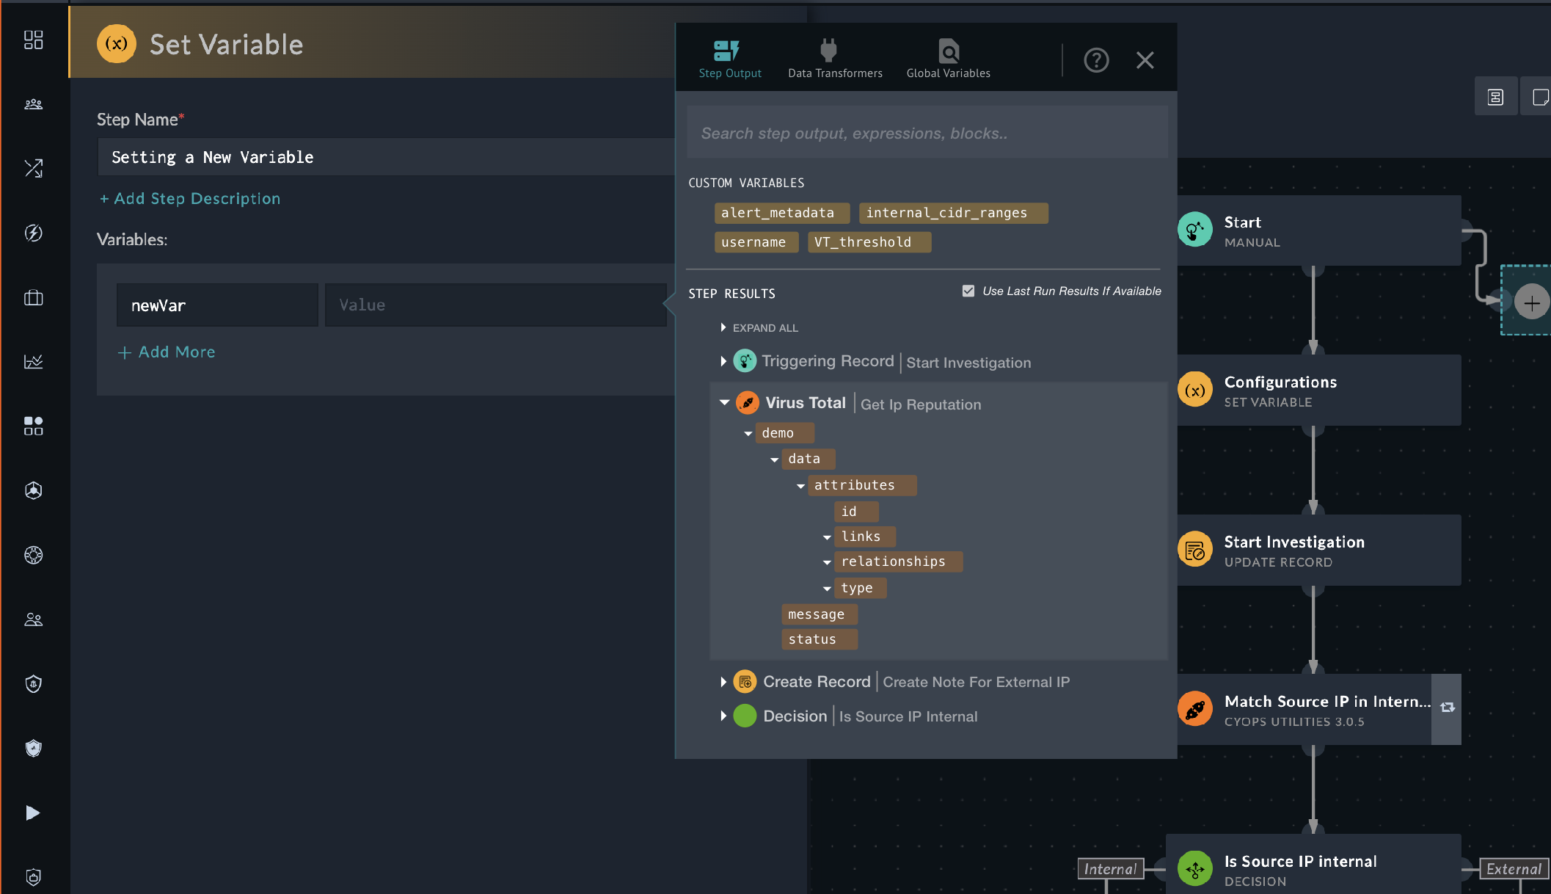
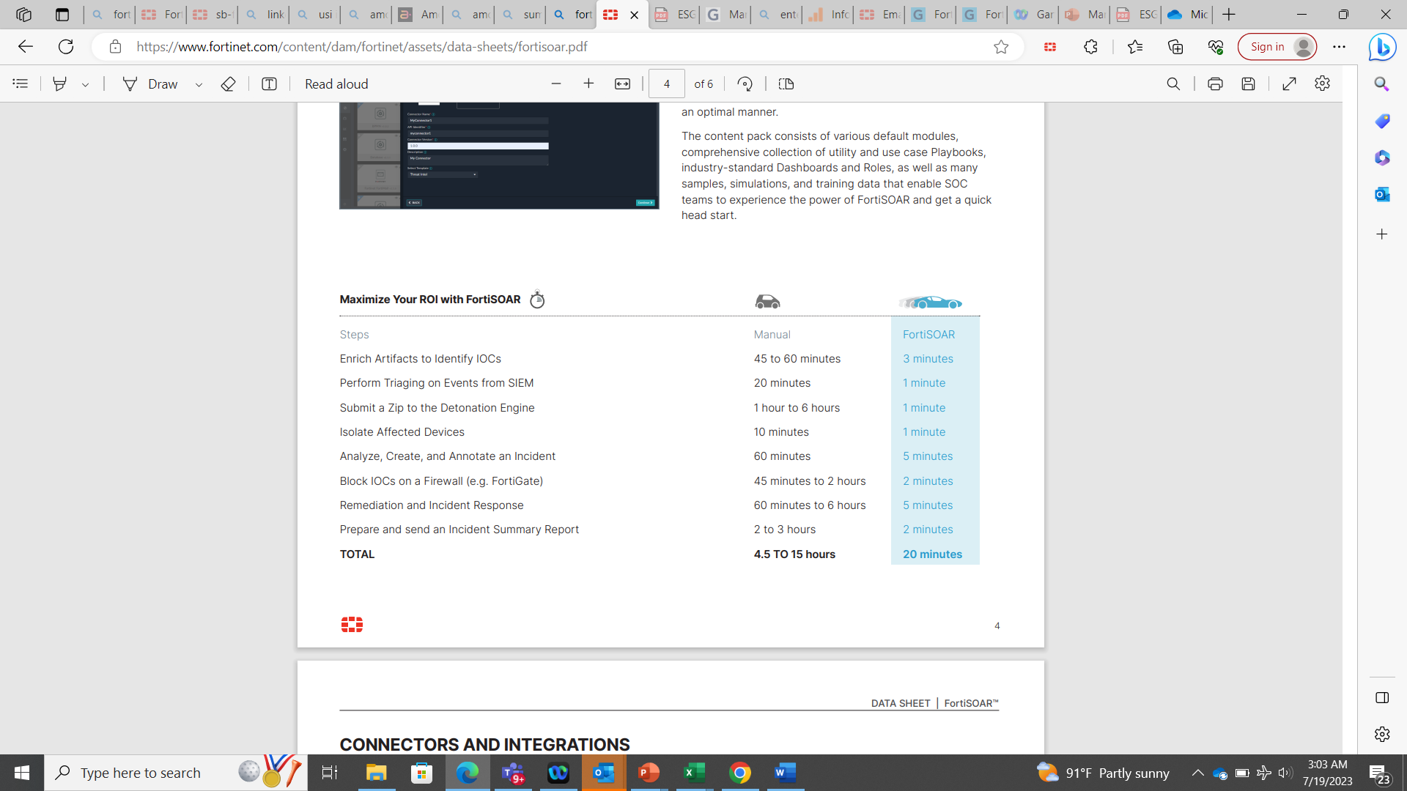
Using SOAR with AI to Speed Automation Processes
Centralize, Standardize, and Automate IT/OT Security Operations

Slide 15

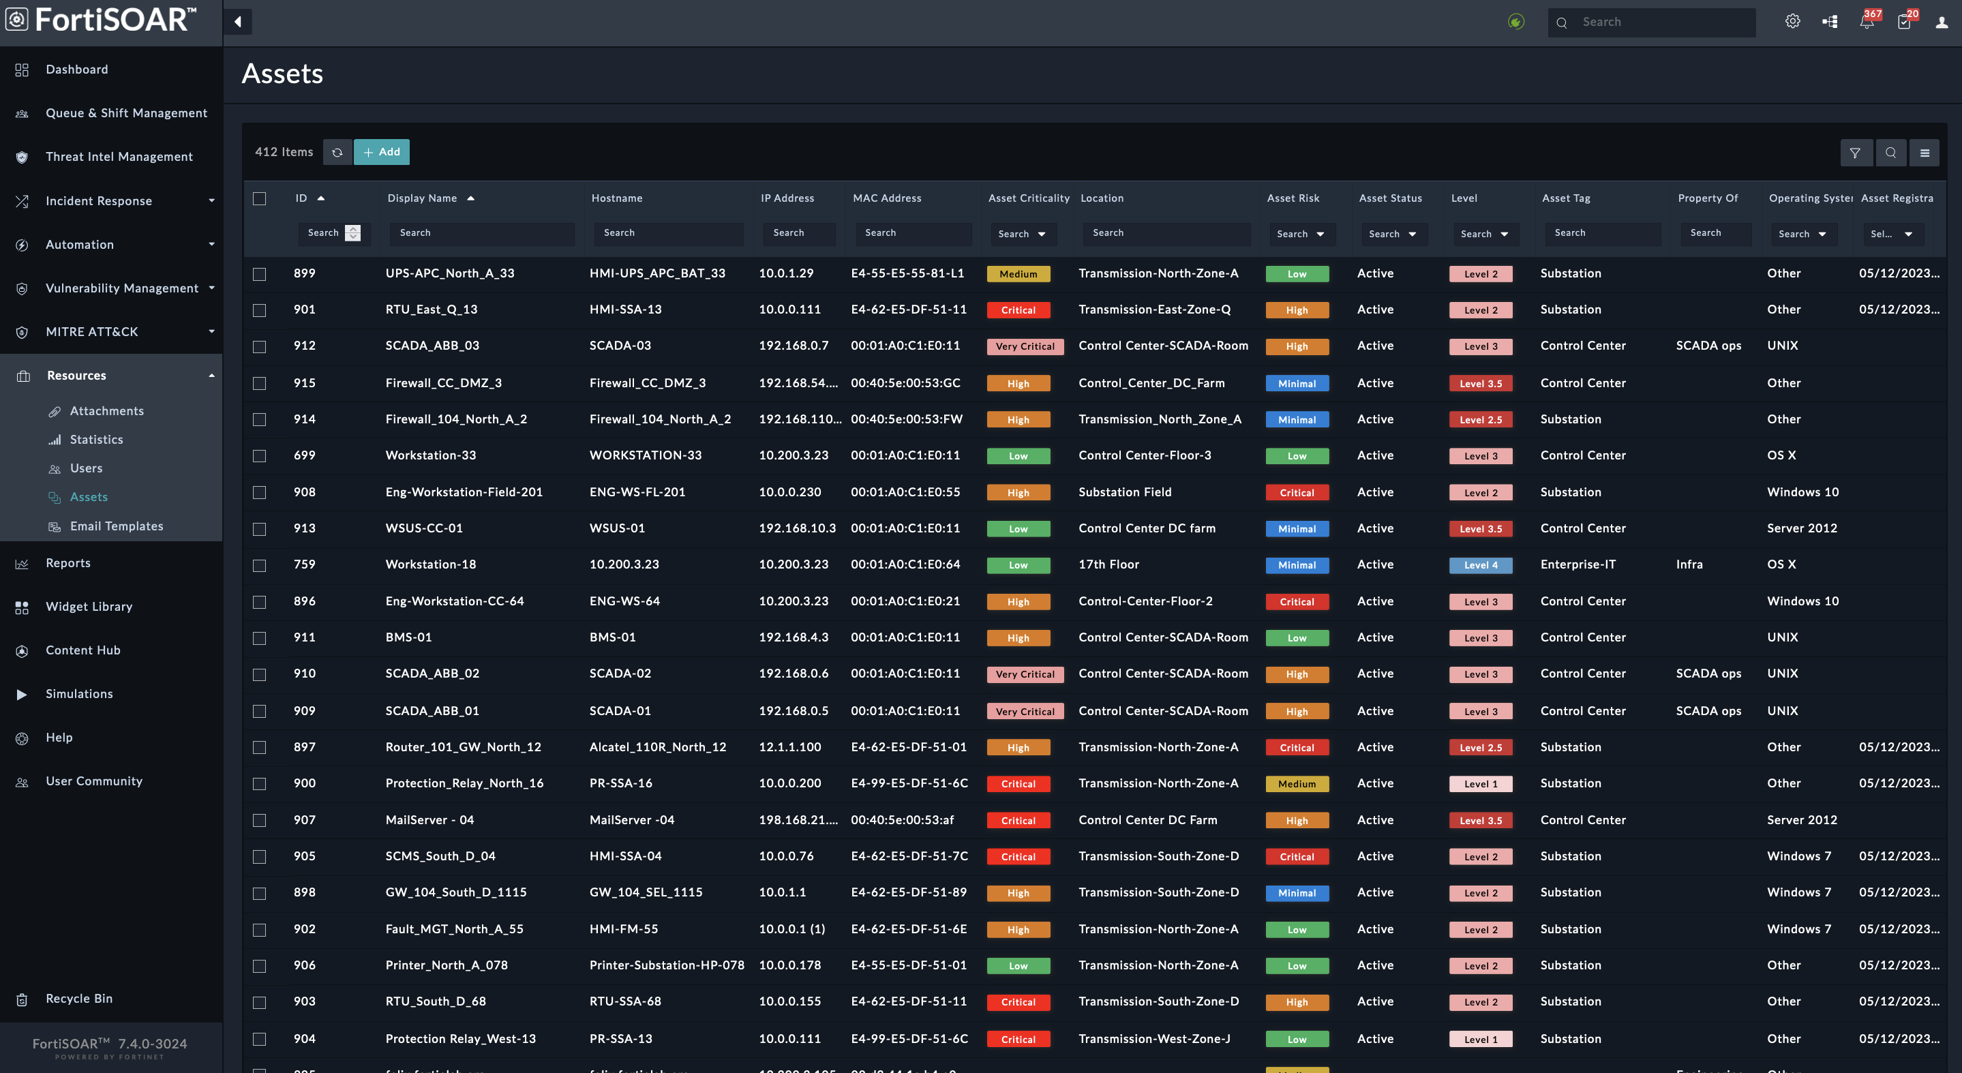
Asset &Vulnerability Management
NGFW
API
SIEM
NAC
SOAR
IT/OT tailored Asset Discovery
Zone/Level Context based on Purdue Model
Integrations with 3rd party Vulnerability Management vendors
Vulnerability Management and Orchestration
Asset Inventory with context

Slide 16

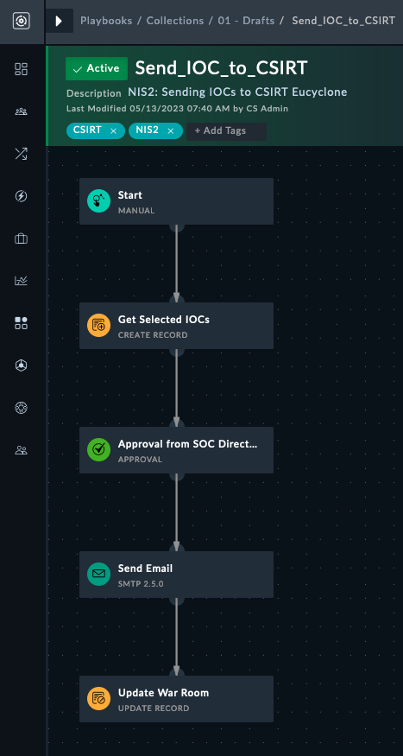
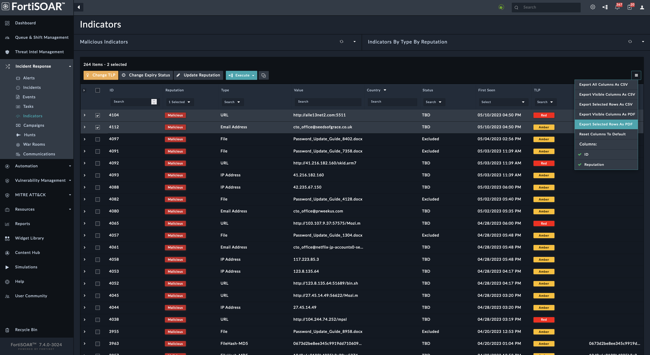
Incident reporting to CSIRT

Slide 17
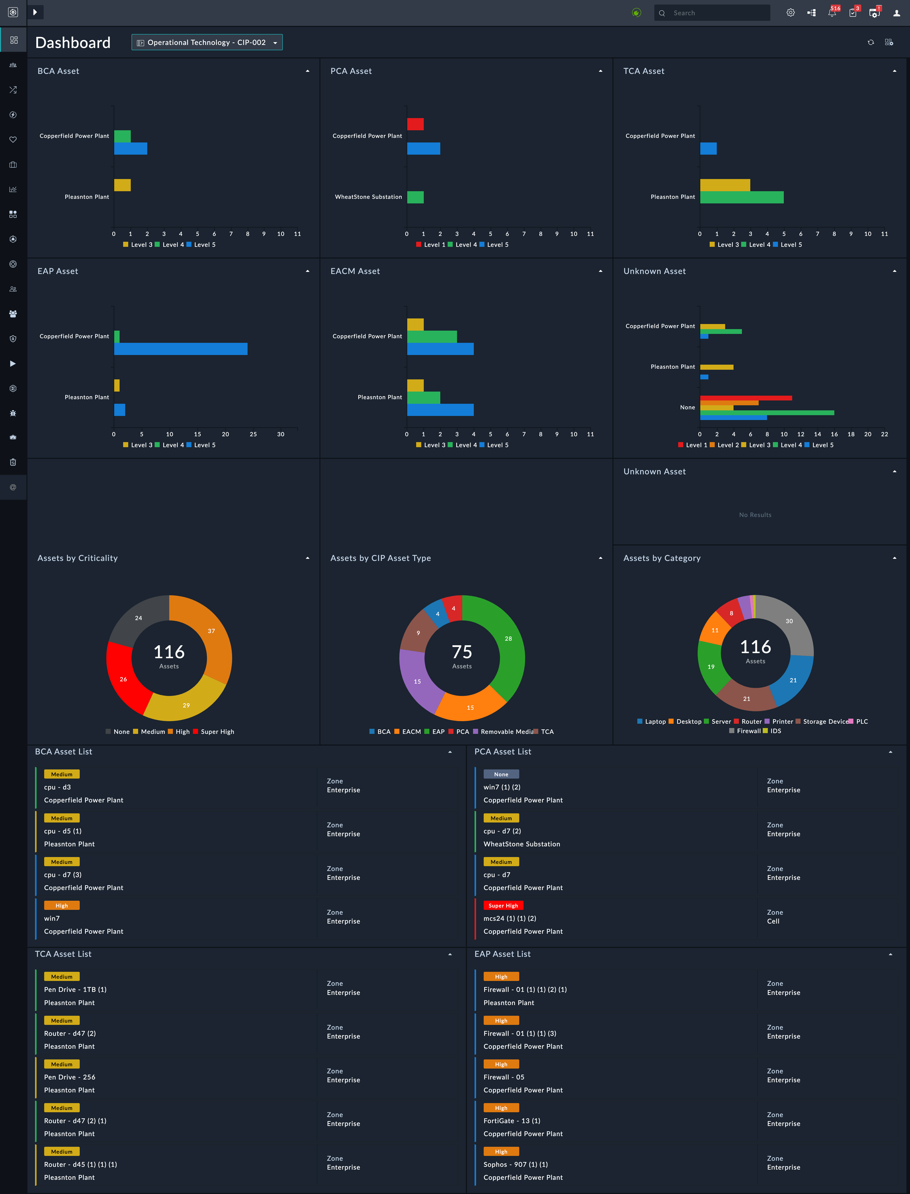
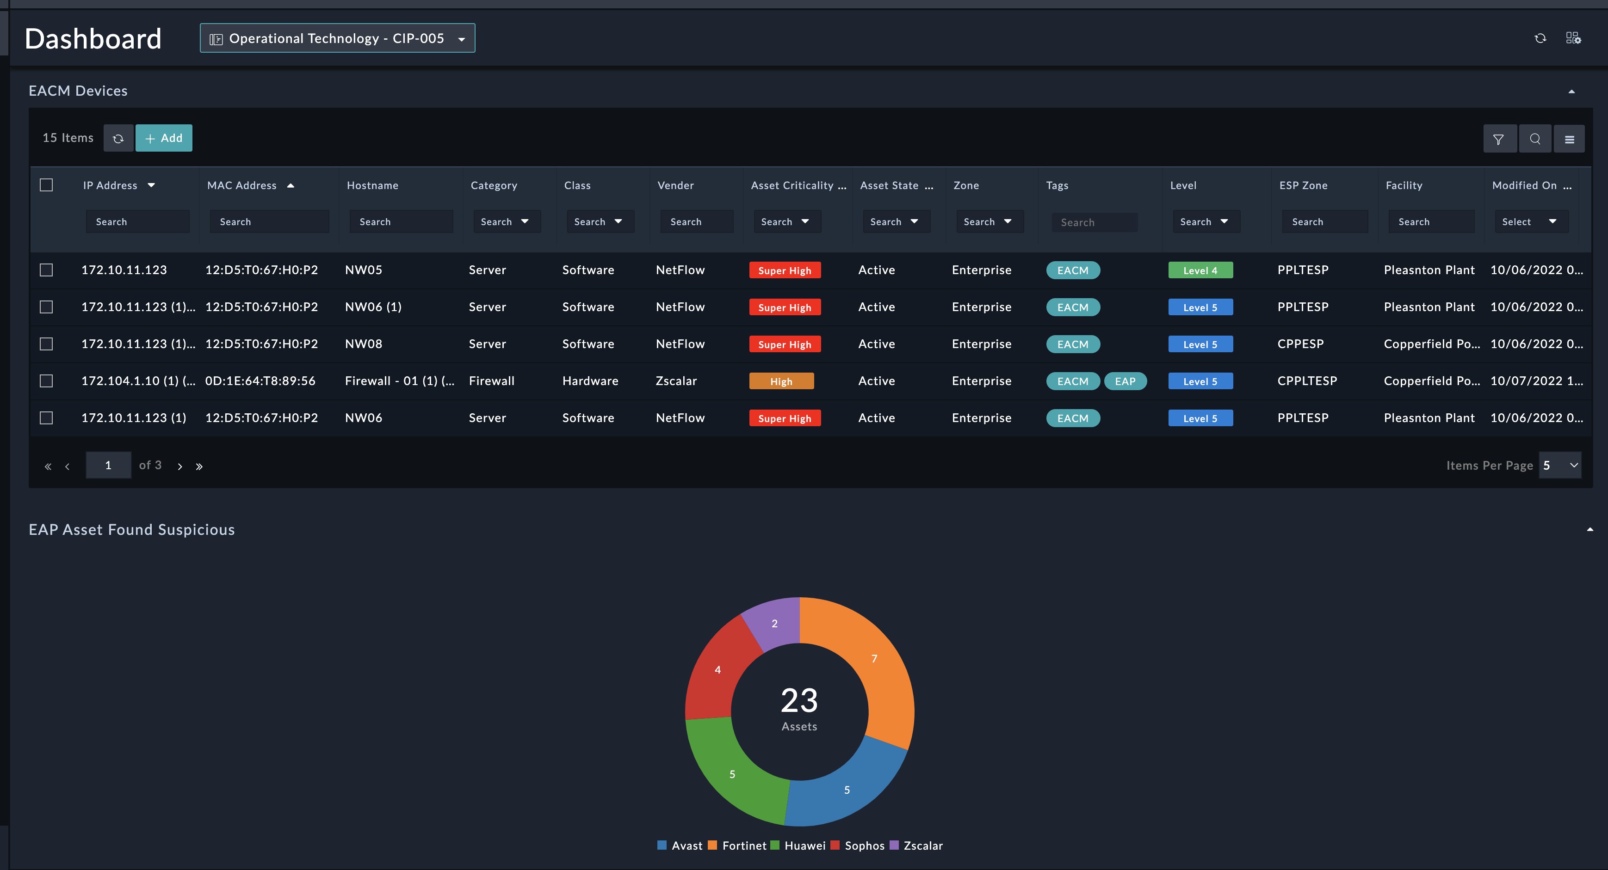
Reporting to Board

Slide 18
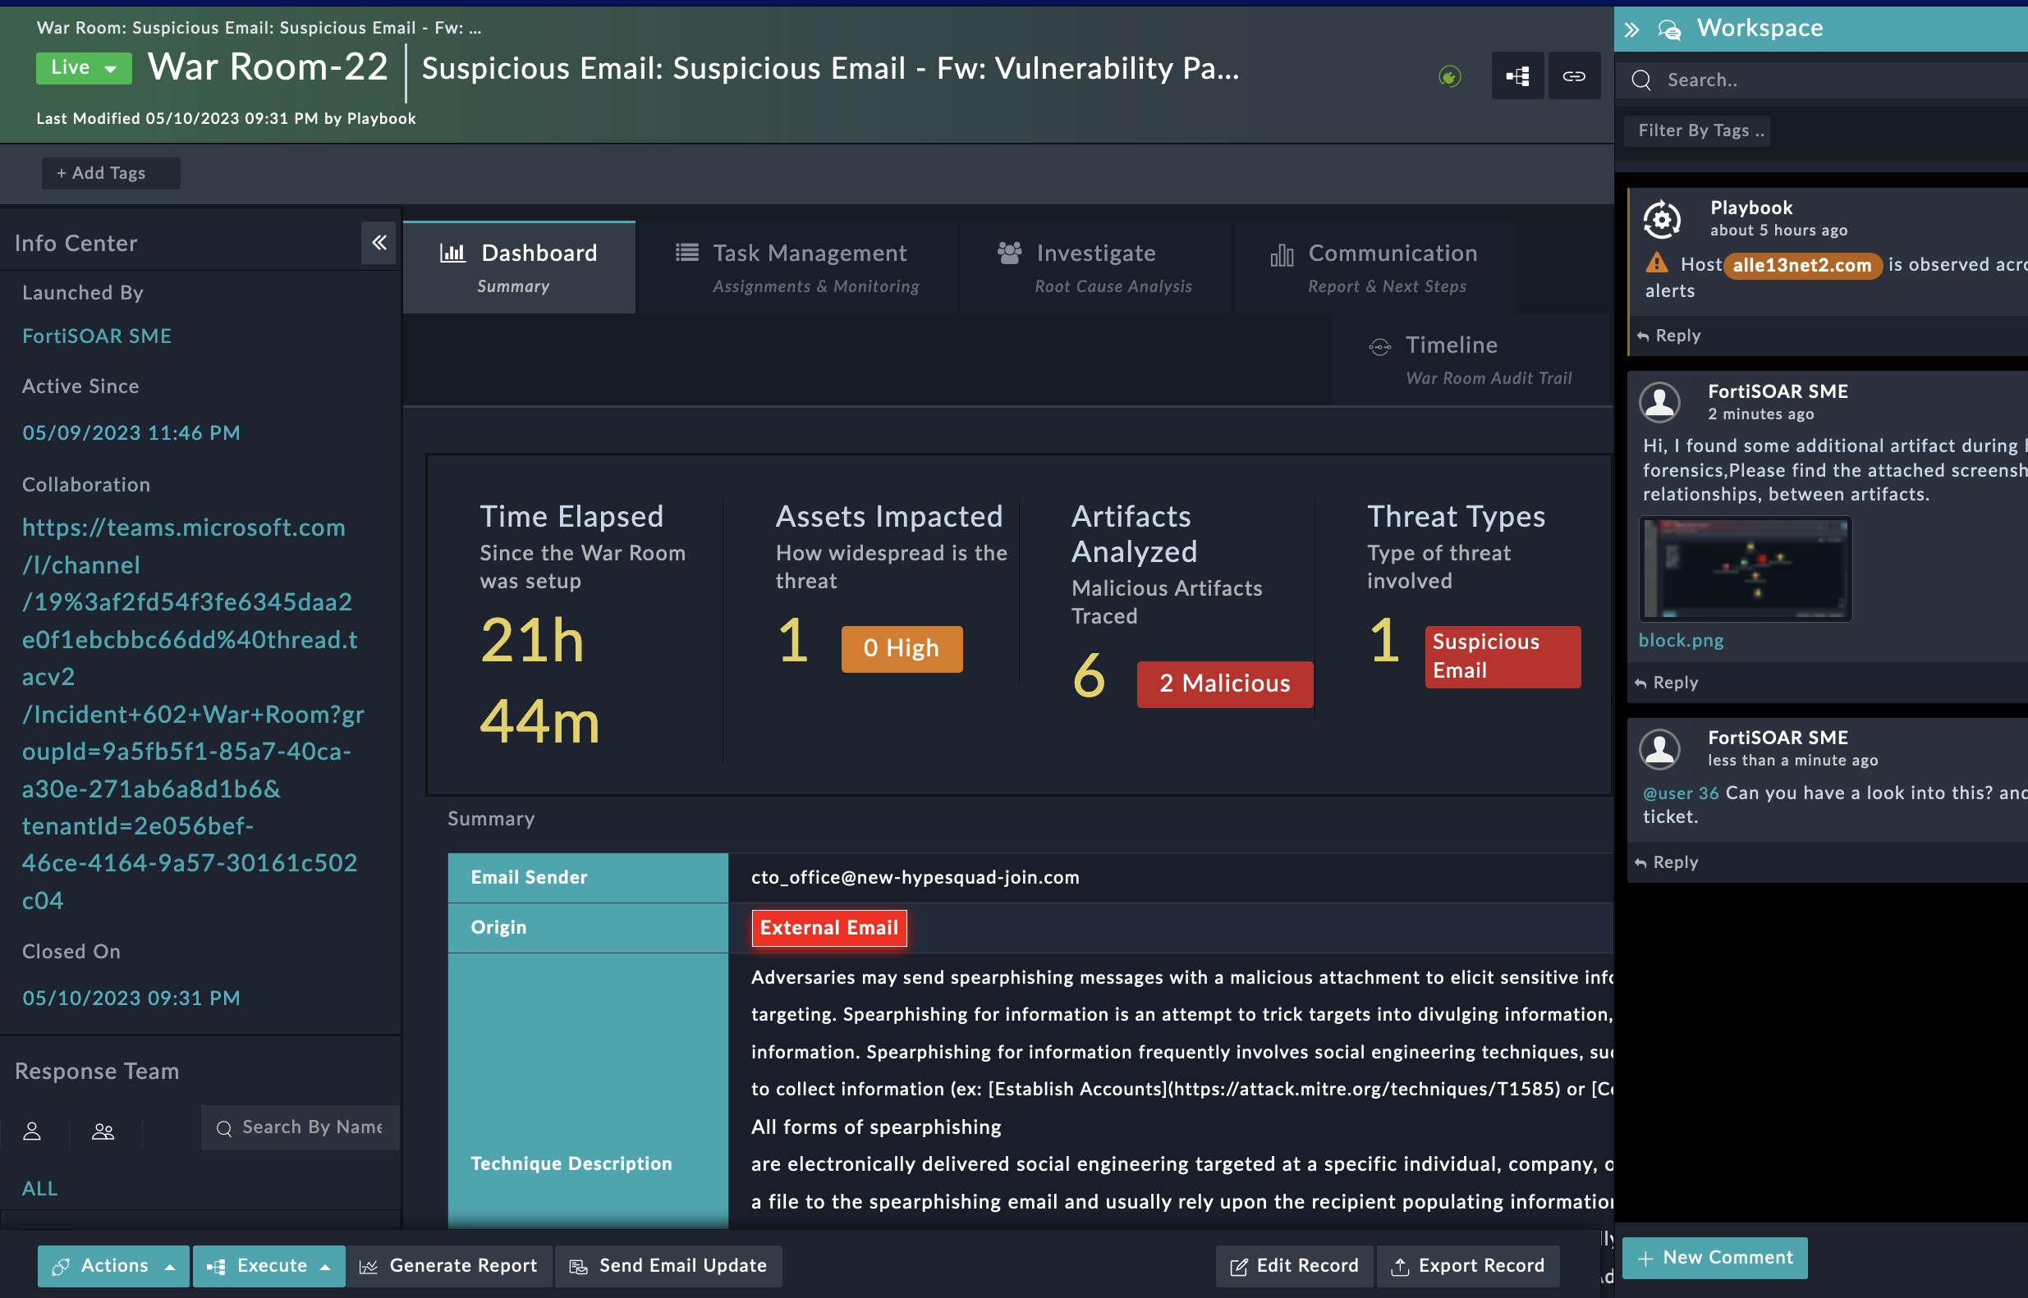
Crisis Communication
Collaboration between OT, IT, Safety, Engineering and Legal teams
From NIS2 Directive perspective Incident reporting obligations needs to be met in tight deadlines.
Helps to consolidate all the artifacts and Indicators of compromise
Easy to track all the vulnerable and compromised assets, helps in faster containment and remediation

Slide 19


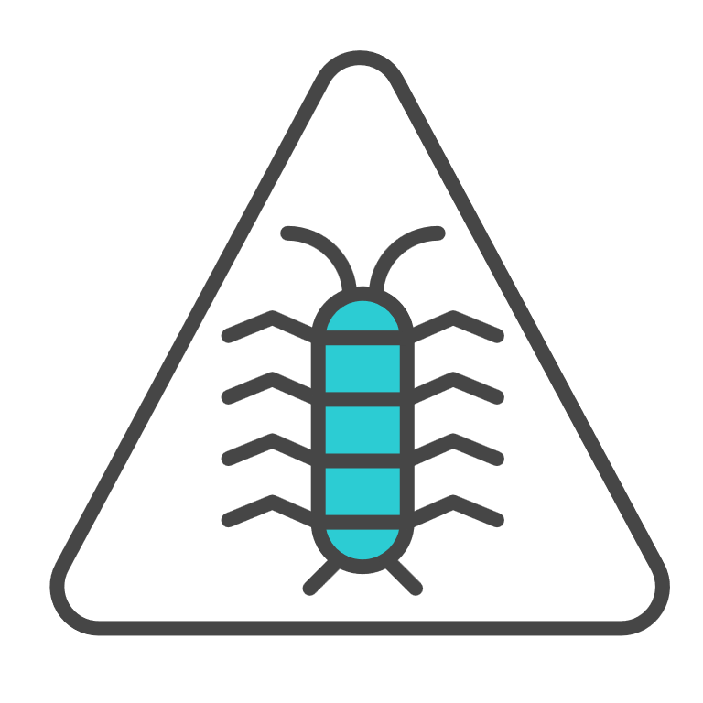








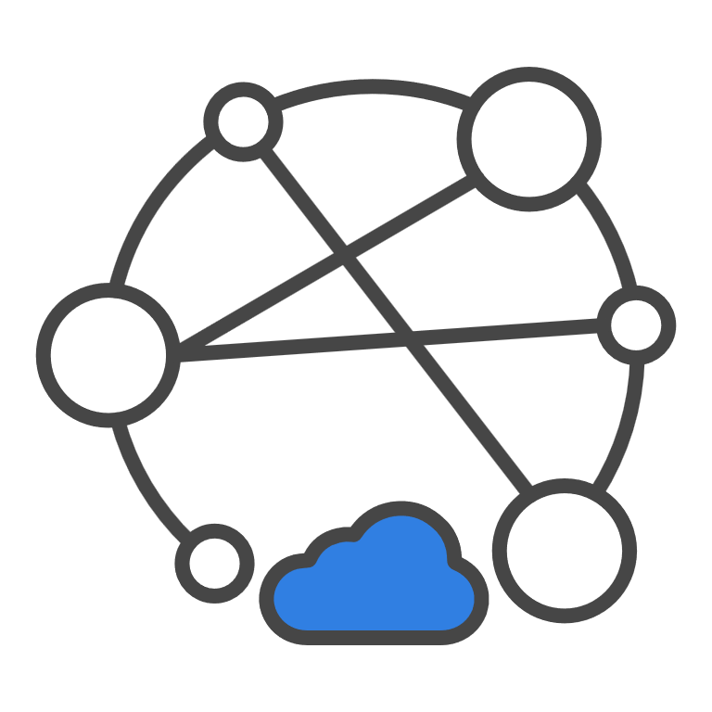
FortiRecon – for Supply Chain Security
Digital Risk Prevention Service
Comprehensive view of all potential and imminent internal / external risks for early, actionable intel and fast response
Pre-Attack
Reconnaissance
Weaponization
Delivery
Exploitation
Installation
Command & Control
Action on Objectives
Attack Surface Management
Continuous discovery and monitoring of
the internal & external attack surface
Internal & External
Attack Surface Management
+
Brand Protection
Detect brand and identity impersonations,
website typosquatting, rogue applications
Brand Protection
+
Adversary Centric Intelligence
Curated, actionable FortiGuard Labs
threat intelligence
Dark Web Monitoring
Notes:
FortiRecon is Fortinet’s, SaaS based, AI and HUMINT-fueled Digital Risk Protection (DRP) service, combining three robust modules – Attack Surface Management, Brand Protection, and Adversary Centric Intelligence, to provide security professionals with a complete view of all potential and imminent internal and external risks attackers can exploit and the intelligence in order to defend against these attacks.
Operating from outside and inside the organizational perimeter, the service maps an organization’s digital footprint and continuously monitors and alerts on known/unknown exposed, vulnerable assets, impersonations and brand abuse, phishing campaigns, malicious dark web activities, attack intel related to the organization and its supply chain vendors/third parties, and more, providing early threat indicators of attacks and potential threats for proactive mitigation.
FortiGuard Labs’ cybersecurity experts enhance the offering with guidance on prioritization of remediation efforts, and targeted threat research and intelligence. The team’s unparalleled visibility and access to adversary forums, some of which are invite-only, provide a rich understanding of threat actors’ motivations, TTPs (Tools, Techniques & Procedures), as well as detect early evidence of attacks against the organization and its third-party vendors. With this type of intel, and using the integration with FortiSIEM and FortiSOAR, it becomes exceedingly easier for Security and risk (S&R) professionals to act fast.
This service is available as stackable modules, you can license FortiRecon EASM as a standalone service, or combine it with Brand Protection, or with both Brand Protection and Adversary Centric Intelligence for complete coverage. Internal ASM can be added to all bundles. Customers can license exactly what they need – and when they need it.
Plug and play service – The onboarding process completes within 48 hours, where customers can immediately gain valuable insights and actionable remediation information. Customers can request analyst time for deeper dives

Slide 20
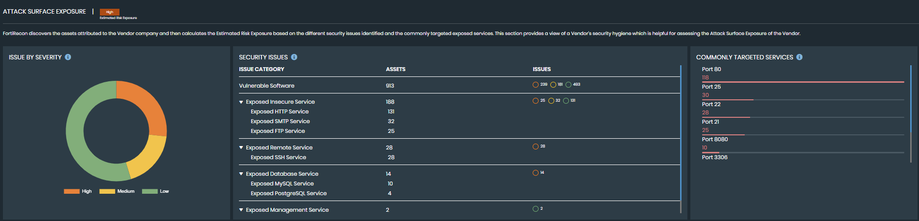

FortiRecon - Vendor Risk Assessment

Slide 21
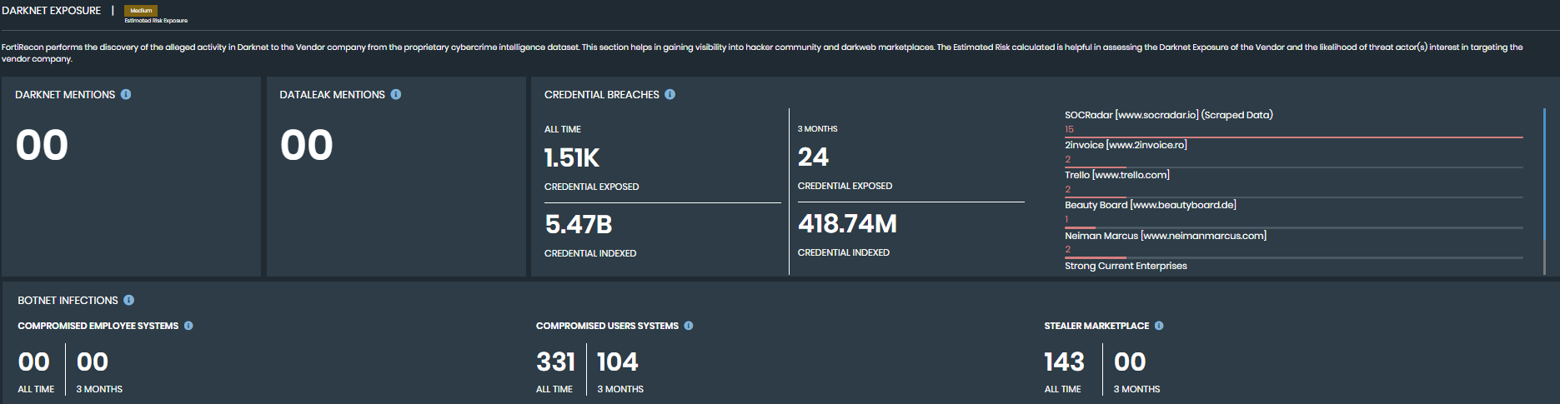
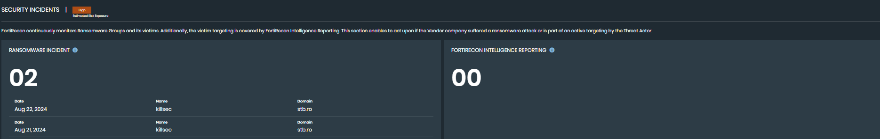
Vendor Risk Assessment

