Slide 1

AI's Impact on Business Innovation
How AI is driving digital transformation in business
Adrian Niga
Head of Channel & Alliances South-East Europe

Slide 2
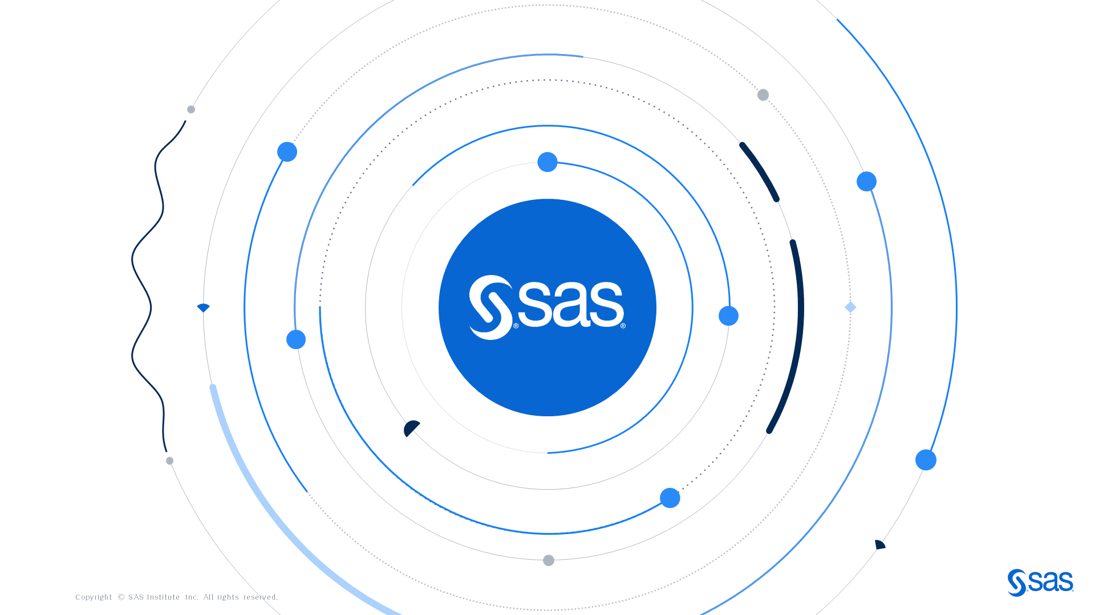

Slide 3

SAS is a
cloud native data and AI company

Slide 4
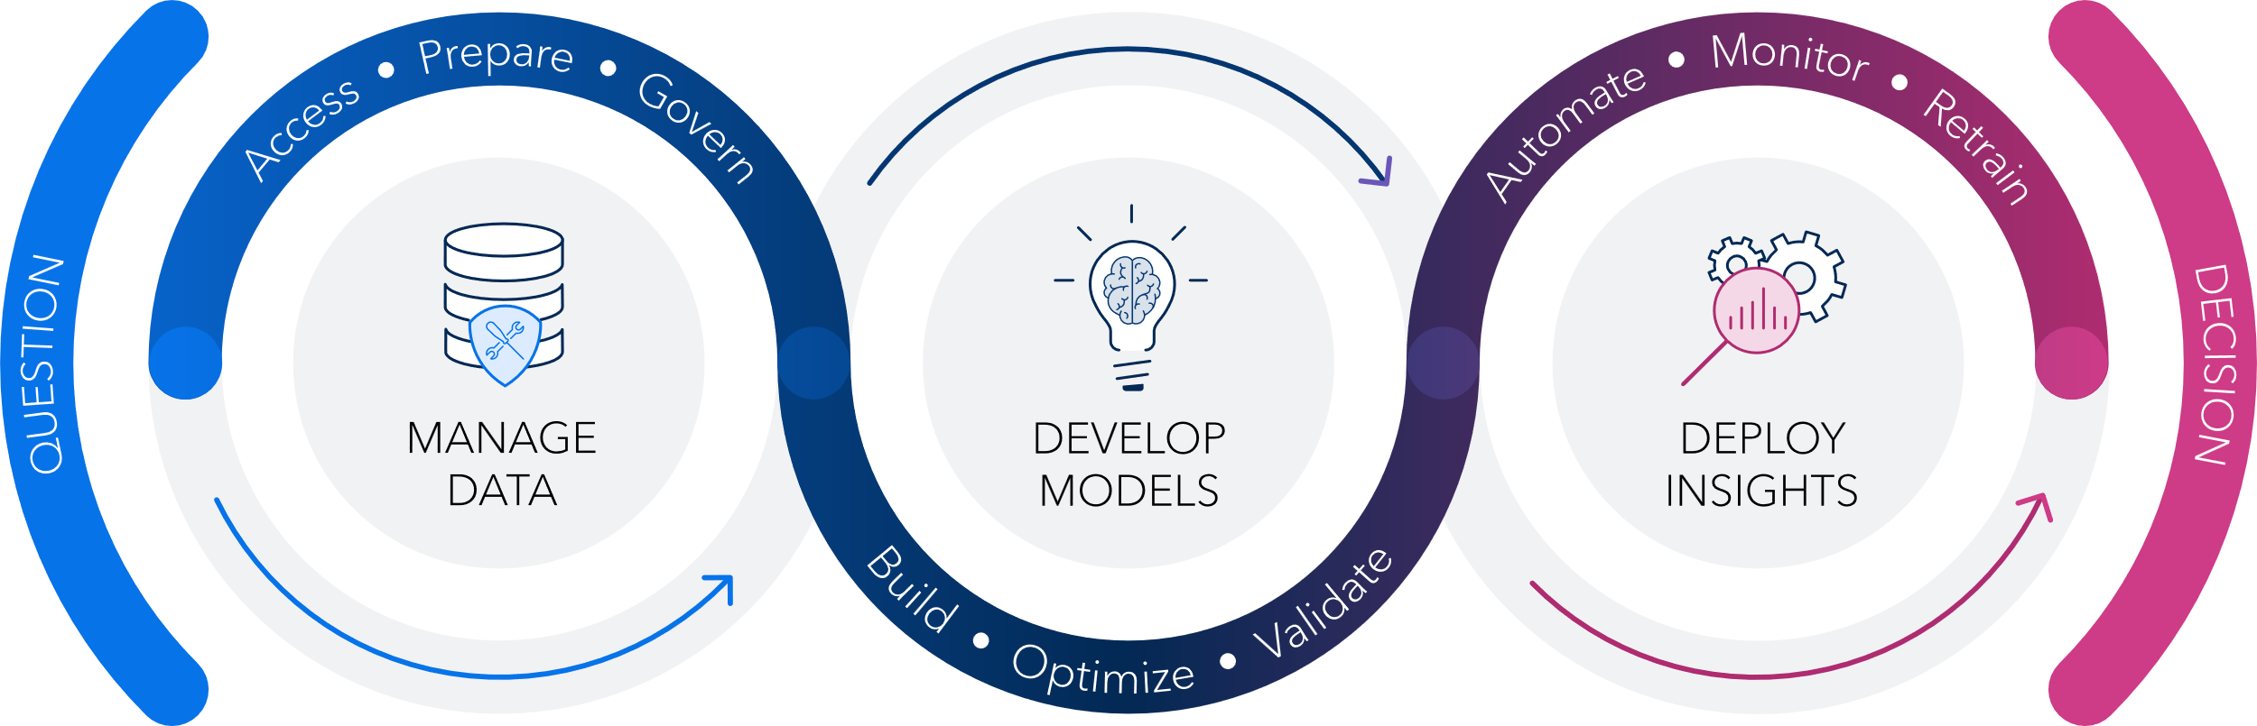
Digital Business Demands a Comprehensive Data and AI Platform

Slide 5

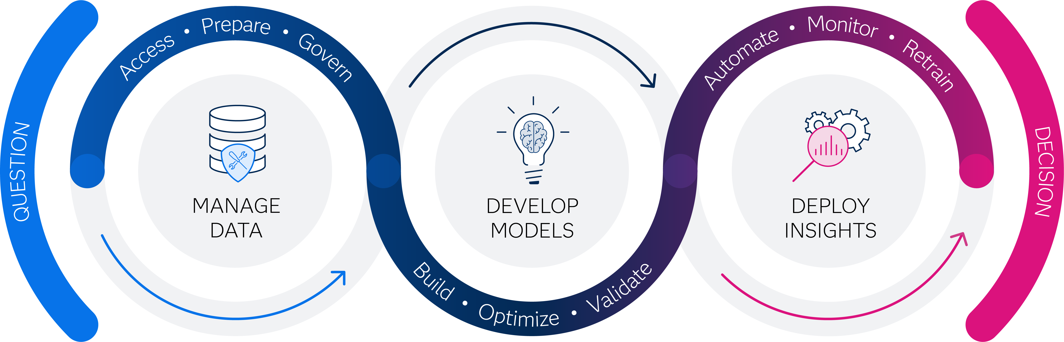






Fraud & Security
Intelligence
Risk
Management
Customer
Intelligence
IoT
SAS
Solutions
Clinical
Innovation
Health
Outcomes
Supply
Chain
On-Premise

Slide 6





Generative
AI

Slide 7

Generative AI
An AI method capable of generating NEW content
Notes:
Introduce the concept of GenAI
Generative AI (GAI) is a specific subset of AI algorithms designed to generate new content that closely resembles the data on which it’s trained.

Slide 8
Creating New Realities
Generative AI
LEARNS FROM DATA
GENERATES SOMETHING NEW
Text
Text
Conversations
Images
Audio
Videos & Images
Tables
3D Systems
3D signals
Generative AI
Graphs
Prompt

Slide 9
The Economic Impact of Generative AI
Generative AI could increase
the impact of all AI by up to 40%
Artificial Intelligence
Generative AI
$13 Trillion
Global Economic Potential
+ up to $4.4 Trillion
Global Economic potential
Source : McKinsey, The economic potential of AI, 2023

Slide 10
However…
66%
of leaders are ambivalent or dissatisfied with their progress on GenAI and AI
BCG Survey, 2024

Slide 11



Hurdles To Overcome
ROI
Data
Technology
Talent
Source: Colemans Report Market Research (North America, Survey covers 300 Decision-Makers for Gen AI Strategy or Data Analytics, across industries)
Notes:
The biggest adoption hurdles in 4 groups:
Unproven ROI: Let's look at returns – First order effect is enhancing productivity... difficult to quantify.
The formula to translate the “ah ha moments" to numbers is not yet there and
Further complicate... real benefits will be after business processes get redesigned....
Let's examine costs – all model providers provide a good token cost estimate (which companies are realizing to be prohibitive).... However.... the costs for private knowledge preparation, training and ModelOps mgmt is complex and lengthy.
Data & security: Enterprise is keen to use private data . .
But it requires intricate experimentation to address the data management issues of access controls, privacy/ security as well as knowledge refresh rates.... Basically, the inability to utilize both on-premises and cloud datasets effectively, insufficient data to fine tune LLMs.
Another significant concern to manage is hallucination... which requires a human in the loop and a work flow adjustment...
Security and governance remain paramount, with major concerns in data protection
Talent and skills shortage: While foundational models promises to lower the AI app development barriers.... At this stage we requires talented team in cloud development, data engineering, data science and DevOps.... to develop and integrate new apps within the enterprise.
Technology:
Lack of appropriate platform to implement and govern LLMs
Only 1 in 10 are fully prepared to comply with current and upcoming regulations concerning Gen AI
48% are planning to enlist third-party support to integrate and orchestrate GenAI and as built-in feature of enterprise platforms
12% of Gen AI budgets are being dedicated to improving governance and monitoring
8 in 10 tech decision makers show a strong interest in using synthetic data to address data challenges to support GenAI initiatives

Slide 12
Beyond the Buzz:
Challenges span across different personas
HEAD OF DATA AND ANALYTICS
Creating new business models with Generative AI
Scale existing investment on Generative AI
Reshaping workforce to harness Generative AI potential
HEAD OF IT
Risk of IP infringement
Integration with existing business and data workflows
Oversight on Generative AI initiatives (costs)
USERS
Understanding and explaining model output
Improve LLM Accuracy
Build and Deploy Generative AI projects faster (productivity)

Slide 13
SAS’ Approach to Generative AI
SAS is equipped to be the trusted partner to help organizations to confidently succeed in the Generative AI journey, across different industries, regulatory scenarios and use cases
Accelerated Business Productivity - Results You Can Trust - Faster Innovation

Slide 14
Generative AI in action with SAS
Viya Copilots
Synthetic Data Generation
SAS Viya
Explain, Govern, Orchestrate LLMs
Accelerate AI
Lifecycle / Industry/ Business Tasks
Mitigate Data
Quality and Scarcity

Slide 15
LLMs with SAS Viya APIs
Explain
Govern
Orchestrate
LLM Governance
Enable Conversational AI

Slide 16


Let’s see a Real-World Example

Slide 17





EMAIL
PHONE CALLS
WEBPAGE
TEXT
Complaints Management
Resolution for the Customer
Notes:
A bank has complaints from different channels like web page, email, text, phone calls … and they were already using existing solutions to do some sort of management of the complaints but wanted additional capabilities.

Slide 18

Summarize Conversations
Generate
a Reply
Validate
Response
Notes:
Specifically:
They wanted to be able to summarise conversations that had taken place over several contact episodes, so that a new operator could quickly catch up with and understand the situation without the customer having to tell their whole story again.
They wanted to automatically generate a reply to the customer,
They wanted the complaints handler to review the reply before sending it, to ensure that it was appropriate.

Slide 19

We want to
use LLMs
LARGE
LANGUAGE MODEL
Notes:
And they wanted to use LLMs!
this is typically the 90% of the conversation today with organizations. they already have some sort of systems in place that do some basic or complex analytics, there might be some degree of automation.
And they are wondering how do I use LLMs to make all this better and faster?

Slide 20
We want to
use LLMs
LLMs alone do not solve business tasks.
LARGE
LANGUAGE MODEL
Notes:
we have all come to the realization that LLMs alone do not solve business tasks.
Generative AI is nothing more than a feature that can augment businesses’ existing processes and make them faster.
But to get there, you need systems and technology that integrates LLMs with your existing processes and you need developers and engineers to maintain and govern them.
SAS Viya is helping with exactly doing just this..
Here is how we applied it to this use case

Slide 21
Customer ID
ID1
LARGE
LANGUAGE MODEL
ID2
COMPLAINT
ID3
ID4
Summary
ID5
ID6
ID7
ID8
ID9
ID10
ID11
ID12
ID13
ID14
ID15
ID16
ID17
ID18
ID19
ID20
ID21
ID22
ID23
ID24
Notes:
Developers used SAS Viya to build a flow that, for each complaint, would send the full text of the complaint and any previous interactions is then sent to the LLM, which provides a summary.

Slide 22

ID1
ID2
Customer ID
ID3
Reply
Generated
ID4
LARGE
LANGUAGE MODEL
COMPLAINT
Next Best Action
ID5
Explain Output
ID6
ID7
Summary
ID8
ID9
ID10
ID11
ID12
ID13
ID14
ID15
ID16
ID17
ID18
ID19
ID20
ID21
ID22
ID23
ID24
Notes:
That summary is sent to SAS Viya, which uses natural language processing techniques to explain how the summary was generated, takes the customer information from the enterprise data base (such as customer churn probability, customer credit score, customer value), and uses a decisioning system to recommend a next best action.
All this information is then passed back to the LLM to generate a reply to the customer.

Slide 23

ID1
ID2
Customer ID
ID3
Reply
Generated
ID4
LARGE
LANGUAGE MODEL
COMPLAINT
Next Best Action
ID5
Explain Output
OPERATOR REVIEW
OPERATOR APPROVAL
ID6
ID7
Summary
ID8
Automatic
Reply Sent
ID9
ID10
ID11
ID12
ID13
ID14
ID15
ID16
ID17
ID18
ID19
ID20
ID21
ID22
ID23
ID24
Notes:
The operator reviews that reply and can then send it to the customer if considered appropriate.
Or the entire process can be automated based on the level of human in the loop necessary.
Now…the important thing to notice here is that of all the different tasks involved in this use cases, only 2 were handled by the LLM … summarising the complaints and generating a reply. The other important things like recommending the next best action, incorporating your customer information, orchestrating the full decision-making process are handled by the platform… Viya.

Slide 24


LARGE
LANGUAGE MODEL
EXPLAIN
GOVERN
ORCHESTRATE
Notes:
This is what we mean that Viya allows developers to Explain, Govern and Orchestrate LLMs integrating them with decisioning systems.
Now, customer complaints in banking is just one of many application areas where this is leverage.
Think of credit landing, other scenarios where you need to analyze documents and take an action on them. LLMs only won’t do it.

Slide 25
in volume of complaints handled
20%↑
Integrating
Gen AI
for real world benefits
in average
response time
30-40%↓
in cost of
handling complaints
8-15%↓
Notes:
The benefits that we saw from integrating Generative AI to the existing business processes of the bank for this particular use cases were great.
[BUILD]
We were able to decrease average complaints handling time by 20%–40% … and increase the volume of complaints handled by up to 20%.
[BUILD]
The average response time decreased by 30%–40% … and the complaint resolution time by 20%–25%.
[BUILD]
The cost of handling complaints also decreased by 8-15%.

Slide 26
in volume of complaints handled
20%↑
Integrating
Gen AI
for real world benefits
in average
response time
30-40%↓
in cost of
handling complaints
8-15%↓

Slide 27
Thank You
sas.com

