Slide 1


Radical Resilience to Keep Your Business Running
Dan Popa
Regional Manager SEE
Cornel Popescu
Sr. Systems Engineer
Notes:
Hello, my name is [Name and Title]. Today I’m excited to share Veeam’s purpose with you: how we power data resilience to keep every business running.

Slide 2




The perfect storm of complexity and threats:
Data
Explosion
Infrastructure Complexity
Vendor
Lock-In
Surge in Ransomware Complexity
150⁺ ZB
created in 2024
doubling every year…
92%
Enterprises have a multi-cloud strategy
Every 3 Years
IT Hardware Refresh
1 in 4
27% of organizations paid the ransom and never got their data back
Complexity
Threats
Notes:
To start, it’s important to recognize that data is the lifeblood of every business, and presents increasingly complex challenges for organizations like yours to manage. As data explodes year on year, and sprawls across multiple clouds, countless endpoints and geographic locations, Veeam is tracking two emerging threats to data resilience.
The first is Vendor Lock-in. To keep data resilient, you need the ability to move your data easily to new applications or platforms, especially as the industry tracks aggressive vendor price increases, sending budgets spiraling.
The second is the increasing volume and sophistication of Ransomware – a costly problem, especially when you consider that 27% of organizations who paid a ransom still couldn’t recover their data.

Slide 3
The perfect storm of complexity and threats:
Data
Resilience
Data
Explosion
Infrastructure Complexity
Vendor
Lock-In
Surge in Ransomware Complexity
150⁺ ZB
created in 2024
doubling every year…
92%
Enterprises have a multi-cloud strategy
Every 3 Years
IT Hardware Refresh
1 in 4
27% of organizations paid the ransom and never got their data back
Complexity
Threats
Notes:
The world runs on data. Every business runs on data. If that data is unavailable, every business stops. You need to protect your data across every cloud, every endpoint, VM, app, container.
We call this “data resilience.”

Slide 4





Veeam is
Data
Backup
DATA
DATA
RESILIENCE
Data Intelligence
Data Recovery
purpose-built
for powering
data resilience
Data Security
Data Freedom
Notes:
So what does it mean for a company to pursue “data resilience”? Veeam looks at it across 5 core pillars:
The first is Data Backup. Backups are often the first target of ransomware attacks – regardless of where that data resides. Next is Data Recovery. Traditional recovery strategies leave businesses vulnerable, with 43% of data unrecoverable post-attack.
Then, Veeam is passionate about Data Freedom – the ability to freely move your data whenever, wherever and however you want. Data resilience wouldn’t be possible without Data Security – ensuring your data is secure, immutable and recoverable. And finally, Data Intelligence. Veeam is committed to making our products better, and helping you derive insights from your backup data.
We’ll talk more about all of these pillars in today’s presentation.

Slide 5











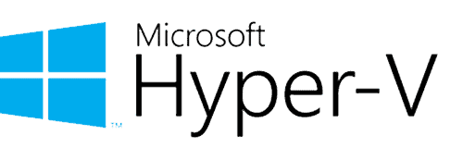






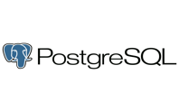




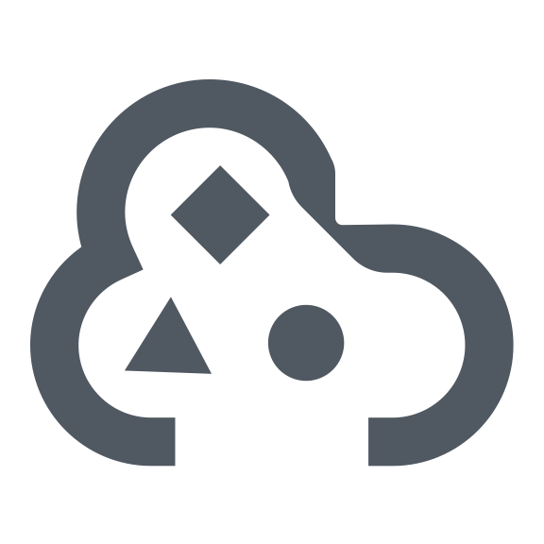



Extensive workload coverage unmatched in the industry
DATA
RESILIENCE
DATA
Native APIs
New for 2024
Cloud
Amazon FSx
AmazonRedShift
Azure Cosmos DB
Coming soon
in 2024
Virtual/Database
Proxmox VE
MongoDB
Cloud
Microsoft Entra ID
Azure Data Lake Storage Gen2
Cloud
Virtual
Physical
Apps
Unstructured data
SaaS
Containers
NAS
Object Storage
more coming soon
Notes:
But first, Veeam recognizes that to meet modern data protection requirements, we need to support a broad set of workloads across physical, virtual, cloud, apps and containers. And you can expect new workloads to be continuously added with each release!

Slide 6




Veeam has the most comprehensive backup capabilities
DATA
RESILIENCE
DATA
Industry best Recovery Point Objective (RPO) = minimal to no data loss
Broad coverage with platform-native backup
Optimized RPOs
and RTOs with
4-in-1 protection
Automated recoverability testing with SureBackup
Unified backup management at enterprise scale
Data Backup
Notes:
Data Backup is the foundation of data resilience. Veeam leverages native APIs at the platform layer, enabling your team to retire point tools in favor of a platform that combines backups, snapshots, replication and continuous data protection capabilities, optimizing your total cost of ownership.
And that commitment to TCO extends to the scalability enhancements we add each year. You can manage complex, distributed and multi-cloud environments with centralized management tools, enabling automated policy-setting that leaves no workload unprotected.
Plus, Veeam empowers IT teams to move ‘testing’ off the ‘nice to have’ list by automating recoverability testing at scale, instilling confidence that Veeam just works!

Slide 7




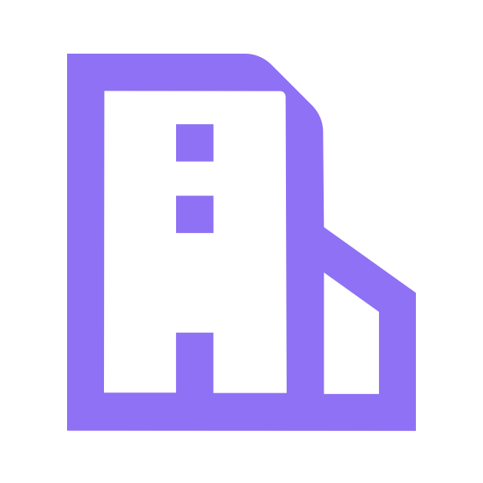




Veeam enables the fastest recovery with industry-leading RPOs and RTOs
DATA
RESILIENCE
DATA
5x faster recovery¹ speeds vs competition • Flexible, portable, granular recovery
Reduced
downtime with Instant Recovery
Granular search
and recovery
across platforms
Advanced disaster recovery planning
and orchestration
Clean, verified recovery at scale
with Secure Restore
Data Recovery
Notes:
Speaking of testing, it’s a good reminder that disruption to your business is inevitable! And the time to find out how successfully you’ll recover isn’t while you’re in the middle of a disaster.
Veeam’s comprehensive recovery capabilities aim to reduce downtime, recover with precision, provide documentation, and even sequence disaster recovery – offering you a level of confidence most IT Teams don’t have today.
Perhaps the worst kind of disaster is when you have to recover from a successful cyber attack. Veeam’s Secure Restore enables you to scan a backup with your antivirus software, or with YARA tools, to ensure it’s verified clean before you restore to production.

Slide 8




Patented Portable Data Format delivers complete
Data Freedom that no other vendor can deliver
DATA
RESILIENCE
DATA
Broadest storage support, avoiding vendor lock-in
Migrate and modernize your apps and infrastructure
Recover from anywhere to anywhere
Modern protection for modern workloads
Data Freedom
Notes:
When recovering from a cyber attack, you may have to opt for plan b, c, or d to get your business back up and running. At Veeam we are passionate about keeping data portable – so in the event of a disaster Veeam enables you to relocate and replatform your data so you can recover wherever and however you need to.
And that portability promise extends to other use cases. If you’re executing a hardware refresh, or replatforming a VM, or even building a container practice, Veeam can support the migration and ongoing data protection.
And we’re able to do this in no small part to our broad storage support. So whether you’re looking to reuse and optimize existing storage, leverage Veeam’s turnkey backup service – Veeam Data Cloud – or point backups to your cloud-of-choice, Veeam has you covered!

Slide 9




Veeam’s AI-driven threat detection is the industry benchmark
DATA
RESILIENCE
DATA
Veeam has integrated the most comprehensive array of threat detection technologies
Built-in security with a Zero Trust Architecture
End downtime with Incident Response services and tools
Detect threats
earlier with proactive threat hunting
Data integrity
with immutability everywhere
Data Security
Notes:
Another cornerstone of the Veeam story is our relentless commitment to security innovation. We believe organizations shouldn’t relegate data protection to the back-half of an incident response plan. Instead, Veeam offers a 360-approach, pre-, during- and post-incident.
For example, Veeam now offers a broad range of options to detect suspicious activity by performing low impact scans on your backups, adding yet another set of signals for your organization to detect incidents faster.
Another way we think proactively is our dedication to supporting immutability everywhere. Keeping backups in immutable storage ensures your data is authentic, accurate and free from tampering.

Slide 10






DATA
RESILIENCE
DATA
Hardware-agnostic security with
Zero Trust Data Resilience
Secure by design with Zero Trust Architecture
Production
Backup Software
Backup Storage – 3-2-1 Backup Rule
Segmentation of software & storage
RPC, SSL
Public Cloud
Physical
NFS, iSCSI
Backup Server
Target storage
Veeam Vault
SNMP, Kerberos
Service Provider
Multiple data resilience zones
Attack Surface
Primary
Data Center
Target storage
Minimal attack surface
Virtual
SSH, RDP
Proxies
CIFS, WMI
Zero access
to root and OS
Secondary Data Center
Target storage
Cloud
Agents
Immutable backup storage
Secondary Data Center
Multiple data resiliency zones
Notes:
A common best practice for pre-incident planning is Zero Trust – a model that drives organizations to assume breach across their data estate.
Veeam plugs that principle into the foundational architecture of every solution, employing physical and/or logical separation of environments, and least privilege access, to minimize the attack surface and blast radius.

Slide 11
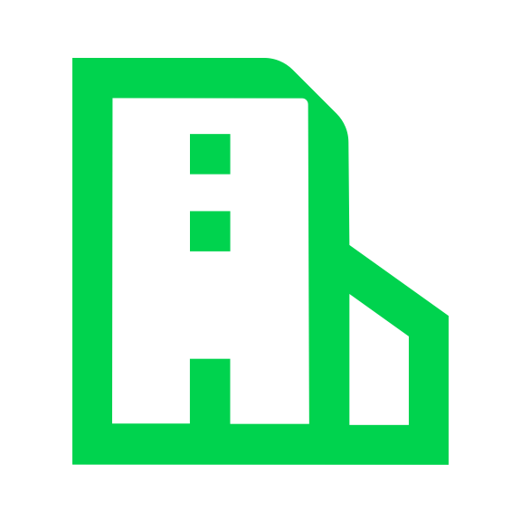
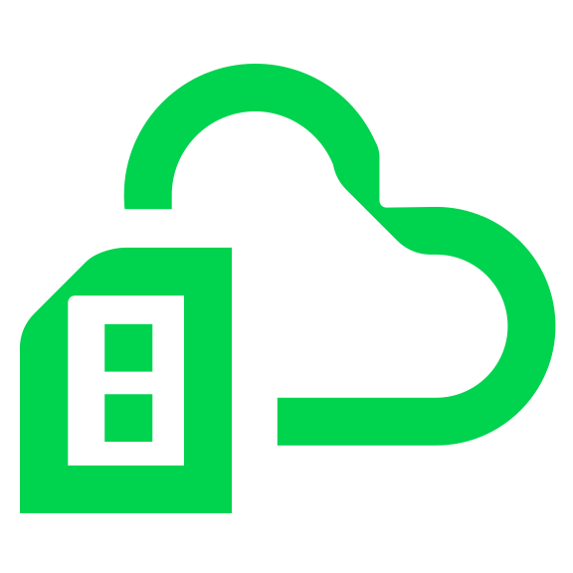









Veeam provides the most complete end-to-end ransomware protection and recovery
Veeam Cyber Secure Program
24/7/365 SWAT Team | Health Checks | Ransomware Warranty | Incident Response Retainer
Ransomware Prevention
Threat Detection
Rapid, Clean Recovery
AI in-line Malware Detection
Immutable
Backup
YARA
Rules
Clean-room, verified, immutable backups
Recover Anywhere Pre-tested, automated clean recovery
SIEM Integrations
Incident Response –
Forensic
Analysis
Negotiation
(if required)
Settlements (if required)
Decrypt/
End Downtime
Post-incident
documentation
Largest commercial database of Cyber Incident Data
Notes:
Recently Veeam acquired Coveware, a leading provider in cyber-extortion incident response.
Coveware Incident Response is now offered as part of Veeam’s Cyber Secure program, combining our powerful security capabilities with expertise backed by the largest commercial database of Cyber Incident Response data.
No other vendor in the market provides this level of complete support for Enterprise Data Resilience. Period.

Slide 12




Driving relentless innovation to derive deeper insights from your data
DATA
RESILIENCE
DATA
AI-powered
detection and
security scoring
Teams get
answers faster with
AI Digital Assistant
Automatic diagnostics and remediation analysis
Backup data reuse for data mining, dev/test
Data Intelligence
Future
Roadmap
Joint development to integrate with Microsoft Copilot
Data protection of AI model workloads (LLMs, MLs, NLP)
Enabling customers to unlock insights with AI from their immutable backup data
Notes:
I’ve mentioned our AI-powered threat detection before, but what I didn’t mention is how easy it is to use. The engine sends signals to the Veeam Threat Center dashboard, highlighting potential threats and measuring risk via an automated security scoring function. As cyber attacks become increasingly sophisticated, you should be looking to exploit the power of AI to stay one step ahead!
And part of that means using Veeam to its fullest extent. For example, when 450,000 organizations use your solution, you can learn a lot from their experiences. Back in 2019, Veeam launched Intelligent Diagnostics, a solution that leverages a database of signals from Veeam Tech Support to recommend remediation actions for common misconfigurations. These kinds of diagnostics can help you fix issues before they become a blocker to data resilience.
We also recently launched the Veeam AI Digital Assistant, unlocking in-product guidance using generative AI. This engine will only become more powerful, as we recently announced a joint partnership with Microsoft to co-develop and integrate with Microsoft Copilot.
And that Copilot integration will expand our existing capabilities for Backup Data Reuse. Veeam makes it easy to crack open backups and use them for dev/test, expose them to third-party data mining tools, execute eDiscovery requests and more, ultimately maximizing the value of your backup investments.

Slide 13






Flexible delivery, customer choice: self-managed software or as-a-Service
Software Subscription
as-a-Service (SaaS)
Veeam Data Platform
Veeam Cloud Service Providers
(3rd party)
Veeam Data Cloud
(1st party)
Kubernetes
M365
Salesforce
M365
M365
Vault
Self-managed on-premise, cloud, or hybrid
Managed service through Veeam cloud service providers
1st party Veeam managed service for M365, Azure, AWS
All services will eventually be provided as-a-service
Notes:
A theme I’ve hit on throughout the five pillars of data resilience is Flexibility. Unlike other vendors in the space who have prescriptive and restrictive deployment options, Veeam offers customers choice with flexible delivery models.
Execute complete control over the architecture and deployment of your backup strategy with our Software Subscription options, or accelerate time to value with backup services from Veeam or one of our Veeam managed service partners.

Slide 14


Products that bring data resilience to life
DATA
DATA
RESILIENCE
Proactive Threat Assessment | Forensic Triage | Incident Response
Ransomware Patterns & Signals
Data Backup
Data Recovery
Data Freedom
Data Security
DATA
RESILIENCE
Cloud Vault
Data Intelligence
Secure cloud data
management
Native APIs
Cloud
Virtual
Physical
Apps
Unstructured data
SaaS
Containers
Secure by design with Zero Trust Architecture
Notes:
To bring these 5 pillars together, across our delivery models, I want to refresh on the beginning of the presentation. Our industry is currently experiencing the perfect storm of complexity and threats. Data volumes are growing, data is increasingly getting locked up in proprietary environments, workloads are going unprotected as they move to multiple clouds, and bad actors are gaining ground. The time is now to prioritize data resilience.

Slide 15



Veeam is #1 in Data Resilience
Data
Resilience
Worldwide Semiannual Software Tracker
for Data Replication & Protection
Notes:
450,000 customers, 74% of the Global 2000 trust Veeam to keep their business running. VMware backup was just the start for us – as you’ve heard, we continue to create the standard that other vendors follow across disaster recovery, data resilience, cloud data protection and more.

Slide 16

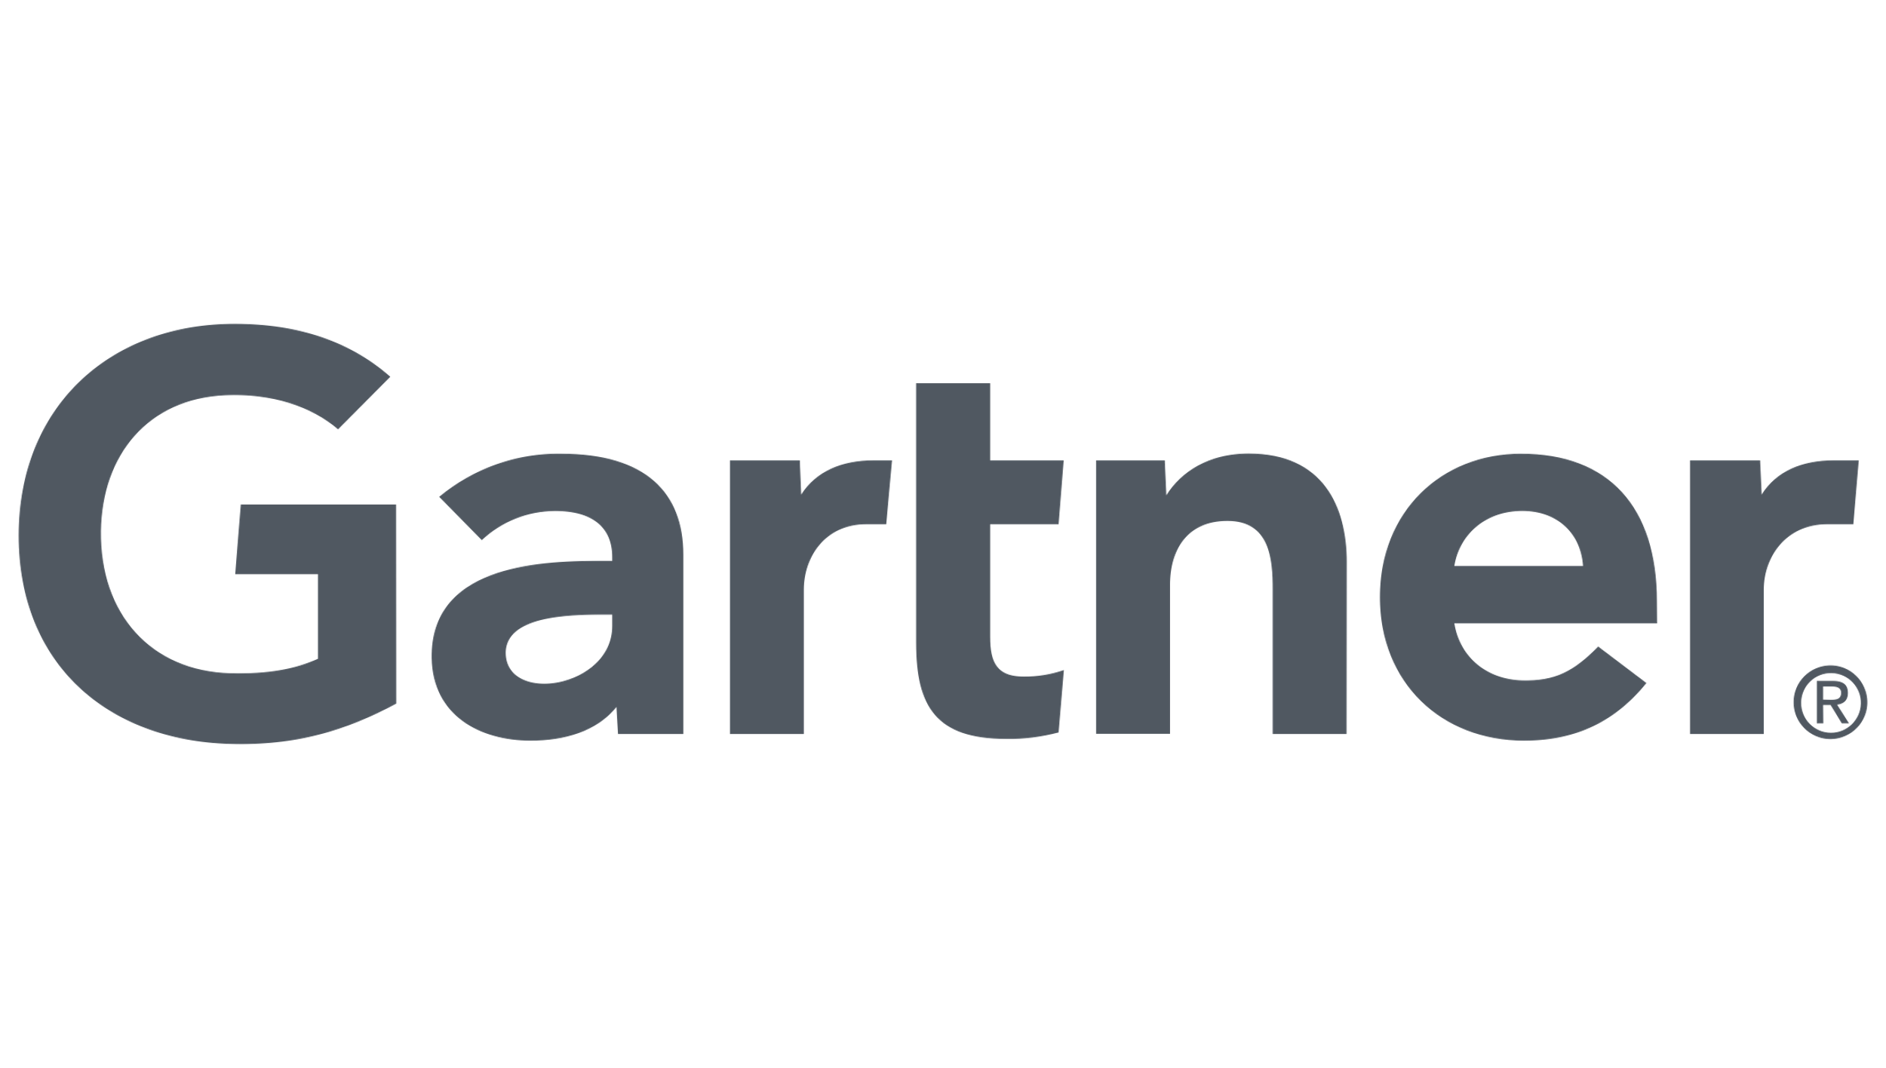
Veeam is #1 in Data Resilience
global market share in Data Replication & Protection | Secure Recovery, 5x faster | Data Portability | Microsoft 365
 | Kubernetes | Multi-cloud / Hybrid | Magic Quadrant, ability to execute
#1
#1
#1
#1
#1
#1
#1
Notes:
Our category leadership is why analysts from IDC, Gartner and others recognize us for our commitment to innovation. From leading in data protection for modern workloads, to our disciplined approach to data portability, to our award-winning recovery capabilities, there’s a lot to brag about at Veeam. But we truly do this because we are passionate about keeping businesses like yours up and running. With Veeam by your side, you have the confidence knowing that you can meet the IT needs of today, and tomorrow.

Slide 17


Notes:
Our category leadership is why analysts from IDC, Gartner and others recognize us for our commitment to innovation. From leading in data protection for modern workloads, to our disciplined approach to data portability, to our award-winning recovery capabilities, there’s a lot to brag about at Veeam. But we truly do this because we are passionate about keeping businesses like yours up and running. With Veeam by your side, you have the confidence knowing that you can meet the IT needs of today, and tomorrow.

Slide 18
Notes:
I look forward to discussing more about your current business requirements, sharing insights from other organizations we work with, and proving the power of Veeam in a proof of concept. Thank you for the time today!

Slide 19
Veeam Data Platform Packaging

Slide 20
Veeam Data Platform Packages
Platform Editions | Backup and Recovery | Monitoring and Analytics | Recovery Orchestration | Ransomware Warranty (add-on)
Premium
Advanced
Foundation
Supporting product components | Veeam Backup & Replication | Veeam ONE | Veeam Recovery Orchestrator
Also Available:
Veeam Backup & Replication Community Edition
Veeam Data Platform
Essentials Edition for Small Business
Notes:
There are three enterprise-grade editions of the Veeam Data Platform to meet your specific needs and budget. All editions contain Veeam’s award-winning Secure Backup and Instant Recovery
Advanced and Premium editions also deliver advanced data resiliency features including - monitoring, analytics and fully orchestrated recovery.
Premium Edition is your clear path to data resilience, enabling you to be ready for any scenario with orchestrated recovery - providing you access to the full capabilities available with the Veeam Data Platform, adding the ability to rapidly respond to a ransomware attack with orchestrated recovery that is secure, tested and documented for compliance
Advanced Edition, which combines backup & recovery with monitoring and analytics enables you to maintain full visibility for proactive management and recovery success with deep, intelligent monitoring and observability to identify and resolve any backup or recovery problems before they become emergencies
Foundation Edition allows you to own, control, backup and recover all your data, anywhere in the hybrid cloud

Slide 21










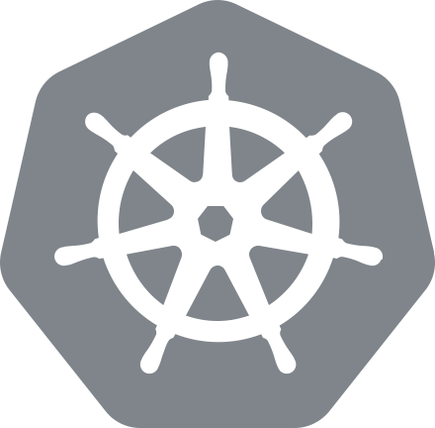



Veeam Data Cloud unlocks the full potential of Veeam Data Platform as a service
Veeam Data Cloud
ROADMAP
Policy Management
Product Automation
Consumption Management
Reporting
eDiscovery
Archive
AI Analysis
AI Copilot
Data Backup
Data Recovery
Data Freedom
Data Security
Data Intelligence
Cloud Vault
Secure cloud data
management
Workloads
M365
Cloud
Cloud
Salesforce
Kubernetes
Entra ID
Virtual
Physical
ROADMAP
Confidence without Complexity • Secure Architecture • All-inclusive and Predictable Pricing

Slide 22
Veeam has a relentless track record on disruptive innovation in data resilience
2-in-1: Backup
and Replication
Built-in deduplication
Instant VM Recovery
SureBackup
Universal Application Item Recovery
Cloud Connect Backup
Instant recovery from ANY backup to VMware vSphere
Data
Integration
API
Smart Object Storage API
Only E2E cyber resiliency solution in market (Coveware)
2008 | 2009 | 2010 | 2011 | 2012 | 2013 | 2014 | 2015 | 2016 | 2017 | 2018 | 2019 | 2020 | 2021 | 2022 | 2023 | 2024
VMware vStorage API and Changed Block Tracking (CBT)
Microsoft
Hyper-V CBT
Built-in WAN acceleration
Backup and Restore directly from Storage Snapshots
Scale-out Backup Repository
Driverless CBT for Windows
BitLooker
Backup I/O Control
Cloud Connect Replication
On-Demand Sandbox on Storage Snapshots
Universal Storage
API
Block Cloning
integration
Secure
Restore
Staged
Restore
Hardened Linux Repository with certified immutability
Kasten Application mobility and disaster recovery (DR)
Instant Recovery for Nutanix
Instant Recovery of any image-based backup to Hyper-V
Instant Recovery for databases
Instant Recovery for NAS file shares
AI-Powered inline malware detection
Suspicious file system activity detection
I/O Anomaly Analyzer
Veeam Incident API
Veeam Threat Center
Orchestrated recovery to Microsoft Azure
Universal Storage API v2 and Smart Object Storage API v2

Slide 23

Introducing Veeam Cloud Vault
Secure data management in the cloud optimized for Zero Trust Data Resilience
Zero Trust Data Resilience Best Practice
3
2
1
1
0
3
2
1
      Different copies
      Different media
      Offsite Immutable copy
Veeam Cloud Vault
Cloud Vault
    Multiple Resiliency Domains, uniquely secured
    Object lock. True air gap. Industry tested protocols
    Complete immutability
    Data is encrypted
    in flight and at rest
Secure cloud data
management

Slide 24










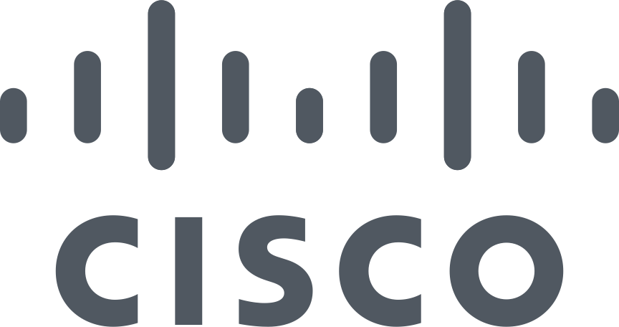










Made more powerful by a robust Security partner ecosystem
Security
Malware Detection & Secure Restore | Key Management Systems | Security Incident and Event Management | Security Orchestration, Automation & Response | Others
IBM Security
XDR*
Azure

