Slide 2
DISCLAIMER
All information submitted via said platform/system/email is and shall be treated as confidential information, trade secret and property of Bitdefender. (“Confidential Information”) and it may only be used by the You to evaluate the possibility of, and/or perform under, future agreements entered into by the parties for the mutual benefit of the parties (Purpose).
The Confidential Information presented imply no legal liability, no express warranties or any assumptions.
You shall handle, use, treat and utilize such Confidential Information as follows:
hold all Confidential Information received from the Bitdefender in strict confidence;
use such Confidential Information and reproduce only for the Purpose;
restrict disclosure of such Confidential Information to its employees, agents, advisors and subcontractors with a need to know (and advise such persons of the obligations assumed herein and be responsible for their compliance with these obligations); and
except as set forth in herein, not disclose such Confidential Information to any third party, without prior written approval of Bitdefender.
You irrevocably undertake to keep harmless and to indemnify Bitdefender against all losses, liabilities and damages which may suffer and/or any costs, charges and expenses (including reasonable legal fees and disbursements and the costs of enforcing this indemnity) which any of them may incur as a result of or arising out of any breach of the confidentiality obligation provided herein.
Bitdefender and its affiliates retain ownership of the Confidential Information and all right, title, and interest, including all modifications, derivative works, developments, improvements, enhancements, feedback received and all intellectual property rights.”

Slide 3
Threat Intel, always revealing
Ionel Burtan
Senior Product Manager – Threat Intelligence

Slide 4
Agenda
↳ Threat Intel – demystifying
When stakes are high, traditional defenses need the extra hand!
What do Security Analysts do with Threat Intel?
↳ Case studies – Romania in the crosshairs
Telco and Manufacturing – Case study 1
Threat Actor dropping Miner – Case Study 2
↳ How can I get it?
Existing and coming solutions

Slide 5
Threat Intel – demystifying
1
…is it just a fancy name?

Slide 6
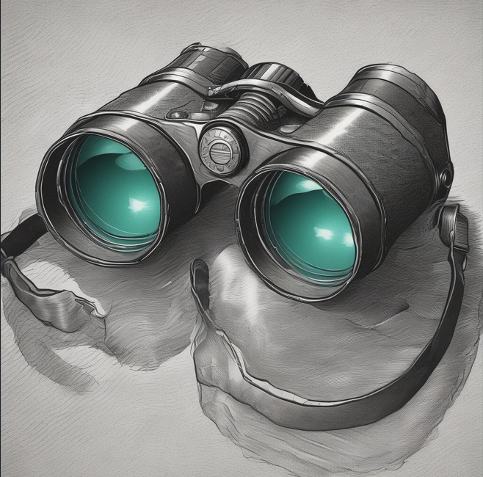
Threat Intel – demystifying
WHAT is it ?
For Partners
Over-the-horizon information delivered @ the right time
For Bitdefender
A permanently updating global cyber-database
Known attacks, indicators, timestamps, methods, vulnerabilities exploited etc. Used by attackers, journaled for actionable purposes.
Threats – correlated information, attribution, CVEs, malware families, TTPs etc.
Quantities: 500k-1mil / week

Slide 7
Threat Intel – demystifying
Why Threat Intel
Automate security solutions need extra intel because:
Determined OR high-budget attackers will get through
Sophisticated attacks take days / weeks
Attackers are innovating & sharing
Attackers already use AI:
Break down the language barrier and fix grammar
Break down the industry-specific language barrier
Make them more creative

Slide 8
Threat Intel – demystifying
Why Does THREAT INTEL work ?
To scale, reuse code,
methods of attack, text etc.
Rotate the (limited, costly)
infrastructure (IP, Domains)
Attackers leave traces,
that can be correlated!

Slide 9
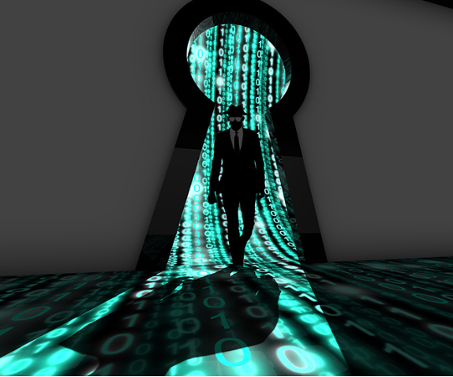
SOC Analysts – we need this mysterious species ☺
Yep, humans are still needed in the AI Era !
Experienced, smart, detective-like folks
Objectives :
eliminate the element of surprise
prevent or reduce impact/probability of attacks and breaches
Sourcing
In house (Company’s SOC) or
External : MDR, MSSP
Activities:
Set alerts’ triggers and triage alerts
Incident-response
Threat hunting
Cyber-forensic

Slide 10
Telco & manufacturing / transportation attacks
2
CASE 1

Slide 11
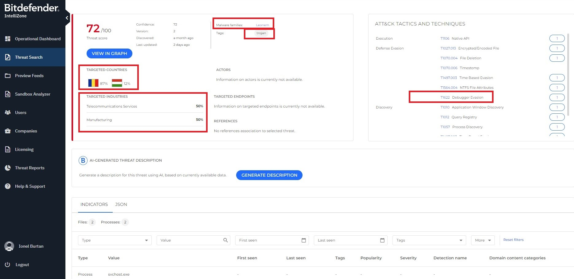
Case 1- Telco & manufacturing / transportation attacks
1 month Ago, Targeting Romanian Organizations

Slide 12
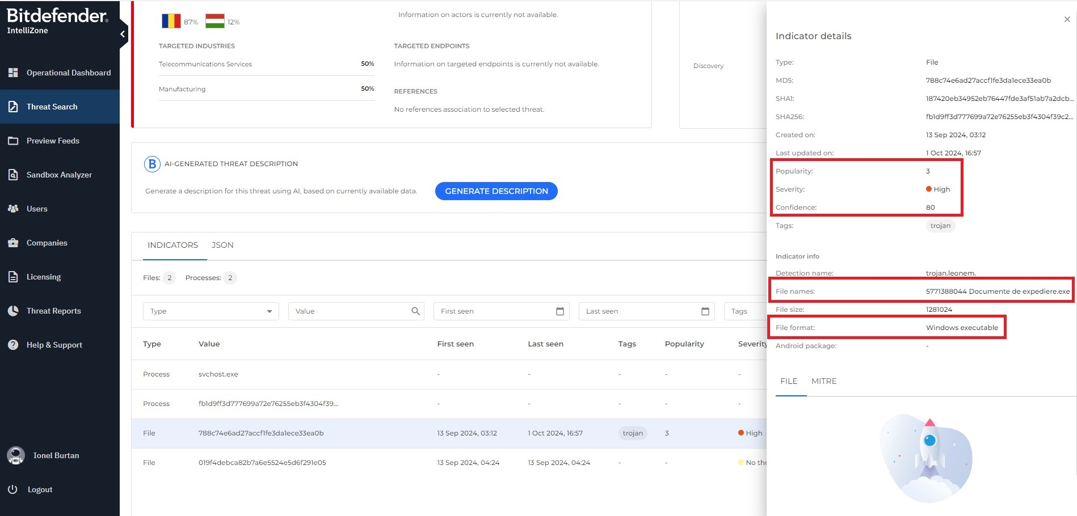
Case 1- Telco & manufacturing / transportation attacks
1 month Ago, Targeting Romanian Organizations

Slide 13
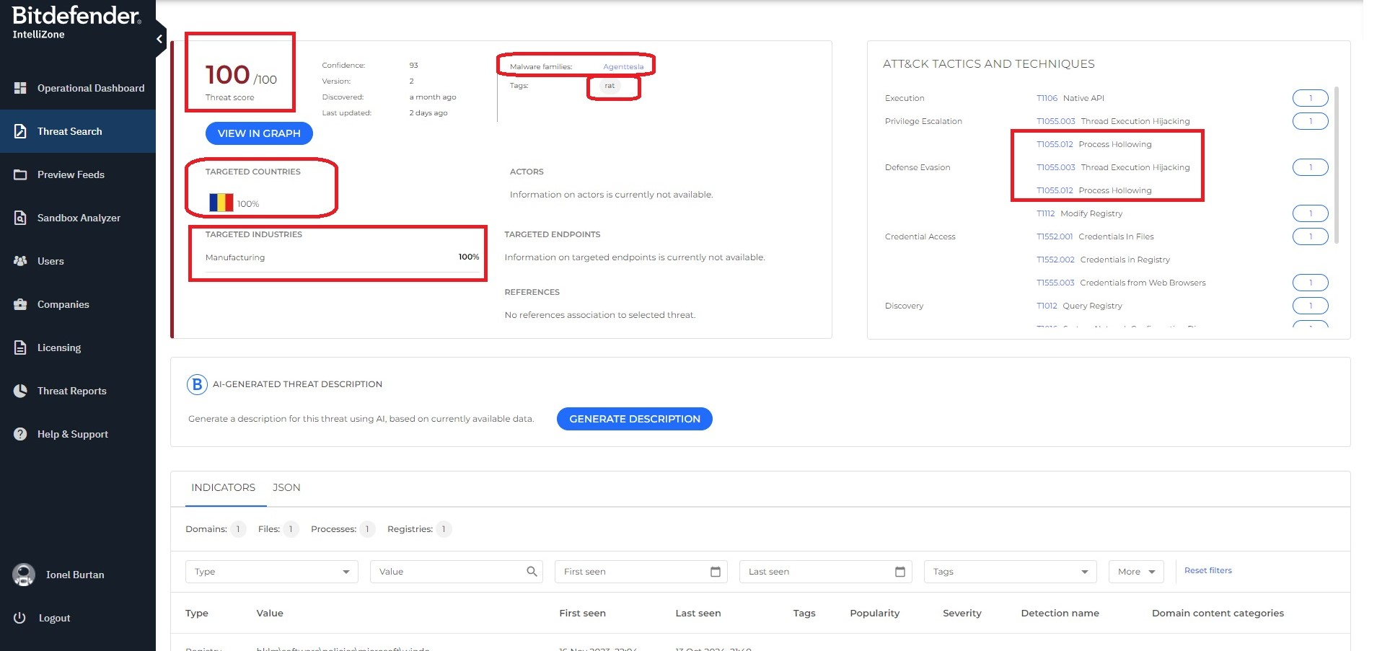
Case 1- Telco & manufacturing / transportation attacks
1 month Ago, Targeting Romanian Organizations

Slide 14
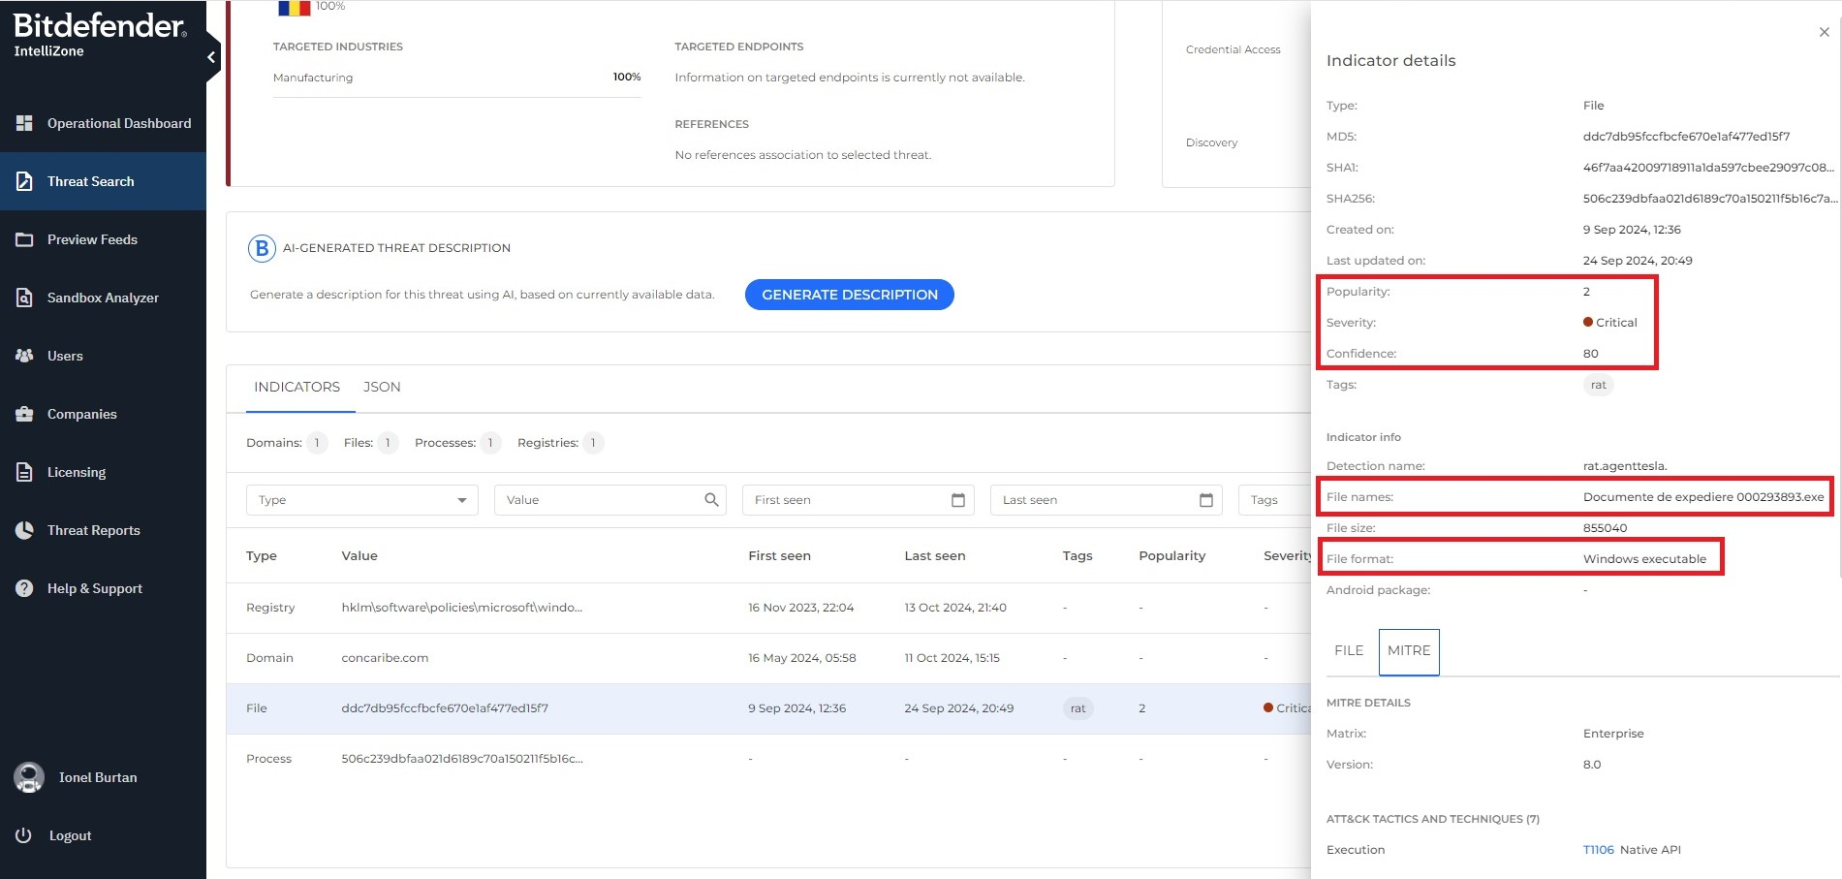
Case 1- Telco & manufacturing / transportation attacks
1 month Ago, Targeting Romanian Organizations

Slide 15
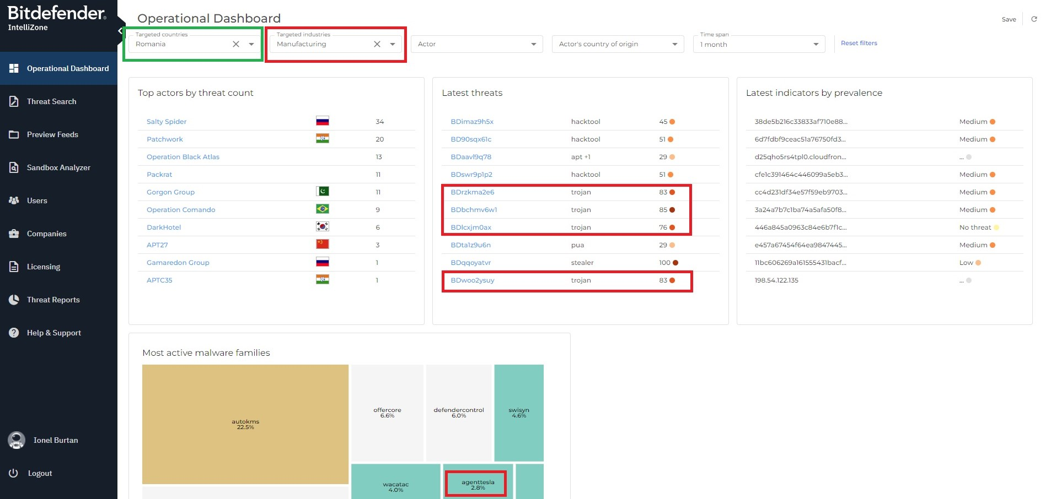
Case 1- Telco & manufacturing / transportation attacks
1 month Ago, Targeted on Romania

Slide 16
Threat Actor deploys Miner
2
CASE 3

Slide 17
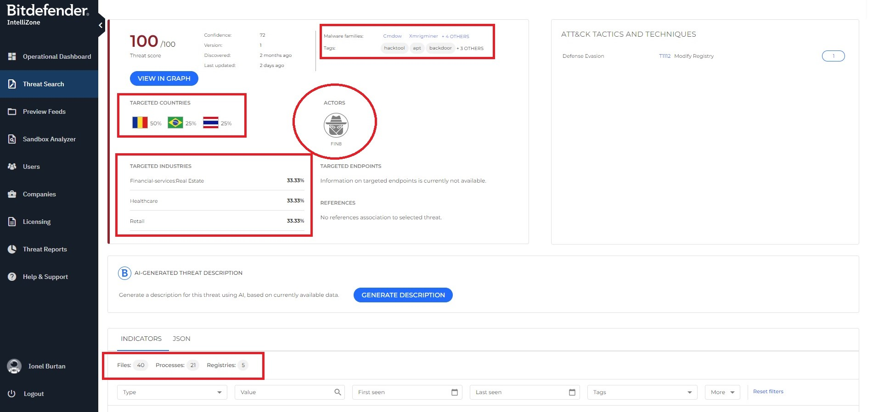
Case 3: FIN8 Threat Actor deploys Miner
2 months Ago, Targeted on Romania

Slide 18
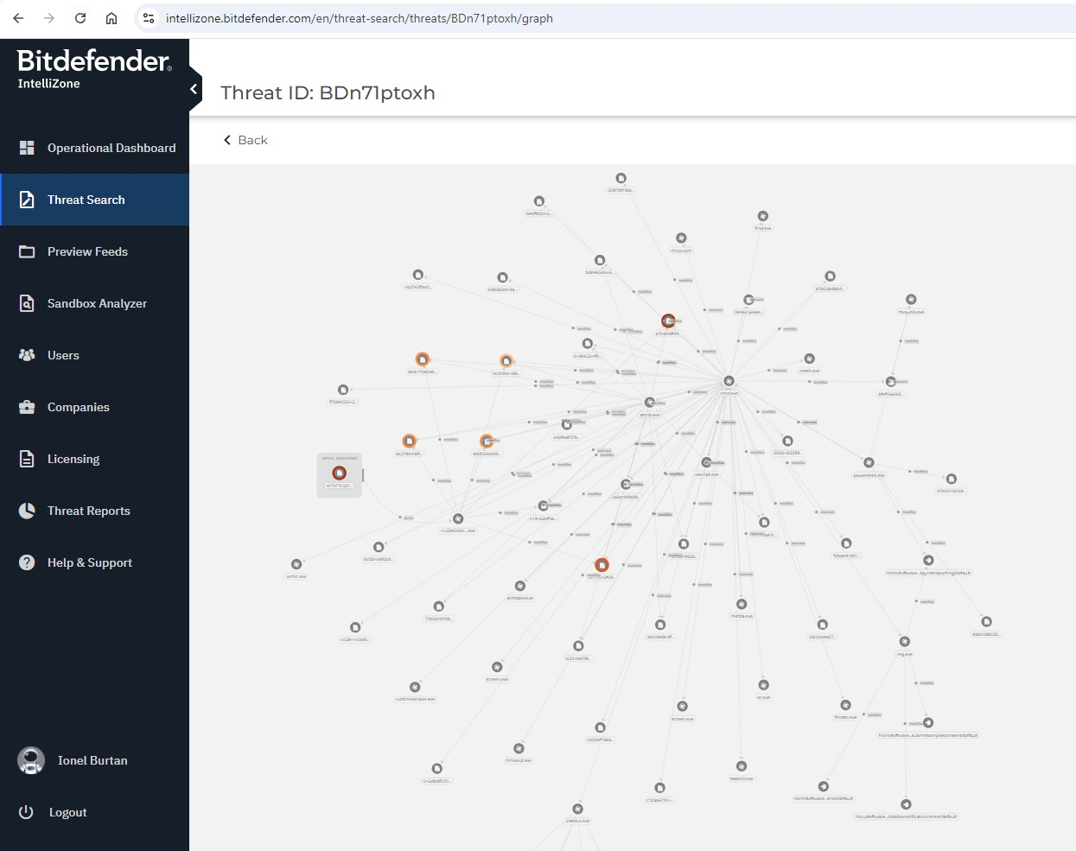
Case 3: FIN8 Threat Actor deploys Miner
2 months Ago, Targeted on Romania

Slide 19
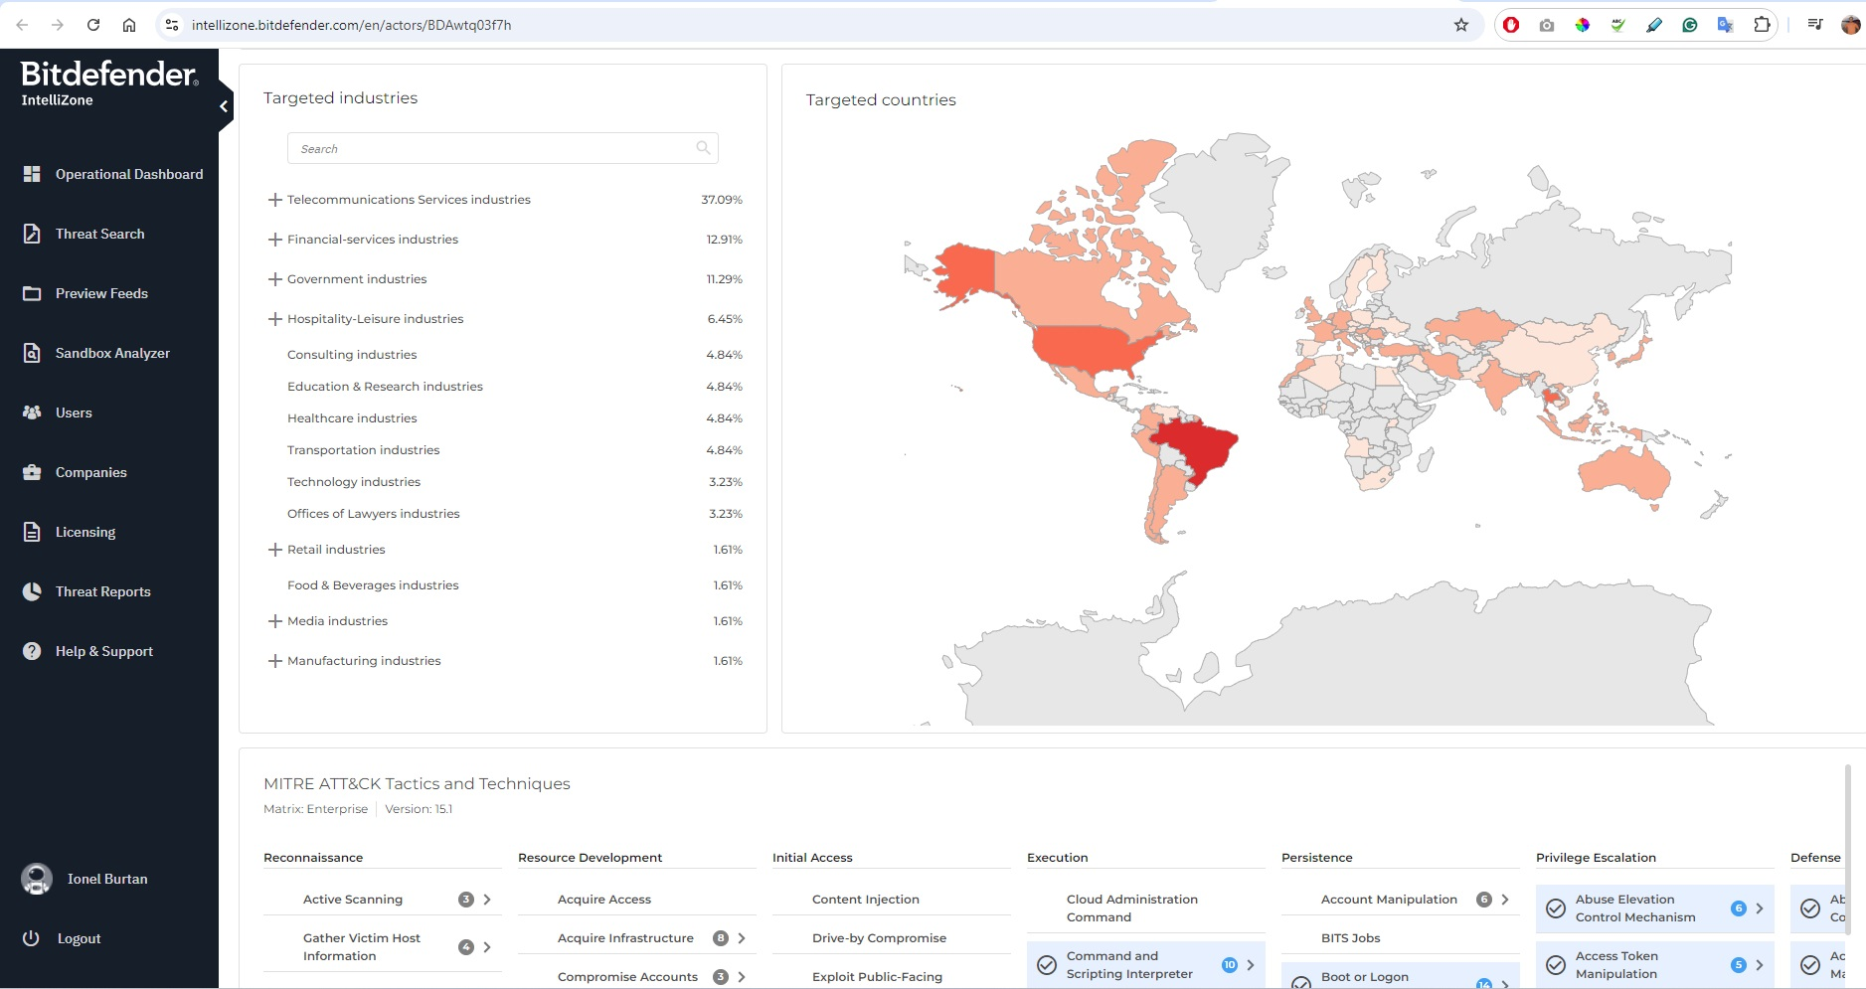
Case 3: FIN8 Threat Actor deploys Miner
2 month Ago, Targeted on Romania

Slide 20
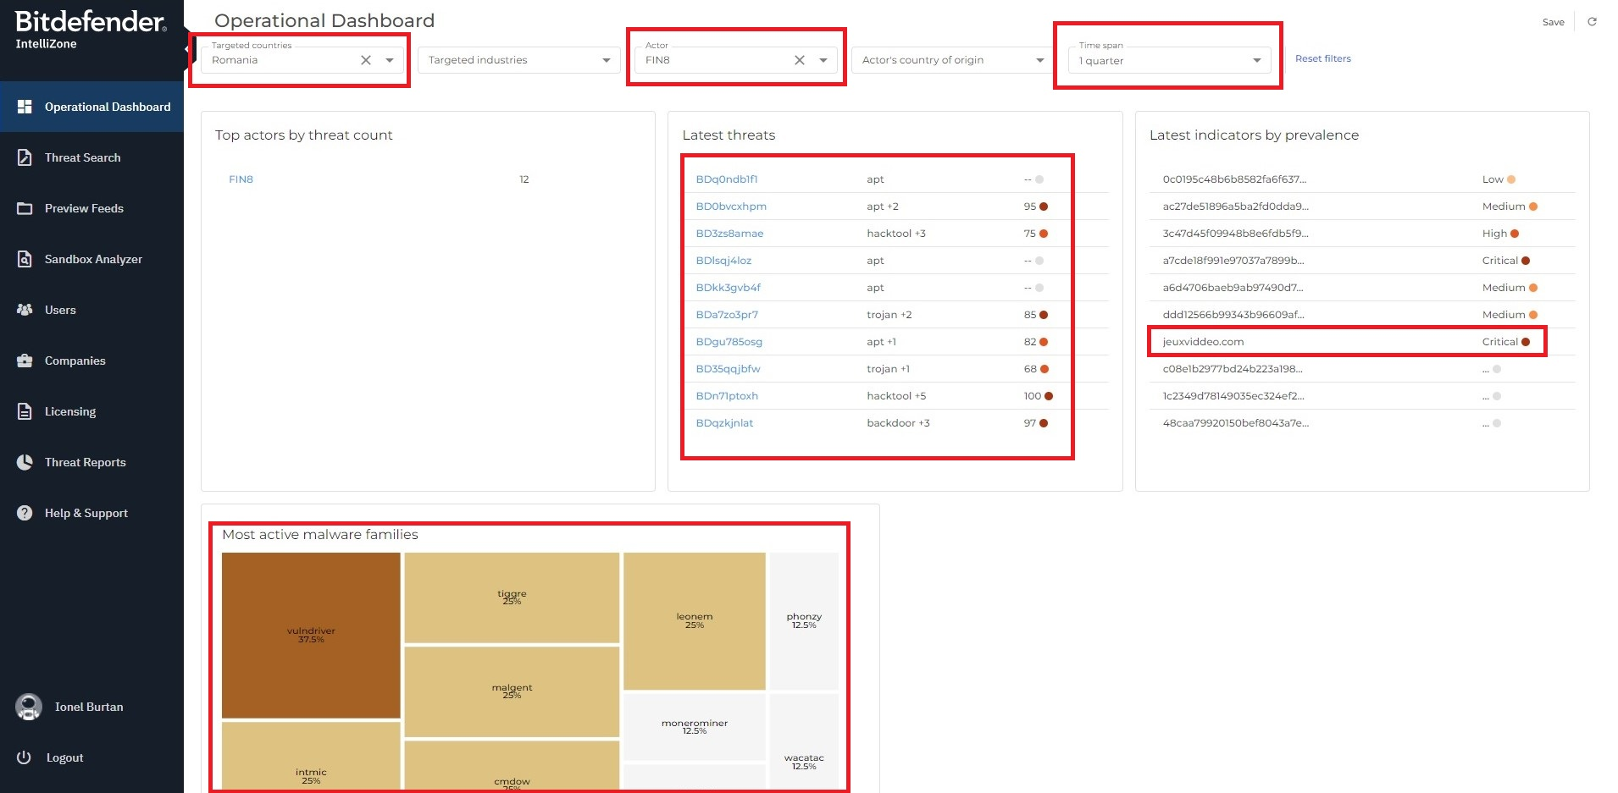
Case 3: FIN8 Threat Actor deploys Miner
1 month Ago, Targeted on Romania

Slide 21
How can I get this intel?
3
Existing & coming developments

Slide 22
How to get the Threat Intel - Bitdefender
Multiple Avenues
IntelliZone Portal – standalone
GravityZone – integrated with IntelliZone
Third-party stores
Anomali
Ticura
ThreatQ
ThreatConnect (soon)
Feeds
Bitdefender Threats (fixed-schema JSON)
STIX format
MISP format
Connectors
SPLUNK (soon)
Remember: Bitdefender Threat Intelligence is a product line that Bitdefender distributes through partners, such as our host Maguay.

Slide 23
[reference] Threat intel from Bitdefender recap
How Does IT HELP
Bitdefender Threat Intel:
Multiple sources: information from B2C, B2B, OEM Partners, Industry partners/exchange, Law Enforcement.
Multiple geos and industries – both local – Romania and E. Europe, but also global: Americas, APAC, EMEA.
Based on powerful lab, 100s of researchers and on pattens/innovation
Covering sophisticated attacks: Ransomware, Spyware, Fraud/Scam
Capabilities:
- Possibility to search, visualize, the permanently-updating information
- Create new rules for extra protection
- Automation, via APIs / Feeds, multiple formats
- Detect potentially dangerous attacks early => stop/divert
- Keep up the pace with the attacker, relevant to your industry and geo.

