Slide 1
Cyber Resilience Innovation
Mihai Ghita
Veritas Technologies

Slide 2
Agenda
Responding to Cyber Resilience Challenges
The most secure backup platform in the world
Witness the creation of the Leading AI-Powered Data Security Company
Q&A
Notes:
Azi o sa aflati viziunea Veritas privind protectia la atacuri cibernetice.
O sa cunoasteti platforma care nu a fost niciodata criptata de vreun ransomware.
Si o sa fiti martori la nasterea unui lider de necontestat in industria de aparare impotriva amenintarilor cibernetice.
Ma numesc Mihai Ghita si ma ocup de siguranta si securitatea clientilor in aventura digitala din care toti facem parte.
De peste 30 de ani fac parte din aceasta transformare accelerata, sunt arhitect de solutii, manager de proiecte, elev si profesor, precum si doctorand in criptografie.
De 4 ani sunt ambasador al Veritas in Romania si Bulgaria.

Slide 3
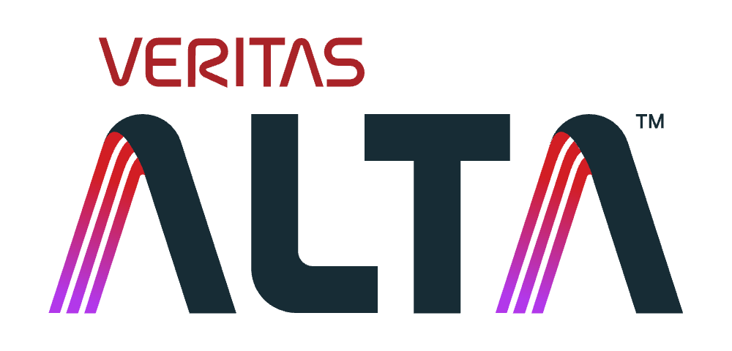
Responding to Cyber Resilience Challenges

Slide 4


Threat Actors’ Methods Have Evolved…
…from attacking infrastructure to attacking humans (and their credentials)
65%
74%
85%
experienced successful ransomware attack¹
of breaches involved social engineering²
cyber security leaders say attacks are powered by AI³
Notes:
You’ll remember we talked about this last Spring but it bears mentioning again.
Cyber criminals are shifting their tactics.
First wave of attacks going after storage and systems
These days, instead of only going after your systems, they’re going after you…
the data shows increasingly malicious actors are logging in to your infrastructure vs. breaking in.
65% of organizations experienced a successful ransomware attack in the past two years. Source: Veritas https://www.veritas.com/content/dam/www/en_us/documents/analyst-report/AR_veritas_data_risk_management_report_2023.pdf
74% of breaches involved the human element, which includes social engineering attacks, errors, or misuse. Source: Verizon — 2023 Verizon Data Breach Investigations Report, https://www.verizon.com/business/resources/reports/dbir/
85% of cybersecurity leaders say attacks are powered by AI – Source: CFO. https://www.cfo.com/news/cybersecurity-attacks-generative-ai-security-ransom/692176/

Slide 5






Using AI for Scale and Sophistication
AI-Powered Phishing
Vishing | Fraudulent Calls
Deepfakes
Convincing and natural-sounding phishing emails and text messages
Phone calls can dupe employees to take actions, share credentials or information
AI and the use of video and voice deepfakes now mature enough to be a major threat
Notes:
They are now going after the “soft targets” i.e. you and your people, to steal or otherwise gain access to credentials: social engineering like AI-powered Phishing and Vishing, Deepfakes etc…
And they’re taking advantage of MFA fatigue, disgruntled insiders, etc. – whereas we know, the admin population is likely already over-stressed and under -skilled (45% lack security skills, 29% lack data protection skills).
https://www.verizon.com/business/resources/reports/dbir/

Slide 6






AI-powered Self-Defense
Smarter
Admin Behavior
Anomaly Detection
    Threat Actors steal admin credentials and attempt to compromise backup data
    AI-powered Self-Defense detects anomalous behavior, steps in
    Automatically adjusts MFA / MPA
      If operation abnormal, operation is declined, and data secured
      If operation normal, operation is approved
Backup Admin
Operations
Increased MFA / MPA
Notes:
For example, just recently we released the industry’s first self-defending data protection solution that uses AI to detect admin behavior anomalies and automatically adjust the MPA and MFA settings before allowing critical data access. And now we’re expanding on those capabilities with more cyber resilience innovations that make cyber resilience simpler, smarter, and recoveries faster.

Slide 7


What Has Changed?
Cyber outages are inevitable. The need to recover quickly and confidently is a top priority.
Impact
19 Days
Average Cyber Outage²
35%
Recover <1 Month¹
$2.73M
Avg. / Incident¹
Incalculable
Reputation & Brand
52% 2 Years Ago
$1.4M 2 Years Ago
Recovery is Confusing, Chaotic, and Time-consuming
Industry Regulations: Transparency & Readiness
    Requires global collaboration
    Primary backup may not be available
    Finding best data recovery point difficult
    Lack of recovery plan or automation
    Overworked and under trained teams
    Detecting and managing cyber incidents
    Data backup and recovery plans
    Recovery rehearsals
    Human resource security, access control
SEC – USA
DORA – EU
Notes:
So what has changed since we talked about how threat actors have evolved?
Short answer: Cyber outages are inevitable, putting greater emphasis on the ability to recover because downtime is just too expensive.
The avg. downtime from cyber outage is 19 days. This is just to restore service. Other reports take into consideration all the clean-up tasks and process changes to be defined and implemented as part of the recovery timeframe. According to an IBM report, factoring all these in could make the full recovery take ~73 days.
Meanwhile, the number of orgs who claim they can recover within a month has dropped by 1/3rd and the cost / incident has gone up 95%

Slide 8





Aligned to NIST Cybersecurity Framework
PROTECT
DETECT
RESPOND
RECOVER
IDENTIFY
Identify
What are the workloads/data I protect?
GOVERN
Protection
Can my data and platform resist an attack?
Detection
Did an attack occur?
Cybersecurity Framework
Incident Response
Is our data, apps and environment clean?
Post Incident Recovery
Are apps and resources ready to resume?
Notes:
Veritas cyber resilience solutions help organizations secure data from attacks with intelligent automation that simplifies operations while enabling quick and confident cyber recoveries. The fundamentals of the NIST framework’s Detect, Protect, Identify, Recover, and Respond have not changed.
At Veritas, we have a keen focus on how to do this at scale in a way that is simpler, smarter, and faster.

Slide 9


NEW! Cyber Resilience Innovations
Simpler
Smarter
Faster
    Alta Copilot
      Intelligent Job Failure Analysis
      Automated Protection Policy Creation
      Audit and Protection of Undetected Assets
    Standardized Policy Management for Cloud and Kubernetes
    Expanded Cloud Support
    Threat hunting and Blast Radius
    Security Risk Score
    Enhanced Cloud Elasticity
    Enhanced AI-powered Malware Detection
    SIEM / SOAR Integration
    Recovery Orchestration Blueprints
    Recovery Point Recommendations
    Cross-cloud Recovery
    Multi-stream Cloud Object Storage Protection
Notes:
We continue to deliver a number of new innovations that make cyber resilience simpler, smarter, and faster.
This is not an exhaustive list but should give the audience an idea of the breadth of capabilities we’re delivering.
Items in red will be showcased in following slides.

Slide 10
Simpler

Slide 11
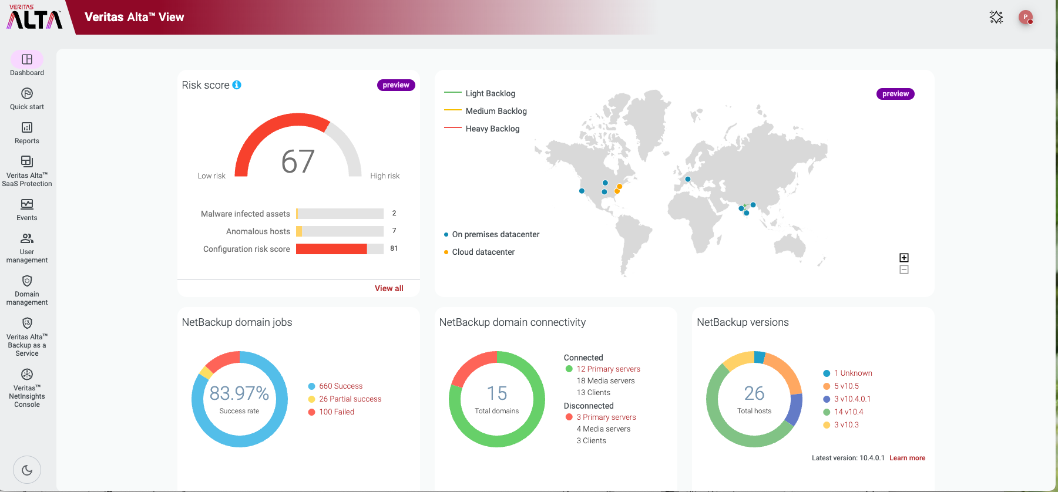
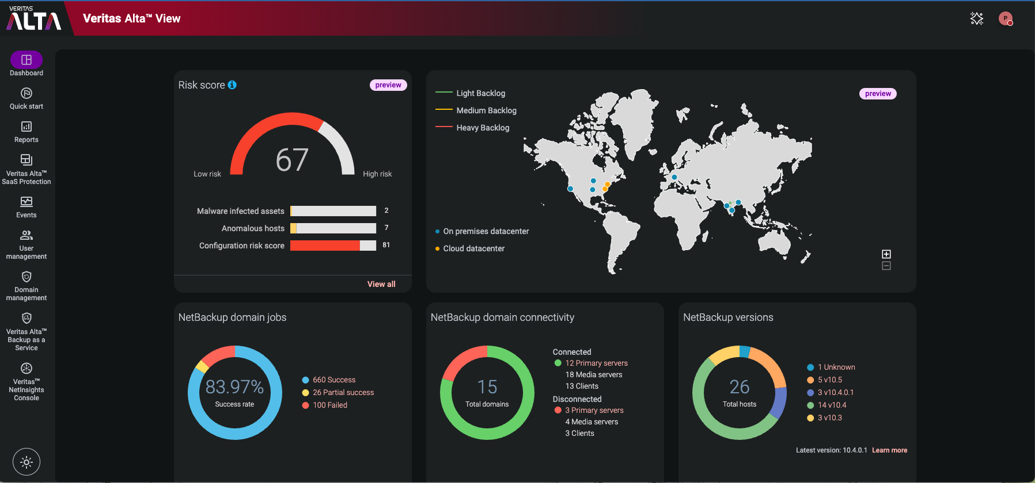
Veritas Alta View
Simpler
Modern, Intuitive, Unified Experience
ABOUT THE FEATURE
Modernized, intuitive design
Enhanced reporting and analytics
BENEFITS
Unified experience across entire Veritas data protection estate
Centralize control and visibility
Streamline operation
Notes:
While intelligent automation plays a big role in simplifying operations, the first place people look is at the UI.
The latest release of Alta View shows a modernized and intuitive design that makes it easier for users to:
Quickly find and act on the info they need
See vulnerabilities at a glance
Access Alta Copilot for GenAI-powered operational assistance (more on this shortly)
About
The new design emphasizes simple, smart functionality. Dark and light mode options.
What’s New
Streamlined layout
AI-powered insights
Actionable intelligence
Risk profile dashboard
Customer Benefit
Enhance efficiency
Simplify data management
Easy navigation through complex tasks
Seasoned IT professionals and newcomers can effortlessly leverage Veritas Alta View’s powerful capabilities

Slide 12
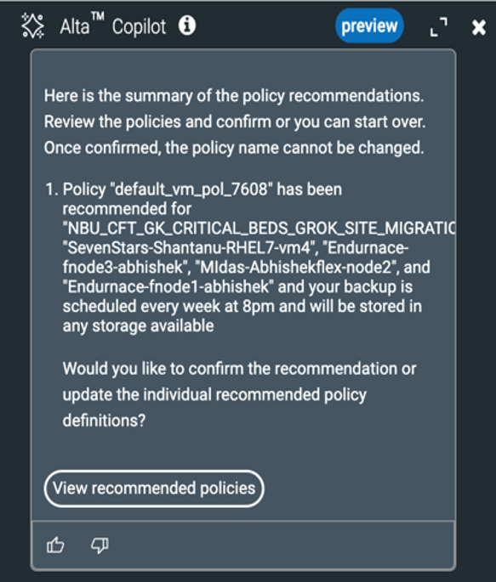
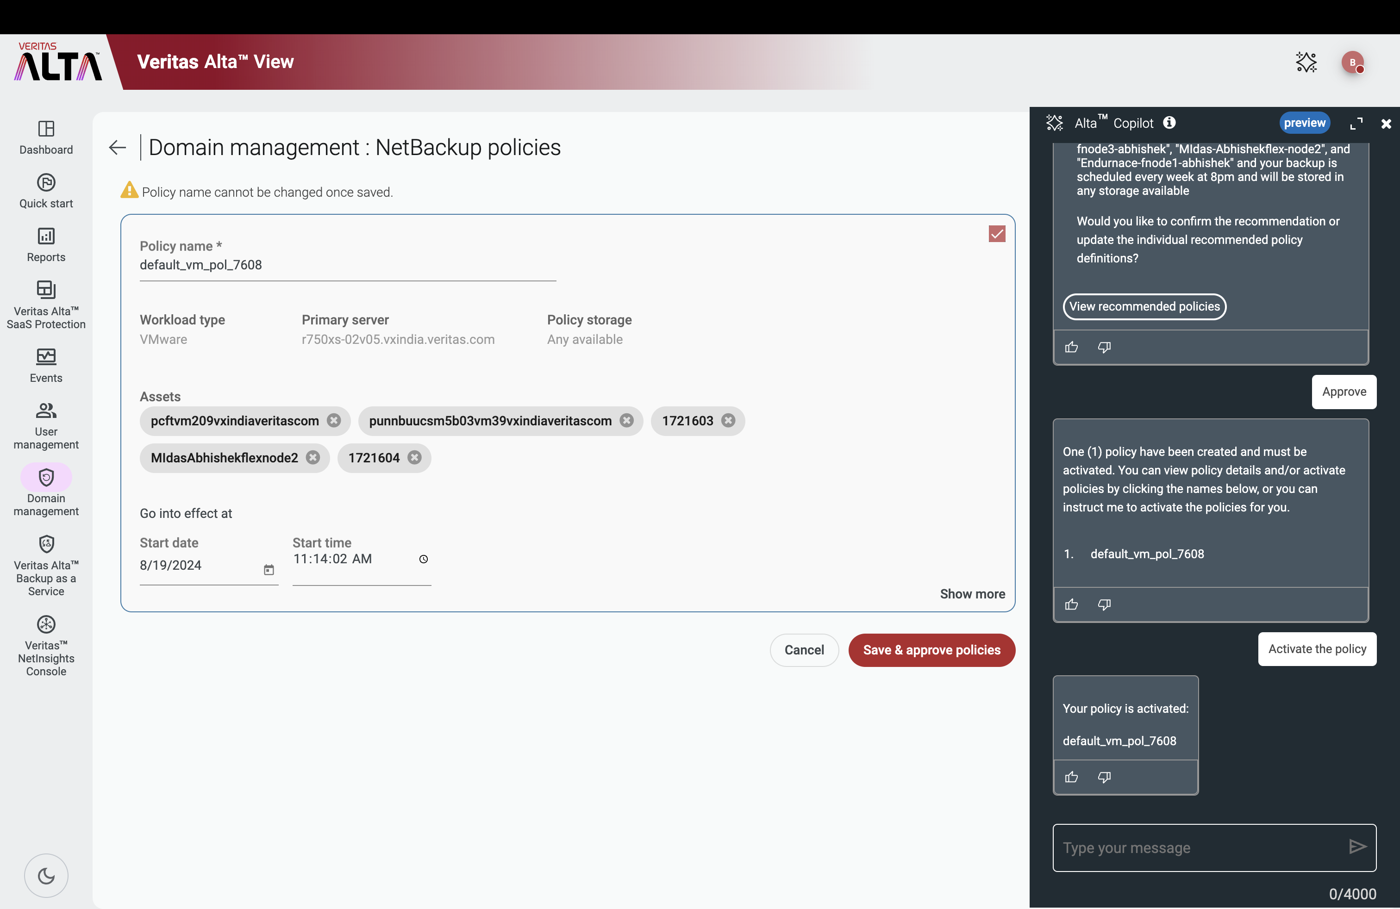
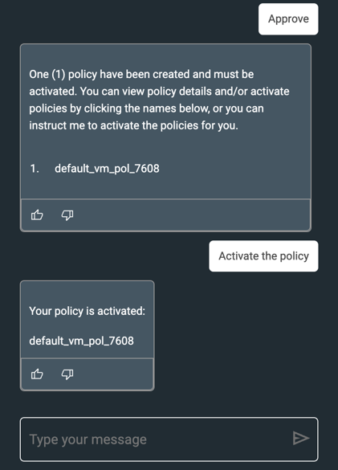
Alta Copilot: Automated Protection Policy Creation
Simpler
ABOUT THE FEATURE
GenAI used to:
  Analyze assets, workloads, and environmental conditions
  Generate optimized policy recommendations
One-button implementation
BENEFITS
Streamlined Operations
Enhanced Security
Continuous Optimization
Notes:
About the Feature
Alta Copilot Automated Protection Policy Creation leverages Generative AI, NLP, and AI Agents to automatically generate and recommend protection policies. It analyzes asset data and configuration settings to create tailored backup policies, ensuring optimal protection without manual intervention.
What’s New
AI-Driven Policy Recommendations: Utilizes NLP and AI Agents to automatically suggest and configure backup policies based on asset and workload analysis.
Context-Aware Configurations: Dynamically adapts to the specific requirements of the environment, ensuring the best possible protection settings.
Automated Deployment: Instantly applies recommended policies across the domain, reducing the need for manual setup.
Customer Benefit
Streamlined Operations: Significantly reduces the time and effort needed to create and manage protection policies.
Enhanced Security: Ensures that assets are always protected with the most appropriate policies, minimizing the risk of data loss.
Scalability: Easily scales with the environment, automatically adjusting to new assets and workloads.

Slide 13
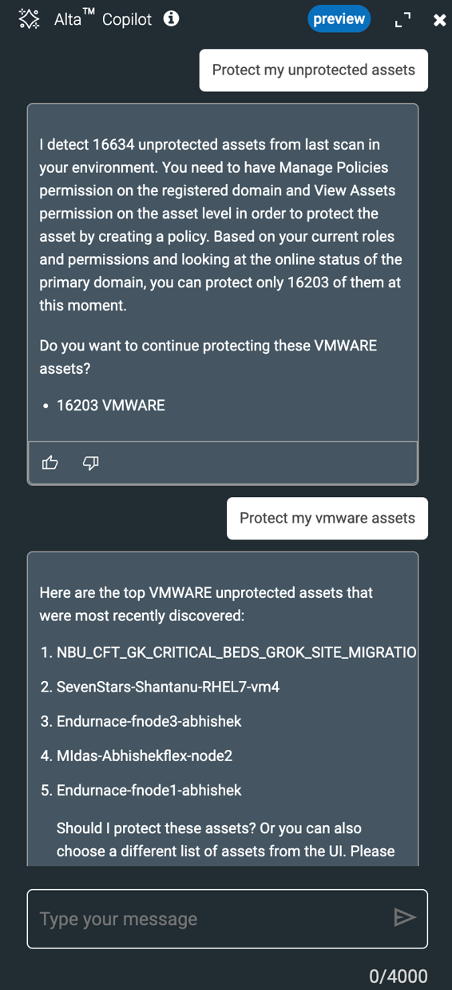
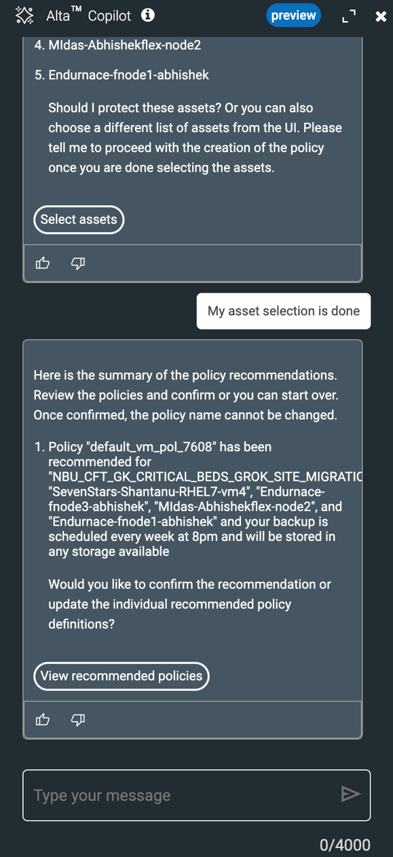
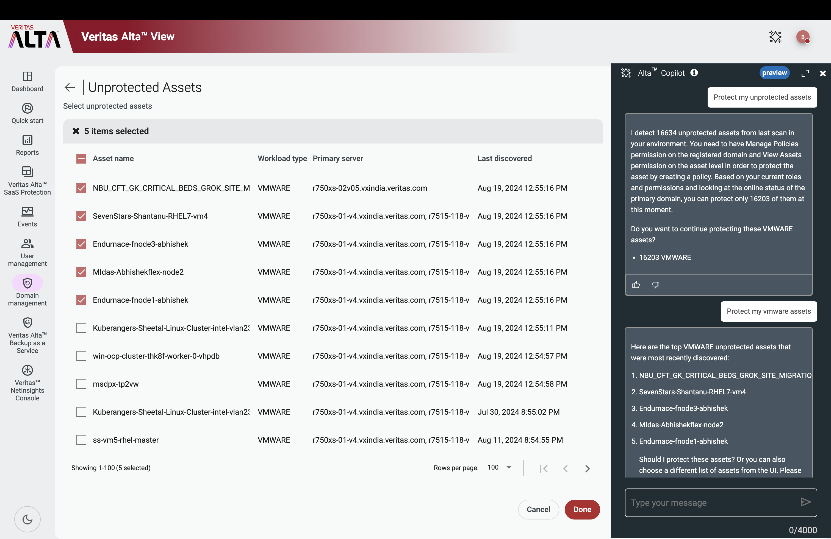
Alta Copilot: Audit and Protection of Unprotected Assets
Simpler
ABOUT THE FEATURE
GenAI automatically detects, audits, and protects unprotected assets across the environment.
Automatically suggests and applies tailored protection policies.
BENEFITS
Comprehensive Coverage
Operational Efficiency
Notes:
About the Feature
Audit and Protection of Unprotected Assets leverages Generative AI and AI Agents to automatically detect, audit, and protect unprotected assets across the environment, ensuring comprehensive coverage.
What’s New
AI-Driven Asset Detection: Automatically scans and identifies unprotected assets in real-time.
Automated Policy Recommendations: Suggests and applies protection policies tailored to each asset.
Seamless Integration: Instantly integrates with existing protection frameworks, ensuring all assets are covered.
Customer Benefit
Comprehensive Coverage: Ensures no assets are left unprotected, reducing risk of data loss.
Operational Efficiency: Automates the audit and protection process, saving time and resources.

Slide 14
Smarter

Slide 15
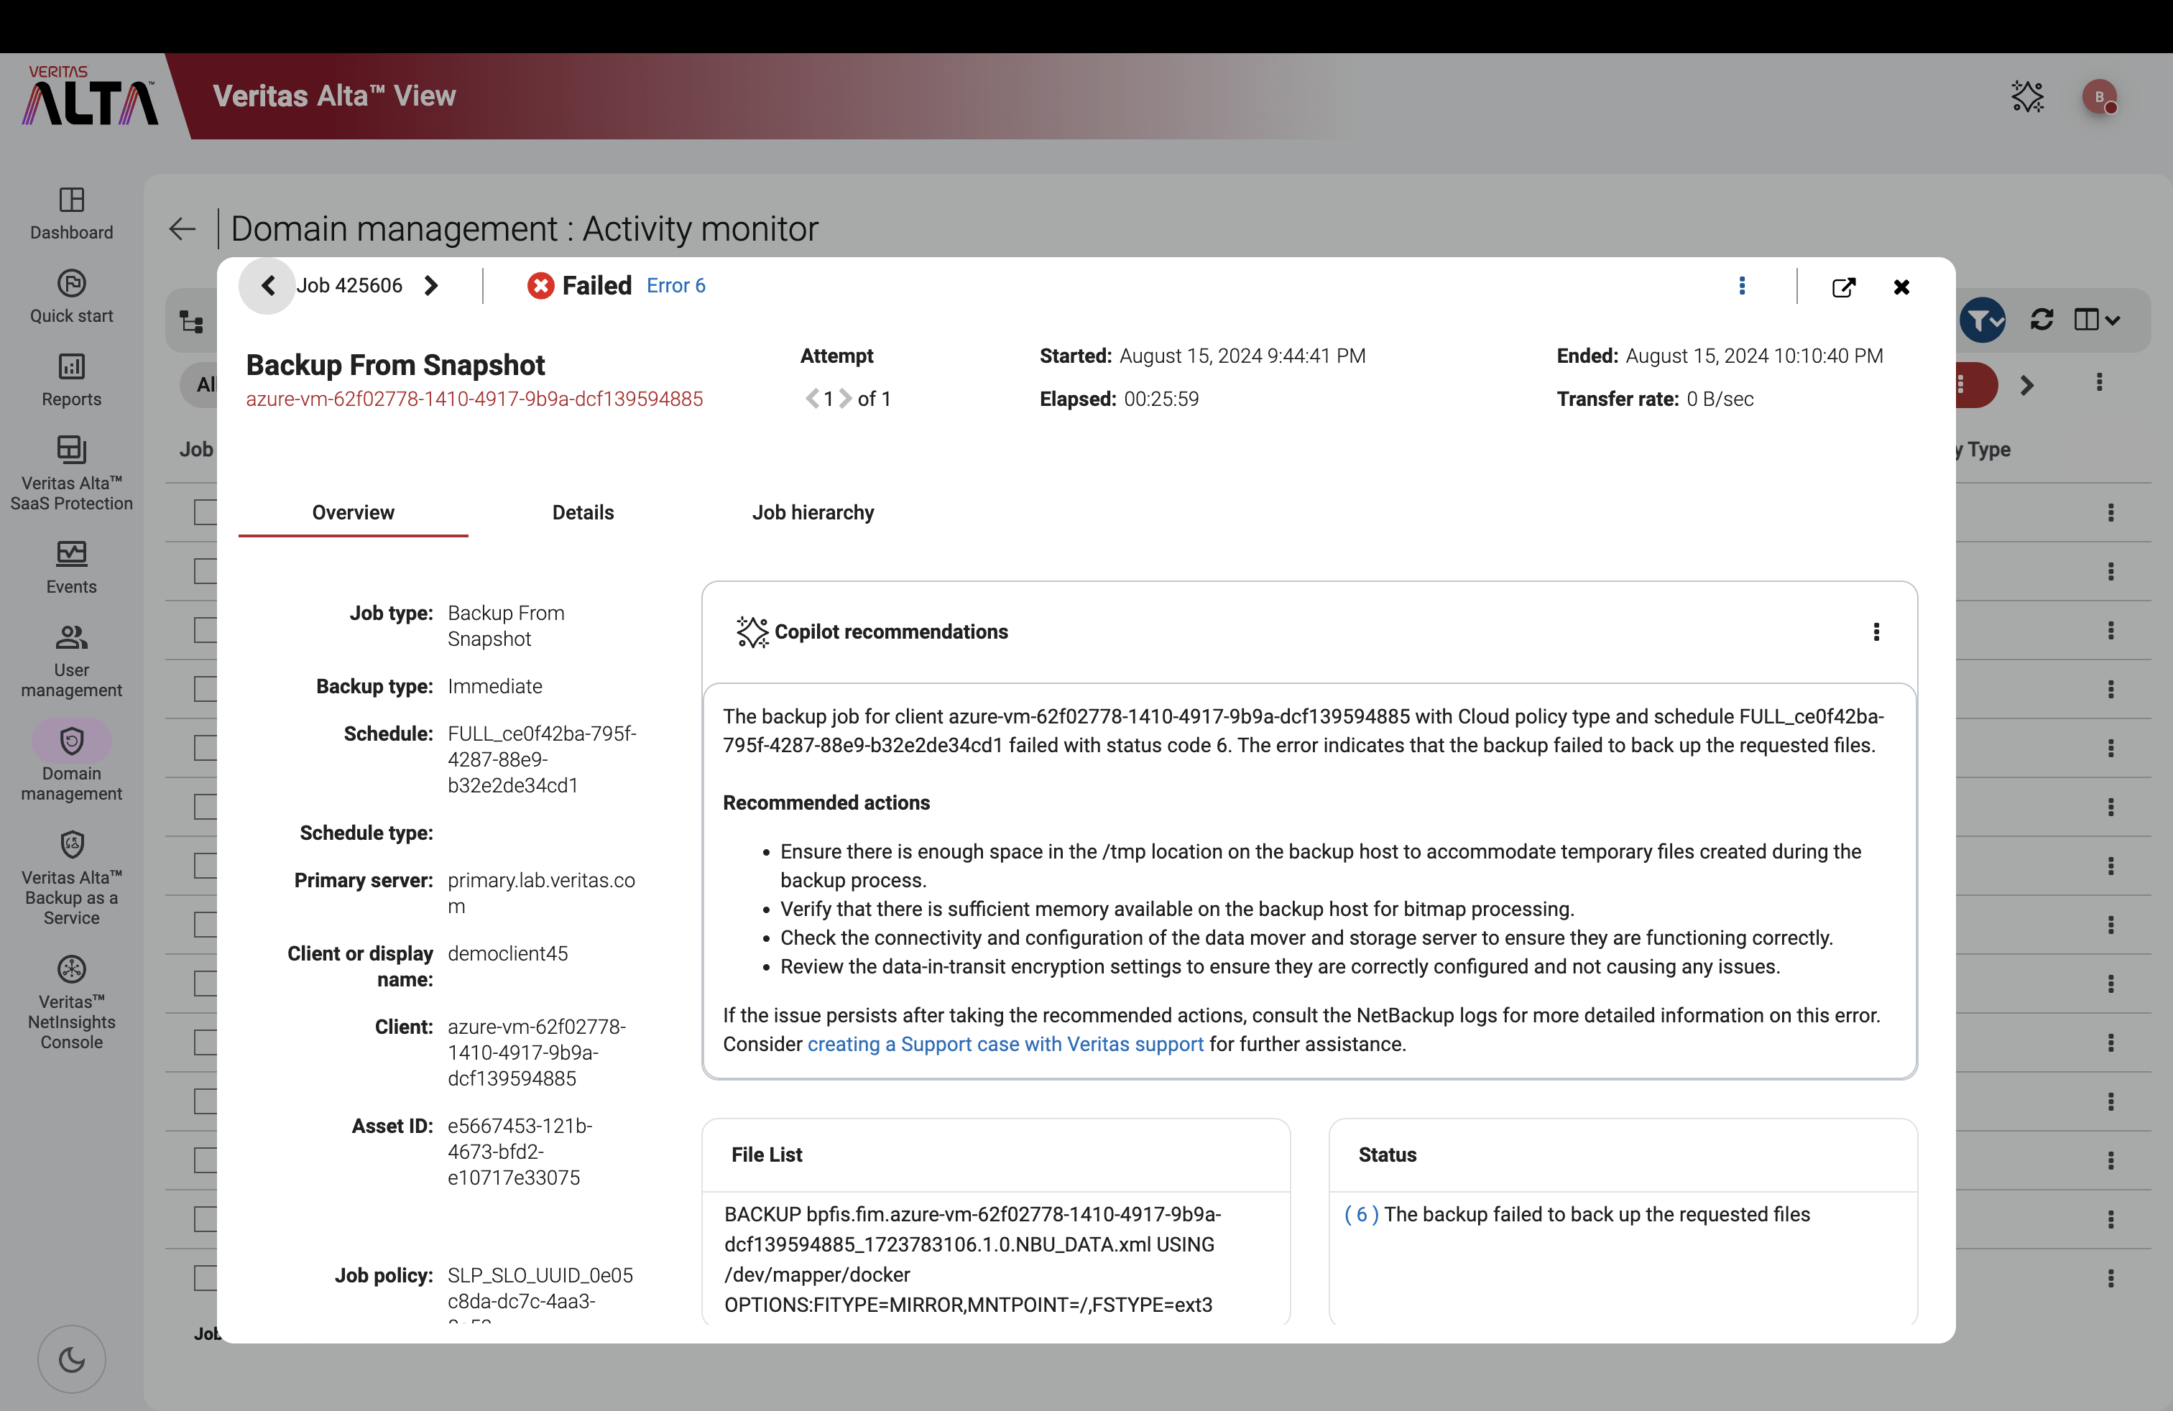
Alta Copilot: Intelligent Job Failure Analysis
Smarter
ABOUT THE FEATURE
Alta Copilot IDs and analyzes failed backup jobs
Uses AI to recommend corrective actions
BENEFITS
Comprehensive Coverage
Operational Efficiency
Notes:
This AI-powered feature reduces the time required to identify and resolve job failures, improving overall system reliability and efficiency.
Continuous Learning: The system continuously learns from past job failures and remediation efforts, improving its recommendations over time.
Improved Reliability: Continuous learning ensures that the system becomes more accurate and efficient in diagnosing issues, leading to more reliable backups and overall system stability.
Detailed Description:
About the Feature
Alta Copilot Intelligent Job Failure Analysis uses Generative AI and Natural Language Processing (NLP) to examine logs from failed backup jobs. It then recommends remediation pathways within Domain management using the Activity monitor.
What’s New
AI-Powered Root Cause Analysis: Leverages advanced NLP techniques to automatically analyze and categorize failure logs, pinpointing the root cause with high accuracy.
Proactive Recommendations: Provides AI-driven, actionable remediation steps tailored to the specific job failure context, minimizing manual intervention.
Customer Benefit
Reduced Downtime: Automated analysis and recommendations significantly reduce the time required to diagnose and resolve job failures.
Operational Efficiency: By automating the failure analysis process, IT teams can focus on higher-value tasks, leading to better resource utilization.

Slide 16
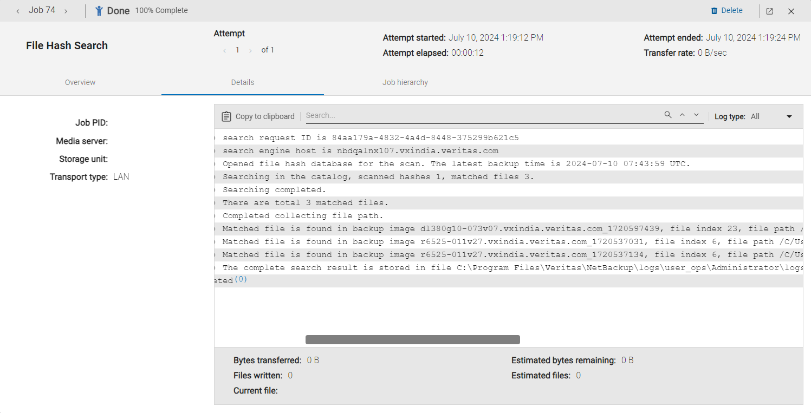
Threat Hunting and Blast Radius Analysis
Smarter
UP TO
Up To
ABOUT THE FEATURE
93%
Search for potential Incidents of Compromise (IoCs)
Searches index (vs. full scan) of hash-based signatures created from recent scans
SCAN TIME
REDUCTION*
BENEFITS
Reduce search time from hours to minutes
Identify all infected unstructured files across the entire NetBackup environment
*Based on one TB of data, anticipate scan time reduction to increase as data volume increases
Notes:
About the Feature
Utilizes a hash-based content index to rapidly identify and locate infected files across a NetBackup environment
What’s New
Identify all copies of an infected file without additional malware or file-scanning operations
Search for infected files across all managed NBU domains with Alta View
Analyze the dispersion of malware across an entire ecosystem via blast radius mapping
Customer Benefit
Accelerate threat identification and response across an entire enterprise environment

Slide 17
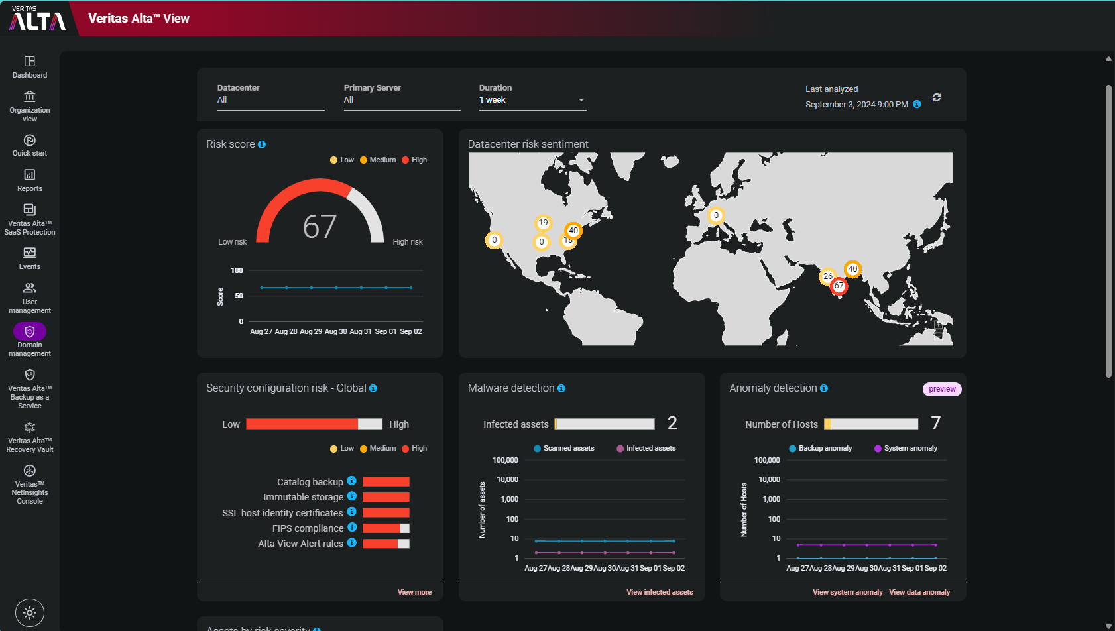
Automated Risk Assessment and Security Score
Smarter
ABOUT THE FEATURE
Visualize risk posture across entire data estate (datacenters, clouds, regions, etc.)
Minimize duplicative alerts
BENEFITS
Quickly ID and mitigate risks
Reduced alert fatigue
Evaluate and improve current risk mitigation measures
Notes:
About the Feature
Visualize risk posture across security, data protection, and host communication to evaluate and improve current risk mitigation measures
What’s New
Track changes from the selected baseline security configurations
Monitor risk level as indicated by current posture criteria
Identify opportunities to improve risk posture by enabling security settings
Customer Benefit
Mitigate risks and enhance security posture
Risk Score = Shows global cyber resiliency status of your environment that includes information on system anomalies, backup data anomalies, and global configurations. The trend graph shows historical data for the selected duration.
- Map to see which location is at most risk
Configuration Global = Help you to identify where you are most risk within your configuration.
Configuration score indicates asset backup, recovery SLA and other NetBackup specific configurations like version, OS version, alert rules etc. are configured.
Malware = Shows the number of assets that are infected with malware. The trend graph shows historical information on the scanned assets and the malware-infected assets for the selected duration.
Anomalies = Shows the information on backup data anomalies and system anomalies for the selected datacenter. The trend graph shows historical information for the selected duration.

Slide 18
Faster

Slide 19
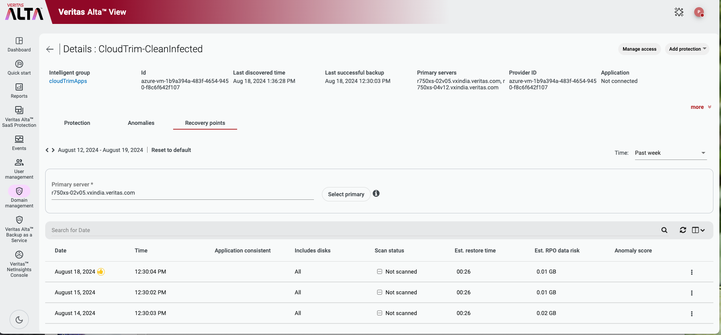
Automated Intelligent
Recovery Point Recommendation
Faster
ABOUT THE FEATURE
Identify ideal recovery points for complex cyber recoveries
DETERMING FACTORS
Job Risk Score
Estimated Data Loss
Media Type
HASH / Malware Scan Status
Time Since Backup
‘Thumbs up” recommended recovery point
BENEFITS
Quicker recovery from cyber breaches
Increased confidence in recovered data
Notes:
Cyber Recovery is very complicated and requires the coordination of multiple tasks, processes and technologies.
One of those tasks is identifying the best known good recovery point that doesn’t contain the contaminated data.
It’s like looking for a needle in a haystack.
In this case, the haystack is the number of available recovery points you have to pick from
The avg. number of recovery points for an average Veritas customer is 90,000
The recovery point that has the most-recent data but doesn’t have the contaminated data is the needle.
Finding the right one and restoring it with confidence it won’t restore contaminated data is the challenge many organizations face.
The old answer of wait for a ticket, restore a single system with “hunt and peck” technologies isn’t enough.
About the Feature
Another step on our journey toward Autonomous Data Management
Proactive in-depth analysis with recommended recovery points that minimize recovery time and potential data loss
What’s New
Assistance with rapid initiation of recovery process
Recommendation powered by risk engine analysis to reduce reliance on expensive malware scans
Customer Benefit
Improved RPO and RTO compared to recovering from the “last known good copy”
Decision Criteria
Job Risk Score
Estimated Data Loss
Media Type
HASH / Malware Scan Status
Time Since Backup
***For speaker***
Calculation for 90,000:
The average customer has 10,000+ backup systems, each with 90+ available recovery points, representing more than 100 mission critical applications.
Can you pick the right 1 in 90,000 decision correctly in an emergency, knowing that malicious actors may have been present for 73 days¹?

Slide 20
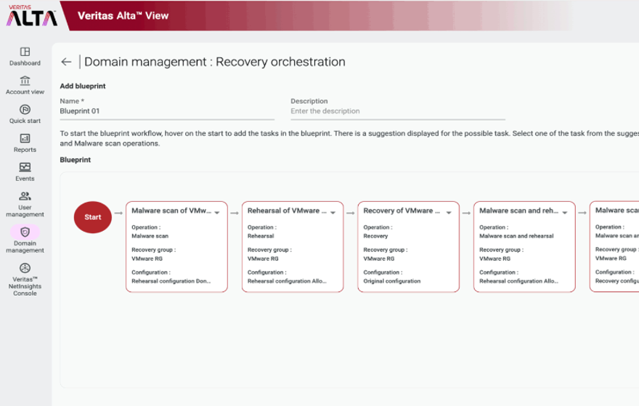
Recovery Blueprints for Orchestrated Recovery
Faster
ABOUT THE FEATURE
User-defined process for automated disaster and cyber recovery
Easily customizable and granular controls to meet complex hybrid, PaaS, containerized, and multi-cloud requirements
BENEFITS
Quick and confident recoveries
Easily test recovery scenarios
Meet emerging regulatory requirements for recovery
Notes:
About the Feature
Create blueprints for disaster and cyber recovery that automate the recovery process.
What’s New
Easily create and edit recovery blueprints for specific challenges of a disruptive event..
Manage granular recovery across multiple domains in complex hybrid environments, PaaS, and containers.
Customer Benefit
Improve cyber resiliency by enabling recovery teams to quickly build and test recovery plans to help mitigate the risks and threats of their organizations

Slide 21
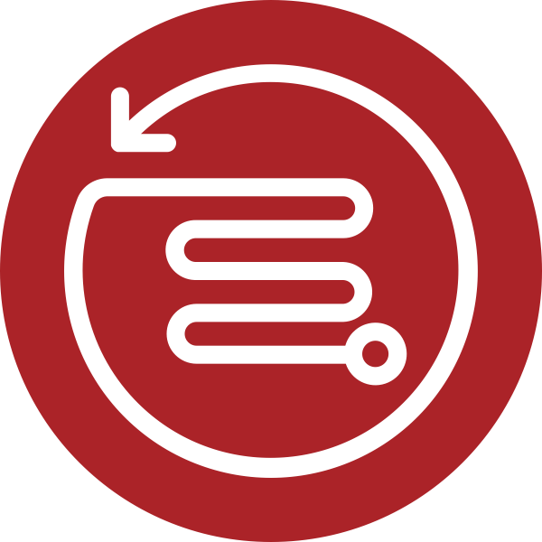
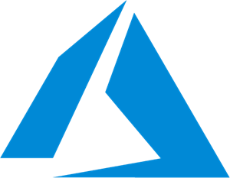

Cross-Cloud / Cross-Platform Recovery
Faster
ABOUT THE FEATURE
Capturing, storing, securing, and recovering raw, cloud hypervisor-independent images of virtualized data
  AWS to Azure
  Azure to AWS
BENEFITS
Recover data to alternate cloud when current Cloud domain unavailable
Move data to different domains and Clouds
Alta Data Protection or NetBackup
Cross-cloud Recovery
Notes:
About the Feature
NetBackup stores backup images as raw images, which allows seamless data movement between different hypervisors
What’s New
New cross-cloud provider VM recovery with the capability to read data from a source cloud provider and write/recover to a different cloud provider
Both directions are supported
AWS to Azure
Azure to AWS
Customer Benefit
Improved recoverability and resilience for heterogeneous, multi-cloud environments

Slide 22
SIMPLER. SMARTER. FASTER.
New AI-Powered Capabilities and Turnkey, Cyber Secure Appliances

Slide 23





Getting Cyber Resilience Right Is a Hard Problem
Customers are looking for an all-inclusive, hardened solution in a preconfigured appliance.
Hardware
Platform
OS &
Applications
Network
Security
User
Security
Securing the servers
Storage immutability
Encrypted storage
Closing every backdoor
Securing APIs
Isolating applications
Limiting access
Securing access
Protecting from user mistakes and
malicious actions
Doing this on your own takes months, skillset, and resources.

Slide 24



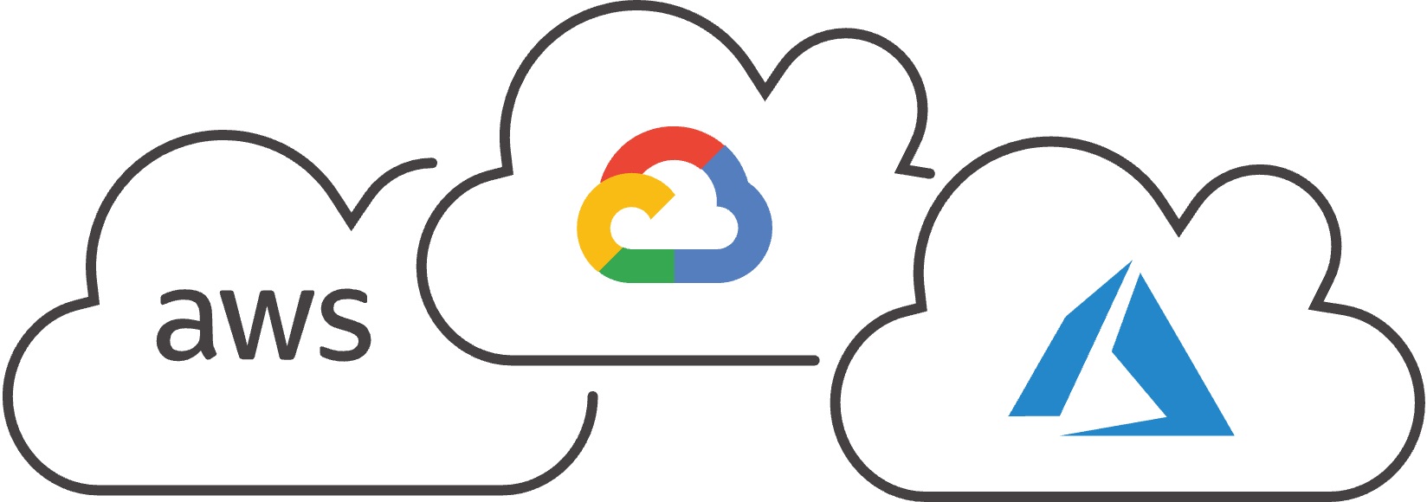
Veritas Appliances Architecture
Engineered to deploy quickly, use the power of NetBackup, and deliver highest levels of cyber resilience.
Alta View: Unified Management
NetInsights: AI-powered Monitoring
APIs
WebUI
Secure Shell
Containerized NetBackup Services
Appliance Virtualization (Storage, Cluster & Application Management)
Hardened RHEL (VXOS) & Security Software
3rd Party Plugins
Hardware, Network, Storage Integration
Optimized Integration of Containers, Storage Management, and a Hardened Operating System
24
Notes:
Use this slide to describe the 5 layers of the turnkey, cyber resilient NetBackup-powered Appliance technology stack.

Slide 25





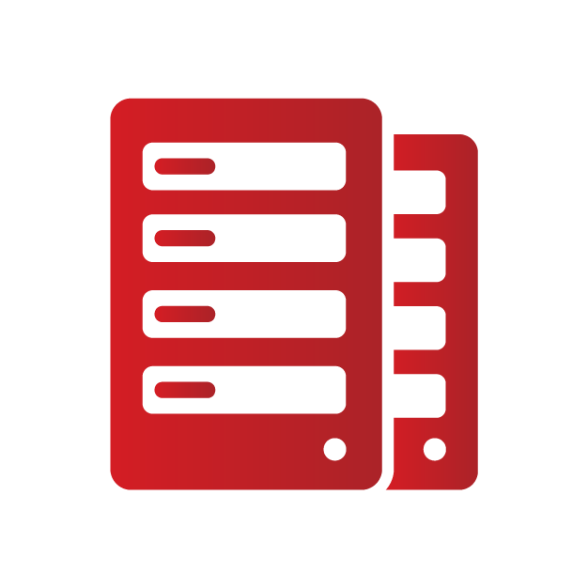
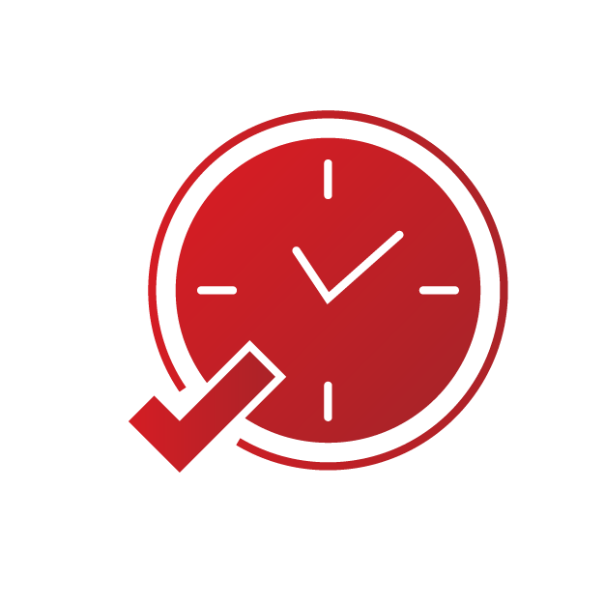

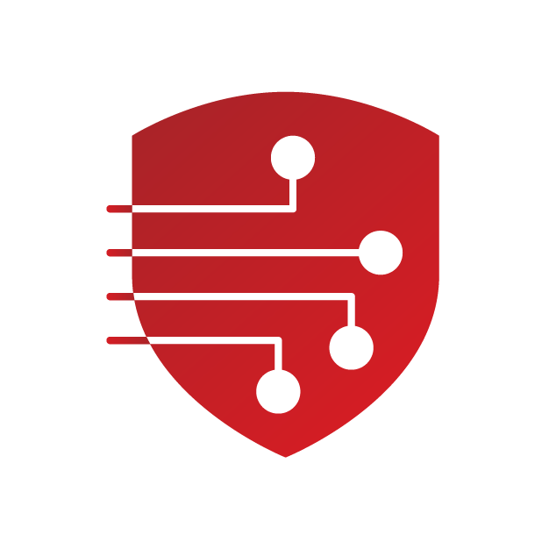
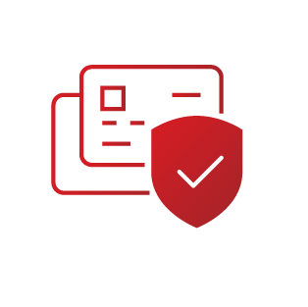


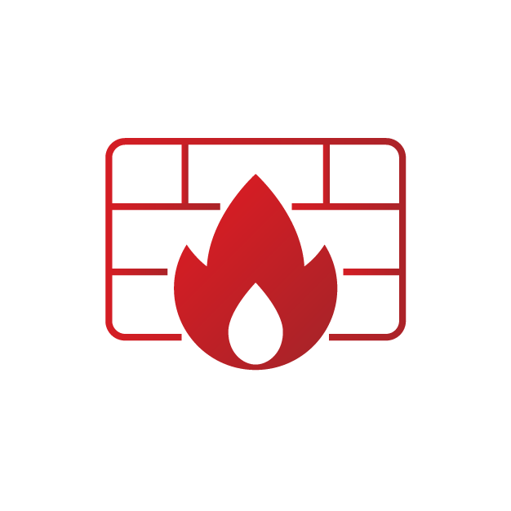

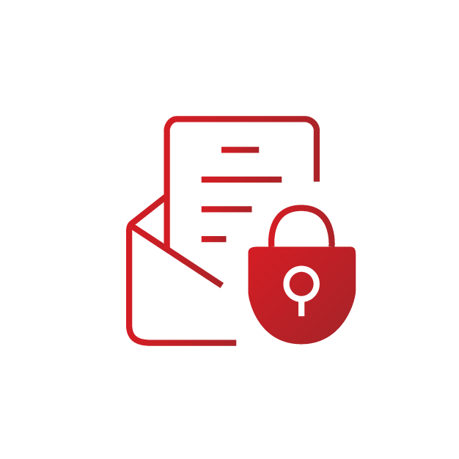
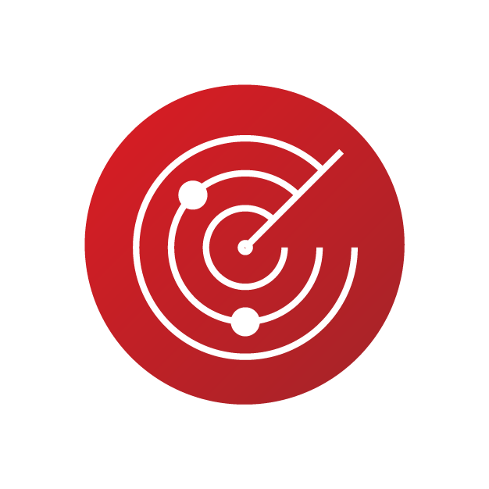

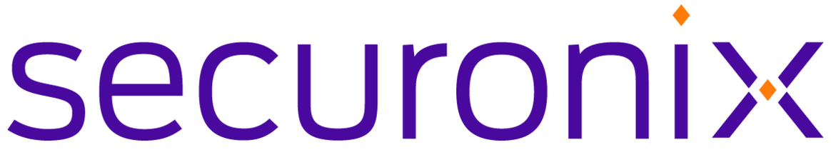


Appliances Deliver Enterprise Class Cyber Resiliency
Attack Path
Step 1:
Gain System Access
Step 2:
Login to System
Step 3:
Acquire Elevated Permissions
Step 4:
Perform destructive operations
Built in Protection
Restricted Admin Access
File System, Namespace and Network Isolation
WORM storage
Tamper-Proof Retention Clock
MPA
Network access controls
MFA, SSO, ECA
Automated Credential Management
Secure, Recorded Sessions
Root access removal
RBAC, MAC
Restricted
IPMI
Secure Data
Encryption
Anomaly detection
Threat monitoring
Malware scanning
Intrusion Detection System
Audit Logging
Log Forwarding
Built in Detection
Continuous Threat Monitoring and Mitigation
Notes:
Cyber criminals attack backups by remotely gaining access to your system, application or services either by taking advantage of security vulnerabilities or with stolen credentials.
The most important thing is to build a data protection solution that is designed with a zero-trust framework: never trust, always verify. NetBackup powered appliances were designed from inception with this methodology and protect you from all levels of attack. Let’s look at how an attack happens and how Veritas protects your backup data:
Click> First an attacker tries to gain access to a system.
Click> Veritas appliances prevent network access to backup systems by making it easy for backup admins to setup an allow list for specific IP addresses or subnets and denying access to all others. This puts the power in the backup admins hands to make changes when necessary, instead of having to rely on a network admin.
Click> If they gain access they will then try to use stolen passwords to login to the backup system.
Click> Veritas appliances include more secure login options including Multifactor authentication, single sign-on, and external certificate authentication. We also have integration with CyberArk for privileged access management,
Click> If they were able to login they would next try to acquire elevated permissions.
Click> Veritas appliances strictly limit user and process permissions and isolate service access permissions so that even if an attacker was able to enter a system via a stolen password, they would have limited rights to any action.
Click> If they acquire elevated permissions then they will try to perform destructive operations.
Click> Veritas appliances highly restrict access to your filesystem and destructive operations. This includes unique security features such as a tamper-proof compliance clock that is instantiated at the filesystem layer, ensuring that even if someone hacked the system or NTP time that images can’t be prematurely expired. Access to the underlying OS and data requires multi-person authentication. Access to destructive system level operations via the IPMI can be restricted, to prevent anyone from wiping and repartitioning the disks.
Click> As you can see, whether this is an external or internal attacker, there are many steps they take before they can perform the destructive operations. Veritas appliances also help security admins detect attack attempts so they can stop the attack before damage is done.
Click> As you know, the threat landscape is always changing with new vulnerabilities constantly being identified. Veritas has a threat intelligence team of experts that ensures product designs are highly secure, that constantly test and provide expedited fixes to new vulnerabilities and threats as they emerge.

Slide 26





Veritas Application Security Assurance Program (ASAP)
Veritas DevSecOps processes, aligns with the US Government’s Secure Software Development Framework (NIST SP 800-218)
</>
Training
Compliance
Design
Implementation
Verification
Deployment
Response
Security Awareness Training
Compliance with Security Standards
Secure Design Principles
Source Code Reviews
Security Testing
Vendor and 3rd Party Assessment
Preparing for Incident Response
ROLE-BASED SECURITY TRAINING
CYBER RANGE
US GOV SECURE DEVELOPMENT FRAMEWORK
EXEC ORDER 14028
ARCHITECTURAL RISK ANALYSIS & THREAT MODELING
SECURE BY DESIGN AND DEFAULT
CRYPTOGRAPHY REVIEW
STATIC CODE ANALYSIS
COVERITY
VULNERABILITY SCANNING
FUZZING
DISA STIG / CIS HARDENING
CONTAINER SCANNING
PENETRATION TESTING
3rd PARTY CODE ASSESSMENT
VULNERABILITY MANAGEMENT
3RD PARTY MONITORING
PARTNERED WITH CISA
REDLab

Slide 27

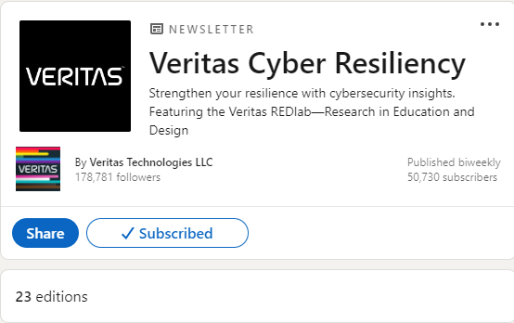
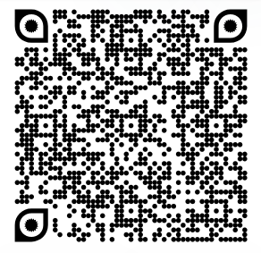
Real-World Testing with Best-in-Class Ecosystem
Live Malware Testing
Security Research
Informed Products
Inject live malware
Validate resiliency
Ensure recoverability
Independent research
Identify new attack vectors
Update defense mechanisms
Test real attack scenarios
Inform future product features and functionality
Notes:
Key points for this slide:
Veritas REDLab studies ransomware and malware attacks firsthand.
We regularly conduct live simulations and execute real attacks on our products. This provides Veritas with many advantages to study and research everything from defense mechanisms to new attack vectors. This also enables us to inform future product features and functionality.
Additionally, partners are joining us in this effort, MICROSOFT and Qualys are examples of partners that are slated for REDLab testing in the future.
https://www.veritas.com/why-veritas/trust/redlab

Slide 28
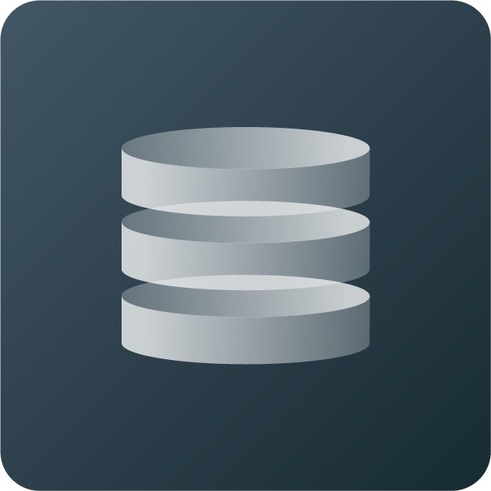
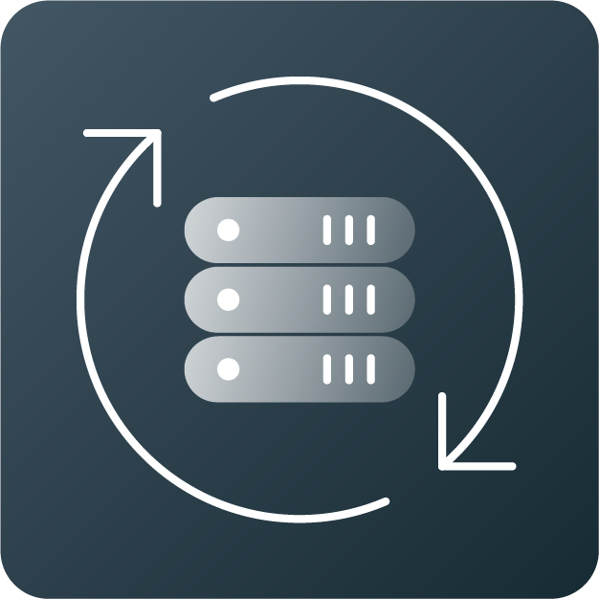
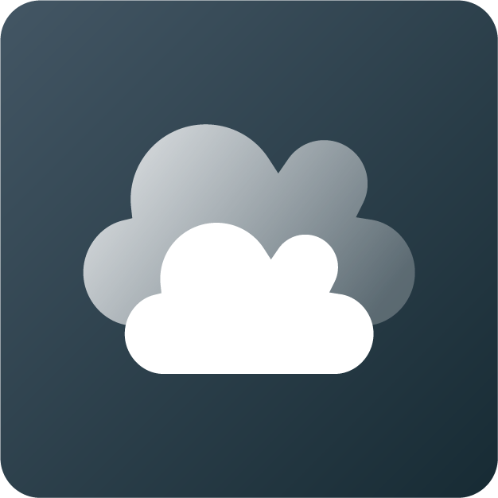
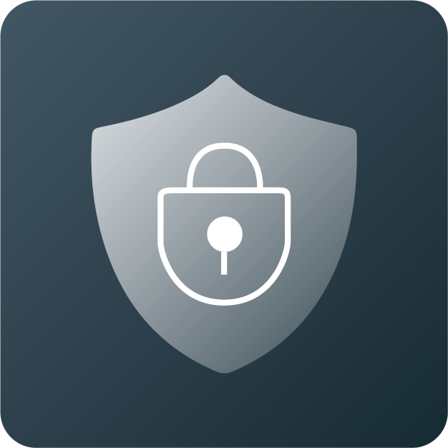
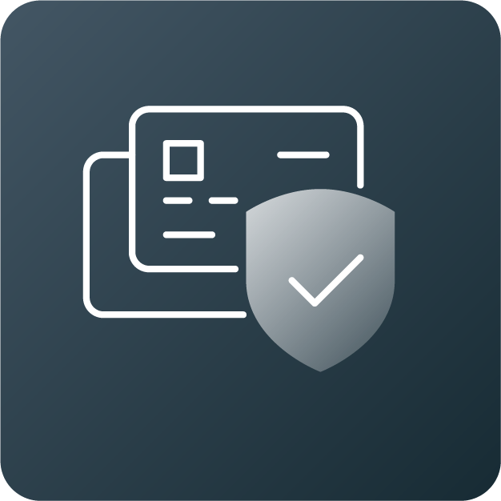
Maximize the Protection with 3-2-1-1-0 Backup Strategy
3-2-1+1+0 BACKUP STRATEGY
  3 copies of your production data, plus 2 backups. Production backup on Flex or Flex Scale, one backup copy on Access Appliance, and another backup copy in the cloud
3
+
+
    Copies
Production data and two backup copies
    2 different formats/media. Diversity protects against specific types of failure. With Flex/Flex Scale and Access enabling on-prem disk-based media, cloud copy enabling off-prem media
2
+
    Media
Two different media types
1
    Resiliency
    1 copy should be immutable and/or air-gapped. All appliances and RVLT offer immutability and air-gap
One copy is virtual air gapped and immutable
1
    Location
    1 copy should be offsite using RVLT
One copy is offsite or in cloud
    0 errors; monitor/test recovery of business frequently to ensure integrity, and instant access, making it faster
0
    Integrity
Zero errors

Slide 29

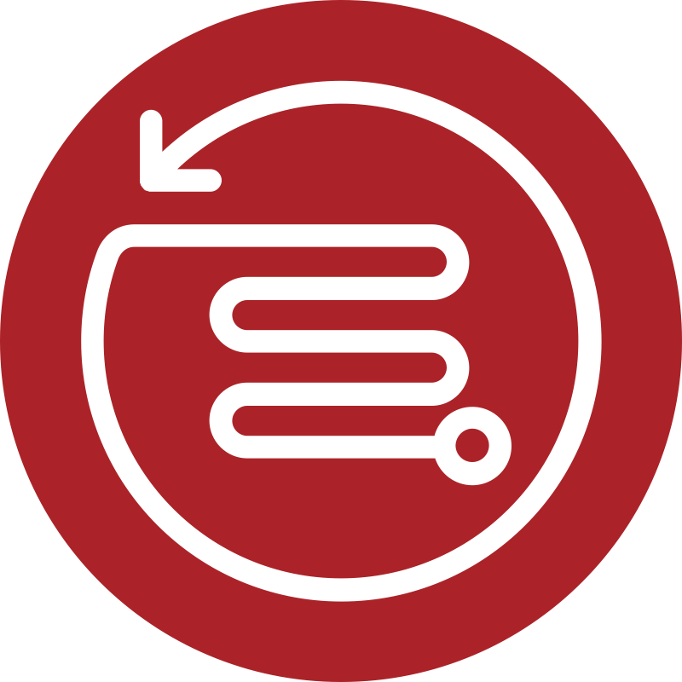




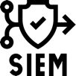




Gain Insights During Backup and Provide Clean Restore
THREAT DETECTION
During Backup
BLAST RADIUS
Post Backup
RECOVER
Clean Copy
Cloud
Bare Metal
Original Source
Backup Client Source Data
NetBackup
Backup Storage
More cost efficient than storage scanning
Validated Backups
Pause Expiration
and Backups
Action
NetBackup
Malware
Scanner
Real-time Proactive Anomaly Detection Job meta data & Dedup characteristics Runtime Entropy Computation | On-demand or Automated Integrated Malware Scan Auto-Trigger Malware Scan on Anomaly score threshold | Scan awareness at Restore Recover clean copy of data Positive scan: Pause backups and expiration for infected endpoints
29
Copyright © 2024 Veritas Technologies LLC | Veritas Confidential & Proprietary. Veritas Internal Use Only.

Slide 30
Summary
Cyber outages are inevitable
Recovering quickly and confidently is critical
Veritas data protection and security has been a leader in Gartner MQ for 19 years straight.
Veritas innovations continue to make cyber resilience simpler, smarter, and recoveries faster

Slide 31
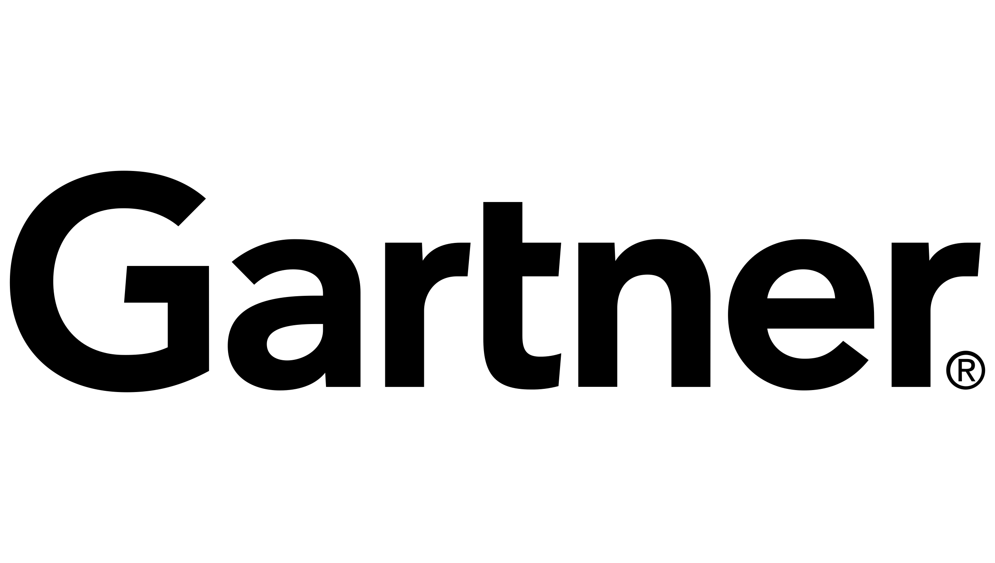






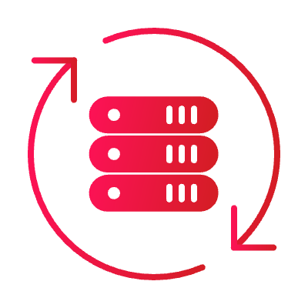
Veritas: Industry Leader for 30+ Years
for Enterprise Backup and Recovery Software Solutions
for Enterprise Information Archiving
19x
96%
15x
LEADER
of the Fortune 100 Trust Veritas
LEADER
6,000+
Employees
Worldwide
20,000+
Global
Partners
80,000+
Global
Customers
2,000+
Developers
Worldwide
2,200+
Global
Patents
800+
Supported
Workloads
100+ EB
Data Under
Management
Gartner is a registered trademark and service mark of Gartner, Inc. and/or its affiliates in the U.S. and internationally,and is used herein with permission. All rights reserved. *Fortune Global 500 and Fortune 100, June 2022
Notes:
We allow customers to get access to their data where and when they want it. ​
We do this at scale for the worlds largest and most complex environments, ​including 95% of the Fortune 100.
For decades, Veritas has been leading in data protection, and no company in the industry can match this record.
17x leader in Gartner’s Magic Quadrant, over 2,000 global patents and over 100 exabytes under management.
We protect the world’s most important asset—data.

Slide 32


Veritas Separation & Integration
Veritas Enterprise Data Protection +
Cohesity
Application Resilience, Data Governance &
SME Backup
A new leader in AI-powered data security and management
Support for 1,000+ data sources and 1,000+ storage targets
Best-in-class speed, scale and simplicity
Industry-leading security, Gen AI & ML
$30bn Market; $1.6bn Revenues
96 of the Fortune 100 and 80%+ of the Global 500
15X Gartner Magic Quadrant Leader in Enterprise Information Archiving
InfoScale underpins the world’s mission-critical apps
BackupExec has broad and committed customer base
$17bn Market; $400m Revenues

Slide 33
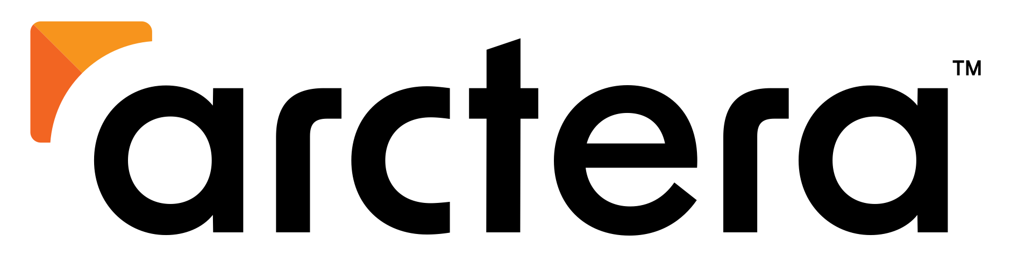


Arctera At-a-Glance
Data Compliance and Governance
Data Protection
(Backup Exec)
Data Resilience
(InfoScale)
Our mission is to help organizations thrive by delivering market-leading solutions that enable them to trust, access, and illuminate their critical data.
Proven Products
Market Leader
Enterprise & Commercial
30 Locations
+75,000 Customers
Notes:
Veritas is a leader in the Data Compliance and Governance space, offering complete end-to-end electronic communication surveillance and eDiscovery in one simple solution.

Slide 34

Veritas & Cohesity
Creating the Leading AI-Powered Data Security and Management Company
Veritas Enterprise Data Protection +
Cohesity
Veritas and Cohesity are merging, creating the biggest data protection company in the industry.
“We are deeply committed to our mission to protect the world’s data”.
“Bringing Veritas’ differentiated cloud-native architecture to Cohesity’s strong innovation engine will ideally position us to offer our customers transformative solutions against cyber attacks”.
Copyright © 2024 Veritas Technologies LLC
Notes:
Veritas + Cohesity, Creating the Leading AI-Powered Data Security and Management Company
We all heard that Veritas and Cohesity are merging in February, creating the biggest data protection company in the industry. While many teams have been working to prepare for the eventual close, now is a good time to show you a sneak peek at coming attractions in the product space.
But before we do, let’s address the critical questions we hear from employees, customers, and partners.
Question #1: After the merger, will NetBackup and appliances be available? Absolutely, yes, we have a strong roadmap, and the products will continue to be available on day one and importantly continue to be improved for years to come.
Question #2: After the merger, will customers be forced to migrate to Data Protect? Absolutely not. We’ll have two separate products NetBackup with Appliances and Data Protect. We’ll work hard to bring new functionality to both products and help you integrate best-of-breed functionality; there are no forced migrations. The enterprise needs stability, and we’ll deliver that without interruption.

Slide 35
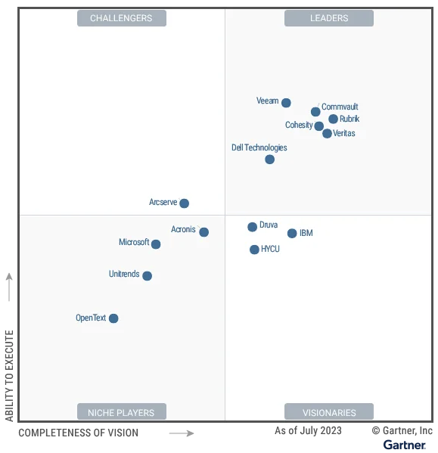
Veritas & Cohesity
Creating the Leading AI-Powered Data Security and Management Company
Copyright © 2024 Veritas Technologies LLC
Notes:
Veritas + Cohesity, Creating the Leading AI-Powered Data Security and Management Company
We all heard that Veritas and Cohesity are merging in February, creating the biggest data protection company in the industry. While many teams have been working to prepare for the eventual close, now is a good time to show you a sneak peek at coming attractions in the product space.
But before we do, let’s address the critical questions we hear from employees, customers, and partners.
Question #1: After the merger, will NetBackup and appliances be available? Absolutely, yes, we have a strong roadmap, and the products will continue to be available on day one and importantly continue to be improved for years to come.
Question #2: After the merger, will customers be forced to migrate to Data Protect? Absolutely not. We’ll have two separate products NetBackup with Appliances and Data Protect. We’ll work hard to bring new functionality to both products and help you integrate best-of-breed functionality; there are no forced migrations. The enterprise needs stability, and we’ll deliver that without interruption.

Slide 36
Thank You

