Slide 1
AI Frontiers: Overcoming Challenges, Seizing Opportunities
No Time for Downtime Event
October 2024
Madalina Popa
Cloud Solutions Sales Manager

Slide 2
What leaders want from AI
2X
Increasing employee productivity
Helping employees with necessary, but repetitive/ mundane task
Increasing employee well-being
Eliminating time-spend on low-value activities
Augmenting/ enhancing human capabilities
Accelerating employee pace of work
Enabling employees to access and recall organization institutional knowledge
Helping me understand if employees work is aligned to company goals
Removing the coordination challenges of hybrid work (e.g., scheduling virtual meetings)
Increasing inclusivity
Reducing headcount
Notes:
This is one place where employees and leaders agree. Our data shows managers are two times more likely to say they’re looking to empower people with AI, rather than replace them. In fact, reducing headcount was last on their list. Their top hopes for AI? Increasing productivity, automating tasks, increasing employee well-being and enabling employees to focus on impactful work.

Slide 3
What employees want from AI
Finding info and answers
Summarizing meetings and action items
Analytical work
Admin tasks
Creative work
Planning their day
Notes:
They envision using AI not just for administrative tasks, but also for analytical and creative work.

Slide 4
Where do we see AI?
Enrich employee experiences
Reinvent customer engagement
Reshape business processes
Bend the curve on innovation
41%
24 hours
70%
98%
increase in search & response quality to increase productivity
Healthcare staff time saved weekly
faster investigations into financial crime & risk
of initial development work done by Copilot
Notes:
And this transformation is driving tangible benefits
By harnessing the capabilities of Gen AI, KPMG is increasing their response quality by their critical AI assistant toosl by 41% increasing productivity
National Health Service in UK is saving on average 24 hours of staff time that can be better used in front of patients
SymphonyAI has built a solution that helps investigate & identify financial crime & risk 70% faster
And GM has freed-up their development time significantly to allow their technical teams to focus on innovation and not mundane tasks

Slide 5
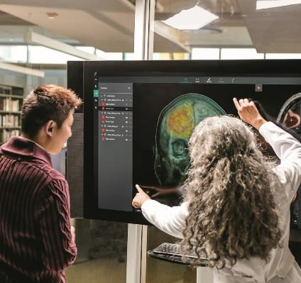
AI Transforming Healthcare Ecosystem
Accelerate clinical research, intelligence & productivity
Empower clinical teams to focus on patient outcome
Accelerate innovation across Pharma & MedTech
Notes:
AI is transdforming the healthcare industry, from accelerating clinical research, providing more intelligence in the fingertips of clinicians & making the more productive.
Empowering clinical teams to spend less time documenting & working on mundane tasks and as you saw earlier giving them time back to focus on the patient
And of course accelerating innovation across the pharma & med tech industries.

Slide 6
AI is Reinventing Financial Services
Empowering Financial Advisors & Brokers
Enhancing Contact Center Experiences
Know Your Product
Notes:
Now to get more specific we will look at a few industries and have some fun. First Financial Services…
Empower financial advisors through eliminating manual searches through extensive documentation, providing fast, clear access to key product attributes and client information.
Search and know your product: build powerful knowledge bases to enable contact center agents, advisors, and branch staff to get answers to complex product queries and market research.
Enhance contact center services by responding faster to customer questions. You’ll also be able to summarize and aggregate customer sentiment to provide insight to agents and track KPIs.
And across all the markets that I serve, I see continuous race on which bank, which insurer, which investment advisory firm is the first to make their advisor smarter more efficient. But right here in Romania, Banca Transilvania is once again leading the way…
Enhancing Contact Center
- Summarize insights from across conversations.
Aggregate customer sentiment to track KPIs.
Coach agents in real-time using real-time agent assist.
Know your product
Eliminate the need to manually search extensive product documents.
Easily compare and summarize key product attributes.
Retrieve information quickly to serve clients.
Empower financial advisors
Create client meeting decks using content and data from multiple sources with copilot.
Generate and summarize data points in real time.
Accelerate development of pitchbooks and materials for capital raises, mergers, and acquisitions.
Moody’s
LSEG
Akbank
Ceska Sporitelna
Symphony AI – Financial Crime & regulatory compliance
Progressive virtual agent
John Hancock freeing call center capacity
H&R Block for call center & internal documentation

Slide 7
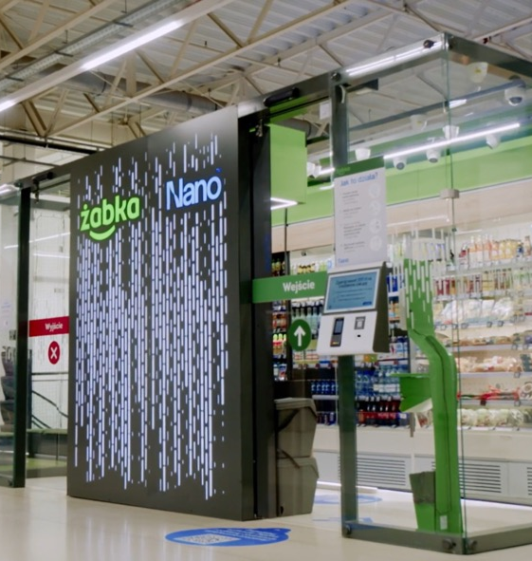
AI Transforming Retail
Unlock new Shopping experiences
Empower Store Associates
Personalize & Transform E-Commerce
Notes:
Now another industry that is rapidly transforming is retail.
We are seeing Generative AI create new shopping experiences like the nano stores from Zabka in Poland; empowering store associats with faster, more contextual data at their fingertips or personalizing & transforming e-commerce with shopping assistants that are helping Carrefour customers plan their meals more effectively & immediately order what they need.
But one example a customer that is truly transforming with Gen AI is Walmart – the world’s largest retailer.
Zabko – AI Nano Stores & connected to Gen AI Ecommerce experience
Walmart – empowering Back-office, Associates & Partners with Generative AI to optimize end to end shopping experience
Transforming e-commerce – Allegro GenAI infused in online marketplace, Carefour & other grocers transforming grocery & recipe building experience
Carmax – generating content, product reviews, etc.

Slide 8
AI Transforming Government Sector
Transform Citizen Services across Ministries
Re-invent Education with personalized approach
Build Intelligence in Military & Defense Operations
Notes:
Now let’s switch gears a bit to the government sector. And this is an area where in our region we have seen the most transformation. Across Europe & Middle East, governments are racing to transform citizen services across federal governments & ministires. In Greece, they have recently launched a Gen AI bot in Greek language that can support 4000 citizen services from renewing your drivers license to getting permits all through natural language in Greek. Albania has done the same. Transportation ministires, Ministries of Labour, of Tax and much more are looking for ways to optimize their processes & ultimately service their citizens faster, more efficiently & with less friction.
We are seeing transformation in Military & Defense Operations, while the opportunities here are endless from the front lines to the control room; one interesting example I’ve seen is one of the Ministires of Defence using Gen AI to comb through thousands of NATO documents, translate in local language & empower their intelligence officers with guidance & directives at their fingertips – work that would have taken months to do with significant resources.
But perhaps the industry that is being transformed the most, the one that is near & dear to my heart and to many of you parents out there is Education. I am seeing this every day with my 9 year olds, I am inspired by Ministries like those in UAE putting a personalized AI tutor in the hands of every student and by start-ups that are transforming both the learning and the teaching experience.

Slide 9
Enabling AI Transformation
Industry clouds
Microsoft Cloud
c
b
a
Unlock productivity across your business with Microsoft Copilot
Infrastructure
Comprehensive
Trusted
Digital and app innovation
Security
Microsoft
Cloud
Ask me anything…
Build your AI capability with an open AI platform and partner ecosystem
Business applications
Data and AI
Co-innovate with trust and safeguard your business
Modern work
Notes:
Our goal is to enable this AI transformation, these 3 imperatives and have embedded them across our Microsoft Cloud Solutions that many of our customers are already using today – helping everyone helping everyone be more productive, more creative, more efficient, and more innovative with Microsoft Copilot across every Microsoft Cloud experience.
But we recognize that organizations have their own unique IP, data & applications and building or extending AI capabilities in new and existing apps using the same open ecosystem stack and AI services Microsoft used to build our own copilots.
And of course we want to help co-innovate with you on a foundation of trust.
Let’s talk about Copilot first, let’s roll the video.

Slide 10
120 secs
Unlock productivity with Copilot
Software developers
Domain experts
Knowledge workers
Employee performance
Marketing
Code 55% faster
Create workflows in half the time
Complete tasks 37% faster
Reduce employee attrition by 20%
67% say it saves time
50% say it improves the work quality
Customer service
Security operations
Sales
Resolve 14% more customer issues per hour
Respond to threats in minutes, not hours
Streamline the process of checking and answering emails
Notes:
And the productivity gains we have seen after the first year are significant…
Software develoeprs code 55% faster and are 70% happier with their work
Knowledge workers complete tasks 37% faster
Marketrs say its saving them 67% of time and 50% say it improves their quality of work
Customer Service reps resolve 14% more customer issues per hour
And more…

Slide 11
Choosing a Copilot
Working back from a use case to the Microsoft Capability
What is the business problem?
Who is the persona?
Can we leverage “out of the box” gen AI?
Build your custom use case
Microsoft Copilot Studio
Low Code
Developers
Productivity
Sales
Contact
Center
CISO/
Security
Finance Function
GitHub Copilot
Copilot for Microsoft 365
Microsoft Copilot for Sales
Microsoft Copilot for Service
Security
Copilot
Microsoft Copilot for Finance
Azure AI Studio
Pro-code
Notes:
Before the release of Microsoft 365 Copilot and Microsoft Copilot Studio in November 2023, customers had a small number of Copilots to choose from – Azure OpenAI service, sales, and service copilots. Now there are more choices to choose from – this slide shows how you can choose the right solution for a given use case.
Start with framing the business problem and scenario. Next see if the scenario can be delivered with one of the ‘out of the box’ Microsoft Copilots such as Sales, Service. For core productivity scenarios deploy Microsoft 365 Copilot. If the scenario requirements do not fit, then explore how you can build your own copilot. Microsoft Copilot is ideal for use cases that fit use cases that are small in scope and can be delivered with low code/no code. Enterprise-wide use cases that need custom development/integration and more choice of foundational models should be built with Azure AI Studio.

Slide 12
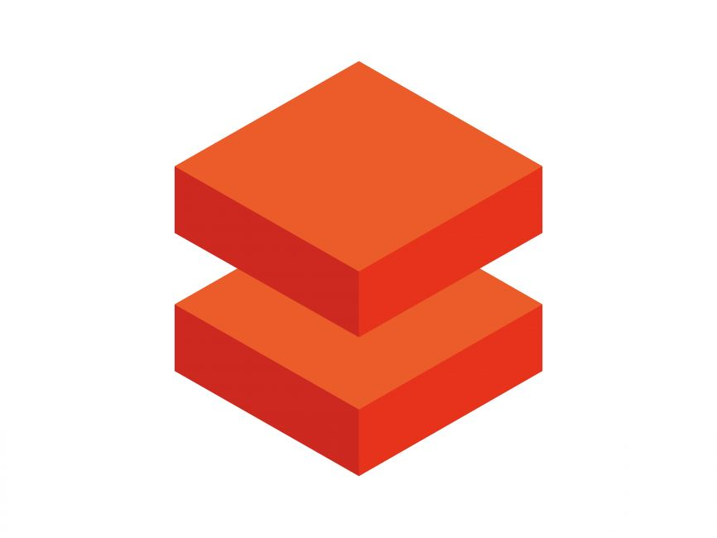
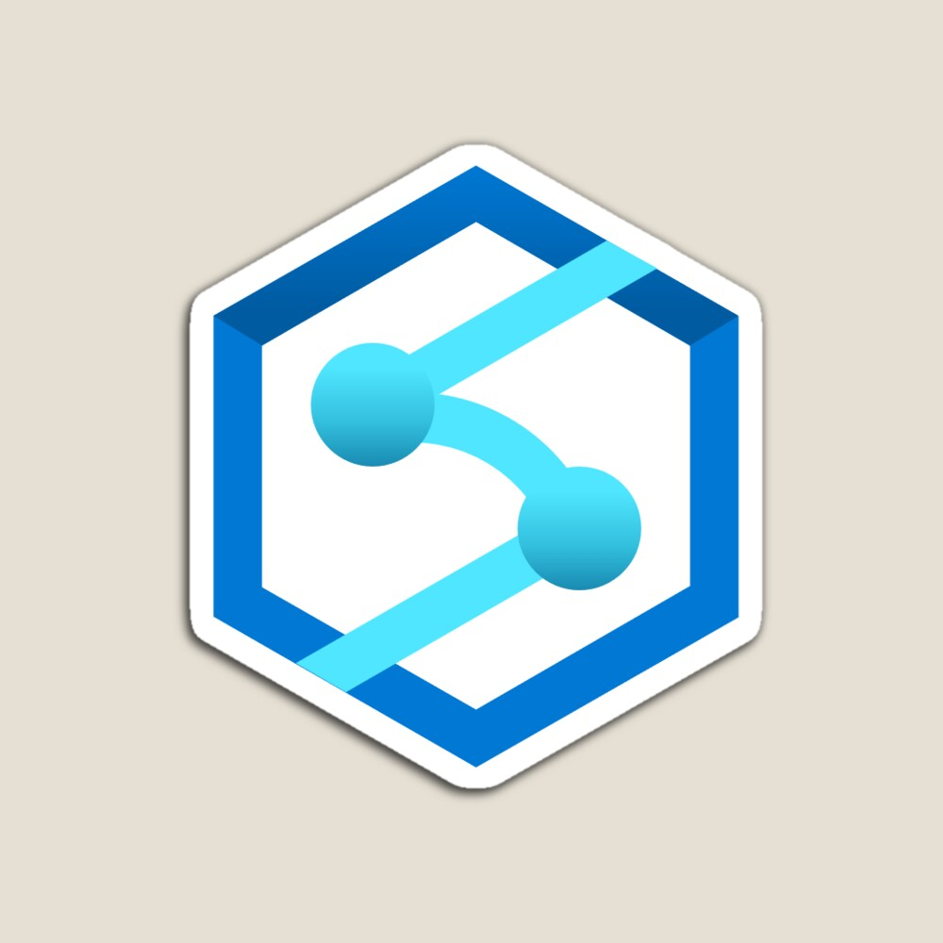
Microsoft AI Services
Applications
Partner Solutions
Business Users
Application Platform
AI Builder
Fabric
Power Apps
Power Automate
Copilot Studio
Scenario-Based Services
Applied AI Services
Bot Service
AI Search
Doc Intelligence
Video Indexer
Immersive Reader
Customizable AI Models
Developers & Data Scientists
Cognitive Services
Vision
Speech
Language
Decision
Azure OpenAI
ML Platform
Azure Databricks
Azure Synapse
Fabric
Azure M. Learning
Notes:
Narrative/talk track:
Azure AI is a collection of artificial intelligence services offered by Microsoft as part of its Azure cloud platform. The Azure AI services are designed to make it easy for developers and organizations to add AI capabilities to their applications, without the need for extensive expertise in AI.
Azure AI includes a wide range of services, such as:
Azure Cognitive Services: A collection of pre-built APIs that allow developers to add capabilities such as natural language understanding, computer vision, and speech recognition to their applications.
Azure Machine Learning: A cloud-based platform that allows developers to build, deploy, and manage machine learning models, as well as to create custom machine learning algorithms.
Azure Applied AI Services: A suite of scenarios-based services that enable organizations to accelerate adoption such as Azure Cognitive Search which provides search capabilities over structured and unstructured data by using machine learning models.
These services are integrated with Azure platform, which provides capabilities such as scalability, security, and compliance, as well as many other tools and services that can be used to build and deploy AI-enabled applications.
The Azure OpenAI Services are designed to make it easy for developers and organizations to add AI capabilities to their applications, without the need for extensive expertise in AI. Microsoft's Azure OpenAI Services allow developers to quickly build, deploy, and scale AI-enabled applications, and to take advantage of the scalability, security, and compliance capabilities of Azure.
Azure AI integration in AI Builder within the Microsoft Power Platform allows businesses and developers to quickly and easily build and deploy custom AI models, and to integrate them with Power Apps, Power Automate and Power Virtual Agents, in order to add advanced capabilities and improve data management and security. It also allows to easily scale up and improve performance of the models, as well as easily integrating with other Azure services.
Microsoft has adopted Azure AI across a wide range of its products and services, in order to improve the functionality, performance and user experience. Some examples of where Microsoft has adopted Azure AI at scale include:
Office 365: Microsoft has integrated Azure AI capabilities into Office 365, such as natural language processing, computer vision, and text analytics, to improve the functionality of products such as Outlook and Word. This allows users to perform tasks such as automatically summarizing long documents, or automatically tagging images in email attachments.
Dynamics 365: Dynamics 365 is a collection of business applications that enable organizations to manage customer data and interactions, as well as automate business processes. With Azure AI integration, Dynamics 365 offers features like predictive lead scoring, sentiment analysis, and chatbots to help businesses better understand and interact with their customers.
Bing: Bing, Microsoft's search engine, uses Azure AI to analyze large amounts of data and improve search results for users. For example, Bing uses natural language processing to understand users' queries and generate more relevant search results.
LinkedIn: Microsoft's professional networking site, LinkedIn, uses Azure AI to help users find job opportunities, connect with others in their field, and improve the performance of its recruiting tools. For example, LinkedIn uses natural language processing to help match job seekers with relevant job opportunities, and uses machine learning to help recruiters find the best candidates.
Xbox and Gaming: Microsoft uses Azure AI to power its Xbox gaming console. Azure AI allows Xbox to learn a gamer's preferences and automatically adjust the gaming experience. Additionally, it allows Xbox to improve the performance of the games and to offer more personalized gaming experiences.
These are just a few examples of how Microsoft has adopted Azure AI at scale within its products and services. Overall, Microsoft has been using Azure AI across its various products and services, to improve user experience and to offer more personalized, efficient and automated experiences to its customers.

Slide 13
Microsoft Fabric: The data platform for the era of AI
Unify provider data into one data estate for analytics | Build fit-for-purpose industry analytics and AI models | Scale transformative analytics applications | Democratize analytics responsibly to build trust
Centralize and curate all your data in an open and governed hub that can virtualize data from Azure or other platform providers and enable the same copy of data to be used across workloads. | Give everyone the ability to fuel their own, tailor-made AI experiences in Azure AI Studio with curated data flowing from Microsoft Fabric. | Gain visibility and uncover insights with responsible, self-service access to power analytics tools—accelerated by Copilot and integrated into the apps you know and trust. | Give everyone the ability to unlock insights in a unified platform that has industry-leading governance and compliance to help you stay in control.
Financial services data incorporated within Fabric from major market data providers such as:
Notes:
LSEG and Moody’s are examples of data providers that are integrated into Fabric. Other data providers on Azure can also be integrated.

Slide 14
Top Use Cases for Generative AI
Enterprise ChatGPT
Better knowledge mining
Intelligent Call Centers
Better analytics and service
Build your own copilot
Your data. Your apps. Your people
Content Generation
New products and services
Hyper-personalization
Better sales and marketing
Notes:
And while there is no limits to what GenAI can do, we see across customers from enterprsie to small business to governments consistently leveraging Gen AI in 5 ways:
To create their own version of Enteprrise ChatGPT for better knowledge mining
Build intelligent call centers with better analytics & service
Create new content, new products, services
Hyper-personalize sales & marketing
And ultimately build your own copilot ony our data, your apps and for your people.

Slide 15
Becoming a Data and AI Driven company – The Journey
01 Executive Sponsorship
Start to drive Culture Transformation
Data driven culture
Employees are focused on customer relationships
Employees reskill continuously
05
Executive Engagement
04
Line of Business Solutions
03
Modernize and migrate
your Data Platform
02
Securing the foundations
Data Governance + Security
Notes:
As we look across our customers who are advanced in their Data Transformation, we see a set of common patterns/workstreams to drive success
First off – a Data Driven Culture has to be driven and led by the CEO – most CEOs are pushing their organizing their companies to do this but without sponsorship a lot of efforts fail
Securing the foundations. Microsoft has a trusted cloud platform with world class security and privacy and compliance investments. We also help you build the right governance with tools like Microsoft Purview
Thirdly – the technology team has to modernize the data platform – leverage a platform that can bring siloed data together and use platform services for new applications
Fourth – technology and the business teams need to be aligned to drive data workloads and applications on to the new data platform – misalignment here can lead to failed investments and its critical that the business and technology teams work in concert
Fifth Step – in addition to sponsorship – CX teams need to be engaged to make sure the initiatives land and escalations are managed
This journey is a continuum

Slide 16
AI Business School
Audience: Business Decision Makers (e.g. Business Unit Managers, Senior Management)
Format: Online course, Free, On demand, Diversified content (articles, videos, use cases)
Objective: Share insights and practical guidance from top executives (Microsoft , Customers, Partners) on how to strategically apply AI in your organization.
6 Pillars
Define an AI strategy to create business value
Discover ways to foster an AI-ready culture
Identify guiding principles for responsible AI
Introduction to AI technology for business leaders
Scale AI in your organization
Enable AI business users with
Learn more at microsoft.com/ai-business-school
In partnership with

Slide 17
Preparing for the era of AI
What are your organization's goals for using AI?
What are your organization’s pain points that AI can address?
What are your organization's current capabilities in terms of AI?
Does your organization have a data strategy in place?
Does your organization have the necessary infrastructure and resources to support AI initiatives?
Notes:
Before starting on the path to AI, it’s important every organization pause and think through five important questions.
What are your goals for using AI?
What are the pain points within your organization that can be addressed with AI?
What are your current AI capabilities?
Does your organization have a data strategy in place?
Do you have the necessary infrastructure and resources to support AI initiatives?
Each of these elements will help guide and shape how you bring AI into your organization.

Slide 18
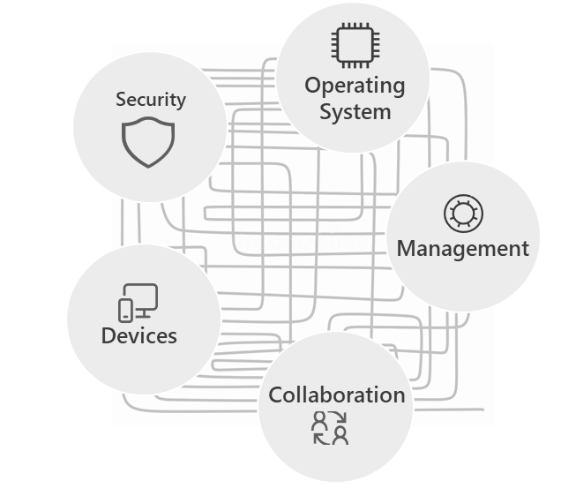
Are you ready to join the era of AI? Pivoting to a proactive AI strategy (Access, Devices, and Data)
A complex, disconnected tech stack limits the power and promise of AI
Do you have comprehensive ‘Zero-Trust’ security?
AI introduces new vectors for security risk with repercussions like data breaches, financial losses and reputational risks. Zero-trust using anomaly detection can tighten access controls and minimize security breaches.
Are your endpoints and apps easily managed?
A modern tech stack is critical to success with AI, so IT teams can easily enhance data loss protection controls, apply robust data governance and enforce data retention policies and access rights.
Do you have the right tools to fuel productivity?
The right mix of tools can improve productivity, breakdown silos to boost collaboration, and help employees get more value out of AI, while still prioritizing security for the organization.

Slide 19
Microsoft protects your data and enables you to control it
Protecting your data through the LLMs
Inheriting Microsoft Cloud policies and controls
Data access & permissions
Security and Compliance
User-tenant focus
Data Usage and Privacy
Customer data protection
Data processing and residency
Committed to responsible AI

Slide 20
Azure AI
Runs on trust
Your data is your data
Data is stored encrypted in your Azure subscription
Azure OpenAI provisioned inside your Azure subscription
Your data is not used to train the foundational AI models
Inference metadata never leaves your Azure subscription
Model fine tuning stays in your Azure subscription and never moves into the foundational AI models
Your data is protected by the most comprehensive enterprise compliance and security controls
Encrypted with Customer Managed Keys
Private Virtual Networks, Role Based Access Control
Soc2, ISO, HIPAA, CSA STAR Compliant

Slide 21
Ethical Considerations and Challenges

Slide 22
Microsoft is putting responsible AI into action

Slide 23
Swift
Situation
Swift’s network and platform is trusted to provide seamless automated transmission, receipt, and processing of more than nine billion financial messages a year.
Detecting and stopping fraudulent attacks and crime is a priority for Swift’s customers so the cooperative is constantly innovating to strengthen security
Solution
Swift collaborated with Microsoft to use federated machine learning techniques and Azure Confidential Compute to build a highly accurate anomaly detection model.
Their banking partners can securely and compliantly share data to pool their financial intelligence fraud insights
Impact
The shared vision is that it will become a potent new tool for reducing financial crime while achieving the highest level of security, privacy, and cost efficiency.
Microsoft Customer Story-Swift innovates with Azure confidential computing to help secure global financial transactions
Notes:
With the rapid increase of cross border transactions, and growth in instant payment networks, the financial services industry is focusing on fighting fraud that can cost hundreds of billions annually. As the leading infrastructure provider for financial messaging services, Swift has long worked with its community of over 11,500 institutions to drive new ways to detect and catch fraudulent transactions. And now it is working with Microsoft to innovate further in the fight against financial crime. Using federated learning techniques along with Azure Machine Learning and Azure confidential computing, Swift and Microsoft are building an anomaly detection model for transactional data—all without copying or moving data from secure locations. The shared vision is that the model will become the new standard for reducing financial crime while achieving the highest level of security, privacy, and cost efficiency.
Using Azure Machine Learning, we can train a model on multiple distributed datasets. Rather than bringing the data to a central point, we do the opposite. We send the model for training to the participants’ local compute and datasets at the edge and fuse the training results in a foundation model.
Johan Bryssinck: AI/ML Product and Program Management Lead
Swift
Transcript
Leading the charge for the industry
Citizens. Countries. Continents. The entire world relies on the efficiency, reliability, and security of Swift’s global financial messaging network. Swift sets the industry standard for how financial institutions and banks communicate with each other. The member-owned cooperative provides secure infrastructure for money and security transfers and related information for over 11,500 financial institutions worldwide. Swift’s network and platform is trusted to provide seamless automated transmission, receipt, and processing of more than nine billion financial messages a year.
Detecting and stopping fraudulent attacks and crime is a priority for Swift’s customers so the cooperative is constantly innovating to strengthen security. “We connect financial institutions around the globe to our network and deliver products and services in over 200 countries. Our standards are used for financial institutions and banks to communicate with each other, which puts us in a unique position to bring the industry together to try to solve some of the most complex problems,” says Tom Zschach, Chief Innovation Officer at Swift.
As the industry provides faster payment solutions between individuals and organizations across borders, Zschach says the risk footprint increases, as do costs. This is especially true when accounting for secondary impacts like fraud remediation and fund recovery, making fraud a massive issue for all financial intuitions and their customers. “Fraud in payments is a major concern for our clients—in the order of magnitude of billions of dollars every year,” says Isabel Schmidt, Co-Head of Global Payments Products at BNY Mellon, a member of the Swift network. “Preventing financial crime is a problem that we cannot solve individually as a bank, we need to it solve collectively."
Innovating without sacrificing privacy
With the aim of creating a solution that combats the latest financial security threats, Swift, as part of its robust innovation agenda, has been collaborating with Microsoft. Using federated learning techniques in Azure Machine Learning combined with Azure confidential computing, Microsoft Purview, and a Zero Trust based policy framework, the two organizations are working to build a highly accurate anomaly detection model for financial transactional data. This is being done without copying or moving data from Swift members’ secure locations. Participants’ data remains confidential even while the new model detects anomalies and gains new insights that will help predict and prevent financial crime.
Johan Bryssinck, AI/ML Product and Program Management Lead at Swift, says the organization’s intent is to provide the model so Swift’s banking partners can share their own data to further educate the model. Once data has been collected, Azure confidential computing will securely run new models on the latest data to gain additional insights creating an ongoing cycle of learning that will help drastically improve the rate at which we can detect fraudulent financial transactions across the globe. “Our first ambition at Swift is to build a foundation model for anomaly detection that underpins the detection and prevention of fraud. Our ultimate goal is collaborating with Microsoft and our community to start thinking about how we can stop fraud occurring in payments,” says Bryssinck. “We are exploring the federated learning aspects of Azure Machine Learning where we take a model developed by Swift and further train and enrich it with additional customers’ data through Azure confidential computing.”
“Using Azure Machine Learning, we can train a model on multiple distributed datasets. Rather than bringing the data to a central point, we do the opposite. We send the model for training to the participants’ local compute and datasets at the edge and fuse the results in a foundation model,” says Bryssinck.
Solving complex problems for the greater good
While the full potential of the model has yet to be reached, the shared vision is that it will become a potent new tool for reducing financial crime while achieving the highest level of security, privacy, and cost efficiency. “Working together with Microsoft and with our banking customers, we can build a model that's much more accurate and much more performant than I think has ever been seen in financial services,” says Zschach. ”Microsoft is a very important and productive strategic partner for us. There's a strong alignment in core values like trust and security. They’re able to bring the capability and the expertise to help us solve some of the toughest problems in finance.”
Find out more about Swift on Twitter, Facebook, and LinkedIn.
We are exploring the federated learning aspects of Azure Machine Learning. We take a model developed by Swift and further train and enrich it with Swift’s members’ data through Azure confidential computing.
Johan Bryssinck: AI/ML Product and Program Management Lead
Swift

Slide 24
The potential of AI is clear… the question is what will you build?
Notes:
And while these off-the-shelf copilots can be leveraged to boost productivity, optimize efficiency and cost savings, and secure your organization…
We understand that companies may also want to explore using AI in other, more extensive, ways to develop custom solutions.
AI-powered apps that, when combined with the right data foundation, can unlock transformative experiences that enable contextual interactions, amplified automation, and intuitive discovery with customers and within your organization.
And this is the same AI platform that you can use to build intelligent apps of your own.

Slide 25
Thank you

