Slide 1
Pure1 AIOps & Ransomware mitigation

Slide 2
Summary: 1 – Presentation 2 – Pure Storage Portfolio 3 – What is AI? 4 – Pure1 AIOps 5 – Ransomware mitigation 6 – Data protection pillars

Slide 3
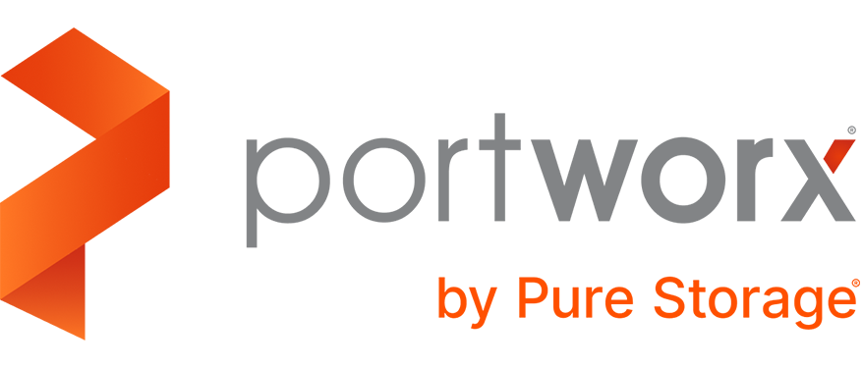
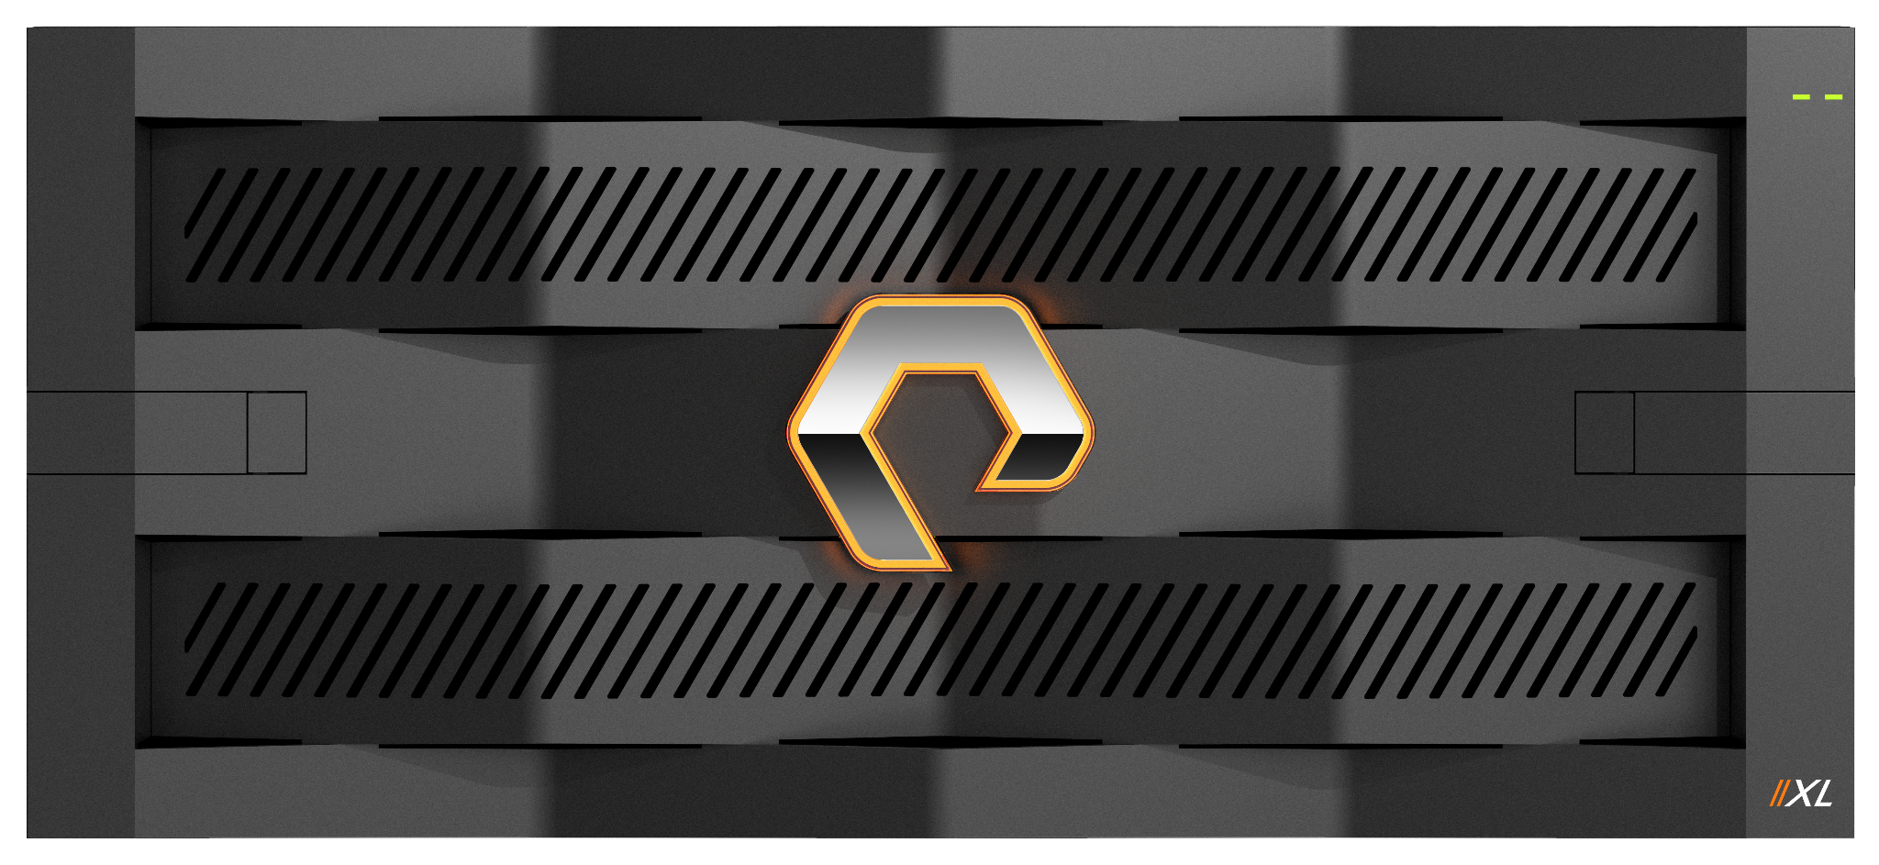
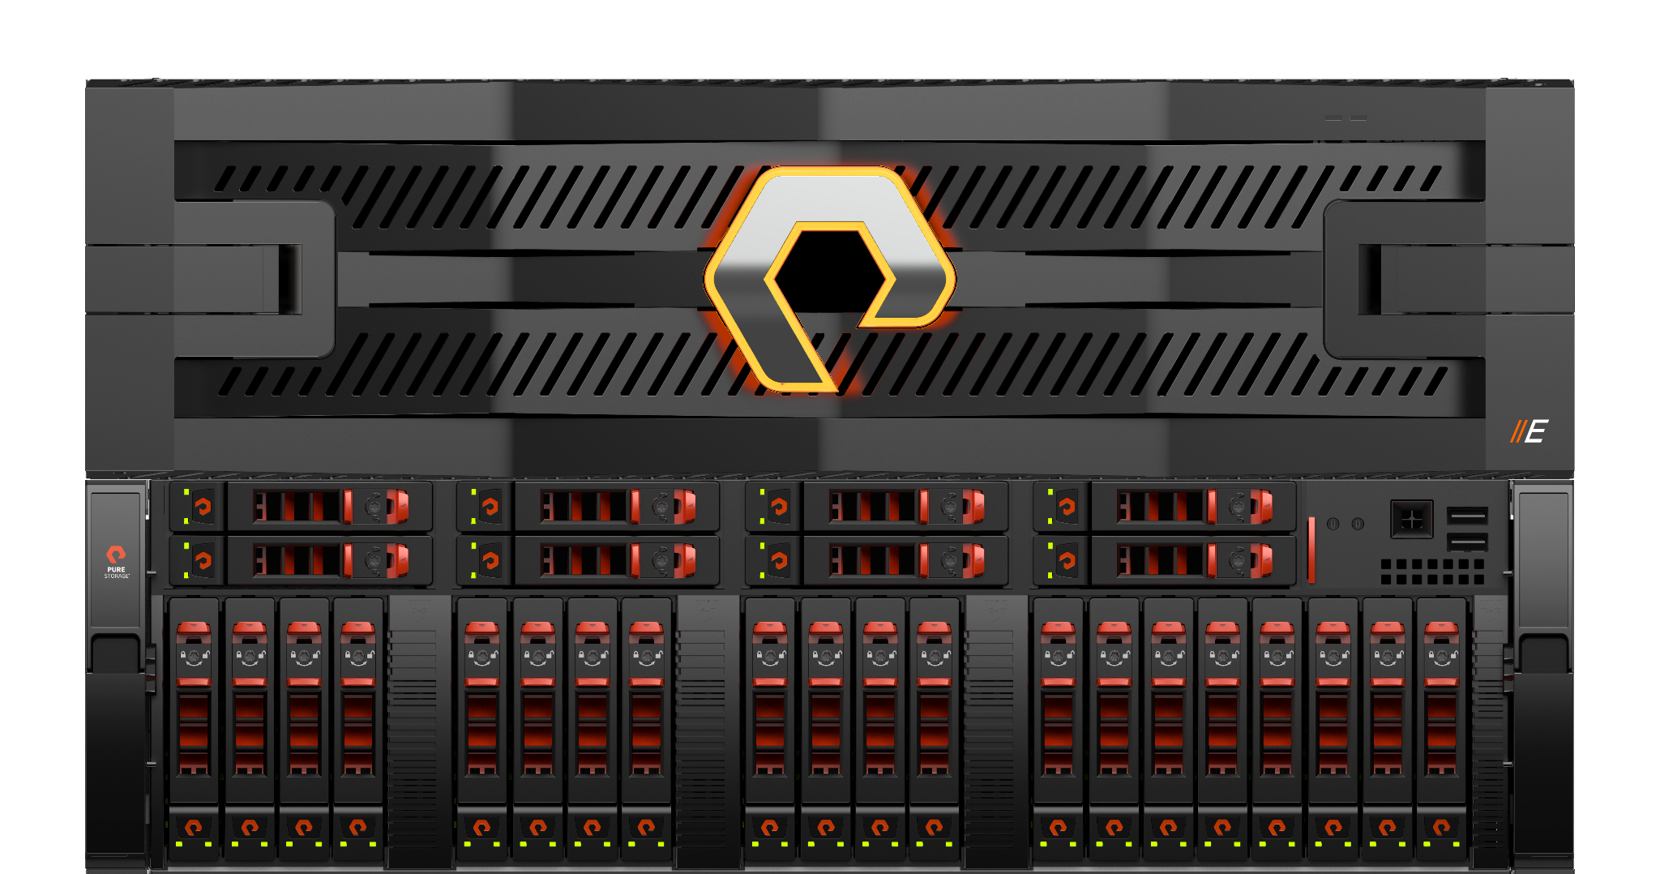
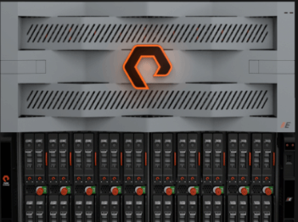
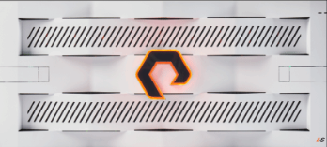
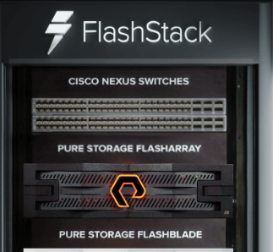
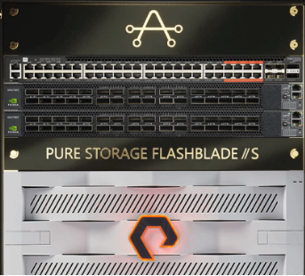
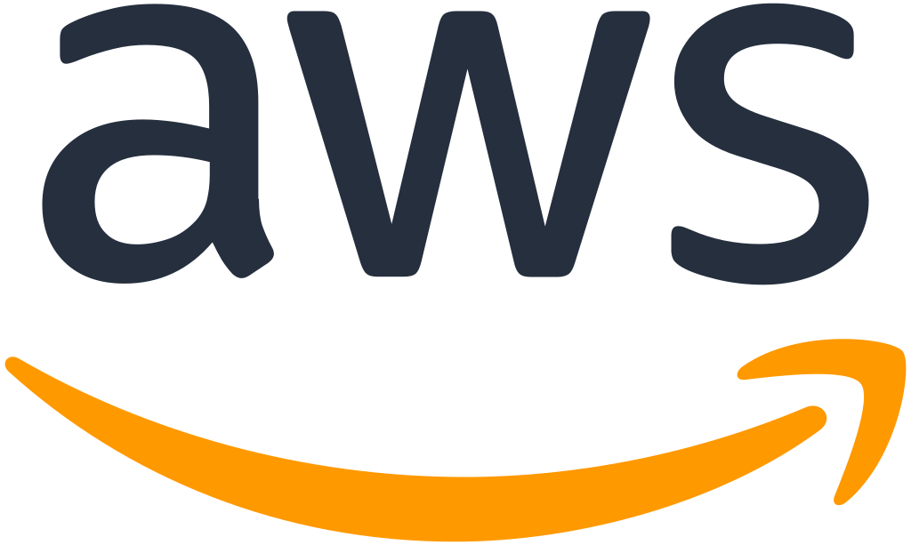
Pure Storage portofolio
Pure Cloud Block Store
Software-defined unified storage that scales
Pure cloud experience

Slide 4
Innovation without Delay with Evergreen
Choose the purchasing model that works best for your business
Traditional purchase with ongoing subscription to
software and hardware upgrades
Hardware ownership with usage-based capacity
and software subscription
SLA-driven Storage-as-a-Service
Buy it once, use it forever
Flexibility with control
Ultimate storage subscription
Storage ownership combined with subscription to software and hardware upgrades and world-class customer experience.
Own and control the hardware with the flexibility to pay for the subscription based on utilization of purchased capacity.
SLA-driven storage service for customers that want cloud operations and cloud economics for their on-premises or hybrid data centers

Slide 5
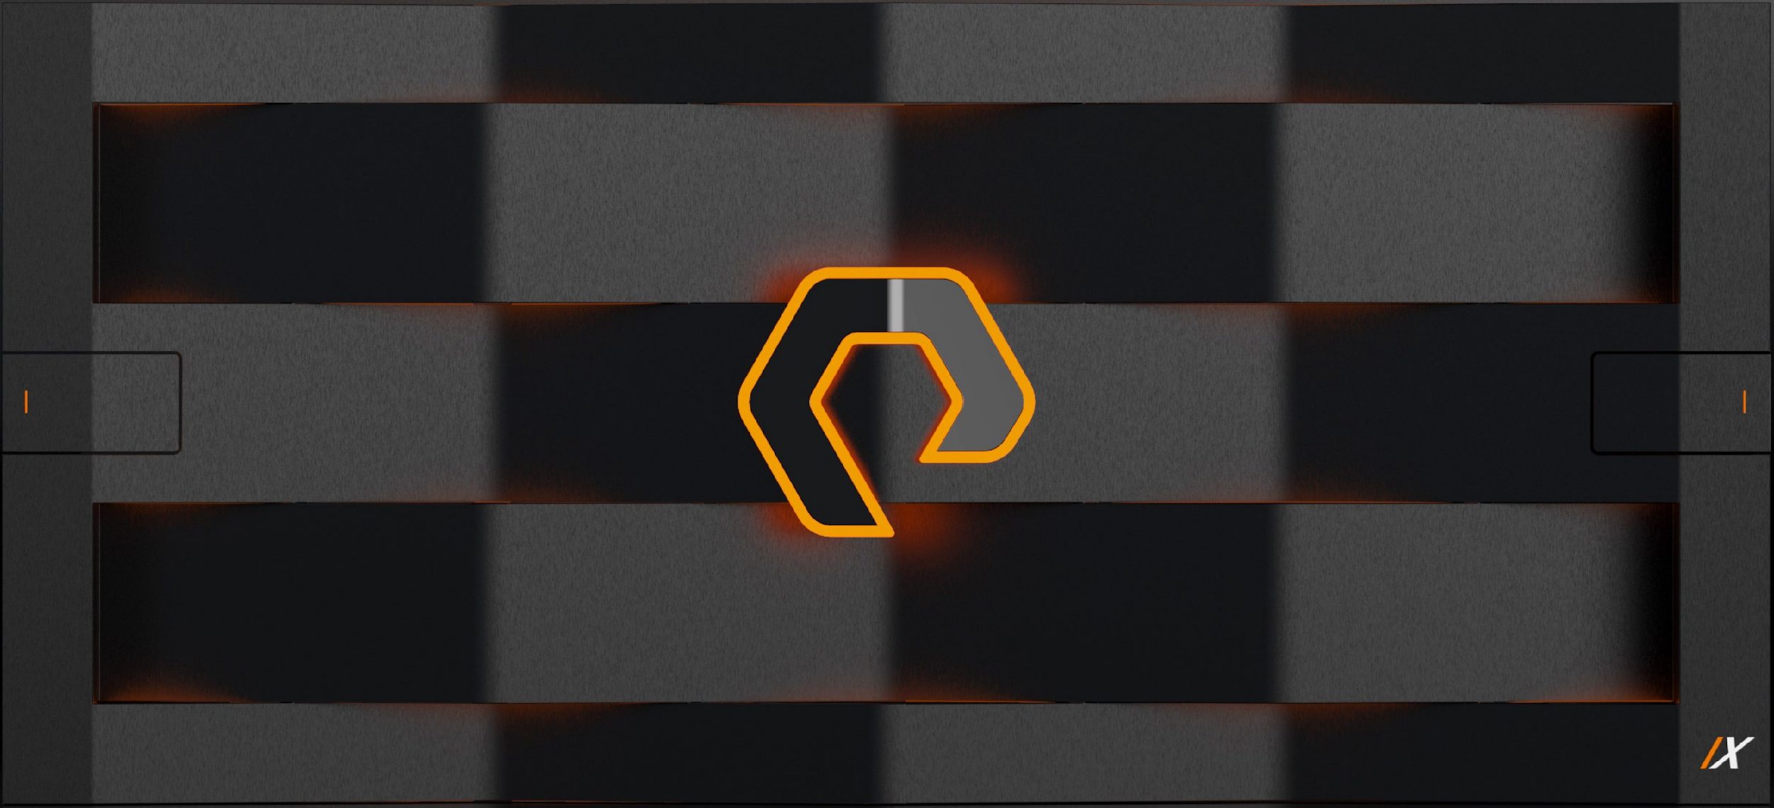
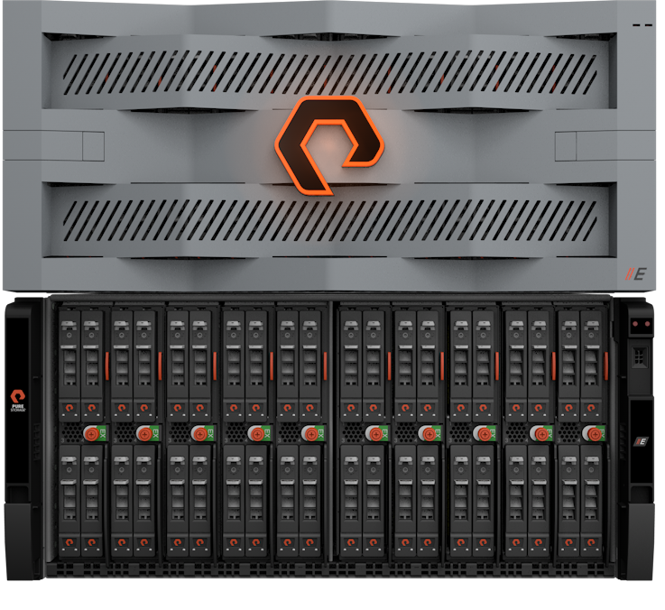
A FlashArray for Every Business Need
From demanding databases to virtualized workloads to large-scale data repositories
As low As 250µs Latency
Mission-critical applications
Workload consolidation
Virtualized environments
Up to 36GB/s Throughput
Most-demanding critical applications
Extreme workload consolidation
Large-scale virtualized environments
Up to 9PB effective capacity
Business-critical workloads
Disaster recovery & data protection
Test/dev environments
FlashBlade
Pure
Family
Scales from 1 to 4PB
Unified file and block data
Large-scale data repositories
Data protection snapshots
Log/cold data archives
Scales from 4PB to 10+PB
Unified file and object data
Largest-scale data repositories
Video content libraries
Healthcare imagery

Slide 6
The First Truly Unified Block and File Platform
A non-layered architecture to bring the benefits of FlashArray™ to block and file
Native Unified
Fully utilized arrays.
Eliminate block and file silos.
FlashArray
Old Multi-Protocol
Block & File on Same Array
Single management system.
Single robust data protection.
Global Storage Pool
All-Flash
Volume
Volume
Innovative Data Platform
Simplicity and automation.
IT team to focus on innovation.
Pool
Pool
Raid Group
Raid Group
Hard Disk / SSD

Slide 7
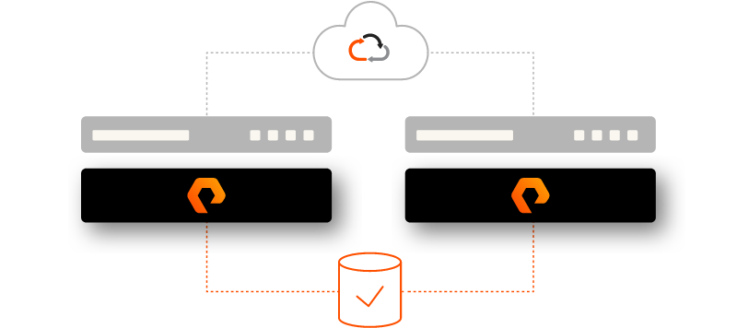
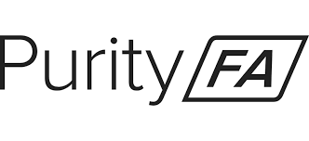
Recover Effortlessly After an Outage or Disaster
Business continuity and disaster recovery options included with every array purchase
ActiveCluster for Business Continuity
Synchronous replication and symmetric active-active design
Zero RPO/RTO automatic failovers without user intervention
ActiveDR for Disaster Recovery
Replicates across any geographic distance with latency between arrays not affecting application performance
Respond to outages and testing with a single click
Pure Snapshots for Asynchronous Replication
Faster and lower bandwidth sync with industry-leading compression, pattern removal, and deduplication
Snapshots are space efficient, immutable, and portable.

Slide 8
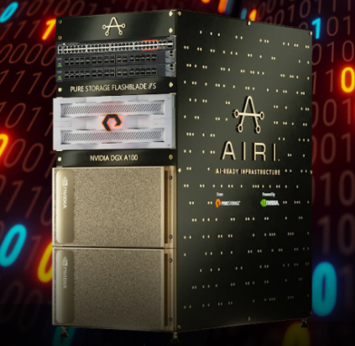
AIRI – AI-Ready Infrastructure
- Pure Storage FlashBlade//S
- first complete AI-ready architecture
- latest NVIDIA DGX Systems – Enterprise AI
- complete HW & SW solution
- essential foundation for AI development optimized for
enterprise
- simplify AI infrastructure
- maximize efficiency and productivity
- get better economics for all of your data

Slide 9
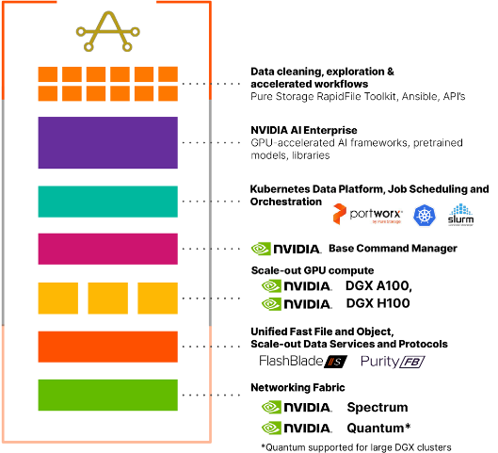
AIRI Technology Stack
- AIRI is optimized out-of-the-box and can
seamlessly scale storage and AI compute
- NVIDIA Base Command software and NVIDIA
AI Enterprise SW + Purity//FB Operating ENV
- increased data processing speeds by 2x and
expanded GPU usage from 30 to 80%

Slide 10
What is AIOps?
- application of machine learning to big data analytics for the automation and management of IT operations
- AIOps – fusion of AI with IT operations
- usage of advanced algorithms to analyze and interpret vast amounts of data
- continuously learning from hystorical data, adapting and evolving to optimize IT operations
- advantages:
Lower operational costs
Proactive and predictive management
Faster mean time to resolution MTTR
Adaptability to complexity

Slide 11
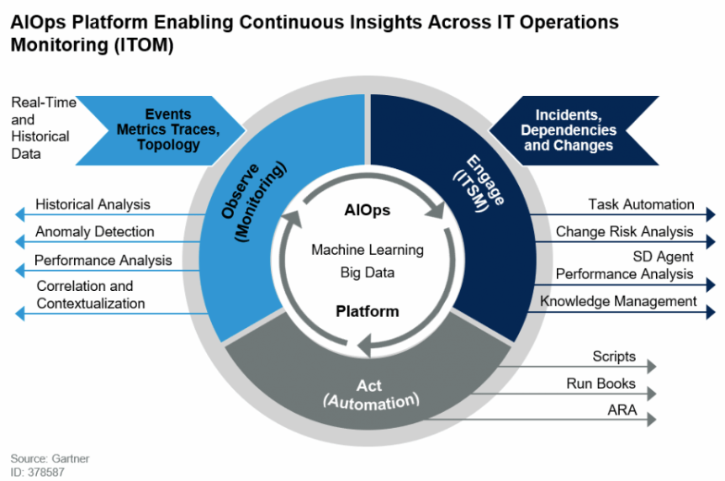
Pure1 AIOps

Slide 12
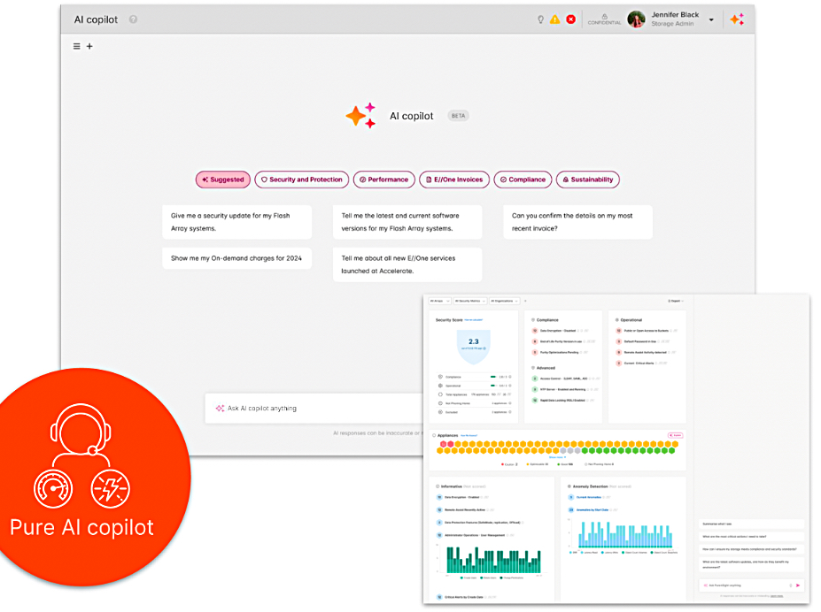
AI Copilot

Slide 13
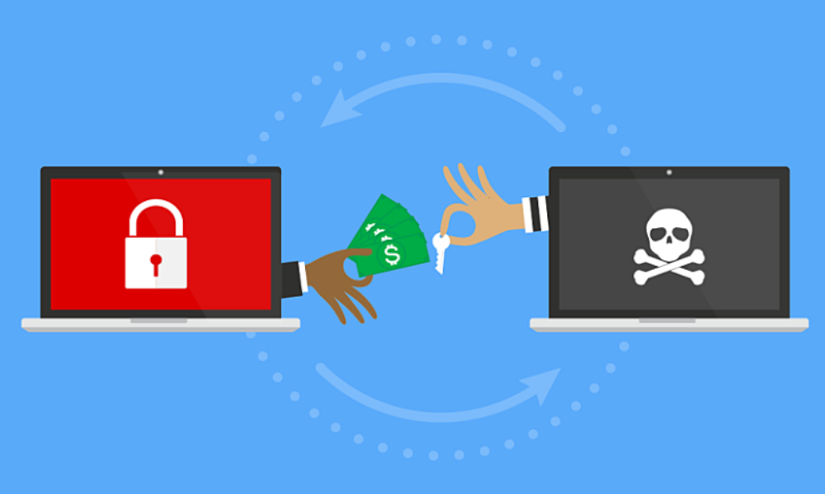
Ransomware mitigation
- in 2022 – 500M attacks, one every 11 sec
- ransomware extortion groups
- increased sophistication of attacks
- AI-developed malware code, chatbots
- the key motivation is financial – topping an average of $740.000 in 2023
- cyber insurance cannot cope anymore with the ransom cost
- small companies don’t have enough budget and are an easy target for attacks

Slide 14
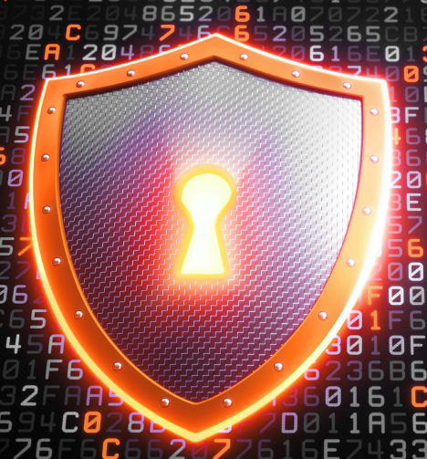
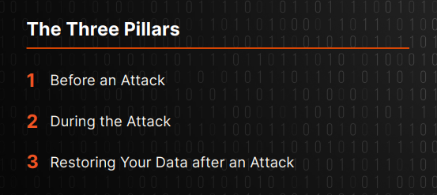
The three pillars of ransomware protection

Slide 15
Before an attack
1 – gain visibility
2 – get control
3 – reduce the surface area of your environment
4 – increase the cost of an attack
5 – build a tiered resiliency architecture
6 – create a response policy
7 – provide proper training
8 – build a comprehensive business continuity and disaster recovery plan

Slide 17
During the attack
1 – identify the attack
2 – execute your plan
3 – prepare for investigations
4 – should you pay the ransom?
5 – what happens if you don’t have a
security plan

Slide 18
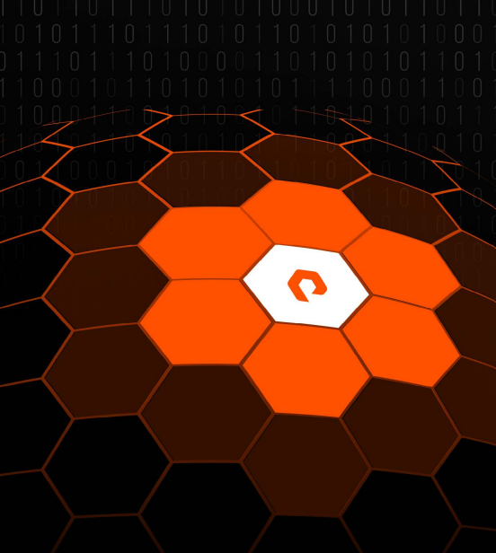
Restoring your data after an attack
1 – clean up your system
2 – rapid restore
3 – adapt, recover and respond

Slide 19
Be Prepared for Ransomware Before an Attack
Security best practices come pre-configured with your storage
Auto-on SafeMode for Ransomware
Restore business services quickly without paying the ransom!
Immutable, space efficient snapshots cannot be destroyed
Recovery data protected from attackers with admin privileges
New volumes protected by default with snapshot schedule
Always-on Security
All data at rest is encrypted with AES-256
Third-party live authentication eliminates risks associated with user intervention and key management

