Slide 1
HPE - building blocks for modern IT
NETWORKING
AI
CLOUD

Slide 2
HPE - building blocks for modern IT
NETWORKING
AI
CLOUD

Slide 3
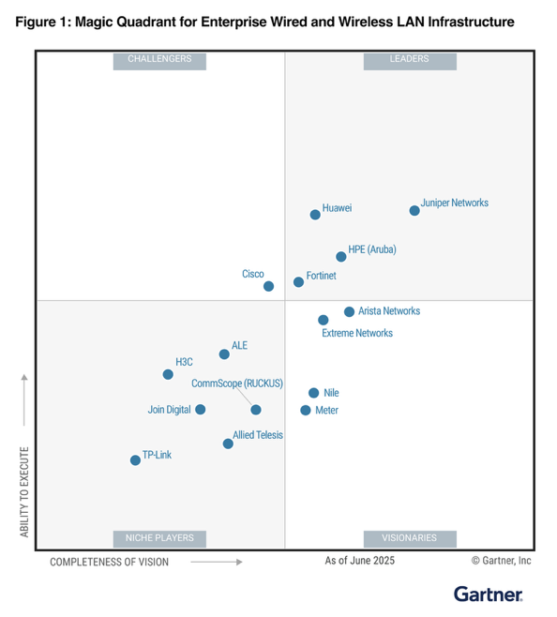
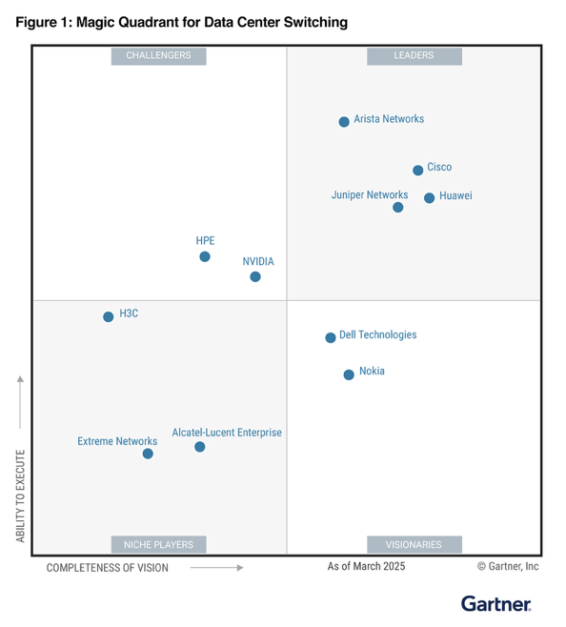
Recognized as a leader
A LEADER Wired/Wireless: Furthest in Vision, Highest in Execution
#1 in all critical capability use cases
A LEADER Data Center Networking #1 in Enterprise Build Out use case
Gartner, Magic Quadrant for Enterprise Wired and Wireless LAN Infrastructure, Mike Leibovitz, Christian Canales, Nauman Raja, Tim Zimmerman, 25 June 2025.​
Gartner, Magic Quadrant for Data Center Switching, Andrew Lerner, Simon Richard, Nauman Raja, Jorge Aragon, Jonathan Forest, 31 March 2025​
Gartner does not endorse any vendor, product or service depicted in its research publications, and does not advise technology users to select only those vendors with the highest ratings or other designation. Gartner research publications consist of the opinions of Gartner’s research organization and should not be construed as statements of fact. Gartner disclaims all warranties, expressed or implied, with respect to this research, including any warranties of merchantability or fitness for a particular purpose.​
GARTNER is a registered trademark and service mark of Gartner, Inc. and/or its affiliates in the U.S. and internationally, and MAGIC QUADRANT is a registered trademark of Gartner, Inc. and/or its affiliates and are used herein with permission. All rights reserved.​
This graphic was published by Gartner, Inc. as part of a larger research document and should be evaluated in the context of the entire document. The Gartner document is available upon request from Juniper Networks.​
​
Notes:
People are definitely taking notice of this innovation.
Look at the Gartner Magic Quadrant for wired and wireless access, for example, HPE leads in both ability to execute and vision (and has for several years)
And when it comes to data centers networking…. Gartner brought the MQ back after many years given the new rise in Ai data centers, and guess what?!? We are a leader there too. In fact, in the accompanying critical capabilities report we are #1 in Enterprise Build Out #2 in Ai Ethernet fabric use cases.
In my opinion, there is no better 3rd party validation of HPE’s vision and ability to execute.

Slide 4
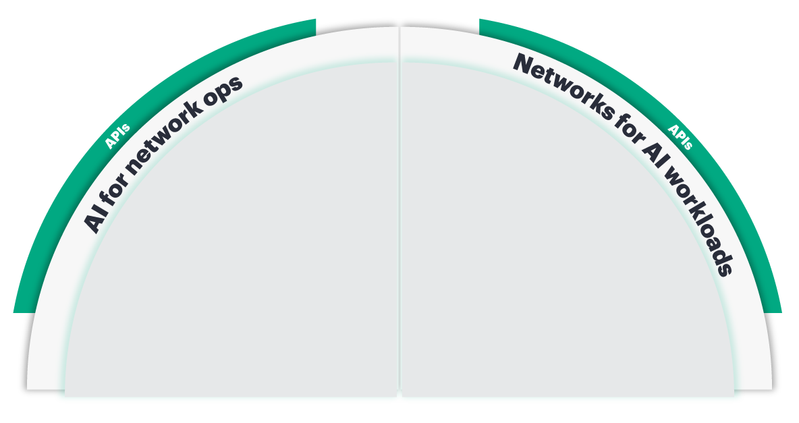






The secure AI-native network
Wired switching
AI fabric
Wireless LAN
Operations/Optimization
Data center networking
Data center interconnect
SD-WAN/SASE/WAN routing
WAN routing
Security (SSE, NAC, NGFW)
Mesh firewall
HPE Aruba Networking
HPE Juniper Networking
AIOps + Cloud + Central Operations
AIOps: Right data and results
Comprehensive portfolio
Integrated security
APs
Switches
Routers
Firewalls
Notes:
When it comes to AI for networking—making operations smarter and more autonomous – HPE Networking has a comprehensive portfolio that covers end to end wired, wireless, WAN and security needs.
It is, what we call, a “client to cloud” platform, because we provide insight, automation, and assurance every step of a user’s journey.
Similarly, we have a full networking for AI solution that includes the operations, networking infrastructure and security required to support AI training, inference and storage environments.
Our AI data center networking solutions are quick to deploy and easy to manage, with industry leading performance and scale.
In fact, HPE is the markets share leader in 800G, which is critical to these environments!

Slide 5












HPE Networking market recognition
10 to^{of}p 10 20 to^{of}p 20 20 to^{of}p 20 20 to^{of}p 20
GLOBAL UNIVERSITIES
GLOBAL BANKS
SERVICE PROVIDERS
CLOUD PROVIDERS
47,000+ Global Partners | HPE and Juniper Networks both named Leaders in the Gartner® Magic QuadrantTM for Wired and Wireless¹
1. Gartner, Magic Quadrant for Enterprise Wired and Wireless LAN Infrastructure, Mike Leibovitz, Christian Canales, Nauman Raja, Tim Zimmerman, 25 June 2025.

Slide 6
HPE - building blocks for modern IT
NETWORKING
AI
CLOUD

Slide 7








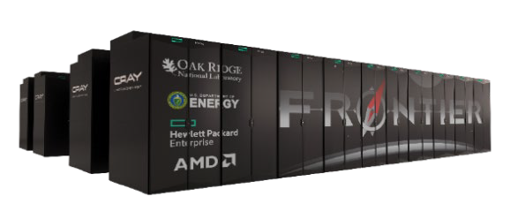

SUPERCOMPUTING LEADERSHIP
Top 3
FASTEST SUPERCOMPUTERS
Six of the top 10 fastest supercomputers in the world¹
Four of the top 10 Green500² most energy efficient systems
Industry-first 100% fanless Direct Liquid Cooling system
TOP500, TOP500 List, June 2025
TOP500, GREEN500 List, June 2025

Slide 8
Why only 1 out of 10 AI pilots make it into production
Data silos limit direct access
Incapable of bringing pilot into production
Enterprises want to start small & then scale up
GenAI environments are too complex for IT
→ HPE Ezmeral
→ Partner Services
→ HPE GreenLake
→ HPE PCAI
Integration with existing systems
Regulations & Compliance
AI Skills, Talent & Experience
Costs & Sustainability
→ HPE PCAI
→ Hybrid Deployment
HPE PCAI
Partner Services
HPE GreenLake

Slide 9
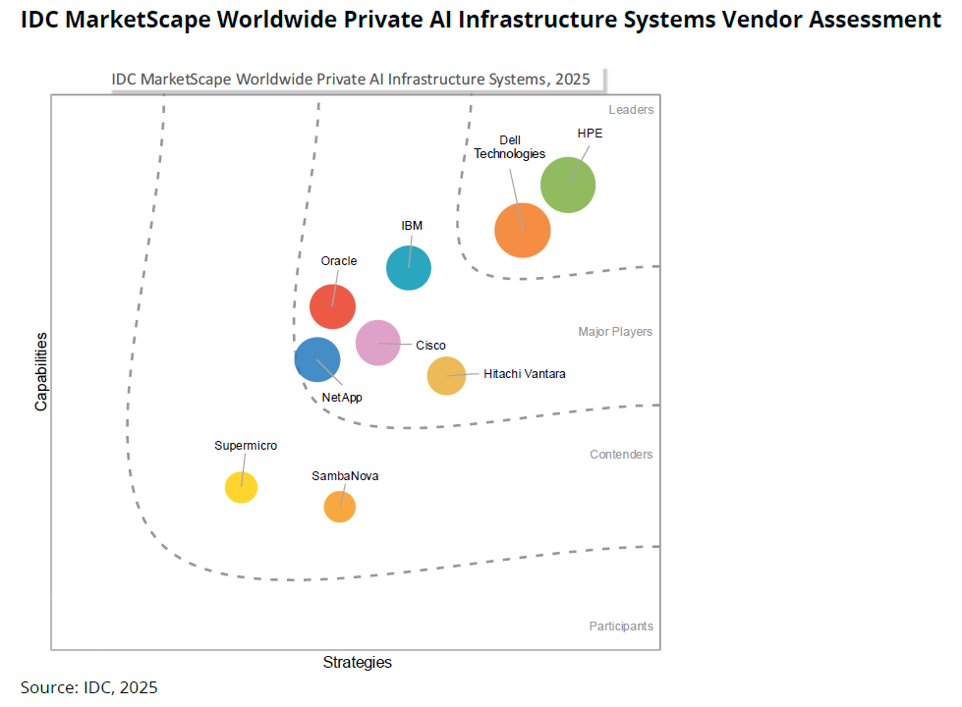


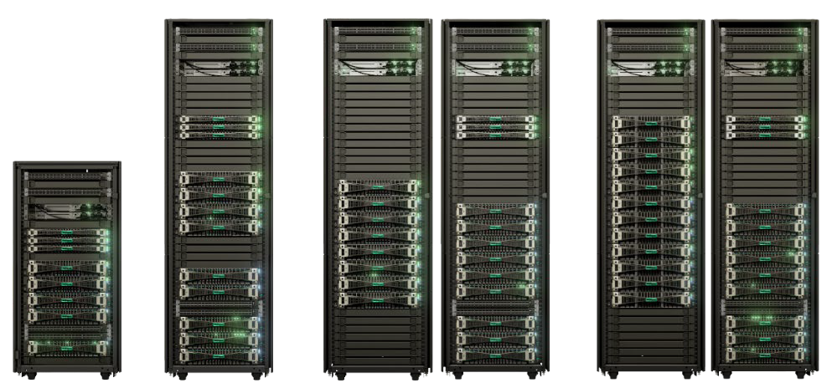


DELIVERING ENTERPRISE AI-AT-SCALE OFFERING
AND EASY-TO-DEPLOY PRIVATE CLOUD AI SOLUTIONS
Leader
PRIVATE AI
INFRASTRUCTURE SYSTEMS¹
Private Cloud AI (PCAI) is a turnkey AI factory ready to run in a few steps
PCAI includes comprehensive software and storage integration
AI factories at scale give enterprises AI infrastructure with greater scale than PCAI

Slide 10
HPE - building blocks for modern IT
NETWORKING
AI
CLOUD

Slide 11
The difficulty behind the Hybrid-Cloud reality
… and its only getting harder
88%
90%
2,4(avg.)
of technology leaders say the complexity of their tech stack has increased in the past 12 months, and 51% say it will continue to increase.*
public cloud providers are nowadays used by enterprises*
of organizations will adopt and operate a hybrid-cloud approach through 2027*
* The state of observability 2024: Overcoming complexity through AI-driven analytics and automation strategies
* Gartner: Gartner IT Infrastructure, Operations & Cloud Strategies Conference 2024
Confidential | Authorized HPE Partner Use Only
11
* Flexers: 2025 State of the Cloud Report

Slide 12
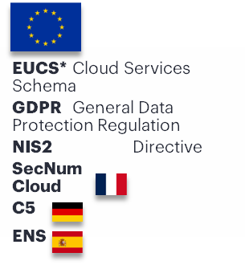



Enterprise challenges
Customers are increasingly required to comply with local regulations regarding data residency, privacy and security.
Data sovereignty and compliance
Organizations seek greater control over their workloads, data and infrastructure to protect against potential data breaches, unauthorized access, or surveillance by foreign governments.
Enhanced security and control
What are viable alternatives to global hyperscalers? Customers aim to avoid dependency on global cloud providers that may not align with local governance or data protection laws.
Alternatives ?

Slide 13

Dimensions of sovereignty
Portability
Business
IT service delivery
Operations
Interoperability
Residency
Data
Jurisdiction
Control
Self- determination
Legal
Assets &
property
Usage
Intellectual property & transparency
Technology
Research & development
* Image source: Adobe Stock

Slide 14


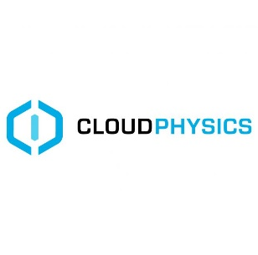



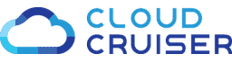

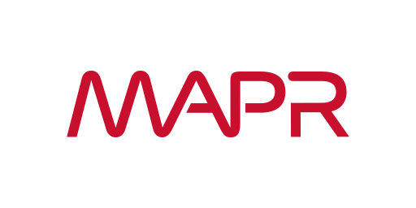
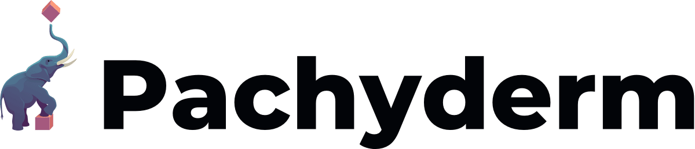
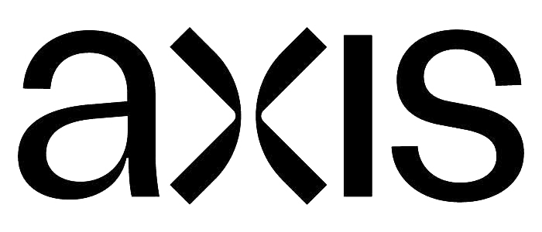


HPE GreenLake evolution to a platform-based hybrid cloud
Platform-based cloud experience
Full stack hybrid cloud
Financial model
As-a-service consumption model
Platform introduction + cloud services
Hybrid Cloud
management & ops
1
2
3
Pay per use
Managed service
Capacity on demand
Workload-optimized private cloud
Cloud platform for unified management
Consumption analytics
On-demand self-service
Multi-vendor, multi-cloud observability & AIOps (HPE OpsRamp)
Hybrid cloud management & orchestration (HPE Morpheus)
Integrated data protection/disaster recovery (HPE Zerto)
Cloud cost optimization
Data platform
Now

Slide 15
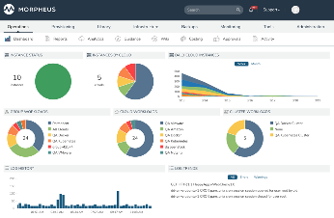
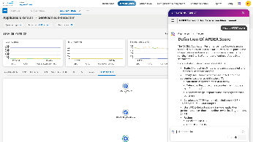
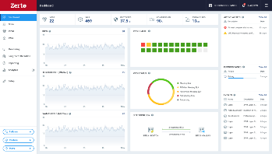
HPE CloudOps Software suite
One solution suite to power your cloud operating model with operational intelligence.
Provision
HPE Morpheus Enterprise Software
Provision and orchestrate application service delivery
Observe every workload, everywhere
Protect data with built-In resilience
Leverage HPE Services or HPE Managed Services for full Day –1 through Day N operations
Observe
HPE OpsRamp Software
Protect
HPE Zerto Software
Across any cloud, any runtime, any workload, anywhere.
15

Slide 16
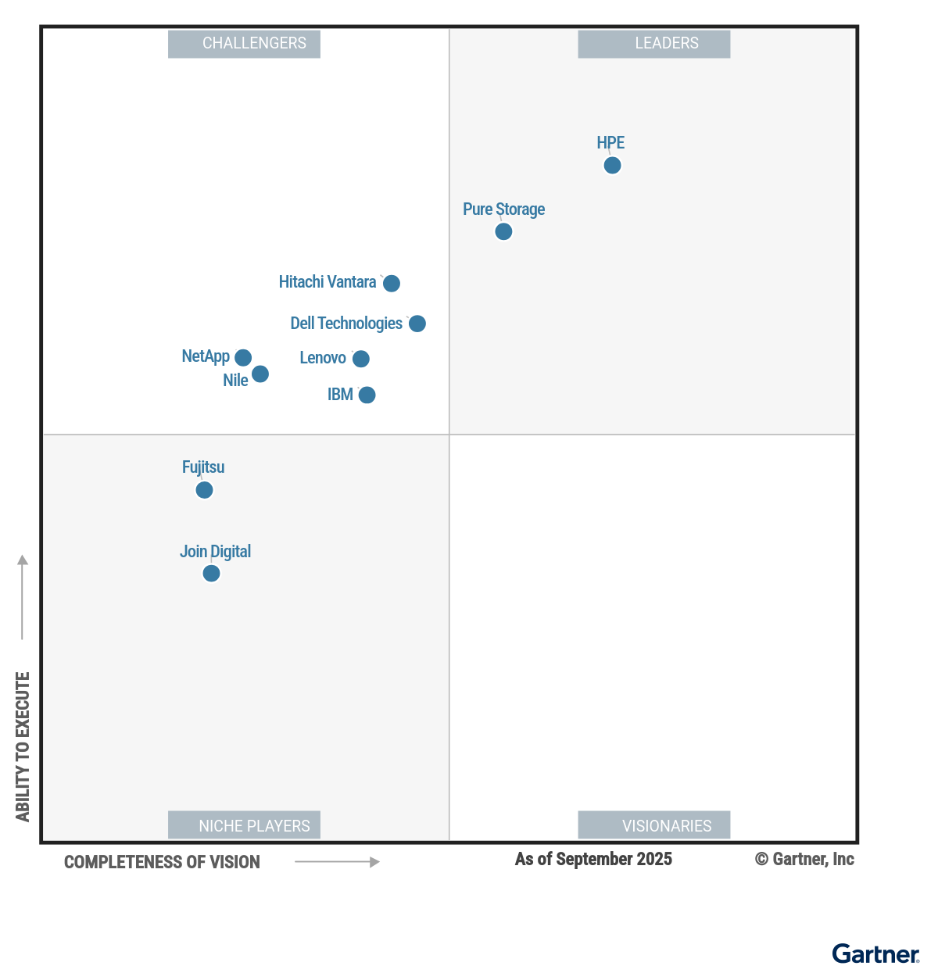
Gartner
Magic Quadrant for Infrastructure Platform Consumption Services

Slide 17







LEVERAGIN G TH E GREAT VM RESET TO OFFER A B ETTER WAY TO VIRTU ALIZE
74%
OF GARTNER PEER INSIGHTS COMMUNITY MEMBERS POLLED ARE ACTIVELY LOOKING AT VMWARE ALTERNATIVES¹
Enhanced private cloud offerings with integrated Morpheus software
Seamless multi-cloud orchestration between public and private clouds
Robust virtualization management
1. Gartner Peer Community Poll: https://www.gartner.com/peer-community/post/rethinking-relationship-vmware-light-changes-broadcom-making

