Slide 1
Intel Server Edge
Presented by:
Michiel van Zanten

Slide 2
Legal Disclaimer
Information in this document is provided in connection with Intel® products. No license, express or implied, by estoppels or otherwise, to any intellectual property rights is granted by this document. Except as provided in Intel's Terms and Conditions of Sale for such products, Intel assumes no liability whatsoever, and Intel disclaims any express or implied warranty, relating to sale and/or use of Intel® products including liability or warranties relating to fitness for a particular purpose, merchantability, or infringement of any patent, copyright or other intellectual property right. Intel products are not intended for use in medical, life saving, or life sustaining applications. Intel may make changes to specifications and product descriptions at any time, without notice.
Designers must not rely on the absence or characteristics of any features or instructions marked "reserved" or "undefined." Intel reserves these for future definition and shall have no responsibility whatsoever for conflicts or incompatibilities arising from future changes to them.
Intel processors and chipsets may contain design defects or errors known as errata which may cause the product to deviate from published specifications. Current characterized errata are available on request.
This document contains information on products in the design phase of development. The information here is subject to change without notice. Do not finalize a design with this information.
Intel®, Intel® Xeon® processors, Intel® Intelligent Power Node Manager, Intel® Data Center Manager (Intel® DCM) are trademarks of Intel Corporation in the U.S. and other countries.
Intel processor numbers are not a measure of performance. Processor numbers differentiate features within each processor family, not across different processor families
All products, computer systems, dates, and figures specified are preliminary based on current expectations, and are subject to change without notice.
Intel Confidential
Copyright © 2012, Intel Corporation
*Other brands and names may be claimed as the property of others.

Slide 3
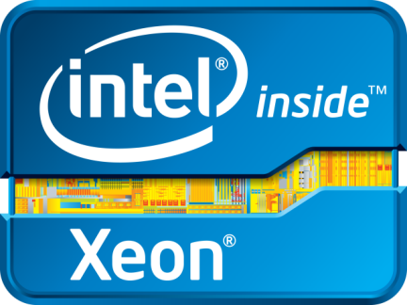
For Your thriving Datacenter
Server
Storage
Network
Notes:
Key Message: The Intel Xeon processor E5-2600/1600 product families is for all data center devices
The challenges to scale and the capabilities we’ve built into the Xeon processor are needed across the entire data center – servers, storage devices and network solutions.
The Intel Xeon processor E5 family is not only the engine of today's leading servers and workstations and are the solution of choice for cutting edge storage solutions and communications infrastructure networks. These standard, modular building blocks allow efficient scaling of compute, storage and network systems to match the capabilities of all aspects of the data center to changes in user needs and offers flexible solutions to be delivered on cost effective industry standard building blocks.
Traditionally storage devices used lower performance, proprietary ASICs, but today the demand for performance has increased to tackle challenges like data de-duplication and improved archiving. This in addition to distributed files systems for cloud based storage and a desire for improved analytics drives a need for more processing power and vendors are increasingly turning to Xeon.
This means that the improvements that Intel offers in our latest processors can benefit every aspect of what your infrastructure does.

Slide 4
Why are we here?
The Data Center is thriving
Enterprise Infrastructure is…..leading your business
Customers are organized and are speaking up.
Discuss Tools to grow, thrive and build your business.
Notes:
Thanks you and it is my pleasure to be here today to present the future of the Enterprise Datacenter. As most of you today are aware the demands for the data centers that you manage continue to evolve. There are consistent demands for more power, more space, more compute, networking and storage requirements. Each of us is dealing with these pressures while building a compatible evolution to maintain legacy application environments.
However, customers (end users and external customers) continue to demand more. More capabilities, more innovation and more security. Intel’s Enterprise Infrastructure promises to deliver these capabilities but standards and interoperability are part of the requirements for success.
As importantly, Enterprise IT leaders are uniting to lead the industry in a direction that drives value not just vendors and innovators but for those customers they serve in a daily capacity.
At Intel, our focus is on delivering technology, usage models and reference architectures that maximize the value of Enterprise Infrastructures deployed using Intel technologies.

Slide 5
For business to thrive….IT Must Scale!
Data Storage
Security
Power Costs
Responsiveness
IT Staff Constraints
Network Bottlenecks
Notes:
Key Message: but to get there IT needs to efficiently scale their resources to overcome challenges
What all six focus areas have in common is that they put more pressure on IT departments and telecommunications service providers to scale. Data centers must be able to support not only thousands of employees but hundreds of thousands or millions of consumers and partners as well. To achieve this IT must overcome multiple constraints including storage, security threats, network bottle necks, plus make sure to fit inside their existing staff, space and fiscal budgets. All of that and IT must ensure that everything works seamlessly together, all the time, everywhere no matter when software was written; no matter what device it runs on to offer a responsive, compelling experience to users of all types.

Slide 6
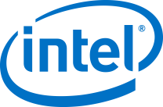
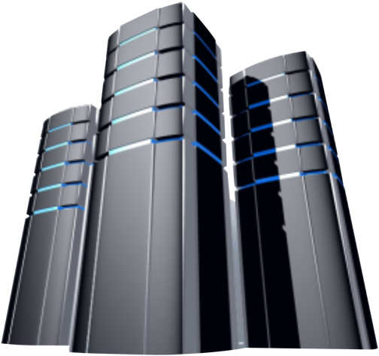
Infrastructure Virtualization Delivers Agility & Cost Savings Intel IT provides a good example
Traditional IT – 2009
Private cloud - 2011
Resource provisioning
90 days
45 minutes
Virtualized Platforms
12%
65%
Asset Utilization
10-20%
>60%
Capacity
Silos
Shared globally
Cost Savings
$9M in savings
But….there are barriers to adoption
Technology Maturity
Risk Aversion
Security
Automation
Storage
Compliance
Quality of Service
Lock In
Notes:
Key message: There are real benefits to be gained from cloud and company adoption is growing
Based on IT surveys, many companies are either adopting or have plans to adopt public clouds, private clouds, or hybrid clouds that combine both public and private and allow for usages, such as cloud bursting where businesses “burst” from their private cloud to consume public cloud resources such as servers and storage when needed. In fact, many companies view hybrid cloud as helping companies truly realize the benefits of cloud via flexibility and efficiency to use whatever form of cloud they choose based on business and IT requirements. You can see the stats here –
Running Intel’s Business in the Enterprise Cloud with Virtualization:
Intel IT has had an aggressive evolution to cloud in the past 2 years via deployment of a private cloud behind the company’s firewall. In 2011, we continued to make rapid progress in transitioning to our enterprise private cloud. We focused on virtualizing more demanding applications, including Internet facing and mission-critical applications with higher security requirements, and migrating them to the private cloud. Sixty-five percent of our Office and Enterprise environment is virtualized, and we are on track to reach our target of 75 percent.
Building on a foundation of virtualized infrastructure, we dramatically decreased the time it takes to acquire new capacity
using self-service provisioning and extensive automation. Self-service is now the norm:
Most new services are now delivered within 45 minutes in our private cloud. In contrast, just two years ago, server provisioning in the traditional IT environment typically took as long as 90 days. And Intel IT has realized $9M in savings in the past 2 years via efficiency & agility gains.
In spite of these gains, Intel is like many enterprises in that there remain many opportunities to more fully take advantage of cloud computing and realize its benefits.

Slide 7
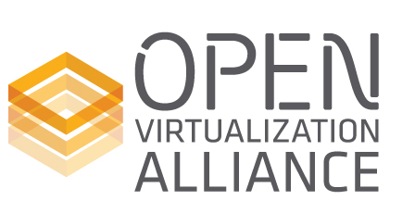
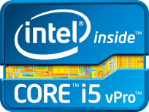
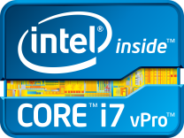
Intel Data Center Infrastructure Guidance
IT Requirements & Open Standards
Intel® Data Center
Guidance
Define and Prioritize IT Requirements & Accelerate Open Industry Standards
Deliver optimized products for more secure, efficient, automated platforms built on a common architecture
Notes:
forTo achieve the Cloud 2015 Vision, Intel is driving 3 strategies focused on deep engagements with IT and service providers, delivering products that align to user requirements and proven solutions via Intel Cloud Builders. Intel is working directly with leaders in global IT for enterprise and services providers to understand their needs and is a non-voting technical advisor to the Open Data Center Alliance (ODCA). The ODCA will define a roadmap of the highest priority usage models for cloud and next generation data centers and lay out the requirements to address with multi-vendor, interoperable solutions that embrace standards. Intel responds to these usage models and others that we identify through our end user engagements to deliver products and technologies that meet the requirements of the usage models. Our innovation will span our silicon, technologies and firmware for server, storage and networking and extend to the client devices for end to end solutions. Technology examples include Intel Virtualization Technology and Intel Trusted Execution Technology that are perfectly suited for and enabling today’s cloud computing.
And just as important, we have collaborated with ecosystem leaders to bring solutions to market and define best practices for making these usage models deployable today and optimized for Intel Architecture. These tools and best practices from a range of industry leading systems and solutions providers that have been brought together via the Intel® Cloud Builders program.
I’ll now talk a little more about each of these 3 areas and give examples.

Slide 8
Dynamic Infrastructure of Servers, Storage, Networking
Challenge:
Need scalable, efficient performance for unpredictable demand
NETWORK Unified Networking
Solution:
Intel® Xeon® processor E5-based servers up to 80% performance boost with hardware-enhanced security
STORAGE Open Platforms
SERVERS Flexible Workloads
Virtualized Infrastructure
Challenge:
Network becomes next bottleneck in virtualized environments
Challenge:
Cost effective storage to handle >50% CAGR in unstructured data
Solution:
Intelligent scale-out storage built with Intel Xeon processor E5-based storage
Solution:
Intel 1/10/40 GbE for proven performance and flexibility for virtualized environments
Notes:
Storyline: To move towards a more highly-virtualized environment and start delivering cloud services, it starts with ensuring you are proactively refreshing your infrastructure with the latest server, storage and networking technologies that offer greater performance, efficiency, and features like virtualization and security.
Speaker notes:
The dynamic DC provides maximum flexibility with powerful compute, network and storage resources.
But things continue to change and with flat IT budgets it is hard to meet the ever increasing demands for more capacity and faster performance while keeping the latency and cost low.
The next generation enterprise data center storage needs a new dynamically balanced infrastructure that delivers energy efficient performance, scalability and advanced storage technologies to address the new bottlenecks.
In each of these areas Intel is delivering critical building blocks. For applications, the Intel Xeon E5-based platform has enhanced virtualization capabilities of the processor with Extended Page Tables, along with enhanced IO virtualization capabilities which allow the use of native drivers by directly assigning network resources to each virtual machine (VT-d and VT-c).
Our 10Gb Ethernet solution leads in virtualization on the network, and we are leading the next phase toward unifying the data center storage and network fabrics with support for both Fiber Channel or iSCSI technologies over Ethernet.
The compute power of Intel Xeon is enabling storage solutions to deliver optimization & workloads where the data resides – breaking through key bottleneck hold outs in the data center.
Moving into the future - Intel believes the cloud of 2015 will look dramatically different from today’s computing infrastructure. Compute power, open platforms and common fabrics are a requirement for your next generation usage models and provide an excellent foundation for Enterprise Cloud computing.

Slide 9
Evolving Platform Capabilities
2012
2013
2014
Server
Performance & efficiency optimized
Increasing application performance , reliability, scale, serviceability
Storage
Scalable converged storage servers+ storage apps
SSD and NVM for low latency/high bandwidth
Enhanced distributed storage & file systems, erasure code, analytics
Add’l core data protection
NVM acceleration
Data mgmt optimizations
Network
Programmable network equipment, open interfaces
Unified networking
Programmable control plane & 10/40G switch
Management APIs
10/40/100G platform with CPU based network apps
Converged virtual appliances
Security
Automated controls, data protection, multi- tenant datacenter
Hardware-based data and multi-tenant workload integrity
Dynamic integrity assurance and recovery
Orchestration
Automated density/ efficiency
DC efficiency and density tuning via deep power and resource usage instrumentation
Increased intelligence on platform & VM resource usage /optimizations
Notes:
To achieve the Open Platform Architecture Intel is developing platform capabilities across the datacenter for Server, Storage, Network, Security and Orchestration.
Let’s take a moment to discuss the technologies and solutions that Intel is working with the industry to achieve.
Servers: For IT leaders the performance and optimization remain critical to the success of business agility. Compute demand continues to rise and Intel is continuing to accelerate Moore’s Law in our current E5 and E7 Xeon platforms by delivering increasing levels of application performance, new reliability features and continuing to work with our Industry partners to deliver industry scale. As we deliver these new capabilities we continue to develop new form factors and instrumentation that deliver increasing levels of serviceability and control.
Storage: The coming years will marked by the unprecedented growth in data and storage devices. The new emerging architectures for storage are providing IT leaders with the capabilities to deliver new storage tiers capable of providing multiple levels of storage performance. From high performance and lower power SSD technology to next generation low latency Non Volatile Memory architectures capable of transforming the way applications and operating systems are written. It is now time to begin the transition of building test and development environment to take advantage of these technologies to prepare for this explosion of data management and traffic.
Network: The 10Gbe transition is underway. The value of this transition is the ability to unify port management, scale bandwidth and cable reduction. However, as 10GBe port costs are reduced, the next generation of 40Gbe Top of Rack switch solutions are providing a programmable control plan and new management API’s to take advantage of increased bandwidth and optimizations. By the end of 2014 these networking capabilities will become virtualized and scalable to meet the most demanding needs of your data center. Through our investments in Fulcrum, Qlogic and Cray interconnect, Intel is developing the available tools for the industry to meet their most demanding data center requirements for Cloud computing.
Security: Data protection, compliance, and multi-tenant data center present a new level of security concerns for IT leaders to address. Through our investments in Intel TXT and AESNI technologies we are working with industry leaders such as RSA, VMware, Microsoft, Symantec and our newest security acquisition MacAfee to deliver tools and solutions to address your security concerns.
Orchestration: One of the key to scaling your data center infrastructure is automation through the use of orchestration technologies. Today’s Intel Xeon-based platforms provide instrumentation capabilities of managing energy consumption, memory usage, hyper-threading and CPU utilization. Our future platforms begin to increase this intelligence and add additional optimizations for VM resource allocation, automated resource scheduling. This level of orchestration is a requirement to move to a more dynamic Cloud Computing infrastructure.
Let’s spend some time talking how these evolving platform capabilities enable flexibility for Cloud Computing.

Slide 10
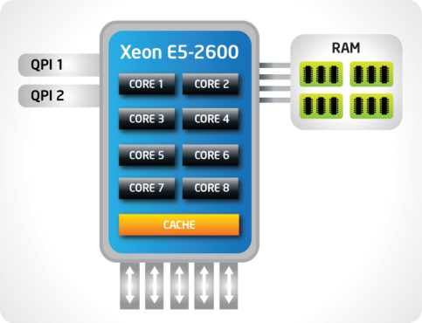
The Heart of a Next-Generation Data Center
Up to 80% performance boost vs.. prior gen¹
Dramatically reduce compute time with Intel® Advanced Vector Extensions
Performance when you need it with Intel® Turbo Boost Technology 2.0
Intel® Integrated I/O with Intel® Data Direct I/O cuts latency² while adding capacity & bandwidth
Up to 4 channels DDR3 1600 MHz memory
Up to 8 cores Up to 20 MB cache
Integrated PCI Express* 3.0
Up to 40 lanes per socket
Software and workloads used in performance tests may have been optimized for performance only on Intel microprocessors. Performance tests, such as SYSmark and MobileMark, are measured using specific computer systems, components, software, operations and functions. Any change to any of those factors may cause the results to vary. You should consult other information and performance tests to assist you in fully evaluating your contemplated purchases, including the performance of that product when combined with other products.
For more information go to intel.com/performance
1 Performance comparison using best submitted/published 2-socket server results on the SPECfp*_rate_base2006 benchmark as of 6 March 2012.
2 Source: Intel internal measurements of average time for an I/O device read to local system memory under idle conditions comparing Intel® Xeon® processor E5-2600 product family (230 ns) vs.. Intel® Xeon® processor 5500 series (340 ns). See notes in backup for configuration details
* Other names and brands may be claimed as the property of others
Notes:
Key points:
Significant performance gains delivered by features such as new Intel® Advanced Vector Extensions and improved Intel® Turbo Boost Technology 2.0
To improve flexibility and operational efficiency significant improvements in I/O with new Intel® Integrated I/O which reduces latency ~30% will adding more lanes and higher bandwidth with support for PCI Express 3.0
Story:
To meet the growing demands of IT such as readiness for cloud computing, the growth in users and the ability to tackle the most complex technical problems, Intel has focused on increasing the capabilities of the processor that lies at the heart of a next generation data center.
The Intel Xeon processor E5-2600 product family is the next generation Xeon processor that replaces Platforms based on the Intel Xeon processor 5600 & 5500 series.
Continuing to build on the success of the Xeon 5600, the E5-2600 product family has increased core count and cache size in addition to supporting more efficient instructions with Intel® Advance Vector Extensions, to deliver up to an average of 80% more performance across a range of workloads.
These processors will offer better than ever performance no matter what your constraint is – floor space, power or budget – and on workloads that range from the most complicated scientific exploration to simple, yet crucial, web serving and infrastructure applications.
In addition to the raw performance gains, we’ve invested in improved I/O with Intel Integrated I/O which reduces latency ~30% will adding more lanes and higher bandwidth with support for PCIe 3.0. This helps to reduce network and storage bottlenecks to unleash the performance capabilities of the latest Xeon processor.
The Intel® Xeon® processor E5-2600 product family – versatile processers at the heart of today’s data center.
Let’s look at just what kind of performance that these products are capable of…
Legal Info:
Configuration for 80% claim:
Source: Performance comparison using best submitted/published 2-socket server results on the SPECfp*_rate_base2006 benchmark as of 6 March 2012. Baseline score of 271 published by Itautec on the Servidor Itautec MX203* and Servidor Itautec MX223* platforms based on the prior generation Intel® Xeon® processor X5690. New score of 492 submitted for publication by Dell on the PowerEdge T620 platform and Fujitsu on the PRIMERGY RX300 S7* platform based on the Intel® Xeon® processor E5-2690. For additional details, please visit www.spec.org. Intel does not control or audit the design or implementation of third party benchmark data or Web sites referenced in this document. Intel encourages all of its customers to visit the referenced Web sites or others where similar performance benchmark data are reported and confirm whether the referenced benchmark data are accurate and reflect performance of systems available for purchase.
Configuration for latency reduction: Source: Intel internal measurements of average time for an I/O device read to local system memory under idle conditions comparing the Intel® Xeon® processor E5-2600 product family (230 ns) vs.. the Intel® Xeon® processor 5500 series (340 ns). Baseline Configuration: Green City system with two Intel® Xeon® processor E5520 (2.26GHz, 4C), 12GB memory @ 1333, C-States Disabled, Turbo Disabled, SMT Disabled. New Configuration: Meridian system with two Intel® Xeon® processor E5-2665 (2.4GHz, 8C), 32GB memory @1600 MHz, C-States Enabled, Turbo Enabled. The measurements were taken with a LeCroy* PCIe* protocol analyzer using Intel internal Rubicon (PCIe* 2.0) and Florin (PCIe* 3.0) test cards running under Windows* 2008 R2 w/SP1.

Slide 11
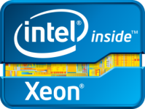
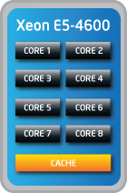
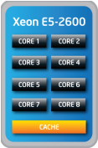
High Density Value in 4-Socket Servers
Up to 83% performance increase vs.. Intel Xeon processor E5-2600 product family¹
Up to 2X the memory (48DIMMs) and 2X the I/O² to increase flexibility and performance
Supports new technologies & features of Intel Xeon processor E5 family
High Density, Cost Effective 4-Socket
Best 2-Socket Efficient Performance
Software and workloads used in performance tests may have been optimized for performance only on Intel microprocessors. Performance tests, such as SYSmark and MobileMark, are measured using specific computer systems, components, software, operations and functions. Any change to any of those factors may cause the results to vary. You should consult other information and performance tests to assist you in fully evaluating your contemplated purchases, including the performance of that product when combined with other products.
1 Source: Based on comparing the best published results on the Intel Xeon processor E5-2600 product family to the E5-4600 product family, both at the 130W TDP processor specification.
2 Intel internal assessment compared to Intel Xeon processor E5-2600 product family
Notes:
Let’s take a look at the Intel Xeon processor E5-4600 product family.
In addition to extending the new features and technologies of the Intel Xeon processor E5 family to four-socket processors, such as Intel Advanced Vector Extensions (Intel AVX) and Intel Integrated I/O, the Intel Xeon processor E5-4600 product family and increases platform performance and flexibility by providing double the memory and I/O compared to the Intel Xeon processor E5-2600 product family. Also, the performance of the Intel Xeon processor E5-4600 product family scales to yield up to 83% more performance than the equivalent Intel Xeon processor E5-2680 at 2.7GHz, 130W. Looking down the stack, the performance scaling gets better, resulting in an approximately 2X gain in the middle of the stack and 3X gain near the bottom of the stack (see the ‘Increase Performance by Moving up from 2S to 4S’ slide).
The Intel Xeon processor E5-4600 product family supports (see the Reference Table for further details):
Up to 4 processors with up to 8 cores per processor
Up to 1.5TB memory (up to 48 DIMMs; up to 32GB capacity each)
Up to 160 lanes PCI Express* 3.0
Up to 2 QPI links per socket (QPI speeds up to 8.0 GT/s)
Up to 83% performance gain claim based on comparing the best published results on the Intel Xeon processor E5-2600 product family to the E5-4600 product family, both at the 130W TDP processor specification.
General Purpose Throughput (based on the SPECint*_rate_base2006 benchmark).
Baseline 2-socket Fujitsu PRIMERGY* server using two Intel® Xeon® processors E5-2680 (8C, 20M Cache, 2.7GHz, 8.0GT/s Intel QPI), 128GB memory, Intel C++ Compiler XE2011 (12.1). Baseline Score: 639. Source: http://www.spec.org/cpu2006/results /res2012q1/cpu2006-20120312-19833.html
New 4-socket populated Dell PowerEdge* R820 server with four Intel® Xeon® processors E5-4650 (8C, 20M Cache, 2.7GHz, 8.0GT/s Intel QPI), 256GB memory, Intel C++ Compiler XE2011 (12.1). Baseline Score: 1170. Source: submitted to SPEC.org.

Slide 12
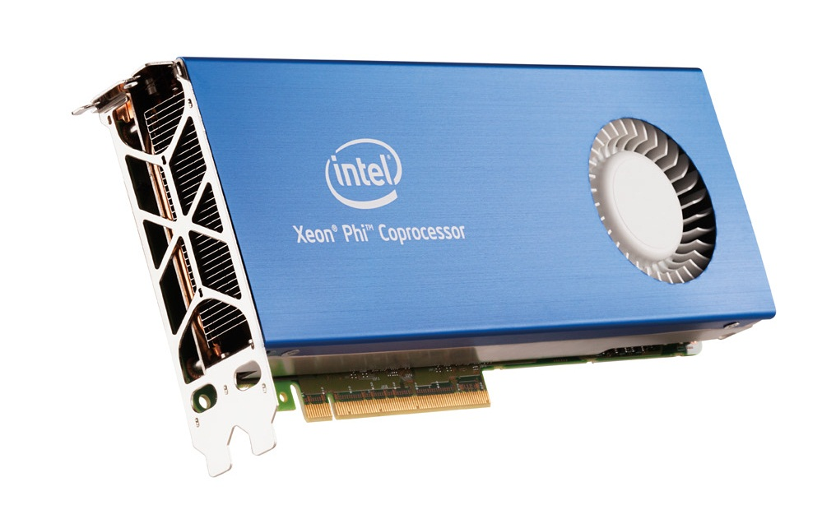
Announcing Breakthrough Performance on Intel® Xeon Phi™ Coprocessor (Codenamed Knights Corner)
>1 TFLOP Linpack (HPL) in a node
118 TFLOPs #150 on the Top500
In Production In 2012, Enabled by 22nm
3-D TriGate Transistors
Source: Intel Discovery Cluster Linpack benchmark run, June 2012
Notes:
Able to run complete applications
8GB+ GDDR5 memory
“The ability to use our preferred, familiar tools (like Intel Fortran/C compiler and Intel Amplifier) made it easier to port our application from Xeon to MIC. It was a big plus not to have to learn a new language like CUDA or OpenCL. We are happy with the results and performance given the stage of MIC at this point, and we are confident that the programming environment and hardware performance will only continue to improve.” --Eric Lequiniou, HPC Director, Altair
“By providing Altair HPC applications on MIC, we are ensuring our users will be able to run highly compute-intensive work on Intel’s most cutting-edge, high-performance architecture, so we are providing the most efficient computing platform possible for end users.” - Eric Lequiniou, HPC Director, Altair
“Running our compute-intensive RADIOSS solver on MIC means we are able to take advantage of the many core architecture to drastically reduce time to solution.” - Eric Lequiniou, HPC Director, Altair
“We are already seeing requests for MIC in customer quotes for our workload manager PBS Professional, and we want to make sure we can support these requests.” – Piush Patel, VP, Global Partner Programs, Altair (NOTE TO INTEL: the quote requests referred to are long lead hardware vendor quotes for 2013 and beyond)

Slide 13
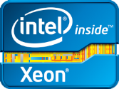
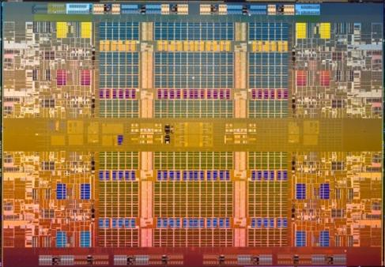
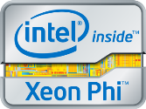
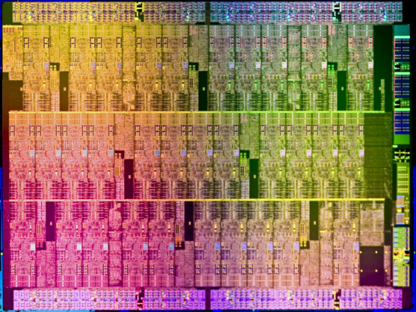
Intel’s Many Core and Multi-core Engines
Intel® Xeon® processor:
Intel’s Foundation of HPC Performance
Suited for full scope of workloads
Industry leading performance/watt for serial & highly parallel workloads.
Ex – SMB>HPC, Virtualization, Database
Intel® Xeon Phi™ coprocessor:
Optimized for highly parallelized compute intensive workloads
Common programming model & S/W tools with Xeon processors, enabling efficient app readiness and performance tuning
Ex – HPC parallel workloads, Oil and Gas, Big Data
Multi-core Intel® Xeon® processor at 2.0-3.5 GHz
Many Core Intel® Xeon® Phi™ coprocessor at 1-1.5 GHz
Die Size not to scale
Notes:
Some recent press articles have inaccurate said that Intel is competing in the Accelerator Market.
Let me show you why that isnt true.

Slide 14
New Technologies Reduce Total Cost of Ownership
Technical Advancements Since 2007:
Intel® Turbo Boost Technology 2.0
Higher frequencies to address workload spikes
Intel® AES-NI Accelerate encryption by up to 10X¹
Intel® Trusted Execution Technology
Defend against attacks during launch
Intel® Advanced Vector Extensions
Increases FLOPS per clock up to 2X²
Intel® Integrated I/O Reduce I/O latency up to 30%³
Intel® Hyperthreading
Double the number of threads per core
Intel® Virtualization Technology
Additional platform capabilities to enhance virtualization performance
Intel® Node Manager 2.0
Power monitoring & limiting to maximize operating efficiency
Intel® Data Center Manager
Data to enable improved dynamic workload placement & migration
Intel® QuickPath Interconnect
High bandwidth processor interconnect
Integrated Power Gates
Enables idle cores to go to near zero power draw
1-3: Please see speaker notes for details.
Notes:
14
14
Key points:
Compared to a system likely up for refresh in 2012 a latest generation processor has significant new technologies
These technologies combine to make systems higher performing, more efficient, secure and easier to manage.
Story:
All of these new technologies combine to offer the microprocessor at the heart of your next generation data center high performance, optimized I/O, flexible power management and robust security to meet the growing demands on your IT infrastructure.
Industry analysts (IDC Server Workloads 2008 MCS) estimate that dual socket servers are refreshed every 3-5 years with an average life of a bit over four years. Compared to quad core systems from that timeframe Intel now offers processors that have improvements across a range of vectors – from improved system bandwidth with Intel Quickpath interconnect, to Intel integrated IO, to adaptive performance with Intel Turbo Boost technology.
These technologies have addressed many of IT’s top concerns including providing tools to reduce the risks of security threats, reduce energy consumption, offer better tools for power management, and of course add in significant increases in performance, I/O throughput, and core/thread count to be able to get more work done, in less space at less cost.
Legal Info:
¹ (AES-NI Performance) Source: testing with Oracle Database Enterprise Edition 11.2.0.2 with Transparent Data Encryption (TDE) AES-256 shows as much as a 10x speedup when inserting one million rows 30 times into an empty table on the Intel® Xeon processor X5680 (3.33 GHz, 36 MB RAM) using Intel IPP routines, compared to the Intel® Xeon® processor X5560 (2.93 GHz, 36 MB RAM) without Intel IPP.
2 (AVX Performance) Source: Performance comparison using Linpack benchmark. Baseline score of 159.4 based on Intel internal measurements as of 4 August 2011 using a Supermicro* X8DTN+ system with two Intel® Xeon® processor X5690, Turbo Enabled or Disabled, EIST Enabled, Hyper-Threading Enabled, 48 GB RAM, Red Hat* Enterprise Linux Server 6.1 beta for x86_6. New score of Y 350.3 based on Intel internal measurements using an Intel® Rose City platform with two Intel® Xeon® processor E5-2690, Turbo Enabled or Disabled, EIST Enabled, Hyper-Threading Enabled, 64 GB RAM, Red Hat* Enterprise Linux Server 6.1 beta for x86_6.
3 (Integrated I/O) Intel measurements of average time for an I/O device read to local system memory under idle conditions. Improvement compares Xeon processor E5-2600 product family vs. Xeon processor 5600 series

Slide 15
Server Platform Guidance
2012
2013
2014
Intel® Xeon® processor E5-2600/4600 and E7
Next-gen Xeon E5, E7
CONTINUE regular refresh of servers >4-years old throughout guidance horizon
Up to 67% TCO reduction due to more consolidation, reduced licensing costs & energy savings¹
CONTINUE migration of mission-critical apps from legacy RISC to IA
12-100% more performance at 55-70% lower system cost²
Platform Guidance & Benefit
PILOT big data in-memory analytics on latest 4-socket servers
Over 37% more in-memory analytics performance than 2010 servers³
DEPLOY
PILOT high-ambient temperature datacenters
4% OpEx savings from cooling for every 1-degree C increase in ambient temperature⁴
DEPLOY
Link to information on TCO reduction claim
Link to information on performance and cost claims (I got these out of the E7 gold pitch)
http://www.intel.com/content/www/us/en/high-performance-computing/high-performance-computing-xeon-e7-analyze-business-as-it-happens-with-sap-hana-software-brief.html?wapkw=sap+hana
http://www.datacenterknowledge.com/archives/2008/10/14/google-raise-your-data-center-temperature
Notes:
Server Refresh:
RISC Migration:
In-Memory Analytics:
High Ambient Ops: Datacenter architects from Intel and industry organizations such as Green Grid, ASHRAE and EU Code of Conduct recommend moving the temperature of a modernized, managed datacenter from the historical target of 21-degrees C into the range of 27-35 degrees C. Just hitting 26-degrees, a 5-degree rise, could represent a 20% reduction in cooling costs. Server designed for HTA are now becoming available from OEMs world wide, including Dell DCS and NEC.

Slide 16
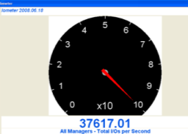
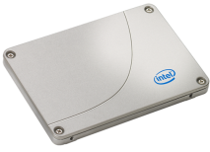
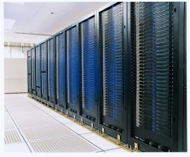
Intel® SSD 710 Series for the Data Center Quality You Can Trust
Better $/GB value over X25-E
Meeting Datacenter Endurance
Up to 1PB
Extreme Performance
Up to 36K IOPs Read
Up to 2.4K IOPs Write
Intel® SSD 710 Series
Capacities:
100GB
200GB
300GB
Features
Power safe write cache
Temp Sensor
¹ Endurance of 200GB with over-provisioning 1.3PB. Endurance of 100GB = 500TB with over-provisioning 900 TB
² Total 4KB random write
³ Soft Start Circuit + Staggered Spin Up
16

Slide 17
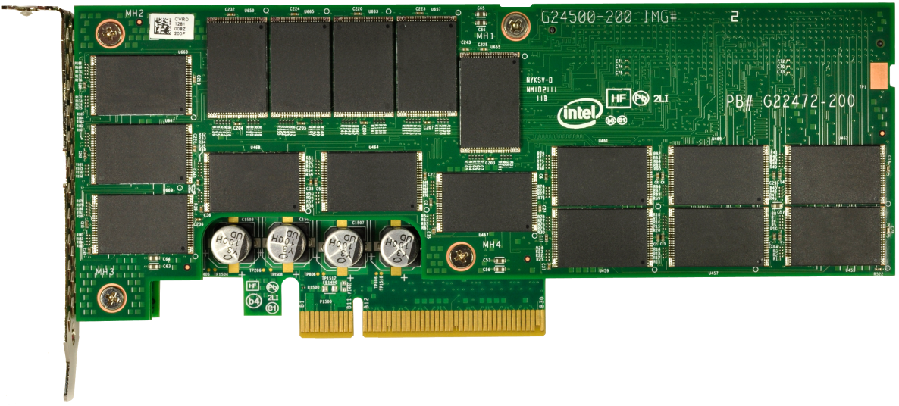
Intel® SSD 910 Series Highlights
Ultimate Performance
Up to 2.0 / 1.0 GB/s Seq. Read/Write
Up to 180/75K RND Read/Write
Latency R/W: 65/65us
High Endurance
25nm HET MLC NAND
10x drive writes / day for 5 years
30x endurance over standard MLC
Ease of Deployment
No HBA HW/SW config
No chassis adaptation
No system tuning
Quality & Reliability
Intel validation, system compatibility, and support
5 year warranty
180K IOPS
4K Random Read
75K IOPS
4KB Random Write
PCIe Card
½ Height ½ Length
Power Safe Write Cache
Intel HET MLC
25nm NAND
PCIe Driver Broad OS Support
Backed by Intel NAND expertise, ^{SSD quality, and manufacturing}

Slide 18
Storage Platform Guidance
2012
2013
2014
ENABLE intelligent IA based storage with storage optimization capabilities to gain business value
Reduce total storage footprint by >50% with de-duplication, compression; regain 40-60% disk space with thin provisioning, storage cost optimizations via tiered storage architecture ¹
DEPLOY SSDs where speed, caching and power are prioritized over capacity
2x lower TCO, 2x less power, 9x less space, Performance (IOPS/$) ²
Platform Guidance & Benefit
PILOT large object storage solutions for Massive Data
Capacity ($/GB)²
DEPLOY open distributed storage solutions for Massive, Fast, Intelligent data
Same level of data durability using fewer disks, delivering lower TCO
DEPLOY
PILOT NVM use models
Non-Volatile Memory
Performance enhancements and application optimization
DEPLOY
Intel IT Datacenter Strategy for Business Transformation (www.intel.com/go/storage)
NSG Claim source
Notes:
Storyline:
Sophisticated capabilities are shifting compute intensive workloads into the performance and capacity storage tiers

Slide 19
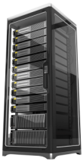
Simplify & Reduce TCO with Intel 10GbE
1. Consolidate¹ multiple connections
2. Unify different traffic types
GbE server connections
10GbE server connections
InfiniBand/ Ethernet
<5% attach
Clustering
network
Local area
network
Ethernet
~100% attach
Up to 45%
Reduction in power per rack
Up to 15%
Reduction in infrastructure costs
Storage
network
Up to 80%
Reduction in cables and switch ports
Up to 2x
Improved bandwidth per server
Fiber channel or iSCSI SAN
<30% attach
Ethernet consolidation source: Intel 10GbE ROI Calculator. This ROI calculator is a cost comparison for a highly virtualized solution, using multiple 1GbE connections versus a dual port 10GbE implementation. http://www.event-management-online.de/LAD/calculator.aspx.
Notes:
Key points:
10GbE can simplify your network infrastructure by reducing power, improving bandwidth, and reducing cabling complexity
You can further simplify your network by unifying different types of traffic onto a single, low cost, high bandwidth interconnect
Story:
Beyond the improvements at the host level to feed data to the processor faster, now may be the time to accelerate your transition to 10GbE and reduce cost and power for your network.
By combining multiple smaller Ethernet ports onto a single high speed 10GbE connection that reduces the number of ports hence the power and cabling costs of all those ports in addition to providing more total bandwidth.
Intel 10GbE NICs are designed to take advantage of the benefits of Intel® Data Direct I/O to maximize the benefit of this feature to achieve that 2.3X improvement.
Now lets extend the discussion talk about how 10GbE can consolidate different traffic types on a single fabric. If you review network deployment in discrete datacenters today, there are three networks deployed that carry different types of network traffic.
First, Data traffic. This is typical email, files etc. The Network carrying such traffic is predominantly Ethernet based. Every server in the data center has Ethernet connectivity to participate in a Local Area Network (LAN).
Second, Storage Traffic. As data stored on Disks became more and more important – IT managers started storing data in a common remote location over highly reliable Storage Targets (disks). Now to access this storage data there was a new types of network deployed call Storage Area Network or SAN. One about 25%-30% of servers in the data center connect to a SAN all the others use local disks. Also, SANs can be either purpose built over a Fiber Channel technology or can be built over an Ethernet networking using iSCSI
Third, Clustering traffic. All the high performance clustering application require data to be moved with very low latency. For such applications special purpose network was build over a technology called InfiniBand. Again, a portion of customers deploy Ethernet technology to carry clustering traffic as well.
If you notice all the three types of networks have Ethernet in common. That essentially begs the question of why can’t we move all the different traffic over a single Ethernet network. Up until now we could do that because of limited bandwidth of GbE network … but with the advent of 10Gbe there is enough bandwidth to have a truly unified and single network. The benefits of such a network will be Simplification, lower TCO due to infrastructure consolidation and high flexibility.

Slide 20
Networking Platform Guidance
2012
2013
2014
DEPLOY 10Gb Ethernet across datacenter servers, as well as storage networks (FCoE, iSCSI)
Greater consolidation; Up to 15% lower infrastructure costs, up to 80% fewer cables/switch ports, up to 45% lower power per rack, and 2X bandwidth per server¹
PILOT unified LAN and Storage networks on unified network infrastructure
Up to 20% lower infrastructure costs with FCoE²
DEPLOY
Platform Guidance & Benefit
PILOT Overlay Networking with VXLAN/NVGRE
Extends L2 frames over L3 networks
Enables seamless migration of workloads between public and private clouds
DEPLOY
PILOT software-defined networks
Remotely accessible control planes using open protocols
DEPLOY
PILOT 40Gb Ethernet server connections
4X greater bandwidth for converged networks³
Link to information on cost, cables, power and bandwidth claims
Link to information on FCoE cost claim
40 Gb Ethernet compared to 10 Gb Ethernet
Notes:
IT networks have reached a juncture where they must transition from static, host-centric, IP-centric infrastructures, to a modern, efficient programmable network fabric that allows enterprises to leverage capacity on-demand. The ability to onboard a virtual machine (VM) to a cloud provider and move workloads between the data center and cloud providers (known as VM mobility), is critical. However, VM mobility places new requirements on data center networks to efficiently support multi-tenant environments.
Virtual LANs (VLANs) are reaching a breaking point when asked to scale beyond a few hundred servers or a thousand separate tenants. Issues including: Layer 2 VLAN size limitations, scalability, overlapping IP addresses, inherent Spanning Tree complexity, geographically dispersed data center requirements, and on-demand capacity expansion, are creating operational burdens on network administrators and leading to a far-from-seamless experience for end users.
Virtual eXtensible Local Area Networks (VXLANs) is an emerging IETF standard and Network Virtualization using Generic Routing Encapsulation (NVGRE) a draft Internet standard are aimed at addressing the challenges of cloud networking. VXLAN provides a robust mechanism to take Layer 2 packets and encapsulate them in a Layer 3 protocol to span local and remote networks in a single virtual network. With VXLAN, IT can improve security, reduce network complexity, and enable virtual machine mobility.
Pilot Overlay Networking to explore how to reduce complexity, improve security and speed VM migrations to make hybrid cloud deployments simple and agile.

Slide 21
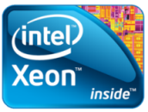
Server Security Technologies Intel® Helps Protect Your Business Refresh your infrastructure with Intel ® Xeon® Processor-based systems
Intel® VT
Isolate
Protect system from tampering and segregate workloads on shared resources
VM1
VM2
VMM
Intel® TXT
Enforce
Control over virtualized environments with better visibility into system integrity
VM2
VM3
VM1
VMM
VMM
Intel® AES-NI
Encrypt
Provide better protection of data in flight, in use and at rest
Leading Use Models
Growing Ecosystem
Notes:
Key Message: The latest Intel server platforms provide new capabilities to raise an enterprise’s security bar with data and platform protections
Security is a growing concern for businesses of all sizes. As customers deploy new technologies, (such as virtualization) explore new use models (such as public or private clouds) and build out datacenter architectures they need to consider the security implications: Some of their key questions are:
- How will my data be protected?
- Am I in compliance with corporate, industry or governmental regulation?
Is there a simpler, more cost-effective or efficient approach that I can take to secure my data and infrastructure?
Intel technology helps with this problem, providing enhancements that better isolate workloads on virtualized and cloud infrastructures, enforce software integrity checks that provide valuable enforcement points for virtual and cloud infrastructures and lower the compute burden of encryption to allow broad use of data protection. All of this with capabilities that are built-in to processor silicon.
Intel VT is well established technology for accelerating virtualized environments. But it also provides a number of attributes that enhance security. It provides hardware that reduces software size, which reduces attack surfaces, that is good. But it also provides hardware capabilities such as memory and IO isolation that helps address concerns of security on shared resources.
Intel TXT is a multi-faceted protection technology, but the main protection is around measuring the launch environment, whether it’s the virtualization hypervisor or a bare-metal operating system. This is a Launch-time complement to runtime protections such as anti-virus or intrusion detection systems and helps reduce software attacks to ensure the foundation of system has not been tampered with.
Intel AES-NI speeds up encryption algorithms to lower the “security tax”. This allows IT departments to deploy encryption of data not feasible before due to performance concerns. This could be the use of AES-NI optimized SSL and IPsec for protecting data in transit. database encryption to protect data in process. Or full-disk encryption to protect data at rest.
With these Intel technologies, our leading use models and our relationships with McAfee and the broader security and software ecosystem and key standards groups, businesses that build on the latest Intel server platforms gain the ability to better and more efficiently protect their systems and data.

Slide 22
Security Guidance
2012
2013
2014
DEPLOY hardware-accelerated encryption wherever data is stored or transmitted
Reduces “performance penalty” of encryption by speeding operations 8-10X¹
DEPLOY policy-based protection & identity management as part of consumerization strategy
Secure, end-to-end data & comprehensive policies for ID management, data, email and web²
Platform Guidance & Benefit
PILOT secure boot of virtualized servers with HW-based root of trust and associated mgmt tools (trusted compute pools)³
Foundation for centralized, automated policy enforcement & reporting rooted in measured platform integrity
DEPLOY
www.oracle.com/goto/data-encryption
http://www.intelcloudsso.com/
http://www.intel.com/content/www/us/en/cloud-computing/cloud-builders-hytrust-cloud-computing-security-video.html

Slide 23
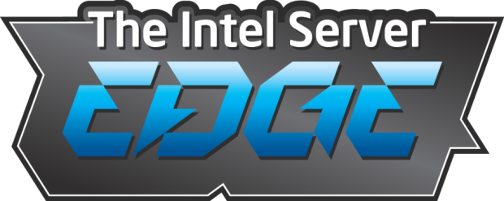
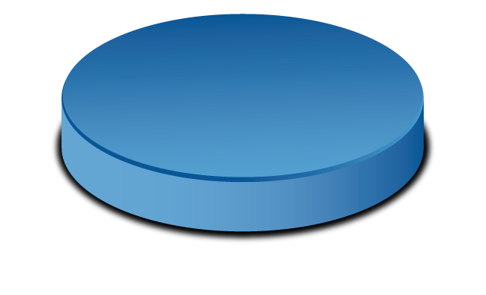
QUALITY
INGENUITY
COMMITMENT
http://www.intelserveredge.com

Slide 24
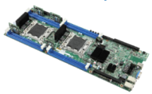
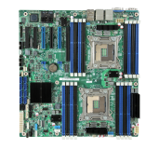
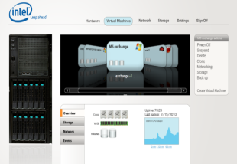
The Intel Server Edge Enterprise Platforms & Services Division (EPSD)
Exceptional Investment & Roadmap
Innovative Software & Services
Unmatched Quality & Support
3X
3X more boards for HPC, SMB & Embedded Segments
Integrated Virtualization, Biz Continuity & Extended Warranty
Your Trusted Partner
Unmatched customer experience

Slide 25
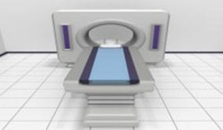
The Intel Server Edge Enterprise Platforms & Services Division (EPSD)
SMB / Infrastructure
Embedded / Appliance
High Density / Cloud
Rack & Pedestal 1S
Rack & Pedestal 2S
Rack 4S
Intel Modular Server
New Chassis Family
Management Tools
Long Life Roadmap
Extended Warranty
Short Depth Chassis
Front I/O Chassis
Varied board Form Factors
Optimised ½ width boards
maximum performance
maximum memory capacity
lowest $/node
Infiniband* & 10 GigE
Highly Redundant Chassis

Slide 26
Intel® Modular Server Virtualization Manager “Bear River”
Integrated virtualization management with “Drag and Drop” Live Migration
High availability coming in Q4’12
Enterprise Class Features
Simple to Manage
“Single pane of glass” GUI
Manage anytime from anywhere
One call for HW and virtualization support
Lower Cost
Lower introductory costs than comparable solutions¹
Scalable to SIX modules at no extra cost
Virtualization has never been so easy!
Claim is based on estimated channel pricing for Intel Modular Server Virtualization Manager with Live Migration, compared to VMware Essentials Plus* kit
Notes:
IMS Virtualization Manager provides game-changing system management capabilities in a single easy to use interface without the cost and complexity that is common with virtualization solutions today. This gives your customer a competitive advantage over the “other guys” who are still doing it the hard way.
By consolidating the Virtualization, Backup and Disaster Recovery user interfaces into a single, easy to use console, we have made server and SAN management simple. At launch Bear River will provide “push button” virtualization, virtual machine management and live migration. Continuous Data Protection with predictive failure analysis and pro-active backups will be available separately.
Features:
Simplified set up via the Intel Modular Server GUI – “Push Button Virtualization”
Single pane of glass management for compute, storage, networking, power, cooling, and VM management
Easily move VMs from module to module with drag-and-drop Live Migration
Update entire system in one click
Complete map from physical HDDs to virtual HDDs to virtual machines
Unified VM event and audit log

Slide 27
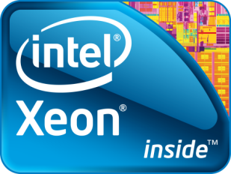
Intel® Node Manager
Power Management Service embedded into the Intel Chipset
Monitoring: Server, CPU and memory power and chassis Inlet Temperature
Power Limiting:
Dynamic adjustment of system, CPU & memory power
Dynamic core allocation
Power limiting during OS Failure
< 1 sec response time
Power optimized boot
Power supply RAS functionality to ride through power & thermal events
Intel MSM
Console
Intel DCM SDK
WSDL API
NM API Coding
OR
OR
Power, Thermal
Policy
NM
BMC
Supported Intel Chipset
PSU
*Note: Requires PMBus PSU for all functionality.
CRPS required for power throttling of PSU.
Please see user guides to ensure support.
Second Generation Power Reporting and Capping Technology from Intel®

Slide 28
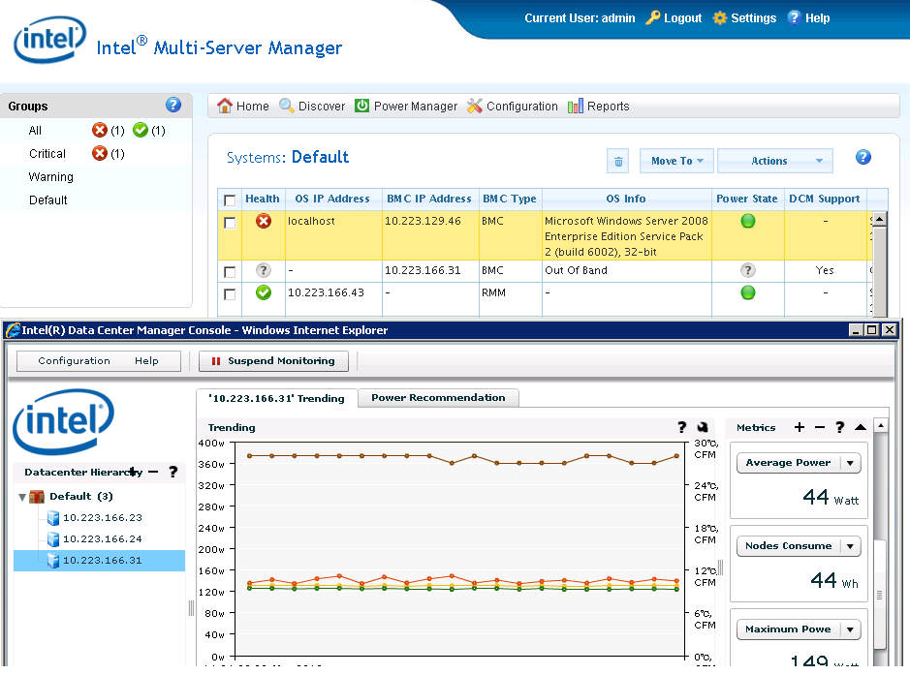
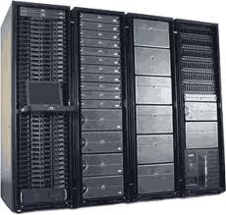
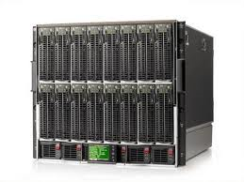
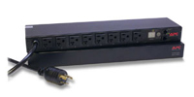
Available Solutions for Power Management
Intel® Multi-Server Manager w/ Power Management (Available Q3 2012)
Power Management Feature powered by Intel® DCM
Standalone console for managing up to 200 servers
Manage server health, asset inventory, reporting and power actions.
Includes full power management of Node Manager compatible systems.
Intel® Data Center Manager (DCM)
Real-time monitoring of actual power and inlet temp.
Trending power and thermal data
Set maximum power consumption limits at DC, rack or server (power capping)
Benefits of both solutions
Monitor and measure DC power consumption
Increased rack density using dynamic power management
Your Management Console
DCM SDK (Web Service API)
MONITOR
CONTROL
TREND
SCALABILITY
STANDARDS
Rack Servers
Blade Servers
PDU & UPS

Slide 29
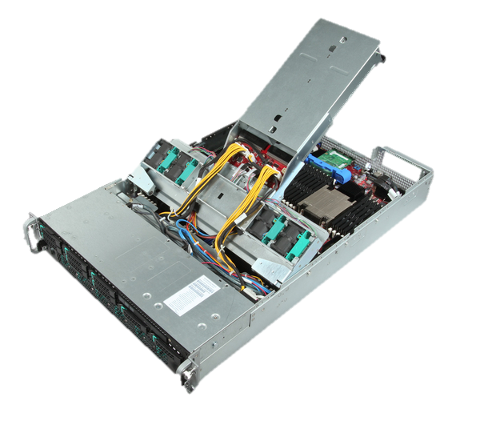
Intel® Server System R2000LH2
Best in class “Serviceability” features
Configuration Options
Same chassis supports 2 different boards options
S4600LH2 (Lizard Head Pass LOM: Dual 1GbE)
S4600LT2 (Lizard Head Pass LOM: Dual 10GbE)
Flexible & Efficient Power Supplies
Common Form Factor, Hot-Pluggable
1600W AC Redundant 80+ Platinum
1600W DC Redundant 80+ Gold
I/O Support
6 x16 PCI Gen3
2 x8 I/O Modules
RMM4 Mgmt NIC
Maximum memory 48 LR/U/R-DIMMs at up to 1600MT/s . 1.5TB supported
Quad Intel® Xeon® processor E5-4600
130W
Hard Drives
Up to 4x3.5” Hot Swap HDD
Up to 8x2.5” Hot Swap HDD
Notes:
Intel® Server System R2000LH2
Intel® Server System R2000LT2
“Swan Peak”
Chassis Features
2U Chassis
Power Supply
2 x 1200W AC Common Redundant Power Supply
2 x 1600W AC Common Redundant Power Supply
AC Power Supplies are Platinum Efficiency w/ PM BUS
2 x 1600W DC Common Redundant Power Supply
DC Power Supply is Gold efficiency
Flexible Hard Drives Configurations
Front Access
Up to 8x2.5” Hot Swap Hard Drives
Up to 4x3.5” Hot Swap Hard Drives
I/O Expansion Capability
4 FHFL PCI cards or 2 GPU Cards or 2 FHFL, 2 FHHL + 2 half length internal cards
2 I/O modules
System Cooling
(11) 40mm x 40mm x 56mm hot swap fans (7 external & 4 internal)
System level mgmt
Intelligent system level mgmt to monitor overall system healthy status
Support Intel® Intelligent Power Node Manager
Front Panel

