Slide 1
Unified storage solutions, 2012 line-up overview
Eduards Putra
Business Development Manager EMEA

Slide 2

Quick Facts of PROMISE
23 Years of Tested RAID technology
Delivering High Performing, Economically Sensible Solutions through OEMs, Integrators & VARs
Gartner Ranked #4 in WW : Block Entry-Level Modular Disk Array (Gartner, 2011, April)
Gartner Ranked #4 in WW HBA Market (Gartner, 2009/July)
Unparalleled Customer Support
  24x7 Access to Customer Support
Rich, Diverse Product Portfolio
Trusted Partner: SONY, Apple, Intel, NEC, AMD
Shipped over 1.6 million products with PROMISE RAID
Notes:
PROMISE is well positioned to succeed in the current tough economic environment through its global presence, competitive product pricing, and product portfolio suitable for segments that have good growth potential

Slide 3
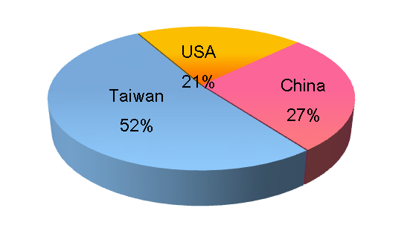
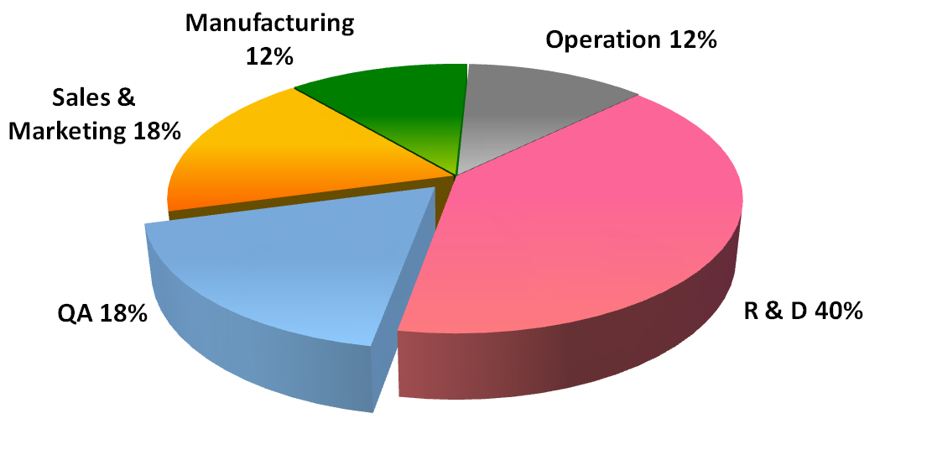
Our People
R&D 40%
R&D + QA ~60%
450+ total employees
100+ patents (avg. 1 patent/4 employees)
180+ experienced R&D professionals
Total R&D storage experience avg. 15 years

Slide 4
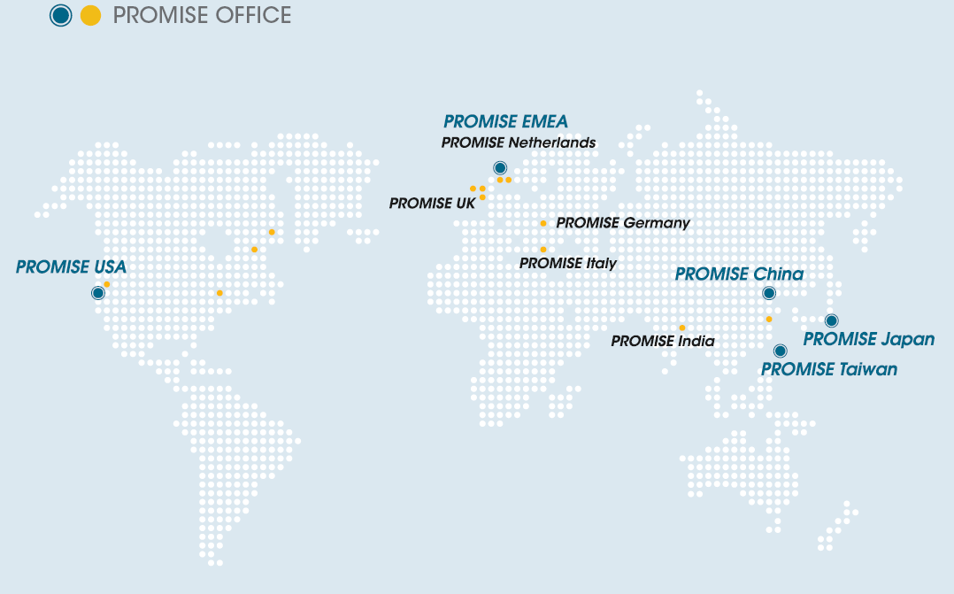



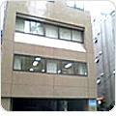

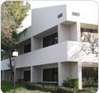
PROMISE Worldwide
EMEA & Germany
Sales & Marketing
Post service & support
Logistic Hub
China
Sales & Marketing
Engineering
Post service & support
Japan
Pre-Sales & marketing
Post service & support
USA
Sales, Marketing
Engineering
Quality Assurance
Post service & support
Taiwan
Sales & Marketing
Engineering
Manufacturing
Quality Assurance
Traded at TAIEX

Slide 5
Technological Core Value
FC to
SAS/SATA
iSCSI to
SAS/SATA
SAS JBOD
SAS to
SAS/SATA
Subsystem
SCSI to SATA
SATA
3G/6G
Gigabit
Ethernet
SAS
HBA
NAS
RAID Engine/
WebPAM
Management
Software
eSATA
eSATA
DAS
Thunderbolt
ASIC &
Software
ROMB
IEEE 1394
SW
RAID
USB 2.0
eSATA

Slide 6












Product Lineup by Segment
Datacenter
Enterprise
SMB
SOHO & Home
VTrak S3000
VTrak Ex30/Jx30
VTrak Ex10/Jx10
VessRAID 1000f/1000s/1000i
SmartStor NSx700
SmartStor NSx600/ DS4600
SuperTrak
FastTrak

Slide 7

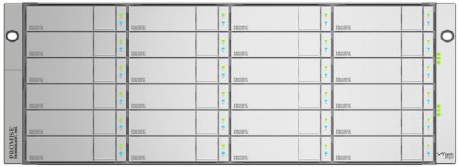

VTrak Ex30/Jx30 Series
Intel Xeon C5500/C3500
Host Interface: 8G FC x 2 (each controller)
High Availability Design
Up to 6000MB/s bandwidth
2U-12 Bay/ 3U-16 Bay/ 4U-24 Bay
Up to 7 JBOD expansion through 6G SAS
Notes:
Dual Controller, 8G FC, 12/16/24, 7JBOD Expansion, PDM

Slide 8
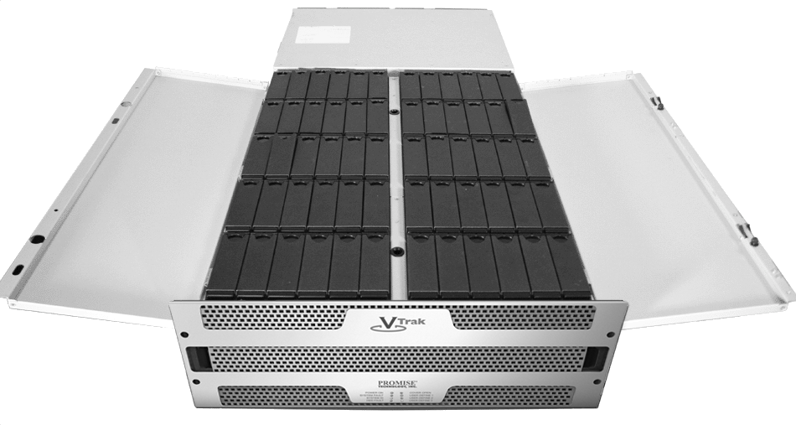
VTrak J930s
Ultra-Density 4U/60-bay
Configured with sixty 3TB drive for 180TB of raw capacity
Expandable up to 2 chassis
Notes:
Applications: archival, post-production editing, broadcast, asset management, near-line storage

Slide 9
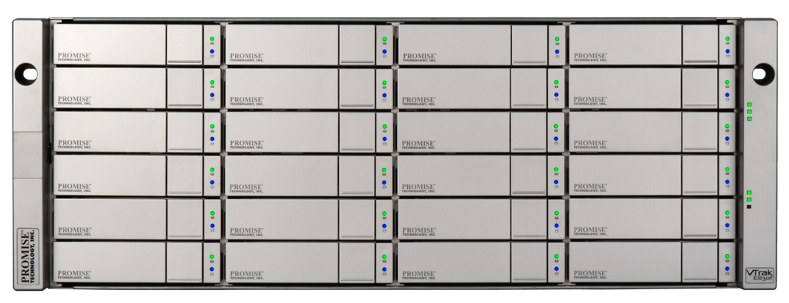
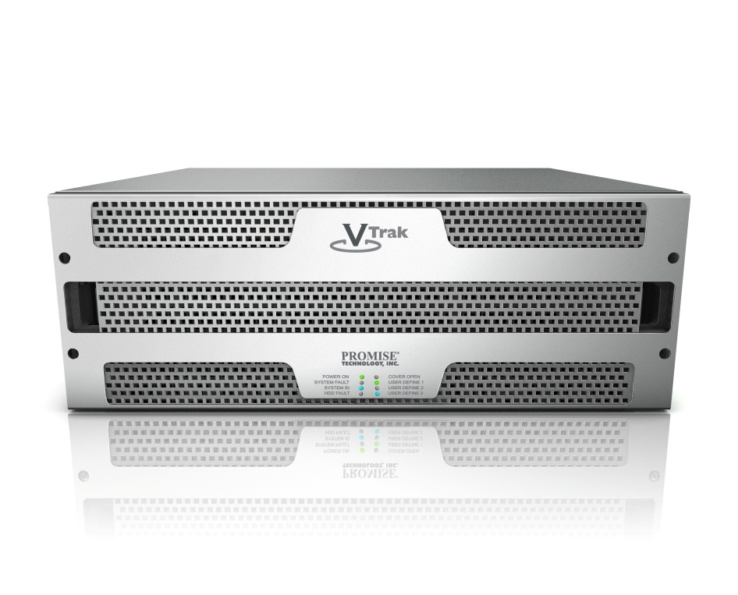
Expansion Configurations
Max Performance
Expand using one J930s for max performance, lowest latency
252TB Total Raw Capacity
Delivers over 5.5GB/s reads, 2.5GB/s Writes
Stream over twenty 10-bit 1920x1080p24 uncompressed videos
Easily support 2K, 4K streaming

Slide 10
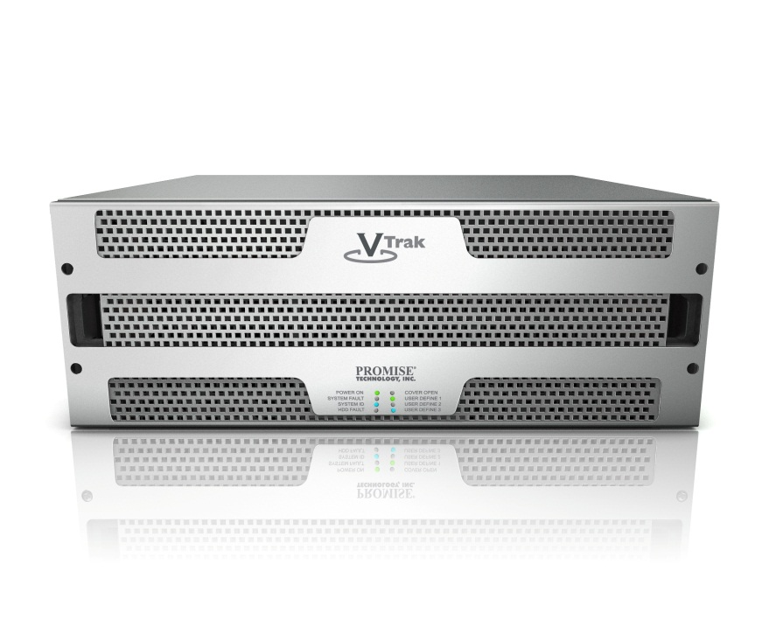
Expansion Configurations
Max Capacity
Expand using two VTrak J930s
144 total spindles in 12U
432TB Total Raw Capacity
Ideal for archival, backup, asset management

Slide 11
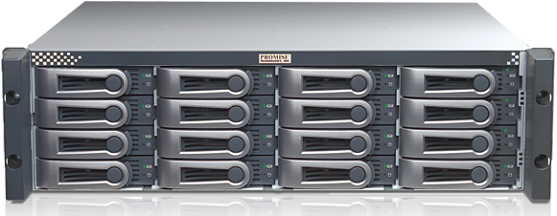
Vtrak Ex10/Jx10 Series
VTrak RAID and JBOD Subsystems
SAS and SATA disk drives
Dual Controller –High Availability
4Gb Fibre Channel SAN Host Connectivity
4Gb SAS Wide Host Connectivity

Slide 12

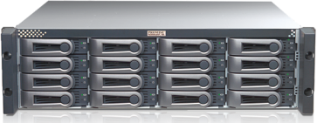
Internet Datacenter in US
PROMISE VTrak’s real installation case of an Internet data center in USA
Installation of 7000+ VTrak chassis
Over 85PB+ of usable storage and growing

Slide 13

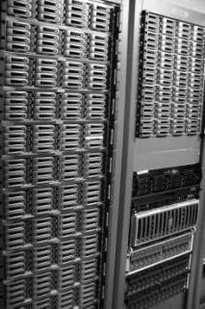
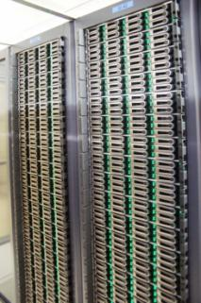
VTrak within CERN‘s IT Center
100+ VTrak system installed in CERN’s IT center
Actual installed
  About 80 VTrak Ex10f-s with SATA HDDs = 2 PB
  About 30 VTrak Ex10f-s with SAS HDDs = 110 TB

Slide 14
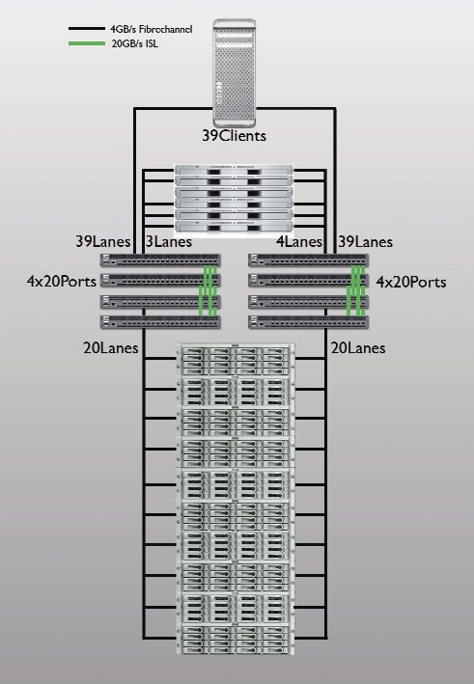

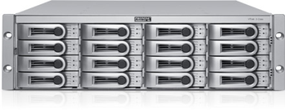
VTrak in 2010 FIFA Broadcasting
Solely HDTV (16:9) is used for the first time.
For the services of the International Broadcast Centre the storage capacity is less critical than the reliably available data transfer rate.
10 Promise VTrak E-Class basic units with 16 SAS hard drives (3,5 Inch, 15.000 rpm, 450GB) in each of them are networked together and simultaneously utilized as an RAID 5.
The expected data transfer rate for the access on about 66 TB usable storage capacity is 10 x 300 MB/s

Slide 15

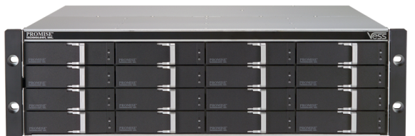

VessRAID Series
VessRAID and JBOD Subsystem
SAS and SATA disk drives
Single Controller
FC 8Gb SAN Host Connectivity
4x3Gb SAS Wide Host Connectivity
iSCSI SAN and Parallel SCSI Host Connectivity

Slide 16
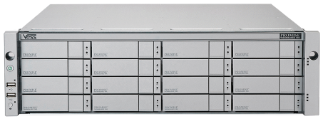


VessRAID 2000 Series
Fiber Channel 8Gbps, iSCSI 1Gbps & 10Gbps host connect ports
Dual Controller High Availability Design
High Scalability (112 HDDs) and Green Design
Predictive Data Migration (PDM)
PerfectRebuild - Rebuild with improved recovery efficiency
Advanced battery flash backup
PerfectFlash™ -Non-disruptive image update without system downtime
Built-in performance monitor and power usage monitoring
OPAS Service Log and UPS Monitor through USB
Notes:
64bit 6-core @ 1.1GHz Processor, Standard 2GB cache per controller (up to 8GB), iSCSI FUNCTIONS, Support multiple nodes, Up to 4 Multiple Connections per Session (MC/S), 128 concurrent sessions per controller, Support IPv6

Slide 17
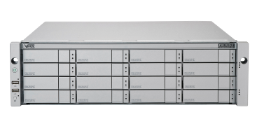
Solution Focus Areas
Data Archive
ERP
Exchange Email
Unstructured Data
Video Recording
Historic Data
SMB Marketplace
Finance
Education
Manufacturing
Health Care
Gaming
Online Services
Video Surveillance
Banking
Government
School & institute
Airport & Subway station
City Surveillance

Slide 18
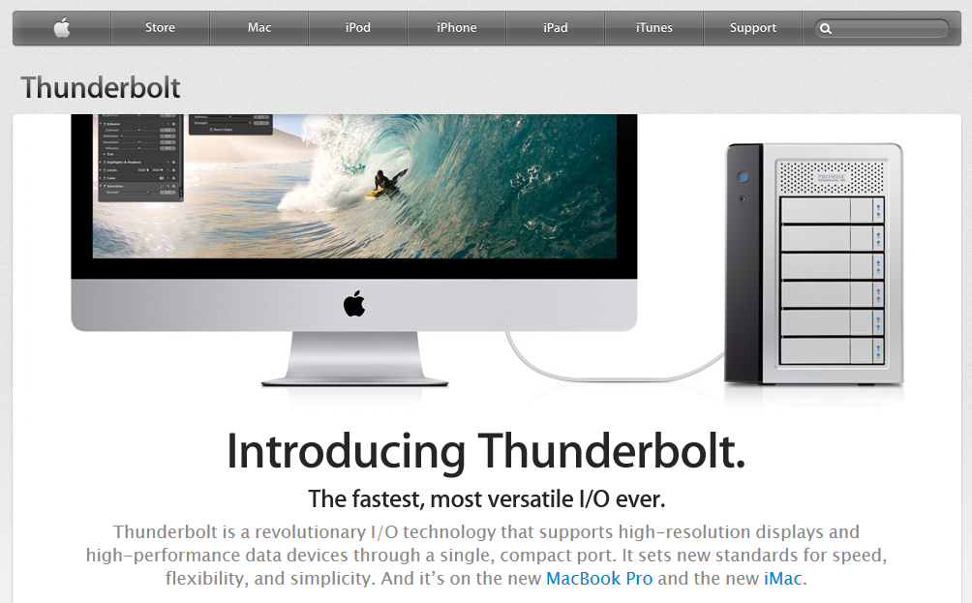

World’s First H/W RAID with Thunderbolt

Slide 19
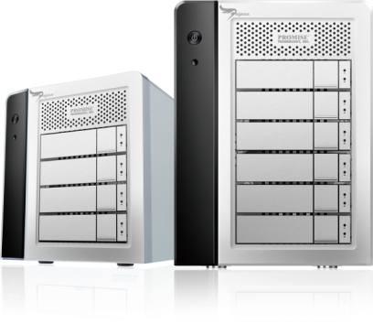


Pagasus Product Introduction
Pegasus R4
Pegasus R6
First Hardware RAID Solution with Thunderbolt™ Interface
Up to 800 MB/s Sustained Data Transfer Rates
Support 4/6 HDDs
Advanced RAID Engine
RAID Level:
  R4: RAID: 0, 1, 5, 6, 10
  R6: RAID 0, 1, 5, 50, 6 and 10
Attractive, Stylish and Combat Enclosure
Ultra Quiet Design
Thunderbolt™ Technology ports (2x)
Hot-Swappable Bays for Effortless Replacement of Failed Drive
Robust Error Handling Provides Superior Data Protection

Slide 20
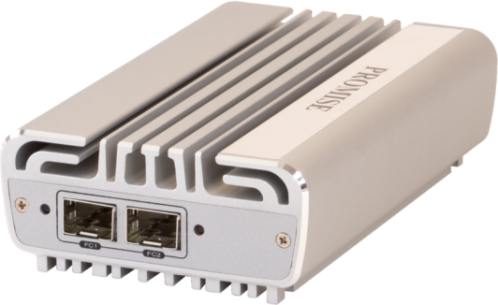
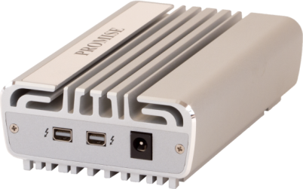
SANLink
Got Thunderbolt?
Your iMac or MacBook Pro
on the SAN with
PROMISE SANLink.
Notes:
Thunderbolt technology enables devices that have never been on the SAN before to connect through FC to the SAN directly such as the iMac and MacBook Pro and any future services that support Thunderbolt.

Slide 21


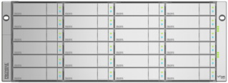


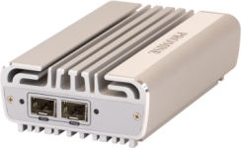
SANLink Connectivity
x30 RAID Subsystem
iMac
or
x30 Expansion Chassis
Macbook Pro
SANLink Adapter
Notes:
Possible usage models
- in office: allows for quick attachment of portable units (MacBook Pro) or visiting editors or producers
- in office: enables high powered notebooks and iMac systems to connect to the SAN
- in office: when MacBook Pros or iMacs are used, SANLink can streamline workflows by eliminating unnecessary file copies and transfers (remove AFP reshares as well)
- on the go: for mobile notebooks for portable SANs. Removed need to transport Mac Pro workstation for each editor

Slide 22
SANLink Compatibility
Fully qualified Mac OS X, Mac OS X Server, Final Cut Studio and Xsan
Zero Software Install on Mac OS X
Qualified solution with PROMISE VTrak x30 Series and VTrak x10 Series storage subsystems
Notes:
- SANLink has been designed to provide the smoothest user experience possible.
- Zero software is required to get SANLink working as drivers will be embedded in Mac OS X.
- Device will appear to the system as a FC device, much like an Apple Fibre Channel PCIe card appears in a Mac Pro.
- SANLink is a fully tested and qualified with all VTrak x10 and x30 Series products and can deliver similar performance as a FC card on a Mac Pro. (e.g. 5 streams of 8-bit uncompressed 1080p 30fps can be delivered to a MacBook Pro using SANLink)

Slide 23
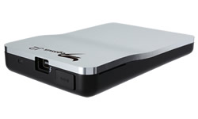
Pegasus J2
The World's Fastest and Smallest Thunderbolt™ Enabled Storage
Hyper-Portable
Incredibly Fast
Premium Performance Wherever You Go!
Notes:
The world’s smallest Thunderbolt™ attached storage easily fits in your pocket!
Breathtaking throughput of up to 750MB/s
Engineered for remarkable performance with or without the power adapter

Slide 24

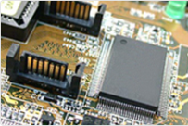







Vertical Solution
Cloud Datacenter
A/V Post-production
Surveillance
OEM
VTrak S3000
VTrak Ex30/Jx30
VTrak Ex10/Jx10
VTrak for Mac
Pegasus
VessRAID 1000f/1000s/1000i
SmartStor NSx700
SmartStor NSx600/ DS4600
SuperTrak/ FastTrak
SW ROMB

Slide 25
Summary – Why PROMISE
PROMISE
Global Industry Veteran
Outstanding Price/ Performance
Trusted Technology Provider for Major OEM Customers
World-class Service and Support Organization
Leading RAID Technology Innovator

Slide 26
Thank You!

