Slide 1
Quantum certainty
Daniel Rothbart
Regional sales manager
October 4th, 2012
Date
Notes:
To change (or delete) the image, go to View→slide master.
Next, move the Q out of the way to access the image behind the Q
Right click on the image and select “change image”. This will allow you to select an alternate image in the same area.
Reposition the Q around the image, centering as needed

Slide 2


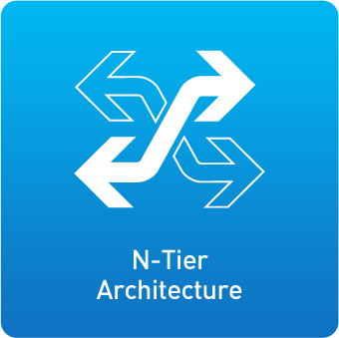
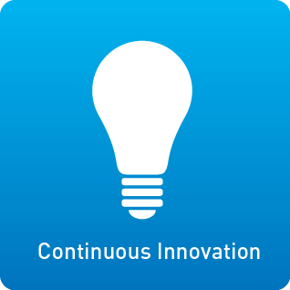
Quantum Today
Who We Are
Proven global expert in data protection and big data management
What We Do
Provide industry-leading solutions for storing and protecting information in physical, virtual, cloud, and big data environments
Why You Should Care
With Quantum, you can be certain you’re maximizing the value of your data by protecting and preserving it over its entire lifecycle…
in any environment and at any scale
Notes:
Use this slide to give the elevator pitch. Try not to tell the whole story with this or follow the typical vendor approach. Be edgy and provocative.
Thank you for the opportunity to share a bit about Quantum. I know your time is valuable, so I’ll spare you the facts and figures and concentrate on who we are, what we do, and why you should care.
Over the last few years, Quantum has proven ourselves as a global expert in data protection and big data management. We provide customers with industry-leading solutions for storing and protecting information across physical, virtual, and cloud environments. We also deliver tiered storage solutions for some of the most demanding big data environments.
Here’s why this matters to you. With Quantum’s specialized solutions and expertise, you can be certain you’re maximizing the value of your data because it’s well-protected and preserved over it’s entire lifecycle. And we’re an independent provider with a broad range of solutions, so you can be assured that we have the proficiency and products to do this across any environment or at any scale, from a TB to multiple PB’s.
To us, it’s about delivering unmatched value, specialized expertise, a unique N-tier architecture to lifecycle management, and continuous innovation to help you get from point A to point B… on your terms.
If you need to sprinkle in a few Quantum numbers, consider the following:
30 years delivering data protection and tiered storage
Service infrastructure in over 100 countries
Over 50,000 customers and >500 PB’s of managed storage
Revenues of ~$650M, traded on NYSE: QTM
1,800 employees

Slide 3
Top IT Priorities for 2012
1
Improve data backup and recovery
2
Increase use of server virtualization
3
Major application deployments or upgrades
4
Manage data growth
5
Information security initiatives
6
Business continuity / disaster recovery programs
Source: ESG 2012 IT Spending Intentions Research, 2012
Data protection, management, and retention top the charts as strategic IT priorities
Notes:
Use this slide to emphasize that IT priorities rank BU/Recovery, virtualization, and DR very high on the list. Ask customer’s opinion of the ranking and get buy-in that these are priorities.
ESG recently conducted a study among IT management on their top priorities for the year. As may be well aware of, data protection and preservation are very high on the list. This reflects the growing importance of data and the need to extract maximum value from it.

Slide 4











Environment of Change
Economics of Data
Economics of Data
drivers
opportunity
New Technologies
New Technologies
deduplication
wide area storage
virtualization
cloud
IT Constraints
IT Constraints
budget
time
staff
infrastructure
Notes:
Use this slide to drive a discussion that highlights the strategic importance of data and the need to manage, protect, and retain it over the entire lifecycle. This will elevate the importance of data protection and big data management and demonstrate Quantum’s expertise across these two areas.
Economics of Data
Tee up the concepts of data drivers and the opportunity behind extracting value from the data… hence the need to protect and manage it over time.
I want to take some time to share our perspective of the market and give you some insights into how we’re approaching it from a strategic point of view.
We’re seeing increased customer focus on the economic value of data … customers are storing more data for longer periods of time and finding new ways to analyze and reuse it for new revenue streams or new technological breakthroughs. IT departments like yours play a critical role in your company’s success. You need to be certain you are taking full advantage of the information and knowledge locked-up in that data. That’s why topics like data protection and big data management are so relevant and consistently show up as top priorities in end-user research studies. {reference ESG study in the bullpen if needed}
New Technologies
We see several new architectures and technologies that can help you unlock the value of data while reducing costs and increasing efficiency. The challenge is that they can also introduce disruption for your IT department if deployed incorrectly, so it requires careful planning and smart solutions to take steps forward rather than steps backward.
Then I’d give an example or two…
Deduplication, for example, is a game-changing technology and one that Quantum is very successful with. However, if you choose the wrong deployment model, you might take two steps backward in terms of backup performance or long-term retention.
Wide Area Storage is a new approach for PB-class data stores that delivers dramatic availability and accessibility improvements over traditional RAID systems. Wide Area Storage uses data dispersal technology that distributes content across sites and in the cloud. This provide continuous access even when disks fail, when entire sites have outages, or when customers want to upgrade to new technologies. I’ll talk more about Quantum solutions in a few minutes.
Virtualization is another example that I see with my customers. Deploying virtual servers is obviously a priority for most organizations, and it’s easy to pencil-in the ROI in terms of infrastructure utilization. But if you don’t have a 360-degree view of your deployment or chose the right partner to help, your ROI can be diminished by must-have functions like data protection.
Cloud is the same story. Yes, it can help, but what do you expect from the cloud and how will you get from point A to point B? What are your SLA’s for recovery, and will you still need local copies on-site?
IT Constraints
Touch briefly on IT Constraints and the implications without overplaying this point.
As I’m sure you live every day, there are real constraints within the IT department. Resources are scarce and budgets are tight. If you are like most IT departments, you are looking for ways to reduce acquisition and operational costs. In fact, cost reduction will be the biggest driver of IT spending in 2012 according to an ESG IT Spending Intentions Survey.
But there’s also the need to support legacy environments and applications, often with risk aversion to change the architectures or existing vendors. This situation is not trivial, and you’re likely to require specialists that can help you get from point A to point B.

Slide 5











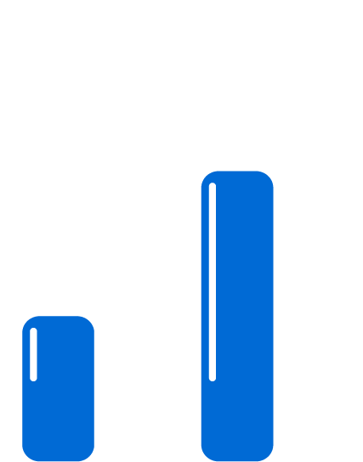
Quantum Helps You Adapt
Keep More Data,
Longer
Keep More Data,
Longer
N-tier architecture aligns data value and total cost
Bridge from Today
to Tomorrow
Bridge from Today
to Tomorrow
Continuous innovation for physical, virtual, and cloud
Reduce Cost,
Increase ROI
Reduce Cost,
Increase ROI
Specialized expertise and approach that deliver unmatched value
Notes:
Quantum helps you adapt to that changing environment by helping you keep more data for longer periods of time, bridge from your current state to meet your future needs while reducing cost and increasing return on investment. With Quantum’s approach you can be certain that you’re extract full value from your data.
Keep More Data, Longer
We realize that you can’t always predetermine what data will be valuable in the future, so the best plan is to build a model to preserve data and provide access for long periods of time. Our N-tier architecture incorporates a wide range of technologies and data management policies, allowing you to align the value of data to the cost of storage throughout the data lifecycle. This N-tier architecture incorporates technologies from SSD’s through to primary storage, deduplication tiers, wide area storage, and tape.
Bridge from Today to Tomorrow
We focus on not only meeting your current data protection and big data management needs but also helping you transition to new infrastructure like virtualization and the Cloud. We recognize that you can’t always anticipate what your future needs will be, nor can you just rip-out your existing infrastructure for a new approach. We continuously innovate to help you get from point A to point B, and our indepence ensures that you can be certain that our solution integrate across a wide range of server, storage, and networking types. Finally, our products are flexible and highly scalable – up to 100s of PB’s in the case of StorNext – and why we pioneered the concept of capacity-on-demand, first made available in our Scalar libraries and recently introduced in select DXi and vmPRO appliances.
Reduce Cost, Increase ROI
Quantum can deliver (insert company name) unmatched value, with low initial and ongoing costs that result in the lowest TCO solutions, thereby improving overall IT infrastructure efficiency. This focus on cost-effectiveness also enables Quantum to provide you a fast return on your investment. In fact, a recent IDC study shows that Quantum DXi customers typically experience a payback in just over six months. We do all this without compromising on features and functionality. Finally, Quantum can deliver unmatched value because we’re focused solely on data protection and big data solutions for our customers.

Slide 6




Quantum Solutions
BIG DATA
DATA PROTECTION
CLOUD
Tiered Solutions and Wide Area Storage
Solutions that help you maximize revenue and results by extracting full value from your data
Deduplication Systems
and Tape Libraries
Systems that optimize backup and recovery, simplify management,
and lower cost
Virtual Server Backup and Disaster Recovery
All-in-one solutions that protect virtual environments while minimizing impact to servers and storage
Cloud Software and Services
Technology that enables cloud backup and disaster recovery for physical & virtual servers
Central Management, Professional Services, & Global Support
Notes:
Summarize our Solutions Portfolio, emphasizing our offerings across Big Data, Virtualization, and the cloud
This approach leads to a family of unique offerings across Data Protection, Big Data, and the Cloud. And frankly, in certain customer segments these three areas are converging fast and our customers combine products or services together to solve their data management challenges.
Big Data
Our Big Data suite solutions allow you to store, manage and protect massive files and petabytes of data. These solutions are typically deployed in very high-scale environments, where Quantum is a pioneer in high-performance streaming of large files, data lifecycle management, and archiving. Our StorNext software and appliances are used by some of the largest Media companies, leading-edge research firms, and federal governments. Earlier, I mentioned Wide Area Storage as an alternative approach to legacy RAID. With Quantum Wide Area Storage solutions, customers will be able to store more data in a cost-effective archive using data dispersal technology that distributes content across sites and in the cloud. This provide continuous access even when disks fail, when entire sites have outages, or when customers want to upgrade to new technologies. We’ll be releasing wide area storage solutions later this year, but if you’re interested, we’d be happy to bring in one of our experts.
Our Big Data solutions provide cost-effective and innovative alternatives to EMC Isilon or IBM GPFS.
Data Protection
We provide N-tier solutions for data protection as well, including our innovative deduplication appliances and our virtualization data protection products.
Our DXi appliances incorporate advanced, patented variable-block deduplication to not only deliver best-in-class performance and efficiency but also enable optimized and affordable replication for disaster recovery. For reference, our midrange DXi series offers 2X the performance of EMC Data Domain systems at nearly ½ the cost.
Our vmPRO line of software and appliances combines deduplication and advanced VM optimization utilities, offering market-leading data reduction, recovery time and value for both physical and virtual data protection.
DXi appliances feature direct tape creation (also known as path to tape), providing integrated tiered storage capabilities to further reduce costs for long-term retention and offer remote DR. This enables you to take advantage of the enhancements we've continued to make in our industry-leading Scalar tape libraries, such as dual robotics for high availability and policy-based media integrity checking.
For customers deploying multiple Quantum products, our Vision software provides common management across global locations, systems and tiers.
Cloud
Quantum provides best of breed, highly optimized, low-cost cloud-based data protection that is powerful yet simple to deploy. Our cloud solutions operate in public, private or hybrid environments. Our DXi V1000 software dedupe appliance and vmPRO software serve as the technology foundation to power Xerox cloud BU and DR. I’ll talk more about this in a moment.

Slide 7
Data Protection Drivers
1
Managing data protection policy across
physical and virtual servers
2
Data growth due to the increasing number
of virtual servers
3
Managing growing data volumes across
geographically distributed sites
Notes:
These are the top 3 data protection drivers that customers indicated in a recent study Quantum performed of Midrange and Enterprise companies.

Slide 8


Certainty in a Virtual Environment
Bend Memorial Clinic implements a cost-effective solution for protecting physical and virtual environments
CHALLENGE
Data volume outgrowing IT staff capacity
SOLUTION
Quantum N-tier solution consisting of DXi dedupe, Scalar library, vmPRO software, and Vision management
IMPACT
- 6x faster backups
- Restores slashed from days to minutes
- 4x improvement in IT productivity
“
Across the board in terms of speed, ease of use, capacity, virtual backup and more, the Quantum solution was clearly the best option.
– Chris Hale, IS Director
”
Notes:
Bend Memorial Clinic is an excellent example to show you how we can effectively protect data in both physical and virtual environments. The clinic’s IT staff could not keep up with the growing volume of data. Quantum’s N-tier solution drastically improved back-up and restore times and IT productivity. Now, Bend Memorial is certain that their data is highly secure and accessible for the next potential medical breakthrough.

Slide 9
Cloud Drivers
1
1
Achieving cost-effective backup and recovery
across public, private and hybrid clouds
2
Enabling new disaster recovery models across sites
3
Protecting prior investments while readying for the future
Notes:
These are the top 3 Cloud drivers that customers indicated in a recent study Quantum performed of Midrange and Enterprise companies.

Slide 10
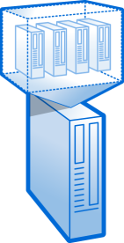

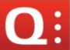
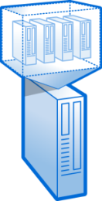


Certainty in a Cloud Environment
Innovative virtual backup and recovery technology
enables Xerox’s cloud backup and DR services
Xerox
Cloud
CHALLENGE
Enable warm failover of business critical data
for Xerox customers
SOLUTION
Quantum DXi V1000 virtual dedupe appliances and vmPRO data protection software enable Xerox cloud services
IMPACT
Enterprise-class backup and DR helps leading IT brand capitalize on massive new market opportunity
vmPRO
DXi V1000
Notes:
Xerox needed an offering for their customers that provided warm failover of data in the cloud. Quantum’s virtual backup and recovery products allow Xerox to provide these data protection services. Xerox is certain to drive bottom line revenues from this new market opportunity.

Slide 11
Big Data Drivers
1
Vast amounts of data need to be captured,
shared, managed and protected
2
Costs must be controlled and value maximized
even as data grows uncontrollably
3
Users are demanding uninterrupted access
Notes:
These are the top 3 big data drivers that customers indicated in a recent study Quantum performed of Midrange and Enterprise companies.

Slide 12
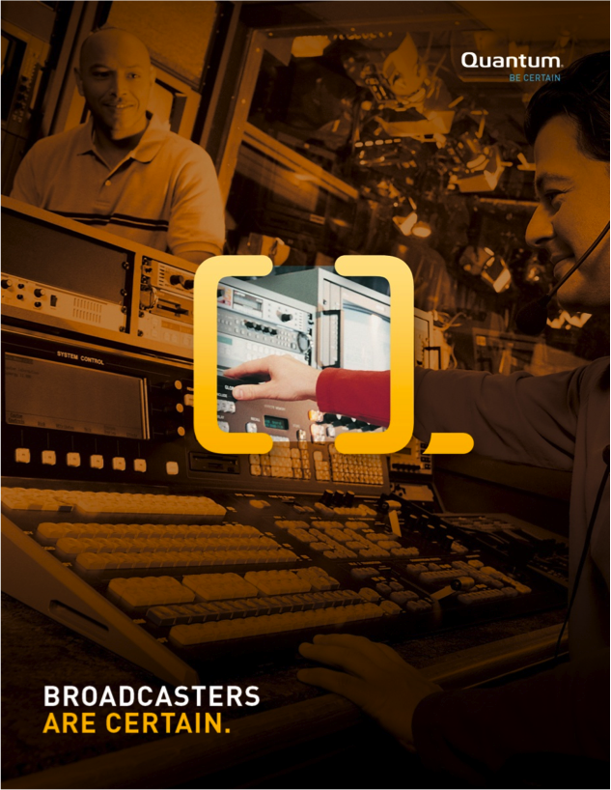
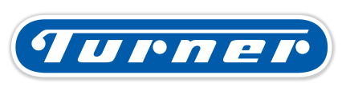
Certainty in a Big Data Environment
Turner implements tiered solution to store and retain video centrally, maximizing value of digital content
CHALLENGE
Storage and staff inefficiencies created by storage islands
SOLUTION
Quantum N-tier storage architecture based on StorNext software, tiers of disk storage, and Scalar tape libraries
IMPACT
Increased productivity via access to large files and greater content reuse due to tiered storage
“
StorNext was the best choice we found for handling our challenging combination of simultaneous access to large files with high performance streaming.
–Senior VP, Production
”
Notes:
Turner was faced with storage and staffing inefficiencies which reduced productivity and drove up operational costs. With Quantum’s N-tier storage architecture, they were able to more effectively access and reuse large data files allowing them to maximize the value of their video and digital content.

Slide 13
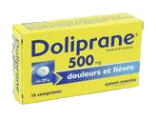



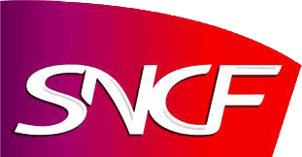






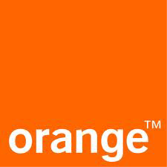




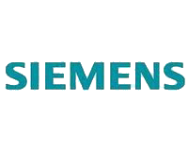




6:00 AM - Wake up, need a from ->yesterday I went to
6:30 AM - After watching I take a train to instead of my
You may not know it
but you are in contact with
Quantum customers
every day
7:00 AM - At airport, went to to buy some papers like
7:45 AM - Using my phone to call Nicola on her to confirm flight info.
8:00 AM - Preparing some inflight entertainement with my
9:15 AM - Just landed, need some cash from or
10:00 AM - Not taking a train, but a taxi, missing my bike
10:20 AM - Having a with a partner, chating about results ☺

Slide 14
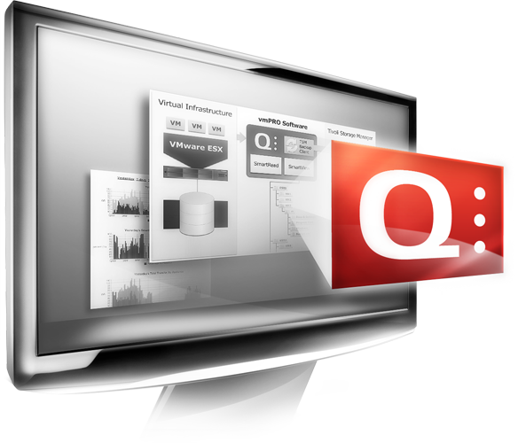

Quantum Cloud Solutions
Cloud Backup & DR Solutions

Slide 15



Foundational Cloud Technology Platform: vmPRO and DXi V1000
DXi V1000
vmPRO
Backup-as-a-service starting at $2,000/month
for up to 40TB of backup capacity
Simplicity of Deployment
    Integrates with existing VM infrastructure on both sides
    Minimal bandwidth required
    Full replication capabilities to/from any DXi system
Optimized Protection
  Highly efficient, cost-effective backup, restore and DR
  Provide fast restore with local copy and bootable VMs
  Reduce data set by as much as 95%
Future Proof Flexibility
  Very compelling value for Local / Cloud Connected VM Data Protection (BaaS)
  Groundbreaking value for BC/DR
  Cloud provider delivers app specific SLAs for failover and continued operation of VMs
© 2012 Quantum Corporation. Forward-looking information is based upon multiple assumptions and uncertainties, does not necessarily represent the company’s outlook and is for planning purposes only.

Slide 16
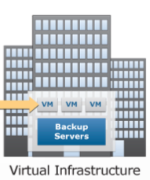
Xerox Cloud Services - DRaaS Use Case
Customer Infrastructure
Xerox Cloud Infrastructure
vmPRO
DXi V1000
DXi V1000
  DRaaS – Cloud-based Business Continuance (BC) and Disaster Recovery provided by Xerox. It requires BaaS and works for virtual data only today (physical data is TBD). DRaaS provides the capability to restore the replicated vms and execute them on pre-reserved cloud computing resources with defined SLAs.
Recover & Run
© 2012 Quantum Corporation. Forward-looking information is based upon multiple assumptions and uncertainties, does not necessarily represent the company’s outlook and is for planning purposes only.
Notes:
© 2011 Quantum Corporation. Company Confidential. Forward-looking information is based upon multiple assumptions and uncertainties, does not necessarily represent the company’s outlook and is for planning purposes only.
16

Slide 17
Quantum Differentiators
Software-based virtual appliances
Industry-leading data reduction
Local dataset for restores
Maintains VM format for quick and easy DR
Works in conjunction with DXi hardware or software
Protection for physical, virtual, and mixed environments
Future-proof to bridge from today to tomorrow

Slide 18
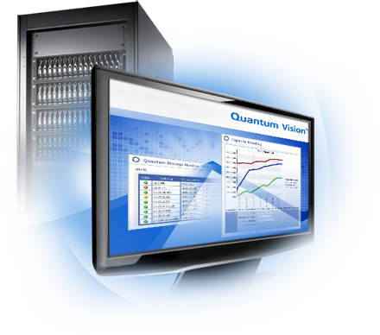
Quantum Data Protection Solutions

Slide 19





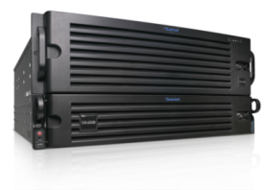






Why Quantum Data Protection
Protect Data Across
Evolving Architectures
P2C
P2C
vmPRO
V1000
Exchange
SQL
Gmail
Gmail
Oracle
CRM
File and Print
CRM
File and Print
Small Remote Site
Simplify Data Protection Across Distributed Sites
Gmail
CRM
File and Print
vmPRO
V1000
Consistently Meet Increasingly Demanding SLAs
DXi
DXi
Small Remote Site
Scalar
Vault
Tame Tomorrow’s Data Growth with Today’s Budget
Datacenter
Notes:
“Quantum provides a comprehensive portfolio of solutions to help companies solve their data protection challenges. Quantum’s solutions protect data across architectures – both physical and virtual environments – and across distributed sites, enabling customers to meet constantly evolving SLAs with today’s budget. Our specialized expertise in data protection, as well as our n-tier architecture and approach to data protection enable our customers to maximize the value they get from their data and IT investment - and from their data - today and over time.”
Quantum’s Data Protection Solutions Enable You to…
...PROTECT DATA ACROSS Evolving Architectures
Protect traditional, virtualized and cloud environments with one solution, enabling customers to leverage these disruptive IT technologies while ensuring a robust strategy for business continuance and disaster recovery.
Transition smoothly from traditional data protection approaches to virtual- and cloud-based infrastructures – protecting their prior investments while readying for the future.
Simplify transition from Physical, Virtual, to Cloud. Bridge from today to tomorrow.
Future-proof your IT (or DP) infrastructure for disruptive technology.
Simplify DATA Protection ACROSS DISTRIBUTED SITES
Centralize and simplify data management at a edge to core enable data movement
Reduce IT complexity to improve performance, manageability.
Innovations like de-duplication, replication enable data protection across sites
Consolidate (Centralize?) sites (backup storage?) to reduce complexity and costs
Reduce (eliminate?) IT staff requirements at remote sites
We make disaster recovery viable for remote sites and small businesses (Offer backup where you didn’t have this before)
Consistently Meet INCREASINGLY DEMANDING SLAS
Certainty of data accessibility for business continuity
Drastically reduce backup sizes and times
Restore any data at near backup speed
Restore VMs in minutes not hours
Meet business demands for constant data availability
Assurance your data is secure across the organization from the time it’s backed up to when you expire it. (compliance)
...THRIVE IN A “SAVE EVERYTHING” WORLD WITH TODAY’S BUDGET
Leverage the benefits of tape and disk in an integrated solution.
Handle increased data volume while gaining order of magnitude reductions in costs.
N-tier architecture matches data cost to data value and manage data effectively and affordability over its entire lifecycle.
Grow backup capacity without growing staff. Do more with less. Simplicity.
4x improvement in IT productivity (where did this come from?)

Slide 20

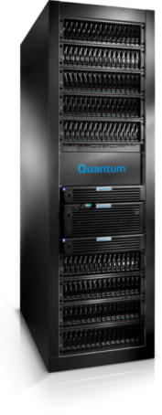

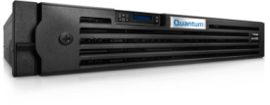


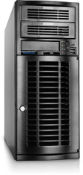

Disk-Based Data Protection Portfolio
8.8
DXi8500
5.8
DXi6700
Performance (TB/hr)
DXi4000, vmPRO 4000,
& DXi V1000
Comprehensive Solutions
1.7
Quantum vmPRO
NDX and RDX
Quantum Vision
1
8
2
12
8
80
40
320
Capacity (TB)

Slide 21
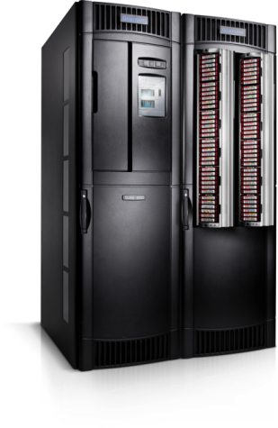
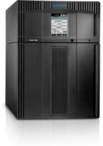
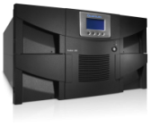

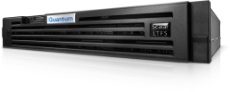

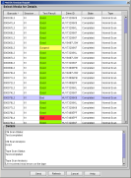
Tape-Based Data Protection Portfolio
Scalar i6000
Scalar i500
Performance
Comprehensive Solutions
Quantum Vision
Scalar i40, i80
Scalar LTFS
Scalar Key
Manager
EDLM Policy-based
Data Integrity Checking
25
80 slots
40
400 slots
100
5,300 slots
Capacity

Slide 22
Quantum By The Numbers
Prominent Companies Choose Quantum
Quantum Outperforms the Competition
85
100,000
31
of the Fortune 100
plus customer
deployments
percent market share in tape
automation (worldwide leader)
Quantum Solutions Deliver
Quantum Certainty
5
652
product of the year awards for Quantum
deduplication and VMware backup*
$M in revenue
6
100
month payback on investing in Quantum deduplication** and Big Data products (IDC)***
countries with Quantum
service infrastructure
1 Mission
To provide industry-leading Data Protection and Big Data management solutions for storing and protecting information in physical, virtual, and cloud environments
*Deduplication: Network Computing, 2012, and Storage Magazine, 2011 and 2012. VMware: Storage magazine/SearchStorage.com, 2011, and Storage, Virtualization and Cloud Computing (UK), 2011
**IDC White Paper: “Demonstrating the Business Value of Deduplication for Data Protection,” December 2011
***IDC White Paper soon to be published
Notes:
Quantum helps you adapt to that changing environment by helping you keep more data for longer periods of time, bridge from your current state to meet your future needs while reducing cost and increasing return on investment. With Quantum’s approach you can be certain that you’re extract full value from your data.
Keep More Data, Longer
We realize that you can’t always predetermine what data will be valuable in the future, so the best plan is to build a model to preserve data and provide access for long periods of time. Our N-tier architecture incorporates a wide range of technologies and data management policies, allowing you to align the value of data to the cost of storage throughout the data lifecycle. This N-tier architecture incorporates technologies from SSD’s through to primary storage, deduplication tiers, wide area storage, and tape.
Bridge from Today to Tomorrow
We focus on not only meeting your current data protection and big data management needs but also helping you transition to new infrastructure like virtualization and the Cloud. We recognize that you can’t always anticipate what your future needs will be, nor can you just rip-out your existing infrastructure for a new approach. We continuously innovate to help you get from point A to point B, and our indepence ensures that you can be certain that our solution integrate across a wide range of server, storage, and networking types. Finally, our products are flexible and highly scalable – up to 100s of PB’s in the case of StorNext – and why we pioneered the concept of capacity-on-demand, first made available in our Scalar libraries and recently introduced in select DXi and vmPRO appliances.
Reduce Cost, Increase ROI
Quantum can deliver (insert company name) unmatched value, with low initial and ongoing costs that result in the lowest TCO solutions, thereby improving overall IT infrastructure efficiency. This focus on cost-effectiveness also enables Quantum to provide you a fast return on your investment. In fact, a recent IDC study shows that Quantum DXi customers typically experience a payback in just over six months. We do all this without compromising on features and functionality. Finally, Quantum can deliver unmatched value because we’re focused solely on data protection and big data solutions for our customers.

Slide 23

Uniquely Positioned for the Long Term
Notes:
Use this slide to wrap up the presentation.
By partnering with Quantum, you can be certain you’re maximizing the value of your data over its entire lifecycle. Your data will be protected and preserved in any environment at any scale.
Our solutions help you overcome your resource and budget constraints by delivering unparalleled value and improving your infrastructure efficiency.
Quantum’s specialists can provide you unmatched expertise and support with innovative and customized solutions.
Through N-tier architecture, we can ensure that your data is aligned to the cost of storage throughout the entire data lifecycle while improving backup and restore times for better overall productivity.
Lastly, Quantum’s innovative solutions will continue to evolve to support your ever changing IT environment.

