Slide 1
Why hackers don’t care about your firewall
FortiWeb incorporates Fortinet's industry leading threat research to protect web-based
applications, improving the security of confidential information and aiding in legislative and PCI
compliance.
Martijn Duijm
Consultant System Engineer EMEA
mduijm@fortinet.com
Notes:
1

Slide 2
Quick introduction
13 years information security experience
Consulting Systems Engineer Europe, Middle East and Africa, Fortinet
OWASP member
www.owasp.org
mduijm@fortinet.com
Mobile: +31 6 12 10 92 91

Slide 3
Myth
We are secure because we have a firewall
75% of Internet Vulnerabilities are at Web Application Layer *
*Gartner Group (2002 report)

Slide 4
A firewall friendly protocol
=
“a skull friendly bullet”
(Bruce Schneier)

Slide 5
Your security “perimeter” has huge holes at the application layer
Application Layer
Custom Developed Application Code
Databases
Legacy Systems
Web Services
Directories
Human Resrcs
Billing
APPLICATION ATTACK
App Server
Web Server
Hardened OS
Network Layer
Firewall
Firewall
You can’t use network layer protection (firewall, SSL, IDS, hardening) to stop or detect application layer attacks
Notes:
MAIN THEME: applications are different than networks – software is full of holes
HTTP Request is like an ENVELOPE that passes thru all those components. Envelope is finally opened by YOUR CODE.
Introduce SSL, only prevents eavesdropping. Actually helps hacker by protecting their attacks with a tunnel.
LMCO apps may be internal users, but that doesn’t deplete the threat environment. So, the picture above still applies to internal apps.

Slide 6
OWASP Top 10
A1: Injection
A10: Unvalidated Redirects and Forwards
A7: Failure to Restrict URL Access
A6: Security Misconfiguration
A5: Cross Site Request Forgery (CSRF)
A4: Insecure Direct Object References
A3: Broken Authentication and Session Management
A2: Cross-Site Scripting (XSS)
A8: Insecure Cryptographic Storage
A9: Insufficient Transport Layer Protection
Notes:
The red ones are the new ones.

Slide 7
A1 – Injection
Injection means…
Tricking an application into including unintended commands in the data sent to an interpreter
Interpreters…
Take strings and interpret them as commands
SQL, OS Shell, LDAP, XPath, Hibernate, etc…
SQL injection is still quite common
Many applications still susceptible (really don’t know why)
Even though it’s usually very simple to avoid
Typical Impact
Usually severe. Entire database can usually be read or modified
May also allow full database schema, or account access, or even OS level access

Slide 8
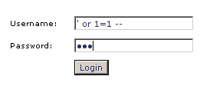
example : SQL-injection attack
Select user_information from user_table where username=’input username’ and password=’input password’
Select user_information from user_table where username=’’ or 1=1 -– ‘ and password=’abc’

Slide 9
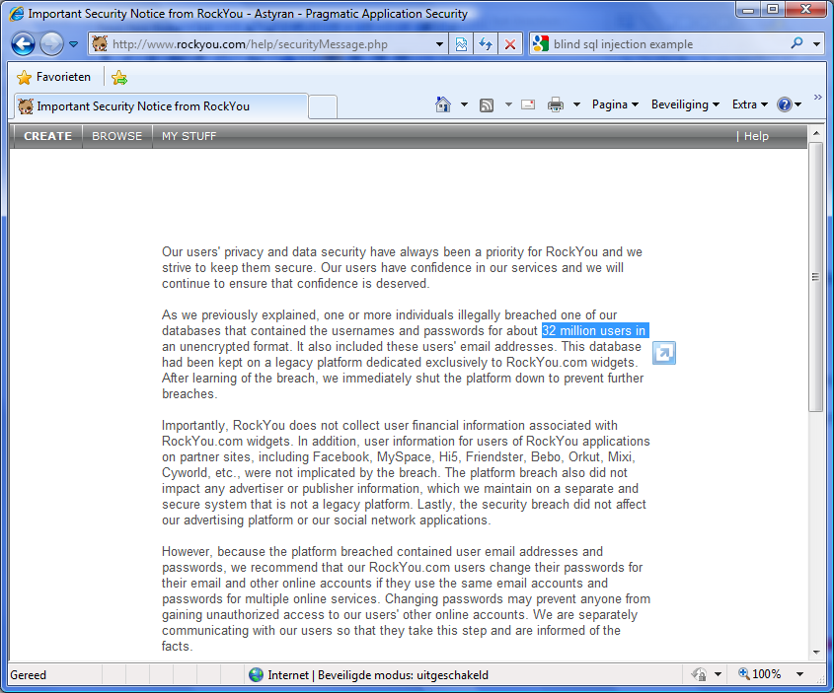
RockYou?
December 2009
a hacker used SQL Injection techniques to hack the database of RockYou
RockYou creates applications for MySpace, Facebook, ...
Result
data of 32.603.388 users and administrative accounts was compromised (credentials + clear text passwords)
the data also contained email-addresses and passwords for 3rd party sites
Question: how many of those users use the same password for other sites too?
Notes:
http://igigi.baywords.com/rockyou-com-exposed-more-than-32-millions-of-passwords-in-plaintext/

Slide 10
SQL INJECTION EXAMPLE
Quick search on YouTube, over 1000 clips with tutorials and examples
Ready to use software like SQLi Helper and MD5 cracker

Slide 11
A2 – Cross-Site Scripting (XSS)
Occurs any time…
Raw data from attacker is sent to an innocent user’s browser
Raw data…
Stored in database
Reflected from web input (form field, hidden field, URL, etc…)
Sent directly into rich JavaScript client
Virtually every web application has this problem
Try this in your browser – javascript:alert(document.cookie)
Typical Impact
Steal user’s session, steal sensitive data, rewrite web page, redirect user to phishing or malware site
Most Severe: Install XSS proxy which allows attacker to observe and direct all user’s behavior on vulnerable site and force user to other sites

Slide 12
XSS = Cross-site Scripting
Web application vulnerability
Injection of code into web pages viewed by others
XSS = new buffer overflow
Javascript = new Shell Code
Notes:
Cross-site scripting (XSS) is a type of computer security vulnerability typically found in web applications which allow code injection by malicious web users into the web pages viewed by other users. Examples of such code include HTML code and client-side scripts. An exploited cross-site scripting vulnerability can be used by attackers to bypass access controls such as the same origin policy. Vulnerabilities of this kind have been exploited to craft powerful phishing attacks and browser exploits. Cross-site scripting was originally referred to as CSS, although this usage has been largely discontinued
This can be compared with the old buffer overflow: you achieve in injection data that will eventually be executed: here as javascript.
Javascript is the new Shell Code
Perform first demo here!

Slide 13
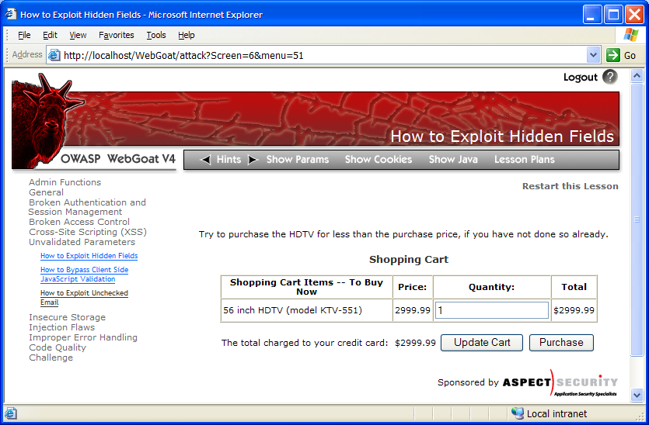
Cross-Site Scripting Illustrated
1
Attacker sets the trap – update my profile
Application with stored XSS vulnerability
Attacker enters a malicious script into a web page that stores the data on the server
2
Victim views page – sees attacker profile
Finance
Transactions
Accounts
Administration
Communication
Knowledge Mgmt
E-Commerce
Bus. Functions
Custom Code
Script runs inside victim’s browser with full access to the DOM and cookies
3
Script silently sends attacker Victim’s session cookie

Slide 14
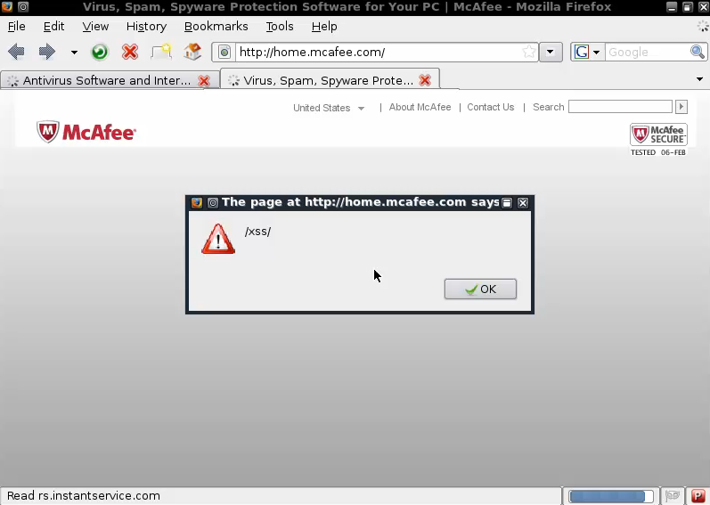
XSSED.ORG
Still not fixed (with redirection): http://www.google.com/search?btnI&q=allinurl:http://www.xssed.com/

Slide 15
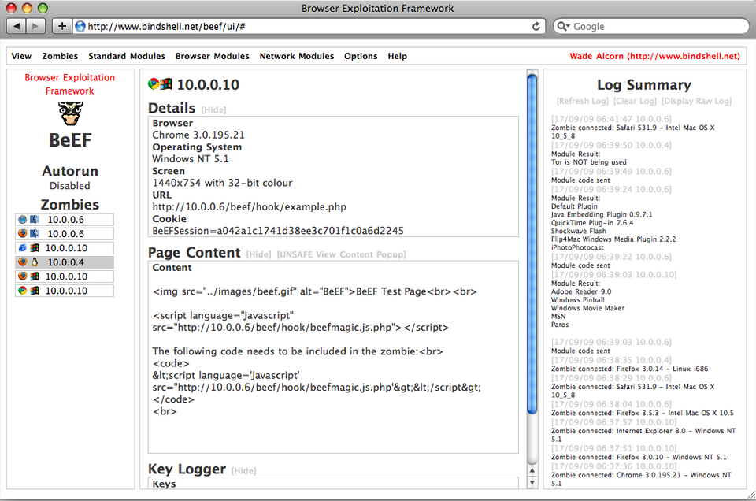
Browser Exploitation Framework

Slide 16
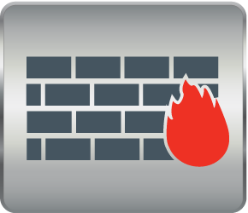
Introducing - FortiWeb Web Application Firewall
WAF
Web Application Firewall - WAF
Secures web applications to help customers meet compliance requirements
Web Vulnerability Scanner
Scans, analyzes and detects web application vulnerabilities
Application Delivery
Assures availability and accelerates performance of critical web applications
Secures Web Applications
Scans and Detects Web Vulnerabilities
Optimizes Application Delivery

Slide 17
FortiWeb Customers Worldwide
Government
Telco
Retail/Technology/Financial/Other

Slide 18
FortiWeb Product Line
FortiWeb-400B
Competitive in SMB PCI security market
FortiWeb-3000C
1Gbps / 40,000 tps
FortiWeb-1000C
Medium/Enterprise performance platform
FortiWeb-4000C
2Gbps / 70,000 tps
18

Slide 19
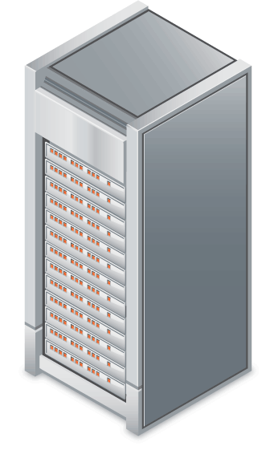
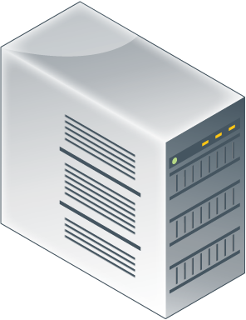
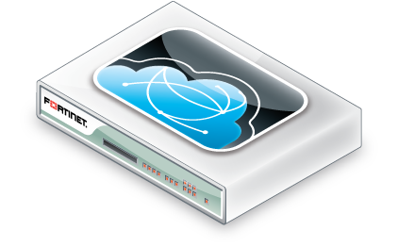
FortiWeb-VM
Deploy FortiWeb in a virtualized environment
Mitigates blind spots
Protects web applications regardless of connection origin
Provides visibility to internal connections as well
Same functionality as appliance
DMZ
Public Zone
Servers / DMZ
FortiWeb Virtual Appliance
Requirement | Min needed for FortiWeb-VM
Licenses | 2-vCPU, 4-vCPU, 8-vCPU
Hypervisor | VMware ESXi/ESX 3.5/4.0/4.1
Memory | Min. 1024
CPU | Min. 2 virtual CPU’s
10/100/1000 Interfaces | Min. 2 Max. 4virtual NIC’s
Storage Capacity | Min. 40G
Desktops / Private
Virtualized Data Center

Slide 20
FortiWeb Web Application Firewall
Can block against | Using
Cross Site Scripting (XSS) | Specialized signature database and / or Dynamic white listing (autolearn)
SQL injection | Specialized signature database and / or Dynamic white listing (autolearn)
Cookie poisoning | Cookie hashing
Parameter tampering | Parameter validation rules
Broken authentication management | Enhanced authentication management
Security Misconfiguration | Denying access to sensitive files/ folders
Data theft | Data loss prevention

Slide 21
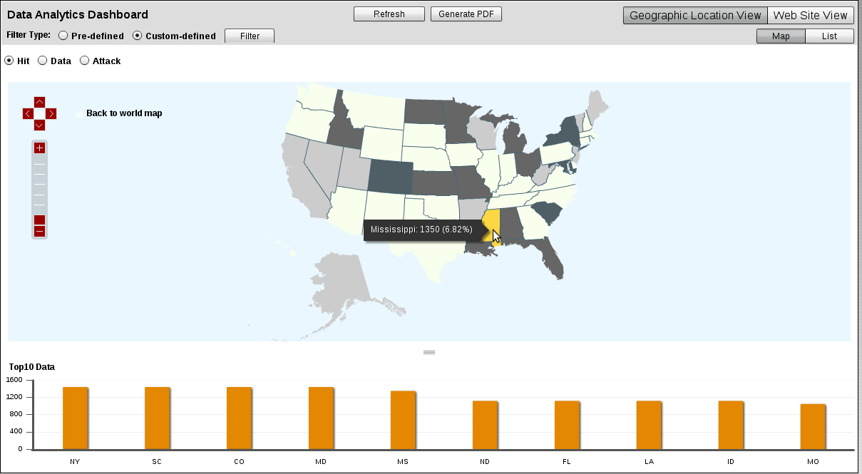
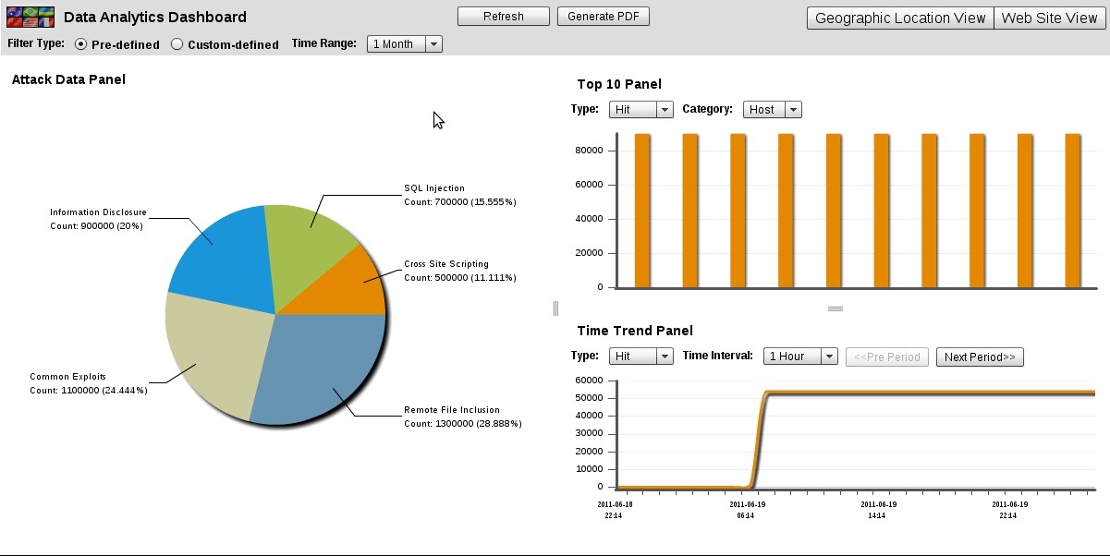
Data Analytics – Geo IP Analysis & Security
Analyses web app usage based on geographic location and server access
Dissect traffic based on Hit, Data and Attack type
Easily block access from a country using right click
Map view or List view
Provides a graphical interface that helps organizations understand application trends both from a user and server perspective
Notes:
Administrators can monitor HTTP activity to their applications and view real time events using the Data Analytics dashboard

Slide 22
No Time for Downtime ☺ - Hosted DDOS attacks

Slide 23
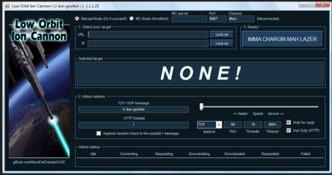
What about those web app dedicated DDoS attacks?
Application based DDoS is on the increase accounting for a quarter of all DDoS attacks
Under the radar’s bandwidth threshold
Targeting specific web app/protocol flaws rather than bandwidth consumption
CPU intensive SQL queries to backend DB
Writing to hard disks
Server specific
Slow based and legitimate request attacks
Slowloris - Sends legitimate, but partial, never ending requests
Using tools that can be easily downloaded from the internet such as HOIC and LOIC
Using botnets and automatic tools to reach mass
Sometimes camouflaging real data breach attempts
SQL Injection primarily
Zombie Botnet
Many become one

Slide 24
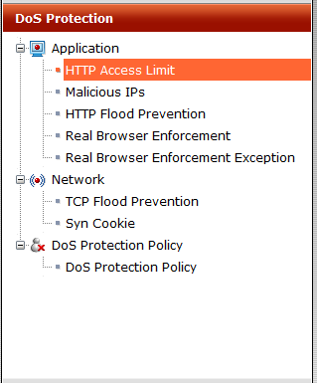
FortiWeb DoS/DDoS Protection Application and Network Based
Analyzes requests originating from different users based on different characteristics such as IP and cookie
Sophisticated mechanism understands whether these are real users or automated attacks (HOIC, LOIC tools)
Application layer – 4 different policies
HTTP Access Limit - Limits the amount of HTTP requests per second from a certain IP
Malicious IPs - Limits the number of TCP connections with the same session cookie
HTTP Flood Prevention - Limits the number of HTTP requests per second with the same session cookie
Real Browser Enforcement - Sets the number of HTTP requests per TCP connection, per second, to a specific URL before FortiWeb issues a script to the client to validate whether this is a real browser or an automated tool
Network layer – 2 different policies
TCP Flood Prevention - Limits the number of TCP connections from the same source IP address
SYN Cookie – Protects against SYN flood attacks

Slide 25
Payment Card Industry
Formed December 2004 by top 5 credit card companies
Aligned each company’s individual policies and released the PCI DSS
A standard that ensures merchants meet minimum levels of security when they store, process and transmit cardholder data
Merchants that process credit cards must comply with the new PCI standard
In October 2008 version 1.2 was introduced
Prevention of common coding vulnerabilities such as those defined by OWASP
Code reviews or - Verify that a web-application firewall is in place in front of public-facing web applications to detect and prevent web-based attacks
Compliance enhances reputation and lowers risk
Non-compliance can result in fines and sanctions
Fortinet is a part of the PCI Security Standard Council (oct 6th, 2009)
Notes:
The PCI SSC was formed in 2004 by the top 5 credit card companies in order to create a standard across the board.
PCI DSS aligned each of the companies own policies and in 2008 version 1.2 introduced new mandates requiring merchants to prevent vulnerabilities such as those defined by OWASP and run periodic code reviews or deploy a WAF.

Slide 26
Fortinet Addresses PCI DSS
FortiWeb addresses PCI 6.6
Web Application Firewall
Web Application Scanner
FortiDB addresses PCI requirements with Data Activity Monitoring and Vulnerability Assessment for Databases
Requirement 2 : No vendor supplied defaults for system passwords
Requirement 3 : Stored cardholder data must be protected
Requirement 6 : Develop and maintain secure systems
Requirement 7 : Access to data restricted on a need-to-know basis
Requirement 10 : Track and monitor access to cardholder data
Requirement 11 : Regular systems testing
Requirement 12 : Maintaining an information security policy
Notes:
Fortinet addresses PCI DSS with FortiWeb web app firewall and scanner and extends compliance coverage to Database Activity Monitoring with FortiDB

Slide 27
FortiWeb Value Add
Dramatically reduce the risk of corporate data loss.
Accurate protection with multiple layers of defense
Integrated Web Vulnerability Scanner
Easily deploys in any environment
Multiple deployment options
Automated management using Auto Learn Baselining
Helps achieve PCI compliance
Application Security
HTTP Compliance
Application Signatures
Auto Learn
Data Leak Prevention
Application Delivery
Authentication
Application Delivery
ASIC Acceleration
FortiClient Desktop
Vulnerability Assessment

Slide 28
Thank You

