Slide 1
Symantec Backup Exec™ 2012 Family Overview
Bogdan Stefanescu
Presales Consultant
Symantec Romania & Bulgaria
bogdan_stefanescu@symantec.com
Notes:
Hello, and welcome to today’s discussion of the Backup Exec family of products. My name is <presenter_name>, and I will be your presenter today.

Slide 2
Today’s IT Challenges
2

Slide 3
Today’s IT challenges
Virtualization
Data Growth and Storage
Complexity
Backup Exec 2012 Family
3
Notes:
Virtualization
Last year Symantec conducted an extensive global survey of thousands of end-users. It is astonishing that nearly two-thirds of virtual machines are not backed up! The amount of risk businesses are taking on as a result of not backing up virtual machines is amazing. There are some very real historical reasons for these results:
1. Virtual machine sprawl – virtual machines spread like rabbits. Often times, IT just doesn’t know about the new machine (or knows about it but doesn’t know the RPT/RTO requirements/no SLA). This is one of the top reasons virtual machines are not backed up.
2. Cost of backup agents – in the past, IT would have to buy individual backup agents for each new server. Potentially costing thousands of dollars...destroying much of the cost savings created with virtualization.
3. Tools from virtualization vendors – two ways existing tools impact the failure to backup
a. tools in the past have not been mature and have made backup complicated, error prone etc. ‘
b. some people use existing tools from VMware or Hyper-V as primary backup (for instance clone a machine) and think that sufficient “backup”. It isn’t.
4. I/O & bandwidth impact – IT may have been concerned with dragging down the host machine and/or network by moving a lot of data for backup. The whole idea of virtualization is to increase server utilization/CPU utilization/network utilization and if you are successful, there is less “slack in the system” to handle backup loads.
In addition to the problems above, many customers are using more than one backup solution to protect their heterogeneous (some physical, some virtual) environments. Why is this a problem?
Data Growth and Storage
¹Source: Sheila Childs, Gartner: New Archiving Technologies That Deliver Cost Savings and More, LSC28_154, 12/09, AE
² Source: ESG Research: Data Protection Market Trends, January 2008.
Growing data volumes and rising storage costs also remain significant problems for partners and customers today. Up to 70% of the data in your customer environments is duplicate (Gartner), 57% of your midsize organizations increase storage volumes by 11-30% annually (ESG) – overall making data lifecycle management more complex and challenging for mid market IT administrators pressed for resources.
With the release of Backup Exec 2012 there is a new opportunity to further improve your customers backup and recovery environment through integrated deduplication and archiving options introduced in Backup Exec 2010. These latest options can help your customers easily reduce their storage costs and their backup windows, plus these offerings easily adapt into any mid market business infrastructure making it an easy up-sell for new or existing Backup Exec environments.
The deduplication technology within Backup Exec 2012 includes additional capabilities specifically designed to enable efficient deduplication of virtual machines backups, which we will cover in further detail later in this discussion.
Complexity
Backup itself has grown more and more complex. Multiple solutions are commonly used for different types of backup, such as data and application protection and disaster recovery. Different solutions are commonly considered for different infrastructure types, such as virtual infrastructures vs. physical servers. Backup jobs themselves have become more complicated, as customers need backup data to reside in more than one location and on more than one type of backup storage for offsite and disaster recovery protection. Even the licensing of a backup solution can be complex, due to different agents and options offering specific functionality to protect specific server and application types or to support specific storage configurations.

Slide 4
The Future of Backup
Unification of Physical and Virtual
One Backup, Any Recovery
Eliminate Complexity
simple
Easy to use
Backup Exec 2012 Family
4
Notes:
Unification of Physical and Virtual: Having multiple applications, multiple solutions, multiple fire extinguishers to put out the data protection fire makes no sense. So why not have one application that fulfills all the needs that you have in your data protection environment?. Backup Exec 2012 has united physical and virtual protection - you can take one application to protect your physical systems, your virtualizations systems, and really get that single pane of glass across your entire environment.
But what we’re seeing is a shift in Symantec’s strategy to say “protect virtual - with an option to protect physical”. So it’s a mental shift as well - it’s a change in how we have to look at the technology, because virtualization is becoming so predominant across the board, from the largest enterprises to the small business. V-Ray technology allows us to provide those unified solutions.
One backup, any recovery: Speaking of single panes of glass, one of our key messages for this release is “One product, Any recovery” - again, focusing on the fact that you only need one thing in your toolbox to solve many different problems. In this case, it’s restore. That’s what you buy backup products for, right? So you can restore what you need, when you need it? We’ve got the concept of no hardware disaster recovery – converting backups into virtual machines that you can instantiate in your virtual environment for instantaneous recovery. And we’ve integrated bare-metal disaster recovery into Backup Exec 2012. It just makes no sense to complicate your life further by having multiple applications to And of course we have granular recovery of anything that Backup Exec supports anytime you need it. We’ve also got powerful cloud based disaster recovery.
Eliminate Complexity: We’ve talked with a lot of customers and partners – and making things easier for them has been top-of-mind for some time now. Symantec is striving to make it easier for customers to buy, configure, and use Backup Exec. So we’ve got a simplified user interface, we’ve got a better, easier, faster, more configurable, more available interface for customers to use; we’ve got flexible delivery models, you’ll see with that software we’ve got appliances in the BE 3600 we’ve got a cloud option for backupexec.cloud; and then we are also offering several new pieces in the BE portfolio, specifically our BE small business edition, that will really try and make it easier for SMBs to purchase and consume Backup Exec.

Slide 5
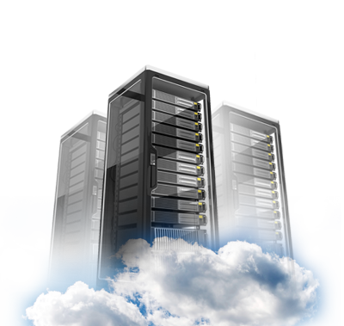
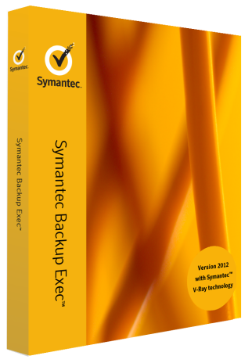
Symantec Delivers Better Backup for All
Software
Cloud*
Backup Exec 2012 Editions
Backup Exec.cloud Hybrid Cloud
Protecting Your Virtual and Physical Systems
5
Notes:
Backup Designed for Your Customers
When it comes to tackling these modern IT challenges, everyone else starts with technology. Symantec starts with you. With our new strategy for Backup Exec, we are delivering backup the way you want it.
We are removing complexity, enabling simplification, and driving down costs by offering Backup Exec 2012 software solutions, appliance solutions, and cloud solutions. We are delivering choice…because we know you have specific data protection needs.
And 1.5 million customers and more than 2x the market share of our nearest competitor has given us insight that few others have. You need solutions that can work in your environments with your data.
Note: The appliance and cloud solutions are initially available in NAM and Western Europe only.

Slide 6
Better Backup for All … needs
Small Business
Physical and Mixed Physical & Virtual
Virtual Only
One license delivers total protection for smaller Windows® and Hyper-V® environments
Recommended for 1-3 Servers
Complete Physical and Virtual protection
Licensed by Agent/Option and by Capacity
Recommended for 3-100’s of Servers
Total protection for VMware® or Hyper-V systems
Licensed per hypervisor socket
Includes application protection and full system recovery
Symantec Backup Exec™ 2012 Small Business Edition
Symantec
Backup Exec 2012
Symantec Backup Exec™ 2012 V-Ray Edition
6
Notes:
Here are the new software editions that we’re releasing with Backup Exec 2012.
First, we have a new edition specifically designed for Small Businesses. If you have a single server to protect, or up to 3 servers, the Backup Exec 2012 Small Business Edition is the right product for you. One license delivers the Microsoft application, server, and Hyper-V protection you need. This is especially good for customers who have Microsoft Small Business Server, as it can completely protect Microsoft SBS Essential and Microsoft Small Business Server with the Premium add-on pack.
If you have a physical environment, or a mixed physical and virtual environment, then the traditional Backup Exec 2012 software package is right for you. You can purchase Agents and Options designed to protect Hyper-V, VMware, and applications, and have a solution that grows with your business. If you are a larger customer, you might be interested in our new Capacity licensing, licensed per front-end Terabyte.
If your business is 100% virtualized, then the Backup Exec 2012 V-Ray Edition is right for you. This Edition includes all you need to protect your VMware or Hyper-V virtual machines, and the virtualized applications you run in them. Plus, this Edition is licensed per hypervisor socket, and lets you protect unlimited virtual guests!

Slide 7
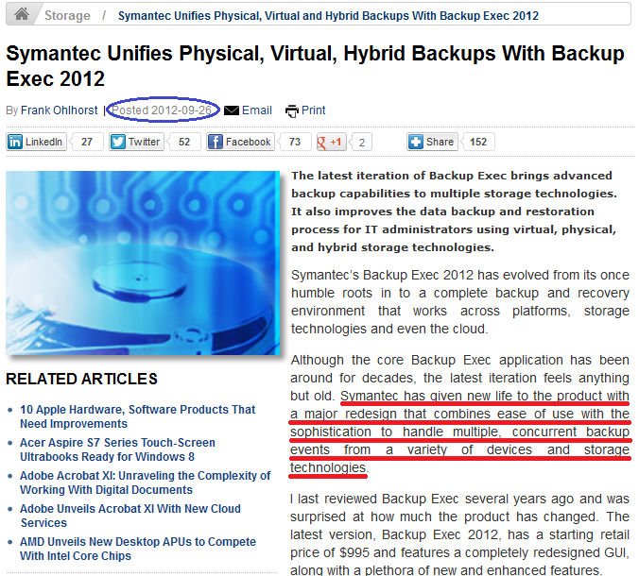

Slide 8
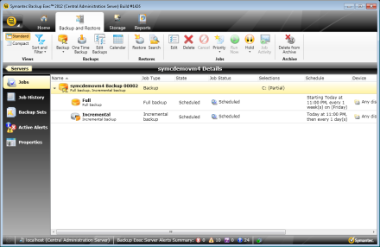
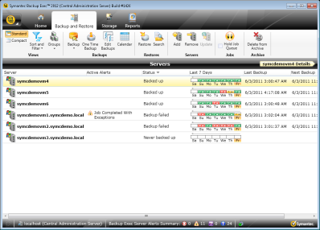
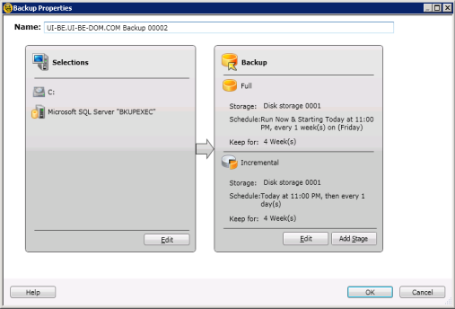
Ease Of Use
Simplified new user interface
New user experience
Focus on ease of use
Resource-centric
Manage resources, not jobs
Backup job stages
Modular backup job stages
Easy to expand protection
Simply add an additional stage to:
Duplicate/copy backups
Convert to virtual
…
8

Slide 9
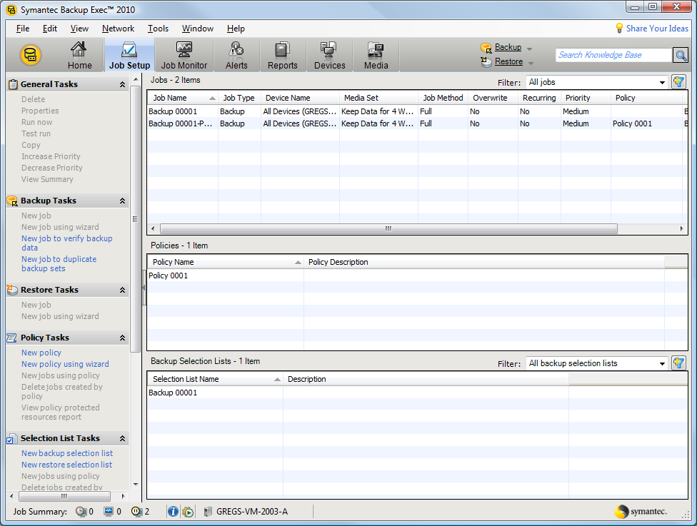
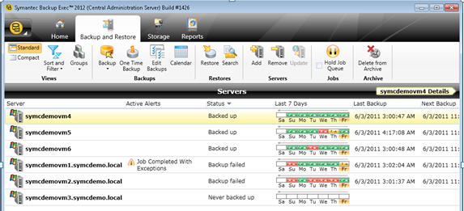
Before And After
Modern
Resource Centric
Unified workflow
Consolidated views
Toolbar instead of “task pane”
9

Slide 10
Better Backup for All
Virtualization Centric Protection
One Product, Any Recovery
Eliminate Complexity
10
Notes:
Symantec is committed to bringing Better Backup for All with Backup Exec. Were doing that in multiple ways with this release of Backup Exec 2012.
Uniting Physical and Virtual Backups
V-Ray Edition for virtualization only workloads
Backup your entire infrastructure – physical or virtual - with a single application
Restore entire virtual machines
Restore entire virtualized applications and granular data in virtualized applications
GRT Recovery for Virtual Machines
Application GRT for virtualized applications
One Product, Any Recovery
Bare-metal disaster recovery for servers
No-hardware DR with P2V conversions for instant restore in a virtual environment
Restore emails, files, folders from disk-based backup or tape-based backup
Reduce Complexity
Completely Redesigned Administration Console designed to make administering backup and recovery easy
All the great features of Backup Exec, now in an intuitive and easy-to-use Administration console
Easier to purchase and maintain
New Editions make it simple to know what Backup Exec product suits your needs
Cleaner licensing designed to simplify the buying experience

Slide 11
Better Backup for All
Virtualization Centric Protection
One Product, Any Recovery
Eliminate Complexity
11
Notes:
Uniting Physical and Virtual Backups
Backup your entire infrastructure – physical or virtual - with a single application
Restore entire virtual machines
Restore entire virtualized applications and granular data in virtualized applications
GRT Recovery for Virtual Machines
Application GRT for virtualized applications

Slide 12
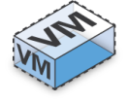
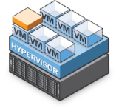
Unite Physical and Virtual
Symantec V-Ray
One vendor, one backup, one application.
Reduce cost and management of multiple products – Complete data, application, and system protection for physical and virtual environments from a single console.
Reduce licensing costs – Backup unlimited Windows and Linux Guest VMs to disk or tape with a single agent licensed per vSphere Host or Hyper-V Host.
Reduce backup storage requirements – Advanced deduplication for physical and virtual backups; granular file and application recovery from a single online, image-level backup.
Physical
Symantec Backup Exec™ 2012
Virtual
12
Notes:
Physical and Virtual Environment Protection
Backup Exec 2012 continues to focus on the need to protect all types of servers found in customer environments, whether they be physical or virtual, with one consolidated solution.
Backup Exec 2012 allows customers and partners to protect everything in their environment using a single backup product. There is no need to purchase one solution for physical server protection and another for virtual server protection – Backup Exec includes powerful integration with VMware’s vSphere platform and Microsoft’s Hyper-V platform to ensure virtual servers are protected properly and protected using the latest technology, ensuring optimal performance and efficiency.
Using a single solution like Backup Exec helps customers and partners save money through the use of a single backup solution for all critical servers in an environment, and offers additional savings through a simplified virtual licensing methodology. Regardless of how many CPU cores a virtual host has, and regardless of how many individual virtual machines a virtual host includes, an entire virtual host and all of its virtual machines can be protected through a single host-based license. This one license per host model continues to save partners and customers more and more as their virtual environments grow. As virtual hosts become more powerful and as additional virtual machines are added to an environment, Backup Exec 2012’s virtual licensing model remains the same – one license per host.
Also, Backup Exec 2012 includes deduplication technology that can be added to an environment to further reduce costs associated with backup storage. This deduplication technology applies to backups of both physical and virtual servers, and includes new technology specific to VMware and Hyper-V to further reduce storage costs and shorten backup windows.
Finally, Backup Exec continues to provide market-leading recovery technology to its customers and partners. Whether protecting physical or virtual servers, Backup Exec 2012 allows customers and partners access to the following recovery features, all from a single-pass backup:
Full machine recovery
Application recovery
Granular application recovery
Granular file and folder recovery
Redirected recovery
For virtualized servers, granular application recovery support has been expanded to include SharePoint, allowing Backup Exec 2012 to support protection and granular recovery for all key Microsoft applications whether they are physical or virtualized, including Exchange, SharePoint, SQL, and Active Directory.
For protection of virtual environments, Backup Exec 2012 is everything a customer or a partner needs. Period.

Slide 13
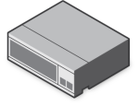
Advanced VMware And Hyper-V Support
Symantec V-Ray
VMware and Hyper-V Protection
Symantec Backup Exec™ 2012 Server
Host-Level Backup
Easy Management
Easy Application Recovery
Data reduction technologies
Optimized data deduplication
Block optimization
Incremental, differential backups
Hyper-V
vSphere
Single pass backup, all recovery options
Full VM recovery
Application Data Recovery for Exchange, SQL SharePoint and Active Directory when licensed
Granular file/folder recovery
Redirected recovery
Virtual Servers & Machines
Note: The Agent for Applications and Databases must be installed in a VM to collect Application MetaData, enabling granular application data recovery.
Backup Exec 2012 Family
13

Slide 14
Agentless Or Agent-based Protection – You Decide
Symantec V-Ray
Go Agentless
Use an Agent in the Guest
Optimize for virtual performance
Restore an entire virtual guest
Integrated Management View with vStorage API
Little or no I/O impact
Optimize for recoverability
Restore an entire guest
Restore granular data
Restore granular application data
Integrated Management View with vStorage API
Agentless
Symantec Backup Exec™ 2012
With an Agent
14

Slide 15
Better Backup for All
Virtualization Centric Protection
One Product, Any Recovery
Eliminate Complexity
15
Notes:
One Product, Any Recovery
Bare-metal disaster recovery for servers
No-hardware DR with P2V conversions for instant restore in a virtual environment
Restore emails, files, folders from disk-based backup or tape-based backup

Slide 16
Integrated Bare Metal Disaster Recovery
Stop managing multiple solutions – included in Backup Exec 2012
Built into the backup process – one backup job gives you data and system protection
Restore to same hardware or dissimilar hardware
Backup Exec™ 2012 Server
Recovery Disk
Symantec
SRD
Simplified System Protection Job
Server Protected
Server Fails
Server Recovered
Backup Exec 2012 Family
16
Notes:
New! Integrated Bare Metal Recovery
Another key enhancement in Backup Exec 2012 is the integration of bare metal restore capabilities.
Leveraging the powerful Symantec Recovery Disk, also used in the Symantec System Recovery product, administrators can easily restore critical business servers from a bare metal state. Bare metal restore operations can be performed using backups stored to either disk or tape storage, including backups that have been stored in deduplicated format. When performing a bare metal restore operation from a backup set stored in a deduplication storage folder, the restore must be done using backup data stored on a remote Backup Exec 2012 server. The Backup Exec 2012 server performs rehydration tasks against the data to be restored, which is then transmitted to the remote server to be restored.
Bare metal restore capabilities come as a part of the Backup Exec 2012 product; no additional license is necessary.
In order to enable bare metal recovery for a protected server, the backup job must be configured for full system protection. This feature is known as Simplified System Protection. Simplified System Protection ensures that the backup set contains all the critical operating system components needed to perform a bare metal recovery. By default, backup jobs in Backup Exec 2012 are enabled for Simplified System Protection.

Slide 17
“No Hardware Disaster Recovery”
Symantec V-Ray
Convert a backup to a Virtual Machine (Hyper-V or VMware)
Have that virtual machine ready & waiting if a disaster strikes!
Can accelerate the move to a more virtualized environment
Backup Exec™ 2012 Server
Protected Server
Hypervisor
Parallel Option
Convert
Backup
Serial Option
Backup
Convert
Backup Exec 2012 Family
17
Notes:
New! Backup and Convert to Virtual
Backup Exec 2012 also expands upon its virtualization story by adding two new key capabilities, physical to virtual conversions, known as P2V.
The parallel conversion process utilizes parallel data streams to store backup data from a protected server to a Backup Exec 2012 server while simultaneously sending the same backup data, in the form of a virtual machine, to a virtual host in the environment. Both VMware vSphere and Microsoft Hyper-V environments are supported. The result of this conversion operation is a fully recoverable backup set as well as a fully functional virtual machine that can be used for warm failover, disaster recovery scenarios.
The serial process is similar, except that the virtual process happens after, or on a different schedule, from the backup operation. The result is still a full virtual machine on a VMware or Microsoft virtual host.
Regardless of how the conversion takes place, a form of dissimilar hardware restore is utilized to ensure that the virtual machines being generated will boot and function properly in a virtualized mode. This happens automatically without user intervention.
Another great thing about this feature is that it can help accelerate the move to a more fully virtualized environment. With Backup Exec 2012, you can convert your physical servers to virtual servers – and then just run them in your virtual environment, retiring your physical server. This makes a lot of sense for a lot of customers today.

Slide 18
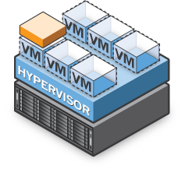
Granular Recovery for Physical and Virtual
Symantec V-Ray
VMware or Hyper-V
Running Virtualized Application Servers
Backup Exec™ 2012 Server
+ Virtual Agent
Single-pass Backup of
Virtual Guest Systems
2
1
Restore granular Exchange, SQL, SharePoint, and Active Directory Data in Seconds:
Individual Mailboxes
E-mails
Private or Public Folders
Calendar Items
Tasks
User Accounts or Attributes
SQL Databases
Backup Exec 2012 Family
18
Notes:
Data and Application Protection, Recovery
Let’s talk about application protection and recovery in a bit more depth. As we all know, customers and partners perform backup tasks for one reason and one reason only: to be able to recover in the event of a disaster.
When protecting virtualized applications, Backup Exec performs a single-pass, image-based backup of the targeted virtual machine. This virtual machine might be hosting critical applications, such as Exchange, SharePoint, SQL, or Active Directory. From that single-pass backup, administrators can recover:
The entire virtual machine, including the application it is hosting
The application itself
Granular application elements, such as Exchange e-mails and attachments, SQL databases, Active Directory objects, or SharePoint documents
Granular file and folder elements
In addition, any of the above items can be restored to an alternate location – known as a redirected recovery – offering customers and partners superior power and flexibility when it comes to recovering virtual machine resources.
It’s important to point out that all this is possible from a single-pass backup. One pass. Backup Exec 2012 does not require multiple backup passes in order to achieve different levels of restore granularity. A single-pass backup enables all of these recovery options to an administrator.
And don’t forget that data deduplication can be added to a Backup Exec environment to further reduce storage costs associated with physical or virtual server backups. We will talk about this deduplication technology in greater detail later in the presentation.

Slide 19
Better Backup for All
Virtualization Centric Protection
One Product, Any Recovery
Eliminate Complexity
19
Notes:
Eliminate Complexity
Completely Redesigned Administration Console designed to make administering backup and recovery easy
All the great features of Backup Exec, now in an intuitive and easy-to-use Administration console
Easier to purchase and maintain
New Editions make it simple to know what Backup Exec product suits your needs

Slide 20
New! Resource-centric User Interface
New Backup Exec 2012 Interface
User experience based around server protection status
Transition from job management to server management
Backup Exec 2012 Family
20
Notes:
New! Resource-centric User Interface
Another significant improvement in Backup Exec 2012 is the redesign of the user interface. The focus has changed from backup job management to the management of critical application servers. Rather than helping administrators focus on the status of individual backup jobs, the new Backup Exec 2012 interface helps administrators focus on the backup status of the servers they are protecting in their environment.
As was mentioned earlier in this presentation, the heart of modern small and medium businesses is the critical application servers that drive business operations. The new resource-centric design of the Backup Exec 2012 user interface puts the critical application server front and center. The Backup Exec 2012 home page will show the administrator the servers they are protecting, their backup status, any active alerts affecting the server, a “last seven days” view, and other key indicators that allow administrators to make important decisions about how to properly protect their environment. If desired, administrators can organize their console views into server groups, further simplifying the management process by allowing administrators to group servers by site, by importance, by type, or by whatever attribute they desire.
A new modern look and feel has also been applied to the Backup Exec 2012 user interface, with a top bar ribbon allowing administrators to easily access common operations. This ribbon automatically changes and adjusts according to the context of the product the administrator has navigated to, whether they are reviewing server status on the Backup Exec home page, configuring protection policies, or managing backup storage.
These changes, and others, are designed to help experienced administrators have access to all of the powerful capabilities of Backup Exec that they need, while making the process of setting up and managing Backup Exec very simple and intuitive for new users.

Slide 21
Eliminate Complexity with easy Backup Job Creation
New job stages feature
Easily expand protection
Just click “Add Stage”
Example:
Stage 1: Backup to Disk
Stage 2: Copy to Tape
Stage 3: Convert to Virtual
Backup Exec 2012 Family
21
Notes:
New! Modular Backup Protection Methodology
Another key enhancement to the Backup Exec user experience is the simplification of backup job creation. Jobs can be simple, such as jobs that store backup data to disk, or can be expanded to include additional steps and operations to offer more advanced and complex protection capabilities.
For example, after initially configuring a backup job to store data to disk, the administrator can click the “Add Stage” button to also copy the same backup data to tape. Other stages can also be added to the same chain, such as converting backups to virtual or copying them to a remote media server.
Administrators get a clear picture of how, when, and where their backup data is flowing with this intuitive new feature in Backup Exec 2012.

Slide 22
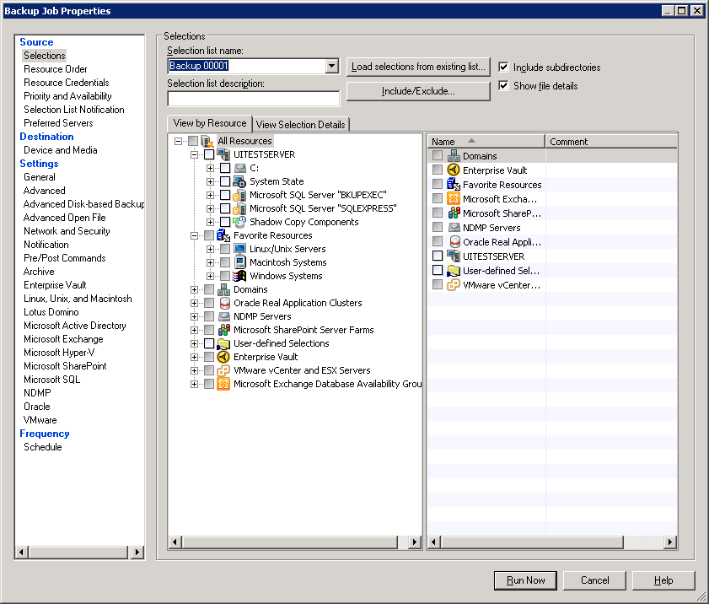
Simplified - User Only Shown Relevant Options
22

Slide 23
Powerful And Flexible Data Deduplication Technology
Client/Source
Deduplication
Server
Deduplication
Appliance
Deduplication
Catalog Data
Backup Exec 2012 Server
Backup Exec 2012 Server
Backup Exec 2012 Server
Backup Stream
File & Application Servers
File & Application Servers
File & Application Servers
OST Powered Storage
Requires Deduplication Option on Backup Exec server and Remote Agent on each client/source
Requires Deduplication Option on Backup Exec server
Requires Deduplication Option on Backup Exec server and OST certified deduplication appliance
23

Slide 24
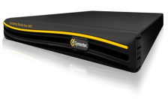
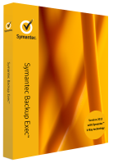
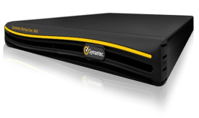
Deduplication Everywhere
Symantec V-Ray
Deduplication optimized for virtual platforms
Stream handlers for VMDK, VHD files
Increases deduplication efficiency across VMs
Flexible deduplication choices
Client-side, server-side, appliance-side
Mix and match
Fully integrated technology
Integrated into Backup Exec software
Integrated into the Backup Exec 3600 appliance
Heterogeneous platform support
Deduplication for Windows
Deduplication for Linux
A
C
B
A
A
B
D
C
A
B
C
D
B
D
D
C
Client
Server
Appliance
24

Slide 25
Backup – Software, Whatever Your Needs
Backup Exec Capacity Licensing
Backup Exec 2012
Backup Exec Small Business Edition
Capacity Licensing
Single SKU Protects an entire site
Metered Per TB
Includes:
Backup Exec 2012
Unlimited Agent for Windows®
Unlimited Agent for Linux®
Deduplication
Unlimited Agent for Applications and Databases,
Unlimited Agent for VMware® and Hyper-V®
Agent for Mac®
Backup Exec
Backup Exec Server
Agent for Windows/Linux/Mac
Remote Media Agent for Linux
Application Agent
Virtualization Option
Deduplication Option
File System Archiving Option
Exchange Mailbox Archiving Option
Enterprise Server Option
NDMP Option (per device)
Library Expansion Option (per device)
VTL Unlimited Drive Option (per device)
Backup Exec Small Business Edition
Manage multiple instances of Backup Exec Small Business Edition
Self-contained
Protects an entire server, can be scaled to protect up to 3 servers in total
Microsoft Servers Supported
Windows (all Editions), SQL®, Exchange® SharePoint®, Active Directory®, Hyper-V
Integrated System Recovery
Virtual Conversions
Backup Destinations
Disk (B2D)/Local Tape
18+ Servers 1000+ Seats
4-17 Servers 71-999 Seats
1-3 Servers 3-70 Seats
Backup Exec 2012 V-Ray Edition
Technical Overview: Backup Exec 2012
25

Slide 26
Backup Exec 2012 Edition To Protect Virtual Environments
Symantec V-Ray
V-Ray Edition
Protection For Virtualized Infrastructures
Backup Exec 2012
Agent for VMware and Hyper-V
Agent for Applications and Databases
Deduplication Option
A
C
B
A
A
B
D
C
A
B
C
D
B
D
D
C
Metering based on number of cores (multiples of 2); OPL generic meter: per processor
Technical Overview: Backup Exec 2012
26

Slide 27
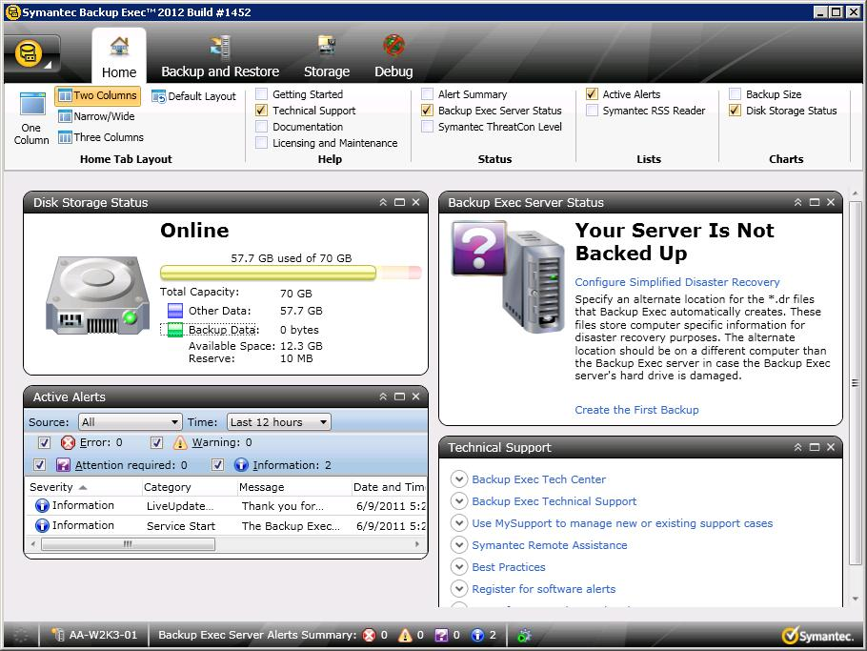
Symantec Backup Exec™ 2012 Small Business Edition
Replaces legacy “SBS” editions
Protects both Windows and Windows Small Business Servers
Protects up to three servers
Microsoft Application & Hyper-V support included
Integrated disaster recovery
B2V, P2V support (Hyper-V only)
Uses new Backup Exec interface
Upgradeable to full Backup Exec
Data Protection in 3 Simple Steps
27
Notes:
New! Backup Exec 2012 Small Business Edition (SBE)
A new edition of Backup Exec is also being introduced, called the Backup Exec 2012 Small Business Edition. This new edition of Backup Exec will replace the previous Small Business Server (SBS) editions of the product.
This new version of Backup Exec is designed specifically for small business. It protects up to three servers, and includes a very simplified user experience designed for those who are not IT professionals. However, key functionality is included with this new edition, including:
Protection and recovery of all key Microsoft applications, such as SQL, Exchange and SharePoint, Active Directory and Hyper-V
Granular application recovery (GRT)
Bare metal recovery
Dissimilar hardware recovery
Physical and virtual protection through one console
For those customers who eventually outgrow their Small Business Edition of Backup Exec, the Small Business Edition easily upgrades to the full Backup Exec 2012 product.

Slide 28
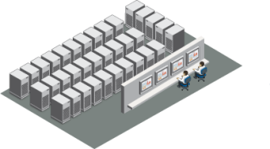
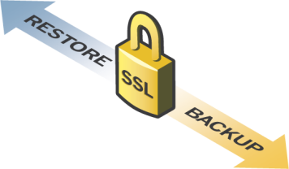
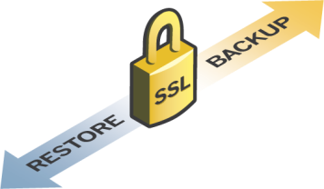
Protect Data in the Cloud with Backup Exec.cloud
Main or Branch Office
Symantec Data Centers
Backup Exec.cloud Admin Anywhere
Deploy Manage Monitor
Remote and Mobile Users
28
Notes:
Simplify Backup, Regain Productivity
Your data, automatically streamed, encrypted, to Symantec’s secure, off-site datacenters
Get started in minutes
Powerful data history
Achieve Predictable costs
No need to buy backup hardware or add maintenance resources
Buy only the data protection you need
Pay no per-user licensing fee
Set-up is fast and simple:
Log onto the web-based management console.
Deploy service agent to target systems (desktops, laptops, and servers).
Create backup policies in the console and set the desired backup schedule.
Perform an initial backup
Automatic backups occur silently in the background
The web-based management console is used for ongoing maintenance
Data is stored for the life of your contract unless it is deleted from your computer or replaced by a newer version – it will then be removed from your backup after 90 days

Slide 29
Do you need more info … ?
29

Slide 30
Top Resources for More Information
URL | What
www.backupexec.com | Backup Exec Family Website
www.backupexec.com/save | Backup Exec Family Promotions
www.backupexec.com/topreasons | Backup Exec 2012 Top reasons to Upgrade
www.backupexec.com/FAQ | Backup Exec 2012 FAQ
www.backupexec.com/compatibility | Software and Hardware Compatibility
www.backupexec.com/video | Backup Exec Videos
www.backupexec.com/configurator | Backup Exec Product Configurator
www.backupexec.com/skugenerator | SKU Generator
30

Slide 31
Try Backup Exec Today!
FREE 60-Day Trial of
Backup Exec 2012
& Backup Exec.cloud
www.backupexec.com
31

Slide 32
32

