Slide 1
The following is intended to outline our general product direction. It is intended for information purposes only, and may not be incorporated into any contract. It is not a commitment to deliver any material, code, or functionality, and should not be relied upon in making purchasing decisions. The development, release, and timing of any features or functionality described for Oracle’s products remains at the sole discretion of Oracle.
© 2011 Oracle Corporation

Slide 2
© 2011 Oracle Corporation

Slide 3
Oracle Database Appliance
Victor Maghiari/Alexandru Tecuceanu/Ciprian Pustianu
Oracle Romania
© 2011 Oracle Corporation
Notes:
Hello, my name is [name] and today I want to cover how the Oracle Database Appliance makes creating a highly available database service simple, reliable and affordable.

Slide 4
Growing Business Critical Services and Data High Availability solutions desirable, but not easily deployed
Complex and
Costly
Specific Skills Required
High Risk
of Failure
© 2011 Oracle Corporation
Notes:
In today’s networked and mobile business world, an every increasing number of services are considered business critical to their organizations, and each typically has an ever-growing data. Should database downtime of these applications occur, it often results in lost revenue, lost productivity, and loss of customer confidence. Unless you have the right technology, skills, and resources, protecting databases from downtime can be risky and error-prone.
Building highly available systems is difficult, complex
Requires advanced integration skills many organizations don’t have
Risky and error-prone with no vendor accountability
Staying with status quo often not an answer
Aging database infrastructure and limited IT budgets impacts application performance and availability
Data that was once not considered business critical often has become so, yet the supporting infrastructure doesn’t support it that way
Rapid data growth has lead to an inefficient use of computing resources, often resulting in many small, disparate databases

Slide 5
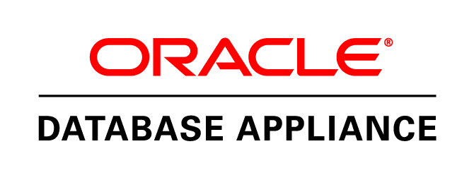
Oracle Database Appliance
Simple. Reliable. Affordable.
Available Now
© 2011 Oracle Corporation
Notes:
The Oracle Database Appliance saves time and money by simplifying deployment, maintenance, and support of high-availability database solutions. Built with the latest generation of the world’s most popular database—Oracle Database 11g—it offers customers a fully integrated system of software, servers, storage, and networking in a single box that delivers high-availability database services for a wide range of homegrown and packaged online transaction processing (OLTP) and data warehousing applications.

Slide 7
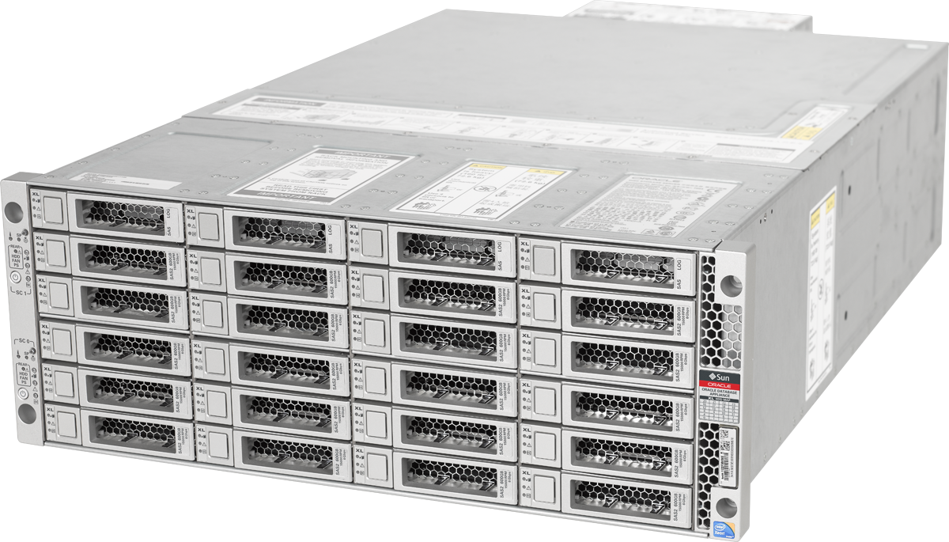
Oracle Database Appliance
Ideal for SMBs and Departmental Systems
Easy to Implement
One box: server, storage, networking
One button installation of software
High availability out of the box
Easy to manage & maintain
One button patching
Self-managing storage
Auto-detects and auto-corrects
Easy to diagnose and support
Automated Service Request filing (phone home)
© 2011 Oracle Corporation
Notes:
Simple
Complete, plug-and-go hardware and software
Scale
Start with as few as two cores, and scale all the way to 24 total cores without the usual expense and downtime of a typical hardware upgrade
Reliable
Configure highly available database cluster in minutes
Advanced management features and single vendor support
Affordable
Pay for capacity as you need it
Consolidate small databases for even more savings

Slide 8
Highly Reliable Software
Oracle Database 11g Enterprise Edition
Automatic Storage Management
Oracle Real Application Clusters
Oracle Clusterware
Oracle Linux
Oracle Appliance Manager software
Phones home automatically to file Service Requests
© 2011 Oracle Corporation
Notes:
The Oracle Database Appliance runs Oracle Database 11g Enterprise Edition, that stripes and mirrors all the data with Auto Storage Management
For high availability and to take advantage of the “cluster in a box” of the Oracle Database Appliance, customers have the choice of running Oracle Real Application Clusters (Oracle RAC) or Oracle RAC One Node for “active-active” or “active-passive” database server failover. Oracle RAC can be part of the initial deployment, or added in the future to extend high availability easily within the same server hardware. This takes advantage or Oracle Clusterware (http://www.oracle.com/technetwork/database/clusterware/overview/index.html) and runs on top of Oracle Linux.
The Oracle Database Appliance comes with the extremely easy-to-use Application Manager software, which can automatically notify you and your Oracle Support Team of issues, and even automatically open Service Requests. Application Manager provide significantly more benefits beyond extending reliability and resilience, and I’ll talk more about it in just a moment.

Slide 9
Test\Demo Program:
ODA – Hardware complet redundant – Cluster in a box - 10-15 min
ODA – Instalare si configurare (15-20 min)
RAC – disponibilitate continua pentru baza de date (15-20 min)
ASM – Managementul usor si performanta maxima pentru discurile bazei de date (15-20 min)
Testele se desfasoara in standul Oracle

Slide 10
Oracle Database Appliance - Complete and Integrated
1 box contains everything you need for a HA Database Cluster
2 High performance Servers
12TB Disk
Internal Interconnect
External network connections
Operating System
Oracle Database Enterprise Edition
High Availability software
Software kit for Installation, patching and management
© 2011 Oracle Corporation
Notes:
The Oracle Database Appliance hardware is a single 4U rackmountable chassis containing two Oracle Linux server nodes, each with two 6-core Intel Xeon processors X5675 and 96 GB of memory. The two server nodes are connected via an internal redundant gigabit Ethernet (GbE) interconnect for cluster communication, and each provides both GbE and 10 GbE external networking connectivity. The appliance contains 12 TB of raw storage that’s triple-mirrored, offering 4 TB of resilient usable database storage. There are also four 73 GB solid-state disks for database redo logs to boost performance. The appliance is designed with mission-critical requirements in mind, with hot-swappable and redundant components.

Slide 11
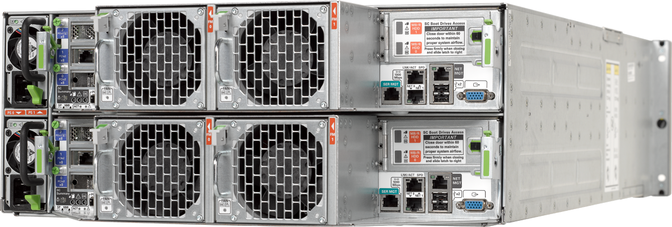
Fully Redundant Hardware
Built-in redundancy
Server, storage, network, power and cooling
2 x dual-socket Oracle X86 servers
192 GB main memory (96GB per node)
24 Intel Xeon processor X5675 cores (2 x 6C, 3.06 GHz CPU per node)
Two internal boot disks per node
12 TB raw disk storage
24 3.5” dual ported SAS/SATA/SSD disk slots
20 x 600GB 15K RPM SAS(4 TB Usable for database files)
292 GB solid state storage
4x 73GB STEC GEN3 SSD(for redo logs)
2 Hot-swap redundant power supplies
© 2011 Oracle Corporation
Notes:
The Oracle Database Appliance hardware is a single 4U rackmountable chassis containing two Oracle Linux server nodes, each with two 6-core Intel Xeon processors X5675 and 96 GB of memory. The two server nodes are connected via an internal redundant gigabit Ethernet (GbE) interconnect for cluster communication, and each provides both GbE and 10 GbE external networking connectivity. The appliance contains 12 TB of raw storage that’s triple-mirrored, offering 4 TB of resilient usable database storage. There are also four 73 GB solid-state disks for database redo logs to boost performance. The appliance is designed with mission-critical requirements in mind, with hot-swappable and redundant components.

Slide 12
Easy to Install
Rapidly Deploy a Database Cluster
Plug in the power
Plug in the network
Wizard-driven install
© 2011 Oracle Corporation
Notes:
Running the appliance does not require specialized clustering or high availability skills. Just plug in the power, plug it into the network, push the one-button install on Application manager software, and you’re ready to go.

Slide 13
Easy to Deploy, Manage, and Maintain
Reduced Installation and Administration Effort
Installation Expertise
Optimization Expertise
Network Administration
Storage Administration
System Administration
Database Administration
Savings
Time
Cost
Oracle Appliance Manager
Build Your Own
Oracle Database
Appliance
© 2011 Oracle Corporation
Notes:
13
All of this ease in deployment and on-going management saves on the enormous effort it takes to run highly available systems, which adds to the costs. With the Oracle Database Appliance, the typically required installation and optimization, as well as administration required for system and networking are automated, removing significant time requirements and related costs, and reducing the required skill sets to operate.

Slide 14
Three Tiers of Availability
Single Instance
Active – Passive
Active – Active
Good Availability
Oracle Database 11g Enterprise Edition
Better Availability
Oracle Database 11g Enterprise Edition
Oracle Real Application Clusters One Node
Can have mutual failover
Best Availability
Oracle Database 11g Enterprise Edition
Oracle Real Application Clusters
Mutual failover and loadbalancing
© 2011 Oracle Corporation
Notes:
The Oracle Database Appliance runs Oracle Database 11g Enterprise Edition, that stripes and mirrors all the data with Auto Storage Management
For high availability and to take advantage of the “cluster in a box” of the Oracle Database Appliance, customers have the choice of running Oracle Real Application Clusters (Oracle RAC) or Oracle RAC One Node for “active-active” or “active-passive” database server failover. Oracle RAC can be part of the initial deployment, or added in the future to extend high availability easily within the same server hardware. This takes advantage or Oracle Clusterware (http://www.oracle.com/technetwork/database/clusterware/overview/index.html) and runs on top of Oracle Linux.
The Oracle Database Appliance comes with the extremely easy-to-use Application Manager software, which can automatically notify you and your Oracle Support Team of issues, and even automatically open Service Requests. Application Manager provide significantly more benefits beyond extending reliability and resilience, and I’ll talk more about it in just a moment.

Slide 15
‘Pay-as-you-Grow’ Database Licensing
Purchase single hardware configuration
Start with minimum of 2 processor core licenses
Scale to maximum of 24 processor core licenses
No hardware upgrades required
License database software just for the cores you use
© 2011 Oracle Corporation
Notes:
The Oracle Database Appliance offers customers a unique pay-as-you-grow software licensing model to quickly scale from 2 to 24 processor cores without any hardware upgrades. Customers can deploy the Oracle Database Appliance with as few as 2 processors cores to run their database servers, and incrementally scale up to the maximum of 24 processor cores within the same hardware envelope. This avoids the usual costs and scheduled downtime of a typical hardware upgrade, and enables customers to deliver the performance and high availability that business users demand as they align software spending with business growth.

Slide 16
When to Use the Oracle Database Appliance
Ideal for SMBs and Departmental Systems
Database(s) up to a maximum of 4 TB of data
Fast, efficient replacement of aging servers
Higher availability for application databases
Migrate and consolidate databases
© 2011 Oracle Corporation
Notes:
The Oracle Database Appliance is the ideal database platform for SMB and departmental solutions running databases up to 4TB. Whether you are looking to deploy new databases or replace aging systems with faster and more efficient new servers, the Oracle Database Appliance can deliver the high availability many of your applications require today or in the future. And as you look at all of your servers running databases, the Oracle Database Appliance provides you a very affordable platform to migrate and consolidate various databases while improving quality of service.

Slide 17
Test Program:
ODA – Hardware complet redundant – Cluster in a box (10-15 min)
ODA – Instalare si configurare (15-20 min)
RAC – disponibilitate continua pentru baza de date (15-20 min)
ASM – Managementul usor si performanta maxima pentru discurile bazei de date ( 15-20 min)
Testele se desfasoara in standul Oracle

Slide 18
INTERBRANDS – CONS - proof of concept -
Ciprian Pustianu
Technology Senior Sales Consultant

Slide 19
Agenda
Context
Cerinte functionale POC
Solutia tehnica propusa
Rezultate POC
Beneficiile solutiei propuse
Recomandari

Slide 20
Context
Oracle Database 11.2.0.1 – Microsoft Windows Server 2008
Arhitectura bazei de date are la baza o versiune veche de solutie tranzactionala
Nu mai exista suport pentru aceasta aplicatie
Raportarea se face folosind QlikView sau query-uri ad-hoc
Tinta o constituie interogarile costisitoare din baza de date
Se doreste:
Imbunatatirea timpilor de raspuns
Asigurarea unei disponibilitati ridicate
Realizarea operatiilor de backup intr-un timp cat mai scurt
Managementul usor pentru solutia de baza de date

Slide 21
Cerinte functionale POC
Au fost selectate 11 interogari semnificative pentru activitatea de raportare din cadrul companiei:
Balante (analitica, contabilitate, partiala, solduri)
Fisa cont (magazine, centralizata, 5121BW02)
Provizioane si Aging
Instalare usoara si rapida baza de date
Simplitate in administrare solutiei
Disponibilitate ridicata baza de date

Slide 22
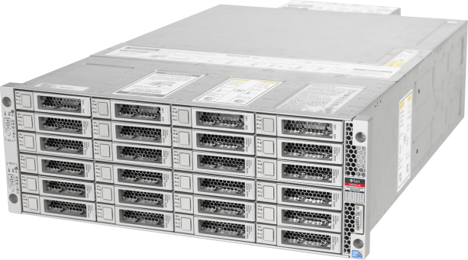
Solutia tehnica propusa

Slide 23
Hardware redundant – Cluster in a box
2 x dual-socket Server Nodes (X5675), 96Gb RAM fiecare
20x600Gb disk, 4x73Gb SSD, conectivitate1GbE si 10GbE
Software fiabil si robust – Oracle Database & Clusterware
Oracle Linux 5.8 and Oracle Database 11.2.0.3
Usurinta in instalare, administrare si configurare
Oracle Appliance Manager
Configuratie optima bazata pe best practices
Mod de licentiere de tip Pay-as-you-grow

Slide 24
Security
Performance & Availability
Manageability
Advanced Security Label Security Database Vault
Active Data Guard In-Memory DB
Diagnostics Pack Tuning Pack Lifecycle Mgmt Pack Test Data Management
Data Masking
Pack Real Application Testing
Partitioning Advanced Compression OLAP Advanced Analytics Spatial
Cloud File System Secure Backup Audit Vault Database Firewall
Data Integrator GoldenGate

Slide 25
Rezultate POC
Testele de performanta au fost rulate in mod comparativ
Caracteristici baza de date de test (ODA):
A fost clonat mediul de productie CONS3
Scripturi generate din baza de productie (DBMS_METADATA);
Datele au fost incarcate cu insert as select;
Indecsii si codul PL/SQL( triggeri, functii, etc) s-au generat prin fisiere de tip dump
522 GB dimensiune totala
AL32UTF8 setul de caractere si 16k blocksize
ASM
12 core si 48Gb SGA

Slide 26
Rezultate POC
Denumire test | ODA (test) Run1 | ODA (Test) Run 2 | CONS (Prod) Run 1 | CONS (Prod) Run 2
01 – Balanta analitica | 421 s | 416 s | 1002 s | 711 s
02 – Balanta obisnuita | 420 s | 418 s | 775 s | 662 s
03 – Balanta contabilitate | 443 s | 337 s | 693 s | 528 s
04 – Balanta partial | 496 s | 425 s | 1014 s | 800 s
05 – Balanta solduri | 419 s | 317 s | 712 s | 642 s
06 – Fisa cont 5121BW02 | 19 s | 12 s | 86 s | 56 s
07 – Fisa cont centralizata | 277 s | 31 s | 446 s | 344 s
08 – Fisa magazine | 77 s | 83 s | 259 s | 143 s
09 – Rev stoc | 221 s | 220 s | 282 s | 275 s
10 – Aging | 153 s | 156 s | 300 s | 291 s
11 – Provizioane | 210 s | 202 s | 242 s | 291 s
12 – Backup full RMAN | 30 minute |  | 60 minute

Slide 27
Rezultate POC

Slide 28
Rezultate POC
45%
imbunatatire a timpului de raspuns

Slide 29
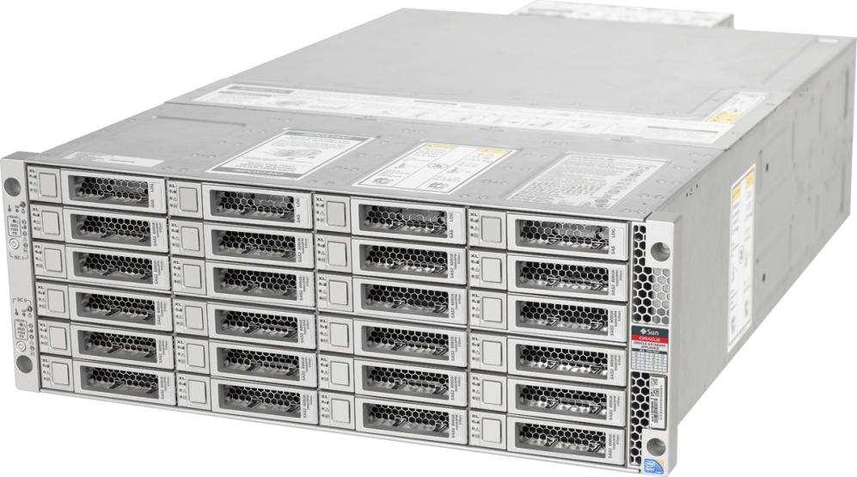
Beneficiile solutiei propuse
Simplitate in instalare, configurare si administrare
Hardware integrat si performant, de clasa enterprise
Pay-as-you-grow
Flexibilitate arhitectura baza de date
RAC
Single Instance
ASM pentru managementul discurilor
Configuratie software optimizata
Punct unic de suport

Slide 30
Test Program:
ODA – Hardware complet redundant – Cluster in a box (10-15 min)
ODA – Instalare si configurare (15-20 min)
RAC – disponibilitate continua pentru baza de date (15-20 min)
ASM – Managementul usor si performanta maxima pentru discurile bazei de date ( 15-20 min)
Testele se desfasoara in standul Oracle

Slide 32
Q&A
© 2011 Oracle Corporation
Notes:
Let’s take any of your questions.

Slide 33
© 2011 Oracle Corporation
Notes:
Thank you for your time.

