Slide 1
VMware News: vSphere and vCloud Suite, ingredients for Building Your Software Defined DataCenter
Cristian RADU
Territory System Engineer – Ro, Bg, Md

Slide 2
Agenda
New model - Software Defined Datacenter
vSphere 5.1 Overview
Compute, Storage, Network - Enhancements and Features
Availability, Security, Automation - Enhancements and Features
vCenter Server - Enhancements and Features
Additional Features and Enhancements – “The Best of the Rest”
Products PnP Highlights

Slide 3
Three Key Trends Drive Us Towards a New Model
X86 Price/ Performance
Virtualization for all Apps
Virtualization of all Hardware Components

Slide 4
A New Approach to Cloud
The Software Defined Datacenter

Slide 5
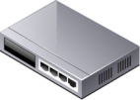
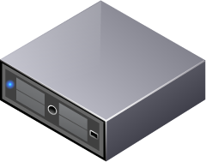
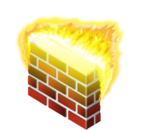
Virtualization Simplifies Provisioning of VMs, But Additional Steps Needed to Deploy in a Production Environment
Enterprise storage
Past
Present
VLAN networks
+
Firewall, load-balancer
$300 2 minutes
IDS, security, monitoring
$10,000 10 weeks
$1,800 5 days, 2 minutes
Availability

Slide 6
Software-Defined Datacenters Simplifies Process to Define an Application and All the Resources It Needs
Future
VDC
Software-defined Datacenter Services
5 days, 2 minutes
3 minutes

Slide 7
In a Software-Defined Datacenter…
All infrastructure services are delivered as software
And, the control of this datacenter is entirely driven by software

Slide 8
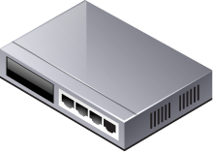
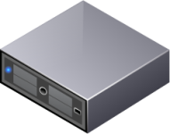
APP
APP
APP
APP
APP
APP
APP
APP
OS
OS
OS
OS
OS
OS
OS
OS
Compute

Slide 9
APP
APP
APP
APP
APP
APP
APP
APP
OS
OS
OS
OS
OS
OS
OS
OS
Software Defined Storage
Compute

Slide 10
APP
APP
APP
APP
APP
APP
APP
APP
OS
OS
OS
OS
OS
OS
OS
OS
Software Defined Storage
Software Defined Networking and Security
Compute

Slide 11
APP
APP
APP
APP
APP
APP
APP
APP
OS
OS
OS
OS
OS
OS
OS
OS
Management & Automation
Software Defined Storage
Software Defined Networking and Security
Compute

Slide 12
APP
APP
APP
APP
APP
APP
APP
APP
OS
OS
OS
OS
OS
OS
OS
OS
Software Defined Datacenter
VDC 1
VDC 2
Management & Automation
Software Defined Storage
Software Defined Networking and Security
Compute

Slide 13
The Cloud Bill Of Materials
Management
Cloud Infrastructure
Extensibility
Secure Multi-Tenancy
Placement and Load Balancing of Software Defined DC Services
Software Defined Storage
Software Defined Networking
Software Defined Security
Software Defined Availability
Automated Provisioning for Applications
Automated Cloud Operations Management
Cloud APIs
Application Migration b/w Clouds
Orchestration with 3rd Party Systems
Virtualization
SW Defined Compute & Memory

Slide 14
VMware’s Complete Cloud Infrastructure & Management Suite
Management
Cloud Infrastructure
Extensibility
vCloud Director
Software Defined Storage
Software Defined Networking
Software Defined Security
Software Defined Availability
vFabric Application Director
vCenter Operations Mgmt Suite
vCloud APIs
vCloud Connector
vCenter Orchestrator
Virtualization
vSphere

Slide 15
VMware’s Complete Cloud Infrastructure & Management Suite
Management
Cloud Infrastructure
Extensibility
vCloud Director
Distributed Storage Tech Prev
vCloud Networking & Security
Site Recovery Manager
vFabric Application Director
vCenter Operations Mgmt Suite
vCloud APIs
vCloud Connector
vCenter Orchestrator
Virtualization
vSphere

Slide 16
VMware’s vCloud Suite is…
A cloud infrastructure suite that dramatically simplifies IT operations…
…delivering the best SLAs for all Apps
…available in one SKU

Slide 17
VMware vSphere 5.0
Application Services
Infrastructure Services
Virtual Appliance
Web Client
vCenter Server
vCenter Server
New HA
Architecture
vMotion over
higher latency links
ESXi Firewall
32 way SMP
1 TB VMs
Availability
Security
Scalability
VMware vSphere 5
Compute
Storage
Network
ESXi Convergence
Auto Deploy
HW version 8
Storage DRS
Profile-Driven Storage
VMFS 5
Storage I/O Control (NFS)
Network I/O Control
(per VM controls)
Distributed Switch
(Netflow, SPAN, LLDP)

Slide 18
What’s New in vSphere 5.1?
Single Sign On (vCD, vShield, vCenter)
vSphere Web Client
vCenter Server 5.1
Enhanced vCenter Orchestrator
Data Protection
Replication
vMotion w/o shared storage
0 Downtime upgrades of VMware Tools
vShield Endpoint
Storage DRS and
Profile-Driven Storage
working with VCD
Enhanced Auto
Deploy
Availability
Security
Automation
VMware
vSphere 5.1
Compute
Storage
Network
HW version 9
64 way SMP
1 TB VMs
Storage Space Reclamation for VDI
Enhanced Distributed Switch
SR-IOV support

Slide 19
Compute, Storage, Network -Enhancements and Features

Slide 20
Auto Deploy
Overview
vCenter Server with Auto Deploy
Deploy and patch vSphere hosts in minutes using a new “on the fly” model
Coordination with vSphere Host Profiles
2 new operating modes
Image Profiles
Host Profiles
Benefits
Fast initial deployment and patching
Centralized host and image management
Reduce manual deployment and patch processes
Continue deployment even when a failure occurs
vSphere
vSphere
vSphere
vSphere

Slide 21
Distributed Switch
Overview
Distributed Switch now delivers:
Network Healthcheck
Configuration Backup and Restore
Roll Back and Recovery
LACP Support
vSphere
vSphere
vSphere
Benefits
Visibility into physical and virtual network status
Backup and recover network settings
Fast recovery from lost connectivity or incorrect configurations

Slide 22
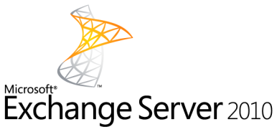
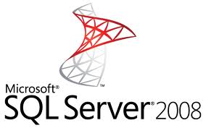
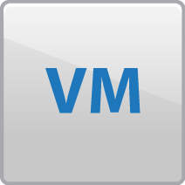
vSphere Scales to Support Mission-Critical Applications
Overview
Create virtual machines with up to:
64 vCPU
1 TB of vRAM
Benefits
2x
2x size of previous vSphere versions
Run even the largest applications in vSphere, including very large databases
Virtualize even more applications than ever before (Tier 1 and 2)

Slide 23
Availability, Security, and Automation - Enhancements and Features

Slide 24
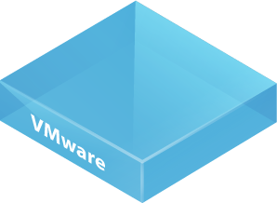
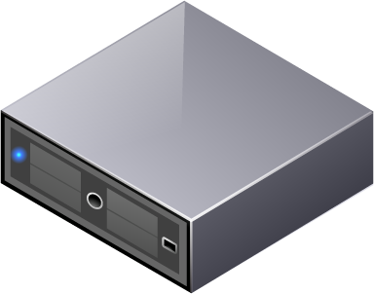
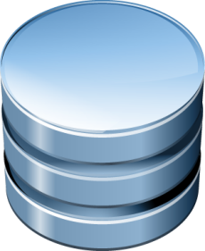
vMotion (w/o Shared Storage)
Overview
Live migration of a virtual machine without the need for shared storage
Extends VMware’s revolutionary technology for automated virtual machine movement
Benefits
Zero downtime migration
No dependency on shared storage
Lower operating cost
Helps meet service level and performance SLAs

Slide 25
vSphere Data Protection
Overview
New backup and recovery tool for the vSphere platform
Replaces vSphere Data Recovery
Based on EMC Avamar
VDP
VMware vSphere
Benefits
Use less disk space with deduplication
Simple setup and management
Proven technology
DATA DEDUPLICATED
AND STORED ON VDP
APPLIANCE
*All editions and kits with the exception of Essentials

Slide 26
vSphere Replication
Site A (Primary)
Overview
Virtual machine level replication by the vSphere host
Included with vSphere*
vSphere
vSphere Replication
Benefits
Site B (Recovery)
Low cost/efficient replication option
Simple setup from within vCenter Server
Integration with SRM enables automated DR process
vSphere
*All editions and kits with the exception of Essentials

Slide 27
vShield Endpoint
Overview
Secure your VMs with offloaded anti-virus and anti-malware (AV) solutions without the need of agents
Included with vSphere*
Benefits
Simplified AV administration
Higher consolidation ratios by preventing the possibility of AV storms
Improved performance
*All editions and kits with the exception of Essentials

Slide 28
vCenter Server - Enhancements and Features

Slide 29
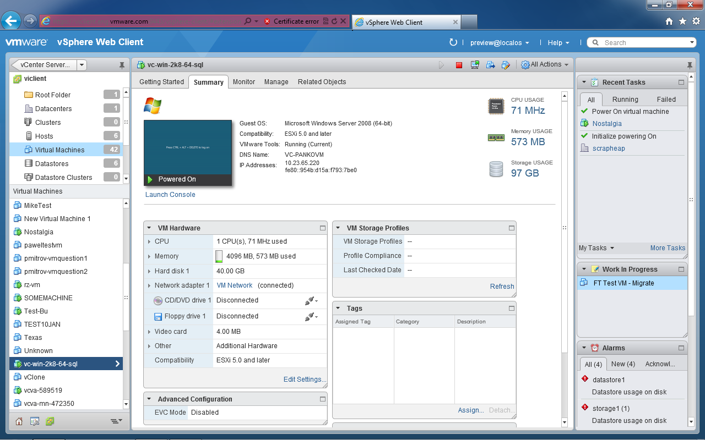
Web Client
Inventory Objects
Create Custom Actions
Overview
Object Navigator
New, improved interface into vSphere delivers:
Browser-based experience
Custom tagging
Scalability
Enhanced workflow management
Tabs
Benefits
Platform independence
Tag based on specific business cases
Manage more objects and 3x more active sessions than ever before
Pause and resume even the most complex workflow or task
Portlets
Add right-click extensions
Sidebar Extension

Slide 30
Single Sign-On
Overview
Sign-on once rather than multiple times in vCenter Server
vSphere Solutions
Benefits
vCenter
vCO
Inventory Service
vSphere
Web Client
vSphere
Platform
Services
Faster operations
Less complexity
Support for multiple identity services
Future building block for other VMware
products and solutions
Authorization
Authentication
(Single Sign On)
Auditing
Customer
Identity Sources
Active
Directory
Open
LDAP
NIS
Local OS
Users

Slide 31
vCenter Orchestrator
Overview
Workflow Engine
Enhancements:
Web Client Integration (launch workflows)
New workflow design
Simplified configuration and installation
Benefits
Execute workflows with a single interface
Simplicity thru drag and drop workflow creation
Automatic configuration
Deploy as a virtual appliance

Slide 32
Additional Features and Enhancements

Slide 33
The Best of the Rest
Platform
Hardware Version 9
ESXi Platform Updates
New VM Features and Capabilities
VMware Tools
Host Profiles
Network
SR-IOV
Port Mirroring Enhancements
Scale
OS Support
Windows 8 Server and Desktop
Storage
VMFS File Sharing Limits
Space Efficient Sparse Virtual Disks
5 Node MSCS Cluster
Storage Protocol Enhancements
Storage Resource Management Enhancements
vCloud Director Interoperability
**Details on the new vSphere Storage Appliance 1.5 (which works in conjunction with vSphere 5.1) are available in a separate customer overview

Slide 34
Products PnP Highlights
vSphere, vSphere Storage Appliance

Slide 35
vSphere 5.1: vSphere and vCenter Server Purchasing Options
vCenter Server Standard Edition (purchased separately)
1
vSphere Editions
Per CPU licenses, completely scalable
vSphere Standard
vSphere Standard w/ Operations Management
vSphere Enterprise
vSphere Enterprise Plus
2
vSphere Kits
Essentials Kits
Acceleration Kits¹
For small environments,
up to 3 virtualized hosts
All in one soft bundles for new customers to get started
Starts at 6 CPUs, scalable with vSphere Editions
Essentials Kit $495
Essentials Plus Kit
$4,495
Standard AK
$6,995
Standard w/ Ops Mgmt AK
$10,000
Enterprise AK
$17,495
Enterprise Plus AK $21,995
vCenter Server for Essentials
vCenter Server for Essentials
vCenter Standard
vCenter Standard
vCenter Standard
vCenter Standard
vSphere Essentials (6 procs)
vSphere Essentials Plus (6 procs)
vSphere Standard (6 procs)
vSphere Standard w/ Ops Mgmt (6 procs)
vSphere Enterprise (6 procs)
vSphere Enter. Plus (6 procs)
VSA for Essentials +
vSphere Storage Appliance
vSphere Storage Appliance
vSphere Storage Appliance
vSphere Storage Appliance
1 Limited to one per customer site

Slide 36
vSphere 5.1: Edition Lineup
New in vSphere 5.1
Improved in vSphere 5.1
Standard
Enterprise
Enterprise+
Price (license only)
$995
$2,875
$3,495
Entitlements
vRAM Entitlement
Unlimited
Unlimited
Unlimited
vCPU / VM
8-way
32-way
64-way
Features
High Availability
Data Protection
vMotion
vShield Endpoint
vSphere Replication
Hot Add
vShield Zones
Fault Tolerance (1 vCPU)
Storage vMotion
Virtual Serial Port Concentrator
Storage APIs for Array Integration, Multipathing
Distributed Resource Scheduler and Distributed Power Management
Distributed Switch
I/O Controls (Network and Storage)
Host Profiles and Auto Deploy
Storage DRS and Profile-Driven Storage
SR-IOV
All editions include: Thin Provisioning, Update Manager, Storage APIs for Data Protection, Image Profile, and SLES (except Ess and Ess +)

Slide 37
vSphere 5.1: Edition Lineup (cont’d)
New in vSphere 5.1
Improved in vSphere 5.1
Essentials
Essentials+
Standard
Standard with Operations Management
Price (license only)
$83
$749
$995
$1,995
Entitlements
vRAM Entitlement
Unlimited
Unlimited
Unlimited
Unlimited
vCPU / VM
8-way
8-way
8-way
8-way
Features
High Availability
Data Protection
vShield Endpoint
vSphere Replication
vMotion
vShield Zones
vSphere Storage Appliance
Hot Add
Fault Tolerance (1 vCPU)
Storage vMotion
vCenter Operations Management Suite Advanced
vCenter Protect
Virtual Serial Port Concentrator
Storage APIs for Array Integration, Multipathing
Distributed Resource Scheduler & DPM
Distributed Switch
I/O Controls (Network and Storage)
Host Profiles and Auto Deploy
Storage DRS and Profile-Driven Storage
SR-IOV
37
All editions include: Thin Provisioning, Update Manager, Storage APIs for Data Protection, Image Profile, and SLES (except Ess and Ess +)

Slide 38
vSphere 5.1: No Change in Entitlement Paths
vSphere 5.0
vSphere 5.1
Enterprise Plus
Enterprise Plus
Enterprise
Enterprise
Standard
Standard
Essentials Plus
Essentials Plus
Essentials
Essentials

Slide 39
vSphere 5.1: Upgrade Paths for vSphere Editions and Kits
Paid upgrade SKUs available
Enterprise
Enterprise Plus
Enterprise Plus
Enterprise
Standard
Standard with Operations Management
Essentials Plus
Any one of the Acceleration Kits
Any one of the Acceleration Kits
Essentials
Essentials Plus

Slide 40
vSphere Storage Appliance 5.1: Edition Lineup
VSA on a standalone basis is licensed per instance, where 1 VSA instance = 1 VSA cluster
 | VSA 5.1
 | VSA for Essentials Plus | VSA
Pricing/Packaging | $4,495 (Essentials Plus) | $3,495 (1 cluster standalone) $3,995 (Essentials Plus with VSA ROBO for 1 site) $6,995 - $21,995 (Acceleration Kits)
Scalability Limits
Nodes per cluster | 3 | 3
Features
RAID 5/6/10 Support
Brownfield deployment (install on existing environments)
vCenter running on VSA cluster
Add/replace hard disk drives non-disruptively
Centralized mgmt of multiple VSA clusters 1 vCenter Server Standard : 150 VSA clusters
Introduced in VSA 5.1

Slide 41
vCloud Suite Edition Lineup
vCloud Suite Standard
vCloud Suite Advanced
vCloud Suite Enterprise
Price (per CPU, license only)
$4,995
$7,495
$11,495
Virtualization
vSphere Enterprise Plus Virtualized infrastructure with policy-based automation
Cloud Infrastructure
vCloud Director & vCloud Connector Virtualized datacenters with multi-tenancy and public cloud extensibility
Standard vCloud Networking and Security Software defined networking, security, and ecosystem integration
vCNS Standard
vCNS Advanced
vCNS Advanced
Advanced vCloud Networking and Security Continuous firewall and network availability
vCenter Site Recovery Manager Enterprise Automated disaster recovery planning, testing, and execution
vCenter SRM
Operations Management
vCenter Operations Management Suite - Performance monitoring and alerting - Capacity planning, reporting, and optimization
vCOps Advanced
vCOps Enterprise
vCenter Configuration Manager Configuration and compliance management of virtual infrastructure
vCenter Infrastructure Navigator Application discovery, dependency mapping, and management
vCenter Chargeback Manager Metered chargeback reporting and accountability
vFabric Application Director Multi-tier application service catalog publishing and provisioning

Slide 42
Thank You!

