Slide 1
Driving the Next Wave of Datacenter Innovation
Alejandro Pacheco
Technical Consultant

Slide 2

No Time for Down Time
2

Slide 3
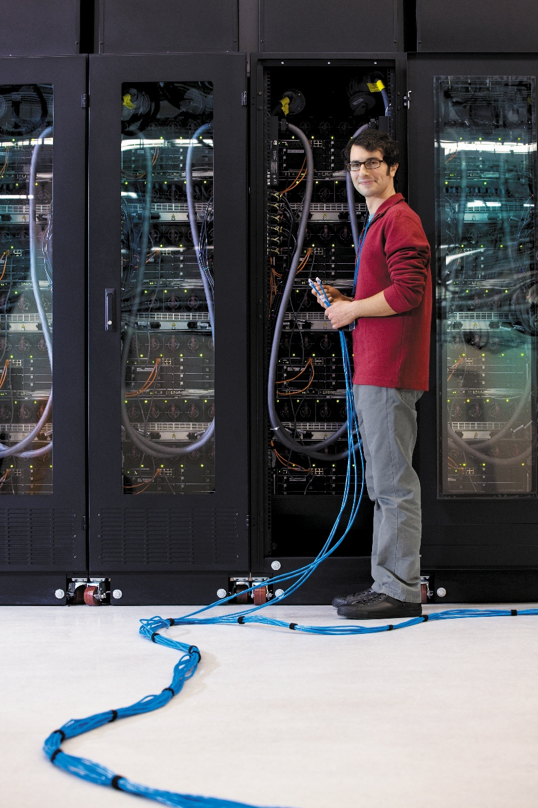
Maguay is Intel Partner since 1998.
In 2000 Maguay become - Intel Authorized Solution Provider
Intel Technology Provider Platinum Partner .
Maguay fully embraced Intel concept of offering the latest technology.
In 2001 Maguay built the first server with 8 CPUs in Romania, PowerServer 8-way
Maguay is the only Romanian partner trained and certified by Intel to provide Intel Itanium 2 solutions
In 2012 at CeBIT Intel awarded Maguay for their outstanding contribution to educate clients on Intel Server Technology in Romania.
In 2012 Maguay launched The first Ultrabook PC in CEE region Maguay MyWay U1401i in 2012.
3

Slide 4
Legal Disclaimers
All products, computer systems, dates, and figures specified are preliminary based on current expectations, and are subject to change without notice. Intel processor numbers are not a measure of performance. Processor numbers differentiate features within each processor family, not across different processor families. Go to: http://www.intel.com/products/processor_number
Intel, processors, chipsets, and desktop boards may contain design defects or errors known as errata, which may cause the product to deviate from published specifications. Current characterized errata are available on request. Intel® Virtualization Technology requires a computer system with an enabled Intel® processor, BIOS, virtual machine monitor (VMM). Functionality, performance or other benefits will vary depending on hardware and software configurations. Software applications may not be compatible with all operating systems. Consult your PC manufacturer. For more information, visit http://www.intel.com/go/virtualization
No computer system can provide absolute security under all conditions. Intel® Trusted Execution Technology (Intel® TXT) requires a computer system with Intel® Virtualization Technology, an Intel TXT-enabled processor, chipset, BIOS, Authenticated Code Modules and an Intel TXT-compatible measured launched environment (MLE). Intel TXT also requires the system to contain a TPM v1.s. For more information, visit http://www.intel.com/technology/security
Intel, Intel Xeon, Intel Atom, Intel Xeon Phi, Intel Itanium, the Intel Itanium logo, the Intel Xeon Phi logo, the Intel Xeon logo and the Intel logo are trademarks or registered trademarks of Intel Corporation or its subsidiaries in the United States and other countries.
Other names and brands may be claimed as the property of others.
Copyright © 2013, Intel Corporation. All rights reserved.

Slide 5
Legal Information
Today’s presentations contain forward-looking statements. All statements made that are not historical facts are subject to a number of risks and uncertainties, and actual results may differ materially. Please refer to our most recent Earnings Release and our most recent Form 10-Q or 10-K filing for more information on the risk factors that could cause actual results to differ.
If we use any non-GAAP financial measures during the presentations, you will find on our website, intc.com, the required reconciliation to the most directly comparable GAAP financial measure.
INFORMATION IN THIS DOCUMENT IS PROVIDED “AS IS”. NO LICENSE, EXPRESS OR IMPLIED, BY ESTOPPEL OR OTHERWISE, TO ANY INTELLECTUAL PROPERTY RIGHTS IS GRANTED BY THIS DOCUMENT. INTEL ASSUMES NO LIABILITY WHATSOEVER AND INTEL DISCLAIMS ANY EXPRESS OR IMPLIED WARRANTY, RELATING TO THIS INFORMATION INCLUDING LIABILITY OR WARRANTIES RELATING TO FITNESS FOR A PARTICULAR PURPOSE, MERCHANTABILITY, OR INFRINGEMENT OF ANY PATENT, COPYRIGHT OR OTHER INTELLECTUAL PROPERTY RIGHT.
Software and workloads used in performance tests may have been optimized for performance only on Intel microprocessors. Performance tests, such as SYSmark and MobileMark, are measured using specific computer systems, components, software, operations and functions. Any change to any of those factors may cause the results to vary. You should consult other information and performance tests to assist you in fully evaluating your contemplated purchases, including the performance of that product when combined with other products.
Intel product plans in this presentation do not constitute Intel plan of record product roadmaps. Please contact your Intel representative to obtain Intel's current plan of record product roadmaps.
Intel's compilers may or may not optimize to the same degree for non-Intel microprocessors for optimizations that are not unique to Intel microprocessors. These optimizations include SSE2, SSE3, and SSE3 instruction sets and other optimizations. Intel does not guarantee the availability, functionality, or effectiveness of any optimization on microprocessors not manufactured by Intel.
Microprocessor-dependent optimizations in this product are intended for use with Intel microprocessors. Certain optimizations not specific to Intel microarchitecture are reserved for Intel microprocessors. Please refer to the applicable product User and Reference Guides for more information regarding the specific instruction sets covered by this notice.
Notice revision #20110804
Notes:
Slide must be displayed for 10 seconds before presentation starts.

Slide 6






Intel's Vision
This Decade We Will Create and Extend Computing Technology
to Connect and Enrich the Lives of Every Person On Earth

Slide 7

What we cover today
Press
The 4 driving forces in the Datacenter
Intel’s Datacenter ingredients for YOU
Intel® Xeon® Processor with Intel® Xeon Phi™
Platform Updates

Slide 8










The Datacenter Virtuous Cycle
DEVICES
… and so on
SERVICES
CLOUD
DEVICES
Other brands and names are the property of their respective owners

Slide 9





The Forces Driving the Cycle
Press
Intelligent Devices
Cloud
HPC
Big Data
19B
Connected devices
by 2016¹
$200B
Cloud services
In 2016²
2X
Annual growth in supercomputing FLOPS³
300M
Facebook* photos per day⁴
1 Source: Cisco® Visual Networking Index (VNI) Forecast (2011-2016)
2 Source: Gartner Worldwide IT Spending Forecast, 2Q12 Update
3 Source: Top 500 list: Top 10 change from November 2007 to November 2012
4 Source: Facebook public statements
* Other names and brands may be claimed as the property of others.
Notes:
We have a strong growth story for the datacenter and connect systems group because the underlying drivers are dynamic and compelling:
ISG:
Per Cisco: The proliferation of tablets, mobile phones, and other smart devices as well as machine-to-machine (M2M) connections are driving up the demand for connectivity. By 2016, the forecast projects there will be nearly 18.9 billion network connections compared with 10.3 billion in 2011. By 2016, there are expected to be 3.4 billion Internet users about 45 percent of the world's projected population (7.3B). Works out to 2.6 devices per person or 5.6 per internet user. Advanced economies will be above this average: A report from the OECD on the internet of things estimates that a family of four will go from having an average of 10 devices connected to the internet now to 25 in 2017 (6.25 per user)
On the intelligent systems side – there’s a very wide range of estimates on the device to server ratio. In energy, we have pilots in which intelligent systems are placed in the energy substation to optimize and balance energy in real time at a local level, while servers aggregate and analyze data across the entire energy grid. In this case, there is about 1 server for every 65 intelligent systems at the edge. Digital signs and kiosks drive 1 server for every 20 devices. Other high end example digital camera = 6:1 ratio for facial analysis.
Cloud:
Gartner estimates total cloud services spending at $200B in 2016 is more than double that of 2011 ($~90B). Global cloud IP traffic will increase six-fold over the next 5 years. Global cloud IP traffic will account for nearly two-thirds of total data center traffic by 2016. Fastest growing DCSG business segment: >25% CAGR is our last public forecast Beyond the CPU, we have 2X attach rate of non-CPU revenues than average in cloud – for every $1 of CPU revenue, we garner up to $.50 of non-CPU revenue
Big Data:
The overall market for Big Data technology — hardware, software and services — is projected to increase to $23.7 billion by 2016, from $8.1 billion last year, according to IDC
More than 75 percent of midsize to large businesses are implementing big data-related solutions within the next 12 months — with customer care, marketing and sales departments increasingly driving demand, according to new Microsoft Corp. research (http://www.microsoft.com/en-us/news/Press/2013/Feb13/02-11BigDataRoundupPR.aspx)
Per Morgan Stanley CIO survey: 34 % of surveyed CIOs expect to increase analytics spending over the next three years (vs 13% that said they would decrease analytics spending)
HPC:
Top500 public data on how fast this portion of the market is growing:
The total FLOP’s on the Top500 has been growing at a ~72% CAGR; FLOP’s for the #1 machine is ~106%, and the Top10 ~116% CAGR from November 2007 to November 2012
Total number of “cores” has been growing ~ 55% over the same timeframe

Slide 10












1. Intelligent Devices - New Era of Computing
Enabling an Industry of Pervasive Computing
Press
Focused
Segments
Automotive
Sector
Retail
Sector
Smart
Mfg
Health
Gaming
Infotainment
ADAS
Autonomous
Visual Retailing
Transactional
Retailing
Retailing Services
Mil/Aero
Imaging
DSS
Energy
CONNECTED  MANAGED  SECURED  DATA ANALYTICS  SAFETY

Slide 11
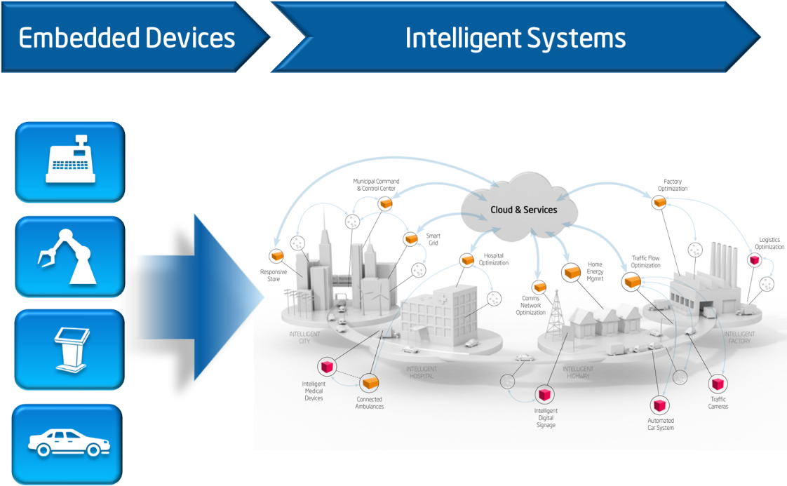
Intelligent Systems Framework 1.x:
Set of interoperable solutions that address connecting, managing,
and securing devices in a consistent and scalable manner
Intelligent Systems Framework1.x
  Consistent framework for Connectivity, Security and Manageability
  Flexible recipes utilizing scalable, off-the-shelf elements
  Enables vertical specialization
  Shifts investment from interoperability to extracting value from data
Notes:
Today we’re announcing ISF and that is about defining an interoperable framework for the internet of things. Going forward, our next step will be to unlock the data that exists on intelligent systems, especially in legacy environments like manufacturing where there is a lot of data collected, but not necessarily analyzed. To do this we’ll enable new devices and capabilities through are ecosystem that start to collect, aggregate and filter data from the edge. For instance, a temperature sensor only needs to communicate changes in temperature or an airplane or car needs to pre-process the terabytes of data that are generated on-board to identify the relevant bytes, increasing the value of data that is analyzed and decreasing the cost. This will drive opportunities in new categories of devices, the data aggregators, drive upsell in our current business as intelligent systems need to pre-process data and will increase investment in the data center using the data from intelligent systems

Slide 12
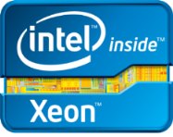
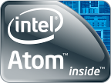
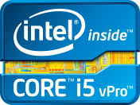




Intel Ingredients for Intelligent Systems
Press
Intel® Xeon® E3 Processor
Intel Core Processors w/ vPro
Intel® Atom Processor
Intel Mulit-Coms – LAN/WifI/WWAN
Providing the Essential Ingredients and Tools for End to End Scalable Solutions
Intel SW and tools, including
Automotive IVI Solutions with Tizen
Wind River OS, Hypervisor, Tools
McAfee Security Products
Notes:
The embedded market continues to evolve rapidly towards the intelligent systems markets. The change is the embedded market is profound, and the change to intelligent systems creates an enormous opportunity for leadership and rapid MSS growth.
Constraints of IOT and scale
The idea of billions of connected devices creates tremendous opportunity to build solutions with better experiences, experiences for consumers, machine operators, improved productivity for factory managers, and better traffic flows through Beijing. Why? Because the data coming off of those devices can be turned into information that provides insights never contemplated before. Do you know why our product yields are so good at intel? Because we pull terrabytes of data of our manufacturing equipment, we perform distributed real time analytics on the data and forward control the manufacturing process. If we find even the smallest anomaly in the production flow we instantaneously warn and adjust controls downstream. It gives us a competitive advantage in manufacturing. That’s the power of data… Move over to a city with millions of different pieces of equipment, devices, interfaces, vendors, system integrators etc, and it becomes a daunting task to scale the idea of an Intel factory into a broader environment. That’s why we need interoperability and standardization between devices.
Bringing standards to market, through leadership on IA platforms
We can’t connect billions of devices if they all speak a different language. We will not be able to 1. Understand the data, and 2. Trust the data. It will quickly become garbage in garbage out. We need to deliver on a framework that allows the market to scale. It is critically important to accelerate our growth. Without it we are back to the old days of highly proprietary implementations that take years to deploy and the industry will not find the scale and motivation to innovate on the data, which is the real opportunity AND it’s important to us because it creates the performance pressure on the application that’s so important to realize our value proposition. Don’t be confused, we don’t do this just because we want to help the industry. We do this because unleashing the data results in analytics which drives a huge performance spiral end to end.
Our vertical market focus to gain leadership in this market transition
Automotive
By 2013 all new cars will be connected cars
Making the car part of a connected experience is key, people strongly desire to bring their social network experience into the vehicle. You spend 2 months of your waking hours each year in your car, you want to be connected
Autonomously driven vehicles can’t be realized with strong local analytics, cloud connectivity, and car to car connectivity. 92% of the 32K highway fatalities and 1.3 million emergency room visits due to car crashes are because of human error. We can profoundly change this, and do society a huge services in lives saved and economic costs removed, if we can create a connected autonomously driven vehicle infrastructure.
Retails
The retailers lose over 800B$ a year in inventory distortion… they don’t know the status and locations, of their products and as a result they promote the wrong thing at the wrong time. Running specials on umbrella’s on a nice summer day when you are actually out of stock is not a good idea, but that’s what’s happening today! With better data feeds, improved analytics, and state-of-the-art content distribution, we can give the retailers billions of dollars back, and there is an opportunity for us to extract revenue out of those savings.
The market is broad and wide and the intelligent systems framework will give us scale into hundreds of applications. This scale is important to drive growth for ISG. We can’t rely just on IVI and Retail, we need to build horizontal solutions for many applications. The horizontal differentiation we are building into our platforms through managed, secure, and analytics will give us the opportunity to differentiate in a broad set of applications and market segments.
Tizen is an open source, standards-based software platform supported by leading mobile operators, device manufacturers, and silicon suppliers for multiple device categories, including smartphones, tablets, netbooks, in-vehicle infotainment devices, smart TVs, and more. Tizen will offer an innovative operating system, applications, and a user experience that consumers can take from device to device.
The Tizen project will reside within the Linux Foundation and will be governed by a Technical Steering Group co-chaired by Intel and Samsung. The Technical Steering Group is the primary decision-making body for the open source project, with a focus on platform development and delivery, along with the formation of working groups to support device verticals. The effort is also sponsored by the LiMo Foundation.
Tizen will provide a robust and flexible environment for application developers, based on HTML5. With HTML5's robust capabilities and cross platform flexibility, it is rapidly becoming the preferred development environment for mobile apps and services. The Tizen SDK and API will allow developers to use HTML5 and related web technologies to write applications that run across multiple device segments, including smartphone, tablet, smart TV, in-vehicle infotainment, and netbook.

Slide 13

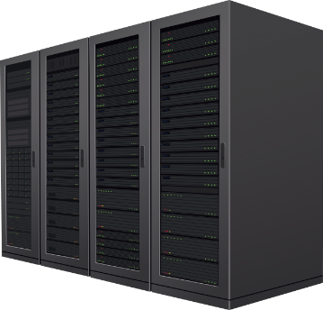
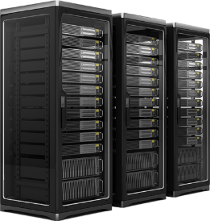



2. The Cloud – ‘Datacenter as a System’
Press
>3B
connected users by 2015¹
2X Growth
in information every two years²
15B
connected devices by 2015³
Private
Public
>11x
increase in mobile data traffic by 2015⁴
FEDERATED
AUTOMATED
Up to 2x or $27B⁵
in additional data center power costs by 2015
CLIENT AWARE
Open Clouds: Interoperable, Built on Open, Multi-vendor Solutions and Industry Standards
1 Cisco Global Cloud Index Nov 2011
2 IDC Extracting Value from Chaos June 2011
3 Intel ECG – One Smart Network device forecast
4 Cisco Visual Networking Index: Global Mobile Data Traffic Forecast Update, 2011–2016, Feb 2012
5 Datacenter Dynamics Global Datacenter Energy Demand 2012 forecast http://www.datacenterdynamics.com/research/energy-demand-2011-12; projected to 2015 by Intel; Assume $0.10/kWh
Notes:
There are 2 types of primary cloud environments that exist today. Private enterprise clouds and public service provider clouds.
An enterprise private cloud is a cloud architecture that’s for internal use behind the corporate firewall, designed to deliver “IT as a service”. Examples of software that enable private cloud deployments includes Canonical, Citrix, Red Hat, Univa, Vmware, among others. There are similarities with a public cloud in that enterprise private clouds are meant to be scalable and provide use based IT services. But compared to public clouds, private enterprise clouds typically deliver greater levels of security, much better ability to manage compliance and audit and provide for interoperability within the datacenter infrastructure.
A public service provider cloud resides on the public internet, typically with pay as you go usage models. Example of public cloud services include commercial offerings that deliver applications (e.g. Salesforce CRM) or virtual infrastructure for a fee (e.g. Amazon’s EC2, AT&T Synaptic Hosting). Public clouds have the benefit of providing rapid deployments, reduced up front costs of new IT equipment, and ability to take advantage of expertise of external suppliers of IT. As an example, Intel IT is using public cloud service providers for Intel’s employee benefits information and expense processing.
Virtual private clouds, like Amazon Virtual Private Cloud, is meant to provide secure access via a VPN to public cloud resources that are isolated and available to only one company vs a public cloud that is “multi-tenant” where multiple companies share the same resources. A virtual private cloud is also meant to extend existing company’s IT security protocols, firewalls and intrusion detection systems into a virtual provide cloud. VPN is an example of a hybrid cloud that provides the benefit of security and dedicated resources, but also the economies of a public cloud service provider. Another example of a hybrid cloud is ‘cloud bursting” where an enterprise can take advantage of a service providers capacity when internal capacity is exceeded.
Cloud brokers – cloud brokers may emerge that provide linkages between cloud service providers and end users, providing guidance on choosing the right platforms, deploying apps, and managing the engagement. They may help federate data and apps across multiple clouds. This is still emerging.

Slide 14
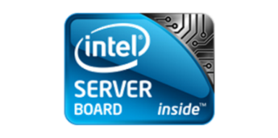
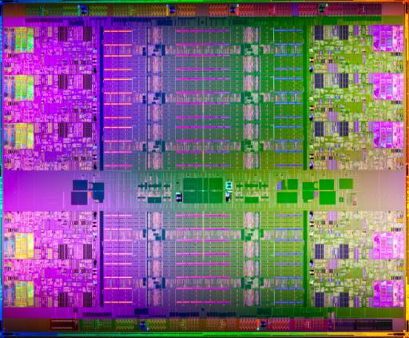
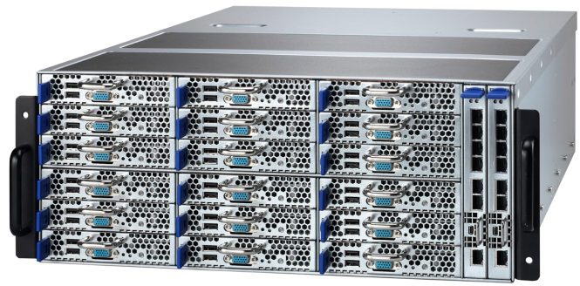

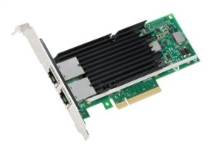
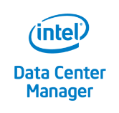

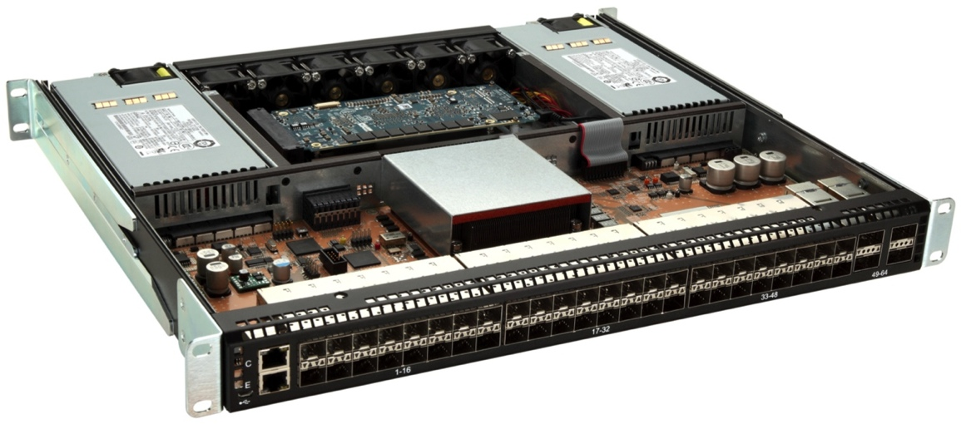
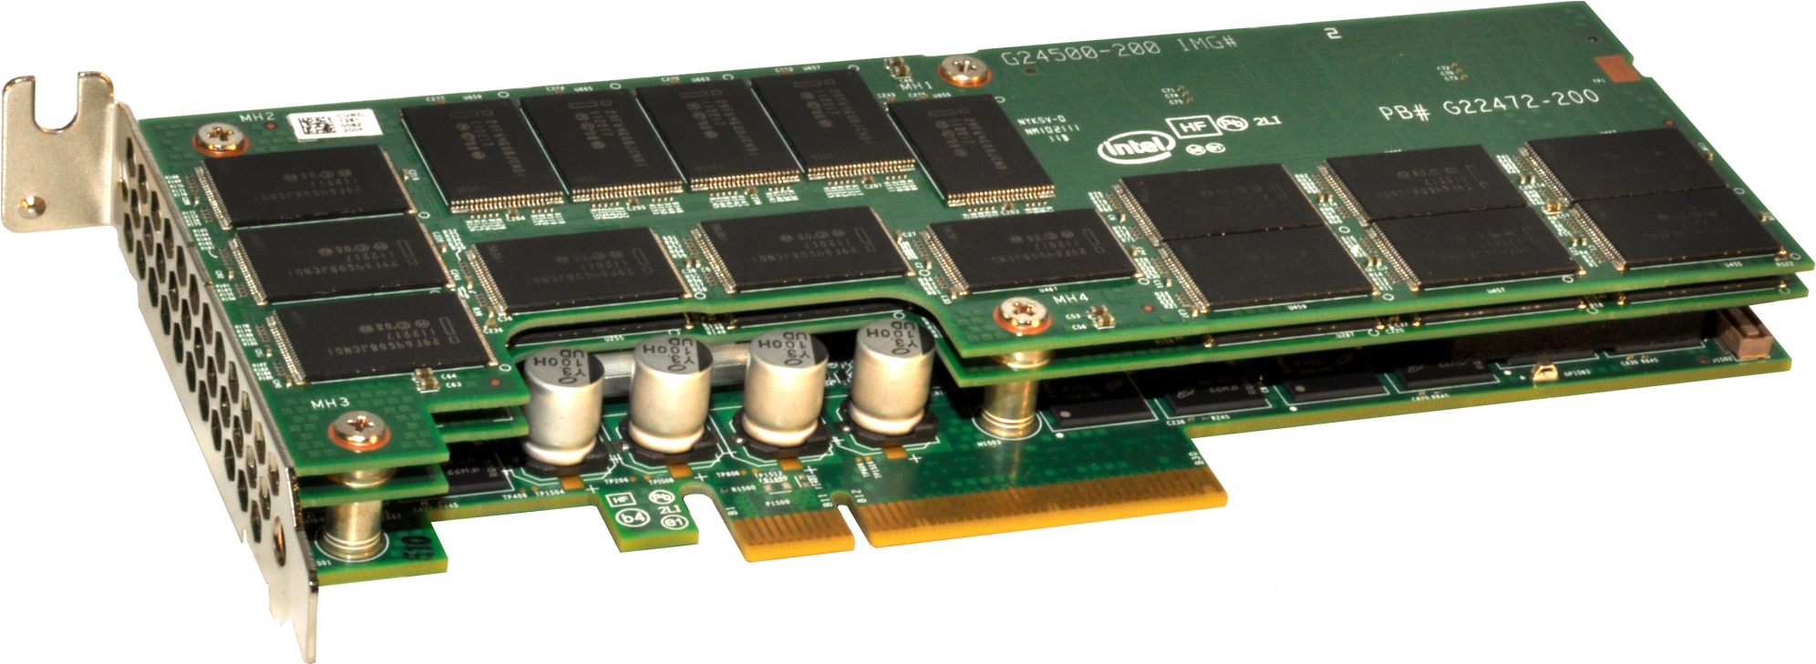
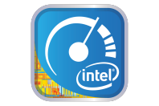
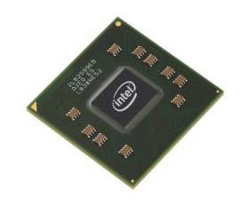
Intel Datacenter Ingredients for Cloud Solutions
Press
EPSD Cloud Systems
Intel® Xeon® E3 & E5 Processors
Intel® Atom for Cloud
Intel® Cache Acceleration Software
Intel® Cloud Finder, helping customers find cloud services
Intel® Datacenter Software &
McAfee Security Products
Intel® Networking
Intel® SSDs and Caching Software
Notes:
For cloud, Intel provides:
a portfolio of leading platform technologies – both HW and SW – that help address more challenges in cloud adoption.
We are enabling open standards to make it easier for companies to deploy clouds and connect them securely
We are making it easier for companies to build clouds and buy cloud services to gain the benefits of cloud computing faster
1) Leading platform technology portfolio:
For security, Intel providers hardware-enhanced security capabilities, such as Intel AES-NI to speed encryption up to 10X faster to better protect data. Moreover, through our acquisition of McAfee, we provide security software solutions, such as McAfee anti-virus SW for virtualized environments, called McAfee MOVE AV, to offload and speed anti-virus checking. We also provide Intel Expressway Service Gateway which enhances security for web services.
Intel Data Center Manager provides a platform agnostic software layer that is typically used with ISV management consoles to improve power management across racks and the datacenter to reduce power costs. When combined with Intel Node Manager that is available in several OEM systems, notably Dell PowerEdge 12G servers, there are added capabilities to cap and provide add’l controls over power management.
Xeon E5 providers leading efficient performance for virtualized cloud infrastructure, along with boards and systems from Intel EPSD. Grizzly Pass Cloud “Focused SKUs” stocked and ready to ship for 2013
S1200 : World’s first 6W, 64-bit SoC for Data Centers
In storage, there are a side range of Xeon E5 based storage that is excellent to handle the increasingly compute intensive storage tasks, such as data de-duplication, to reduce storage costs of significant growth in data most companies are experiencing. Intel also providing industry leading SSDs and Intel Cache Acceleration Software drives significant performance improvement and more concurrent users and VMs on I/O intensive applications such as Microsoft* SQL Server, Exchange, BI Applications, and more.
Intel SSD 910 series plus Intel Cache Acceleration Software provides up to 50X IOPS throughput increase.
Finally, in networking, Intel provides the #1 10GbE ethernet controllers that improve bandwidth up to 2X, reduce cabling by up to 80% and rack power by up to 45%. X540 Controller: Next Gen Immunity for 10GBASE-T
Sea Cliff Trail: 40G SDN Top of Rack Switch Platform
2) Enabling open standards
Intel works with a broad range of standards groups that are defining and creating standards to enable more open, interoperable cloud environments. One such group is the ODCA made up of >300 global IT organizations and which Intel is the technical advisor. The ODCA has published several usage models for more effective and transparent cloud implementations which you can learn more about at www.opendatacenteralliance.org.
3) Making it easier to build clouds and buy cloud services
Via the Intel Cloud Builders program, you can take advantage of >100 reference architecture solutions that are optimized on IA and show your customers how to build clouds, enhance efficiency, security and scalability.
In mid 2012, Intel introduced Intel Cloud Finder, an online resource for companies to use to more easily select cloud infrastructure providers by selecting from >80 criteria relevant to picking cloud providers appropriate for your customers. Over 30 leading CSPs are participating today and if you are providing cloud infrastructure services, you can join the site to be highlighted and gain visibility as well as leads. If you are not offering cloud infrastructure services, you can use the Intel Cloud Finder tool to help guide your customers in adoption of cloud services mapped to their needs. Visit www.intelcloudfinder.com

Slide 15




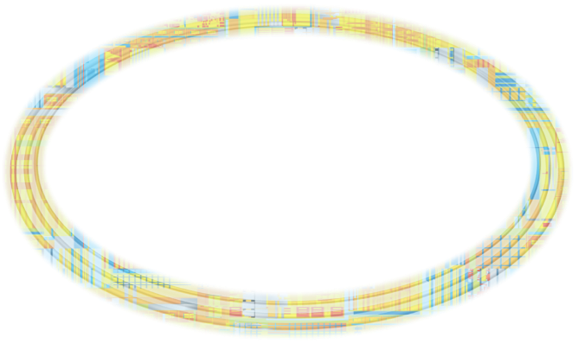


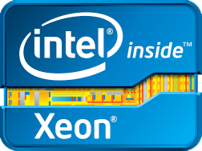
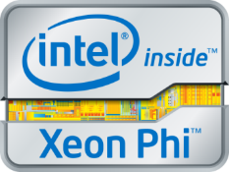




3. HPC – Future Breakthroughs Start Here
Press
ENERGY EXPLORATION
COMPUTATIONAL RACE
MEDICAL
IMAGING
FINANCIAL ANALYSES
CLIMATE
WEATHER
MODELING
DIGITAL
CONTENT
CREATION
SCIENTIFIC
RESEARCH
CAD
MANUFACTURING
SECURITY
To Compete You Must Compute
Notes:
Key Message: HPC is essential technology for discovery and innovation, research and development, academia, government and finance. It helps organizations solve their toughest challenges.
This is true across a wide range of industries and institutions. HPC helps industries address challenges like:
Exploring for new energy sources
Finding cures for cancer and other diseases
Optimizing product designs
Making block buster movies
High Performance Computing (HPC) is a critical asset for achieving global competitiveness and solving complex scientific challenges. It enables the biggest solutions for the biggest problems on the planet.
To compete nationally, in business, or in research – YOU MUST COMPUTE
TRANSITION TO NEXT SLIDE
Key Message: HPC is essential technology for discovery and innovation, research and development, academia, government and finance. It helps organizations solve their toughest challenges.
This is true across a wide range of industries and institutions. HPC helps industries address challenges like:
Exploring for new energy sources
Finding cures for cancer and other diseases
Optimizing product designs
Making block buster movies
High Performance Computing (HPC) is a critical asset for achieving global competitiveness and solving complex scientific challenges. It enables the biggest solutions for the biggest problems on the planet.
To compete nationally, in business, or in research – you MUST COMPUTE (Transition)

Slide 16
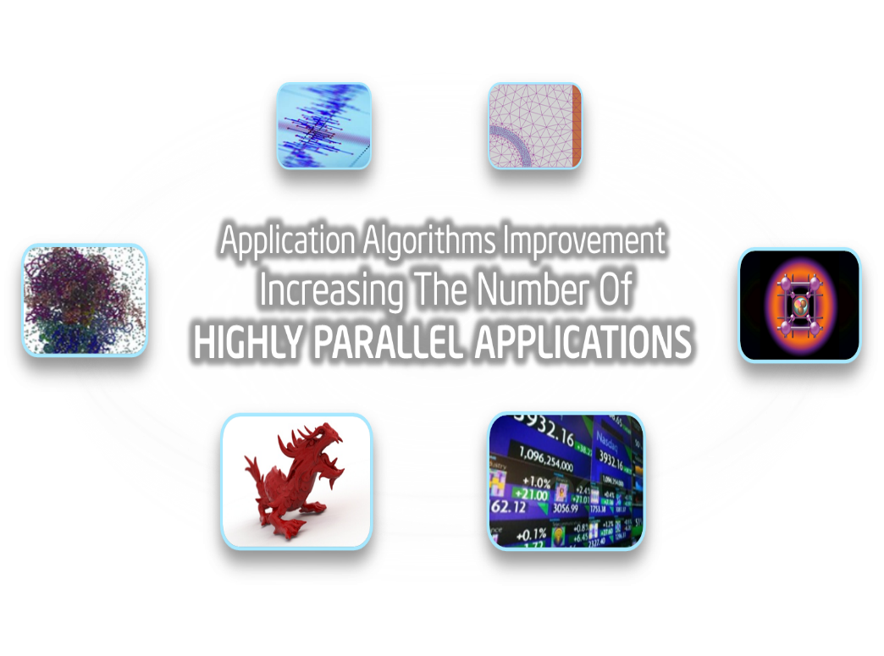
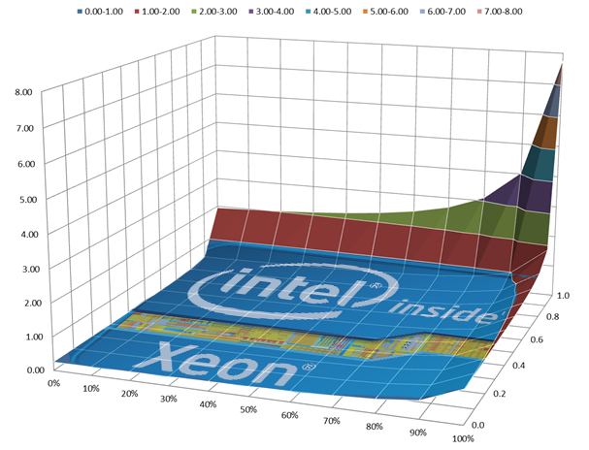
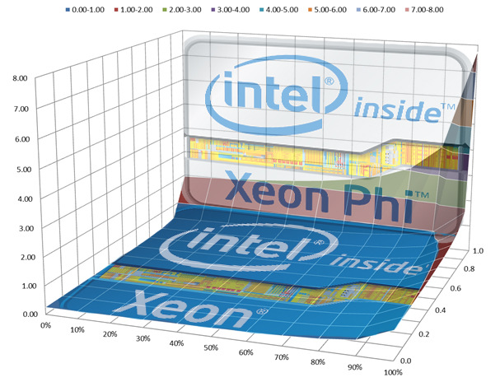
HPC: Greater Processing Required for Highly Parallel Applications
Press
Molecular
Dynamics
Seismic
Finite Element Analysis
Physics
Fraction Parallel
%Vector
Embree
Raytracing
Finance
* Theoretical acceleration of a highly parallel processor over a Intel® Xeon® parallel processor (<1Intel® Xeon® faster)
Notes:
Key Message: New Intel Xeon Phi coprocessors extend Intel Architecture to these Highly Parallel applications
Intel Xeon Phi is a new design point for Intel processors (joining Xeon and Atom), featuring:
Many low power, cache coherent Intel processor cores with 4 threads per core
This is no mere accelerator, Intel Xeon Phi runs a richly featured Linux OS, can host users, and host complex applications
New, wider SIMD 16 processing unit for increased data parallel processing
for both vector floating point and vector integer computing
New vector instructions like scatter/gather, FMA, masks, swizzle… requested by developers
acceleration for mathematical functions like exponent, reciprocal, tangent among others
Up to 16 channels of fast GDDR5 memory with ECC

Slide 17


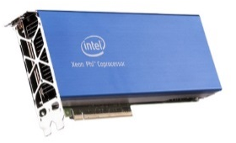
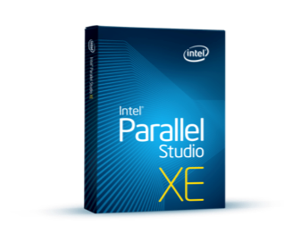
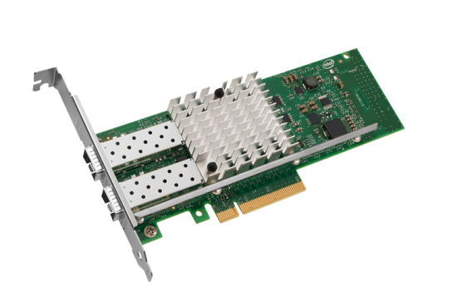



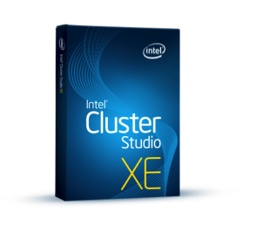

Intel Datacenter Ingredients for HPC Solutions
Press
EPSD HPC Systems
Intel® Xeon® E5 & E7 processor
Intel® Xeon PHI
Complete Parallel Technical Computing Solutions To Enable New Discoveries
Intel®
TrueScale
Infiniband
*
Intel® 10G NIC / Infiniband Truescale
Intel® HPC Software
Intel® Xeon® based Storage
Lustre* is the property of others
Notes:
Intel® Xeon Phi™ Coprocessor 5110P General Availability (GA) January 28, 2013

Slide 18
Lustre* Overview
Alejandro Pacheco
High Performance Data Division
*Other names and brands may be claimed as the property of others.

Slide 19

Lustre from Whamcloud to Intel
Started July 16, 2010
    Brent Gorda – CEO
    Eric Barton – CTO
Founded Whamcloud to keep Lustre* in play and vendor-neutral for HPC
    Recognized by OpenSFS and EOFS as the maintainer
    of open source repositories
Acquired by Intel in July 2012
  Becomes the High Performance Data Division
  Same team, same mission, more resources
Lustre* is the property of others

Slide 20
What is Lustre
Lustre is a multi-vendor global parallel file system
  Parallel
  Shared
  Multi-vendor
  Open source
  Scalable
  Provided by Intel
Notes:
Infiniband is the vest choice
To speed the metada operation you could use SSDs

Slide 21

Why do Companies use Lustre?
Lustre accelerates workflow
and ‘time to solution
  Performance – Up to 1TB/sec
  Global name space
  Highly scalable – Up to 512 PB in one file system
  Dominates the world’s largest computing systems
  Faster and more scalable than NFS
Notes:
More than 1TB Ps has been achieved
2TBps has been achieved in Japan
60% top 100 are using Luster

Slide 22
Why do Companies use Lustre?
Lustre can easily accommodate mixed vendor environments for storage and server hardware
Users can add storage capacity incrementally
Can ‘build up’ for more performance
Can ‘build out’ for more capacity
High performance access via LAN and WAN
Notes:
We don’t have Vendor lock in
We support the Enterprise and the community edition and the user can increase the capacity with out any downtime
You can scale up and escale down
You can used for metropolitan network
In the USA we have universities that are 200km apart sharing the same storage
You can have a mix of enviroment

Slide 23
Typical Lustre Customers
Departments such as:
  R&D
  Technical computing
  Advanced computing
Any areas doing work in:
  Energy (Oil/gas – from seismic exploration to reservoir modeling)
  Simulation (computer-aided engineering, finite element analysis)
  Financial modeling (risk modeling, high frequency trading)
  Climate modeling and weather forecasting
  Bio-IT (genomics, computational chemistry)
  Big Data (including interface to Hadoop File System)
Notes:
Energy we have CEA the department of energy in France
Bank of Poland / and Bank of Italy
Institute SANGER in UK
AIBUS in France Daimler Chrysler in Germany

Slide 24
What Intel Provides
Intel® Enterprise Edition for Lustre* software
A New Generation of Lustre* Software Expands High Performance Computing into the Commercial Enterprise
  24x7 Enterprise support
  Production quality Lustre file system
  Intel® Manager for Lustre*
  Intel® Lustre* Adaptor for Apache® Hadoop
  Documentation
  Professional services and training
  Available from Intel HPDD partners
Notes:
The manager of luster is to lower the complexity of managing luster

Slide 25
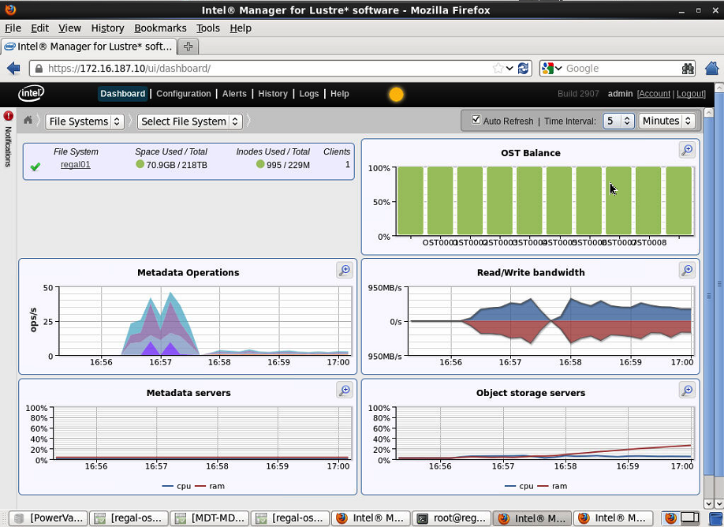
Intel® Manager for Lustre
Experience the benefits of Lustre* quicker
Simplified installation, configuration, monitoring and management
Extensible storage plug-in
Management Console
    GUI and CLI administration
    Detailed monitoring
    Centralized database and statistics
Storage Servers
    Intelligent software layered over object servers

Slide 26
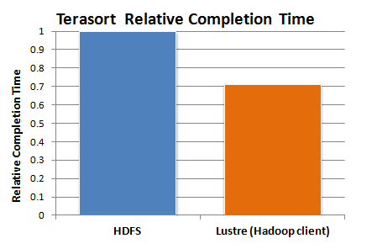


Accelerating Hadoop Workloads
Bringing Hadoop analytics to HPC
Value:
  Exploit the superior performance, scalability and management simplicity of shared storage
  Allow seamless MapReduce access to existing Lustre* files
Delivers the combined benefits of Lustre* with Intel® Distribution of Apache Hadoop*
Hadoop Cluster/Compute Nodes
Interconnect
Lustre Storage
Notes:
We want for the existing Luster community to run Hadoop

Slide 27
Lustre for Big data Technical Computing
Evaluating Hadoop + Lustre configurations for technical computing and other high-performance, parallel opportunities
Intel® Manager for Lustre
  Simple provisioning, monitoring and management
  Browser, CLI and REST interfaces, fully scriptable
  Lowers complexity and costs, highly extensible
  Priced per number of attached storage devices
Lustre File System
  Proven sustained performance at massive scale
  Flexible, scale-up and scale-out solutions
  Fee-paid development of new features and enhancements
Intel Support Services for Lustre
  Unrivaled Lustre support expertise
  Professional services offerings ensures success
  Priced per storage server
Lustre* is the property of others

Slide 28
4. Big Data – Making Sense of
One Petabyte
Press
50x
Size of the
The British Library
13y
To View
as HD Video
11s
To Generate
in 2012
http://blogs.loc.gov/digitalpreservation/2011/07/transferring-libraries-of-congress-of-data/
Notes:
“The amount of data generated worldwide in 2012 was 2.87 Zettabytes according to IDC report “The Digital Universe in 2020,” Dec 2012.
By Intel’s calculation, that translates to 1 petabyte of data generated every 11 seconds.”

Slide 29
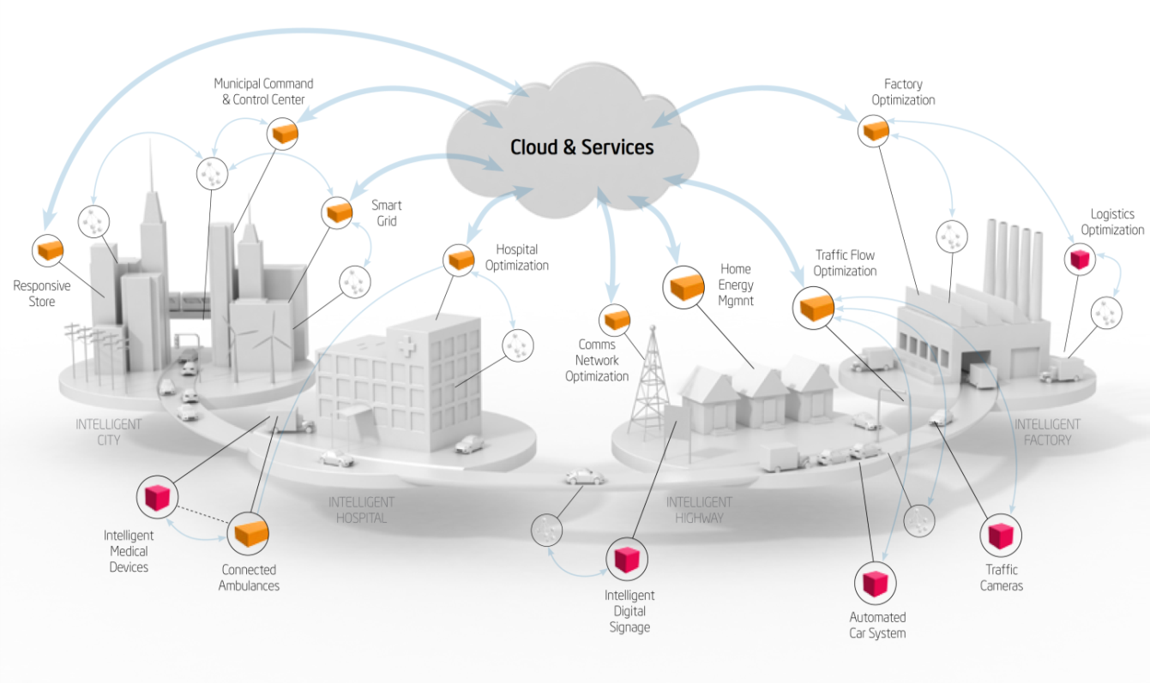



Big Data – Driving Advancements Across Society
Smart City
Healthcare
Therapies tailored to a persons genome
Decoding the human genome:
From 10 years to hours
On track to hit <$1000 per person
Telecom
Explosive growth, 30 Tb/month billing data
Radical overhaul of customer service:
Self service, real time access
30x performance increase
Notes:
One of our next steps will be to unlock the data that exists on intelligent systems, especially in legacy environments like manufacturing where there is a lot of data collected, but not necessarily analyzed. To do this we’ll enable new devices and capabilities through are ecosystem that start to collect, aggregate and filter data from the edge. For instance, a temperature sensor only needs to communicate changes in temperature or an airplane or car needs to pre-process the terabytes of data that are generated on-board to identify the relevant bytes, increasing the value of data that is analyzed and decreasing the cost. This will drive opportunities in new categories of devices, the data aggregators, drive upsell in our current business as intelligent systems need to pre-process data and will increase investment in the data center using the data from intelligent systems

Slide 30
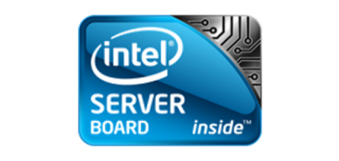
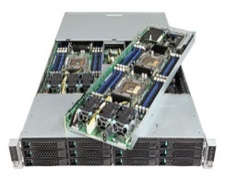


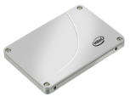
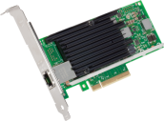
Intel Datacenter Ingredients for Big Data Solutions
Press
EPSD Big Data Systems
Intel® Xeon® and Xeon PHI
Intel® Big Data Software
Intel® Distribution for Apache* Hadoop
Intel® 10G/40G Switch & NIC
Intel® Xeon® based Storage
Intel® SSD and Caching Software
Notes:
Hadoop is a
Call out: Seize the opportunity in the rapidly growing storage segment! For system integrators (Sis), there is storage software available from our ISV partners that can be loaded onto standard, widely-available, server-storage HW. For resellers, there are complete storage solutions available from our OEM partners through distributors to resell.
Why Xeon: With the dramatic growth in data, it’s becoming more and more important to apply intelligence to way the data gets stored. Instead of just saving it to a bunch of disks, our partners are utilizing the storage capabilities of the Intel® Xeon® processor to better protect, compress, de-duplicate, provision and tier the data across Intel® SSDs and HDDs.

Slide 31








Big Data – A Foundation For Delivering Big Value
Big Data Building Blocks
Compute
Network
Storage
Software & Technologies
Responsive
Energy
Efficient
Intel® Xeon® Product Family E3-E5-E7
Intel® Atom™
Intel® Xeon PhiTM
Intel® Ethernet Controllers
Intel® Ethernet Adapters
Intel® Ethernet
Switch Silicon
Intel® True Scale Fabric
Intelligent Storage¹
Scale-out Storage¹
Scale-up Storage¹
Intel® SSD 710 series, DC S3700 (SATA)
Intel® SSD 910 series (PCIe)
Intel® Distribution for
Apache Hadoop
Intel® Data Center Manager
Intel® Node Manager
Intel® Expressway Service Gateway
Intel® Cache Acceleration Software
Intel’s Lustre
Intel® VT and
Intel® TXT
Intel® AES-NI
Secure
High
Availability
Intel’s Foundational Technologies Offer Advanced Solutions for Big data Analytics
Choice
Xeon-based storage systems are available in a wide range of configuration options from the industry’s leading storage vendors
Notes:
Our main building blocks consist of:
Server. The Xeon family of processors consists of the E3, E5 and E7 product lines which offer different combinations of capabilities and price points for different workloads. The upcoming Intel MIC (Many Integrated Core) processor is targeted primarily at the portion of the HPC market that values maximum parallel processing density such as…. And our Atom line aims at the low-cost, low-power, ultra dense microserver market where node density is paramount.
Networking. Intel is the Industry’s #1 selling 1GbE and 10GbE adapters and silicon and also offers a family of industry leading, low latency 10GbE/40GbE switch silicon products
Storage: one of the biggest trend in storage is the increasing use of compute within the storage box to reduce latencies and also provide lower overall cost/GB of storage thru more efficient storage. For large data sets and those storage workloads requiring the lowest latencies Xeon is the industry choice. Xeon provides the compute capability in over 80% of the storage market. And Intel enterprise SSD’s are designed for the demanding performance and endurance needs of the datacenter
Software and other technologies: We are developing strong open-source components such as our Intel Distribution of Hadoop. Intel Datacenter Manager enables better power management at the server, rack and datacenter level. Advanced RAS (reliability, availability and serviceability) features ensure high levels of system resiliency and availability.
And Intel’s heavy investment in industry enabling ensures these come available in the widest choice of systems. The most popular are general purpose systems, but many of our partners innovate further to create highly workload-optimized platforms and converged architecture systems. The greater level of bundling and integration in these systems allows for simpler and faster deployments and ongoing maintenance.
Now lets look at the specific building blocks….

Slide 32

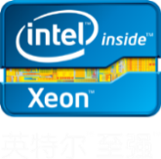
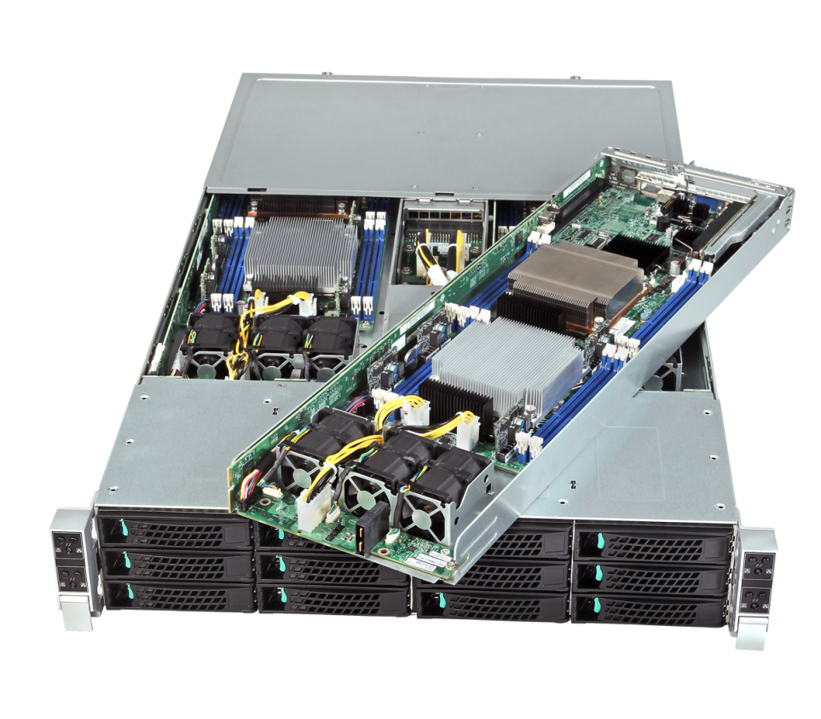
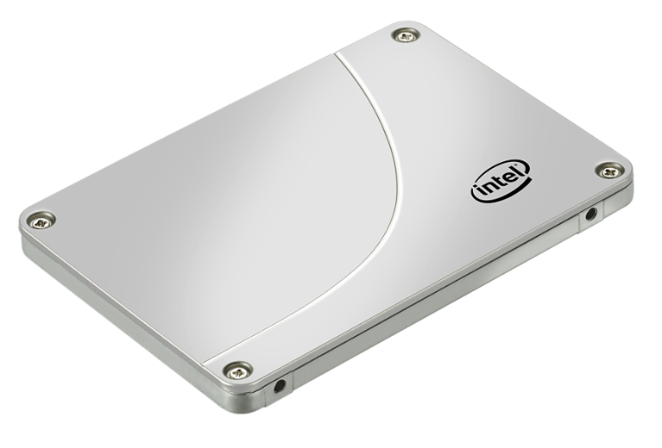


Intel Portfolio Delivers Balanced Performance
>4 hours
Improved performance while analyzing 1 TB of data with 10 servers
From 4 Hours To 7 Minutes
Intel® Xeon 5690
7200 HDD
1GbE Adapter
Intel® Xeon® E5-2690
Processor
~50%
Improved
Intel® SSD 520 Series
Intel® 10GbE
Adapters and Switch
Intel® Distribution for Apache Hadoop* Software
~80%
Improved
~50%
Improved
~40%
Improved
~7 minutes
Based on internal Intel test results Software and workloads used in performance tests may have been optimized for performance only on Intel microprocessors. Performance tests, such as SYSmark and MobileMark, are measured using specific computer systems, components, software, operations and functions. Any change to any of those factors may cause the results to vary. You should consult other information and performance tests to assist you in fully evaluating your contemplated purchases, including the performance of that product when combined with other products. Source: Intel Internal testing For more information go to : intel.com/performance ` Other brands and names are the property of their respective owners

Slide 33
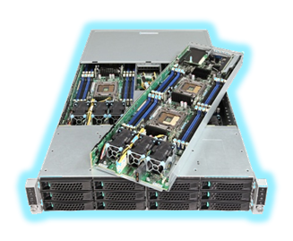
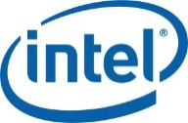


Announcing:
Big Data, Big-Time Bundle, Big Time Savings! EPSD Hadoop Product Bundle
Press
Launching
May ‘13
Intel® Distribution of Apache Hadoop
4 Node License + Premier Support
EPSD H2312XXJR + 4 x HN2600WPXX
Optimized HW/SW/Services Integration
Turn Key Hadoop Cluster Deployment
Total Solution to Kick Start Your Hadoop PoCs
All products, computer systems, dates and figures specified are preliminary based on current expectations, and are subject to change without notice.
Notes:
Building on the recently announced Intel® Distribution of Apache* Hadoop (IDH), EPSD announced that it would enable the channel to deliver big data solutions to IT customers. EPSD will offer bundles of Intel server hardware, including motherboards and chassis, with IDH software, support, and services to the channel.
The hardware will be based on EPSD’s 4 node, half-width cluster containing the S2600WP board codenamed “Washington Pass”. This product was chosen due to its high compute, density, I/O, storage, and memory capabilities.
When purchased together customers will receive a 30% or more discount vs. purchasing the software and hardware components separately. IDH has been optimized to run on Intel hardware and the combination will deliver the performance the channel needs, affordably. For more information, visit EPSD’s website.
Important in this is that the opportunity is not just for HW and SW. Professional services administered by Intel will also be available to the channel via this promotion.
Excellent Big Data hardware, optimized software, support, and services available you in the channel. Everything you need to build your competency and business around Big Data.

Slide 34




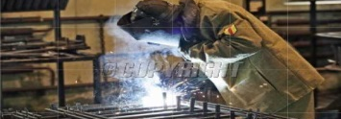
Big Data – A Foundation For Delivering Big Value
Enterprise and Big Data
How is it used in different sectors?
Big data can generate significant financial value across sectors
FMCG: Problem solving ideas, product decisions,
predict market reaction, enhance brand relevance
Financial: To detect credit card fraud, greater accuracy and granularity in risk assessment
Cable and TV: Customize TV ads to individual household
Mobile Ads: Ads based on locations
Retail: Insight and understanding of customer likes, dislikes, influences and behaviors
General business: To discover unknown and untapped behaviors and attitudes
Healthcare: Evidence based medicine
Utilities: Understanding of individualized use patterns and better manage demand
Online businesses: Better understanding of customer preferences and social interactions
Crime prevention/intelligence: Better analysis
of patterns
US health care
$300 billion value per year
~0.7 percent annual productivity growth
Europe public sector administration
€250 billion value per year
~0.5 percent annual productivity growth
Global personal location data
$100 billion+ revenue for service providers
Up to $700 billion value to end users
US retail
60+% increase in net margin possible
0.5-1.0 percent annual productivity growth
Manufacturing
Up to 50 percent decrease in product development, assembly costs
Up to 7 percent reduction in working capital
SOURCE: McKinsey Global Institute analysis
SOURCE: McKinsey
Solving today’s problems faster
Notes:
A recent study by the McKinsey group provides a good backdrop for you to understand how you can get return for your Big Data investments. In nearly every business and technology segment, Big Data can generate significant financial value. This value is available worldwide, with many new uses emerging every day. It’s clear that every sector is finding ways to solve problems faster with today’s technology in an affordable and implementable fashion.
Whether your company is just starting out on Big Data, or well along to POC and deployment, Big Data is the transformational business opportunity that enables your IT organization to be a value-add to the business, enabling insight that leads to results.
Note to field: We have one or two examples of different uses of Big Data in the various sectors, and we will be improving the backup content to specifically address your customer’s segment over time. Please check back for updates to this presentation.

Slide 35




Big Data – A Foundation For Delivering Big Value
Reimagining the Possibilities with Big Data Analytics
Move to Value & Vision
Enhance understanding, drive innovation, and accelerate personalized medical cures
Create new business models
and transform organizational processes
Enhance public safety and transportation, increase energy efficiency and reduce carbon footprint
Notes:
No matter where you want to start with Big Data, you have the opportunity to use your newfound insight to benefit your business. Intel sees a present where you can the opportunity to use Big Data to drive innovation, transform your business, and be more efficient in the way you use resources.
We expect that the value of data analytics will become so valuable that it will be a differentiator for the company, not just for the IT organization within the company. From the variety of customer examples that we’ve seen, we view Big Data as a key emerging opportunity for any company.

Slide 36
Big Data – A Foundation For Delivering Big Value
Big Data Adoption and Deployment Phases
Investigate
Discover
Plan
Implement
Understand
business model
Organization alignment
Market & technology trends
Define problem statement
Identify business use cases
Gather requirements
Develop success metrics
Identify high value,
high visibility use cases
Define scope & ROI for proof of concept (POC)
Identify Big Data
reference architecture
Pilot the POC
Promote and extend the POC result for other projects
Extend and enhance more advanced analytic capabilities
What insights would best benefit your business?
What results are you really trying to get?
What do you want to do with your data?
What kind of data & correlations are you interested in mining?
How much return are you expecting on your investment?
What is your timeline for getting results?
Are there other industries or uses you’re using for a model?
Notes:
Knowing the stage of Big Data adoption is important to your business, and it enables you to devise a strategy and subsequently help you identify right resources to get the job done. The Big Data process is similar to any standard IT process, though it is new enough that we see many companies spending time in the discovery and POC phase. Intel is willing to work with you at any phase of the decision process, and we have the experience and tools to help you understand how best to gain insight that returns value to the company.
Ask yourself the following questions to get better insight:
Have you developed a big data strategy?
What are the business challenges you are hoping to solve with Big Data?
Are you looking for someone to determine whether big data technologies are the right solution for their problem?
Have you identified specific business use cases?
Determine how early in the technology decision life-cycle you are, and how we can help?
Are you looking for help in selecting a specific tool?
Or are you looking for someone to devise a solution for a well-defined problem in a chosen set of tools/technologies?

Slide 37


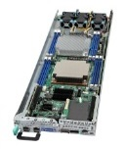


Streamlined Roadmap
Press
EPSD System Volume By SKU
SKU Volume
Action: 50% Cut In System SKUs
Affecting <10% of Projected Volume
Of the <10% of Volume Impacted
1. ~50% of Needs
Filled with Building Blocks
2. ~50% of Needs Filled with
Acceptable Alternatives
3. Some Orders - We Will Need to Work Together
+
Notes:
Another important update from EPSD is the streamlining of the roadmap that has recently been announced.
The chart shows sales volumes across all of EPSD’s system SKUs that were launched as of the end of 2012. The flexibility and choice was amazing, but many of the SKUs had very little volume.
In order to really focus on what you told us you wanted – we undertook the process of discontinuing those products that you told us (by your orders) were non-critical.
There are three very important things to remember here:
Despite cutting the number of SKUs by 50% we impacting LESS THAN 10% of our projected volume. Clearly these were non the SKUs critical to your business.
If you had an order placed on SKU that was EOL’d we have, or will, work with you to find a building block solution or an acceptable alternative. We have encountered VERY few issues at all, and we are almost always able to find a solution. 2 customers that fell through and we added the SKUs back.
Despite cutting 50% of the SKUs we still have a VERY robust, comprehensive, and flexible roadmap for Intel® Xeon® E5.

Slide 38





New Focus SKU Program
Roadmap of SKUs chosen
for key segments
High availability
New distributor and
reseller promos
Training and promotional
materials
HPC
Storage
SMB
Cloud &
Datacenter

Slide 39
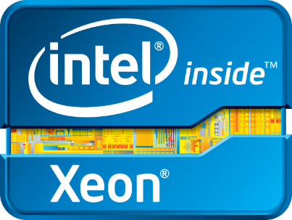
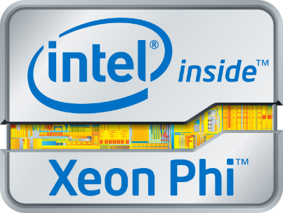
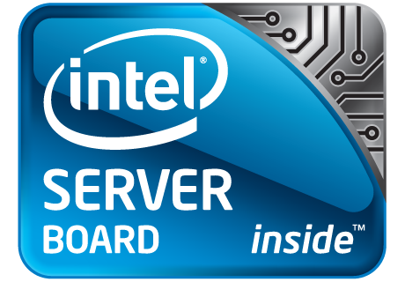
Datacenter Landscape Summary
Press
Intelligent Devices, HPC, Cloud Computing and Big Data driving change in the Datacenter
Increased revenue opportunities with complete
datacenter solutions
Take advantage in transition with 2013 launches: Intel® Xeon® Processors E3, E5 & E7 Families; Intel® Xeon Phi™ Coprocessors
Partner with Intel to co-promote & sell
end-user value based on differentiated technology

Slide 40
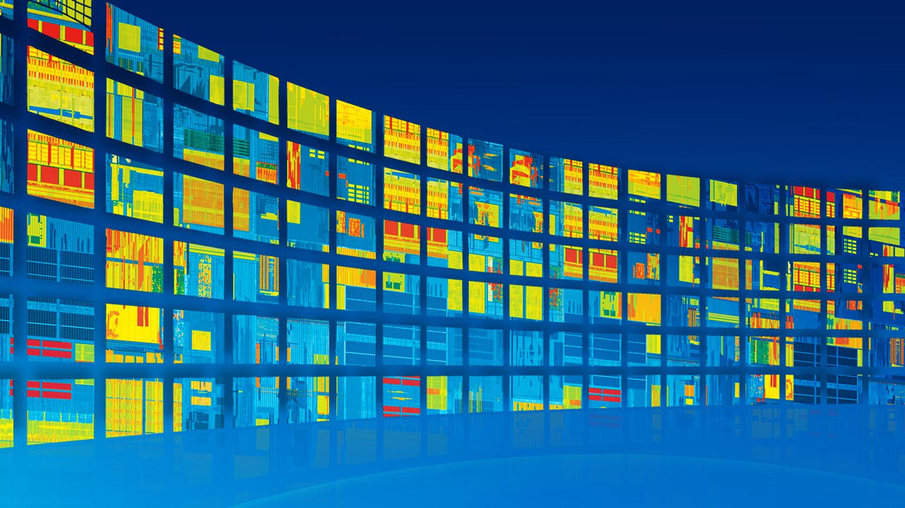
Thank you

Slide 41
Intel Public Roadmap
Datacenter and Connected Systems Group
2H 2013
Expiration Q1 2014
Contact: roadmaps@intel.com

Slide 42
Risk Factors
The above statements and any others in this document that refer to plans and expectations for the quarter, the year and the future are forward-looking statements that involve a number of risks and uncertainties. Words such as “anticipates,” “expects,” “intends,” “plans,” “believes,” “seeks,” “estimates,” “may,” “will,” “should” and their variations identify forward-looking statements. Statements that refer to or are based on projections, uncertain events or assumptions also identify forward-looking statements. Many factors could affect Intel’s actual results, and variances from Intel’s current expectations regarding such factors could cause actual results to differ materially from those expressed in these forward-looking statements. Intel presently considers the following to be the important factors that could cause actual results to differ materially from the company’s expectations. Demand could be different from Intel's expectations due to factors including changes in business and economic conditions; customer acceptance of Intel’s and competitors’ products; supply constraints and other disruptions affecting customers; changes in customer order patterns including order cancellations; and changes in the level of inventory at customers. Uncertainty in global economic and financial conditions poses a risk that consumers and businesses may defer purchases in response to negative financial events, which could negatively affect product demand and other related matters. Intel operates in intensely competitive industries that are characterized by a high percentage of costs that are fixed or difficult to reduce in the short term and product demand that is highly variable and difficult to forecast. Revenue and the gross margin percentage are affected by the timing of Intel product introductions and the demand for and market acceptance of Intel's products; actions taken by Intel's competitors, including product offerings and introductions, marketing programs and pricing pressures and Intel’s response to such actions; and Intel’s ability to respond quickly to technological developments and to incorporate new features into its products. The gross margin percentage could vary significantly from expectations based on capacity utilization; variations in inventory valuation, including variations related to the timing of qualifying products for sale; changes in revenue levels; segment product mix; the timing and execution of the manufacturing ramp and associated costs; start-up costs; excess or obsolete inventory; changes in unit costs; defects or disruptions in the supply of materials or resources; product manufacturing quality/yields; and impairments of long-lived assets, including manufacturing, assembly/test and intangible assets. Intel's results could be affected by adverse economic, social, political and physical/infrastructure conditions in countries where Intel, its customers or its suppliers operate, including military conflict and other security risks, natural disasters, infrastructure disruptions, health concerns and fluctuations in currency exchange rates. Expenses, particularly certain marketing and compensation expenses, as well as restructuring and asset impairment charges, vary depending on the level of demand for Intel's products and the level of revenue and profits. Intel’s results could be affected by the timing of closing of acquisitions and divestitures. Intel's results could be affected by adverse effects associated with product defects and errata (deviations from published specifications), and by litigation or regulatory matters involving intellectual property, stockholder, consumer, antitrust, disclosure and other issues, such as the litigation and regulatory matters described in Intel's SEC reports. An unfavorable ruling could include monetary damages or an injunction prohibiting Intel from manufacturing or selling one or more products, precluding particular business practices, impacting Intel’s ability to design its products, or requiring other remedies such as compulsory licensing of intellectual property. A detailed discussion of these and other factors that could affect Intel’s results is included in Intel’s SEC filings, including the company’s most recent reports on Form 10-Q, Form 10-K and earnings release.
Rev. 7/17/13

Slide 43
Legal Information
INFORMATION IN THIS DOCUMENT IS PROVIDED IN CONNECTION WITH INTEL PRODUCTS. NO LICENSE, EXPRESS OR IMPLIED, BY ESTOPPEL OR OTHERWISE, TO ANY INTELLECTUAL PROPERTY RIGHTS IS GRANTED BY THIS DOCUMENT. EXCEPT AS PROVIDED IN INTEL'S TERMS AND CONDITIONS OF SALE FOR SUCH PRODUCTS, INTEL ASSUMES NO LIABILITY WHATSOEVER AND INTEL DISCLAIMS ANY EXPRESS OR IMPLIED WARRANTY, RELATING TO SALE AND/OR USE OF INTEL PRODUCTS INCLUDING LIABILITY OR WARRANTIES RELATING TO FITNESS FOR A PARTICULAR PURPOSE, MERCHANTABILITY, OR INFRINGEMENT OF ANY PATENT, COPYRIGHT OR OTHER INTELLECTUAL PROPERTY RIGHT. A "Mission Critical Application" is any application in which failure of the Intel Product could result, directly or indirectly, in personal injury or death. SHOULD YOU PURCHASE OR USE INTEL'S PRODUCTS FOR ANY SUCH MISSION CRITICAL APPLICATION, YOU SHALL INDEMNIFY AND HOLD INTEL AND ITS SUBSIDIARIES, SUBCONTRACTORS AND AFFILIATES, AND THE DIRECTORS, OFFICERS, AND EMPLOYEES OF EACH, HARMLESS AGAINST ALL CLAIMS COSTS, DAMAGES, AND EXPENSES AND REASONABLE ATTORNEYS' FEES ARISING OUT OF, DIRECTLY OR INDIRECTLY, ANY CLAIM OF PRODUCT LIABILITY, PERSONAL INJURY, OR DEATH ARISING IN ANY WAY OUT OF SUCH MISSION CRITICAL APPLICATION, WHETHER OR NOT INTEL OR ITS SUBCONTRACTOR WAS NEGLIGENT IN THE DESIGN, MANUFACTURE, OR WARNING OF THE INTEL PRODUCT OR ANY OF ITS PARTS. Intel may make changes to specifications and product descriptions at any time, without notice. Designers must not rely on the absence or characteristics of any features or instructions marked "reserved" or "undefined". Intel reserves these for future definition and shall have no responsibility whatsoever for conflicts or incompatibilities arising from future changes to them. The information here is subject to change without notice. Do not finalize a design with this information. The products described in this document may contain design defects or errors known as errata which may cause the product to deviate from published specifications. Current characterized errata are available on request. Contact your local Intel sales office or your distributor to obtain the latest specifications and before placing your product order. Copies of documents which have an order number and are referenced in this document, or other Intel literature, may be obtained by calling 1-800-548-4725, or go to: http://www.intel.com/design/literature.htm Copyright © 2013 Intel Corporation. Intel, the Intel logo, the Intel Inside logo, Xeon, Xeon Inside, Intel Atom, Intel Atom Inside, Itanium, and Intel Xeon Phi are trademarks of Intel *Other names and brands may be claimed as the property of others.
This document contains information on products in the design phase of development. All products, computer systems, dates and figures specified are preliminary based on current expectations, and are subject to change without notice. Intel may make changes to specifications and product descriptions at any time, without notice. Any code names featured are used internally within Intel to identify products that are in development and not yet publicly announced for release. Customers, licensees and other third parties are not authorized by Intel to use code names in advertising, promotion or marketing of any product or services and any such use of Intel's internal code names is at the sole risk of the user.
Intel processor numbers are not a measure of performance. Processor numbers differentiate features within each processor family, not across different processor families. Click http://www.intel.com/products/processor_number for details
Intel® Hyper-Threading Technology (Intel® HT Technology) requires an Intel® HT Technology-enabled system. Consult your PC manufacturer. Performance will vary depending on the specific hardware and software used. For more information including details on which processors support HT Technology, visit http://www.intel.com/info/hyperthreading. Intel® Turbo Boost Technology Requires a system with Intel® Turbo Boost Technology. Intel Turbo Boost Technology and Intel Turbo Boost Technology 2.0 are only available on select Intel® processors. Consult your system manufacturer. Performance varies depending on hardware, software, and system configuration. For more information, visit http://www.intel.com/go/turbo Intel® Platform/Device Protection Technology (includes the following features: Bios guard; Boot Guard; Platform Trust Technology {PTT}; OS Guard; Anti-Theft Technology {AT}; Trusted Execution Technology {TXT}; and Execute Disable Bit) no computer system can provide absolute security. Requires an enabled Intel® processor, enabled chipset, firmware, software and may require a subscription with a capable service provider (may not be available in all countries). Intel assumes no liability for lost or stolen data and/or systems or any other damages resulting thereof. Consult your Service Provider for availability and functionality. For more information, visit http://www.intel.com/go/anti-theft . Consult your system manufacturer and/or software vendor for more information. Intel® Virtualization Technology (Intel® VT) Intel® Virtualization Technology requires a computer system with an enabled Intel® processor, BIOS, and virtual machine monitor (VMM). Functionality, performance or other benefits will vary depending on hardware and software configurations. Software applications may not be compatible with all operating systems. Consult your PC manufacturer. For more information, visit http://www.intel.com/go/virtualization Intel® Data Protection Technology (includes the following features: Secure Key and Advanced Encryption Standard New Instructions {Intel® AES-NI}) No computer system can provide absolute security. Requires an enabled Intel® processor and software optimized for use of the technology. Consult your system manufacturer and/or software vendor for more information.

Slide 44
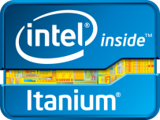
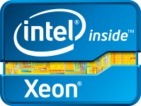


Intel® Datacenter and Connected Systems Group (DCSG) Public Roadmap
2013 2014/Future
Boxboro-MC Platform
Intel® 7500 chipset, Intel® 7500 Scalable Memory Buffer, OEM chipset
Future Kittson processor
Itanium
Intel® Itanium® processor 9500 series
Mission Critical
Boxboro-EX Platform
Intel® 7500 chipset, Intel 7510/7512 Scalable Memory Buffer
Brickland Platform
Intel® C602J chipset
Expandable
Intel® Xeon® processor
E7-8800/4800/2800
product families
Intel® Xeon® processor E7-8800/4800/2800 v2 product families
Romley-EP 4S Platform
Intel® C600 series chipset
Intel® Xeon® processor
E5-4600 product family
Intel® Xeon® processor E5-4600 v2 product family
Efficient
Performance
&
Workstation
Romley-EP Platform
Intel® C600 series chipset
Intel® Xeon® processor
E5-2600 product family
Intel® Xeon® processor E5-2600 v2 product family
Romley Workstation Platform
Intel® C600 series chipset
Intel® Xeon® processor
E5-1600 product family
Intel® Xeon® processor E5-1600 v2 product family
Entry, Perf/Watt Optimized Microserver
Bromolow Platform
Intel® C200 series chipset
Denlow Platform
Intel® C220 series chipset
Intel® Xeon® processor
E3-1200 v2 product family
Intel® Xeon® processor E3-1200 v3 product family
Density-optimized
Microserver
Bordenville Platform
Edisonville Platform
Intel® Atom™ processor
S1200 product family
Intel® processor (Avoton)
Many Integrated Core (MIC)
Intel® Xeon Phi™ Product Family
Intel® Xeon Phi™ coprocessor (Knights Corner)

Slide 45
Mission Critical Platform Roadmap: Itanium®
2013 2014/Future
Boxboro-MC Platform
Intel® Itanium® processor 9500 series
Future Kittson processor
  Intel® 7500 chipset, Intel® 7500 Scalable Memory Buffer, OEM chipset
Technologies
8-Core, 54MB Total On-Die Cache
New architecture with 12-wide Instruction Throughput
Compatible with Itanium® processor 9300 series platforms
Intel® Hyper-Threading Technology, enhanced with dual-domain multi-threading support
Itanium® New Instructions
Intel® Instruction Replay Technology
Intel® Turbo Boost Technology
Intel® VT-i, -d
Enhanced Demand Based Switching
8-Socket Glueless Support
Advanced RAS
Common platform ingredients w/ Intel® Xeon® processor E7-8800/4800/2800 product families
Intel® 7500 chipset
Intel® 7500 Scalable Memory Buffer
Itanium®
- - - - In Planning
Notes:
45
45

Slide 46
Mission Critical Platform Roadmap: Expandable
2013 2014/Future
Boxboro-EX Platform
Brickland Platform
Intel® Xeon® processor
E7-8800/4800/2800 product families
Intel® Xeon® processor
E7-8800/4800/2800 v2
product families
Intel® 7500 chipset,
Intel® 7510/7512 Scalable Memory Buffer
Intel® C602J chipset
Technologies
Up to 10 Cores /20 Threads
30MB Shared Cache
Intel® Turbo Boost Technology
Intel® Hyper-Threading Technology
Intel® VT-x, -d, & -c
DDR3-1066/978/800 MHz memory (1.5V & DDR3L 1.35V)
Intel® Advanced Encryption Standard New Instructions (Intle® AES-NI)
Intel® Trusted Execution Technology (Intel® TXT)
Expandable/Mission Critical
Notes:
46
46

Slide 47
Efficient Performance Server Platforms Roadmap
2013 2014/Future
2013
Romley-EP 4S Platform
Intel® C600 series chipset
Intel® Xeon® processor E5-4600 product family
Intel® Xeon® processor
E5-4600 v2 product family
4S Efficient
Performance
Romley-EP Platform
Intel® C600 series chipset
Intel® Xeon® processor E5-2600 product family
Intel® Xeon® processor
E5-2600 v2 product family
Technologies
Up to 8 cores/16 threads
Intel® Integrated I/O
Integrated 3Gb/s SAS
Intel® Advanced Vector Extensions (Intel® AVX)
Intel® Advanced Encryption Standard New Instructions (Intel® AES-NI)
Intel® Trusted Execution Technology (Intel® TXT)
Intel® Data Direct I/O (Intel® DDIO)
LR-DIMM
Technologies
Up to 12 cores/24 threads
Max 1536GB memory support with octal rank LR-DIMM
Intel® Data Protection Technology with Secure Key
Intel® Platform Protection Technology with OS Guard
Advanced Programmable Interrupt Controller virtualization
PCIe* support for Atomics Operations, x16 Non-transparent bridge
Includes all technologies supported by Intel® Xeon® processor E5-2600 product family
2S Efficient
Performance
Notes:
47
47

Slide 48
Entry Server Platforms Roadmap
2013 2014/Future
2013
Bromolow Platform
Denlow Platform
Intel® Xeon® processor E3-1200 v2 product family
Intel® Xeon® processor
E3-1200 v3 product family
Intel® C200 series chipset
Technologies
Up to 4 cores/8 threads, Up to 8MB of cache, ECC Memory Support, Intel® Active Management Technology (Intel® AMT), Intel® HD Graphics, Intel® Turbo Boost 2.0 Technology, Intel® Trusted Execution Technology (Intel® TXT), Intel® Advanced Encryption Standard New Instructions (Intel® AES-NI), Intel® VT-x & VT-d
Intel® C220 series chipset
Entry
1 socket
Notes:
48
48

Slide 49
Workstation Platform Roadmap
2013 2014/Future
2013
Romley Platform
Expert
Workstation
2 socket
Intel® Xeon® processor
E5-2600 product family
Intel® Xeon® processor
E5-2600 v2 product family
Intel® C600 series chipset
Romley Platform
Essential
Workstation
1 socket
Intel® Xeon® processor
E5-1600 product family
Intel® Xeon® processor
E5-1600 v2 product family
Intel® C600 series chipset
Carlow Platform
Denlow Platform
Entry
Workstation
1 socket
Intel® Xeon® processor
E3-1200 v2 product family
Intel® Xeon® processor
E3-1200 v3 product family
Intel® C216 chipset
Intel® C220 series chipset
Notes:
49
49

Slide 50
Intel® Microserver Platform Roadmap
2013 2014/Future
2013
Bromolow Platform
Denlow Platform
Intel® Xeon® processor
E3-1200 v2 product family
Intel® Xeon® processor
E3-1200 v3 product family
Performance/ Watt Optimized
Intel® C200 series chipset
Intel® C220 series chipset
Bordenville Platform
Edisonville Platform
Intel® AtomTM processor S1200 product family
Intel® processor (Avoton)
Density Optimized
Notes:
50
50

Slide 52




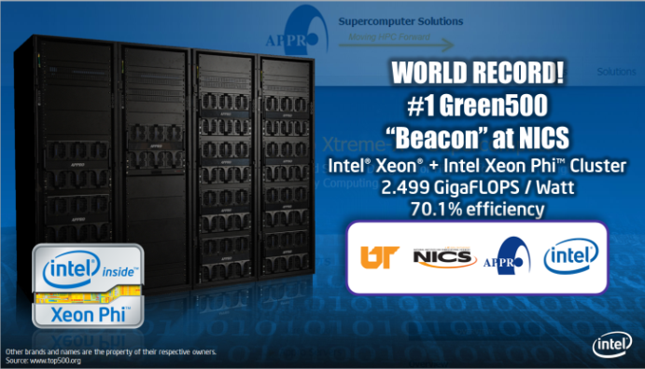

Intel EPSD & the Channel in the Top500 & Green500
25 Entries in the Top500 Supercomputers based on Intel EPSD
12 of the Top100 Supercomputers are built on Intel EPSD
Top500 Supercomputers using Intel® Xeon Phi™ coprocessors
Tianhe the fastest supercomputer in the world achieved 33.86 Petaflops
  16,000 computer nodes, each comprising two Intel® Xeon® Ivy Bridge and tree Intel® Xeon Phi™ for a total of 3’120,000 cores
22 Entries in the Green500 Supercomputers based on Intel EPSD
12 of the Top100
Including…the #1 spot in the Green500!
Notes:
The two key benchmarks in the high performance arena are the Top500 and the Green500.
The Top500 which measures the fastest supercomputers in the world had 25 entries based on EPSD in 2012. What is even more impressive is that if you look at the top 20% of that list, 12 are built on EPSD, and 5 of 7 of the growing number of entries using Intel® Xeon Phi™ are based on EPSD.
What may be even more impressive is the work Cray was able to do with EPSD from a performance per Watt perspective. The Green500 which measures the top supercomputers based on both performance and power consumption had as it’s top entry an EPSD based system.
The top supercomputers in the world are based on EPSD as their platform of choice!

Slide 53




Big Data – A Foundation For Delivering Big Value
Evolving Data Landscape
Relational
(Structured)
Non-Relational
(Unstructured)
Distributed
Edge
Analytics
Scale Up
Operational
Notes:
Depending on where you’re starting, you need to understand the structure of your information, and the decisions that you’ll need to make as a result.
Many traditional companies have an established data repository, which has advantages and disadvantages. Your understanding of your data structure benefits your company in terms of your ability to analyze what you have, but also makes it difficult to incorporate new and less structured data sources, such as customer feedback, internet trend data, or other new “velocity-based” data sources. Your operational analytics capabilities will benefit you as you grow your data sources.
Newer companies, or those who are expanding in new ways, will likely be approaching the problem from a new direction, and will utilize more of an unstructured data approach. This will rely more on garnering data from the edge or the cloud instead of using the existing data store that a typical company would have. As you bring more data from these sources into your environment, it’s likely that the traditional forms of data analytics will only slow your speed to insight.
Often the most daunting task is combining the existing structured data set with the non-relational inputs to get the most insight out of all your data. This is a relatively new area of enterprise computing, and there are a variety of emerging solutions that you can use.
For these reasons, it’s important to understand the tools that are available to you to process data. It’s also important to build the right hardware environment to best process your data.

Slide 54




Big Data – A Foundation For Delivering Big Value
Virtuous Cycle of Data-Driven Innovation
40 Zettabytes of data will be generated WW in 2020¹
Clients
Cloud
Richer user experiences
Intelligent Systems
Richer data to analyze
2.8 Zettabytes of data will be generated WW in 2012¹
(1) IDC Digital Universe 2020, (2) IDC
Richer data from devices
Notes:
It’s no surprise that the amount of data being generated is growing at a phenomenal rate. In the next decade the rate of information generated will grow nearly 15x, powered by a variety of inputs, from cloud to the growth of clients to the increase in machine-to-machine communication.
Big Data has always been with us, and it’s likely that it exists in many places in your environment. If you have a website that accepts comments, you have the potential to mine those comments to make your business better. If you have industrial controls in your manufacturing environment, the data from those could increase your profits. Your employees are also one of your best indicators of how business runs, and the ability to use information to make their jobs easier could greatly benefit your company.
All of this data provides a gold mine of information and decision process… if you have the capability to mine that data to get those insights. As the volume, variety, and velocity of data continues to grow, the opportunities to draw on the data will also increase. And that means insight and value to your business.

Slide 55

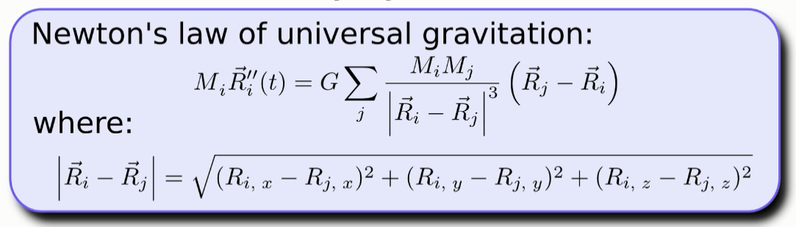
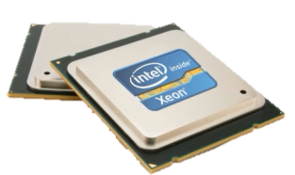
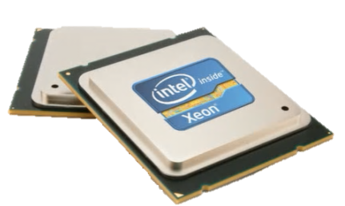

Intel® Xeon® Processor with
Intel® Xeon Phi™ Coprocessor
Intel® Xeon® Processor
Intel® Xeon®
Processor
Intel® Xeon®
Processor
vs.
vs.
+1
Intel® Xeon Phi™
Coprocessor
+2
Intel® Xeon Phi™
Coprocessors

