Slide 1
Time for Downtime …..
Can you afford not to invest in protecting yourself against DDoS attacks ??

Slide 2
Martijn Duijm Working for Fortinet since november 2011 15 year experience in security FortiWeb, FortiDB and FortiDDoS specialist
Introduction

Slide 3
Agenda
Introduction to Fortinet : The IT Security solutions company
Latest of DDoS in the press….
Why DDoS protection today ?
DDoS threat trends…
The wide mitigation gap
Is there a DDoS protection ‘silver bullet’?
How to … Protect your IT Services today
Introducing FortiDDoS
Take-aways

Slide 4
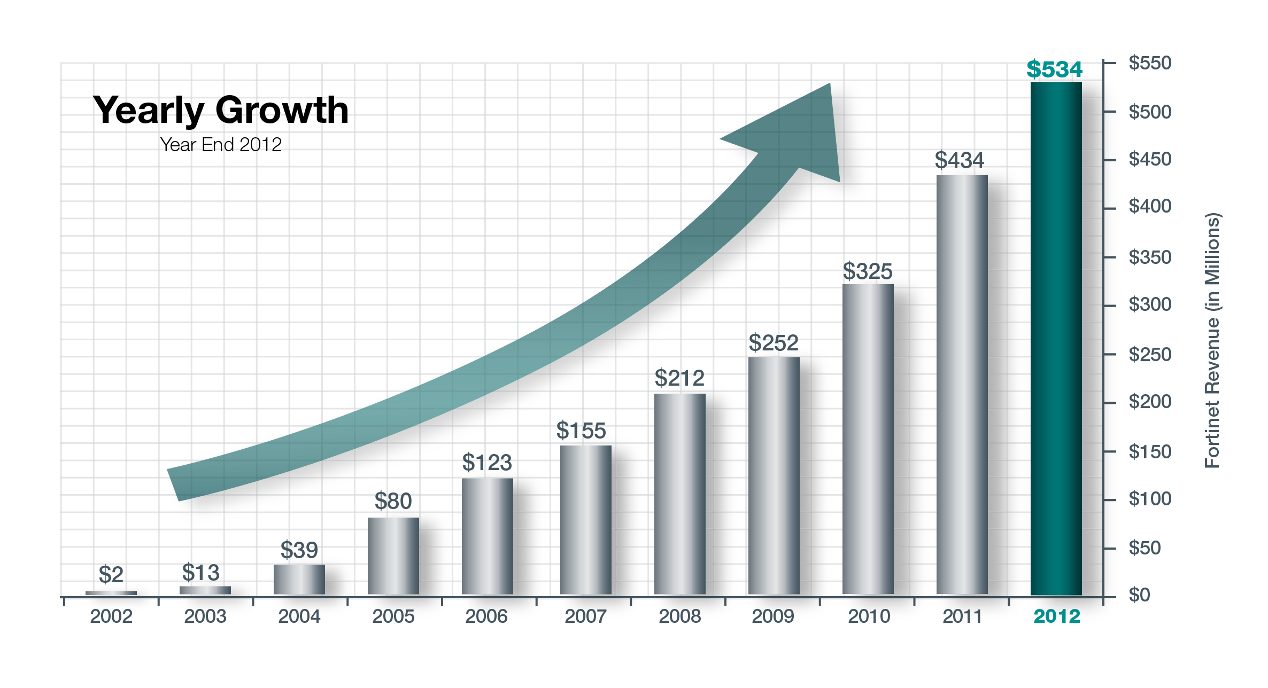
FORTINET HIGHLIGHTS
A leader of multi-billion dollar security market
Top 4 in security appliances market
Fast-growth security segments
Advanced technology and products
121 patents; 95 pending
Strong global footprint
2,000+ employees; 30+ offices worldwide
Blue chip customer base
150,000+ customers
(incl. majority of Global 100)
Shipped 1M+ FortiGate appliances to date
Strong financial stability
FY12 revenues: $534M (23% YoY growth)
FY12 billings: $ 602M (27% YoY growth)
Cash flow positive & profitable
Strong balance sheet: $740M+ in cash; no debt

Slide 5
PRODUCT LINE EXPANSION
CONTINUOUS INNOVATION

Slide 6
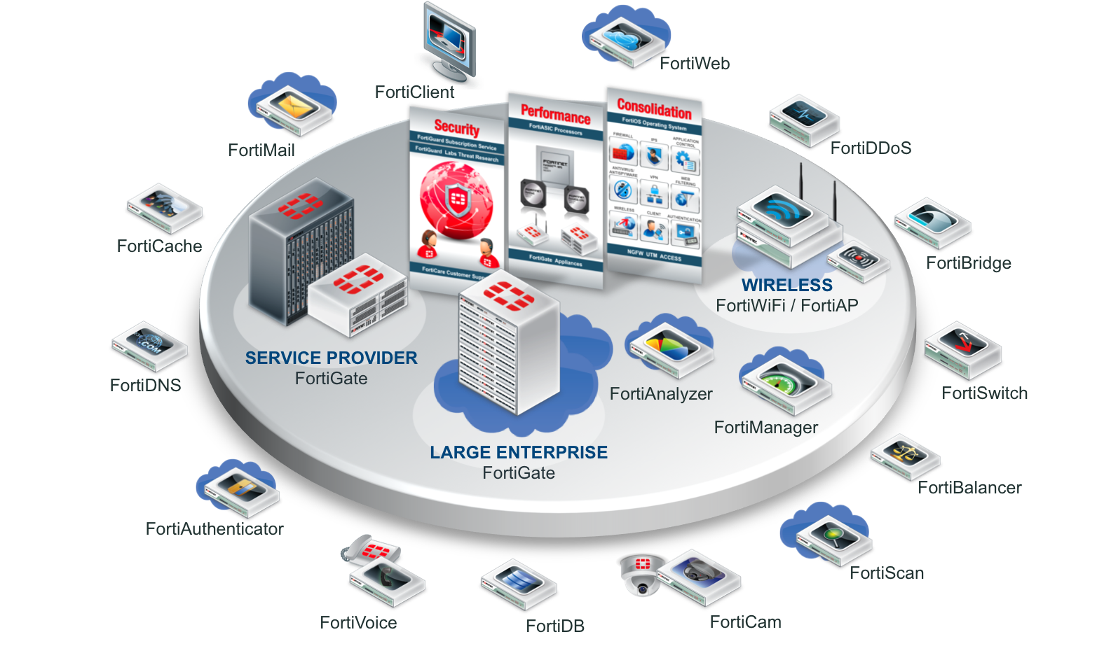
PRODUCT LINE EXPANSION
IT SECURITY
FortiDDoS
Notes:
6

Slide 7
What is DDOS ?
This???
Or this ?

Slide 8
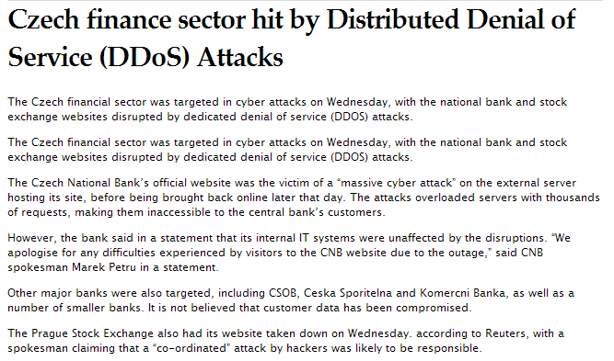
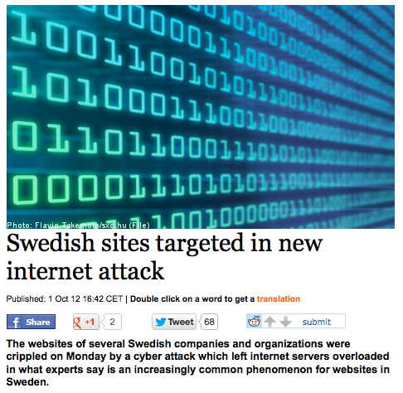
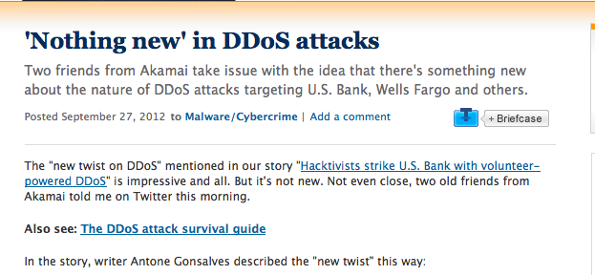
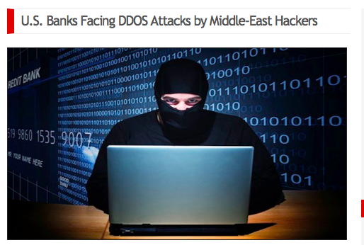
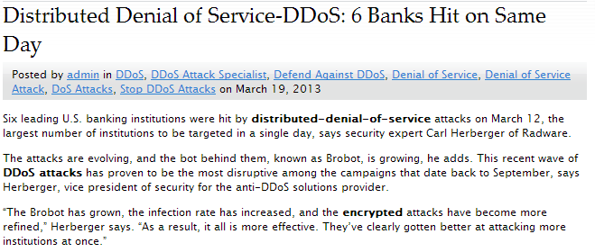
The latest in the DDoS Press …….

Slide 9
The Classification of Attacks
Volumetric Attack
Designed to consume available Internet bandwidth or overload server resources. Typical examples SYN Flood, UDP Flood, ICMP Flood, SMURF attacks.
(Layer 2, 3, 4)
Application Layer Attacks
More sophisticated, attractive to the attacker since they require less resource to carry out (botnet costs) Target vulnerabilities in applications to evade flood detection strategies
(Layer 7)
Cloud Infrastructure Attacks
Cloud solutions can turn the Internet in the Corporate WAN. Modern attackers target the full range of cloud infrastructure (firewall, mail & web servers) Mitigation can be complex and any attack can impact multiple customers

Slide 10
Why Implement DoS/DDoS Protection today ?
THE ODDS ARE STACKED AGAINST US ….
Projecting from current trends analysis, any organisation has a 75% probability of being DDoS’ed over the next 12 months

Slide 11
Why Implement DoS/DDoS Protection today ?
ATTACKS ARE INCREASING ….
DDoS attacks are increasing by 20%-40% annually

Slide 12
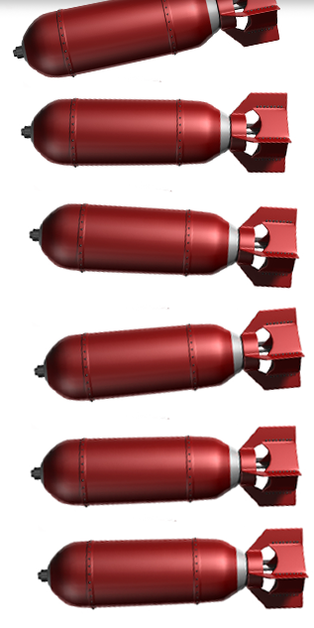
Why Implement DoS/DDoS Protection today ?
SIZE ISN’T EVERYTHING! …
Fewer 10% of attacks > 10Gbps
More than 75% attacks < 1Gbps

Slide 13
Why Implement DoS/DDoS Protection today ?
Costs ???
More than half say <10k/hr
More than 10% say >100k/hr
80% in Financial Services say >10k/hr

Slide 14
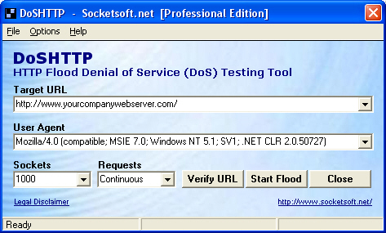
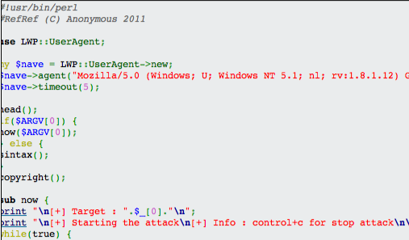
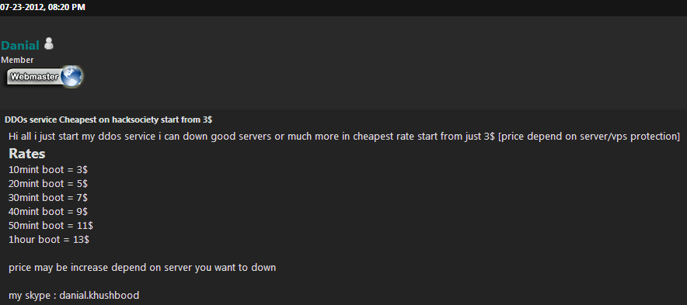
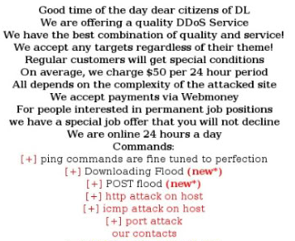
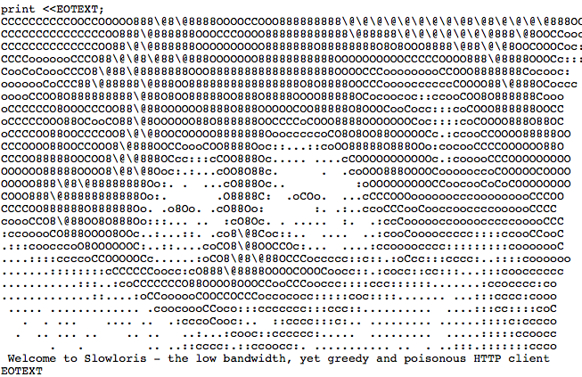
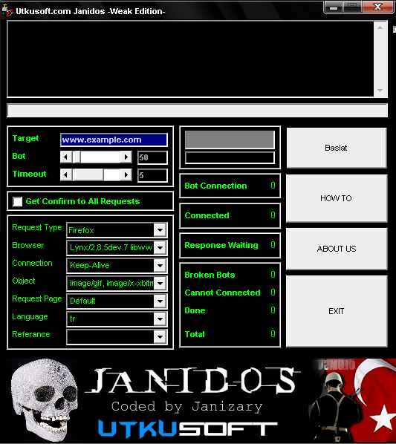
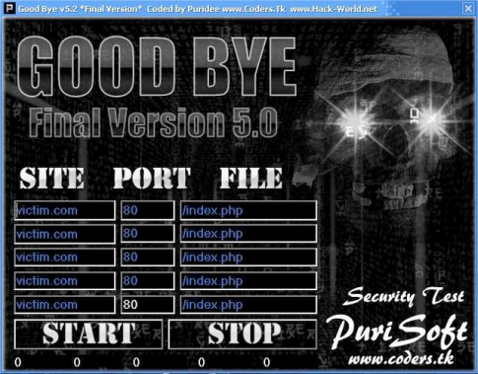
Why Implement DoS/DDoS Protection today ?
HOW EASY ?…
booster scripts

Slide 15
Current customer / 250 attacks a day!

Slide 16
Another customer / Dirtjumper attack

Slide 17
Where is the DDoS Silver Bullet Solution?
Enterprise
ISP
IT Services

Slide 18
Where is the DDoS Silver Bullet Solution?
Scrubbing
Solution
Enterprise
ISP
IT Services
Option A - ISP

Slide 19
Where is the DDoS Silver Bullet Solution?
Cloud based Scrubber
Enterprise
ISP
IT Services
Option B - Cloud

Slide 20
DDOS mitigation in the cloud

Slide 21
Where is the DDoS Silver Bullet Solution?
IT SERVICE PROTECTION
Detection &
Mitigation
Solution
Enterprise
ISP
IT Services
Option C - Dedicated

Slide 22
“Existing single-point solutions are broken”
Software or general CPU-based
High traffic volume can cause false positives
Can’t “set it and forget it” IDC 2011
Service-based
High and generally unpredictable costs
Slower and inflexible
Customer lacks control Frost & Sullivan 2011
Traditional firewall/IPS
Ineffective against sophisticated attacks
Problems scaling to high-volume attacks
Complex IDC 2011

Slide 23
Introducing FortiDDoS
Hardware Accelerated DDoS Defense
Intent Based Protection
Uses the newest member of the FortiASIC family, FortiASIC-TPTM
Rate Based Detection
Inline Full Transparent Mode
No MAC address changes
Signature Free Defense
Hardware based protection
Self Learning Baseline
Adapts based on behavior
Granular Protection
Multiple thresholds to detect subtle changes and provide rapid mitigation
ISP 1
Web Hosting Center
FortiDDoS™
Firewall
ISP 2
Legitimate Traffic
Malicious Traffic

Slide 24
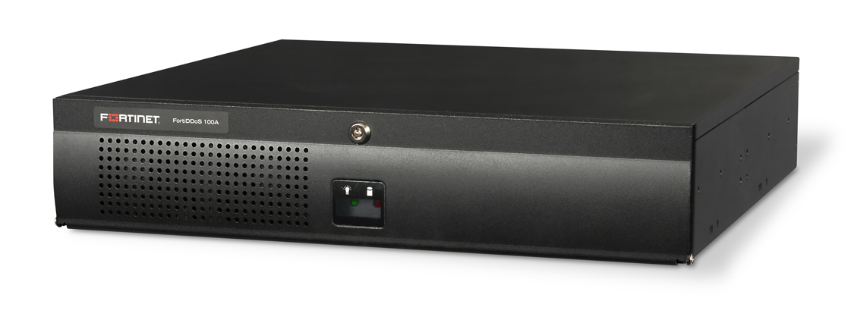
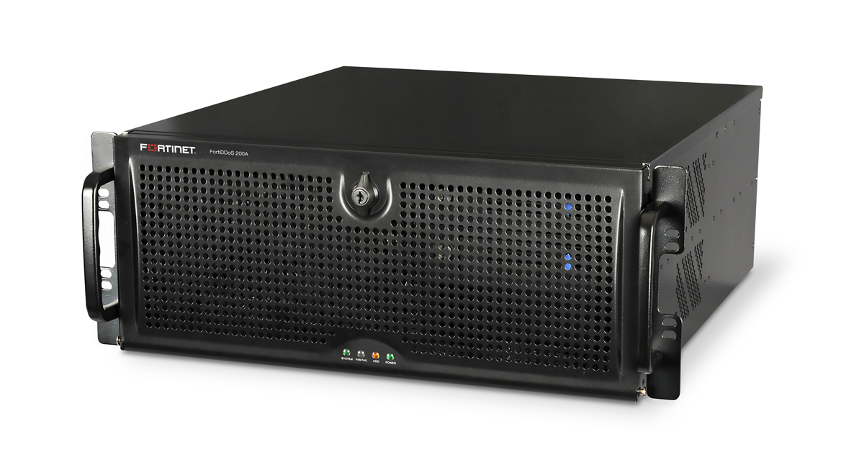
FortiDDoS Current Product Family
LAN 2 x 1G (copper and optical)
WAN 2 x 1G (copper and optical)
FortiASIC 2 x FortiASIC-FP1
Performance 1 Gbps full duplex
FortiDDOS-100A
LAN 4 x 1G (copper and optical)
WAN 4 x 1G (copper and optical)
FortiASIC 4 x FortiASIC-FP1
Performance 2 Gbps full duplex
FortiDDoS-200A
LAN 6 x 1G (copper and optical)
WAN 6 x 1G (copper and optical)
FortiASIC 6 x FortiASIC-FP1
Performance 3 Gbps full duplex
FortiDDoS-300A
Notes:
24

Slide 25
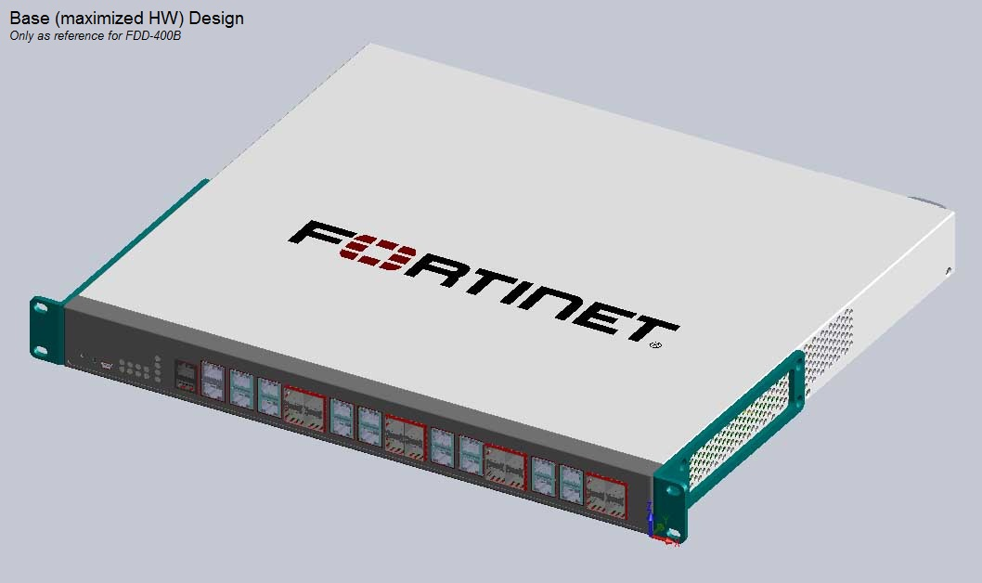
FortiDDoS Products
FortiDDoS-400B
4 Gbps full duplex
Eight-link protection, 1U appliance
LAN | 8 x 1G copper
WAN | 8 x 1G copper
FortiASIC | 1 x FortiASIC-FP2
RAM | 8G
Storage | 1 X 512 GB SSD
Management | 2 x RJ45 10/100/1000
Power | AC
Protection | 4 Gbps full duplex
Notes:
Supports up to 1 million simulations connections/sec

Slide 26
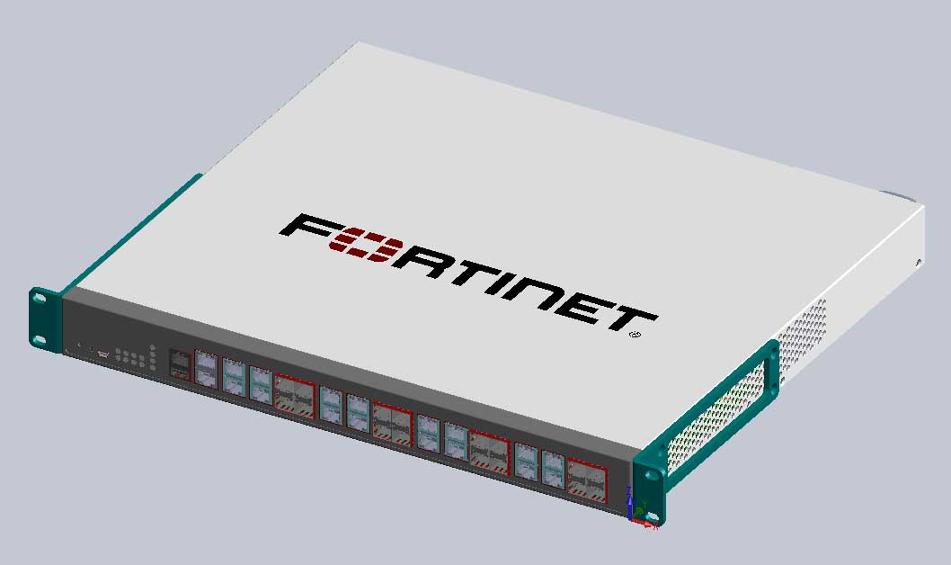
FortiDDoS Products
FortiDDoS-800B
8 Gbps full duplex
Eight-link protection, 1U appliance
LAN | 8 x 1G copper
WAN | 8 x 1G copper
FortiASIC | 2 x FortiASIC-FP2
RAM | 8G
Storage | 1 X 512 GB SSD
Management | 2 x RJ45 10/100/1000
Power | AC
Protection | 8 Gbps full duplex
Notes:
Supports up to 1 million simulations connections/sec

Slide 27
FortiDDoS : 5 Key Features and Benefits
 | Feature | Benefit
A | FortiASIC accelerated detection & mitigation | Custom designed high-speed ASIC processors block attacks before they can affect network availability
B | Automatic traffic pattern learning | Achieves more accurate threat detection through multi-layer profiling Modeling requires almost no end user intervention
C | Virtual Partitions | In multi-tenant or virtual environments, prevents attack on one customer from affecting another Provides flexible deployment options and optimal TCO for service providers and cloud environments
D | Rapid & Resilient deployment | No network topology or configuration changes needed, integrates into existing network architecture
E | Microfine enforcement of network traffic on layers 2, 3, 4 and 7 | Significantly reduces false positives Automatically builds a complex and detailed legitimate traffic model Facilitates detection of sophisticated attacks

Slide 28
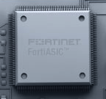
A. Powered By the FortiASIC Traffic Processor
FortiASIC Traffic Processor
Virtual
Partitioning
Geolocation
Based ACL
Protocol
Anomaly
Prevention
Packet
Flood
Mitigation
Stateful TCP
Inspection
Out of State
Filtering
Granular
Layer 3
Layer 4
Flood
Mitigation
Application
Layer
Flood Mitigation
(HTTP)
Algorithmic
And
Heuristic
Filtering
Inbound
Risks
Outbound
Risks
Internet Traffic
Outbound Traffic
Bidirectional Hardware Logic
GUI Management/CLI

Slide 29
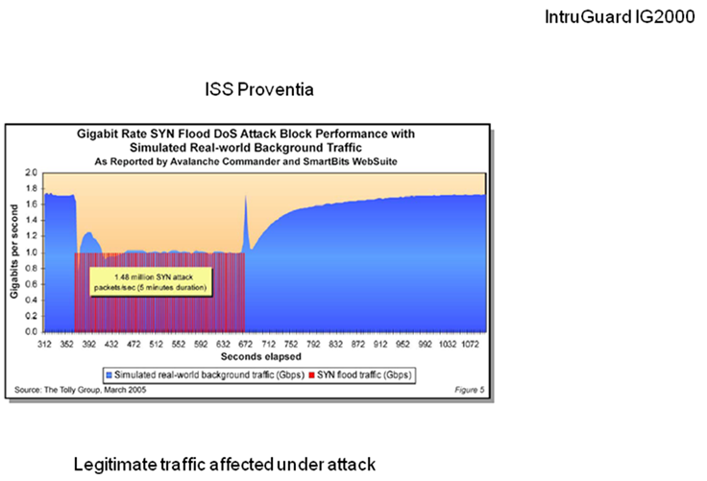
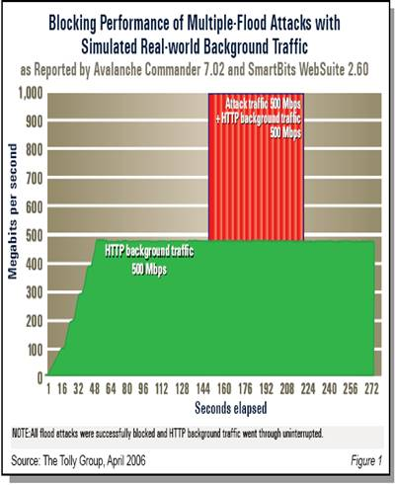
A. ASIC designed to handle high volume attack traffic
FortiASIC : Benchmarked at 27uS wire speed latency
FortiASIC : Benchmarked at <2s mitigate velocity
But ….
Software / CPU Solution : Suffers large performance degradation

Slide 30
FortiDDoS : 5 Key Features and Benefits
 | Feature | Benefit
A | FortiASIC accelerated detection & mitigation | Custom designed high-speed ASIC processors block attacks before they can affect network availability
B | Automatic traffic pattern learning | Achieves more accurate threat detection through multi-layer profiling Modeling requires almost no end user intervention
C | Virtual Partitions | In multi-tenant or virtual environments, prevents attack on one customer from affecting another Provides flexible deployment options and optimal TCO for service providers and cloud environments
D | Rapid & Resilient deployment | No network topology or configuration changes needed, integrates into existing network architecture
E | Microfine enforcement of network traffic on layers 2, 3, 4 and 7 | Significantly reduces false positives Automatically builds a complex and detailed legitimate traffic model Facilitates detection of sophisticated attacks

Slide 31
B. Traffic Learning : Baseline Building
Legitimate traffic model is automatically constructed
Calendar based baseline
Adaptive Threshold Estimation
Typically increases over time, no need to re-measure
Multiple links supported
Links from ISP(s)
DDOS Protection FortiDDOS
Firewall
FortiGate
Hosting
Center

Slide 32
FortiDDoS : 5 Key Features and Benefits
 | Feature | Benefit
A | FortiASIC accelerated detection & mitigation | Custom designed high-speed ASIC processors block attacks before they can affect network availability
B | Automatic traffic pattern learning | Achieves more accurate threat detection through multi-layer profiling Modeling requires almost no end user intervention
C | Virtual Partitions | In multi-tenant or virtual environments, prevents attack on one customer from affecting another Provides flexible deployment options and optimal TCO for service providers and cloud environments
D | Rapid & Resilient deployment | No network topology or configuration changes needed, integrates into existing network architecture
E | Microfine enforcement of network traffic on layers 2, 3, 4 and 7 | Significantly reduces false positives Automatically builds a complex and detailed legitimate traffic model Facilitates detection of sophisticated attacks

Slide 33
C. Virtual Partitions
Uniquely enables up to 8 segmented zones
Segmentation by server address / subnet
Consider an environment with multiple traffic types
Web Browsing
Firmware Updates
Online Ordering
Separate Policies for Unique Traffic Patterns
Connection patterns differ from service to service
Need to protect services from each other
Permits the development of Service Protection Profiles
Links from ISP(s)
8x
DDOS Protection
Firewall
FortiGate
Corporate site

Slide 34
FortiDDoS : 5 Key Features and Benefits
 | Feature | Benefit
A | FortiASIC accelerated detection & mitigation | Custom designed high-speed ASIC processors block attacks before they can affect network availability
B | Automatic traffic pattern learning | Achieves more accurate threat detection through multi-layer profiling Modeling requires almost no end user intervention
C | Virtual Partitions | In multi-tenant or virtual environments, prevents attack on one customer from affecting another Provides flexible deployment options and optimal TCO for service providers and cloud environments
D | Rapid & Resilient deployment | No network topology or configuration changes needed, integrates into existing network architecture
E | Microfine enforcement of network traffic on layers 2, 3, 4 and 7 | Significantly reduces false positives Automatically builds a complex and detailed legitimate traffic model Facilitates detection of sophisticated attacks
Notes:
Microfine Granularity and Accurate Detection
Microfine granularity on defining traffic patterns by using counters at different layers on OSI stack. Much less false positives
Automatic ability on building a complex and detailed legitimate traffic model facilitating detection of sophisticated attacks that attempt to mimic legitimate traffic.
Virtual Network Partitions
Support up to 8 discretely managed servers, subnets or networks into different policy domains using IP addresses/masks providing a second level of granular protection to your network
Ease of Deployments
Because much of the complexities are handled by the FPGA hardware, and good baseline traffic models are built automatically through the continuous learning process, very little human intervention is required
No network topology or configuration change is needed.

Slide 35
D. Resilient Deployment with Multiple ISP Links
Dual links provided for business continuity
FortiDDOS appliance pair provides physical redundancy
Asymmetric Flow Synchronization
Allows FortiDDOS state machines to have complete traffic visibility
Enables handling asymmetric traffic
FortiDDOS devices are interconnected to provide the synchronization path
Mitigation occurs on both appliances
Data / Hosting
Center
Asymmetric Flow
Sync
ISP-A
ISP-B
Attacker

Slide 36
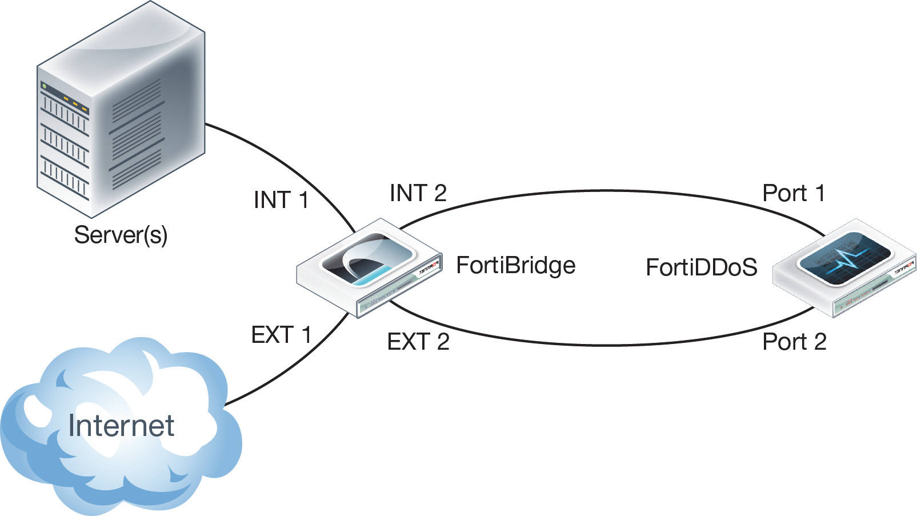
D. Resilient Deployment with Fail Over

Slide 37
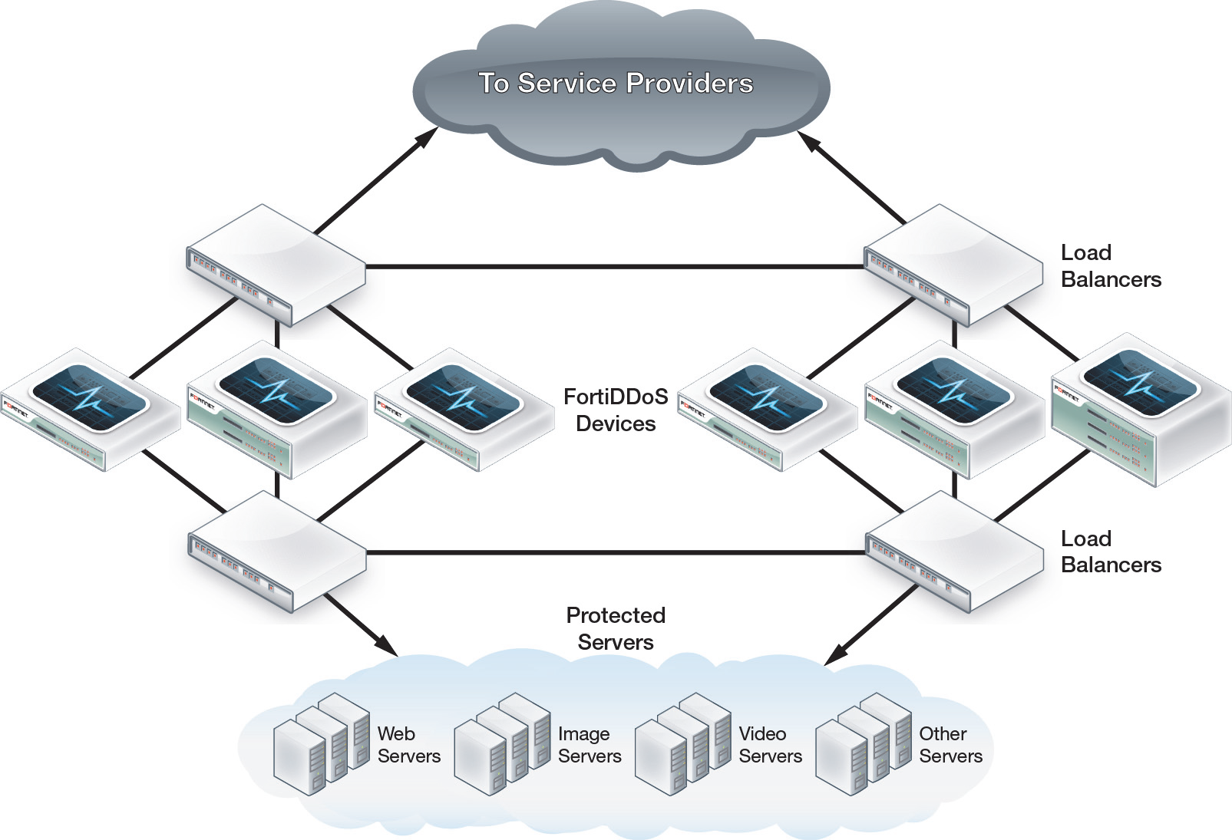
D. Resilient Deployment with Load Balancing

Slide 38
FortiDDoS : 5 Key Features and Benefits
 | Feature | Benefit
A | FortiASIC accelerated detection & mitigation | Custom designed high-speed ASIC processors block attacks before they can affect network availability
B | Automatic traffic pattern learning | Achieves more accurate threat detection through multi-layer profiling Modeling requires almost no end user intervention
C | Virtual Partitions | In multi-tenant or virtual environments, prevents attack on one customer from affecting another Provides flexible deployment options and optimal TCO for service providers and cloud environments
D | Rapid & Resilient deployment | No network topology or configuration changes needed, integrates into existing network architecture
E | Microfine enforcement of network traffic on layers 3, 4 and 7 | Significantly reduces false positives Automatically builds a complex and detailed legitimate traffic model Facilitates detection of sophisticated attacks

Slide 39
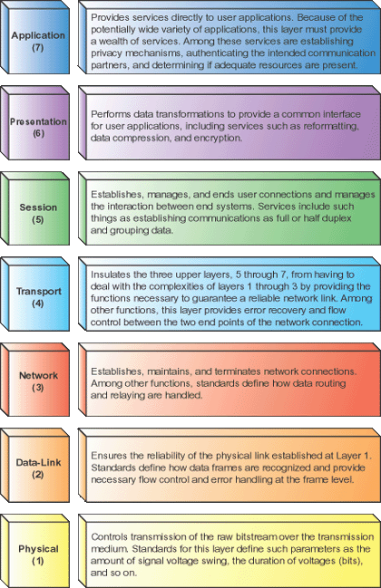
E. Microfine enforcement at multiple network layers
Layer 3 (varying layer 3 headers)
ICMP floods, TCP floods, fragment floods.
Layer 4 (port floods)
TCP or UDP port floods. Single port attacks, ICMP echo flood
Layer 7 (URL floods).
In this attack, a single URL is continuously attacked from multiple sources.

Slide 40
Recent EU Customer Feedback
“ We recently experienced a very large DDoS attack on our network. We've found FortiDDoS withstanding the attack very well at this time. Seeing as this is the largest network attack we've ever experienced, utilizing this information will help us significantly in protecting us against other attacks in the future”
Scale of the attack?
6.8BN : Packets dropped in 8 hours
27 hours : Attack duration
~last 12 hours : Initiated FortiDDoS mitigation

Slide 41
Can you afford NOT to protect IT Services: Take-Aways
DDoS attacks will continue to increase in frequency and complexity through 2013
There is no ‘Silver Bullet’ solution … yet(!)
Firewalls and IPS are not fit to protect against today’s DDoS attacks
Enterprises with multiple carriers or web-centric businesses need an effective and scalable on-premise DDoS protection.
ASIC is the ONLY way : A software/general CPU-based security device cannot keep up with high volume and sophistication of the attack traffic
Critical IT Services demand ‘Next Generation IT Service Protection’!
Come and chat with us to learn HOW ….

Slide 42
Book your FortiDDoS PoC!
Book your FortiDDoS PoC priority by leaving your business card with us today!
 | STEP | DESCRIPTION
1 | Pre-plan | Book FDDoS, test location, contact details, management interface ips, VID names, subnet mask, network diagrams. Determine test criteria
2 | Unit Preparation | Install latest firmware, factory reset config, VIDs set to detection mode, verify country ACL is empty
3 | Unit Deployment | Deploy according to Quickstart Guide Ch1-5. Use unit in ‘learning mode’ for 2 days minimum. Monitor attack counters
4 | Post Learning | Report on traffic statistics, aggregate drops. Adjust thresholds/ACL’s, continue in detection mode,
5 | Prevention Mode | Set VID to detection/prevention. Check not dropping legit packets
6 | Generate Traffic | Use HPing3 to generate flood traffic (DNS, UDP, SYN floods), Slowloris and HTTP vulnerable method
7 | Report | Reconcile reports with initial test criteria

Slide 43
Fortinet Real Time Denial of Service Protection
Detection
Bulk Volumetric
Layer 3 and 4
Scalable
Bandwidth Anomalies
Protocol Anomalies
Mitigation
Protect Infrastructure
Rate Limit
Source Filtering
Scrubbing/ Cleaning Centers
BGP Redirection
Service Provider
WAN
Data Centre
Management and Logging
Enterprise Demarcation
FortiDDoS
Layer 3/4/7 Visibility, ASIC based protection (control/forwarding seperation), Granular Identification, Behavioral Anomalies, Service Centric, Minimal Detection Times, Adaptive Protection
FortiManager
FortiGate
ASIC based Screening protection, High Performance Firewall , Next-Generation Firewall with Advanced Services Protection; UTM, Application Control
FortiAnalyser
FortiWeb
Web application firewall with bidirectional protection against application layer DoS attacks and sophisticated threats like SQL injection and Cross-site scripting
Existing NMS
FortiDB
Database Security and Compliance platform that utilises a flexible policy framework to allow quick and easy implementation of internal control frameworks for activity monitoring and audit and regulatory compliance

Slide 44
Thank You
www.fortinet.com

