Slide 1
Nexenta systems Inc.
Bucharest
3 October 2013
Johan van den Boogaart
Partner Account Manager CEE
Notes:
Thank you for the introduction. I’m Evan – happy to meet you all.

Slide 2
Agenda
Online Campaigns
About Nexenta
Storage requirements of today
Maguay storage solutions
Nexenta Positioning

Slide 3
Company profile
HQ in silicon valley, founded 2005
Global team – 245 people
Offices in US, UK, Korea, Russia, India, Netherlands, China
EMEA HQ in Amsterdam
Over 650PB+ of storage deployed
5.000+ customers
Primary focus
Cloud deployments
Virtual infrastructures
475% growth in 2012 / $400M
Software only; physical and virtual
“Nexenta is the fastest growing storage start-up ever”
March 2011

Slide 4
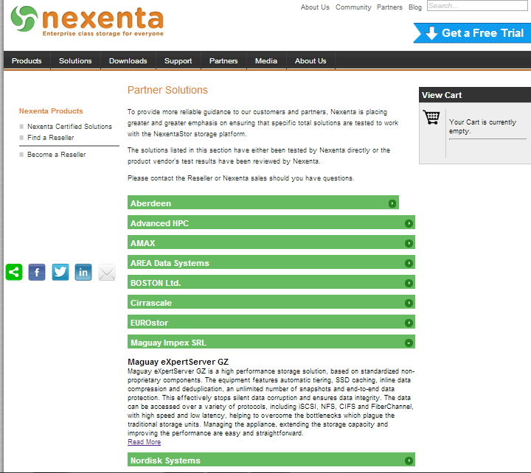

Slide 5
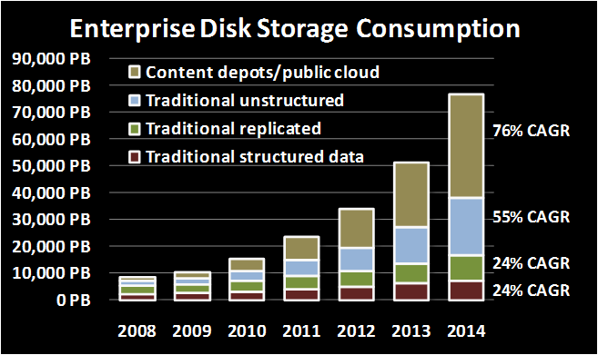
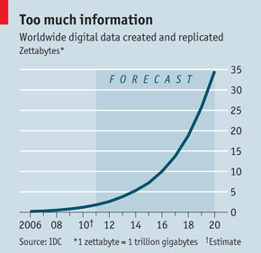
Disruptive approach to the market
Storage is 42% of enterprise IT spending
56% of enterprise software is open source
For storage this amounts to only 1 - 2%

Slide 6
Software only
Leverage open and proven technology
Just like the other 56%
Open partnerships with vendors
Intel, STEC, LSI, DELL, SuperMicro among others
End user benefits from commodity hardware
CPU: number of cores, Hz and hardware virtualization
High density DIMM
SSD technology (SLC and MLC FLASH even DRAM)
Faster adoption of software standards
NFS4, pNFS, NFS refer, etc
Value add of Nexenta
Support, drivers, features, bug fixes, integration and design

Slide 7
NexentaStor
21st century DataCenter:
NexentaVSA for View
NexentaCloud*, etc.
ZFS over multiple storage nodes: Scaling-out und HPC + VDI + Cloud Storage + Global Namespace
NexentaStor Plugins
+ Community (@ nexentastor.org) + Commercial (HA + namespace + cloud archive + DR + backup + VM management)
Hardware independant
NAS (NFS/ CIFS)
SAN (iSCSI/ FC)
Extended Analytics
Namespace Clustering
Enterprise Edition
+ Search + Synch Replication
+ Ease of use + Remote management
Debian-based
#1 Community + Packaging
IllumOS.org:
Years of Enterprise Deployments
>1 million downloads
ZFS Replication Improvements
ZFS Snapshot Management
IllumOS kernel
Multi-core + Clustering
ZFS: File system
Universal, Unlimited RAID
Hybrid storage w/native SSD
Cloud Level Performance
Self-healing, 128bit
ZFS

Slide 8
OpenSolaris - illumos
OpenSolaris project closed by Oracle in 2010
illumos: Fork of OpenSolaris
Important developers of illumos
Garret D`Amore, Bill Moore, Bryan Cantrill, Brendan Gregg, Adam Leventhal, …..)
Contributors: Nexenta, Joyent, Delphix, Areca, LSI, ReliantSecurity, Intel, EveryCity
NexentaStor v.4.0 → illumos

Slide 9
More and always available
Need of storage explodes
Storage has to be expanded easily
Data have to be stored longer
Data should be stored secure
Data should be recovered fast
Data should be availabe any time
Data should be available everywhere

Slide 10
Storage requirements of today
100% Data security
Performance
100% Availability
Unlimited flexibility
Minimal cost

Slide 11
100% data security

Slide 12
CERN Study
Disk errors: CERN wrote a special 2 GB file to more than 3,000 nodes every 2 hours and read it back checking for errors for 5 weeks. → 500 errors on 100 nodes.
RAID errors: CERN ran the verify command on 492 RAID systems each week for 4 weeks. The disks are spec’d at a Bit Error Rate of 10^14 read/written → in reading/writing 2.4 PB of data there were some 300 errors.
Memory errors: Good news: only 3 double-bit errors in 3 months on 1300 nodes. Bad news: according to the spec there shouldn’t have been any. Only double bit errors can’t be corrected.

Slide 13
Results
Checking 8.7 TB of user data for corruption – 33,700 files – 22 files corrupted
CERN concludes that taking measures to improve accuracy
. . . will lead to a doubling of the original required IO performance on the disk servers and . . . an increase of the available CPU capacity on the disk servers (50% ?!).

Slide 14
Traditional file system
Checksum stored with data block
Any self-consistent block will pass
Can´t even detect stray writes
Inherent FS/ volume interface limitation
Checksums validate only the data errors
Traditional
 | Bit rot
 | Phantom writes
 | Misdirected reads/ writes
 | DMA parity errors
 | Driver bugs
 | Accidental overwrite
DATA
DATA
Checksum
DATA
Checksum
DATA
Checksum
Checksum

Slide 15
ZFS Checksum Trees
256 bit checksum
Checksum stored in parent block pointer
Fault isolation between data and checksum
Entire pool (block tree) is self-validating
Adress
Adress
ZFS validates the entire I/O Path
ZFS
Checksum
Checksum
 | Bit rot
 | Phantom writes
 | Misdirected reads and writes
 | DMA parity errors
 | Driver bugs
 | Accidental overwrite
Adress
Adress
Adress
Adress
Checksum
Checksum
Checksum
Checksum
DATA
DATA
DATA
DATA

Slide 16
Transactional file system
Copy on Write (COW)
Write of a new data block
Allocation of new block, no overwrite of original block
Create checksum till Uberblock
Transaction successful

Slide 17
Transactional file system
Copy on Write (COW)
Original blocks are not overwritten.
If error, original data still available
Original data can be used for snapshot

Slide 18
Selfhealing
Application issues a read. ZFS mirror tries the first disk.
Checksum reveals that the block is corrupt on disk.
ZFS tries the second disk. Checksum indicates that the block is good.
ZFS returns good data to the application and repairs the damaged block.
APPLICATION
ZFS MIRROR

Slide 19
Performance

Slide 20
Performance
Storage capacity is cheap
Storage performance is expensive

Slide 21
Performance
Performance Basics:
IOPS (Input/Output Operations per second)
Databases, many small block writes, VMs
Data throughput (MegaBytes per second)
Large or sequential files (e.g. video)
Latency
Better (high) IOPS Worse (low) datathroughput
Better (low) latency Better (high) IOPS
“Data throughput you can buy, latency is forever”

Slide 22
Hybrid Storage Pool
RAM
SSD
FC-HDD
15k SAS
10k SAS
7.2k SAS
SATA
ARC
L2ARC ZIL
Storage Pool
Tiered Storage Management
Hybrid Storage Pool - ARC – Adaptive Replacement Cache
- L2ARC – Level Two Adaptive Replacement - ZIL – ZFS Intent Log

Slide 23
Hybrid Storage Pools
Accelerate storage with SSD
Self learning Level two Adaptive Replacement Cache (L2ARC)
Write Cache: ZIL – ZFS Intent Log
Intelligent pre fetching algorithms
The only unified storage vendor that allows RAM expansion
Decouple capacity and performance scaling
read: RAM and SSD
write: RAM and SSD
capacity: NL-SAS, SAS, FC, FCoE, AoE
Ideally for virtual server and desktop environments
Add write optimized low latency log devices
Synchronous writes are typically NFS and iSCSI
Add write performance as needed by extending the number of log devices

Slide 24
Hybrid Storage Pools
Write Cache (RAM/ ZIL)
Synchronous writes (NFS/ CIFS/ Databases)
Virtual desktop and server environments
Read Cache (L2ARC)
Recovery /Backup
Databases
Virtual desktop and server environments
Video streaming
Performance improvement
More RAM, more ZIL, more L2ARC, more VDEVs
Reduce costs and safe energy
64% initial buy and 77% power savings

Slide 25
100% availability

Slide 26
RAID-Z
Weaknesses traditional RAID
Not designed for current capacities drives
Silent data corruption remains undetected
Rebuilding TB drives takes to long
Mean Time to Data Lost (MTTDL) decreases

Slide 27
RAID-Z
RAID-Z compared to traditional RAID
RAID-Z1 – Single Parity (RAID 5)
Max. loss: 1 drive per virtual device (vDev)
Minimum 3 drives
RAID-Z2 – Dual Parity (RAID 6)
Max. loss: 2 drives per vDev
Minimum 6 drives
RAID-Z3 – Triple Parity (n.a.)
Max. loss: 3 drives per vDEV
Minimum 8 drives
Max 9 drives per RAID-Z

Slide 28
RAID-Z
Resilvering (Rebuilding)
Rebuild of only damaged data. Empty blocks are not processed.
No blind XOR like traditional RAID
Disruption of resilvering will not require a complete restart of the process.
RAIDZ-2: Rebuild only for Parity Index

Slide 29
Performance
Performance
Recordsizes and the RAID volumes can be optimized „on the fly“
RAID-Z protects against inconsistency problems („write hole“)
RAID1, RAIDZ-2, RAIDZ-3
More vDEVs will improve performance

Slide 30
Availability
Full active/active HA Cluster
Metro Cluster (long distance cluster)
Heterogeneous replication (a- and synchronous, file and block)
pNFS (Q1)
Unlimited number of snapshots
Unlimited cloning
SRM VMware (Q1)

Slide 31
Unlimited flexibility

Slide 32
Unlimited Storage
2⁴⁸ — number of entries in every directory
2⁴⁸ — number of attributes in one file
2⁴⁸ — number of files in a directory
16 EiB (2⁶⁴ bytes) — max. size of one filesystem
16 EiB — max. size of a file
16 EiB — max. size of an attribute
2⁶⁴ — number of devices per pool
2⁶⁴ — number of pools in a system
2⁶⁴ — number of filesystems per pool
2⁶⁴ — number of snapshots in every filesystem
2⁵⁶ ZiB (2⁷⁸ bytes) — max. size of a pool

Slide 33
Storage Pool
Traditional file system:
Per Volume one file system
Hard to switch drives to another volume
Extensive planning necessary
Every file system has a limited bandwidth
FS
FS
FS
Volume
Volume
Volume
ZFS:
No partitions/ volumes
Extension automatically (thin provisioning)
Uses bandwidth and I/O all pool members
File systems serve themselves from the pool
File system independent of volumes/ drives
FS
FS
FS
FS
Storage Pool

Slide 34
Every File System
New technologies
Local (System)
CIFS
NFS
iSCSI
Raw
Swap
FC/Others
ZFS POSIX (Block FS) Layer
ZFS Volume Emulator
ZFS zPool (stripe)
RAID-Z1 vDev
zMirror vDev
RAID-Z2 vDev

Slide 35
Minimal Costs

Slide 36
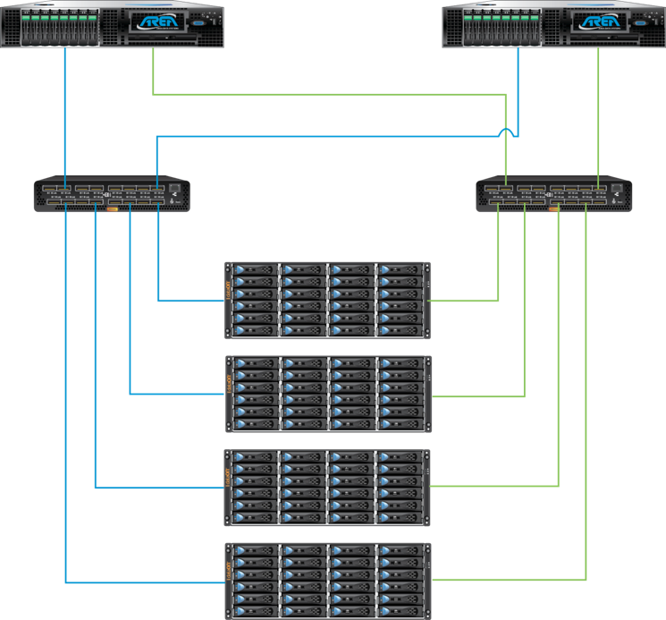
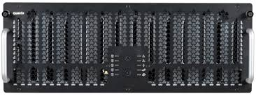
Reference architectures
Scale up solution
SAS theory doesn't match practice yet
Limited number of SAS devices per HBA
Using SAS switches to simply full SAS back-end fabrics
Less cabling constraints
Nexenta can dynamically expand pools
SAS devices are plugged into the switch
Add SSD (IO) or rotating (capacity) as needed
Metro cluster configuration
Multiple HA pairs on top of same SAS back-end
Scale out
36
36
36

Slide 37
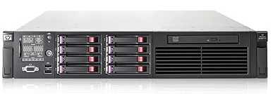
Building blocks
HA Cluster
Metro HA
Notes:
SPOF kann mit Hardware erschlagen, intelligentes Design kann dann für mehr sicherheit sorgen

Slide 38
Building Block Example VDI
Requirements:
1000 Desktops
Low latency for the VM’s
ca. 20TB storage
80% write
Existing Desktops need to be migrated
persistente Desktops
Boot Storms
Design:
2 eXpertServer GZ
2 Quanta M4600 JBOD’s
40 1TB Disks Mirror
2 1TB Disks as Hotspare
2 STEC ZeusRAM as ZIL (write cache)
4 400GB SSD as L2ARC (read cache)

Slide 39
Building Block Example Backup
Requirements:
Replacement of existing VTL’s
Connection by NFS
ca. 600TB storage
2GByte/Sek write throughput
128k Blocksize
Pure sequential load
Design:
1 eXpertServer GZ
4 Quanta M4600 JBOD’s
240 3TB Disks RAID-Z2 8+2
4 3TB Disks as Coldspare

Slide 40
Building Block Example VMware
Requirement:
Connection by NFS
ca. 350TB Storage
Costs per TB are extremely important
500 VM’s with different load
Design:
2 eXpertServer GZ
3 Quanta M4600 JBOD’s
168 3TB Disks RAID-Z2 4+2
4 3TB Disks as Hotspare
4 STEC ZeusRAM as ZIL (write cache)
4 400GB SSD as L2ARC (read cache)

Slide 41
Enterprise features!!
- SAN and NAS
- High performance over 2500MB/s
- Leverage Current technology
- Unlimited number of snapshots
- Unlimited cloning
- Pooled storage model
- asynchronous performance scaling
- Unlimited retention
- Unlimited volume sizes
- DTRACE
- Online hardware refresh
- Full active/active HA config
- Heterogeneous replication - SAN and NAS
- Synchronous (metro-cluster) replication
End to end data integrity
RAIDz 1, 2 and 3
Hypervisor integration
Xen/Vmware/HyperV
inline compression
inline deduplication
API for storage management
Scale out cluster configurations
Write Once Read Many
Thin provisioning
Online volume grow
Optimized for cloud/virtual environments
Consolidate excess storage Unified gateway

Slide 42
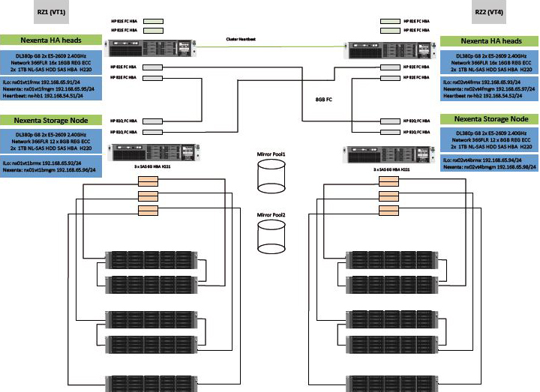
Nexenta MetroHA

Slide 43
Vmworld 2011 SuperRack
43

Slide 44
Storage Module
Part | Description | Total Qty
System | 2U 6HDD Storage Chassis | 4
Motherboard | X8DAH-+-F Motherboard | 4
Processors | Westmere 6C X5670 2.93G 12M 6.4GT | 8
Memory | 8GB NETLIST Hyperstream | 72
HDD | SEAGATE 2.0TB SAS 2.0 7.2K RPM 16M 3.5" | 360
Jbods | DATAON 60 BAY JBODS | 6
controllers | LSI 8port controller | 4
10GB NIC | STD Dual-port 10G Ethernet with SFP+ W/ CDR | 4
SATADOM | Innodisk 64GB SATADOM | 4
Lic | 720TB RAW Capacity Lic. 30x6 RAID Z2 x 2 | 1
SSD | STEC Zeus RAM 8GB x 2 | 8
SSD | STEC Zeus IOPS 200 GB | 8
SATADOM CABLE | DOM CABLE | 4
HA Cluster - 360 HDD - 720 TB capacity - 480 TB capacity usable - 90 HDD per active node (180 per Cluster, 240 TB usable)

Slide 45
Our competitors
2x FAS 3270 Systems
144 x 15K drives
4 PAM cards per system
MSRP $ 1.4 M
Average sales price $ 700K
2x EMC VNX 7500 Systems
3x File Blades per VNX
1 VNX with only SSD ( 96 SSD’s in total)
1 VNX 140+ 15K HDD FAST Cache, FAST VP SSD Tier
HDD VNX - $ 1M+ Dollars
SSD VNX - $ 1.6 M Dollars
Nexenta Systems Inc. CONFIDENTIAL

Slide 46
Our results
Ran 4 of the 8 Workloads for the duration of VMworld
During the first session NetApp are offline – We took their workload as extra
7.9 Billion NFS ops served from 4 Controllers during the labs
38,590 NFS 16K NFS ops/sec on a single controller
Peak controller load 154K NFS ops/sec at 4K sub 1 ms latency
Average Latency – Read 2.19 ms Write 2.13 ms
Highest Bandwidth on a Single Controller (Average I/O 16k)
1,305 MB/sec Total- 928 MB/Sec Reads - 376 MB/Sec Writes
Less than 2 ms latency
RAM failure in a head triggers HA failover
HA works faultlessly and Controller 3 runs the workload of 2 controllers for 6 hours seemlessly.
Cost $ 325,000

Slide 47
SSD Appliance
ISCSI WRITE 4K sustained 253,469 IOPS
ISCSI READ 4K sustained 200,300 IOPS
70 / 30 Read Write workload sustained 215,915 IOPS
Sustained Bandwidth to appliances 2.8GB /sec
Sustained Latency < 2ms

Slide 48
Nexenta Positioning
Unified storage SAN and NAS
NFS is our strength (NetApp)
iSCSI → VAAI certified
FC, Infiniband (PS only), AoE
Optimized for Cloud
No limitation: Volume size, number of files, number of Snapshots, number of directories
Largest Nexenta Cloud Installation 55 PB
“Scale out” – we love JBODs
Optimized for VDI
Latency < 2 ms
Scale up – just add RAM or SSDs
iSCSI
NFS
CIFS
FC
iSCSI
AoE
SAS
FC
InfiniBand

Slide 49
NFS is growing
Storage for VMware: 2008
Storage for VMware: 2010
Notes:
Adds up to more than 100% because customers DO use more than 1.

Slide 50
NexentaStor Differentation
Unified storage SAN and NAS
100% Daten Integrity
No “Silent Data Corruption”
Self-healing
Hybrid Storage Pools
Unique capacity and perfomance scaling
Add CPU and SSD to achieve speed not just more spindles
RAIDZ
Fast rebuild of large data
No need for expensive NVRAM
No need for expensive RAID Controller + Battery Backup
No legacy design limits
Unlimited volumes, files, snapshots, directories
Customized building blocks

Slide 51
THANKS!

Slide 52
Nexenta Licensing
Pro TB
8TB, 16 TB, 32 TB, 64 TB, etc
Incl. 1 year support
Support
Silver, Gold and Platinum
24 x 7, follow the sun
HA Cluster only Gold or Platinum
> 64TB only Gold or Platinum
Plugins
HA Cluster, VMDC, FC-Target, NameSpace Cluster
Professional Services
Software not tight to HW!!!

