Slide 1


Slide 2
The following is intended to outline our general product direction. It is intended for information purposes only, and may not be incorporated into any contract. It is not a commitment to deliver any material, code, or functionality, and should not be relied upon in making purchasing decisions.
The development, release, and timing of any features or functionality described for Oracle’s products remains at the sole discretion of Oracle.

Slide 3
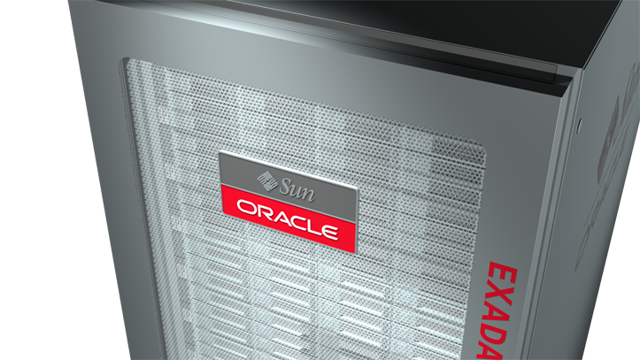
Oracle Engineered Systems
Adrian Gheorghevici, Oracle Romania

Slide 4
Agenda
Vedere generala Oracle Engineered Systems
Intrebari/discutii deschise

Slide 5

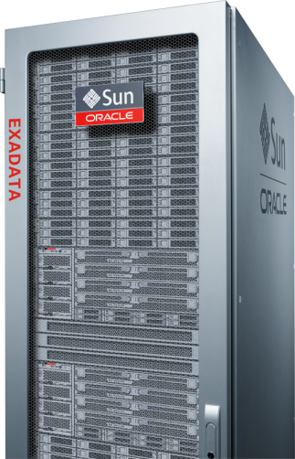
Vedere generala Oracle Engineered Systems

Slide 6

“Engineered Systems”
  – ce inseamna?

Slide 7
Engineered System
Un intreg in care partile au in comun
  o unica autoritate de proiectare
  un set de scopuri de proiectare
Partile constituente
  sint proiectate in contextul intregului sistem
  isi cunosc designul intre ele
  sint optimizate la momentul proiectarii pentru a lucra impreuna

Slide 8
Sistem asamblat
Nu exista o unica autoritate de proiectare
  nici pentru sistem, nici pentru partile componente
Partile constituente
  sint proiectate in necunostinta fata de celelalte
  nu au informatii despre sistem ca un tot
  ca urmare nu pot fi optimizate prin design

Slide 9
Sistem evolutiv
Nu exita autoritate de proiectare
Nu exita scopuri de proiectare
Partile constituente
  sint proiectate in necunostinta fata de celelalte
  nu au informatii despre sistem ca un tot
  sint selectate dupa un model ad-hoc
  sint adaugate la ceea ce exista deja

Slide 10

Sistem asamblat (non IT)

Slide 11
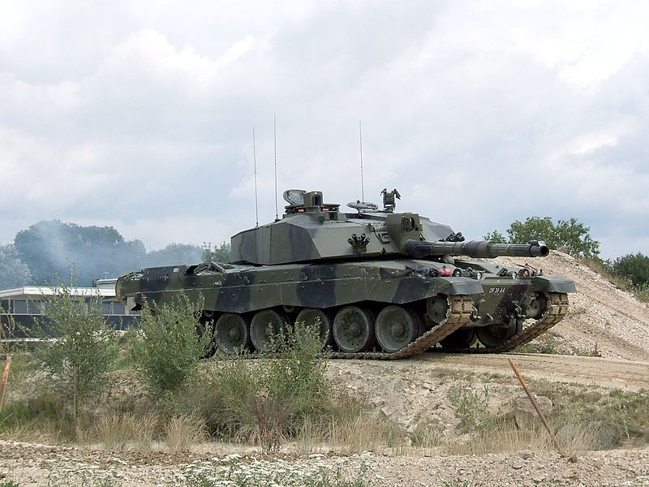
Engineered System (non IT)

Slide 12
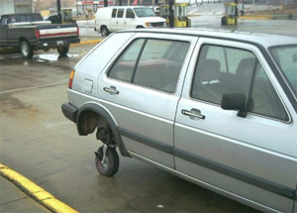
Sistem evolutiv (non IT)

Slide 13
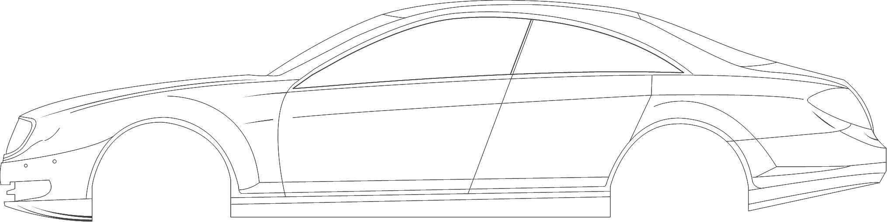




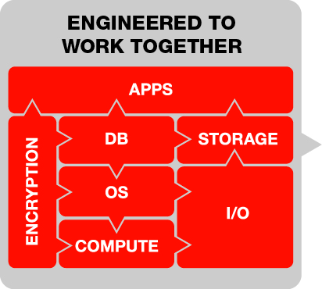
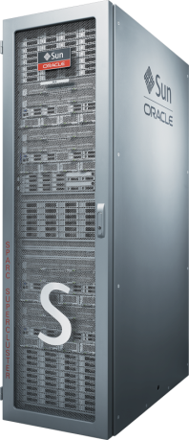
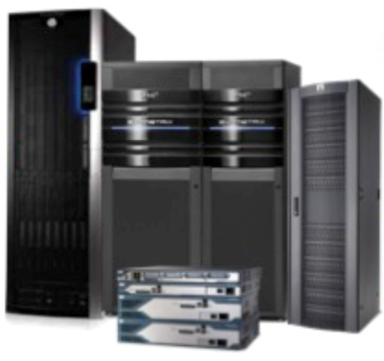







O strategie pentru simplificarea IT
Imaginati-va ca trebuie cumparata o masina
vs
Notes:
For a long time Oracle’s vision included the notion of taking all the pieces of a system, all the hardware, and all of the software pieces, and before they’re designed, give some thought about how they would work together. As we mentioned earlier, Oracle has spent many years designing and building the industry’s most complete and consistent architecture for our enterprise software and systems products. That architecture is called the Oracle Fusion Architecture. Oracle Fusion Architecture is a standards-based technology blueprint that details the linkage between all Oracle products.
Oracle is the only company that develops storage products, designs microprocessors and server platforms, as well as database and a comprehensive portfolio of business applications. When all those disparate pieces are built by design teams working toward the same vision, the result is an integrated system that dramatically improves performance, reduces costs and downtime, and provides customers with a more easily managed infrastructure.

Slide 14
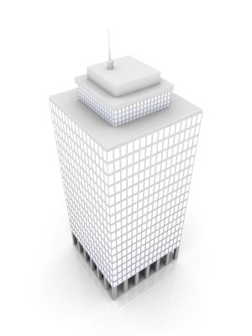

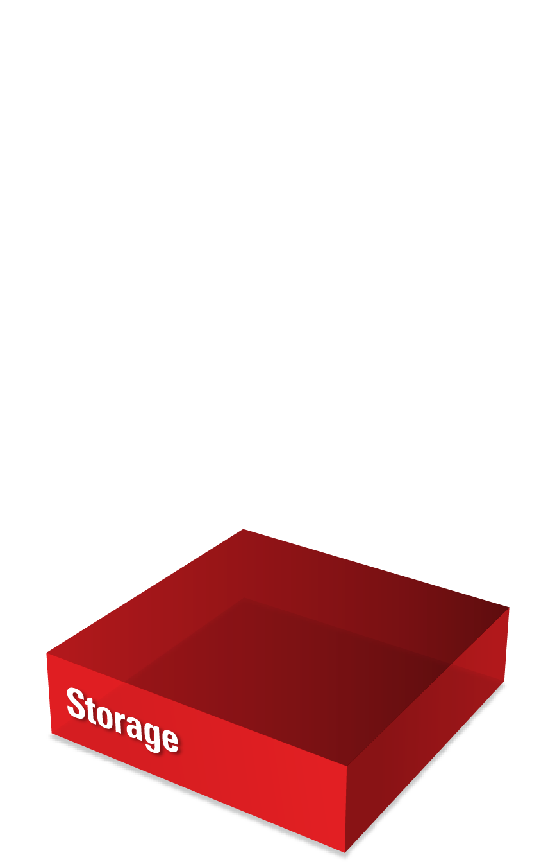
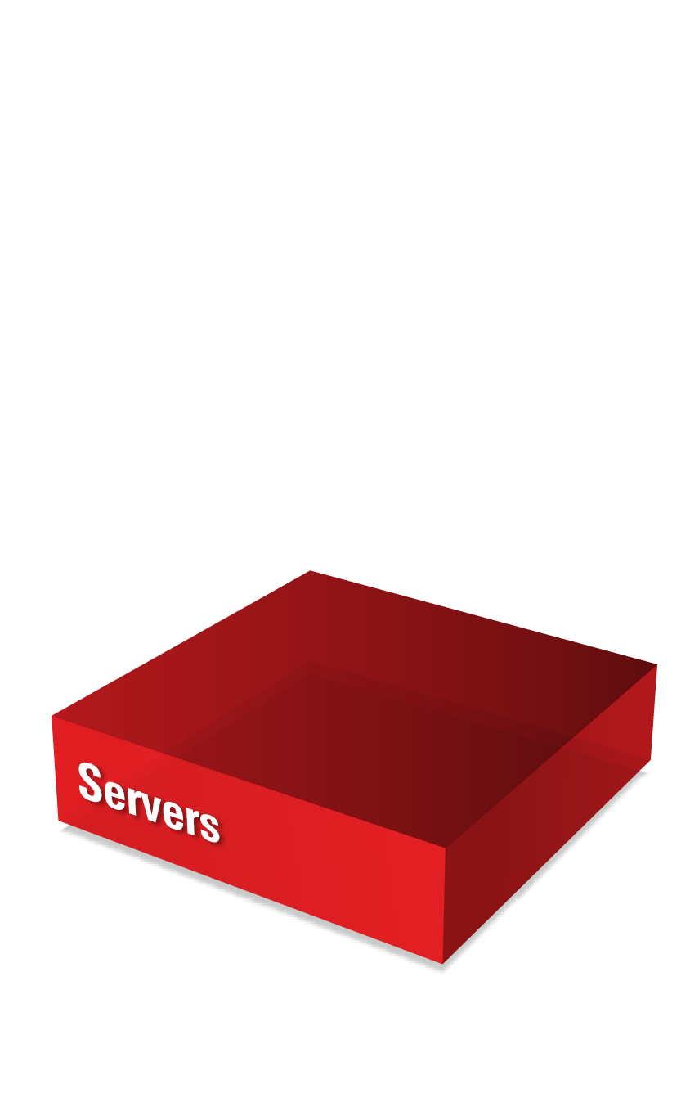
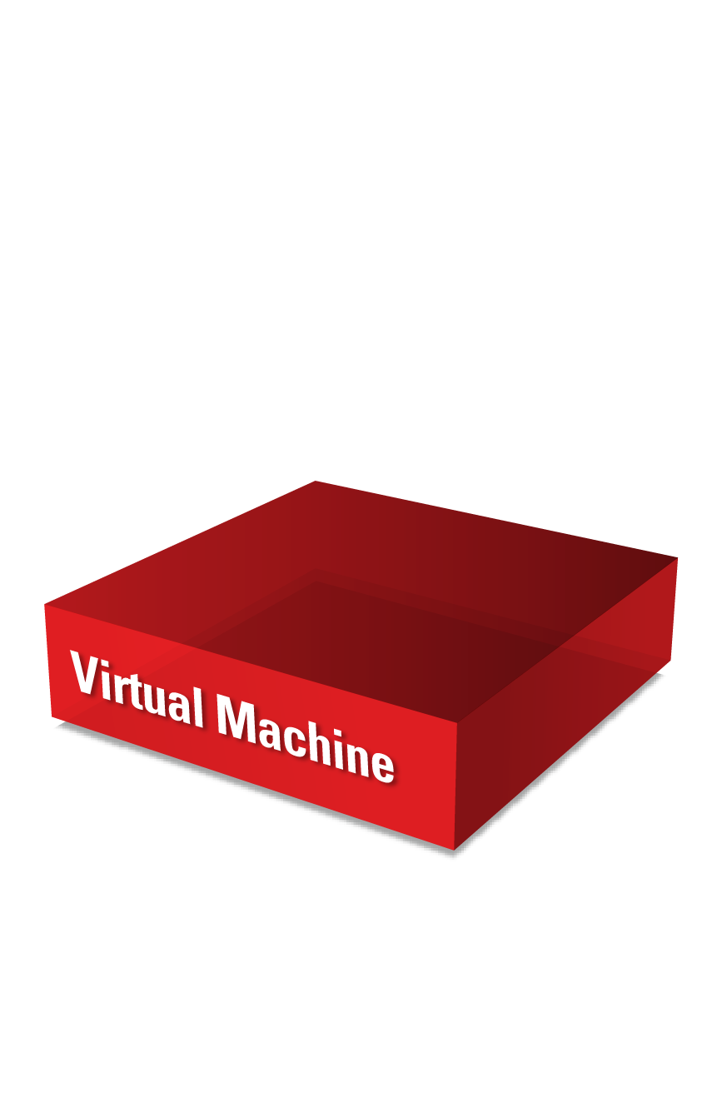
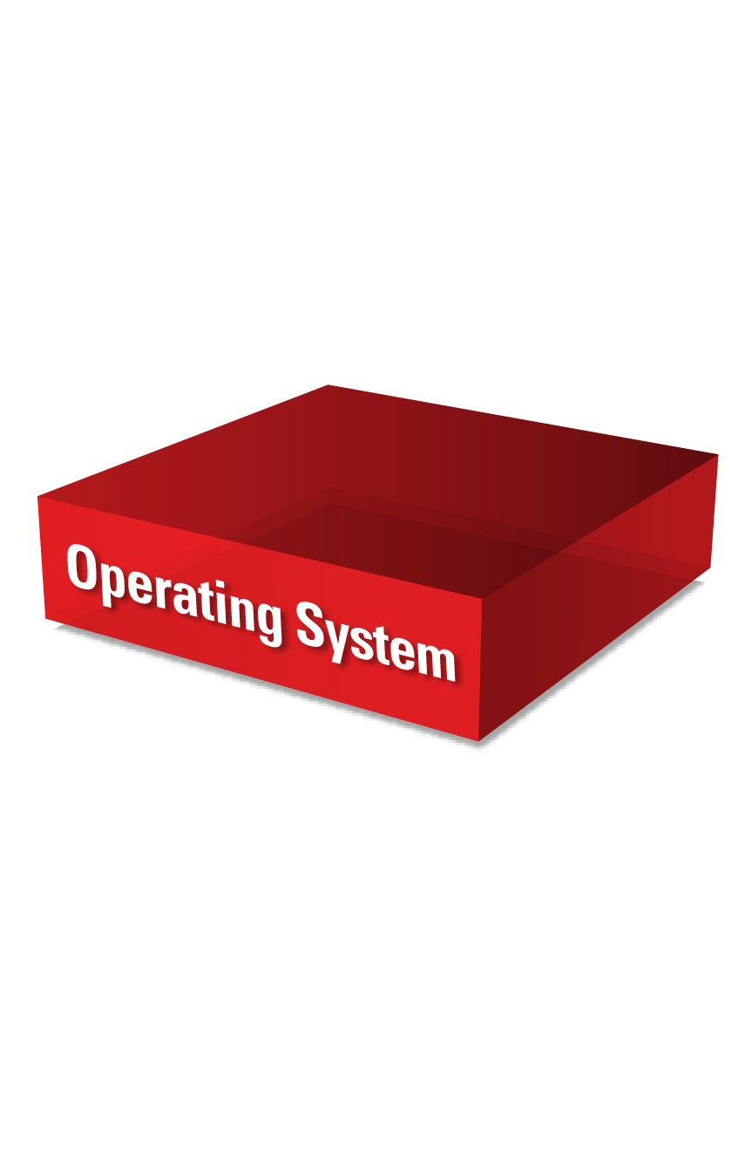
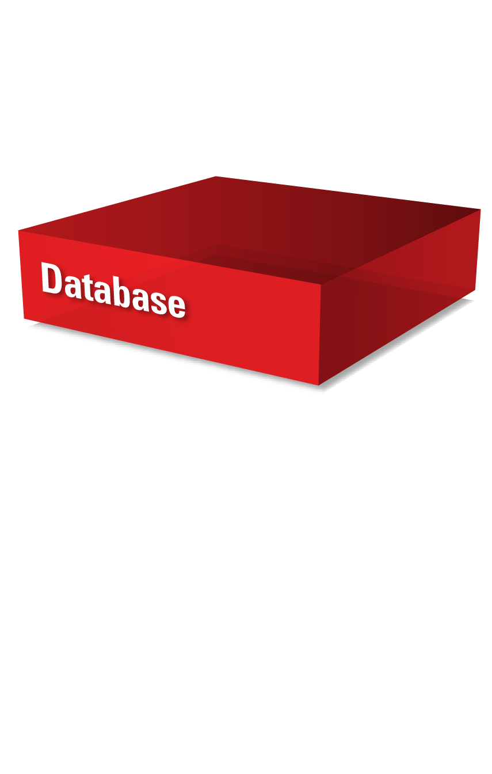
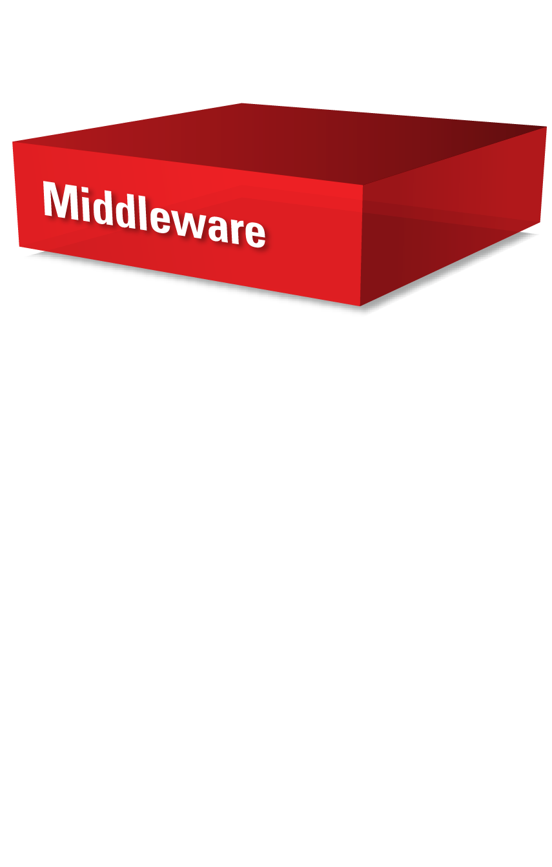

Strategia Oracle
Stiva completa
Toate alternativele
Best-of-Breed
Open
Vertical Integration
Extreme Performance
Engineered Systems
On-Premise
Private Cloud
Public Cloud
Hybrid
Notes:
Oracle’s Strategy:
Best of breed technology at every layer of the stack. All the way from hardware to apps.
Let’s our customers choose our products a la carte to work in a high level of enterprise fit, open at every turn.
And customers can work with our products in an IBM – or insert any vendor name – environment.
We want to be the best at everything we do in those heterogeneous environment and we’re lined up from engineering to sales to make that happen.
In addition, we vertically integrate these piece parts to deliver extreme performance and extreme TCO.
And we can help our customers save money and drive performance at the same time.
The vertical integration story is an incremental story – not a substitute story.
We deliver this to customers in a series of choices from a delivery perspective: on-premise, cloud, hybrid. Their choice.
We’re open. Heterogeneous environment. Vertically integrated environment. Full deployment choices. We spend billions in R&D to give customers that choice.
We’re a one-stop shop, or leverage our piece parts – customers can pick the best of them to fit into their environment.
Push hard for the integrated stack, but it’s important that we have the position of open, best of breed, customer choice.
In a nutshell, here’s our story:
When we say that Oracle hardware and software is engineered to work together, this refers to the fact that we are the only vendor that offers customers a complete hardware and software stack, from apps, to disk
We design our technology specifically for this stack. It’s fined tuned and optimized between, within and across the layers
It provides better performance, reliability, security, upgradeability manageability, and supportability built in, and far better than our customers can build for themselves
Too many organizations spend their time cobbling together IT components, creating a complex, hard-to-manage IT environment that drains resources and brain power
With Oracle, customers dump the complexity that holds back their progress, replacing it with IT simple enough to change the game
Instead of focusing all of their technology and expertise on managing complex IT, they can focus on the innovation that defines performance in their operations, like better understanding market diversity and developing new products and services to meet those market needs.
When IT is simple, it fuels innovation – and innovation fuels success
That’s our message – and no other vendor today can deliver choices for simple IT like Oracle can.

Slide 15
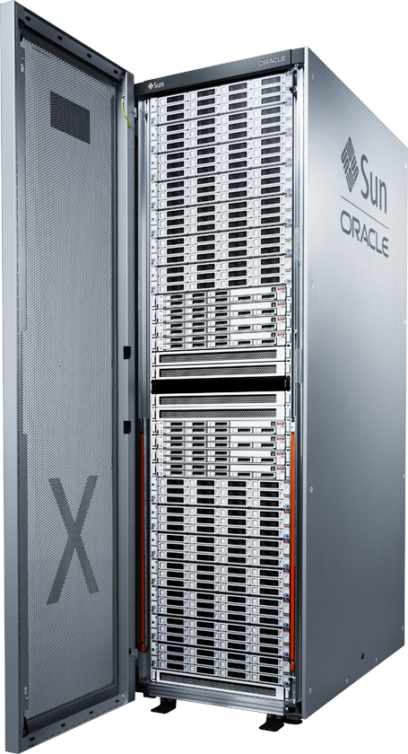
Beneficiile Engineered Systems
Eng Systems Business Value
1-Business impact
2- IT Cost Savings
3- IT simplification
You can do more
Assets
Operations
Standardize
Consolidate
Time to market
HW
SW
Green
Support

Slide 16
Engineered Systems furnizeaza performanta, simplificare, si controlul costurilor
SATISFACTIA CLIENTILOR
NUMARUL de CONVERSII
1 secunda intirziere
in timpul de incarcare a paginii
=
La ce bun?
16%
7%
(conform unui studiu al unui retailer online britanic)
Notes:
Your business can’t afford to miss a beat
If you fail to keep up, you lose business
For example, a recent study by a British online retailer showed that… (see slide)

Slide 17
Performanta Engineered Systems
Engineered Systems
Aplicatii business: TIMP de RASPUNS
Standard hardware
E-Business Suite
Order to Cash
E-Business Suite
Self Service and HR
and Procurement
PeopleSoft
Self Service HRMS, FIN
Siebel UCM
Customer Hub
JD Edwards
Order Management
3x better Response Time
2x better Scalability
8x better Response Time
2x better Scalability
3x better Response Time
5x better Scalability
8x better Response Time
4x better Scalability
3x better Response Time
2x better Scalability
Timp de raspuns
2.23 s
1.18 s
0.51 s
11.94 s
200 ms
3X
3X
3X
8X
8X
0.74 s
0.39 s
0.17 s
1.42 s
25 ms

Slide 18
Engineered Systems Performance
Engineered Systems
Aplicatii business: SCALABILITATE
Standard hardware
Utilities
Meter Data Management
Communications
Billing Revenue Management
ATG Web Commerce
Commerce Reference
Store
2x better Response Time
7x better Scalability
2x better Response Time
2x better Scalability
3x better Response Time
3x better Scalability
Scalabilitate
4000
10
20
million
2X
3X
2027
7X
3.1
2.75
million

Slide 19
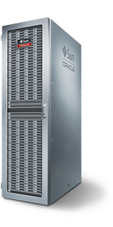
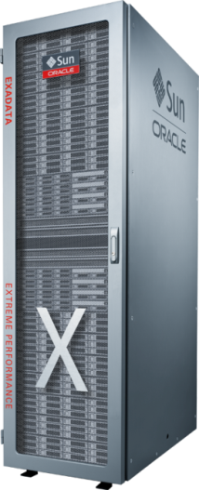
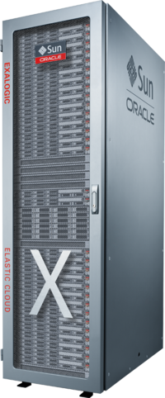
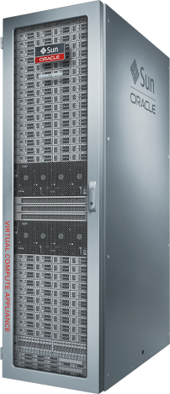
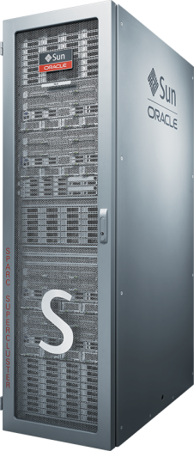
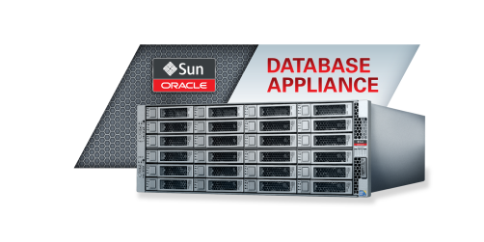
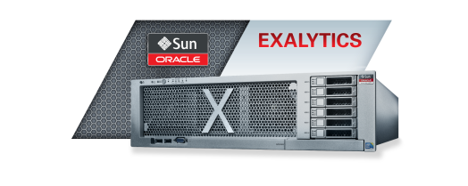
Oracle Engineered Systems
Familia de produse
NEW!
Exadata
Database
Machine
Exalogic
Elastic Cloud
Big Data Appliance
SPARC
SuperCluster
T4-4/T5-8
Oracle Virtual
Compute Appliance
And more…
Oracle
Database Appliance
Exalytics
In-Memory
Machine X3-4/T5-8
Notes:
We are excited to launch 4 new products that joined Exadata and Exalogic in the Engineered Systems family earlier this year. These new products adhere to the same technology principles as Exadata and Exalogic, and extend the Engineered Systems’ value proposition.
We have been in this business delivering Engineered Systems since 2008 with the introduction of Exadata followed closely by Exalogic. The success of these products has been truly amazing – outpacing even our goals for adoption. We have over 1200 systems sold to date and expect that number to be 4000 later this year. Exalogic has already surpassed Exadata as the fastest growing product in Oracle’s history and the demand for our new products leads us to believe we will see even greater adoption of our products as they were designed to be “Better Together”.
With all of our products the deployment time is minimized, manageability is maximized, the lowest total cost of ownership in comparison to our competitors is delivered to you, implementation risk is minimized, and as always you have one single point of contact for support. These core principles apply to our existing products, our new products, and will certainly apply to the innovation we continue to deliver.

Slide 20
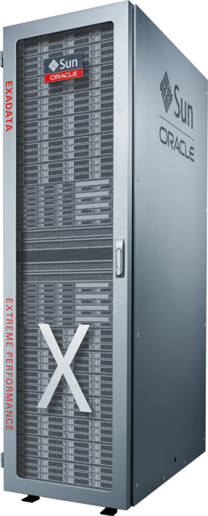
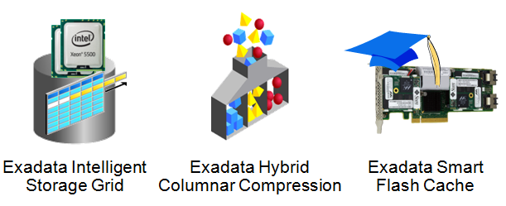
Oracle Exadata Database Machine
Oracle Exadata este masina de baze de date care furnizeaza performanata extrema atit pentru aplicatiile de tip OLTP cit si pentru cele de tip Data Warehousing
Beneficii
10x baza de date mai rapida
10x storage mai eficient
Completa si gata de utilizare
Administrare a resurselor de tip end-to-end
Inalt disponibila si securizata
Caracteristici unice
Mai multe informatii: www.oracle.com/exadata
Notes:
Exadata is the best system to run the Oracle DB and it saves you money on storage.
Automatically manages flash to provide the performance of flash with the cost per Terabyte of disk. Frequently accessed data is automatically migrated into flash by Exadata’s smart flash cache algorithms.
DB processing directly into the storage subsystem so that for query workloads only a fraction of the data needs to be returned to the DB server
Scale-out InfiniBand based architecture to provide the best scalability in the industry.
Hybrid columnar compression that achieves 10x data compression without reducing performance.
Consolidation is the best approach to reducing IT cost. Consolidation is typically limited by the available server memory. Exadata has the unique ability to run any workload with extreme performance including large parallel queries and small OLTP transactions. Since consolidation inherently mixes many different workloads into a single system it is an ideal match for Exadata.
Exadata is the first database machine to be able to run a fully encrypted database with near zero performance overhead. DB2, Teradata, and Netezza do not have built in encryption capabilities

Slide 21
Oracle Exalogic Elastic Cloud
Oracle Exalogic Elastic Cloud furnizeaza performanta extrema pentru aplicatiile Java, Oracle Applications, precum si pentru orice alte aplicatii tip entrprise
Beneficii
Cel putin 2x mai rapid ca timp de raspuns si throughput
Cel putin 50% TCO mai scazut
Caracteristici unice
Exabus ca backplane de comunicatii de inalta performanta
Cea mai buna performanta pentru Java si Oracle Business Applications
Ruleaza fara modificari aplicatiile existente Oracle Linux si Oracle Solaris
Integrare exclusiva cu Oracle Exadata Database Machine
Mai multe informatii: www.oracle.com/exalogic
Notes:
Exalogic has surpassed Exadata as the fastest growing product in Oracle’s history. Since general availability we have sold more units to more customers than we did over the same period of time with Exadata. The drivers of the success of this product are:
Java Performance
Java is an essential technology to Oracle and almost all of our customers. There was a real focus on what we could do for Java and there was a lot of opportunity: Java is well known for being sophisticated to tune, and performance was something we could optimize
Mission Critical Cloud
Real end to end standardization, consolidation and ultimately CLOUD – IT as a service
This isn’t something that just works for small enterprise applications. The real business value is when it can be deployed across the enterprise, which means you need an infrastructure that can support the most mission critical applications
Engineered System
We focused on the benefits of what can be delivered out of the box while carefully balancing the requirement to not take too much control from customers
We have a long standing commitment to best of breed components, and our business is likely not going to move away from selling those components
We focused on the best standalone components that our customers would use to build their own systems and used those same components to build this new engineered system that we can deliver out of the box, pre-integrated and ready to run.
These were our design goals, and we achieved them! We are very pleased with what we have done accomplished with this product.

Slide 22

Oracle Database Appliance
Oracle Database Appliance este un pachet de software, servere, storage and retelistica ce ofera o solutie simple, de incredere si ieftina
Beneficii
  Simplitate extrema – implementare si patching
  Licentiere tip Pay-As-You-Grow Licensing – cea mai eficienta varianta din punct de vedere costuri pentru Oracle Database Enterprise Edition, aliniata cu ciclurile bugetare
Caracteristici unice
  Sistem complet, integrat pentru Single Instance (Enterprise Edition), RAC One Node si RAC
  Hardware si software complet, plug-and-go
  Baza de date inalt disponibila in cluster configurata in citeva minute
  Functionalitati avansate de administrare si suport de la unic furnizor
Mai multe informatii: http://www.oracle.com/oda
Notes:
Plug in and get up and running quickly – great for a growing business
Path forward to take advantage of RAC w/o the previous cost/complexity that was required for a business this size
Not a Dev/Test box for Exadata – you would architect the DB much differently to leverage Exadata’s advanced DB features

Slide 23

Oracle Exalytics
Oracle Exalytics este prima masina de Business Intelligence in memorie care furnizeaza cea mai rapida performanta pentru aplicatiile de planificare si BI
Beneficii
Analize vizuale interactive instantanee
Scaleaza la mii de analisti
Caracteristici unice
Analize inmem orie
Ruleaza aplicatii BI si EPM
Se integreaza cu infrastructura si sursele de date existente
Optimizata pentru Exadata – InfiniBand
BI Foundation Suite optimizat – OBIEE si Essbase
Mai multe informatii: http://www.oracle.com/exalytics
Notes:
The industry’s first Engineered System for analytics
Provides a new level of performance for Oracle BI, Oracle’s BI Applications and Hyperion EPM and Essbase.
Speed is great, but so what – it’s what enables “speed of thought” advanced data visualization and exploration and enables more and deeper operational and financial planning iterations
Brings analytics to a wider audience
Allows more people, business people, to slice & dice data visually
Speeds data exploration responsiveness for analysts using traditional PCs, laptops, and mobile devices
Provides IT with a more flexible middle tier BI server for a more optimal data warehouse architecture
Interactive – means no “GO” button, you literally interact with the data and visualize the changes based on your thoughts
Competitive differentiator to SAP HANA is you don’t have to re-architect your BI infrastructure – SAP requires redeploying / modifying Business Objects Universes and deployment model whereas Exalytics runs the same Oracle BI 11g, BI Applications, and Hyperion Planning & Essbase applications with no change from deployment of these same versions on generic servers.

Slide 24
Oracle Big Data Appliance
Oracle Big Data Appliance este un Engineered System optimizat pentru achizitia, organizarea si incarcarea datelor in baza de date Oracle
Beneficii
Valorifica Big Data pentru deciziile strategice
Administrarea mai eficienta a mediului Big Data
Valorifica instrumentele de tip SQL si platformele DW pentru o analiza completa a datelor disponibilia tuturor analistilor
Caracteristici unice
Engineered System pentru achizitia, organizarea si analiza “Big Data”
Super-rapid– Procesare paralela masiva si incarcare in baza de date Oracle
Interconectare InfiniBand de viteza mare pentru transferul infromatiilor catre Exadata
Mai multe informatii: http://www.oracle.com/bigdata
Notes:
Big Data Defined
High Volume – driven by historic data gathered from semi-structured and unstructured data sources
High Velocity – data changing every sub-second
Wide Variety - data from sensors and other automated data gathering devices, social media, documents and images
Low Value – contains a lot of data of little use, but also contains extremely valuable data embedded in this massive amount
Individually insignificant – collectively significant – our big data solution allows you to compile extreme amounts of semi-structured data and sift through the data to find valuable nuggets that produce powerful insights
Example: Sensor data – enables prediction of failures by analyzing telemetry for abnormal trends in certain indicators
Example: Health Care – an individual patients heart monitor data might not add value, but analyzing data across all patients can produce the opportunity to identify when preventative care (e.g. Pacemaker Replacement) is required
Our Solution
Acquire – Store unstructured and semi-structured data in a key value transactional store (Oracle NoSQL Database) or data for historical analysis in Hadoop
Organize – Use MapReduce to determine result sets, ODI to build loading into an Oracle Database, and the Oracle Loader for Hadoop to actually load the data into Oracle
Analyze
Leverage in-Database analytics, such as Oracle R Enterprise for statistical analysis, and query optimization
Leverage traditional SQL based tools and advanced solutions such as Oracle BI residing on Exalytics for data exploration

Slide 25
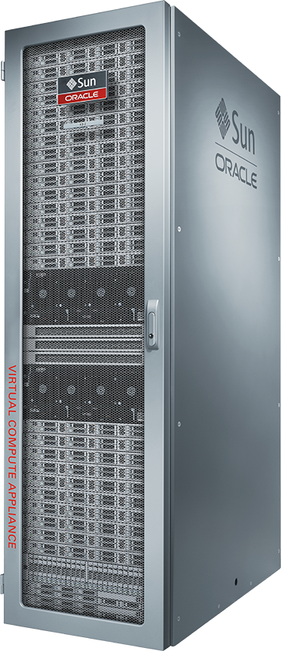
Oracle Virtual Compute Appliance
Oracle Virtual Compute Appliance este un sistem pre-construit, gata de a fi utilizat cu o configurare minimala, care inlatura riscurile de integrare la instalarea infrastructurii
Beneficii
Accelereaza instalarea aplicatiilor cu template-uri Oracle
Expansiune si integrare facila si liniara
Completa si gata de utilizare
Administrare a resureslor tip end-to-end
Inalt disponibila si securizata
Caracteristici unice
Doar Oracle poate accelera atit instalarea infrastructurii, cit si a aplciatiilor
De la bagat in priza la aplicatii complet configurate in 2-3 ore
Alte infrastructuri convergente – zile sau saptamini
Mai multe informatii: www.oracle.com/ovca

Slide 26
SPARC SuperCluster
SPARC SuperCluster este un Engineered System pentru utlizare generica, facilitind consolidarea in data center, performanta extrema si un TCO scazut
Beneficii
Ruleaza toate mediile SPARC Solaris existente
Consolidare a nivelului aplicativ si a nivelului baza de date pe un singur sistem
Caracteristici unice
Procesor SPARC T4/T5
Software Exadata and Exalogic
Exadata Storage Cells
Solaris 10 si 11
Integrare a backplane-ului InfiniBand in Solaris, Java si Baza de date
Coordonarea intreagii solutii si orchestrarea dependentelor a.i. sa se asigure failover si recuperare rapide si sigure
Securizat prin design – functionalitati de criptare integrate care asigura securitatea aplicatiilor Oracle
Mai multe informatii: www.oracle.com/supercluster

Slide 27

Banca Transilvania
DESPRE COMPANIE
Una din cele mai mari si in crestere banci din Romania
Industrie: Servicii financiare
Angajati: 6,000
Cifra de afaceri: $528 M
PROVOCARI
Accelerarea timpului de lansare pentru noi produse si servicii bancare
Imbunatatirea ofertelor pentru a creste satisfactia clientilor
Gestionarea unei incarcari crescute simultan cu asigurarea inaltei disponibilitati
Eliminarea riscurilor operationale
SOLUTIA
Oracle FLEXCUBE Universal Banking
Oracle Exadata Database Machine
Oracle Exalogic
Oracle Financials Accounting Hub
Oracle Advanced Customer Support Services
Oracle Premier Support for Systems
Oracle Platinum Services
PERSPECTIVA CLIENTULUI
“Rularea Oracle FLEXCUBE pe Oracle Exadata a transformat potentialul afacerii noastre si ne-a permis intarirea pozitiei noastre fruntase pe piata serviciilor financiare din Romania.
Marius Ursuti, Director IT
REZULTATE
Procesarea a 95% din tranzactii in mai putin de o secunda
Respectarea pragului de 3 secunde impus de VISA si MasterCard
Reducerea inchiderii de zi la jumatate
Punerea la dispozitie a rezultatelor zilei precedente la inceputul zilei de lucru curente pentru a imbunatatii procesul decizional
August 2013

Slide 28

Despre parteneriatul Oracle – Maguay
Parteneriatul între Maguay și Oracle a demarat în urmă cu 10 ani. Maguay deține certificarea Oracle Gold;
În parteneriatul cu Oracle, Maguay vine cu expertiza proprie relevantă în domeniul infrastructurilor de tip server și storage;
Proiecte implemetate și alte referințe:
  Ministerul Educației, Cercetării, Tineretului și Sportului
  ADR Muntenia
  Interbrands
  Servicii de consultanță, implementare, project management asociate platformelor de tehnologie Oracle livrate la clienți din sectorul public și privat
  În ultimii 2 ani Maguay cifra de afaceri pe zona de Oracle s-a dublat

Slide 29

Intrebari & Raspunsuri

Slide 30


