Slide 1
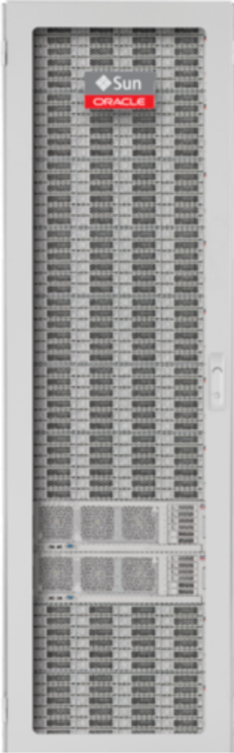
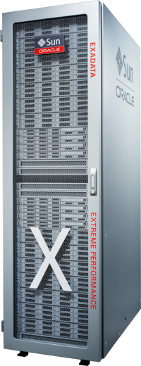
Why a DBA Cares About Storage
Oracle ZFS Storage ZS3 systems will make a difference in daily operations
Cristian Termure
Ciprian Pustianu
No time for Downtime, 2014

Slide 2

Why Should a DBA Care About Storage?
Oracle has engineered features in the database that uniquely work with the Oracle ZFS Storage ZS3
  These features make Oracle ZFS Storage ZS3 an appealing platform for database storage
Little storage knowledge required to exploit the benefits of the Oracle ZFS Storage ZS3 for database storage
  The touch points with the Oracle ZFS Storage ZS3 are user friendly and don't require deep storage experience.
Benefits of using the Oracle ZFS Storage ZS3 can be described along typical daily use cases.

Slide 3

Day in the life of a DBA with ZS3 series storage…

Slide 4

9:00am – Troubleshooting
DBA is just sitting down at his desk when the phone rings.
It’s a panicked call from one of the business owners that a key production database has slowed to crawl.
Time to figure out what’s going on and how to fix it…

Slide 5

Challenges in Responding to Trouble Calls
Call comes in from a user that is having an issue
  Application performance has dropped, and they need it back to where it was.
  Many applications are relying on the database, and the first call is to the DBA
The process of troubleshooting begins
  DBA begins eliminating possible problems, starting with the AWR report, no blocking locks or contention issues
  Do you see apparent storage issues that the storage administrator isn’t capturing?
  How would a DBA identify if storage is causing the issue?

Slide 6
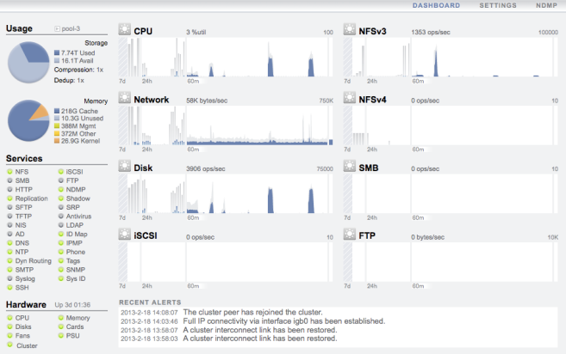
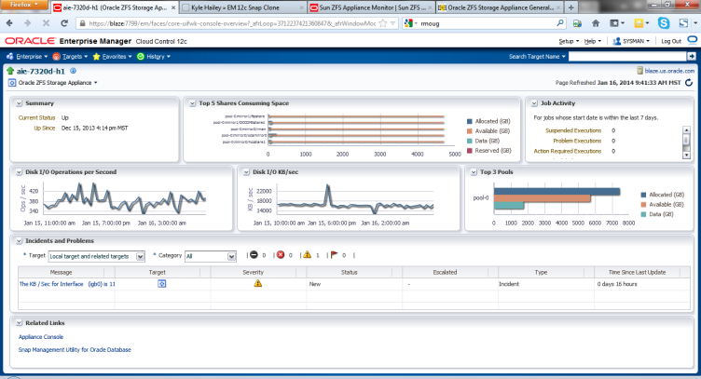
Using Oracle Tools to Diagnose an Issue
Enterprise Manager
  Identify share: interface and mount point
  Summary view to find alerts
  All metrics: follow the data path to see problems
    Network interface
    NFS I/O per share
Launch Dtrace Analytics on the ZS3 for root cause analysis
Notes:
Call comes in from a user that is having an issue. Application performance has dropped, and they need it back to where it was. Many applications are relying on the database, and the first call is to the DBA. How would a DBA use EM to help identify if there is a storage problem that is causing the issue? We will start by identifying the associated share, and walk through some EM and ZFSSA views.

Slide 7
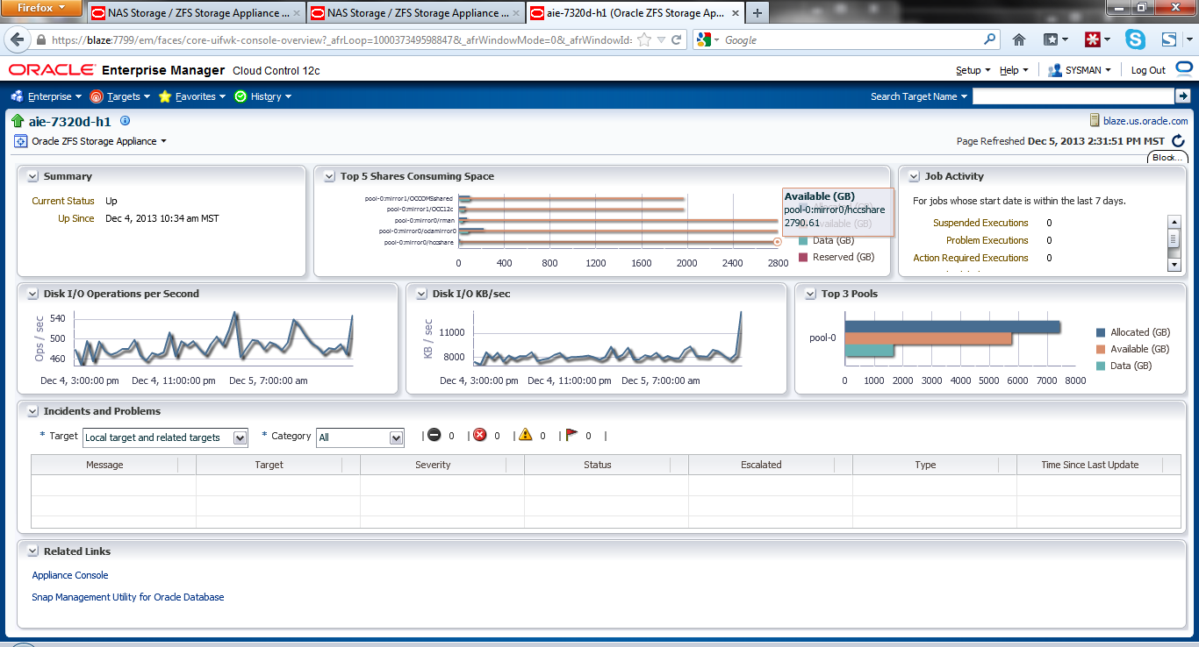
Review Storage Summary
Begin the process with Enterprise Manager
  Select the storage appliance that retains the database files
  First, check the alert window near the bottom of the screen
  Second, quickly scan the remaining charts for peaks/valleys
Notes:
With the target appliance identified, our first view will be the summary screen. In this screen we can see a collection of graphs and an alert log. We first take a look and see if there are any alerts that would immediately indicate an error with the storage platform. Next, we can take a quick peek at the charts to see if there are any spikes that could be related to the reported problem. From here, we can dive into more of the specific metrics that are gathered with the plug-in.

Slide 8
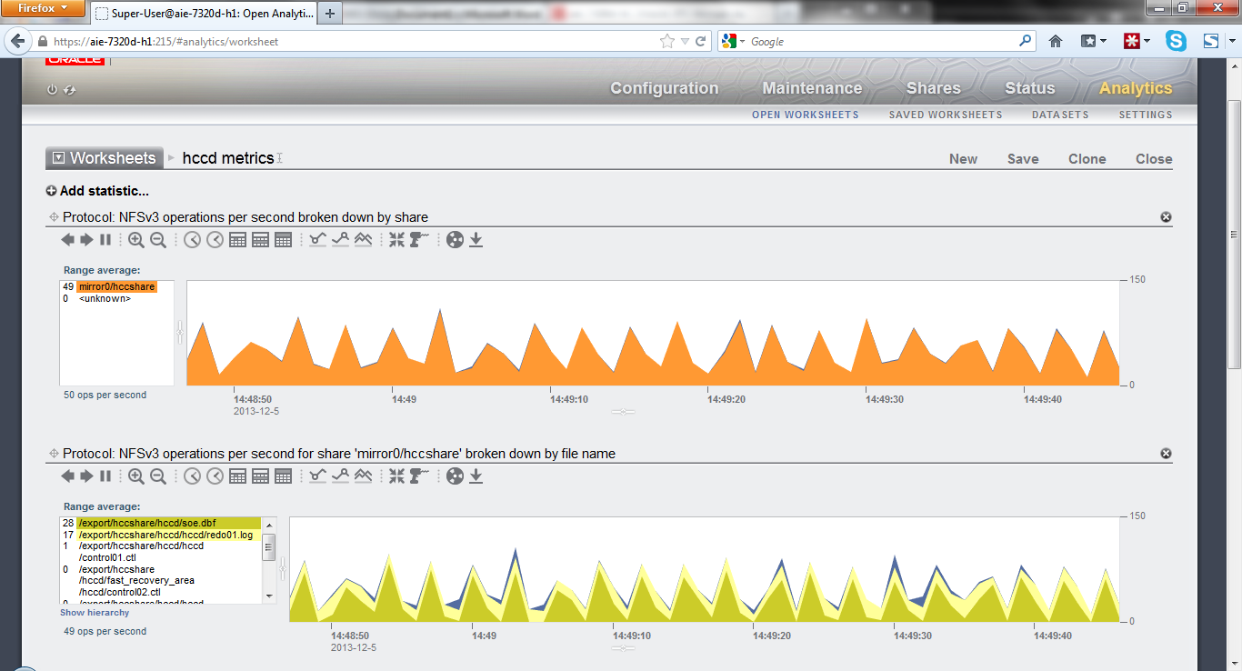
ZFS Storage Appliance Storage Analytics
Provides historical insight into key storage metric performance
  Identify client utilization
  View share status in real time
  Pinpoint network interface and disk latency
  Navigate to the file-level and isolate file performance
Notes:
It may be that we can’t see enough detail to make an intelligent decision just using EM. We find that EM can help identify some of the key indicators, but may not always be enough to properly diagnose what is happening at a more granular level. From the storage summary screen, there is a link to launch the ZFSSA management interface. From here, we can utilize Dtrace Analytics to dig deeper into the system. Since it is possible to save different views using the save worksheet function, it may be helpful to store the most useful metrics together in a custom worksheet. Using Analytics, we can get more data past simple share throughput information. We can see which clients are active, and we can look into the individual files that are being accessed within the share. This could be used to identify if a specific database file is responding optimally. The path to finding the problem may follow these general steps, or may take a different path. But knowing that EM delivers a wide set of storage metrics for monitoring, and that more granular analysis can be easily performed at the ZFS appliance is key to helping reduce any blind spots you have in the enterprise architecture.

Slide 9
Consolidated Environment Visibility
Quickly check status of database-related storage
  Are the network and disks responding to the requests?
Confirm storage performance relative to particular application/SQL operation
  Is throughput and latency from the storage where you need it?
Eliminates finger pointing, and reduces reliance on other administrators
  Saves effort in troubleshooting, more quickly identifying the root cause with real time analysis

Slide 10

Noon – Lunch Out
Easy troubleshooting of the performance issues and so the morning went smoothly. Operations running normal.
Time for lunch at the new sushi place down the street …

Slide 11
1:00pm – Innovation
There is a big project underway with executive visibility. New solutions are in development but testers are constantly demanding new environments.
Time to figure out a way to help the apps developers get these new solutions to market sooner…

Slide 12
Hurdles to Rapid Development and Deployment
Increasing the speed of application development
  Fast moving application/database requirements require systematic approach to dev/test
  System/application patch/upgrades can introduce risk to dev/test
  Custom application/development require deployment in less time
Efficient duplicate of mission-critical databases for application development, test, and performance trouble-shooting
  Multiple clones of production databases/systems often required to support dev/test activities
  Dev/test and cloning of application and databases must be non-disruptive to production database
Typically see 3-8 dev/test databases for each production environment
Notes:
Database administrators face the challenge of efficiently duplicating their large mission- critical databases to support continuous demands for application development and subsequent testing of the code. This challenge is compounded by the fact that multiple clones are often required for each production database in order to support the many development and test activities associated with large production systems.
It is also important that the cloning process have zero impact to the production database. While the basic method of creating a clone is to restore a database from a recent backup on to a different database server, it is quickly obvious how such an approach is inefficient and highly time-consuming.
Without an efficient solution for cloning production databases, enterprises are saddled with substantial administrative burden that diverts attention away from more time-critical support functions along with increased storage consumption and high cost.

Slide 13




Challenges to Development Agility Today
Data Protection
Development
Storage
Administrator
Development
DBA
DBA
Step 1
2
3
23
24
………22
Notes:
Using Snap Management Utility for Oracle Database as a business differentiator looks a bit like this…
Let’s look at a typical product development cycle today, at a high level.
Step 1. The first step is the development team places a request to the database administrator for a new test environment - for a new employee, for example.
<click>
Step 2. The DBA collects the information about the s/w environment needed
<click>
Step 3. DBA contacts the storage admin for space. Some storage admins then require an approval process before provisioning a DB but let’s assume for this they don’t.
<click>
They go through the approximately 9 steps to make a snapshot and 12 steps to make a clone and then
Step 23 The Storage Admin gets back to the DBA and
<click>
Step 24 closes us out with the development team getting their test environment confirmation….
In a large organization this can take days, weeks, I’ve even heard of a month of approvals and back and forth negotiations for storage allocation and justification. Which means that your development team is working off of outdated data or didn’t get to start their work for a significant amount of time.

Slide 14
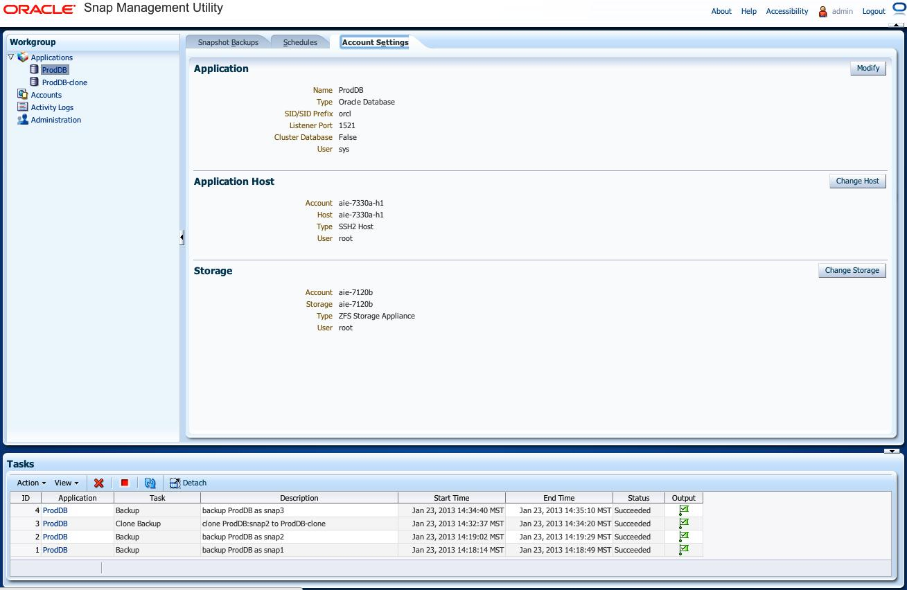
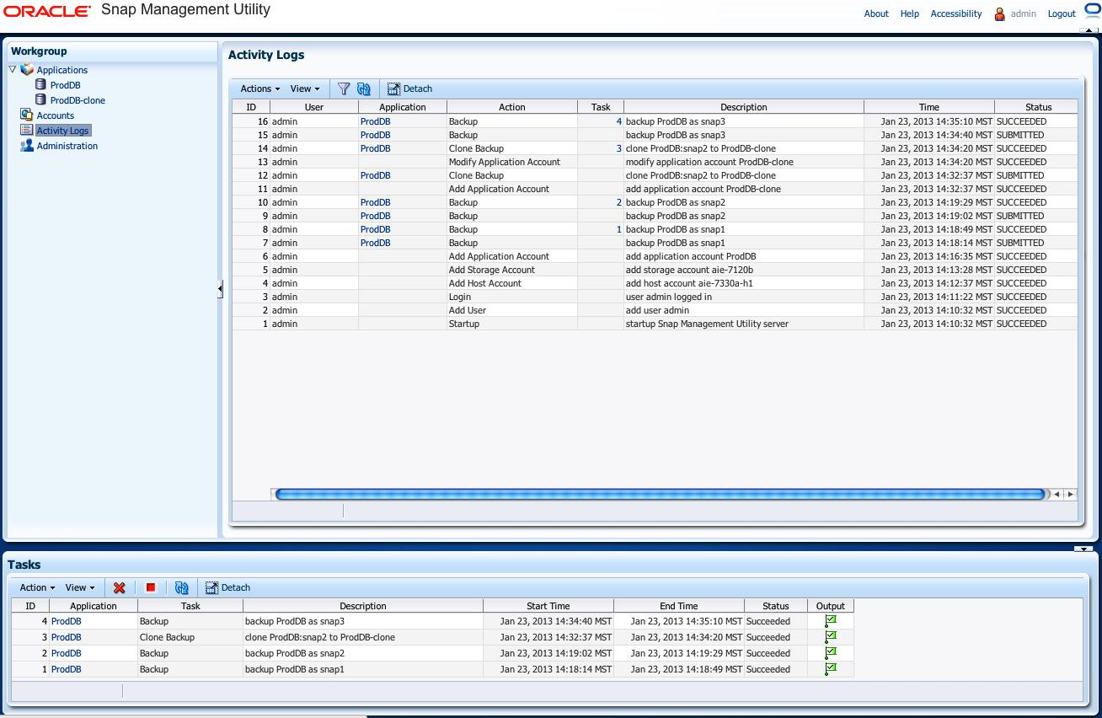
Snap Management Utility for Oracle DB
Eliminate 88% of steps for database snaps
Storage control for the DBA
Enables snapshot & clone control from DBA –facing console
Simple and intuitive BUI or CLI
Takes advantage of ZS3 system capabilities without additional storage admin inputs
Virtually unlimited snapshots and clones (capacity limited)
Supports Oracle DB environments as well as Engineered systems
Notes:
The point of this slide is the operational expense reduction for Oracle customers when those customers make and use storage snapshot copies of their databases.

Slide 15
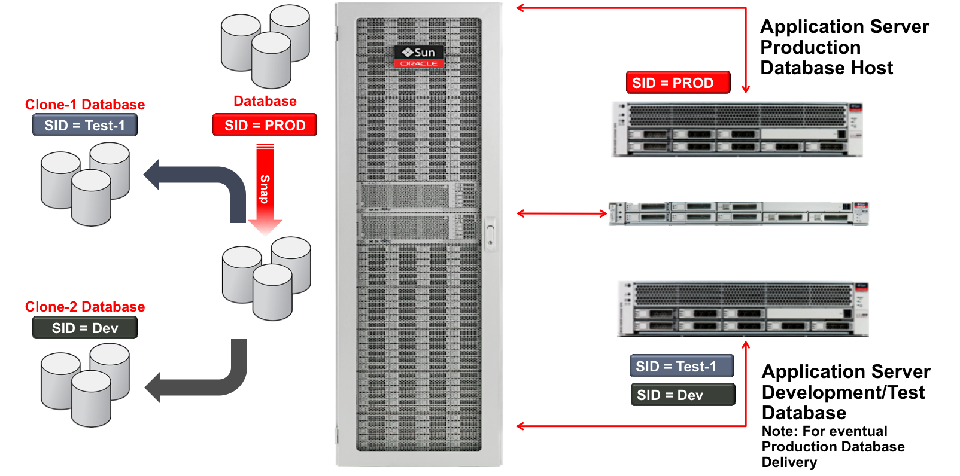

Oracle Snap Management Utility

Slide 16
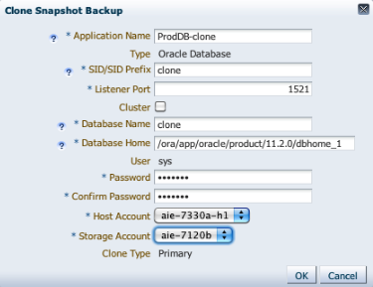
Creating a Database Clone from a Snapshot
Easily create a clone from a standard database snapshot
  Define target clone name, profiles
  Enter system passwords
Snap Management Utility directs all relevant processes without additional intervention
  Quickly deploy clones for development efforts

Slide 17
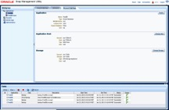
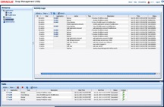
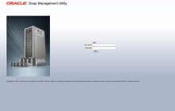
Provision Oracle Database Efficiently, Faster
Improved productivity
  Gain control of the process
  DBA's get more done, faster
Simplified management
  Rapid familiarity
  Eliminates complexity
Development
Development
DBA
Step 1
2
3
4
  Leverage RMAN backups already on ZFS Storage to facilitate low-footprint dev/test environment
Notes:
This is contrasted to the processes with Snap Management Utility….
Step 1. Is the same - the development team places a request to the database administrator for a new environment.
<click>
Step 2. The DBA launches the Snap Management Utility browser,
<click>
in one step creates a snapshot and in a 2nd step creates a clone.
<click>
Step 4. The DBA provides the test environment back to the development team and revenue generating activities commence!
Your developers are now working off of current copies and you’ve stripped significant time off of your development process. And, you can achieve the same ease when using snapshots for Data Protection – rapidly create database copies for backup and recovery.
Simplified, streamlined, efficient and fast – Oracle Snap Management Utility for Oracle Database.

Slide 18
4:00pm – Business Reports
Those new snaps & clones will give the testers all they need and the automation makes it so easy.
Time to check on the daily reporting activities …

Slide 19

Top Reporting and Data Warehouse Concerns
Report/Dashboard availability
  Uninterrupted access to data
Fast queries against new and older data
  Run queries on multiple table types
Backup and restore take too long
  Quick/easy backup/restore databases
ZS3 Storage improves reporting performance
Notes:
Data is the lifeline of most business organization, and as business grow, so does the volume of business data that needs to be stored and analyzed.
Oracle offers data warehousing capabilities and business intelligence tools with the Oracle Database, that meet the scale and complex reporting and analytics needs of the most demanding organizations.
Database administrators face multiple and significant challenges in managing their Data Warehouses, and among those challenges are:
Uninterrupted data availability. Most corporations rely on business intelligence analysis to drive their operations, and uninterrupted access to data is becoming more critical.
Ensure fast ETL (Extract, Transform, and Load) process completion
Fast-response to queries on new and old data
Data doubling every year in many corporations, need an easy way to scale with the business
Backup and restores take too long. Must have efficient way of performing quick and easy database backups and restores.
Management complexity. Needs simplified management with facilities to easily tune and troubleshoot, and provide fast datawarehouse copies to developers.
An ideal storage platform, needs to provide the facilities to address these database administrator’s challenges.

Slide 20
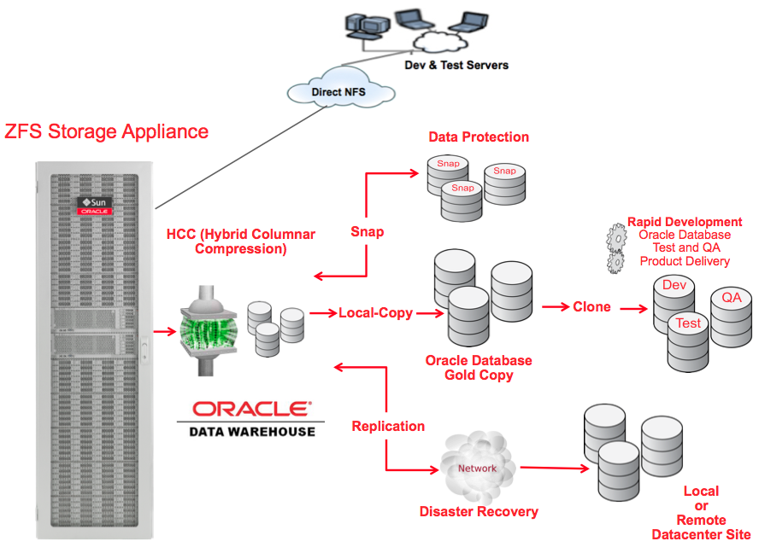
Oracle ZFS Storage ZS3 Advantages
Unlimited Snapshots/Clones
  Maintain instantaneous access to backups
  Run queries on latest data and multiple points-in-time
Optimized for performance
  Proven performance leadership on SPC-1, SPC-2, SPECsfs
Highly-efficient storage
  Leading analytics, easy to use and manage
  End-to-end checksum. Snapshot, clone, local and
  remote replication, mirroring
Hybrid Columnar Compression (HCC) support for Oracle DB
  Up to 50x data compression
  Average 5x faster queries, runs on compressed data
Notes:
Oracle Sun ZFS Storage Appliance provides many features that help a database administrator address the main challenges in managing Oracle data warehouses.
One of the main features of the ZFS Storage Appliance is the support for Oracle Database Hybrid Columnar Compression (HCC). Depending on the nature of the data, compression ratios can be up to 50x, helping maximize space efficiency, while at the same time delivering faster query performance since queries run on compressed data and the size of the data transferred is less than with non-compressed format.
The ZFS Storage appliance supports snapshots to maintain copies of the different data warehouse revisions as data is changed. Recovery at different points in time can be done within seconds, and queries can be run on any of those revisions. To support the ETL process, which sometimes may take hours, snapshots offer an efficient way to ensure that different revisions are maintained during the ETL process, to easily revert to an older version and continue the ETL process should a failure occur. In addition, the appliance also offers Cloning capabilities, allowing DBAs to easily provision data warehouse copies to support other business decision analysis.
Having a data warehouse storage that is optimized for high performance will ensure faster completion of business analysis. The ZFS Storage appliance is engineered for performance, implementing an architecture that offers up to 80-cpu-cores with 2TB of Memory and specialized read- and write-SSDs as cache, helping to deliver industry leading performance as demonstrated with several industry benchmarks such as SPC-1, SPC2, and SPECsfs.
Database administrators also need a storage system that is easy to use and manage, with tools to easily optimize for performance and troubleshoot when needed. In a third-party study, the ZFS Storage appliance performed 33% faster to provision and administer and 44% faster to troubleshoot than an equivalent NetApp system.
With all these features, combined with modular scalability of up to 1.7PB capacity to address data growth and no single point of failure architecture, and at a lower TCO than other leading vendors, the ZFS Storage Appliance is the ideal platform to consolidate storage for Oracle Data warehouse requirements.

Slide 21
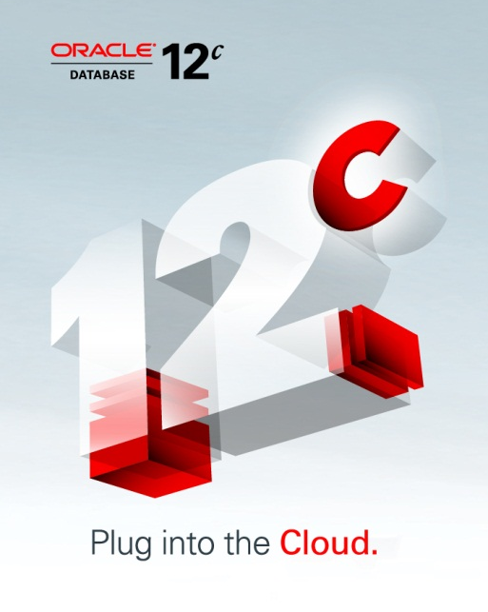
Oracle 12c Optimized for Oracle Storage
HYBRID COLUMNAR COMPRESSION
AUTOMATIC DATA OPTIMIZATION WITH HCC
ORACLE INTELLIGENT STORAGE PROTOCOL
ORACLE ENGINEERED SYSTEMS INTEGRATION
Notes:
Average of 56 Days per year spent tuning database and storage for optimal performance—now 19 days. Reclaim a month of productivity.
10 Storage Admins tuning NAS filers—now 3 admins. 7 admins can be strategically positioned for more business-critical projects.
Bottom Line: Do 3x more work with the same amount of people.

Slide 22

Two “Flavors” of Hybrid Columnar Compression
Warehouse compression
  Compression algorithm has been optimized for query performance
  Specifically designed for scan-oriented queries used heavily in data warehouses
Archive compression
  Compression algorithm has been optimized for maximum storage savings
  Ideal for tables that are infrequently accessed
Optimized for Speed
Optimized for Space
Smaller Warehouse
Faster Performance
Reclaim 93% of Disks
Keep Data Online
Can mix OLTP and Hybrid Columnar Compression by partition for Oracle ILM
Compression Advisor estimates savings for 11g or 12c databases
HCC is fully supported using ZS3 storage and IS NOT available from other vendors

Slide 23
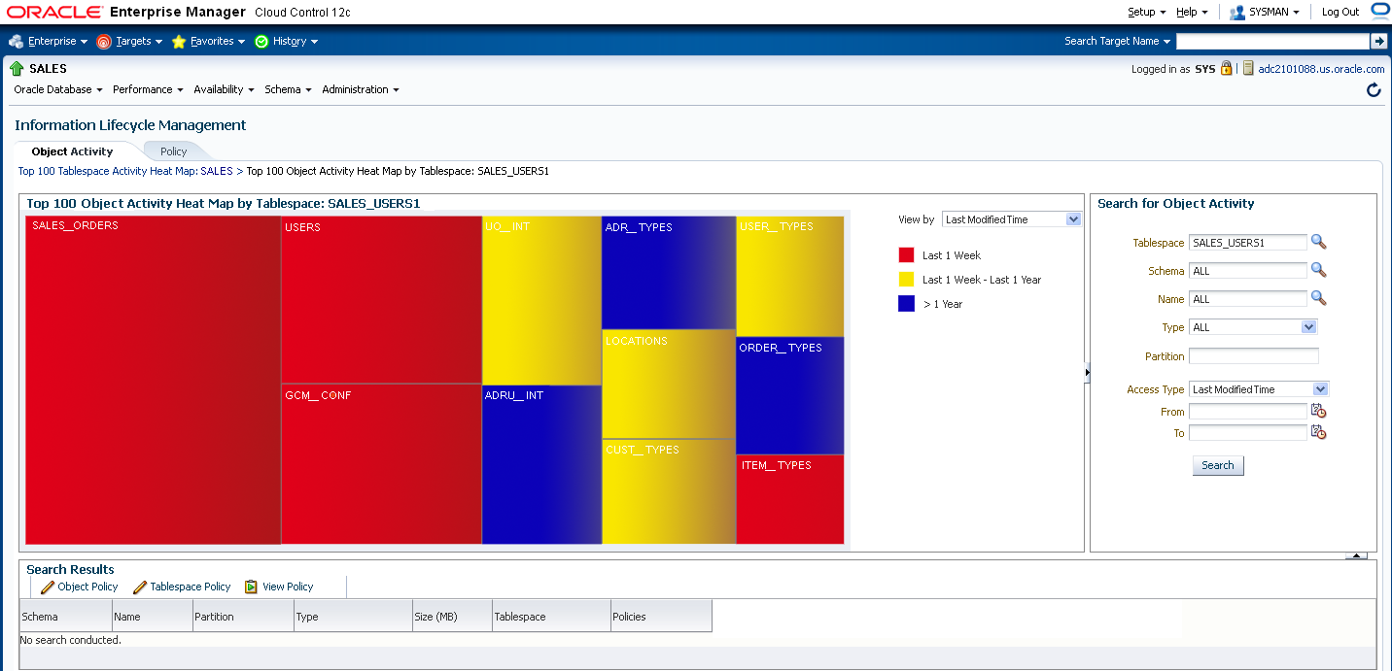
Automatic Data Optimization
Heat Map
Notes:
Heat Map - collects data usage information at block and segment levels – when used with Automatic Data Optimization Oracle Database can automate compression and storage policies based on the usage of the data -- reducing storage costs, improving performance and optimizing storage.

Slide 24






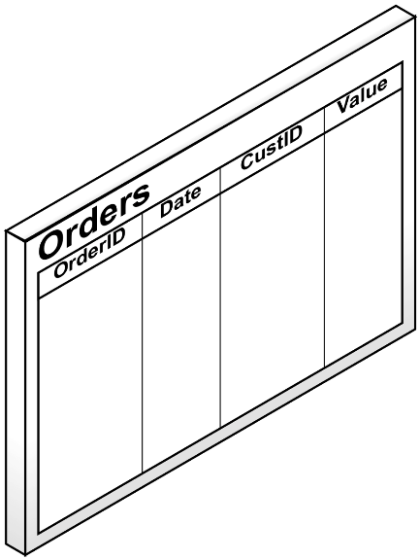


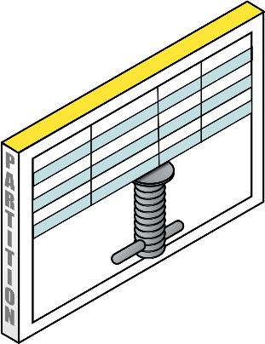


Automatic Data Optimization
Compress data over it’s lifecycle
15X
Compression
Compliance
10X
Compression
Reporting
3X
Compression
OLTP
Hybrid Columnar
Archive
Compression
Hybrid Columnar
Query
Compression
Advanced Row
Compression
No Compression
Partitioned By Time
Oldest Data
Most Recent Data
Notes:
Automatic Data Optimization - enables organizations to create policies that implement compression and storage tiering automatically. ADO policies define conditions and corresponding actions to be applied to specific objects

Slide 25
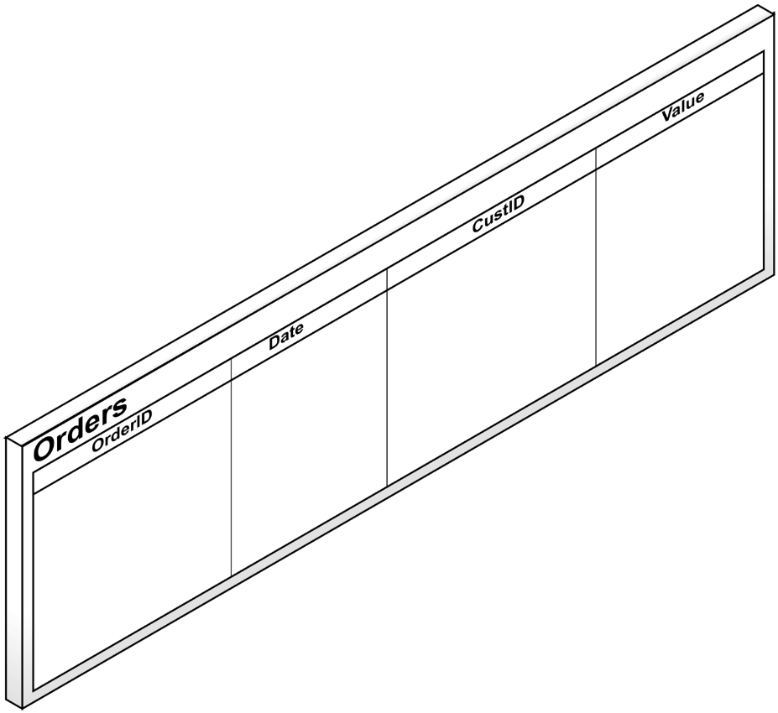


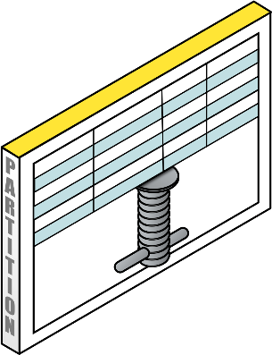


Automatic Data Optimization
Automatically tier data to lower cost storage
Tier 2 Storage
If the tablespace is nearly full compress the oldest partition with archive compression and
move it to Tier 2 Storage
Tier 1 Storage
Partitioned By Time
Oldest Data
Most Recent Data

Slide 26



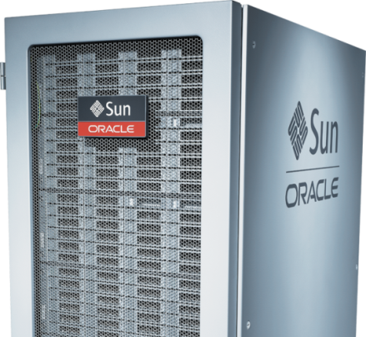


Oracle Intelligent Storage Protocol (OISP)
ONLY ON ORACLE ZFS: Virtually Eliminate Manual Tuning for Oracle Database
Oracle
Database 12c
IO metadata details
exchanged with
ZFS Storage Appliance
ZFS Storage
Appliance Dynamically
Tunes Critical
Storage Parameters
Oracle ZS3
Storage System
Notes:
Oracle Intelligent Storage Protocol is a unique file storage protocol for Oracle Database 12c and Oracle ZFS Storage Appliance that, for the first time, allows storage to have database awareness
Oracle Database can send over 70 different cues, which Oracle ZFS Storage Appliance categorizes into 5 different groups
Oracle Intelligent Storage Protocol enables continuous communication between database and storage, automatically and dynamically optimizing critical tuning parameters in real time.

Slide 27
5:00pm – Backup
Analysis of the performance of the business is complete. Another productive day is winding down.
Time to check on the backup plans before heading home…

Slide 28



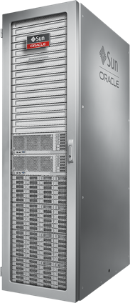
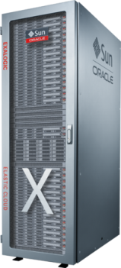

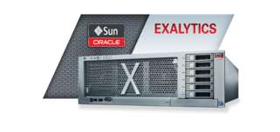
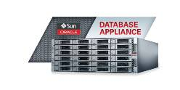
Challenges with Data Protection
Data loss
  ESG 2008 estimates that 1 in 7 (14%) backups and
  1 in 6 (17%) restores fail.
Meeting SLA’s
  Slow backup and restore performance
Reducing costs
  Reducing CAPEX & OPEX while improving staff efficiency
Reducing complexity
  Complexity of backup & recovery processes
Managing data growth
  Compounding year over year
RMAN
ZS3
*Enterprise Strategy Group 2008

Slide 29

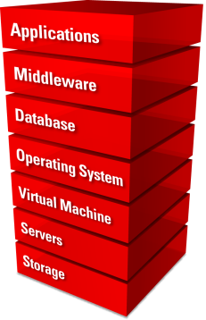
Snap Management Utility
Database Storage Efficiency
  ZFS Storage unlimited snapshot, clone, rollback capabilities
  Rapid and efficient backups, restores and provisioning
Simplifies Database Storage Management
  Browser User Interface and CLI affords rapid familiarity
  Setup DR environment with optional Remote Replication
Engineered to work together
  Oracle ZFS Storage ZS3 - Oracle Database integration
  Empowers secondary processing such as Dev/Test, Reporting
Notes:
29
29

Slide 30
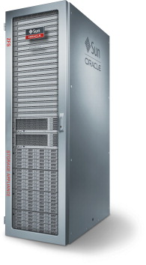
ZS3 for Backup
Clear benefits can be found using the right storage platform
Reduce data loss risk
  Replication of Oracle RMAN disk backup to remote destination
  Image copy backups are EXACT byte-for-byte copies
  of database files
Meet tight SLA’s
  Backup: up to 25 TB/hr
  Restore: up to 14 TB/hr
Shrink storage costs
  Provides compression for Oracle RMAN image backups for optimal resource utilization
Minimize operational complexity
  Managed and tracked by Oracle RMAN

Slide 31

6:00pm – Dinner with Family
Another productive day is over. Troubleshooting took less time, so new projects could be started. Reports were delivered on time, and the backup is securely stored on ZS3.
Time to head home…

Slide 32
Additional Information
Oracle ZFS Storage ZS3
  http://www.oracle.com/us/products/servers-storage/storage/nas/overview/index.html
Enterprise Manager Plug-in
  http://www.oracle.com/technetwork/oem/grid-control/downloads/zfs-storage-plugin-487867.html
Snap Management Utility
  http://www.oracle.com/us/products/servers-storage/storage/nas/snap/overview/index.html
Hybrid Columnar Compression
  http://www.oracle.com/technetwork/issue-archive/2010/10-jan/o10compression-082302.html
Oracle Intelligent Storage Protocol (OISP)
  http://docs.oracle.com/cd/E27998_01/html/E48433/integration__oracle_intelligent_storage_protocol.html

