Slide 1
Explore Data & Discover Hidden Insights with Endeca Information Discovery
Ciprian Antoniu
CEE DataWarehouse Presales Competency Center
Notes:
Good Day/Morning /Afternoon – I’m very excited to be speaking with all of you today and introduce an emerging analytic capability, known as Unstructured Data Analytics, that is proving valuable to our customers to make more information decisions about their business. We’ll talk about why unstructured data analytics matters, what opportunities it exposes, how it complements existing business analytics solutions and finally what Oracle offers and how it’s made a difference for many enterprise customers across multiple industries.

Slide 3
Oracle Business Analytics
Drive Better Business Outcomes
BETTER DECISIONS
FASTER
ACTION
Discover
ACQUIRE
Analyze Plan Predict
ANY
DATA
ORGANIZE
Notes:
Speaker notes:
Now Let’s look at “Analyze.” There are two type of analysis – business analysis that is done by your business decision-makers every day. And advanced analytics are used by data scientists to do more complex modeling, prediction and simulation.

Slide 4
Dialogues Contain Critical, Untapped Insights
“Why should I pay a checking fee if other banks don’t charge one?”
“She saved the project with strong leadership & building trust with the customer.”
“Competitive pricing is 15% lower than yours and they offer discounted shipping.”
“Refuse collection hasn’t been so reliable recently … they’ve been coming late”
Customers
Workforce
Supplier &
Partners
The Public

Slide 5
New Insights Drive New Opportunities
“ ”
Customers
Workforce
Revenue & margin
Customer retention
Brand perception
Segmentation and targeting
Employee retention
Improved productivity
Hiring& Staffing
Compensation
Impact
3rd Parties
The Public
Revenue & margin
Operational efficiency
Better partnerships
Product positioning
Public sentiment
Trends insight
Brand perception
Hiring ability
Revenue & margin
Operational efficiency.
Better partnerships
Product positioning.

Slide 6
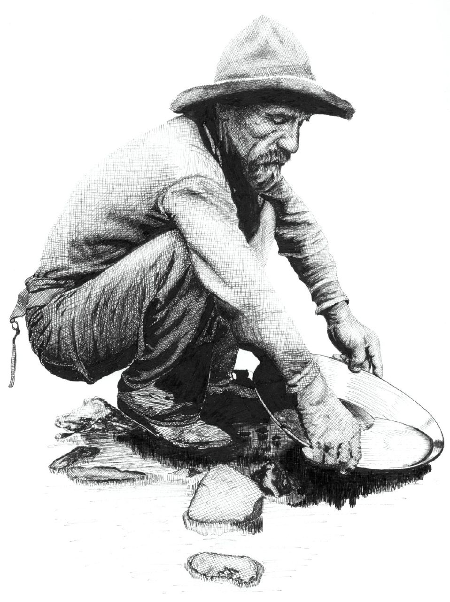
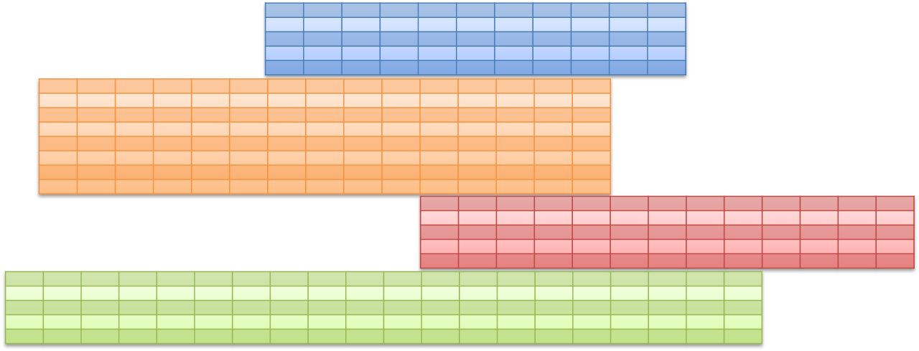
The Challenges of Unstructured Data
A
MOSTLY TEXT, AND DIVERSE SCHEMAS
DATA CAN BE DIRTY OR OF UNCERTAIN VALUE
DATA IS GROWING IN VOLUME AND DIVERSITY
XML
20% STRUCTURED
80% UNSTRUCTURED
Business Intelligence and Data Warehouses
Text in Enterprise Applications
Enterprise Content Systems, File Systems, Email
Websites
Social Media
Big Data

Slide 7
Oracle Endeca Information Discovery
Extend Business Analytics with Unstructured Data
Oracle Business Intelligence
Best platform for integrated ROLAP and MOLAP
Oracle Endeca Information Discovery
Best platform for Unstructured Analytics
BI Server + Essbase
Common Enterprise
Information Model
Endeca Server
Hybrid Search/Analytical Database
Flexible Data Model
Structured Data
Unstructured Data
OLTP & ODS
Systems
Enterprise Applications
(Oracle, SAP, Others)
Data Warehouse
& Data Marts
Websites
Content Systems, Files, Email
Social
Media
Big Data

Slide 8
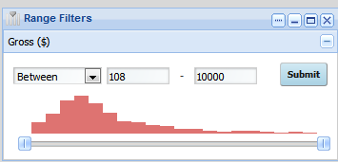
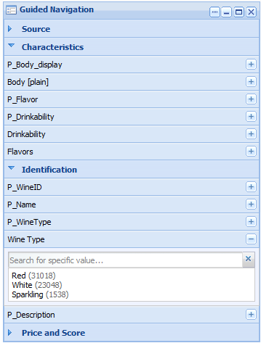
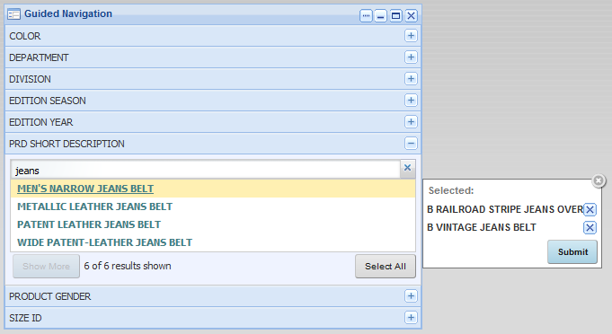
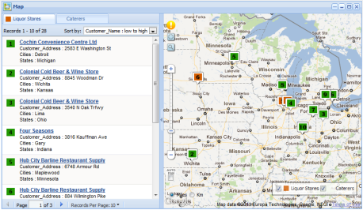
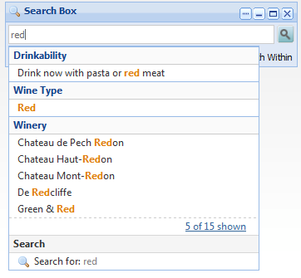
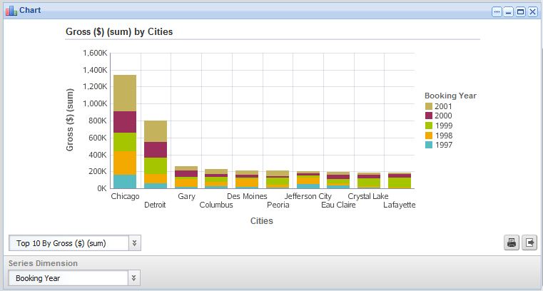
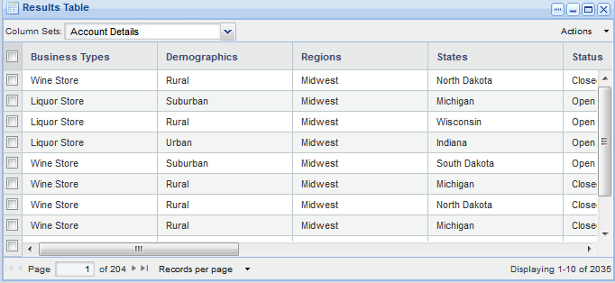
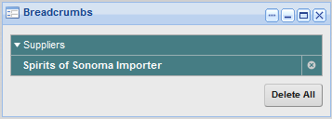
Oracle Endeca Information Discovery Interactive Data Exploration and Analysis
+
+
Visual Analysis
Charts, crosstabs, key metrics
Geospatial visualization
Tag clouds
Deep Search
Search across all data
Dynamic typeahead
Automatic spell correction
Unlocks unstructured data
Contextual Navigation
Data-Driven. Freely browse data without predefined paths or writing queries
Interactive. Shows only valid next steps
Easy to Use. Familiar online experience

Slide 9
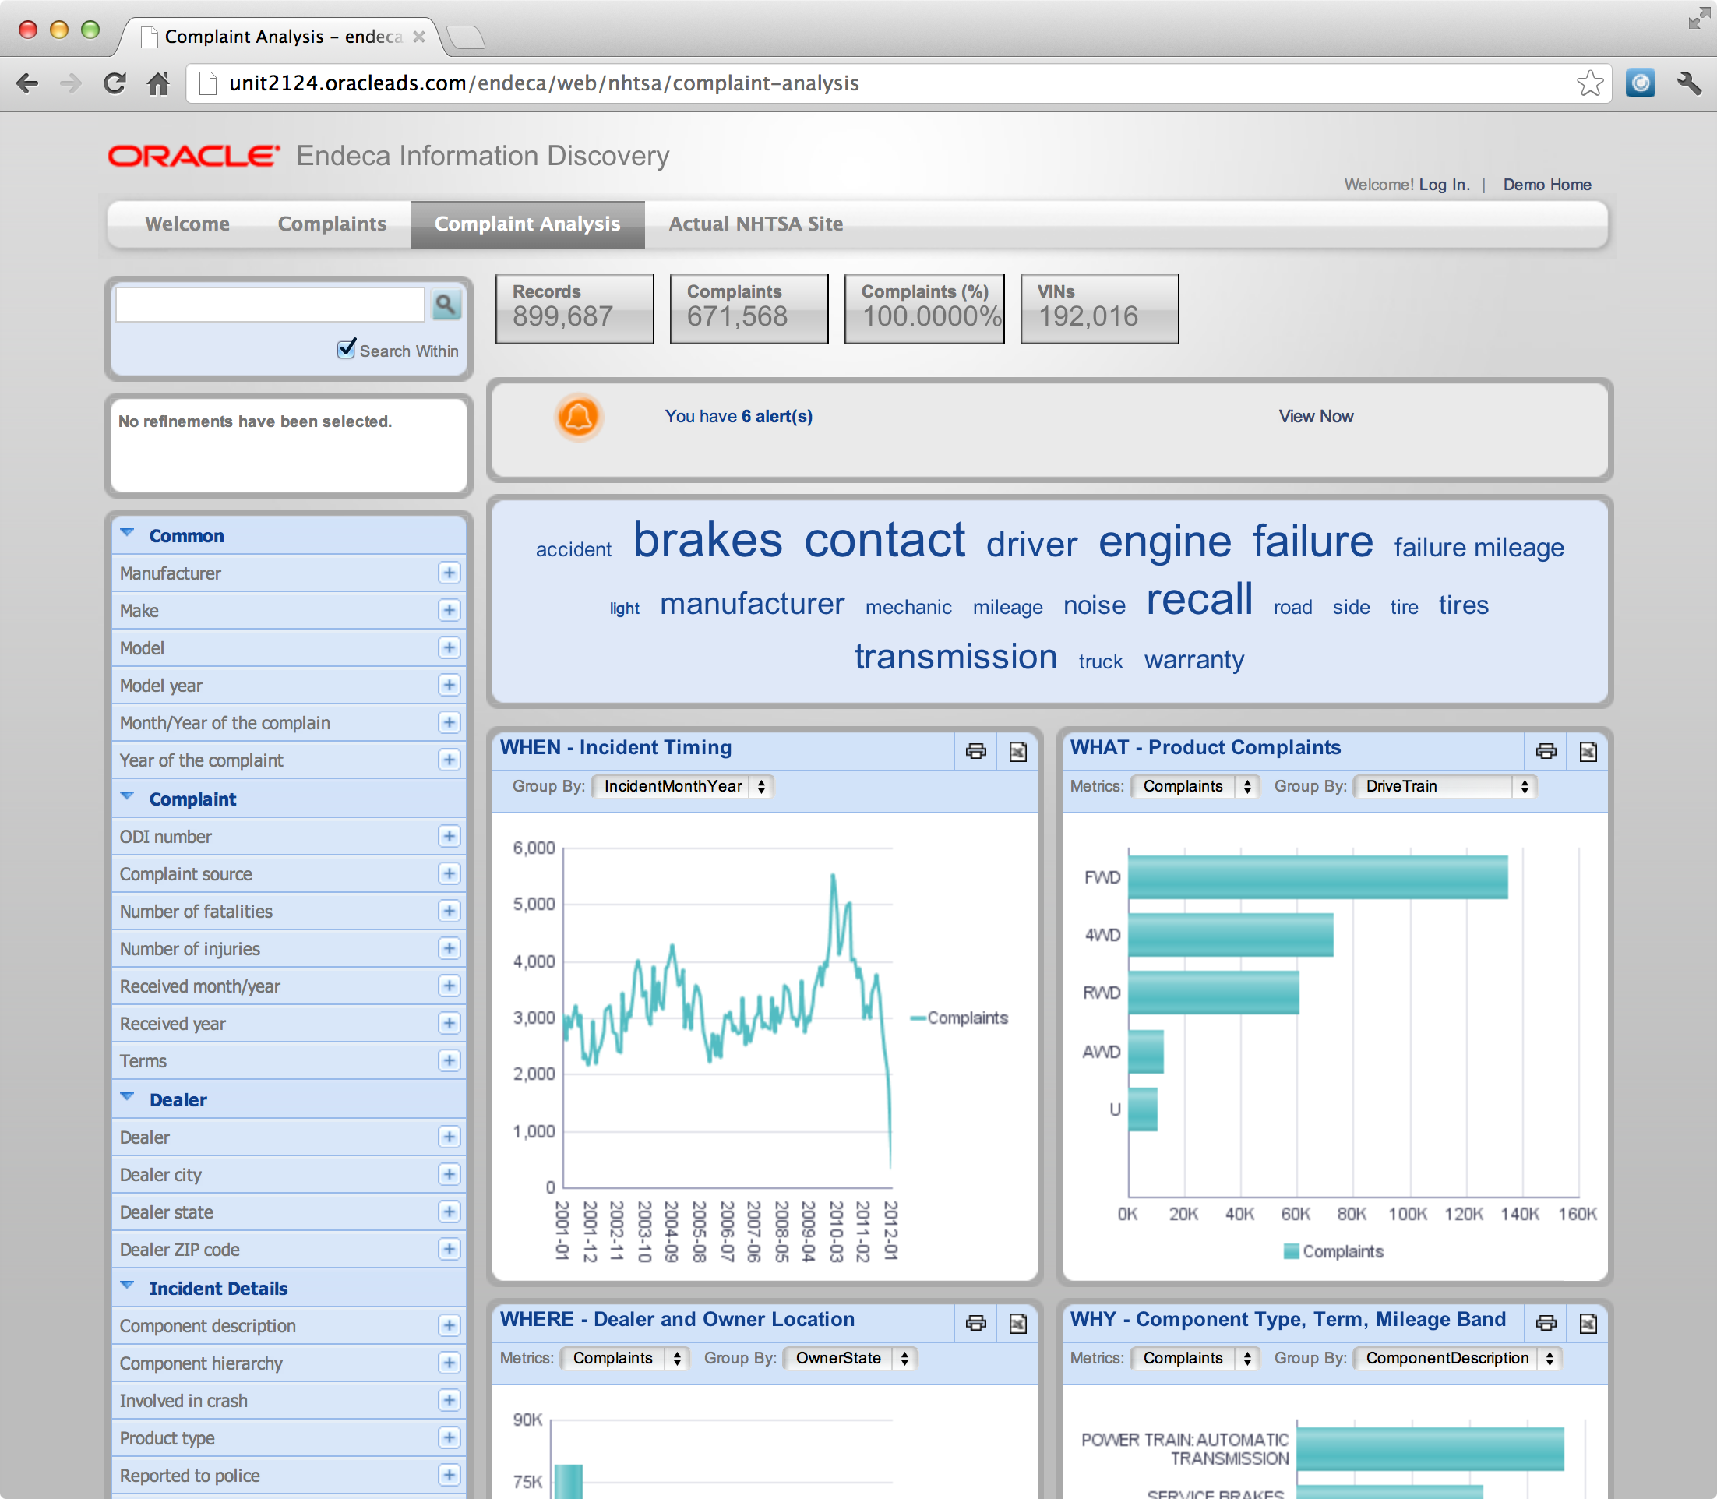
Global Automotive Manufacturer Gets Ahead of Quality Issues
Investigate Root Cause
Reduce warranty costs and detection to correction time
Common view of six years of product and quality data from multiple systems
Quality engineers explore root cause (why) of product issues from unstructured data.
Operates along side Oracle BI EE, Essbase, EPM and PeopleSoft

Slide 10
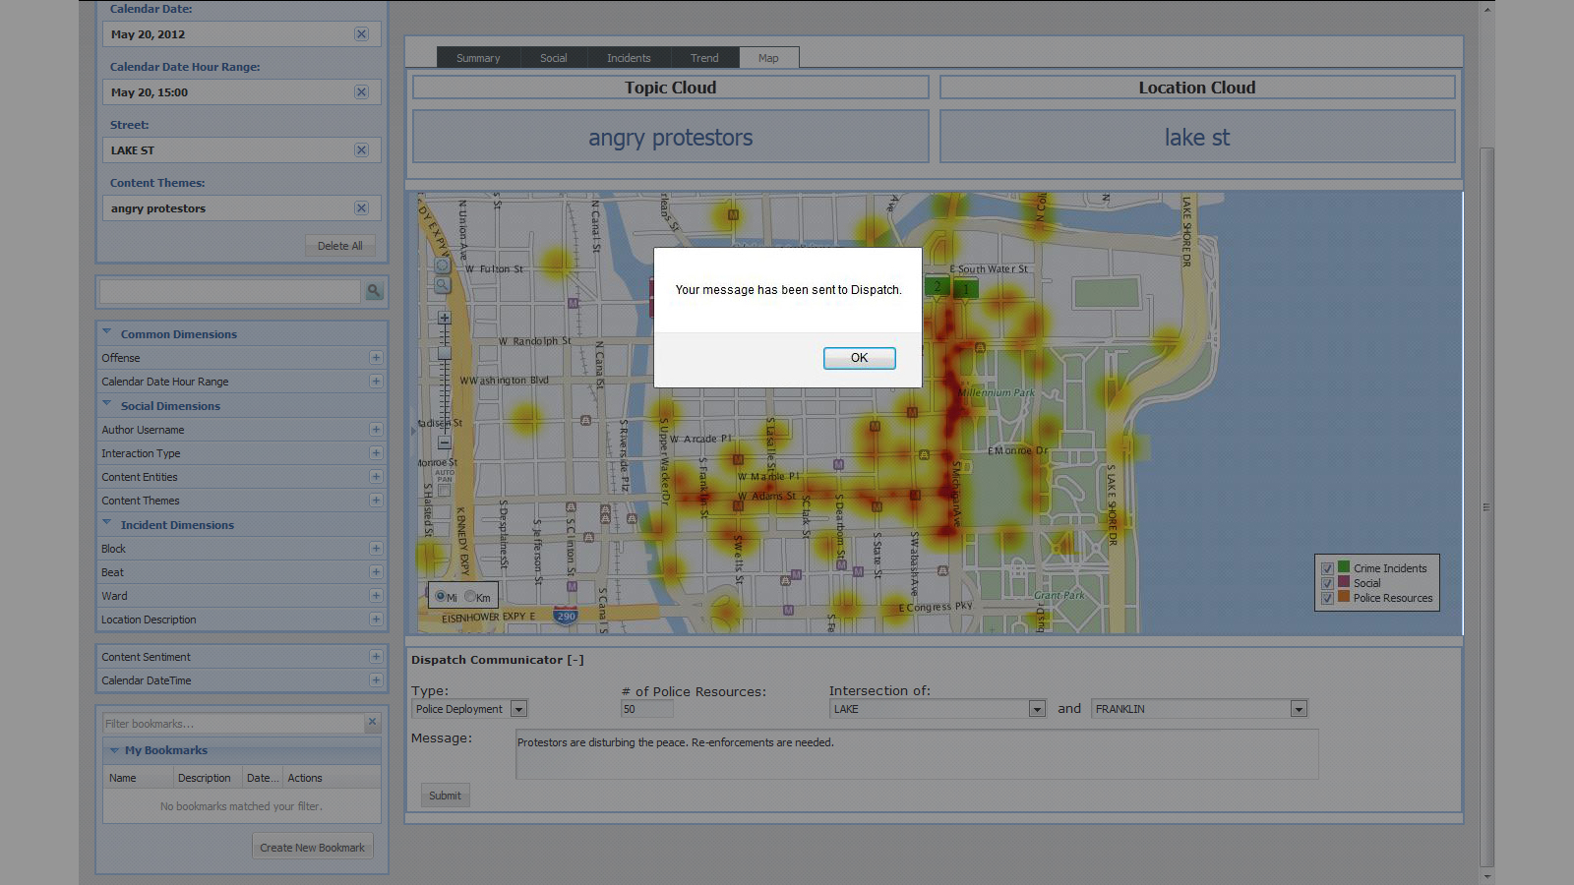
Protecting Citizens
Discovering Protest Activities
Background
NATO Summit in Chicago, May 2012
7,000 Visiting Dignitaries
2,200 Journalists
10’s of thousands of protestor
Thousands of Officers
Solution
Monitor Social Media to identify hot-spots
Correlate with police deployment
Initiate operational orders
Retrospectively identify potential witnesses

Slide 11
Better insight into regional sales performance
Explore New Concepts
Interactive, exploratory analytics across 20 data sources for 4000 sales and marketing users
Oracle BI EE and Oracle BI Applications for enterprise reporting and dashboards, on JD Edwards and other transactional systems
RESULTS
1.5 years time savings and $4 million implementation cost savings over alternative approach

Slide 12
Oracle Endeca Information Discovery
Understand the complete picture with context from any source
Enterprise Content System MS Office Documents, Internal Notes
BI Star Schemas
Metrics: Margin = Sales - Cost, …
Dimensions: Customer, Product, …
Marketing Strategy Document
Chapter 1. …
Transactions
TxnID | ProductID | Category | Amount
12324 | 506 | Mountain Bike | 499
12325 | 507 | Road Bike | 1399
Websites
Product Reviews
“Why did sales fall? Was it bad reviews? An unsuccessful marketing campaign? Quality issues?”
“The new 506 from Acme is a solid road bike. 3.5 stars.”
Enterprise Applications
Unstructured Text Fields
Social Media
Customer Comments
“Customer reported receiving wheel with bent spokes…”
“Thinking about buying a new road bike. Anyone know anything about the Acme 506?”

Slide 13
Business Intelligence and Information Discovery
Complete Business Analytics Solution
Optimized for Exalytics
In-Memory Machine
Analysis Problems Measure, Analyze, Report
Discovery Problems
Investigate, Explore, Understand
Oracle Business Intelligence
Proven Answers to Known Questions
Structured Data
Modeled and conforming
Oracle Endeca Information Discovery Fast Answers to New Questions
Unstructured Data
Diverse, textual, uncertain quality

Slide 14
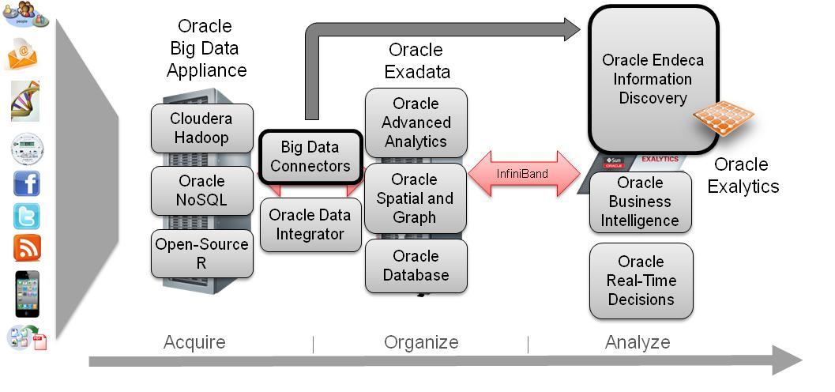
Big Data Discovery
Endeca used for interactive exploration and analysis on top of the Big Data Appliance. Make Big Data actionable for the business.
Only Oracle provides a complete Big Data solution
Oracle provides everything customers need to acquire, organize, analyze, and understand Big Data.
Only Oracle delivers the full integrated stack from hardware to software.
The industry definition of Big Data includes Variety as a key criterion.
Endeca creates meaningful opportunities to enable business users to generate insights from the diverse data being gathered today.

Slide 15
Diverse
Unstructured Information
ORACLE®
Critical Insights
Solve the Mystery of YOUR BUSINESS

