Slide 1
Symantec Backup Exec™ 2014
Marius ȚURLEA
Technology Solutions Manager
Notes:
Hello, and welcome to today’s discussion of Backup Exec 2014. My name is <presenter_name>, and I will be your presenter today.

Slide 2
What’s New in Backup Exec 2014?
Up to 100% faster backups*
Protect your entire environment – virtual and physical with a single solution
Windows Server 2012 and 2012 R2 support
Granular recovery for Exchange 2013 and SharePoint 2013
Superior visibility into backup jobs
Easy upgrades
*Backup Exec 2014 versus Backup Exec 2012 Backup Performance, Symantec Testing (Jan/2014)
Notes:
Before we dive into Backup Exec and how Backup Exec is going to improve your backup and recovery, let’s take a quick look at what’s new in this latest release.
Optimal performance – 100% Faster Backups* - With Backup Exec 2014, backup performance just got even better. Now with up to 100% faster backup and deduplication speeds , Backup Exec helps you backup quicker, reduce your backup windows and save you time.
Windows Server 2012 and 2012 R2 Support - New platform support is included in Backup Exec 2014. Now Backup Exec fully supports Windows Server 2012 and Windows server 2012 R2. You can back up anytime and recover Windows Server 2012 and 2012 R2, at any level, whenever and however you need to.
Granular Recovery for Exchange 2013 and SharePoint 2013 -- Backup Exec extends its market leading patented granular recovery technology to Exchange 2013 and SharePoint 2013. Through a single pass backup, Backup Exec gives you immediate visibility into your backup jobs with the ability to instantly recover files, folders and granular objects – all without staging or mounting backup jobs.
Superior Visibility Into Backup Jobs - The Backup Exec job monitor and server centric model is back! Monitor the status of all your backup jobs from one convenient view with the new backup job monitor giving you superior visibility in the status of your backup jobs. In addition, save time and simplify the creation of backup jobs by backing up and managing multiple servers with a single backup job.
Easy To Upgrade or Migrate - Backup Exec maintains Backup Exec 12.5, 2010 and 2012 job policies and settings making it quick and easy to move to Backup Exec 2014. The result is seamless, worry free upgrades.
In addition, our engineering team and product management team have been laser focused on reliability, availability, supportability, manageability, and usability. Our number 1 priority is always our customers – you. We are committed and dedicated to making improvements release after release.
Some data points on the Backup Exec Beta program if needed:
On Site Visits (Tier1) - 36
Active beta participants (Tier1 & Tier2) – 864
Registrations (Tier1 & Tier2) – 3732
Look at the appendix slide for real life beta quotes.

Slide 3
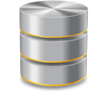
Reduce Costs and Complexity
One Console, One Backup, One Vendor
Reduce management of multiple products
Reduce management and licensing costs
Reduce storage with efficient deduplication
Fast recovery and increased uptime
Virtual
Symantec Backup Exec™ 2014
Physical
Notes:
Reducing costs and backup complexity: Lowering costs and simplifying backup tasks starts with deploying a single solution that can protect an entire physical and virtual infrastructure. Having two backup solutions instead of one can be worse than carrying around two mobile phones. It can introduce high costs and negative consequences such as:
Higher storage and infrastructure costs, because separate backup solutions require separate hardware and storage. Also because you are backing up deduplicate data across physical and virtual.
Higher deployment and management costs, because there are fewer opportunities to optimize storage and deduplicate redundant data. Also, because you are managing two disparate solutions that takes up time and money – two backup jobs = twice the time to backup. Two management consoles.
Lost productivity and lost revenue, because it takes longer to backup and recover virtual and physical servers in the event of a problem.
Inability to respond to compliance requirements, because virtual-only products provide little support for long-term archiving on tape, disk or cloud storage, and have limited capabilities to recover individual emails and files.
Deeply integrated with VMware, Microsoft and Linux platforms, Backup Exec can protect from one to thousands of servers and virtual machines all from the same user console, providing optimal performance and efficiency.
Reduce cost and management of multiple products - Complete data, application, and system protection for physical and virtual environments from a single console. You don’t have to manager, configure and monitor two solutions.
Reduce cost of multiple agents - Regardless of how many CPU cores a virtual host has, and regardless of how many individual virtual machines a virtual host includes, an entire virtual host and all of its virtual machines can be protected through a single host-based license. This one license per host model continues to save partners and customers more and more as their virtual environments grow. As virtual hosts become more powerful and as additional virtual machines are added to an environment, Backup Exec 2014’s virtual licensing model remains the same – one license per host. Alternatively, go with the capacity edition.
Reduce storage resources – Also, Backup Exec 2014 includes deduplication technology that can be added to an environment to further reduce costs associated with backup storage. This deduplication technology applies to backups of both physical and virtual servers (global deduplication across physical and virtual), and includes new technology specific to VMware and Hyper-V to further reduce storage costs and shorten backup windows.
Fast recovery and increased uptime – Finally, Backup Exec continues to provide market-leading recovery technology to its customers and partners. Whether protecting physical or virtual servers, Backup Exec 2014 allows customers and partners access to the following recovery features, all from a single-pass backup:
Full machine recovery
Application / database recovery
Granular file and folder recovery
Granular application object recovery

Slide 4
Minimize Downtime With Instant Recovery
Migration Accelerator – P2V, B2V & V2P
Accelerate Move to Virtualized Environment
Dramatically Reduce System Downtime
Reduce Management Time and Set-up
Protected Server
Hypervisor
Parallel Option
Convert
Backup
Serial Option
Backup
Convert
Backup Exec™ 2014 Server
4
Notes:
Backup Exec 2014 also expands its disaster recovery capabilities with physical to virtual conversions, known as P2V. You can also simultaneously back up a physical computer and convert it to a virtual machine or virtual disk (P2V), or convert an existing backup set to a virtual machine or a virtual disk (B2V) at a later time. The result of this conversion is a fully recoverable backup set and a completely functional virtual machine. In the event of a disaster, your backup set is ready to go, which dramatically helps reduces downtime and disruption.
Another great thing about this feature is that it can help accelerate the move to a more fully virtualized environment. With Backup Exec 2014, you can convert your physical servers to virtual servers – and then just run them in your virtual environment, retiring your physical server. This makes a lot of sense for a lot of customers today.
Overall benefits:
Dramatically Reduce System Downtime - Scheduled physical to virtual conversions enable immediate system recovery in virtual environments
Reduce Management Time and Set-up - Easy-to-use, virtual conversion wizard provides scheduled or on-demand P2V and V2P conversion for quick recovery
Recover Back to Different Physical or Virtual Hardware (V2P) - Recovery to Completely Different Physical or Virtual Hardware
More data if needed:
The parallel conversion process utilizes parallel data streams to store backup data from a protected server to a Backup Exec 2014 server while simultaneously sending the same backup data, in the form of a virtual machine, to a virtual host in the environment. Both VMware vSphere and Microsoft Hyper-V environments are supported. The result of this conversion operation is a fully recoverable backup set as well as a fully functional virtual machine that can be used for warm failover, disaster recovery scenarios.
The serial process is similar, except that the virtual process happens after, or on a different schedule, from the backup operation. The result is still a full virtual machine on a VMware or Microsoft virtual host.
Regardless of how the conversion takes place, a form of dissimilar hardware restore is utilized to ensure that the virtual machines being generated will boot and function properly in a virtualized mode. This happens automatically without user intervention.

Slide 5
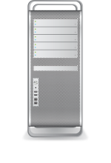
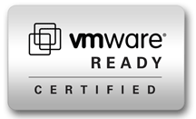
Modern Technology Built for Virtualization
Flexible Support for Virtual Platforms
Fast, Efficient Recovery
Reduce Backup Storage and Management Costs
Deep integration with Microsoft VSS and VMware ADP for fast VM snapshots
Zero impact on the VMs
Dynamically protects new VMs found at job run-time
VMware Ready and Microsoft® certified
Restore full virtual machines, applications and databases
Granular files/folders
Granular application data
Restore directly from storage to same to other location
No mounting or staging required
Block level deduplication across all virtual and physical backups
Change block tracking
Convert physical servers to virtual machines
Centralized management with deep visibility
“Backup Exec is the backup and recovery gold standard” Terry@Autochair
5
Note: The Agent for Applications and Databases must be installed in a VM to collect Application Metadata enabling application data recovery.
Notes:
5
Many of you may be looking at adopting virtualization or have adopted virtualization for some of the immediate benefits of server consolidation but as you adopt virtualization – you will most likely experience new storage challenges and backup and recovery complexities.
Backup Exec 2014 provides the technology you need to solve some of these tough IT challenges. Let’s explore Backup Exec’s comprehensive and innovative virtualization capabilities and unique value it provides your business.
Flexible Support for Virtual Platforms
Backup Exec’s integration with Microsoft® Volume Shadow Copy Service (VSS) and VMware’s vStorage APIs for Data Protection (VADP) provides reliable and consistent application-aware backups for all your virtual machines. Using market-leading technology, Backup Exec minimizes CPU, memory, and I/O load performance impacts on the virtual host. By executing post-processing tasks that don’t impact the backup window, such as log truncation, collection of meta data, and searchable catalogs, Backup Exec delivers highly optimized backup and fast, agile recovery of granular application data directly from storage.
Backup Exec tackles VM sprawl by automatically identifying and protecting new VMs as they appear so you can be assured your VMs are protected from day one. You can also accelerate moving to a virtual infrastructure by rapidly converting physical machines into virtual machines on demand with the Backup Exec Migration Accelerator.
Unlike other backup solutions, Backup Exec is both VMready and Microsoft certified.
Fast, Efficient Recovery
Backup Exec provides fast, agile recovery with the ability to recover data at any level, “from anywhere, to anywhere” through a single pass backup. Backup Exec doesn’t require multiple backup passes to achieve different levels of restore granularity. In a few simple clicks, you can recover anything from physical servers and virtual machines. This includes entire applications and individual objects including files, folders, and granular application items, from Exchange, Active Directory, SQL Server, and SharePoint.
Reduce Backup Storage and Management Costs
Unlike point solutions, get greater storage savings with integrated data deduplication that deduplicates data across your entire virtual and/or physical environment. For even greater efficiency and enhanced storage savings, Backup Exec includes change block tracking. With change block tracking, Backup Exec backs up only the blocks that have changed, rather than backing up every block of every VM in the infrastructure.
You can also simultaneously back up a physical computer and convert it to a virtual machine or virtual disk (P2V), or convert an existing backup set to a virtual machine or a virtual disk (B2V) at a later time. The result of this conversion is a fully recoverable backup set and a completely functional virtual machine. In the event of a disaster, your backup set is ready to go, which dramatically helps reduces downtime and disruption.
Backup Exec delivers an easy to use interface with an intelligent dashboard and intuitive wizards to quickly track and monitor every backup and recovery job. With a few simple clicks, you can set backup policies, view backup status, and perform recoveries. When setting backup policies, you no longer need to configure each job separately.
Backup Exec’s centralized administration console delivers scalable management of distributed Backup Exec servers and reduces the time and resources needed to manage your backup operations.

Slide 6
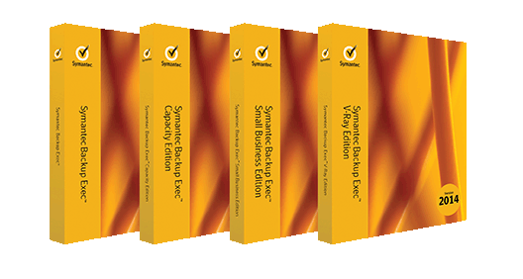
Easy to Buy and Deploy
On premise software
Per TB – benefit from all the features and functionality of Backup Exec
Per socket – protect an unlimited number of guest machines per host with a single license
Per module – license only the components you need
All-in-one award winning integrated appliance inclusive of Backup Exec software
Save time and money
Notes:
Ease of acquisition and deployment through software or an appliance - Backup and recovery doesn’t have to be complicated to license or expensive to acquire, deploy, and manage. Backup Exec is a cost effective backup and recovery solution that’s easy to acquire, license, and deploy. Choose from two deployment options - on- premise software or an all-in-one, integrated hardware/software appliance with unlimited licensing. And with three cost effective and flexible licensing options for on-premise software including per module, per TB or per socket, Backup Exec gives you the ability to choose the right licensing model for your environment – all at affordable prices.

Slide 7
Make The Move To The Backup Exec 2014 Today!
Backup Exec customer with active maintenance
Free Upgrade!
Backup Exec customer without maintenance
Save up to 35% Off* MSRP
Upgrading to Backup Exec from a competitive solution
Save up to 35% Off* MSRP
7
* Applies to software license MSRP only, and does not apply to support or maintenance, which is included with every purchase.

Slide 8
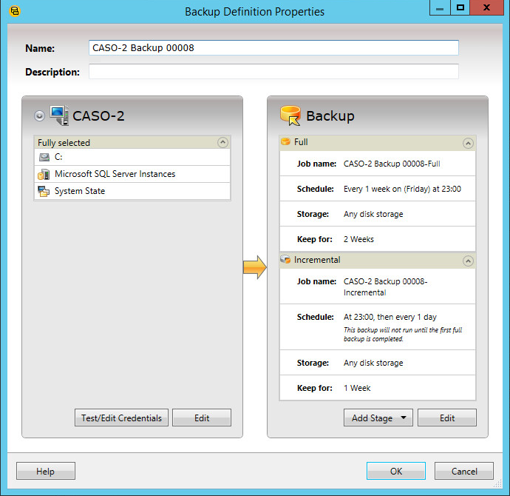
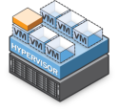
Backup Exec 2014: Improved Management Modular Backup Protection Methodology
Set up backup jobs in a few simple clicks with Stages™ technology
Easily expand protection
Just click “Add Stage” Example:
Stage 1: Backup to Disk
Stage 2: Copy to Tape
Stage 3: Convert to Virtual
Technical Overview: Backup Exec 2014

Slide 9
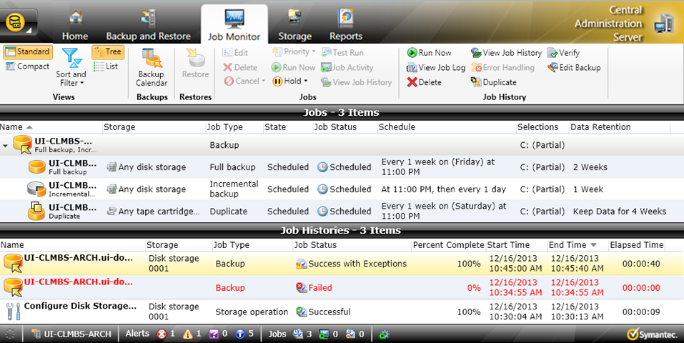
Job Monitor

Slide 10
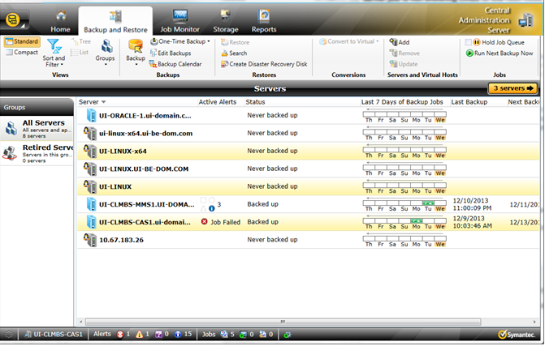
Creating a Multi-Server Backup Definition
One or more servers are selected from the Backup and Restore view (or a server group is selected). (CTRL or shift-click)

Slide 11
Backup Exec 2014: New Platforms and Applications
Operating systems
Supported Windows Platforms
Windows 2012 R2
(client* and server)
Windows 2012
(client* and server)
Windows 8/8.1
(client* and RAC)
*Agent for Windows cannot be installed on ReFS volumes or any volumes that are enabled for Windows deduplication
Supported Linux Platforms
RHEL 5.8, 5.9, 6.2, 6.3, and 6.4
(client)
SLES 11 SP3, OES 11
(client)
Ubuntu 12.04 and 12.10 (client)
Supported MAC Platforms
Software Compatibility Lists:
http://www.symantec.com/business/support/index?page=content&id=TECH205797
Macintosh OS X
10.5 – 10.7
(client)
11
Notes:
Operating System Support
Backup Exec 2014 continues to expand upon the platforms and applications it supports, ensuring support for modern partner and customer environments. Backup Exec 2014 now includes support for Windows 2012 R2 and Hyper-V 2012 R2 configurations, in addition to the other platforms in its support portfolio. For additional details on the platforms supported by Backup Exec, please refer to the Software Compatibility List or SCL available at no charge from the support knowledge base (www.symantec.com/support).

Slide 12
Backup Exec 2014: New Platforms and Applications Virtual Platforms
Supported Client Virtual Platforms
VMware 5.1 & 5.5
(client)
Hyper-V 2012 R2
(client and server)
Hyper-V 2012
(client and server)
Hyper-V 2012/R2 VHDX-based virtual machines are supported, but non-GRT only.
Supported platforms listed above generally apply to both software and appliance editions of Backup Exec.
Refer to the Backup Exec Software Compatibility List for additional details on supported platforms.
12
Notes:
Operating System Support
Backup Exec 2014 continues to expand upon the platforms and applications it supports, ensuring support for modern partner and customer environments. Backup Exec 2014 now includes support for Windows 2012 R2 and Hyper-V 2012 R2 configurations, in addition to the other platforms in its support portfolio. For additional details on the platforms supported by Backup Exec, please refer to the Software Compatibility List or SCL available at no charge from the support knowledge base (www.symantec.com/support).

Slide 13
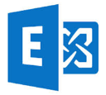
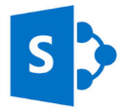
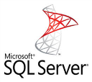
Backup Exec 2014: New Platforms and Applications
Microsoft and non-Microsoft applications
Microsoft Applications
Exchange 2013
(includes GRT)
SharePoint 2013
(includes GRT)
SQL Server 2012, 2008/R2
New and notable
Non-Microsoft Applications
Enterprise Vault 11, 10 SP3/SP4
Lotus Domino 9, 8.5.1/.2/.3
Oracle 11g, R1/R2
Supported applications listed above generally apply to both software and appliance editions of Backup Exec.
Refer to the Backup Exec Software Compatibility List for additional details on supported platforms.
13
Notes:
Application Support
Backup Exec 2014 has also expanded its support for key applications, including Exchange 2013 and SharePoint 2013, both of which are now supported for granular application recovery operations. For additional details on the applications supported by Backup Exec, please refer to the Software Compatibility List or SCL available at no charge from the support knowledge base (www.symantec.com/support).

Slide 14
Try Backup Exec – FREE for 60 days
Backup Exec 2014
DOWNLOAD NOW!
www.backupexec.com/trybe
14
Notes:
Unlike other solutions that provide 15 days to try out their solution, with Backup Exec you get 60 days! Backup Exec Trialware unlocks all features and functionality for a period of 60 days so that you can see how Backup Exec is powerful to help meet your backup windows, flexible to meet all your recovery needs and easy to reduce complexity and cost.

Slide 15
Symantec Enterprise Vault for Exchange
Storage considerations

Slide 16
Storage considerations
Exchange 2013 standalone
1,000 Mailboxes (2GB each)
DAG
6TB
2TB
+
2TB
+
2TB
=
6TB of email
+ Content Indexing (15%)
= 0.9TB
0.9TB
PSTs(2GB per user)
PST Files
2TB
6TB
+
2TB
+
2TB
=
6TB of email
+ Content Indexing (15%)
= 0.9TB
0.9TB
+
+
+
= 13.8TB in Exchange

Slide 17
Storage considerations
Enterprise Vault
Exchange 2013 and Enterprise Vault
All content > 60 days
1,000 Mailboxes (2GB each)
SIS/Compress=40%
2TB
1TB
2TB
1.6TB
1TB
SIS/Compress=50%
Content Indexing 13% =0.47TB
0.47TB
DAG
2TB
2TB
2TB
1.2TB of email
0.4TB
1.2TB
0.4TB
0.4TB
+
+
=
+ Content Indexing (15%)
= 0.18TB
0.18TB
PSTs(2GB per user)
PST Files
+
= 1.38TB in Exchange
2TB
+
= 2.47TB in Enterprise Vault

Slide 18
Summary
1,000 Mailboxes (2GB each)
1,000 PST files(2GB each)
Exchange Standalone
with Enterprise Vault
13.8TB in Exchange
1.38TB in Exchange
2.47TB in EV
Take-away’s
1. 90% less email storage in Exchange with Enterprise Vault
2. 70% less combined storage required with Enterprise Vault

Slide 19
Notes:
Thank you again for taking time out of your busy schedule today. Before we wrap up, does anyone have any questions?

Slide 20
Marius ȚURLEA
marius_turlea@symantec.com

