Slide 1
Operate at velocity of Business with VMware
Cristian RADU, VMware

Slide 2


Traditional IT Pain Points That Have Kept CIOs Up at Night
Inefficiency
Downtime
High capex and opex
High complexity, IT in silos
Operational inefficiencies
Challenging to
meet SLAs
Long issue identification / resolution times
Security and compliance issues

Slide 3


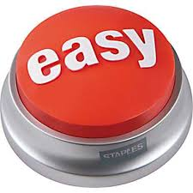


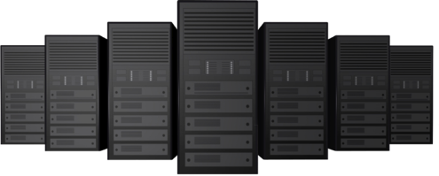
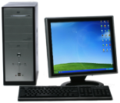

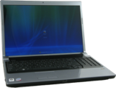

What’s Changing: Rise of “Shadow IT”
Funding for
Central IT
62% of total IT
spend
Self-procured
(cloud) Services
38% of total IT
spend
IaaS
PaaS
SaaS
* Source: Gartner, November 2011: “By 2015, 35% of enterprise IT expenditures for most organizations will be managed outside the IT department's budget."

Slide 4

The Other Thing That is Changing: Customers
Want Choice

Slide 5


Emergence of New IT Pain Points
Inefficiency
Downtime
Inflexibility
Fear of Lock-In
High capex and opex
High complexity, Siloed IT
Operational inefficiencies
Challenging to
meet SLAs
Long issue identification / resolution times
Security and compliance issues
Slow time to market
Reactive IT organizations
Rise of “Shadow IT”
Managing heterogeneous IT environments
New applications types e.g. Big data, mobile
Vendor lock-in

Slide 6

SDDC Enables IT to meet the demands of the mobile-cloud era
IT Technology Eras
Mainframe
Client-Server
Mobile-Cloud
IT at the
Speed of Business
Business Expectations
Ability of IT to Deliver
$ $ $ $ $ $
Steady IT Budgets*
* Source: Gartner, 2013: “Hunting and Harvesting in a Digital World: The 2013 CIO Agenda”

Slide 7
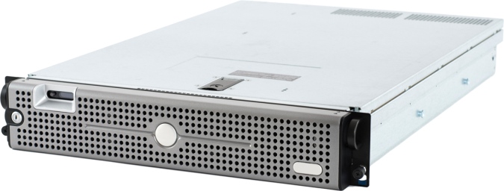

The same principles that transformed a single layer of the data center…
What if…
Abstract.
Pool.
Automate.
and delivered unprecedented
value for customers…
were applied to
the entire data center?

Slide 8
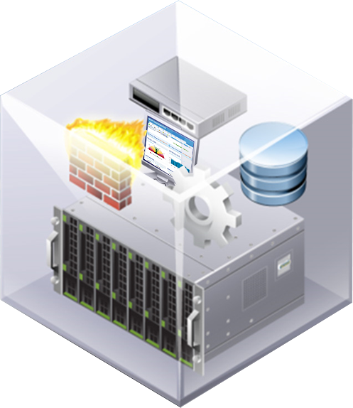
Software-Defined
Data Center
The ideal architecture for private,
hybrid and public clouds.
All infrastructure is virtualized
and delivered as a service, and
the control of this data center is
entirely automated by software.

Slide 9
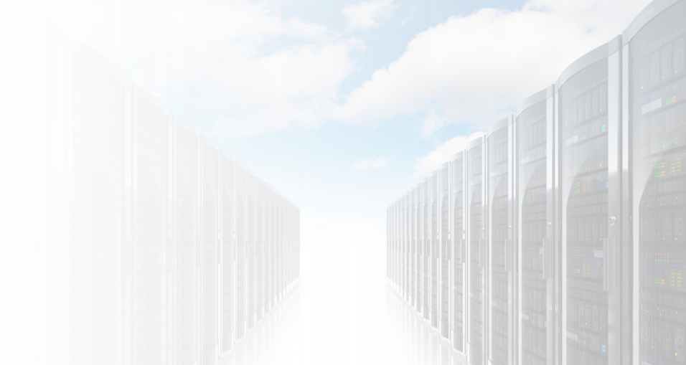







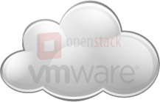
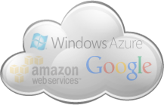
The Software-Defined Datacenter
Software-Defined Datacenter
Policy-based Management & Automation
Cloud Automation
Cloud Operations
Cloud Business
Virtualized Infrastructure
Abstract & Pool
Hybrid Cloud
VMware &
vCloud Datacenter Partners
Compute Abstraction = Server Virtualization
Network Abstraction = Virtual Networking
Storage Abstraction = Software-Defined Storage
Private Clouds
Public
Clouds
Physical
Hardware
Compute
Network
Storage
15

Slide 10




VMware’s Software-Defined Data Center Value Proposition
VMware provides an evolutionary approach to modernizing IT with the Software-Defined Data Center that delivers new levels of…
Efficiency
Control
Agility
Choice
Traditional IT pain points
New IT pain points
Inefficiency
Downtime
Inflexibility
Fear of Lock-In
Reduce IT capex by 75% and opex by 56%*
Reduce downtime
for tier 1 applications by 36%*
Increase IT productivity by 67%*
Support for over 500 ISV solutions and 80 operating systems
Virtualization Economics, Across the Data Center
Business-Aware IT control
Apps at
Business Speed
Your Data Center, Your Terms
* Taenja Group Research 2014

Slide 11
Key Software-Defined Data Center Capabilities
Efficiency
Control
Agility
Choice
Compute virtualization
Network and security virtualization
Software-defined storage
Automated operations management
Automated Business
Continuity / Disaster Recovery
Virtualization aware security and compliance across clouds
Management across private and public clouds
Operational analytics
Service provisioning across multi-platform multi-cloud
Policy driven automation
Self-service portal and catalog
Hybrid cloud extensibility
App deployment across multiple hardware stacks physical or virtual
Support for multiple hypervisors (Hyper-V, KVM) and clouds (OpenStack, Amazon AWS)

Slide 12





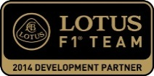



















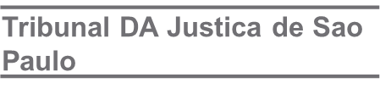
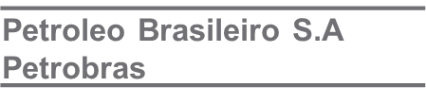


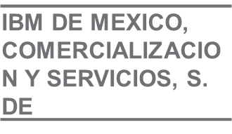
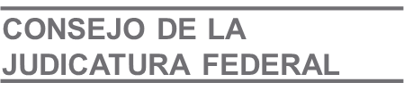
Strong SDDC Customer Momentum
Virtualized SAP applications, automated application provisioning and provided disaster recovery
Accelerated time-to-market for product innovations and expanding footprint in emerging markets
Switched from Hyper-V to increase application availability, fast data access & analysis and capability for cross-data transfer
Reconstructed virtual infrastructure (Hyper-V displaced)
Reduced hardware costs by 70%
Reduced time to identify and resolve systems issues (20 minutes to a few sec)
Hosted mapping application through VMware hybrid cloud partner
Facilitated global distribution with ability to handle traffic peaks that occur when up to 7,000 pilots try to download up to 800MB of data at the same time
Automated cloud lab environment to improve support SLAs for 150+ enterprise products
Decreased time to resolve customer issues from 2-3 weeks to 30 minutes
Increased efficiency by 25% with capacity reclamation
Increased VM density by 20%
Decreased operational costs by 20%

Slide 13

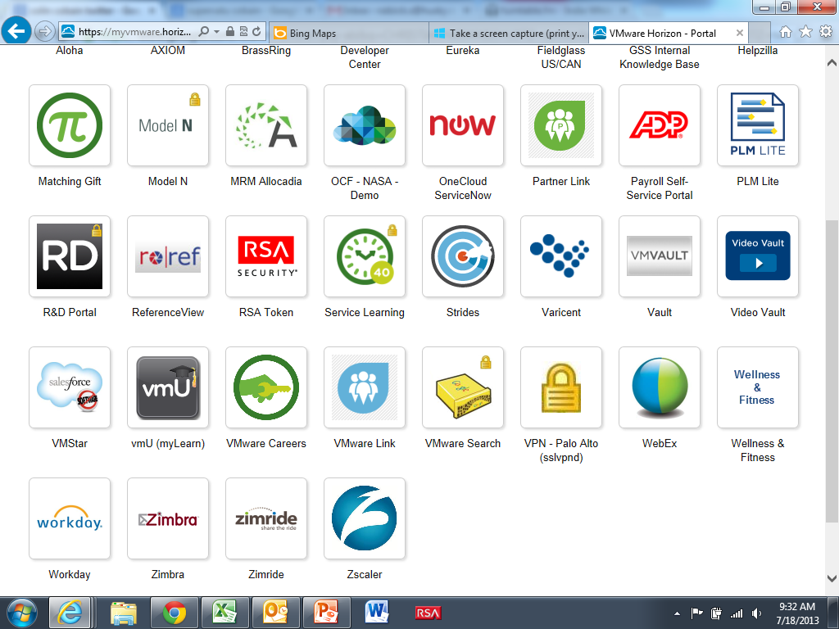


VMware IT creates a private cloud for DevOps based on SDDC architecture
Enterprise Application Portfolio
Customer: 600+ developers
Infrastructure footprint:
99% virtualized
~4000 non-production servers
~500 production servers
~290 physical hosts
~4 Petabytes of storage
SaaS 65
IT tools 50
Business 100
Total 215

Slide 14
VMware IT Achieves Dramatic Efficiency and Productivity
Reduced provision time
95%
(4 weeks to 36 hours)
Improved productivity
of 600 developers
20%
Reduced
IT operations costs
$1.5M /year
Able to say
“yes”
to developer requests
Reduced the cost of
a VM/month
80%
($133 to $20)
Reduced
infrastructure costs
$4.5M/year

Slide 15
SDDC On-Premises Products
Management and Automation
vCloud
Automation Center
vCenter Operations
Management Suite
IT Business
Management Suite
vCenter Server
Storage/Availability
Compute
Network/Security
vCenter
Site Recovery Manager
vSphere
vCloud
Networking and Security
Virtual SAN
NSX

Slide 16
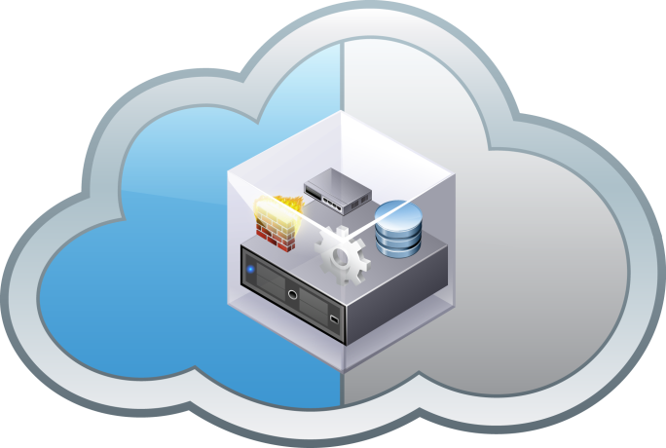
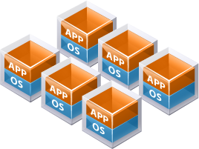
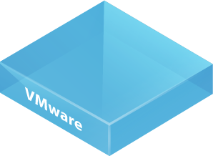
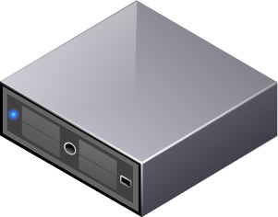
SDDC Comes in Two Form Factors
Existing & New Apps
On-Premises
Off-Premises
Seamless Networking
Common Management
One Support Call
vCloud Suite
or vSphere w/Ops Mgmt
vCloud Hybrid Service
Any Application, Any Place… No Changes

Slide 17
SDDC IT Use Cases / Capability Maturity Model
Capability Maturity Stages
Use Case
Capabilities Summary
SDDC Stage 1
SDDC Stage 2
SDDC Stage 3
IT Cost Transparency
Automated IT Service Costing for Complex Workloads Across Hybrid Environments
Infrastructure Costing
IT Financial Planning and Forecasting
IT SLA and Vendor Management
Service Broker
ITBM STD
ITBM ADV
ITBM ENT
On-Demand Infra. and Apps
Rapid Application Delivery Through Policy-Based Infrastructure Automation
Automated Infrastructure Provisioning, Policy-Based Governance
App Lifecycle Automation, Multi-Cloud Brokering
On-Demand Network, On-Demand Storage
vCloud Suite STD/ADV
vCloud Suite ENT, vCHS
VSAN, NSX
Business Continuity and Disaster Recovery
Automated High Availability for Apps and IT Services Across Host, Cluster, Site
High Availability, Data Protection
Automated DR
DRaaS
Business Partner
vSphere ENT+, VDPA
vCloud Suite ENT
DRaaS (vCHS)
Secure and Compliant
Network
Ensure Zero Compliance Drift Across Large Number of Complex, Related Workloads
Automated Regulatory Compliance
Software-Defined Layer 2 to Layer 7 Network and Security Services
Network to Any Public Hybrid Cloud
vCloud Suite STD/ADV/ENT
NSX
vCHS
Optimized Capacity and Operations
Predictive Analytics and Smart Alerts to Optimize Data Center Performance, Capacity and Health
Performance and Capacity Optimization, Log Analytics
3rd Party Integration, Customizable Dashboards
App Monitoring, Quality-of-Service
Cost Center
vSOM
vCloud Suite ADV
vCloud Suite ENT
Data Center Consolidation and Standardization
A Logical Operational Model for the Data Center Based on Virtualized Compute, Network, Storage
Server Virtualization, High Availability
Software-Defined Storage,
Network Virtualization
Cloud Bursting (Storage/Compute)
vSphere ENT+
VSAN, NSX
vCHS

Slide 18
Journey to the Software-Defined Data Center
Phase III
Service
Broker
Capabilities
Phase II
Business
Partner
IT Cost Transparency
Network Virtualization
Software-Defined Storage
Phase I
Cost
Center
vCloud Suite
On-Demand Infra. and Apps
Business Continuity / Disaster Recovery
Secure & Compliant Network
vSphere with Ops Mgt
Optimized Capacity and Operations
vSphere
Data Center Consolidation
Cost efficiency
Service quality
Agility

Slide 19
Groundwork for a SINGLE Engineered Suite (with regular release cadence) to be SIMPLE for Customers to Purchase, Deploy and Operate
Software-Defined Data Center
Policy-based Management & Automation
Cloud Automation
Cloud Operations
Cloud Business
Virtualized Infrastructure
Compute
Network
Storage
Physical
Hardware
Compute
Network
Storage

Slide 20









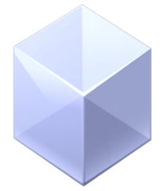

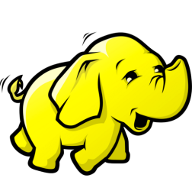

Compute: Designed to Capture New Workloads and BCA
1
Optimized for Next Gen Cloud Applications Growth
2
Increasing BCA Virtualization Share
2016
48M
2016
141M
700%
70%
2012
6M
2012
83M
New Features
New Features
Enhanced application performance
Increased Performance/Scale
vSphere Flash Read Cache
Support for next-generation applications
Hadoop (vSphere Big Data Extensions)
Application aware availability
vSphere App HA
VMware estimates,
Note: Server workloads

Slide 21
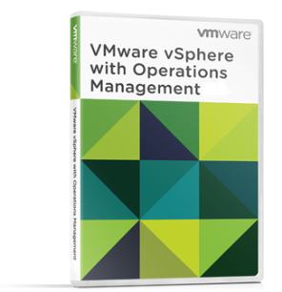
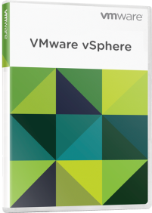
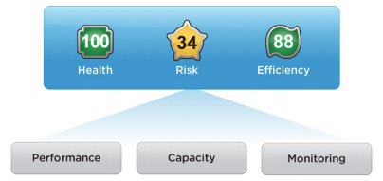



Virtualization with Capacity and Performance Management
vSphere with Operations Management
Reliable, battle-tested virtualization platform
Capacity and performance management
VMware vSphere
The proven compute virtualization platform
Capacity planning – forecast capacity shortfalls
Optimize efficiency – reclaim resources from over-provisioned VMs
Improve performance – identify emerging system issues faster
Proven virtualization platform – provide availability for your business applications
vSphere vCenter Server

Slide 22
vSphere with Operations Management vs. vCenter Server
vSphere with Operations Management
  Collects the metrics from vCenter Server and provides a holistic view and deep insights into the health, risk and efficiency of IT infrastructure
vSphere vCenter Server
vCenter Server
vCenter Server collects real time performance data from virtualized hosts
vCenter Server stores the data in vCenter database and also keeps a historical roll up of data

Slide 23
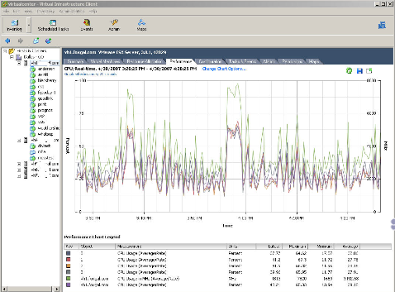
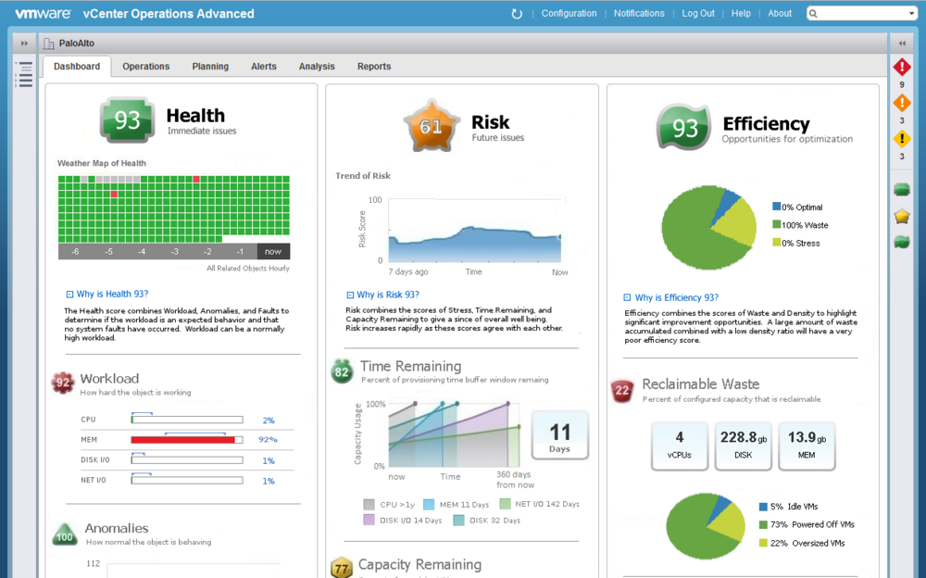
Another View
Immediate Problems
Future Problems
Opportunities to Optimize
vCenter Server
vSphere with Operations Management

Slide 24
The Path to Increased Capacity Savings
Phase 3: Increase Over-Commit or Density Safely
Assess potential density without performance risk
Phase 2: Increase Utilization
Consolidate under-utilized clusters
Right-size oversized VMs
3
Phase 1: Reclaim Waste
Idle VMs
Powered off VMs
2
1
Increasing Capacity Savings

Slide 25
Groundwork for a SINGLE Engineered Suite (with regular release cadence) to be SIMPLE for Customers to Purchase, Deploy and Operate
Software-Defined Data Center
Policy-based Management & Automation
Cloud Automation
Cloud Operations
Cloud Business
Virtualized Infrastructure
Compute
Network
Storage
Physical
Hardware
Compute
Network
Storage

Slide 26

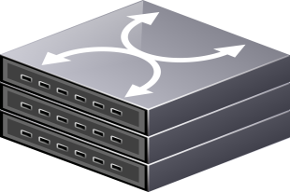
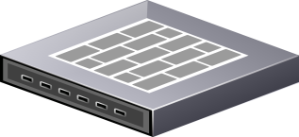
A data center network…
Internet
Existing Physical Network

Slide 27
Compute infrastructure….
Internet
Existing Physical Network

Slide 28
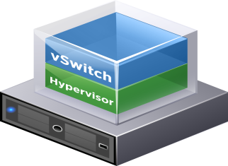
Hypervisors and vSwitches…
Internet
Existing Physical Network

Slide 29

NSX | The “Network Hypervisor”
Internet
Network Hypervisor
Existing Physical Network

Slide 30
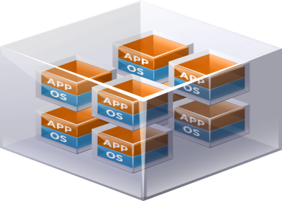

Virtual Networks – Like Virtual Machines for the Network
Virtual Networks
Internet
Network Hypervisor
Existing Physical Network

Slide 31

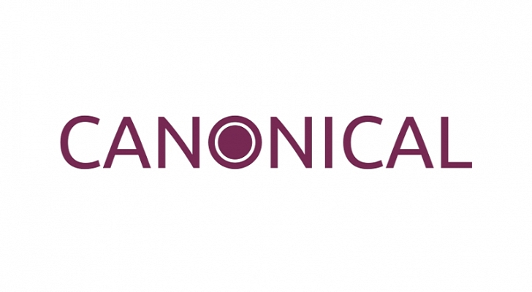
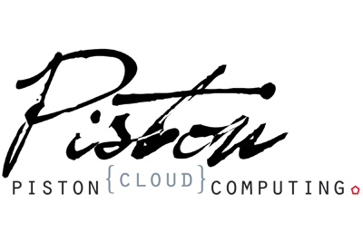
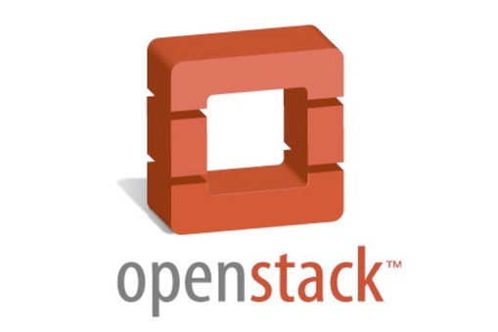
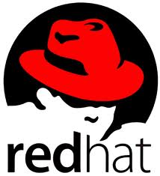

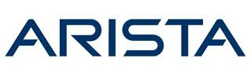
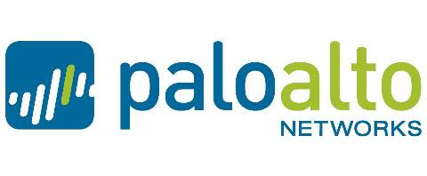
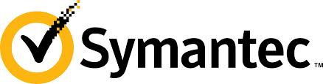
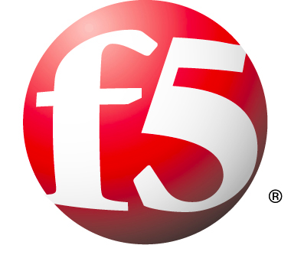

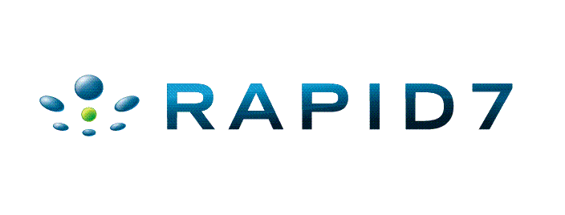

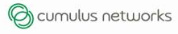
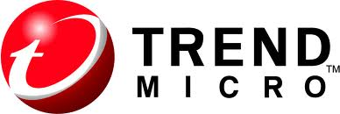
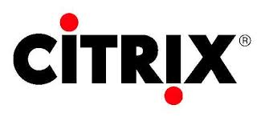
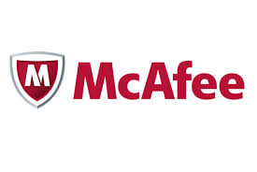
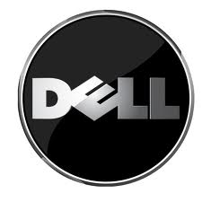
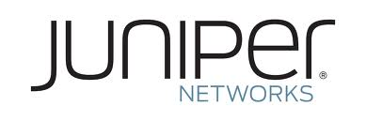

Partner Extensibility – Available in 2013
+
Cloud Mgt.
Platforms
NSX API
NSX Controller
Partner Extensions
L2 Gateways
Firewalls /
NG Firewalls
Security
Services
ADC/LB

Slide 32
Groundwork for a SINGLE Engineered Suite (with regular release cadence) to be SIMPLE for Customers to Purchase, Deploy and Operate
Software-Defined Data Center
Policy-based Management & Automation
Cloud Automation
Cloud Operations
Cloud Business
Virtualized Infrastructure
Compute
Network
Storage
Physical
Hardware
Compute
Network
Storage

Slide 33




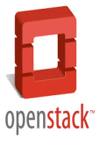

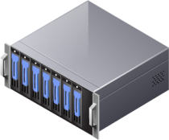


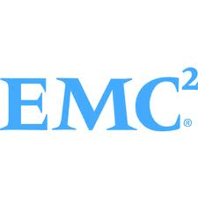


Applications and Storage are Becoming Increasingly Diverse
Traditional Applications
Next Gen Cloud Apps
Traditional enterprise storage
HW-based resiliency, QoS
Scale out, flash, DAS
Application specific storage
Traditional SAN/NAS
All SSD
Array
Server
DAS
Object / BLOB
Virtual Storage Arrays
vSphere
SSD
HDD

Slide 34
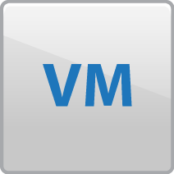


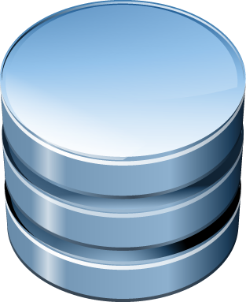




Software-defined Storage
Bringing compute’s operational model to storage
Policy-driven Control Plane
Common policy-based automation and orchestration
Virtual Data Services
Data Protection
VM centric data services
Third-party services integration
Mobility
Performance
LUN
LUN
LUN
LUN
Virtual SAN
Virtual Data Plane
Hypervisor-converged
Storage pool
SAN/NAS Pool
Object Storage Pool
Abstraction and pooling
Infrastructure integration
New storage tiers
LUN
LUN
VVOL
Cloud Object Storage
x86 Servers
SAN / NAS

Slide 35
Groundwork for a SINGLE Engineered Suite (with regular release cadence) to be SIMPLE for Customers to Purchase, Deploy and Operate
Software-Defined Data Center
Policy-based Management & Automation
Cloud Automation
Cloud Operations
Cloud Business
Virtualized Infrastructure
Compute
Network
Storage
Physical
Hardware
Compute
Network
Storage

Slide 36



SDDC Management and Automation:
Investment Areas
Empowering IT to govern services across platforms and providers
Things we’re working on next
Cloud Automation
Continue to extend management and automation for hybrid environments
Reducing mean time to problem identification
New capabilities to support DevOps
Further improving efficiency through resource reclamation
Cloud Operations
Cloud Business

Slide 37

Accelerate Application Delivery
  Streamline the deployment and update process
  Leverage pre-built components
  Re-use application models across environments and clouds
Application Blueprint
Components
Components
Components
Components

Slide 38

Self-Service: Applications, Infrastructure, XaaS, Desktops
Your logo
Portal branding per tenant
App store experience
Service category
Custom Service
Entitlements and Approvals for each item
Extensible to new services

Slide 39

VMware Professional Services
Services Enabling Success

Slide 40
SDDC Operating Model
An Integrated Approach to SDDC Implementations
Platforms
People
Processes
  Refine architecture to position for private, hybrid, and public cloud deployments
  Transformations services that align IT with the service life-cycle in the core areas of Platforms, People and Processes
Skills Assessment
Target State Skills
Role-Based Learning
Organizational Design & Change
Talent Planning
Talent Acquisition
Talent Retention
Strategic Functions
Service Operations
Infrastructure Operations
Relationship Management
Platform Operations
Support Functions

Slide 41

VMware Professional Services
Accelerate Time to Value

Slide 42


















VMware Professional Services
Accelerating Success for Leading Customers

Slide 43
Summary: SDDC Delivers Transformational Benefits
Efficiency
Control
Agility
Choice
Virtualization Economics, Across the Data Center
Business-Aware IT control
Apps at
Business Speed
Your Data Center, Your Terms
Reduce IT capex by 75% and opex by 56%*
Reduce downtime
for tier 1 applications by 36%*
Increase IT productivity by 67%*
Support for over 500 ISV solutions and 80 operating systems
*Taneja Group Research 2014

Slide 44
Thank you.

