Slide 1
Software Defined Storage by Nexenta
Johan van den Boogaart | Regional Manager CEE
October 2014

Slide 2
Market Forces: What’s Happening
Storage Doubles ~ Every 18 Months or Less But … Can IT Budgets Keep Up?
Capacity growth in tbs
62%
CAGR
Storage
2%
CAGR
IT Budget
vs.
Flash
Data Protection and Recoup
Convergence
Cloud-Based Solutions
Open Source
Software-Defined Storage
The Answer: Storage Market Innovation
Source: IDC.

Slide 3
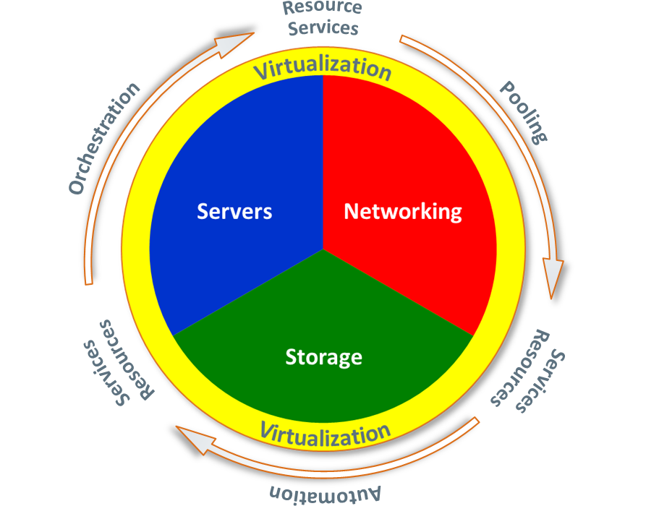
Virtualization is the Driving Force Behind the Adoption of the Modern Data Center
Business Benefits
Optimized IT Enables
Efficient
Agile
Control
Flexibility
Availability
Security
Performance
Density
Cost
Energy
Scalability
Manageability
Cloud
Mobility
Internet of things
Big data
Social media
Infrastructure as a Service
Software Defined Data Center
Virtual, dynamically managed resources and services
Business: IT is now in an app/biz service focused environment

Slide 4
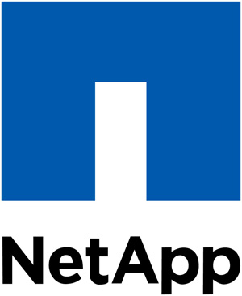
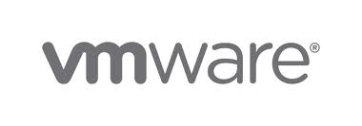
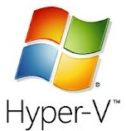
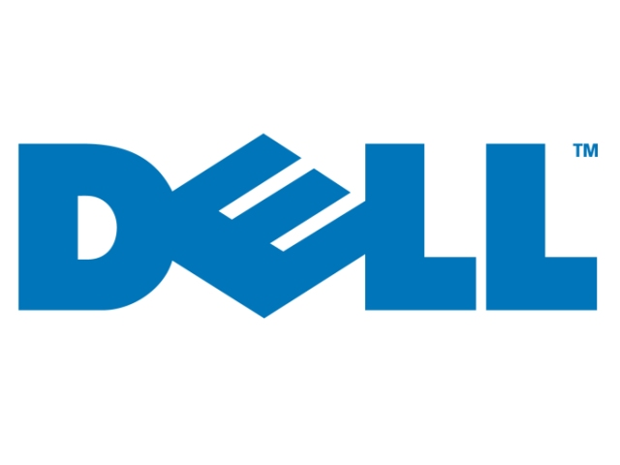
Trend Towards Hardware Commoditization; Software Differentiation
Software-Defined Storage
Storage
Server Virtualization
Server

Slide 5
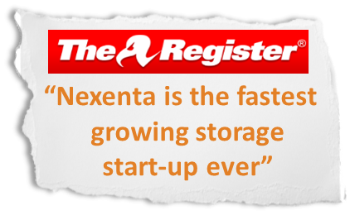
Nexenta Overview
Business Focus
Software-Defined Storage (SDS) Leader
Affordable Enterprise-Class Storage Software
Eliminate hardware vendor lock-in: often the most expensive part of IT
Use Cases
NAS and SAN
Cloud Hosting, Virtualization and VDI
Archival, Backup and Disaster Recovery
History
Sales launch in 2008, 200+ people
8 yrs of R&D w 130+ top class engineers
Unique: unified, hybrid storage; software-only model
Channel-centric go to market
Headquartered in Silicon Valley
Offices in USA, UK, Netherlands, India, China, Russia
Sales
Over 5,000 commercial deployments
72k total downloads (including Free Version)
2,500+ customers and > 1 ExaByte
300+ resellers
Notes:
This is who we are

Slide 6
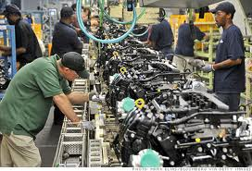
NexentaStor Markets and Use Cases
Government
Education
Hosting and
Cloud Services
Healthcare and
Life Sciences
Financial Management
Media and Entertainment
Technology
Companies
VIRTUALIZATION
CLOUD
STORAGE
VDI
BACKUP AND ARCHIVE
USER HOME DIRECTORIES

Slide 7
Scale Up / Scale Out / Hyper-Converged
Positioning Nexenta products

Slide 8
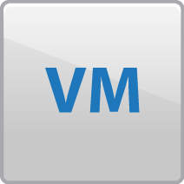
Shared Scale-Up Storage – All Legacy & NexentaStor
VMware vSphere
VMware vSphere
VMware vSphere
File / Block Presentation
…

Slide 9
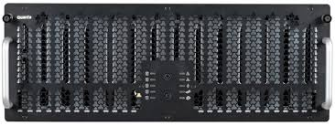
Reference Architecture
Scale up solution
SAS theory doesn't match practice yet
Limited number of SAS devices per HBA
Using SAS switches to simply full SAS back-end fabrics
Less cabling constraints
Nexenta can dynamically expand pools
SAS devices are plugged into the switch
Add SSD (IO) or rotating (capacity) as needed

Slide 10
Building block VDI
Requirements:
1000 desktops
Low latency for VM’s
ca. 20TB Storage
80% writes
Existing desktops will be migrated
persistent Desktops
Boot Storms
Design:
2x Maguay eXpertServer 2U
2x Intel Maguay 1600 24 Disk JBOD’s
40x 1TB Discs mirrored
2x 1TB Discs as Hotspare
2x STEC ZeusRAM as ZIL (write cache)
4x 400GB SSD as L2ARC (read cache)

Slide 11
Building Block Backup
Requirements:
Replacement of existing VTL’s
NFS mount
ca. 550TB storage
2GByte/s writes data throughput
128k blocksize
100% sequentiel
Design:
Maguay eXpertServer 2U
4x 60 bay dual I/O JBOOD SAS
260 3TB Disks RAID-Z2 8+2
4 3TB Disks as Coldspare

Slide 12
Building Block VMware
Requirements:
NFS mount
ca. 350TB storage
Cost per TB are very important
500 VM’s with different load
Design:
2x Maguay eXpertServer 2U
3x 60 bay dual I/O JBOOD SAS 60 Disk JBOD’s
168 3TB Disks RAID-Z2 4+2
4 3TB Disks als Hotspare
4 STEC ZeusRAM als ZIL (Schreibcache)
4 400GB SSD als L2ARC (Lesecache)

Slide 13
IDC Perspective on Unified Scale-Up & Object Segments
Unified Scale-Up
Block and File
Scale-Out Object
Block and File
Active market disruption, with shift to SDS, scale-out and cloud
Foundation for next generation hyper-scale infrastructure and apps
2013 Market Size $12 Billion
2013 Shipped Capacity 10.1 EB
2017 Market Size $11 Billion*
2017 Shipped Capacity 27.5 EB*
2012-2017 Rev CAGR - 2%
2012-2017 Capacity CAGR 28.9%
2013 Market Size $8.4 Billion
2013 Shipped Capacity 22.7 EB
2017 Market Size $21.7 Billion*
2017 Shipped Capacity 117.3 EB*
2012-2017 Rev CAGR 27.2%
2012-2017 Capacity CAGR 55.3%
Source: IDC #242287 Worldwide File and Object based Storage 2013-2017 Forecast

Slide 14
Shared Nothing Scale Out Storage – Isilon / NexentaEdge
VMware vSphere
VMware vSphere
VMware vSphere
File / Block Presentation

Slide 15
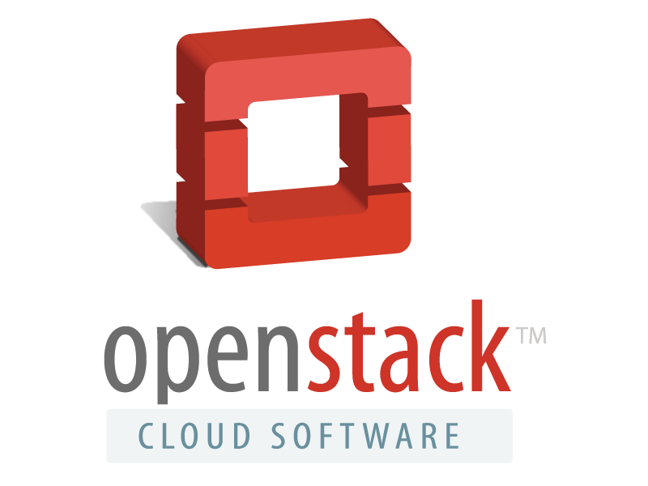
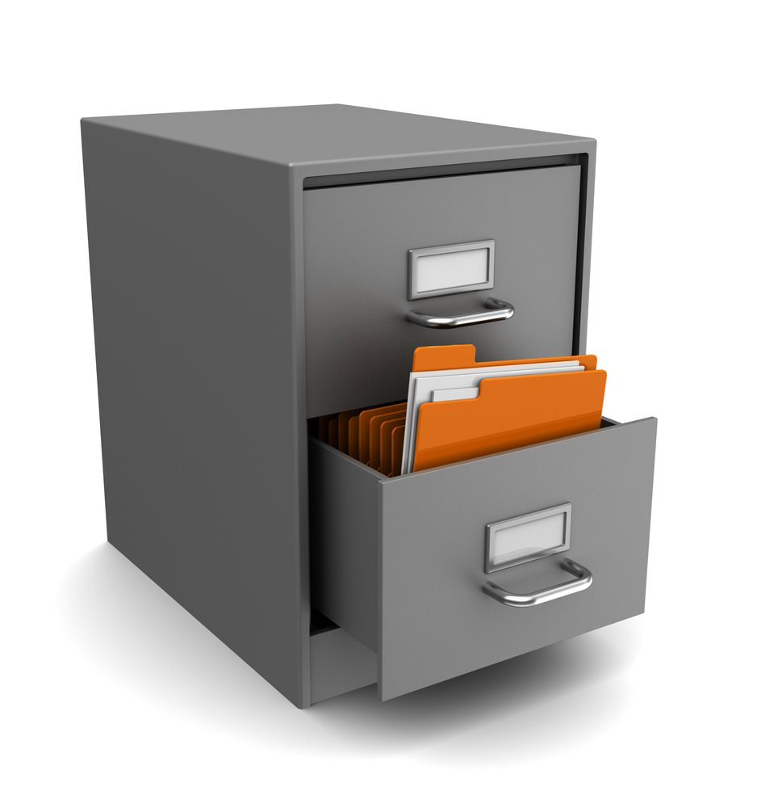
Software Solutions to Your Storage Challenges
NexentaEdge
Block, Object & File
…
…
…
…
…
High Performance Block, Object (S3 and Swift) and File Storage
Ground up design delivering global inline deduplication,
Real time dynamic load balancing and no single point of failure
on scale out cluster of low cost industry standard hardware

Slide 16
Why Object?
Why Object? Because it’s too hard to do File Systems at very large scale
ZFS is great with unlimited namespace (file system size)
But it’s ‘unlimited’ to a point…
NetApp has a hard limit at 16TB
So does VNX
The hard part is ‘consistency’ during shared access – shared & consistent => locking
Locking slows things down
Distributed locking (required if you’re going scale out) slows things down even more
Object isn’t a file system and pushes the ‘consistency management’ problem to the application
And that’s OK!!
While the database that keeps track of your money at your favorite bank has to be highly consistent, most new app designed for cloud and mobile don’t.

Slide 17
Object, Locking and Files
NexentaEdge is an Object stores
It support Block access
It will support File access
But it will NEVER do file as well as NexentaStor
That’s a technical fact
But that doesn’t mean that customers will always want file done as well as NexentaStor
Future applications and use cases might be satisfied with the “eventually consistent” NexentaEdge
NexentaEdge is unlikely to do small IO (typical of databases and VM backends) as well as NexentaStor
But on the other hand
NexentaEdge is designed to scale to 10’s of petabytes
NexentaEdge can run on extremely low cost hardware
And still provide very good Block and Object (and eventually file) performance
That’s how EMC sells VNX (scale up Block and File – good at small IO) and Isilon (Scale Out Block and File – good at large IO and streaming)

Slide 18
Bringing It All Together
 | Block | Block & File | Unified Block & File
Scale-Up | EMC VMAX HDS VSP IBM DS8000 IBM XIV HP 3PAR Dell Compellent Pure Storage AFA Nimble (iSCSI) | EMC VNX HDS HUS | NetApp FAS NexentaStor Tegile Windows Storage Server
Scale-Out | Dell Equalogic (iSCSI) HP Lefthand (iSCSI) |  | EMC Isilon

Slide 19
HyperConverged Storage – Nutanix / Simplivity / VMware Virtual SAN
Storage Presentation (One Pool)
VMware vSphere
VMware vSphere
VMware vSphere

Slide 20
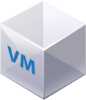
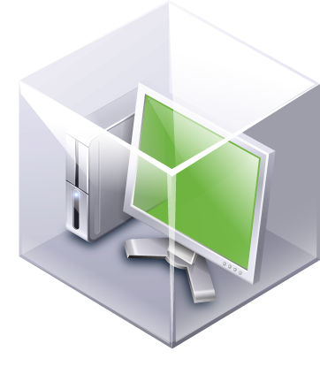
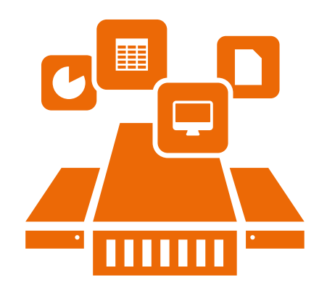
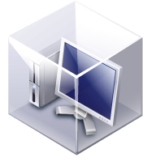
NexentaConnect for VMware Virtual SAN
Full Featured File Services
for Virtual SAN
Features
Easily provision file services (NFSv3, NFSv4, SMB)
Managed through vCenter Web Client
Capacity saving using inline compression and de-duplication
AD / LDAP / Kerberos authentication
Benefits & Use Cases
Scalable and highly available
Seamless integration with vSphere
Fulfills the software based hyper-converged model
Integrated VDI pods
SMB & NFS
NFS & SMB
Virtual SAN Datastore

Slide 21
Product Positioning
Today
Tomorrow
EMC VMAX
NStor
All Flash
Performance
NexentaStor
Performance
NexentaStor
NetApp
NexentaEdge
EMC Isilon
Capacity
10PB
Capacity
100PB

Slide 22
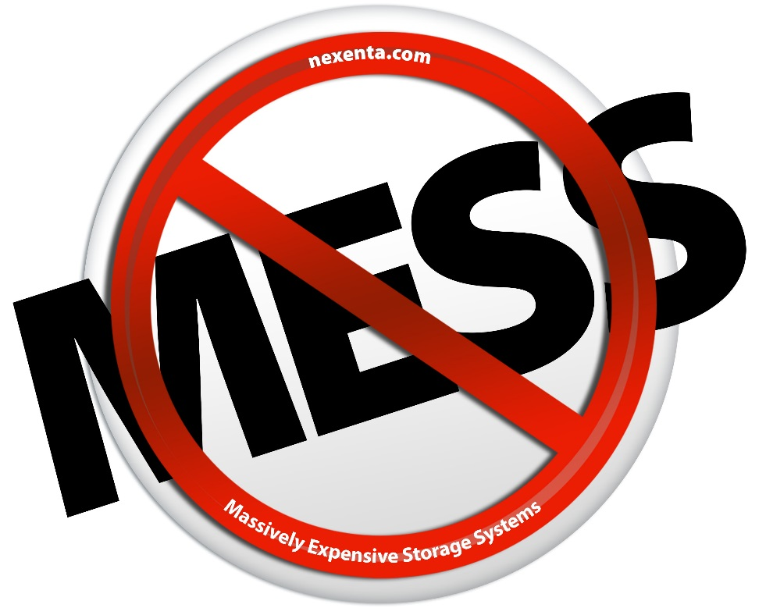
Freedom From Massively Expensive Storage Systems
100% software defined storage
Total freedom, ultimate flexibility, agility and speed to market
Fundamentally changing storage market economics

Slide 23
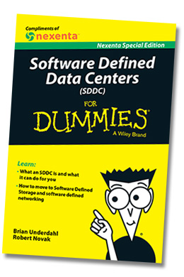
Software Defined Data Centers for Dummies
Download your free copy:
http://www.nexenta.com/sddcfordummies

Slide 24
thank you!

