Slide 1
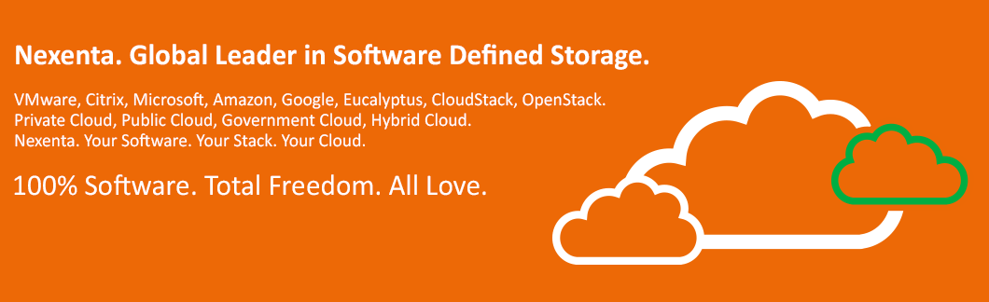


Dell. Global Leader in Storage.
Fastest growing storage provider worldwide in 2014 according to IDC.

Slide 2

Speaker
Christian Browers
Regional Sales Manager Central and Eastern Europe
Christian.Browers@nexenta.com
Mobil: +49 160 97 3063 98

Slide 3
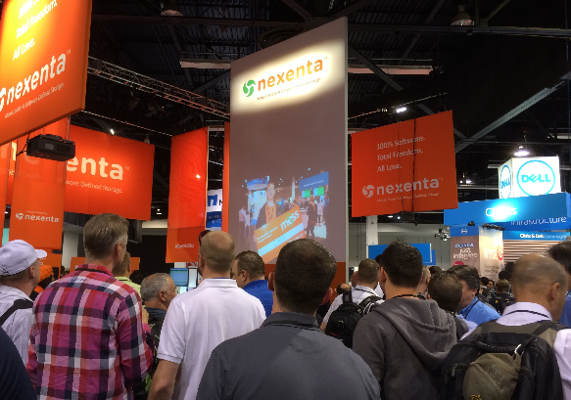

Nexenta is #1 in Open Software Defined Storage (OpenSDS)
#1 SDS player; founded in 2008; 200+ employees; HQs in Santa Clara.
#1 w 6,000+ total customers, 1,000+ partners, and 1,1EB+ in production.
#1 in open “only-software”; 10 years of R&D; w 130+ FTEs; 40 patents.
#1 in partner eco-system for any HDD, SSD, Server, Platform, App/workload, Protocol.
#1 Open Source Community w 46,000+ downloads and membership.
#1 in unified block, file and object access support vision.
#1 in WW service/support at enterprise level in OpenSDx-based OpenSDS
#1 in HW, SW, cloud platform certification/delivery process
#1 in flexible SW pricing model – w no HW, SW, and GM dependency
#1 in File System control/innovation (ZFS and CCOW)
#1 in integration for VMware, Citrix, MSFT, OpenStack, CloudStack, etc.
#1 in app-centric vision – orchestration and predictive rules engine
#1 in repeat business with F500-class enterprise customers in the segment

Slide 4
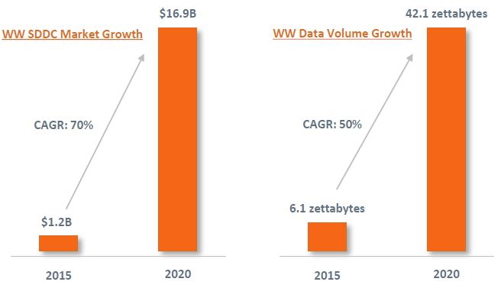
Top Trends – Nexenta OpenSDx Vision via OpenSDS Platform
Mega IT Trends –2015 -2020
Social media meet social commerce via rich media
Mobility and IoT–devices, apps and management
Big Data with global security, privacy and data governance
Hybrid Cloud –public, private, and personal
Cloud via Software Defined Everything (SDx) and Open Source at Web Scale/WOAs on commodity hardware: DC to EUC; Infrastructure to Apps –OpenSDx
Open Source-driven SDS (OpenSDS) –The Latest Frontier
Explosive Data Growth: OpenSDx driven by OpenSDS
Faster time to market and simplicity
Flexibility and interoperability
Improved risk management
Lower TCO –OPEX and CAPEX

Slide 5
Enabling the Software-Defined Data Center
Nexenta’s Leading Open Source-Based Enterprise-Class Storage Platform
SCALES with Data Center Workloads of the Future
RUNS on an Extensive List of Nexenta Certified Standard Server Hardware
BRIDGES Evolution of Your Business to the Software Defined Data Center
Software Defined Data Center
Data Center Fabric
COMPUTE
STORAGE
NETWORKING
Software-Defined Compute
(Hardware Virtualization)
Software-Defined
Storage
Software-Defined
Networking
Evolution of the Data Center

Slide 6







Why truly Software-Defined is better
Software-Based Storage
Software-Defined Storage
Stack / Protocol Specific Vendors
Various Object-centric
SDS Vendors
Software-Based is about closed technology bundles
  Software integrated with with standard x86 hardware – typically high priced systems
  Same hardware can be acquired off the shelf
  Hardware Lock-in
Software-Defined is about an open business model with lower TCO
  Software on standard x86 hardware and HDD/SSDs
  Open source collaboration, innovation and flexibility
  Flexibility on platform reduces costs by over 50%

Slide 7
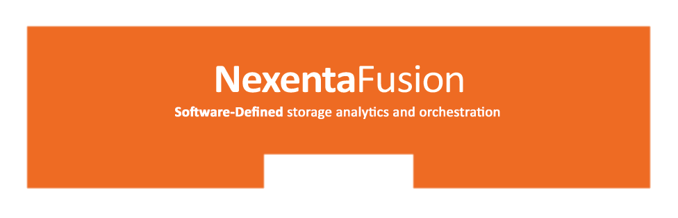

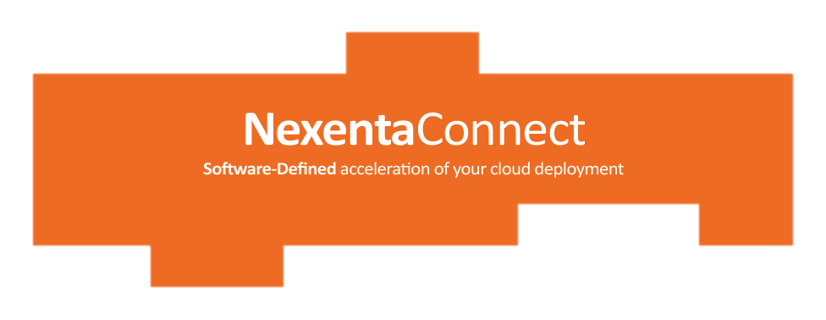

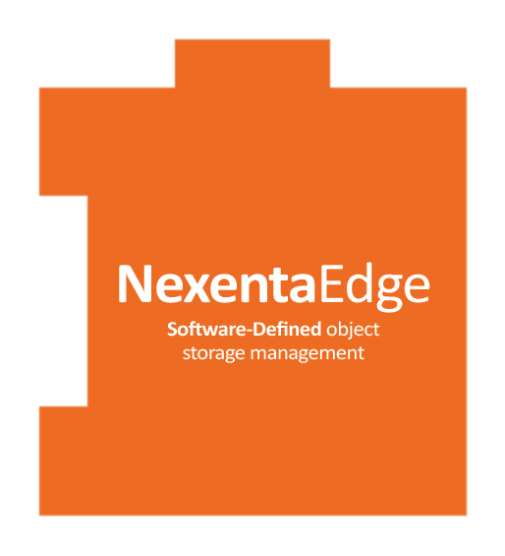

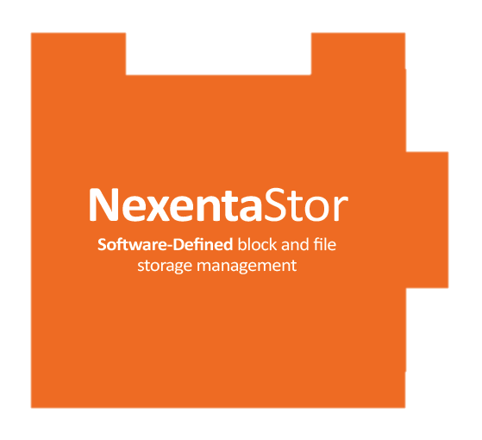

Comprehensive Software Defined Storage Portfolio
Unified analytics and orchestration
Single pane of glass for entire storage infrastructure
*
*
Storage Services for virtualized infrastructure
VMware Virtual SAN, Horizon and Citrix XenDesktop
Scale-up , block and file
Unified Storage
Enterprise Apps
Cloud backend and unstructured data repositories
Scale-out object, block and file storage
OpenStack Swift
Amazon S3
Next Gen Cloud &
Big Data Apps
*
*
*
Future

Slide 8
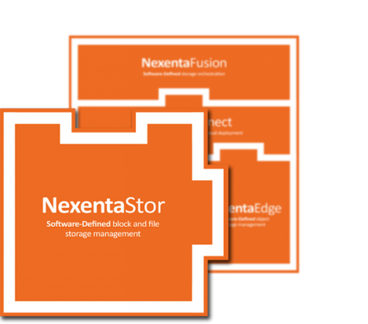
NexentaStor
NO more massively expensive storage systems

Slide 9
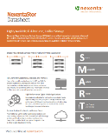
NexentaStor
Scale-Up High Performance Unified Block & File
Unified Storage Services
  File: 10GbE, NFSv3, NFS v4, CIFS, SMB2 (SMB3 in 2H15)
  Block: 16Gbps FC, 10GbE iSCSI (40GbE in 2H15)
  All SSD, all HDD, or any hybrid combination
High Availability & Disaster Recovery
  2 node active / active cluster / MetroHA
  Periodic async replication over any distance
Data Protection
  ZFS powered end-to-end data integrity with block level check summing
  Software based RAID 1, RAID N+1, RAID N+2, and RAID N+3
  All RAID operations performed on allocated blocks for faster recovery
Beats:
NetApp FAS
Mid-size Isilon <3PB
Performance & Capacity Optimization
  Thin provisioning
  Up to 1TB dynamic read cache per head
  High performance inline data reduction
  Support fast 12Gbps SAS and 16Gbps FC (40GbE in 1H2015)
Scale
  From 10’s of TBs to Multiple PB
  Unlimited file system size
  Unlimited space optimized snapshots and clones

Slide 10
Built on Open Technologies and Communities
Started with OpenSolaris and ZFS
    Strong ties to original ZFS development team
    Evolved to Illumos and ZFS+ (reliability/performance/scalability)
NexentaStor Community Edition
    free, non-commercial, single-node, for capacities up to 18TB
    Strong community of users and thought leaders
NexentaStor Enterprise Edition
    Capacity-based perpetual licensing
    Must license for total Raw capacity
3rd party extensions for Enterprise & Community editions
Chef & Puppet integration
Graphite analytics

Slide 11
ZFS
Pooled storage - automatic and intelligent use of DRAM, SSD, and HDD
    File system + volume manager + RAID built together
Highly Scalable Capacity
    128-bit addressing scheme and can store 256 quadrillion zettabytes
Native Compression
    lz4, gzip, zle, lzjb
    Compression ratio: 20+%
Unmatched Data Integrity
    Always consistent on disk - Copy on Write, no journaling
    Data checksummed at every point
    Detects and corrects silent data corruption
Simple and efficient snapshots, clones, and replication
Simple and fast initialization and resilvering - increasingly important with growing HDD sizes
Uber Block
ABCD
EFGH
Checksum
Checksum
AB
CD
EF
GH
Checksum
Checksum
Checksum
Checksum
A
B
C
D
E
F
G
H
Notes:
NexentaStor is based on the 128 bit ZFS file system. One of the significant features of this filesystem is the data integrity. We use what’s called Copy-on-Write for all of our updates to disk.
A traditional system does a read/update/modify/write and rewrites the same space on the disk. We never rewrite to the same space on the disk, we read/modify or update and then write to a new space on the disk. This provides us the ability to take a snapshot without any overhead because all we’re really doing is setting the trigger on the filesystem which says “when you do your garbage collection - do not delete this set of data”. The other thing that this does is it provides a facility so that there is no need for journaling or the traditional FSCK command. As filesystems have gotten to be hundreds of terabytes to petabytes an FSCK itself can take hours to complete after a system outage.
As you can see in the diagram, the way this works is - as data gets written to the discs, they are grouped into what’s called a transaction group. Each one of those little bits of data gets a 256 bit SHA checksum generated against it. Those bits are then grouped together into a parent transaction group which also gets the 256 bit checksum created against it and then those are collapsed again and again until at such a point we get to a single Uber block which we then update. What this does is it ensures that the data we received is the data that we wrote and that it will be the data that you read when you make a request for it on the discs. The other thing that this adds is that this operation is a called an atomic operation, so if this occurs, once the write has officially occurred it is guaranteed to be written to the disk. If at any time during the buildout of this merkle tree, the power is lost to the system or access is lost to the drives, the system will show that the write was a failure because the Uber block didn’t get written. When that failure occurs we will then send a request back to the underlying application asking for the data to be resent. So we are in a constant state of checksumming every bit and block that goes on to the discs and we also have a cleanup routine that continually goes and scrubs the discs for any potential silent data corruption or bit rot.
Another interesting thing is the way that we do our Raid sets. We have Raid z1, z2, and z3 and one of the nice features of this is as today’s discs have gotten larger such as the 4TB drives the resilvering process can take multiple days to complete so in our Raid environment when a disk fails and we have a need to replace it we only resilver what has actually been written to the disk. In a traditional system you resilver every block on the disk regardless of whether it contains data. So using our system, we are able to speed up the resilvering process since we only care about the actual real data that has been written to the disk.

Slide 12
CERN Study
Disk Errors: CERN wrote a special 2 GB file to more than 3,000 nodes every 2 hours and read it back checking for errors for 5 weeks
    500 errors on 100 nodes
RAID Errors: CERN ran the verify command on 492 RAID systems each week for 4 weeks. The disks are spec’d at a Bit Error Rate of 10^14 read/write
    In reading/writing 2.4 PB of data there were some 300 errors
Memory Errors:
    Good news: only 3 double-bit errors in 3 months on 1,300 nodes
    Bad news: according to the spec there shouldn’t have been any
    Only double bit errors can’t be corrected

Slide 13
CERN Study: Results
Checking 8.7 TB of user data for corruption – 33,700 files – 22 files corrupted
CERN concludes that taking measures to improve accuracy
  . . . will lead to a doubling of the original required I/O performance on the disk servers and an increase of the available CPU capacity on the disk servers (50%?!)

Slide 14
ZFS advantage - End to end checksumming
256 bit checksum
Checksum stored in parent block pointer
Fault isolation between data and checksum
Entire pool (block tree) is self-validating
 | Disk block chks | ZFS chks trees
Bit rot | ✓ | ✓
Phantom writes | ✗ | ✓
Misdirected R/W | ✗ | ✓
DMA Parity errors | ✗ | ✓
Driver bugs | ✗ | ✓
Accidental overwrites | ✗ | ✓

Slide 15
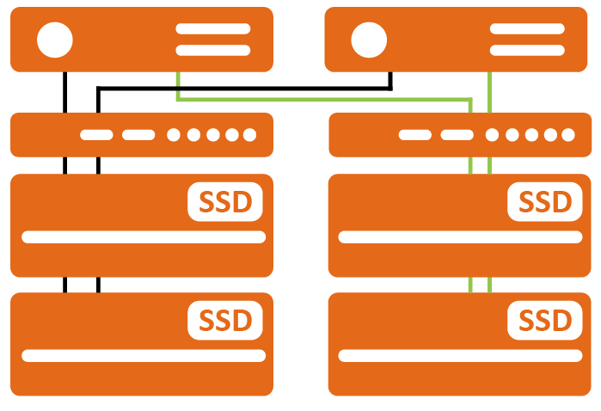
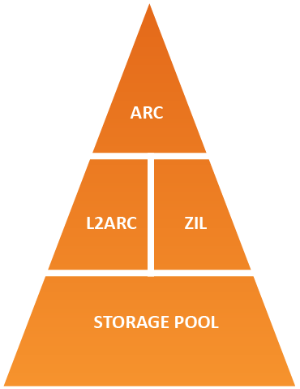
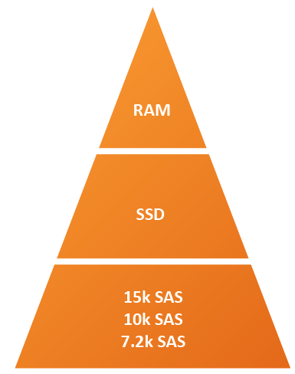
Hybrid Storage Pool
Up to 50km
DataCenter A
DataCenter B
Controller
Best possible value:
/ €
FibreBridge
< 0,025 € / IO
JBODs
/ €
< 0,08 € / GB
Benefits
Write cache for sync IO mirrored in JBODs
No need for cache mirroring between controller
Full performance in case of controller failure
Tiered Storage Management
Hybrid Storage Pool
ARC – Adaptive Replacement Cache
L2ARC – Level Two Adaptive Replacement
ZIL – ZFS Intent Log

Slide 16
Hybrid Storage Pool
Accelerate storage with SSD
  Self learning Level two Adaptive Replacement Cache (L2ARC)
  Write Cache: ZIL – ZFS Intent Log
  Intelligent prefetching algorithms
  Only unified storage vendor that allows RAM expansion
Decouple capacity and performance scaling
  read: RAM and SSD
  write: RAM and SSD
  capacity: NL-SAS, SAS, SSD
Ideally for virtual server and desktop environments
  Add write optimized low latency log devices
  Synchronous writes are typically NFS and iSCSI
  Add write performance as needed by extending the number of log devices

Slide 17
ZIL / SLOG devices
Used to satisfy synchronous write operations
Exists in every pool when needed but can be sped up using Separate Log Device (SLOG)
Consider bypassing the SLOG(s) for high-throughput synchronous applications
ARC
ZIL
Storage Pool

Slide 18





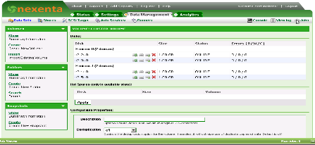

Common Deployment Scenarios
Local unified storage
  NAS and SAN
High Availability cluster
  Two head nodes
  Shared storage
  Write cache coherency
  No single point of failure
Disaster recovery with replication
  Auto-sync to remote data center
Powerful UI with real-time display
All HDD, Hybrid and All SSD configurations
Site A
Site B
2 way replication
Scheduled
Backup
Scheduled
Backup
Backup Target Array

Slide 19
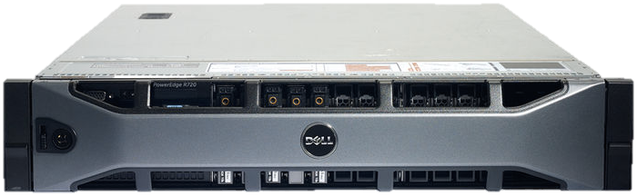


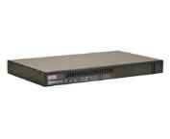
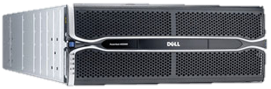
Metro HA
NexentaStor 4.0.3 or later
2x or 4x ATTO FibreBridge 6500
  SAS 7k,10k or 15k disks
Better performance by ZFS design
No mirrored cache
R720
SAN
ATTO FibreBridge
MD3060e

Slide 20




Why Nexenta Store?
Highly scalable, unified storage solution
    Tunable for different workloads
6,000+ customer deployments
    Over 1,1 EB under management
    Firm footprint in many of the worlds leading Telco’s,
    Cloud Hosting Providers, Financial Institutions, and Governmental Agencies
Best “software-only” solution enabling SDS
    8 years of R&D
    130+ top class engineers
    35+ patents
    Numerous awards
Enterprise class service and support
    Dell ProSupport integrated

Slide 21

















Nexenta Customers
Korea
Telecom

Slide 22




Few of the Top Deals & How we Won
GMO Internet Group
  Vertical: Cloud/Hosting
  Capacity: 0.5PB (going to 7PB)
  Workload: Internet hosting service on OpenStack
  Competition: Oracle, Supermicro
  How we won: Lowest cost/GB plus Dell support on end-to-end solution.
Standard Chartered
  Vertical: Financial Services
  Capacity: 1.2PB
  Workload: Email Archive
  Competition: HP, EMC
  How/Why we won: Flexibility and scalability, plus competitive price point of the total solution.
Penn State University
  Vertical: Higher Education
  Capacity: 5PB
  Workload: Private Cloud and HPC
  Competition: EMC
  How/Why we won: Impressed with high performance levels achieved with a storage product so easy to deploy.
National Institute of Health
Vertical: Research Institutions
  Capacity: 1PB
  Workload: Tier 2/3 Storage
  Competition: EMC Isilon
  How/Why we won: Price to performance was impossible to beat.

Slide 23
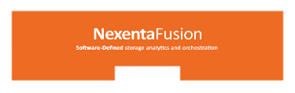
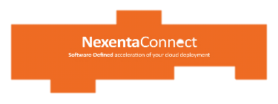
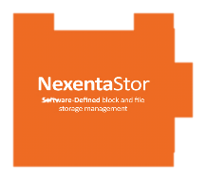
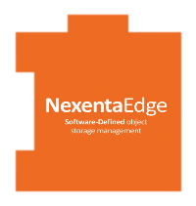
Thank you

