Slide 1
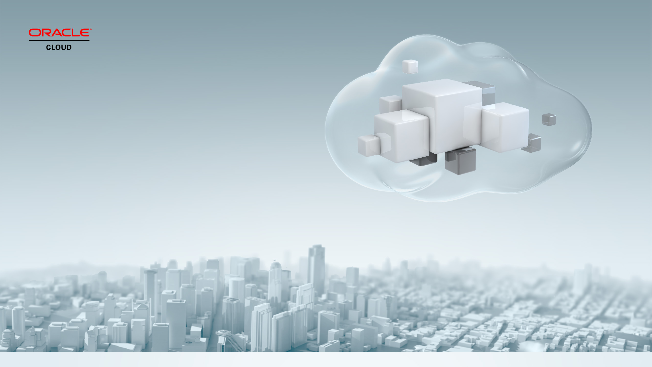
Disaster Recovery: The Hybrid Cloud
Costin Jiurjiu
NO time for DOWNTIME
1st of October 2015

Slide 2
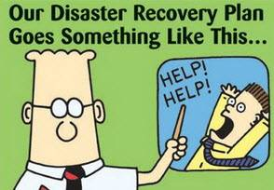
Why You Need Disaster Recovery Plan ?
Business Continuity
Avoid Single Point of Failure
Prevent Data Loss
Reduce Downtime Cost & Revenue Impact for Planned & Unplanned Outages
Disaster and Data Protection for Compliance & Regulatory Purposes
Notes:
Single points of failure in an I.T. environment can result in serious consequences business critical applications. They are analogous to walking a tight rope with no safety net, one mistake and you are out of business.
The purpose of a high availability architecture is to eliminate vulnerability to single points of failure so that applications and data remain available when an outage occurs, whether due to human error, software bugs, hardware faults, or even catastrophic events that can cause an entire data center to fail.
There are a number of challenges when implementing HA. It can’t be done in a vacuum – it needs to be cost effective, practical to manage, and provide high return on investment. It also needs to be comprehensive, addressing both unexpected outages and planned downtime to the extent required to meet service level expectations.
Customer’s don’t like to talk about cases where their HA architecture falls short but we have all heard of various reports – the ecommerce site that is no longer accepting orders or the online banking systems unable to process transactions or provide account balances – lets review three actual examples, the first two reported in the trade press and the third a service request that let to Oracle publishing an alert for other customers.

Slide 3

Typical Challenges with Disaster Recovery Deployment
Complexity in deployment and management
It takes time for planning & deployment of DR
Cost associated with CAPEX / OPEX for maintaining another data center and standby
Keeping up DR site’s resources with production
On-demand elasticity after failover / switchover
Return on investment challenges
Lack of data protection when deploying storage replications based DR

Slide 4





Cloud Deployment Models: Private, Public, Hybrid
HYBRID
PUBLIC
CLOUD
ON-PREMISE
PRIVATE CLOUD
Public Cloud:
Multi Tenant
Short time to Benefit
Perceived as lower cost
Don’t own /manage infrastructure
Private Cloud:
Single Tenant
Complete control
Secured by customer, Data Local
Virtualized for efficiency and low cost
Notes:
Customers have realized they are no longer bound to an on-premise IT infrastructure and are looking to cloud technologies to lower costs, increase flexibility and generally get out of the low-value work of maintaining infrastructure in order to concentrate on the operational & business needs of their agencies.
[Click] Virtualization technology brought “private clouds” into the picture, which increased the efficiency of the data center and allowed for HW consolidation, reducing costs. Since these clouds are still on premise (or in a DC specifically for the agency), there is little/no chance of data commingling or spillover to other users and agencies have complete say over the security controls that they implement, as well as when & how to upgrade or patch systems.
[Click] Some agencies did not want to own infrastructure, however. They also believed that a commercial provider with hundreds or thousands of clients could drive down costs significantly (may or may not be true as we will see). The advantages are on the slide.
[Click] Oracle thinks governments will eventually use all these models for different parts of their infrastructure and may want to move applications between clouds. To Oracle, cloud is a deployment choice—not a mystical solution to all customer problems—but we want to give customers complete flexibility.

Slide 5
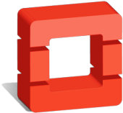
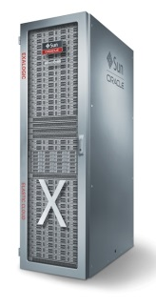

Oracle Cloud Strategy
Complete Solution, Complete Choice
DEPLOY ANYWHERE
Public Cloud
OpenStack
Private Cloud
Same Architecture
Same Standards
Same Products
DaaS
SaaS
PaaS
IaaS
PaaS
IaaS
Transparent workload portability across Public & Private cloud

Slide 6
Comprehensive Portfolio of Cloud Platform Services
Mobile
Cloud
Documents
Cloud
Business
Intelligence Cloud
Application
Performance Monitoring Cloud
Social Cloud
Process Cloud
Internet
of Things Cloud
Big Data
Discovery Cloud
ENTERPRISE
MANAGEMENT
Integration Cloud
MOBILE
CONTENT AND
COLLABORATION
BUSINESS
ANALYTICS
Documents
Cloud
IT
Analytics
Cloud
Log
Analytics
Cloud
Internet of
Things Cloud
Sites
Cloud
Sites
Cloud
Big Data
Preparation
Cloud
Big Data Cloud
Java
Cloud
Integration Cloud
Big Data
SQL Cloud
Exadata
Cloud
Developer Cloud
Mobile
Cloud
ORACLE CLOUD
PLATFORM
Data
Management
APPLICATION
DEVELOPMENT
Internet
of Things Cloud
SOA
Cloud
Big Data
Preparation Cloud
INTEGRATION
Database
Cloud
Application
Builder
Cloud
Node
Cloud
Database Backup
Cloud
NoSQL
Database
Cloud
GoldenGate Cloud
Notes:
Takeaway:
Wow! Oracle has a lot of Platform services
This is great! I don’t have to buy all the services together. I have the option to buy based on my priority and seamlessly expand with additional services as my needs grow
Everything fits together perfectly and the whole is > sum of the parts

Slide 7

“Database is our largest software business and Database will be our largest cloud service business.”
Larry Ellison, CTO, Oracle
Q1 2015 Earnings Call on 9/18/2014

Slide 8


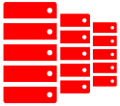





Oracle Database Cloud Common Use Cases
Giving businesses a competitive advantage
1
2
3
4
5
Disaster Recovery
in OPC
Extend
Existing Capability
to OPC
Move
Dev/Test
to OPC
Extend
New Capability
in OPC
Innovate
in OPC
(achieve Revolutionary Agility)
OPC
OPC
OPC
Ex: Create new app in OPC, deploy to On-Prem
Ex: Quickly create/
deploy new mobile app
Or leverage BICS
Ex: Rapidly test/deploy
Adv. Analytics w/ Big Data
Ex: Migrate DR to OPC
Ex: Implement a Hybrid Cloud
Lower IT Cost
Increased Business Value
(increased agility, faster time-to-market)

Slide 9

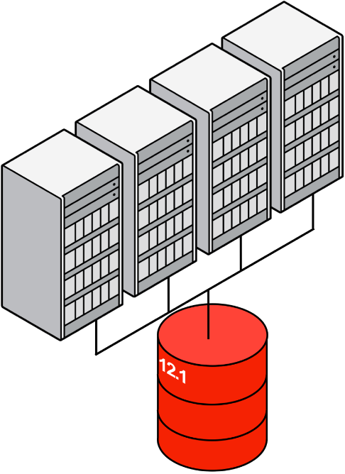


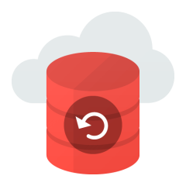


Oracle Maximum Availability Architecture (MAA)
On-Prem, Public Cloud, Hybrid Cloud
Production Site
Enterprise Manager Cloud Control
Site Guard, Coordinated Site Failover
Application Continuity
Application HA
Global Data Services
Service Failover / Load Balancing
Active Replica
RAC
Scalability
Server HA
Active Data Guard
Data Protection, DR
Query Offload
ASM
Local storage protection
GoldenGate
Active-active replication
Heterogeneous
Flashback
Human error correction
RMAN, Oracle Secure Backup,
Zero Data Loss Recovery Appliance
Backup to disk, tape, or to cloud
Oracle Database Backup Service
Backup to cloud
Notes:
Describe what MAA is – a Best Practices Blueprint and Integrated HA Architecture

Slide 10



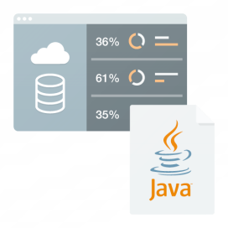

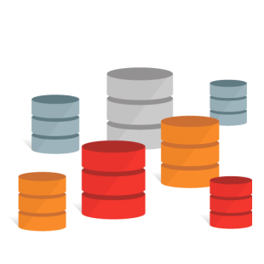




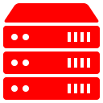

DR to Cloud – Added Value
Reporting
Oracle Public Cloud
Active Data Guard
(Encrypted)
Sandbox Test/Dev in the cloud
Firewall
Active Data Guard
(Encrypted)
Database Cloud Service
Database
Backup
Service
Clients
Applications
Databases
On-Premises (Production)
Standby Database(s) on Oracle Public Cloud

Slide 11
Oracle Database Cloud Services - Offerings
Database as a Service
Full Database Instance Service
Virtual Image
VM + DB + Disk Image
Database Cloud Service
VM + DB + Full Provisioning
Similar to Azure image or AMI
Full distribution extracted on disk
Same as on premise hosts
Customer manages their database
Backup/recovery automation
Patching and upgrade automation
Data Guard setup
Monitoring & management portals
Local management console
  Oracle Linux 6.4
  On-demand storage & compute
Choice of editions SE1, EE and Database 12c 12.1.0.2, and 11g 11.2.0.4
Bundles: EE High Performance (most options), EE Extreme Perf (all options)
Full network, VM and OS isolation, Full SQL*Net access
Self-managed with SSH access into VM with root privilege

Slide 12

Oracle Database Cloud Service Infrastructure
General Purpose
Engineered Systems*
Test, Development, Departmental Applications
Compute Shapes - by OCPU, Standard or High RAM
Block Storage – by the GB
Up to 2TB database
Mission Critical, Intensive OLTP and Decision Support
¼, ½ and Full Rack Shapes
Fixed Storage and Memory by Shape
Up to 168TB database

Slide 13


Oracle Database Cloud Service – Compute Shapes
OCPU
Standard Memory (GB)
High Memory (GB)
1
7.5
15
2
15
30
4
30
60
8
60
120
16
120
240
OCPU = Oracle Compute Unit. An OCPU provides equivalent CPU capacity of a 3.0 GHz Intel Xeon processor w/ hyper threading enabled.

Slide 14

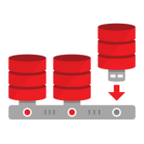
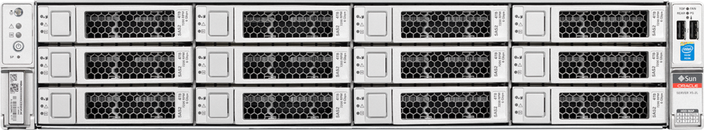
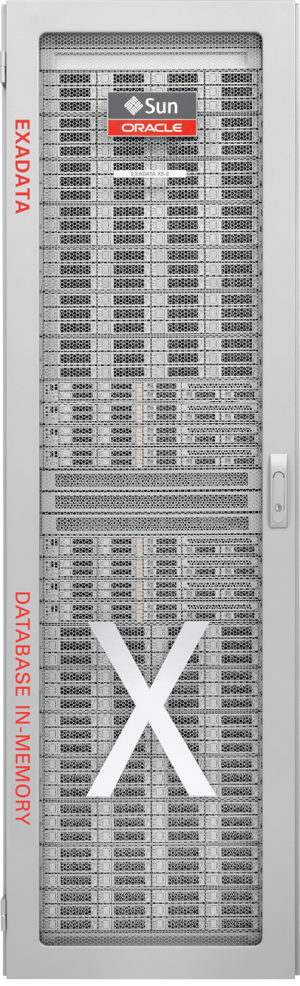
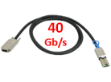

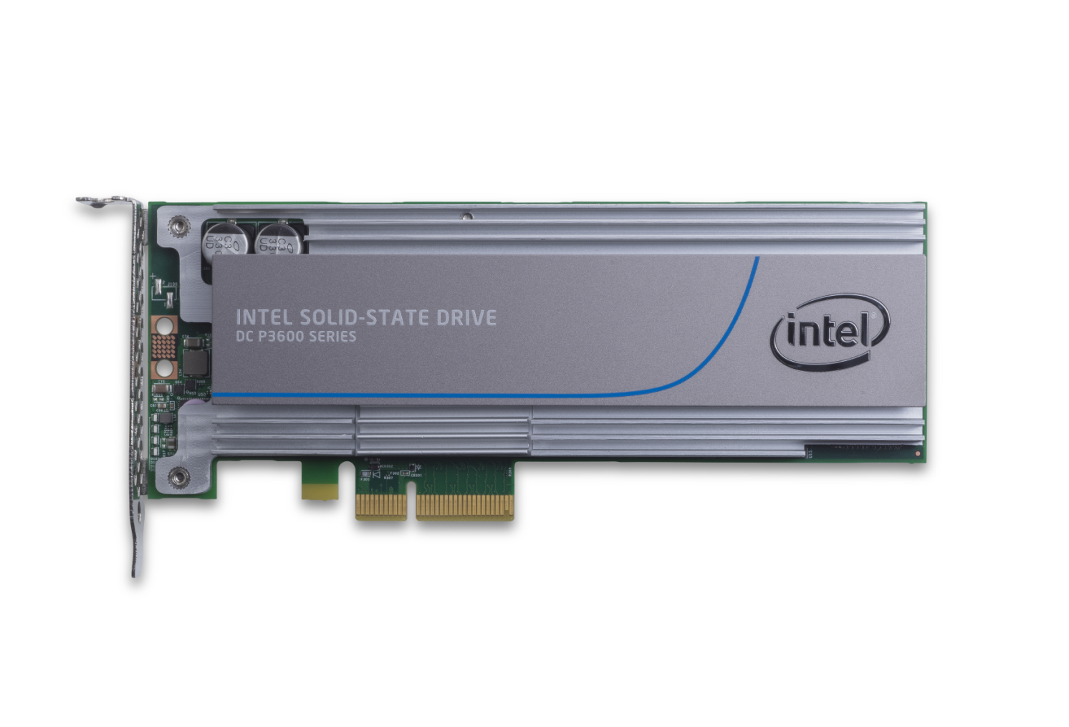




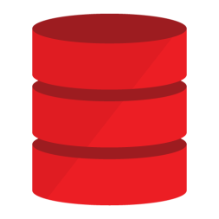

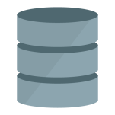
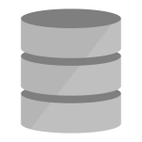

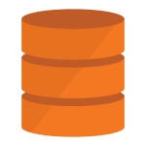



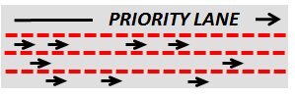



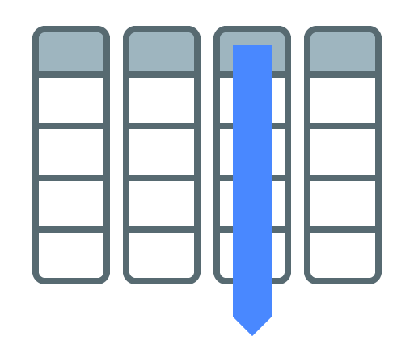

Exadata Service: Best Database on Best Cloud Platform
37 Years of Database Innovation - Proven at Millions of Mission Critical Deployments
In Memory
Smart Scan
Multitenant
InfiniBand Fabric
Real Application Clusters
Smart Flash Cache,
Smart Flash Log
PCI Flash
Active Data Guard
Columnar Flash Cache
Partitioning
All Oracle Database Innovations
All Exadata
Unique Innovations
Hybrid Columnar
Compression
Advanced
Compression
HCC
10:1
Advanced Security, Label Security, Database Vault
I/O Resource Management
I/O
I/O
I/O
Network Resource Management
Real Application Testing
In-Memory Fault Tolerance
OLAP, Analytics, Spatial and Graph
Exafusion Direct-to-Wire Protocol
Management Packs

Slide 15
DR to Cloud: Lifecycle
Subscription & Licensing
Cloud Service Creation
Enabling Security
Network Configuration
Instantiate Standby
Runtime Management
Pre-paid DBCS Subscription
Instance creation
Automated or Virtual Image
Extreme Performance
Cloud-side SSH
Restrict IP address access
Create listener port
On-premises network security
On-Premises SQL*Net
TDE encryption (optional)
From on-premises
Using RMAN DUPLICATE
Using Oracle Database Backup Service
Health Check / Monitor Lags
Failover/Switchover to Cloud
Use Standby for reporting, testing
Validate DR setup
On-premises Active Data Guard licensing

Slide 16

Customer Benefits: Cloud-based Disaster Recovery Site
Huge CAPEX & OPEX savings
  No need to maintain DR infrastructure
Instantaneous availability of DR site
  No need to wait for months
DR for compliance & regulatory purposes
  Physically remote location with data protection
Use standby in the cloud for DR and also reporting and testing
  Multiple use cases with DR site
Short and long time DR site
  Commission or de-commission on-demand

Slide 17


