Slide 1
Protecting against Advanced Persistent Threats
Madalin Vasile
Presales Systems Engineer, SEE

Slide 2
What We Used To Think
APT
Advanced Persistent Threats
Notes:
We first need to bring everyone to same level of understanding of the type of threats that we’re talking about. They used to be referred to as APT’s, Advanced Persistent Threats, but over the past 2 – 3 years there has been a tendency to move away from this terms. The drive behind this is that the term APT was frequently associated with those attacks launched by countries against targets in other countries, either commercial or government targets. It also had a military connection as it was first “coined” by the US Air Force.
But more important the use of the term “threat” implies that it’s a single effort, something tangible that can easily be identified. And as you’ll see, an APT is far from a single effort.

Slide 3
How We Think Today
APT
Advanced Persistent Threats
ATA
Advanced Targeted Attacks
Notes:
With APT falling out of favor the term ATA, Advanced Targeted Attack, has gained traction in a commercial setting and has been adopted and used by Gartner. It’s a more accurate term as it implies a highly sophisticated attack against a target. But before going any further let’s take a look at the structure of an attack.

Slide 4


The Anatomy Of An Attack
Exploit
Delivery
Execution
“Generic Threat”
Bot
Zero Day Threat
Trojan
Virus
Worm
Devices
Email
Web sites
Physical media
Notes:
An attack is made up of 3 distinct levels; Delivery, Exploit and Execution. Delivery is how the malware gets into the network, either through a “phishing” email or a compromised web site. But it also includes media just as USB flash drives and even mobile phones and tablets. Imagine that the mobile device while being used over a public, and unprotected, wireless network becomes infected with some sort of malware. If that device connects to the enterprise's internal WiFi network, there is a chance of the malware entering the corporate network. Once in the network, the malware can then do what it’s designed to do including taking advantage of a previously unknown vulnerability, a Zero Day Attack.
But a single attack does NOT constitute an Advanced Targeted Attack, it is only one step of a long and sophisticated process.

Slide 5





Kill Chain of an Advanced Attack
Bots leverage legitimate IPs to pass filters. Social engineering fools recipient.
Anti-spam
Spam
Malicious
Email
Malicious
Link
Web Filtering
Fast flux stays ahead of web ratings
Intrusion Prevention
Exploit
Malicious
Web Site
Zero-days pass IPS
Compression passes static inspection
Malware
Antivirus
Command &
Control Center
Bot Commands
& Stolen Data
Encrypted communication
passes controls
App Control/
IP Reputation
Notes:
So how does an advanced attack work? Here’s a snapshot of a typical kill chain for an advanced attack and the typical security technologies that are in play in order to block that attack and break the kill chain.
The number one, most popular method for initiating an advanced attack is to send a malicious email to the target. This email may have a malicious file attachment or a URL that connects to a malicious web site. You hope your anti-spam will stop this email from ever reaching an end user target. However there are ways to get around antispam and other email gateway security techniques. For example Bots may leverage legitimate (but compromised) IPs from which to send the email or they may use targeted spear phishing techniques and social engineering to get through filters and to entice an end users to click on a URL. They may encrypt a malicious attachment to hide it from AV scanning.
If an email with a malicious URL gets through and an end user clicks on that URL link, you hope your web filtering protection will stop the user from ever connecting to that malicious web site and in many cases this will work. However, some attackers use a fast flux approach, only using a site for a few days or a few hours – harvesting what they can before moving on to another URL.
If the end user connects with the malicious web site, that site will launch exploits at the user and you hope your Intrusion prevention will block the attack. However exploits can slip through by taking advantage of zero-day vulnerabilities, new variants, and encryption.
If an exploit gets through, you hope you will catch any malware it tries to deliver with your antivirus. And many times this will work but sometimes it doesn’t. Malware can use file compression, encryption, and new malware variants to get through an AV filter.
If that malware gets into the organization, it will try to proliferate and it will look for valuable data to collect. Eventually it will try to exfiltrate stolen data or simply go out to try to pull more threats into the organization and here’s where your application control and IP reputation controls may be able to identify and stop a connection to a command & control center. But if it doesn’t (maybe because the traffic was encrypted) your organization is breached.

Slide 6
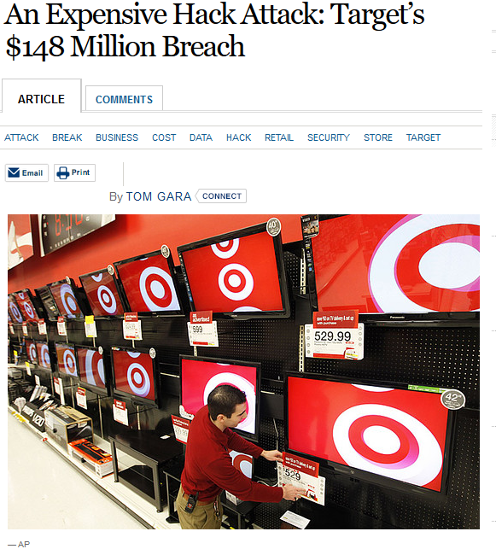

Value of data changed.
Confidential

Slide 7
How to loose 148M USD – a practical guide
Get infected by malware from a contractor’s computer. The malware stole a user’s credentials.
Hacker connects using stolen credentials and accesses Target’s application dedicated to contractors
Hacker exploits an internal web app. This exploit allows privileged code execution, so a set of tools installed on the server hosting the app.
Hackers perform LDAP searches until admin account is identified. Steal the cached admin token from the web server memory.
Hacker creates a new LDAP admin account ☺
Hackers copy readable information from reachable DBs (around 70M customer records, but no credit cards)
Install malware on POS system, steal 40M credit cards (Kaptoxa malware)

Slide 8


No One Is Immune
Did you change your password?
Notes:
Note to speakers:
At this point I normally poll the audience to find out who DOESN”T have an ebay account. Normally it’s a very small number of people regardless of the size of the audience.
I then pick out a person who did NOT raise their hand and ask them if they changed their password. Assuming an affirmative answer, I then ask approximately how much time did the whole process take. Most people will say 1-2 minutes.
I’ve chosen the ebay example to look at a major breach from a different perspective.

Slide 9
ebay – The Impact by the Numbers
145 M
User accounts compromised
525,600
Minutes in a year
262,800
Number of Passwords changed in a year
(Average 2 minutes/password)
551
Man/years wasted changing passwords
Notes:
At the time of the breach, ebay announced that 145 Million user accounts were compromised and that everyone with an account should change their password. The account information was encrypted and at the time of the breach assumed to be safe but ebay wanted their users to take the proactive step of changing their login credentials.
To understand the massive undertaking this would be, I’ve calculated the number of minutes in a year. Assuming an average of 2 minutes for changing a password, 262,800 passwords could be changed during the course of a year.
Applying that to the 145M user accounts, it would take 551 man/years of effort for every user to change their password, an enormous waste of productivity.
This is only one aspect of the impact that a data breach can have. What if the encryption technique used by ebay was broken and the cybercriminal now had you login credentials? It might no longer be valid for ebay but it wouldn’t be that difficult for a hacker to find your browsing history and to try the ebay credentials on every web site that you’ve logged into. Most people, myself included, do NOT have separate passwords for each and every web site that requires one.
So if this is the scope of the problem, what sort of solution exists to provide an effective defense against an ATA?

Slide 10

What’s next? 2015-2016 Forecast
Organizations living out of malware & data theft
Blastware to destroy systems and evidence
Hackers frame the innocent, tamper with evidence
Rise in counter threat intelligence
‘Denial of Revenue’, damage beyond data breach
Internet of Things → Internet of Threats
Actionable threat intelligence
Proactive incident response

Slide 11
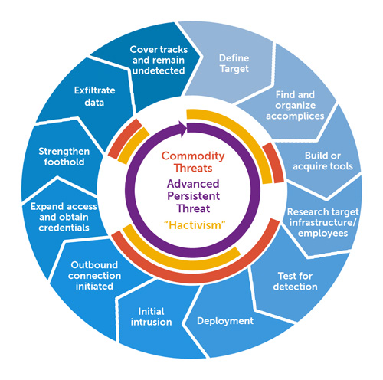
Advanced Targeted Attack Lifecycle
Day 1
2 Years +
“Bot net”
Activation
“Social
Engineering”
Advanced Targeted Attack
Zero Day
Exploit
Notes:
The best analogy to understanding an ATA is that of product development. Both start with a concept, are defined in terms of objectives and requirements and sometimes an ATA will go through internal and external testing before actually being used or introduced into the market.
Among the different stages or steps of an ATA are a number of key actions including the use of social engineering. It’s amazing how much information can be obtained with just some simple research or calling the company being targeted and posing as an employee. It’s human nature to want to help someone asking for assistance and as long as credibility can be established quite a bit of information can be divulged.
While certainly not necessary, an ATA may take advantage of a Zero Day exploit or vulnerability. As you’ll see in later slides, quite a lot of malware being used for attacks is already well known and has been used for 10 years or longer!
Finally, once in the network the data that was the objective of the attack needs to be extracted from the network. A “bot” is frequently used as an ex-filtration agent to get the targeted info out of the network.
Judging by the number of steps and processes it’s obvious that an ATA occurs over an extended period of time, not days and weeks but months and years if they can successfully avoid detection.

Slide 12
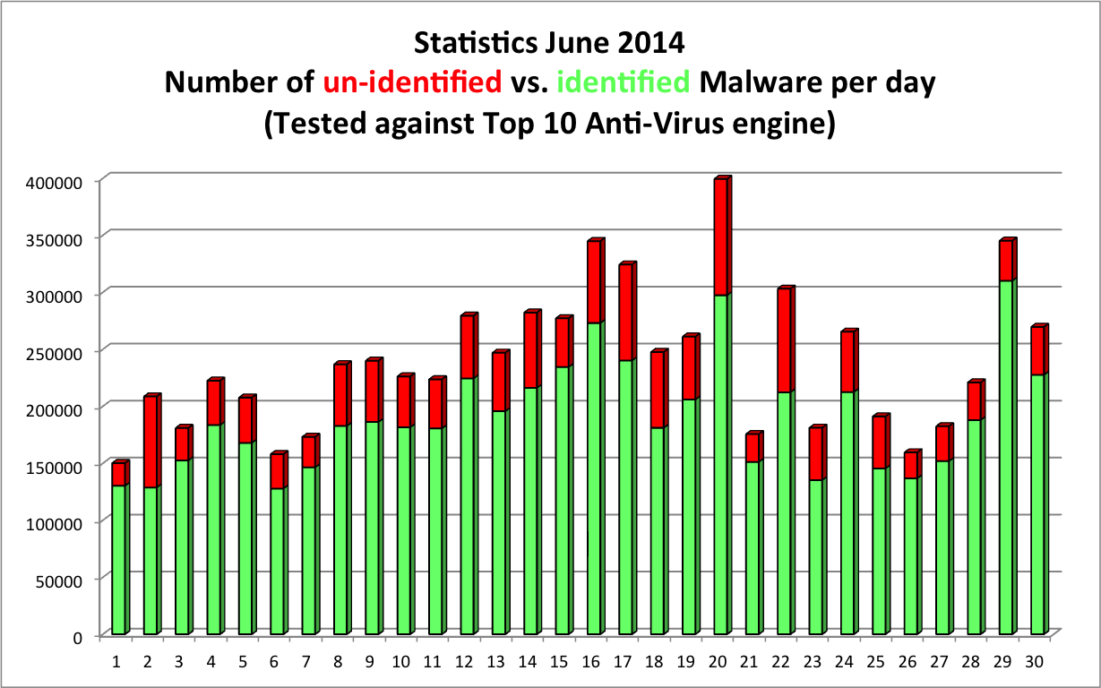
The Threat is Worse Than Ever
*Akylus July 2014
Notes:
So the real question is whether ATA’s are a real problem or something created by security companies to influence sales. Looking at this statistic snapshot from July 2014, there are two important issues being illustrated, distribution and creation. Distribution is shown in green, the number of malware samples that were seen everyday during the month in question. It’s a numbers game, throw out enough malware for a long enough period of time and you will find your way into a network. Take a look at July 20, on that day alone 300,000 known malware samples were detected during the course of that day. Not sure what might have been going on in the world that day to account for it but that was certainly the “high water” mark for the month.
The second issue, creation, is shown in red. New malware is being created on a daily basis and again on July 20, 100,000 of previously unknown malware was sampled on top of the 300,000 known samples. This is scope of the problem that our customers are facing on a daily basis. And for what reason?

Slide 13
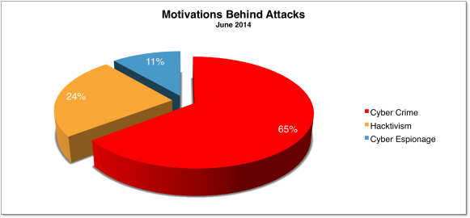
With A Consistent Motivation
*Hackmageddon July 2014
Notes:
The efforts on the previous slide are for a simple reason; crime. This is another reason why the term ATA has come into common usage, cyber espionage that was associated with the term APT has fallen into a distant second place. Nearly 2/3 of all attacks are prompted for a single reason, cyber crime.

Slide 14
Companies should be concerned
FACT:
Prevention techniques sometimes fail, so detection and response tools, processes, & teams must be added
229 days
Average time attackers were on a network before detection
67%
Victims were notified by an external entity
GOAL:
Reduce time to Find/Detect incidents
Reduce time to Investigate incidents
Reduce time to Remediate incidents
Notes:
You may have any number of excellent security technologies in place already in your organization – things such as firewalls, VPNs, authentication, antivirus, web filtering, IPS, and antispam. This is good and these solutions will prevent a lot of threats from ever impacting your organization. However, nothing is 100% and sometimes advanced attacks will find a way to get through these prevention techniques. You need to be ready to deal with these types of advanced targeted attacks.
In recent breaches it took 229 days on average to detect an attack that’s gotten on the network if it has managed to slip past existing defenses. And in 67% of the time the victim organizations only learned about the breach from an external entity.
Clearly no organization wants to be part of this statistic.
The goal behind advanced threat detection is to prevent what attacks you can and then, accepting that some things will get through, to reduce the time to find and detect an attack. And once youv’e identified an attack, reduce the time it takes to investigate and analyze the threat. Finally, with this intelligence in hand you can more quickly remediate any impact on your organization.

Slide 15
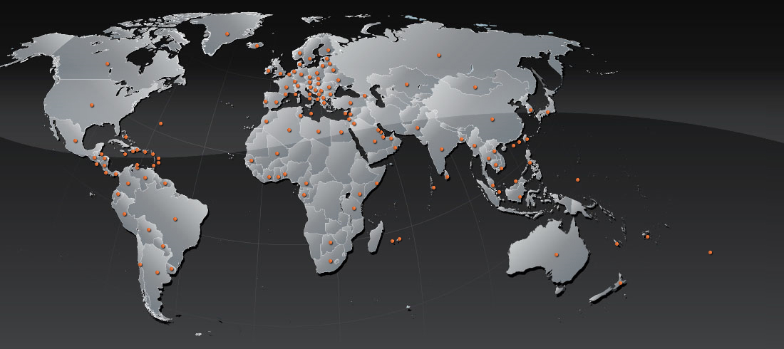

2014 Threat Landscape Developments
IoT:
The Moon Worm
Linksys Routers
Heartbleed
Vulnerable OpenSSL
Apple iCloud
Ransomware
$100 EUR
Oleg Pliss
Havex RAT
OPC Server Spy
Cybervor
1.2B User & Pass
500M emails
Feb 13
Apr 07
May 26
Jun 23
Aug 05
Aug 15
Supervalu Data Breach,
200 Stores Affected
Evernote Hack
50M Users
Mar
2013
Evernote Hack
164,644 Forum
Members
Jun 10
Q2 2014 (IDC):
301.3M Smart Phones Shipped
Android 84.7% Market
February:
Drive-By Mobile
(DriveGenie)
June:
Pletor Mobile Ransom
(Doc Encryption)
July:
Dorkbot/Ngrbot
Kamikaze
Notes:
15
So if we know the motivation for these attacks what are some of the highlights so far in 2014. The attacks shown here are only part of many that have occurred since the beginning of the year. Some of these that you may have heard of, certainly the HeartBleed vulnerability made worldwide news because of its sheer scale.
But let’s look at a different incident that certainly everyone in the audience heard of, and quite possibly was touched by it. eBay.

Slide 16
Follow The Acronym Trail
APT
Advanced Persistent Threats
ATA
Advanced Targeted Attacks
ATp
Advanced Threat Protection
Notes:
An attack as sophisticated an ATA requires a response equally sophisticated. Fortinet’s response is Advanced Threat Protection, ATP.

Slide 17
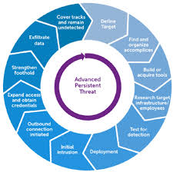

Is There A Silver Bullet For Defeating an ATA?
Advanced Targeted Attack
Notes:
It would be foolish to think that there is a single technology that can stop an ATA. With so many steps to the attack and so many tools at the cybercriminal’s disposal, an effective ATP solution has to intimately understand that the only way to combat an attack is to have a multi-layer defense.

Slide 18




Focus on Three Key Actions
Step 1 - Prevent
Prevent threats before they enter your network
Proactive is key
Step 2 - Detect
Discover threats that have or tried to enter the network
Step 3 - Mitigate
Respond to any threats that have breached the network
Notes:
18
It’s so that the network defense can focus on three distinct actions; mitigation, detection and remediation. Mitigation is to prevent threats from entering into the network in the first place. This is about understanding the different attack vectors that an ATA could use and making sure that all “loopholes” or backdoors are closed to prevent unauthorized access to the network.
While the objective of mitigation is to prevent an attack from entering the network, it’s done with the understanding that eventually there will be a breach of the network’s defenses. This is why Detection is the second key action; to be able to quickly identify when there has been an attempted or successful breach of the network.
And finally, Remediation to have the tools, technology and procedures to respond to the breach; understand where it came from, how it penetrated the network’s defenses, the extent of the breach and how to minimize the subsequent damage.

Slide 19
Step 1 - Prevent
Stateful Firewall
2 Factor Authentication
Intrusion Prevention
Application Control
Web Filtering
Email Filtering
Anti-Virus
Notes:
Looking at this list of technologies that make up Prevention there shouldn’t be anything in the list that anyone in the audience should not be familiar with. This combination of technologies is designed to block the a high percentage of malware and attacks that might be encountered by the network.
The one technology that might be a bit of a shock however is anti-virus

Slide 20
Step 2 - Detect
Stateful Firewall
2 Factor Authentication
Intrusion Prevention
Application Control
Web Filtering
Email Filtering
Antivirus
Botnet detection
Client reputation
Network behavior analysis
Sandboxing
Notes:
Like we did with Prevent, let’s look at the technologies that make up the Detection component of our ATP defense. While you might not be as familiar with these as you were with the technologies used for Prevent, they are critical to the effectiveness of the solution. The one technology that should be familiar to everyone, at least judging by the headlines that it has received, is sandboxing.

Slide 21
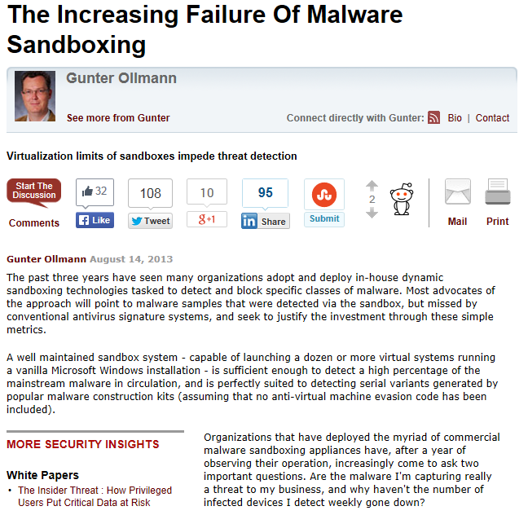
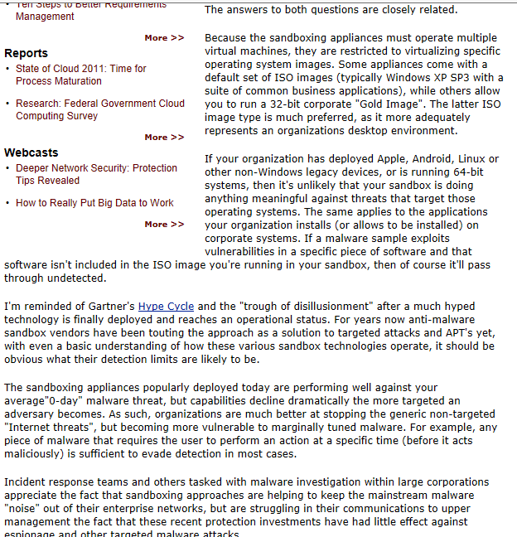
But a Word of Caution,,,,,
http://www.darkreading.com/attacks-breaches/the-increasing-failure-of-malware-sandbo/240159977
Notes:
Like anti-virus, not all sandboxing implementations are created equal. However, just because sandboxing has become a part of an ATP strategy it doesn’t mean that the cybercriminal is going to through up their hands and admit defeat! We have seen how the hacker community responds to new technologies and techniques; they figure out how they work and find new ways around them. As this report highlights, the cybercriminal is already figuring their way around the use of sandboxes.

Slide 22
Step 3 - Mitigate
Stateful Firewall
2 Factor Authentication
Intrusion Prevention
Application Control
Web Filtering
Email Filtering
Antivirus
Botnet detection
Client reputation
Network behavior analysis
Sandboxing
Consolidated logs and reports
Professional Services
User or Device Quarantine
Real-time Activity Views
Security Reporting
Threat Intelligence
Threat Prevention Updates
Notes:
Following on from Detection is Mitigation. These are the “soft” technologies and internal procedures to understand how the breach occurred, where it came from, and how to recover from the breach.
However, there is an important human element here and that is Threat Intelligence and Updates.

Slide 23

Fortinet - Advanced Threat Protection Framework
Integrated Solutions for Better Protection
Hand off :
High risk items
Known Threats
Reduce Attack Surface
Inspect & Block Known Threats
FortiGate,
FortiMail, FortiWeb &
everything that can enforce a security policy
FortiSandbox &
everything that is behavior based
Prevent
Detect
Unknown Threats
Identify Unknown Threats
Assess Behavior & Identify Trends
Mitigate
Response
Identify scope
Mitigate impact
Hand off :
Security updates
Hand off :
Ratings
& results
FortiGuard teams and automation
Notes:
There is no “silver bullet” to protect organizations against all advanced targeted attacks. There is too much rapid innovation happening in cyber crime for any single approach to be the solution. The most effective defense is through a cohesive, integrated solution. The Fortinet Advanced Threat Protection Framework provides a guide to building a more effective layer of protection – one that is continually improving.
This cohesive ATP solution includes:
technologies to prevent known threats from getting into an organization,
technologies to detect that which is unknown and cannot be stopped by traditional preventative measures, and
the ability to mitigate threats through remediation and security updates aimed at continually improving the preventative technologies already in play.
It sounds simple but it can difficult to create this with just a collection of point solutions.
In the case of the Fortinet solution, FortiGate NGFW and UTM technologies and FortiMail email security work to prevent threats from impacting an organization through IPS, web filtering, AV, IP reputation, antispam, application control and VPN functions. FortiAuthenticator also helps to control access to the network and FortiClient can help protect endpoints.
FortiGate and FortiMail integrate with FortiSandbox to hand off high risk items for deeper analysis with the aim to detect advanced new and evasive threats. FortiSandbox identifies and analyzes threats and gathers information that then can be used to mitigate attacks – either through automated mitigation leveraging integration with FortiGate or FortiMail directly or through security updates from the FortiGuard Labs research team that feed back into the greater Fortinet security solution ecosystem.

Slide 24
Coordinated Defense Strategy
In-Network
Defenses
Continuous
Updates
Threat Research
and Discovery
Notes:
So how do we put all of that into practical terms? It starts with the network and those technologies that have been implemented. In order to be effective, those technologies must be supported by an off network Threat Research and Discovery capability. This function serves two purposes; one is to try and beat the hacker at their own game, finding unknown vulnerabilities in a wide range of software programs. But at the same time, it is the central collection point for threat information coming from the actual networks. The second function is to develop updates that are fed back to the networks to keep them up to date and efficient.

Slide 25



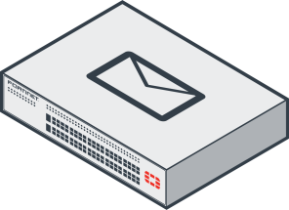
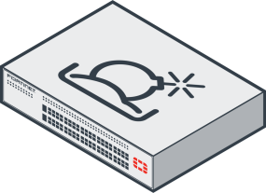
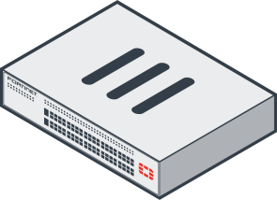
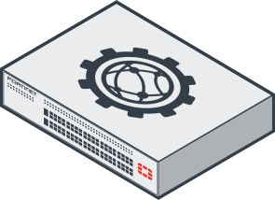


The Fortinet ATP Solution
FortiClient
FortiMail
FortiSandbox
FortiGate
FortiWeb
FortiGuard Lab
FortiGuard Services
Notes:
To deal with the different attack vectors, the Fortinet solution deploys FortiGate, FortiMail and FortiWeb. At the same time, FortiClient is deployed on the user’s desktop. What ties all of these together is that all of these products have the same antivirus capability, providing a strong prevention capability at the perimeter of the network. In addition to antivirus there are a number of different services running on FortiGate, FortiMail and FortiWeb. It’s the role of FortiGuard to keep these services up to date through a consistent update procedure, updates that are driven from real time reporting from Fortinet units installed worldwide.
Providing the prevention capability is FortiSandbox, equipped with it’s own antivirus capability. FortiSandbox will also work interactively with the other elements of the solution. For example, if FortiMail discovers a suspicious email attachment, it will forward the suspected sample to FortiSandbox while holding the email until it receives feedback from FortiSandbox. FortiMail will then either forward the email to the email server or delete it depending upon the response from FortiSandbox.

Slide 26

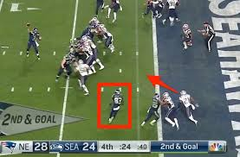

Protecting Today’s Network
Evolution, evolution, evolution
Wherever there is value, the cyber criminal will follow
React, Respond
… Anticipate
Notes:
Securing a network is a continuous “cat and mouse” game between the cyber criminal and Fortinet, each searching for an advantage. A better analogy might be sports in general and specifically football. In football there’s both an offense and a defense and in general the offensive player will always have the advantage because he knows what he’s going to do. The defensive player is forced to react and respond. However, depending upon the skill and advance preparation of the defensive player it is possible to do more than just react and respond. The best of the defensive players will anticipate what the offense is going to do and minimize or even eliminate the offensive player’s advantage.
That is the philosophy of Fortinet in providing its ATP solution, to be able to both anticipate and react to minimize, eliminate the cyber criminals advantage.

Slide 27


DON’T GO UNPROTECTED

