Slide 1
Veritas InfoScale™ Storage
Marius ȚURLEA
Technology Solutions Manager
Notes:
Hello. I would like to take some time today to introduce InfoScale to you.

Slide 2
WE BELIEVE:
INFORMATION
INFRASTRUCTURE
Data and information are not the same thing
Infrastructure availability does not equal application availability
More data does not equal more value
Notes:
I would like to start with describing our key belief that information has primacy over infrastructure.
Three truths underlie our belief in the primacy of information.
Data and information are not the same thing:
Example: There are many technology solutions out there that offer storage reduction benefits. If these solutions can’t tell the difference between data and information, then they will apply the same protection characteristics (SLAs) to everything. Many of the organizations we work with have realized this and are adopting a more intelligent storage solution and were able to put less important information into dedupe storage, whereas the more important information would live in advanced disk storage so that it could be recovered faster.
Infrastructure availability does not equal application availability:
Example: Organizations want to adopt cloud for mission-critical workloads because many vendors (Amazon) tout eleven nines of availability. However, this resiliency is tied to the HW infrastructure NOT the application. Therefore, if the application fails, companies usually find out when customers call to complain. True IT service continuity requires knowledge of both the application and multi-tiered infrastructure layers.
More data does not equal more value:
Example: Companies rightfully assume that their information is valuable. However, the amount of value they can get out of it does not depend on how much of it they keep and store. When companies understand the right information – what they have, where it exists, and how old it is, they can start to get rid of the stuff that has no value (or incriminating value) and drill down into the stuff that matters.
Sources:
http://www.esg-global.com/blogs/the-year-ahead-in-data-storage/
https://hbr.org/2012/10/big-data-the-management-revolution/ar

Slide 3
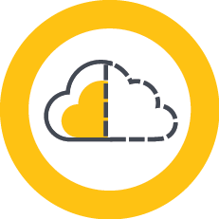
Data center transformation
Markets
Challenges
Trends
Software defined
Multiple point tools
Data center transformation
Cloud
Virtualization
Operational complexity
Business continuity
Unpredictable service levels
Virtualization & cloud
Notes:
The key trends we are seeing include data center transformation, increasing cloud adoption and still growing, albeit less slowly, virtualization.
That has caused fragmentation limiting visibility and control, yet organizations continue to buy hardware.
Converged Infrastructure (CI) is forecasted to grow in 54.7% CAGR from $2B in 2011 to $17.8B in 2016
By 2016, Converged infrastructure will account for 12.8% of IT spend up from 3.9% in 2012
CI revenues are roughly allocated as following: Servers (30%), Storage (60%), and networking (5-10%)
Source: IDC - WW Semiannual Software Tracker 2013H1, Nov. 2013, WW Storage Software, 4Q2013, WW Server Tracker – 2Q2013
At the same time data is exploding. By 2020 there will be 44ZB of data in existence.
40ZB of data: http://www.webopedia.com/quick_ref/just-how-much-data-is-out-there.html
Challenges
Infrastructure sprawl and data explosion have resulted in several challenges for IT and the business it supports. With new infrastructure, new point tools are introduced in the environment resulting in operational complexity because they are either not integrated with the old tool set or they do not support legacy systems that the business still relies upon. At the same time, service level requirements are growing, such that the business expects their applications to be available all of the time. From an IT perspective, while many believe the “recovery” problem is solved, it is often times difficult to predict when an application or business service will meet service level objectives. Again, this can largely be blamed on multiple point tools that are not integrated with each other or existing infrastructure.
(From a Forrester Report What IT challenges are driving your organization to consider or invest in a converged infrastructure? – 55% Budget constraints / cuts, 51% Provisioning infrastructure and applications takes too long, 46% IT sprawl, 44% Can’t keep up with all of the IT requests, 40% Lack of agility, 29% Need to free up budget for innovation, 4% Other)
Markets
Resulting from these trends and challenges is the emergence of new markets like Software-Defined Storage. The idea behind Software-Defined Storage is to virtualize and abstract the complexity of managing large storage environments for efficiency and scale. The SDS market is expected to grow to $5.4B by 2018. Another key market is business continuity, keeping business up and running in the event of small or large scale problem. Virtualization is a technology that is prevalent in the data center. It is expected that 86% of workloads will be virtualized by 2016. Organizations are also thinking about cloud. How can they leverage cloud services to increase availability of their applications and data, while reducing cost?
SDS: http://itexpo.tmcnet.com/east/shownews/articles/366488-analyst-estimates-2018-software-defined-storage-market-will.htm
SDS: Software-Defined Storage market is growing 36% CAGR from 2014 to 2019 - StorageNewsletter.com – “WW Software-Defined Storage to Grow from $1.4B in 2014 to $6.2B by 2019”
Flash marketing growing to $1.6B by 2016 - http://itexpo.tmcnet.com/east/shownews/articles/366488-analyst-estimates-2018-software-defined-storage-market-will.htm
86%: http://www.cioinsight.com/it-strategy/cloud-virtualization/slideshows/useful-virtualization-stats-trends-and-practices.html
Most will adopt a hybrid model: http://www.cio.com/article/2865477/enterprise-software/8-enterprise-software-predictions-for-2015.html
Cloud Market Stats (Forrester): http://searchcloudapplications.techtarget.com/feature/Comparing-private-cloud-vs-public-cloud-application-support
Enterprise public cloud usage falls from 2/2014 – 2/2015: http://www.thewhir.com/web-hosting-news/enterprises-see-hybrid-cloud-sdn-iot-future-survey
Cloud growth rates: http://www.computerworld.com/article/2860980/hybrid-cloud-adoption-set-for-a-big-boost-in-2015.html
________________________________________
Migrating from UNIX to Linux:
By 2013, customers purchased only $6.4 billion of Unix servers. In terms of operating systems spending, the market share for Unix servers dropped from 38% of vendor server revenue in 2003 to only 12.9% of operating systems purchases by 2013. During the same time frame, Windows and Linux servers collectively added 38 points of the worldwide operating system revenue market share. (IDC, The Changing Platform Paradigm: What’s Next fro Unix Servers? June 2014, Al Gillen, Peter Rutten)
Consolidation at all levels – data center, applications, databases, platforms, infrastructure

Slide 4
Introducing the InfoScale family
Value added graphical management tool
InfoScale Operations Manager
InfoScale Enterprise
Extensive application availability coupled with software defined storage
Software defined storage; comprehensive storage management
InfoScale Storage
InfoScale Availability
Extensive capability (including DR) for application availability
InfoScale Foundation
Base offering targeting storage management
Notes:
Note – this slide builds
Now let me walk you through the members of the InfoScale family. I will give an overview of what functional components make up each of the InfoScale family products (i.e. how the earlier SFHA products map to InfoScale) on the next slide.
At the top we have InfoScale Enterprise – which is our full application availability and software-defined storage (SDS) offering. It brings together the capabilities of the other InfoScale products and adds support for database high availability environments such as Oracle RAC (real application clusters) and Sybase ASE CE (cluster edition).
Next are the two core SDS and availability products – they help address meet customer needs in the storage management and application availability arenas respectively:
On the left, InfoScale Storage – is the premier cross-platform host-based storage management solution. Basically, what you would need to meet your Software Defined Storage needs. InfoScale Storage adds cluster file system, snapshots, replication, storage migration, deduplication, compression, etc. functionality on top of more basic storage management technologies such as volume manager (VxVM), file system (VxFS), dynamic LUN expansion, etc. which are provided by our base storage management offering.
On the right, InfoScale Availability – helps keep an organization’s information and critical business services up and running on premise and across globally dispersed data centers through local clustering and disaster recovery to remote sites and uses our industry leading, cross-platform clustering technology – the same technology that powers the well known Veritas Cluster Server.
Next, InfoScale Foundation – which is the base offering targeting storage management that I just mentioned. It provides heterogeneous storage management while increasing storage utilization and enhancing storage I/O path availability for physical and virtual environments.
Finally, InfoScale Operations Manager, formerly Veritas Operations Manager, is the graphical management tool that helps you extract maximum value from your investment in InfoScale products – it is our front-end or GUI available (at no charge) with each of the four InfoScale core products. It brings value-added capabilities such as enabling our virtual business services (or VBS) capability, automation (such as run book automation) and supports managing license deployment and compliance, as well as active management of your InfoScale and previous SFHA deployments.
Please note that if you need support for Oracle RAC or Sybase ASE CE then the appropriate product is InfoScale Enterprise.
As you might imagine, the InfoScale products pack a bigger punch than the earlier, SFHA product offerings…

Slide 5
Mapping to previous SFHA offerings
InfoScale Operations Manager
InfoScale Enterprise
DMP
vDMP
SF
SFHA
SFCFSHA
Repli-cator
SFRAC
SFSYBCE
VCS
HA DR
InfoScale Storage
InfoScale Availability
DMP
vDMP
SF
SFCFS
Repli-cator
VCS
HA DR
InfoScale Foundation
Transitions
DMP
vDMP
SF*
Co-Deploy
*Subset of features available in Storage Foundation Standard
Notes:
Note – this slide builds
…indeed you can see that here from the mapping of the SFHA products to InfoScale.
InfoScale Foundation comprises a subset of Storage Foundation functionality along with DMP and DMP for VMware.
I will cover further detail on InfoScale Storage and InfoScale Foundation features in the next slide but at a high level, InfoScale Storage rounds out the storage management capability with features such as SmartIO and SmartMove and adds the Veritas Cluster File System and file & volume replication.
InfoScale Availability comprises the Veritas Cluster Server technology along with the Global Cluster Option.
And InfoScale Enterprise comprises the components of InfoScale Availability and InfoScale Storage along with support for database clustering environments – specifically Oracle RAC and Sybase ASE CE.
Please note that the functionality available varies by platform and not all functionality is available on all supported platforms. For example, SFRAC is only supported on Linux and not on Windows. The Services and Operations Readiness Tool (SORT) shows the detailed feature support. If there is interest and time, go to SORT and show the customer.
Note - ApplicationHA and Veritas Risk Advisor, formerly Disaster Recovery Advisor, do not map to InfoScale and remain independent offerings. This is for your awareness, no need to bring it up

Slide 6
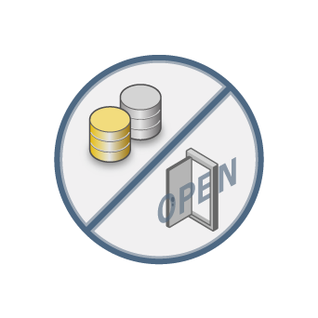
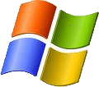
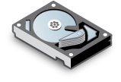
Storage management challenges
Multiple Vendors & Diverse Protocol Needs
Persistent Data Availability Requirements
Mapping Applications to the Right Storage
?
High Total Cost of Ownership
Notes:
The key challenges we see IT professionals dealing with when it comes to storage management include:
Need to deal with diversity from a vendor, protocol and not to mention, application needs perspective
Requirement that data be available on a persistent and reliable basis
And that the storage furnished to an application meet the performance and redundancy needs of the application
And finally, cost effectiveness remains a focus – there is ever-present pressure to do more with less

Slide 7
InfoScale supports the diverse technologies of today and tomorrow
Heterogeneous Support
Platforms
Storage
Protocols
CIFS
NFS
Notes:
We support heterogeneity – indeed, heterogeneous support has been a hallmark of Veritas from the early days, whether you are thinking about platforms, storage (we support more than a 1000 different storage choices) or access protocols.
A key benefit of our wide support is that your employees do not need to deal directly with the diversity by learning how to manage/ support all the equipment under their care separately. Instead, the standardization that we provide means they can use Veritas to manage their storage.

Slide 8
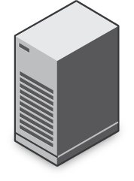
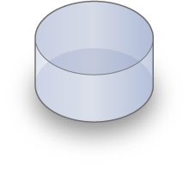
InfoScale enables access to data anywhere, anytime
Data Accessibility and Availability
Flexible Storage Sharing
Dynamic Multi-Pathing
Replication, Snapshots & Checkpoints
Synch/Asynch Replication
Global Name Space
Dynamic Multi-pathing (DMP)
Notes:
Veritas brings a range of capabilities that help ensure data accessibility:
Flexible storage sharing or FSS – enables network sharing of local storage, DAS or internal, across a global namespace to provide data redundancy, high availability, and disaster recovery without the need of shared storage. Utilizing network interconnect between the nodes, FSS allows network shared storage to co-exist with physically shared storage, meaning logical volumes can be created out of network shared storage as well as physically shared storage to provide a common storage namespace.
Dynamic multi-pathing – improves storage I/O performance and availability across heterogeneous server and storage platforms using intelligent algorithms and load balancing. It increases application availability by rerouting I/Os to other available data paths in the event of a storage path failure, and automatically restores failed paths that become healthy. Dynamic Multi-Pathing for VMware provides improved storage I/O performance and availability for VMware ESX attached storage.
Replication, snapshots, check-pointing – help ensure your data are protected in case of local failures

Slide 9
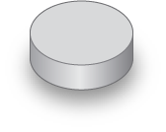
InfoScale maps storage to information to meet the demands of business
Intelligent Information Mapping (Quality-of-Service)
SmartIO
Storage Tiering
Application
Distributed Caching Layer
Tier 1
Protected
Tier 2
SAN
Tier 3
Notes:
Capabilities such as SmartIO and storage tiering help deliver the Quality of Service that an application requires.
SmartIO - brings value is in application performance, specifically those with lots of small, random reads and writes, such as a transactional database. By keeping hot data inside the server on super fast solid state devices, application reads are filled in microseconds rather than milliseconds on traditional SAN. Indeed, SmartIO
achieves up to 400% performance gains, while reducing costs by over 80% over traditional Storage Area Network (SAN).
Storage tiering – allows less frequently accessed or lower priority data to be stored on lower grade, less expensive storage
As you see, both of these capabilities contribute not only to storage performance and QoS but also to the cost-effectiveness of the overall storage environment

Slide 10
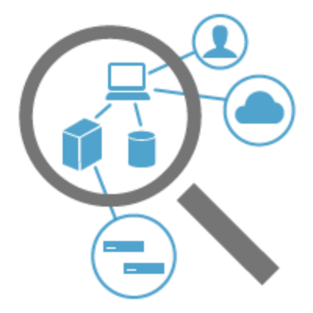
Management challenges
Poor visibility
Weak automation and control
Limited reporting
High Total Cost of Management
Notes:
Data center personnel are faced with operational complexity as a result of the heterogeneity in their environment and the often-pace of change.
The wide range of vendors and associated management tools lead to poor visibility, weak control and limited reporting. Yet they are tasked with responding with agility to evolving business needs and while ensuring asset utilization is high from an economic perspective and IT risks are low.

Slide 11
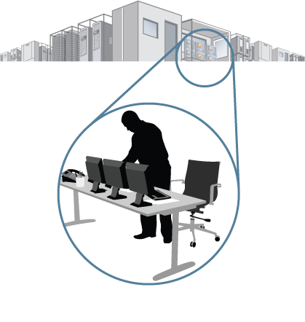
InfoScale Operations Manager: Maximize InfoScale benefits
Centralized Visibility
Automation and Control
Extensive Reporting
Role-based access control
Centralized audit recording
Multi-cluster management
Customizable interfaces
Virtual Business Services
Recovery automation
Built-in wizards
Policy driven
Server
Storage
Availability
Licenses
Notes:
InfoScale Operations Manager helps maximize the benefits of your InfoScale deployment:
Minimize risk - with alerting and end-to-end visibility
Accelerate operations - with standardization and automation
Optimize - with reporting and remediation
Centralized Visibility
---------------------
Multi-cluster management
Multi-tenancy
Customizable Dashboards
Automation & Control
---------------------
Auditing
Virtual Business Services
Recovery Plans
Built-in Wizards
Template Provisioning
Centralized Patching
Reporting & Monitoring
-----------
Licensing Reports,
Server and Storage utilization
Cluster Up time Analysis

Slide 12
More information
Access datasheets and whitepapers - InfoScale product page
Watch short videos to learn about underlying technologies – InfoBits videos page
Notes:
Please note that the product page will be live by the end of July
Please note that while the InfoBits videos may reflect the earlier SFHA nomenclature and Symantec branding, they are pertinent to InfoScale and a useful source of understanding about the technologies underlying InfoScale.

Slide 13
Marius ȚURLEA
marius.turlea@veritas.com

