Slide 1
VMware NSX
Network virtualization platform for SDDC
Cristian RADU
Senior System Engineer Ro, Bg, Md

Slide 2

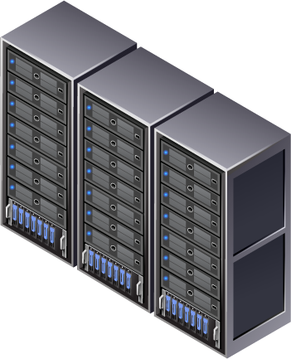

Enterprise business leaders want their IT to be like Amazon
Internal/Hybrid
Software Defined
Data Center (SDDC)
New IT
or
or
Hardware Defined
Data Center (HDDC)
No IT
Outsourced

Slide 3

What is a Software Defined Data Center (SDDC)?
Software
Data Center Virtualization Layer
Hardware
Intelligence in Software
Operational Model of VM for Data Center
Automated Configuration & Management
Intelligence in Hardware
Dedicated, Vendor Specific Infrastructure
Manual Configuration & Management
Compute, Network and Storage Capacity
Pooled, Vendor Independent, Best Price/Performance Infrastructure
Simplified Configuration & Management

Slide 4
The approach taken by the most agile & efficient data centers is SDDC
Google / Facebook /
Amazon Data Centers
Custom Application
Software / Hardware Abstraction
Custom Platform
Software / Hardware Abstraction
Any x86
Any Storage
Any IP network

Slide 5
The Choice for “New IT” – SDDC or HDDC
Software Defined
Data Center (SDDC)
Google / Facebook /
Amazon Data Centers
Hardware Defined
Data Center (HDDC)
Any Application
Custom Application
Any Application
Software / Hardware Abstraction
SDDC Platform
Custom Platform
HDDC Platform
Data Center Virtualization
Software / Hardware Abstraction
Any x86
Any x86
Integrated x86
Vertical Integration
Any Storage
Any Storage
Integrated Storage
Any IP network
Any IP network
Vendor Specific
Network

Slide 6
SDDC Within, Between and Across Data Centers
Software Defined
Data Center (SDDC)
Inter- Data Center
Hybrid- Data Center
Any Application
Any Application
Any Application
SDDC Platform
SDDC Platform
Data Center Virtualization
Any x86
Any x86
Any x86
Any Storage
Any Storage
Any Storage
Any IP network
Any IP network
Any IP network

Slide 7


Taking what we have learned….
Automated Operational Model
Programmatically Create,
Snapshot,
Store,
Move,
Delete,
Restore
Applications
Intelligence in the virtualization layer
Vendor independent x86 capacity
Transformative operational model
Automated configuration & management
Virtual
Machines
Software
Server Virtualization
Compute
Capacity
Manual Operational Model
Hardware
Network
Storage
Intelligence in hardware
Dedicated, vendor specific infrastructure
Manual configuration & management

Slide 8
To deliver a Software Defined Data Center approach
Automated Operational Model
Programmatically Create,
Snapshot,
Store,
Move,
Delete,
Restore
Applications
Virtual
Machines
Virtual
Networks
Virtual
Storage
Software
Data Center Virtualization
Hardware
Compute
Capacity
Network
Capacity
Storage
Capacity
Pooled compute, network and storage capacity
Vendor independent, best price/performance
Simplified configuration & management
Location Independence

Slide 9













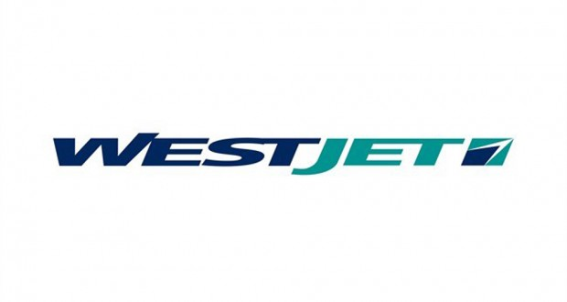

VMware NSX Momentum: Customer Snapshot
4 of 5
Leading global
top investment banks
enterprises & service providers

Slide 10
Understanding Network Virtualization
What it is. How it works.

Slide 11



Evolution of Data Centers
Distributed
  Manual Provisioning
  Limited scaling
  Rack-wide VM mobility

Slide 12




Evolution of Data Centers
Distributed
Fabric Based
Cloud
Cloud
L3
L2
Fabric
Compute
Compute
Storage
Storage
Services
Services
  Manual Provisioning
  Limited scaling
  Rack-wide VM mobility
  Policy-based Provisioning
  Scale Physical & Virtual/Cloud
  DC-wide/Cross-DC VM Mobility

Slide 13



Evolution of Data Centers
Distributed
Fabric Based
Application Driven
Cloud
Monitoring
Apps
Provisioning
Apps
Networking
Apps
End-User
Apps
Cloud
Programmable
Provisionable
L3
L2
Fabric
Compute
Compute
Storage
Storage
Services
Services
L3
L2
Compute
Compute
Storage
Storage
Services
Services
Integrated Fabric & Cloud
World of Many Clouds
  Manual Provisioning
  Limited scaling
  Rack-wide VM mobility
  Policy-based Provisioning
  Scale Physical & Virtual/Cloud
  DC-wide/Cross-DC VM Mobility
  Service-centric Provisioning
  Flexible – Anywhere, Anytime
  Cross-cloud VM Mobility

Slide 14
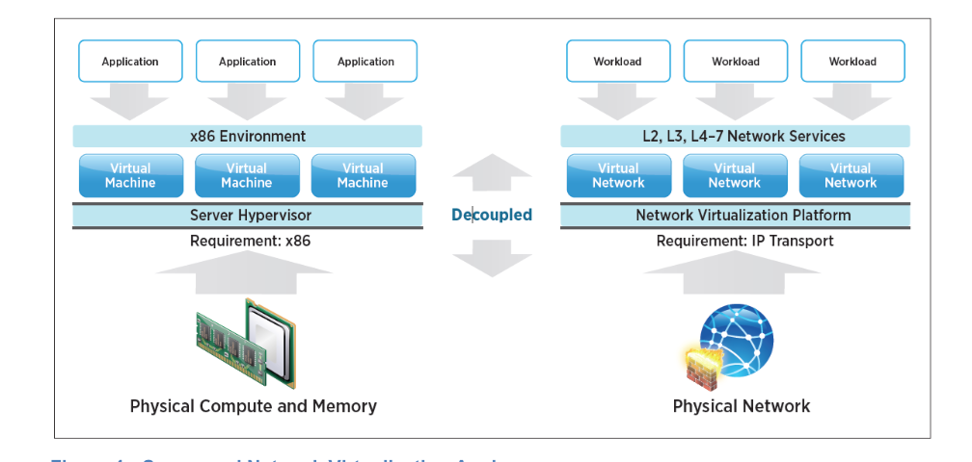
Server and Network Virtualization Analogy

Slide 15
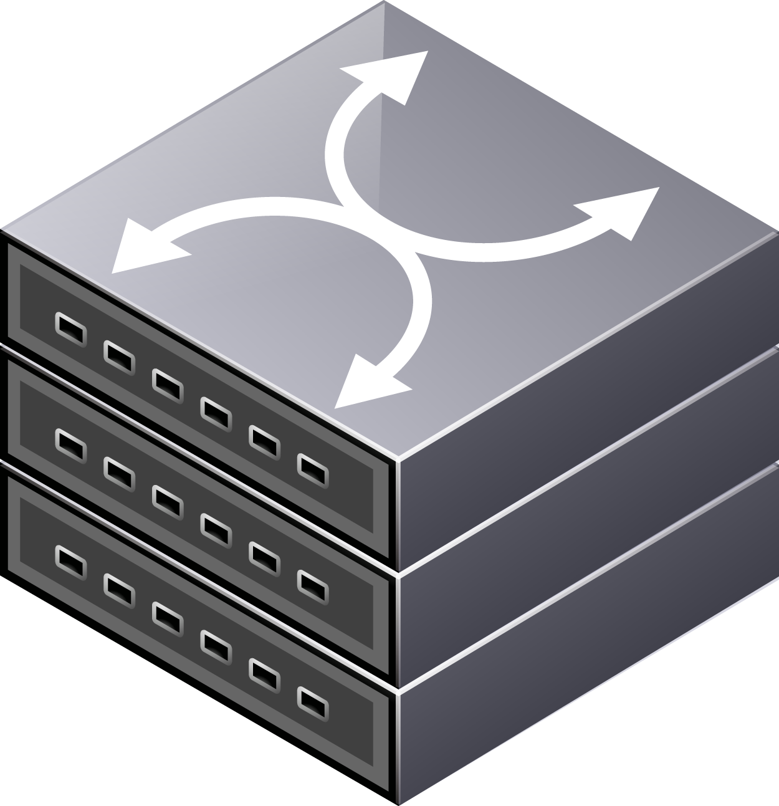
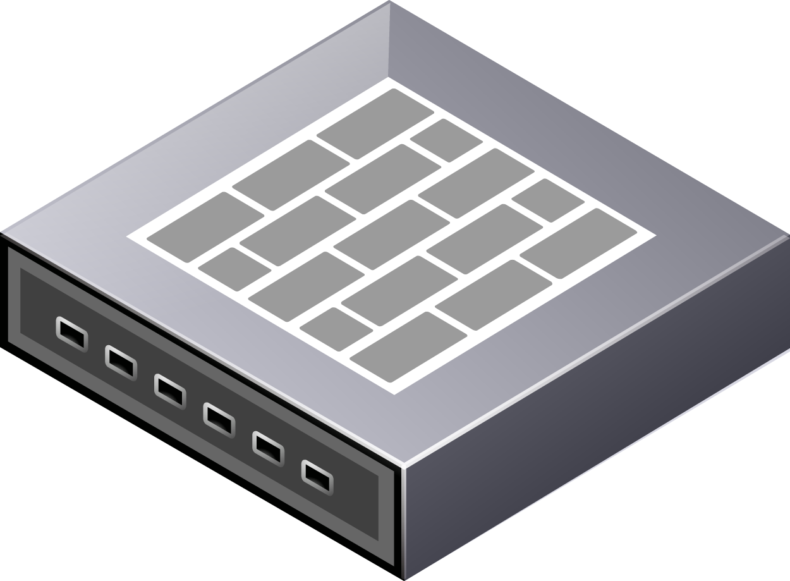
Network Capacity…
Internet
Physical Network Topology

Slide 16
Compute Capacity….
Internet
Physical Network Topology

Slide 17
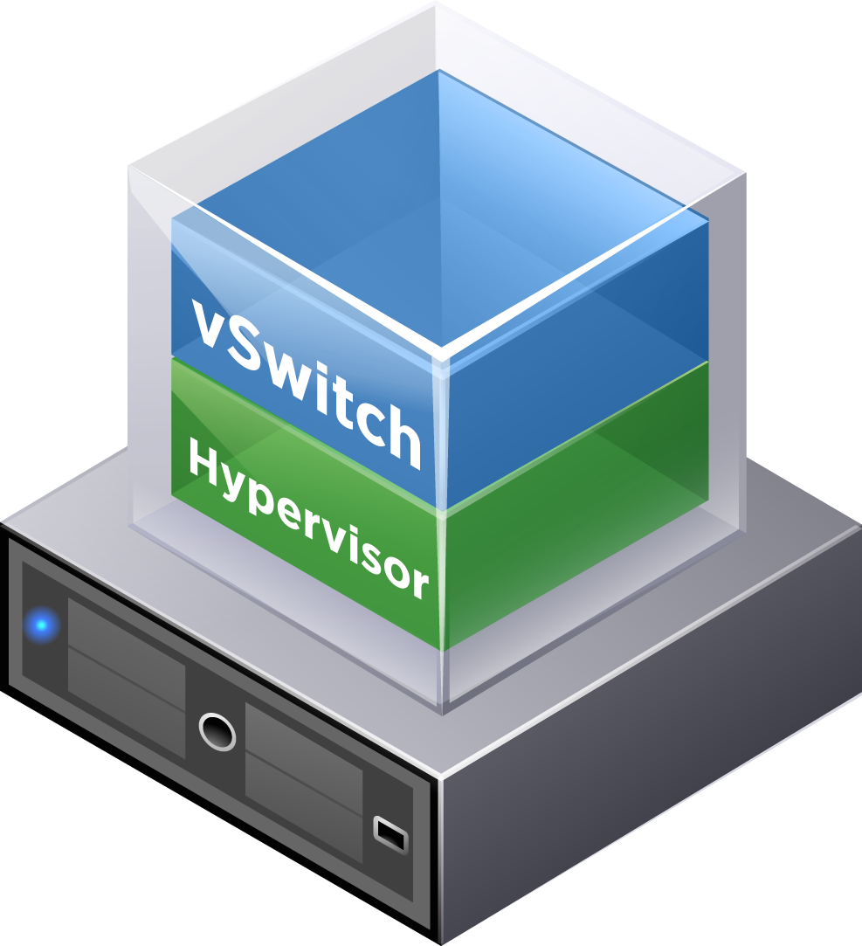
Data Center Virtualization Layer…
Internet
Physical Network Topology

Slide 18

A “Network Hypervisor”
Internet
Network Hypervisor
Physical Network Topology

Slide 19
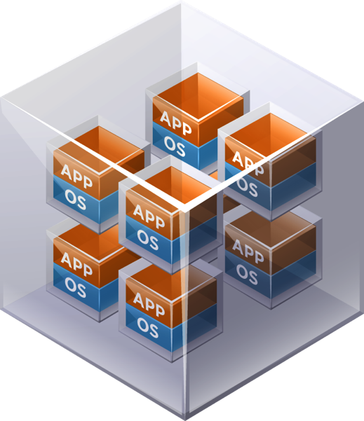
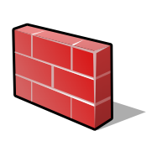
The Operational Model of a VM for the Networking
Virtual Networks
Software Containers, Like VMs
Virtual Network Topology
Internet
Network Hypervisor
Physical Network Topology

Slide 20
NSX is AGNOSTIC to Underlay Network Topology or HW
L2 or L3 or Any Combination
Only TWO Requirements
IP Fabric
MTU of 1600

Slide 21
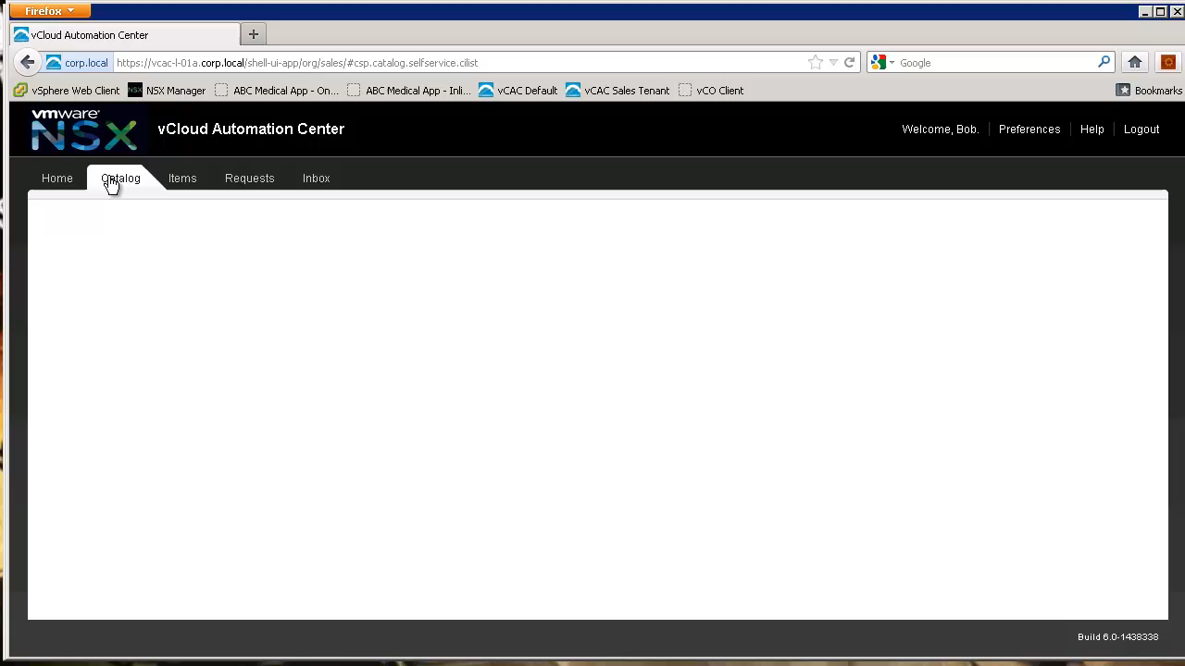

Slide 22






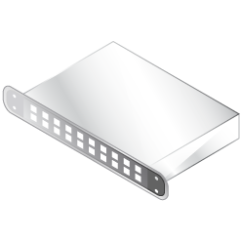
Resulting Software Defined Data Center Deployed
VM
VM
Web Tier
L3 Subnet
Internet
VM
App Tier
All Software Construct
NAT
L3 Subnet
VM
DB Tier
L3 Subnet
Physical Network

Slide 23
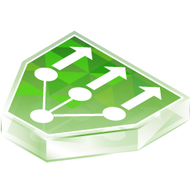

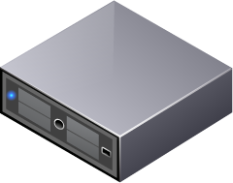
A Virtual Network?
Virtual Network
NSX vSwitch
Hypervisor
VM
VM
VM
User Space
NSX vSwitch
Physical Network
Hypervisor

Slide 24
A Virtual Network?
Virtual Network
NSX vSwitch
Hypervisor
VM
VM
VM
User Space
NSX vSwitch
Physical Network
Hypervisor

Slide 25
Non-Disruptive Deployment
VM
VM
VM
User Space
Virtual Network
NSX vSwitch
Hypervisor
VM
VM
VM
User Space
NSX vSwitch
Physical Network
Hypervisor

Slide 26




Programmatically Provisioned
Cluster Controller
VM
VM
VM
Virtual Network
NSX vSwitch
Hypervisor
VM
VM
Distributed
Network Services
VM
User Space
NSX vSwitch
Physical Network
Hypervisor
Cloud Mgt Platform
Distributed
Network Services

Slide 27

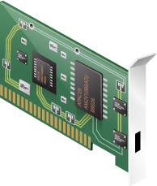
Services Distributed to the Virtual Switch
Cluster Controller
VM
VM
VM
User Space
Virtual Network
NSX vSwitch
Flow Identified as
“Elephant Flow”
Hypervisor
VM
VM
Physical Host
Encap Header
VM
User Space
Physical Network
DSCP Tagging
NSX vSwitch
Physical Network
Hypervisor
Simplified IP Backplane No VLANs, No ACLs, No Firewall Rules
Cloud Mgt Platform

Slide 28
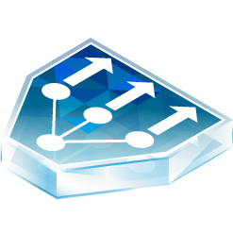



Native Isolation
192.168.2.11
192.168.2.11
VM
VM
VM
User Space
192.168.2.10
Virtual Network
NSX vSwitch
192.168.2.10
Hypervisor
VM
VM
Physical Host
VM
User Space
NSX vSwitch
Hypervisor

Slide 29
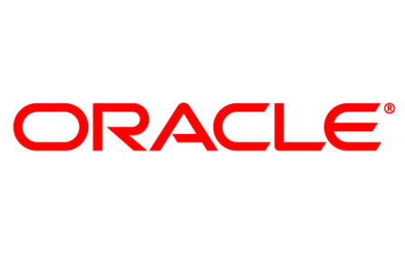
Support for Physical Workloads and VLANs
Cluster Controller
VM
VM
VM
User Space
Virtual Network
NSX vSwitch
Hypervisor
VM
VM
Physical Host
VM
User Space
VLAN
Physical or Virtual
Workloads
NSX vSwitch
Hypervisor
x86 Gateway
Physical Workload

Slide 30
Support for Physical Workloads and VLANs
Cluster Controller
VM
VM
VM
User Space
Virtual Network
NSX vSwitch
Hypervisor
VM
VM
Physical Host
VM
User Space
VLAN
Physical or Virtual
Workloads
NSX vSwitch
Hypervisor
Top-of-Rack Switches
(OVS/DB – VTEP)
Physical Workload

Slide 31
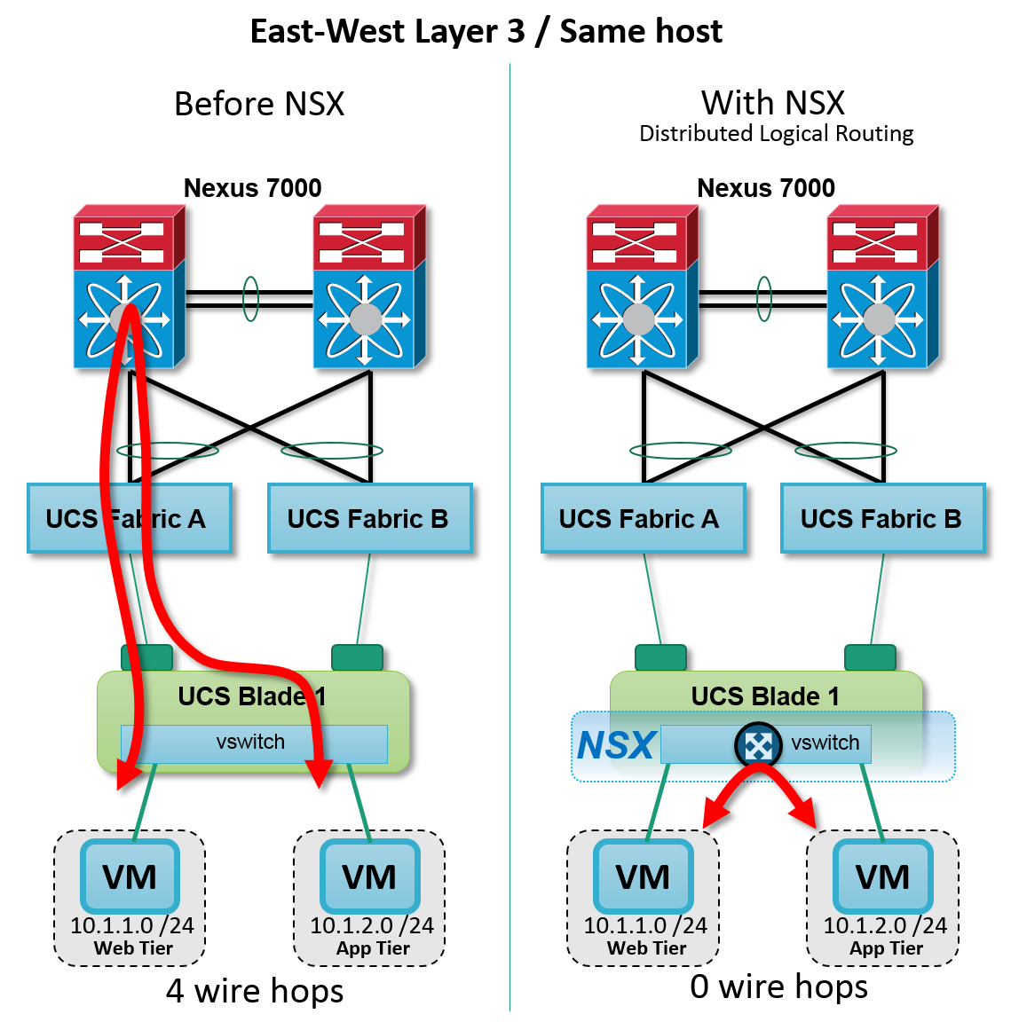
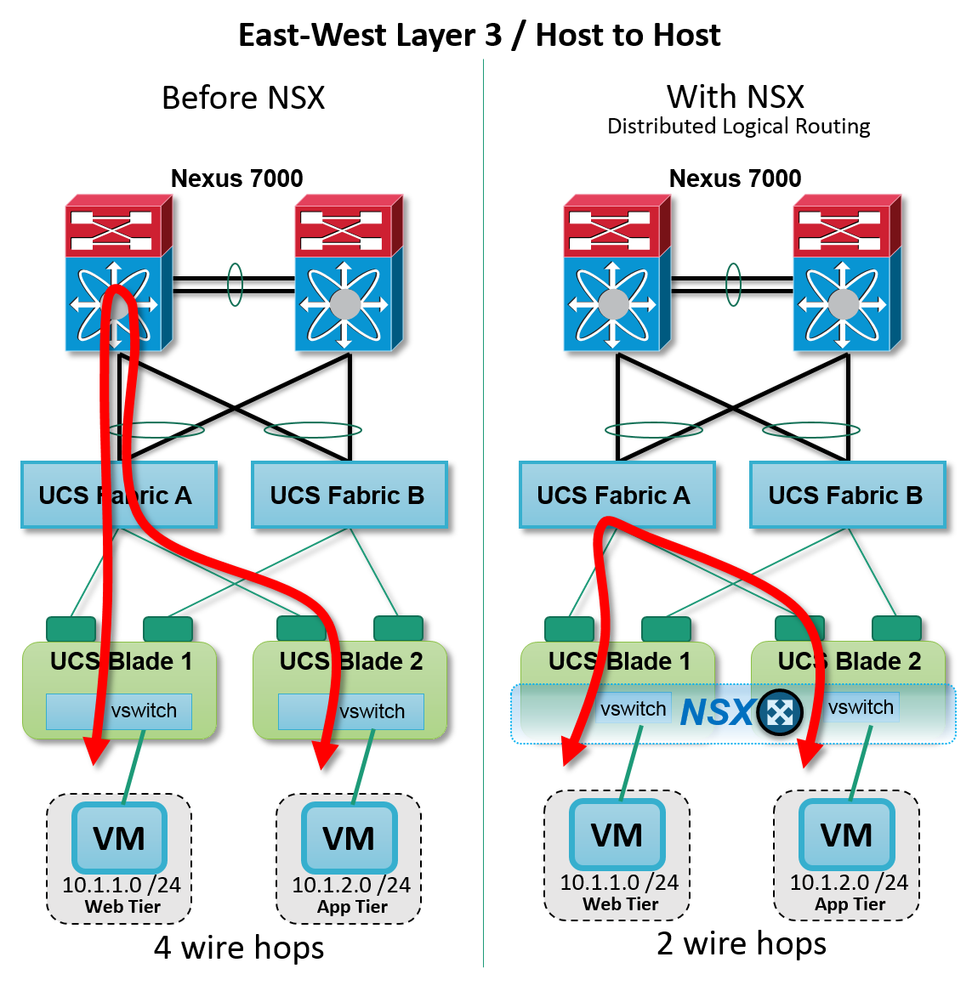
Non-Disruptive Deployment

Slide 32
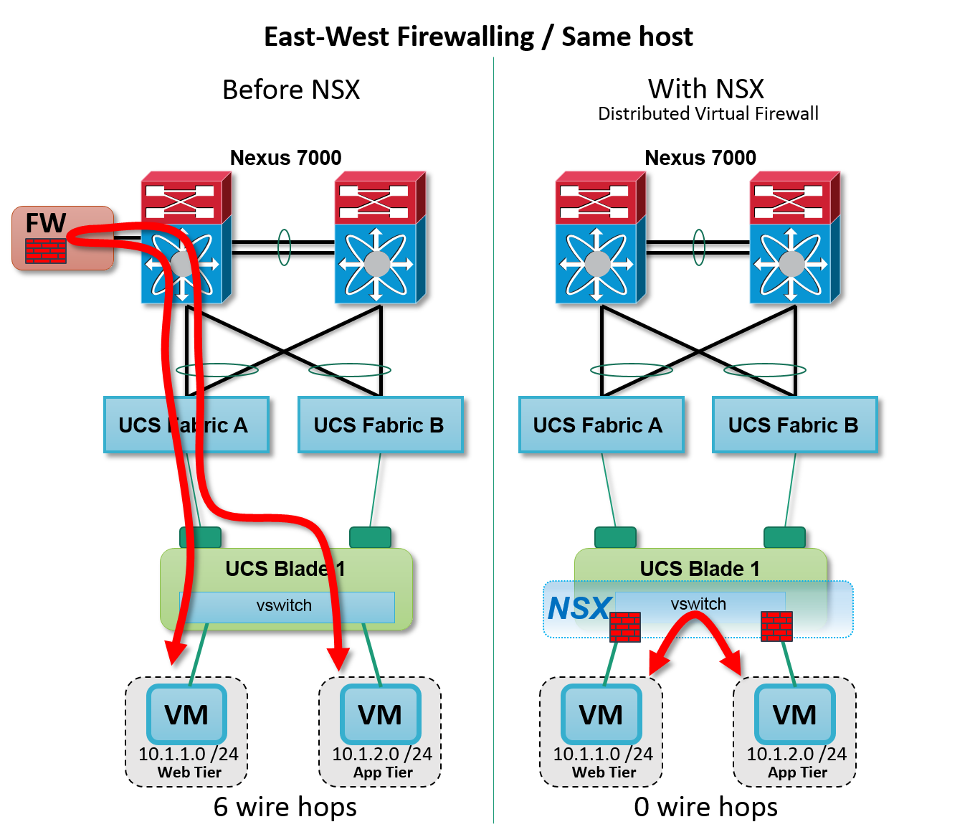
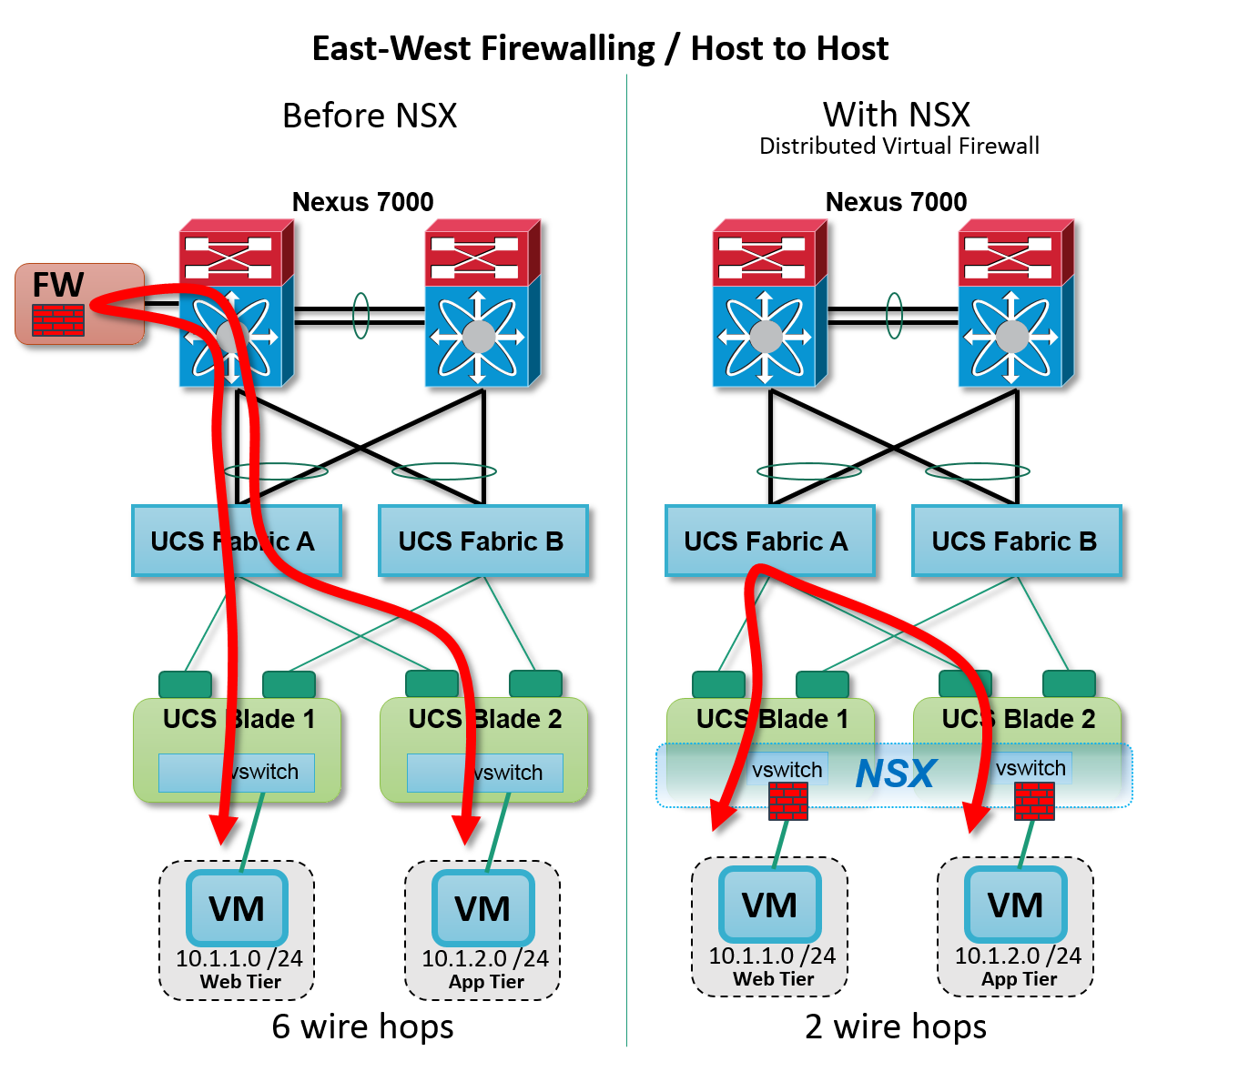
The Power of Distributed Network & Security Services & Policies

Slide 33
Applying the Magic – A Killer Application of SDDC
Leveraging the Power of SDDC Network & Security Services Distribution for Data Center Micro-Segmentation

Slide 34
Problem: Data Center Network Security
Perimeter-centric network security has proven insufficient, and micro-segmentation is operationally infeasible
Data Center Perimeter
Data Center Perimeter
Internet
Internet
Little or no
lateral controls
inside perimeter
Insufficient
Operationally
Infeasible

Slide 35




Solution: Leverage SDDC Approach for Micro-Segmentation
Hypervisor-based, in kernel distributed firewalling
Platform-based automated provisioning and workload adds/moves/changes
VM
Security Policy
Cloud
Management
Platform
VM
VM
VM
VM
VM
Internet
VM
vSwitch
Perimeter
Firewalls
vSwitch
Hypervisor
Hypervisor
Physical Host
Physical Host

Slide 36

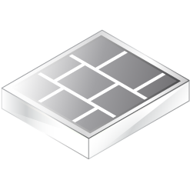
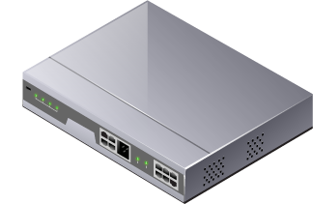
There is a BIG difference…
VM
VM
VM
Hypervisor
VM
VM
VM
Hypervisor
VM
VM
VM
Host
Hypervisor
VM
VM
VM
Host
Hypervisor
Host
Distributed Firewalling
VM
VM
Host
VM
Automated Policy Mgt & Operations, Distributed Enforcement
Kernel-based Performance, Distributed Scale-out Capacity (20 Gbps/host)
Physical Firewalls
Traditional Firewall Rule Mgt & Operations
Physical Firewalls (2 – 100 Gbps)
Hypervisor
Host
Virtual Firewalls
Traditional Firewall Rule Mgt & Operations
Virtual Firewalls (1 – 3 Gbps)

Slide 37
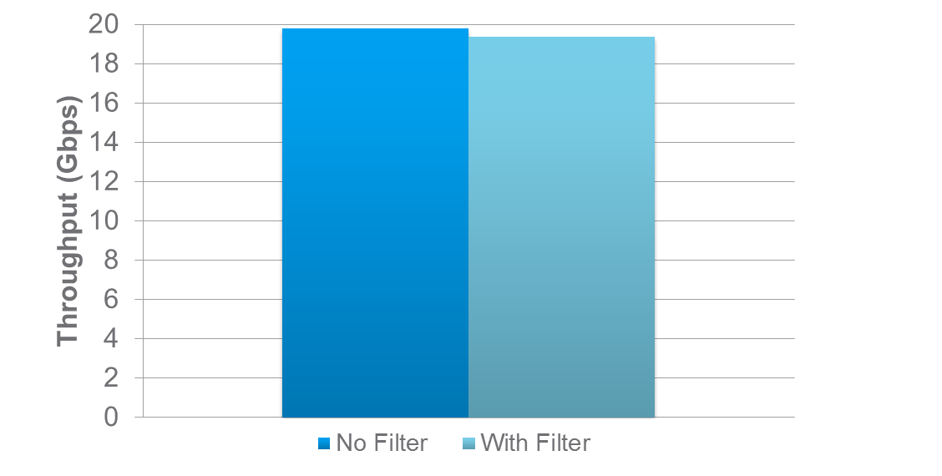
NSX Distributed Firewalling Performance
20Gbps Per Host of Firewall Performance
with Negligible CPU Impact

Slide 38
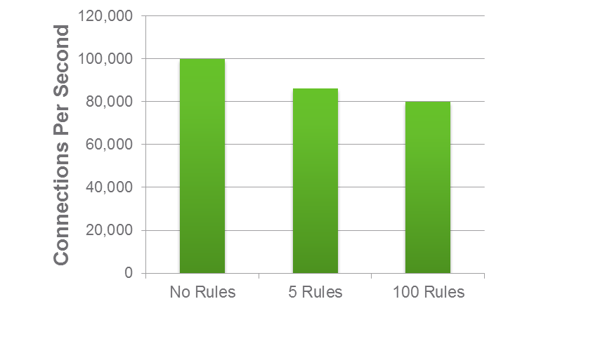
NSX Distributed Firewalling Performance
80K CPS with 100+ Rules per Host
A Typical Virtual Appliance does ~6K CPS per VM
A Physical Appliance performs 300K – 400K CPS per appliance

Slide 39
SDDC Platform – Native Security Capabilities
Hypervisor-based, in kernel distributed firewalling
High throughput rates on a per hypervisor basis
Every hypervisor adds additional east-west firewalling capacity
Native feature of the VMware NSX platform
Platform-based automation
Automated provisioning and workload adds/moves/changes
Accurate firewall policies follow workloads as they move
VM
VM
VM
NSX vSwitch
Hypervisor
Physical Host
Data center micro-segmentation
becomes operationally feasible
20 Gbps Firewalling
throughput per host

Slide 40


Isolation
Segmentation
Service Insertion
Dev
Web
Web
Test
App
App
Production
DB
DB
No
Communication Path
Controlled
Communication Path
Advanced Services Controlled
Communication Path

Slide 41



Advanced Services Insertion – Example: Palo Alto Networks NGFW
NSX
Controller
Security Admin
Security Policy
VM
VM
VM
Internet
VM
Traffic
Steering
vSwitch
vSwitch
Hypervisor
Hypervisor
Physical Host
Physical Host

Slide 42
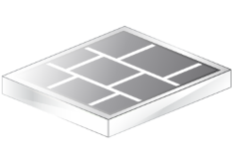


Automated Security in a Software-Defined Data Center
Data Center Micro-Segmentation
W
W
W
A
A
A
D
D
D

Slide 43

Automated Security in a Software-Defined Data Center
Data Center Micro-Segmentation
W
W
A
D
D
A
W
W
A
A
D

Slide 44


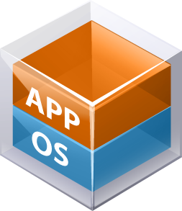






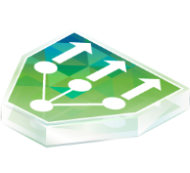

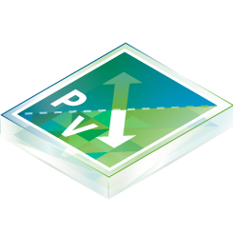


Automated Security in a Software Defined Data Center
Quarantine Vulnerable Systems until Remediated
Security Group = Quarantine Zone
Members = {Tag = ‘ANTI_VIRUS.VirusFound’, L2 Isolated Network}
Security Group = Web Tier
Policy Definition
Standard Desktop VM Policy
☑ Anti-Virus – Scan
Quarantined VM Policy
☑ Firewall – Block all except security tools
☑ Anti-Virus – Scan and remediate
Software Defined Data Center
Virtual Network
Service Composer
Cloud Management

Slide 45








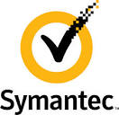





VMware NSX is the platform – extensive 3rd-party integrations
14 NSX technology partners with GA products as of Q3 2014, 50+ in pipeline
Notes:
Everything in physical must be timed…

Slide 46
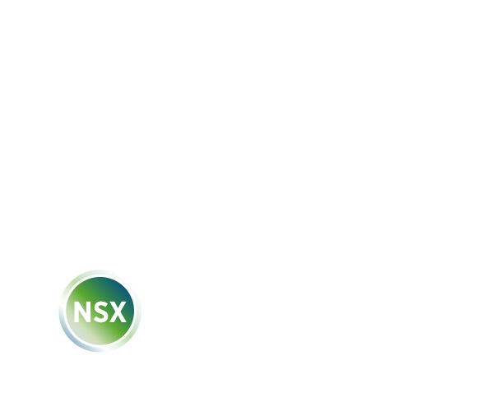
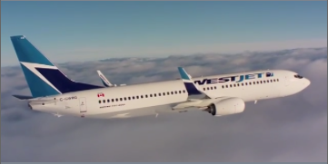

More information
NSX Certification and Training
www.vmware.com/products/nsx/
Learn how WestJet secured their network with NSX
www.vmware.com/go/NVtraining
#virtualizeyournetwork

Slide 47
Thank you

