Slide 1
Data Center IT Agility and Control:
Intel® Data Center Manager
No Time for Downtime
Dragos Georgescu – Intel Business Development Manager

Slide 2
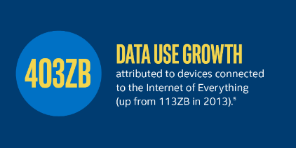
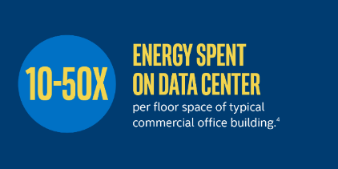

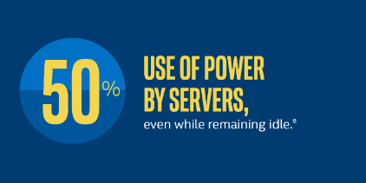
Why do we care about Data Center Management?
attributed to devices connected to the Internet of Everything
(up from 113ZB in 2013).⁵
⁵Upsite; ⁶Intel White Paper; ⁷NTT White Paper; ⁸Intel, Klaus
Notes:
Cred ca acest slide il puteti vedea mai in toate prezentarile despre Data Centere. Oricine este implicat in acest business stie ca este o piață în tranziție rapidă. De la explozia conceptului de public si private Cloud, pana la virtualizare și securitate, orchestrație și provisioning, Intel și o serie de alte companii s-au implicat pentru a redefini ceea ce un este un centru de date și cum funcționează el.
Mai multe date inseamna si marirea capacitatii de procesare a lor. Aceasta procesare se face uneori prin aplicatii noi care stau pe echipamente noi. De aici si nevoia unor tool-uri software de management si administrare a resurselor existente.

Slide 3
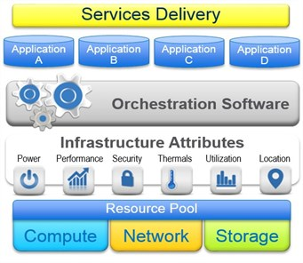
Notes:
Intel s-a implicat activ in dezvoltarea conceptului de SDI – Software Defined Infrastructure. Viziunea Intel despre Software Defined Infrastructure este una a redefinirii centrelor de date prin optimizarea proceselor, cresterea vitezei de deployment a aplicatiilor și alocarea dinamica a resurselor bazate pe cerințele acestora. Totul se traduce prin cât de rapid se pot lansa in productie serverele si aplicatiile software, cât de bine sunt utilizate resursele de sistem pentru o functionare optima a acestuia.
Conceptul de SDI inseamna transformarea celor 3 componente fizice (serverele, storage-ul si reteaua) intr-un singur pool de resurse virtuale, alocate intr-un mod dinamic diferitelor aplicatii.
Softul a devenit mult mai important in comparatie cu hardware-ul.
Agilitatea, performanta si eficienta sunt cheia unui Data Center modern.

Slide 4
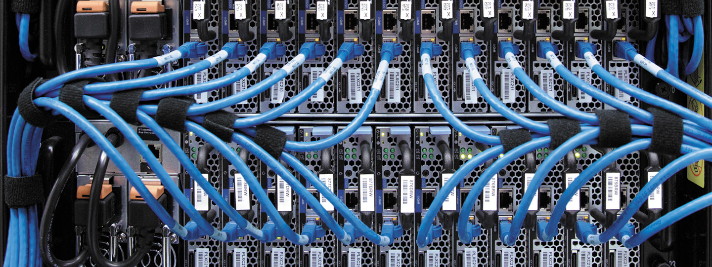
Intel® Data Center Manager

Slide 5

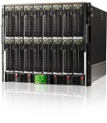











Intel® DCM Technology
  A middleware with web service APIs for data center power and
  thermal management
Maguay DCM Console
DCM Middleware (Web Service API)
MONITOR
CONTROL
TREND
SCALABILITY
STANDARDS
Hardware Protocols
Node Manager
IPMI
iDRAC IPMI
iLO/DCMI
IPMI
IMM
IPMI
CMC
HTTPS/WS-MAN
OA
SSH/CLI
IMM
SSH/CLI
SNMP
Rack Servers
Blade Servers
PDU and UPS
http://software.intel.com/sites/datacentermanager/supported-devices.php
IPMI = Intelligent Platform Management Interface iDRAC = Integrated Dell Remote Access Controller iLO = Integrated Lights-out
IMM = Integrated Management Module CMC = chassis management controller OA = Onboard Administrator
SNMP = Simple Network Management Protocol CLI = command line interface SSH = Secure Shell
WS-MAN = Web Services-Management DCMI = Data Center Manageability Interface
Intel Confidential
Copyright © 2011, Intel Corporation. All rights reserved.
*Other brands and names are the property of their respective owners

Slide 6
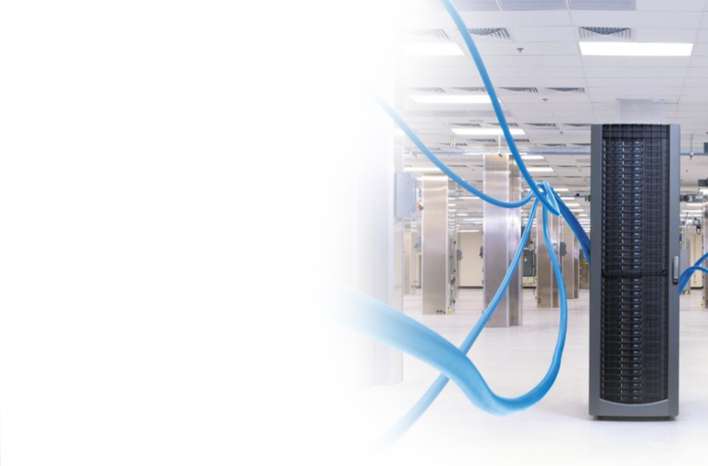
Intel® DCM Console Delivers
Real time Power and Thermal Data for racks/ blades
Policy Based Power capping for racks/ Blades
IT Device Power (PDU, UPS, Network, Storage)
Aggregated Control
Historical Trending
Cross Platform Support
Intel DCM Console delivers the data center power management solution

Slide 7
Intel® Virtual KVM Delivers
  Real-time Visibility and Control for IT Assets
  Racks/Blades/Storages/Networks
  Consolidated Central Access
  One-to-many solution
  Cross OEM Vendors Support
  HP, IBM, Dell, Fujitsu, Lenovo, Sun, and etc.
  Full Device Coverage
  Combined OOB and IB Access
Notes:
Real-time Visibility and Controls for IT Assets
Getting to the systems is critical when issues happen. The Intel Virtual Gateway improves response time using proven OOB functionality that provides a remote console quickly using existing functionality previously integrated into hardware. Further Intel Virtual Gateway offers control capability that allows for systems to shutdown remotely.
Consolidated Central Access to racks/blades
Access to a system console for maintenance or error resolution is easer then ever using virtual Gateway because it supports standard protocols that enable remote sessions and its centralized management interface / API for easy integration and administration
Full Device Coverage with Combined OOB and IB Access
Virtual Gateway is an efficient solution that’s flexible adapting to what the server community can support. This offers the administrator choices of what remote control capability to use.
Cross OEM Vendors Support
(HP, IBM, Dell, Fujitsu, Lenovo, Sun, and etc.)
SDK for Easy ISV Solution Integration
Virtual KVM is an integral element that can fold into other solutions enhancing time to market, and support speed for any software provider looking to enter the market quickly.
The API supports flexibility and sound linkages between components while allowing innovation.

Slide 8
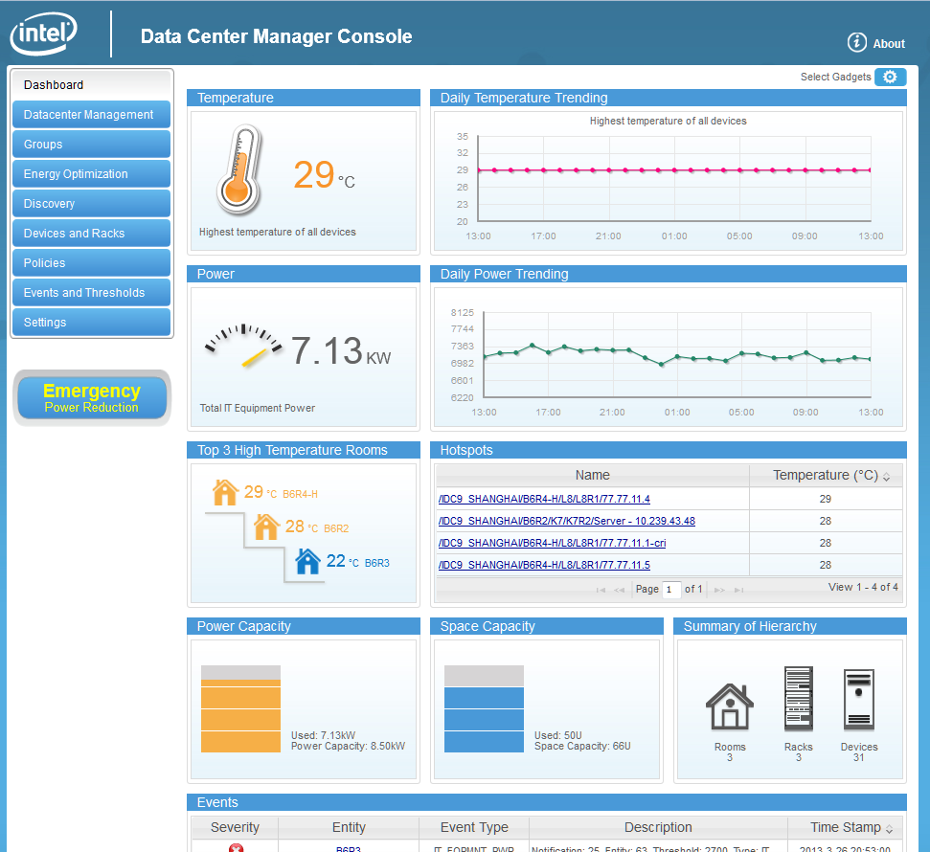
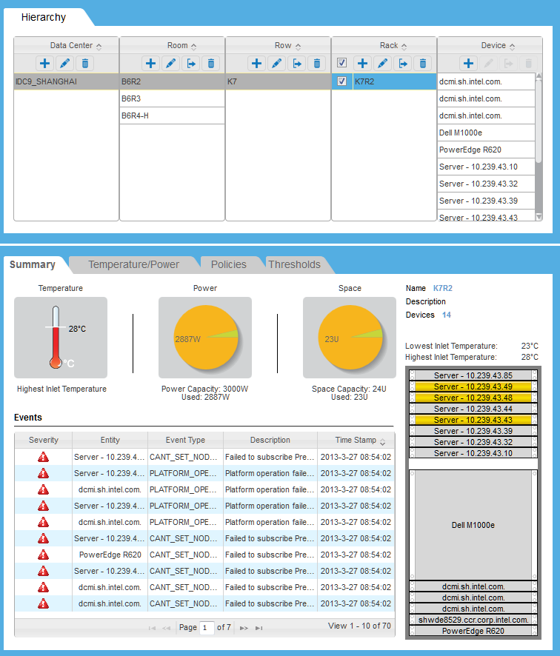
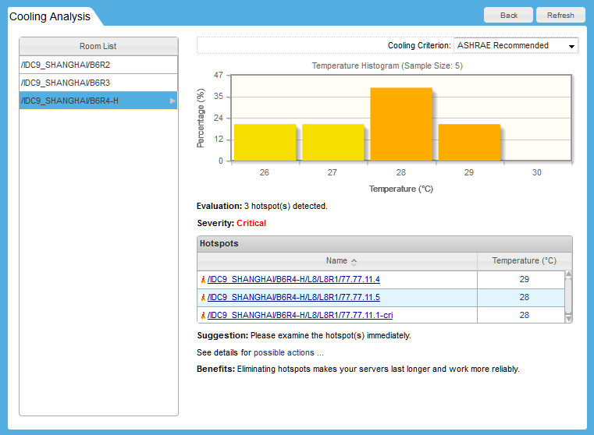
Maguay Console Dashboard View
Easy to Deploy and Use!

Slide 9
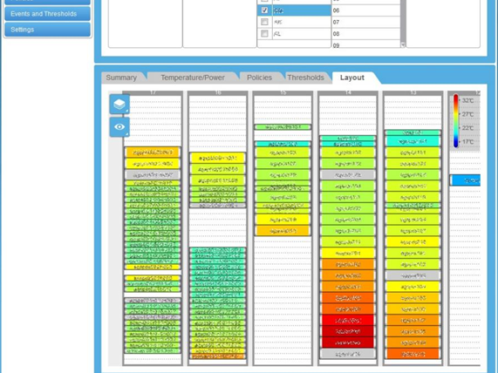
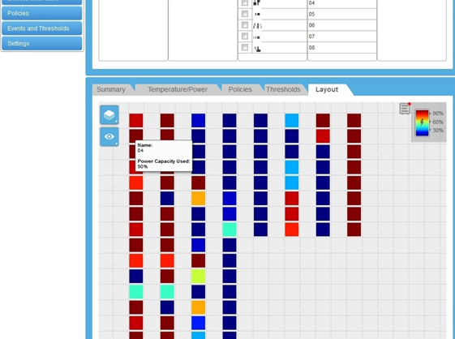
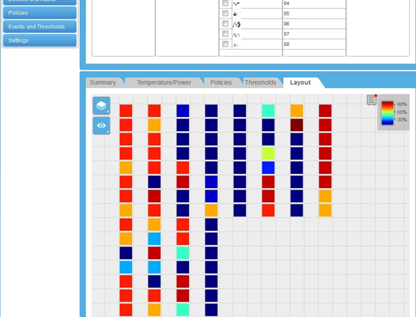
Built-in Analytics in Console
Space Capacity
Temperature layout
Power Capacity
Built-in Analytics to drive Data Center Efficiency, Consolidation and server refreshes

Slide 10
Reasons to Deploy Intel® SW Consoles with HW
  Data Center Manager
  Showcase/Utilize the latest energy efficiency technology built in the HW platform and drive refresh
  More efficient capacity planning/ provisioning based upon real power and thermal data and power capping capabilities. Get 10% - 20% - 30% more capacity of each rack.
  Identify and consolidate under-utilized servers/ghost servers estimated
  Maximize energy consumption based upon actual energy usage.
Virtual KVM Gateway
  Server diagnostics and troubleshooting. Analyze server logs. Configuration changes or verification
  Checking BIOS settings and BIOS configuration
  Remote power cycling
Use these solutions to fully utilize the built-in technologies of latest generation Servers

Slide 11




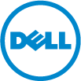

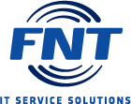



























Intel® DCM Deployment Options for End User
Notes:
SPEAKER NOTES:
This foil shows the existing customers who are using DCM in their SW stack

Slide 12












Intel® DCM Case Studies
Power Monitoring
Increase Rack Density
Ghost Server Identification
Identify Power/Thermal Failure
Improve Thermal Profile
Power Management
Use
Large PRC IPDC
Reduced monthly data center electricity bill while peak power demand kept increasing
Allowed customers to increase rack density by 71%
by implementing Intel DCM
Identified 10 – 15% of underutilized servers and virtualized
those systems
UPS uptime can
be extended up to 15% with limited performance impact during power outage
Thermal data collection allows users to see 2D heat maps of the data center
Decreased power by 18% of KWh with little/no impact on performance
Top Japan Online Retailer
Customers
Charge back system allows facilities to correctly charge
colo and other service users
Up to 83% rack density increase within same power envelope with power management policy
With 13% of servers underutilized, one compute geo improved usage or terminated devices
Prolonging business continuity time by up to 25% during power outage
Dramatically improved thermal monitoring from floor level to device level
Saved 15%
power without performance degradation
Large PRC IPDC
Identifies peak electrical usage
and reduces usage by 18% during
peak hours
Monitoring capabilities and power consumption ceilings allowed up to a 60% increase in rack density.
$630k can be saved in 3 years for a 10k data center by consolidating low utilization servers
Existing alert infrastructure sped up market launch of new product
4°C increase expected to save 32% in power consumption for cooling
25% savings
on power consumption
with DCM and Node Manager

Slide 13
THANK YOU

