Slide 1

Intel® Server Technologies
@ ntfd 2016
    Bogdan Georgescu
    September, 2016

Slide 2



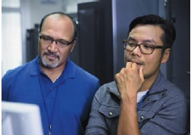




IT Challenges: What to Worry About Next?
Implement Private Cloud
Data Analytics
Performance Improvement
Energy Efficiency
Improved Utilization
Operating Expenses

Slide 3















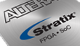


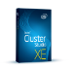







Bringing it all together – Intel’s Datacenter Portfolio
Processor Families
Platform Ingredients
Workloads
Intel® Server Platforms
2/4/8S
Intel® Xeon® processor
E7 family
Mission Critical
Intel® Datacenter SSD’s
Database
High Performance Computing
Intel® Omni Path Fabric Products
Intel® Xeon® processor
E5 family
Big Data
1/2/4S
Cloud
Intel® Ethernet Converged Network Adapters
Enterprise Infrastructure
SDN/NFV
Intel® Xeon Phi™ Coprocessors
Intel® Xeon® processor
E3 family
Enterprise Storage
1S
SMB
Workstation
Altera FPGA Products
Cloud Media
Webhosting
Network Edge
Intel® Compilers and Tools
SOC
Intel® Xeon® processor
D family
Micro
Servers
Appliances
Cold Storage
Intel® Cache
Acceleration Software
SOC
Intel® Atom™ processor product family
Intel® Data Centre Manager
Notes:
The Data Center Group is organized to address the breadth of opportunity and diverse requirements of our increasingly digital world. We provide foundational components across server, storage and network as well as partnering with leading software providers such as Cloudera to make easy to deploy, yet power analytics solutions broadly available. These components and solutions address the needs of a spectrum of customers including the enterprise IT segment, cloud service providers, telecommunication service providers and the technical computing segment. Intel’s portfolio supports multiple processor families to offer workload optimized options for today’s diverse user needs. Our leading processor families feature the industries 1st 64 bit enterprise class SoC, the Intel Atom processor, and the Intel Xeon processor which is at the heart of 9 out of every 10 servers sold today.

Slide 4






Intel® Xeon® Processor E3-1200
Delivering Value to Multiple Segments
Intel® Xeon® Processor E3-1200 v4
w/Intel Iris Pro Graphics P6200
Intel® Xeon® Processor E3-1200 v5
w/Intel HD Graphics P530
Intel® Xeon® Processor E3-1200 v5
without integrated graphics
Data Center Graphics
Workstation
Small Business
Energy efficient; Visually amazing
Built for Pros – your work demands
reliability, stability & performance
Equip your SMB w/ a “Real Server”
Density optimized Servers
Comms & Intelligent Sys
Storage
Right sized processing for webscale workloads & deployment
Enabling the internet of things
Energy efficient; Faster I/O

Slide 5




Ideal Entry-Level Server Platform:
Intel® Xeon® Processor E3-1200 v5 Product Family
Increase productivity with Intel® Turbo Boost Technology, Intel® Hyper-Threading Technology, and more performance than previous generations¹
Protect small businesses with hardware-based security features like Intel® Data Protection Technology and Intel® Platform Protection Technology
Keep small businesses running smoothly with support for ECC memory, redundant storage, and remote management capabilities
Offer a smart investment with affordable platforms and business-class features like hot-swap hard drives, redundant power, and 24x7 reliability
1. Software and workloads used in performance tests may have been optimized for performance only on Intel microprocessors. Performance tests, such as SYSmark and MobileMark, are measured using specific computer systems, components, software, operations and functions. Any change to any of those factors may cause the results to vary. You should consult other information and performance tests to assist you in fully evaluating your contemplated purchases, including the performance of that product when combined with other products. For more information go to http://www.intel.com/performance

Slide 6

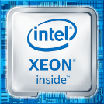

Introducing
Intel® Xeon® Processor E5-2600 v4 Product Family
Orchestration
Performance
Security
Introducing
Intel®
Resource Director Technology
Up to 22
cores per CPU
Up to 70%
more encryption performance per core²
Up to 44%
increased performance¹
with improved
malware protection & key generation
with improved
virtualization
Notes:
Key Message: Intel Xeon Processor v4 is purpose built for the cloud and offers the most advanced foundation for software defined infrastructure.
Story Line:
Let’s review our new Xeon E5 v4 processor and how it addresses these cloud requirements that I talked about: performance, orchestration, and security
Performance: in my mind Xeon E5 biggest strength is it delivers performance on such a wide range of workloads which is critical when you move to a cloud. We see great performance improvements at the same power across a wide range of server, storage, and networking workloads including up to 44% on various applications, in this case fluid dynamics. This is delivered by the Broadwell micro-architecture improvements, now up to 22 cores, increased memory bandwidth with DDR4 2400, and virtualization performance improvements including features that help reduce the number interrupts and that then lower the interrupt latency when you enter or exit an interrupt
We have also improved our AVX instructions in turbo mode allowing for cores to turbo independently based on AVX usage. Additionally, we now have TSX (transactional memory instructions) used on workloads like databases on Xeon E5 for the first time.
Orchestration. We are excited to announce a new set of hardware technologies optimized for orchestration – Intel Resource Director Technology. Intel Resource Director Technology allows orchestration software to monitor and control key resources. I will explain this in more detail in a bit later.
Finally security: customers want to run more securely, but must often must make a hard trade off and sacrifice performance to get the level of security required. To minimize this impact, we have made another leap forward on crypto performance and are offering up to 70% per-core crypto improvement via micro-architectural improvements and new instructions called ADCX & ADOX which improve large integer arithmetic. We also have a new malware protection feature called SMAP (Supervisor Mode Access Prevention). Finally, we have a new instruction called RDSEED which helps generate high quality keys to seed a pseudorandom number generator

Slide 7
Intel® Resource Director Technology
Orchestration
Before
With Intel resource director Technology
VM1
VM2
High Priority VM
Low Priority VM
Performance
Performance
Hypervisor
Hypervisor
Hardware
Hardware
Cache
Cache
Notes:
Key Message: Intel Resource Director Technology is an exciting new feature for cloud orchestration.
Storyline:
I want to now switch gears into orchestration and explain how the Intel Resource Director technology works in more detail.
Working with our customers over many years, we have been able to add silicon specific instructions for orchestration into the architecture. Basically, these are a set of Quality of Service (QoS) features to monitor and control caches and memory.
As you can see here, before Intel Resource Director Technology you could have a low priority VM2 hog the cache slowing down the high priority VM1. With RDT, the software can monitor usage and allocate the high priority VM1 its needed cache.
This is really important because it allows for cloud software to ensure they hit an SLA response time on key applications and then use the extra cycles for increased throughput on other applications that are not as time critical. And in networking when moving from fixed function networking to Network Function Virtualization (NFV), this includes the ability to while maintaining packet processing SLAs while also deploying new services on the same infrastructure.
Additional Information
Cache monitoring was released on Xeon E5 v3. Cache allocation technology (CAT) was released only on the networking SKUs on Xeon E5 v3 to get the long life networking SW transition started.. We also have twice the RMIDs (Resource Monitoring ID, 8/slice) on Xeon E5 v4 over Xeon E5 v3.
Intel RDT consists of four features: Cache Monitoring Technology (CMT), Cache Allocation Technology (CAT), Code and Data Prioritization (CDP), and Memory Bandwidth Monitoring (MBM). CDP is an extension of CAT which enables separate masks for code and data. This allows code to be protected at the L3 cache level for instance.
We have a broad OS/VMM enabling plan at the likes of Vmware, Xen/KVM, & others. Because it is new, not all these vendors are ready with support TTM w/ launch.

Slide 8












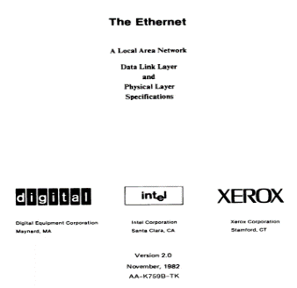
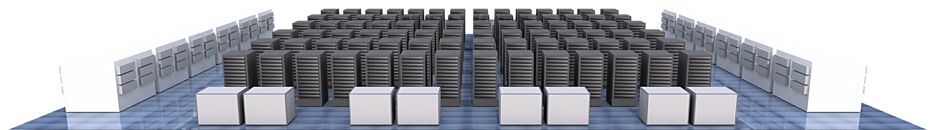

History of Intel® Ethernet Innovations
Intel ships world’s 1st
high-volume 10Mbps Si
1982
First Low Latency
Ethernet L3+router
2008
Intel Introduces 1st
Quad-port Adapter
2006
Intel Introduces
FCoE CNA
2010
Intel Introduces 1st
SDN Switch Silicon
2012
Intel ships world’s 1st
single-chip 10/100 Si
1997
Intel ships world’s 1st
dual-port 10/100/1000 Si
2002
Intel Introduces
Intel® I/OAT
2005
Intel Introduces
10Gb 82598 Si
2007
Intel ships world’s 1st
10/100 Adapter
1994
Intel ships world’s 1st
single-chip 10/100/1000 Si
2001
Intel ships 1st
10GBASE-LR Adapter
2003
First Low Latency
DC Switch Silicon
2006
Intel Introduces
VMDq on 82575
2007
Intel Introduces 1st
10Gb Integrated PHY
2009
Intel ships world’s 1st
Single chip 10GBASE-T CNA
2012
Intel launches XL710 40 GbE silicon and Adapters
2014
1982
1990
2000
2002
2004
2006
2008
2010
2012
2014
2015
1990
IEEE 802.3a
10BASE-T
1998
IEEE 802.3z
1000BASE-SX
2002
IEEE 802.3ae
10GBASE-SR/LR
2005
Intel Co-authors
PCI-SIG SR-IOV
2006
IEEE 802.3an
10GBASE-T
2007
Intel open sources
1st FCoE stack
2011
IEEE 802.1Q-amend.
Data Center Bridging
2015
Intel® Ethernet Switch FM10000 Series (Red Rock Canyon Compute Fabric)
1980
Digital, Intel, Xerox
Ethernet specification
1985
IEEE 802.3
10BASE5
1995
IEEE 802.3u
100BASE-TX
1999
IEEE 802.3ab
1000BASE-T
2003
iSCSI Software Initiator
for Windows & Linux
2005
IEEE 802.1Q
VLAN Bridging
2007
IEEE 802.3ap
10GBASE-KX/KX4
2010
IEEE 802.3ba
40GBASE-SR/KR4
100GBASE-SR10/LR4
2012
IEEE 802.1Qbg
Edge Virtual Bridging
Ethernet
Fast
Ethernet
Gigabit
Ethernet
10Gb
Ethernet
40Gb
Ethernet
100Gb
Ethernet
Notes:
We hit the 1 Billion Intel Ethernet ports shipped mid-2014
Key Message: Intel has been evolving the Network and Ethernet since it co-authored the original blue book in 1980 by developing Ethernet Controllers, server platforms, enabling ecosystem partners and enhancing the Ethernet standard. Even with all the evolution and innovation that has happened over the past 30 years, Intel® Ethernet products are designed for simplicity, low cost, compatibility, and flexibility which are the same goals for Ethernet that Intel helped define back in 1980. Following these goals has made Intel the leading supplier of Ethernet components worldwide for over three decades.
Presentation Points:
Intel and the continuing evolution of Ethernet
Since the inception of Ethernet, Intel has continued to help drive Ethernet technology by providing technological advances and active leadership in standards committees and industry associations. The company has planned a key role in developing faster standards, delivering architectural innovations, and fostering networking product growth into new market segments. Intel was a founding member of the Fast Ethernet Alliance (100 Mbps) in 1993, the Gigabit Ethernet Alliance (1000 Mbps) in 1996, the 10 Gigabit Ethernet Alliance in 2000, and the broader Ethernet Alliance in 2006.
Goals for Ethernet… taken from the 1980 Blue Book
Simplicity: Features which would complicate the design without substantially contributing to the meeting of the other goals have been excluded.
Low cost: Since technological improvements will continue to reduce the overall cost of stations wishing to connect to the Ethernet, the cost of the connection itself should be minimized.
Compatibility: All implementations of the Ethernet should be capable of exchanging data at the data link level. For this reason, the specification avoids optional features, to eliminate the possibility of incompatible variants of the Ethernet.
Addressing flexibility: The addressing mechanisms should provide the capability to target frames to a single station, a group of stations, or to all stations on the network.
Fairness: All stations should have equal access to the network when averaged over time.
Progress: No single station operating in accordance with the protocol should be able to prevent the progress of other stations.
High speed: The network should operate efficiently at a data rate of 10 Megabits per second.
Low delay: At any given level of offered traffic, the network should introduce as little delay as possible in the transfer of a frame.
Stability: The network should be stable under all load conditions, in the sense that the delivered traffic should be a monotonically non-decreasing function of the total offered traffic.
Maintainability: The Ethernet design should allow for network maintenance, operation, and planning.
Layered Architecture: The Ethernet design should be specified in layered terms to separate the logical aspects of the data link protocol from the physical details of the communication medium.
Some Intel achievements include:
Intel ships world’s first high-volume 10Mbps Si in 1982
The world's first 10/100 Mbps network interface card (NIC) in 1994.
The first single-chip 10/100 Mbps controller in 1997.
The first single-chip 10/100/1000 Mbps controller in 2001.
In 2002, Intel shipped the first XPAK Multimode Optical Transceiver delivering 10-Gigabit Ethernet and
10-Gigabit Fibre Channel transport for storage systems at half the cost, a third less power consumption and a third of the size of earlier solutions. The world's first 10 Gigabit Ethernet NIC in 2003.
In 2006, Intel introduced the first low-profile quad-port Ethernet network interface card (NIC). By incorporating four Gigabit Ethernet connections in a low-profile PCI Express slot, it improved server throughput and rack density at the same time.
Industry firsts from the switch products. They include:
2006: Industry's lowest latency Ethernet L2 switch (250ns)
2008: Industry's lowest latency Ethernet L3+ router (300ns)
In 2007, Intel released first "initiator" source code to enable Linux implementations of Fibre Channel over Ethernet (FCoE). By allowing fiber channel SAN traffic to run over Gigabit Ethernet networks, FCoE enables consolidation of storage area network (SAN) and LAN traffic, simplifying network infrastructure in datacenters.
Intel Introduces 1st Intel® Ethernet Converged Network Adapter in 2011
Intel ships world’s 1st Single chip 10GBASE-T CNA in 2012
Intel Introduces 1st 40GbE SDN Switch Reference Design in 2012

Slide 9

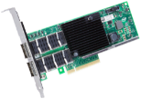

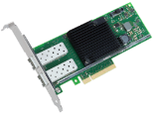

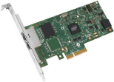

When Technologies fit
Time to Load
Storage
Network
Transfer Times
Solid State Drive
NVMe Flash Memory
40GbE
Best
36 Sec
Intel® SSD
DC P3700 Series
PCI Express* Interface
Intel® Ethernet CNA
XL710-QDA2
22 Sec
Solid State Drive
NAND Flash Memory
10GbE
Better
3 Min 24 Sec
Intel® SSD
DC S3520 Series
SATA Interface
1 Min 22 Sec
Intel® Ethernet CNA
X710-DA2
Spinning Disk
Serial Attached SCSI
1GbE
Good
15 Min 48 Sec
15K SAS
Hard Disk Drive
14 Min 40 sec
Intel® Server Adapter
I350-T2
100GB file calculated time to load and transfer times
Source as of Aug 2014: Based on Intel SSD product data sheet Sequential Read and transfer time calculations of a 100GB file over the given Ethernet speed
Notes:
P3700 Data Sheet: Performance measured using Iometer* with 128 KB (131,072 bytes) of transfer size with Queue Depth 128. Power mode set at 25W.
Sequential Read (up to) 2,800MB/s
S3500 Data Sheet: Performance measured using Iometer* with 128 KB (131,072 bytes) of transfer size with Queue Depth 32.
Sequential Read (SATA 6Gb/s) 500MB/s
Need SAS Test Details:
Estimated Sequential Read (SAS) 108MB/s

Slide 10
Memory–Storage Gap
CPU
DDR
Latency
Insufficient performance
Expensive
No resiliency
Gartner: NAND ~5% undersupplied by ‘17*
Gartner: DRAM ~14% undersupplied by ‘17*
NAND SSD
Hard Disk Drives
Notes:
KEY POINT: These emerging usages open up a gap in today’s memory-storage hierarchy.
DDR is expensive, and technology limitations in its design will prevent it from moving down to fill the gap at a price most customers would pay. It also lacks resilience through a power cycle.
Sound bite: “A typical server today is configured with 128 GB of DDR which costs $1000. To configure a server with 2TB of DDR would cost $16,000!”
NAND, the NVM technology in today’s SSDs, can’t fill the gap, either. Latencies are too long and performance to low to satisfy the requirements of all three usage models. Even in a DIMM form factor, NAND does not have sufficient performance and too much latency.
Sound bite: DDR4 averages about ~100 nanosecond latency. Today’s NAND SSD has latency ~70 microseconds. Also, SSDs are block devices. They require data to be constructed into blocks (e.g. 4KB, rather than 64B cache lines) before it can be read or written. What happens if only a few cache lines within the block are needed, you are wasting time transferring data you do not care. NAND is not a substitute for DDR.

Slide 11
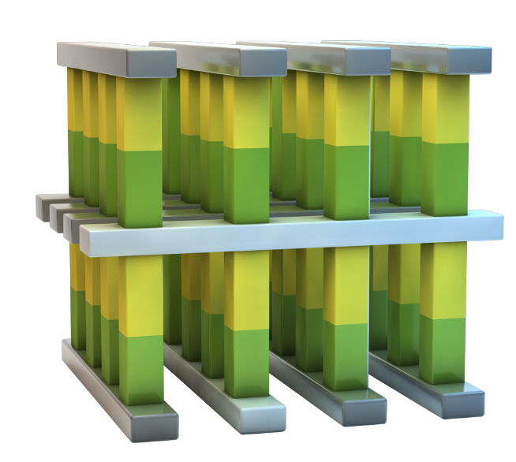
3D Xpoint™ Technology
Breakthrough Material Advances
Compatible switch and memory cell materials
Cross-Point Structure
Selectors allow dense packing
and individual access to bits
Scalable
Memory layers can be stacked in a 3D manner
High Performance
Cell and array architecture that can switch states 1000x faster than NAND

Slide 12
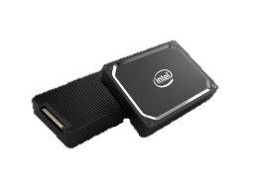
Intel’s Solution
CPU
DDR
Apache Pass
(3D XPoint™ based DIMM)
Coldstream
(3D XPoint™ based NVMe SSD)
NAND SSD
Hard Disk Drives
Notes:
KEY POINT: Intel has a strategy and product roadmap to fill the gap and meet the need of all three usage models.
First, we’ll scale up with SSDs based on our next-generation NVM technology. This is a breakthrough technology beyond today’s NAND-based devices. Although not as low latency as DDR, NG-NVM latency will be close enough that its advantages really shine through.
Sound Bite: DDR4 latency ~100ns. NG-NVM latency ~300ns, approximately equivalent to DDR2-800.
Second, we will use the same next-gen NVM in a DIMM form factor to deliver a memory solution that rivals DDR performance with the cost and resiliency advantages of NVM.
These products will deliver amazing performance and capacity at an affordable cost. Intel created critical IP in the DIMM controller, memory controller on the processor, and the NVM technology that will put us in a strong competitive position. If we execute, we have the opportunity to build a multi-billion dollar business with increased share-of-wallet.
Sound Bite: A 2-processor Purley-EP can accommodate up to 6 TB of Apache Pass, 12 TB in a 4-processor Purley-EX platform.
Why deploying NG-NVM in both NVMe SSD and DIMM? NVMe SSD comes in a larger form factor than DIMM, can support more capacity per device and hot add/remove. On the other hand, NG-NVM on a DIMM can take advantage of the high bandwidth DDR4 bus, delivers higher performance and lower latency than NVMe SSD can.

Slide 13
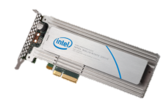






Storage Evolution
Yesterday
Today
Near Future
Memory
&
Storage
Revolutionary
Storage
Class Memory
3D XPoint™ based
Apache Pass (AEP) for DDR4
World’s Fastest
NVMe SSD
3D XPoint™ based
Coldstream SSD for NVMe
Storage
NAND based Intel P3700
(Fultondale) for NVMe
3D XPoint enables world’s fastest NVMe SSD and revolutionary storage class memory

Slide 14
Intel® optane™ ssds
NAND SSD technology offers ~500X reduction in latency versus HDD
Latency (uS)
NVMe eliminates 20 µs of latency today
10,000
100
Intel® Optane™ SSDs reduce NVM latency, offering ~10x reduction in latency versus NAND SSD
175
150
125
100
75
50
25
0
HDD
+SAS/SATA
NAND SSDs
+SAS/SATA
NAND SSDs
+NVMe™
Optane™ SSDs
+NVMe™
Drive Latency
Controller Latency
(ie. SAS HBA)
Software Latency
Source: Storage Technologies Group, Intel
The latency comparisons above include internal Intel estimates for the SSD NAND NVMe™ and SSD with Intel® Optane™ technology

Slide 15
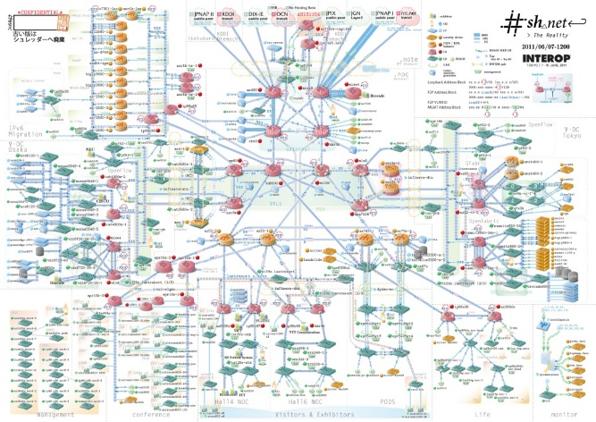
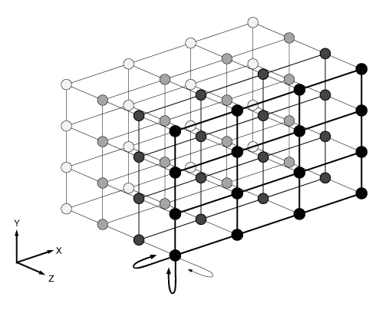
What is Different Between Networks and Fabrics?
Network: Universal interconnect designed to allow any-and-all systems to communicate
HPC Fabric: Optimized interconnect allows many nodes to perform as a single system
Intel® Omni-Path Architecture
Key NETWORK (Ethernet) Attributes:
  Flexibility for any application
  Designed for universal communication
  Extensible configuration
  Multi-vendor components
Key FABRIC Attributes:
  Targeted for specific applications
  Optimized for performance and efficiency
  Engineered topologies
  Single-vendor solutions

Slide 16
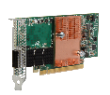


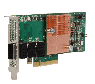



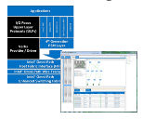


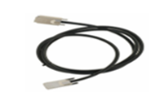
Intel® Omni-Path Architecture
Evolutionary Approach, Revolutionary Features, End-to-End Solution
Building on the industry’s best technologies
  Highly leverage existing Aries and Intel® True Scale fabric
  Adds innovative new features and capabilities to improve performance, reliability, and QoS
  Re-use of existing OpenFabrics Alliance* software
  HFI Adapters
  Single port
  x8 and x16
  Edge Switches
  1U Form Factor
  24 and 48 port
  Director Switches
  QSFP-based
  192 and 768 port
x16 Adapter
(100 Gb/s)
768-port
Director Switch
(20U chassis)
48-port
Edge Switch
x8 Adapter
(58 Gb/s)
24-port
Edge Switch
192-port
Director Switch
(7U chassis)
  Silicon
  OEM custom designs
  HFI and Switch ASICs
  Software
  Open Source
  Host Software and
  Fabric Manager
  Cables
  Third Party Vendors
  Passive Copper Active Optical
Robust product offerings and ecosystem
  End-to-end Intel product line
  >100 OEM designs¹
  Strong ecosystem with 70+ Fabric Builders members
HFI silicon
Up to 2 ports
(50 GB/s
total b/w)
Switch silicon
up to 48 ports
(1200 GB/s
total b/w
¹ Source: Intel internal information. Design win count based on OEM and HPC storage vendors who are planning to offer either Intel-branded or custom switch products, along with the total number of OEM platforms that are currently planned to support custom and/or standard Intel® OPA adapters. Design win count as of November 1, 2015 and subject to change without notice based on vendor product plans. *Other names and brands may be claimed as property of others.
Notes:
Host-Fabric-Interface
Feature details:
Traffic Flow Optimization: configuring enables ability for a higher priority job packets to be moved without waiting for the (possibly very long) lower priority packets to completely traverse a interleaved link. This mechanism substantially reduces latency variation in the network, while still allowing very large (efficient) packets for bulk data operations. The result of this is a highly robust link, with low latency, providing almost all of the available physical bandwidth to packets.
Dynamic Lane Scaling: is designed to maintain link continuity in the event of a failure of one of more physical lanes (each link contains four lanes). Upon a lane(s) failure, Intel® OPA operates with the remaining lanes until the failure can be corrected at a later time. This enables a workload to continue to completion. In contrast, InfiniBand will shut down the entire link.
Packet Integrity Protection (PIP) allows for rapid and transparent recovery of transmission errors on an Intel® OPA link without any additional latency. This is in sharp contrast to the heavy latency penalty associated with alternate error recovery approaches such as Forward Error Correction (FEC).

Slide 17
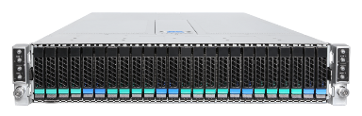
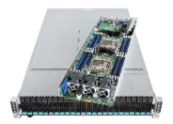
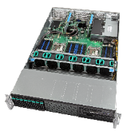
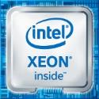




Intel® Server Products for HPC – ‘blocks’ definition
New for
2016
Market Access
New opportunity with pre-certified and validated block
Increased value
Faster time to market, cost effective, configured to needs
Drive Innovation
Focus resources on value-add and differentiation
SW Certification
Other
required
3rd Party
component
+
+
+
+
+
Boards, Chassis
Processors
Enterprise
SSDs, NVMe*
3rd Party Memory
2
http://www.intelserveredge.com/intel-cloud-block-vsan/
1: 3rd party SW stack and HDD NOT included.
2: White Paper Design Guide, not preconfigured SKU
Notes:
Accelerating your path to cloud!
Cloud Blocks are an easy button approach. PCSD has put together the key ingredients to successfully deploy ISV validated systems easily.
We created the Cloud Block concept that comprises of:
Board, chassis, processors, Enterprises SSDs (SATA and/or NVMes), 3rd party memory and the whole validation and certification process with VMWARE vSAN
It does not include 3rd party SW stack and HDD (when applicable)
High quality system tested and certified by Intel and the software vender - easy approach to deploy Private Cloud and Software Defined Storage.

Slide 18
Va multumesc!

