Slide 1
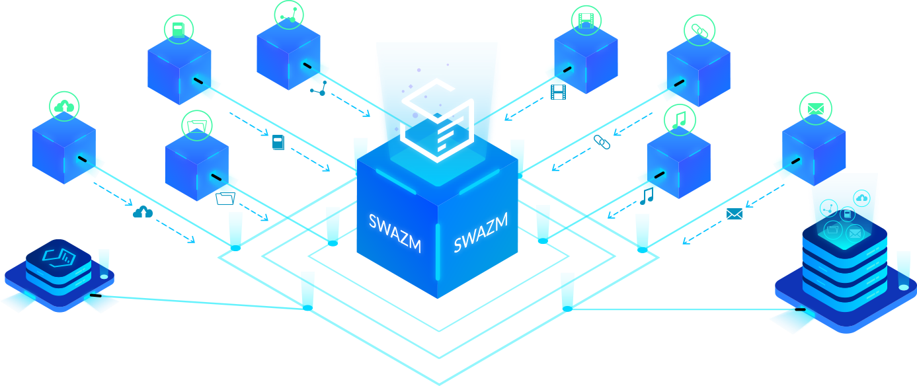
A new infrastructure to power the decentralization wave

Slide 2
What’s the problem ?
Millions of users
Continuous delivery
Network speed
To scale up and into mainstream, each Dapp must perform flawlessly, serving tens, if not hundreds of millions of users at the same time.
Businesses or developers need the flexibility to enhance their applications with new features or to deploy fixes to patch bugs or security holes.
Traditional applications today rely on a very short feedback loop, no more than a few seconds. Longer page loads, long responses and delays frustrate the end user. Fast network speeds are a huge advantage for the traditional application market.

Slide 3
What else ?
Decentralized Storage
Microservice Architecture
Localized Deployment
This reality suffers from all the weakness associated with the trust-based model. The traditional cloud is vulnerable to a variety of security threats, like man-in-the-middle attacks, malware and infrastructure flaws which may expose sensitive data from private and corporate parties.
When it comes to “the right tool for the right job”, applications should not be limited to a certain programming language that isn’t robust enough to handle all the requirements. Instead, the right platform should allow the use of existing technologies that run on industry standard stacks and operating systems to aid in scaling the applications.
Deploying an application in the place where your target market resides is critical in creating the best user experience. The competition for user attention is at an all-time high and tech products that load faster, with smoother transitions and the lowest waiting times are prefered by the end user.

Slide 4
SWAZM
Advantages
Powerful and flexible blockchain computing and storage engine
SWAZM is a powerful and flexible blockchain computing and storage engine which aims to use any existing unused computing power, storage and bandwidth. We want to put these resources to good use, to serve the needs of real-world financial businesses, ICOs and other organizations.
Any programming language
SWAZM DApps can be developed in any programming language that can run on top of the Linux microkernel. They can communicate and use existing available systems, not being forced to work with what's already in the blockchain.
Accelerated development lifecycle
SWAZM is changing the way DApps are created and accelerates the development lifecycle for blockchain applications. We do this by:
-allowing any existing programming language to be used inside its compute units
-control the environment where the application runs
-scale, debug and upgrade it on the fly
-select the geographical point where the compute units are deployed

Slide 5
SWAZM
Architecture
4
SWAZM Data Transfer Socket
The goal of SDTS is to be limited only by hardware, disk or NIC bandwidth but not by latency.
3
SWAZM Data Storage Layer
The goal of SDSL is to be a decentralized database and storage layer in order to handle large volumes of structured data across clusters of commodity servers. It organizes data and assures ACID transactions for all operations.
2
SWAZM Container Runtime
The SWAZM software introduces a new blockchain architecture designed to enable horizontal scaling of decentralized applications. This is achieved by creating a new blockchain with a reliable transfer network, storage capabilities, and compute containers. The software provides certificate authorities, authentication, storage and the scheduling of applications across many of CPU cores or clusters.
A SWAZM container bundle encapsulates all the information needed to load and run a container: a set of structured files, all the necessary data and metadata for SCL to perform the basic operations needed for compute.
1
SWAZM Vault Permission System
In SVPS a vault is an entity that issues digital certificates. A digital certificate certifies the ownership of a public key by the named subject of the certificate. This allows others (third parties such as developers or ephemeral contractors) to rely upon signatures or on assertions made about the private key that corresponds to the certified public key.

Slide 6
APPLICATIONS
Exchanges
Why would you build on swazm?
Due to the fact that SWAZM has support for interoperability, an exchange would have several advantages to be built on SWAZM:
-transparency
-decentralized nature
-community - it would be easier for developers to contribute, develop its wallets or the token mechanics

Slide 7
APPLICATIONS
DApps ICO
Why would you build on swazm?
There are numerous initiatives out there that hold vast promises into disrupting traditional technologies through the use of blockchain. Even though most of them are lacking the technology to achieve that, by taking advantage of SWAZMs decentralized storage and compute layers, they can easily develop the technology using the already existing programming languages and technologies. They would only be focused on what makes their product unique and leverage the SWAZM technology to deliver on that promise and reach their target market.

Slide 8
APPLICATIONS
Existing Hosting Providers
Why would you build on swazm?
By using SWAZM, existing hosting providers can leverage the power of their unused bandwidth/compute/storage infrastructure. By joining forces they would be able to monetize their resources in a democratic manner inside SWAZM and be part of a competitive infrastructure which can take on the biggest established players on the market.

Slide 9
APPLICATIONS
Storage Provider Applications
Why would you build on swazm?
By leveraging the technologies that SWAZM offers, like fast transfer technologies and decentralized storage, the community could build numerous applications that may challenge the traditional storage providers.

Slide 10
APPLICATIONS
Content Delivery Networks
Why would you build on swazm?
By leveraging the global city level distribution of SWAZM nodes, a content delivery network could leverage high speeds and targeted content storage for web assets, media or any kind of network. For example, there have been cases where huge media providers were forced to pay fees to ISP because the household connections were not performant enough to deliver the content in specific areas. SWAZM solves such cases by delivering peer to peer content through it’s storage layer.

Slide 11
SHOWCASE

Slide 12
Transparrent Operation Log
Internal Ledger
swazm Advantages
Realtime Logging
Decentralized User
Improved Security
Optimizing Interchain operability costs

Slide 13
Thank You
Email me at vali@swazm.com, @0x4139

