Slide 1
Intel Data Center Products
MAGUAY
No Time for Downtime
Presented by Aaron Voelker - EMEA Inside Sales, Data Center and Storage Application Engineer

Slide 3
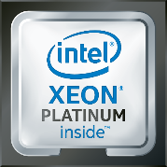
Technologies driving HPC innovation
More performance, flexibility, and energy efficiency
The Intel® Xeon® Scalable processor family is a powerful platform that has been designed to deliver advanced HPC.
This platform represents a significant leap forward in the performance and efficiency of cutting-edge HPC systems.
Boost floating point performance
Intel® Advanced Vector Extensions 512 (Intel® AVX-512)
Reduce latency and power
Intel® Mesh Architecture
Intel® Ultra Path Interconnect (Intel® UPI)
Efficient fabric
Intel® Omni-Path Architecture (Intel® OPA)
Host Fabric Interface (HFI)
Accelerate compression
Intel® QuickAssist Technology (Intel® QAT)
rethink the impossible with breakthrough HPC innovation

Slide 4
Intel® AVX-512 delivers significant performance and efficiency gains
Source as of June 2017: Intel internal measurements on platform with Xeon® Platinum 8180, Turbo enabled, UPI=10.4, SNC1, 6x32GB DDR4-2666 per CPU, 1 DPC. Software and workloads used in performance tests may have been optimized for performance only on Intel microprocessors.
For additional disclaimers and configuration, see following slides.
Tests document performance of components on a particular test, in specific systems. Differences in hardware, software, or configuration will affect actual performance. Consult other sources of information to evaluate performance as you consider your purchase. For more complete information about performance and benchmark results, visit www.intel.com/benchmarks
Benchmark results were obtained prior to implementation of recent software patches and firmware updates intended to address exploits referred to as "Spectre" and "Meltdown." Implementation of these updates may make these results inapplicable to your device or system.

Slide 5
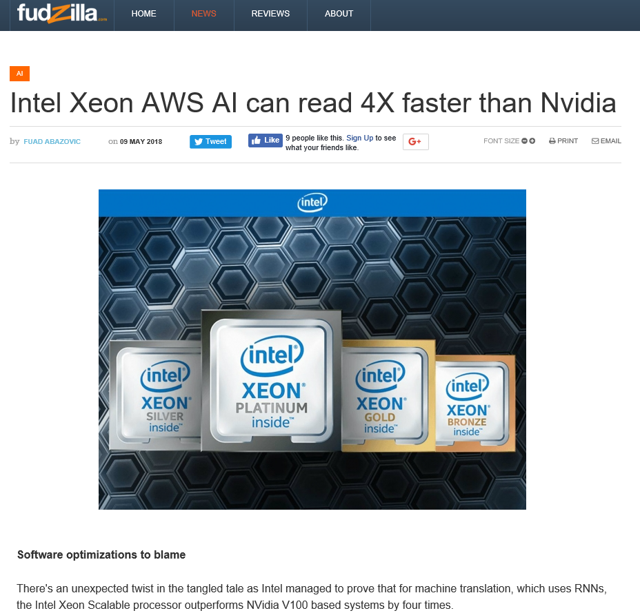
https://fudzilla.com/news/ai/46258-intel-xeon-aws-ai-can-read-4x-faster-than-nvidia
Notes:
https://fudzilla.com/news/ai/46258-intel-xeon-aws-ai-can-read-4x-faster-than-nvidia
Software optimizations to blame
There's an unexpected twist in the tangled tale as Intel managed to prove that for machine translation, which uses RNNs, the Intel Xeon Scalable processor outperforms NVidia V100 based systems by four times.
To bring you up to speed, RNN is a recurrent neural network, and this is a class of artificial neural network where connections between units form a directed graph along a sequence.
Intel did a demo in Oregon labs using AWS Sockeye Neural Machine Translation (NMT) model with Apache* MXNet* with Intel Math Kernel Library (Intel MKL).
Believe it or not, the library makes the whole difference and previously deep learning training and inferencing on CPU took an unnecessarily long time because the software was not written to take full advantage of the hardware features and functionality.
Intel Xeon beats Nvidia V100 by 4X
For machine translation which uses RNNs, the Intel Xeon Scalable processor outperforms NVidia V100 by 4x on the AWS Sockeye Neural Machine Translation (NMT) model with Apache MXNet when Intel Math Kernel Library (Intel MKL) is used.
Previously, deep learning training and inference on CPUs took an unnecessarily long time because the software was not written to take full advantage of the hardware features and functionality. That is no longer the case. The Intel Xeon Scalable processor with optimized software has demonstrated enormous performance gains for deep learning compared to the previous generations without optimized software.
Intel Xeon v3 processor better known to Fudzilla readers as Haswell, gains up to 198x for inference and 127x for training measured with GoogleNet v1 for inference and AlexNet for training using Intel Optimized Caffe.
Video of the live demo
This gains apply to various types of models including multi-layer perceptron (MLP), convolutional neural networks (CNNs), and the various types of recurrent neural networks (RNNs). The performance gap between GPUs and CPUs for deep learning training and inference has narrowed, and for some workloads, CPUs now even have an advantage over GPUs.
Intel has much more detail in its blogs and it even includes a demo on the video where Vivian TJanecek from Intel's data center marketing and Sowmya Bobba, Intel's ML engineer demonstrate this demo on video. You can clearly see that the Intel bases system scores 93 sentences per second while Nvidia V100 machine scores 22 sentences per second. The experiments were conducted using the servers at Amazon Web Services (AWS) with the publicly available Apache MXNet framework. It is important to mention that a neutral framework was not maintained by neither Intel nor Nvidia. The benchmark used is the AWS Sockeye, an open source project for NMT.
We advise you to check the blog and look at the video - it definitely sounds interesting to any data scientist.

Slide 6
Intel® QuickAssist Technology benchmarks
Security benchmarks
Big data benchmarks with compression²
Compression ratio²
big data example
SW Snappy Compression
Intel® QAT Level 1 Compression
Apache Accumulo* run time reduced significantly
60
42
¹
³
¹
Compression Ratio Output/Input Lower is better
NGINX* and OpenSSL* connections/second. Conducted by Intel Applications Integration Team. Claim is actual performance measurement. Intel® microprocessor. Processor: Intel® Xeon® processor Scalable family with C6xxB0 ES2 Performance tests use cores from a single CPU, Memory configuration:, DDR4–2400. Populated with 1 (16 GB) DIMM per channel, total of 6 DIMMs Intel® QuickAssist Technology driver: QAT1.7.Upstream.L.0.8.0-37 Fedora* 22 (Kernel 4.2.7) BIOS: PLYDCRB1.86B.0088.D09.1606011736.
Cloudera* 5.4.2 with Snappy* Software vs. Intel® QuickAssist Technology hardware solution. Conducted by Intel Applications Integration Team. Claim is actual performance measurement. Intel® Xeon® processor E5-2699 v4 (56 cores enabled) 256 GB DDR4 1.6 TB NVMe SSD 1 Intel® C6xxx-based card (24x) 10 Gbps CentOS* 6.7 w/ 2.6.32 kernel Cloudera* 5.4.2 QAT driver 0.9.1 Snappy* 1.1.2 (popular, fast compression codec) One NameNode Eight DataNodes 10 Gbps network.
3- 24 Core Intel(r) Xeon® Scalable Platform -SP @1.8GHz, Single (UP) Processor configuration. Intel(r) C627 PCH with crypto acceleration capability (in x16 mode) Neon City platform. DDR4 2400MHz RDIMMs 6x16GB(total 96 GB), 6 Channels, 1 x Intel® Corporation Red Rock Canyon 100GbE Ethernet Switch in the x16 PCIe* slot on Socket 0. 8 cache ways allocated for DDIO.
Tests document performance of components on a particular test, in specific systems. Differences in hardware, software, or configuration will affect actual performance. Consult other sources of information to evaluate performance as you consider your purchase. For more complete information about performance and benchmark results, visit www.intel.com/benchmarks
Benchmark results were obtained prior to implementation of recent software patches and firmware updates intended to address exploits referred to as "Spectre" and "Meltdown." Implementation of these updates may make these results inapplicable to your device or system.
Notes:
Intel® QuickAssist Technology integrates hardware acceleration of compute intensive workloads, such as bulk cryptography, public key exchange, and compression on Intel® architecture platforms.

Slide 7
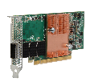
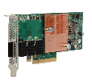
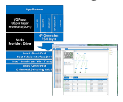
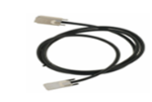
Intel® Omni-Path Architecture (Intel® OPA)
End-to-end HPC fabric solution that cost-effectively scales from entry clusters to the largest supercomputers
Builds on the industry’s best technologies
Highly leverage existing Aries and Intel® True Scale Fabric
Adds innovative new features and capabilities to improve performance, reliability, and QoS
Robust product offerings and ecosystem
>100 OEM designs¹
Strong ecosystem with 80+ Fabric Builders members
HFI Adapters
Single port
x8 and x16
Edge Switches
1U Form Factor
24 and 48 port
Director Switches
QSFP-based
192 and 768 port
x16 Adapter (100 Gb/s)
48-port Edge Switch
768-port Director Switch (20U chassis)
x8 Adapter (58 Gb/s)
24-port Edge Switch
192-port Director Switch (7U chassis)
Silicon
OEM custom designs
HFI and Switch ASICs
Software
Open Source
Host Software and Fabric Manager
Cables
Third Party Vendors
Passive Copper Active Optical
HFI silicon
Up to 2 ports (50 GB/s total b/w)
Switch silicon
up to 48 ports
(1200 GB/s total b/w
Maximize price/performance, freeing up cluster budgets for increased compute and storage capability
Intel internal information. Design win count based on OEM and HPC storage vendors who are planning to offer either Intel-branded or custom switch products, along with the total number of OEM platforms that are currently planned to support custom and/or standard Intel® OPA adapters. Design win count as of November 1, 2015 and subject to change without notice based on vendor product plans.

Slide 8
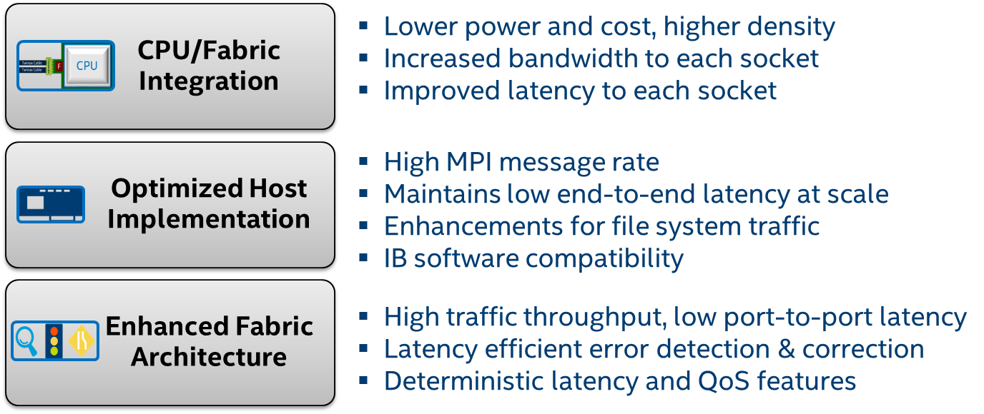
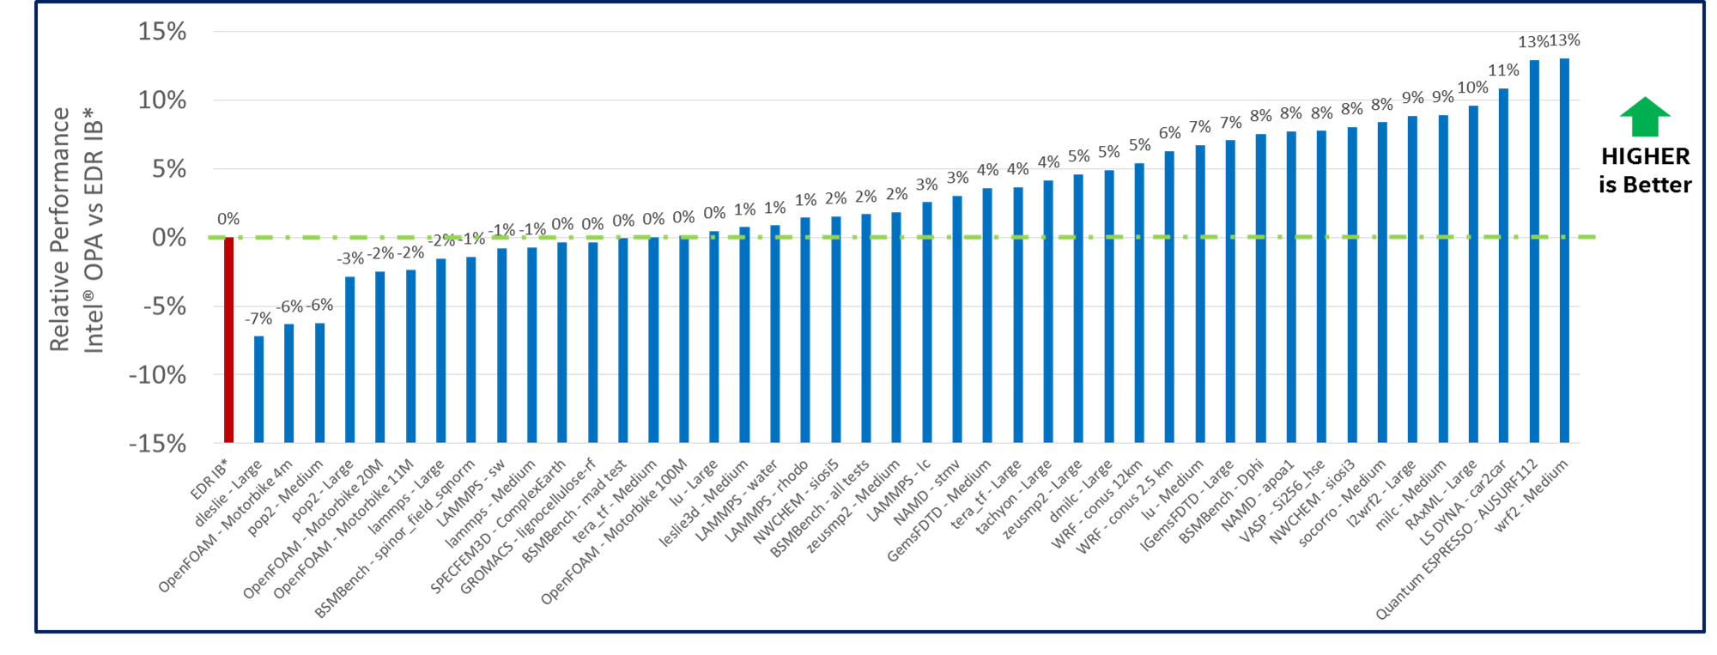
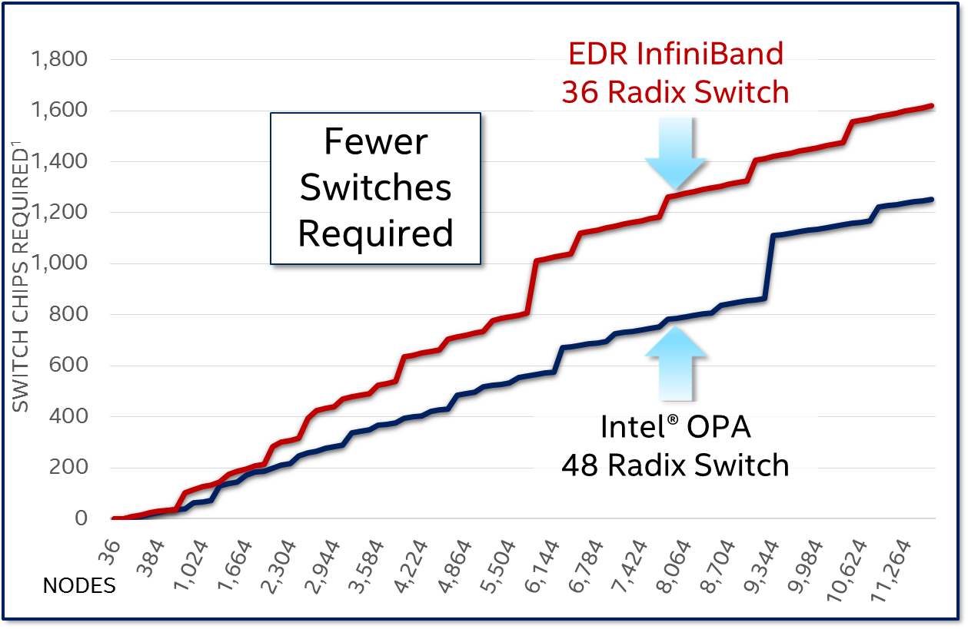
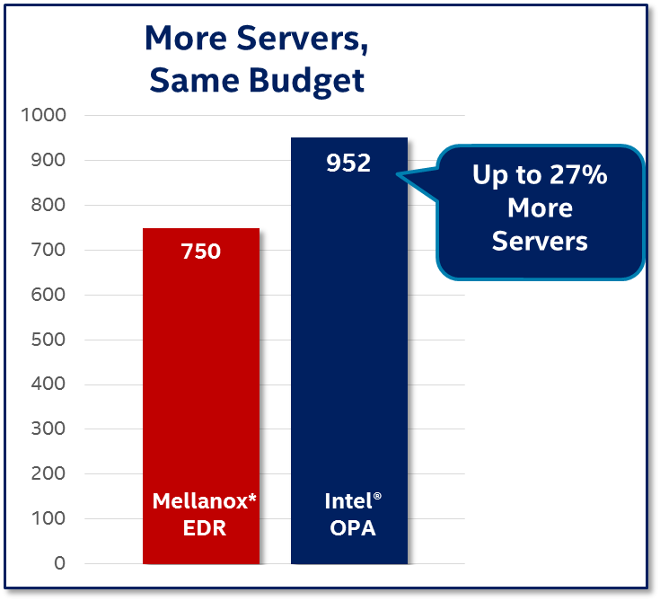
More performance , flexibility, and energy efficiency Intel® Omni-Path Architecture (Intel® OPA)
Skylake Performance
Configuration assumes a 750-node cluster, and number of switch chips required is based on a full bisectional bandwidth (FBB) Fat-Tree configuration. Intel® OPA uses one fully-populated 768-port director switch, and Mellanox EDR solution uses a combination of 648-port director switches and 36-port edge switches. Mellanox component pricing from www.kernelsoftware.com, with prices as of April 4, 2017. Compute node pricing based on Dell PowerEdge R730 server from www.dell.com, with prices as of April 4, 2017. Intel® OPA pricing based on pricing from www.kernelsoftware.com as of August 15, 2017
Tests document performance of components on a particular test, in specific systems. Differences in hardware, software, or configuration will affect actual performance. Consult other sources of information to evaluate performance as you consider your purchase. For more complete information about performance and benchmark results, visit www.intel.com/benchmarks
Benchmark results were obtained prior to implementation of recent software patches and firmware updates intended to address exploits referred to as "Spectre" and "Meltdown." Implementation of these updates may make these results inapplicable to your device or system.
See Performance/Configuration slide for configuration information

Slide 9
Intel® 3D NAND Product Portfolio

Slide 10
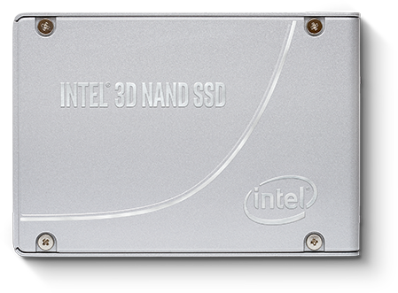
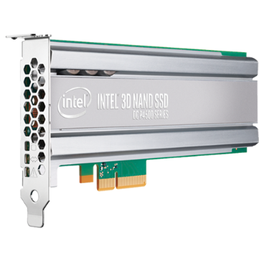
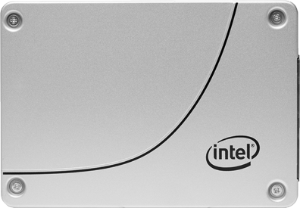
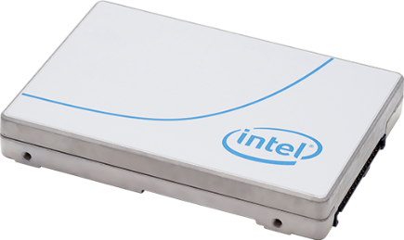
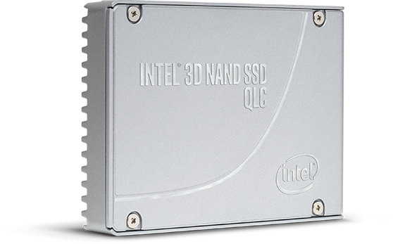
Data Center
1.6TB
2TB
3.2TB
4TB
6.4TB
240GB
480GB
960GB
2TB
4TB
8TB
1.6TB
3.2TB
6.4TB
7.68TB
Intel® SSD
DC P4600
Intel® SSD
D3-S4610
Intel® SSD
DC P4610
Intel® SSD
D3-S4610
PCIe* 3.1 x4, NVMe*
PCIe* 3.1 x4, NVMe*
SATA 6GB/s
Intel® SSD
DC P4510
1TB
2TB
4TB
8TB
Intel® SSD
DC P4500
1TB
2TB
4TB
8TB
Intel® SSD
D3-S4510
240GB
480GB
960GB
2TB
4TB
8TB
Intel® SSD
D5-P4320
7.68TB
PCIe* 3.1 x4, NVMe*
PCIe* 3.1 x4, NVMe*
SATA 6GB/s
PCIe* 3.0 x4, NVMe*
*Other names and brands may be claimed as the property of others.
Copyright © 2018 Intel Corporation. All rights reserved. Intel and the Intel logo are trademarks of Intel Corporation in the U.S and/or other countries.

Slide 11
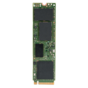
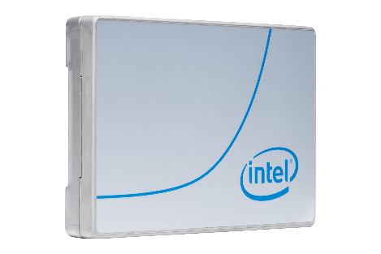
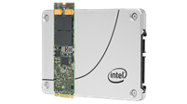
INTEL® 3D NAND technology Product portfolio-Data center
Product | Intel® SSD DC P4510/P4610 | Intel® SSD DC P4500/ P4600 | Intel® SSD DC P4500 E1.L (EDSFF* Long “Ruler”) | Intel® SSD D5-P4320 & D5-P4326 E1.L (EDSFF* Long “Ruler”) | Intel® SSD D3-S4510 & D3-S4610 | Intel® SSD DC S4500 & DC S4600 | Intel® SSD DC P3100 | Intel® SSD DC S3100
Image
Audience | Data Center, Cloud, Enterprise. Demanding service levels. | Data Center, Cloud, Enterprise. Caching. | Data Center, Cloud, Enterprise. Caching. | Data Center, Cloud, Enterprise. | Data Center, Cloud, Enterprise. Switch from HDDs. | Data Center, Cloud, Enterprise. Switch from legacy HDDs. | Boot, Storage, Edge Cache, Search Index. | Cloud, Database, Cassandra, No SQL, Boot OS.
Positioning | Delivers performance, QoS and capacity improvements to optimize storage efficiency: minimize service disruptions and efficiently manage at scale. | Optimized for the data caching needs of cloud storage and SDI. Modernizes the data center with a combination of performance, capacity, manageability & reliability. | For data centers, it’s the perfect fit. The new ruler has been designed for data center racks to deliver Space Efficient Capacity and Operational Efficiency and Efficient Management at scale. | Delivers big, affordable PCIe* drives to warm storage. Packing 33% more bits/cell than the prior generation, it consolidates storage footprints up to 20x.² | Delivers performance, QoS and capacity improvements to optimize storage efficiency enabling data centers to do more per server, and minimize service disruptions. | Replace legacy HDDs with the Intel® SSD DC S4500 & DC S4600 Series. Highly reliable, these storage inspired SSDs enable data centers to reduce costs, improve server efficiency, and minimize service disruptions. | Value-based performance designed for data center usage. Transform the economics of data center storage with Intel® 3D NAND SSDs. | An entry level data center SSD that delivers consistent performance, value endurance, low latency and high reliability to cost effectively accelerate read intensive workloads.
Interface/ FF/ Capacity¹ | PCIe* 3.1 x4, NVMe* 1.2 U.2 15mm P4510: 1, 2, 4, 8TB P4610: 1.6, 3.2, 6.4, 7.68TB | PCIe* 3.1 x4, NVMe* 1.2 U.2, 2.5in x 15mm, AIC P4500 U.2: 1, 2, 4TB P4500 AIC: 4, 8TB P4600 U.2: 1.6, 2, 3.2, 6.4TB P4600 AIC: 2, 4TB | PCIe* 3.0 x4, NVMe* 1.2 EDSFF 1U Long 4, 8TB | QLC PCIe* 3.0 x4. NVMe* 1.2 U.2 15mm, EDSFF 1U Long P4320 U.2: 7.68TB P4326 EDSFF: 15.36TB | SATA 6Gb/s 2.5in S4510: 240, 480, 960GB, 2, 4, 8TB S4610: 240, 480, 960GB, 2, 4, 8TB | SATA 6Gb/s 2.5in x 7mm S4500: 240, 480, 960GB, 2, 4TB S4600: 240, 480, 960GB, 2TB | PCIe* 3.0 x4, NVMe* 1.2 M.2 128GB, 256GB, 512GB, 1TB | SATA 6Gb/s 2.5”, M.2 128GB, 256GB, , 512GB
Additional Information | P4510: Product page P4510: Product spec P4510: Product Brief P4610: Product page P4610: Product spec P4610:Product Brief Assets | P4500: Product page P4500: Product spec P4500: Product Brief P4600: Product page P4600: Product spec P4600: Product Brief Assets | Product page Product spec Product Brief Assets |  | S4510 Product page S4510 Product spec S4610 Product page S4610 Product spec Product Brief Assets | S4500 Product page S4500 Product spec S4600 Product page S4600 Product spec Product Brief Assets | Product page Product spec Product Brief | Product page Product spec Product Brief
1. Consult OEM selling guides for capacity point qualification, as not all capacities are offered by each OEM.
2. Consolidate storage footprints up to 20x. Comparing 3.5’ 4TB WD Gold TB Enterprise class 7200 RPM HDD enabling up 24 HDDs per 2U to 30.72TB E1.L Intel® SSD D-5 P4326 enabling up to 32 per 1U.
Performance results are based on testing as of July 2018 and may not reflect the publicly available security updates. See configuration disclosure for details. No product can be absolutely secure.
*Other names and brands may be claimed as the property of others.

Slide 12
Intel® Optane™ Technology Product Portfolio

Slide 13
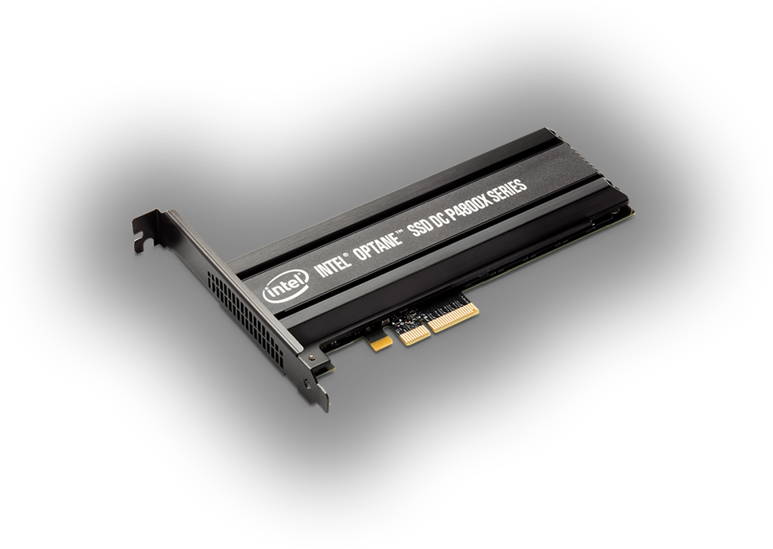
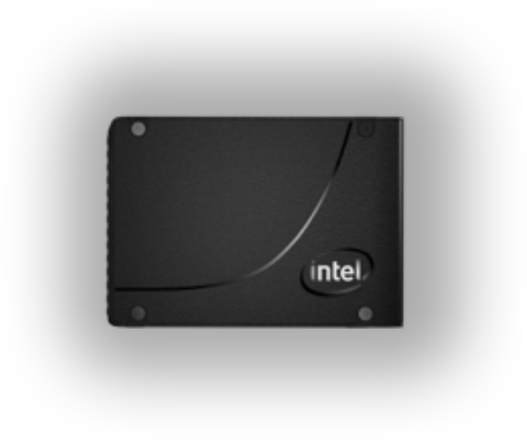
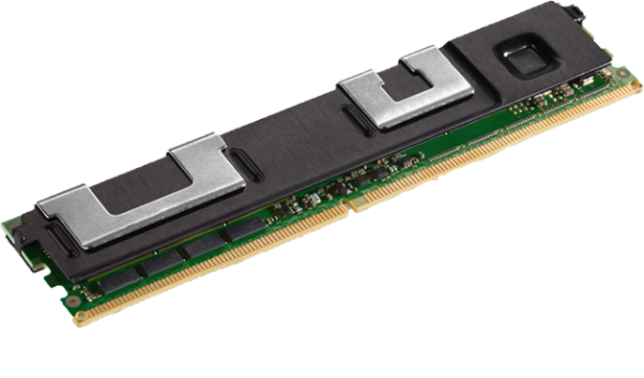
Data Center
Intel® Optane™
SSD DC P4800X
375GB
750GB
1.5TB
Intel® Optane™
DC Persistent Memory
QLC PCIe* 3.0 x4, NVMe*
*Other names and brands may be claimed as the property of others.
Copyright © 2018 Intel Corporation. All rights reserved. Intel and the Intel logo are trademarks of Intel Corporation in the U.S and/or other countries.

Slide 14
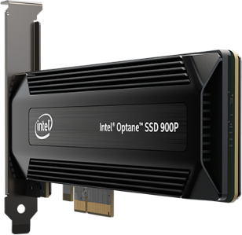
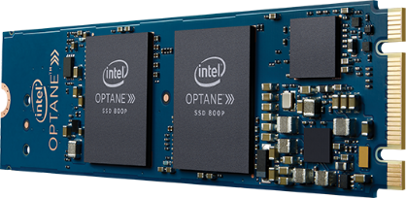
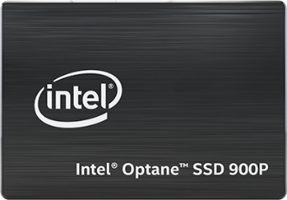
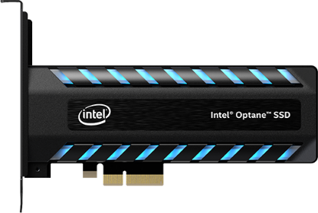
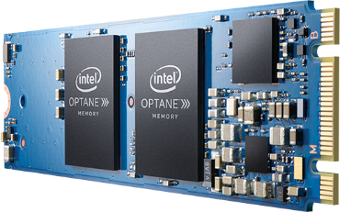
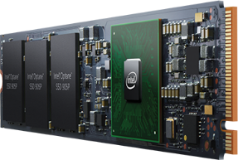
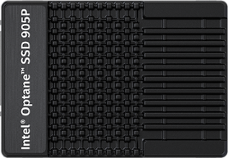
Client
Intel® Optane™
SSD 800P
58GB
118GB
Intel® Optane™
SSD 900P
280GB
480GB
PCIe* 3.0 x2, NVMe*
PCIe* 3.0 x4, NVMe*
Intel® Optane™
Memory
16GB
32GB
Intel® Optane™ SSD 905P
PCIe* 3.0 x2, NVMe*
PCIe* 3.0 x4, NVMe*
480GB
960GB
*Other names and brands may be claimed as the property of others.
Copyright © 2018 Intel Corporation. All rights reserved. Intel and the Intel logo are trademarks of Intel Corporation in the U.S and/or other countries.

Slide 15
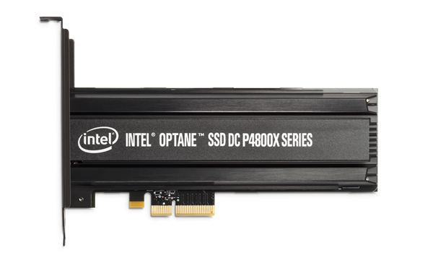
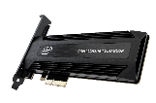
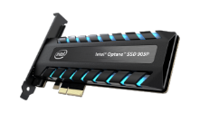
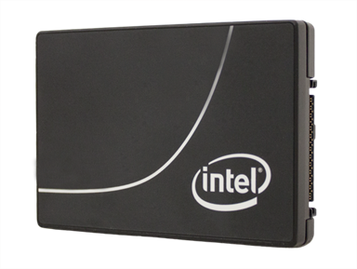
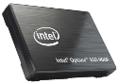
INTEL® Optane™ technology Product portfolio
 | DATA CENTER |  | CLIENT
Product | Intel® Optane™ SSD DC P4800X | Intel® Optane™ SSD DC P4800X with Intel® Memory Drive Technology | Intel® Optane™ Memory | Intel® Optane™ SSD 800P | Intel® Optane™ SSD 900P | Intel® Optane™ SSD 905P
Image
Audience | Data Center, Cloud, Enterprise Fast Storage/Cache, Extended Memory | Data Center, Cloud, Enterprise | General Consumer | General Consumer | Enthusiast/Workstation | Enthusiast/Workstation
Positioning | Highly responsive SSD delivering an industry-leading combination of high throughput, low latency, high QoS, and high endurance. | Revolutionary software increases memory capacity beyond DRAM limitations and transparently delivers DRAM-like performance. | Smart, adaptable system accelerator Affordably improves the responsiveness of HDD or SATA-based SSD mobile and desktop. | High performing Intel® SSD in the M.2 form-factor for mobile and desktop platforms | High performing Intel® SSD sets the precedent for high performance desktops and workstations. designed for the most storage-demanding desktop or workstation workloads.¹
Use Cases | Extend memory via Linux Swap, application optimization, and caching | Extend Linux OS virtual memory. Displace DRAM up to 8:1 in select workloads (i.e.: Analytic, In-memory database, HPC, Batch workloads) | Accelerate HDD or SATA-based SSD mobile and desktop platforms, to affordably get both massive capacity and responsiveness. Windows* 10 only Compatible platform required | Optimized for fast application loading, RAID, and fast boot. | Workstation, high-end desktop, enthusiast, digital content creation, Engineering. | Content Creation, Engineering, Video Rendering, Game Development
Interface/ FF/ Capacity² | PCIe* 3.0 x4, NVMe* 1.2 U.2 15mm, AIC 375, 750GB, 1.5TB | PCIe* 3.0 x4, NVMe* 1.2 U.2 15mm, AIC 375 , 750GB, 1.5TB | PCIe* 3.0 x2, NVMe* M.2 16, 32GB | PCIe* 3.0 x2, NVMe* M.2 58, 118GB | PCIe* 3.0 x4, NVMe* Add-in Card, 2.5in x 15mm U.2 AIC: 280, 480GB U.2: 280GB | PCIe* 3.0 x4, NVMe* Add-in Card, 2.5in x 15mm U.2 AIC: 960GB U.2: 480GB
Additional Information | Product page Product spec Product Brief Assets | Product Brief | Product page Product Brief Assets | Product page Product specs Product Brief Assets | Product Page Product Specs Product Brief Assets | Product Page Product spec Product Brief Assets
1. For Intel® Optane™ SSD 900P Series, warranty is void if used in (i) any compute, networking or storage system that supports workloads or data needs of more than one concurrent user or one or more remote client device currently, (ii) any server, networking or storage system that is capable of supporting more than one CPU per device, or any device that is designed, marketed or (iii) sold to support or be incorporated into systems covered in clauses (i) or (ii)
2. Consult OEM selling guides for capacity point qualification, as not all capacities are offered by each OEM.
Performance results are based on testing as of July 2018 and may not reflect the publicly available security updates. See configuration disclosure for details. No product can be absolutely secure.
*Other names and brands may be claimed as the property of others.

Slide 17
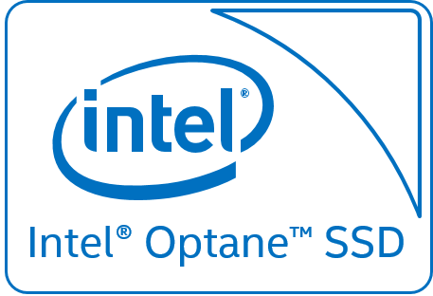
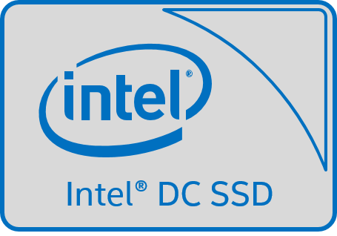
MySQL* 5.7 Sysbench benchmark
What is P99 Latency?
This represents latency being in the 99th percentile or 99% of the requests are faster than the given latency.
Storage
CPU
Memory
Transactions Per Second
Intel® Optane™ ssd vs. “good” solution
P99 Latency
Lowest latency of the configurations shown and most efficient use of cores.
17,235
Intel® Xeon™
4x better
BEST
up to
Intel® Optane™ SSD
Intel® Xeon® v4 (44 core)
DRAM
256GB
12 ms
TPS¹
BETTER
2x better latency than “good” configuration with the benefits of NVMe*.
Intel® Xeon™
51 ms
5,834
Intel® SSD DC P4500
Intel® Xeon® v4 (44 core)
DRAM
256GB
8x better
up to
Highest latency of shown configurations.
Not able to transfer the IO load to the storage as effectively as NVMe*.
100 ms
GOOD
Intel® Xeon™
3,535
Latency¹
Intel® SSD DC S3520
Intel® Xeon® v4 (44 core)
DRAM
256GB
System configuration: Server Intel® Server System R2208WT2YS, 2x Intel® Xeon® E5 2699v4, 384 GB DDR4 DRAM, boot drive- 1x Intel® SSD DC S3710 Series (400 GB), database drives- 1x Intel® SSD DC P3700 Series (400 GB) and 1x Intel® Optane™ SSD DC P4800X Series (140 GB prototype), CentOS 7.2, MySQL Server 5.7.14, Sysbench 0.5 configured for 70/30 Read/Write OLTP transaction split using a 100GB database. Cost per transaction determined by total MSRP for each configuration divided by the transactions per second. Estimated results were obtained prior to implementation of recent software patches and firmware updates intended to address exploits referred to as "Spectre" and "Meltdown". Implementation of these updates may make these results inapplicable to your device or system.
*Other names and brands names may be claimed as the property of others

Slide 19
Learn More
Intel Xeon Scalable processors: intel.com/xeonscalable
Intel Omni-Path Architecture: intel.com/omnipath
Intel Cluster Checker: https://software.intel.com/intel-cluster-checker
Intel Parallel Studio XE: https://software.intel.com/parallel-studio-xe
Intel Scalable System Framework: intel.com/ssf
Intel Select Solutions: intel.com/selectsolutions
Intel Software Solutions Showcase: intel.com/softwaresolutions
Intel Products page: https://ark.intel.com/
Intel Xeon upgrade suggestions: https://xeonprocessoradvisor.intel.com
Intel AI: https://ai.intel.com/

Slide 20
HPC Resources – External Access
For more HPC material:
Hyperion - https://hyperionresearch.com/hpc-news/
HPC User Forum - https://hpcuserforum.com/index.html
Intersect360 - http://www.intersect360.com/
The Next Platform - https://www.nextplatform.com/category/hpc/
HPCwire - https://www.hpcwire.com/
insideHPC - https://insidehpc.com/

Slide 21
Want to see more Intel® Xeon® Scalable processors proof points?
Cloud segment: goto.intel.com/XeonCloudEAMG
Qihoo, Huawei, Virtuozzo, Zizo …..and more.
Comms segment: goto.intel.com/XeonCommsEAMG
Ericsson, 6Wind, Sandvine, Pexip…..and more.
Enterprise segment: goto.intel.com/XeonEnterpriseEAMG
IBM, Oracle, Qlik, Altibase, Innovatrics…..and more.
Intel® Xeon® Scalable processors EAMG: goto.intel.com/XeonScalableEAMG
An overall and summarized presentation of each segment; links for each segment.
See more enabled software performance content at www.intel.com/XeonSoftwareSolutions
Learn more about the Intel® Xeon® Scalable Processors at www.intel.com/XeonScalable
*Other names and brands may be claimed as the property of others

Slide 22
Thank you!

Slide 24
Legal Disclaimer
Intel may make changes to specifications and product descriptions at any time, without notice. Designers must not rely on the absence or characteristics of any features or instructions marked "reserved" or "undefined". Intel reserves these for future definition and shall have no responsibility whatsoever for conflicts or incompatibilities arising from future changes to them. The information here is subject to change without notice. Do not finalize a design with this information.
The products described in this document may contain design defects or errors known as errata which may cause the product to deviate from published specifications. Current characterized errata are available on request.
Intel technologies’ features and benefits depend on system configuration and may require enabled hardware, software or service activation. Performance varies depending on system configuration. No computer system can be absolutely secure. Check with your system manufacturer or retailer or learn more at intel.com.
Intel disclaims all express and implied warranties, including without limitation, the implied warranties of merchantability, fitness for a particular purpose, and non-infringement, as well as any warranty arising from course of performance, course of dealing, or usage in trade.
Performance results are based on testing as of July 2018 and may not reflect all publicly available security updates. See configuration disclosure for details. No product can be absolutely secure.
Tests document performance of components on a particular test, in specific systems. Differences in hardware, software, or configuration will affect actual performance. Consult other sources of information to evaluate performance as you consider your purchase.
Cost reduction scenarios described are intended as examples of how a given Intel-based product, in the specified circumstances and configurations, may affect future costs and provide cost savings. Circumstances will vary. Intel does not guarantee any costs or cost reduction.
Intel does not control or audit the design or implementation of third party benchmark data or Web sites referenced in this document. Intel encourages all of its customers to visit the referenced Web sites or others where similar performance benchmark data are reported and confirm whether the referenced benchmark data are accurate and reflect performance of systems available for purchase.
Intel, the Intel logo, Intel Optane, and others are trademarks of Intel Corporation in the U.S. and/or other countries.
© 2018 Intel Corporation. All rights reserved.
*Other names and brands may be claimed as the property of others.

