Slide 1
Information Management journey
with Veritas
Stefan Bogdanović
Regional Channel Manager East Europe Veritas Technologies

Slide 2
Veritas is Leading Data Management Company
Experience
Portfolio
Flexibility
Vision
30 YEARS OF EXPERIENCE
WIDEST PORTFOLIO FOR INFORMATION MANAGEMENT
TAKE CARE OF YOUR DATA ANYWHERE: PHYSICAL, VIRTUAL, CLOUD. HW & SW VENDOR INDEPENDENT
500+ PATENTS GRANTED IN BACKUP AND RECOVERY
61 PATENTS FILED LAST 12 MONTHS
TRUST & INNOVATION
Top 20
10+
Alliances
#1
MARKET LEADERSHIP
ENTERPRISE SOFTWARE COMPANY
BY REVENUE
LEADERSHIP QUADRANT
INDUSTRY AWARDS AND RECOGNITIONS
LAST 12 MONTHS
STRATEGIC ALLIANCE WITHIN INDUSTRY: AMAZON, MICROSOFT, GOOGLE, IBM, ORACLE
15 YEARS LEADER: EXECUTES WELL TODAY, WELL POSITIONED FOR TOMORROW
> 86%
50,000+
93%
>20,000
LOYAL CUSTOMERS
FORTUNE 500 RELY ON VERITAS
ENTERPRISE CUSTOMERS
RENEWAL RATE
AVERAGE CUSTOMER > 8 YRS
PARTNERS
>700 MANAGED GLOBAL DISTRIBUTORS
Notes:
Veritas is the #1 or #2 leader in all major market segments that it serves, a position endorsed by leading analysts and Fortune 500 customers. We also have a significant amount of intellectual property from having been innovators in Information Management for nearly 30 years. We are trusted by some of the largest and most demanding customers in the world as well as many thousands of smaller businesses in every major region, and enjoy continued growth in both our core businesses as well as newer initiatives.

Slide 3
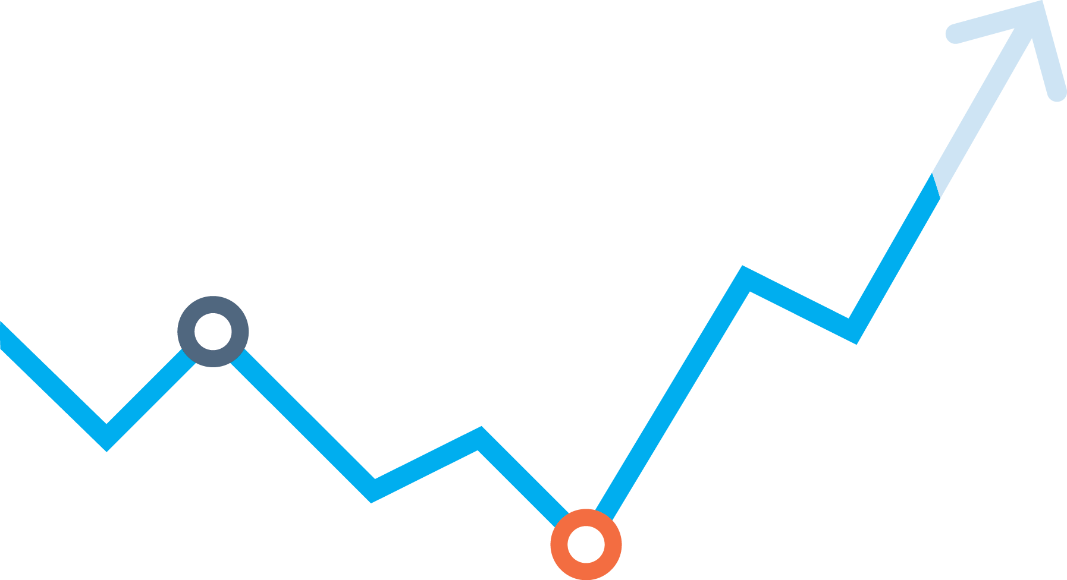
INFORMATION IS THE MOST
CRITICAL ASSET…
Notes:
Data is at the core of the way modern businesses operate and in today’s digital economy, this data is increasingly valuable as an asset in its own right. If you consider the most valuable companies of the last decade what are they valued for? The information they create from that data - and a large proportion of that comes from the individuals using those services; their personal data.
If we think about the most valuable company’s over last 10 years what are they valued for? Their information… more succinctly your information.
Facebook is the world’s largest content provider but they don’t create any content
Uber is the world’s largest taxi company but they don’t own any vehicles
AirBnB is the world’s largest accommodation provider but they don’t own any accommodation.
BUT – not all companies are at this stage, and unfortunately we see all too often in the news, headlines of companies where the data of individuals has been compromised – organisations that have been breached, accounts have been hacked, disgruntled employees sell off customer data bases to competitors. Personal Data has value - and is big business.

Slide 4
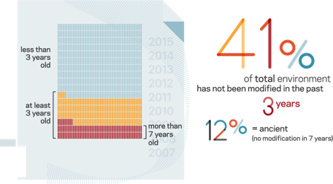
Veritas research on actual DATA shows problem
Clean
14%
ROT
32%
Dark Data
54%
Notes:
How are we doing in understanding this data? As it turns out from the significant research Veritas has undertaken – pretty badly – see the flow of the three reports below
1 GENOME - understand what is going on with the actual data – the files we create and store. The Data Genomics Index was real data about what the average organization stores
Result – the avg. corporate environment is incredibly complex and spending exorbitantly for data that is probably worthless.
2 DATABERG REPORT, ask IT if they know that this is going on, and can they see a way to change it
Result – yes and absolutely not. Can’t tell jewels from junk to even decide where to put it, hence they store everything.
3 DATA HOARDER Asked what kind of user behavior are causing this. Data Hoarder quantitative survey
Result – people are hoarders, they store incredibly risky stuff and will give up clothes or weekends instead of their data.

Slide 5
Customer’s business challenged
Data Growth
Privacy
Data Fragmentation
Data Agility
Global
Data Governance
Data Visibility
Notes:
So what is GDPR in one slide?
Firstly it’s a “ready-made” privacy law which applies automatically around all Member States of the EU
Applies to “personal data” – any information relating to an identified or identifiable individual (known as a 'data subject‘), whether they can be identified, directly or indirectly
Ensures that individuals can control how information about them is used, and that those controlling it protect it from disclosure
It’s a global issue, and applies to any organization holding information on EU citizens
GDPR also introduces penalties, very large ones in fact.
We can use this slide but on the idea of the time aspect – many other projects are ongoing
IT tech debt, migration projects, swapping out filers, cloud transformation, digital transformation – why not see this as the driver to combine
The clock is ticking for all organizations affected by GDPR – the regulation will be implemented on 25th May 2018.
This means any organization that is affected by the regulation needs to start preparing for it if has not already done so.

Slide 6
Veritas Approach - 360 Data Management
Privacy
Data Visibility
Data Protection
INTELLIGENT CORE
Discovery, Classification, Policy Automation
NetBackup
Backup Exec
DLO (Desktop/Laptop Option)
SaaS Backup
Enterprise Vault
Information Map
Data Insight
Digital Compliance
Data Portability
Enterprise Vault
E-Discovery
Global
Cloud Mobility
Access
Business Continuity
Storage Optimization
VRP
Infoscale
Data Insight
Enterprise Vault
Access
Deduplicaiton engine

Slide 7
360 Data Management as GDPR Solution
Privacy
Data Visibility
Data Protection
360
Data Management
GDPR solution
Digital Compliance
Data Portability
Global
Business Continuity
Storage Optimization
Notes:
Data is at the core of the way modern businesses operate and in today’s digital economy, this data is increasingly valuable as an asset in its own right. If you consider the most valuable companies of the last decade what are they valued for? The information they create from that data - and a large proportion of that comes from the individuals using those services; their personal data.
If we think about the most valuable company’s over last 10 years what are they valued for? Their information… more succinctly your information.
Facebook is the world’s largest content provider but they don’t create any content
Uber is the world’s largest taxi company but they don’t own any vehicles
AirBnB is the world’s largest accommodation provider but they don’t own any accommodation.
BUT – not all companies are at this stage, and unfortunately we see all too often in the news, headlines of companies where the data of individuals has been compromised – organisations that have been breached, accounts have been hacked, disgruntled employees sell off customer data bases to competitors. Personal Data has value - and is big business.

Slide 8
stefan.bogdanovic@veritas.com

