Slide 1
Security Automation
Madalin Vasile
Systems Engineer Manager

Slide 2


Current situation
Internal Security Policies
Premium Security Appliances from validated vendors
Implement Network and Security Best Practices
NOC and SOC monitoring
And then Chaos!!! – Security Breach!!!

Slide 3

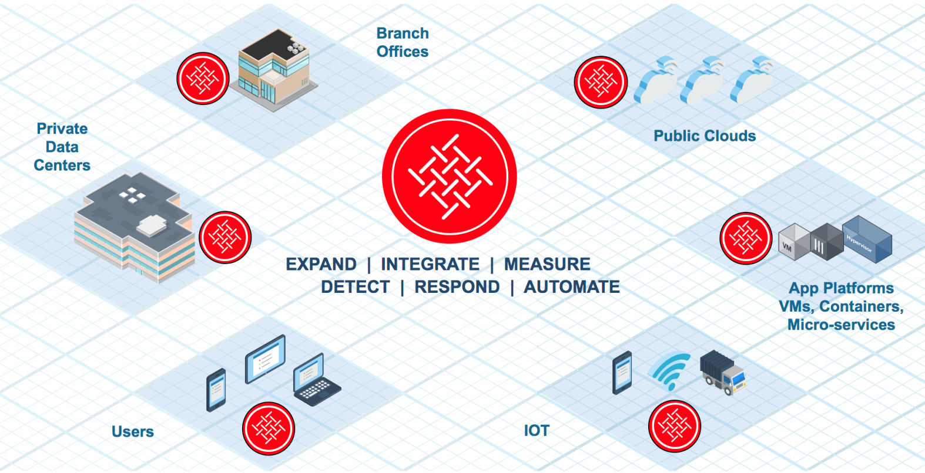
A consistent policy across your entire network
What is
Security
Fabric?
Notes:
* The simple answer: A consistent policy across your entire network

Slide 4
1
Expanded ATTACK SURFACE
EXPAND
Telemetry
5.6
- visibility
- control
Access
INTEGRATE
6.0
Endpoint
6.0
- expand
- integrate
- measure
Historical
MEASURE

Slide 5
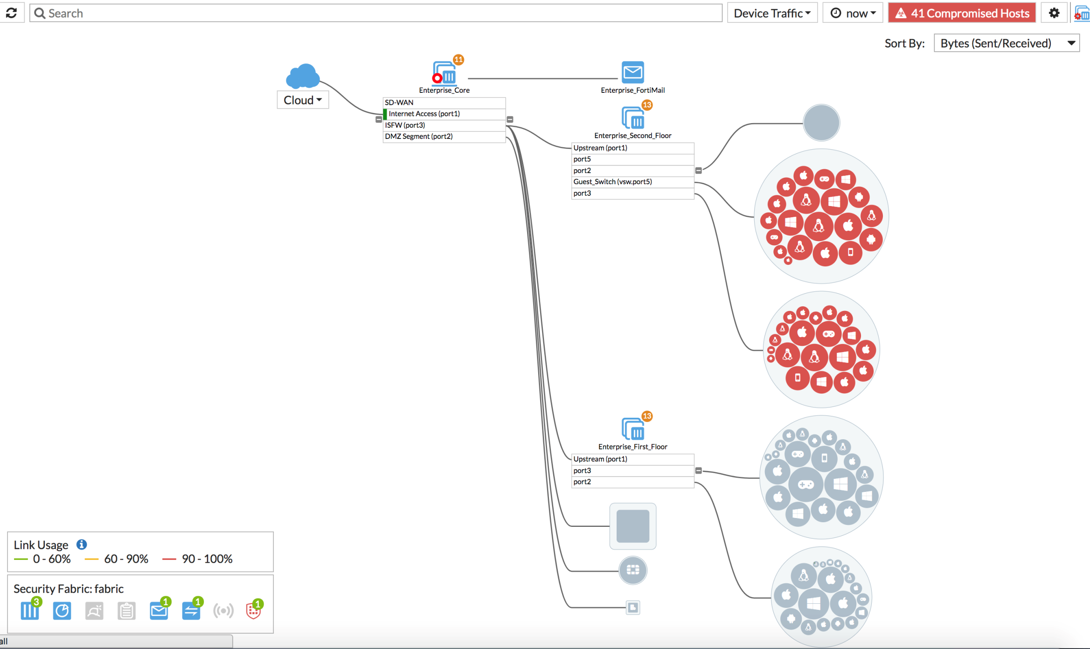
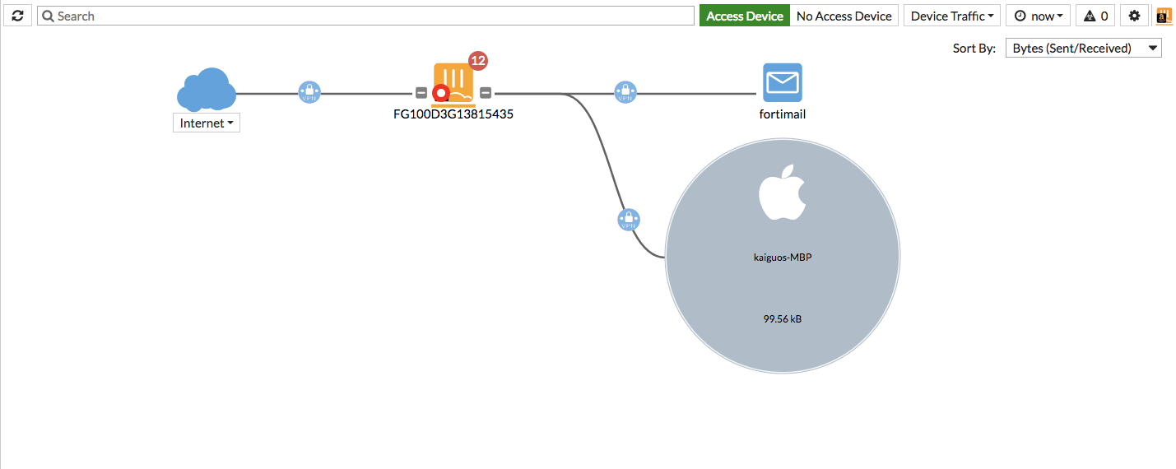
AWS
Azure
Google
Oracle
VMWare
KVM
Xen
HyperV
AzureStack
Acceleration
EXPAND
Dynamic Policies
EXPAND
Cloud
SDN
CASB
SD-WAN
UEBA
Single Pane
IAAS
Telemetry & Segmentation
Cloud
SDN
Strategy & Priorities
Server Protection
Tech & Standards
Security Oversight
Security Advisor
CISO
Industry Comparisons
Integrated NOC / SOC
Priorities & Metrics
Vulnerability & IOC Detection & Response
Unified Views
Threat Intel Exchange
Audit & Compliance

Slide 6
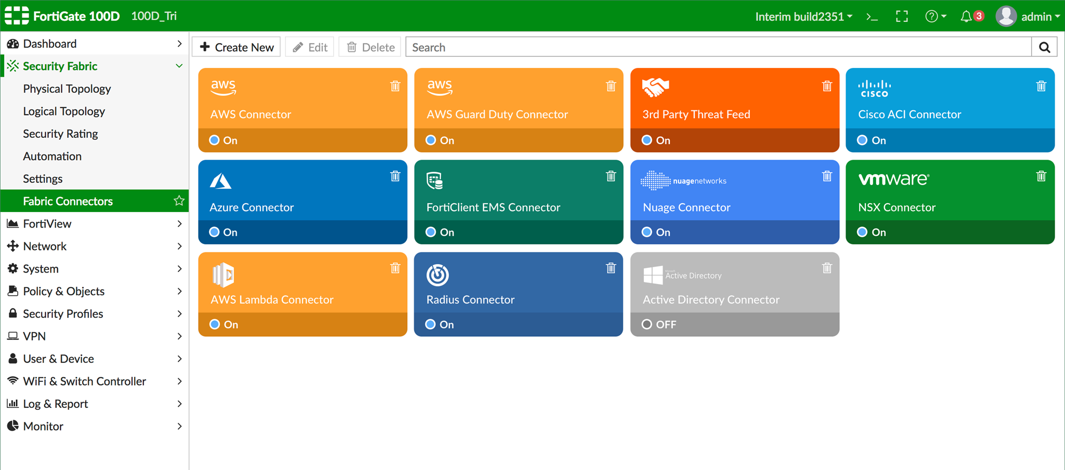
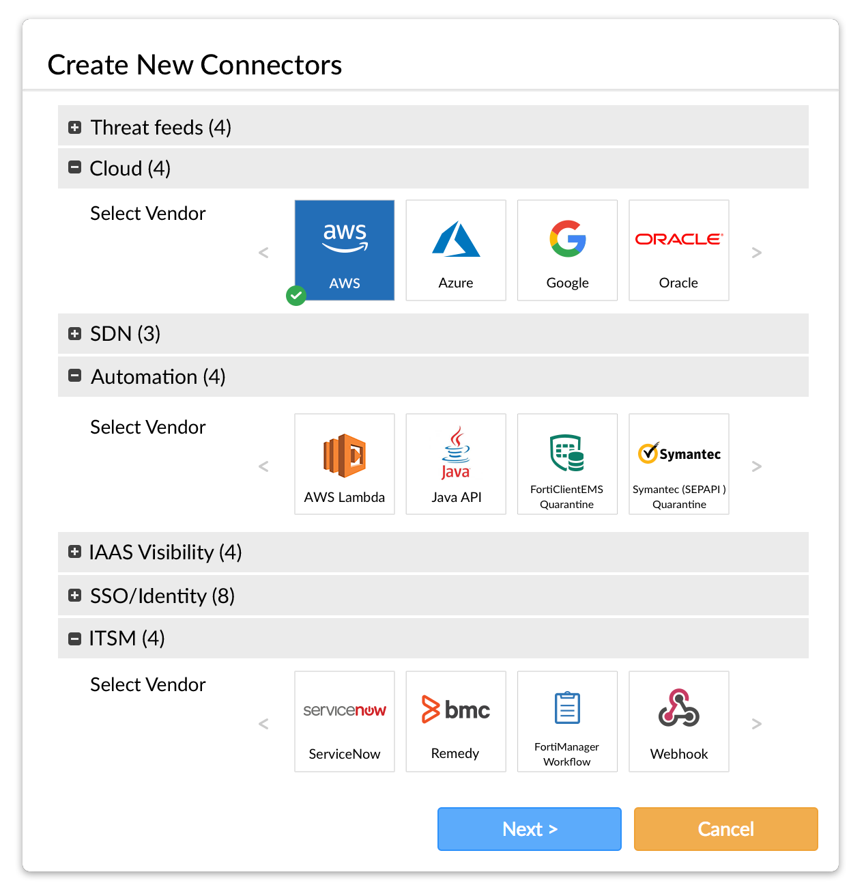
INTEGRATE
Fabric Connectors
  Threat Feeds
  Dynamic Policy
  Automation / Remediation
  IAAS
  SSO
  ITSM
  Endpoint CVE

Slide 7
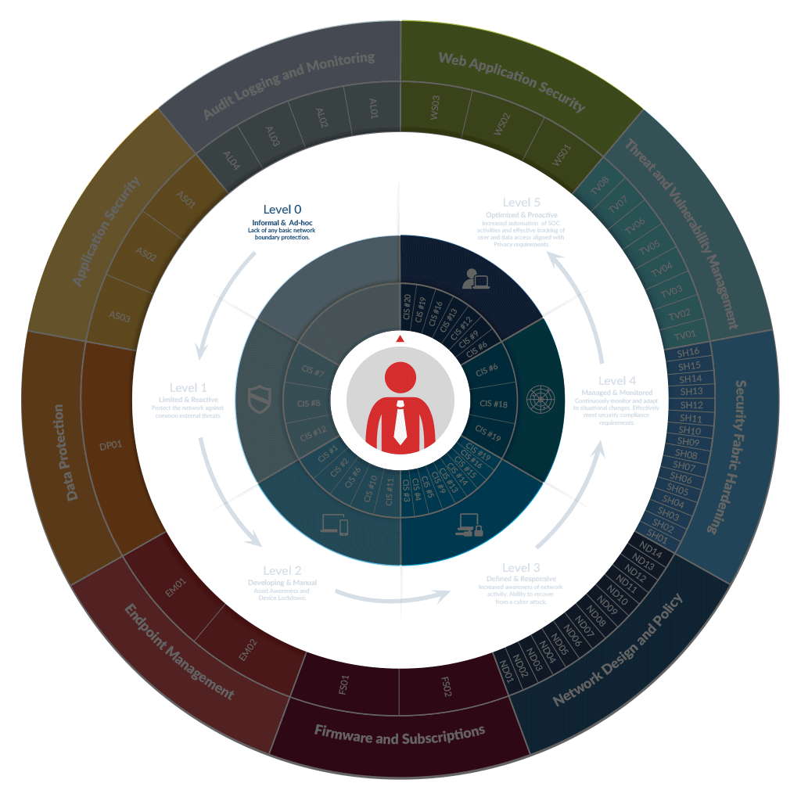
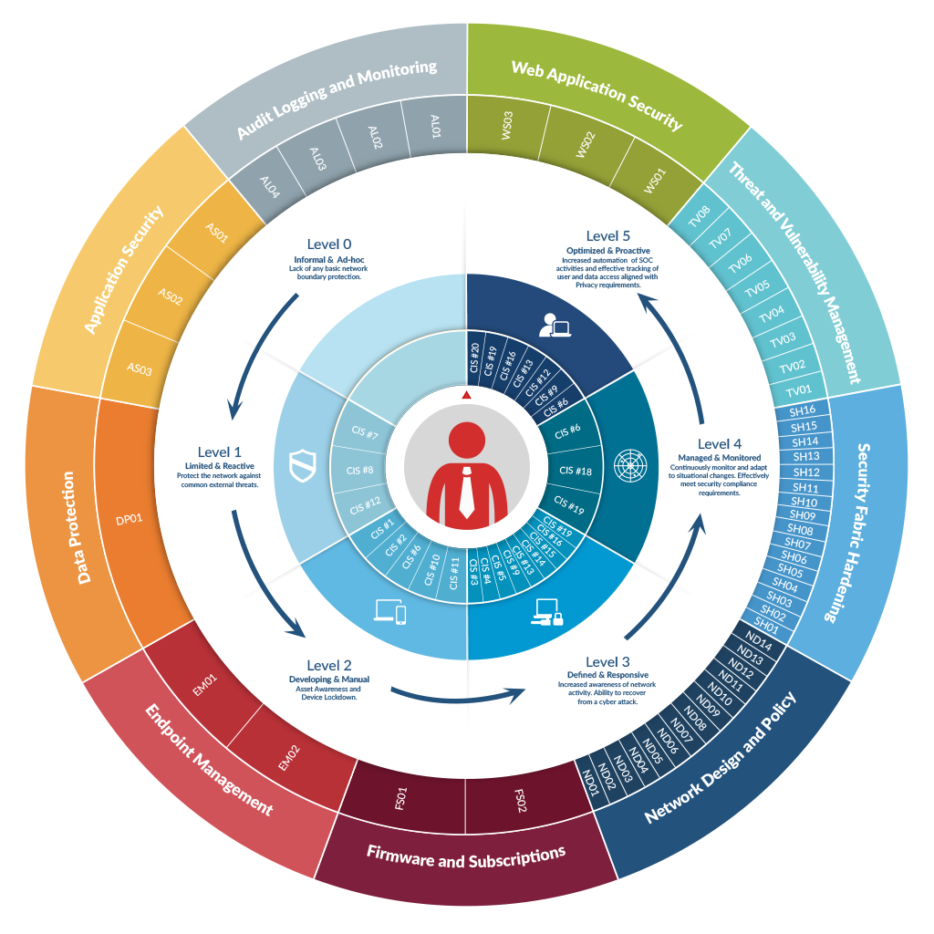
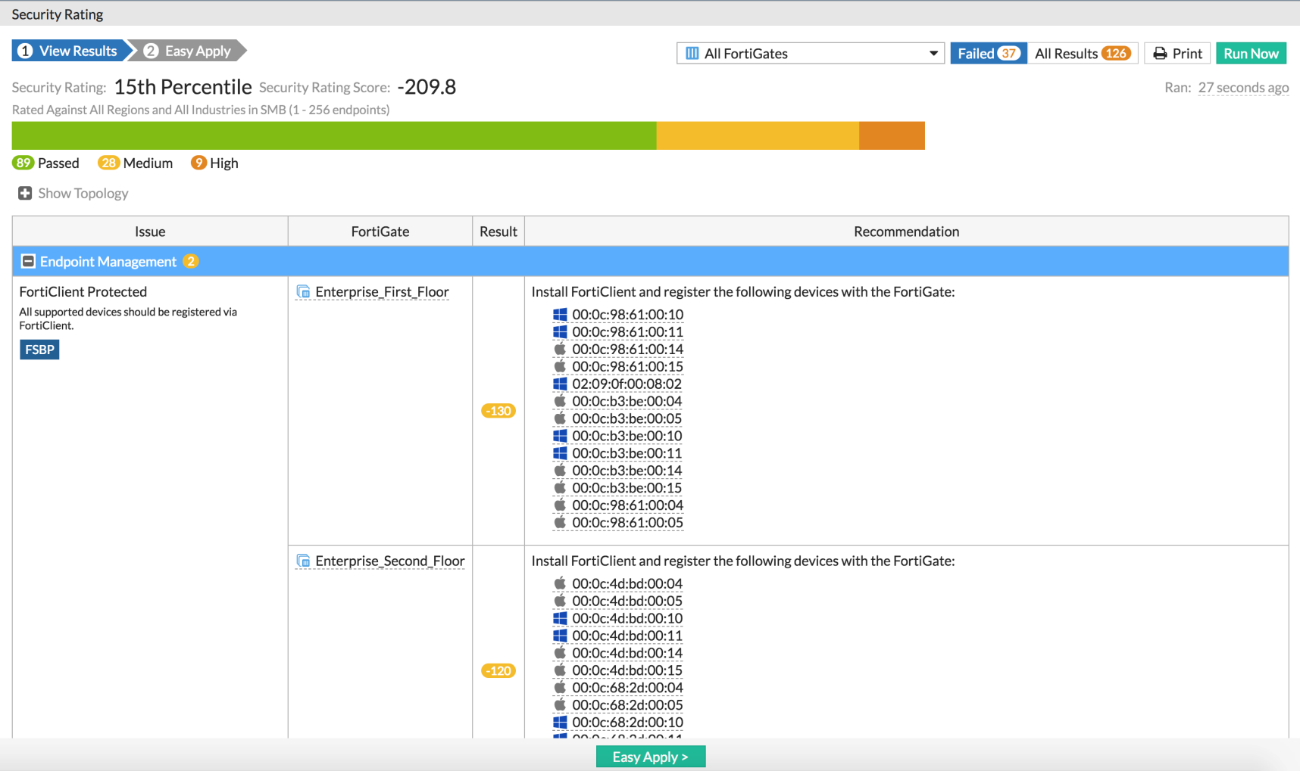
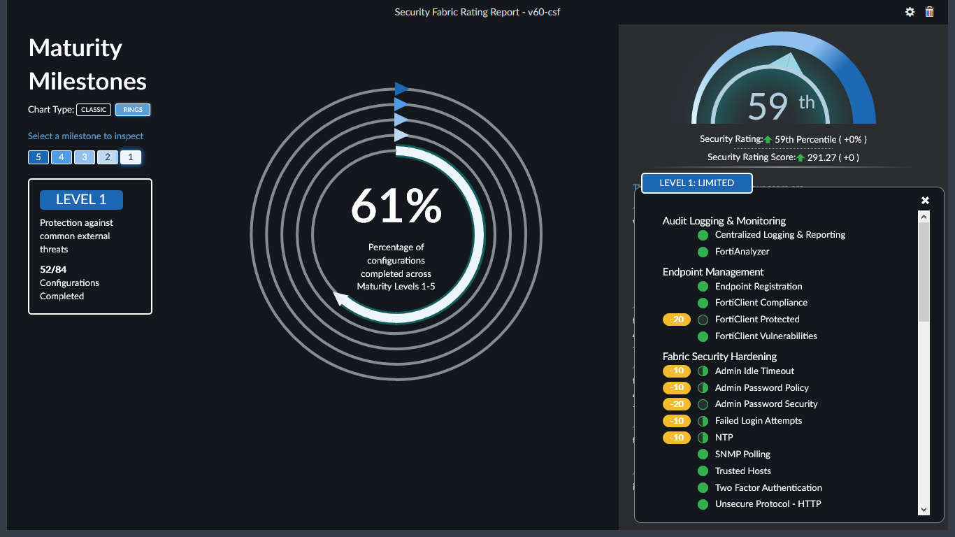
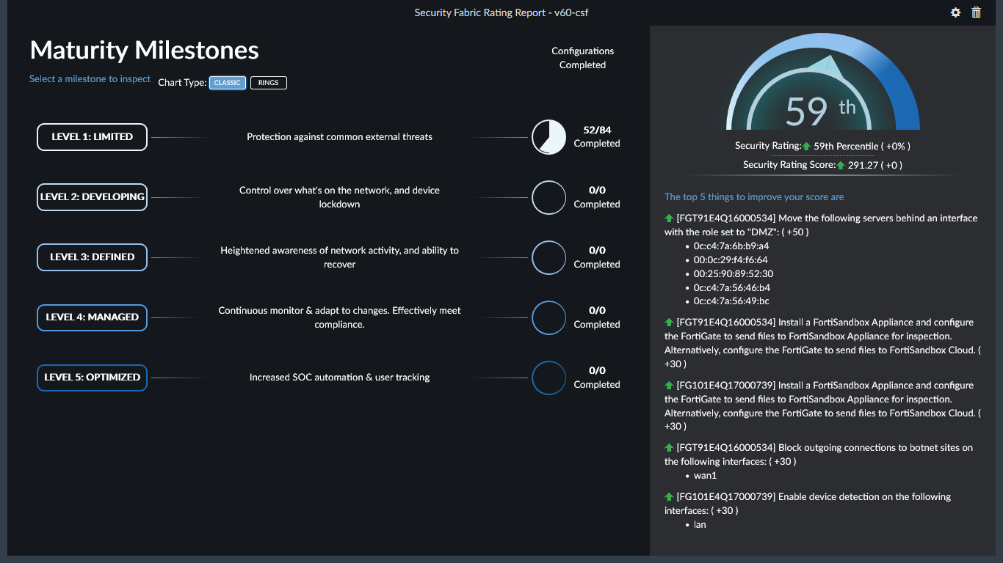
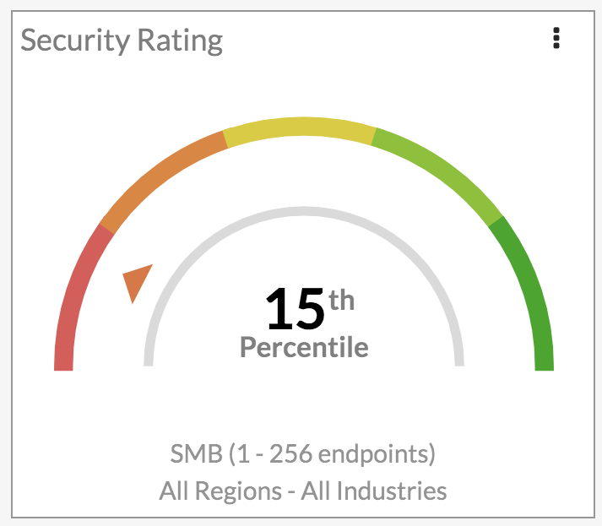
MEASURE
Security Roadmap
Integrated Measurement
Fabric-wide Reporting
Multi-product
Industry, Region & Size Comparison
How Secure Am I?
Standards
Based
Feature Map

Slide 8
FortiView History
DETECT
IOC
6.0
Central Policy
5.6
- historical
- IOC
RESPOND
2
Expanded
SOC INTEGRATION
6.0
- detect
- respond
- automate
AUTOMATE

Slide 9
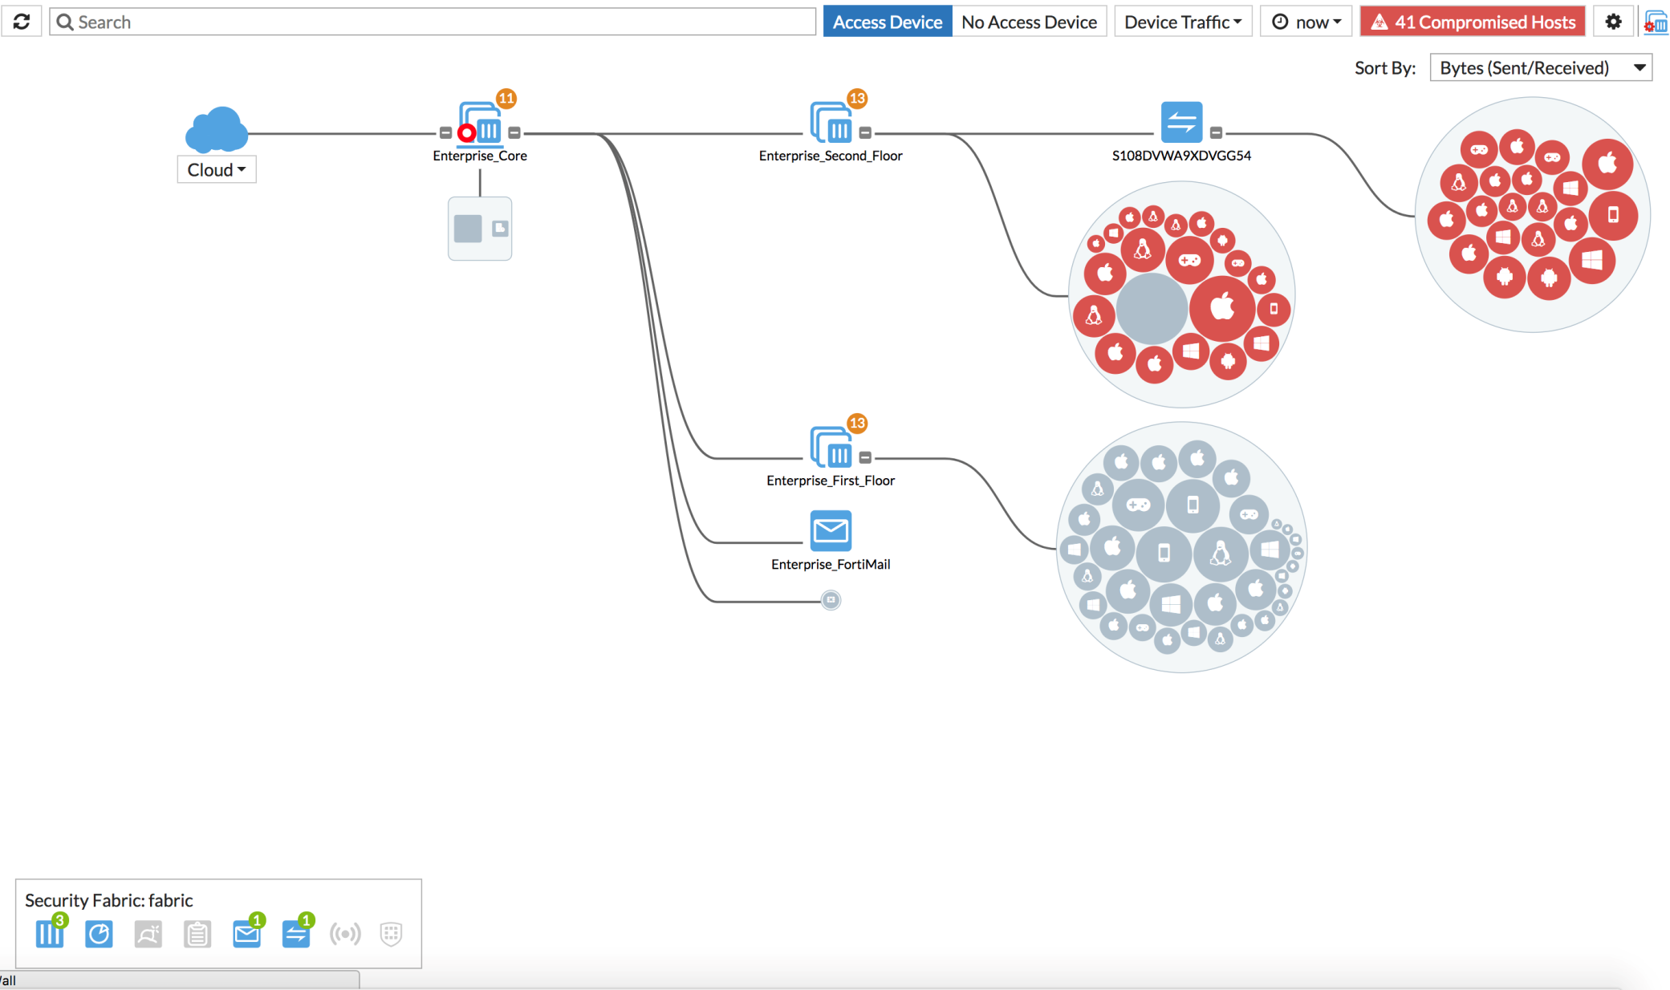
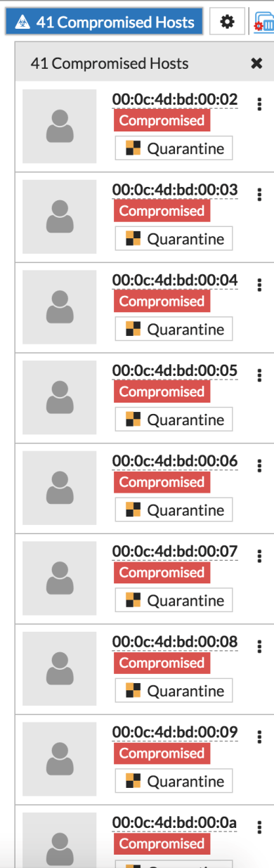
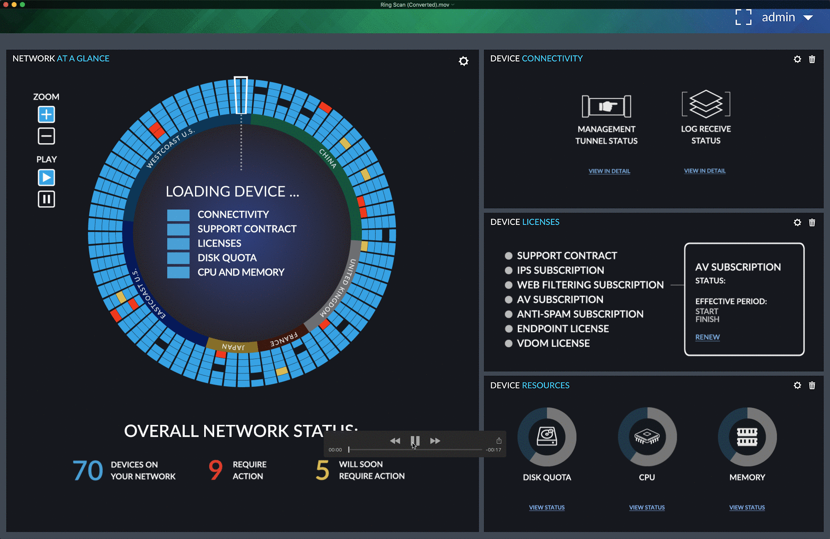
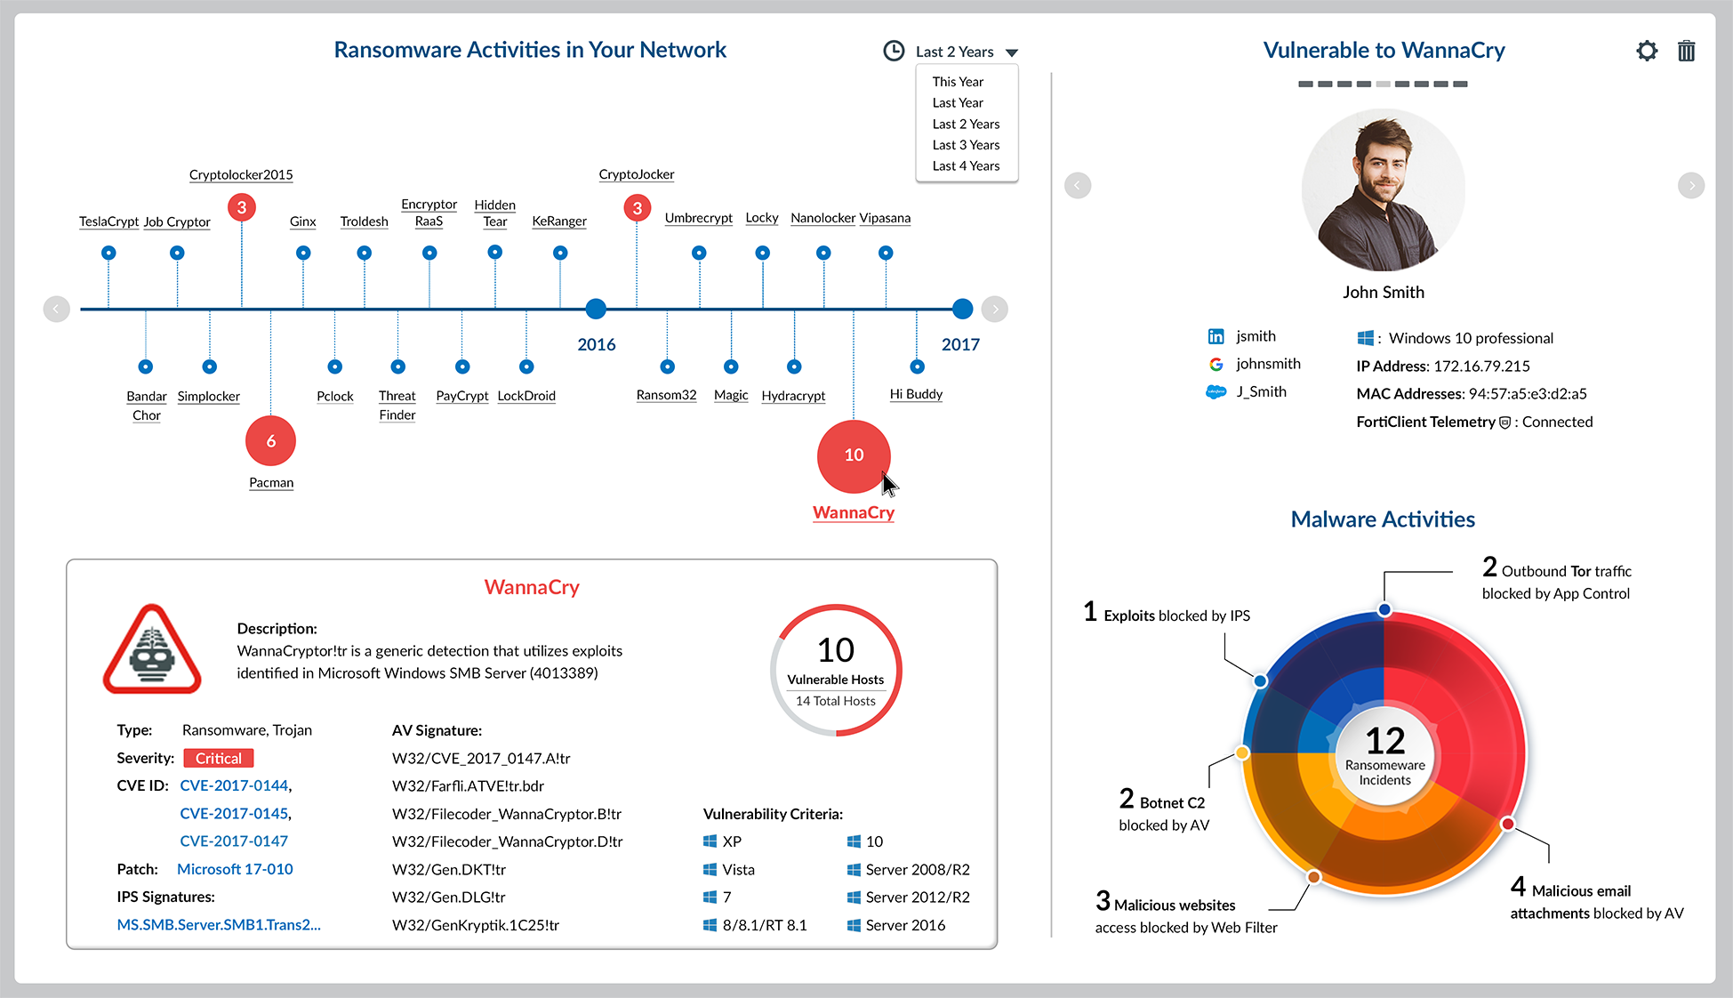
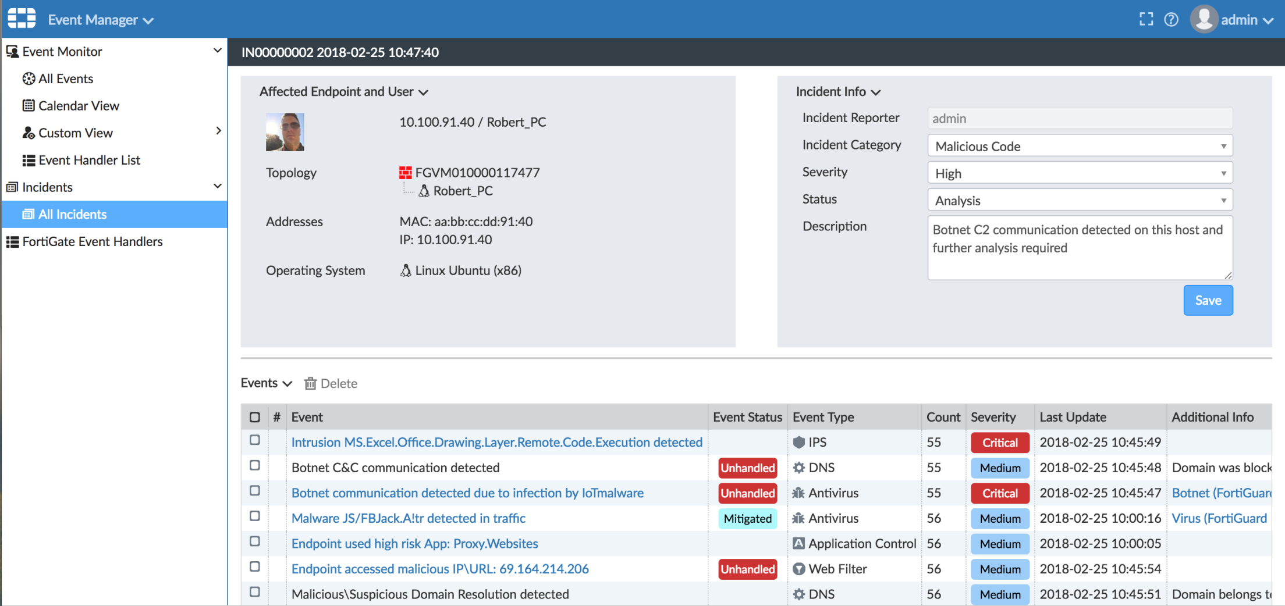
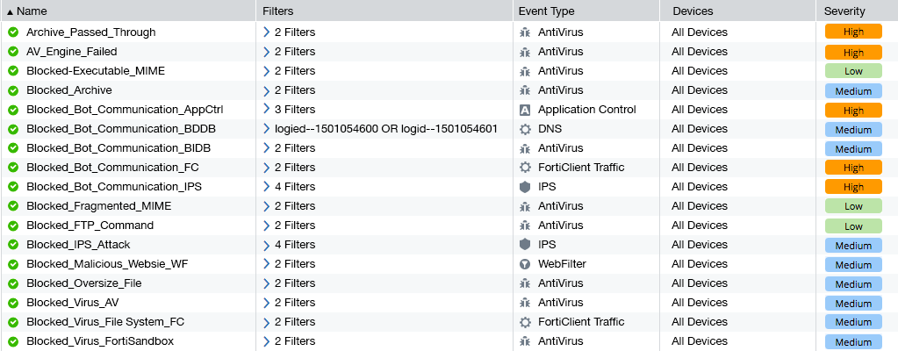
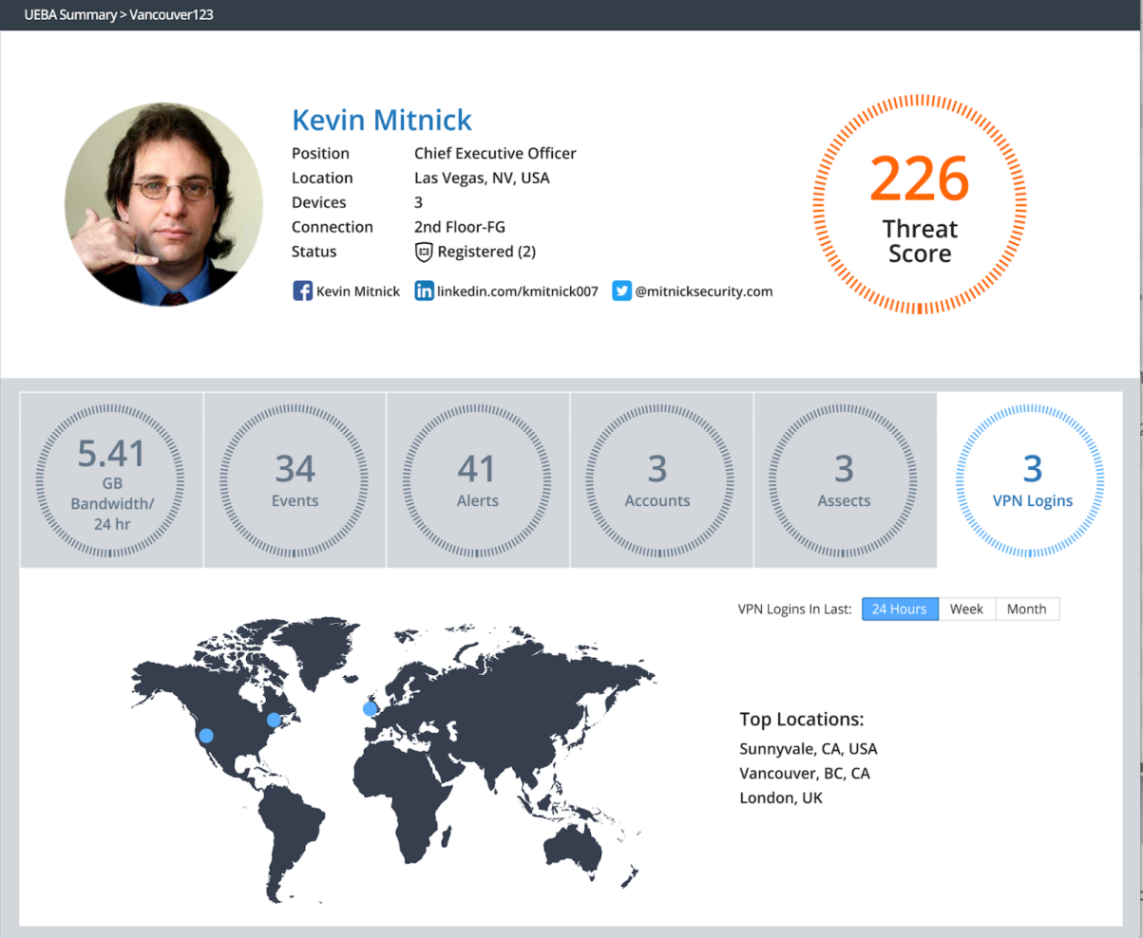
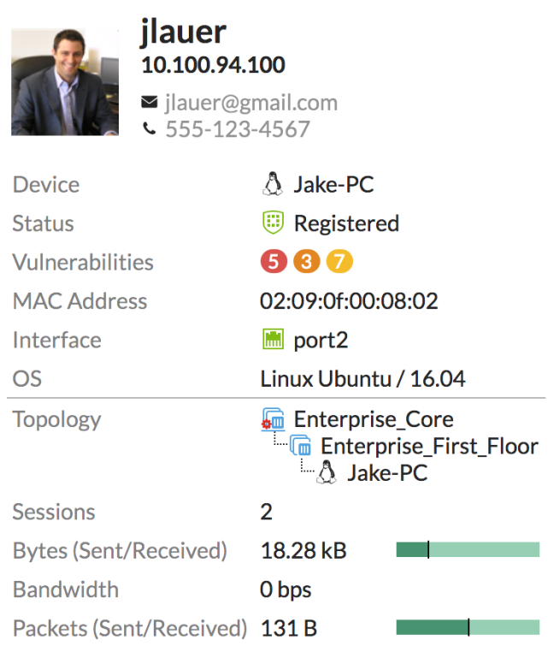
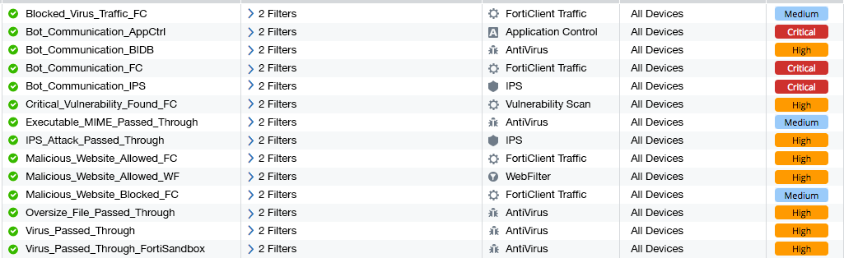
DETECT
DETECT
APT
IOC
3rd Party
Vulnerability
UEBA
Weakness

Slide 10
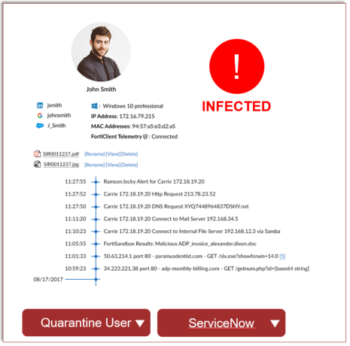

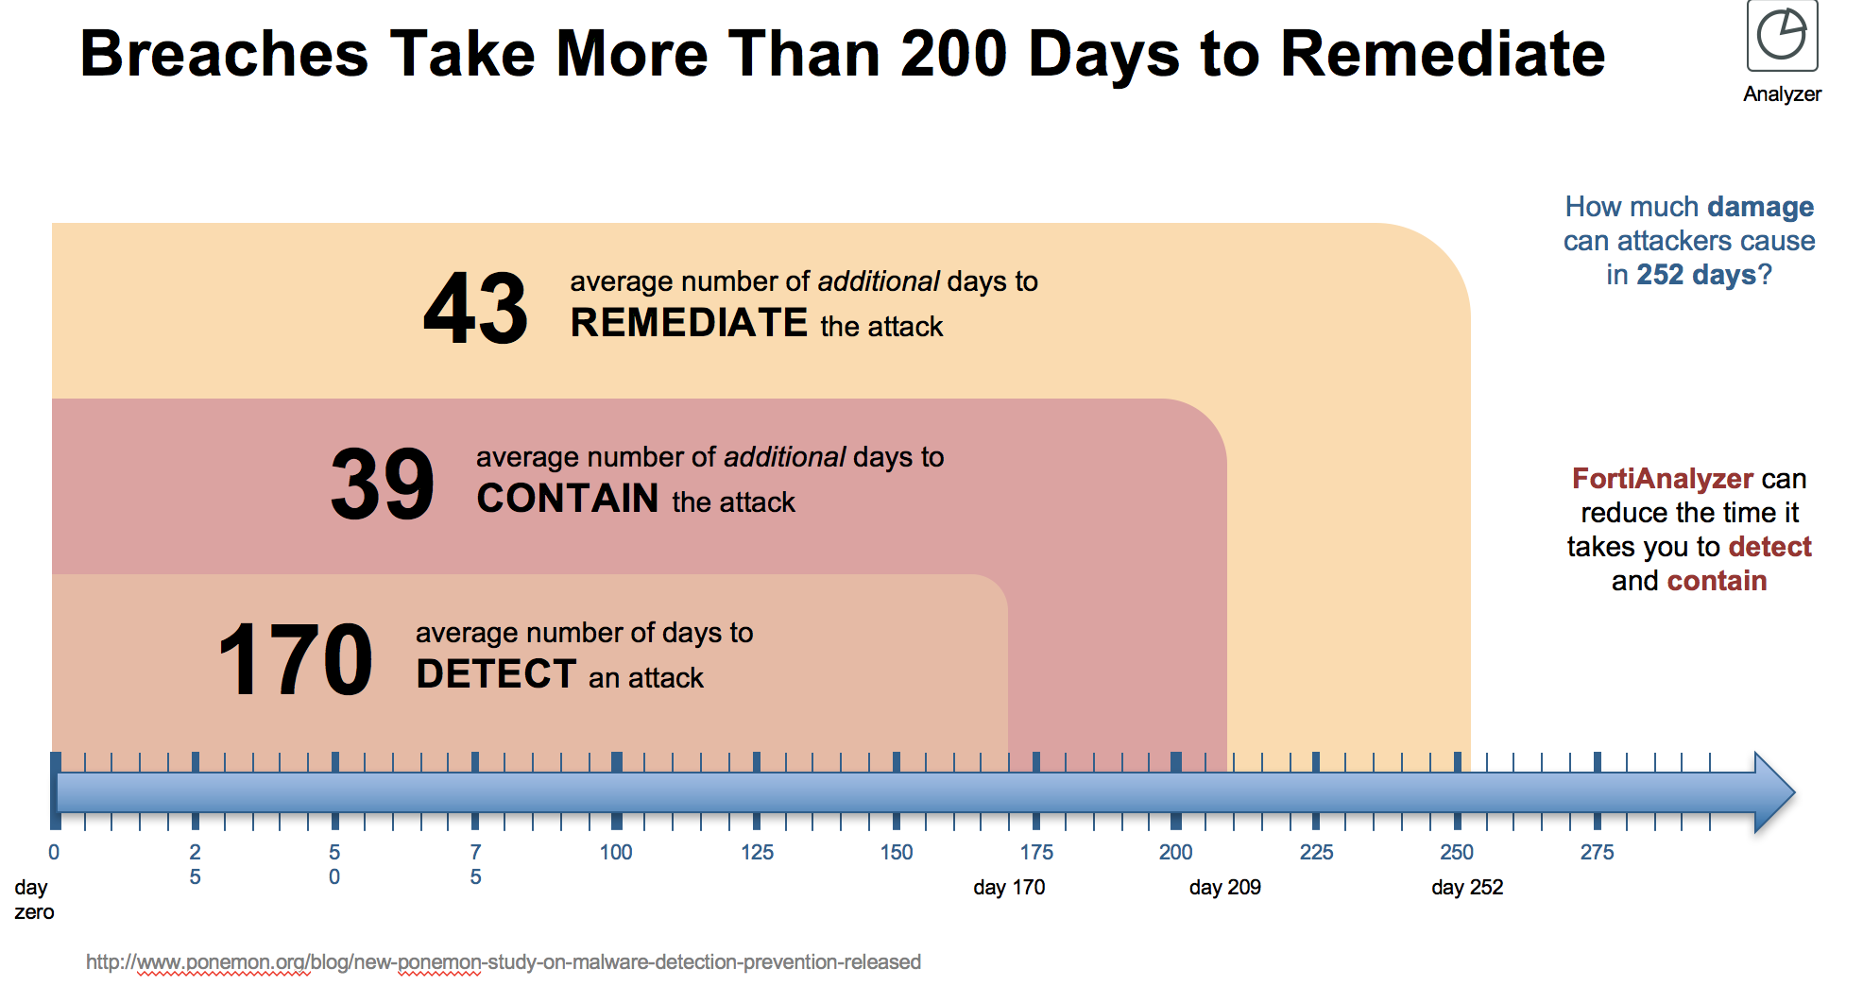

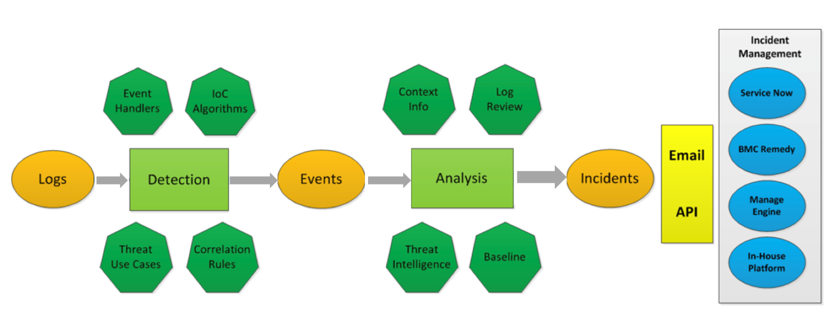


RESPOND
Automate
Automate
DETECT
Incidents
ITSM
Automation
Workflow
API
Change Management Workflows
FAZ API
Defined Change Controls
Incident Response Workflows
Integrate

Slide 11
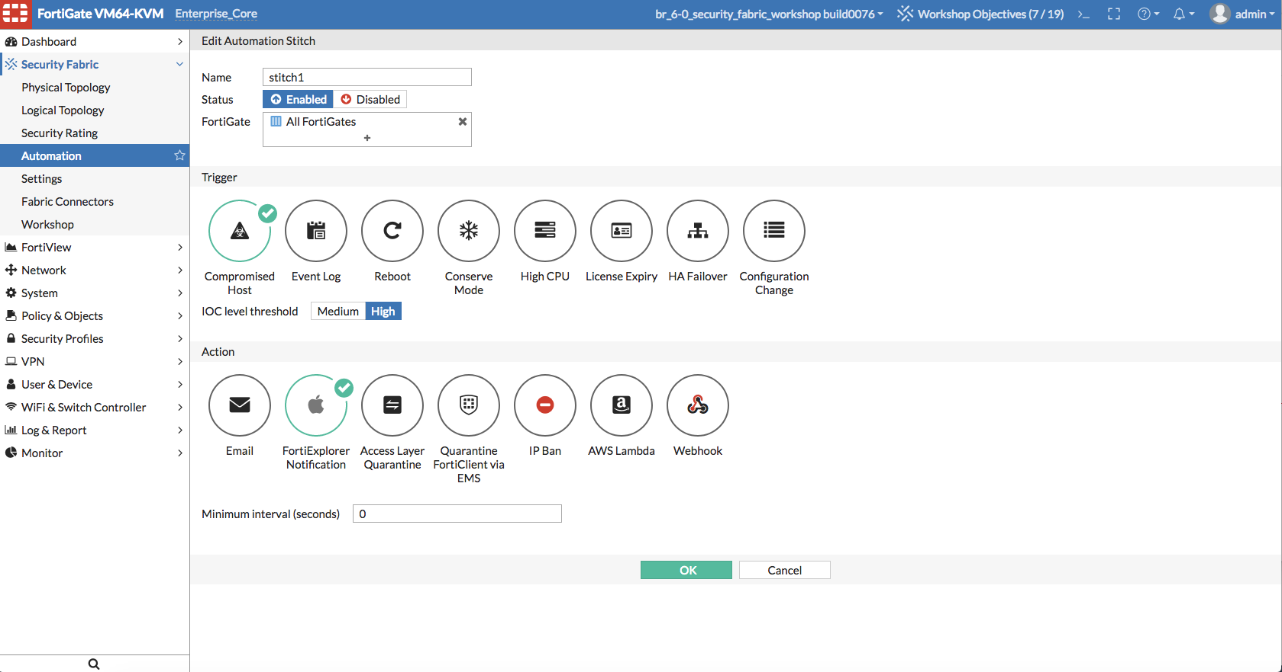



AUTOMATE
DETECT
0-day
Any Source
Audit
Real-time detection
FortiAnalzyer
  IOC
  EVENTS
REST API
…
Remediation
Framework (Stitches)
Fabric Inputs
Fabric Outputs
IFTTT
Endless
Event
Infected IP
IOC
Bot Infection
Action
Any Destination
Fabric Config
Push Notification
Configuration change
Endpoint Actions
REST API
…
Quarantine
Switch
(VLAN)
SSID
(VLAN)
Host

Slide 12
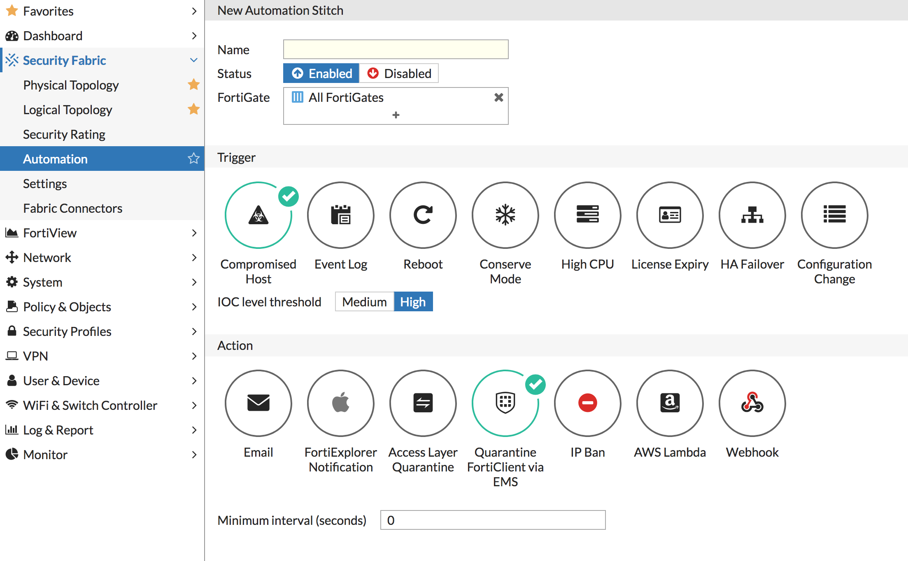
FortiClient Automatic Quarantine (FOS 6.0.0)
FOS 6.0.0
Based on IOC level (medium/high)
Automatic FortiClient quarantine via EMS

Slide 13

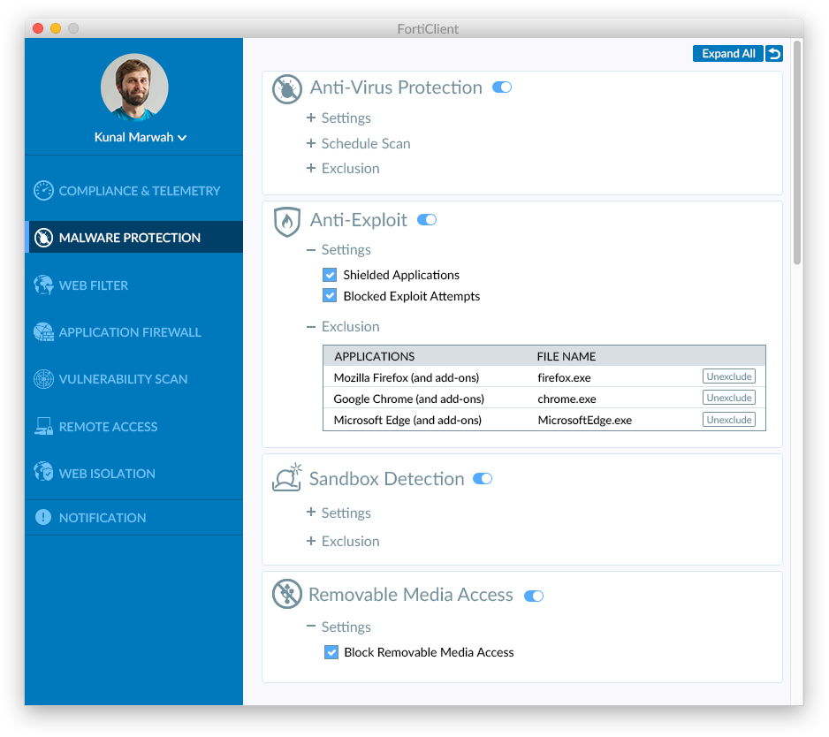
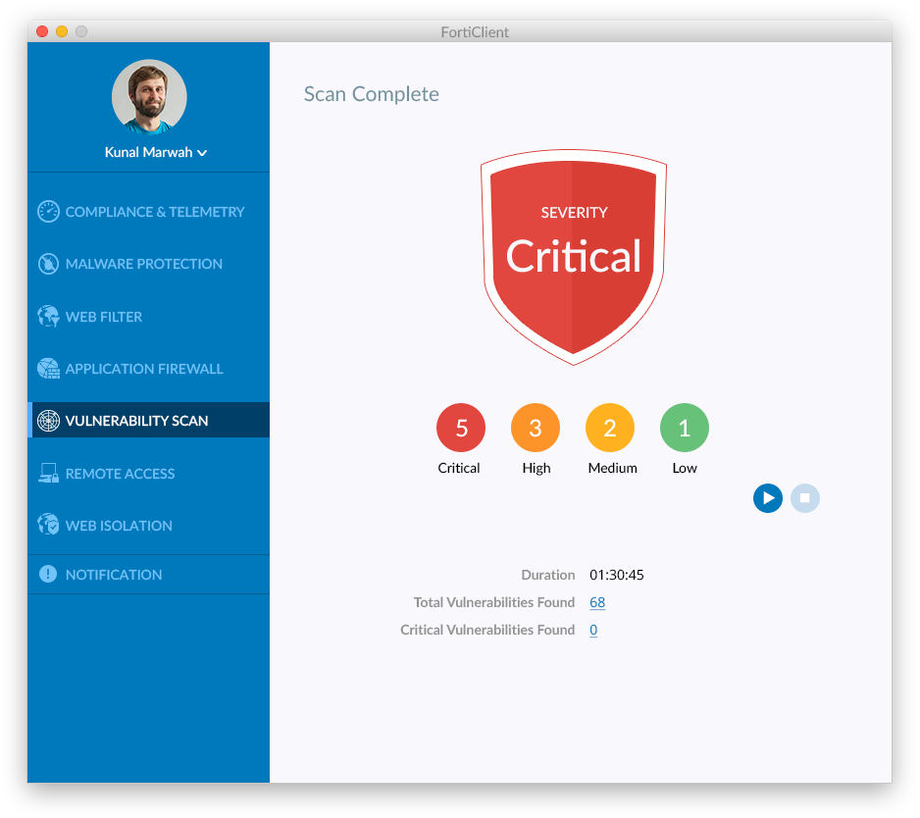

AntiMalware Protection
NEW 6.0.0
NEW
New GUI for Windows, Mac and Linux
Anti-Virus Protection
Anti-Exploit GUI
Sandbox Detection
Removable Media Access Analysis
Vulnerability Detection
NEW
NEW

Slide 14
Wireless user quarantine
FOS 6.0.0
Quarantine Host option to quarantine devices that are connected in Tunnel-mode
Host gets an IP address from the quarantine VLAN

Slide 15

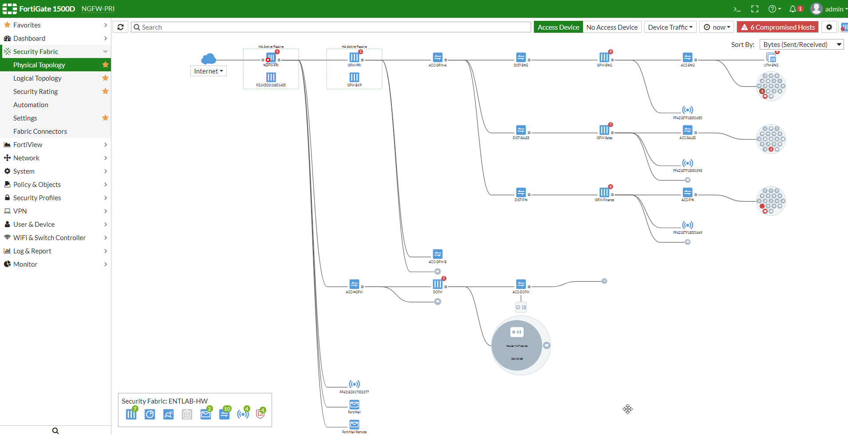
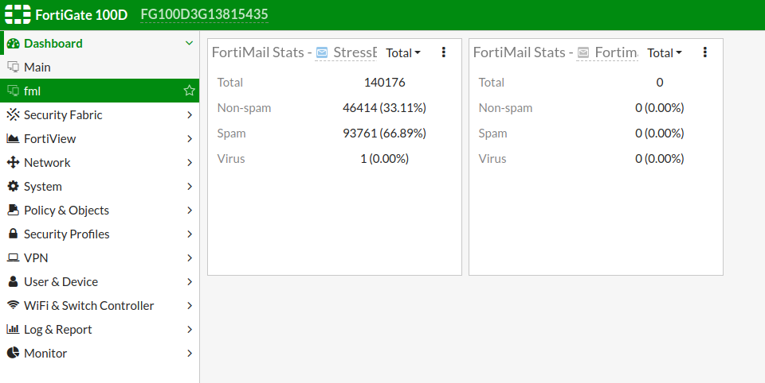
FORTIMAIL FEATURE UPDATE
6.0
FortiView & Cooperative Security Fabric
Security Fabric
FortiMail becomes part of the FOS Security Fabric
  Appears as member of Physical Topology
Mantis: N/A Func Spec: N/A

Slide 16
A consistent policy across your entire network
Every enterprise needs to answer the question "How Secure Am I?”
Security Fabric delivers transparency throughout network, endpoint and cloud, and enables Enterprises to develop a clear security roadmap aligned to meet business goals.
Security Fabric is designed to streamline & automate the fundamental security of the Enterprise AND deliver assurance to stakeholders at each level.
What is
Security
Fabric?

