Slide 1
Data is the new currency $$$
Marcin Pączko
Enterprise & Platforms
Country Manager BELT
mail: marcin.paczko@wdc.com
mobile: +48 601 333 928
skype: leon.zaw

Slide 2






Corporate and Product Brand Structure
New: Devices Group Commercial and Enterprise
Corporate Brand
Product Brands
Consumer
Consumer
Consumer
Target Audiences
Commercial
Enterprise
Commercial = OEM & Cloud Service Provider (CSP)
©2018 Western Digital Corporation or its affiliates. All rights reserved. Confidential.

Slide 3










Acquisitions for Storage Technology Breadth …
Mar. 2012
Sept. 2013
Oct. 2013
Mar. 2015
May 2016
Aug. – Sep. 2017
HDD
SSD
System / SW
NAND
Embedded, Removable Flash, Persistent, Cloud Services
… and Strategic Investments

Slide 4
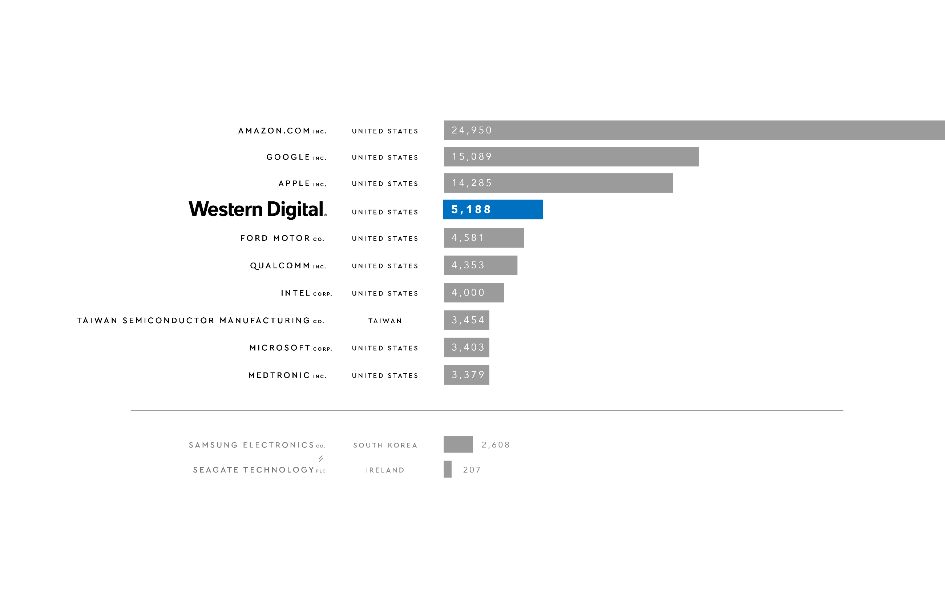

The World’s Most “Valuable” Patent Portfolios
14,000+
Total Issued
Patents, WW
Source: 2017 IEEE includes SanDisk, WDC, and Skyera

Slide 5
Market Trends

Slide 6




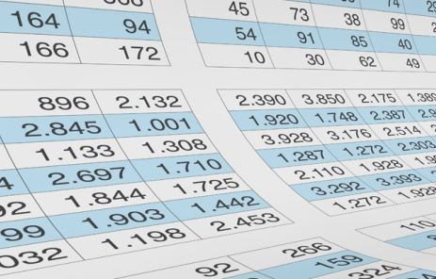






The Evolving Role of Data
Creating the data-driven economy
Data as
a record
Data as communication
Data as
efficiency
Data as
currency
Richness
Notes:
Over time the role of data has been evolving both in terms of value and richness
<CLICK> Data as a Record
<CLICK> Data as Communication
<CLICK> Data as Efficiency and Productivity
<CLICK> Data as Currency
This has led to exponential growth in the volume, velocity, variety and value of data
Doubling every 2 years to 44ZB by 2020 (42% CAGR)
Thanks to data scientists and an increasingly connected world, the volume of valuable data is growing even faster at 50% CAGR

Slide 7










Every Minute of the Day….
THE WEATHER CHANNEL receives
18M
forecast requests
NETFLIX subscribers stream
69K
hours of video
GOOGLE conducts
3,6M searches
YOUTUBE
users watch 4.1M
videos
INSTAGRAM users post 47K
photos
DROPBOX
users upload 833K
new files
15M
text messages are sent in the U.S.
SNAPCHAT
users share
527K
photos
Spammers sent
103M
SPAM MAILS
Source: “What People Do on the Internet, Every Minute of Every Day”, Domo Research, July 25, 2017
Notes:
Data is exploding
“Every minute of the day (2017)” Domo research
Americans use approximately 2.7PB of internet data
YouTube users watch 4M videos
People send 15M text messages
Netflix users stream 69k hours of video
The Weather Channel receives 18M forecast requests
Snapchat users share 527k photos
Instagram users post 46k photos
Uber riders take 46k trips
Today the world generates 2.5EB of data per day
In 2017 the industry shipped approximately 850 exabytes of storage between HDD and NAND
Western Digital shipped 43% of the worlds exabytes more than any other company

Slide 8

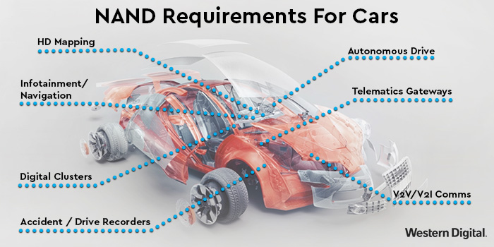
Connected &
Autonomous Driving
19
car mfr
by 2020
2PB/yr
Generated
per car
4TB/hr
while
driving
Tesla and Daimler have announced autonomous trucks
2022
all cars will use 1TB
https://blog.westerndigital.com/driving-toward-autonomy-introducing-the-inand-7520a-for-connected-and-self-driving-cars/
Notes:
One autonomous car generates 4TB per hour of driving
Around 2PB of data per car per year
19 car companies have announced plans to roll out autonomous cars by 2020
Around 80 million passenger cars are sold worldwide per year
RFQs for these cars are for a 2TB SSD
Not only passenger cars both Tesla and Daimler have announced autonomous trucks
Today the industry estimates 15.5M delivery trucks operate in the U.S.
The autonomous cars of tomorrow will require storage for the following:
High definition mapping
Infotainment/navigation
Digital clusters
Telematics gateways
V2V and V2I communications
Accident recording and more

Slide 9

Surveillance Market
1080p
30PB
per day
4K
120 PB per day
>500K CCTV cameras
45EB per year
London
Surveillance Storage Needs
Notes:
London has the most surveillance cameras out of any city, with approximately 500,000 CCTV surveillance cameras (2008 figure)
The average Londoner is recorded on camera 300 times a day
For a 1080p surveillance camera
# of Cameras in London = 500,000
Current File Size for one camera (1080p) = 60 GB/24 hours using latest compression techniques
Current File Size for all cameras (1080p) = 30 PB/24 hours
Converted to 4K for all cameras (4x) = 120 PB/ 24 hours 3.6EB for 30 days

Slide 10

eCommerce Market
Less than
2 sec
page load
$2.3T
Market size
2017
>3 sec 53%
abandon website
Not satisfied
79%
wont
return
Source: https://www.hobo-web.co.uk/your-website-design-should-load-in-4-seconds/
Source: https://www.statista.com/statistics/379046/worldwide-retail-e-commerce-sales/
Notes:
2 seconds is the threshold for ecommerce website
In 2016, A presentation by AliExpress claimed they reduced load time for their pages by 36% and recorded a 10.5% increase in orders and a 27% increase in conversion rates for new customers.
In 2017, retail e-commerce sales worldwide amounted to 2.3 trillion US dollars and e-retail revenues are projected to grow to 4.88 trillion US dollars in 2021.

Slide 11


90% of the world’s data created in the past 2 years
2017 Statistics
850EB
of storage shipped in 2017(HDD and SSD)
163 ZB
data generated by 2025
shipped
43%
of World’s Exabytes
65% to 80%
of Data Center spend is on storage
Source: “What People Do on the Internet, Every Minute of Every Day”, Domo Research, July 25, 2017. “What will we do when the worlds data hits 63 Zettabytes in 2025”, Forbes, April 13, 2018
and Western Digital internal market analysis, March 2018
Notes:
https://www.forbes.com/sites/andrewcave/2017/04/13/what-will-we-do-when-the-worlds-data-hits-163-zettabytes-in-2025/#1870985b349a
One exabyte is one quintillion bytes (10E-18)
One zettabyte is one sextillion bytes (10E-21)

Slide 12
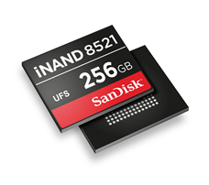


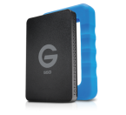




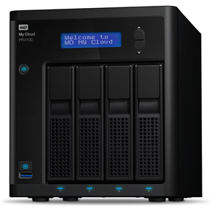

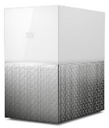
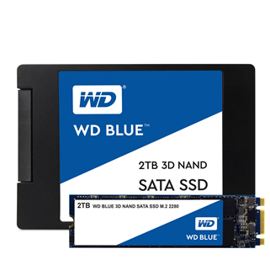
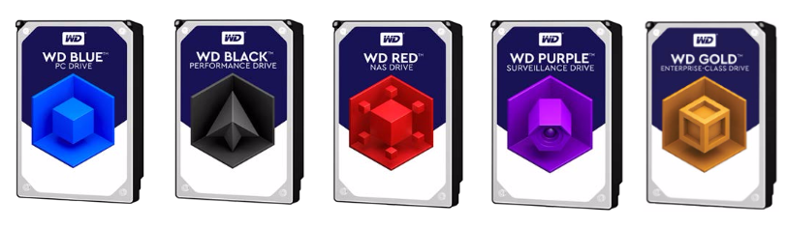
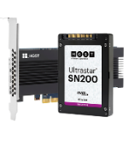
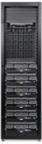
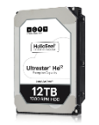

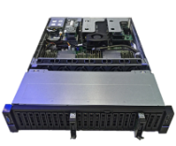
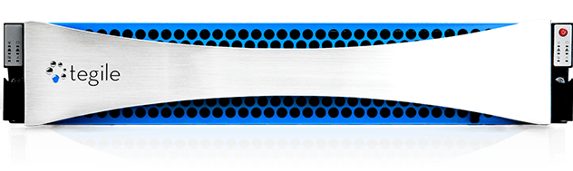
Broadest Portfolio of Products & Solutions
NAND
Components
Embedded NAND
Cards
USB
Portable Storage
Client SSD
Client HDD
Network-Attached Storage
Direct-Attached Storage
Personal Cloud
Enterprise HDD
Enterprise SSD
JBOD & JBOF
Storage Servers
Tegile All-Flash & Hybrid Arrays
Object Storage Systems

Slide 13






Diverse and Connected Data Types
Fast Data
Big Data
Data
Aggregation
Streaming
Analytics
Mobility
Insight
ALGORITHMS
Machine
Learning
Real-time
Results
Prediction
Batch
Analytics
DATA
Artificial
Intelligence
Smart
Machines
Prescription
Modeling
Performance
Scale
Notes:
The expanding role of data can be thought of in two driving forces: Big Data and Fast Data
The world has become very familiar with Big Data and what it brings to us:
Insights based on the discovery of new connections within massive data lakes
Predictions based on the ability to spot trends that correlate to historical sequences of events – weather, stock markets, outbreaks of disease
The ability to go beyond simple averages to be more prescriptive, precise and even personal with our answers – genetics in cancer treatment, biomechanical analysis for rehab or conditioning
Leveraging the algorithms and intelligence gathered from Big Data, Fast Data applications are rapidly emerging and growing
Fast Data applications are where the data needs to be kept close to computing for real time analysis or visualization
When you can’t afford to wait for data to be transmitted across a network for processing
It’s the key to increasing mobility
For real time analytics, such as fraud detection, information and physical security
To fuel smart machines like autonomous vehicles that have hundreds of sensors and control points
Or to enable more immersive interactions with Virtual Reality and Augmented Reality
Fast Data is the key to Machine Learning and Artificial Intelligence
It’s the key to Edge Computing to bring the power of data closer to where it’s needed
This increasing diversity of data is bringing new demands and challenges to how we capture, store, protect and access it
Big Data is all about scale
Preserving and accessing the increasing amounts of data for longer periods
Even bringing offline data archives back online to light up dark data, so that we extract value
For data storage this means capacity, not only of storage devices but also of advanced storage architectures like Object Storage
And because of the massive scale of Big Data needs, that also means affordability or Total Cost of Ownership
Fast Data is all about performance
Capturing and transforming data when and where it’s created
Making real time decisions based on the flow of new data
For data storage, Fast Data means solid state technologies and high performance architectures

Slide 14
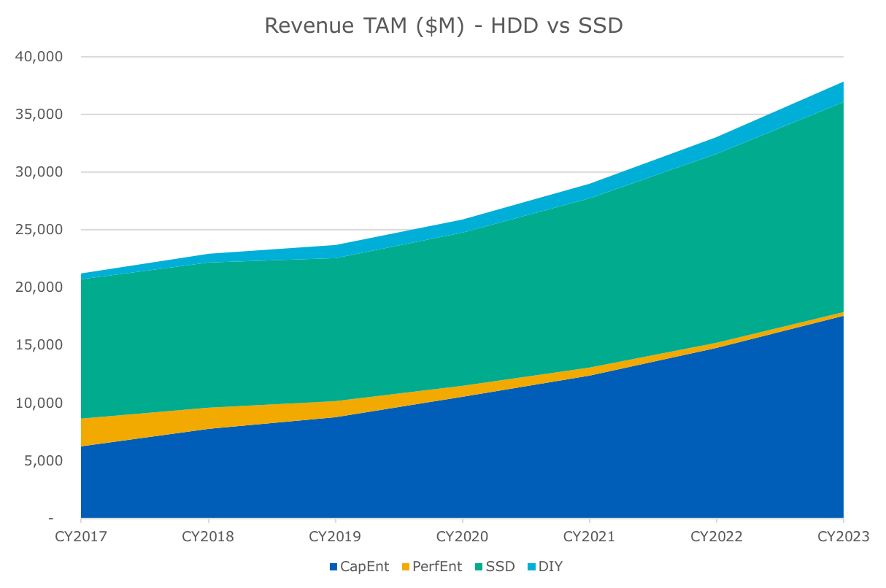
Enterprise Devices – Market Growth
CAGR
26%
  Capacity eHDD growth rebounds with strong Q2 FY18. Flat to 2019 but strong growth longer term
eSSD revenue growth stronger for SATA and Essential PCIe than SAS and Performance PCIe
Significant increase in DIY TAM
9%
eSSD
-33%
eHDD
23%
©2018 Western Digital Corporation or its affiliates. All rights reserved. Confidential.

Slide 15
Critical Components of Areal Density
Increase Density by Placing Tracks and Bits Closer Together
Tracks per inch
(TPI)
Bits per inch
(BPI)
9/28/18

Slide 16


Driving Leadership Through Proven Execution
The last five years of innovations are a foundation for the future
Helium
Micro Actuator
Damascene Process
Reduced turbulence for maximum head stability
Provides finer control and supports higher track density
Enables greater process control and complex head structures
He
These technologies enable higher capacity and reliability

Slide 17


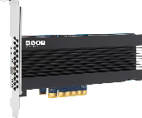




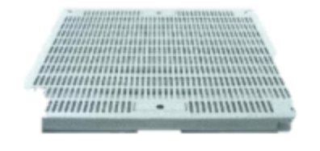

TCO Benefit: 17% Lower Storage Cost
More Capacity. Less Power.
Enterprise Scale
Storage Cluster
4 data nodes
w/12x OSD HDDs each
Triple Replication
Key Components
Cost Ratio
48
50%
HDDs
HDDs
4
8TB Servers
12TB Servers
SSDs (NVMe)
50%
4
Servers
Non-HDD Storage
8TB
Air
Capacity (TB)
Power (W)
Watts/TB
$/TB
8U
+ Shared system costs
Rack Space
384
365
0.95
Baseline
12TB
Helium
+50%
-30%
-54%
-17%
576
254
0.44
@ $/TB Parity

Slide 18



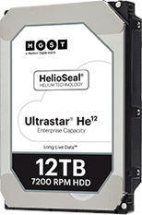
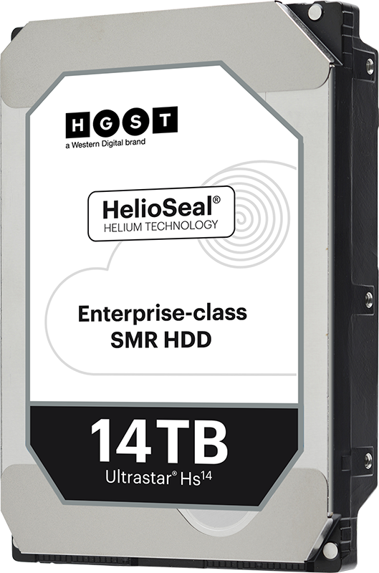
Leadership Capacity Through Proven Execution
HelioSeal®
How do we address
the Writeability Limit?
Micro
Actuator
Writeability Limit
Damascene
Capacity
for Big
Data
Today
Future
9/28/18
Notes:
With this technology, we’ve delivered
He6, He8, He10, He12, Hs14…
A set of proven technologies to build upon
But we’ve hit a wall, and to get past the write

Slide 19
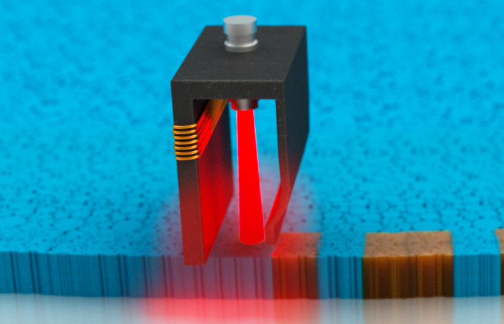
How HAMR Works
  Heat from laser lowers the energy barrier to write on media and magnets can be switched with smaller magnetic field
  When media cools, the data is harder to erase
Writer
400º to 700ºC
Media
HAMR comes with reliability, cost and complexity challenges
9/28/18
Notes:
Media heated to high temperature of 400-700º C
HAMR requires new materials and process
Glass substrate for media
New magnetic materials (Iron-platinum)
Head with laser and wave guide
New electronics
Head and media wear leveling
Many reliability challenges due to complexity and heat

Slide 20

How MAMR Works
Writer
  Microwave fields emitted by a Spin Torque Oscillator (STO) located near the write pole allows writing of perpendicular media at lower magnetic fields
Spin Torque
Oscillator (STO)
Same temp as PMR
Media
MAMR achieves density without reliability, cost or complexity challenges
9/28/18
Notes:
Magnets on disk are like spinning gyroscopes that are stable in up or down direction in absence of external field
Magnetic field applied causes the magnets to flip by lowering the energy barrier
When a narrow head cannot provide sufficient field, additional assistance is needed
STO in MAMR head converts DC current to AC field
AC (microwave) field pumped into media propels the tiny magnets to flip even with less magnetic field

Slide 21

Video
9/28/18

Slide 22


Slide 23
Energy Assisted Head Reliability
HAMR and MAMR Writer Lifetime Comparison
HAMR
MAMR
HAMR Reliability Challenge: Temperature
  Media temp during recording
  HAMR: 400ºC – 700ºC
  MAMR: PMR HDD temperature
Probability (arbitrary unit)
100X
HAMR
Median
TTF
MAMR
Median
TTF
Writer lifetime (hours, log scale)
Our MAMR drives will meet the same data center reliability requirements as PMR drives
Source: WDC Analysis
9/28/18
Notes:
Median TTF is already above our current data center reliability targets
Our reliability tests show median head Time-to-Failure (TTF) to be 100x better than current HAMR head

Slide 24
Capacity Growth Outlook
MAMR
15% CAGR
40TB
PMR
8-disk
20TB
12TB
10TB
8TB
6TB
Source: WDC Analysis
9/28/18
Notes:
We’re reaching the limits of areal density growth on PMR alone
Adding disks is not a cost- effective, long-term solution
Growing MAMR areal density on our new 8-disk platform enables capacity growth far into the future

Slide 25
HDD vs. Flash SSD $/TB Annual Takedown Trend
MAMR will enable continued $/TB advantage over Flash SSDs
SLC
2008-10
-63% $/TB
MLC
2010-16
-38% $/TB
Supply Constraint
TLC + 3D
2017-22
-20% $/TB
QLC
2022-28
-16% $/TB
Supply Constraint
PMR
2008-11
-30% $/TB
>10x
He/Damascene
2013-20
-18% $/TB
MAMR
2020-28
-15% $/TB
Calendar Year
Source: WDC Analysis
9/28/18
Notes:
MAMR Enables 10x $/TB advantage over Flash for next decade

Slide 26

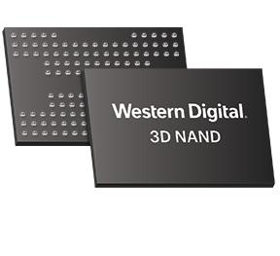
3D NAND Technology Leadership
BiCS4
96-layer 3D NAND technology
X4 technology
Four-bits-per-cell flash memory architecture on
64-layer 3D NAND

Slide 27
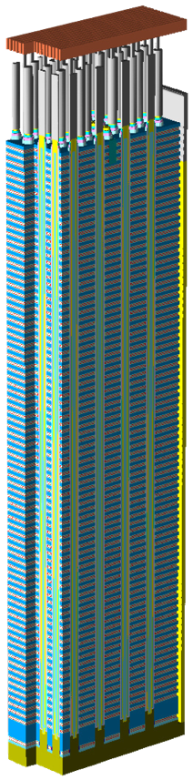
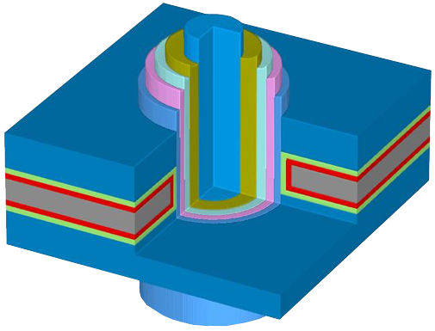
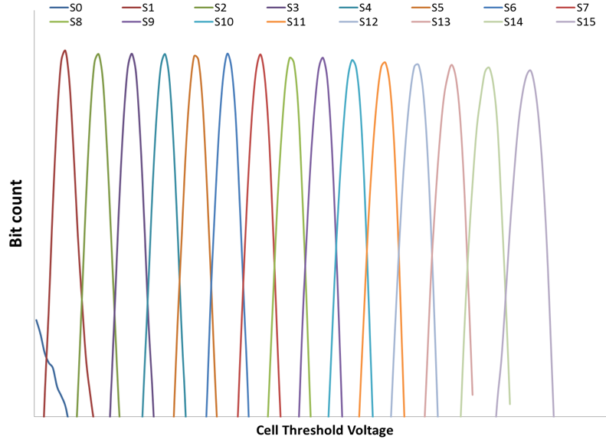
Four-Bits-Per-Cell (X4) Technology
16 data levels per cell
Single
memory cell
Industry-leading
64-layer 3D NAND
SSDs based on 768Gb X4 die showcased at FMS
Enables expanded choice of storage solutions
for customers

Slide 28
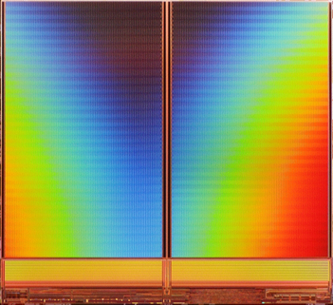
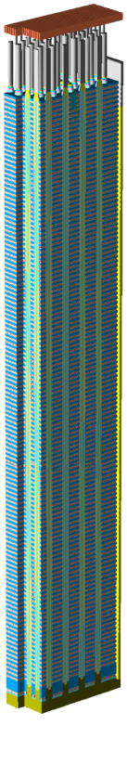
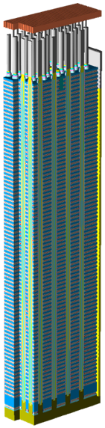
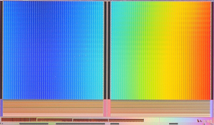
96-Layer 3D NAND Technology
1.5x
layers
Denser storage, improved scalability at an attractive cost
Enables up to 1 terabit
of storage per die
Faster I/O speed using
low power, low voltage
I/O design
512G, 64L BiCS3
35%
die
shrink
512G, 96L BiCS4

Slide 29
Insatiable Growth in Data
HDDs continue to play an important role in the future of data storage
Fast Data
By 2020
of exabytes will still reside on HDDs
Big Data
Flash
~70%
HDD
Source: WDC Analysis
9/28/18
Notes:
Insatiable growth in data requires increasing efficient infrastructure to preserve and access it

Slide 30
Insatiable Growth in Data
In the data center, HDDs continue to play an even bigger role
Fast Data
By 2020
of data center exabytes will still reside on HDDs
Big Data
~90%
Flash
HDD
Source: WDC Analysis
9/28/18
Notes:
Insatiable growth in data requires increasing efficient infrastructure to preserve and access it

Slide 31










Application-Specific sulotions
It is Important to Consider Two Key Questions
WHAT type of application will the be installed in?
HOW will the application be used and in what type of environment?

Slide 32
Enterprise HDD

Slide 33
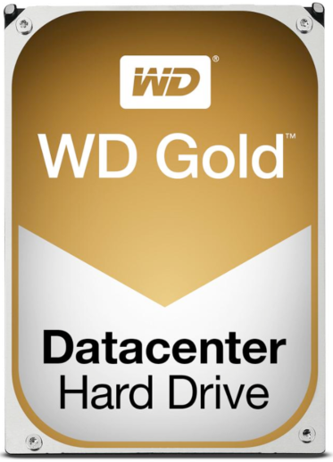


Western Digital Ultrastar
These changes are specific to Capacity Enterprise product offerings, and do not affect any branding on our Client HDD or SSD products
Capacity Enterprise HDD Brand Lineup
Ultrastar
Launched under Western Digital Ultrastar Brand
Legacy-HGST Orderable Part Numbers & Model Numbers for existing products do not change.
Notes:
Decoder for new Model Names
Think of the naming sequence like how BMW has a 3 series, 5 series, etc.
In future we will have 18 digit Orderable Part Number (OPN). Existing products use the model number of HUH and new products will use WUH instead.

Slide 34
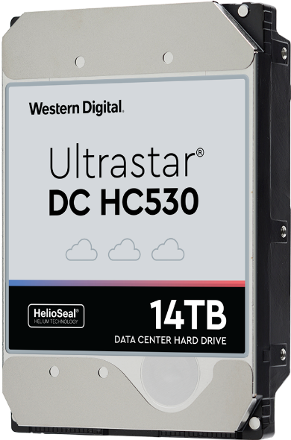
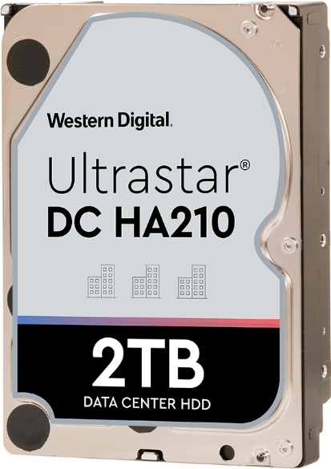
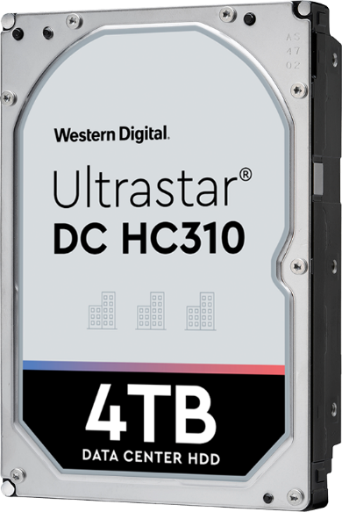

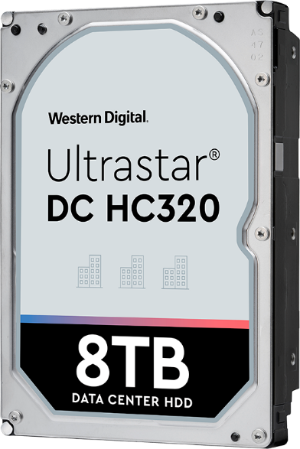
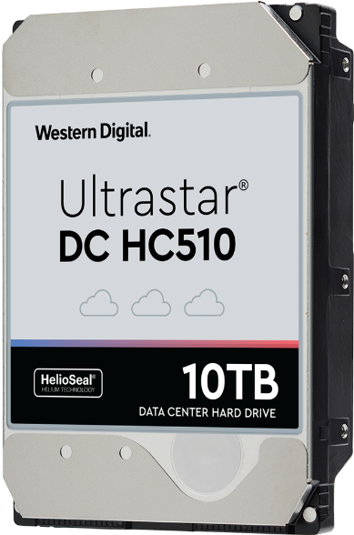






End-to-End Storage
Enterprise class products
SATA Only
Entry Level
Mid Range
High Capacity
Highest
Reliability
Best TCO
Lowest Power
Legacy Longevity
Highest IOPS/TB
4-3-18

Slide 35
Platforms Overview

Slide 36
Shifting Enterprise Storage Market
SDS SW + WDC Platforms
For sale to their end customers
Their SW + WDC Platforms
For use in their business
OEM Platforms
For sale to their end customers
Source: Wikibon, Hyperscale and Hyperconverged Server SAN Project 2017

Slide 37





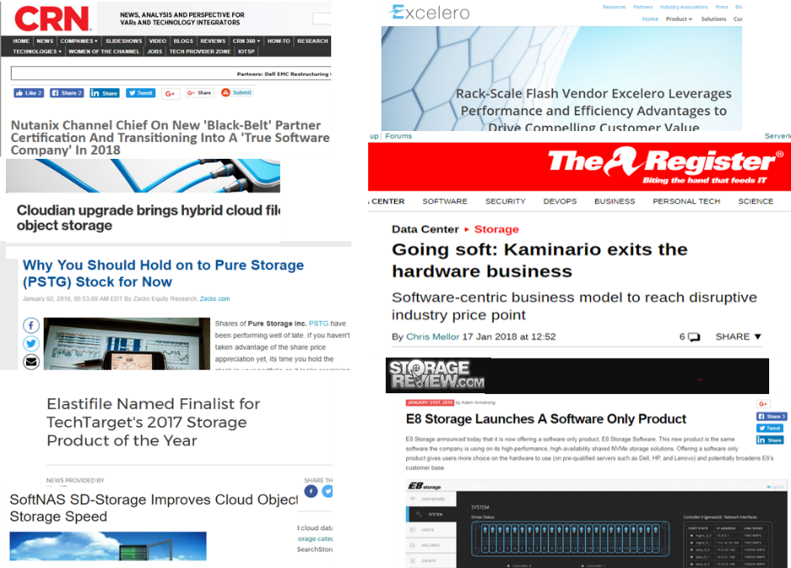
Market Trend: Software Defined Storage
Software-Defined Storage
  From proprietary hardware and software
  To all enterprise storage functionality performed in software run on white-boxes
Storage start-ups changing
  From hardware and software
  To a software-only business model

Slide 38
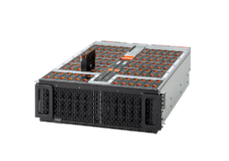
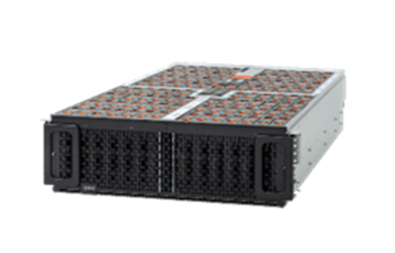
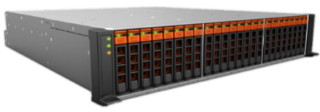
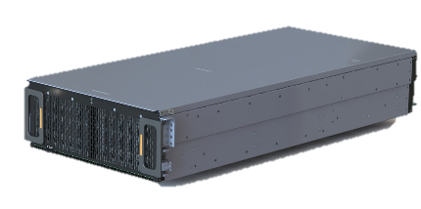
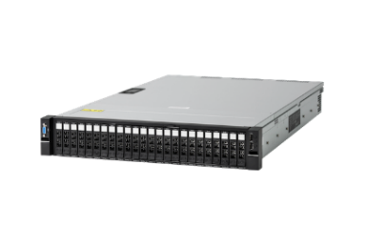
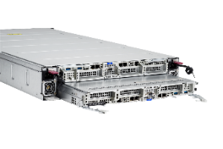
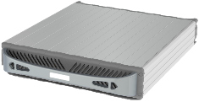

WDC Platform Portfolio
JBOD
Ultrastar® Data60
Ultrastar Data102
JBOF
Hybrid Storage Server
2U24 Flash Storage Platform
Ultrastar Serv60+8
Flash Storage Servers
Ultrastar Serv24A
Ultrastar Serv24
Ultrastar Serv24-HA
Notes:
Add capacities and basic descriptions
Discuss branding here

Slide 39
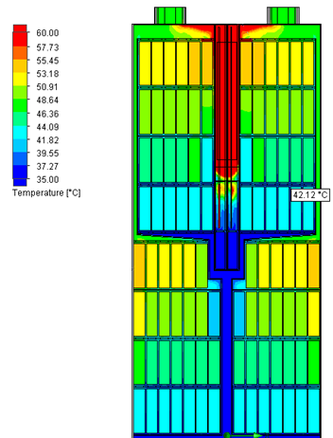
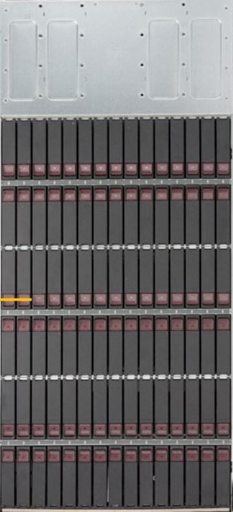

Patented Innovation - ArcticFlow™
Lets UltrastarData102 run cooler
  ArcticFlow™
  Lower Temperature
  Reduced Failures
  Lower Fan Speed
  Energy Savings
Modelled device temperatures @12W consumption per device in 35°C environment
Alternative 4U90
Ultrastar Data102

Slide 40
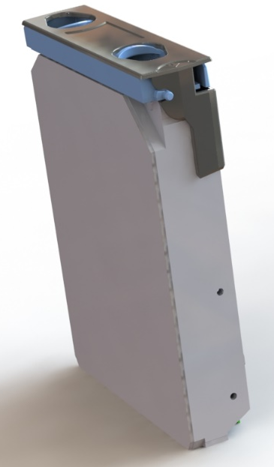
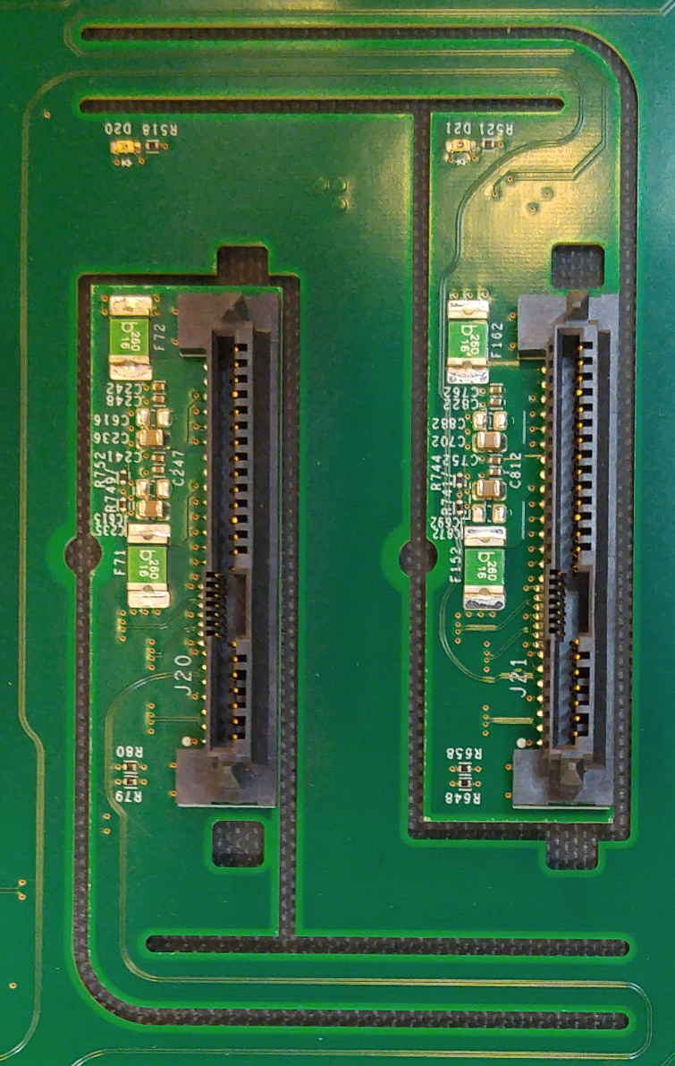

Patented Innovation - IsoVibe™
Keeps HDD at maximum performance
  IsoVibe™
  Less Vibration
  No Cross-Talk
  Stable Performance
HDDs are fixed to chassis by lock down clips
No screws required
All drives are mechanically isolated by elastic backplane mounts

Slide 41
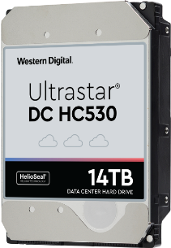
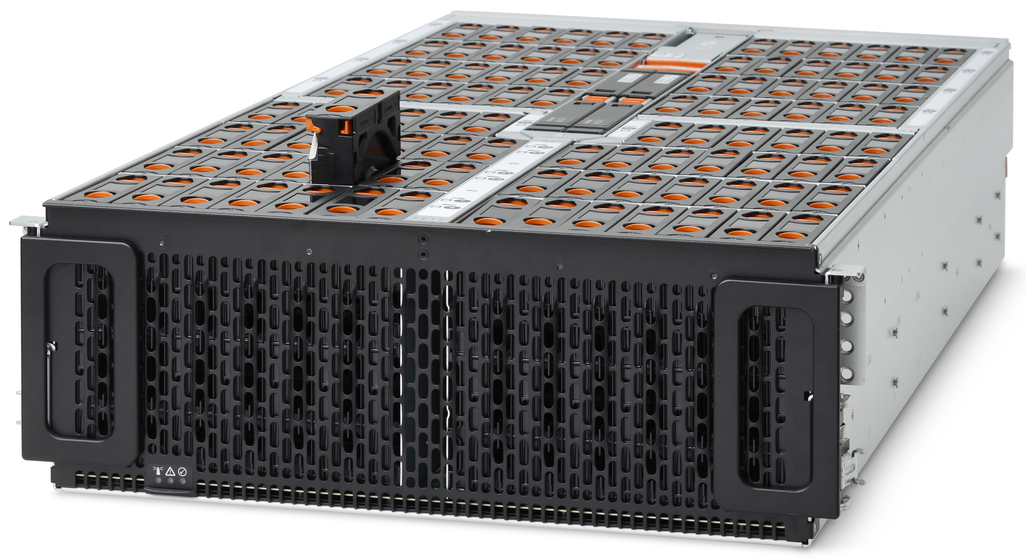
Why Platforms from Western Digital?
Rich Experience
  50+ years of designing storage
Vertical integration
Patents in our Platforms
  Build on patents in our Drives
  Fastest Time to Market
Quality, Reliability & Energy Efficiency
First in the industry to offer a 5-yr limited warranty on HDDs
First in the industry to offer a 5-yr limited warranty on storage and server platforms
9/28/18
Notes:
Why Platforms from WDC
We have a rich experience in storage design, Our patent portfolio stretches all the way back to the very first disk drive and earliest models of the SSD
We have close to 50 years of designing storage, and this is reflected in our Platforms. This expertise has made us the largest storage company in the industry
Our vertical integration – Disks & flash, all the way through Platforms – enables us to deliver these innovations simply better than any other vendor in the industry
Our patent portfolio consists of over 11,5000 patents and demonstrates that we understand better than anyone how HDDs and SSDs are affected when they are packed into shelves and racks
Patents in our Platforms build on patents in our Drives
IsoVibe™ vibration isolation technology enables higher capacities without performance degradation
ArcticFlow™ thermal zone cooling technology allows higher density, reduced power and lower costs
Time to Market
A lot of our devices sold to enterprise or channel customers end up in enclosures.
If our drives are delivered through OEM vendors, it can take up to 9 month for first sample as it first needs to be qualified by the OEM vendor.
By delivering our devices directly into a JBOD or server, we can dramatically reduce this qualification penalty allowing our customers to have access to the latest storage technology at the most attractive cost
This all results in platforms that are outstanding in Quality, Reliability and Energy Efficience
Ultrastar HDDs were the first in the industry to offer a 5-year warranty
Now we extend that to a 5-year warranty on the entire enclosure

Slide 42
Enterprise SSD Overview

Slide 43

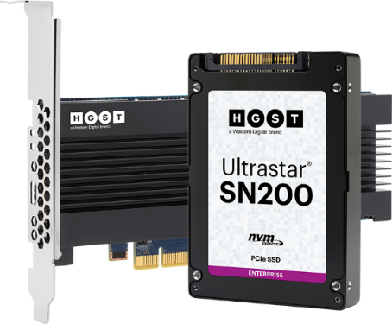
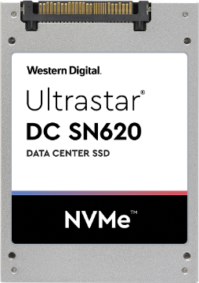






Enterprise SSD Portfolio –
UltraStar Western Digital brand
SN200/260
SN620
SS200/300 / 530
SA620
SA210
BIG
NVMe 1.2
800GB – 7.68TB
1-3 DWPD
Up to 1.2M/200K IOPS
NVMe 1.2
1.6TB – 3.84TB
1-3 DWPD
Up to 250K/83K IOPS
SAS 12Gb
400GB – 15.36TB
0.5-10 DWPD
Up to 440K/320K IOPS
SATA 6Gb
120GB – 1.9TB
0.1-1.8 DWPD
Up to 77K/34K IOPS

Slide 44



Insights
Machine Learning
Context
Aware
Automation
Anytime
Precise
Predictions
Real-Time
Results
Protection
Anywhere
Analytics
Delivering the Possibilities of Data
©2018 Western Digital Corporation or its affiliates. All rights reserved. Confidential.

