Slide 1
Kingston Technology
How Kingston can help you improve your business and make it more secure
Adrien Viaud
FAE
Notes:
Server Architecture and Kingston Memory Solutions
Presentation maintained by Kingston “US” Server Resources Team (SRG)

Slide 2


Kingston Snapshot
Founded in 1987
Privately Held Company
Financially Secure
3,000 Employees Worldwide
Worldwide Manufacturing & Testing
Focused Business:
Memory Modules, Flash Products & Tech Solutions
Delivering over 1M units per day
Products distributed in 125 Countries and available in over 30,000 locations worldwide; widely accepted brand
Notes:
KTC:
Kingston was founded 30 years ago.
The company is privately held, no board of directors or shareholders – the company is run by the original owners. This allows Kingston to be very flexible and respond to market needs without having the delays to obtain a “majority approval” or shareholder agreement.
Kingston has no long term debt and is very financially secure. There is a strong emphasis on financial stability: Zero long term debt, rich cash reserves.
For 8 straight years, yearly revenue exceeding $4B
Kingston employs over 3,000 people worldwide.
Revenue Per Employee is over $1.5M
We have manufacturing and testing facilities all around the world.
Our business is focused on memory: memory modules, memory flash cards/drives and tech solutions.
We have the capacity to ship over 30M units per year, as we deliver over 1M units per day.
Kingston products are distributed in 125 countries around the world and available in over 30,000 retail and resellers locations. Kingston is a widely accepted brand.

Slide 3
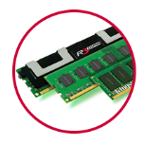
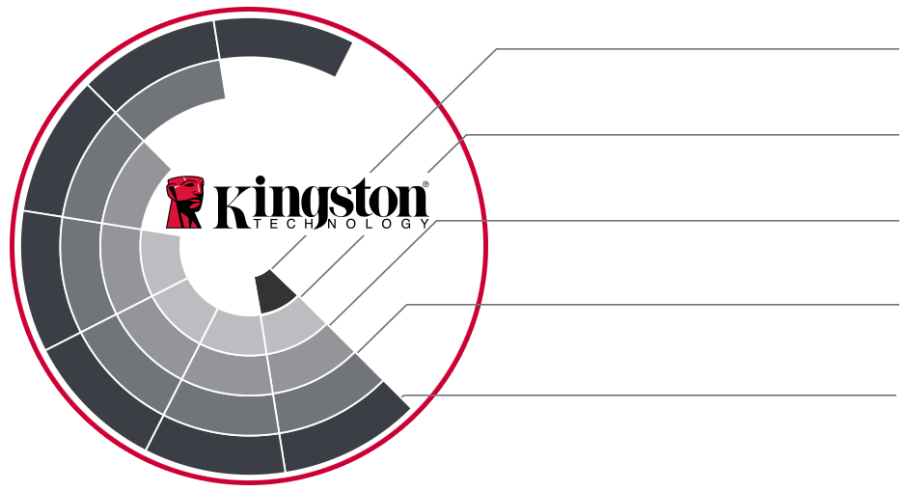
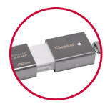
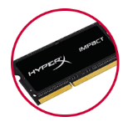
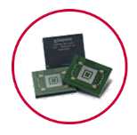
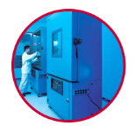

Kingston Technology Corporation
Kingston Technology
DRAM Solutions
Kingston Digital
NAND Solutions
HyperX
Gaming Solutions
Kingston Solutions Inc. Embedded Solutions
Advanced Validation Labs
Testing Services
Kingston Technology Services
OEM/ODM & EMS Logistics
Source: Kingston Technology, February 2016
Notes:
Kingston Technology is a family of companies, collectively called “Kingston”
Kingston Technology Corporation is the holding company for all other “Kingston” companies

Slide 4

Memory Roadmap 1987 – 2018
2014-2016
2018
2001-2003
2004-2006
2007-
2009
2010-
2013
2017
2019
2020
1987-
1990
1997-
1999
2000
DDR5
DDR4-2133
DDR4-2400
DDR4-2666
DDR4-3200
DDR200
DDR266
DDR333
DDR400
RDRAM
PC1066
DDR2-400
DDR2-533
DDR2-667
DDR2-800
FB-DIMMs
DDR3-800
DDR3-1066
DDR3-1333
DDR3L-1600
DDR3-1866
LRDIMM
FAST
PAGE
MODE
EDO
PC66
PC100
PC133
RDRAM
PC600
PC700
PC800
DDR4-2933
Technology | Data Rate | Module Classification | Peak Bandwidth
DDR3 (1.5V) DDR3L (1.35V) | 800 | DDR3-800/PC3-6400 | 6400 MB/s or 6.4 GB/s
 | 1066 | DDR3-1066/PC3-8500, DDR3L-1066/PC3L-8500 | 8500 MB/s or 8.5 GB/s
 | 1333 | DDR3-1333/PC3-10600, DDR3L-1333/PC3L-10600 | 10600 MB/s or 10.6 GB/s
 | 1600 | DDR3-1600/PC3-12800, DDR3L-1600/PC3L-12800 | 12800 MB/s or 12.8 GB/s
 | 1866 | DDR3-1866/PC3-14900 | 14900 MB/s or 14.9 GB/s
DDR4 (1.2V) | 2133 | DDR4-2133 / PC4-2133 | 17000 MB/s or 17 GB/s
 | 2400 | DDR4-2400 / PC4-2400 | 19200 MB/s or 19.2 GB/s
 | 2666 | DDR4-2666 / PC4-2666 | 21300 MB/s or 21.3 GB/s
 | 2933 | DDR4-2933 / PC4-2933 | 23400 MB/s or 23.4 GB/s
 | 3200 | DDR4-3200 / PC4-3200 | 25600 MB/s or 25.6 GB/s

Slide 5







Module Types For Server Platforms
Registered DIMM
Load Reduced DIMM
ECC Unbuffered DIMM
288-pin DIMM
Registered DIMM
Load Reduced DIMM
ECC Unbuffered DIMM
240-pin DIMM
Optimizing Memory:
  DDR4 is NOT compatible with DDR3 based systems (module will not fit)
  Install memory in kits of identical modules according to memory architecture
  Configure all processors the same way for most bandwidth
  Do Not Mix Module Types within a server on Intel platforms. See AMD rules for mixing on EPYC.
  Mixing DDR3 (1.5V) and DDR3L (1.35V) will default the memory to 1.5V.

Slide 6








Server Premier is our fully controlled data center solution, new for 2017+ server platforms. Ideal for system builders and OEMs alike.
Fully BOM controlled (DRAM, Register, PCB)
DDR4 2400MT/s and 2666MT/s
Targeted for Intel “Purley” Xeon-SP and AMD “Naples” EPYC server systems
PCNs with 90 Day Notice
No price premium
Platform validated and ODM qualified
Notes:
Server Premier for 2017 is new, featuring a shortened part numbering system and further identification of locked components (DRAM supplier, Die revision, Register vendor).
Server Premier for 2017 (KSM) is targeted to support Intel “Purley” Xeon-SP and AMD “Naples” EPYC server systems with supported speeds of 2666 and 2400.

Slide 7
Bandwidth in GB/s
Theoretical potential bandwidth
Notes:
Bandwidth numbers are based on the JEDEC module data transfer rate and do not represent actual server memory throughput. These numbers will vary slightly by platform and processor.

Slide 8
Optimising Memory for Balanced Performance on Purley
Common Unbalanced “6CH” Configurations
Balanced 6CH Configuration
1
384GB at 98GB/s (Triple Channel)
3
384GB at 187GB/s (Six Channel)
2
384GB at 63GB/s (Quad + Single Channel)
3
2
GB/s
1
Intel S2600WF (Wolf Pass), 2P 24S, 12 x KSM26RD4/32HAI

Slide 9
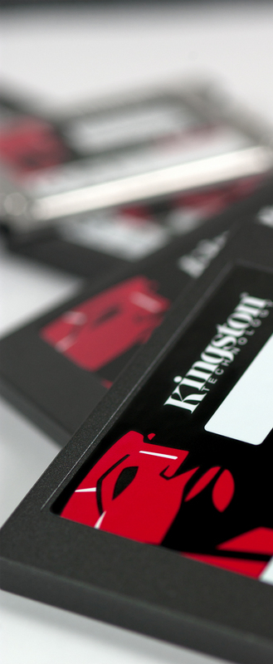
SSD target markets and applications
Consumer – Desktop & Notebook
  UV500
Enthusiast – Gamers & Overclockers
  HyperX Fury, HyperX Savage & HyperX Predator SSD
Corporate – Desktop & Notebook
  UV500
Enterprise – Server environments
  DC400, DC500
System builder, Integration & Embedded
  M.2, mSATA

Slide 10




Pick the right SSD for the job
(client vs. enterprise)
Know your workload
(High reads or writes)
Do you need pFAIL ?
What is your useful life expectation?

Slide 11
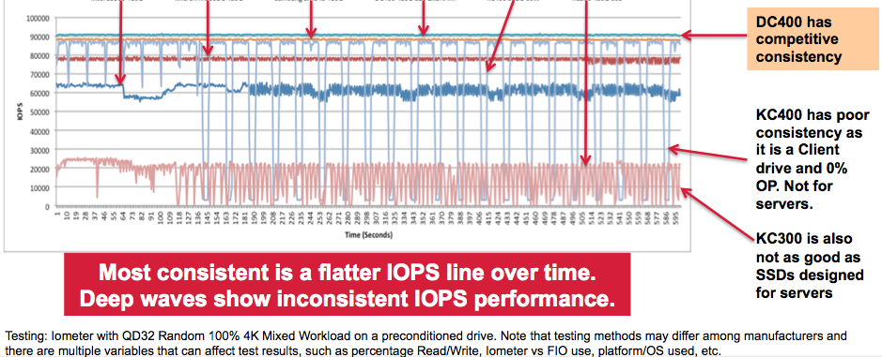
What IOPS consistency looks like

Slide 12
Datacenter SATA – DC500
DC500R
Designed for “Read-Centric” Workloads
256bit AES Encryption
Endurance - 0.5 DWPD for 5yrs
Capacity – 480GB, 960GB, 1.92TB, 3.84TB
Hardware PLP (Pfail)
Target Launch – November 2018
Samples Sept.
DC500M
Designed for “Mixed Use” Workloads
256bit AES Encryption
Endurance - >1 DWPD for 5yrs
Capacity – 480GB, 960GB, 1.92TB, 3.84TB
Hardware PLP (Pfail)
Target Launch – Q1 2019
Samples Oct.
IO and latency consistency is the key design criteria

Slide 13
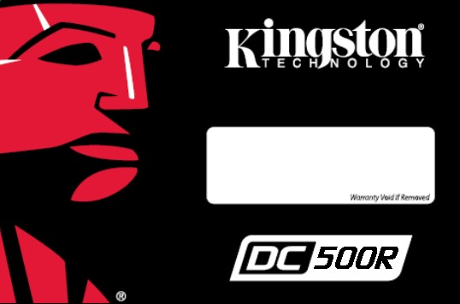

DC500 Specs
Model | DC500R | DC500M
Interface | SATAIII, 6Gbps | SATAIII, 6Gbps
Capacity | 480GB – 3.84TB | 480GB – 3.84TB
Seq. Read 128KB | 560MB/s | 560MB/s
Seq. Write 128KB | 528MB/s | 528MB/s
Random Read 4KB | 98k | 98k
Random Write 4KB | 17k | 35k
Avg Latency R/W* | .118ms/.056ms | .118/.056ms
Power Avg/Max | 1.6/4.86w | 1.6/4.86w
P-fail | Yes | Yes
Note: *Avg latency measured using 4k random R/W, QD1

Slide 14
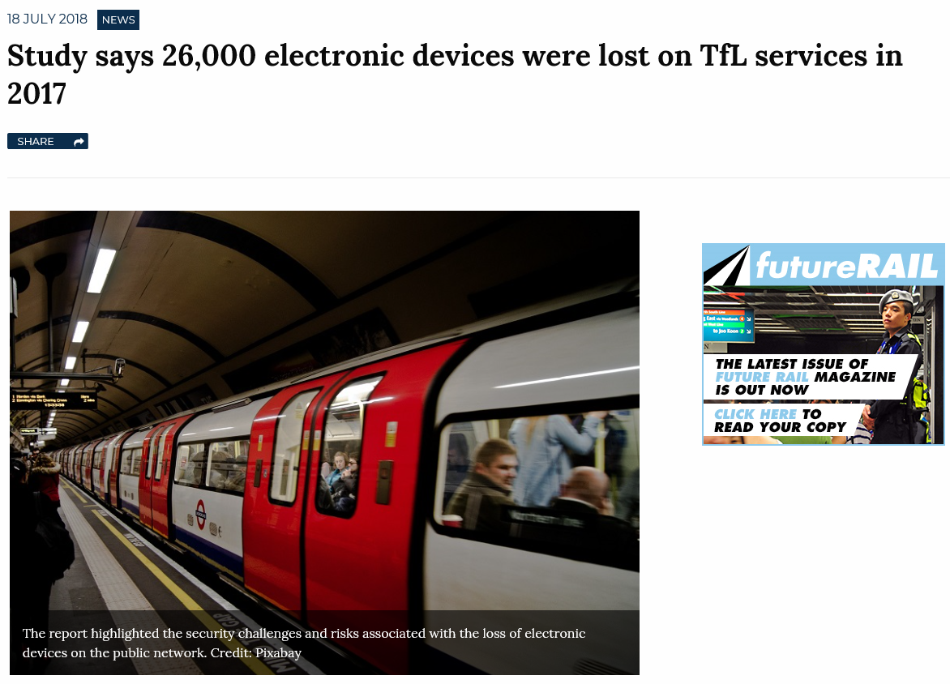
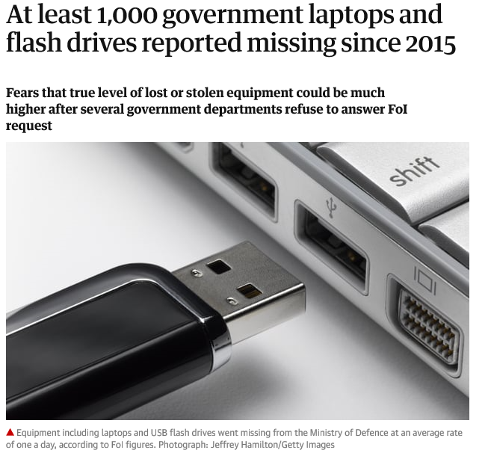
The lost laptop – a security and data breach risk
Sources: Railway Technology https://www.railway-technology.com/news/tfl-lost-devices-risk/
The Guardian https://www.theguardian.com/politics/2016/dec/21/at-least-1000-government-laptops-and-flash-drives-reported-missing-since-2015
Notes:
0:46 to 1:46

Slide 15




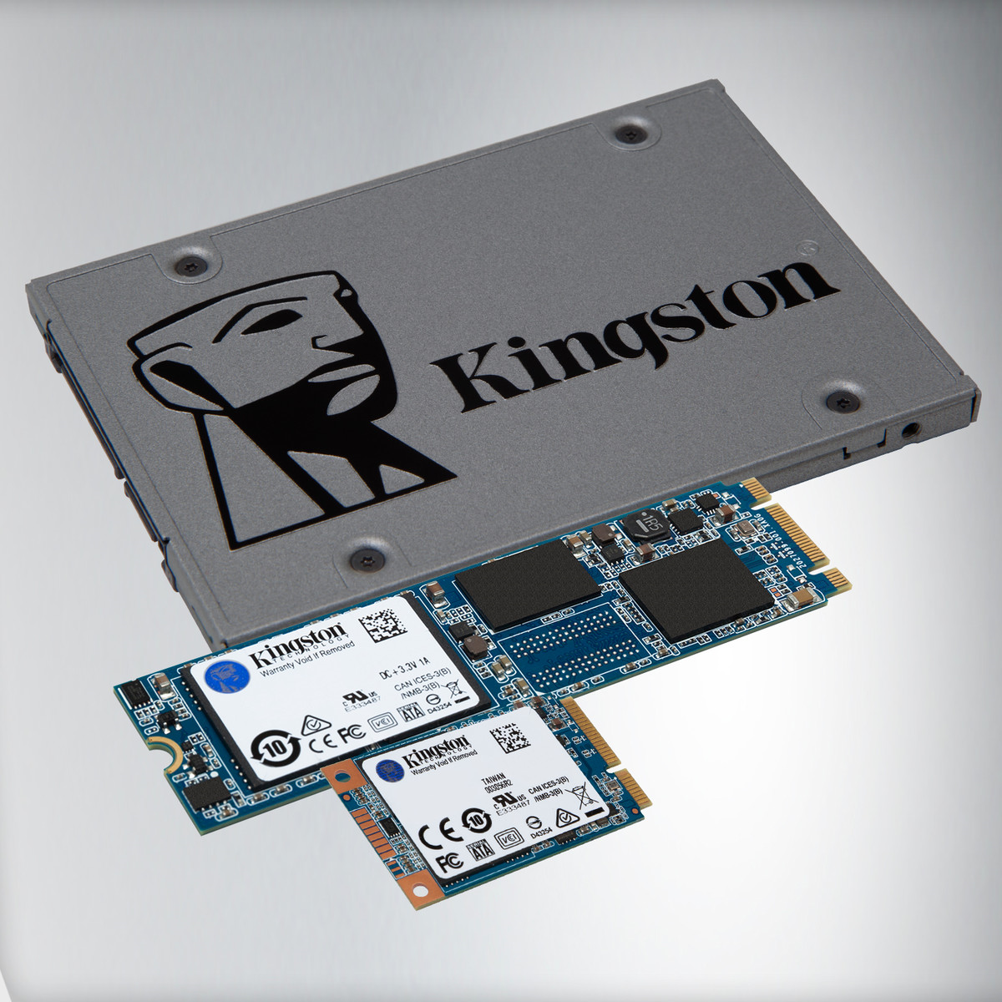


Kingston’s TCG Opal compliant SSD UV500
AES 256-bit Hardware-based Self-Encrypting Drive (SED)
Next Gen 3D NAND
  Sequential Reads up to 520 MB/s and sequential writes of up to 500MB/s (10X faster than a 7200RPM hard drive)
  Available in multiple form factors (2.5”/M.2/mSATA) and capacities of up to 1.92TB
GDPR ready
5 year warranty
Notes:
13:17 to 15:32

Slide 16


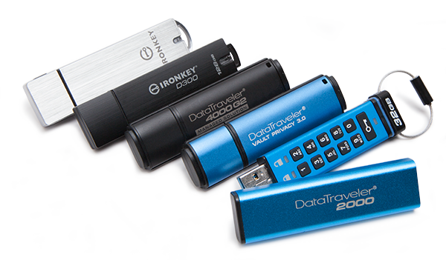
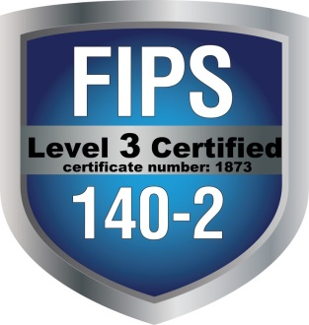


Why Kingston Encrypted USB
30 years of Leading Technology, Innovation and Reliability
The world’s leading hardware encrypted, enhanced hardware-based security and managed USB storage drives.
Designed to protect highly sensitive data requiring airtight security, these drives meet specific agency directives like TAA and FIPS compliance.
Trusted by government, enterprise, healthcare, education, financial and consumer segments
Notes:
Why Kingston – Because we’re BATMAN!

Slide 17



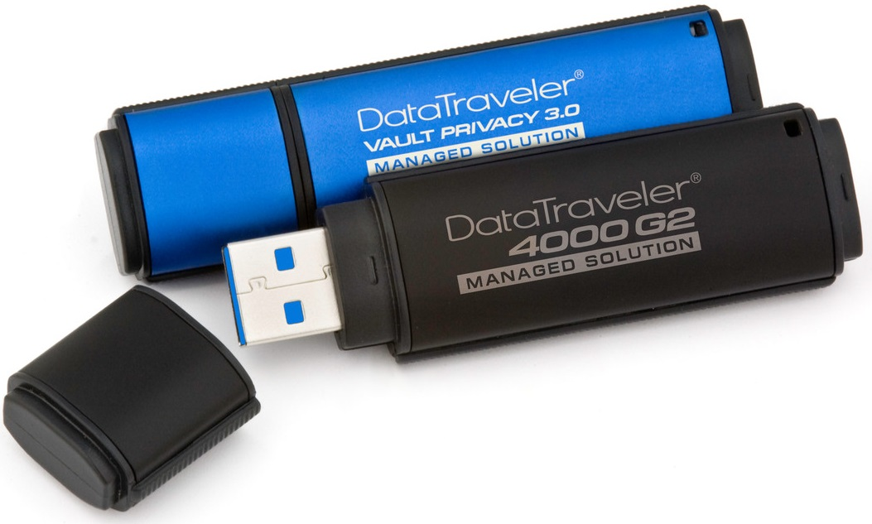
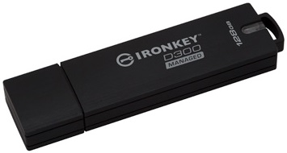
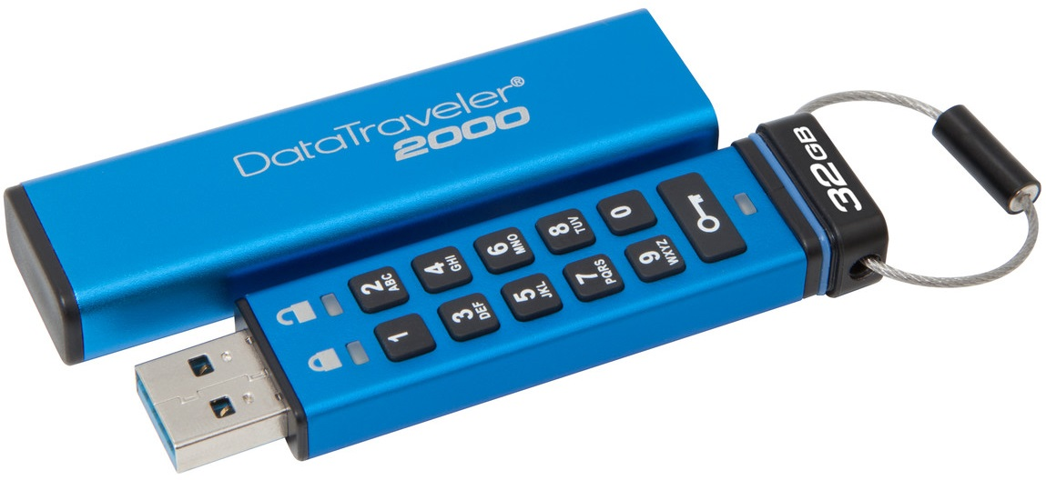
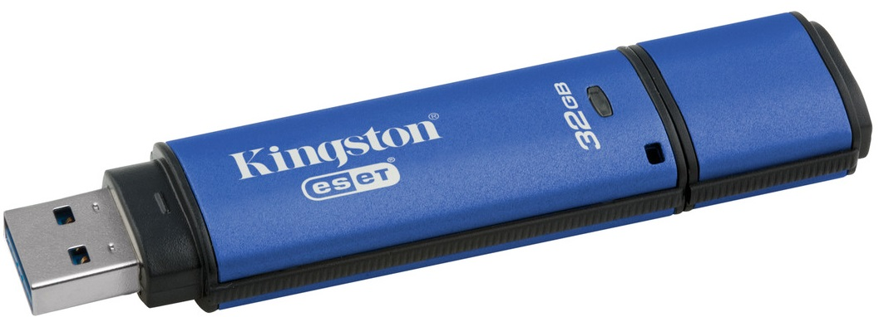
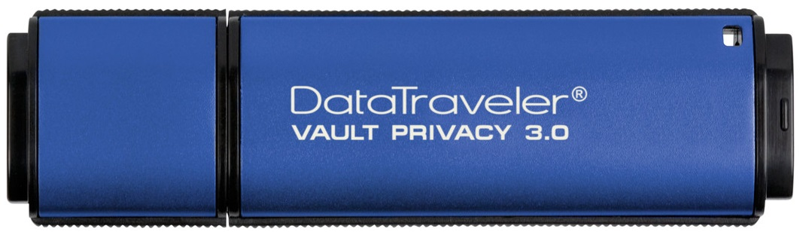
Encrypted USB Product line
Kingston keeps you Compliant
Personal Security • SMB / Professional Security • High-End Military Grade
DataTraveler Encrypted USB
DT2000
DTVP30
DTVP30AV
DTVP30DM
DT4000G2DM
IKD300 / IKD300M
IKS1000B / IKS1000E
Notes:
Manage Risk – Reduce Costs - A quick overview at our solutions that cover your needs from “Personal Security, Professional Security on up to High-end Military grade” – We’ve got you covered for any need or desire!

Slide 18



