Slide 1
END-TO-END BREACH AVOIDANCE
ENDPOINT NETWORK CLOUD HUMAN
Gabriel Mazarache
Solutions Architect

Slide 2
WE ARE: A GLOBAL
CYBER-SECURITY INNOVATOR
We provide: end-to-end breach avoidance
@endpoint @network @cloud @human
38% OF CYBERSECURITY FIRMS USE BITDEFENDER
1,600+ EMPLOYEES WORLDWIDE
800+ IN R&D / ENGINEERING
20K+ RESELLERS & DISTRIBUTORS
150+ TECHNOLOGY PARTNERS
SECURITY OPERATIONS CENTER FOR GLOBAL 24/7 MANAGED DETECTION & RESPONSE
Notes:
Bitdefender invests in what matters to you. Our solutions are tailored to your needs and built to empower, not detract your performance. We have over 1600 ingenious minds committed to your growth and success, ensuring you can focus on your day-to-day business without worrying about security issues.
Bitdefender understands the complexities of business today, and knows what it takes to ensure world-class cybersecurity.
OVER ONE THIRD OF ALL SECURITY MARKET USES BITDEFENDER TECHNOLOGIES
Bitdefender is the provider of choice, used in over 38% of the world’s security solutions.

Slide 3
ACKNOWLEDGED INNOVATION LEADER
+300 patents with more then 10% in Machine Learning
First machine learning-based detection
First automated stream detection based on machine learning
First IoT security
(Bitdefender Box)
First tunable machine learning (HyperDetect)
First integrated Prevention, Detection, Response and Risk Analytics
2008
2011
2013
2014
2015
2016
2017
2018
2019
2020
First noise reduction algorithm for finding misclassified samples
First use of deep learning to increase detection rates
Only Hypervisor-based memory introspection (HVI)
First tunable machine learning in agentless virtualization security
First human risk analytics
Notes:
The culture of innovation and original thinking at Bitdefender has raised the bar for the entire security industry and made the company the clear leader in its field. ​
Our technologies are developed in house, across our five think-tank innovation hubs. With more than 50% of workforce in research and development.
Top 3 points on the innovation timeline:
2015 - First IoT security (Bitdefender Box)
2016 - Only Hypervisor-based memory introspection (HVI)
2019 - First integrated security platform for Prevention, Detection, Response and Risk Analytics

Slide 4
UNMATCHED ATTACK PREVENTION
Most #1 rankings in from 2018 up to 2020 in AV comparatives tests.
Bitdefender
Trend Micro
ESET
McAfee
Kaspersky
Sophos
Microsoft
CrowdStrike
63%
19%
19%
13%
13%
6%
6%
0%
BASED ON ENTERPRISE AV COMPARATIVES RESULTS FROM JAN 2018 UP TO APR 2020
(REAL-WORLD PROTECTION, PERFORMANCE & MALWARE PROTECTION TESTS).
Notes:
The results are computed as how many time each company ranked 1st in the AV Comparatives tests in the period between Jan 2018 – Apr 2020. For example Bitdefender ranked 1st in 10 tests out of the total 16 tests, Trend Micro ranked 1st in 3 tests.
The total number of tests in the selected period was 16, if one company didn't participated in a test, it was counted has lower than 1st place, in order to keep the total tests at 16 for all companies.

Slide 5
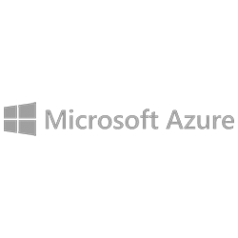
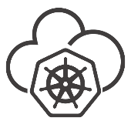
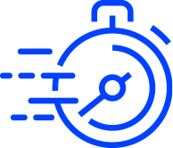
Endpoint Protection
TECHNOLOGIES & SERVICES
Extended EDR
Cloud Workload Security
Managed Detection and Response
Bitdefender GravityZone
Attack Prevention | Anomaly Detection | Security Analytics | Threat Intelligence
Workstations
Servers
Virtual Machines
Cloud Platforms
Containers
Security
Efficacy
Workload
Performance
Management Automation

Slide 6
PREVENTION
LOCAL & CLOUD
MACHINE
LEARNING
HYPERDETECT™
(TUNABLE MACHINE LEARNING)
AUTOMATIC SANDBOX ANALYZER
NETWORK ATTACK DEFENSE
INTEGRATED TECHNOLOGIES & SERVICES
FOR THE BEST BREACH AVOIDANCE
Bitdefender GravityZone is a
next-generation security platform that lets you protect all the endpoints in the enterprise, including client devices and both virtual and physical datacenter infrastructure.
FILELESS ATTACK DEFENSE
RANSOMWARE
MITIGATION
PATCH
MANAGEMENT
ROOT CAUSE ANALYSIS
PROCESS INSPECTOR
EXPLOIT DEFENSE
RISK ANALYTICS &
HARDENING
DETECTION
&
RESPONSE
FIREWALL
WEB THREAT
PROTECTION
ANOMALY DEFENSE
INCIDENT VISUALIZATION
GLOBAL
THREAT INTELLIGENCE
CONTAINER SECURITY
DEVICE
CONTROL
HUMAN RISK
ANALYTICS
ENDPOINT RISK
ANALYTICS
EXTENDED
EDR
MITRE EVENT TAGGING
SANDBOX INVESTIGATION
THREAT HUNTING
PROACTIVE REMEDIATION
FULL DISK ENCRYPTION
PROCESS INSPECTOR
PROFESSIONAL SERVICES
THREAT INTELLIGENCE SERVICE
MANAGED
DETECTION &
RESPONSE
(MDR)
PREMIUM SUPPORT
SERVICES
Notes:
GravityZone is a unified enterprise platform that integrates layered next-gen EPP with EDR. GravityZone provides attack surface reduction (via patch management, web-threat control, etc.), data protection (via full disk encryption), prevention, pre- and on-execution detection (via tunable machine learning, real-time process inspection and sandbox analysis), and post-execution detection, investigation and in-place remediation (via EDR).
The result: best-in-class security efficacy and smart, effective incident response plus visualizations, reports and dashboard enabling single-pane-of-glass visibility.

Slide 7
MORE THAN EDR: eXtended EDR* (XEDR)
CROSS-ENDPOINT EVENT CORRELATION
(EXTENDED DETECTIONS)
ORGANIZATION-LEVEL INCIDENT VISIBILITY
(EXTENDED VISIBILITY)
The cross-endpoint event correlation technology, the eXtended EDR (XEDR), takes threat detection and visibility to a new level by combining the granularity and rich security context of EDR with the cross-endpoint event correlation of XDR (eXtended Detection and Response).
*XEDR is available only for cloud-deployed solutions. Standard EDR is available for on-premises deployments.

Slide 8
ADVANCED ATTACK DETECTION AND RESPONSE
Uncover suspicious activity
Machine-learning, cloud-scanning and sandbox
MITRE ATT&CK and IoC search
Response actions
Kill or Block Process
Isolate
Start Sandbox Analysis
Block Hash
Remote Connection

Slide 9
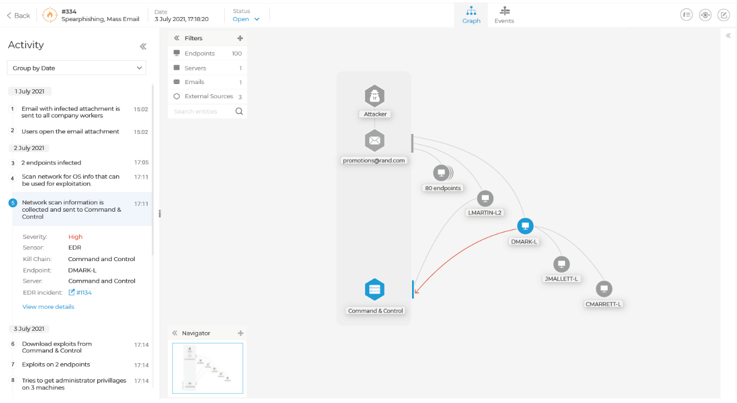
BRIDGING THE CYBER SECURITY SKILLS GAP
Respond, limit spread, stop attacks
Threat visualizations
Understand complex detections
Identify root cause
Prioritized alerts
Respond with one click

Slide 10
Linux and Containers Security

Slide 11
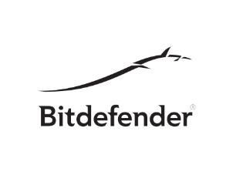
Deployment Models
Guest Agent
Suitable for environments in which we have direct guest access (IaaS)
Runs as in-guest agent
Monitors running containers
Monitors guest OS
Compatible with OCI compliant runtimes
Operating System
C3
C4
Proc / Apps
CTC
C1
C2
Server Security
Agent
Proc / Apps
Docker
Linux Kernel
Notes:
Bitdefender GravityZone is a next-generation security platform that lets you protect [click] all the endpoints in the enterprise, including client devices and both virtual and physical datacenter infrastructure.
GravityZone is easy to deploy and integrate into your existing environment because it is universally compatible with [click] key OS platforms, [click] all existing hypervisors [click] and multiple cloud environments.
It provides single-pane-of-glass visibility, simplified and efficient manageability, and security automation from a single central management console for maximum efficiency of security operations

Slide 12
Deployment Models
Sidecar Container
Suitable for environments in which we don’t have direct guest access:
PaaS deployments
Cloud-native distros
Runs as privileged container
Monitors neighboring containers
Monitors guest OS
Runs on OCI compliant runtimes
Operating System
C3
C4
Proc / Apps
CTC
Sidecar
Container
C1
C2
Proc / Apps
Docker
Linux Kernel
Notes:
Bitdefender GravityZone is a next-generation security platform that lets you protect [click] all the endpoints in the enterprise, including client devices and both virtual and physical datacenter infrastructure.
GravityZone is easy to deploy and integrate into your existing environment because it is universally compatible with [click] key OS platforms, [click] all existing hypervisors [click] and multiple cloud environments.
It provides single-pane-of-glass visibility, simplified and efficient manageability, and security automation from a single central management console for maximum efficiency of security operations

Slide 13
Key Differentiators
Built from the ground up with modern technology
Most competitors from EPP/EDR/Next-gen AV retrofitted existing technologies
Best in class operating system and platform compatibility
Major enterprise Linux distributions
Cloud-native Linux distribution
Best in class security controls for Linux
Server workload EDR
Anti-exploit
Antimalware with Hyperdetect
Integrated container management
Visibility into container runtime environment
Container events integrated with detection and response workflows
Cloud-native product packaging
Notes:
Bitdefender GravityZone is a next-generation security platform that lets you protect [click] all the endpoints in the enterprise, including client devices and both virtual and physical datacenter infrastructure.
GravityZone is easy to deploy and integrate into your existing environment because it is universally compatible with [click] key OS platforms, [click] all existing hypervisors [click] and multiple cloud environments.
It provides single-pane-of-glass visibility, simplified and efficient manageability, and security automation from a single central management console for maximum efficiency of security operations

Slide 14
Managed detection and response

Slide 15
World class prevention technology to deter and prevent malware infections before they can cause business risk
Host & network telemetry backed by security analytics and automation to enable proactive hunting, anomaly detection and speedy investigations.
BITDEFENDER
MANAGED
DETECTION & RESPONSE
SECURITY SERVICES
(MDR)
Bridge your skills gap with 24/7 expert threat hunting.
PREVENT
DETECT
MDR
REPORT
RESPOND
Real time and monthly report to support security decision making for the organization and provide visibility during incidents.
Pre-approved actions that can be executed quickly by the security team to limit adversarial dwell time and reduce business risk.
Notes:
Bitdefender invests in what matters to you. Our solutions are tailored to your needs and built to empower, not detract your performance. We have over 1600 ingenious minds committed to your growth and success, ensuring you can focus on your day-to-day business without worrying about security issues.
Bitdefender understands the complexities of business today, and knows what it takes to ensure world-class cybersecurity.
OVER ONE THIRD OF ALL SECURITY MARKET USES BITDEFENDER TECHNOLOGIES
Bitdefender is the provider of choice, used in over 38% of the world’s security solutions.

Slide 16
MDR IOA/IOC monitoring
Find early indicators of an attack before it has time to impact the business.
Unauthorized publication of code or customer information monitoring on third party repositories
Dark web monitoring to detect any stolen customer data being sold or shared
Phishing domain registration monitoring specific to the customer web presence
Compliance monitoring to verify if confidential data has been exposed outside the organization
High-value target and high-risk target to identity specific users and their data to limit damage (Whale phishing or critical systems)
Monitoring of communication to/from known malicious domain IP’s
Notes:
Bitdefender invests in what matters to you. Our solutions are tailored to your needs and built to empower, not detract your performance. We have over 1600 ingenious minds committed to your growth and success, ensuring you can focus on your day-to-day business without worrying about security issues.
Bitdefender understands the complexities of business today, and knows what it takes to ensure world-class cybersecurity.
OVER ONE THIRD OF ALL SECURITY MARKET USES BITDEFENDER TECHNOLOGIES
Bitdefender is the provider of choice, used in over 38% of the world’s security solutions.

Slide 17
File Locations
USB Drives
Network Shares
Browsing
Risky websites
Phishing links
MDR User Risk Analytics
Bitdefender Risk Management
Endpoint Risk Analytics monitors endpoints for misconfiguration and software vulnerabilities
User Risk Analytics monitors user activity to baseline behavior and evaluate risk to the organization
File sources
Downloads
Attachments
Website logins
Apps
Intranets
Insider
Data exfiltration
Passwords
Re-use
Weak
Only MDR solution available today to provide User Risk Analytics
Notes:
Bitdefender invests in what matters to you. Our solutions are tailored to your needs and built to empower, not detract your performance. We have over 1600 ingenious minds committed to your growth and success, ensuring you can focus on your day-to-day business without worrying about security issues.
Bitdefender understands the complexities of business today, and knows what it takes to ensure world-class cybersecurity.
OVER ONE THIRD OF ALL SECURITY MARKET USES BITDEFENDER TECHNOLOGIES
Bitdefender is the provider of choice, used in over 38% of the world’s security solutions.

