Slide 1

Reimagine hyperconverged: software-defined to ai-driven with HPE SimpliVity
Alexandru Vilcu – alexandru@hpe.com
Sep 2021
Notes:
Intent of slide: Setting the context for how HPE SimpliVity reimagines HCI and goes beyond normal capabilities with AI-driven, intelligent HCI.
Thanks for meeting with me today. Enterprises in every industry are looking at HCI as a next-gen architecture for virtualized workloads. While the gains have been significant, there is so much opportunity to go beyond the normal capabilities to take enterprises where they need to go.
So I’d like to take you through our perspective - to reimagine what hyperconverged is and what it can do for your business. It’s about moving beyond software-defined to AI-driven, intelligent HCI.
As well we will educate you on the HPE SimpliVity hyperconverged infrastructure solution that is helping thousands of customers simplify their hybrid cloud journey.

Slide 2
Presenter instructions
Use this presentation for customers with virtualized workloads interested in learning about the HPE SimpliVity solution to simplify their hybrid IT environments. Goal is to show how hyperconverged infrastructure is well suited for variety of use cases and customers
Use the core slides (Slide 1, and Slides 3-30, the Thank you slide)
Use the slides in backup section as needed
More resources:
  HPE SimpliVity Seismic Briefcase
  Reimagine HCI Presentation
  MyLearning for HPE SimpliVity
  HPE Nimble Storage dHCI briefcase
  Competitive Intelligence: Key competitors to HPE SimpliVity
  HPE Demonstration Portal: https://hpedemoportal.ext.hpe.com/search/SimpliVity
  HPE Proposal Web: https://proposalweb.ext.hpe.com and search on HPE SimpliVity
Please delete this slide before presenting
Notes:
Intent of slide: Slide for speakers to understand before giving the pitch.

Slide 3




Today’s reality for every VM admin
Infrastructure complexity
requiring multi-domain experience
Constant fire fighting
with uncontrolled VM sprawl
Pressure to lower cost
requiring efficient utilization at scale
Pressure to do more
supporting traditional and modern apps
Notes:
Intent of slide: Establish the everyday complexities of VM Admins.
VM admins are struggling to keep up with the demands of the digital business. They are constantly dealing with the complexity of infrastructure that slows down time-to-market, fighting fires that ties up their time, and supporting new app demands with more cost pressures.

Slide 4
Artificial intelligence is the key to day 2 and beyond
HW-Confined
SW-DEFINED
AI-DRIVEN
Complex
Manual
Reactive
Wasteful
Automated
On-demand
Reactive
efficient
Autonomous
Self-healing
PREDICTIVE
Self-optimizing
Notes:
Intent of slide: Explain why AI is key to resolving IT complexities of Day 2 and beyond.
In our minds, the world needs infrastructure to move beyond software-defined to AI-driven.
Software-defined has driven tremendous IT productivity and efficiency gains over hardware-confined infrastructure. It’s taken complex, manual silos into automated and on-demand resources. It’s moved wasteful, over-provisioning into efficient, fluid pools of virtual compute and storage.
But as we look forward, IT needs infrastructure to be autonomous, to predict and prevent disruptions and self-heal, to move IT from being reactive to predictive and having the ability for infrastructure to optimize itself across distributed environments.

Slide 5

Global intelligence
Powered by HPE InfoSight
Notes:
Intent of slide: Introduce how HPE InfoSight global intelligence engine empowers infrastructure this AI, back up with data points of HPE InfoSight across our portfolio install base to show how advanced HPE InfoSight is.
At the heart of this shift is global intelligence… An example is HPE InfoSight which is now part of HPE solutions to help customers.
Now with 1) 10 years in the making, 2) over 1250 trillion data points analyzed across our installed base, 3) over 1.5 million hours saved from lost productivity…
HPE InfoSight is the most advanced AI for infrastructure
Every second, we collect and analyze millions of sensors from every system in our installed base, across the HPE installed base that drives our predictive analytics and recommendations full-stack from storage to VMs…
Everything from predicting/preventing issues, to self-improving performance, to self-optimizing resources (repurpose these VMs to free up resources)
– and it’s what uniquely enables a new customer experience.

Slide 6





What if…
91%
More time to INNOVATE
to cloud
1 TB VM recovery in
60 seconds
1 simple experience with INTELLIGENCE
192%
69%
COST SAVINGS
ROI payback within
1 YEAR
Notes:
Intent of slide: List out the beneficial outcomes (time savings, ROI & payback, cost savings, efficiency, UX) of an AI-driven infrastructure.
In light of these challenges…Before we dive in, I would like to ask what may or may not be a hypothetical scenario -
WHAT IF YOU DISCOVERED A TECHNOLOGY THAT delivered the following outcomes:
91% More Time for you to work on innovation and new projects
192% ROI with payback within a year (7 months)
Gave you 69% Cost Savings
Ability to recover Terabyte sized VMs in 60 seconds
And one simple, familiar interface… or experience… to manage everything that includes AI-driven intelligence
It also has unique warrantees in the form of HPE SimpliVity HyperGuarantee that is unique in the industry.
Are you interested in learning more?
Sources:
¹IDC Research, “HPE SimpliVity Drives Operational Efficiency and Customers are Benefiting,” August 2018
https://www.hpe.com/us/en/resources/integrated-systems/simplivity-customer-interviews.html?parentPage=/us/en/products/integrated-systems/simplivity
² Forrester, Total Economic Impact of HPE SimpliVity Hyperconverged Infrastructure , May 2019
https://www.hpe.com/us/en/resources/integrated-systems/simplivity-economic-impact.html?parentPage=/us/en/products/integrated-systems/simplivity
³ HPE SimpliVity HyperGuarantee
https://www.hpe.com/us/en/integrated-systems/simplivity-guarantee.html

Slide 7




Site 1
HPE SIMPLIVITY
Intelligent HCI for the Edge
Site 2
Core Site
Site N
INTELLIGENTLY SIMPLE
HYPER
EFFICIENT
EDGE OPTIMIZED
Notes:
Intent of slide: Show how HPE SimpliVity is intelligent HCI for the edge.
To meet these challenges the answer is HPE SimpliVity, Intelligent HCI for the Edge
SimpliVity delivers an intelligently simple solution from deployment to upgrades, it's hyper-efficient for industry leading data efficiency, it's edge-optimized for admin-free sites and high-availability in the smallest footprint,
and now with support for comprehensive data protection direct to cloud, it's cloud connected helping customers with their hybrid cloud journey.
HPE SimpliVity also supports many virtual machine (VM) applications including databases, file sharing, and virtual desktop infrastructure like Citrix and VMware Horizon View.

Slide 8

Intelligently SIMPLE: ANYONE CAN MANAGE
All-in-One System
Zero Downtime Refresh Cycles
Collapses the stack, removing silos with built-in resiliency, backup and disaster recovery
Flexibly add or remove modular systems non-disruptively to meet business needs
Global Unified Management
Automated Tuning
Centrally manage everything including data protection
Always optimal performance, efficiency, resiliency without knobs or tradeoffs
One-Click Upgrades
Global Intelligence
Simple lifecycle management across firmware, hypervisor, OS
Predictive analytics and support automation
Notes:
Intent of slide: Exemplify how HPE SimpliVity is intelligently simple.
So how is HPE’s offer intelligently simple and differentiated?
We focus on the complete end-to-end customer experience… making HCI simple to deploy, manage, scale, upgrade, support, and own.
1st, HPE SimpliVity collapses the stack in an unique all-in-one system. Beyond standard HCI consolidation, we include native backup and recovery eliminating needs for separate backup software and appliances.
Then, we give our customers global unified management. One GUI to manage any number of distributed sites across the world.
Then as you look at Day 2 and beyond, we have simple, zero-downtime, non-disruptive scale-out where the cluster intelligently balances itself
We eliminate the need to tune with intelligence that ensures optimal performance, efficiency and resiliency
[Click X2]
And now, we are further simplifying the e2e experience with 1-click customer upgrades across firmware, hypervisor and HPE SimpliVity software stack AND the power of global intelligence with predictive analytics and support automation.
For more on the All-in-One benefits see the next slide…
+++++++++++
If you have time, expand on zero-downtime refresh cycles to explain it if asked
For example, start with 2+1, across two sites, run VMs and have off-site backup; this is a typical deployment for a starter config and provides great value. Then when budget cycle opens and new models are available that address growing needs, customer can “refresh” the +1 side, add nodes to cluster, they can simply “evacuate” VMs and Backups seamlessly, automated from the old +1 system to the new nodes. This automated and complete self-optimizing and balancing; then they redeploy the +1 to the dual cluster on primary site; end result is a modernized 3+2 multi-site “refresh,”

Slide 9


All-in-one SYSTEM: One platform / one partner / one generalist
ToR switches
SILOS COLLAPSED
Servers with hypervisor
Storage switches
HA shared storage
NO SPECIALISTS REQUIRED
Backup & deduplication
WAN optimization
SSD array
Storage caching
LOWERS OVERALL COST
Data protection apps
(backup and deduplication)
On-Premise Monitoring
Notes:
Intent of slide: Demonstrate how HPE SimpliVity integrates with industry-leading HPE ProLiant servers, and consolidates HCI and advanced data services for virtualized workloads.
For customers we collapse the “entire” stack on the left into a single All-in-One solution. They have one platform / one partner / one IT generalist to run VMs… Simple to deploy. Simple to grow. Simple to own.
IT is simplified by combining all hyperconverged infrastructure (HCI) and advanced data services for virtualized workloads—up to 10-in1 consolidation (server, hypervisor, SAN, storage, BU appliance, WAN optimization, storage caching, backup s/w and replication s/w)—and
HPE SimpliVity is the only HPE-owned HCI stack that is engineered and fully integrated on HPE ProLiant, the world’s most secure industry-standard server portfolio.
Silos are collapsed.
Eliminates complexity and streamlines operations
One back to pat
No specialists required.
Empower VM admins
Lowers overall cost.
Saves on space, power, cooling, maintenance, licensing

Slide 10


Global Unified management
Global VM-centric management and mobility
Built-in resiliency, backup, and
disaster recovery
Guaranteed data efficiency
Manage resources in a federated pool
Seamlessly move data across sites
Eliminate islands
Notes:
Intent of Slide: Explain our core technology - HPE SimpliVity Data Virtualization Platform—and its benefits.
HPE SimpliVity infrastructure’s core technology is the HPE SimpliVity Data Virtualization Platform, a globally aware file system and object store that facilitates a globally shared resource pools across multiple sites. The Data Virtualization Platform is characterized by the advanced data services it delivers:
Global VM-Centric Management and Mobility
Given our approach to data efficiency, the Data Virtualization Platform makes Virtual Machines lightweight and mobile. So it is extremely easy to move and/or clone VMs between sites to support global “follow the sun” development efforts or to move VMs to the appropriate location based on the requirements of the application.
Our approach to management is also unique. With Global VM-centric management, gone are the days of managing LUNs and shares and volumes. Instead, all management is done at the VM level with a single view across all of data centers and remote sites. Our unique file system abstracts the VMs, policies and management from the underlying hardware. Managing the system is designed to be simple and easy, which is why IDC found that our customers reported an 81% increase in time spent supporting new projects.
Built-in Resiliency, Backup, and Disaster Recovery
Only HPE SimpliVity hyperconverged systems deliver the resilience, built-in backup, and bandwidth-efficient replication needed to ensure the highest levels of data integrity and availability, eliminating the need for legacy data protection.
All data protection is built-in, all at the VM level. Your team can easily backup, restore and move VMs, and they don’t have to worry about the underlying storage infrastructure. They can just right click in vCenter—or use orchestration tools like VMware vRealize Automation– and hit “backup” or “restore” or “move.” And we guarantee that you will be able to restore a local 1 TB VM in one minute or less. On top of that, a recent study from IDC found that 70% of our customers reported improvement in backup/recovery and DR and a majority eliminated the use of existing third-party backup or replication tools after deploying HPE SimpliVity hyperconverged infrastructure.
Guaranteed Data Efficiency
Our solution deduplicates, compresses and optimizes ALL data inline at inception, in real-time, once and forever across all tiers of data.
The real power comes from the optional HPE OmniStack Accelerator Card, a PCIe card that offloads the heavy infrastructure operations, enabling the Intel x86 resources to do what they do best: running VMs. And we do it all a 0% performance impact to production VMs. In fact, we increase performance because we eliminate unnecessary IOPs. That’s revolutionary and differentiated—no one else can do it. And it’s all possible because of the Accelerator Card. From recent Forrester 2019 survey HPE SimpliVity customers experience, on average, 47:1 data efficiency with many seeing over 100:1 data efficiency based on TechValidate surveys. And we guarantee 10:1 data efficiency as part of our standard warranty.

Slide 11

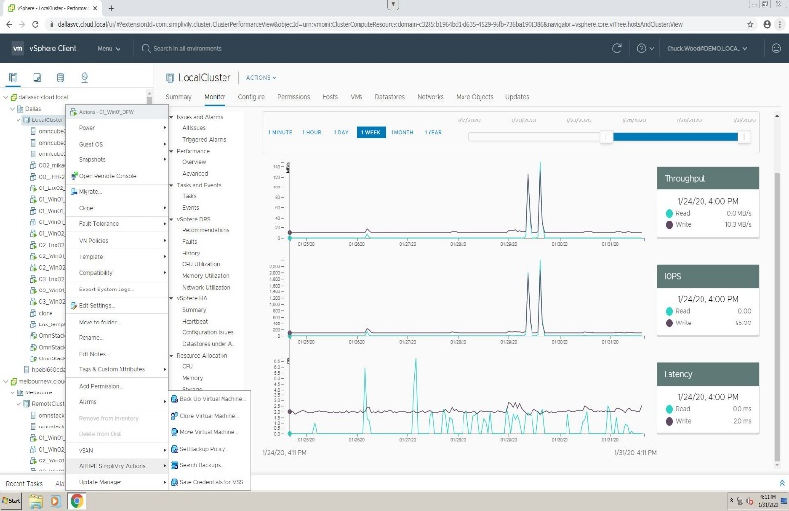

Automated Tuning and resiliency without compromise
  Software-defined and VM-centric
  Compute and storage abstracted and managed through vCenter
  Policy-based automation
  VM-centric snapshots, clones, and recovery and data protection
  Auto-discovery
  New resources easily add to the cluster
  Autotuning
  Perfect combination of resiliency, performance and efficiency without compromise
  Datastore provisioning
  LUN provisioning completely abstracted from admin
  Transparent upgrades
  Easy to scale and upgrade with no downtime
vCenter
Enterprise capabilities without the complexity
Notes:
Intent of slide: List salient features that demonstrate how HPE SimpliVity provides all enterprise capabilities without any of the complexities.
We’ve made this platform simple for anyone to manage full-stack infrastructure, giving customers enterprise capabilities without any of the complexity.
Diving a little deeper….this experience is all through innovative software layer we built that automates stack management, connected in with vCenter.
First, all resources are software-defined. Customer don’t have to spend any time in the silo element managers as the resources are abstracted from the physical hardware and managed through vCenter. Makes it really easy for a VM admin to manage.
Next, all resources are auto-discovered which makes it easy to build out the cluster and across sites in a federated many. You gain global unified management across all your sites and managed all clusters via a simple interface, vCenter.
You manage datastores and VMs and no longer have to worry about LUNs, RAID groups, shares and storage resources. All is abstracted away. The system is complete VM-centric.
Policy-based automation makes it easy to set policies and data services—to configure replication, backup, snapshots, etc natively, without requiring any separate appliances.
No compromise resiliency with autotuning—HPE SimpliVity provides optimal performance, efficiency, and resiliency without knobs or tradeoffs. The system can tolerate any 3 simultaneous drive failures without data loss, and can recover or clone 1TB VMs in 60 seconds to keep data available. Plus there is nothing to configure. It just works.
And for upgrades and lifecycle management is simplified. You can start small and scale in your site or across sites to large scale in small HCI increments. All non-disruptively.

Slide 12
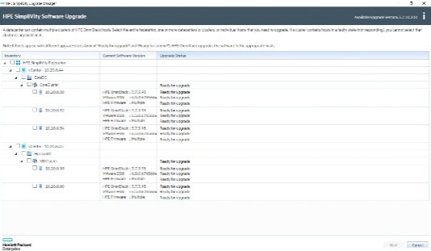
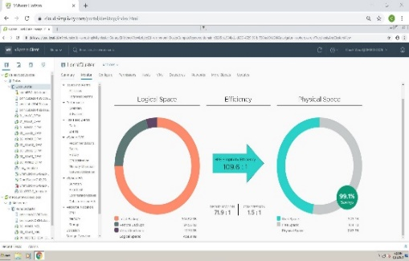

One-click cluster upgrade: Simplifying the experience
SimpliVity S/W
SimpliVity S/W
Hypervisor
Hypervisor
Firmware
Firmware
SimpliVity S/W
SimpliVity S/W
Hypervisor
Hypervisor
Firmware
Firmware
Simple
Non-disruptive
Efficient
Notes:
Intent of slide: Overview of the simplified customer experience.
Continuing to focus on simplifying the customer experience in HCI
Customers benefit in Day 2 and beyond with simplified updates, patching and upgrades.
We are delivering simple Lifecycle Management via 1-click cluster upgrades across HPE ProLiant firmware, hypervisor, and HPE SimpliVity software OS. This delivers a seamless, full stack upgrade.
It’s simple, Non-disruptive, automated, efficient

Slide 13
Global intelligence: Shifting from simple to intelligent HCI
Predictive
Resource Planning
Global
Visibility and analytics
Support
Case automation
Predicts when cluster capacity is full in 90 days with insights into top consumers
Multi-site view of all VMs and backups with efficiency savings
Automated wellness alerts and signature detection into complex problems
Notes:
Intent of slide: Now we move on to how HPE SimpliVity is backed by our global intelligence engine.
Global Intelligence… is truly a game changer for customers… they shift from simple HCI to intelligent HCI with HPE.
In the 1st release of HPE InfoSight for SimpliVity, customers benefit with Predictive resource planning taking the guesswork out… Global visibility and analytics saving precious time…. Support automation and wellness enabling self-managing IT
See next slide for what our customers say about InfoSight and Intelligent HCI
++++
If questions or extra time:
Eg. We’ll tell customers when a cluster of 50 to 100+ VMs plus associated backups will be full based on predictive analytics plus show top consumers from VM perspective. They can properly plan for a refresh or can perform capacity balancing.
Customers gain multi-site view of all VMs spanning data centers along with logical backups. Gives insights into capacity savings that is otherwise time consuming and complex to get.
Automated wellness into complex problems…. prevents problems across installed base before customers even know there is an issue.

Slide 14

Hyper efficient: Eliminating waste in time and money
Data efficiency
90%+
Capacity savings guaranteed
Restore efficiency
Power to recover 1TB VMs in 60 secs
System efficiency
All-in-one collapsing
10 discrete silos
Notes:
Intent of slide: Show how HPE SimpliVity is hyper-efficient when it comes to time and money.
The solution is hyper-efficient…
They gain Data efficiency: HPE SimpliVity has industry leading data efficiency with 90% of storage capacity savings across primary VMs and backups, and these savings are guaranteed with the HPE SimpliVity HyperGuarantee. Only HPE SimpliVity deduplicates, compresses, and optimizes all data inline, globally. This saves on capacity and expensive data center resource.
Gives customers VM restore efficiency: SimpliVity is the most efficient HCI solution for recovery giving you the power to recover 1 TB VMs in 60 seconds. When combined with built-in resiliency and high availability, this gives customers the confidence to deploy and consolidate their workloads on HPE SimpliVity.
All-in-One system efficiency: Collapses the stack in a unique all-in-one system including built-in backup and rapid recovery. No external appliances are necessary. Save on upfront costs and on-going space, power, cooling, maintenance costs.
We are announcing new enhancements to the built-in backup capability. See next slide.
+++++++++
One government customer shared their example, they recovered a 950 GB SQL Server in 40 seconds…. We have many other public reference examples of rapid VM recovery including customers who leverages this facility to recover from ransomware attacks.
See link for story:
https://upshotstories.com/stories/the-town-of-mansfield-s-unexpected-journey-into-hyperconvergence

Slide 15

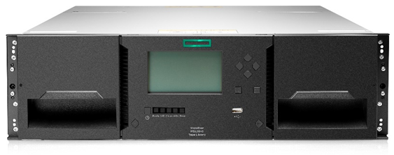

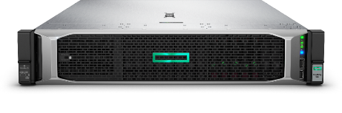
Built-in backup and disaster recovery reduces costs and risk
Alternate hyperconverged without built-in backup/recovery
+ backup media and tape infrastructure
HPE SimpliVity
+ third-party backup for operational recovery
OR
+ replication and disaster recovery automation
+ WAN optimization
Notes:
Intent of slide: Explain how customers can avoid layers of data protection and mitigate risks of data loss with HPE SimpliVity and its built-in data protection capabilities.
Key takeaway:
1. Built-in resiliency, data protection and DR lowers costs, reduces risk and eliminates complexity. Key benefit for customers in delivering a superior total cost of ownership (lower TCO).
2. Density, Resiliency, Performance (Most dense…); “If you have a virtual workload between 10 VMs to 2000 VMs and that workload needs to be Backed up, Replicated, Recovered; HPE SimpliVity is the most cost effective solution in the world.”
3. With unique design and rapid VM recovery, many customers leverage HPE SimpliVity to enable recovering from cyber-attacks (i.e. cryptolocker, ransomware, etc.) with HPE SimpliVity
HPE SimpliVity is the only hyperconverged solution with built-in data protection and automated disaster recovery powered by RapidDR. Most other converged vendors simply converge servers and storage, but only HPE SimpliVity technology hyperconverges across the entire stack, so not just server and storage, but also a built-in data protection application, WAN optimization, backup, and disaster recovery.
With HPE SimpliVity, all data protection is built-in, all at the VM level. You can easily backup, restore, and move VMs, and you don’t have to worry about the underlying storage infrastructure.
In order to deliver the same level of operational recovery and disaster recovery capabilities, customers of other hyperconverged solutions would have to piece together a data protection solution using a combination of third-party solutions. With HPE SimpliVity hyperconvergence, you get it all in a single solution.

Slide 16


Hyper efficient
Save 90% capacity across storage and backup combined¹
Always-on deduplication and compression
All data at inception, globally
100% software-optimized
Acceleration frees CPUs to run business workloads
Guaranteed data efficiency
47 : 1
Customers average 47:1 efficiency
> 1/3rd surveyed achieve over 100:1²
¹HPE SimpliVity HyperGuarantee
² Reported in Forrester Total Economic Impact Study, 2019; TechValidate
27:1 59:1 16:1 77:1 13:1 154:1 28:1 85:1 33:1 42:1 210:1 69:1 53:1 37:1 90:1 146:1 62:1 107:1 22:1 84:1 45:1 12:1 56:1 126:1 76:1 27:1 59:1 16:1 77:1 13:1 154:1 28:1 85:1 33:1 42:1 210:1 69:1 53:1 37:1 90:1 146:1 62:1 107:1 22:1 84:1 45:1 12:1 56:1 126:1 76:1 23:1 44:1 239:1 34:1 18:1 62:1 98:1 145:1 80:1 47:1 66:1 84:1 117:1 35:1 52:1 19:1 27:1 59:1 16:1 77:1 13:1 154:1 28:1 85:1 33:1 42:1 210:1 69:1 53:1 37:1 90:1 146:1 62:1 107:1 22:1 84:1 45:1 120:1 56:1 26:1 76:1 57:1 13:1 154:1 28:1 85:1 33:1 42:1 210:1 69:1 53:1 137:1 90:1 146:1 62:1 107:1 22:1 52:1 15:1
Notes:
Intent of slide: Now we focus on HPE SimpliVity HyperGuarantee, where we provide 90% guaranteed capacity.
HPE SimpliVity offers guaranteed data efficiency. How do we do that? All data, at inception, is globally deduplicated, so before that block is written to disk (locally or remotely), each site will talk to the other site and only send changed blocks to disc. So if you’re doing a backup in a virtual environment, you’re only backing up the parts that are changed.
All of that is done without impact to CPUs that run VMs. Organizations sometimes don’t turn on dedupe because of a performance hit to workloads. HPE OmniStack Accelerator Card allows us to offload these data-processing-intensive tasks to the accelerator card, so there are no performance hits, and you can enjoy the full benefits of deduplication. We also support 100% software optimized versions without needing the accelerator card. We give you choice.
We also back this up with a HPE HyperGuranatee, the most complete Hyperconverged guarantee on the market.
This allows our customers to achieve an average of 47:1 data efficiency (Forrester TEI report 2019), and over 1/3rd surveyed achieved over 100:1 (TVID C39-9B5-4FF) https://www.techvalidate.com/tvid/C39-9B5-4FF
We guarantee you will save 90% capacity across primary storage and backup combined by leveraging HPE SimpliVity. (Note: this equates to 10:1 data efficiency; much less than what many customers are achieving)

Slide 17

Six reasons customers choose HPE simplivity for their edge…
1
Edge Site 1
Most Efficient, All-in-One
2-node HA, security and data services
Always online and recoverable
Built-in backup and DR
Efficiency at the edge
Optimized for 10:1 data reduction
No edge site admin required
Centrally manage all distributed clouds
Intelligent AI operations Predictive analytics, support automation
Delivered as a service Pay per use and financial flexibility
2
3
Edge Site 2
4
Core Data Center
Edge Site n
5
HPE SIMPLIVITY
Intelligent HCI FOR the EDGE
6
IDC whitepaper - Using HPE SimpliVity Hyperconverged Infrastructure to Improve Data Protection and Recovery Effectiveness, April 2019¹
HPE SimpliVity Hyperguarantee²
Notes:
Intent of slide: Explain the reasons why customers choose HPE SimpliVity for their edge sites.
SimpliVity is uniquely edge optimized across all the capability dimensions.
It’s an efficient, all-in-one solution that collapses the stack
Includes built-in data protection, backup and rapid restore… customers as we’ve shown continue to value this capability
Efficiency is fully integrated delivering industry leading, 10:1 data efficiency, guaranteed
Requires no edge site administration
Includes AI-driven operations with predictive analytics, automation
It delivers Intelligent HCI for the edge and is available as a service via HPE GreenLake.

Slide 18


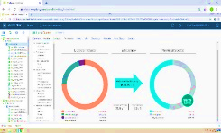
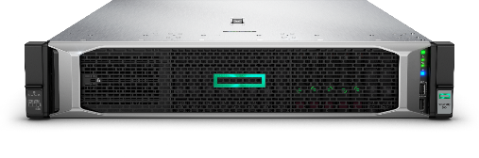

Edge optimized: Reduced complexity with seamless management
2-node high availability
Site 1
Zero administration
Site 2
Rapid multi-site failover
Core site
Site N
Notes:
Intent of slide: Now we move on to the features that make HPE SimpliVity edge optimized.
The solution is Edge optimized:
1) 2-node HA: Customers only need two nodes to achieve high availability with all services included. Customers gain an optimized solution for mult-site / Edge deployments in the smallest footprint.
2) Zero administration is enabled by centralized, unified management across all sites empowering customers to seamlessly manage workloads across distributed sites where staff resources are scarce.
Finally
3) For superior business continuity with Rapid Multi-site Failover, customers can rapidly failover (and failback) virtually any number of edge sites in event of disaster—planned or unplanned - using automated, efficient VM mobility and recovery. Orchestration is fast, efficient enabling all edge workloads to be recovered quickly minimizing business downtime.
This is a perfect fit for manufacturing sites, retail sites, plants as well as Data Center consolidation for midmarket, SMB, and SLED.

Slide 19
NEW: COMPREHENSIVE DATA PROTECTION for the edge
New
New
Rapid Recovery
Instant Restore; Multi-Site DR
COST
Centralized Backup
Cost-effective Retention
Enterprise Cloud Backup
Simplicity & Agility
Orchestration and Automation
SLA/TIME TO AVAILABILITY
Built-into the Hyperconverged Experience
Extending Hyper Efficiency to Cloud
Notes:
Intent of slide: Show new capabilities that deliver comprehensive data protection.
When it comes to data protection—there are 3 things that enterprises care about:
1. the ability to meet every SLA (from disaster recovery to long term retention)
2. the flexibility to choose the right solution that meets the needed RPO/RTO and economics… and
3. simplicity
HPE SimpliVity is known for its inherent backup and resiliency capabilities. Its built-in local and remote backups allow efficient, rapid recovery for applications across multi-site federations - including distributed edges - for disaster recovery. With HPE SimpliVity, VM data is rapidly and automatically backed up to another node, so if one node goes down, no data is lost.
In fact, a 1TB VM can be backed up or restored in <60 seconds. This is critical in protecting edge site data against security threats such as ransomware.
Now, with the introduction of centralized backup store and enterprise cloud backup for ultimate simplicity and agility, HPE SimpliVity extends these capabilities to deliver the most comprehensive data protection solution for the edge.
Customers gain comprehensive data protection built-into the simple, HCI experience.

Slide 20


ADVANCING built-in BACKUP: Native cloud protection
HPE SimpliVity federation
HPE Cloud Volumes
Edge sites
20:1 storage efficiency¹
100% automated protection
Pay as you go
Efficient, No Egress fees
1 Assuming dedupe ratio of 20:1 as compared to a fully hydrated backup
Notes:
Intent of slide: Show how HPE is advancing built-in backup with native cloud backup protection
HPE SimpliVity with HPE Cloud Volumes Backup delivers simple, efficient, flexible backup directly to the cloud. This solution enables multiple edge sites to:
Backup to cloud is 100% automated, setup directly from vCenter without additional software or appliances required.
HPE Cloud Volumes Backup optimizes costs with consumption-based pricing, minimal data transfer for efficient bandwidth usage, and efficient data storage in the cloud.
Backups can be simply restored to multiple, on-premises edge sites without any egress charges.

Slide 21
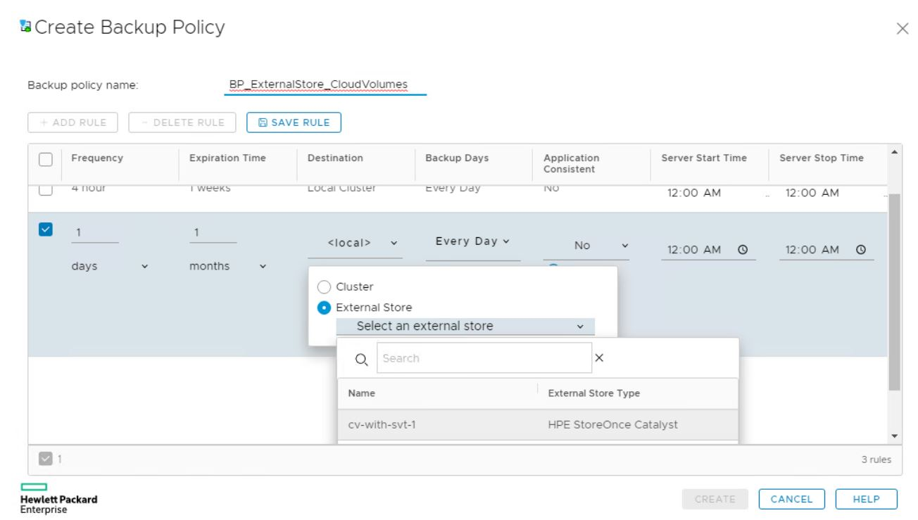
HPE SimpliVity: Enterprise backup to cloud that’s effortless
Simple
to setup, manage, maintain
6 clicks
to set backup policies direct to cloud
<60 seconds
to update backup policies for 1000s of VMs
Zero egress costs
to restore backups to multiple edge sites
Notes:
Intent of slide: Show how simple the built-in backup to cloud is along with key benefits
Here we show the power and simplicity of enterprise backup direct to cloud from HPE SimpliVity. This unlocks agility.
It’s simple to setup, manage right from vCenter
It only takes 6 clicks to set policies to automate backup to cloud
It takes less than 60 seconds to update policies that protect 1000s of VMs across all edge sites
Zero egress costs when restoring VMs from cloud

Slide 22
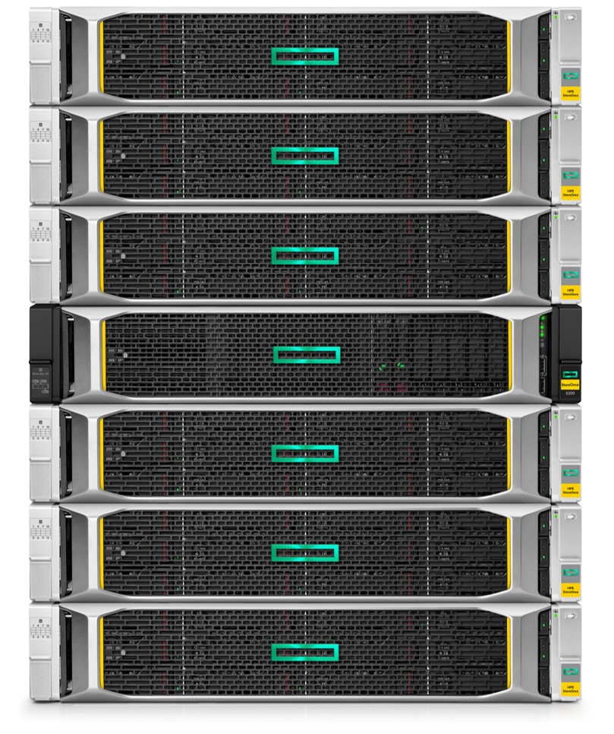
ADVANCING built-in BACKUP: Cost-effective secondary backup TIER
HPE SimpliVity federation
HPE StoreOnce
at central site
Edge sites
20:1 storage efficiency¹
100% automated protection
Cost-effective
SLAs without compromise
1 Assuming dedupe ratio of 20:1 as compared to a fully hydrated backup
Notes:
Intent of slide: Show how HPE is advancing built-in backup with cost effective secondary backup to HPE StoreOnce
We’ve now improved the support by allowing HPE StoreOnce tier to be centrally placed, even over wide-area connections, at a central site for efficiency. All remote sites can send off-site backups to the central tier.
This is 100% automated
Cost effective with up to 7x less cost compared to using HPE SimpliVity tier for backups
Meets all SLAs with fast RTOs of 60 second for 1 TB VM and archive VMs for years for compliance RPOs
Can also be valuable for customers looking to host their off-site VM backups at a central Colo-site on HPE StoreOnce.
++++
As SimpliVity scales into the enterprise, customers are looking to continually modernize their data protection solutions. We’re now introducing support for StoreOnce so that customers can extend SimpliVity to SimpliVity to Tape model to SVT to SVT to StoreOnce preserving rapid recovery and extending cost-effective, long-term retention while preserving the simplicity of policy-based protection that SimpliVity customers love.
In late 2019 we introduced an exciting, innovative capability to extend support for protecting and retaining VMs and data. Our efficient, built-in backup capabilities with HPE SimpliVity are even better with a new cost effective option.
The solution leverages seamless integration between HPE StoreOnce and HPE SimpliVity without need for 3rd party tools.
It is App-aware, VM-centric and 100% fully automated via policy-based automation in HPE SimpliVity.
Cost effective: Up to 7X less expensive from a $/GB perspective compared to storing VMs backups on the SimpliVity tier.
And
Customers gain improved service levels (SLAs) with the Best of Both Worlds: Rapid restores on HPE SimpliVity with long-term retention on StoreOnce. Restore 1 TB VM in 60 seconds with 3 clicks; while securely archiving VMs for years on StoreOnce for compliance.

Slide 23


Network optimization for the edge
Edge sites
Core site
Bandwidth prioritization
WAN cost savings
Performance optimization
Notes:
Intent of slide: Show how HPE is advancing data protection with ability to optimize network bandwidth for backups to edge sites with low speed network connectivity
Edge network optimization (“bandwidth throttling”). This is a very useful feature for customers who have low bandwidth WAN connectivity in edge sites. For example, when edge site backups are scheduled to run simultaneously with business applications, customers can set up policies to prioritize how backup bandwidth resources are throttled and prioritized. This eliminates traffic congestion and ensures consistent performance and performance optimization for critical applications.
Rate limit the backup flow. Backups are assigned to slow speed lane. Apps are performance optimized with the higher bandwidth.

Slide 24
ADVANCING built-in BACKUP: Edge to cloud protection
HPE SimpliVity federation
Core site
Colo
Cloud
Edge sites
Notes:
Intent of slide: Show how the solution is even more effective with the seamless edge to cloud protection to address more SLAs.
We’ve now improved the support by allowing HPE StoreOnce tier to be centrally placed, even over wide-area connections, at a central site for efficiency and direct to cloud backup. All remote sites can send off-site backups to any target improving data protection options and addressing more SLAs.
Can also be valuable for customers looking to host their off-site VM backups at a central Colo-site on HPE StoreOnce.

Slide 25







Evolving app requirements at the Enterprise edge
Virtualization
Containers
Microsoft
Hyper-V
Shift to IT Generalists
Requiring VM-Centric Data Services
Enabling Hybrid Cloud
Virtual Volumes for App Mobility
Shift to Self-Service
DevOps-Centric Provisioning
Persistent Storage
Requiring Software-Defined Storage
Simplicity & Agility
Notes:
Intent of slide: Show how app requirements are evolving at the edge
For some context, organizations are transforming how they develop and deploy applications across hybrid cloud – with IT needing storage infrastructure to be more agile, more automated, and policy-driven.
For virtualization, we’ve clearly seen a shift to IT generalists which increases the need for VM-centric data services. We believe the answer is virtual volumes as it makes storage software-defined and streamlines storage operations.
Also, as workloads increasingly span across hybrid cloud, vVols also enables app and data mobility without requiring your apps to be rearchitected.
And finally for containers, developers need self-service. And organizations are looking to adopt containers for stateful applications requiring persistent storage.

Slide 26









HPE SimPliVity: One platform for the Enterprise EDGE
NEW
+
HPE Ezmeral
Virtualization
Containers
for cloud-native applications
Simplicity & Agility
Notes:
Intent of slide: Show how HPE SimpliVity provides a single platform that supports both VMs and container-based apps
And as every business is increasingly more digital, they are bringing new virtualized and container-based apps to market that will shape their future business. This requires a new level of simplicity and agility including for the enterprise edge with a platform that supports both traditional and modern, cloud native apps. They need one platform for all their every app of today and tomorrow.
------
This only exacerbates the pain that IT is going through. They are already bogged down trying to handle the traditional workloads like databases and virtualization…. Now they also have to try and handle modern apps like containers or real time analytics.
How do you do more with less to help propel the business forward? Ultimately IT needs the resiliency and performance, but also needs the agility to unlock innovation.
They need one platform for all their apps of today and tomorrow.

Slide 27
One edge foundation for any application
NEW
Virtualized Apps
Containerized Apps
HYPERCONVERGED CONTROL PLANE
AUTOMATION
LIFECYCLE MGT
EFFICIENCY
PROTECTION
COMPUTE
EDGE INFRASTRUCTURE
STORAGE
Notes:
Intent of slide: Show how HPE SimpliVity provides a single platform that supports both VMs and container-based apps with a common control plane
Across industries, organizations are transforming how they develop and deploy applications across hybrid cloud – with IT needing infrastructure to be more agile, more automated, and policy-driven to support evolving virtualization and container-based architectures.
HPE SimpliVity now supports the Container Storage Interface (CSI) Driver for Kubernetes to run container-based workloads at the edge.
In our perspective, what you should have is one common hyperconverged platform and control plan that can run VMs and containers at the edge.

Slide 28
HPE SimpliVity runs a variety of workloads
Notes: *e.g. 911 system, healthcare application, legal case management, CAD/CAM, etc.
Source: TechValidate TVID: 232-FC1-EA7, n=626, March 2020
Notes:
Intent of slide: Show the workload variety HPE SimpliVity can handle.
Key takeaway: HPE SimpliVity customers are happily running a wide variety of tier-1 applications including VDI with Citrix, Vmware Horizon View
HPE SimpliVity certified for SAP HANA in early 2019.
Many customers run MSFT SQL server, Oracle databases and more.
TechValidate: Independently validated usage data from survey in March 2020 of 626 customers.
Source: https://www.techvalidate.com/product-research/HPEHybridITSolutions/charts/232-FC1-EA7

Slide 29


HPE SimpliVity gives aston martin red bull racing the density, resiliency, performance that they require
4.5x improved app performance
Nothing matters more in Formula One racing than speed. With HPE SimpliVity, post-processing trackside has gone from nine minutes down to two. In addition, AMRBR optimizes their designs with high-end virtual desktops.
Notes:
Intent of slide: Now we move to a high profile example of HPE SimpliVity enabling customer success.
Key takeaways:
1. Aston Martin Red Bull Racing has reduced the laps it takes to makes adjustments to the car, meaning they can quickly make adjustments. 2.5x faster than they used to. AMRBR also leverages many virtual desktops in the manufacturing process of their race cars. These high-end desktops run on HPE SimpliVity with Citrix and NVIDIA GPUs
Customers are seeing real business value due to implementing HPE SimpliVity.
Aston Martin Red Bull Video is here:
http://www.hpe.com/info/RedBullRacing

Slide 30
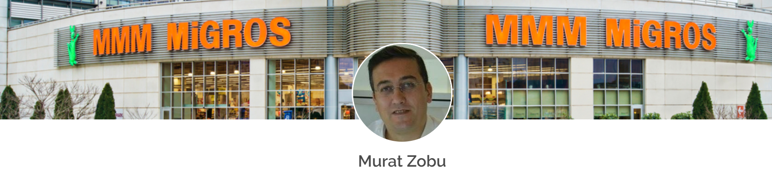
Adapting to the new realities in retail
Business challenges
HPE solution
Outcome
Finding enough time for maintenance
Finding and fixing issues
Managing growth
Scale more employees to Work From Home
Incorporate deduplication and compression technology
Ensure security, compliance, and control
Added 700 users to existing 300 seat VDI in 12 minutes
Leveraged existing compute nodes
Solution
HPE SimpliVity 380 All Flash
VMware vSphere
Citrix for virtual desktops
12,00 concurrent sessions, 100 virtual apps and 500 VM’s
Consistent, familiar desktop experience and performance to employees
Achieving Stress-free 3 second Backups
Reduced Operating Costs by 50%
Quick, easy deployment (leveraged HCI and Pointnext)
Flexibility to improve DR and off-site backup and recovery
Success Story: More than doubles VDI WFH Users in 12 minutes
Notes:
Intent of slide: Showcase SimpliVity VDI success story
Great quote:
“When I meet with other IT colleagues, they’re always asking about remote access. I’ve been telling them, ‘Well, look at HPE SimpliVity. It’s a great solution for VDI, and that’s just the tip of the iceberg in terms of what it can do.’”
David Clark, Kirton McConkie
Specific to the VDI config: 225 VDI desktops are configured, but not all are active or spun up yet. Approximately150 desktops are configured and probably 50 are running at any given time

Slide 31


Profile of a CryptoLocker attack
Ransomware attack holds Central One Federal Credit Union data hostage
3:30 p.m. First signs of trouble
  First noticed problem when employee couldn’t process large file from the Federal Reserve
  At first, thought it was a problem with core application vendor
  Vendor identified corrupt file as possible root cause
6:00 p.m. Attempt to copy folder from another branch location
  Attempted to copy the folder from another branch location
  WAN connection only 1.5 Mbps took about two hours to process
8:00 p.m. Discovery of CryptoLocker ransomware demand
  After transfer, file was still not able to process
  Team then identified the root cause as CryptoLocker
Notes:
Intent of slide: Explain how a customer was faced with a CryptoLocker attack.
So what happened? About 3:30 in the afternoon, they started receiving customer calls that they couldn’t properly process files. At first, it appeared to simply be an error with the application. Working with the application vendor, it was decided to attempt copying files from duplicate data at one of the branch sites. Given the large size of the files and the relatively small WAN connection, this copy attempt took about 2 hours. At the end of the copy, that fix didn’t solve the problem. At this point, they discovered that the root cause of the problem was actually a CryptoLocker infection.

Slide 32

Recovering from CryptoLocker with HPE SimpliVity
A recovery point from prior to the infection was selected
HPE SimpliVity restored the 500 GB virtual machine (VM) in seconds
Database was operational in minutes
Subsequent transactions recovered and processed
8:30 p.m. The team left the office
  No data lost.
  No ransom paid.
Read more: Customer success story including recovery from cyber incident
Notes:
Intent of slide: Show how SimpliVity helped with a CryptoLocker attack.
At this point the team was feeling pretty defeated. One of the team members suggested they restore one of their pre-infection SimpliVity backups. That restore only took a few seconds and effectively wiped out the infection. They were then able to get the database up and missing transactions processed. After only 30 minutes after starting the SimpliVity restore, the team was done and able to head home with no lost data. Best of all, the only money the company had to pay was the cost of some pizza for the staff that had to work late.

Slide 33

HPE SimpliVity HyperGuarantee
1
HyperEfficient: save 90% capacity across storage & backup combined
2
HyperProtected: under 1 minute to complete a local backup or local restore of a 1TB VM
3
HyperSimple: 3 clicks to back up, restore, move, or clone a VM from a single console
4
HyperManageable: under 1 minute to create or update backup policies for 1000’s of VM’s across many sites
5
HyperAvailable: add or replace HPE SimpliVity systems with zero downtime for local or remote sites
Zero disruption to local or remote SimpliVity backups
Zero reconfiguration of SimpliVity backup policies for local or remote sites
Zero re-entry of IP addresses in remote sites
Notes:
Intent of slide: Now explain how confident we are with our solution, with all capabilities backed by our HyperGuarantee.
Key takeaway:
1. All the capabilities discussed in this presentation are backed by an actual guarantee for all customers.
2. This guarantee is built into the warranty.

Slide 34
HPE SimpliVity: Intelligent HCI for the Enterprise edge
Intelligently simple
for peace of mind
Ensure protection
with savings from edge to cloud
More workloads
agility to run new apps
All-in-one
Collapsed stack with HA and backup
10X
Savings on storage
1 solution
for all edge sites
Notes:
Intent of slide: Show how HPE SimpliVity provides Intelligent HCI for the enterprise edge
HPE is helping customers reimagine the enterprise edge with new advancements to protect the edge…
It’s intelligently simple in an all-in-one solution that collapses the stack including built-in backup to save costs
It ensures protection across all sites with hyper efficient use of resources including costly storage across all your edge sites
It supports more workloads from VMs to containers on a single platform.

Slide 35
More ResourceS: Where to learn more
Public site: https://www.hpe.com/SimpliVity
Customer Stories: https://upshotstories.com/companies/hpe-simplivity
HPE Reference Architectures / Reference Configurations: HPE SimpliVity RA's
Notes:
Intent of slide: Links to additional resources

Slide 36
Thank you
Engage with HPE Storage:
Web: hpe.com/simplivity
Twitter: @HPE_SimpliVity
Facebook: facebook.com/HPESimpliVity
YouTube: search HPE Technology

Slide 37




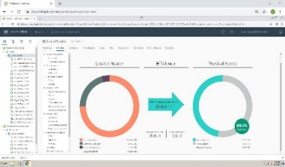

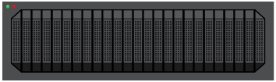


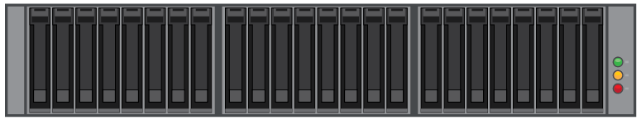




What’s to simplify? Evolution of convergence
Legacy Stack
Other Hyperconverged Solutions
HPE SimpliVity Hyperconverged Infrastructure
Switches
Collapse the “entire” stack into a single, intelligently simple solution with density, resiliency, and performance
Built-in resiliency, backup, and disaster recovery
Performance with always-on inline deduplication and compression
Reduced costs compared to legacy IT and other HCI
Managed via single, familiar interface
Servers & VMware
Storage Switch
HA Shared Storage
Converge only
storage & server
Backup & Dedupe
WAN Optimization
SSD Array
Storage Caching
Data Protection Apps (Backup & Replication)
Notes:
Intent of slide: Explain the evolution of converged infrastructure
Key takeaways:
1. This build slide shows the evolution of convergence.
2. HPE SimpliVity is truly the only HCI, Software-Defined solution that enables your customers to converge the entire stack (hyperconverge everything) into one back to pat, one support contract, one IT generalist to manage ‘all IT Infrastructure below the hypervisor’.” Only one to do this. This empowers customers.
3. It is intelligently simple as an all-in-one solution.

Slide 38

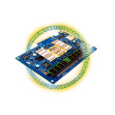




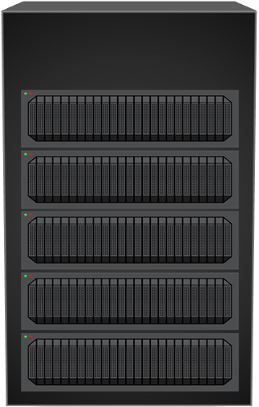
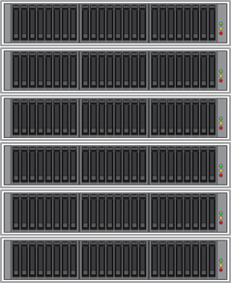


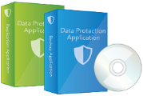
Doing more with less
VM Host
VM Host
VM Host
VM Host
Storage Controller 1
Network
2 HPE SimpliVity nodes
4 VM Hosts
4 HPE SimpliVity nodes
Storage Controller 2
2 Controllers
4 Controllers
2 Controllers
1 Copy of Production Data
2 Copy of Production Data
1 Instance of Backup Data
2 Instances of Backup Data
Primary Storage
Notes:
Intent of slide: Explain how SimpliVity helps customers do more with less
Key takeaway: HPE SimpliVity = we do more with less; Delivers lower TCO; Economic benefits.
We talked about how HPE SimpliVity uses deduplication to reduce the need for storage performance, but now lets talk about how HPE SimpliVity can reduce the number of devices in the data center, while still providing the same level of resiliency of data.
[click]
We start off with a typical legacy infrastructure with four VMware hosts, a primary storage array with two controllers and a single RAID-protected copy of the VMs, and a backup infrastructure including software and disk-based backups…
[click]
…that contains one copy (usually protected by RAID) of the backup data.
[click]
if we replace the four hosts with four HPE SimpliVity hyperconverged nodes
[click]
We will have four controllers (this is the combination of the HPE OmniStack Virtual Controller software and the HPE OmniStack Accelerator Card hardware). So we now have more controllers than before.
[click]
Since VM is written to two different nodes, we have two copies of the VM. Both of which are backed up by RAID.
[click]
That's more resiliency than the storage array was providing, so we can now get rid of it.
[click]
When HPE SimpliVity backups are created, they are created just like the VMs: across two nodes. Both of which are backed up by RAID.
[click]
Since we have the resiliency of that legacy backup solution, we can now eliminate it. Leaving us with just four HPE SimpliVity nodes.
[click]
But to do a closer apples-to-apples comparison, we really only need two HPE SimpliVity hyperconverged nodes, which still leaves us with better resiliency of the data than we had before.

Slide 39
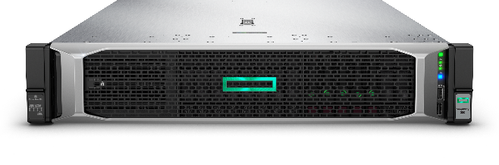
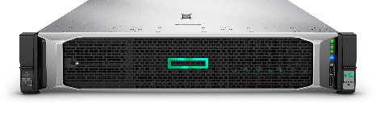
Cloud experience with simple, powerful business continuity
Backup Locally and Globally
Global Unified Management with intelligence
“Best in Class” Replication included
Enable Data Mobility across all sites
Automate VM Moves Across Sites
Establish Hub and Spoke design
Site 1
Site 2
Create Simple DR/BC Strategies as you Scale out across sites
Network
Remote Site 1
Remote Site 3
Remote Site 5
Remote Site 2
Remote Site 4
Notes:
Intent of slide: Show how customers can start with small deployments and scale.
Key takeaway: Customers can start with small deployment across multiple sites and scale in small increments. Edge optimized for many remote sites with central management.
A common use case leverages HPE SimpliVity for multi-site deployments with off-site backup, replication and DR. This shows how easily you can deploy multi-site. We enable VM mobility across sites with very efficient replication. This gives you local backups or remote backups of VMs, and you can create simple disaster recovery procedures via automation to failover VMs or move VMs across sites. Every site with redundant HPE SimpliVity can run active workloads while providing DR/Backup for other sites. This allows very efficient use of infrastructure.
Allows you to start small and scale out to very large deployments in small increments.
Allows you to create very reliable and agile infrastructure spanning sites. HPE allows you to easily and quickly move workloads across sites via rich, built-in data services (efficiency replication, backup/restore, mobility). This gives you freedom to move workloads across sites.
This is an excellent solution for Primary and Secondary sites and for multi-site ROBO/Edge scenarios. Customers can run production and test/dev across multiple sites and efficiently use all resources.

Slide 40

HPE SimpliVity data virtualization platform
VMs
Data Virtualization Platform
Presentation
layer
All data written/registered to virtualization platform
Data
Management
layer
Persistent storage
Only unique data written to disk
“The best IO is the one you don’t have to do.”
Notes:
Intent of slide: Explain how that works in detail
Script:
Let’s take a deeper look at how this works.
Click x2
First, if we take off the bezel and open it up, you’ll see it’s a standard x86 server with standard components like HDD, SSD, DRAM, and x86 CPU and memory. And, just like any other host, we’re running ESXi.
Click
Then we bring in the DVP, which sits architecturally between the hardware and the hypervisor, abstracting the hardware from the VMs / apps that are running on top.
Click x2
Within that layer sits the accelerator card, the PCIe card that deduplicates, compresses, and optimizes all data inline at inception once and forever, like we’ve already discussed.
When we peel back the onion a bit, you’ll see that the DVP actually has two layers: 1. the presentation layer, which is what VMware will logically interact with; and 2. the management layer, where the metadata is stored and managed.
Click
Let’s take a look at the write path. The first thing that happens is a new write will come in.
Click
VMware will write it and
Click
we’ll register the metadata. What actually happens first is that it will really write it to the card. Then the card will synchronously mirror to another card in another node for high availability. When both cards have the data, they’ll persist it and acknowledge back to the host. Each card has 8 GB of cache and NVRAM and supercapacitors. In case the power fails, the card will flush to NVRAM to protect the data.
Click
Then we’ll analyze the data. If it’s unique, as this block is at 8 KB, then we’ll write it to HDD in compressed form.
Click
Another write comes in.
Click
It’s unique, we’ll compress it and write it to disk.
Click
Another write that’s green this time.
Click
It’s unique, we’ll compress it and write it to disk.
Click
Now, let’s see what happens when a duplicate block—which is most blocks—comes in. We know that the fastest I/O is the one you never have to write, and therefore by eliminating I/O, you’ll increase performance. So let’s see what that looks like.
Click
When that duplicate block comes in, VMware thinks it wrote unique data. However, the DVP recognizes that that block already exists somewhere within the shared resource pool. It updates the metadata, and that’s it. No data was written! No new I/O.
Click
And another duplicate block comes in.
Click
And the same—no new data written.

Slide 41
HPE SimpliVity data virtualization platform
VMs
Data Virtualization Platform
Presentation
layer
Data
Management
layer
Persistent storage
“The best IO is the one you don’t have to do.”
Notes:
Intent of slide: Explain how that works in detail
Script:
Let’s take a deeper look at how this works.
Click x2
First, if we take off the bezel and open it up, you’ll see it’s a standard x86 server with standard components like HDD, SSD, DRAM, and x86 CPU and memory. And, just like any other host, we’re running ESXi.
Click
Then we bring in the DVP, which sits architecturally between the hardware and the hypervisor, abstracting the hardware from the VMs / apps that are running on top.
Click x2
Within that layer sits the accelerator card, the PCIe card that deduplicates, compresses, and optimizes all data inline at inception once and forever, like we’ve already discussed.
When we peel back the onion a bit, you’ll see that the DVP actually has two layers: 1. the presentation layer, which is what VMware will logically interact with; and 2. the management layer, where the metadata is stored and managed.
Click
Let’s take a look at the write path. The first thing that happens is a new write will come in.
Click
VMware will write it and
Click
we’ll register the metadata. What actually happens first is that it will really write it to the card. Then the card will synchronously mirror to another card in another node for high availability. When both cards have the data, they’ll persist it and acknowledge back to the host. Each card has 8 GB of cache and NVRAM and supercapacitors. In case the power fails, the card will flush to NVRAM to protect the data.
Click
Then we’ll analyze the data. If it’s unique, as this block is at 8 KB, then we’ll write it to HDD in compressed form.
Click
Another write comes in.
Click
It’s unique, we’ll compress it and write it to disk.
Click
Another write that’s green this time.
Click
It’s unique, we’ll compress it and write it to disk.
Click
Now, let’s see what happens when a duplicate block—which is most blocks—comes in. We know that the fastest I/O is the one you never have to write, and therefore by eliminating I/O, you’ll increase performance. So let’s see what that looks like.
Click
When that duplicate block comes in, VMware thinks it wrote unique data. However, the DVP recognizes that that block already exists somewhere within the shared resource pool. It updates the metadata, and that’s it. No data was written! No new I/O.
Click
And another duplicate block comes in.
Click
And the same—no new data written.

Slide 42
HPE SimpliVity data virtualization platform
VMs
Data Virtualization Platform
Presentation
layer
Data
Management
layer
Persistent storage
“The best IO is the one you don’t have to do.”
Notes:
Intent of slide: Explain how that works in detail
Script:
Let’s take a deeper look at how this works.
Click x2
First, if we take off the bezel and open it up, you’ll see it’s a standard x86 server with standard components like HDD, SSD, DRAM, and x86 CPU and memory. And, just like any other host, we’re running ESXi.
Click
Then we bring in the DVP, which sits architecturally between the hardware and the hypervisor, abstracting the hardware from the VMs / apps that are running on top.
Click x2
Within that layer sits the accelerator card, the PCIe card that deduplicates, compresses, and optimizes all data inline at inception once and forever, like we’ve already discussed.
When we peel back the onion a bit, you’ll see that the DVP actually has two layers: 1. the presentation layer, which is what VMware will logically interact with; and 2. the management layer, where the metadata is stored and managed.
Click
Let’s take a look at the write path. The first thing that happens is a new write will come in.
Click
VMware will write it and
Click
we’ll register the metadata. What actually happens first is that it will really write it to the card. Then the card will synchronously mirror to another card in another node for high availability. When both cards have the data, they’ll persist it and acknowledge back to the host. Each card has 8 GB of cache and NVRAM and supercapacitors. In case the power fails, the card will flush to NVRAM to protect the data.
Click
Then we’ll analyze the data. If it’s unique, as this block is at 8 KB, then we’ll write it to HDD in compressed form.
Click
Another write comes in.
Click
It’s unique, we’ll compress it and write it to disk.
Click
Another write that’s green this time.
Click
It’s unique, we’ll compress it and write it to disk.
Click
Now, let’s see what happens when a duplicate block—which is most blocks—comes in. We know that the fastest I/O is the one you never have to write, and therefore by eliminating I/O, you’ll increase performance. So let’s see what that looks like.
Click
When that duplicate block comes in, VMware thinks it wrote unique data. However, the DVP recognizes that that block already exists somewhere within the shared resource pool. It updates the metadata, and that’s it. No data was written! No new I/O.
Click
And another duplicate block comes in.
Click
And the same—no new data written.

Slide 43
Automated, simplified recovery reduces costly downtime
HPE SimpliVity RapidDR
Disaster recovery orchestration automates VM failover and failback from primary site to secondary site
Reduces costs and complexity by streamlining the DR process
Improves service level agreements (SLAs) by lowering recovery point objectives (RPOs) and recovery time objectives (RTOs) from days or hours to minutes
Cost of downtime: 1 hour IT downtime = $102K; IT downtime costs organizations $20.1M annually**
Miami
Munich
** 2019 Availability Report
Notes:
Intent of slide: HPE SimpliVity RapidDR provides automated, orchestrated, simplified recovery across sites and reduces costly downtime.
Reduces the complexity around DR by streamlining the DR process
Example of streamlining: RapidDR provides a streamlined process for developing an automated DR plan that can then be later executed to recover VMs at a DR site in an automated fashion with minimal user interaction. This also has the ability to specify which VMs to fail over to DR site, in what order, and with what configuration.
RapidDR has support for automated failover and failback of VMs (in the case of VMware offering) across primary and secondary sites for improved orchestration and reduced complexity. Users can execute or test a RapidDR failback with a single disaster recovery plan
When executed, the DR plan will handle a majority of the tasks needed to recover their environment at the DR site, such as restoring VMs from backups, attaching them to new networks, and configuring appropriate network settings within the VM.
HPE SimpliVity RapidDR enables DR orchestration for site-to-site recovery to improve application availability during planned or unplanned DR events. For example, one customer uses RapidDR to failover all 50 of their mission critical VMs across two cities 500 miles apart. Before this failover/failback DR event would have taken them days to accomplish, and now they orchestrate and automate the failover and failback in hours. [See details in the public customer story here: https://upshotstories.com/stories/running-multiple-apps-on-san-it-might-be-time-for-an-upgrade]
This is a perfect data protection and DR solution for many midmarket customers who have highly virtualized workloads.
Available as an optional software licensed product in 25 VM or 100 VM license packs.
For enhanced automation/orchestration in virtualized DR environments and to reduce complexity, RapidDR also improves scalability to support 600 VMs in recovery plans for failover and failback (VMware ESXi option).

Slide 44



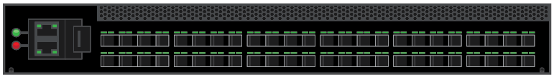
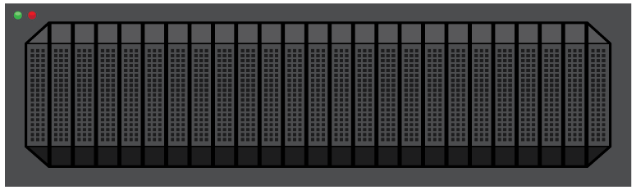






Reducing costs and data center footprint
Powered by
HPE SimpliVity
Data Virtualization Platform
Servers
HPE SimpliVity
Storage Switch
Lowers upfront costs
Reduces energy consumption
Eliminates OPEX
Avoids endless refresh cycles
HA Shared Storage
Backup and Dedupe
WAN Optimization
SSD Array
69% Cost savings
Storage Caching
10:1 Device Reduction
47:1 Average Storage Efficiency
Data Protection Apps
(Backup and Replication)
Reported in Forrester Total Economic Impact Study, 2019
Source: Forrester, May 2019
Notes:
Intent of slide: Show cost savings with SimpliVity
HPE commissioned Forrester to perform a Total Economic Impact (TEI) survey report. The latest Forrester study reveals how HPE SimpliVity customers reduce costs and TCO by 69%, while delivering a 192% return on investment with a short 7-month payback. Forrester surveyed several customers across industries and found they achieved these remarkable business benefits including:
69% cost savings
10:1 Device reduction
47:1 Avg storage efficiency
2.9x TCO savings
Saved ~$2.6 million over three years versus costs of $888.5K
ROI of 192%
Payback in 7 months
Other savings
After HPE SimpliVity, reduced the level of professional services by 50% during the first year
Saved 5 hours every day (25 hrs/week) on managing backups
Another compelling statistic from the Forrester TEI study is that HPE SimpliVity infrastructure was able to reduce the number of devices in our customers’ data centers by a factor of 10:1.
For adopting organizations, this adds up to lower upfront costs, reduced energy consumption, OPEX savings, and an exit to the endless cycle of system refreshes.
Get the report here:
https://www.hpe.com/us/en/resources/integrated-systems/simplivity-economic-impact.html?parentPage=/us/en/products/integrated-systems/simplivity

Slide 45
Top use cases
Data center in a box
EDGE/ROBO
VDI
Power graphics-intensive
VDI workloads with NVIDIA Tesla
M10 and P40 GPU accelerator cards
Mixed workloads
Data
protection
Test/dev
Notes:
Intent of slide: Top use cases
Hyperconverged infrastructure solves problems and addresses the needs of various use cases without pigeonholing you into a single area. As I mentioned earlier, a majority of our mid-market customers use HPE SimpliVity infrastructure for over 75% of their virtualized workloads, including their tier-1 applications like SQL, Oracle, SAP®, and industry specific applications like Epic Hyperspace.
How do you envision using SimpliVity?
//Pick the use cases that are most pertinent to the customer, or their territory and share a one-liner about it.//
EDGE/ROBO: “HPE SimpliVity 380 Gen10 now comes in extra-small and small entry-level, all-flash solutions in single- and dual-socket configurations, priced right for SMBs and ROBOs. HPE SimpliVity 325 is also perfect for Edge sites (1U small footprint with single AMD-based CPU). HPE SimpliVity provides data protection and improves application performance, RTOs, and RPOs. Hyperconverged infrastructure makes better use of bandwidth-constrained WAN links, and cuts TCO. And centralized management means reduces the need for IT expertise—onsite or otherwise.”
VDI: “HPE SimpliVity 380 Gen10 delivers more virtual desktops on less hardware. It offers the highest desktop density of any hyperconvergence vendor, without sacrificing performance or resiliency. The HPE SimpliVity 380 reference architecture for VMware Horizon™ demonstrates enterprise scale with up to 4,000 office worker desktops in a single VDI building block, and unmatched performance, independently validated by Login VSI, the industry-standard benchmarking tool for virtualized workloads. HPE SimpliVity 380 Gen10 now supports NVIDIA M10 and P40 GPUs. SVT 2600 supports NVIDIA M10 and P40 for high-performance graphics. We work with several VDI platforms including Horizon view, Citrix, and Workspot.”
Data center in a box: “HPE SimpliVity is the ideal choice if you’re pursuing a cloud strategy that delivers the best of both worlds: cost savings and the agility of cloud, with enterprise performance and reliability. With a highly scalable, flexible, and cost-effective foundation for implementing private clouds, as well as on-demand services and hybrid cloud offerings available through a broad network of HPE SimpliVity powered service providers, HPE SimpliVity helps you deliver a cloud model that fits any requirement—private, public, or hybrid.”
Mixed workloads: “HPE SimpliVity 380 Gen10 frees up staff time to focus on projects that support and grow the business. Virtualized tier-1 applications run faster and become easier to manage, so you can significantly reduce the need for dedicated server, storage, and data protection specialists. IT generalists and the application team can now back up, restore, clone, or move VMs in just seconds.”
Data protection: “Only HPE SimpliVity delivers a hyperconverged solution with full-featured, built-in backup and recovery at no additional cost. HPE SimpliVity RapidDR—an integrated disaster recovery automation solution—simplifies and accelerates off-site DR and provides VM protection across primary and secondary sites to minimize service disruption and manual errors. With HPE SimpliVity, RPOs and RTOs shrink dramatically because virtualized workloads can be backed up or restored in seconds or minutes, instead of hours or days.”
Test/dev: “HPE SimpliVity provides a highly efficient, agile infrastructure that meets the rapidly changing demands of test/dev environments. Inherent data efficiencies and VM-centric management capabilities, plus seamless integration with key orchestration tools, dramatically simplify operations and accelerate IT service agility. Software developers and test engineers can initiate services without any IT involvement.”

Slide 46
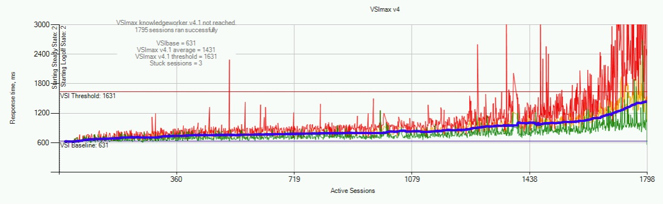
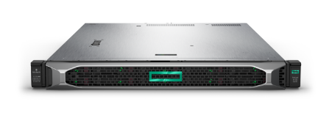

HPE SimpliVity 325 Gen10
Most density in small footprint, powerful all-in-one appliance
Compact, powerful all-in-one appliance:
HPE SimpliVity 325 Gen10 Login VSI results:
Ideal for VDI, ROBO/edge, and SMB/Midmarket consolidation use cases
2P performance at 1P economics
Highly dense, 1U, single 64-core AMD EPYC processor system delivers twice the desktop density vs. alternatives
Peak and predictable VDI performance from 300 to 1800 desktops, tested by HPE and Login VSI
Citrix and VMware client virtualization options
Tested 1,800 Desktops in 6 Rack Units
300 Knowledge Worker desktops per 1U node
https://www.loginvsi.com/login-vsi-blog/1091-login-vsi-results-hpe-simplivity-325
Notes:
Intent of slide: Provide an overview of HPE SimpliVIty 325 Gen10
HPE SimpliVity 325 Gen10 with 2nd Gen AMD EPYC processor is an enhanced platform that offers customers a 1U, small footprint, lower TCO for entry-level and distributed edge HCI use cases. For VDI the solution has full HPE SimpliVity software functionality and is validated to deliver double the desktops per server and half the cost per desktop versus alternatives for knowledge works with peak and predictable performance.
First to market in HCI category with small footprint, powerful 1U 64c platform with 2P performance at 1P economics and full HPE SimpliVity capabilities for general purpose, VDI, edge.
Doubles the number of virtual desktops while cutting cost in half
HPE SimpliVity now deliver twice the remote workers per rack unit
HPE delivers most remote workers per rack unit than ever before (up to 300 users per 1u of space and 1800 per 6u of space); That’s 1800 centrally managed digital workspaces in less than a foot of vertical Rackspace.
HPE achieves highest number of desktops per server validated by Login VSI to date. As of May 5, 2020 HPE has the industry’s most “Validated by LoginVSI” certifications for HCI with HPE SimpliVity to give customers confidence in a verified solution for VDI.
Perfect for following use cases:
Distributed Enterprise and Edge—For Manufacturing, Retailers, Supermarkets, banking, credit unions, SMB/midmarket consolidation use cases
Edge—small plant locations, oil rigs, field operations, smaller retail e.g. Petrobras America
VDI—Perfect for VDI deployments supporting industry leading 300 desktops with peak and predictable performance in 1u form factor with VDI running knowledge worker workloads such as Microsoft Office, Excel, PowerPoint, Outlook, view Acrobat documents and more.. Ability to easily deploy and scale VDI incrementally to six nodes for up to 1800 desktops in 6RU of space with peak and predictable performance.
Customers who require a lower TCO 1U all-in-one HCI for Distributed enterprise, edge, VDI deployments

Slide 47
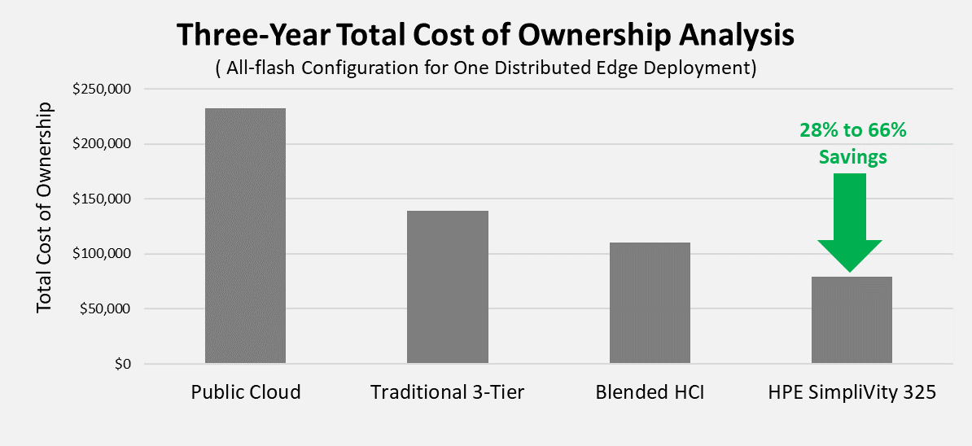
ESG Economic validation—most cost-effective solution for edge
2-node highly available
HPE SimpliVity 325 is most cost effective regarding:
Cost to acquire
Data protection costs
Space, power, cooling
Admin costs
Support
66% less
than Cloud
28% less than other HCI
~$7.6M saved over 50 sites
Independent commissioned study conducted by ESG, Oct 2020
Notes:
Intent of slide: ESG Economic validation—most cost-effective solution for edge
The all-flash HPE SimpliVity 325 offers organizations a lightweight, highly available, two-node deployment solution that has the potential to cut costs when compared with traditional three-tier architecture, other hyperconverged offerings, and public cloud computing services.
ESG completed a total cost of ownership analysis comparing a traditional infrastructure, a blend of other HCI offerings, and public cloud services vs. the HPE SimpliVity 325, with a goal of understanding the quantitative savings organizations can expect across five cost categories: cost of acquisition, data protection, administration, data center, and support.
ESG found that HPE SimpliVity 325 delivers savings of 28% to 66% over three years for a single all flash HCI solution compared to public cloud, traditional three-tier infrastructure, and other HCI solutions.
In total, these advantages yield acquisition cost savings of 28% compared with other HCI solutions, 43% when compared with a traditional three-tier approach and 66% compared to the public cloud.
The cumulative savings that can be achieved with HPE Simplivity 325 HCI over three years for a 50- site edge solution is more than $1.5 MM compared to other HCI solutions, $4MM versus traditional 3-tier and $7.6MM compared to public cloud .
Savings for multi-site deployments, which can also be achieved for production workloads running in the data center, are driven by a variety of factors including
Built-in data protection and resiliency that ensures workloads can survive infrastructure failures
Technology that deduplicates, compresses, and optimizes all data at inception globally across all edge sites and data centers. This saves on capacity and expensive data center resources plus reduces the amount of data sent over the WAN. HPE SimpliVity has industry leading data efficiency with 90% of storage capacity savings across primary VMs and backups, and these savings are guaranteed with the HPE SimpliVity HyperGuarantee.
All management and administration across compute, storage, virtualization, and data protection can be controlled from a familiar VMware vSphere interface.
All-flash storage delivers high levels of sustainable performance

Slide 48
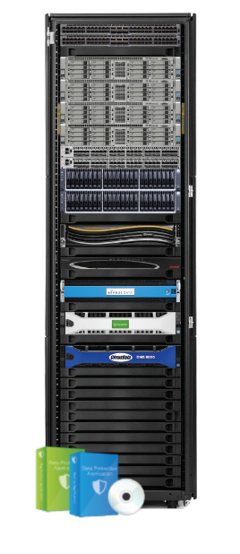

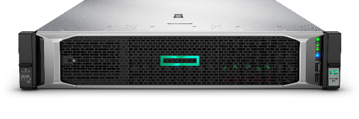
HPE SimpliVity for VDI
Excellent desktop performance with or without hardware acceleration
More desktops on less hardware reduce capital expenditure (CAPEX) and operational expenditure (OPEX)
Linear scaling in affordable increments - from pilot to production
Built-in data protection for client virtualization server workloads
No single points of failure: resiliency to withstand component failure without VM downtime and node failure with no loss of data
Notes:
Intent of Slide: Explain the benefits of using SimpliVity for VDI

Slide 49
HPE SimpliVity
Fully integrated HCI on the world’s most secure industry-standard servers
Unique security
Tested and proven
Leading compliance
Protection against firmware level advanced persistent threats
Continually scans firmware at runtime for malware
Only HPE has independent verification
Black Hat penetration testing ranks HPE two generations ahead of competitors
InfusionPoints’ testing ranks HPE two generations ahead of competitors
Only HPE applied NIST 800-53 controls
Highest and most comprehensive government guidelines for operating HW/SW in the world
No competitors have this level
Accelerates certification/compliance
Made possible by the Silicon Root of Trust
a00005881enw
Notes:
Intent of slide: Establish SimpliVity as the only HPE-owned HCI stack that is engineered and fully integrated on HPE ProLiant, the world’s most secure industry-standard server portfolio.
New recognition by Cyber Catalyst by Marsh Designation
The program evaluated over 150 security solutions against the following criteria before naming 17 industry-leading security solutions as Cyber Catalyst designees:
Verifiable and measurable reduction in cyber risk
Successful implementations
Applicability across a broad range of customers
Differentiated features and characteristics
HPE-exclusive silicon root of trust: HPE provides the only industry-standard servers with a silicon root of trust capability built into the hardware, which prevents compromised firmware code from executing. The HPE Silicon Root of Trust is offered on HPE ProLiant servers, HPE Apollo systems, HPE Synergy Compute Modules, and HPE SimpliVity.
https://www.hpe.com/us/en/newsroom/press-release/2019/09/hpe-cybersecurity-solutions-recognized-for-ability-to-reduce-risk-by-insurers-in-new-cyber-catalyst-program.html

