Slide 1


Slide 2

Eduard PUGHIN,
Maguay Computers
Bucuresti, 16 septembrie 2021
Stejarii Country Club

Slide 3
Parteneri NTFD 2004 (editia a II-a):
INTEL MICROSOFT

Slide 4

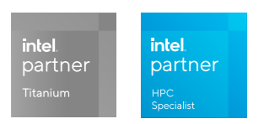
despre noi

Slide 5

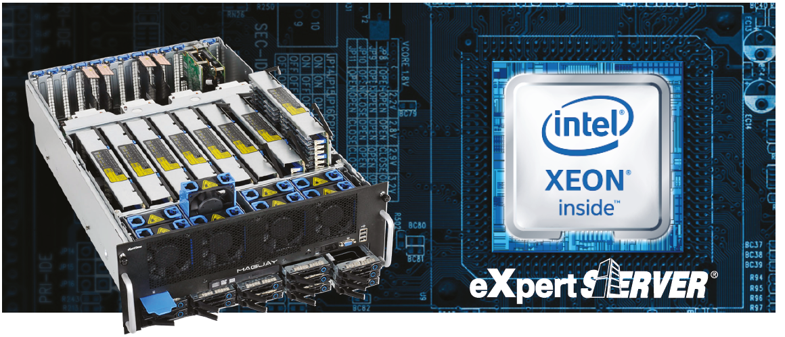
System builder
Maguay oferă soluții PC pentru toate ariile de activitate, bazate pe cele mai noi tehnologii Intel. Configurabile în totalitate, acestea acoperă orice necesitate. Sistemele Maguay au la bază platforme ce dispun de cele mai noi tehnologii, în materie de performanță, dar și tehnologii precum Intel vPro și TPM, pentru management la distanță și securitate sporită.
De asemenea, la capitolul performanță extremă, sistemele Maguay PowerStation și GamePower au fost apreciate și premiate, de-a lungul timpului, de către cele mai prestigioase publicații de profil, câștigând inclusiv în topurile cititorilor.

Slide 11
Integrator de sisteme informatice

Slide 12
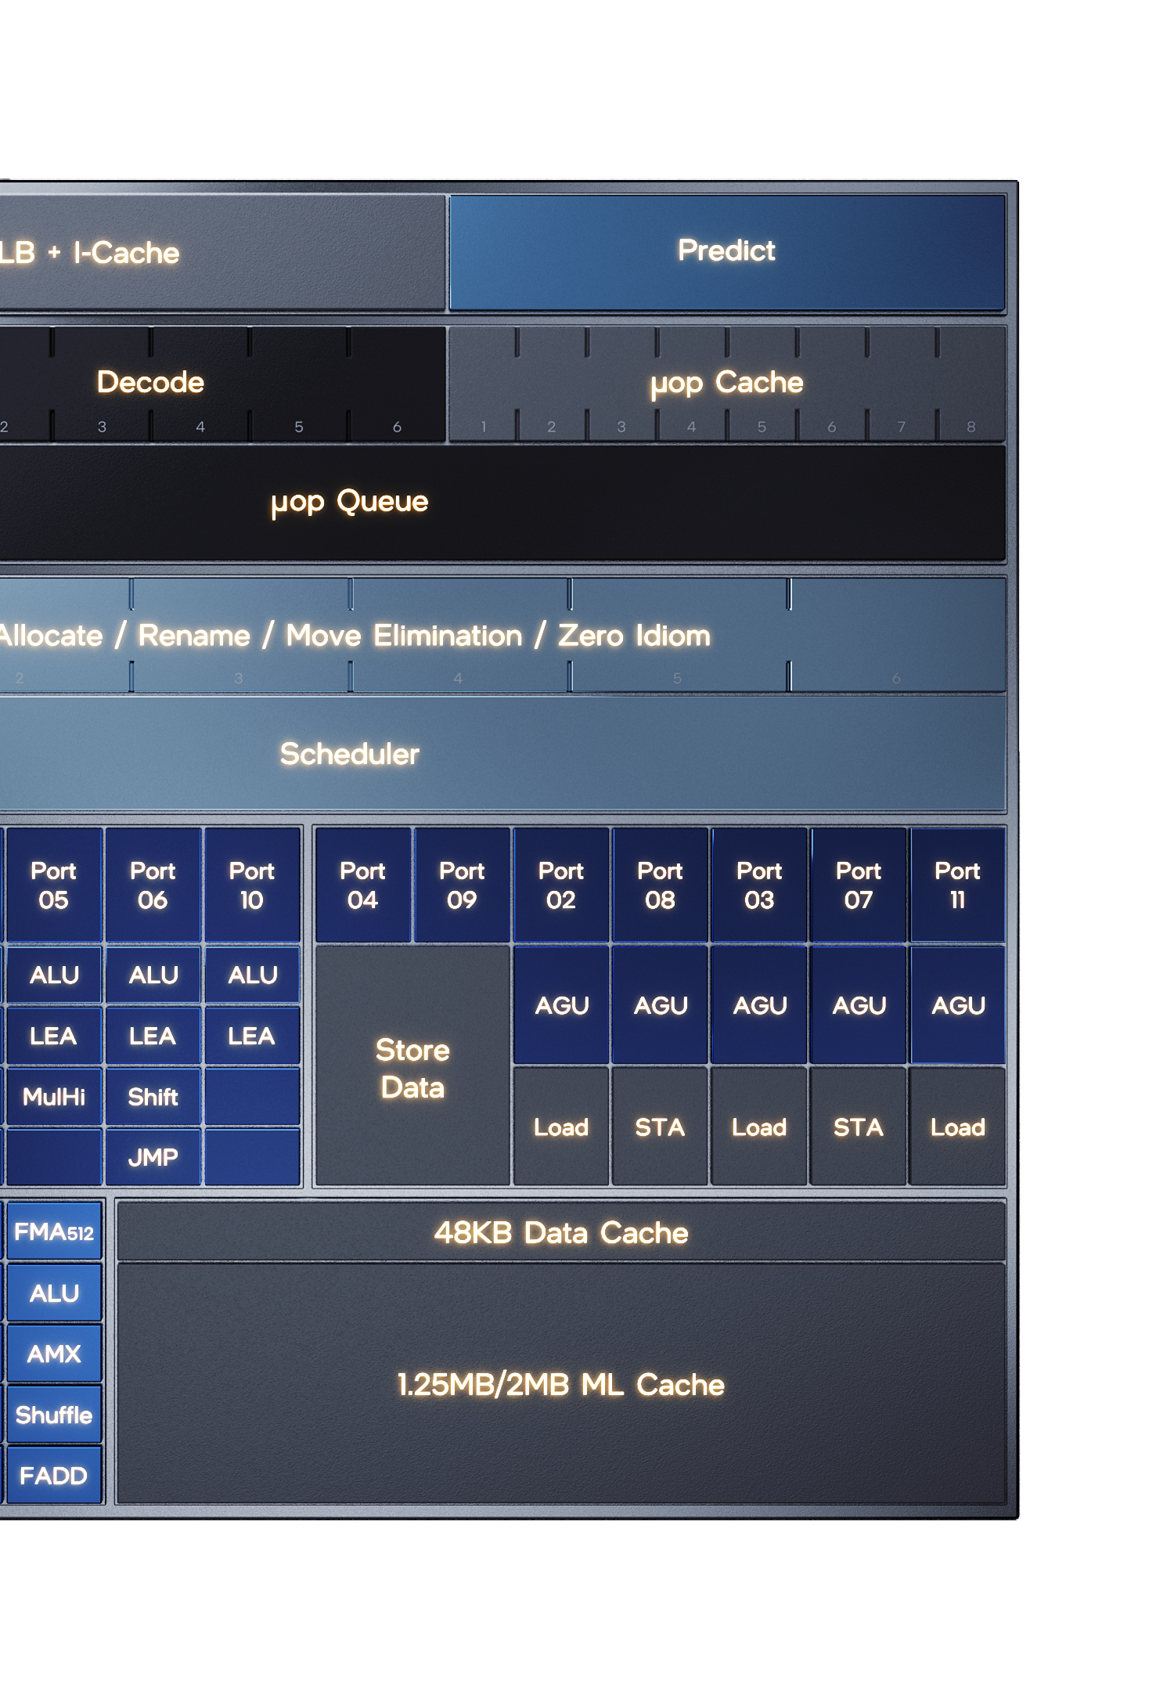
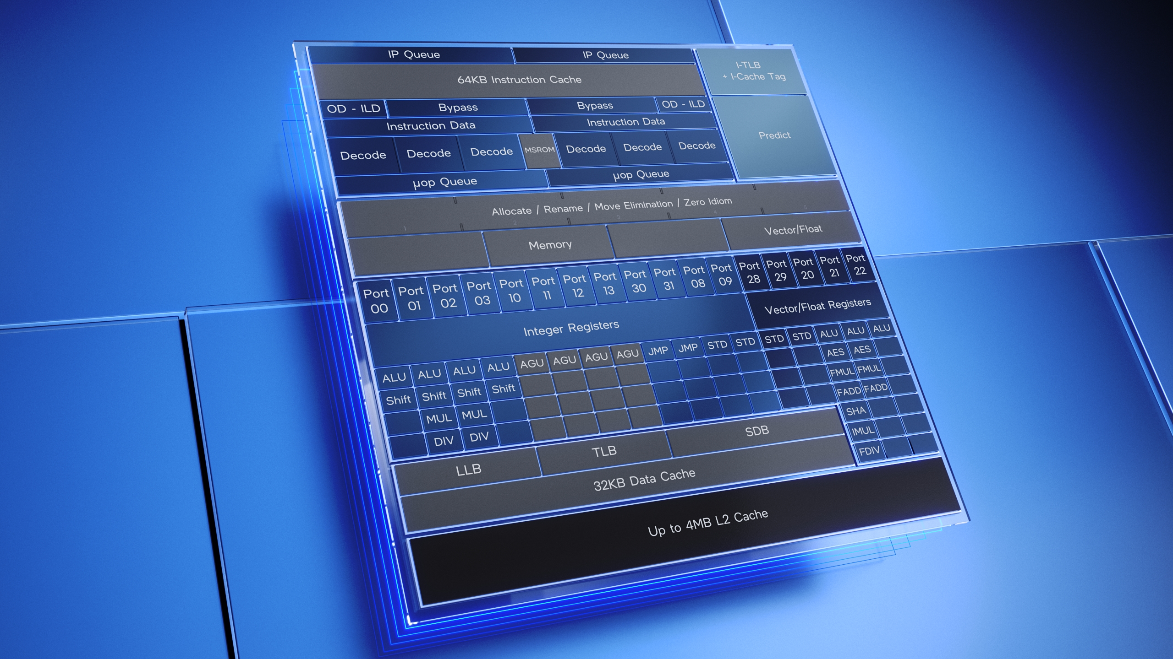
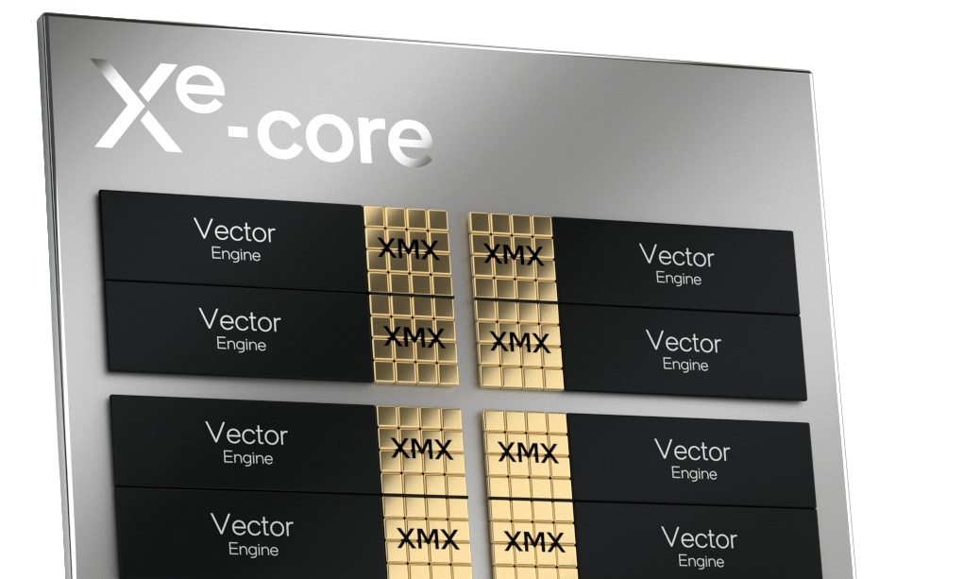
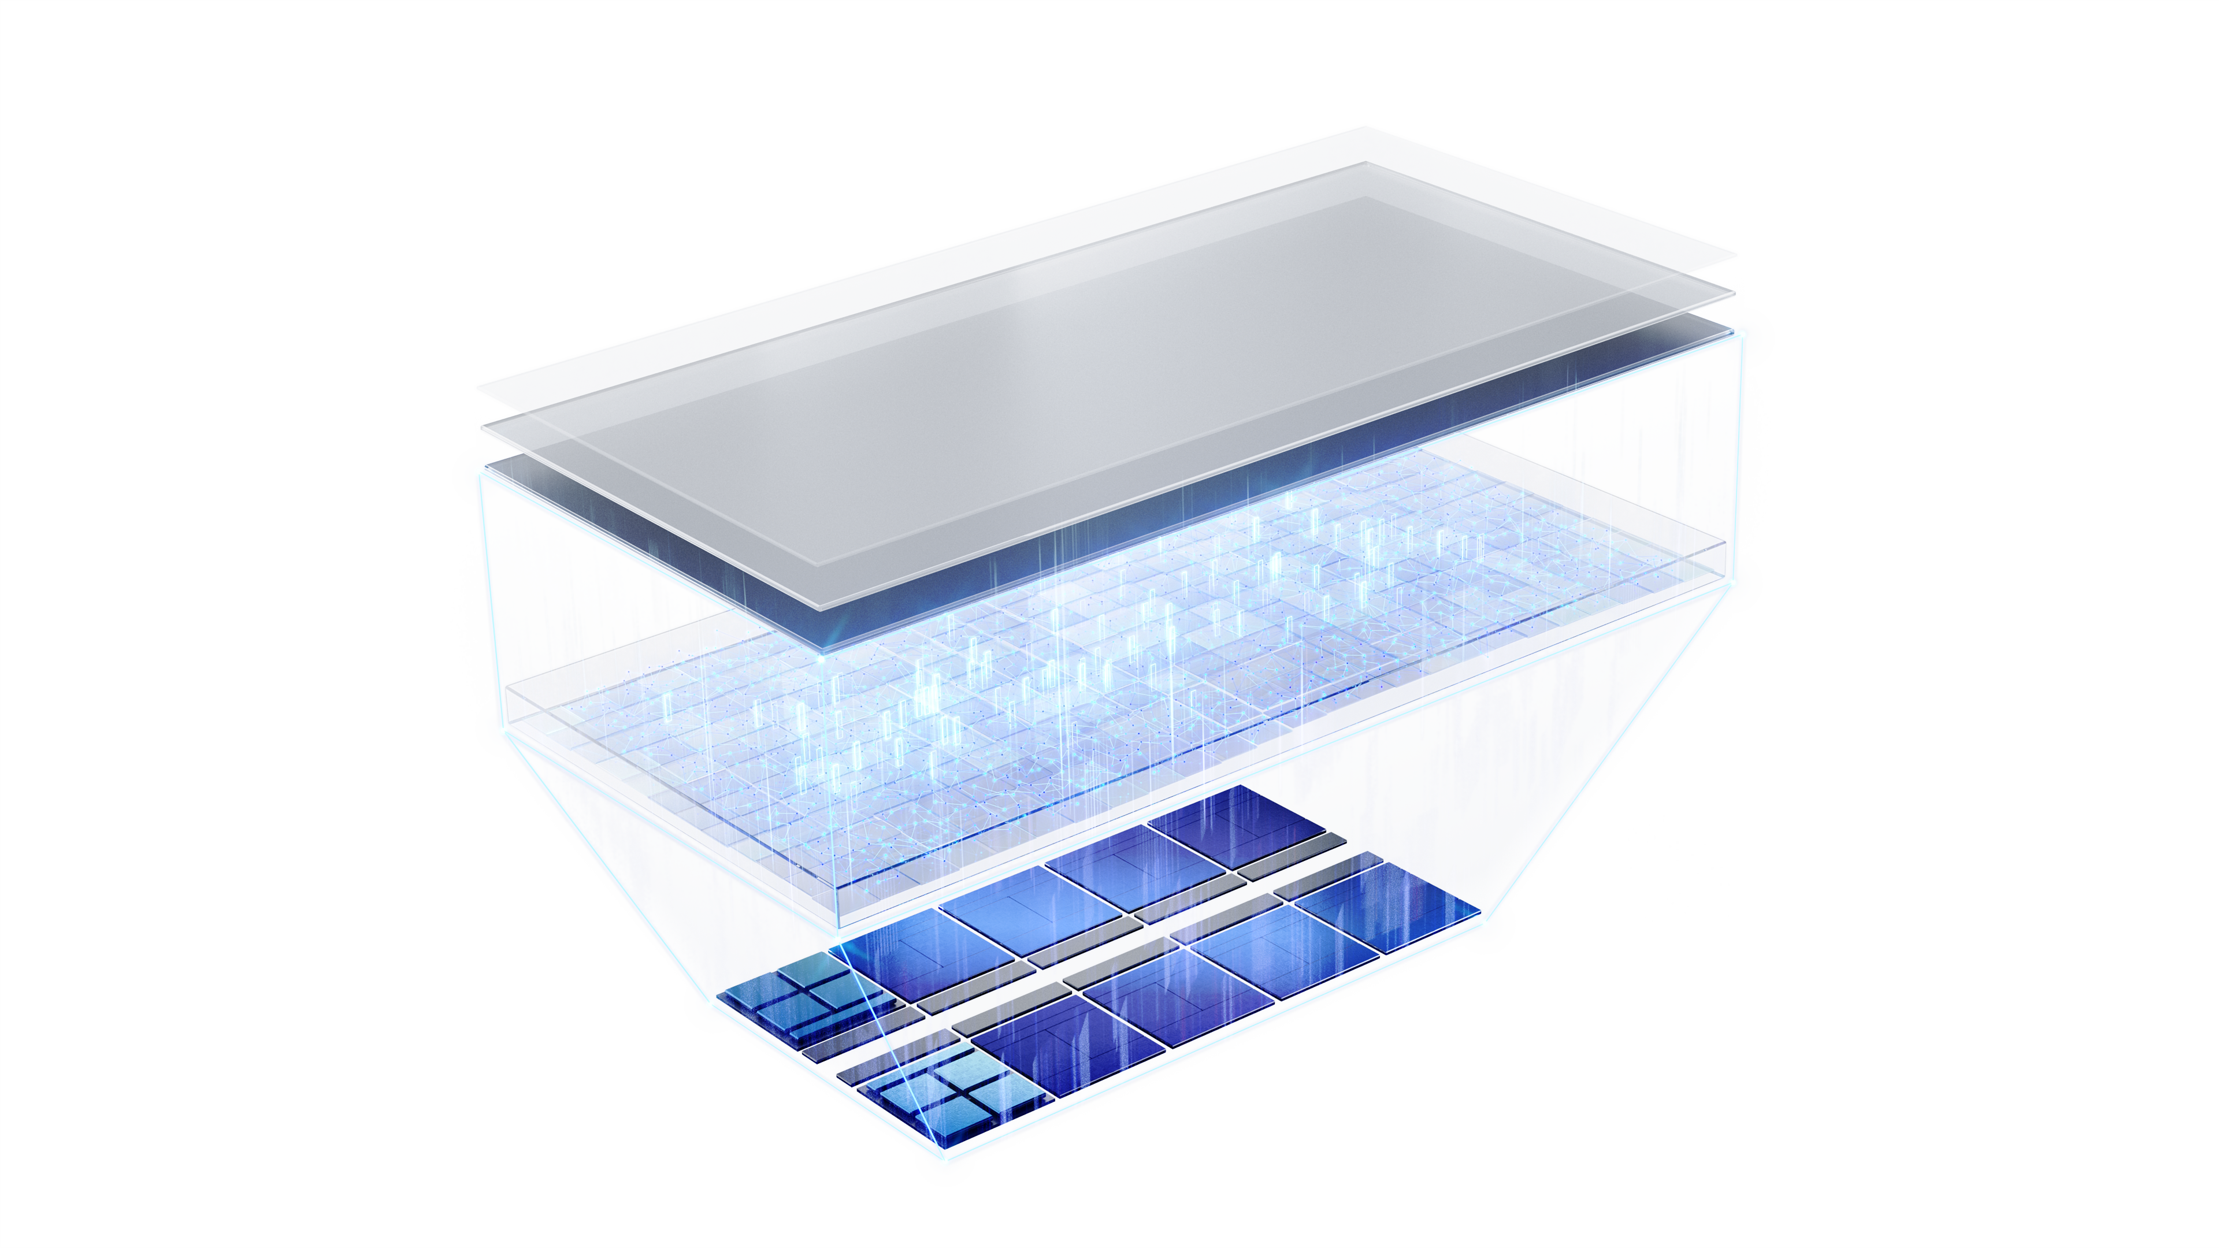
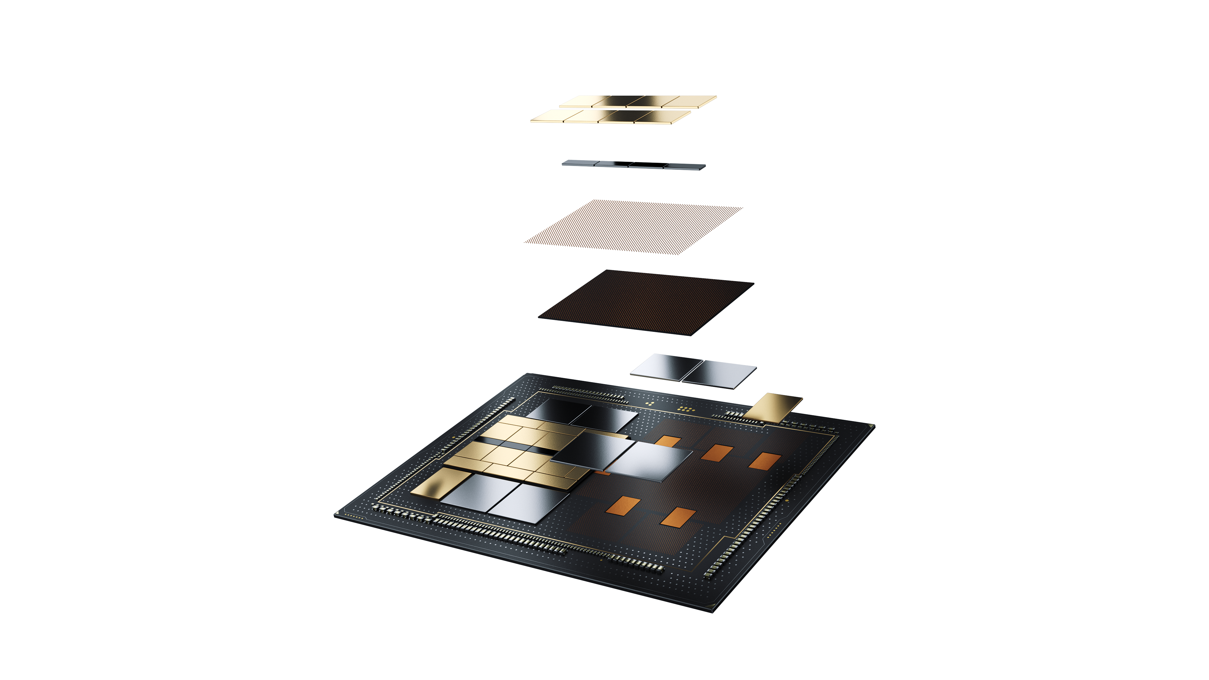
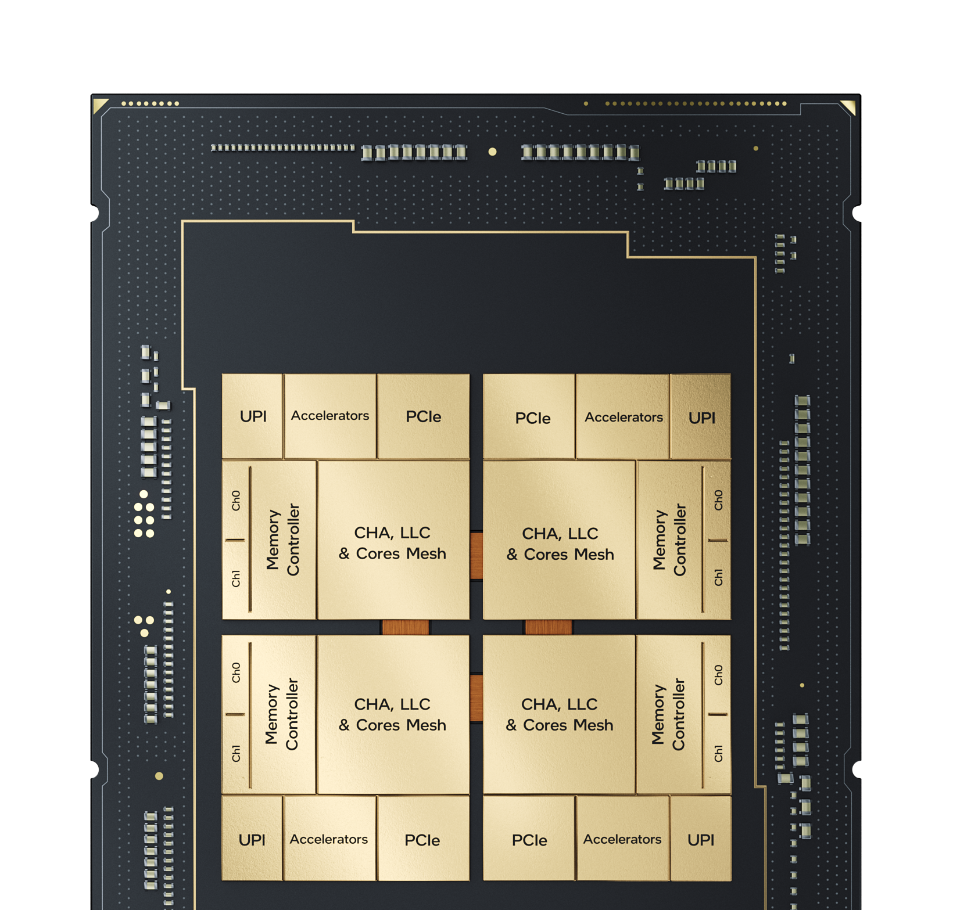
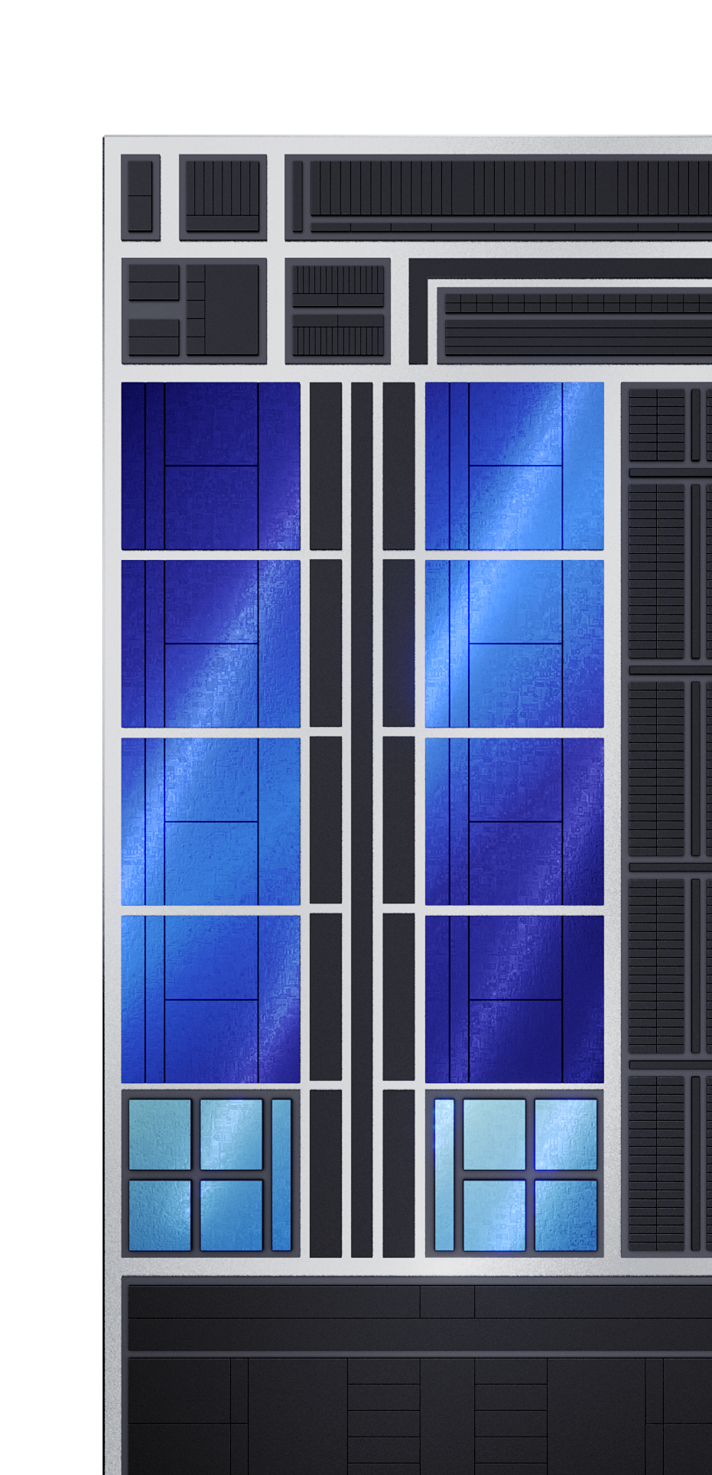
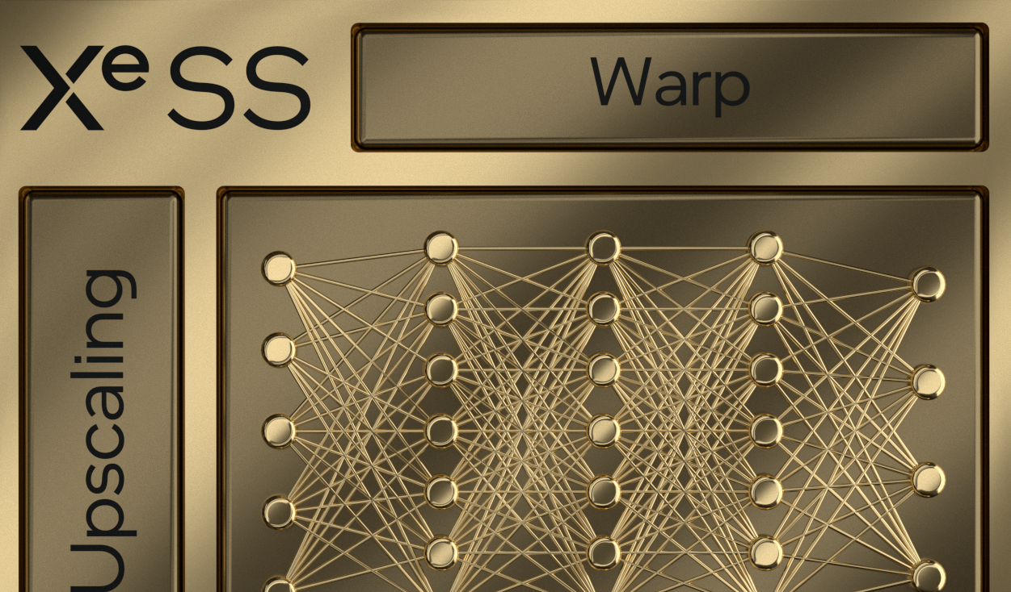
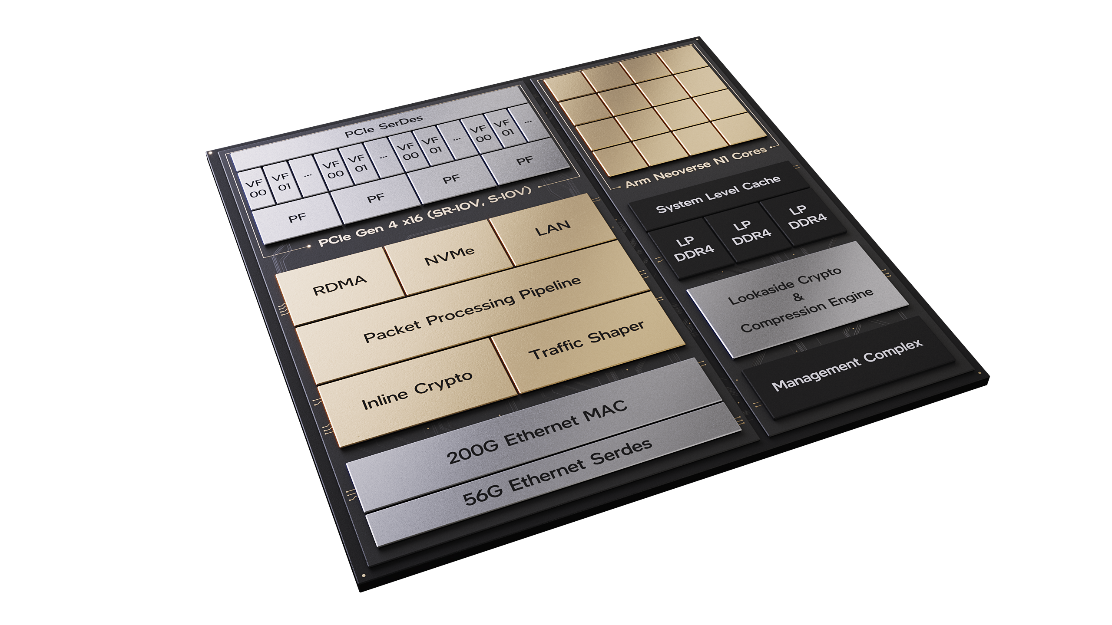

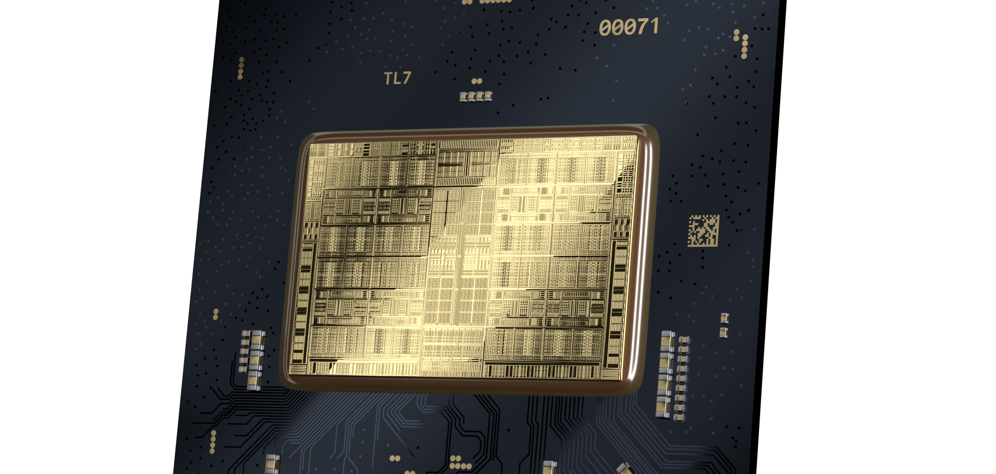
New Architectural Foundations
Xe - core
Intel Thread Director
Foundational
Building Block for Xe
With Xe Matrix Extensions
Xe HPC &
Ponte Vecchio
Scalable Hybrid
Arch. Scheduling
Back to FLOP Leadership
Efficient
Core
Deeper, Wider, Optimized
Sapphire
Rapids
Biggest Leap in DC Capabilities in a decade
Performance
Core
Biggest Shift in
x86 yet
Xe SS
AMX
Xe HPG
Alder Lake
Performance Hybrid
Alchemist SoC
Mount Evans
Advanced Matrix Extension - Engine
Gaming & Creation First Architecture
Dedicated SoC IPU

Slide 13

New
Intel’s Efficient x86 Core Microarchitecture
Designed for throughput, enabling scalable
multi-threaded performance for modern multi-tasking
Optimized for power and density efficient throughput with:
Deep
Front-End
with on-demand length decode
Wide
Back-End
with many execution ports
Optimized Design
for latest transistor technologies
13

Slide 14
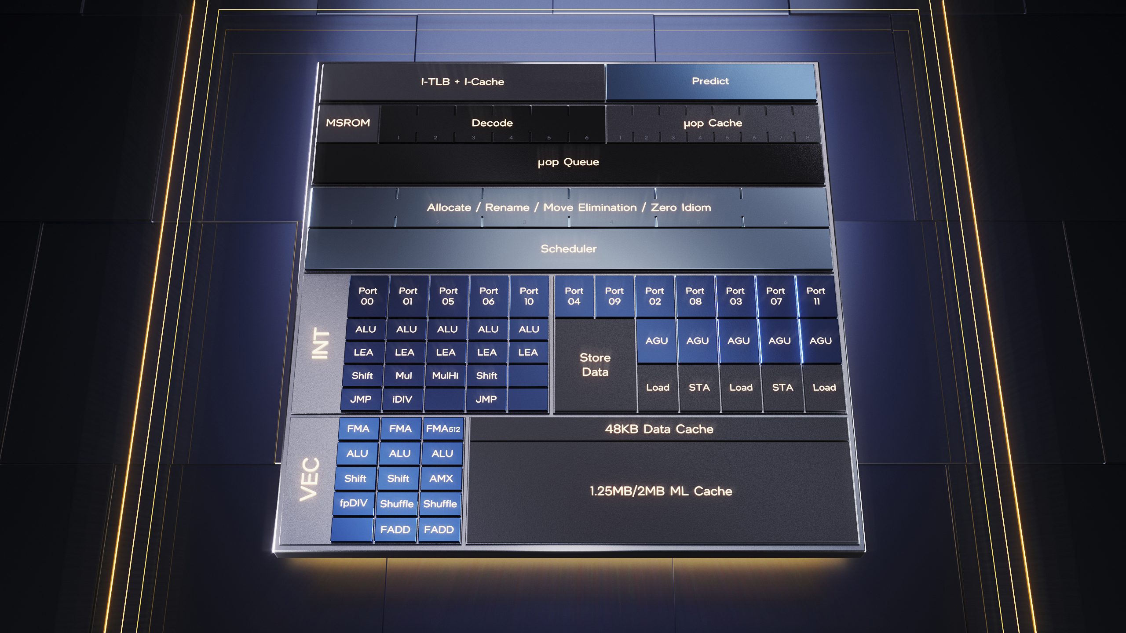
New
Performance x86 Core
Microarchitecture
A Step Function in CPU Architecture Performance For the Next Decade of Compute
A significant IPC boost at high power efficiency
Wider
Deeper
Smarter
Better supports large data set and large code footprint applications
Enhanced power management improves frequency and power
Machine Learning Technology: Intel® AMX – Tile Multiplication
All in a tailored scalable architecture to serve the full range of Laptops to Desktops to Data Centers
14

Slide 15
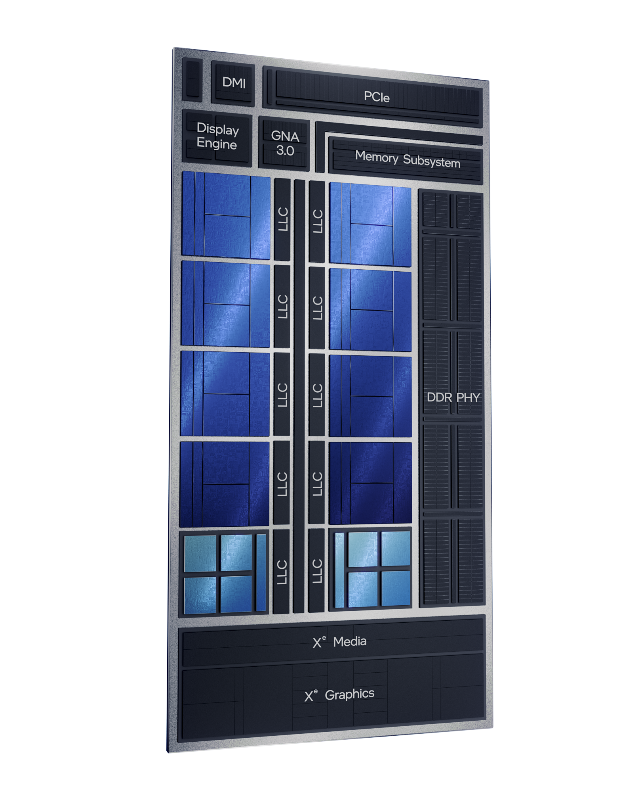

Beginning Fall 2021
Alder Lake
Reinventing Multi Core Architecture
Single, Scalable SoC Architecture
All Client Segments – 9W to 125W – built on Intel 7 process
All-New Core Design
Performance Hybrid with Intel Thread Director
Industry-Leading Memory & I/O
DDR5, PCIe Gen5, Thunderbolt™ 4, Wi-Fi 6E

Slide 16
Introducing
OS Scheduler
Intel Thread Director
Intelligence built directly into the core
Monitors the runtime instruction mix
of each thread and as well as the state of each core – with nanosecond precision
Provides runtime feedback to the OS
to make the optimal scheduling decision for any workload
or workflow
Dynamically adapts guidance
based on the thermal design point, operating conditions,
and power settings – without any user input

Slide 17
Xe HPG architecture

Slide 18
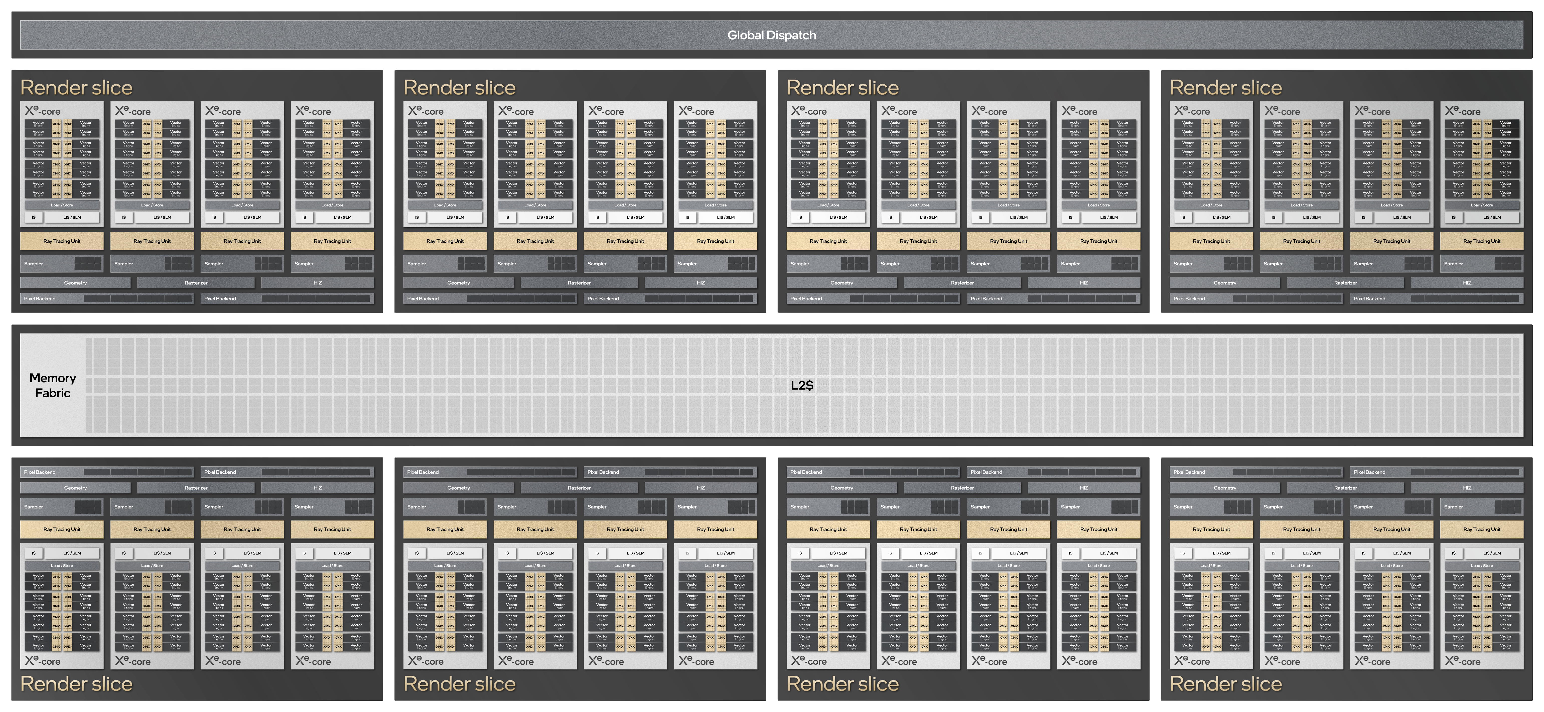
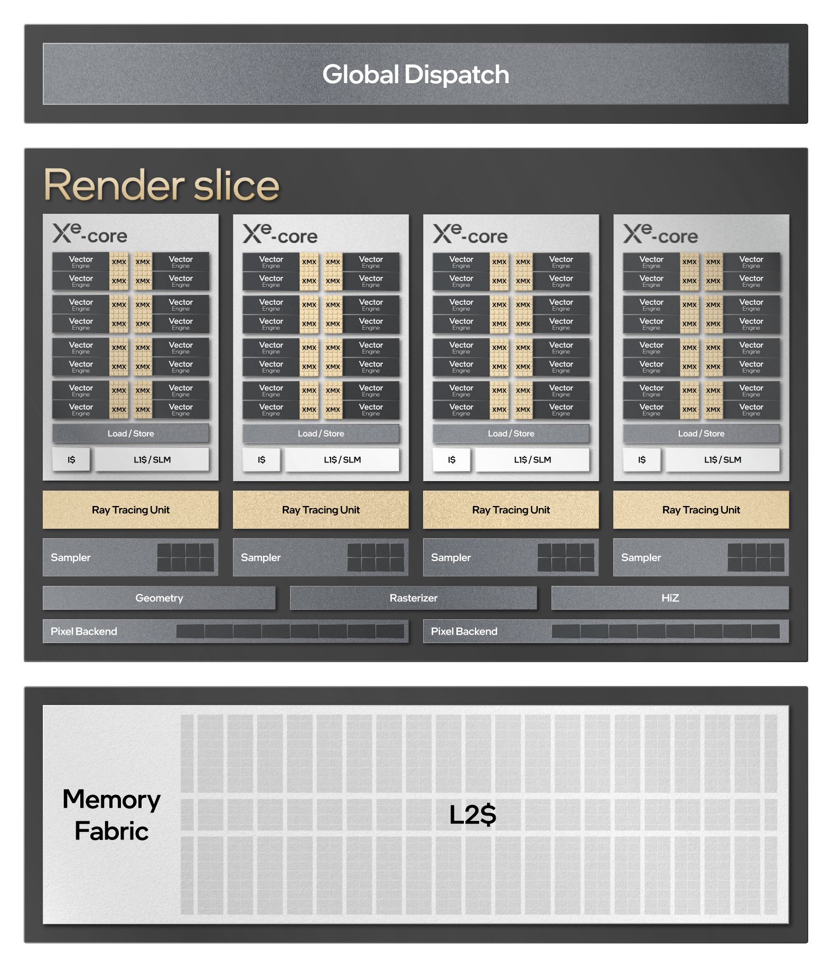

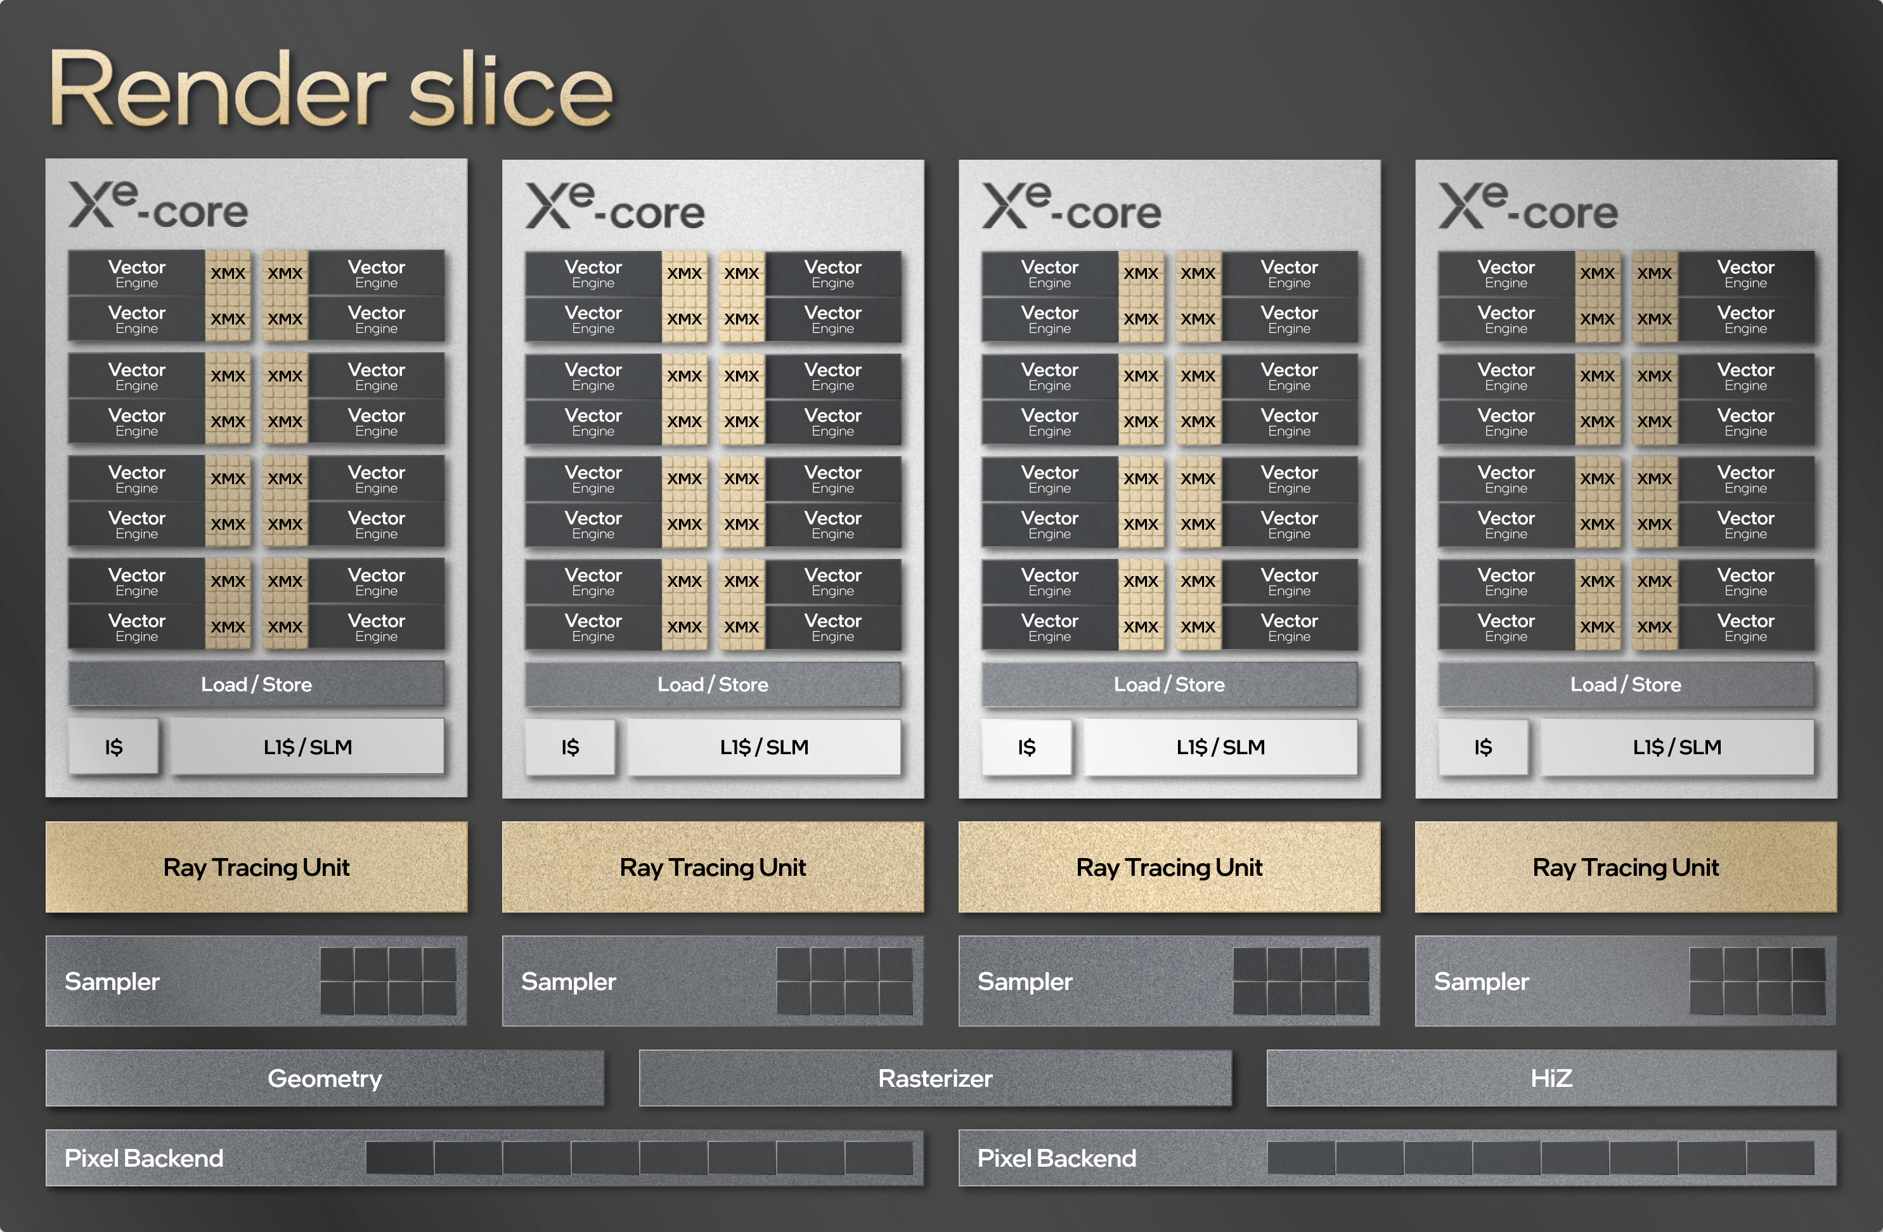
Scaling the Graphics Engine

Slide 19
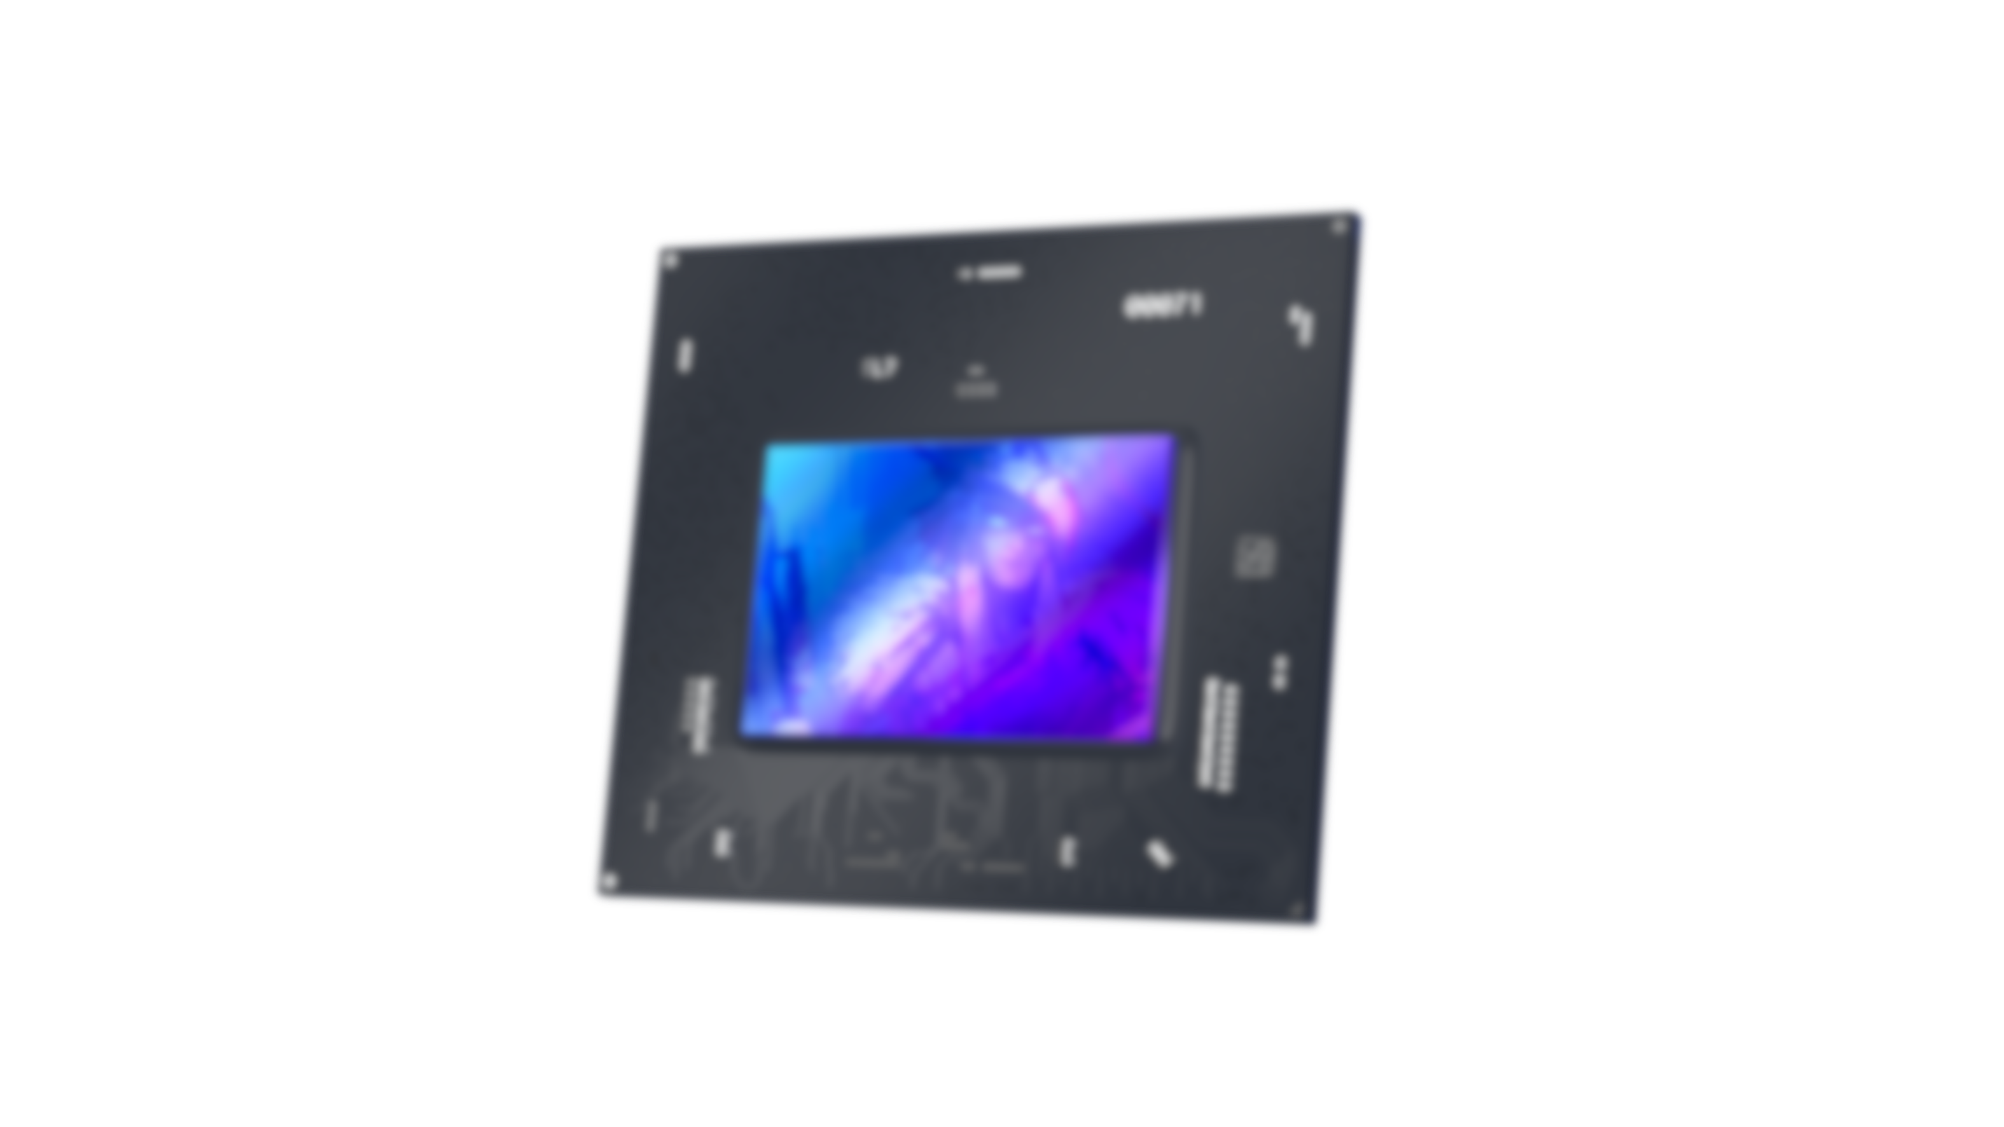
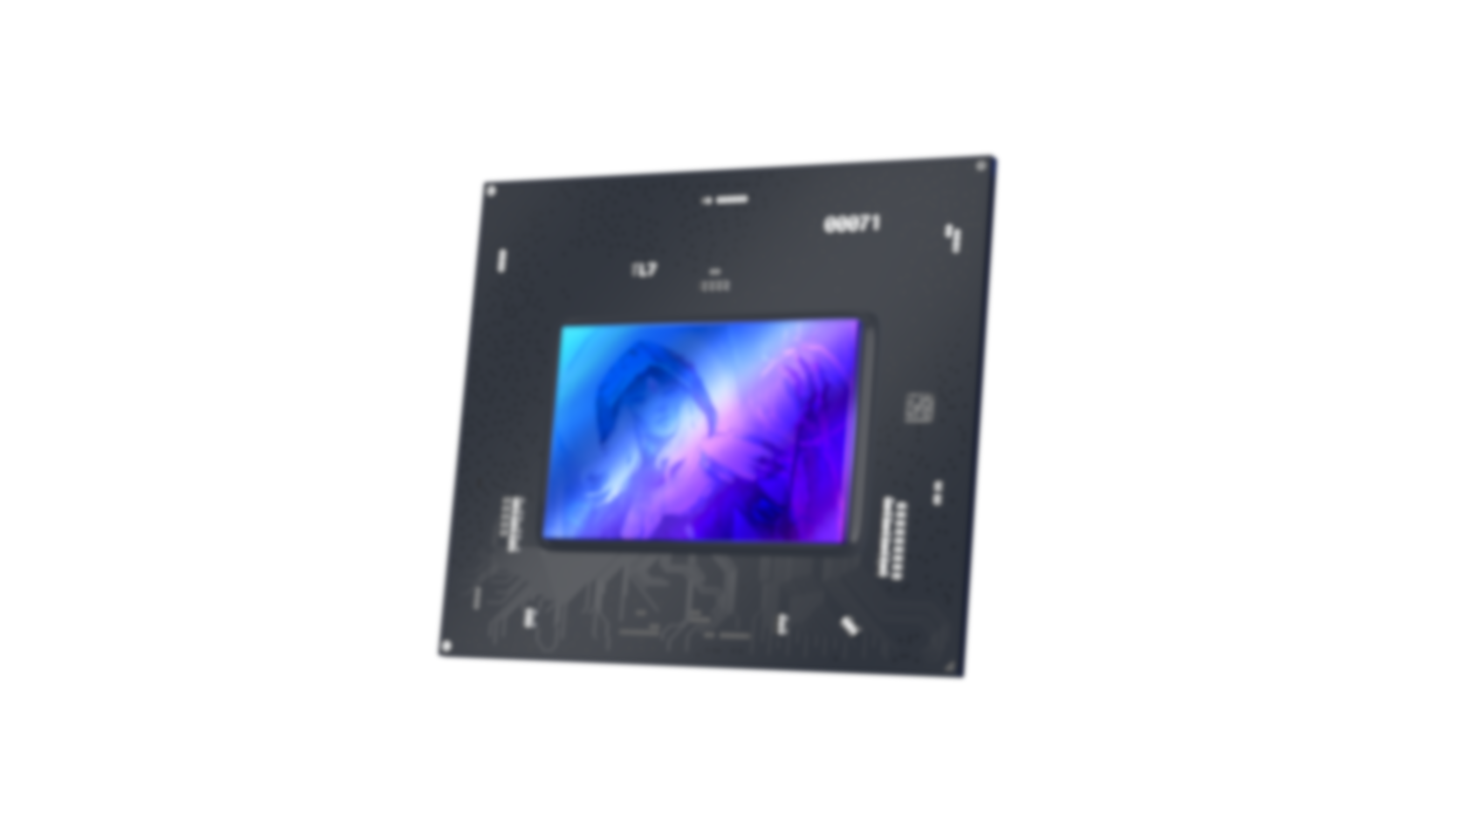
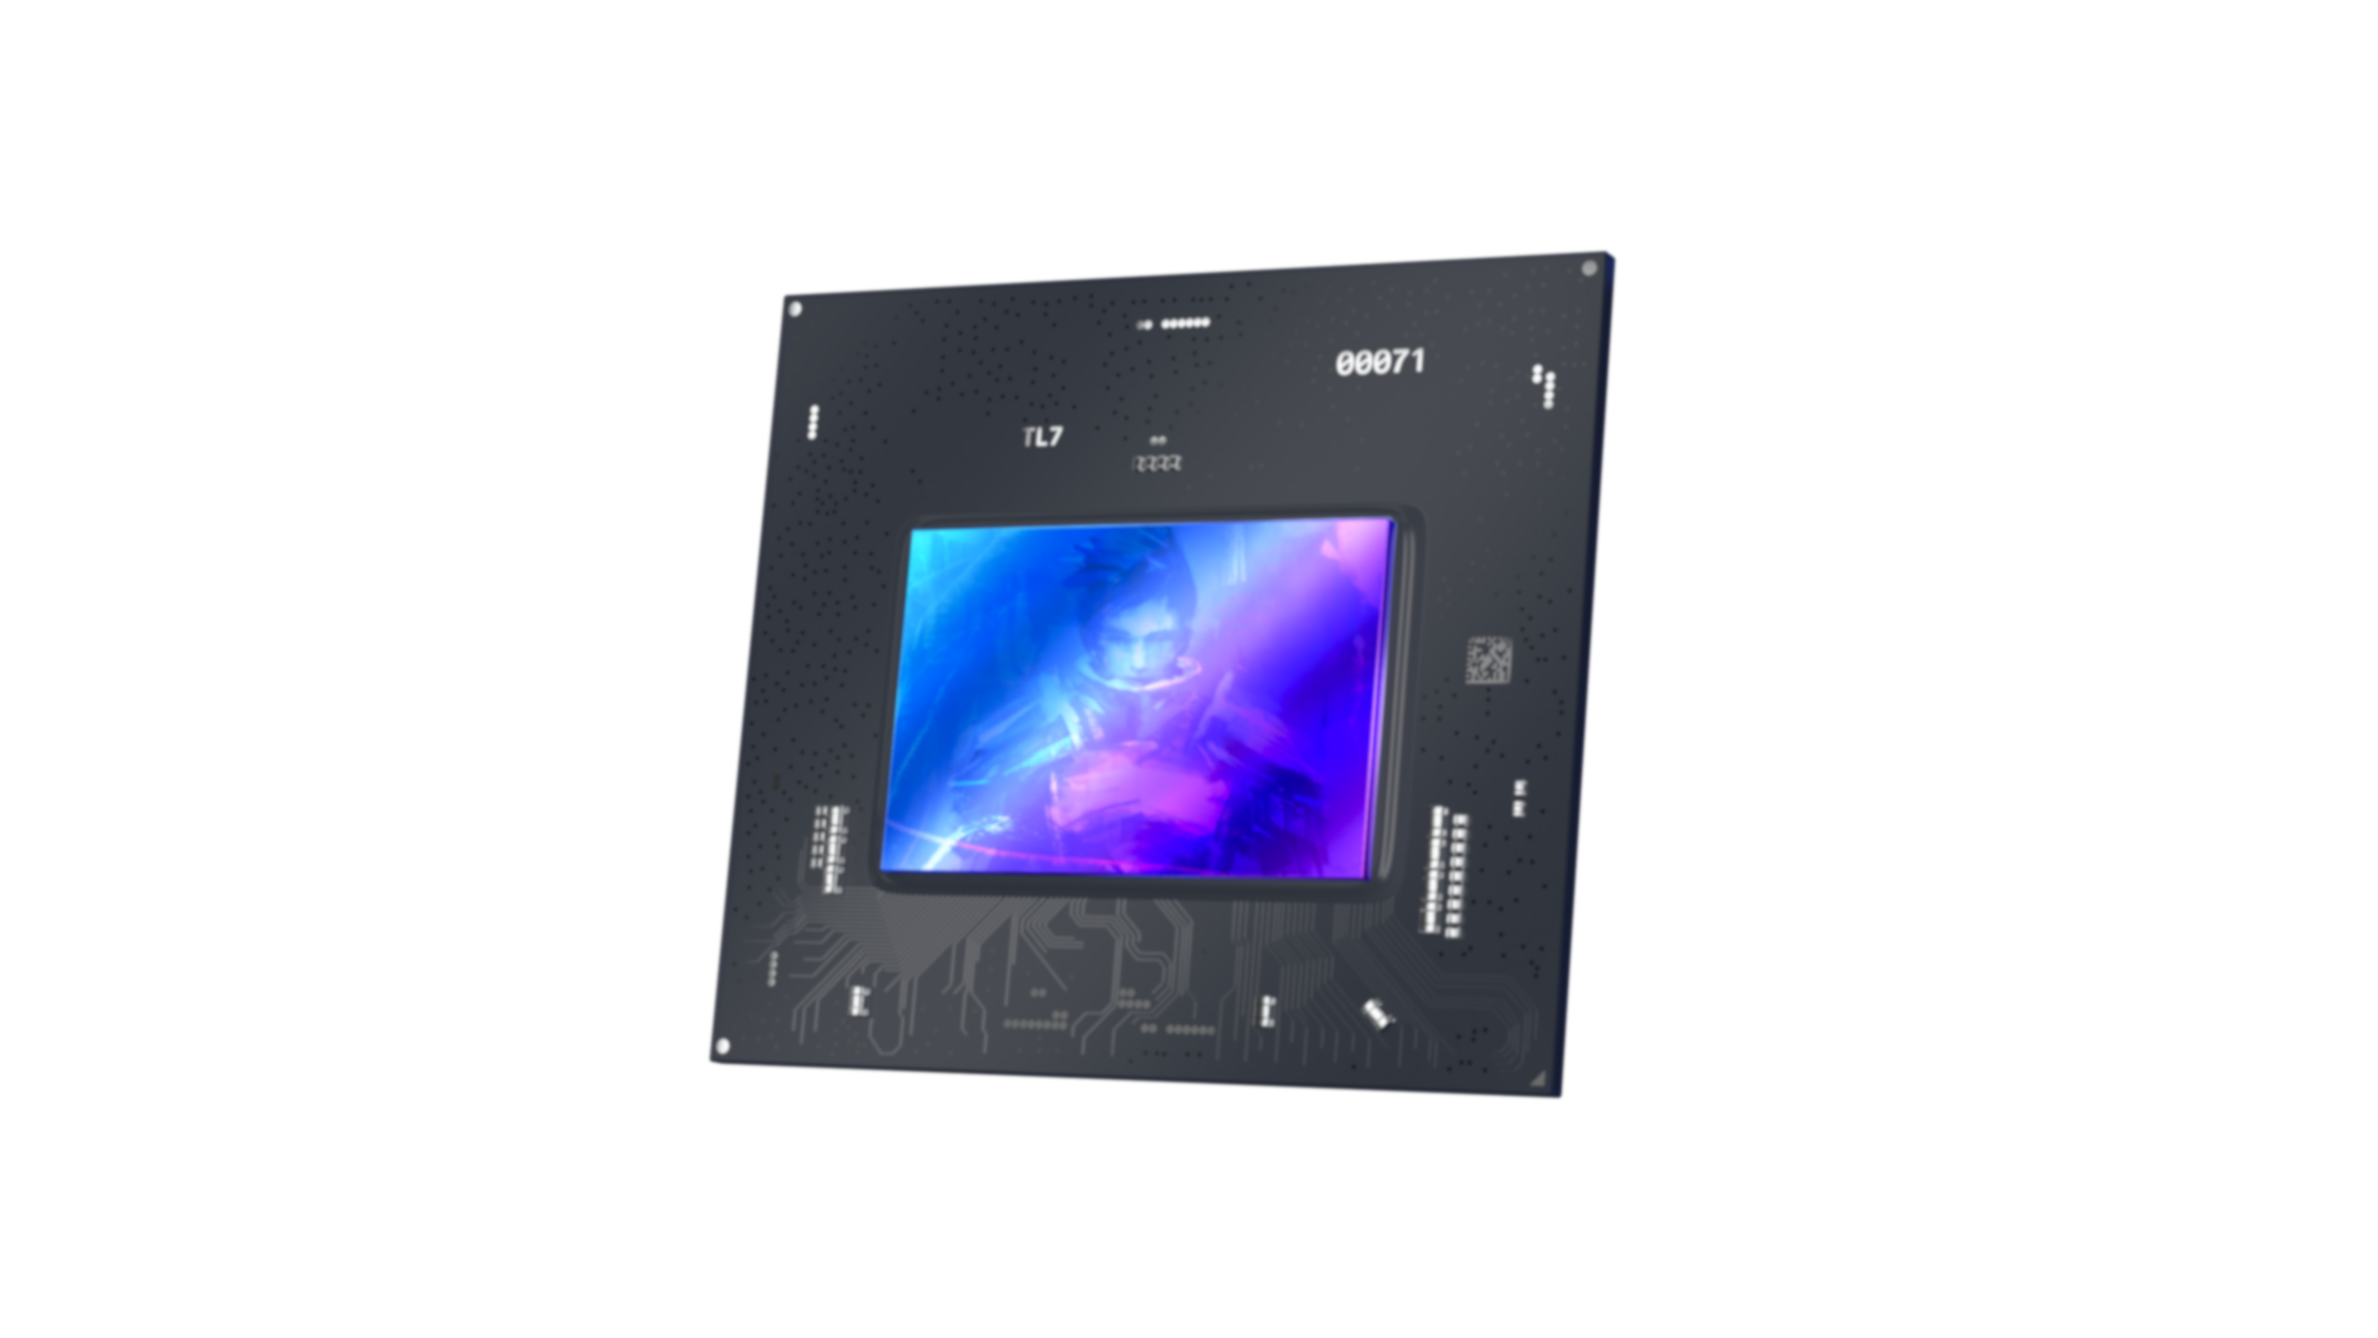
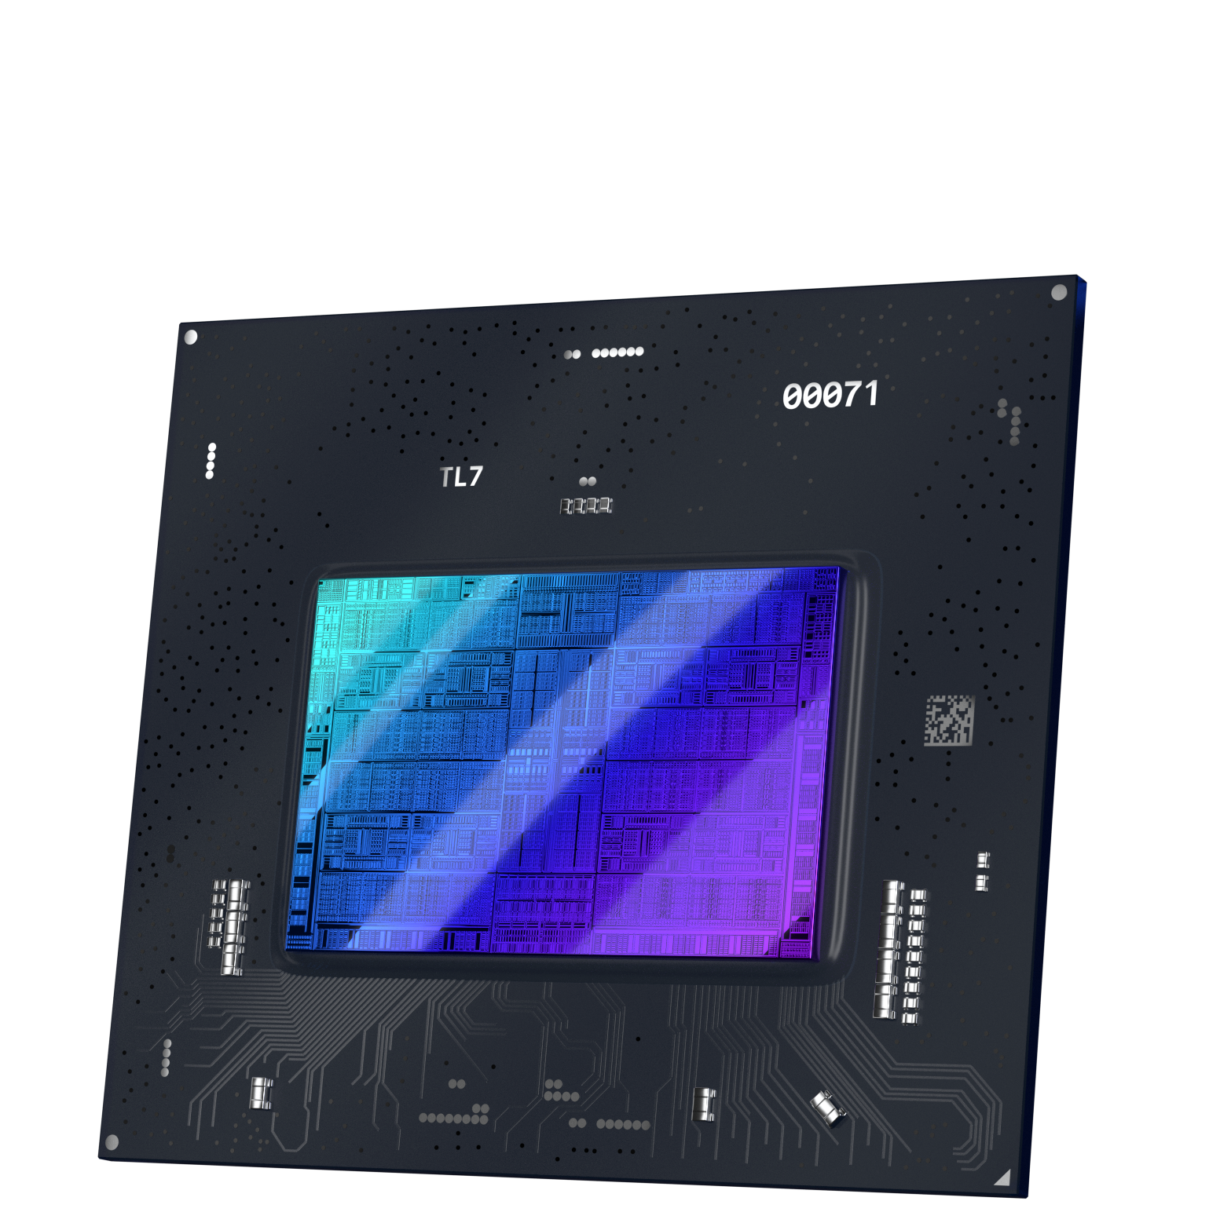
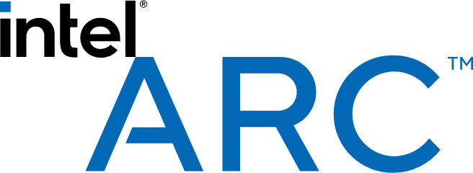
Multi-Year Roadmap
Druid
Celestial
Xe Next Architecture
X^{e3} HPG
Battlemage
Performance
X^{e2} HPG
Alchemist
Xe HPG
Q1
2022

Slide 20
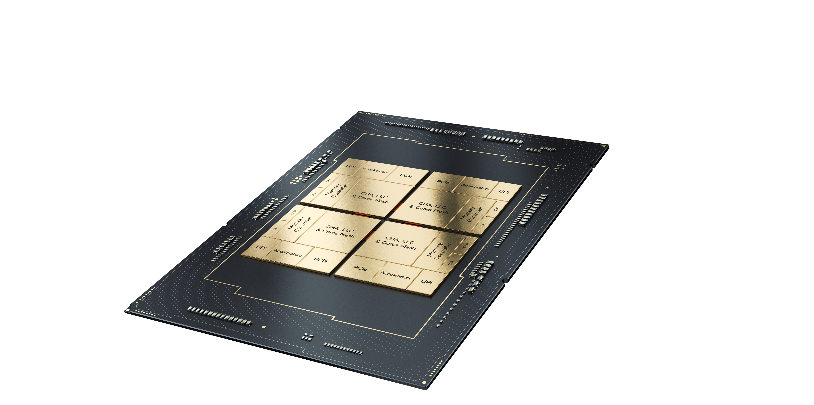
New Standard in Data Center Architecture
Sapphire Rapids
Multi Tile SoC for Scalability
Physically Tiled, Logically Monolithic
General Purpose
& Dedicated Acceleration Engines
Biggest Leap in Data Center Capabilities
in over a Decade
Designed for Microservices and AI Workloads
Performance Core Architecture
Workload Specialized Acceleration
Pioneering Advanced Memory & IO Transitions
DDR 5 &
HBM
PCIe 5.0
Enhanced Virtualization Capabilities

Slide 21
Classic Server Architecture
General Purpose Compute
Network Interface Card
Virtualized Network
Server Hardware
NIC
CPU
Everything runs
on the CPU
Cloud Server Architecture
General Purpose Compute
Infrastructure Processing Unit
Virtualized Network
Server Hardware
IPU
CPU
IPU
Tenant Code & Hypervisor run on the CPU
CSP Code
Runs Here

Slide 22
Mount Evans
Intel’s 200G IPU
Introducing
Hyperscale
Ready
Co-designed with a top cloud provider
Integrated learnings from multiple gen. of FPGA sNICs​
High performance under real world load
Security and isolation from the ground up
Technology
Innovation
Best-in-Class Programmable Packet Processing Engine
NVMe storage interface scaled up from Intel Optane Tech
Next Generation Reliable Transport
Advanced crypto and compression accel.
Software
SW/HW/Accel co-design
P4 Studio based on Barefoot
Leverage and extend DPDK and SPDK

Slide 23

Vă mulțumesc!
Eduard PUGHIN, eduard.pughin@maguay.ro / sales@maguay.ro

