Slide 1
Azure Stack HUB
Microsoft’s approach to a hybrid cloud datacenter
16/09/2021
Marius Marcu – STU Azure Infrastructure Specialist
Notes:
Danielle: Hello and thanks for sticking around for this session. My name is Danielle Damasius, and I’m a Program Manager on the Azure Sphere product team.
Josh: And I’m Josh Nash, a Product Planner on the Azure Sphere product team. Danielle and I work together every day to understand the market and customer needs around IoT and IoT security. Azure Sphere’s mission is to empower every device manufacturer on the planet to create secure and trustworthy IoT devices.
Danielle: We believe for innovation to deliver durable value; it must be built on a foundation of security. Our customers need reliable, consistent security that will set innovation free.
Josh: That’s what we’re here to talk to you about today. Let’s get right into it!

Slide 2
“The ability for customers to embrace both public cloud and local datacenter, plus edge capability, is enabling customers to improve their IT agility and maximize efficiency.
Hybrid cloud is evolving from being only the integration of a datacenter with the public cloud, to becoming units of computing available at the edge, including even the world’s most remote destinations, working in concert with public cloud.”
—Satya Nadella, CEO Microsoft
Intelligent Cloud
Intelligent Edge
Notes:
Todays world is the public cloud and Datacenters. Applications span across those two things and we call this hybrid. Customers who are taking a hybrid cloud approach are seeing real business value – we see this in organizations across the globe.
Hybrid cloud is evolving from being only the integration of a datacenter with the public cloud, to becoming units of computing available at the edge, including even the world’s most remote destinations, working in concert with public cloud.
By bringing the power of the intelligent cloud to the edge, we create this incredible opportunity for devices to be adaptive and responsive in their environments and at the most critical decision moment – an autonomous vehicle knowing when to turn, a piece of factory equipment shutting off before it’s a safety hazard, or a medical device continuing to operate – even when connectivity is limited.
We call this new era “intelligent cloud and intelligent edge”. The ability for customers to embrace both public cloud and local datacenter, plus edge capability, is enabling customers to improve their IT agility and maximize efficiency. The benefit of a hybrid approach is also what continues to bring customers to Azure, the one cloud that has been uniquely built for hybrid. We haven’t slowed our investment in enabling a hybrid strategy, particularly as this evolves into the new application pattern of using intelligent cloud and intelligent edge.

Slide 3
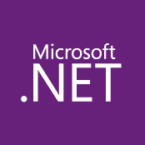
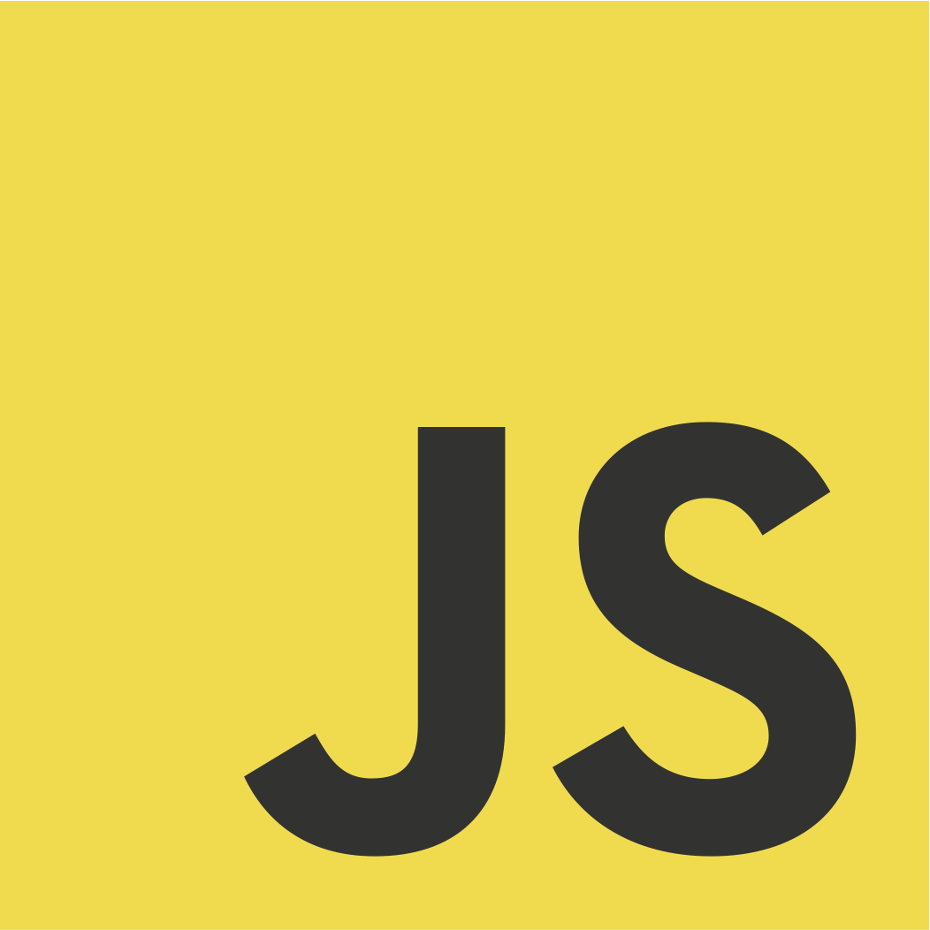
Customer environments are evolving
100’s–1,000’s of apps
Diverse infrastructure
Multi-cloud
VMs
Databases
Datacenters
Hosters
Containers
Serverless
Branch offices
OEM hardware
IoT devices
Edge
Notes:
To enable digital transformation, organizations are modernizing datacenters, building applications in the cloud, and deploying smart IoT devices. As a result, IT environments are continuously evolving, with different types of applications often running on different hardware across distributed locations including on premises, multicloud and the edge.
The IT department faces a set of key challenges:
How to seamlessly govern and secure IT resources regardless of where they are running?
How to bring cloud innovation to existing infrastructure?
How to modernize local datacenters with new cloud infrastructure?
How to extend compute and AI to the edge to unlock new business scenarios?
At Microsoft, we have long understood this reality our customers are facing. Microsoft Azure has been designed from the beginning to help customers meet these challenges.

Slide 4
Reasons for a
hybrid strategy
Regulatory and data sovereignty
Low latency and edge workloads
Application and datacenter modernization
Business continuity and resilience
Notes:
Here are some of the key reasons customers adopt a hybrid strategy:
Some workloads cannot be moved to public cloud due to regulatory and data sovereignty requirements. This is common in highly regulated industries such as financial services, healthcare, and government.
Some workloads, especially edge workloads, require low latency
And many companies have significant on-premises investments that they want to maximize so they choose to modernize on-premises datacenters and traditional apps.
Taking a hybrid approach makes the most sense for these customers.

Slide 5
Azure Hybrid
Innovation anywhere with Azure
Azure
Single control plane with Azure Arc
Bring Azure services to any infrastructure
Modernize datacenters with Azure Stack
Extend to the edge with Azure IoT
Notes:
Azure takes a comprehensive approach and offers unique hybrid capabilities that give customers the flexibility to innovate anywhere in their environment.
Enabled by Azure Arc, you can bring Azure services to any existing infrastructure including other clouds you are using, so you can take advantage of cloud benefits everywhere, such as scalability, fast deployment, and always up-to-date cloud innovation.
You can build Azure-consistent new cloud infrastructure in your own datacenter with Azure Stack, so you can modernize your datacenter and run cloud native applications on-premises while taking advantage of existing investments and meeting regulatory compliances.
You can extend AI to edge devices with Azure IoT, so you can run machine learning and advanced analytics close to the users and the data. As a result, you can gain real-time insights and deliver immersive experiences at the edge of your network, opening up endless new business opportunities.
And you can do it all using Azure Arc as the single control plane to seamlessly manage and secure your IT resources, such as Linux/Windows VMs and Kubernetes clusters, across multicloud, on-premises and the edge.
Now let’s take a deeper look at the three hero Hybrid offerings: Azure Arc, Azure Stack and Azure IoT

Slide 6
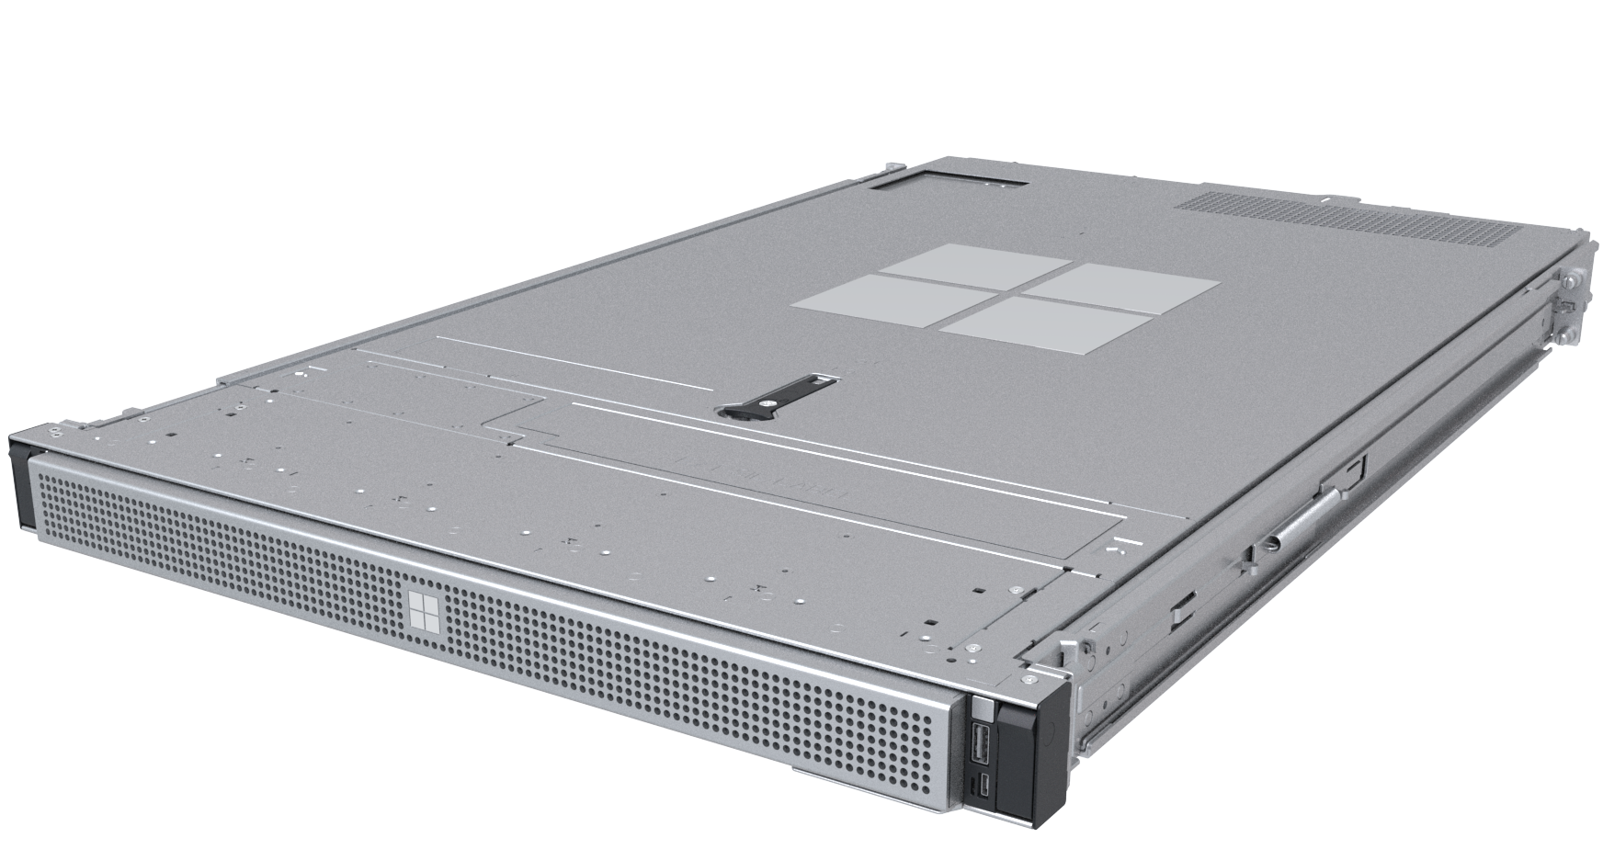
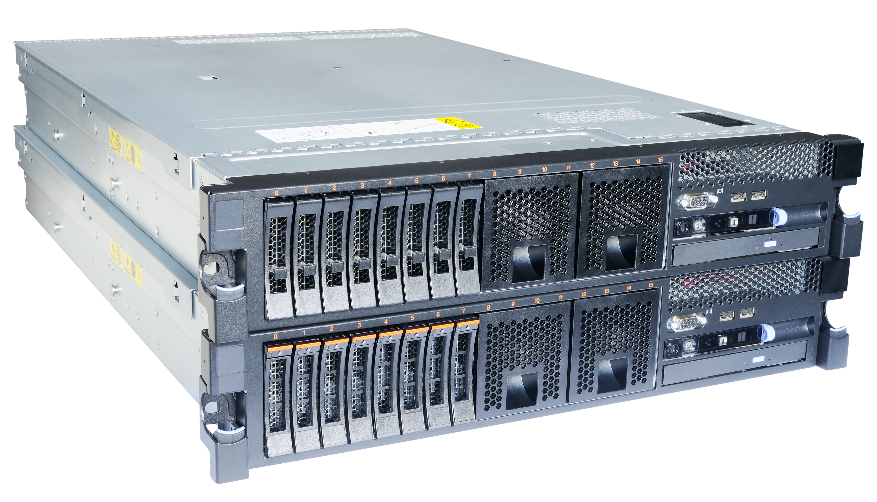
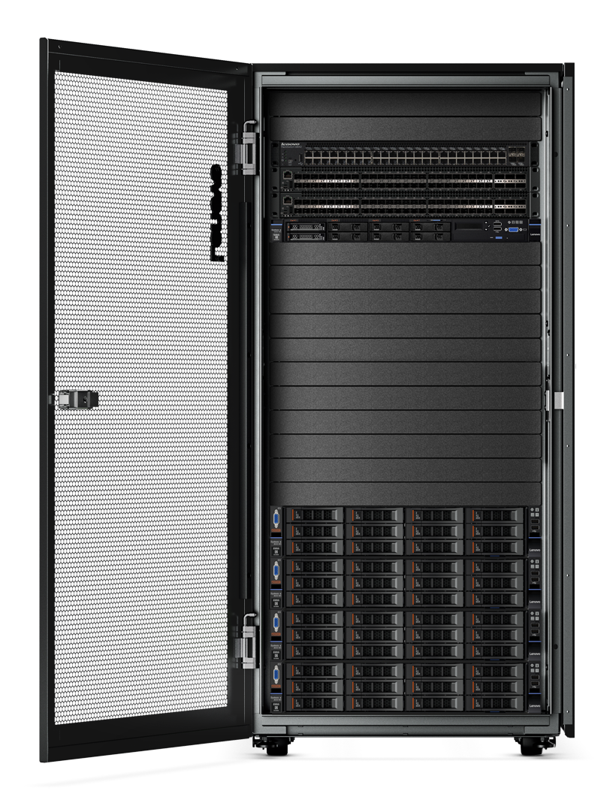
Azure Stack portfolio
Azure Stack HCI
Hyperconverged solution
Azure Stack Edge
Cloud-managed appliance
Compute, AI & IoT
at the Edge
Native Azure Arc integration
Scalable virtualization and storage
AKS on Azure Stack HCI
Azure Stack Hub
Cloud-native integrated system
Disconnected scenarios
Notes:
The final step is modernizing your datacenters with Azure Stack.
Azure Stack is a portfolio of products combining purpose-built hardware and software to bring cloud innovation to your datacenter to simplify the way you work.
The first, Azure Stack HCI, announced last fall, is designed to help you modernize your traditional infrastructure of virtualized servers and storage with a hybrid solution of hyperconverged infrastructure tightly integrated with Azure.
----
Next, Azure Stack Edge is an Azure managed appliance enabling your IoT, AI/ML workloads and other edge computing needs.
----
And finally, Azure Stack Hub is an integrated system for running a disconnected and private cloud—with cloud-native apps using consistent Azure services on-premises.
<CLICK>

Slide 7
Azure Stack Hub

Slide 8
Azure Stack Hub
Azure connected or disconnected cloud
Only consistent hybrid cloud that can run at the connected or disconnected
Autonomous Cloud
Consistent application development and operations
Common application model, tools and APIs with Azure simplifying DevOps
Regulatory & data sovereignty
Azure Services available on-premises
Azure web services, containers, Azure functions, and Azure marketplace
Purpose-built integrated system
Cloud inspired infrastructure via integrated systems from major H/W partners
Application modernization

Slide 9
How to think about Azure Stack
What it is?
What it is not?
First Hybrid Cloud Platform
Virtualization Replacement Play
Integrated System with SelfService IaaS, PaaS and Cloud Solution
DIY Infrastructure
Regulary updated for Azure Cosistency
Static System you Deploy & Forget
Cross Platform Hybrid Cloud
Windows Only Cloud

Slide 10
Microsoft Solution Approach
Capability
Availability
Security
Certified and PreBuilt Onpremises Solution
Multitenancy with Tenant Segregation
Auto Scaling Capabilities
Capability to Lift and Shift most of workloads
Enabling Marketplace for hybrid services
BYOL possibility
Strong connectivity (VPN, ExpressRoute)
DevOps Capabilities
No Single Point of Failure
Utilizing number of EU Datacenters
High Availability and Disaster Recover capabilities
SLA and Availability measurements
Monitoring capabilities and interfaces
Integration with Backup solutions
Logging and Monitoring
Integration with SIEM systems
Role Based Access Control RBAC
Standards conformity
ISO/IEC 9001:2015
ISO/IEC 27001:2013
GDPR
ISO/IEC 22301:2012
ISO/IEC 27017:2015
ISO/EIC 27018:2014
CCM of CSA 3

Slide 11
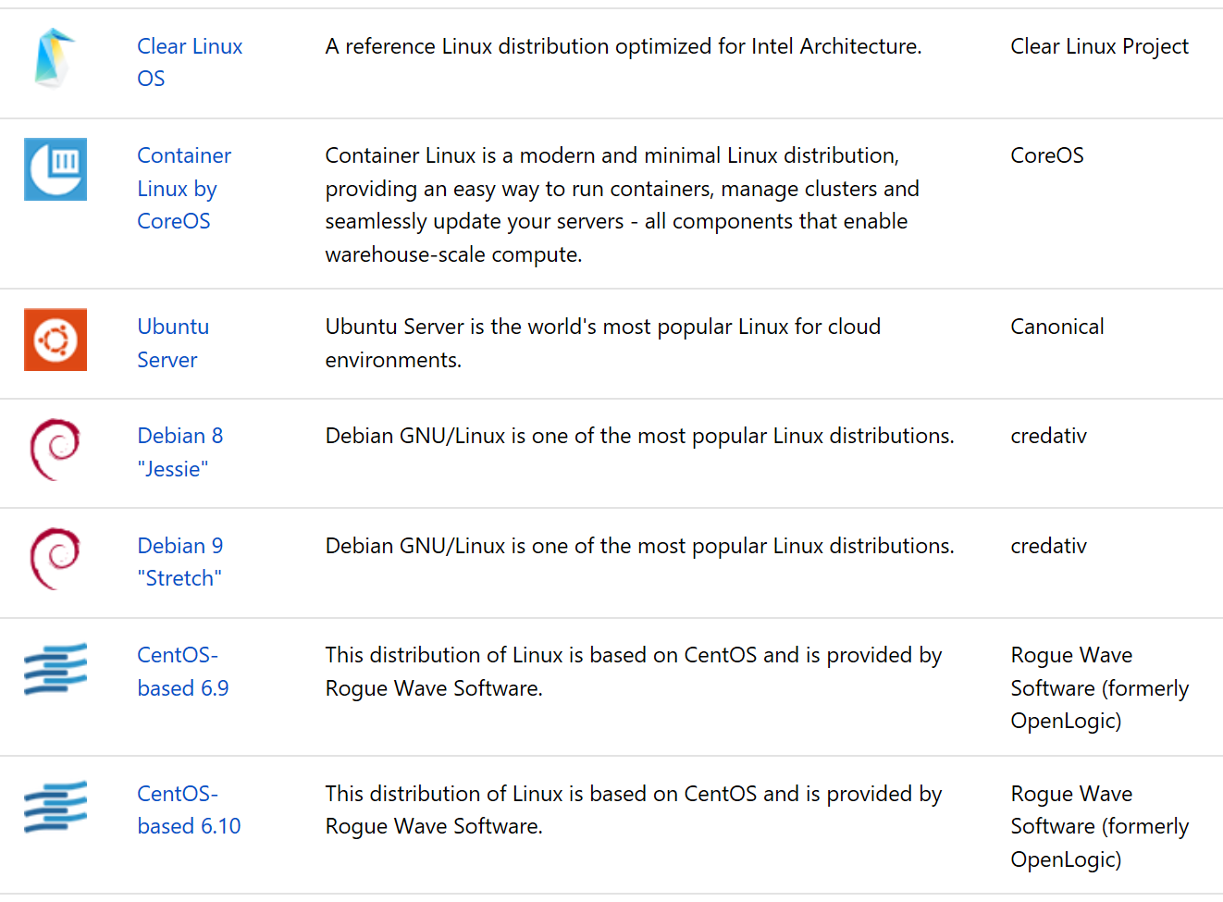
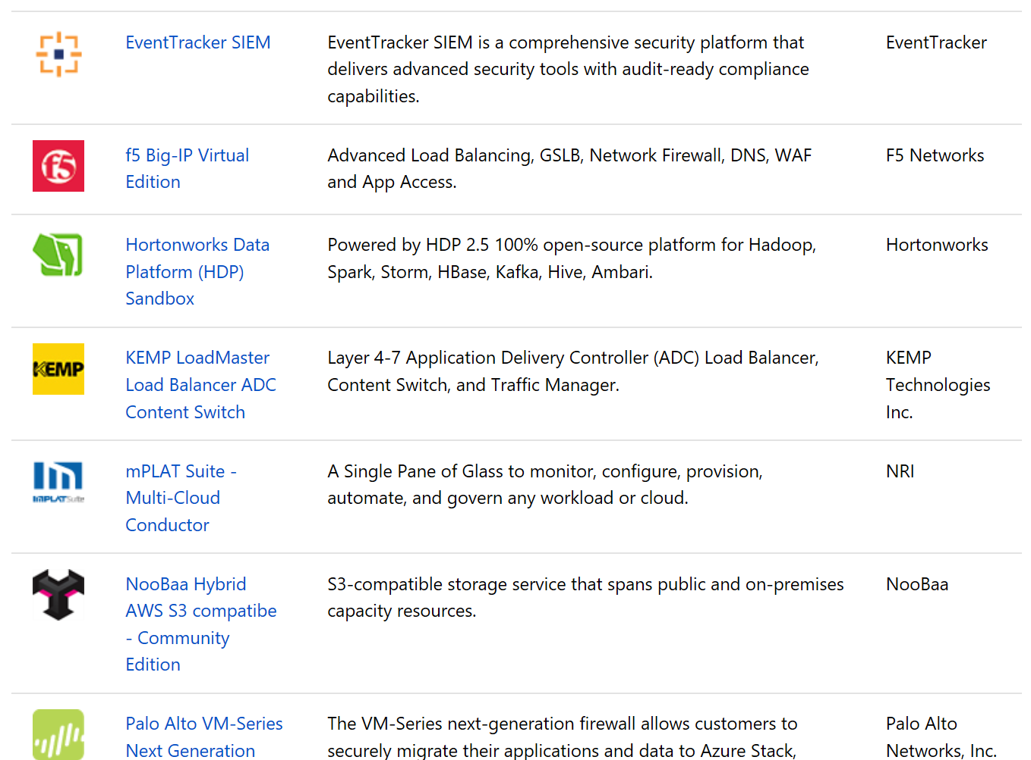
Marketplace syndication
200+ solutions already available to be used on Azure Stack
Their deployment is a simple as in Azure
For custom solutions, customer can import the images in the marketplace and make them part of their Service Catalog

Slide 12
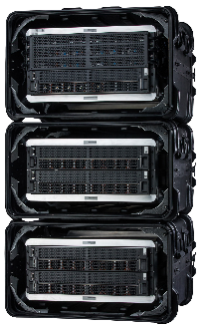
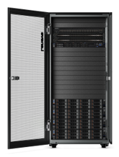
Azure Stack Hub Sample Configurations
4 Node Ruggedized
8 Node Dense
16 Node Hybrid
4 Node Azure Stack Hub
Physical Cores: 66
Usable storage: 34.3 TB
Usable Memory: 1444 GB
8 Node Azure Stack Hub
Physical Cores: 578
Usable storage: 189.4 TB
Usable Memory: 8097 GB
16 Node Azure Stack Hub
Physical Cores: 1192
Usable storage: 468.1 TB
Usable Memory: 7176 GB

Slide 13
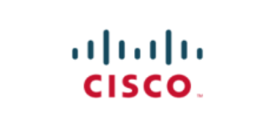
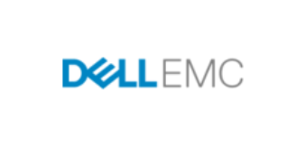
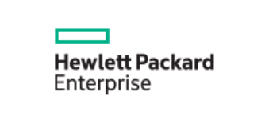
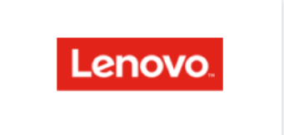
Simplify deployment with Azure Stack Hub integrated system

Slide 14
Azure vs Azure Stack
Mandatory Service | Service Model | On-premise | Public Cloud
Virtual Machines | IaaS | x | x
Storage as a Service | PaaS | x | x
Application Platform as a Service | PaaS | x | x
Relational Database as a Service | PaaS | x | x
NoSQL Database as a Service | PaaS |  | x
Identity Aggregation and Federation as a Service | PaaS |  | x
Integration Platform as a Service | PaaS |  | x
API Management as a Service | SaaS |  | x
Blockchain as a Service | PaaS |  | x
Mobile Backend as a Service | PaaS |  | x

Slide 15
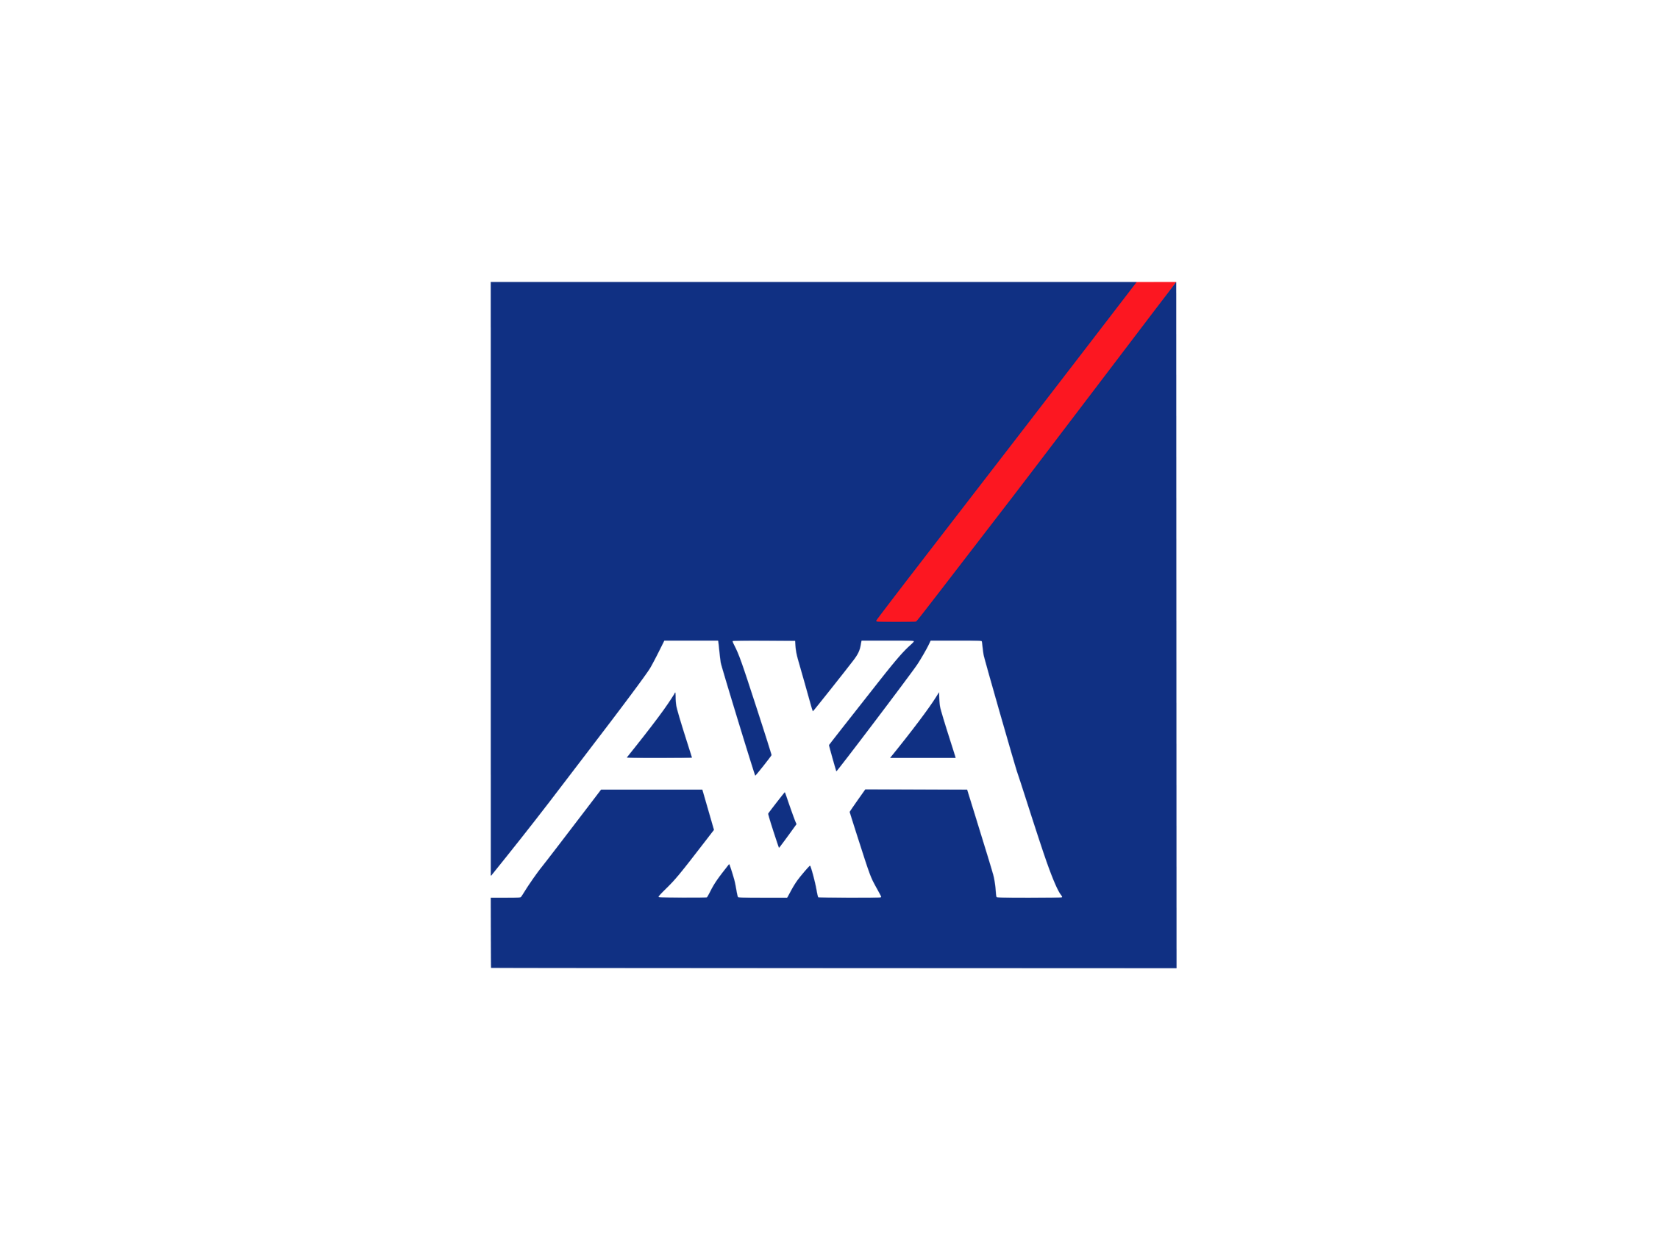
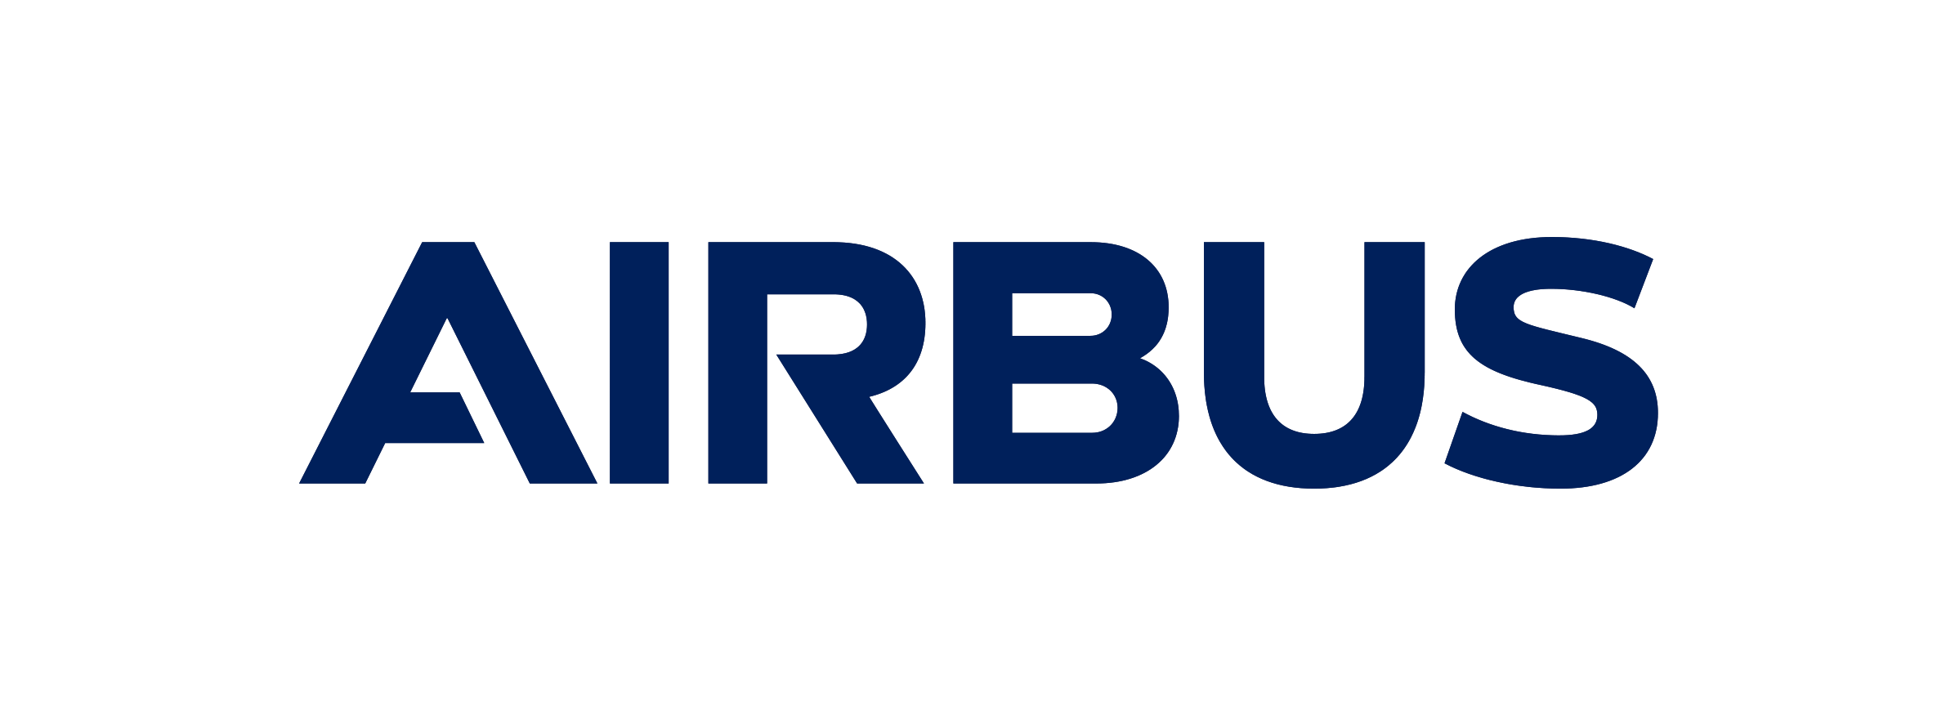
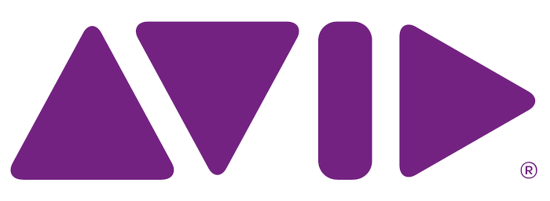
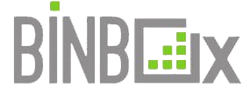
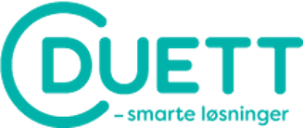
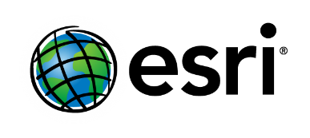
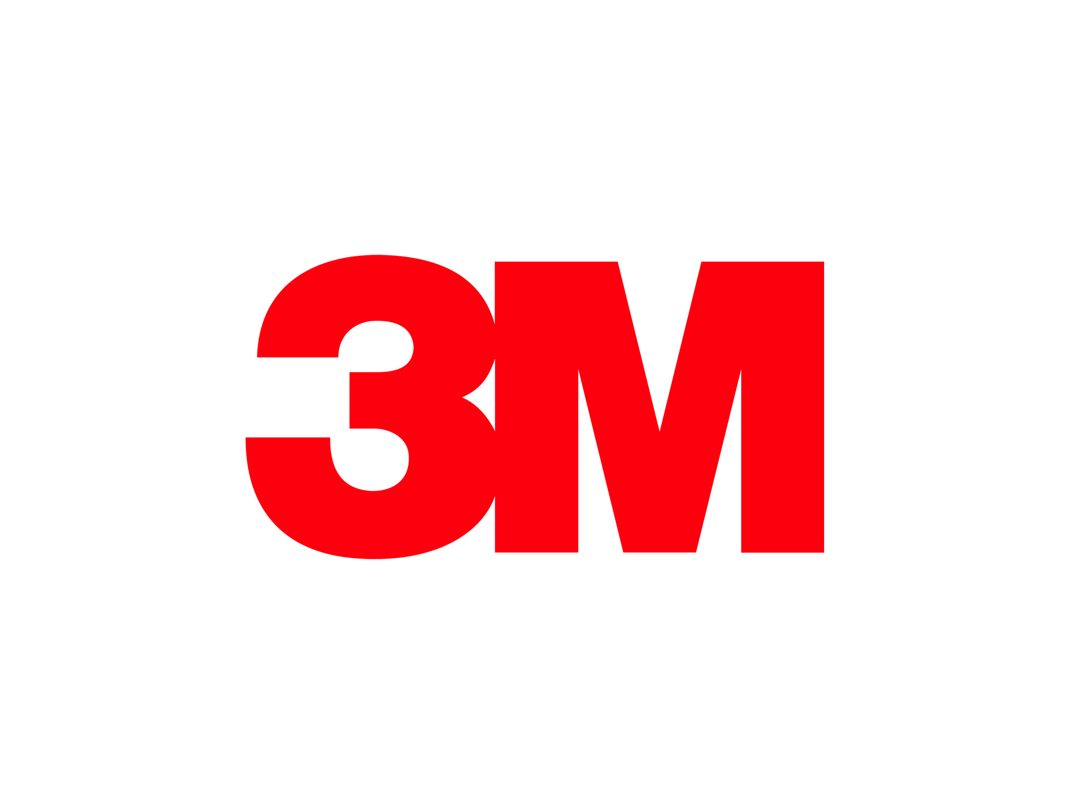
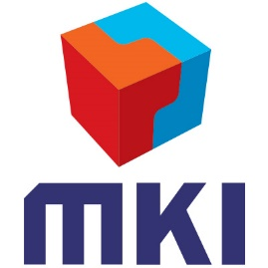
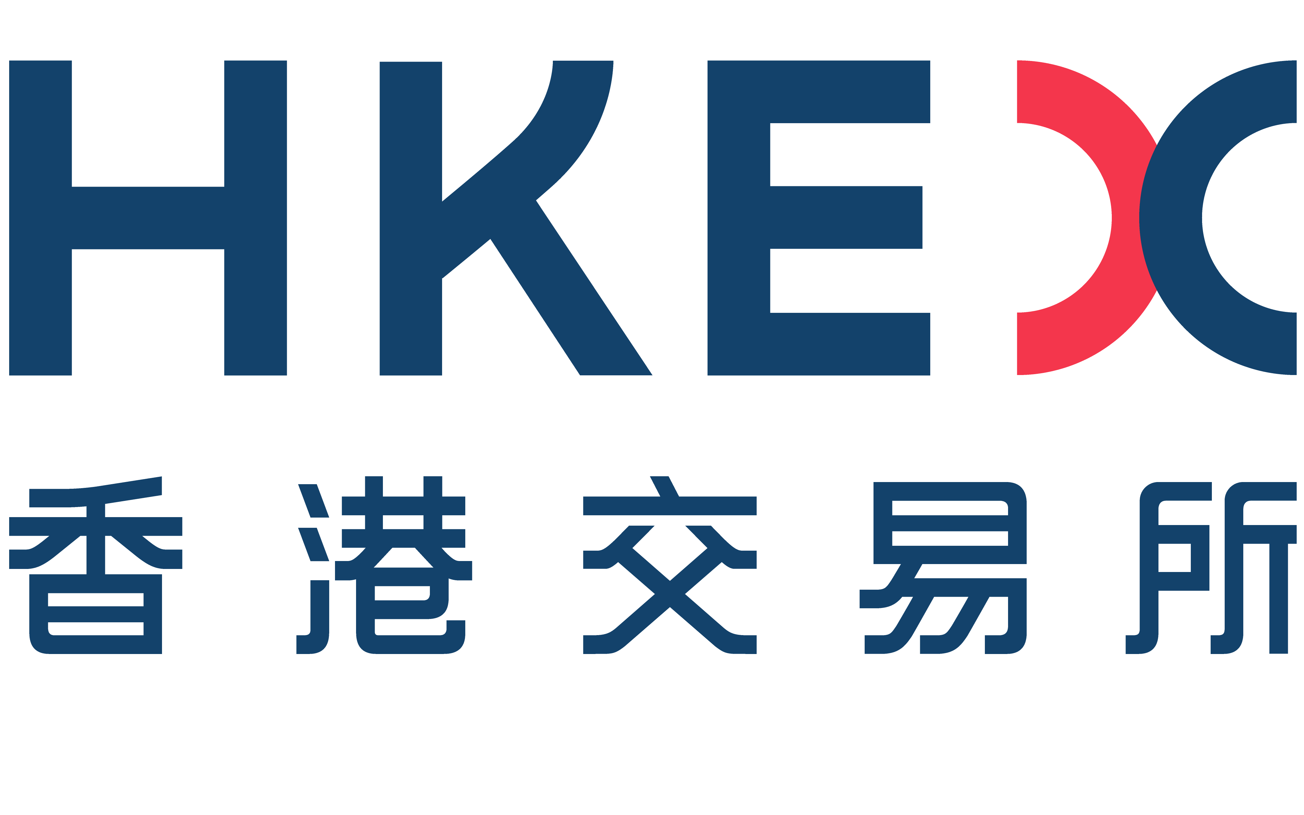
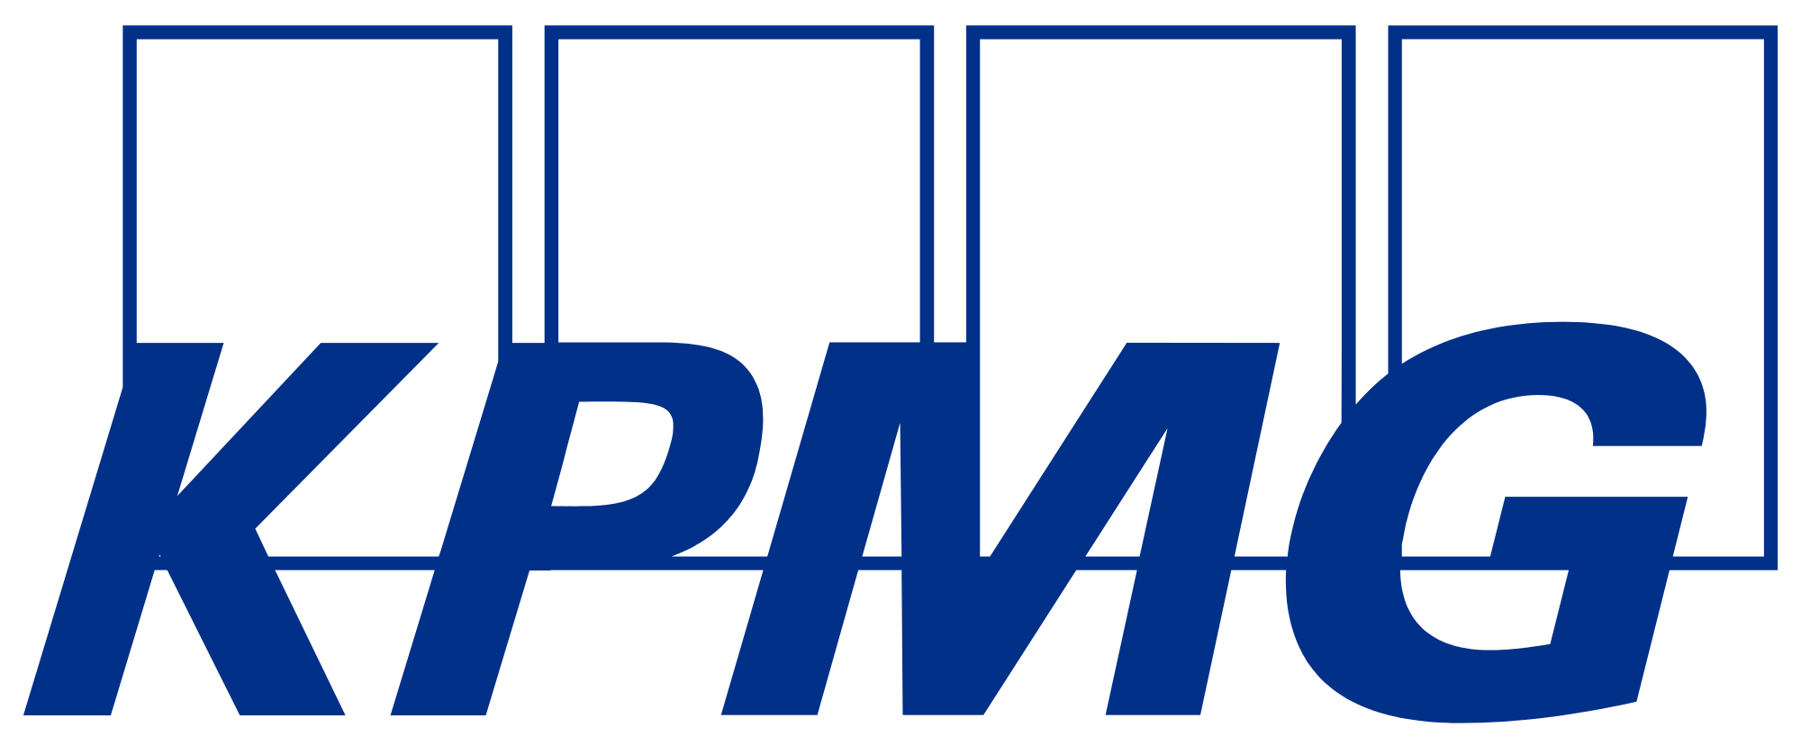
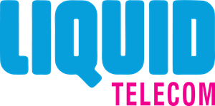
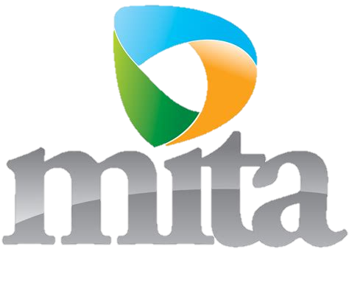
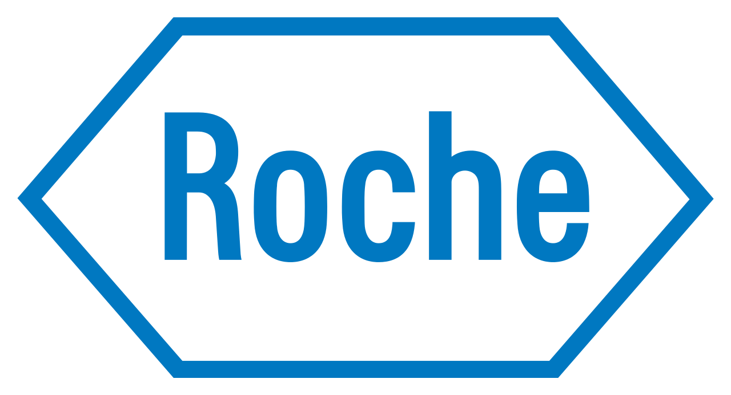
Leading companies across the globe use Azure Stack

Slide 16
IaaS and PaaS Services:
Virtual Machines (to provide a standardized, highly automated offering, where compute resources, complemented by storage and networking capabilities are available on-demand and even through self-provisioning. All components are software defined)
Storage as a Service (to provide an API first storage service exposing different types of storage.)
Application Platform as a Service (to provide a service that offers development and deployment environments for application services, for example using containers, web applications and web services. As a minimum .Net and Java are to be supported.)
Relational Database as a Service (to provide a fully managed database service that provides the capabilities to set-up, managed and administer relational databases based on Microsoft SQL Service (MSSQL).)
Solution Catalogue: a mechanism to develop, add and publish new Services
Security:
Multi-tenancy with full tenant segregation
Network segments that are fully isolated and not routable externally
Guest VM networking management and capability to allow and deny network traffic based on source and destination addresses and ports
VM disk encryption
High availability: The On-Premises Cloud should not have any single point of failure
Management:
Real-time performance monitoring of the Services through the management portal and report on guest VMs which are under / over utilized, i.e. have been allocated too many or too little resources
REST-based API to retrieve health and alerts (including security alerts)
Ease of deployment: Published list of reference architecture diagrams and descriptions
Flexibility: Organizations should be in position to bring their own licenses on the virtual instances or Services they intend to provision (BYOL

Slide 17
Azure Stack portfolio | An extension of Azure
Learn more
Azure Stack portfolio
An extension of Azure to consistently build and run hybrid applications across datacenters, edge locations, remote offices, and cloud
Notes:
Lastly, we have additional resources and programs to enable your journey to the cloud with:
Azure migration resources to support migration of your virtual machines and databases to Azure
Programs that provided best practices, design principles and tools to provide personalized guidance
Learning resources that provide tutorials, hands-on coding and knowledge checks to validate your learning

