Slide 1
Rethink everything!
Transform!
Horia Constantinescu
Regional Sales Manager SEE
Bogusz Blaszkiewicz
SE Manager CEE

Slide 2
Our Founding Vision
DISRUPTING THE STORAGE MARKET
NO TIME for DOWNTIME
NO PLANNED DOWNTIME
LESS UN-PLANNED DOWNTIME
FAST RECOVERY after UN-PLANNED DOWNTIME
Notes:
6 years ago Pure brought together a profoundly gifted team that was profoundly dissatisfied with the current state of storage, and who had had a front row seat to the impact of flash and cloud on the data center
Together we crafted a new storage platform that was the first mover for several essential innovations
All flash for every workload
100% flash below the cost of fast disk, combined with
Compatibility out of the box with existing storage infrastructure
Simplicity – Our platform sheds decades of accumulated complexity, bringing a consumer tech-like experience to storage for the first time
And we rethought the technology and business model to focus on data rather than storage arrays
With Pure, data stays in place while the containing hardware and software non-disruptively evolves around it, as it does within the cloud
Under traditional storage, the data is subordinate to the array, meaning access is disrupted and migrations required to rev the storage

Slide 3
Our Founding Vision
DISRUPTING THE STORAGE MARKET
SOFTWARE
+ HARDWARE
-9.85 °
2.91”
PLATFORM FOR
STORAGE INNOVATION
+
8.18”
FLASH
+ CLOUD
SIMPLE
DATA IS
FOREVER
5.27”
BUSINESS
MODEL
Notes:
6 years ago Pure brought together a profoundly gifted team that was profoundly dissatisfied with the current state of storage, and who had had a front row seat to the impact of flash and cloud on the data center
Together we crafted a new storage platform that was the first mover for several essential innovations
All flash for every workload
100% flash below the cost of fast disk, combined with
Compatibility out of the box with existing storage infrastructure
Simplicity – Our platform sheds decades of accumulated complexity, bringing a consumer tech-like experience to storage for the first time
And we rethought the technology and business model to focus on data rather than storage arrays
With Pure, data stays in place while the containing hardware and software non-disruptively evolves around it, as it does within the cloud
Under traditional storage, the data is subordinate to the array, meaning access is disrupted and migrations required to rev the storage

Slide 4
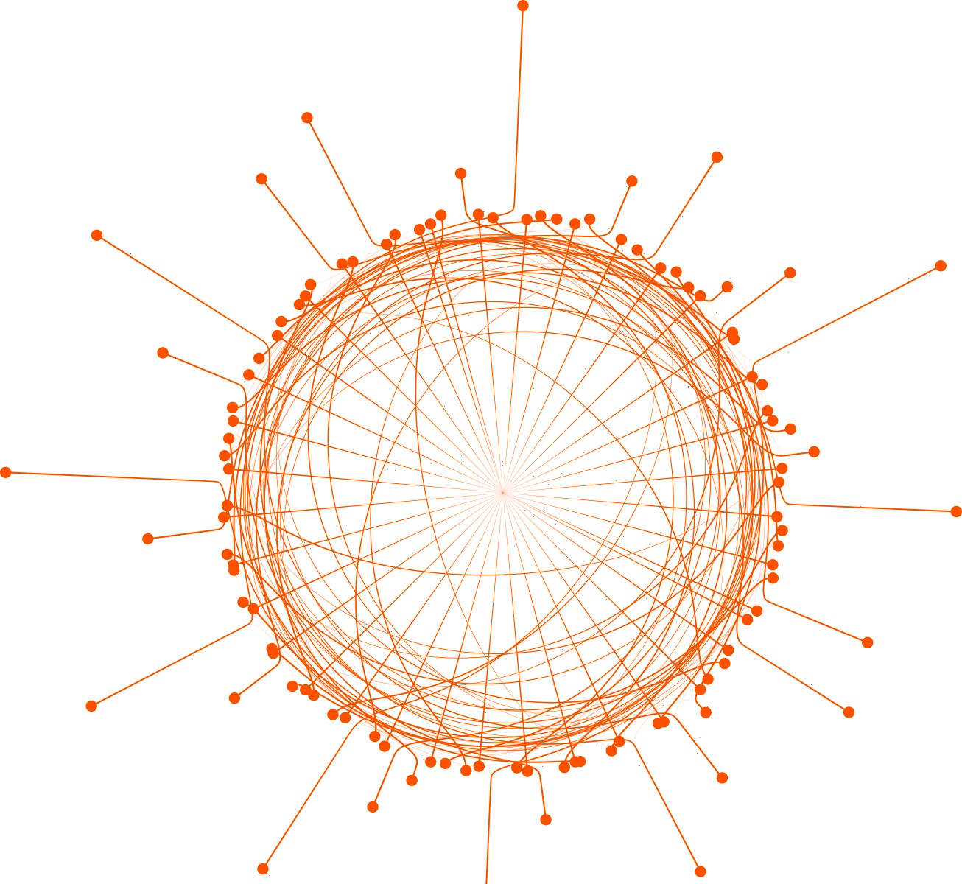
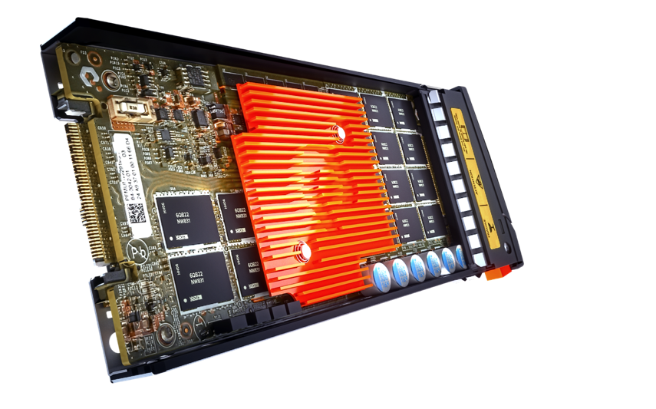
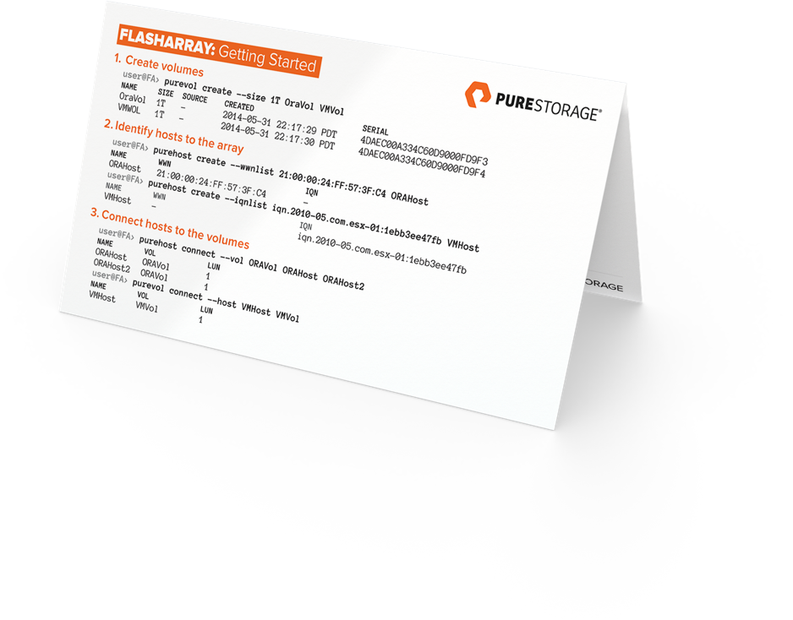
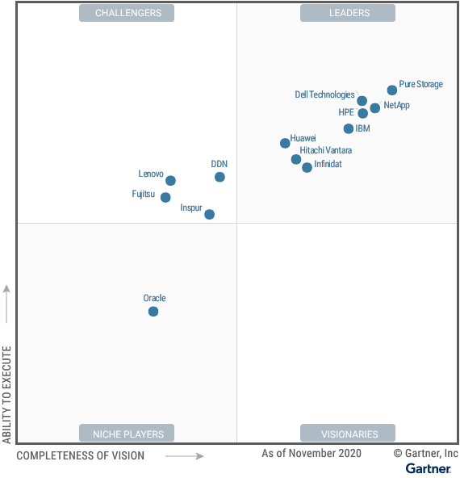
the Grounds of PURE
BUILT FOR NVME Flash
DISRUPTIVELY SIMPLE
EVERGREEN

Slide 5

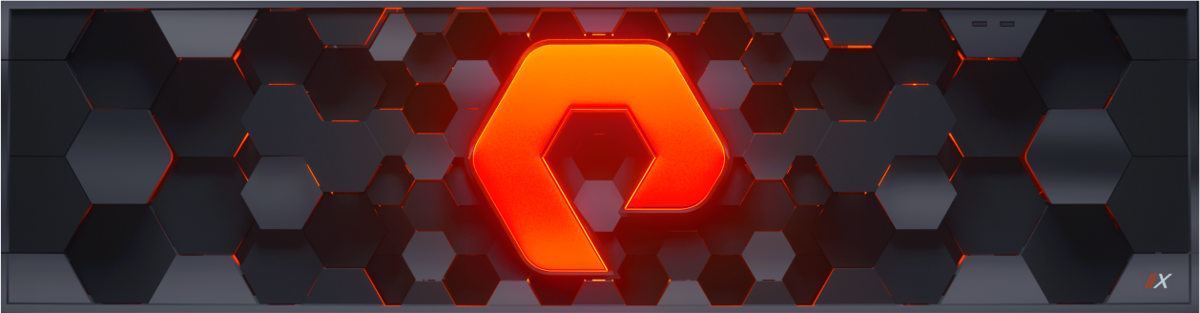
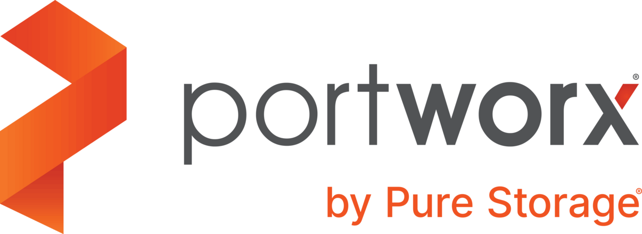
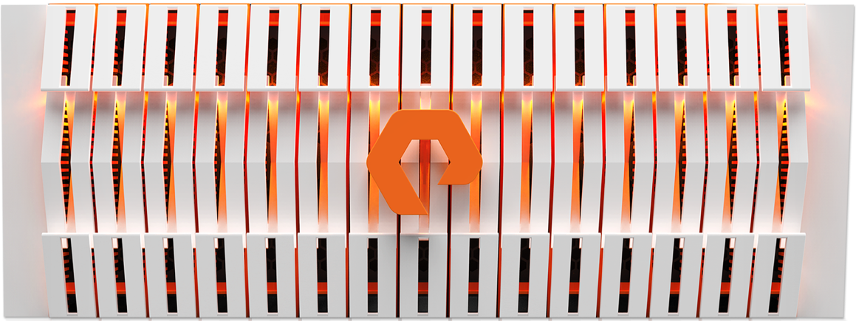
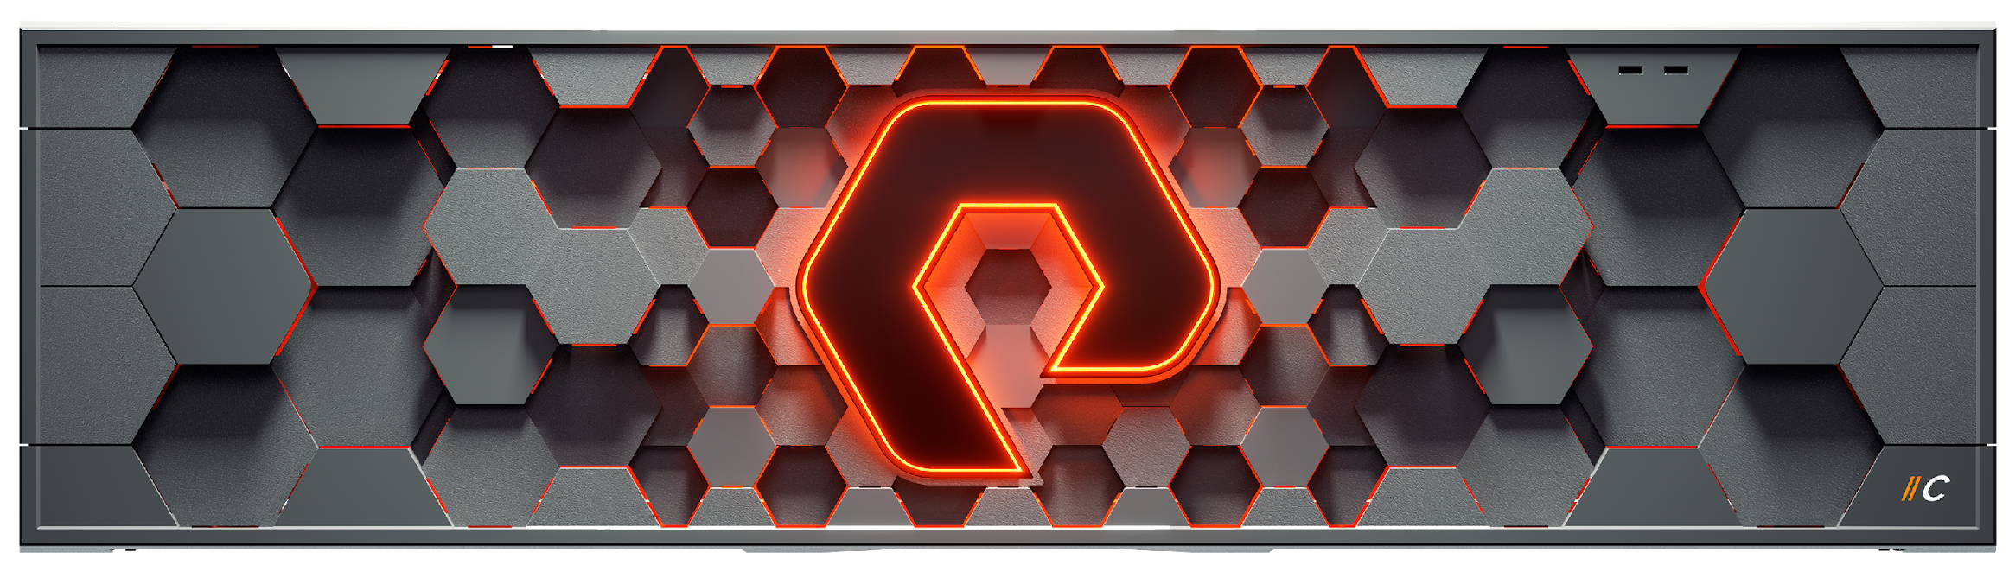
Pure Storage Portfolio
Multi-protocol, multi-tier, and multi-use QOS – all via the same simple platform
Lowest Latency
Structured
(Block, DBs, VMs)
Tier 1 Apps
& Databases
Unstructured
(File & Object)
FlashArray //X
Performance
Block and VVOL
CloudBlock Store
SCALE-OUT SDS STORAGE, CLOUD + ON-PREM
Virtual
Machines
Real-time Analytics
FlashBlade
Concurrent
Sale-outunified
File & Object
FlashArray //C
Capacity-Optimized
QLC Unified Block & File
Tier
2 Apps
HPC
EDA
AI / ML
Containers
Data Warehouse
Rapid Restore
Archive
Back up
Cloud Backup
Lowest Cost
Notes:
The combination of these 4 pillars of a Modern Data Experience make Pure unique in the industry and enable us to deliver a complete solution for all the different data needs in your environment.
If we look at this from a portfolio perspective, you’ll see how we bring everything together.
At the top of the pyramid we have offerings to support for the most mission-critical applications: FlashArray //X and DirectMemory. Long term, Cloud Block Store will supplement this allowing you to take application processes (dev test today, production in the future) to and from the cloud.
For real-time Analytics, HPC, data warehouse and other big data workloads, FlashBlade (Pure’s unified scale-out File and Object store solution) allows unprecedented levels of scale-out bandwidth.
And for your Tier 2 applications, large scale Data protection and backup use cases, FlashArray //C is our capacity-optimized QLC FlashArray that allows the consolidation of Tier2 applications on flash, at affordability levels you never imagined!

Slide 6

Smallest footprint
Best DRR
Evergreen
67% TCO
BUSINESS
MODEL
CUSTOMER
EXPERIENCE
Why
?
CULTURE
NPS 83.5
BEST IN B2B
Satmetrix Certified
100% allFlash
100% All inclusive
100% business continuity
7X
GARTNER MQ LEADER
TECHNOLOGY
Simplest to use
99,9999
24/7 support
Notes:
CONTAINS 4 BUILDS
And we’re doing it together. We’re a modern data storage company unlike the rest. Only Pure brings together:
BUILD #1:
A modern subscription-like business model that delivers more than 55% in total cost of ownership savings;
*Based on leading market analyst’s January 2018 estimated aggressive street pricing models for 1.5PB storage arrays from EMC, HP and NetApp, averaged, versus Pure.
BUILD #2:
A world class approach to customer experience, which is validated by our Satmetrix certified NPS score.
BUILD #3
And superior, innovative technology which is validated by consistent recognition from Gartner and IDC for being the technology leader and innovator in the market.
FINAL BUILD
Each of these pieces combined and anchored by fierce group of passionate employees who bleed orange and love what they do, uniquely set us apart.
Let’s work together to understand what your data can do for you.
<End with transition into next facet of discussion beginning with business model, customer experience or technology.>

Slide 7








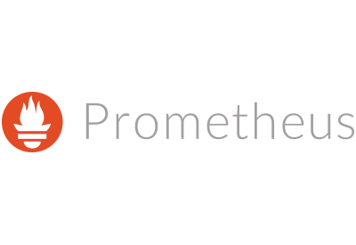





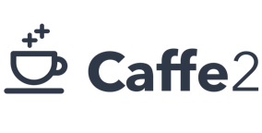









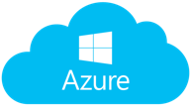



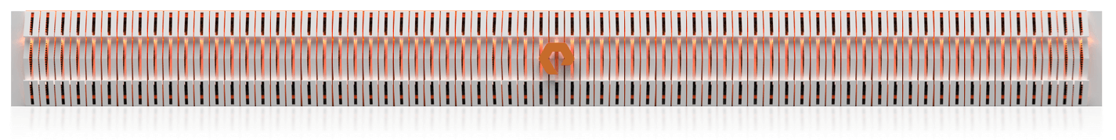
PIPELINE APPLICATIONS
Source
Collect
Process
Store
Visualize
DAS
syslogs
Notes:
How do we automate and scale – containers – PSO, mount, read etc

Slide 8





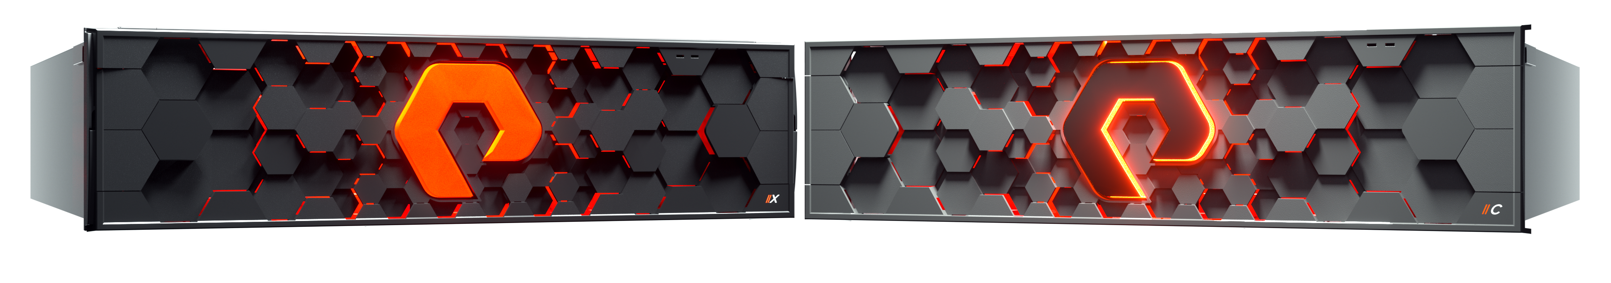
THE NEW FLASHARRAY FAMILY
LATENCY AND CAPACITY OPTIMIZED USE CASES
OPTIMIZE PRODUCTION DATABASES | ENABLE HYBRID CLOUD | DELIVER NEXT-GEN ANALYTICS
TIER 2 DBs AND VMs | TEST AND DEVELOPMENT | DR & SNAPSHOT RETENTION
LATENCY OPTIMIZED 66 TB – 3.2 PB EFFECTIVE AS LOW AS .1 - 1 ms |  | CAPACITY OPTIMIZED 1.3 PB – 5.2 PB EFFECTIVE AS LOW AS 2 - 4 ms
Cloud
Block Store
Notes:
Reduce: DEDUPLICATION
COMPRESSION
THIN-PROVISIONING
Protect:SNAPSHOTS
PURITY//REPLICATE
ACTIVECLUSTER
CLOUDSNAP
Secure: AES-265 ENCRYPTION
RAPID DATA LOCKING
ENCRYPTREDUCE
Optimize: Quality of Service
DirectMemory Cache

Slide 9


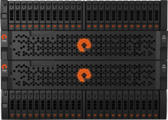
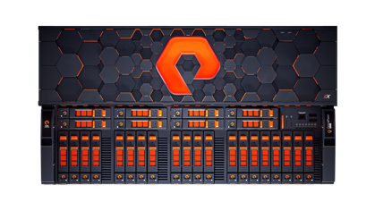
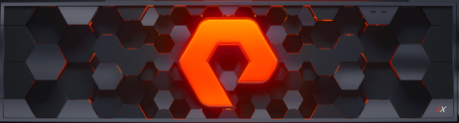

One Architecture
FlashArray
NVMe only
FA-300 Series
FA-400 Series
//MR1
//MR2
//X10R3
12-25 TBs in 3U
//X20R3
Up to 120 TBs in 3U
or 240 TBs in 5u
//X50R3
Up to 540 TBs in 5U
//X70R3
Up to 1500 TBs in 6U
//X90R3
Up to 3000 TBs in 6U
Notes:
Goal is to have installation and upgrade procedures so simple that it is easier for a customer to do it themselves, versus arranging a meeting to schedule it with us.”
Ability to make hardware changes plug and play
One button firmware updates
Non-disruptive controller replacements
Non-disruptive shelf replacements (coming soon)
Customer Value:
Never take a downtime every again
6 9s includes maintenance windows
While achieving consistent performance
Increase capacity and performance while decreasing footprint
Array lives forever

Slide 10
Purity: OS only for Flash
Purity OPERATING ENVIRONMENT
FLASHREDUCE
FLASHPROTECT
FLASHRECOVER
Deduplication
Compression
Thin Provisioning
RAID-3D, NDU, HA
>99.999% Availability
Encryption
Replication
Snapshots
Protection Policies
PURITY CORE
FLASHCARE
512-byte Variable Metadata
IO Scheduling
Global Flash Management
Notes:
Purity is the controller storage software that takes unique advantage of flash
For example, 2-5X better data reduction than anyone else, giving us substantial leverage to maintain margins in the face of competitive discounting
Use of the most cost effective cMLC flash, which also happens to be the most reliable because it’s tested for 100s of millions of phones
Preservation of performance when there is a problem or a change – Unlike all our competitors, Pure Storage doesn’t loose altitude if it looses and engine
Purity is so sophisticated it is proving very hard for competitors to reproduce
We have principles on the team from VMware, including Diane and Mendel who are angels
What we have crafted in Purity is comparable in sophistication VMware at a similar stage
And our engineering team is of similar quality
Most importantly, like VMware at 3 years in the market, we have a substantial lead in innovation and the team that will enable us to grow that lead
Or consider Symmetrix from EMC, the first mover in networked disk storage
Their competitive advantage has help up for 25 years, despite everything that IBM, HP, Dell, NetApp, Hitachi and start ups could throw at them
Only now that flash and cloud have rendered that IP obsolete is the market changing
Moreover, the challenge of getting flash and cloud right is raising the bar to play in storage, a currently fragmented market
Pure is uniquely well positioned as this market consolidates rather than commoditizes

Slide 11
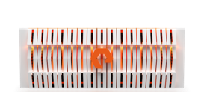



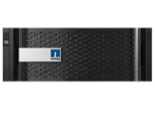

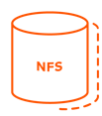










Data Protection
Fully integrated
LOCAL RECOVERY SNAPS
METRO
ACTIVE/ACTIVE
CLUSTERING
Long-Term
Protection & Archiving
GLOBAL
ASYNC SNAP
REPLICATION
<11ms RTT
SNAP TO
FLASHBLADE
Async
Scheduled
ActiveDR
Any latency
NearSync
REMOTE SNAPS
SNAP TO NFS
REMOTE SNAPS
UNIFIED PROTECTION POLICIES
CLOUDSNAP*
CBS
DELTASNAP API
& INTEGRATIONs

Slide 12

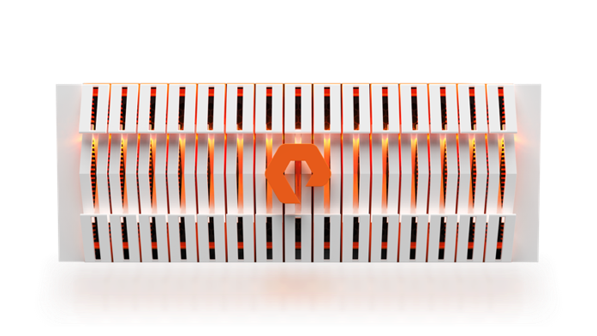
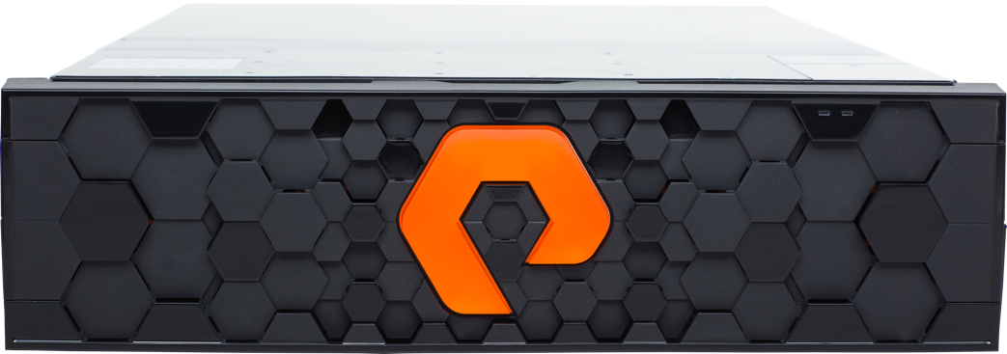
the SAFEMODE SNAPSHOTS
SECURE COPIES WITH BLAZING FAST RESTORES
Secure Backup Copies SafeMode snapshots protect both backup data and metadata
No more Ransomware hit comprised credentials don’t work
For Both block and file FlashArray and FlashBlade

Slide 13
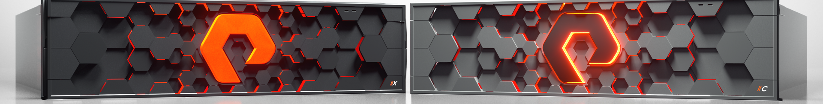




FlashArray SafeMode Configuration
Snapshot Policy
Authorization*
Tune Eradication Timer*
Disable Eradication*
IMMUTABLE SNAPSHOTS
Flexible,granular admin driven snapshot policy
LIMITS PRIVILEGED USERS
Upto 5 authorized contacts,secret PIN
EXTENDS ERADICATION TIMER
24hrs - 30 days
UNALTERED,SECURE DATA
Disables manual eradication
* Support required to enable or modify
Notes:
Configuration Point in time backup,can’t be modified

Slide 14
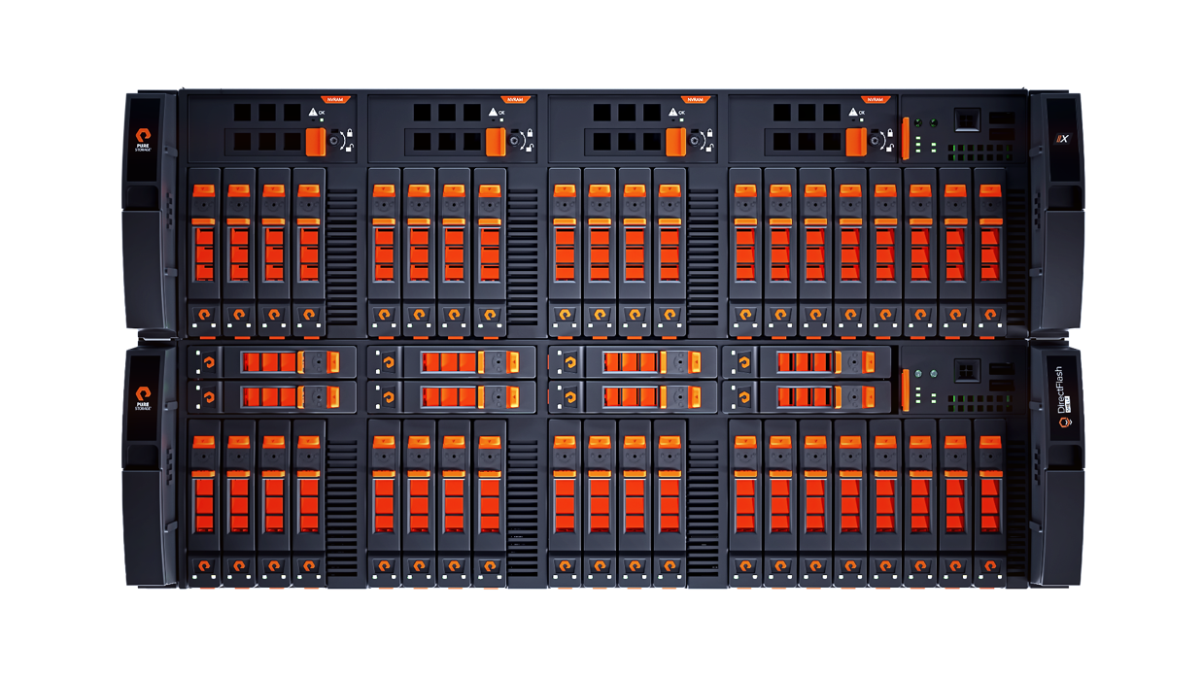



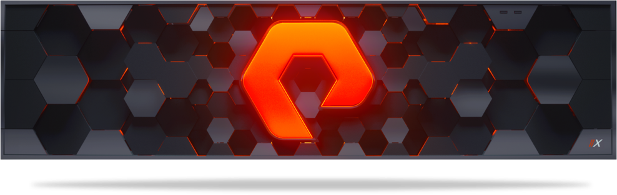








Simple, Immutable Snapshots
Instantly Snapshot Any Volume
Zero reservations or planning required
Zero performance overhead
Flexible consistency groups
…
1000s
Snapshots Are Just New Volumes, With Full Capabilities
Mount, read, write, snapshot again, etc.
Zero dependencies on one another
All have full performance
FlashArray Volumes
100% METADATA
=
Always Full Yet Space Saving
Zero data duplication
Always thin, deduped, compressed
Recover Anything To Anywhere
Instantly roll forward or backward
Recovery ANY volume from ANY snapshot
Notes:
What snapshots want to be when they grow up.

Slide 15




Full Landscape
PURE IS API
FIRST!
of integration
CONTAINERS
HYBRID
VAAI
VVOLs / VASA / SPBM
vCENTER PLUGIN
vREALIZE AUTOMATION XaaS INTEGRATION
vREALIZE ORCHESTRATOR PLUGIN & WORKFLOWS
vROPS MANAGEMENT PACK
LOG INSIGHT CONTENT PACK
SRM STORAGE REPLICATION ADAPTOR
VMSC ACTIVECLUSTER CERT.
PRIVATE CLOUD VVD
vSPHERE 7
SCVMM
ODX
AZURE EXPRESSROUTE
AZURE CLOUD
SMI-S
POWERSHELL TOOLKIT
VSS PROVIDER/REQUESTOR
SCOM MANAGEMENT PACK
FULL IN-TREE CINDER DRIVER
FUEL PLUGIN
PYTHON SDK LIBRARY
OPENSTACK FOUNDATION CORPORATE SPONSOR
CORE CINDER TEAM MEMBER
DOCKER PLUGIN
KUBERNETES PLUGIN
OPENSHIFT RA
MESOSPHERE DVDCLI
DOCKER SWARM
PORTWORX
OPENCONNECT FOR AWS
OPENCONNECT FOR MS AZURE
CLOUDSNAP

Slide 16

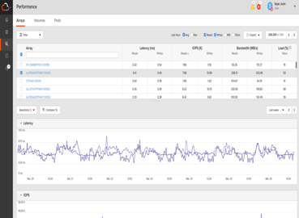
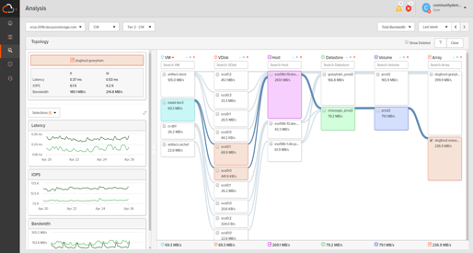


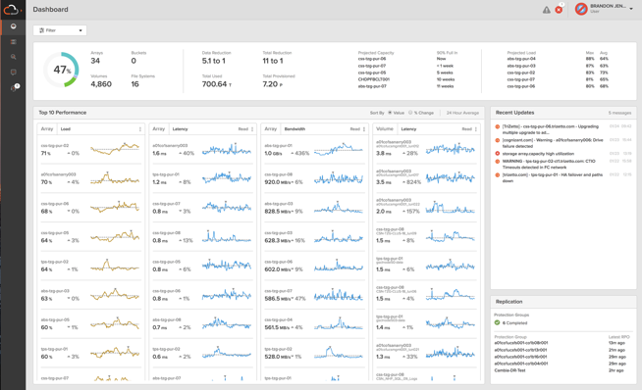
PREDICTIVE SUPPORT
PREDICTIVE ANALYTICS,
FORECASTING & REPORTING
SEV 1
INSTANT L2
SUPPORT
15
SUPPORT MANAGED
UPGRADES
MINUTE SLA
GLOBAL, MOBILE
MONITORING & REPORTING
4HR
ON
SITE
>16,000
ARRAYS
>1B PROBES
/ DAY
>15 PBS
OF DATA
BREAK/FIX
Notes:
This is the Pure1 overview. It’s easy to spend a lot of time on this slide, but try not to. In this presentation we want to talk about management at this point, not support. There’s another section that talks about the predictive support.
Here, focus on the global monitoring (including the iOS and Android apps), predictive analytics and a it on the support managed upgrades. Link everything to “spending less time managing storage”.

Slide 17
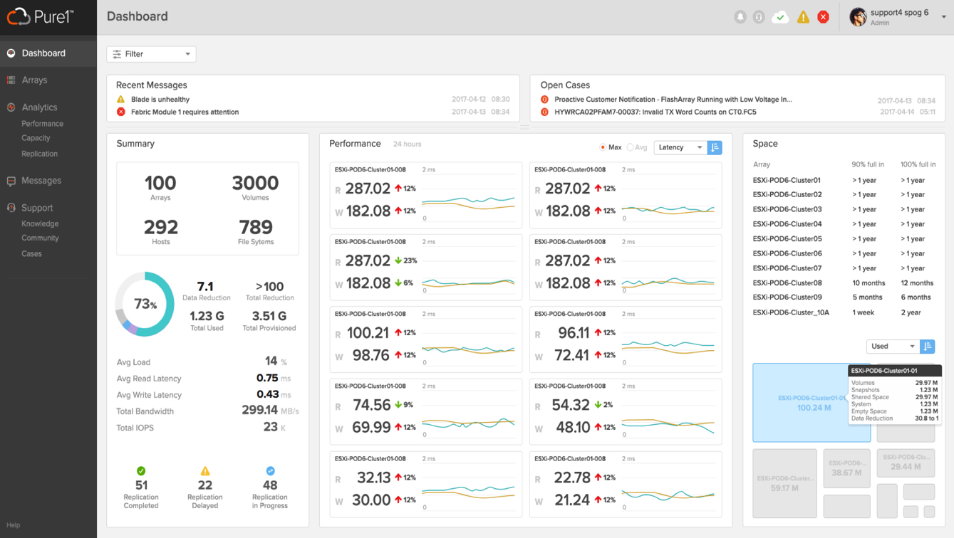

INTRODUCING
GLOBAL DASHBOARD
GET KEY AGGREGATE METRICS ON
YOUR ENTIRE FLEET OF ARRAYS
Get visibility on total data reduction and average load performance
Easily analyze array performance and predict capacity
View alerts & support cases across all arrays

Slide 18

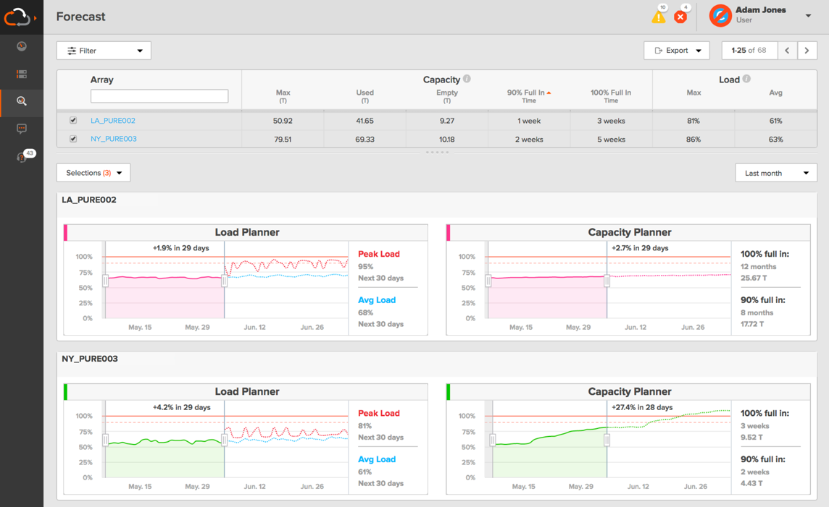


PREDICT THE FUTURE
AI-DRIVEN PERFORMANCE & CAPACITY SIZING
WORKLOAD PLANNER
POWERED BY WORKLOAD DNA
HOW WILL PERFORMANCE & CAPACITY GROW?
WILL A NEW WORKLOAD FIT?
HOW CAN I OPTIMIZE PLACEMENT?

Slide 19
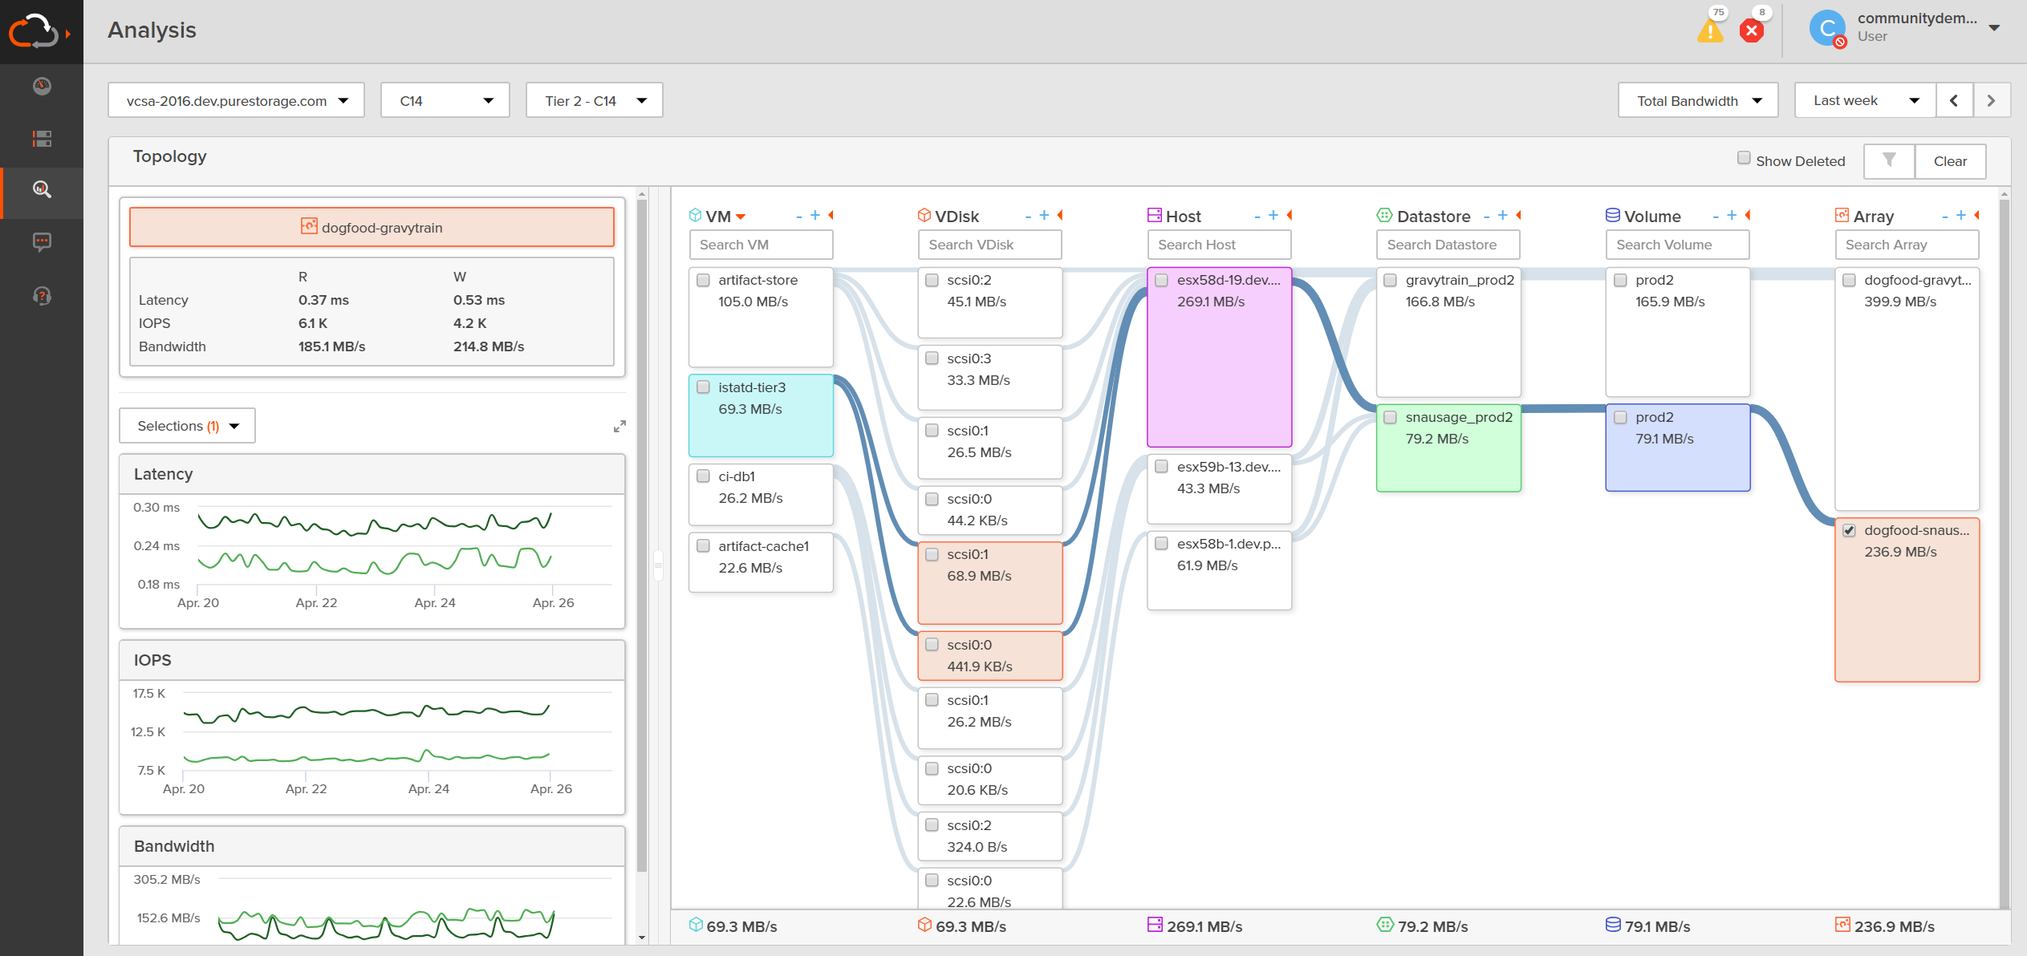
INTRODUCING
VM VISIBILITY
SEE VM-LEVEL PERFORMANCE TO TROUBLESHOOT ISSUES
Visual depiction of performance path
Quickly identify top VMs with latency issues
Find the problematic VM quickly correlated with a volume
Get complete visibility of latency, bandwidth, and IOPS

Slide 20

purchase
Love Your Storage
All-Software Included
Right-Size Guarantee
usage
Forever Maintenance
Flat & Fair
expansion
Free Every Three
Upgrade Flex
Capacity Consolidation
Lifetime investment protection
Notes:
Essentially, Evergreen Storage is a subscription to innovation. Here, you can see the the components of our business model at each stage in the storage ownership lifecycle, from acquisition, to run, to upgrade.

Slide 21

 |  | Evergreen Gold Subscription |  | Evergreen Silver Subscription |  | Industry Standard Support
All-Inclusive Software |  | ✓ |  | ✓ |  | ✕
Future Software Features |  | ✓ |  | ✓ |  | ✕
Flat & Fair Maintenance |  | ✓ |  | ✓ |  | ✕
Evergreen Maintenance |  | ✓ |  | ✓ |  | ✕
Predictive Analytics & Services |  | ✓ |  | ✓ |  | ✕
Instant L2 Support Access |  | ✓ |  | ✓ |  | ✕
Sev 1 Response SLA |  | 15 min |  | 15 min |  | 60 min +
Support Managed Upgrades |  | ✓ |  | ✓ |  | ✕
On-Site Break/Fix SLAs |  | 4HR & NBD |  | 4HR & NBD |  | ✕
Mobile/SaaS-Based Monitoring |  | ✓ |  | ✓ |  | ✕
Evergreen Architecture |  | ✓ |  | ✓ |  | ✕
Right Size & 30-Day Guarantees |  | ✓ |  | ✓ |  | Inferior
Free Every Three |  | ✓ |  | ✕ |  | ✕
Upgrade Flex Controllers** |  | Trade-in Credit |  | No Credit |  | ✕
Capacity Consolidation** |  | Trade-in Credit /w 4X Purchase |  | No Credit |  | ✕
VS
SOFTWARE
SUBSCRIPTION
A-LA-CARTE
SOFTWARE
PURCHASE
HW & SW
MAINTENANCE
SUBSCRIPTION
BASIC HW
WARRANTY
WHITE GLOVE
SUPPORT
SUBSCRIPTION
BASIC
SUPPORT
MEDIA &
CONTROLLERS
SUBSCRIPTION
ONE-TIME
HARDWARE
PURCHASE

Slide 22
Demo
Flash Array
Flash Blade
SafeMode
Test Drive
Flash Array
Flash Blade
Portworx
POC
Flash Array
Flash Blade
Portworx
Lifetime investment protection
Notes:
Essentially, Evergreen Storage is a subscription to innovation. Here, you can see the the components of our business model at each stage in the storage ownership lifecycle, from acquisition, to run, to upgrade.

Slide 23

What.NEXT?

