Slide 1
How to store Petabytes
(of machine created data) ?
Maguay No-Time-for-Downtime, Sept 2021
3Q 2021

Slide 2

IDC forecasts that over 22ZB of storage capacity must ship across all media types from 2018 to 2025 to keep up with storage demands
Around 59% of the capacity will need to come from the HDD industry and 26% from flash technology
22ZB
Tape
Optical
NVM-NAND
SSD
HDD
59%
IDC White Paper, sponsored by Seagate, Data Age 2025: The Digitzation of the World From Edge to Core, November 2018

Slide 3
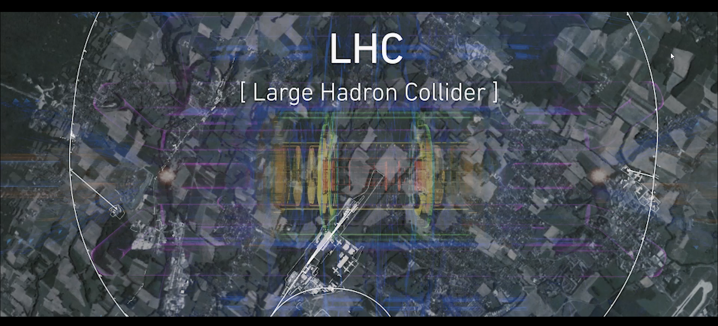
Existing Example of “Experimental” Data

Slide 4
The Nature of “Experimental” Data
High Amount of Data
Unstructured
Random (→ no Compression, no Deduplication)
Continuously created at high, constant Rate
  (like Video Surveillance Data)
Stored for long Time
  (unlike Video Surveillance Data)
Kept online with fast and random read Access for Analytics
→ IT Investment and Operations Strategy will change

Slide 5

Storage Requirements for “Experimental” Data
“ ….the ability of Toshiba to deliver thousands of drives representing multiple petabytes – on time – is critical for the data taking and operations of the LHC”

Slide 6
22ZB
Why (still) HDD ?
Tape
Optical
NVM-NAND
SSD
HDD
59%
IDC White Paper, sponsored by Seagate, Data Age 2025: The Digitzation of the World From Edge to Core, November 2018

Slide 7
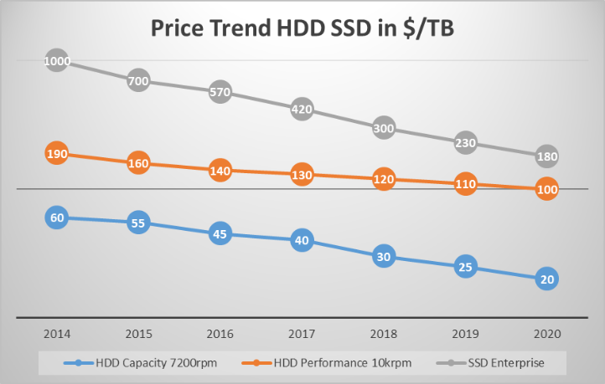
HDD vs SSD: Driving Factor No. 1: Price / Capacity
Source: TEE research & TEE estimates
Log Scale
SSD capacity trend:
Ultra high capacity
  16 TByte → 100 Tbyte → …
Linear trend price / capacity
HDD capacity trend:
Increasing capacity
  8 TByte → 10 TByte (Air) → 14/16 Tbyte (He)
  18/20Tbyte (MAMR) → new technologies
At similar costs/unit
  Few 100$
1000
100
10X
9X
10
Parallel prize trends for eSSD and Enterprise Capacity HDD!

Slide 8
Why (still HDD) - Driving Factor No. 2: Storage Capacity
Source: Gartner / TEE estimates
How much Flash Storage can be manufactured?
2020 Total eHDD/cHDD Capacity shipped: ~1012 ExaBytes (Mio TB) in 251 Mio Units
2020 Total eSSD/cSSD Capacity shipped: ~222 ExaBytes in 387 Mio Units
Only to double SSD capacity shipped in 2020, approx. 100 billions $ additional investments for Flash fabs are required
It would cost the NAND Industry hundreds of billions of Dollars and several years of time to construct new fabrication plants to displace 100% of HDD’s installed in 2020
Within the next 5 - 10 years it will be impossible to manufacture a sufficient
amount of SSDs in order to replace the installed HDD base
18%
Investment needed for
One leading Edge Fab
450mm
300mm
200mm
>$1B
>$5B
>$10B
Market relies on HDDs!

Slide 9
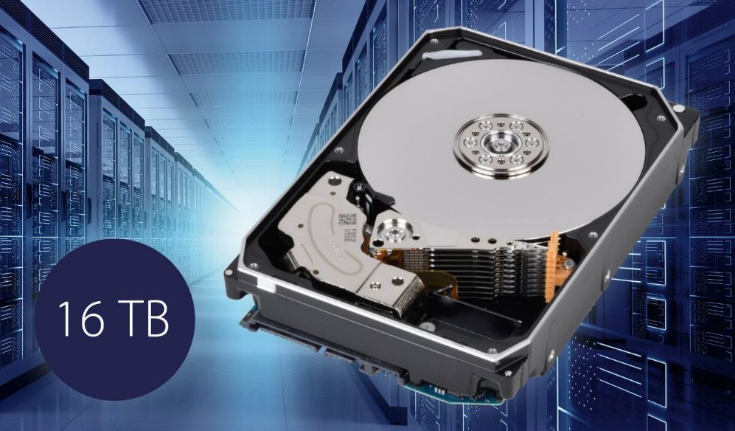
3.5” Enterprise Capacity (Nearline) Hard Disk Drives
First HDD with “Microwave assisted magnetic Recording” (MAMR)
Capacities from 1 TB to 18 TB
SAS 12 GB/s and SATA 6 GB/s Interface
7200 RPM, RV Sensors
  For continuous 24/7 Operation
  Up to 550 TB/year Workload
  Meantime to Failure up to 2.5 Mio hours
  Annualized Failure Rate down to 0.35%
  5 Year Warranty

Slide 10
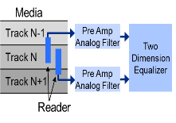
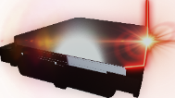
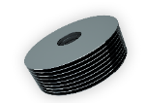

Technology for Toshiba HDD Capacity Increase
 | 2018 | 2019 | 2021
18TB
14TB
16TB
FC-MAMR Technology
Flux Control-Microwave Assisted
Magnetic Recording
Helium-sealed
Technology
TDMR Technology
Two Dimensional Magnetic Recording
SMR Technology
9 Disk Technology
Shingled Magnetic Recording
Higher storage density with two read elements to detect and cancel neighbor track interference signals.

Slide 11
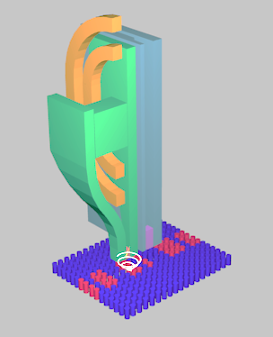
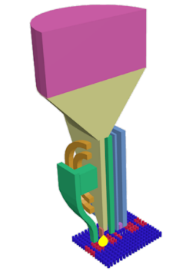
Assist Recording Technology
MAMR
Microwave Assisted Magnetic Recording
HAMR
Heat Assisted Magnetic Recording
Technology to boost disk recording capacity using microwave oscillators on magnetic heads
Technology to boost disk recording capacity using laser diode on magnetic heads
Laser Diode
STO
(Spin torque oscillator)
Wave guide
NFT
(Near field transducer)
Microwave
(High frequency magnetic field)
Near-field light

Slide 12
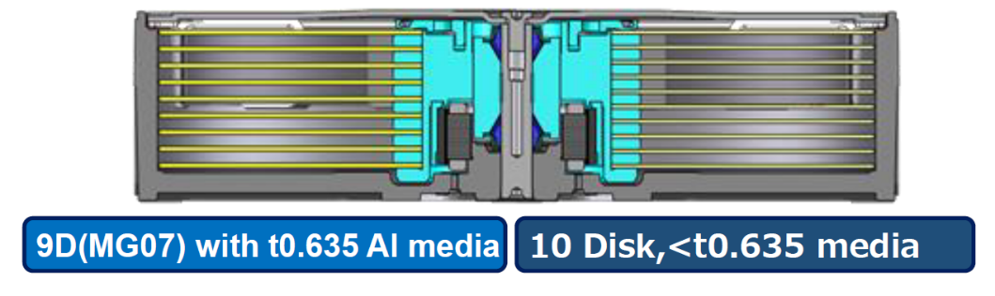
Future Outlook: More Platter

Slide 13
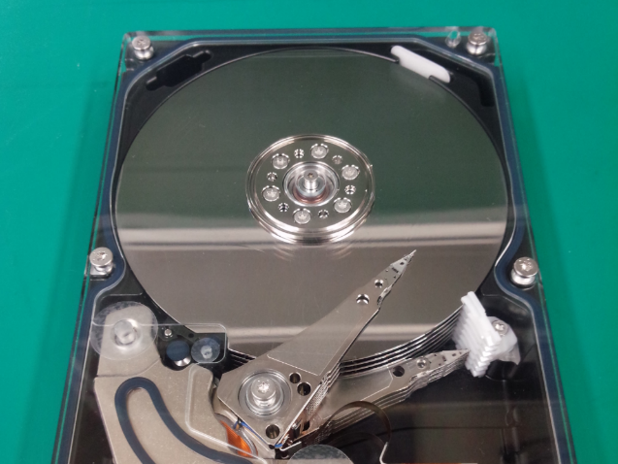
Future Outlook: Multi Actuator
Multi-Actuator
Prototype

Slide 15
Toshiba Enterprice Capacity HDD Lineup
Options:
4k Byte Native Format
MG0xACAxxxA
MG0xSCAxxxA
SED – Self Encrypting Drives
MG0xACP / MG0xSCP
SIE – Sanitize Instant Erase
(Crypto Erase)
MG0xACAxxxEY
MG0xSCAxxxEY
SAS
12G

Slide 16
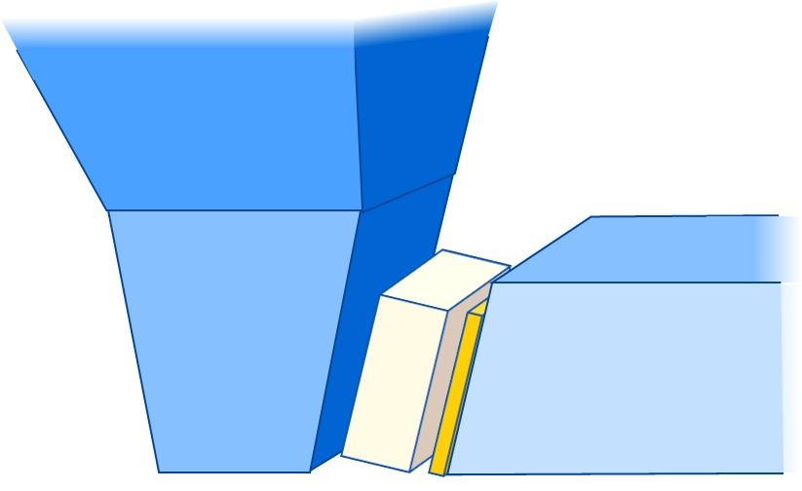
Assist Effects of MAMR
MAMR writing assist relies on two phenomena, the well known microwave assisted
switching (MAS), and the newly highlighted flux control (FC). Oscillation rotation
angle determines relative contributions. FC dominates the assist in the MG09 writer.
Microwave Assisted Switching effect
(MAMR with MAS)
Recording Flux Control effect
(MAMR with FC)
Main Pole
STO
Write Shield
STO
Main Pole
Write Shield
Medium Magnetization
Medium Magnetization
Required recording field for medium magnetization reversal is reduced by magnetic resonance between STO and media.
Recording field amplitude and gradient are improved by STO FC effect.
Original MAMR concept
Extended concept of MAMR

Slide 17
MAMR effects comparison
MAMR with FC (Flux Control) dominant design is for early application.
MAMR with MAS (Microwave Assisted Switching) dominant design and HAMR will be expected similar ADC potential.
 | MAMR with FC dominant design | MAMR with MAS dominant design |  | ( HAMR )
ADC gain | Up to 20% | Over 200% potential |  | Over 200% potential
Assist element reliability | Similar as Reader reliability |  |  | High temperature resistance required
Oscillation frequency control | Not necessary | Required |  | -
Media design optimization | Conventional PMR media is usable | Need MAMR optimized media (resonance frequency, uniform grain property) |  | Novel FePt granular magnetic system required
Assisted ADC gain
MAMR with MAS
MG09 (1st Gen) target
MAMR with FC
2020 2025
ADC: Areal Density Capability

