Slide 1
VMWARE – future ready technology for Your digital journey
No Time for Downtime
Maguay Flagship Event
Florin Marginean - Vmware Romania
Sept 2021

Slide 2
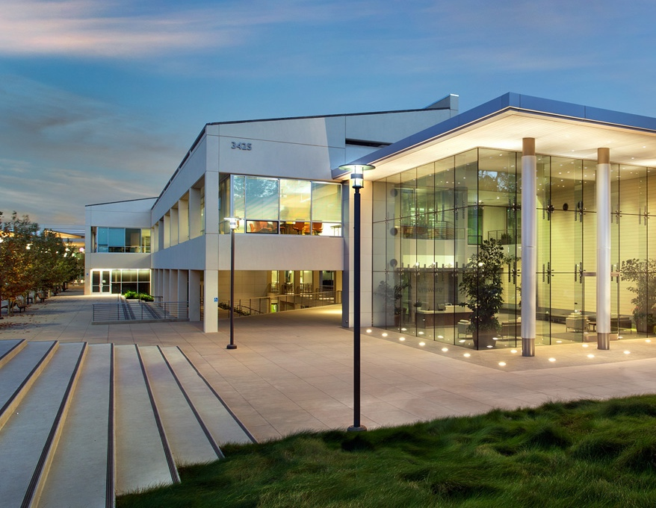
VMware: Fast Facts
A leading innovator in enterprise software, we power the world’s digital infrastructure. Our solutions form a flexible digital foundation that enables technology-driven transformation without disruption.
$11.81B in revenue in the last FY
500,000+ customers
Chosen by over 99% of Fortune 1000
and over 97% of Forbes Global 2000 companies
Among the Top 5 large tech vendors in customer satisfaction in North America¹
33,000+ employees
Offices in 50+ countries
Extensive partner ecosystem
On Global 100 list of Most Sustainable Companies²
Source: Temkin annual survey to 800 IT decision makers of North American companies with >$250 million annual revenue 2013-2018
VMware named #90 on the Global 100 list of Most Sustainable Companies in 2019
Notes:
As you use it, you can use another award that is more relevant to your audience and more current. You will find awards here.

Slide 3

How VMware Helps
Achieve your business and technology objectives
Meet changing needs of customers and employees | Optimize operations and GTM speed | Strengthen security and business resilience
App Modernization
Multi-Cloud
Virtual Cloud Network
Digital Workspace
Intrinsic Security
The Digital Foundation for Successful Digital Business
Notes:
To summarize: You need to meet the rapidly changing needs of your customers and employees. This means acting more quickly than ever before – and relying on the people and systems that you already have. Digitizing your business at its core gives you the speed and flexibility essential for rapid execution while improving security and business resilience.
We help you build your foundation for digital business success in 5 key ways:
Modernize your app environment and take advantage of cloud-based flexibility while enabling better dev and ops collaboration
Manage complexity, cost and security across multiple clouds; provide elastic capacity to scale instantly and on demand
Connect and protect apps and data with consistent end-to-end networking made possible by a virtual cloud network
Empower remote workforces with a digital workspace that delivers access to any app on any device without compromising security
Protect your business and its applications, data, endpoints and users with automated, proactive and intrinsic security
The result is a foundation for resilient digital business.

Slide 4




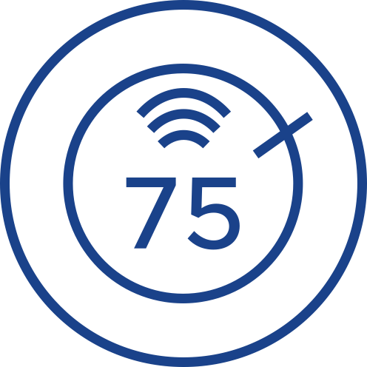





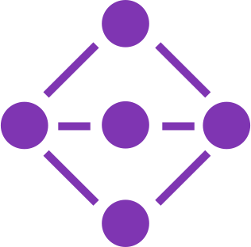
VMware Delivers the Digital Foundation
Build, Run, Manage, Connect and Protect Any App on Any Cloud on Any Device
Any Device
Any Application
Traditional
Cloud Native
SaaS
Any Cloud
Intrinsic Security
Edge
Private
Public
Hybrid
Hybrid
Telco
Notes:
A digital foundation built on VMware enables your existing teams to build, run, manage, connect and protect your entire application portfolio – on any cloud and any device.
It enables you to digitize your core business processes, so you gain the flexibility, security and scalability to respond to external disruptions and the rapidly changing needs of your employees and customers.

Slide 5
Any App
VMware Tanzu™
Build, run and manage existing traditional apps and new cloud-native apps
Traditional
Cloud Native
Simplify multi-cloud operations | Ship great software faster | Transform Dev and Ops together
Get your infrastructure ready for modern apps, and centrally manage your clouds and clusters. | Increase developer velocity with a modern software supply chain. | Unify application developers and operations teams around the shared goal of fast release cycles.
Consistent Developer Experience
Notes:
Let’s take a closer look at what this means for applications.
In a recent Forrester survey of executive priorities, 78% said that improving their application portfolio is a top priority**. But only half have made progress on it in the past year.
Many businesses are heavily invested in legacy apps, including mission-critical systems that were built to be reliable – NOT to change and evolve.
Enterprises have custom applications and integration software that take many manual steps to change. They are facing higher costs and risk to operate this software in the face of growing vulnerabilities and unforeseen disruptions.
How can your business modernize its applications efficiently –while also developing new applications that take advantage of the flexibility and innovations offered by cloud and open source?
We can help. With VMware Pivotal Labs, you can re-platform and modernize your applications and rewrite them as microservices.
Our Tanzu portfolio helps you standardize the way you build and run new applications, making Kubernetes and related container technologies much easier to adopt and deploy.
VMware Tanzu simplifies multi-cloud operations, giving IT consistency across all on-prem and public cloud deployments from a single management console.
This same console lets your developers use their favorite tools and frameworks to build and deploy applications and microservices.
[click to build – consistent dev experience]
This results in a consistent, agile, self-serve experience for your developers, enhancing their productivity while improving their collaboration with ops teams.
In short, you can accelerate software delivery for any kind of app while addressing all your Day 2 operations needs in a consistent manner that’s much easier to automate and scale.
**A commissioned study conducted by Forrester Consulting on behalf of VMware.
How Transformative CIOs Use Customer Experience to Differentiate & Deliver Results. February 2020

Slide 6









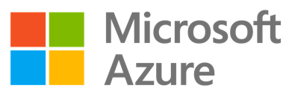
Any Cloud
VMware Cloud Foundation, VMware Cloud
The only complete portfolio for the multi-cloud journey
Consistent Operations
VISIBILITY
OPERATIONS
AUTOMATION
SECURITY
GOVERNANCE
CONTAINER MANAGEMENT
Consistent Infrastructure
VM
VIRTUAL MACHINES
CONTAINERS
KUBERNETES
Private
Edge
Hybrid
Public
Hybrid
Telco
VMware Cloud Deploy on premises or consume as a service
Same cloud stack runs in every major hyperscale cloud + >120 verified service partners
Notes:
…And you can run all your apps in the environment of your choice -- while leveraging the people and tooling you already have.
You can run them on-premises in a fully integrated stack: VMware Cloud Foundation.
VMware Cloud Foundation can run in your environment and be managed in a highly automated way by your existing teams.
Or you can access it as a service and let VMware manage it for you through VMware Cloud on AWS.
It’s also available in every other public cloud—Azure, Google, IBM and more.
Because our hybrid cloud stack runs in every hyperscale cloud, you can migrate existing apps without rewriting them. Or connect them to new cloud services to extend their value.
You can also work with one of our global VMware Cloud provider partners and leverage their managed services.
VMware Cloud is a faster, safer path to hybrid cloud. It provides elastic capacity to scale new users instantly and on demand.
This same integrated stack also runs in edge deployments, so you can get the benefits of consistent infrastructure and operations there too.
When we say ”any cloud" we mean you have tremendous choice and flexibility in your cloud and app strategies, and the ability to change your mind without penalty. We're the ONLY company that enables this.
[click to build] Consistent Infrastructure
You can move data center workloads to the cloud; move native cloud workloads to the data center or edge; and run new container-based apps across any of these environments as well.
[click to build] Consistent Ops
When you’re operating in a multi-cloud environment, your IT teams needs to manage cost, resource utilization, compliance, and ongoing operations across every cloud your organization uses.
VMware enables consistent, highly automated operations on inconsistent multi-cloud infrastructure, providing centralized visibility and simplifying your operational burden, while breaking down silos between on-prem and cloud operations teams.

Slide 7
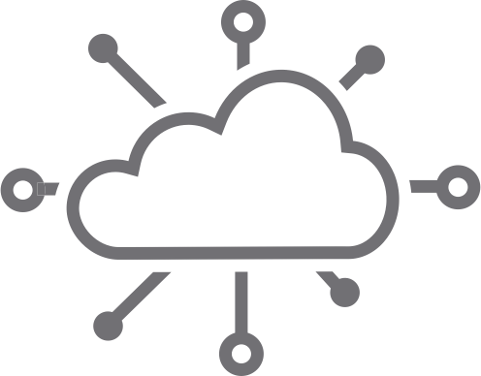
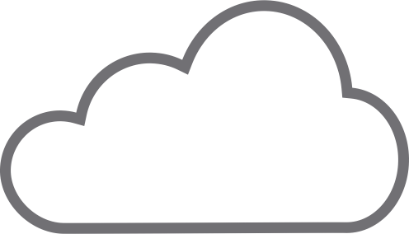







Connect Apps & Data Everywhere
VMware NSX®
We enable a flexible, more secure network from core to cloud to edge
Apps & Data
Apps & Data
Apps & Data
Apps & Data
Edge
Cloud
Data Center
Telco / 5G
Virtual Cloud Network
SD-WAN
Routing
IDS/IPS
Service-defined
Firewall
Advanced
Load
Balancing
Service
Mesh
Switching
Notes:
Another major challenge is connecting and safeguarding all your apps and data.
It’s become more important than ever to distribute network capacity and scale security to meet sudden changes in demand.
Organizations today struggle with the fact that apps and data are no longer restricted to a single environment. As a result, having 3 different networking models—one for WAN/edge, one for cloud, and one for the data center, no longer works. Siloed networking tied to hardware is a bottleneck instead of a business enabler.
What's needed is a software-defined networking layer that provides consistent connectivity, policy management and automation everywhere your apps and data reside.
It needs to work on bare metal, with VMs and containers, at WAN and edge locations, and all public cloud environments.
It must enable more secure remote access so employees can continue business activities from anywhere.
[click to build]
We call this the Virtual Cloud Network and it’s powered by the VMware NSX family of networking technologies.
It delivers consistent end-to-end networking, fully defined and managed in software, that's programmable, automated, and intrinsically more secure than hardware-defined networks.
[click to build]
It not only supports today's environments, but emerging innovations like 5G.

Slide 8
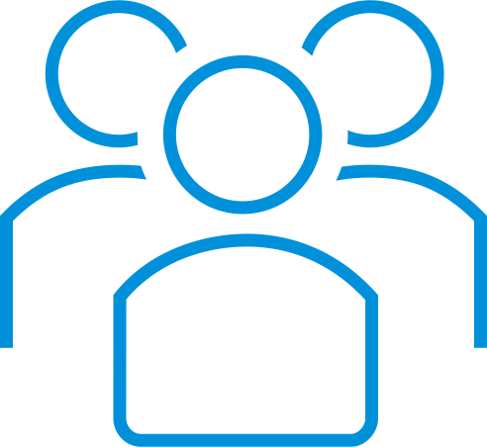
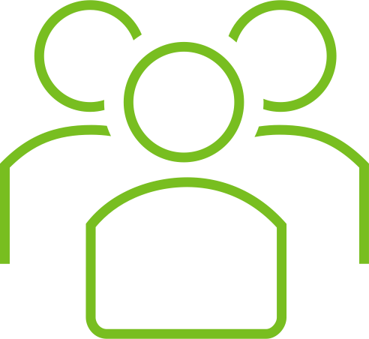
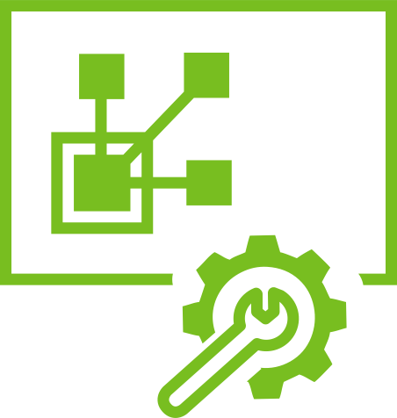



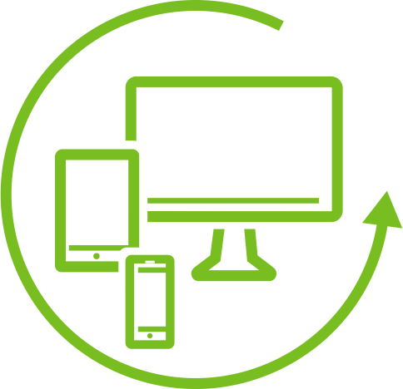

Any Device
VMware Workspace ONE®
Empower your employees anywhere with a digital workspace
END USERS
IT
Immediate productivity from anywhere with easy access to all apps
Simplified app, data, and
device management
One unified platform to simply and more securely deliver
and manage any app on any device.
Notes:
Now let’s talk about how your employees can be productive wherever they need to work, with continuous, highly secure access to applications from a wide range of devices.
VMware Workspace ONE enables highly productive remote working on the devices your employees choose.
Digital workspaces transform the end user experience while greatly simplifying and automating IT’s management burden.
They take the friction out of app delivery and promote user choice and flexibility while improving security.
Workspace ONE unifies and automates the management of all your end user environments (mobile phones, laptops, physical desktops, virtual desktops, and all the related applications) into a single solution.
It integrates access control, application management and multi-platform endpoint management into a single platform available as a cloud service or on-premises deployment.
A Zero Trust access control model helps ensure that employees can safely use any application, whether they run in the cloud or the data center.
The addition of VMware Carbon Black Cloud delivers predictive and automated endpoint security, furthering your ability to support an agile remote workforce.

Slide 9




Intrinsic Security
VMware Carbon Black Cloud™
Leverage all your touchpoints to better secure your business
ANALYTICS
Endpoint
Identity
Build security into the infrastructure
Understand context to protect devices, servers, and cloud workloads
Protect all endpoints that access organizational assets remotely
Unify operational silos by centralizing the analytics
Apps | Data
Devices
Users
Workload
Cloud
Network
Apps
IaaS
Infrastructure
9
Notes:
We’ve touched on security in the previous slides, but let's talk about our overall vision here.
Today's approach to security is too complex and relies on too many products.
Our average customer deploys 70-100 security products, each with its own management console and many with their own agents.
Most are focused on blocking threats at the perimeter, without understanding context. They don’t know enough about the applications or the infrastructure.
The virtualization layer sits in the ideal place to have deep visibility into apps, data and endpoints, while being very hard to compromise from within an app or operating system process.
VMware leverages this to help you implement a "zero trust" security model across all environments, and greatly reduce your attack surface with far fewer products.
Combining this with the real-time threat data from VMware Carbon Black Cloud, and the security capabilities of NSX, you can have a new level of protection for data center workloads, endpoints, and public cloud environments—with much lower operating burden.
You can protect remote workforces against cyber attacks without any additional infrastructure, by leveraging the resources you already have.
You have visibility into network traffic and understanding of app behavior to see and stop progressive lateral infiltrations.
And we’ve centralized the analytics, so teams can share information in integrated workflows and zero in on threats and vulnerabilities. Security becomes a team sport across secops and IT ops.
[Optional drill-down talking points]
[Network / Infrastructure]
Compartmentalize the network and control traffic through micro-segmentation, access, and traffic inspection
[Cloud / IaaS]
Monitor and analyze the configuration of the public cloud infrastructure that you're leveraging
[Workload / Apps]
Our technology enables you to wrap security as close as possible to each of your apps and workloads, ensuring that the app is doing only what it should be doing.
You can learn an app’s known good behavior in terms of how it interacts with the processor, memory, storage, data and the network, and then you can automate actions based on behavioral anomalies.
This capability enables you to detect a zero-day threat, for example, before a malware signature even exists.
[Endpoint / Devices and Identity / Users]
Harden the posture of the device and factor in the level of authenticity of the user connecting to it.

Slide 10




Digital Workspace
VMware
Workspace ONE
Digital Workspace
Workspace ONE
App
Modernization
Tanzu
App Modernization
VMware Tanzu
VMware Pivotal Labs
VMware
Portfolio at-a-Glance
Organized to Meet Customer Objectives
Intrinsic Security
VMware Carbon Black Cloud
Intrinsic Security
Carbon Black
Multi-Cloud
VMware Cloud
VMware vSphere
VMware vRealize
CloudHealth by VMware
Multi-Cloud
VCF / VMC
Virtual Cloud Network
VMware NSX
VMware SD-WAN by VeloCloud
Virtual Cloud Network
NSX
Notes:
VMware’s product portfolio is set up to deliver on the priorities of our customers. We are integrating acquisitions into our portfolio to provide customers with comprehensive, seamless solutions to their biggest challenges.
[NOTE TO PRESENTER: Add any relevant products here that you plan to discuss with your audience.]

Slide 11




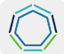
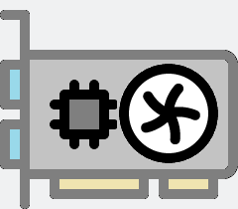
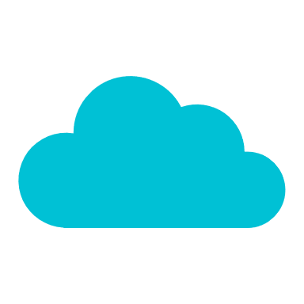
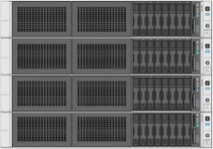
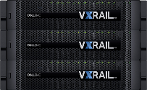
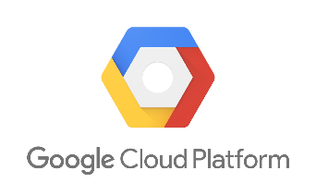
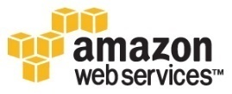


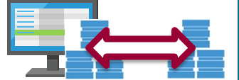
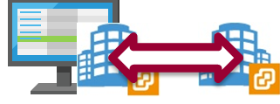
Validated
Designs
Education
Services
VMware
Certifications
Advisory
Services
Customer Experience
& Success
PSO
Delivery
Global Support
Services
Horizon
Carbon Black
Workspace One
Digital Workspace
Services
Intrinsic Security
vROps & Wavefront
Log Insight
Automation
Cloud Health
vRNI, VeloCloud & AVI
Containers
Kubernetes
Tanzu
Bitfusion
Intrinsic Security
Central Cloud Management Platform
Network & WAN
Modern Applications
AI & ML
Intrinsic Security
SaaS
SaaS
SaaS
Hyper-Converged Appliances
VMware Cloud
Storage Replication
Site Recovery
vCenter
vSphere
VSAN
NSX
HCX
VMware on Premises – Data Center #1
Data Center #2
Storage Replication
Site Recovery

Slide 12
Cloud Services
VMware Cloud on Dell EMC
vRealize Suite
VMware Service Broker
VMware HCX
VMware Site Recovery
VMware Cloud Marketplace
Pulse IoT Center
VMware Cloud on AWS Outposts
VMware vRealize Log Insight
VMware Cloud Assembly
VMware SD-WAN by VeloCloud
VMware Tanzu Solutions
VMware Learning Platform
Airwatch
VMware Cloud on AWS GovCloud
VMware vRealize Network Insight
VMware Code Stream
AppDefense
VMware Enterprise PKS
VMware Cloud Providers
Workspace ONE
VMware Cloud Foundation for EC2
VMware vRealize Operations Cloud
CloudHealth
VMware Secure State
VMware Essential PKS
VMware Hybrid Cloud Platform
Horizon 7 on VMware Cloud on AWS
VMware Cloud on AWS
VMware vRealize Automation Cloud
Wavefront by VMware
NSX Cloud
VMware Cloud PKS
VMware Hybrid Cloud Solutions
Horizon Cloud
VMware Cloud Foundation
NFV
End-User Computing
Open Source
Emerging
vCloud NFV
VIO Carrier Edition
Workspace One
Horizon
Xenon
Photo OS
VMware Tanzu Mission Control
VMware Smart Assurance
UHANA
VMware Smart Experience
Workspace One UEM
Horizon 7
Tern
LIOTA
VMware Cluster Memory (vCM)
VCPP
Project Pathway
vCloud Director
vCloud Availability
Usage Meter
Usage Insight
Workspace one Access
Horizon Apps
Chap
Gimbal
DaaS
CSE
OSE
Tenant App
Virtual Service Network VSN
Workspace One Intelligence
ThinApp
Lightwave
Clarity
Cloud Provider Pod
VMware Cloud Marketplace
Cloud Provider Hub
ESXi on ARM
Workspace ONE Assist
NSX for Horizon
vASDKs
Contour
Apps
SmartNIC Virtualization
Pivotal App Suite
Pivotal GemFire
Pivotal RabbitMQ
Pivotal tc Server
PKS
NSX Service Mesh
Sonobuoy
Project VXR
Workspace One Hub
vSAN for Horizon
CMP
Velero
Project Pacific
vRealize Suite
Trust Network partners
(Carbon Black)
App Volumes
vRealize Automation
vRealize Operations
vRealize Lifecycle Manager
Weathervane
Project Magna
Workstation Player
vROPs for Horizon
vRealize Orchestrator
vRealize Code Stream
Bitnami
Admiral
Project Concord
vRealize Network Insight
vRealize Log Insight
Fusion Pro
Workstation Pro
Harbor
Project Milky Way
Virtualization
vSphere
vCenter Server
vSAN
NSX DataCenter
NSX HCX
NSX Advanced LB
NSX SD-WAN
AppDefense Plugin
VMware Cloud Foundation
vCloud Suite
Site Recovery Manager
Dell EMC VxRail

