Slide 1
Fortinet SecOps
Madalin Vasile, Director Systems Engineering

Slide 2
IT Trends and Customer Challenges
A Platform approach to Cybersecurity

Slide 3




Digital Acceleration
Work From Anywhere
IT
TRENDS
Application Journey
Evolving Threat Landscape
Notes:
We are seeing 4 major industry trends: Digital Acceleration, the move to Work from Anywhere, Increased sophistication and intensity of threats and a lack of skilled professionals.

Slide 4
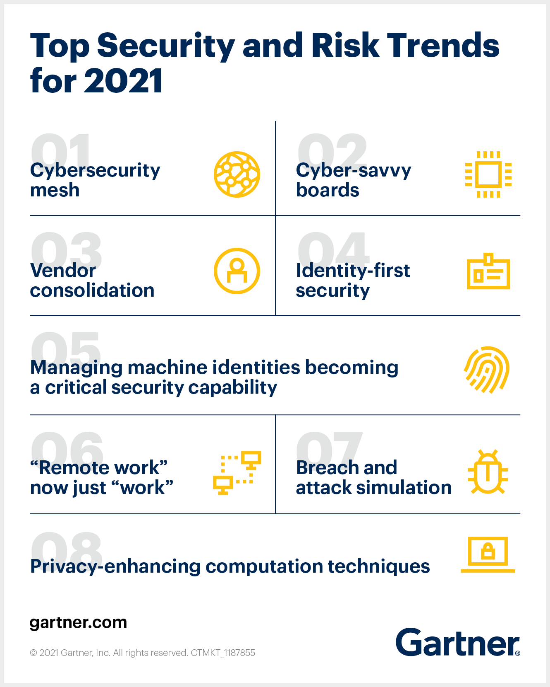
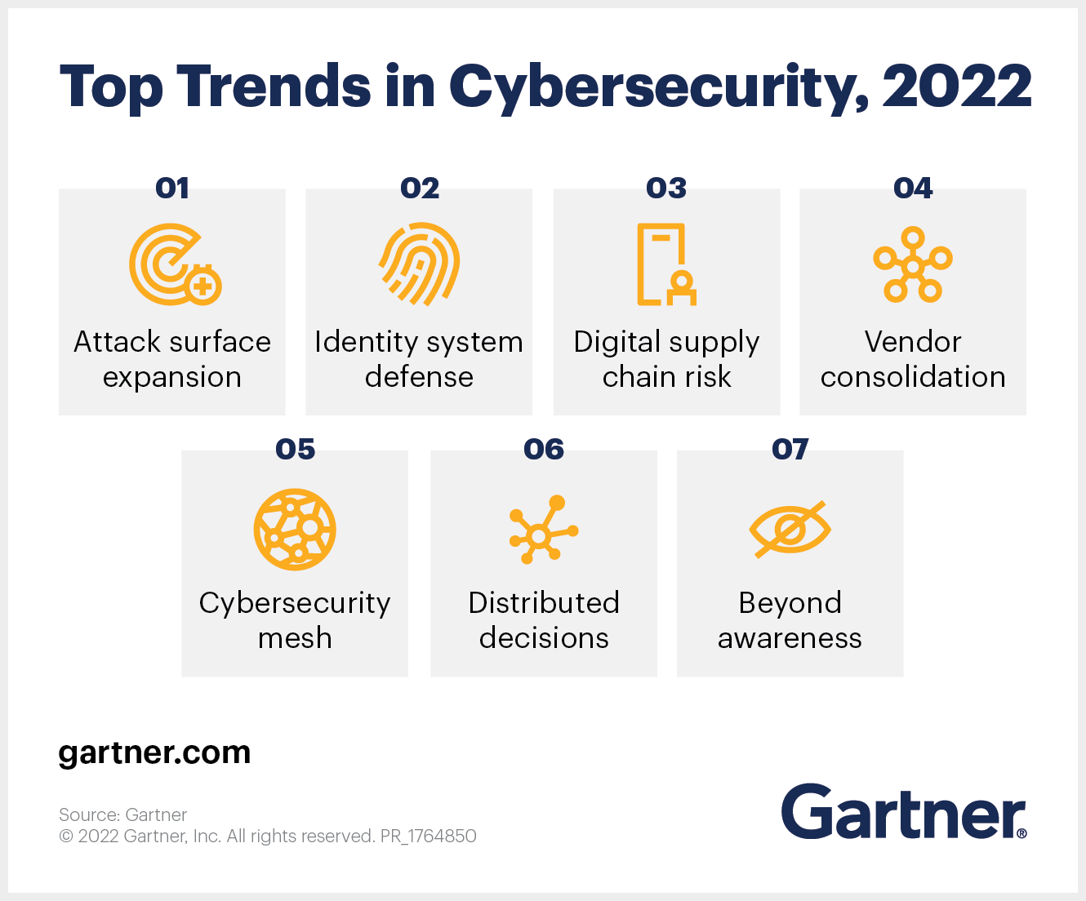
Cybersecurity Security Fabric (Mesh)
https://www.gartner.com/smarterwithgartner/gartner-top-security-and-risk-trends-for-2021
Notes:
Trend No. 1: Cybersecurity mesh
The cybersecurity mesh is a modern conceptual approach to security architecture that enables the distributed enterprise to deploy and extend security where it’s most needed.
Ultimate Guide: Cybersecurity
When COVID-19 accelerated digital business, it also accelerated the trend wherein many digital assets — and individuals — are increasingly located outside of the traditional enterprise infrastructure. In addition, cybersecurity teams are being asked to secure countless forms of digital transformation and other new technologies. This requires security options that are flexible, agile, scalable and composable — those that will enable the organization to move into the future, but in a secure manner.
Trend No. 2: Cyber-savvy boards
With an increase in very public security breaches and increasingly common business disruptions due to ransomware, boards are paying more attention to cybersecurity. They recognize it as a huge risk to enterprises and are forming dedicated committees that focus on cybersecurity matters, often led by a board member with security experience (such as a former chief information security officer [CISO]) or a third-party consultant.
This means that CISOs can expect increased scrutiny and expectations, alongside an increase in support and resources. Be prepared to improve communication and expect tougher questions from your board as a result.
Download IT Roadmap: Cybersecurity Strategy
Trend No. 3: Vendor consolidation
The reality for security today is that security leaders have too many tools. Gartner found in the 2020 CISO Effectiveness Survey that 78% of CISOs have 16 or more tools in their cybersecurity vendor portfolio; 12% have 46 or more. Having too many security vendors results in complex security operations and increased security headcount.
Most organizations recognize vendor consolidation as an avenue for more efficient security, with 80% executing or interested in a strategy for this. Large security vendors are responding with better-integrated products. However, consolidation is challenging and often takes years to roll out. Although lower costs are often a perceived driver of this trend, more streamlined operations and reduced risk are often more achievable.
Trend No. 4: Identity-first security
Hybrid work and the migration to cloud applications have solidified the trend of identity as the perimeter. Identity-first security is not new, but it takes on fresh urgency as attackers begin to target identity and access management capabilities to gain silent persistence.
Misused credentials are now the top technique used in breaches. Nation-state-level attackers are targeting active directory and the identity infrastructure with phenomenal success. Identity is a key lateral movement technique across air-gapped networks. Multifactor authentication usage is growing, but it is not a panacea. Identity infrastructure must be properly configured, maintained and monitored with an elevated importance.
Trend No. 5: Managing machine identities becoming a critical security capability
As digital transformation progresses, there has been an explosive growth in the numbers of nonhuman entities that make up modern applications. Therefore, managing machine identities has become a vital part of security operations.
All modern applications are made up of services that are connected by APIs. Each of these services need to be authenticated and monitored as attackers can use your suppliers’ API access to critical data to their advantage. The tools and techniques for enterprisewide machine identity management are still emerging. However, an enterprisewide strategy for managing machine identities, certificates and secrets will enable your organization to better secure its digital transformation.
Trend No. 6: “Remote work” is now just “work”
According to the 2021 Gartner CIO Survey, 64% of employees are now able to work from home, and two-fifths actually are working from home. What was once only available to executives, senior staff and sales is now mainstream. The movement to hybrid (or remote work) is a durable trend with more than 75% of knowledge workers expecting future hybrid work environments.
From a security perspective, this requires a total reboot of policies and tools to better mitigate risks.
Trend No. 7: Breach and attack simulation
A new market is emerging to help organizations validate their security posture. Breach and attack simulation (BAS) offers continuous testing and validation of security controls, and it tests the organization’s posture against external threats. It also offers specialized assessments and highlights the risks to high-value assets like confidential data. BAS provides training to enable security organizations to mature.
Trend No. 8: Privacy-enhancing computation techniques
Privacy-enhancing computation techniques that protect data while it’s being used — as opposed to while it’s at rest or in motion — enable secure data processing, sharing, cross-border transfers and analytics, even in untrusted environments.
This technology is rapidly transforming from academic research to real projects delivering real value, enabling new forms of computing and sharing with reduced risk of data breaches.

Slide 5
Overall SecOps platform definition

Slide 6







Aligned to Cybersecurity Standards
International cyber security standards
with a focus on the ISO/IEC27001 and the NIST Cybersecurity Framework
Identify
Respond
Data and systems that need to be protected are identified.
Identify
Protect
The response phase requires a company to devise a plan for responding to a threat. The plan will include the different methods used to mitigate the threat, as well as which tools will be used.
Protect
Team puts security measures into place to safeguard the data. These will often involve specific tools, hardware, and software designed to address common security concerns.
Cybersecurity Framework
Recover
In the event an attack penetrates the network, the process outlined by NIST also includes ways of helping an organization recover as quickly as possible.
The Core
Recover
Detect
Detect
Tools and policies are designed to discover an incident when it happens.
Respond

Slide 7

What is SECOPS?
Security Operations
Combination of Security & IT Operations
Highly skilled team focusing on Monitoring Risk Assessment to protect Corporate Assets
Operating from a Security Operations Centre
SecOps
Notes:
<DD> Light Version

Slide 8


















Security Operations Vision
Speed Operations With AI-Powered Analytics, Automation and Augmentation
FortiAnalyzer
Key use cases
Fabric Visibility
Fabric Analytics
Fabric Automation
FortiEDR
Key use cases
Attack Surface Reduction
NGAV
EDR/ XDR
Ransomware Protection
SOC as a Service
Key use cases
Managed Firewall and Endpoint
Alert Triage
Managed Detection & Response
Key use cases
Endpoint Detection and Response
Threat Hunting
Alert Triage
FortiSIEM
Key use cases
Multi-vendor Visibility
Advanced Analytics
Incident Management
Managed SOC
SOC Platform
Incident Response Service
Key use cases
Identify and contain incidents
Scope and remediate
Breach Protection
FortiSOAR
Key use cases
Multi-vendor Automation
Process Orchestration
Threat Intelligence Management
Security Awareness & Training
Key use cases
Automated phish testing
Integrated user training
FortiDeceptor
Key use cases
Detect Reconnaissance
Engage Ransomware
Identify Lateral Movement
FortiNDR
Key use cases
Detect Anomalies
Analyze Malware
Automate Response
FortiInsight(UEBA)
Key use cases
Identify Insider Risk
Detect compromised accounts
FortiRecon
Key use cases
Map the attack surface
Detect threat infrastructure
FortiTester
Key use cases
Assess security posture
Identify gaps

Slide 9























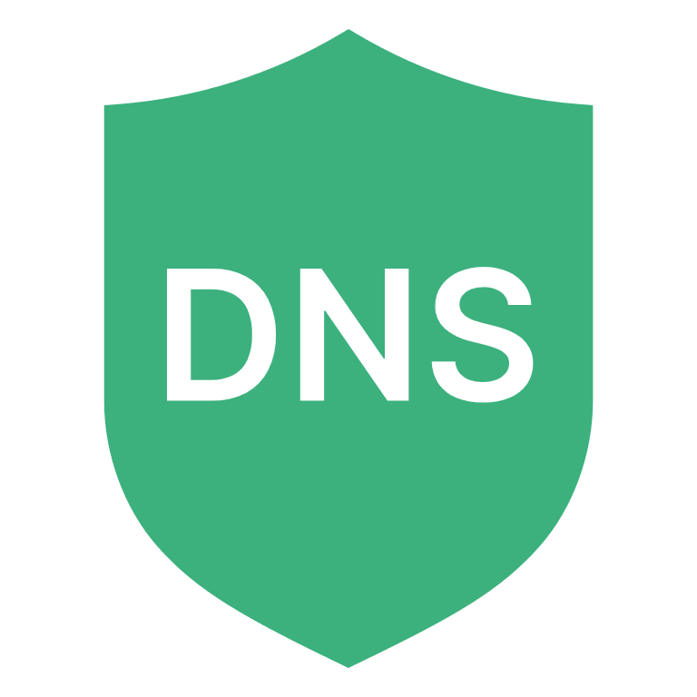
How to Break the Attack Sequence
Lockheed Martin Attack Kill Chain
Pre-Attack
Attack
Recon
Weapon
Delivery
Exploit
Installation
C&C
Action
Web application ​
FortiRecon
FortiRecon
FortiGate
(HW/VM/CN/SASE)
FortiGate
(HW/VM/CN/SASE)
FortiGate
(HW/VM/CN/SASE)
FortiGate
(HW/VM/CN/SASE)
FortiAnalyzer
Event handlers & reports
FortiProxy
FortiProxy
FortiClient
FortiClient
FortiSIEM
Rules Engine & Threat Hunting
FortiClient
FortiClient
FortiEDR
Defuse exploit
FortiEDR
Defuse compromised
endpoint
FortiSOAR
Playbooks
FortiEDR
FortiEDR
Defuse compromised
endpoint
IOC
Threat hunting
Products & Solutions
FortiADC
FortiDeceptor
Defuse Lateral Movement
FortiNDR
FortiADC
FortiSIEM
UEBA
Outbreak Detection
FortiWeb
FortiWeb
Web application
FortiCWP
ZTNA
Auto tagging
FortiNDR
AV+ANN
FortiSIEM
UEBA
FortiClient
Endpoint search
FortiMail
FortiDeceptor
Threat detection, analysis, and response
FortiSIEM
UEBA
FortiEDR|XDR
FortiCASB
FortiDeceptor
Threat intelligence, & attack isolation
FortiCWP
FGD
AI-Powered Security
Credential Stuffing Prevention Service
Anti-malware, AV pre-Filter, SBX, Endpoint Vulnerability Protection, App Control, IL CASB, Credentials
IPS, Application, FW, IOT, OT
URL, AV
Botnet, C2, DNS
SOC
Augmentation by FortiGuard
Know Your Risks & vulnerabilities
Security Assessments
Train your SOC
IRR, Playbooks, Training
Managed Detection & Response
MDR
Augment your SOC
SOC as a Service
Respond Faster and More Effectively
Incident Response

Slide 10
Value proposition
Why SecOps why Fortinet

Slide 11
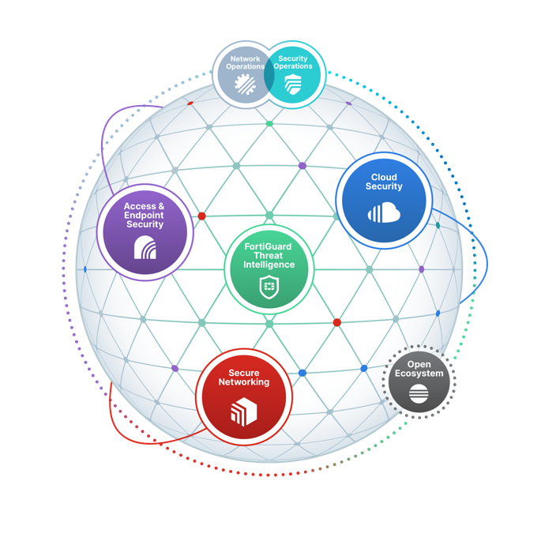

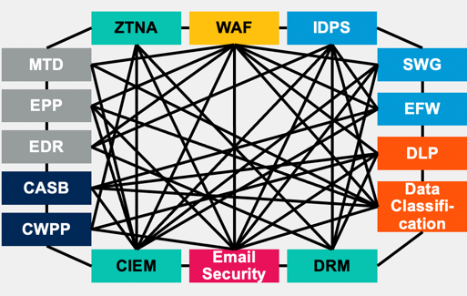
SecOps is not just technology,
it’s all about people, process and technology
CONSOLIDATION
INTEROPERABILITY
AUTOMATION
Executive Guide to Cybersecurity Mesh, 2022
Felix Gaehtgens, James Hoover, Henrique Teixeira, Claudio Neiva, Michael Kelley, Mary Ruddy, Patrick Hevesi. As of October 2021
This graphic was published by Gartner, Inc. as part of a larger research document and should be evaluated in the context of the entire document. The Gartner document is available upon request from Fortinet.
GARTNER is a registered trademark and service mark of Gartner, Inc. and/or its affiliates in the U.S. and internationally and is used herein with permission. All rights reserved.
SecOps

Slide 12
CxO Challenges Today
Gartner Cybersecurity MESH Architecture (CMSA) copies Fortinet Fabric
DLP
SOAR
EASM
SOAR
SIEM
EASM
IAM
CASB
IAM
CASB
XDR
EMAIL
XDR
EMAIL
Cybersecurity Point Products
Cybersecurity Platform Approach
EPP
EDR
SIEM
WAF
EPP
EDR
WAF
20 Vendors
ZTNA
CWP
ZTNA
CWP
4 – 6 Platforms
NAC
vFW
NAC
vFW
LAN
NGFW
SWG
LAN
NGFW
SWG
Current IT architecture are impossible to make sense off
To many products, to many platforms, to many dependencies
The real (net) result is that your teams are killing themselves to the task of just see what you have
Just embrace everything you have in one single visibility)

Slide 13


Cybersecurity Maturity Levels Mapping
FortiAnalyzer
FortiSIEM
FortiDeceptor
Level 1 - Secure
Initial
Level 2 - Defend
Managed
Level 3 - Contain
Defined
Level 4 - Monitor
Quantitatively Managed
Level 5 - Manage
Optimizing
FortiGate
FortiNAC
FortiXDR
FortiSandbox
FortiNDR
FortiSOAR
FortiGate
FortiEDR
3rd Party
Technology
FortiAuthenticator
3rd Party
Levels of Protection
FortiSwitch
FortiToken
FortiClient
Asset Inventory, Data Flows, Risk Assessment, Vulnerability Management, Secure Remote Access, PKI
Technology Gap
Threat Intelligence, SOC Integration, SOAR
Based on CMMI, NIST, ARC
Cybersecurity Maturity

Slide 14

SOC Toolkit –FortiSIEM, FortiSOAR, FortiEDR
FortiSIEM
Multi vendor support
Centralized log aggregation
Correlation & analytics
FortiSOAR
SOC optimization
Enhanced incident response
Response automation
FortiEDR
Advanced, real-time endpoint protection
Endpoint threat detection
Automated endpoint response & remediation

Slide 15
FortiSIEM Key Features Overview
Asset Discovery
Comprehensive & granular
Contextual awareness
Vulnerability awareness
Scalable, Rapid Integration
Custom device support
Scale out architecture
Automated Workflow
Incident response
Case management
Automated remediation
Single Pane of Glass
Comprehensive single GUI
Unified NOC & SOC features
PAM
Unified Platform
Multi-tenancy
Role based access control
FortiGuard Intelligence
FortiGuard threat feed
Domain, IP and URL IOCs

Slide 16












Key FortiSOAR Elements (and Focus Areas)
Form Factors / Licensing
VM and Cloud (Enterprise / SP Ready)
Agnostic (Multi-Vendor )
Multi-Tenant
Best Practice Services
Investigation & Response
Efficiently investigate alerts/incidents Understand, review and manage incidents
  Crisis Response (War Room)
  Mobile Application
Automatic tasking across multiple queues and teams
FortiSOAR in The Cloud
Multi-tenancy support
Flexible deployments
  Enterprise
  Shared tenancy
Auto-firmware upgrade/health monitoring
Simple licensing model
Advanced Orchestration & Automation
Easily build advanced automation to create workflows and integrate into existing tools
AI-Based Recommendation Engine
Playbook and Connector Builder
Content packs
Container in FMG/FAZ
KPI Measuring & Reporting
Quickly identify SOC KPI’s (MTTR, analyst time savings) and reporting for audits, leadership etc
Role-Based Access Control
Built-in visual dashboard enabling easy creation of dashboards specific to a role in and outside the SOC
Control access to connector actions, configurations and Playbook
Concurrent Model
Threat Intelligence Management
Deep FortiGuard integration, provides unrestricted lookup and Threat Encyclopedia access within the Indicator module

Slide 17






FortiEDR – Cloud Native EPP + EDR
Detect, Defuse, Respond and Remote Remediation
Pre-infection/ Pre-execution
Post-infection/Post-execution
Discover
& Predict
Prevent
Detect
Defuse
Respond &
Investigate
Remediate & Roll back
Proactive risk mitigation
Pre-execution protection
File-less and advanced threats
Stop Breach and Ransomware
Full attack visibility
Automated Dis-infection
Discover rogue devices & IoT
Vulnerabilities
Virtual patching
ML AV
FortiGuard Threat Intelligence
Sandbox Integration
Desktop firewall
Web filtering
Behavioral based
Detect memory based attacks
Threat classification
Block Malicious actions
Prevent data loss
Zero Dwell time
Playbook automation
Cross platform response
Forensic data
Behavioral-based threat hunting
Built-in MITRE tags
Clean up / Roll back
Eliminate re-image/rebuild
Minimize business disruption
Automation | Cloud . Hybrid . Air-gap deployment | OS coverage
Notes:
While we focused on the top of mind issues, and unique approach to both pre- and post execution protection, FortiEDR takes to address them, it is worth noting that FortiEDR was built from the beginning as a complete EPP +EDR solution .
It starts with the ability to identify and harden the endpoint attack surface....
Once confirmed malicious, we move to the response phase and use playbook to automate.
The automated playbooks is contextual – you can design a incident response process based on the risk tolerance of the endpoint and the category of the threat.
Orchestrated and automated response
Playbook based on asset value and threat categorization
Risk-based approach to incident response without disruption to business operations

Slide 18
Services of modern Cyber Defence Centre
Security event monitoring, detecting, investigating, triaging
Malware analysis, reverse engineering, digital forensics, insider threats, cyberfraud
Threat intelligence platform management
Threat hunting
Content management
Threat and vulnerability management
Compliance
Reporting and notifications
Training
Identity and access governance

