Slide 1

Modern Data Experience
Cristian Stan – System Engineer CEE
Horia Constantinescu – Regional Sales Manager
No Time for Downtime
Bucharest, Novembe 2nd, 2022

Slide 2

Pure Storage at a Glance
FY22 Annual Revenue
Customers
Satisfaction
Leadership
$2.75 B
10,500+*
85.2 NPS
9 Year Leader
26% Y/Y Growth
Global Customers
Top 1% of B2B Companies
Gartner Magic Quadrant
Q2 FY23 Revenue
Customers
Q1 FY23 Subscription Annual Recurring Revenue (ARR)⁽¹⁾
Q2 FY23 Total Cash & Marketable Securities⁽⁴⁾
$647 M
~54%*
$955 M
$1.36 B
30% Y/Y Growth
Of Fortune 500 companies
31% Y/Y Growth
100% Y/Y Growth
03
Uncomplicate Data Storage, Forever
(1) Subscription ARR is a key business metric that refers to total annualized contract value of all active subscription agreements, including Evergreen, on the last day of the quarter, plus on-demand revenue for the quarter multiplied by four.
©2022 Pure Storage Confidential – For internal use only
(*) As of the end of Q4 FY22
Notes:
4: Here’s Why It’s The Real Problem
(During a presentation, clicking the icons on this slide will jump to the hidden slides that follow, offering an opportunity to dive deeper on any given pain point.)
The real problem is that you are having to spend time focusing on the ins and outs of data storage, rather than the core of whatever their business truly is.The reasons why are variable, but predictable and/or discoverable:
There’s too much information to sift through, unsure whether or not this solution fits your needs, or interfaces with the existing systems you have. This causes issues with availability, risk, and resources management. This may come in the form of:
Teams or individuals spending more time on solving implementation or support problems, and less time delivering business impact
Requiring hyper-specialized and costly technical talent, rather than talent which understands the core of the business, therefore generating solutions that are technically interesting but lack the insight necessary to drive your core business forward.
Your needs have changed but your hardware has not. It became obsolete because your focus has shifted and now you can’t leverage your data the right way because of the structures (hardware & software) can’t adapt. This may come in the form of:
We realize that now that we wanted to build it out ourselves, but once we got into it we see that this is incredibly difficult and it’s not even what we’re good at.
We can’t afford a “good enough” storage solution because if we lose our information, we lose our business.
The structure of the rest of my business is modeled around as a service consumption models, my data storage lacks the same agility and flexibility.
Their business is a cutting edge organization and it doesn’t feel like it can find effective solutions for its advanced data activities. They are inclined to build their own solutions, but that consumes all their time and resources that would be better spent on the core of their business. This may come in the form of:
We’ve been burned again and again with piecemeal solutions that underperform, lost data, and in general been unhappy with our projects are constantly on hold as we have to build yet another system before we can even get started on building value for our company.
Being unable to complete with other firms in the market who are innovating more quickly, have scaling benefits, or otherwise contending with rigorous competition

Slide 3
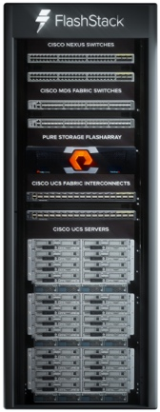
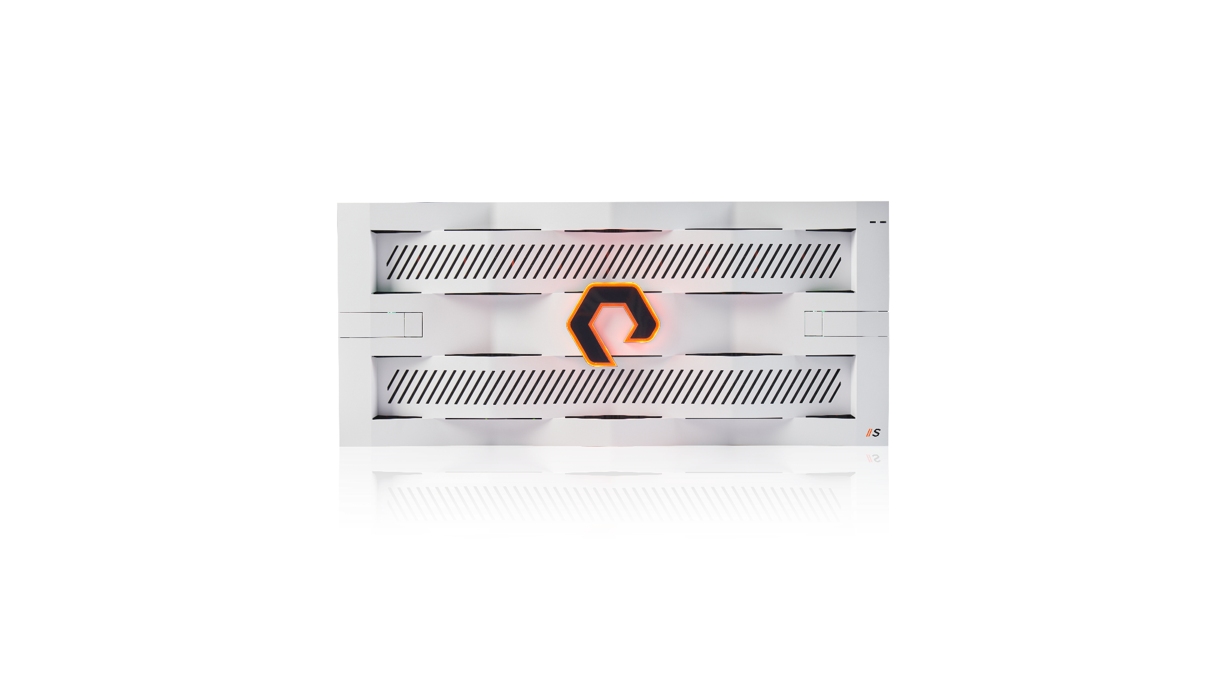

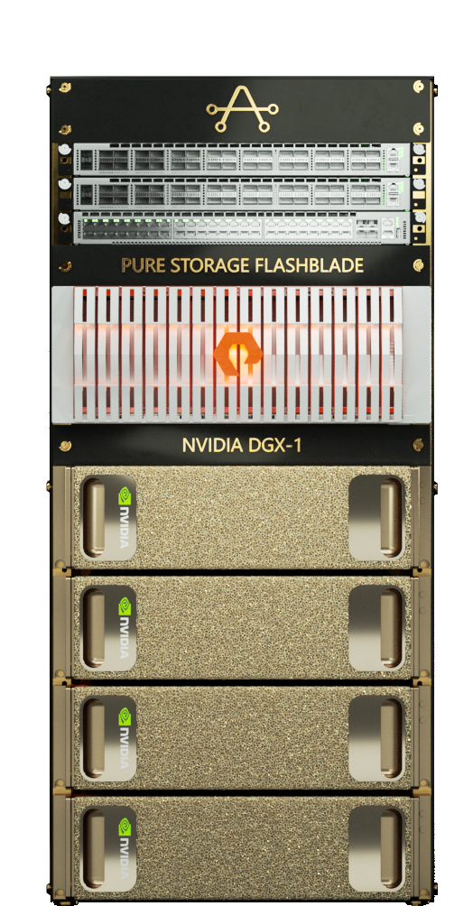
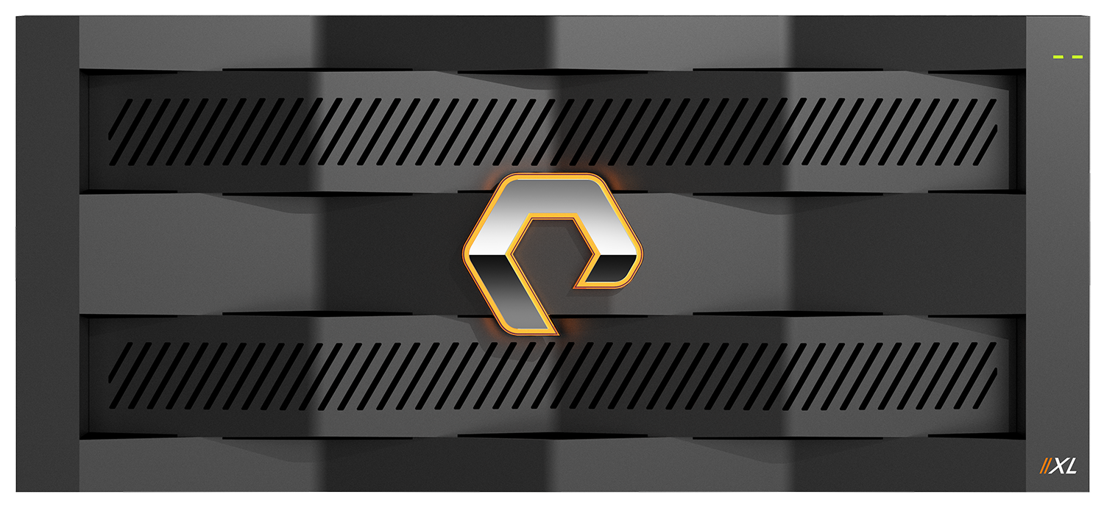

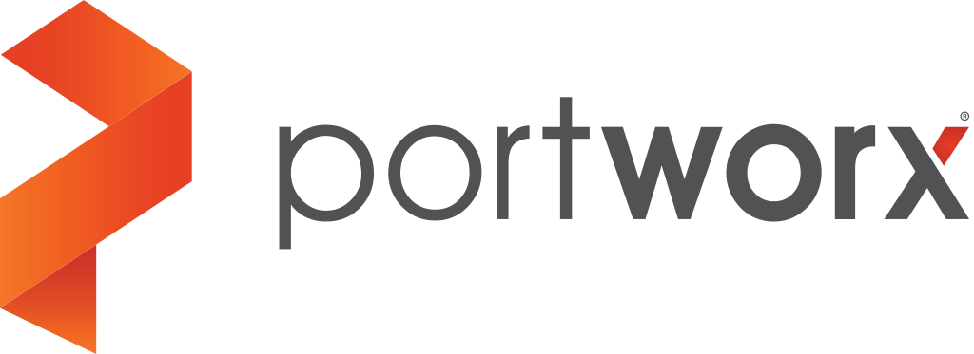


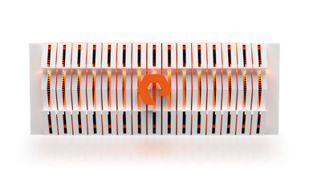
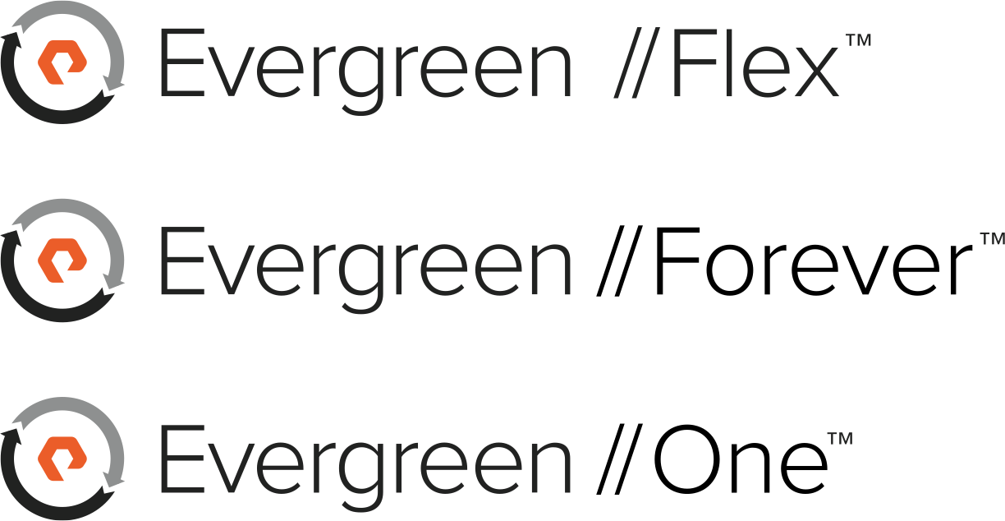


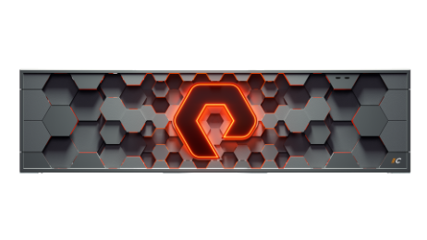
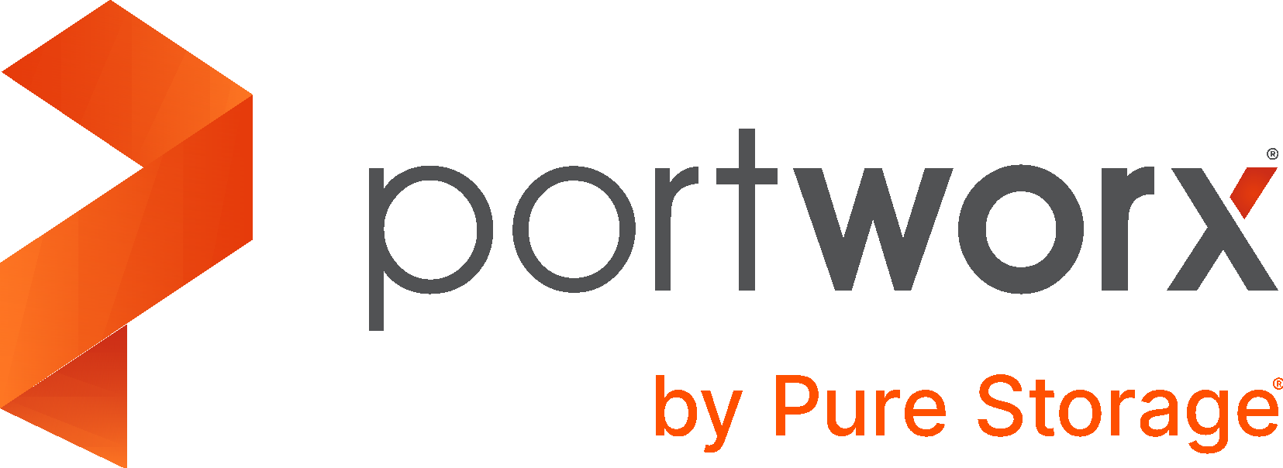

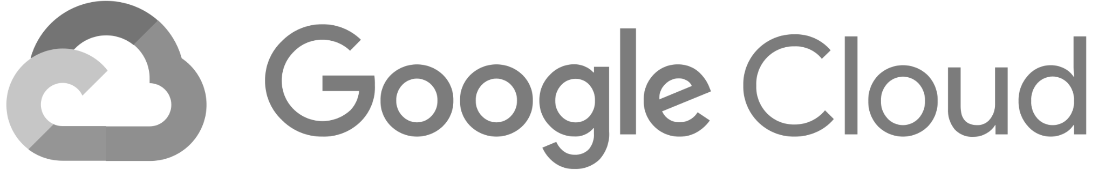
Pure’s Portfolio of Products, Solutions, and Services
FlashArray
data services
DATABASES, VMs & NOSQL APPS
//X FOR TIER 1
//C FOR TIER 2-N
ANALYTICS, AI/ML,
TECHNICAL COMPUTING, FAST OBJECT, SPARK, NEW STACK APPS
CONVERGED PLATFORMS
CISCO: *AAS
NVIDIA: AI/ML
CLOUD-NATIVE KUBERNETES DATA MANAGEMENT
CLOUD OPERATING MODEL & SUBSCRIPTION SERVICES
PUBLIC CLOUD INTEGRATION
08
Uncomplicate Data Storage, Forever
©2022 Pure Storage Confidential – For internal use only
Notes:
7: Here’s What To Do Next
Let’s talk about the most effective way we can help you solve the biggest problems, and then we can dive into what other opportunities we can provide your business. Our solutions and our systems are unmatched in the marketplace today, and we’re excited to show you why.
You’ll see that uncomplicating success is built into our DNA at all levels
The products we build
The way we deliver / install them
The way you use them
All of this has earned us an NPS score in the top 1% of B2B companie.
Setup + upgrades are incredibly smooth
Eliminates lock-in
Protected against ransomware & breakout events
Makes forklift upgrades a thing of the past
Lowers your environmental / carbon footprint
What PURE uses to deliver these solutions:
Infrastructure
FlashArray
FlashBlade
Fusion
Evergreen
Applications / Experience
PX DS
FlashBlade
FlashArray
CBS
Analytics
FlashBlade
Let’s get you in touch with [the right team member] to talk more in-depth about how we can help.

Slide 4
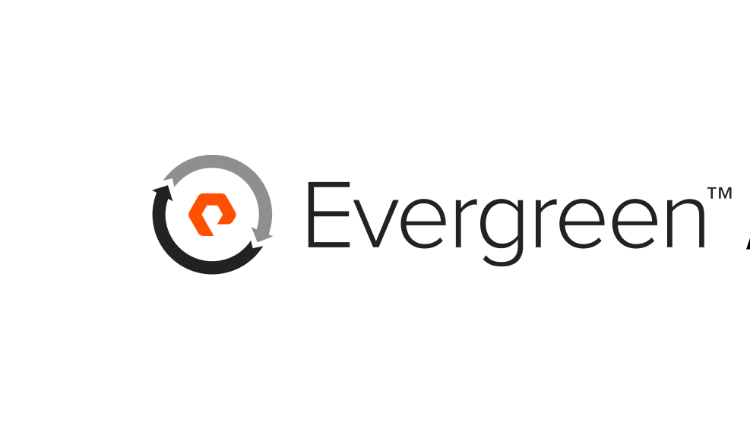
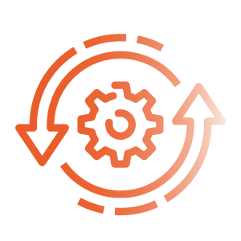

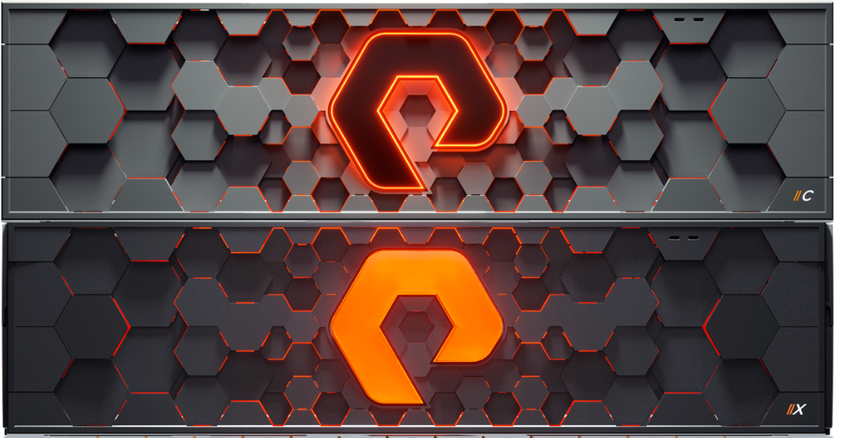


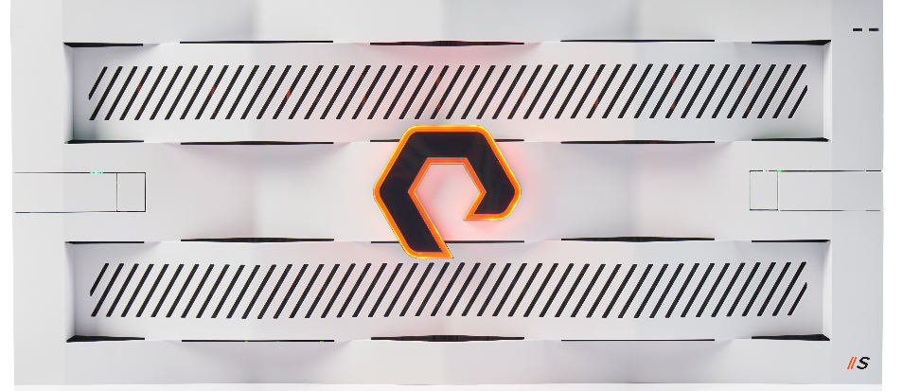



Evergreen: It Starts With the Architecture
Uncomplicate data storage, forever
Deploy Once, Upgrade In Place
No Planned Downtime
No Data Migration
Full Performance, Non-Stop
Modernize Hardware and Software for 10+ Years
Multi-Generational Lifespan
Investments Protected, No Rebuys
Pure Storage Confidential - Embargoed until June 8, 2022
Notes:
Evergreen is a technology and not just a way for buying.

Slide 5



INNOVATION IS OUR DNA
Always up to date with the latest technology during operation with Evergreen Updates
Controller-Upgrades with Evergreen
~
$/TB
~
Time
(years)
1
2
3
4
5
6
7
8
9
Free Every Three
  Controller upgrade included every 3 years
  The latest hardware generation of the current model
  Upgrades always during operation without performance loss or migration
FA-300
(GEN 1)
//M
(GEN 4)
//X
(GEN 6)
.NEXT
(GEN 7/8?)
2012
2015
2018
2023

Slide 6
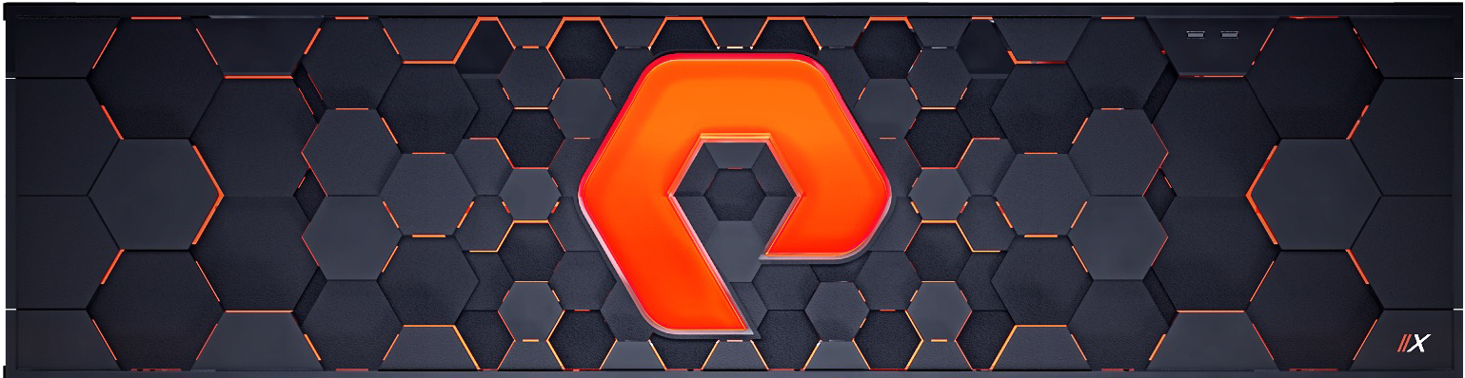

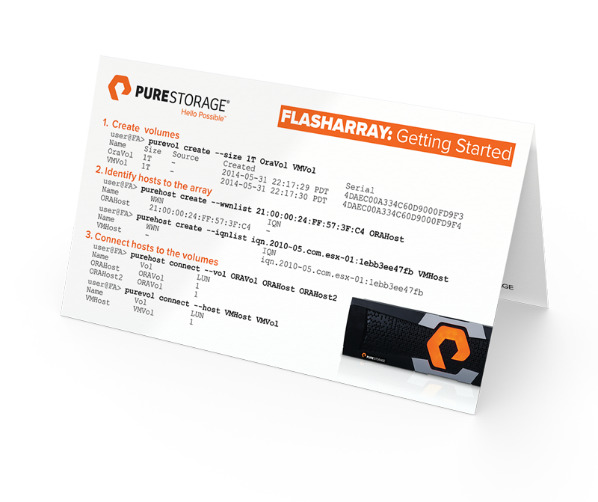

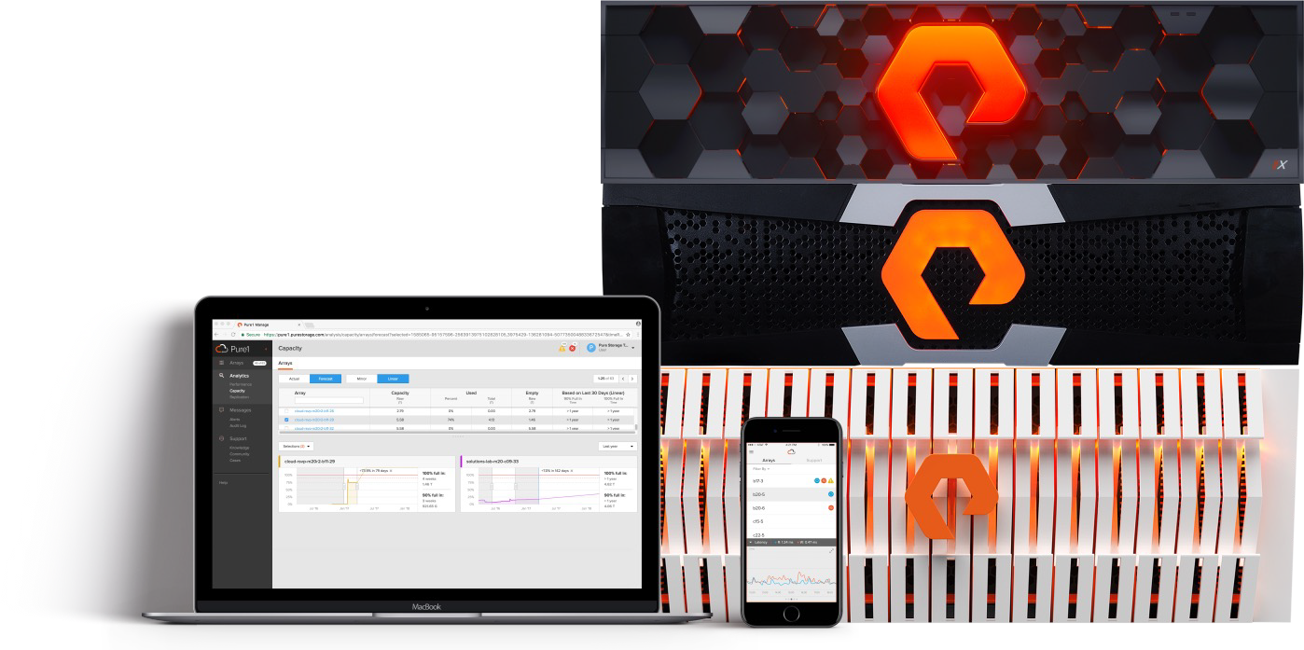

SIMPLICITY
30 minutes set-up and installation
Intuitive & modern operation
No operating instructions
No training
No tuning
No driver installation
No tiering
No licence costs

Slide 7











EFFICIENCY
Deduplication, compression & encryption
Extremely low latency of 0.25ms
100% NVMe incl. shelf connectivity
Non-disruptive operation & scaling
Synchronous mirror with transparent failover
Application Plugins & APIs
99.99999% availability incl. updates / upgrades
100% Flash engineered system
Data mobility : OnPremise, Hybrid & in the Cloud
100% PERFORMANCE
CLOUD MEDIATOR
ACTIVE _{ACTIVE}
COMPUTE
COMPUTE
Multi-Site Active / Active
Zero RPO, Zero RTO
© Pure Storage 2021

Slide 8
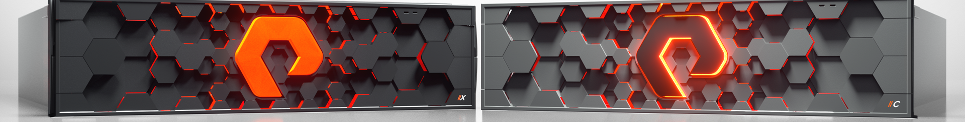




FlashArray SafeMode Configuration
Snapshot Policy
Authorization*
Tune Eradication Timer*
Disable Eradication*
IMMUTABLE SNAPSHOTS
Flexible,granular admin driven snapshot policy
LIMITS PRIVILEGED USERS
Up to 5 authorized contacts,secret PIN
EXTENDS ERADICATION TIMER
24hrs - 30 days
UNALTERED, SECURE DATA
Disables manual eradication
Notes:
Configuration Point in time backup,can’t be modified

Slide 9
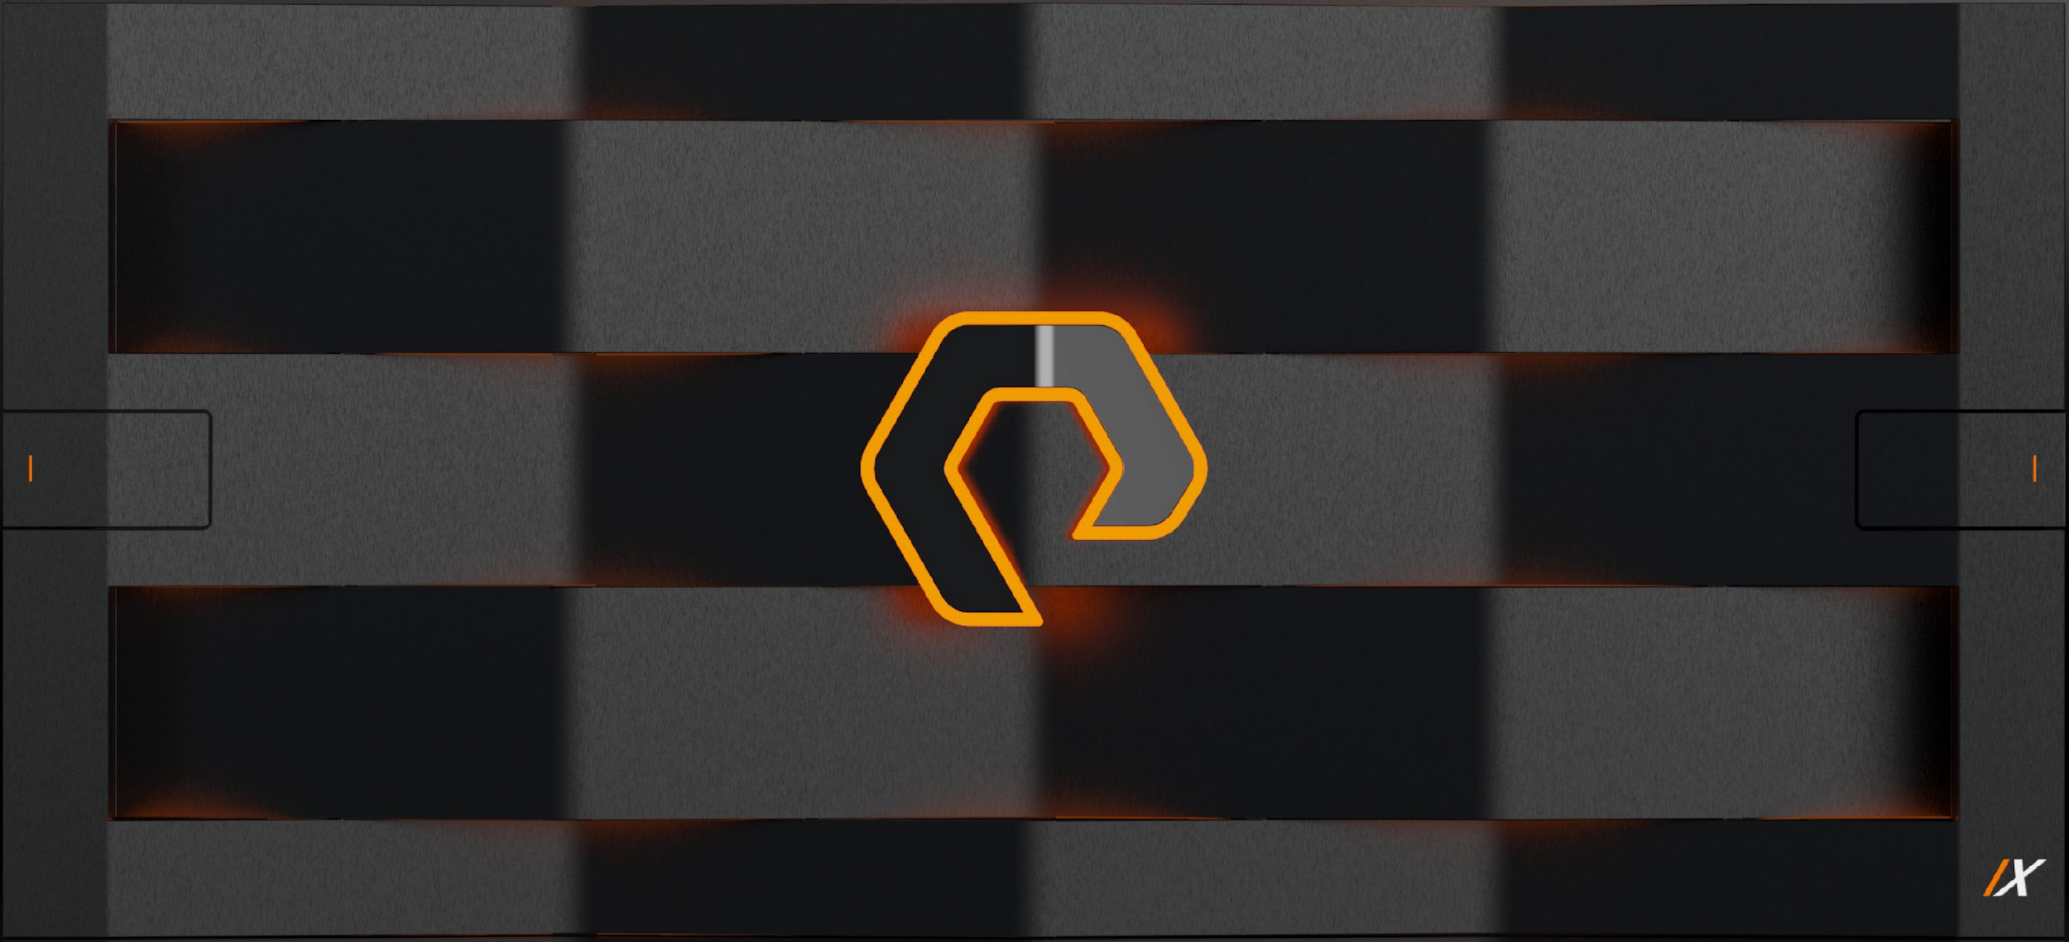
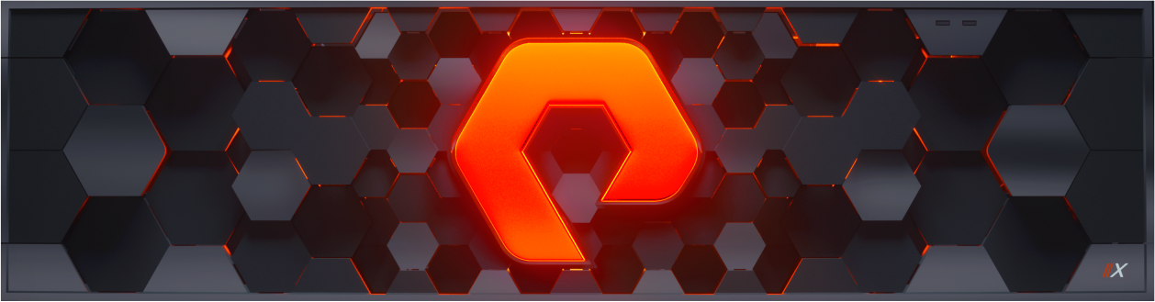
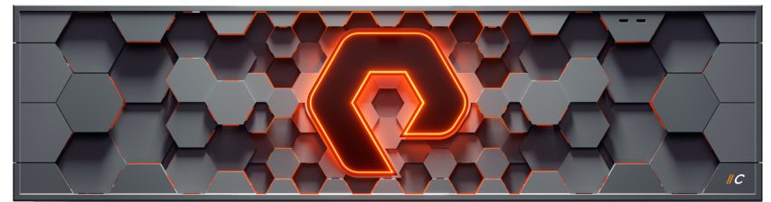



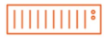




Speed Up Backup and Restore with FlashArray//C
Data protection that’s integrated with your preferred backup provider
High performance to reduce RPO and RTO
Backup with consistent speeds up to 7TB/hour
Restore with consistent speeds up to 2TB/hour
Both snapshots and image-level backups
Instantaneously snapshot any FlashArray volume
Up to 5:1 data reduction reduces capacity costs
Highly available and efficient
Always-on data reduction to reduce capacity
99.9999% of availability prevent data any loss
Ransomware protections for fast, complete recovery
PRODUCTION STORAGE
FILE PROXIES
BACKUP REPOSITORY
Notes:
Together, Veeam and Pure Storage provide a strategy where snapshots and image-level backups complement each other. Veeam is tightly integrated with Pure so that you can instantaneously snapshot any FlashArray volume for backup by Veeam.
Restore speeds are enhanced by using FlashArray//C as the backup repository. FlashArray//C consistently delivers speeds up to 7 TB/hour for backups and up to 2 TB/hour for restores.
That speed is critical when you’re trying to recover from natural or human-made disasters, ransomware attacks, data corruption, or accidental deletions.At the same time, FlashArray//C offers always-on data reduction to reduce capacity requirements. And it offers six nines of availability to prevent any data loss.

Slide 10








Do I Need Fast File AND Object?
FAST FILE
FAST OBJECT
FAST FILE
AND FAST OBJECT
Enterprise Search Analytics
on Elasticsearch
SIEM Analytics
on Splunk
Cloud Native DevOps
on Kubernetes & PSO
Advance Data Protection
on FlashRecover / Cohesity
Data Warehousing
on Vertica EON Mode
SW Development
on CI/CD Pipelines
Technical Computing
for HPC, EDA, Genomics, etc.
Rapid Restore
with Commvault
Data Pipelines
Modern Analytics Workloads
Today’s “OR” Customer Is Quickly Realizing “AND” Is the New Normal.
Notes:
Customers looking to address the before mentioned market drivers are realizing that they have more than one use case that UFFO can address​. This isn’t so much a question of this OR that, but this AND that. Fast file can address rapid restore opportunities depending on the underlying architecture of the data protection software. Splunk smartstore has been re-architected to leverage a Fast Object storage, and we increasingly see cloud native application design principles leveraging both fast file and fast object. The key takeaway here is that Fast File and Fast Object on the same platform offers an investment protection, consolidation, and simplicity for organizations that are growing their unstructured data footprint with modern applications and workloads.

Slide 11



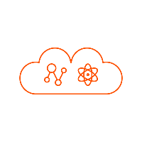
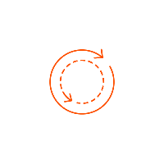




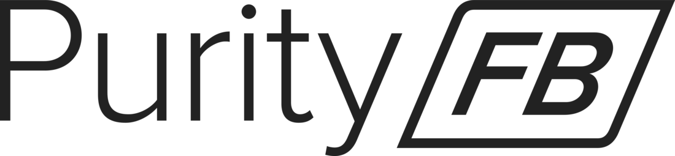
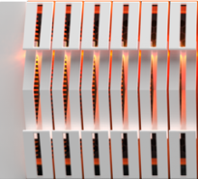

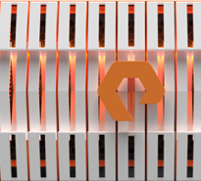

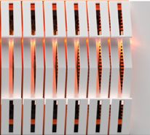
FlashBlade is UFFO
Technical Computing
Analytics
AI
Cloud-Native Apps
Data Protection
File Protocols
Object Storage
Management APIs
High-performance NFS & SMB protocols
Cross-protocol interoperability
Enterprise management: quotas, LDAP/AD/NIS integration, ACLs
AWS S3-compatible object APIs
Low latency, high throughput performance from all-flash core
Rich object features: versioning, custom metadata, lifecycle policies
Storage provisioning via common automation libraries
Monitoring of capacity, performance, and hardware health
Advanced telemetry for troubleshooting at scale
AUTOMATION
SNAPSHOTS
REPLICATION
SECURITY
HYBRID CLOUD
INFRASTRUCTURE & SCALE
Protect data from user and administrator errors
Protect data from rack- or site-level failures
Protect data from malicious actors
Connect workflows from on-prem to public cloud
Scale capacity and performance with ease
Simple, fast APIs
Flexible policies
Granular file recovery
Async file & object replication
High-performance, native implementation
Advanced DR capabilities
SafeMode snapshots to mitigate ransomware attacks
Always-on encryption at rest
Protocol-level authentication and transport encryption
AWS-compatible S3
Object replication to AWS
Pure Service Orchestrator (PSO) for containers/k8s
Up to 8PB effective in 150x52T cluster
No external load balancers or DNS config: min 1 data VIP

Slide 12

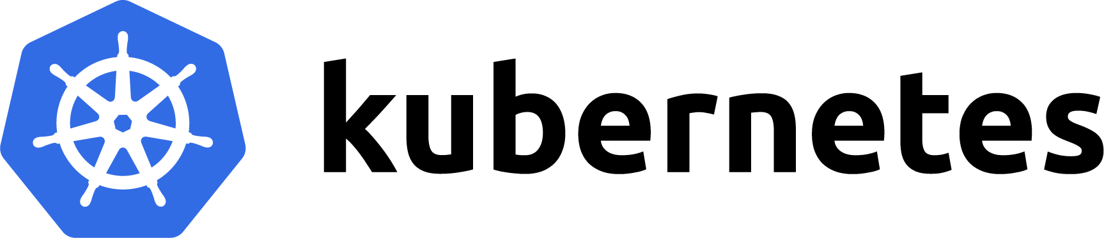

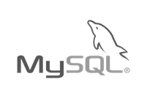






















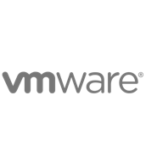






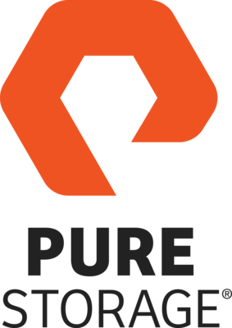





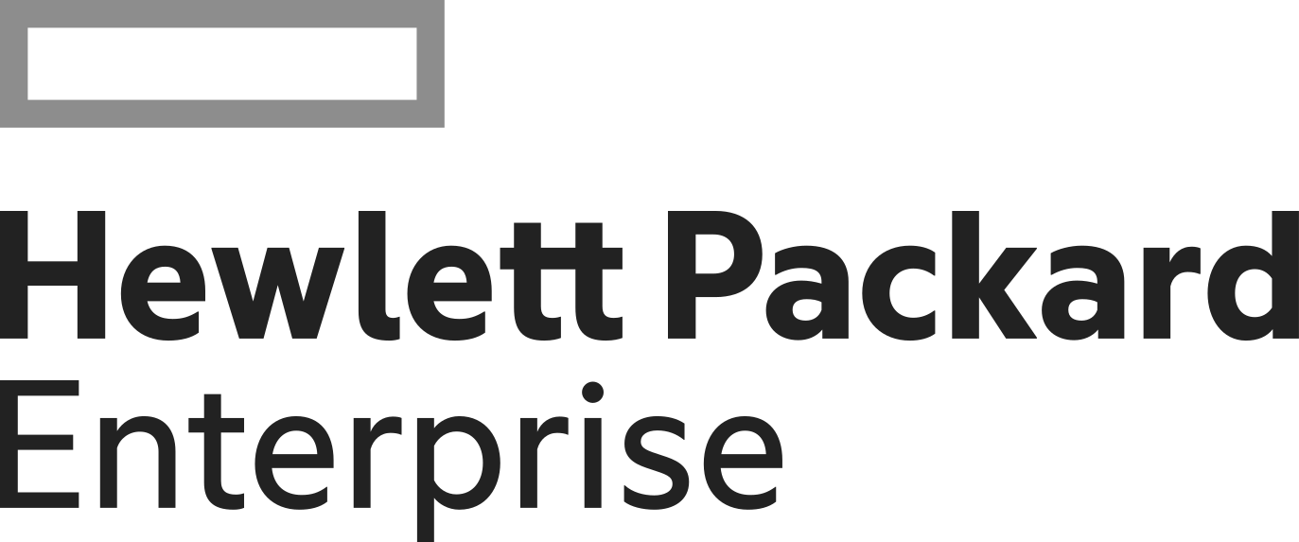

PORTWORX the SDS for K8S
Any App
Any Distribution
DATABASE
ANALYTICS
STREAMING
SEARCH/LOG
5G/IoT
AI/ML
GKE
AKS
Tanzu
The Kubernetes Data Services Platform
PX-Store
PX-Backup
PX-DR
PX-Migrate
PX-Secure
PX-Autopilot
Any Cloud
Any Infrastructure
Every Stage
Pilot
Test/
Dev
Go
Live
Global
CaaS
Bare Metal
Notes:
I mentioned that Portworx is a complete data services platform. Why “data services”? This gets right to the heart of what developers and Kubernetes admins want: they want data to behave just like a cloud service. Said differently - they don’t want to have to know about storage to leverage the power of data. They want to simply request it by their requirements (amount, performance level, resiliency level), and let the data service figure out all the details….and that’s exactly how Portworx behaves. Portworx includes modules for core storage, backup, DR, application and data migration, security, and infrastructure automation providing a complete set of capabilities for running mission-critical applications in containers.

Slide 13

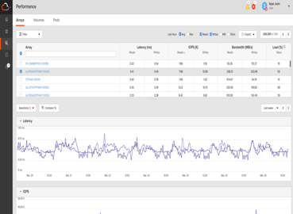
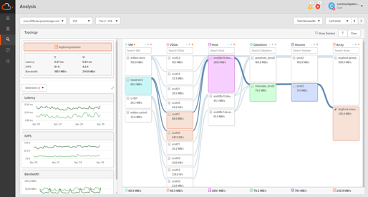


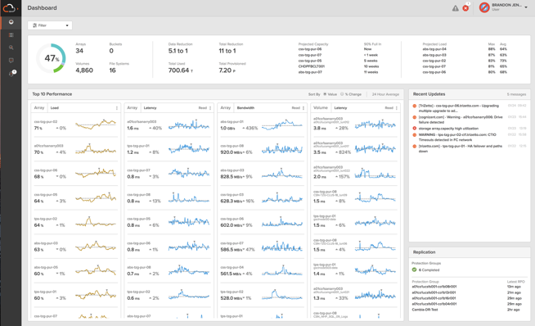
PREDICTIVE SUPPORT
PREDICTIVE ANALYTICS,
FORECASTING & REPORTING
SEV 1
INSTANT L2
SUPPORT
15
SUPPORT MANAGED
UPGRADES
MINUTE SLA
GLOBAL, MOBILE
MONITORING & REPORTING
4HR
ON
SITE
>16,000
ARRAYS
>1B PROBES
/ DAY
>15 PBS
OF DATA
BREAK/FIX
Notes:
This is the Pure1 overview. It’s easy to spend a lot of time on this slide, but try not to. In this presentation we want to talk about management at this point, not support. There’s another section that talks about the predictive support.
Here, focus on the global monitoring (including the iOS and Android apps), predictive analytics and a it on the support managed upgrades. Link everything to “spending less time managing storage”.

Slide 14
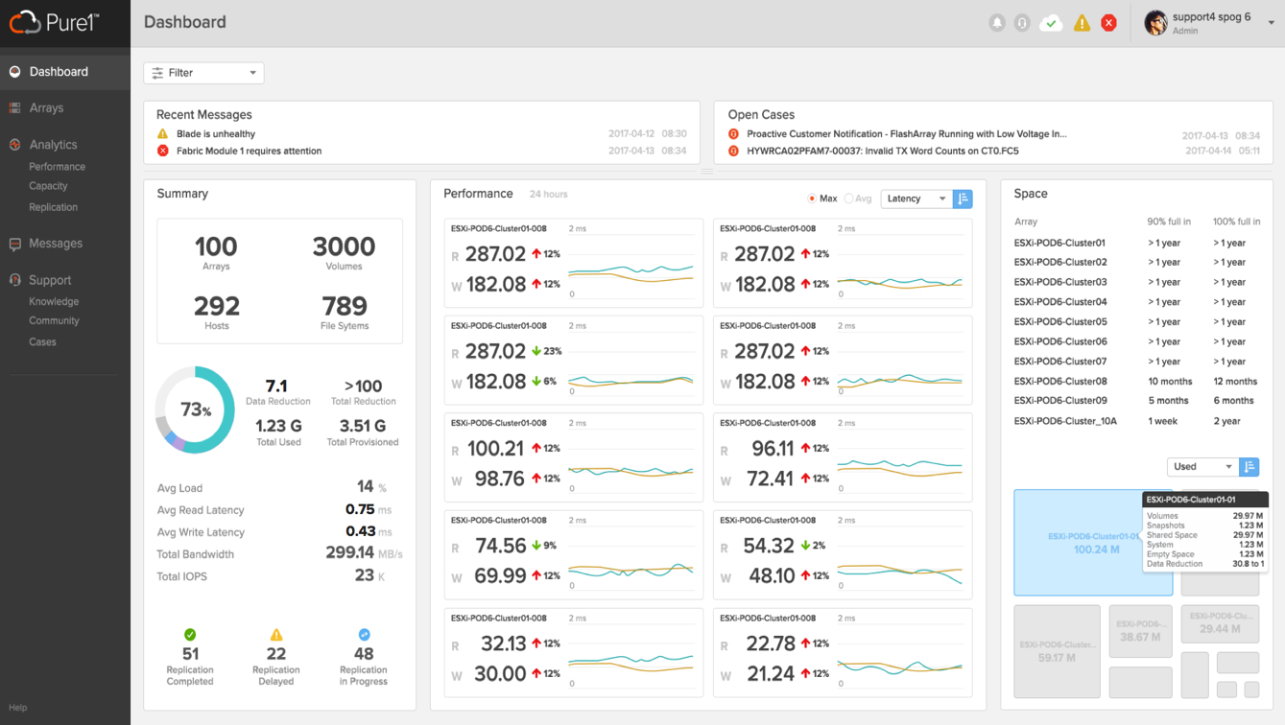
INTRODUCING
GLOBAL DASHBOARD
GET KEY AGGREGATE METRICS ON
YOUR ENTIRE FLEET OF ARRAYS
Get visibility on total data reduction and average load performance
Easily analyze array performance and predict capacity
View alerts & support cases across all arrays

Slide 15

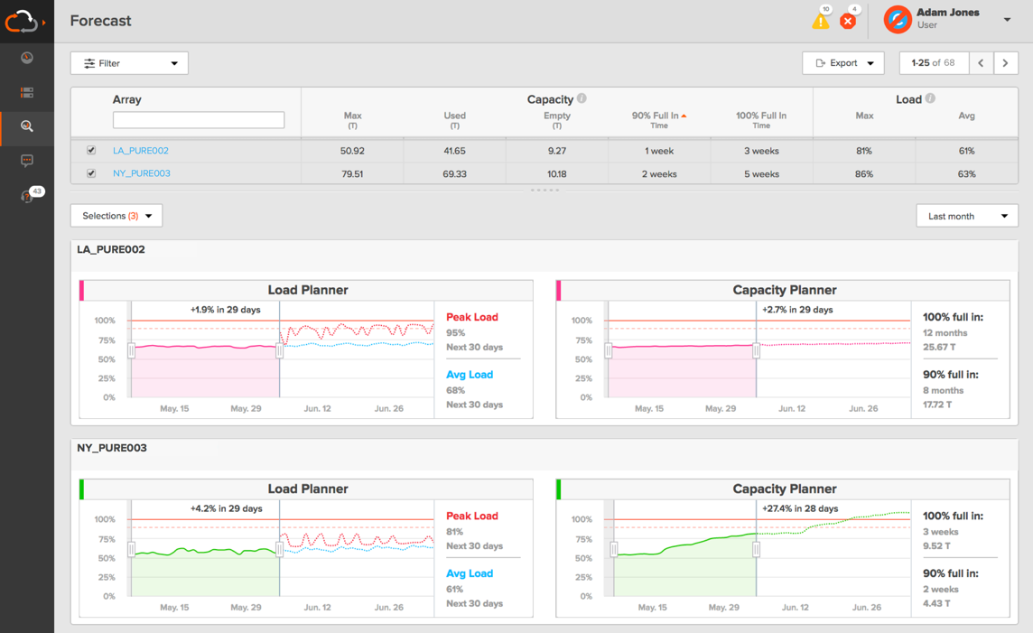


PREDICT THE FUTURE
AI-DRIVEN PERFORMANCE & CAPACITY SIZING
WORKLOAD PLANNER
POWERED BY WORKLOAD DNA
HOW WILL PERFORMANCE & CAPACITY GROW?
WILL A NEW WORKLOAD FIT?
HOW CAN I OPTIMIZE PLACEMENT?

Slide 16

Smallest footprint
Best DRR
Evergreen
67% TCO
BUSINESS
MODEL
CUSTOMER
EXPERIENCE
Why
?
CULTURE
NPS 85.2
BEST IN B2B
Satmetrix Certified
100% allFlash
100% All inclusive
100% business continuity
9X
GARTNER MQ LEADER
TECHNOLOGY
Simplest to use
99,9999
24/7 support
Notes:
CONTAINS 4 BUILDS
And we’re doing it together. We’re a modern data storage company unlike the rest. Only Pure brings together:
BUILD #1:
A modern subscription-like business model that delivers more than 55% in total cost of ownership savings;
*Based on leading market analyst’s January 2018 estimated aggressive street pricing models for 1.5PB storage arrays from EMC, HP and NetApp, averaged, versus Pure.
BUILD #2:
A world class approach to customer experience, which is validated by our Satmetrix certified NPS score.
BUILD #3
And superior, innovative technology which is validated by consistent recognition from Gartner and IDC for being the technology leader and innovator in the market.
FINAL BUILD
Each of these pieces combined and anchored by fierce group of passionate employees who bleed orange and love what they do, uniquely set us apart.
Let’s work together to understand what your data can do for you.
<End with transition into next facet of discussion beginning with business model, customer experience or technology.>

