Slide 1
How to Store Data ?
Maguay – No Time for Downtime 2022
Nov 2022

Slide 2
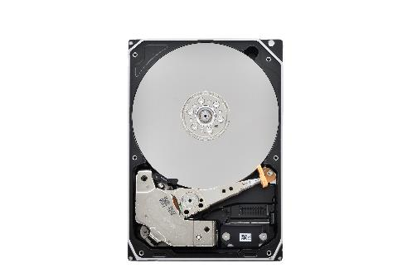
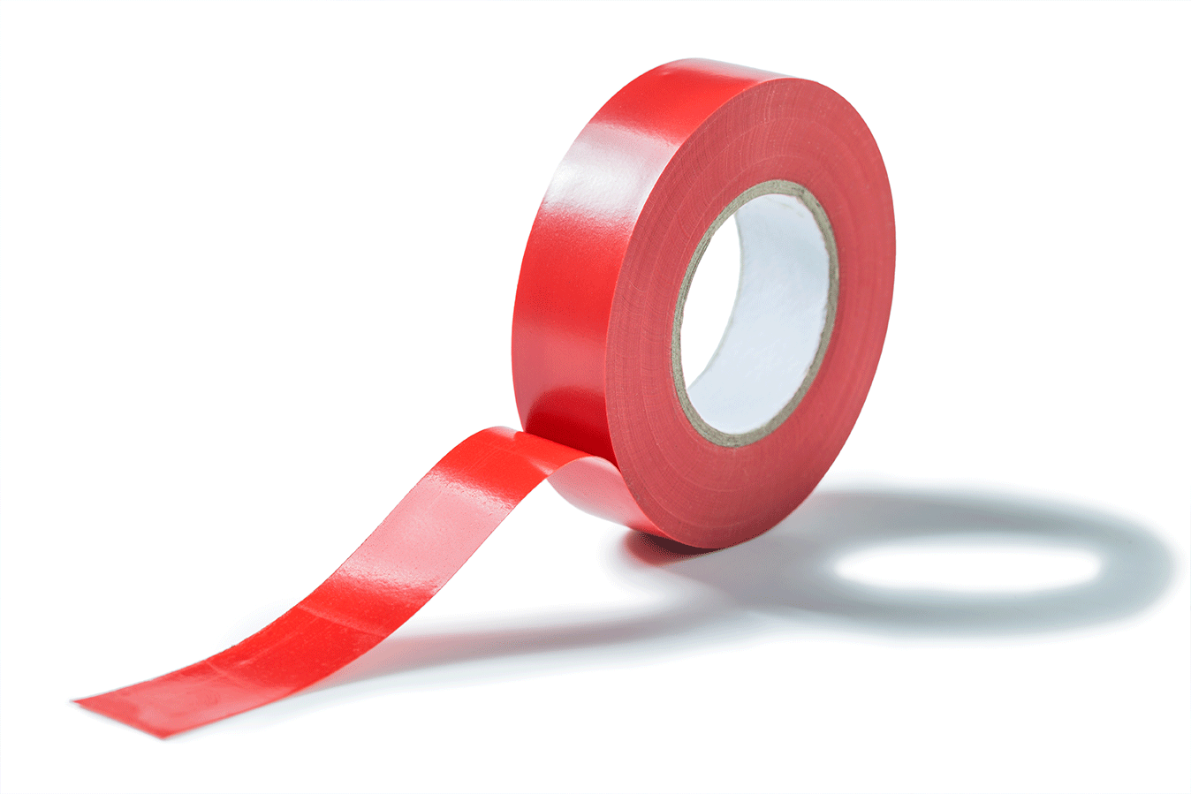
HDD / SSD / Tape
The basis for all Stored Data…
… Home / Enduser: Smartphones, tablets, notebooks, PC’s, external USB
… Business environment - „Enterprise“: CRM, databases, datacenters
… Infrastructure environment: Surveillance systems, industrial applications, IoT
… Cloud: Websites, streaming services, social networks, web-shops
Tape still plays significant role for archives!
Notes:
DATEI-NR.: 300132037

Slide 3
Alternatives?
Yes, but…
Notes:
DATEI-NR.: 268960042

Slide 4
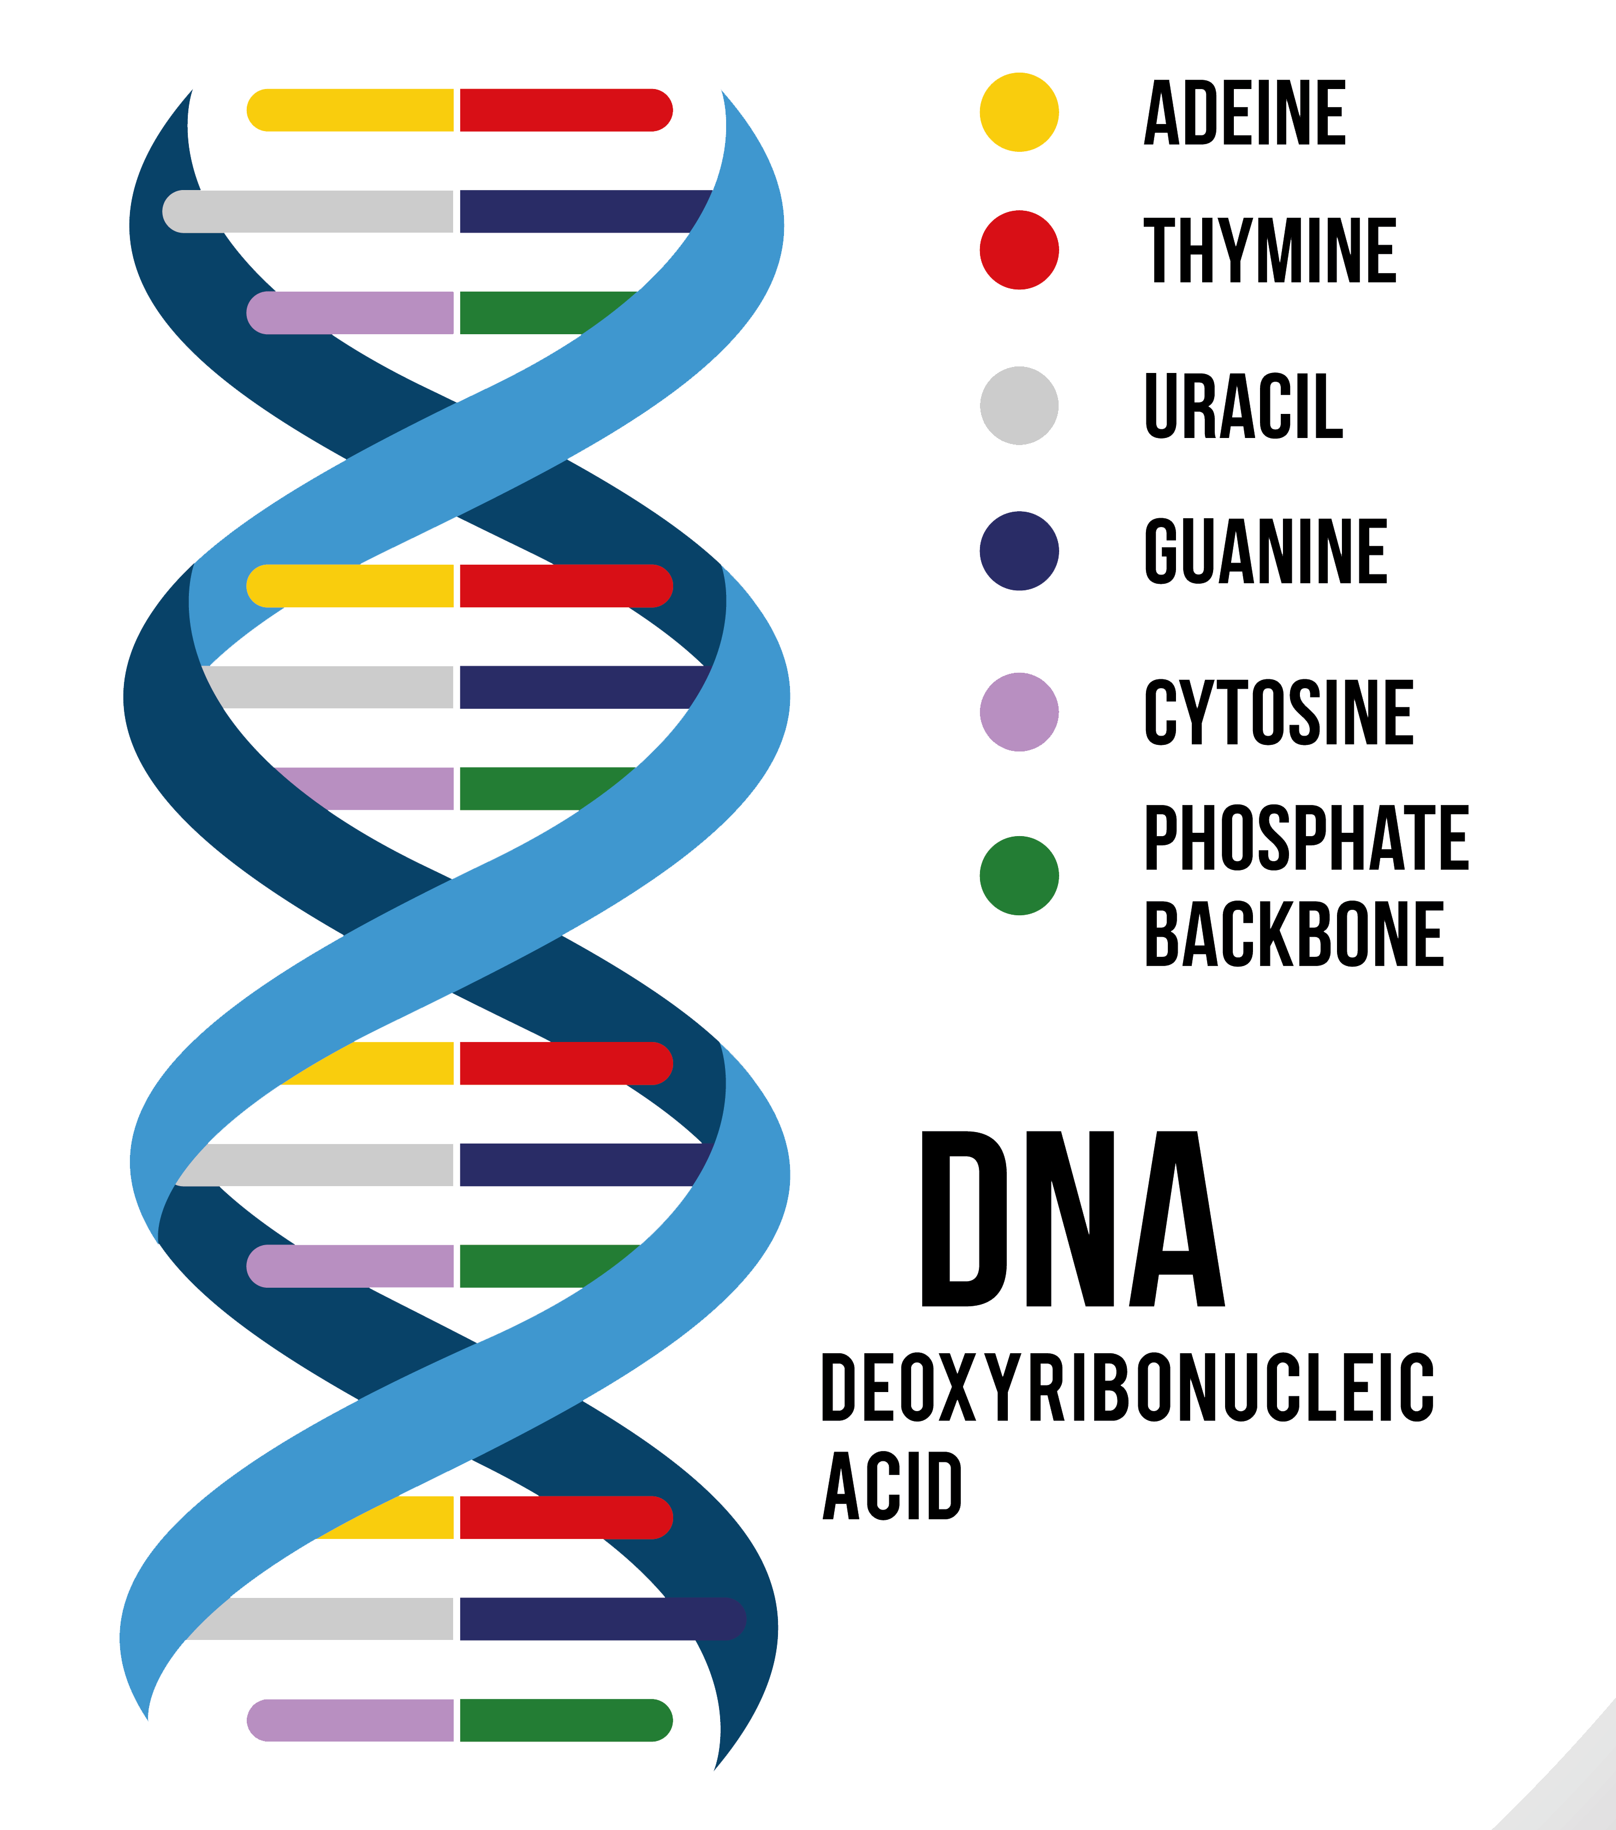
Alternative Approaches for Data Storage in Experimental Stage
Quartz crystal
5-D encoding by laser on nanostructured material
Extremely robust
Quartz of size of a coin can hold 360 TB of data
Data readable even with a usual microscope
DNA
4 molecules: Adenine (A), Guanine (G), Cytosine (C), Thymine (T)
Binary code translated into code of DNA base pairs: A-T and C-G (corresponding to „0“ and „1“)
Stable, durable, cheap, always readable in the future
Giant storage capacity: 1 Petabyte per 1g of synthetic DNA => Data of all mankind would fit into a car
But:
Technologies for data archiving and Cold Storage only
are inappropriate for constantly changing “hot” data due to complicate writing process
Notes:
DATEI-NR.: 163755604
DATEI-NR.: 289647074

Slide 5
Continuing the old competition:
HDD VS SSD
Notes:
DATEI-NR.: 75631577

Slide 6
Central Question
Will SSD‘s replace Hard Disk Drives?
“I think there is a world market for maybe five computers”
Thomas Watson, Chairman and CEO IBM, 1943
“There is no reason for any individual to have a computer in his home”
Kenneth Olsen, Founder and President of DEC, 1977
“Rotating storage is going the way of the dodo”
Linus Torvald, Inventor of Linux, 2012
Let‘s try to find an answer based on driving factors!

Slide 7
Driving Factor
HDD/SSD bit cost comparison^{*1}
Manufacturing capacity 2021:
Total Enterprise-HDD capacity shipped
964 Exabytes (Mio TB) in 87 Mio Units
Total Enterprise-SSD capacity shipped:
158 Exabytes in 67 Mio Units
Total (Enterprise and Client)
HDD: 1361 EB in 258 Mio Units
SSD: 336 EB in 464 Mio Units
HDD bit cost is 1/7 of SSD
Unit: $/TB
1000
100
10
1
SSD
86% HDD
HDD
(Tape)
80% HDD
*1 Source：Techno System Research Co., Ltd. HDD/SSD Market Trend(Annual) Dec. 2021
Source: TEE research & TEE estimates, Gartner 1Q22 Update
Cost and Capacity

Slide 8
Driving Factor
 | Sequential | Random | Cost
Tape | 200 MB/s | [1 IOPS] | 2 $/TB
Hard Disk | 250 MB/s | 300 IOPS | <20 $/TB*
SSD | 500-4000 MB/s | 50k-1M IOPS | >100 $/TB
Enterprise NAS
Enterprise Server / Storage / Backup
Cloud Server / Storage / Backup
Surveillance Storage
Industrial Storage
MP3 Player / Mobile phone
Laptop / Notebook / Desktop PC
Home NAS
(*) For high capacity HDD > 10TB
Performance

Slide 9
HDD vs SDD
Toshiba sees a
coexistence
of HDD’s and SSD’s
for the next
10 years and beyond
There is room for both!
Notes:
DATEI-NR.: 408043029

Slide 10
Roadmap to higher Capacities
22TB CMR
26TB SMR
24TB CMR
30TB SMR
28TB CMR
35TB SMR

Slide 11
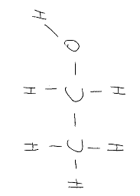
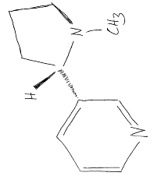
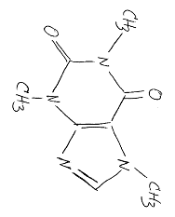
(ethanol)
(Coffee Break)
(nicotine)
(caffeine)

