Slide 1
VMware vSphere® 8
What’s New: Technical Overview
Cristian RADU
Lead Solution Engineer, VMware
2022

Slide 2
vSphere Distributed Services Engine
vSphere with Tanzu
Lifecycle Management
Artificial Intelligence & Machine Learning
Guest OS and Workloads
vSAN
Resource Management
Security and Compliance

Slide 3
vSphere Distributed Services Engine

Slide 4
Leveraging the DPU to
INTRODUCING
Improve infrastructure performance
vSphere Distributed Services Engine
Simplify DPU lifecycle management
Boost infrastructure security
4

Slide 5
Emergence of the Data Processing Unit
Cloud Foundation Architecture
NETWORK AND SECURITY
STORAGE
NSX
Services
vSAN Data Services
Host Management
Compute Hypervisor
x86
ESXi
Isolation Layer
DPU

Slide 6
Meet vSphere Distributed Services Engine
Offload network services to DPU
Compute Hypervisor
x86
ESXi
Isolation Layer
vSphere Distributed Services Engine
NETWORK AND SECURITY
DPU
NSX
Services
ESXi

Slide 7
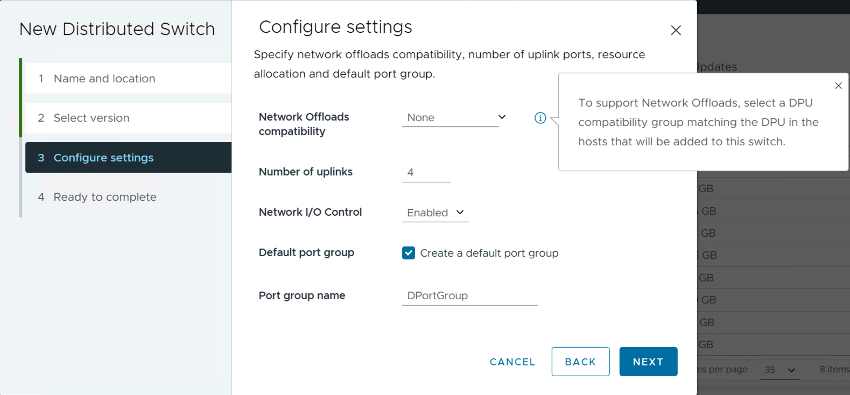
Simple Configuration for Network Offloads
Using vSphere Distributed Switch version 8.0
Network Performance and Security
Increase network performance
Enhance visibility and observability of network traffic
Security encryption, isolation and protection of NSX

Slide 8
VMware vSphere with Tanzu

Slide 9
Single Kubernetes Runtime
Introducing Tanzu Kubernetes Grid 2.0
TKG 2.0
Cluster Class
Availability Zones
Multi Cloud
vSphere+
Customizable Images
Pinniped LDAP/OIDC Auth
Tanzu Package Management
Cluster Auto-scaling
Unified Tanzu Kubernetes Grid
Increased availability with Workload Availability Zones
Declarative cluster lifecycle with ClusterClass
Customize PhotonOS or Ubuntu images
Pinniped Integration

Slide 10
Improving Workload Resilience in Modern Apps
Introducing Workload Availability Zones
Tanzu Kubernetes Cluster
control-plane 1
nodepool-1
control-plane 2
nodepool-2
control-plane 3
nodepool-3
Namespace-01
Tanzu Supervisor Cluster
vSphere Cluster-1
vSphere Cluster-2
vSphere Cluster-3
zone-1
zone-2
zone-3

Slide 11
Define It Once, Use It Many Times
Declarative Tanzu Kubernetes Cluster deployments with ClusterClass
Upstream Kubernetes conformant ClusterAPI
Defines configuration and default installed packages for Tanzu Kubernetes clusters
ClusterClass defined in the cluster deployment specification
ClusterClass
pkg
pkg
pkg
TKG Cluster
TKG Cluster
TKG Cluster
pkg
pkg
pkg
pkg
pkg
pkg
pkg
pkg
pkg

Slide 12
Flexible Package Management using Tanzu CLI
Developers can add packages from the Tanzu Package Repository using Tanzu CLI
Tanzu Package Repository
pkg
pkg
pkg
pkg
pkg
pkg
pkg
pkg
pkg
pkg
pkg
TKG Cluster
pkg
pkg
pkg
Tanzu CLI

Slide 13
Bring Your Own Identity Provider
Federated Authentication with Pinniped
Pinniped Federates identity from many identity providers (IDPs)
OIDC support
Supervisor and TKG Clusters support Pinniped based authentication
Login Integration through Tanzu CLI
Tanzu CLI Login
Supervisor
1
6
Pinniped
5
2
4
IDP Log in
Tanzu Kubernetes Cluster
username
Pinniped
password
IDP
Login
3

Slide 14
Lifecycle Management

Slide 15
Lifecycle Management
DPU support
Staging Support
Parallel Remediation
vSphere Configuration Profiles
Standalone Host Support (API only)
VCG Listings for HSM feature support

Slide 16
Deprecation Awareness
Last release for vSphere Update Manager
Deprecated means vSphere 8 is the last vSphere release that will support baseline-managed lifecycle

Slide 17
Stage Cluster Image Updates to Speed Up Remediation
Stage update payloads in advance of remediation, without the need for maintenance mode
Reduce overall remediation time and time spent in maintenance mode
Less risk of remediation failure from live image transfer
Firmware payloads staged with Hardware Support Manager integration

Slide 18
Quicker Cluster Remediation
vSphere Lifecycle Manager Parallel Remediation
Remediate multiple hosts in parallel
Significantly reduce the lifecycle operation time of a cluster
vSphere Administrator decides how many hosts will be remediated in parallel by placing the desired hosts into maintenance mode
Only hosts in maintenance mode will be remediated in parallel

Slide 19
Enhanced Recovery of vCenter
Recover vCenter without data loss
vCenter
Cluster state persists in ESXi hosts as a distributed key-value store
Distributed key-value store becomes the cluster source-of-truth
vCenter cluster state reconciles with the vSphere cluster during backup recovery
cluster state
Services
vSphere Cluster
Distributed Key-Value Store (DKVS)
ESXi
ESXi
ESXi
ESXi
ESXi

Slide 20
Reconcile Cluster Membership After Restore
vCenter restored from a backup taken before a host was added to the cluster.
vCenter queries the cluster for new or missing hosts
Cluster updates vCenter with the latest cluster state
ESXi
I’ve been restored. What’s new?
ESXi
ESXi
Cluster
ESXi
ESXi
ESXi
DKVS

Slide 21
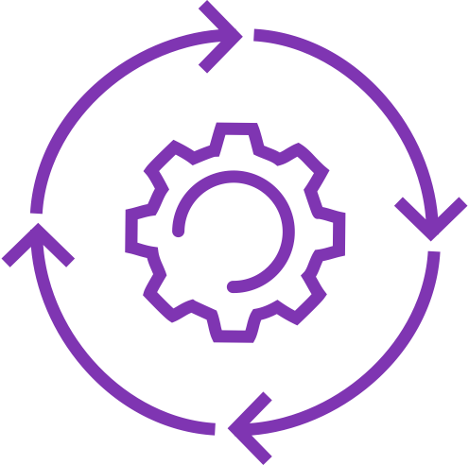
Configuration Management at Scale
Tech Preview
vSphere Configuration Profiles
Uses desired-state model for all configuration operations
Cluster-Level
Comprehensive
Monitors compliance “drift”
Remediates back to desired state
vSphere Configuration Profiles
General
Storage
Networking
Security
Solutions
Desired Config
Apply cluster-wide configuration
Cluster
Host
Host
Host
Host

Slide 22
Artificial Intelligence & Machine Learning

Slide 23
Unified Management for AI/ML Hardware Accelerators
Introducing Device Groups
Combine NIC and GPU devices
Share a common PCIe switch or a direct interconnect
Discovered at the hardware layer and presented to vSphere
Added to a virtual machine as a single unit
NVIDIA®​ support launching shortly after vSphere 8 GA
CPU
CPU
PCIe Switch
PCIe Switch
Device Group
Device Group
NIC
GPU
GPU
NIC
NIC
GPU
interconnect

Slide 24
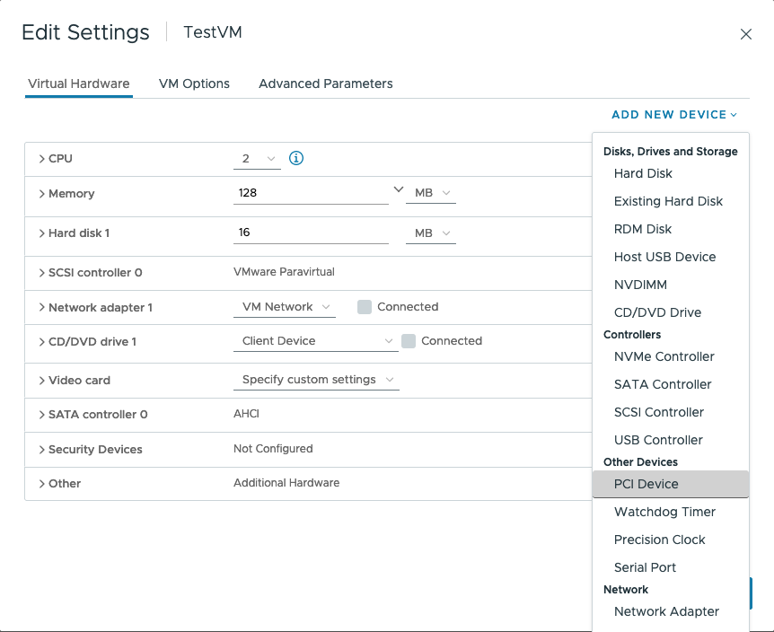
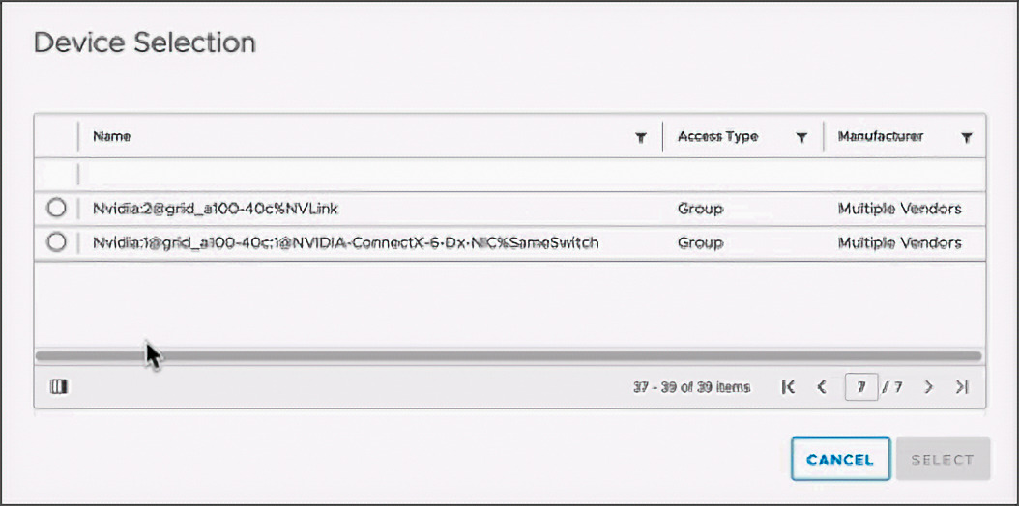
Simplified Hardware Consumption with Device Groups
Attach to virtual machines as a single unit
Device Groups discovered automatically
No change to existing Add New PCI Device workflows
vSphere DRS and vSphere HA aware of device groups for VM placement

Slide 25
Introducing Next-Generation of Virtual Hardware Devices
Device Virtualization Extensions (DVX)
New API for vendors to create hardware-backed virtual devices
Supports vSphere DRS and vSphere HA
Can support live migration using vSphere vMotion
Can support VM suspend and resume
Can support disk and memory snapshots
Virtual Machine
Guest OS
DVX virtual device
DVX driver
DVX driver
DVX driver
hardware device
hardware device
hardware device
ESXi
ESXi
ESXi

Slide 26
Guest OS & Workloads

Slide 27
Guest OS & Workloads
Virtual Hardware version 20
Virtual TPM Provisioning Policy
Migration aware applications
High latency sensitivity with hyper-threading
Simplified vNUMA configuration
Compute Maximums

Slide 28
Virtual Hardware Version 20
Virtualize Hardware Innovations
Guest Services for Application
Performance and Scale

Slide 29
Virtual Hardware Version 20
Virtualize Hardware Innovations
Guest Services for Application
Performance and Scale
Latest Intel and AMD CPU support
Device Virtualization Extensions
Up to 32 DirectPath I/O devices
vSphere DataSets
Application aware migrations
Latest guest operating system support
Up to 8 vGPU devices
Device Groups
High Latency Sensitivity with Hyperthreading

Slide 30
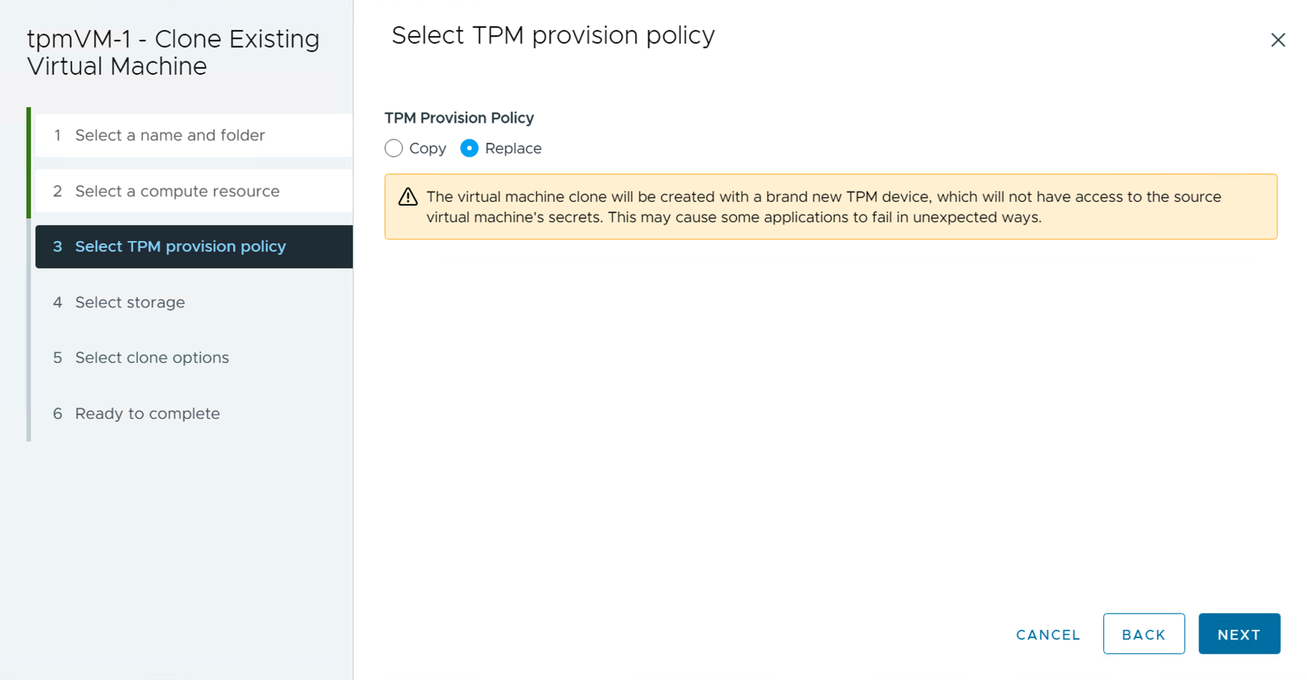
Deploy Windows 11 at Scale
Introducing Virtual TPM Provisioning Policy
Choose between Copy or Replace when deploying VMs configured with vTPM devices
Copy will clone TPM secrets
Replace will reset the vTPM device as new
ovftool support for vTPM device placeholder

Slide 31
Reduce outages by preparing applications for migration
Make application migration-aware
Applications are notified of impending migration task and can prepare before acknowledging the migration can proceed.
Use-cases include:
Time-sensitive applications
VoIP applications
Clustered applications
Virtual Machine
Application
vSphere vMotion
ESXi
ESXi
ESXi

Slide 32
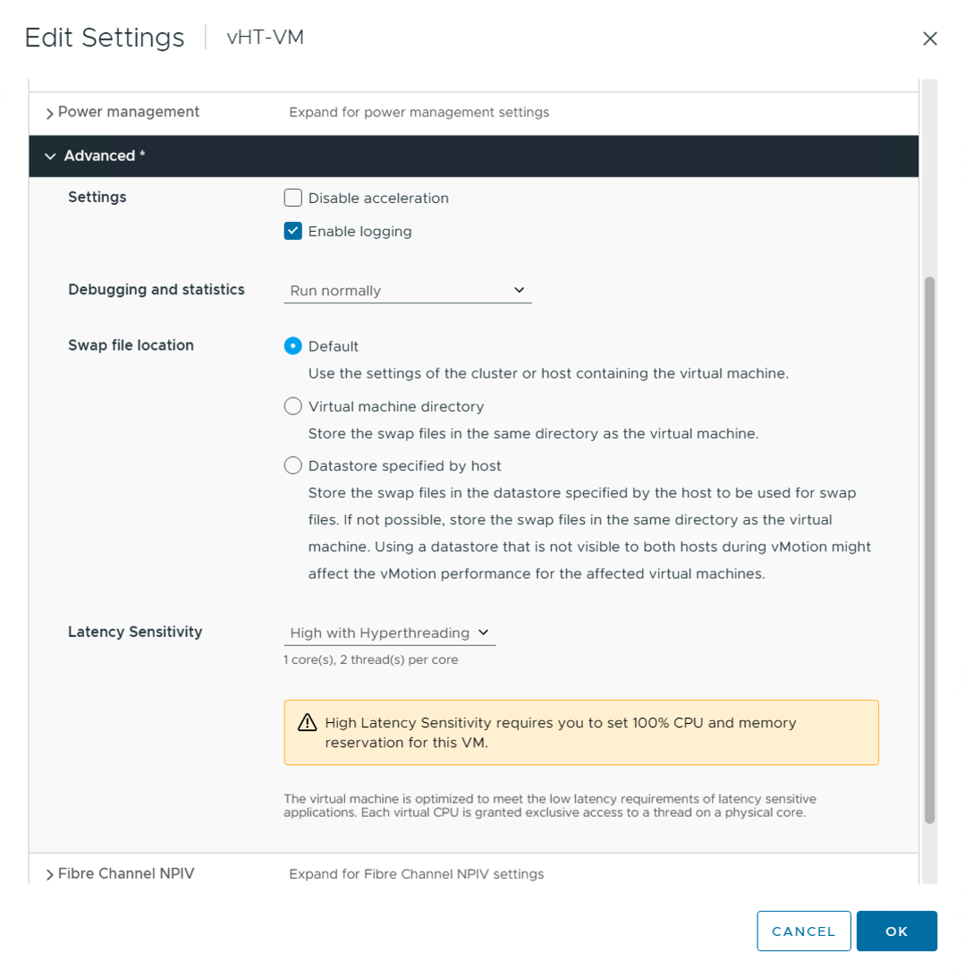
Maximize Performance for Latency Sensitive Workloads
Introducing latency sensitivity with hyperthreading
Virtual Machine vCPUs are scheduled on the same hyperthreaded physical CPU core
Physical host must support hyperthreading
Requires virtual machine hardware version 20
virtual machine
vcpu0
vcpu1
core-0
core-1
HT1
HT2
HT1
HT2

Slide 33
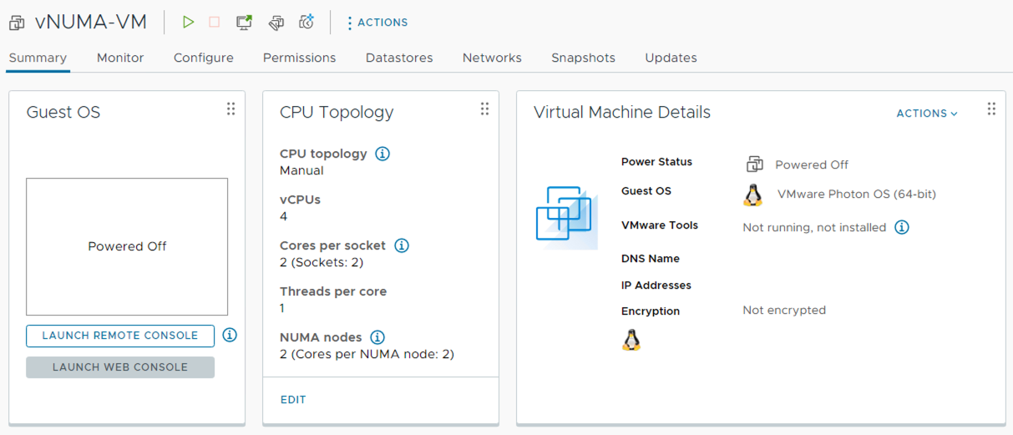
Simplified Virtual NUMA Configuration
Virtual NUMA topology and configuration is exposed to the vSphere Client
Configure virtual NUMA configuration during new VM creation
Edit CPU Topology settings of existing VM
Requires virtual machine hardware version 20

Slide 34
API Driven vSphere and Guest Data Sharing
Introducing vSphere DataSets
Share data between vSphere and a Guest OS
Data is stored and moves with the VM
Use-cases include:
Guest deployment status
Guest agent configuration
Guest inventory management
Requires virtual machine hardware version 20
Virtual Machine
Guest OS
API
VMware Tools
vmtoolsd
DataSets

Slide 35
vSphere Scalability
96 Hosts per vSphere Lifecycle Manager cluster*
10K VMs per cluster
Increased vGPU Resources
©2022 VMware, Inc.
* vSAN continues to support a maximum of 64 hosts per cluster

Slide 36
vSphere Scalability
Scale your resources without compromise
Compute Resource | vSphere 7 U3 | vSphere 8*
vCPU per VM | 768 | 768
Memory per VM | 24 TB | 24 TB
vGPU per VM | 4 | 8
CPU per host | 896 | 896
Memory per host | 24 TB | 24 TB
Hosts managed by vSphere Lifecycle Manager | 400 | 1000
Hosts per cluster | 96 | 96
VMs per cluster | 8000 | 10000
VMDirectPath I/O devices per host | 16 | 32
VMware Configuration Maximums configmax.vmware.com
*vSphere 8 scalability testing still on going and subject to change

Slide 37
vSAN

Slide 38
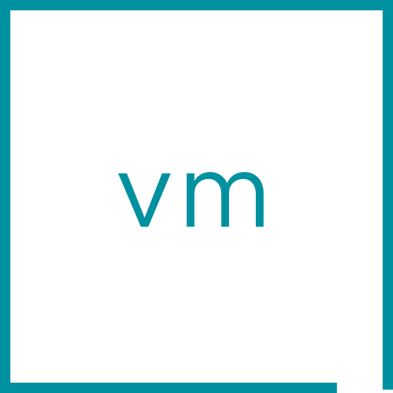
Optional Next Generation Architecture built into vSAN
vSAN Express Storage Architecture™
vSAN Express Storage Architecture™ (ESA) in vSAN 8
Next generation storage architecture for the workloads of today and tomorrow
Optional, alternative architecture to the vSAN original storage architecture
Available when running on qualified hardware in ESA approved vSAN ReadyNodes
Built into the software you know
vSphere
vSAN ESA
Single tier
Single tier
Single tier
vSAN ESA Datastore

Slide 39
A New Way to Process and Store Data Efficiently
vSAN Express Storage Architecture™
vSAN Express Storage Architecture
Highly adaptable to the hardware of today and tomorrow
Stores data efficiently while meeting performance requirements
Higher default levels of resilience
Native, scalable snapshots
Simplifies administration and serviceability
Fast & efficient data path
Native scalable snapshots
Simplified Administration
vSphere
vSAN ESA
Efficient and resilient data structure
Single tier
Single tier
Single tier
vSAN ESA Datastore

Slide 40
Resource Management

Slide 41
Enhanced DRS Performance
vSphere Memory Monitoring and Remediation v2 (vMMR2)
Uses Memory Stats for better VM placement

Slide 42
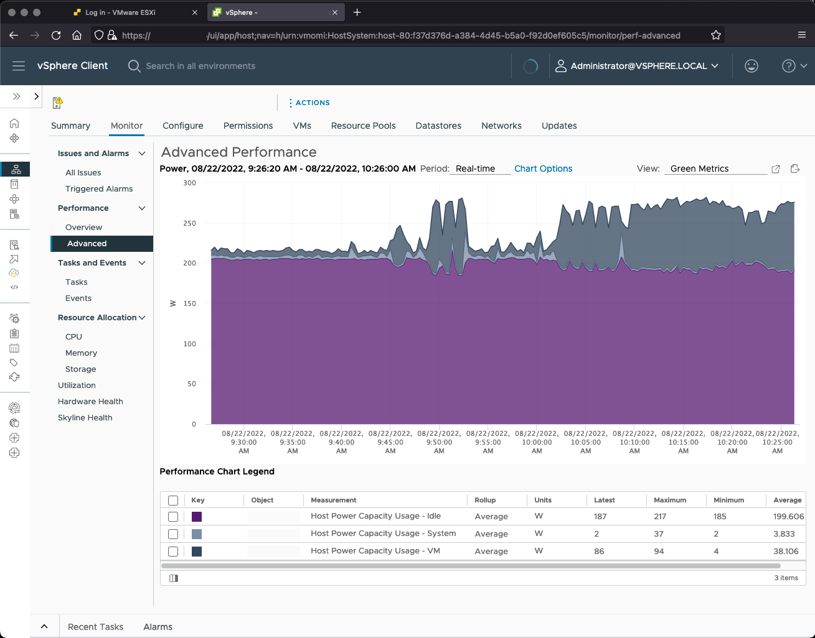
Monitor Energy and Carbon Emissions
Introducing vSphere Green Metrics
Monitor the energy and carbon equivalent emissions of the vSphere infrastructure and workloads.
power.capacity.usageVm
power.capacity.usageSystem
power.capacity.usageIdle
Use vRealize Operations Manager to visualize and predict carbon intensity and emission rate.

Slide 43
Security & Compliance

Slide 44
Making Infrastructure Security Easier & Faster
vSphere 8 Evolves Security and Compliance Controls
Improvements to SGX
TLS 1.2 & Better Cipher Suites
Prevent Untrusted Binaries
SSH Automatic Timeouts
More Secure Product Defaults

Slide 45
VMware vSphere 8 Security Configuration Guide
https://via.vmw.com/scg

Slide 46
Wrap-Up

