Slide 1
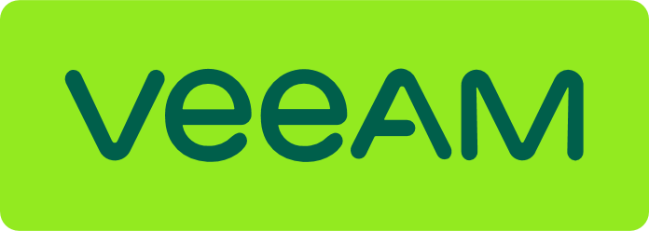
Modern Data Protection with Veeam
Denisa Gilmeanu
Partner Sales Manager,
Veeam Software

Slide 2
The current state of the backup market
Notes:
The backup market continues to evolve, and new workloads and constraints challenge next-gen backup systems. Find out the current 2021 state of the backup market and learn what you should be thinking of in 2022 and beyond to improve your data protection practice.

Slide 3
IDC Semi-Annual Software Tracker: Data Replication & Protection
Change in Growth: Top 5 by Company, 2020H2 — Worldwide
Company | Sequential growth % | YoY growth % | Vendor revenue (US dollar, millions)
Veeam | +21.5% | +17.95% | 563.61
Dell Technologies | +8.0% | -4.2% | 746.60
Commvault | +6.0% | +5.1% | 340.43
Veritas | +2.2% | -4.9% | 537.13
IBM | -9.3% | -16.5% | 487.24
Others | +5.9% | +3.8% | 2,048.49
Market average | +5.6% | +0.4% | N/A
Veeam® has achieved the fastest revenue growth both sequentially & year-over-year among:
The top five vendors
Others
Market average
Source: IDC, Semi-Annual Software Tracker, 2020H2, Data Replication and Protection
Notes:
Sorted by Sequential Growth (quarter over quarter)

Slide 4
IDC Semi-Annual Software Tracker: Data Replication & Protection
Change in Growth: Top 5 by Company, 1H2021- Worldwide
Company | Vendor Revenue (US Dollar, M) | Sequential Growth % | YoY Growth %
Dell Technologies | 657.24 | -12.0% | -4.9%
Veeam | 581.68 | +3.2% | +25.3%
Veritas | 526.28 | -2.3% | -0.1%
IBM | 378.93 | -22.2% | -29.5%
Commvault | 354.32 | +4.1% | +10.3%
Others | 2,489.56 | +1.4% | +7.9%
Market Average | N/A | -2.8% | +2.9%
Veeam has achieved the fastest revenue growth -- year-over-year -- among
the top 5 vendors
other providers
overall market average
Source: IDC, Semi-Annual Software Tracker, 1H2021
Note: Worldwide Data

Slide 5
IDC Semi-Annual Software Tracker: Data Replication & Protection
Change in Growth: Top 5 by Company, 1H2021 – EMEA Only
Company | Vendor Revenue (US Dollar, M) | Sequential Growth % | YoY Growth %
Veeam | 325.60 | +5.2% | +32.5%
Vendor A | 196.66 | -7.2% | -4.0%
Vendor B | 139.98 | +6.7% | +6.5%
Vendor C | 138.61 | -13.8% | -22.5%
Vendor D | 84.80 | +6.6% | +19.6%
Others | 713.67 | +5.3% | +17.2%
Market Average | N/A | +1.8% | +11%
Veeam has achieved the fastest revenue growth -- year-over-year -- among
the top 5 vendors
other providers
overall market average
Source: IDC, Semi-Annual Software Tracker, 1H2021
Note: EMEA Data Only

Slide 6
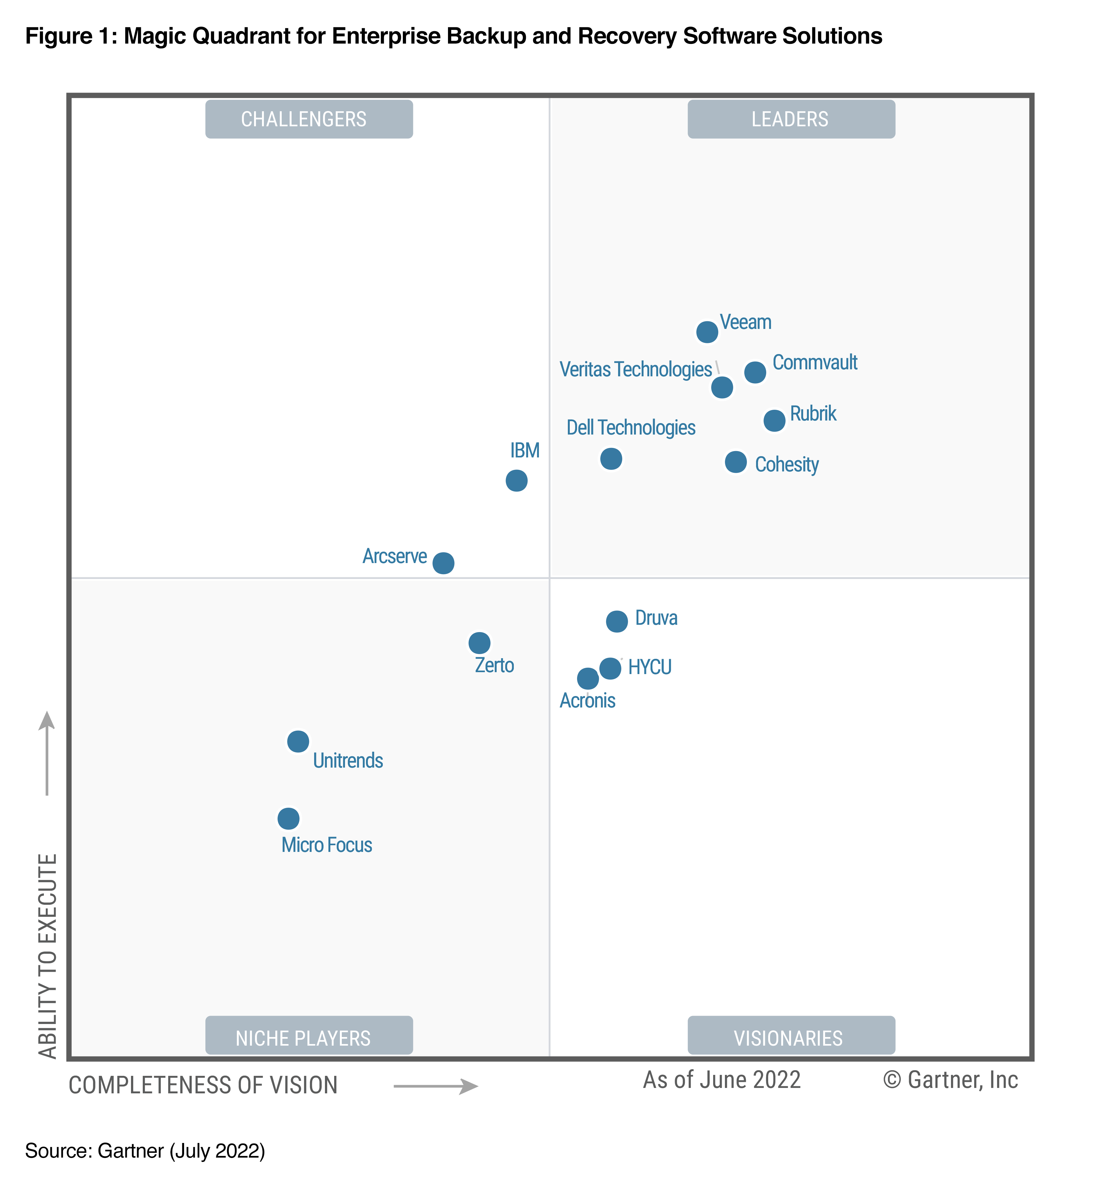
Veeam named a Leader for the 6th time!
Gartner named Veeam as a Magic Quadrant Leader for the sixth time
for its highest Ability to Execute and Completeness of Vision
Veeam is a Leader in Enterprise Backup & Recovery Solutions!
#1
450K+
200+
Market Share Worldwide
customers worldwide and counting
top industry awards
DISCLAIMER
Gartner Magic Quadrant for Enterprise Backup and Recovery Software Solutions, Michael Hoeck, Nik Simpson, Jerry Rozeman, Jason Donham, 28th July 2022. Gartner and Magic Quadrant are registered trademarks of Gartner, Inc. and/or its affiliates in the U.S. and internationally and is used herein with permission. All rights reserved.
This graphic was published by Gartner, Inc. as part of a larger research document and should be evaluated in the context of the entire document. The Gartner document is available upon request from Veeam. https://www.veeam.com/2022-gartner-magic-quadrant.html Gartner does not endorse any vendor, product or service depicted in its research publications, and does not advise technology users to select only those vendors with the highest ratings or other designation. Gartner research publications consist of the opinions of Gartner’s research organization and should not be construed as statements of fact. Gartner disclaims all warranties, expressed or implied, with respect to this research, including any warranties of merchantability or fitness for a particular purpose.

Slide 7
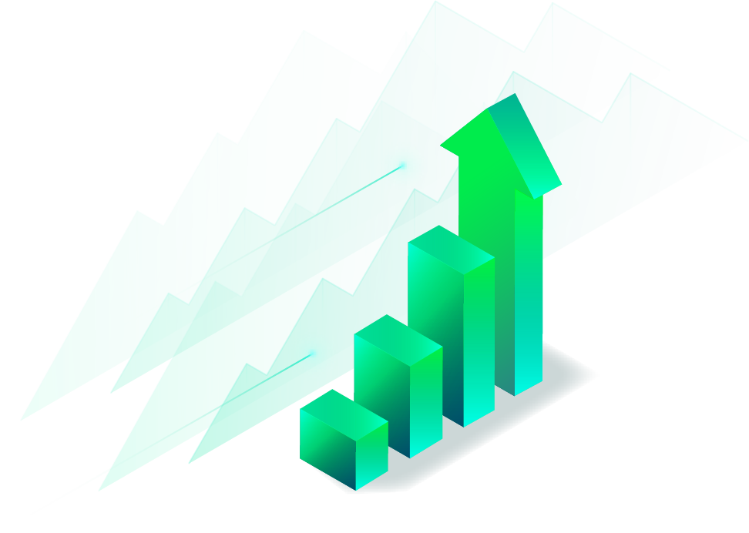
#1 in the EMEA data replication and protection market
Sequentially and YoY among top 5 companies in data replication and protection market
Source: IDC WorldWide Semi-Annual Software Tracker, 2021H2
Notes:
Proud to share that Veeam has achieved the fastest revenue growth worldwide – sequentially and YoY – out of the top five industry vendors in IDC’s latest Semi-Annual Software Tracker.

Slide 8
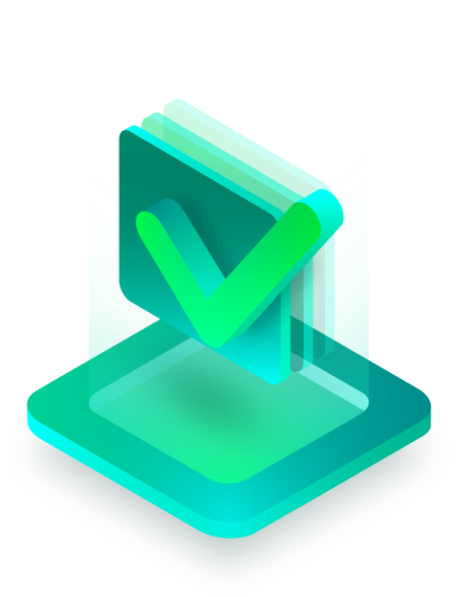
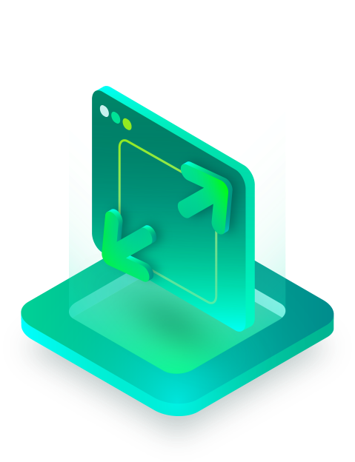
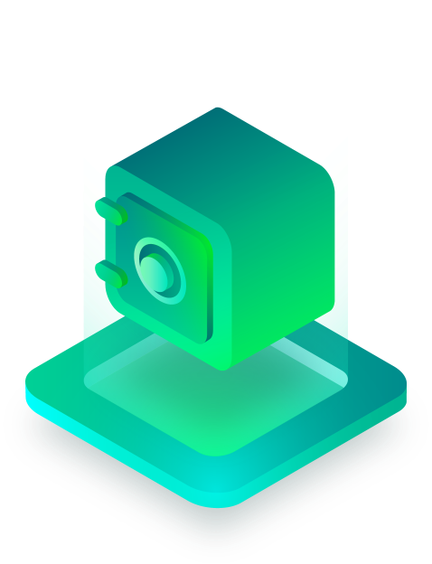
1,000,000
Active Veeam Backup & Replication installations
Simple
Flexible
Reliable
Notes:
We recently surpassed more than 1 million active VBR installations. One million.
I think it is fair to say that we have the largest footprint of data protection in the world. We do more for helping customers protect, manage and unleash their data than we had even dreamed possible a short decade ago.
And this is because we’ve designed every component to be <CLICK> Simple, Flexible, and Reliable.
Simple. I like to say that the same software that protects the data in my home, is the same software that protects the Fortune 500 financial institution. The same software that protects a retail organization with 3000 locations is the same software that protects the organization with one location. Sure, they may have more capacity for storage and more data movers, but it’s the same software. The same software that is intuitive, easy to deploy, manage and maintain.
It’s also flexible. Do you know that we now have primary storage integrations with more than 80 storage solutions? Or that we have been certified on more than 85 secondary storage repositories. Or, maybe you don’t want to keep your data on-prem. Maybe you want to tier the data into object storage. We have officially validated scale-out object storage on 37 systems, 12 of which are immutable – including all three hyperscalers: AWS, Azure and Google Cloud Storage.
And lastly. Reliability. “It just works.” That was a tagline that a customer actually created for Veeam - and it’s stuck. It’s because our data format is portable and self-describing. We’re not dependent on a media server or a filesystem that might be corrupted. If you take a backup with Veeam software, you can rest assured knowing that you will be able to recover.
So … what have we been working on?

Slide 9
How the IT landscape has changed
68%
66%
715%
Cloud service growth
SaaS usage acceleration
Increase in ransomware
91% of all organizations expect to accelerate their cloud investment; how does this affect data protection?
* Veeam 2021 Data Protection Trends Report
Notes:
2021 continued an increase in the amount of cloud services, SaaS usage and a 7x+ increase in ransomware attacks.
This shift must be highly considered when examining resources such as data protection and management. With the large shift to cloud-based IT strategy data, support systems like backup and DR must be modernized in parallel.

Slide 10
The reality of legacy backup in today’s world
23%
of servers will have
at least one unplanned outage
37%
and
34%
58%
of all backup jobs fail
of all restore jobs fail
failure of recovery
Data protection is struggling to keep up with modern platforms
* Veeam 2021 Data Protection Trends Report
Notes:
Availability due to dependency on legacy systems and operations is still a critical factor in many organizations, but so is the lack of core functionality to provide backup and recovery capabilities.
On average, 23% of servers had at least one unexpected outage in the last 12 months (with 36% of organizations stating up to 50% of their servers had at least one outage). As such, the integrity of backup becomes critical. You need to be able to ensure confidence that the backup is successful and can be used for recovery.
Our research showed that a whopping 37% of backups ended up with errors or could not complete in their allocated backup window. Our research also showed that one-third (34%) of all restorations are also failing to restore within the expected SLA. Those are some scary figures, which mean more than half the time, organizations won’t be able to restore their servers due to either failed backups or failed restores.
While there may be many factors relating to this including environment complexity, lack of capability with legacy solutions and IT skills, the adoption of modern data protection and process will have an instant positive effect.

Slide 11
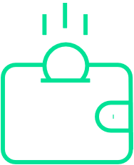
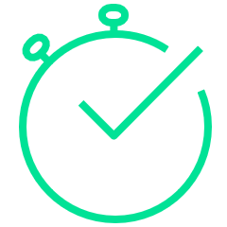
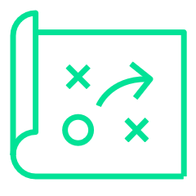
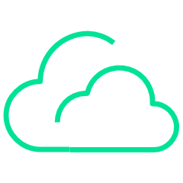
Why change backup solutions in 2022
Which of the following would drive your organization to change its primary backup solution
to a new solution or service? (n=2,800)
All drivers
Most important
Cost
Capability
Complexity
Cloud
Source: Veeam 2021 Data Protection Research

Slide 12
Moving forward with Digital Transformation
Notes:
Not surprisingly, the pandemic created challenges in making progress with digital transformation (DX) initiatives. However, while many issues increased, of note is the second and third largest inhibitors:
Dependency on legacy systems increased year-over-year as a DX inhibitor.
Skills issues increased year-over-year as a DX inhibitor.
Q27

Slide 13
Best practices to improve backup in 2022
Notes:
The backup market continues to evolve, and new workloads and constraints challenge next-gen backup systems. Find out the current 2021 state of the backup market and learn what you should be thinking of in 2022 and beyond to improve your data protection practice.

Slide 14
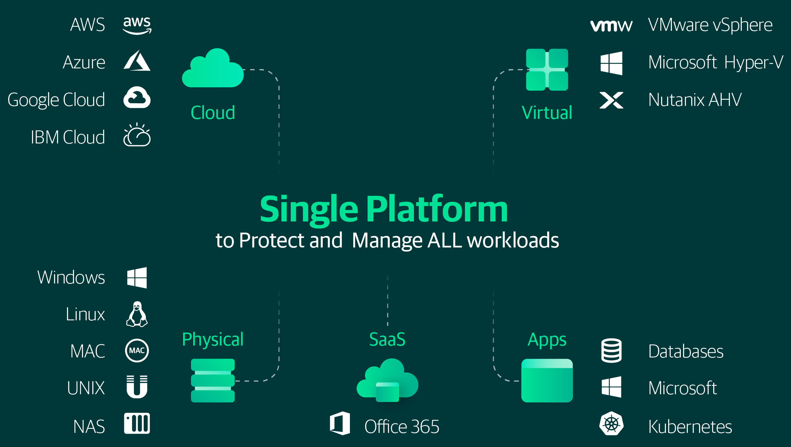
Modern Data Protection Characteristics & best practices
Comprehensive platform
Notes:
There is a need in the industry for a comprehensive, extensible data protection platform that can manage all your data and applications from a single console.
Veeam not only addresses the common issues around backup failures and long restorations times, but natively supports each workload and platform in your hybrid-cloud, multi-cloud data center. Veeam does not retrofit legacy technology into new locations. The Veeam Platform is modular and extensible, with the ability to deliver stand-alone virtual and physical protection on-prem, or SaaS and AWS-, Azure-, and GCP-native protection in the cloud. With Veeam, all workloads integrate into a single platform that offers comprehensive data management capabilities, such as backup & recovery, data re-use, cloud mobility, monitoring & analytics, orchestration & automation, and governance & compliance.

Slide 15
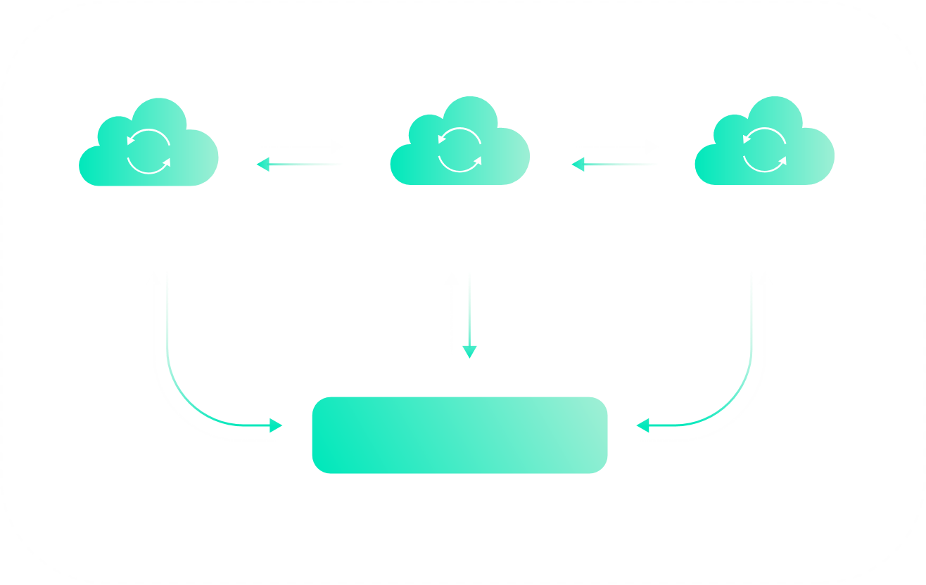
Modern Data Protection Characteristics & best practices
Comprehensive platform
Accelerated cloud adoption
Veeam for AWS
Veeam for Azure
Veeam for Google
Veeam Platform
Cloud | Virtual | Physical
Notes:
Organizations having been increasing their adoption of AWS, Azure, Google and other cloud services, and the pandemic has accelerated many businesses plans to move to, and exploit cloud services even faster. Survey data above shows that moving from on-premises data protection to cloud-based backup capabilities is a top-3 driver for changing backup solutions. However, some backup vendors require bolt-on products, make data retrieval more challenging, or charge extra fees when using the cloud.
Veeam delivers modular, cloud-native backup that can stand on its own to protect cloud-specific workloads in AWS, Azure or Google Cloud. Cloud-native backup can also be snapped in to more comprehensive Veeam Platform deployments, unifying hybrid-cloud, multi-cloud data protection and data management into a single interface and enabling extensive data portability across platforms.

Slide 16
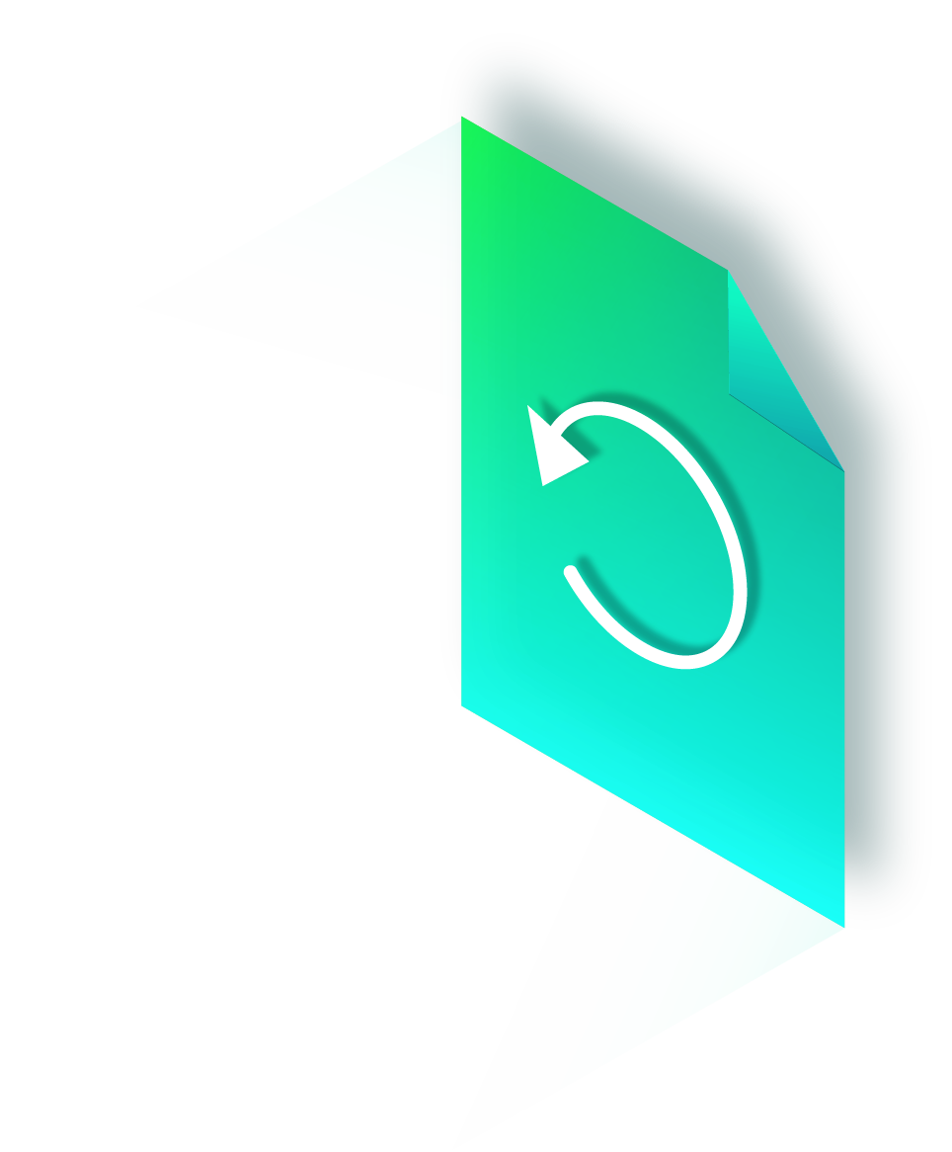
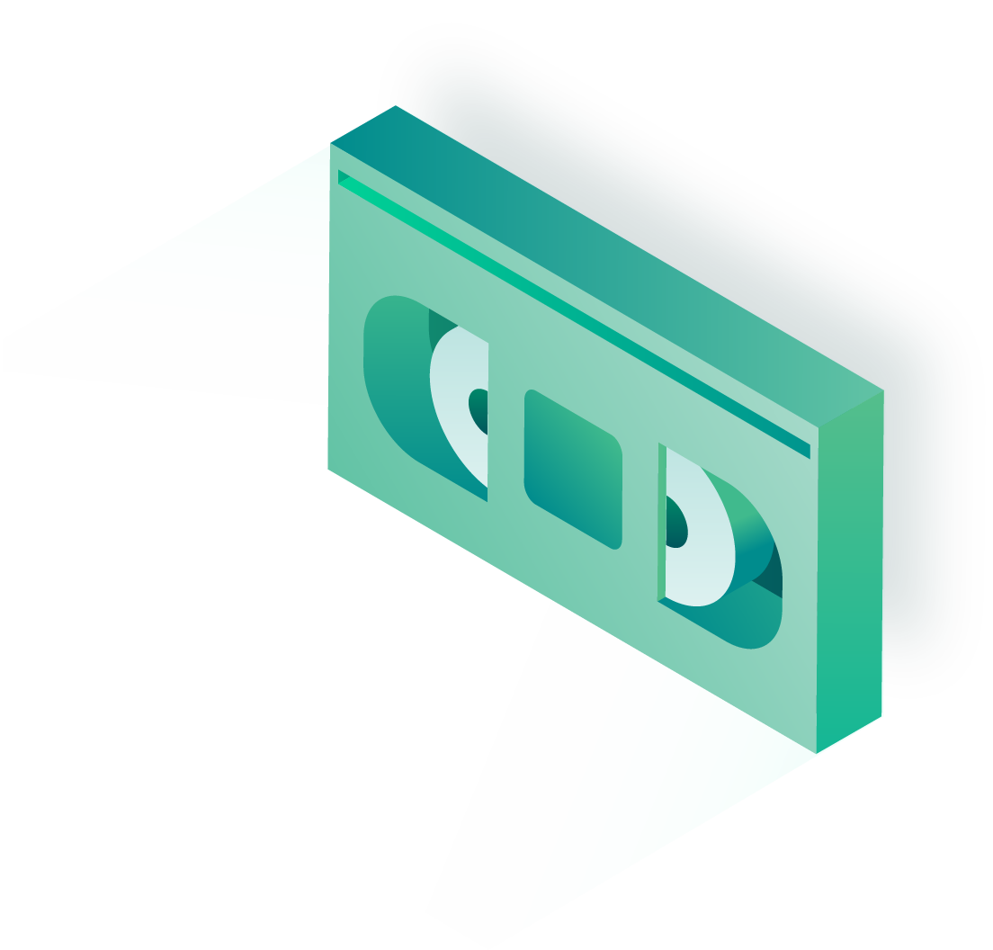
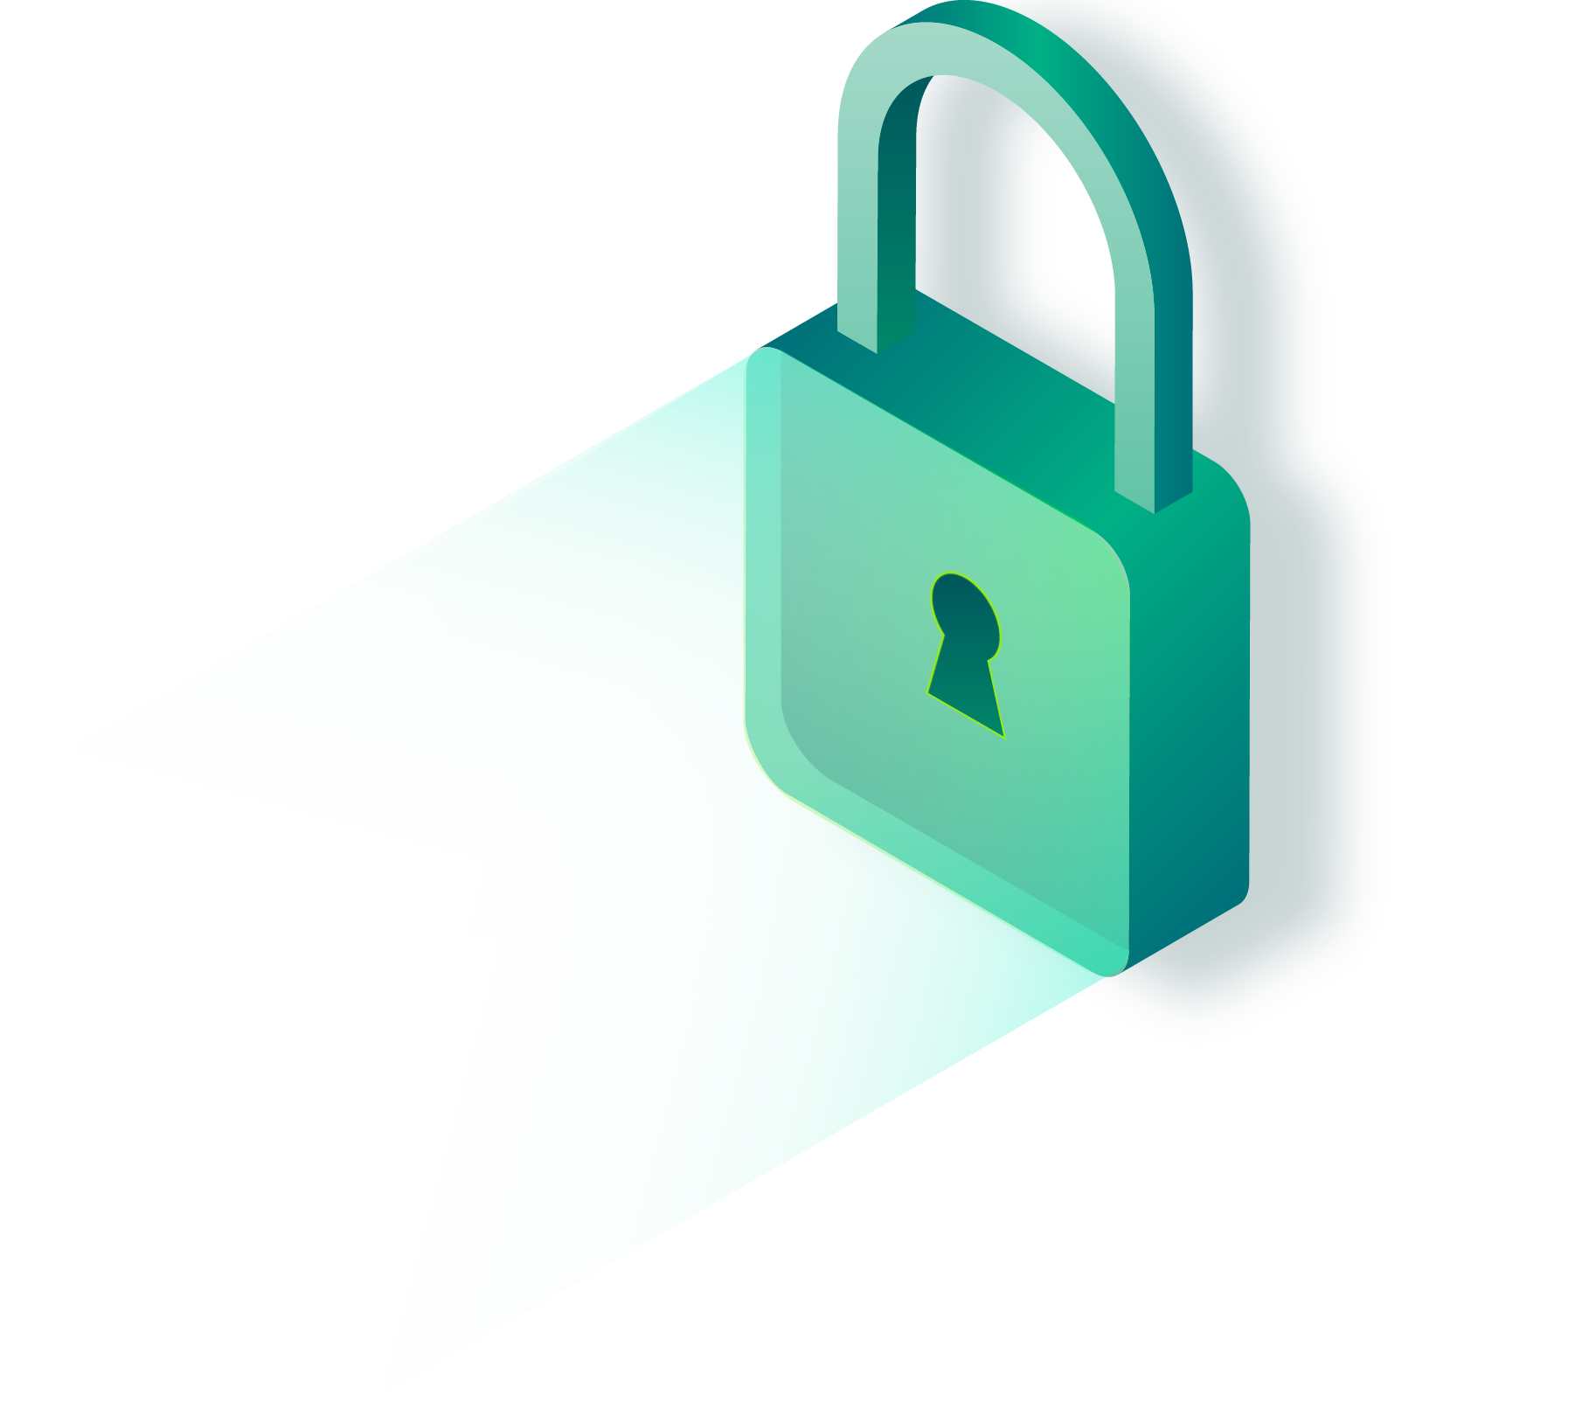
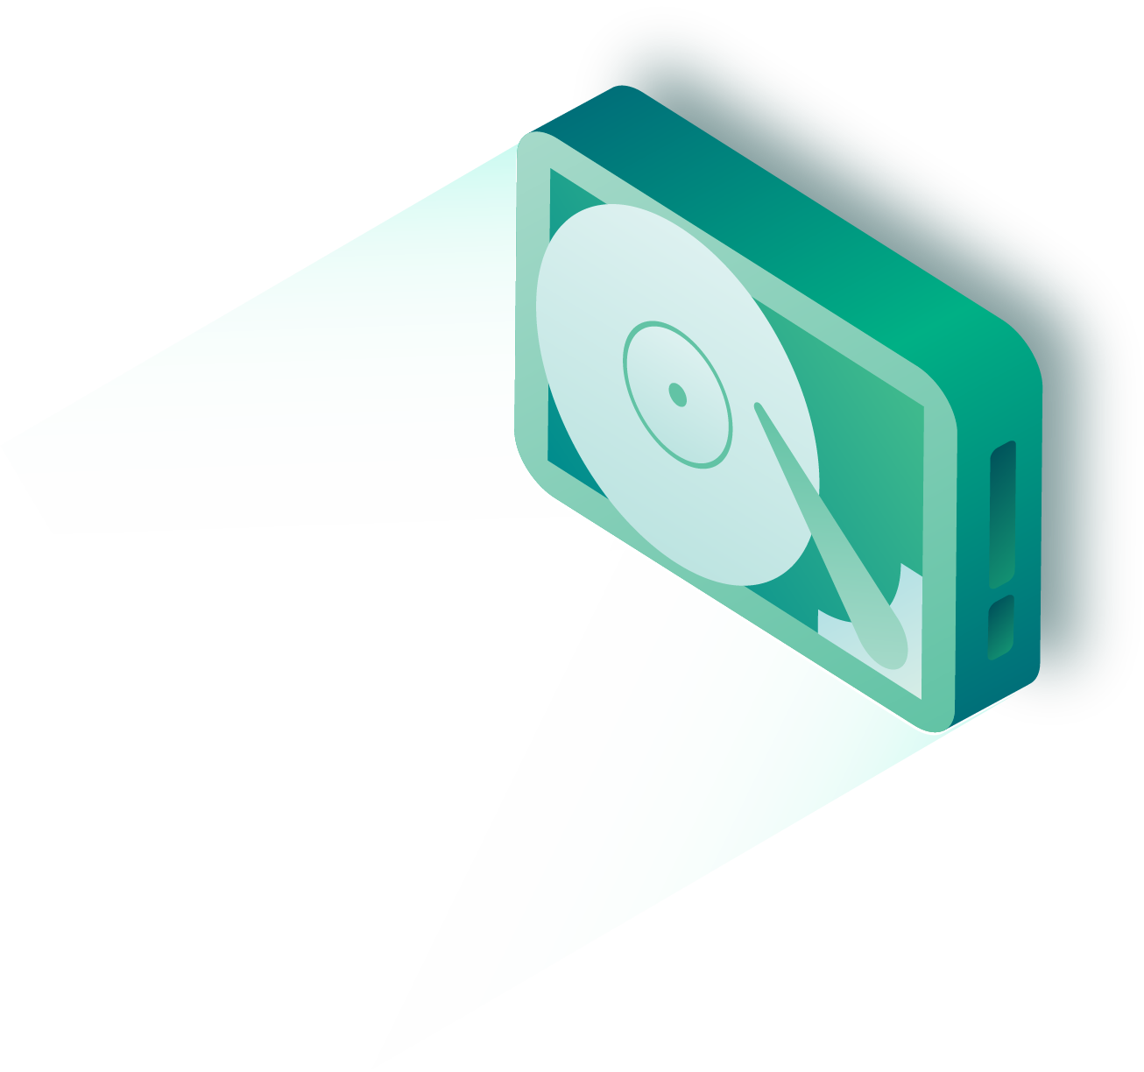
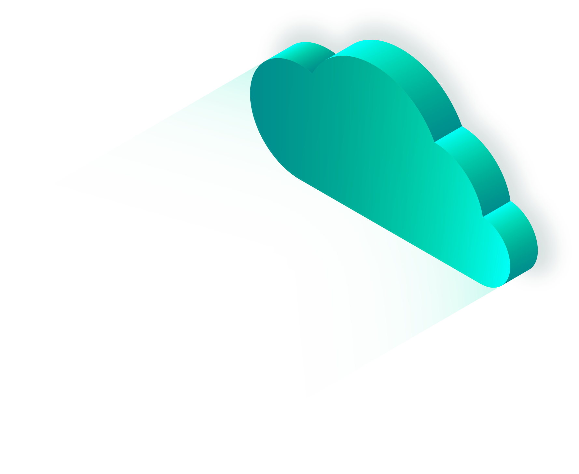
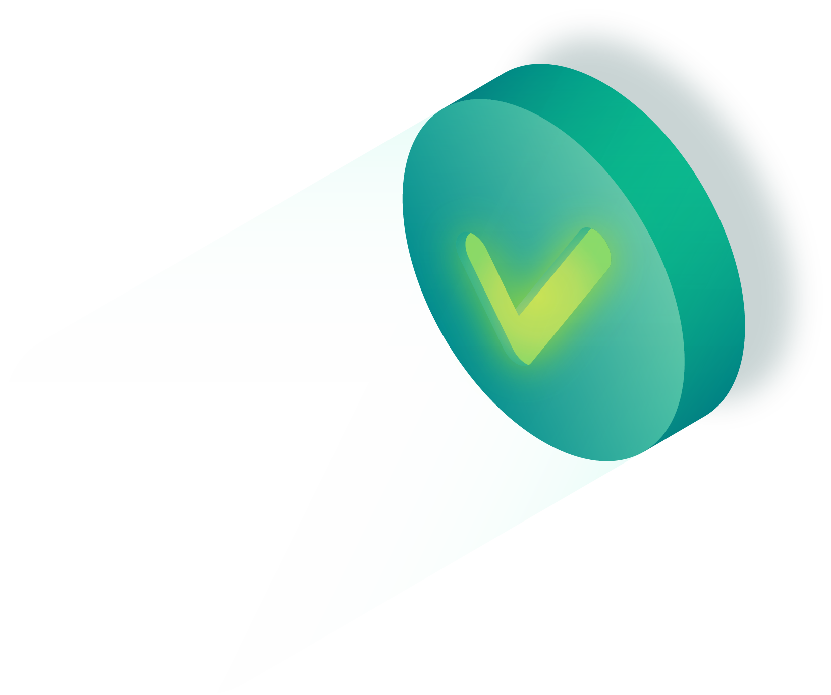
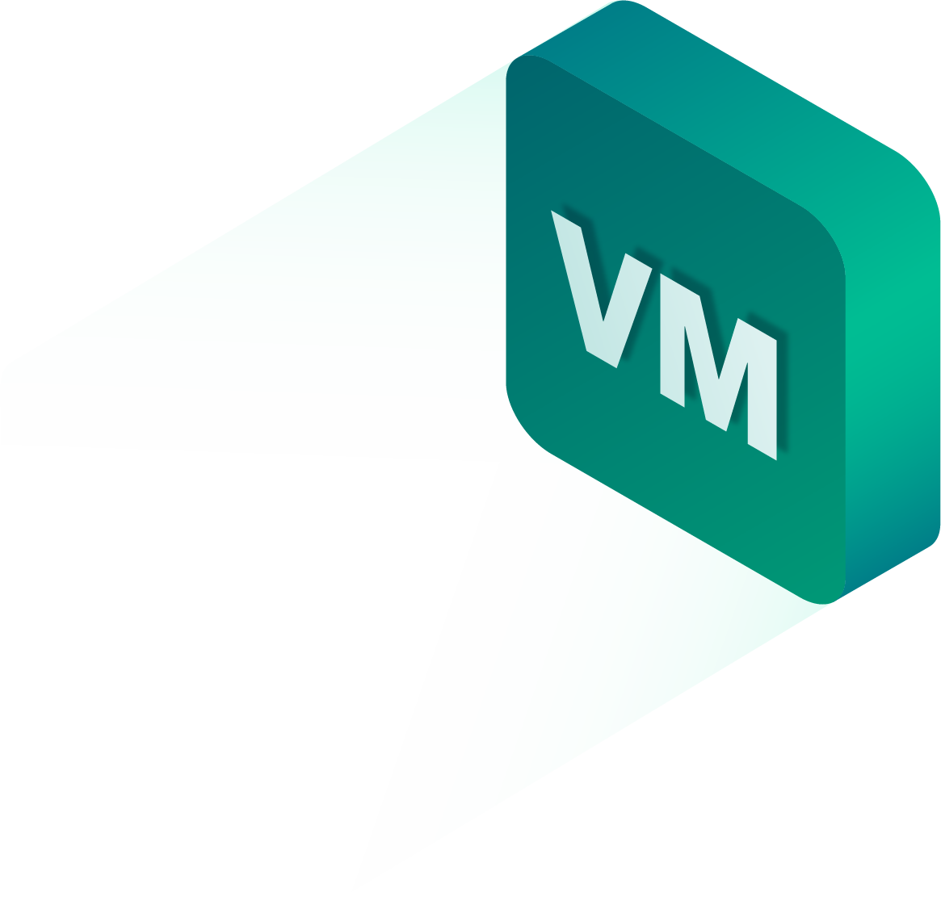
Modern Data Protection Characteristics & best practices
Comprehensive platform
Accelerated cloud adoption
Ransomware & security
Three different
copies of data
Two different media
One offsite copy
Of which is:
offline air-gapped or immutable
No errors after automated backup testing & recoverability verification
Notes:
Every business, in every vertical, in every country is rightfully concerned with ransomware and data security. Ransomware and cyberthreats are on the rise, and bad actors are getting more sophisticated, targeting backup data. With an increasing threatscape, it is imperative that a backup solution has a means of alerting suspicious and anomalous activity, as well as providing strong safeguards to ensure that backup data is safe from accidental or malicious destruction, encryption, or alteration. These capabilities should be available without having to purchase, deploy, and manage proprietary hardware.
Veeam offers alerts and alarms that let you spot potential cyber issues early on.
Veeam was first to market with the Secure Restore capability, which scans machine data with your antivirus software before restoring the machine to the production environment

Slide 17
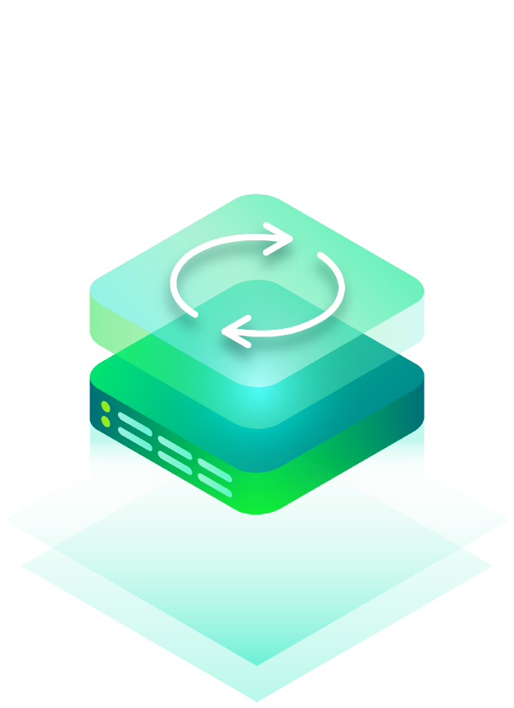
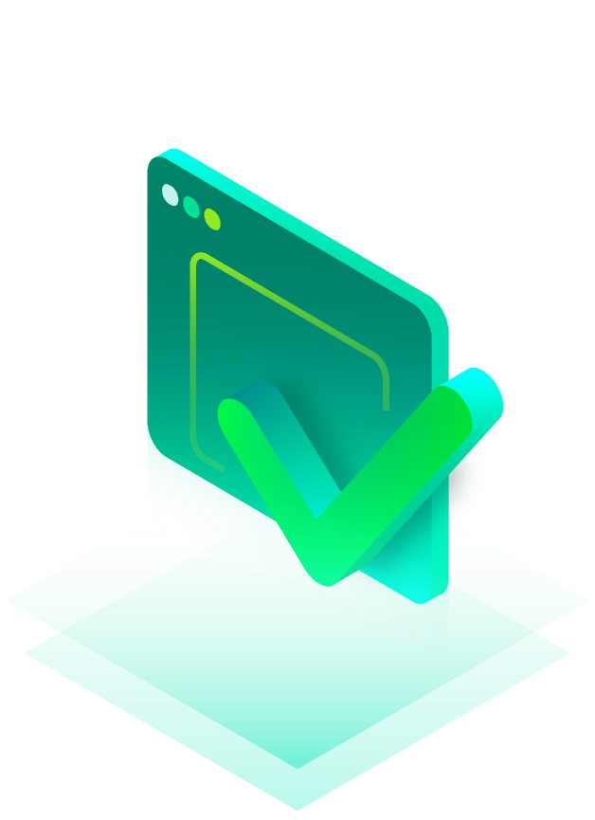
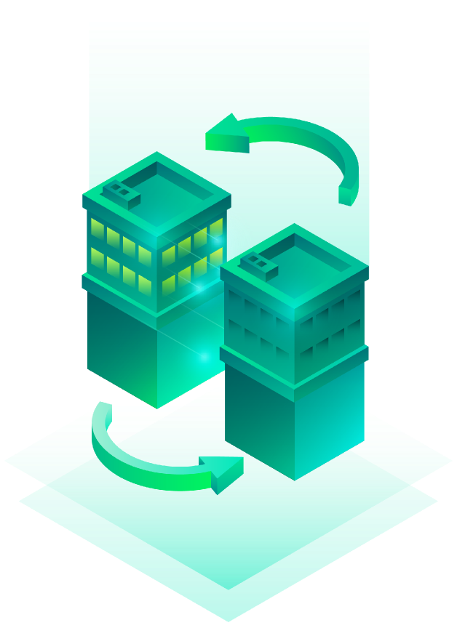
Modern Data Protection Characteristics & best practices
Comprehensive platform
Accelerated cloud adoption
Ransomware & security
Kubernetes
#1 Kubernetes Backup
Kasten K10 by Veeam enables enterprises to confidently run applications on Kubernetes
Backup &
Restore
Application
Mobility
Disaster
Recovery
Notes:
As cloud-native adoption and usage continues to explode, Kubernetes-native backup is one of the most critical, yet overlooked, challenges faced by Kubernetes operators today. Kubernetes, the fastest-growing infrastructure platform, is quickly becoming the foundation for all applications, no matter where they might be deployed. Its ubiquitous nature has it on track to be the next enterprise platform of choice, joining the ranks of Linux and vSphere.
Veeam uniquely saw the rise of server virtualized environments a decade and a half ago, and today we see containers and Kubernetes environments on the near-term horizon. In October 2020 Veeam acquired Kasten, a best-in-industry container protection and Kubernetes orchestration platform. Kasten delivers comprehensive backup, disaster recovery, and application mobility for containerized workloads.

Slide 18
Modern Data Protection Characteristics & best practices
Comprehensive platform
Accelerated cloud adoption
Ransomware & security
Kubernetes
Data portability & Cloud Mobility
Veeam doesn’t lock you in. Veeam’s portable data format means that with your credentials, you can use our Windows and Linux extract utilities to bring back your data without the presence of a Veeam backup server. You can also download the free Veeam Community Edition version of the product and quickly restore your data, again using your secure credentials. This means that you’ll never be locked out of your data.
Notes:
Too often, data is stranded in isolated silos, due to having to deploy multiple backup approaches, each with their own data format. This creates friction for data movement, especially when trying to move data to, from, or across different clouds. Your backup should not be holding your data hostage. It’s your data, and it should be effortless to access, and be seamlessly moved to where you need it to be, when you need it to be there.
Veeam writes data in a self-describing manner. There is a backup catalog to speed up operations, but even if that catalog should become damaged or unavailable, your data can still be recovered. This differentiates Veeam from other providers as backup Veeam data is highly portable, making it easy to migrate data to the cloud, bring it back when you need it, or move from one cloud provider to another. Veeam even automatically performs the UEFI or BIOS conversion from Windows to Linux machines when moving from Azure to AWS, or vice versa.

Slide 19
Modern Data Protection Characteristics & best practices
Comprehensive platform
Accelerated cloud adoption
Ransomware & security
Kubernetes
Data portability & Cloud Mobility
Software-defined & extensibility
Veeam is software-defined and infrastructure agnostic. Our expertise is in delivering innovative backup software. There are many hardware vendors that have spent countless programmer years innovating their storage, compute, and networking solutions. Veeam feels that you should have the flexibility to choose the right mix, of the right components to meet your requirements, and to easily make changes if your requirements shift over time. This may include leveraging infrastructure that you already have or preferring to purchase hardware that you already know how to manage.
Notes:
Some backup solutions are predicated on specific, proprietary hardware. Often this hardware is just commodity compute and storage that a vendor charges a premium for. This can be inflexible, and force costly upgrades for many components, when perhaps only more storage capacity is needed. Making matters worse, given the economic realities that many businesses are in today, they cannot re-use existing infrastructure, and may be forced to implement hardware outside of their preferred vendors. This also can make scaling up, or down more difficult, reducing the backup solution’s extensibility.
Veeam is software-defined and infrastructure agnostic.
Veeam offers a horizontally scalable software defined storage (SDS) architecture.

Slide 20
Modern Data Protection Characteristics & best practices
Comprehensive platform
Accelerated cloud adoption
Ransomware & security
Kubernetes
Data portability & Cloud Mobility
Software-defined & extensibility
Speed & scale
Veeam’s comprehensive 4-in-1 data capture (backup, CDP, replication, storage snapshot-based), industry pioneering Instant Recovery, and other efficiencies, such as built-in WAN acceleration, changed-file-tracking for file shares and network attached storage (NAS), just to name a few of the many capabilities, mean that backups are fast.
Notes:
No organization can afford to wait for backups to complete over a long period of time. And when it comes to restore and instant mount of data, speed, or the time needed to get access to data is important but being able to quickly capture the backup data also matters. Speed is critical to get the business back in business. Scalability also matters. A backup solution should be able to easily scale up, or down, and pivot to meet your current needs, even if they change in the future.
Veeam’s comprehensive 4-in-1 data capture (backup, CDP, replication, storage snapshot-based), industry pioneering Instant Recovery, and other efficiencies, such as built-in WAN acceleration, changed-file-tracking for file shares and network attached storage (NAS), just to name a few of the many capabilities, mean that backups are fast. Veeam can also leverage your investments in storage infrastructure to use hardware snapshots as the source for backups to further reduce production impact.

Slide 21
Modern Data Protection Characteristics & best practices
Comprehensive platform
Accelerated cloud adoption
Ransomware & security
Kubernetes
Data portability & Cloud Mobility
Software-defined & extensibility
Speed & scale
Data reuse & Digital Transformation
Veeam doesn’t know what your digital transformation initiatives are, but we do know that it starts with protecting important data, making it highly available, ensuring proper policy-based data management, and providing the ability to re-use data to fuel the business. Veeam pioneered Instant Recovery of data over a decade ago, and we have been optimizing that capability ever since.
The ability to stand up many simultaneous machines, without requiring solid state drives (SSDs), separates Veeam from other products on the market.
Notes:
It is difficult to imagine a business that is not engaged in one or more digital transformation (DX) projects. DX is being leveraged as a method of expanding customer and partner relationships, delivering new products and services, and as a means of optimizing costs. The ability to quickly and easily re-use data to achieve better business outcomes is what is needed. However not all data protection solutions make leveraging your critical data for expanded use cases, such as application development, DevOps, DevSecOps, DataOps, forensic analysis, or reporting and analytics easy to achieve.
Veeam doesn’t know what your digital transformation initiatives are, but we do know that it starts with protecting important data, making it highly available, ensuring proper policy-based data management, and providing the ability to re-use data to fuel the business. Veeam pioneered Instant Recovery of data over a decade ago, and we have been optimizing that capability ever since. The ability to stand up many simultaneous machines, without requiring solid state drives (SSDs), separates Veeam from other products on the market.

Slide 22
Modern Data Protection Characteristics & best practices
Comprehensive platform
Accelerated cloud adoption
Ransomware & security
Kubernetes
Data portability & Cloud Mobility
Software-defined & extensibility
Speed & scale
Data reuse & Digital Transformation
Ease of use & reduced complexity
Veeam has had long standing design goals of delivering solutions that are Simple, Flexible, and Reliable. Simple does not mean lacking features or capabilities. Simple means easy to deploy, configure, and manage. A fast time to value. Simple to extend. Reducing complexity and operational management (i.e. ease of use) has been one of the top drivers for switching backup products for over a decade. Flexible comes from the software-defined architecture described above, and from the broad ecosystem of partners that is detailed below.
Notes:
Businesses need powerful data protection solutions. But solutions that are difficult to deploy and manage, that require many different piece parts, or that are a collection of acquired products that a vendor offers as a suite, lead to greater complexity and failure rates. Some backup products in the market require such unique knowledge and skills, that finding administrators for those solutions proves difficult or cost prohibitive.
Veeam has had long standing design goals of delivering solutions that are Simple, Flexible, and Reliable. Simple does not mean lacking features or capabilities. Simple means easy to deploy, configure, and manage.
A fast time to value. Simple to extend.
Reducing complexity and operational management (i.e. ease of use) has been one of the top drivers for switching backup products for over a decade.

Slide 23
Modern Data Protection Characteristics & best practices
Comprehensive platform
Accelerated cloud adoption
Ransomware & security
Kubernetes
Data portability & Cloud Mobility
Software-defined & extensibility
Speed & scale
Data reuse & Digital Transformation
Ease of use & reduced complexity
Strong ecosystem of partners
Veeam has had a partner-first business model since the company’s inception. Veeam has a broad range of reseller, co-seller, platform, cloud, storage, global system integrators (GSI), and as-a-Service partners.
Notes:
Almost nothing in the data center or in the cloud is an island. Interconnectedness is innate in today’s hybrid-cloud, multi-cloud landscape. For most of us, the on-premises data center is very much a part of that reality as well. We can add the edge, such as remote and branch offices, work-from-home laptops, and soon IoT aggregation points to this mix as well. That means that deploying a backup solution that can meet a broad range of workloads, locations, infrastructure, service levels and budgets can be challenging. This is where ecosystems come in to play to extend the capability and value of the individual pieces that make up a modern backup practice.
One way that Veeam achieves this is through interfaces, such as the Veeam Universal Storage API, Restful APIs, and PowerShell.
Veeam can integrate with your management solutions, such as Ansible, Chef, Chocolatey, Puppet, and Terraform, just to name a few. See github.com/VeeamHub
Veeam is certified to run on a broad range of infrastructure components Potential call-out box & graphic around 1) Veeam’s integrations (I’ll include in accompanying PowerPoint), or 2) Veeam’s partner ecosystem.

Slide 25
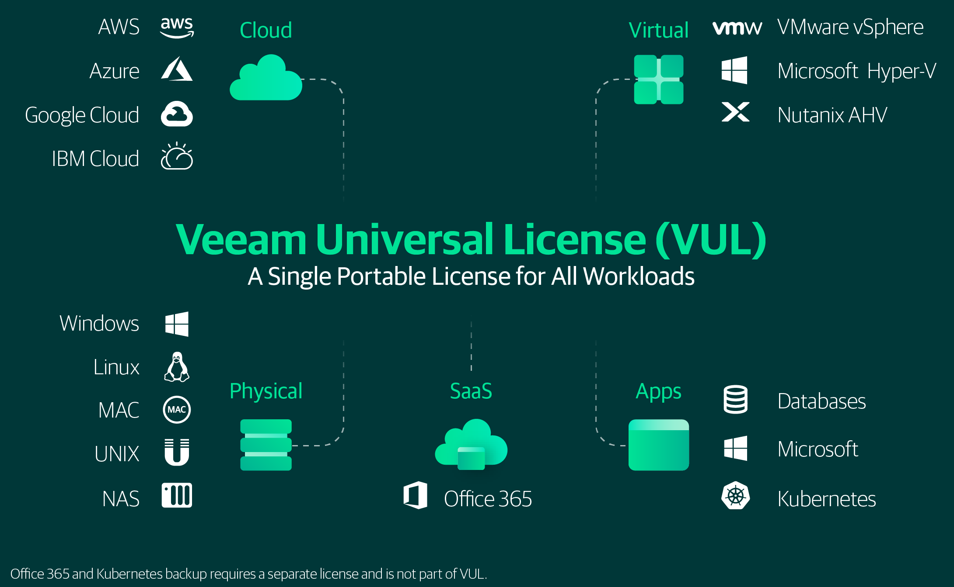
Modern Data Protection Characteristics & best practices
Comprehensive platform
Accelerated cloud adoption
Ransomware & security
Kubernetes
Data portability & Cloud Mobility
Software-defined & extensibility
Speed & scale
Data reuse & Digital Transformation
Ease of use & reduced complexity
Strong ecosystem of partners
Cost containment
Notes:
Cost and licensing are not things that IT professionals want to think about. The reality is that cost matters, and that licensing models can become real impediments in your ability to deliver the backup services that your business needs. A fast-changing world, where workloads and deployment models are shifting can mean that organizations get stuck with shelfware, are left to deal with already poor performing legacy systems for longer periods of time, or worse yet, are not able to protect all of the company’s vital data.
Veeam has always offered backup packages and bundles that fit every size of organization and budget.
Veeam was first to market with CPU socket-based pricing
Veeam Universal License (VUL) is a flexible and portable solution for protecting multiple, different workloads on premises and in the cloud. VUL makes licensing easier than ever and avoids additional fees that other vendors may charge. VUL enables one portable subscription license type to be used across cloud, virtual and physical workloads:
Portable across workloads and locations
Move licenses on your own schedule
Not product or workload-specific

Slide 26
Modern Data Protection Characteristics & best practices
Comprehensive platform
Accelerated cloud adoption
Ransomware & security
Kubernetes
Data portability & Cloud Mobility
Software-defined & extensibility
Speed & scale
Data reuse & Digital Transformation
Ease of use & reduced complexity
Strong ecosystem of partners
Cost containment
Future-proofing & vendor viability
Veeam is one of only a few dozen software companies in any industry to achieve over a billion dollars (USD) in revenue. According to industry analysts such as Gartner and IDC, Veeam is gaining market share, and is the only major backup vendor to grow year over year to start this decade.
Veeam’s financial health makes Veeam a strong and viable partner for your long-term backup needs. Veeam is investing heavily in protecting future workloads, such as Kubernetes, acquiring Kasten for container-based backup in 2020.Veeam continues to invest heavily in new and enhanced products to help you modernize and meet your backup challenges today, and to be ready for the future.
Notes:
If we have learned anything from 2020, it’s that the future can change fast. But it was always a best practice to have a backup solution that could flex and adapt to meet not only the current and anticipated needs, but also be able to address unforeseen future requirements. An extensible platform, with data portability and cloud mobility, along with easily transferable licensing are all a must. Vendor viability becomes important as well, as the provider’s long-term history, and especially the current financial health is key to ensuring that your trusted, strategic supplier for backup today can be counted on to serve as your strategic partner in the.
Veeam is one of only a few dozen software companies in any industry to achieve over a billion dollars (USD) in revenue. According to industry analysts such as Gartner and IDC, Veeam is gaining market share, and is the only major backup vendor to grow year over year to start this decade.
Veeam’s financial health makes Veeam a strong and viable partner for your long-term backup needs.

Slide 27
Thank you

