Slide 1
Azure is the best destination for data in the era of AI
Notes:
Buna dimineata si bine v-am gasit
Ma bucur sa fiu alaturi de voi si sa discutam despre transofrmarea induscriei de customer service. Primul meu job a fost intr-un call center. Pe vremea aceea ma chema Mark si eram din Uk si faceam sondaje pentru o companie auto in intreaga lume.
Cred ca aceasta experienta m-a marcat profund, dand un alt sens interactiunilor pe care le-am avut cu clientii de-a lungul timpului. Cred ca inca de atunci am inteles ce inseamna customer delight, cum fiecare interactiune fie ca vorbim de pre sales sau post sales influenteaza perceptia asupra unei compani, poate sa creeze loialitate sau din contra, frustrare.

Slide 2
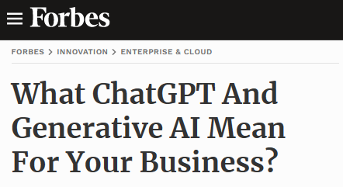
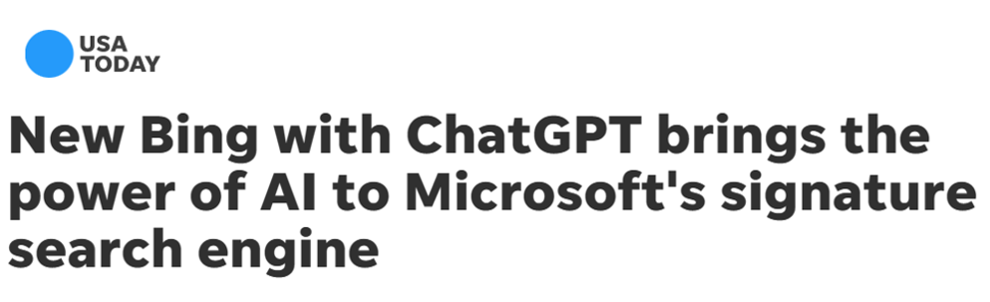
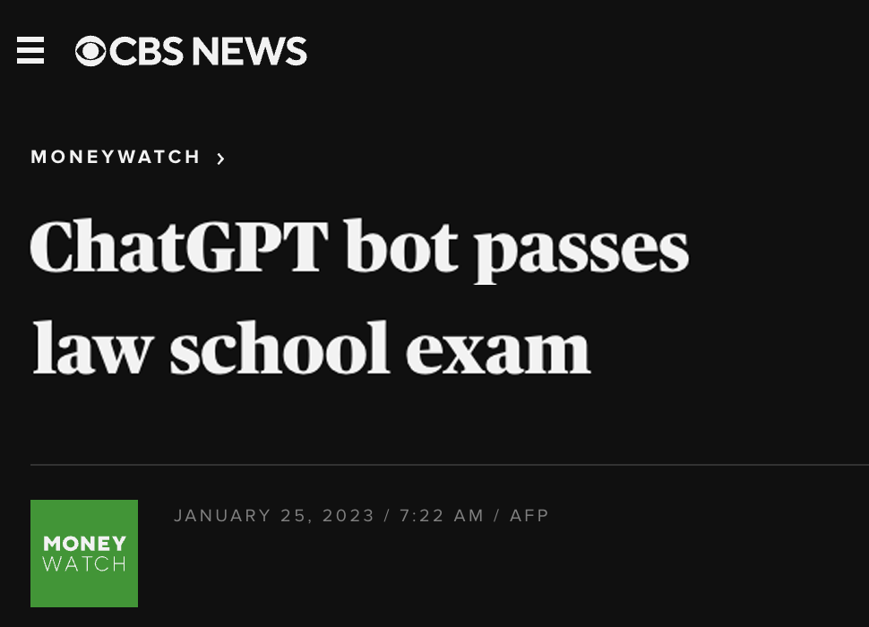
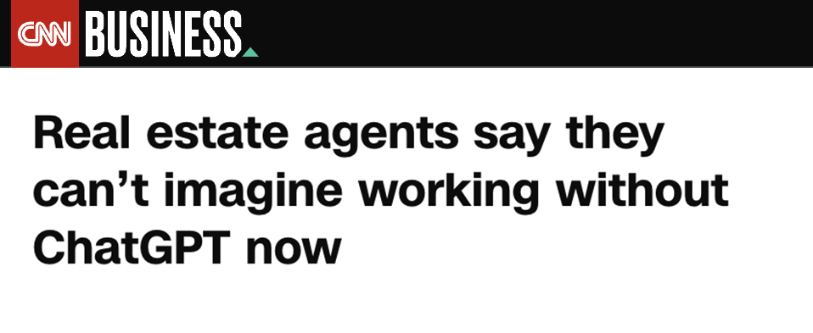
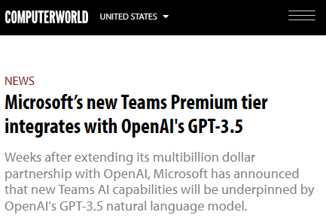
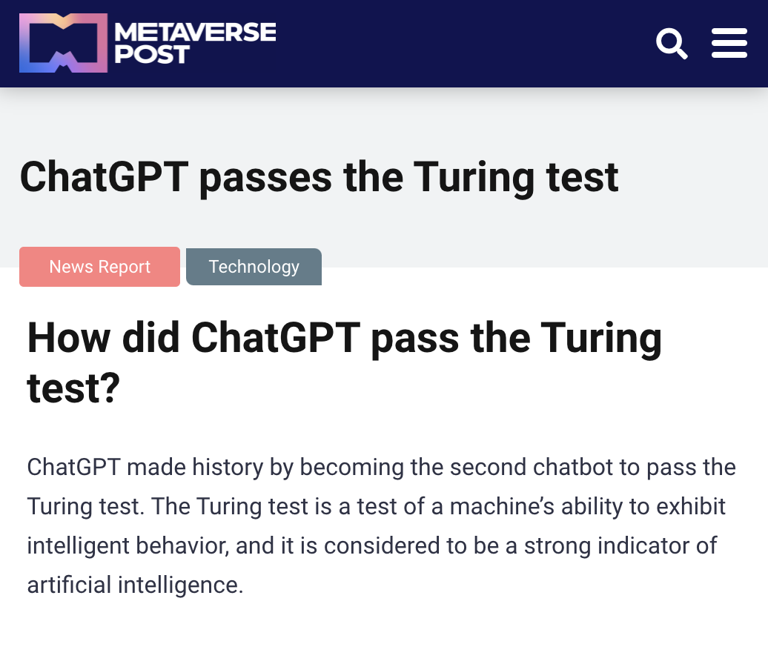
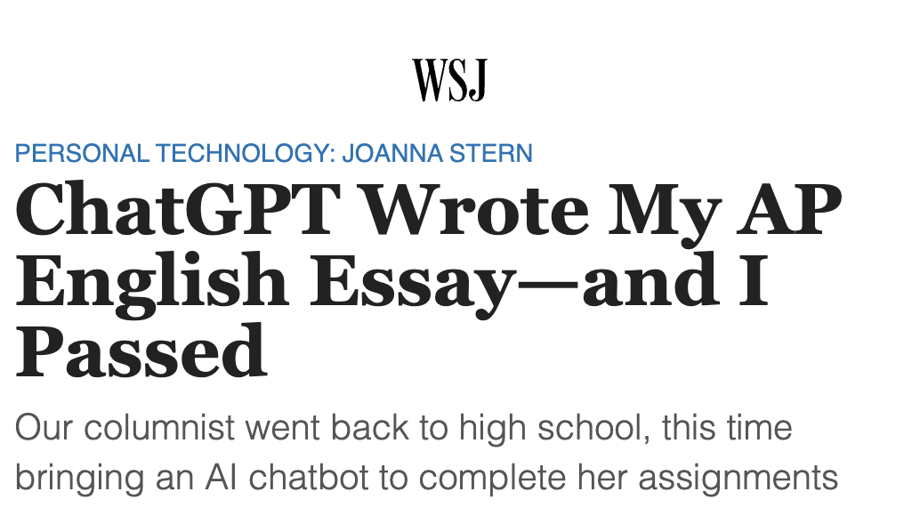
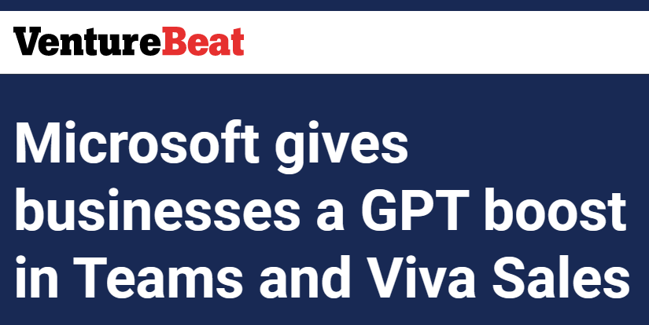
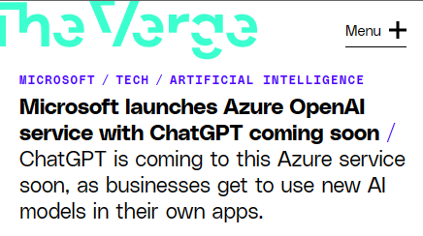
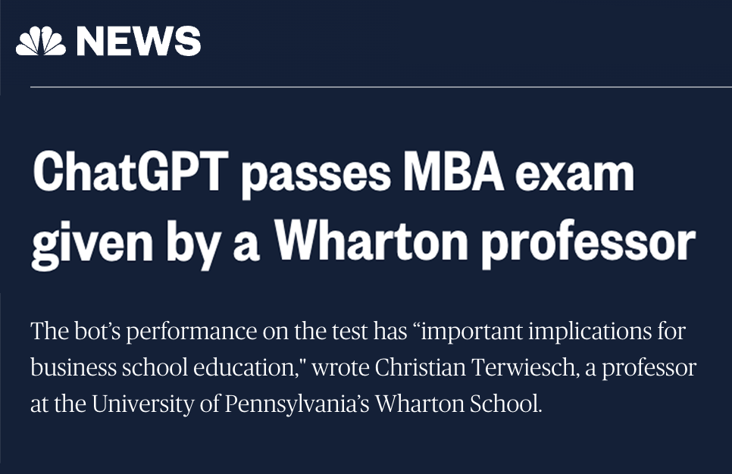
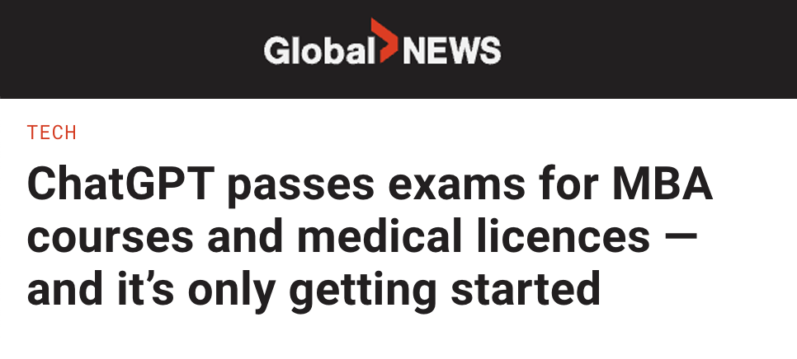
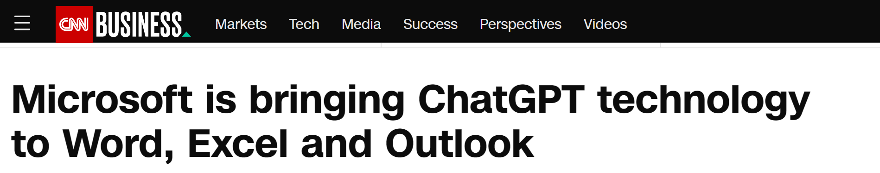
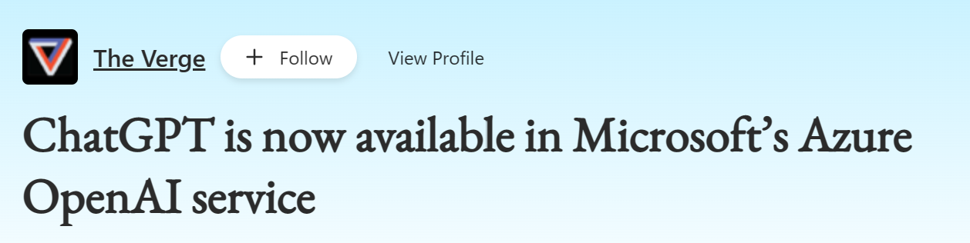
Generative AI is here
Generative AI is here
Notes:
I have been at Microsoft for quite a while.
I have worked on some pretty hot areas over the years, but I have never seen anything catch the hearts, minds and wallets as OpenAI has.
The adoption curve is off the charts.
In fact, the product I run, Azure OpenAI Service is the fastest growing service in our company’s history
And, we have been around a loooong time, actually for 48 years.
So what’s driving the adoption, of OpenAI
Why did ChatGPT catch fire this past January and win the hearts and minds of people around the world?
CLICK

Slide 3


Microsoft and OpenAI partnership
Ensure that artificial general intelligence (AGI) benefits humanity
Empower every person and organization on the planet to achieve more
GPT-3.5 and GPT-4
ChatGPT
Codex
DALL·E 2
Text
Conversation
Code
Images
Notes:
In Azure Open AI sunt cateva modele disponibile in momentul de fata: GPT 3.5 si GPT 4 pentru zona de text, chat GPT pentru partea de conversatii, Codex pentru scrierea si comentarea de cod, Dalle-2 pentru zona de imagini.
The MSFT / OpenAI partnership and how we collaborate
Microsoft has formed a partnership with OpenAI to collaborate on the development of artificial intelligence technologies. The partnership aims to accelerate the development of advanced AI systems and bring the benefits of AI to more people.
As part of the partnership, Microsoft and OpenAI have agreed to work together on several key areas, including:
Developing AI technologies: The two companies will collaborate on the development of new AI models and algorithms, with a focus on natural language processing, computer vision, and other areas of AI.
Building an AI computing platform: Microsoft and OpenAI will work together to build a new AI computing platform that will allow developers to easily access and use advanced AI models and algorithms.
Advancing AI research: The two companies will also collaborate on a range of research projects aimed at advancing the state of the art in AI.
Making AI more accessible: The partnership aims to make AI more accessible to a wider range of developers and organizations, in order to bring the benefits of AI to more people.
Microsoft has also announced it will use OpenAI's GPT-3 technology to add more capabilities to its products such as Cortana, Power Virtual Agents and Dynamics 365.
Additionally, Microsoft has also made an investment in OpenAI, allowing the company to use Microsoft Azure as its preferred cloud platform, and allowing OpenAI to tap into the vast resources of Microsoft to accelerate its research. This partnership gives OpenAI the ability to scale its models and services on Azure and make them more widely available to customers.
Overall, the partnership between Microsoft and OpenAI aims to accelerate the development and use of advanced AI technologies, with a focus on making AI more accessible to developers and organizations, in order to bring the benefits of AI to more people.

Slide 4
Azure OpenAI Service
Capabilities
Subject Research
Creative Ideation
Essay outlines
Extracting insights
Semantic search
Summarizing text
Code generation
Limitless generation with a few lines of input
Dialog agents
Virtual Assistants
Language Translation
Writing assistance
Classifying text
Answering questions
Poem creation
Comments from code
Image Generation
Code refactoring

Slide 5
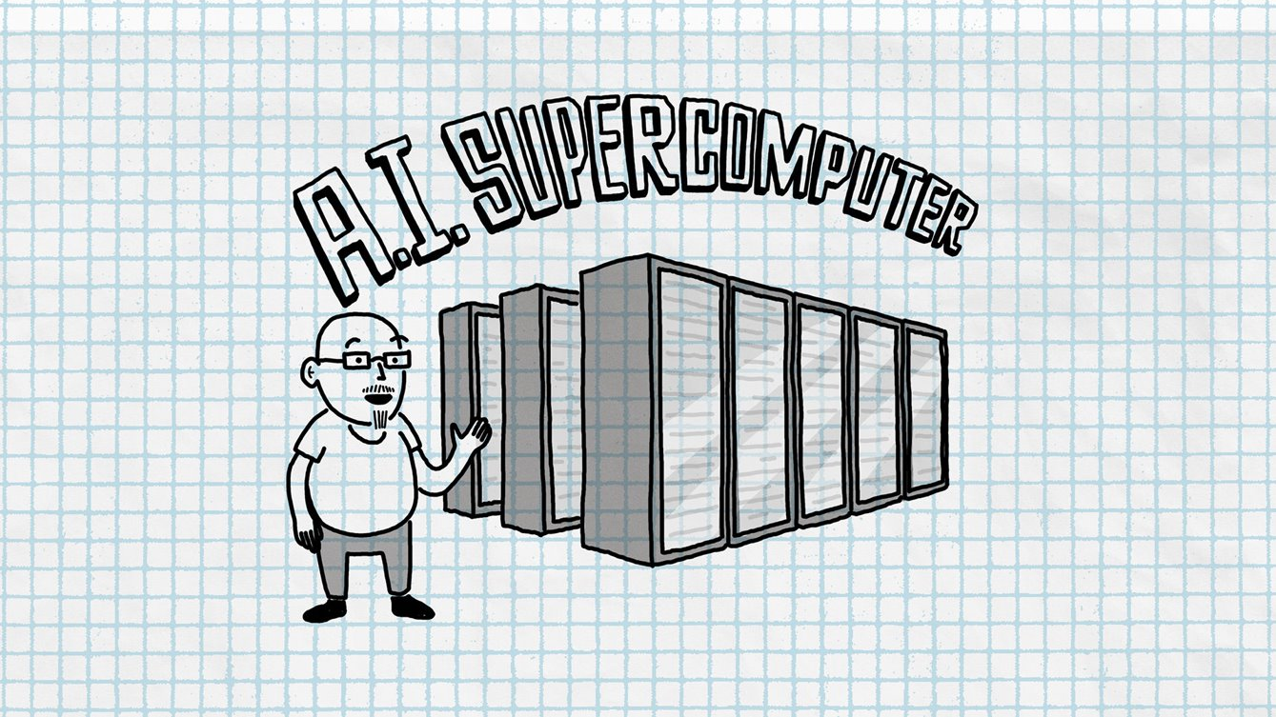
285,000 CPU cores
10,000 GPUs
400 gigabits per second of
network connectivity for each GPU server
Notes:
Supercalculator dezvoltat de Microsoft pentru OpenAI este un singur sistem cu peste 285 mii de CPU cores, 10.000 GPU si conectivitate de 400 GB pe secunda pentru fiecare GPU server. Comparat cu alte super computer in lume, acesta este pe locul 5.
The supercomputer developed for OpenAI is a single system with more than 285,000 CPU cores, 10,000 GPUs and 400 gigabits per second of network connectivity for each GPU server. Compared with other machines listed on the TOP500 supercomputers in the world, it ranks in the top five, Microsoft says.
Compared with other machines listed on the TOP500 supercomputers in the world, it ranks in the top five, Microsoft says.

Slide 6
Power your AI transformation with the
Microsoft Cloud
Empower everyone with a copilot to rediscover the joy of work
Build your own AI-powered apps to deliver transformational experiences
Grow your business with the most open and comprehensive generative AI ecosystem
Microsoft
Copilots
Azure OpenAI
Service
Azure OpenAI Service through Partners
Safeguard your business and data with the most trusted AI platform
Notes:
With the Microsoft Cloud, we can help you power your AI transformation in three ways.
First, we’ve built AI capabilities into the Microsoft Cloud solutions customers are already using today – helping everyone be more productive, more creative, more efficient, and more innovative. This is what we mean when we talk about a copilot for every Microsoft Cloud experience.
Second, we’re making it easy for any organization to build their own copilot solutions using the same stack and AI services Microsoft used to build our own copilots. Two important messages to land as part of this conversation are the critical importance of data as the fuel for AI innovation, and the differentiation of Microsoft’s AI infrastructure.
Third, we are prioritizing partnerships and open innovation across the AI landscape, because we believe that AI must be a global team sport. Our partner ecosystem can co-innovate with customers, helping them quickly realize value from their AI investments.
And we’re doing all of this on a foundation of trust. Every organization needs to safeguard their business, their customers, and their data – particularly in this era of AI. The Microsoft Cloud runs on trust, and we’re helping every organization build safety and responsibility into their AI journey from the very beginning.

Slide 7
A copilot for every Microsoft Cloud experience
Microsoft 365 Copilot
Empower everyone with
a copilot that works alongside you
Dynamics 365 Copilot
Specialized copilots for every role and function
Copilot in Power Platform
Imagine it, describe it, and Power Platform builds it
Microsoft Security Copilot
Defend at machine
speed with Microsoft Security Copilot
Windows Copilot
The first centralized AI assistance on a platform
GitHub Copilot
Increase developer productivity to accelerate innovation
Notes:
By embracing built-in AI in the tools you’re already using, you can radically accelerate developer & employee productivity, creativity, efficiency, and innovation across your entire business.
Our first copilot solution, GitHub Copilot, became generally available in October 2022. Since then, we’ve been bringing this AI-assistant technology to every Microsoft Cloud experience.
We’re empowering knowledge workers with Microsoft 365 Copilot within the apps employees use every day.
We’re transforming business process with copilots designed for core business functions like sales, service, and more.
We’re enabling anyone to create low-code and no-code solutions with Copilot in Power Platform.
And we’re helping organizations defend at machine speed with Microsoft Security Copilot.
These are just a few of the copilot solutions we’re bringing to market across the Microsoft Cloud. Now, let’s take a closer look at some of these AI-powered experiences.

Slide 8











Azure AI
AI services
Document Intelligence
Cognitive Search
Bot Service
Video Indexer
Metrics Advisor
Immersive Reader
Vision
Speech
Language
Decision
Azure OpenAI Service
ML Platform
Azure Machine Learning
AI Infrastructure
Notes:
When we look at the Azure AI stack, you have the flexibility to start as high as you can, and go as low as you need.
At the top, with AI services, you can use specific applications, Search, Bot Service, Form Recognizer and domain-specific pretrained models, including Azure OpenAI Service. These are built on the foundation of Azure Machine Learning. As a user of AI services, you don’t need to know that, but if you do want access to that foundational layer, you can get that by using Azure Machine Learning directly.
Azure Machine Learning is a managed end-to-end machine learning platform for building, training, deploying, and operating machine learning models, responsibly, and securely, at scale. Those models can then be accessed by any application that wants to benefit from them. I highly recommend you watch the “Practical Deep-Dive into Machine Learning Techniques and MLOps” breakout, which will be broadcast tomorrow.

Slide 9

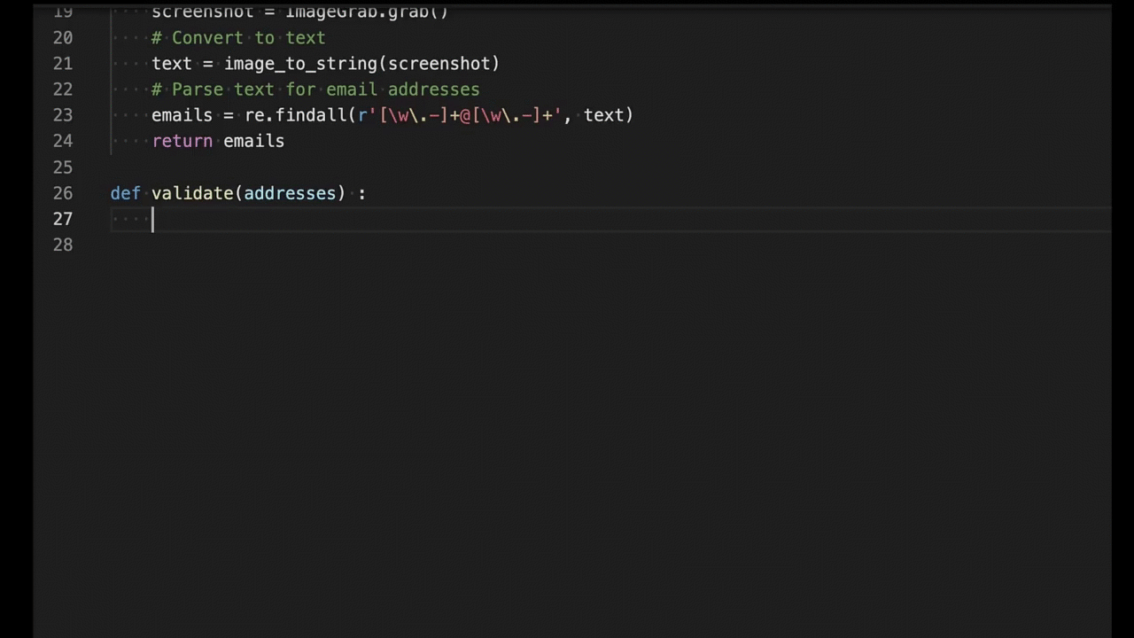
GitHub Copilot Your AI pair programmer
46%
of new code is now written by Ai
faster overall developer productivity
55%
developers feel more focused on satisfying work
75%
Notes:
GitHub Copilot draws context from the code you’re working on and suggests whole lines or entire functions. As you type, it adapts to the way you write code to help you complete your work faster.
More information: GitHub Copilot · Your AI pair programmer

Slide 10







Azure OpenAI Service
Considerations
I need a general-purpose model that can handle multiple tasks e.g., translation+entity recognition+sentiment analysis
I need to generate human-like content, whilst preserving data privacy and security e.g., abstractive summarization, content writing, paraphrasing, code
I need rapid prototyping and quick time to market for many use cases
I want a model that can be customized without training or prompt engineering
I want to explore multimodal solutions/use cases
Azure
OpenAI
Service
Vision
Speech
Language
Decision
Azure AI Cognitive Services
Notes:
Here are typical consideration points that we ask our customers to ask themselves.
If you have said yes to all of the above, then OpenAI may be the right cognitive service to go with. If you haven't checked yes to all of the above or due to any other factors we may come across when doing a deep dive on your use case, we have our other industry leading cognitive services which may cater better to the scenario that we are working with you on. We could also have situations where one of the other cog services may be needed as a complementary service with OpenAI for your particular scenario.

Slide 11



Azure OpenAI Service – Microsoft Azure Cloud
Runs on trust
Your data is your data
Your data from any fine-tuning is not used to train
OpenAI models
Your data is protected by Azure enterprise compliance and security controls
Notes:
Azure OpenAI Service is Azure and comes with all the Azure data security and regulatory compliance that you have experienced with other Azure services
First off, when we say your data is your data, all of the data you use or generate with Azure OpenAI Service is stored encrypted at rest in your organization’s Azure subscription.
The data is always under your control.
And when we say your data is not used to train models, we mean that your data is never used by OpenAI or Microsoft to train or improve any of the models. .
And all of your data and your models are protected by the most comprehensive enterprise compliance and security controls in the industry.
CLICK

Slide 12
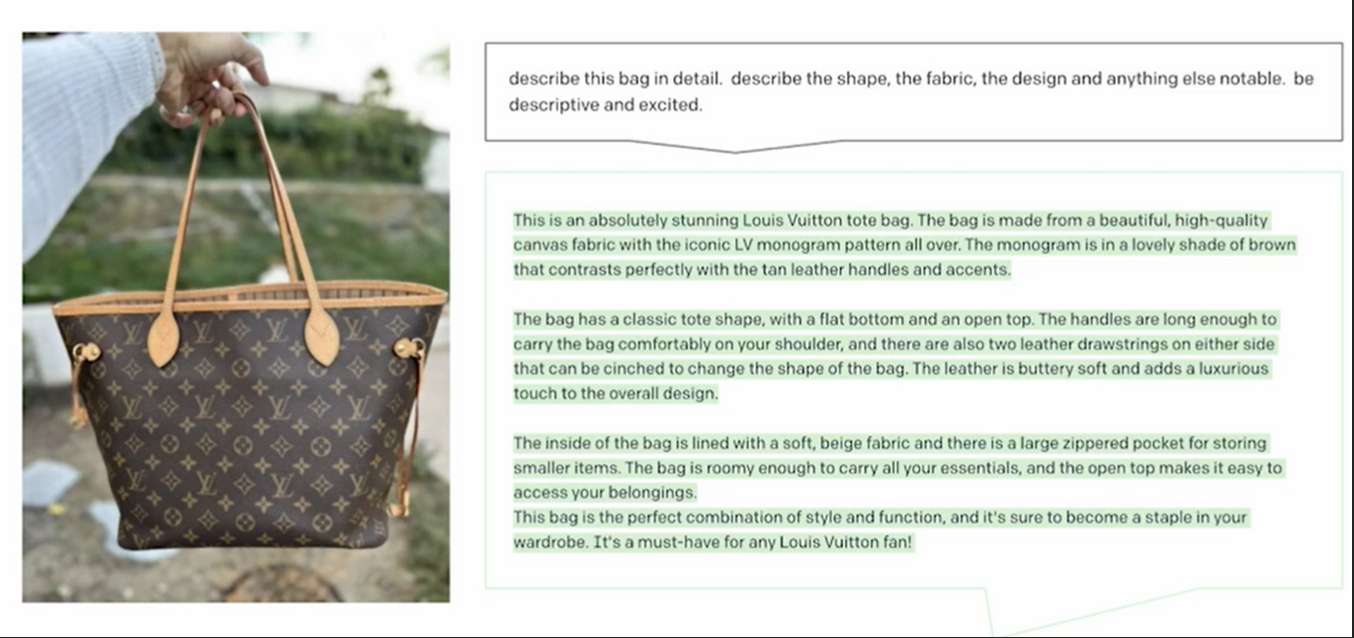
| Coming soon: GPT-4 Vision Capabilities
Notes:
In curand, in GPT-4 vor fi aduse functionalitati noi – cum ar fi descrierea unui obiect.

Slide 13



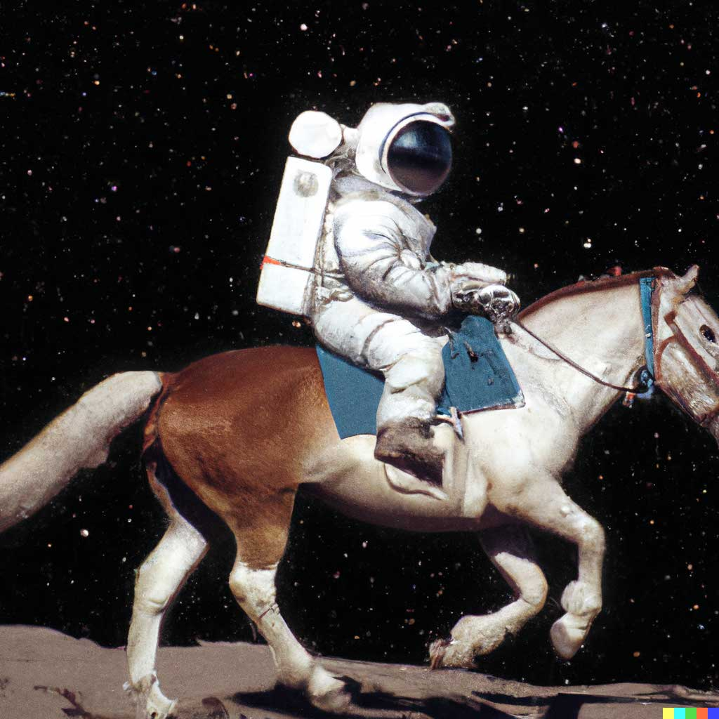


DALL E 2
An astronaut riding a horse in a photorealistic style
Teddy bear working on new AI research on the moon in 1980
A bowl of soup that looks like a monster knitted out of wool
Notes:
OpenAI Dalle-2 model can seemingly create spectacular images from just text

Slide 14

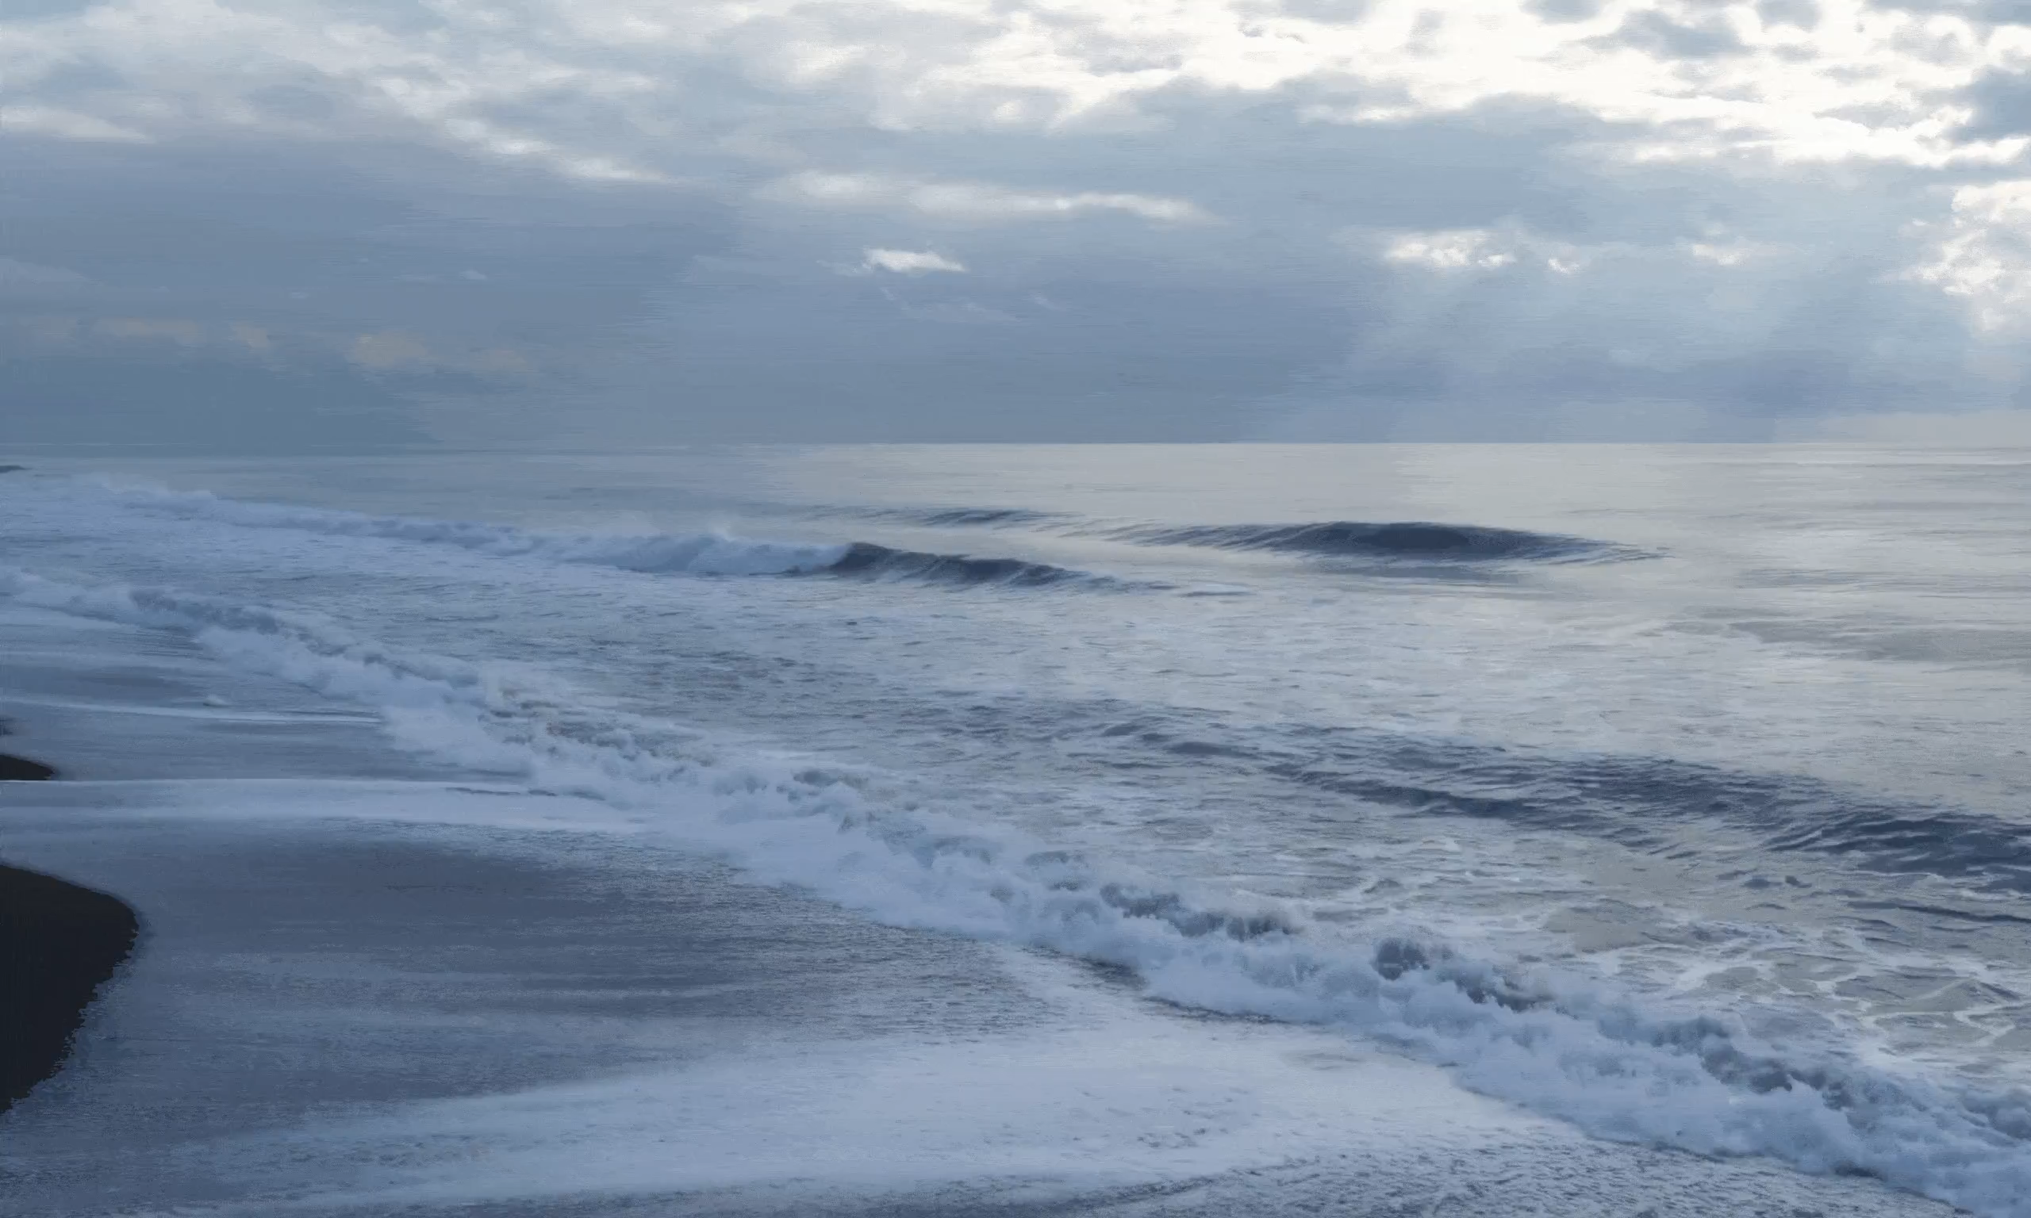

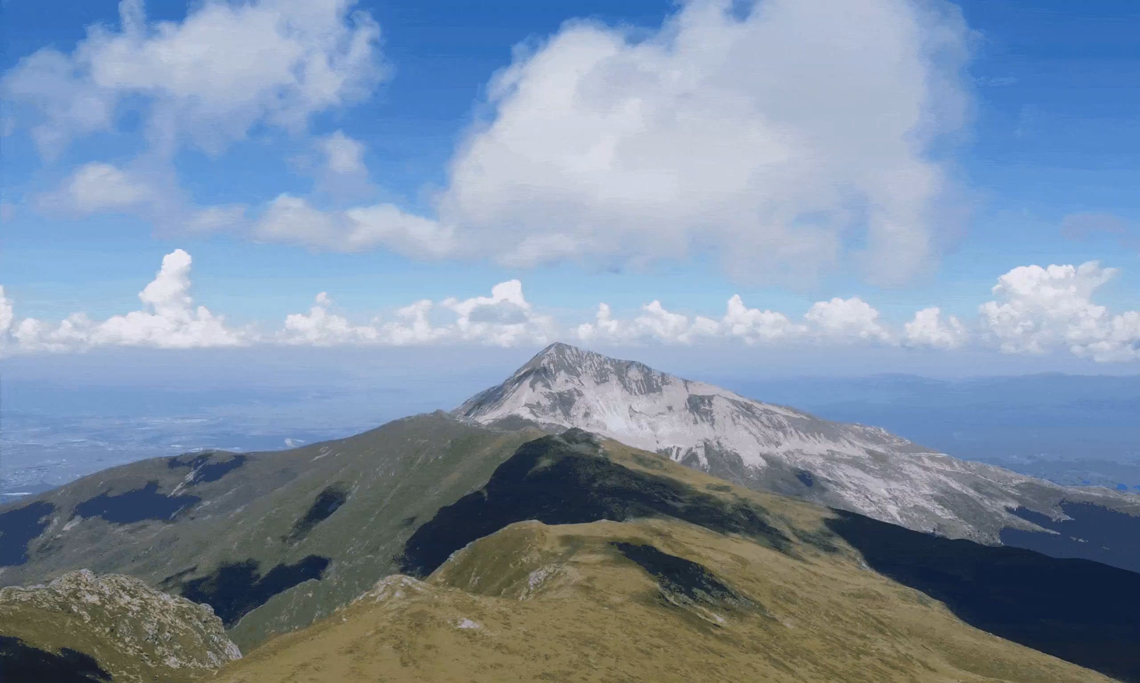
NUWA | Infinity
Text to image
Image to video
A cloudy morning on the beach with the tide coming in
Mountains
with clouds
Notes:
And even more recently, this a new multimodal generative model called NUWA Infiniti announced at our Microsoft Research, this model can also generate high-quality images just from text and can even predict the next frame to generate life like videos.
Note: this is not currently available in Azure AI and this is more about thinking what the future might hold.

Slide 15
| Azure OpenAI Top Capabilities and Use Cases
  Content generation
  Summarization
  Code
  generation
  Semantic search
Call center analytics: automatically generate responses to customer inquiries
Call center analytics: summary of customer support conversation logs
Convert natural language to SQL (or vice versa) for telemetry data
Search reviews for a specific product/service
Generate personalized UI for your website
Subject matter expert document: summarization (e.g. Financial reporting, analyst articles)
Convert natural language to query proprietary data models
Information discovery and knowledge mining
Generate marketing content (images / SEO / blog posts)
Social media trends summarization
Code documentation
Search and retrieve knowledge
base information in contextualized natural language
Generate automated follow-on emails to customers based on call details
Examples of multiple model use cases
End to end call center analytics: classification, sentiment, entity extraction, summarization and email generation
Customer 360: hyper-personalisation using timely summarization of customer queries & trends, search, and content generation
Business process automation: search through structured & unstructured documentation, generate code to query data models, content generation

Slide 16
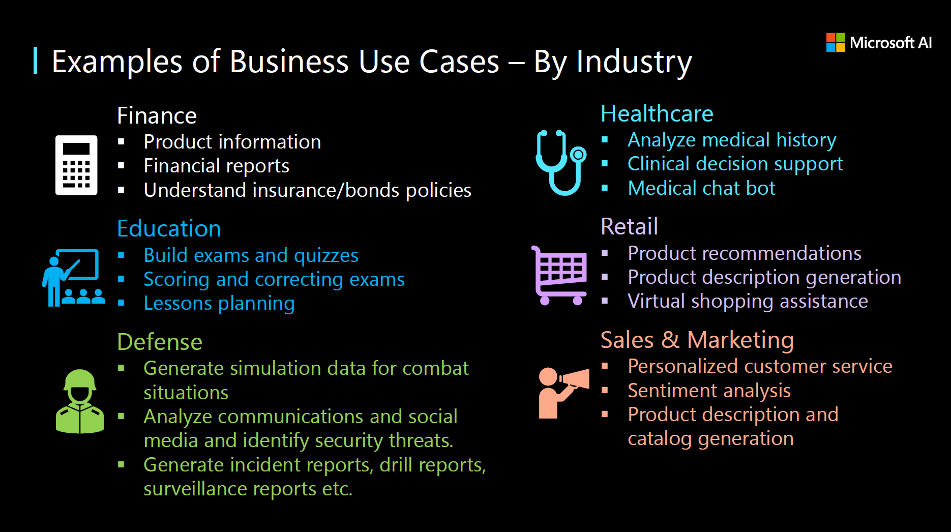

Slide 17
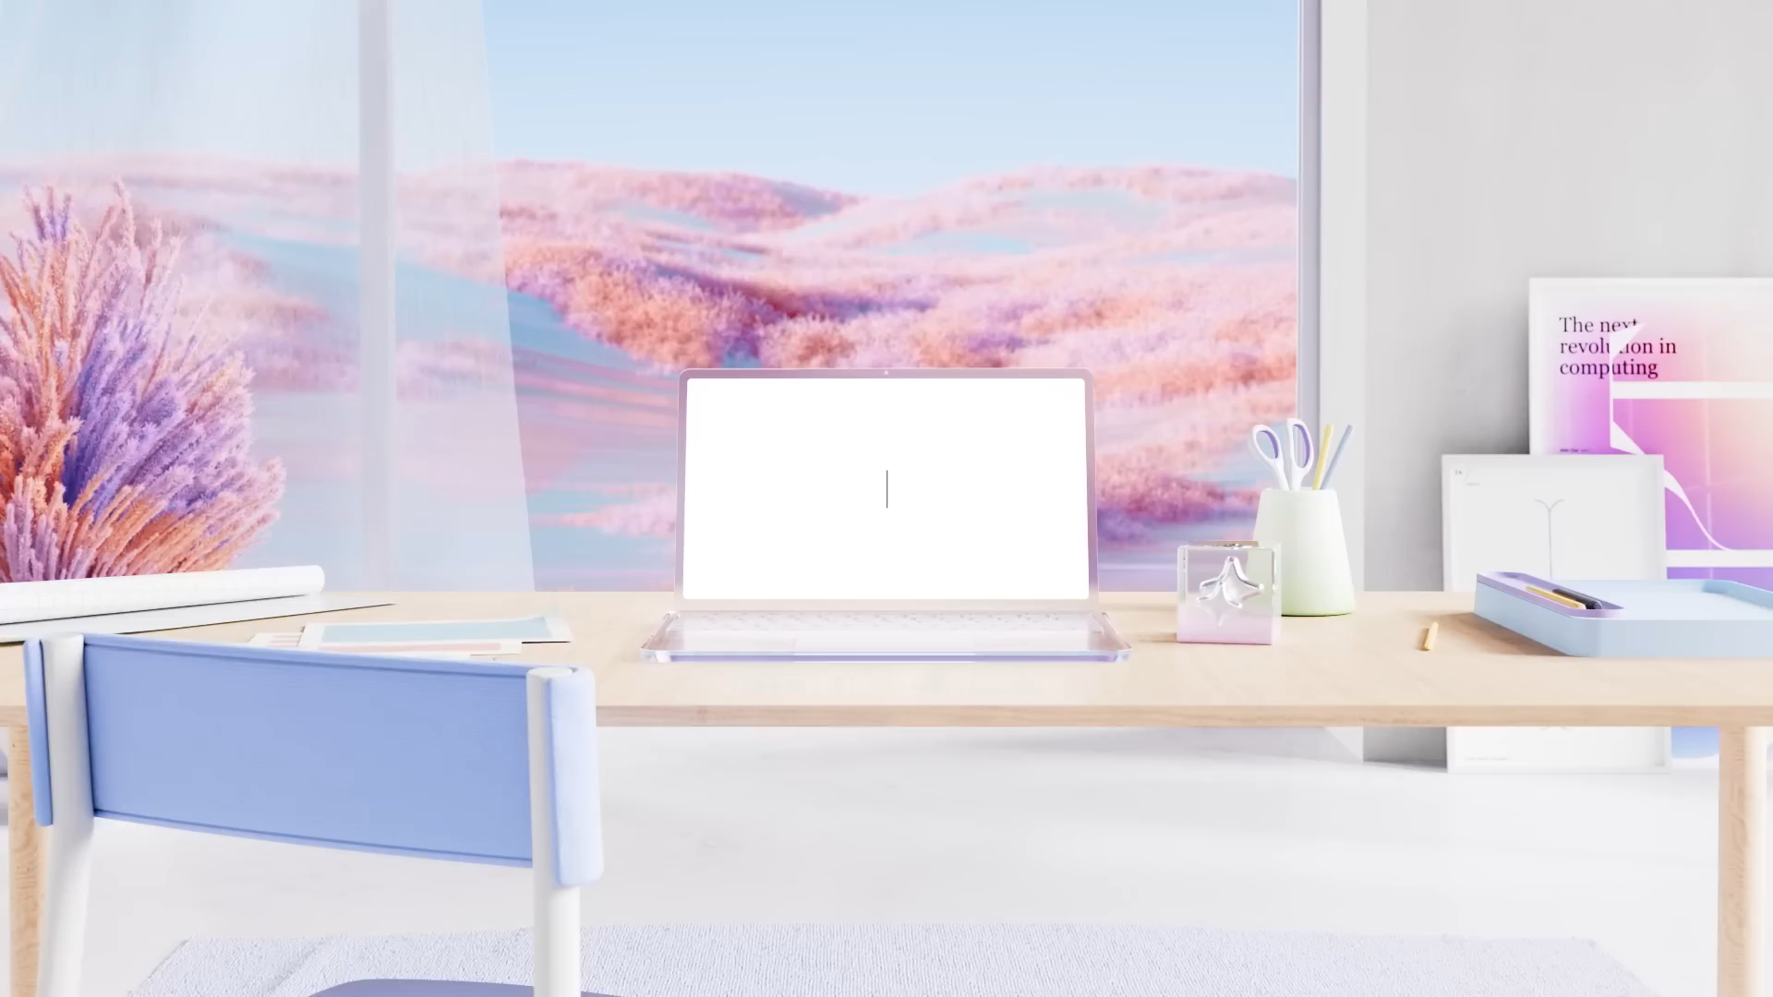

Slide 18

“AI will not replace people, but the people who use AI will replace those who don’t.”
What AI can do
We are here
Time
Notes:
There is a lot of buzz in the recent month around OpenAI. To be honest, even as I person that works as an AI architect for many years, I was startled by recent developments, and it makes me think that we are really at the beginning of exponential explosion of AI. Today we want to discuss our Azure OpenAI service, how it can be useful to our customers and partners,we would like to show you a few quick demos, and at the end discuss how you can support the conversation around OpenAI.

